Slide 1
Embryology and Vertebrate

Slide 2
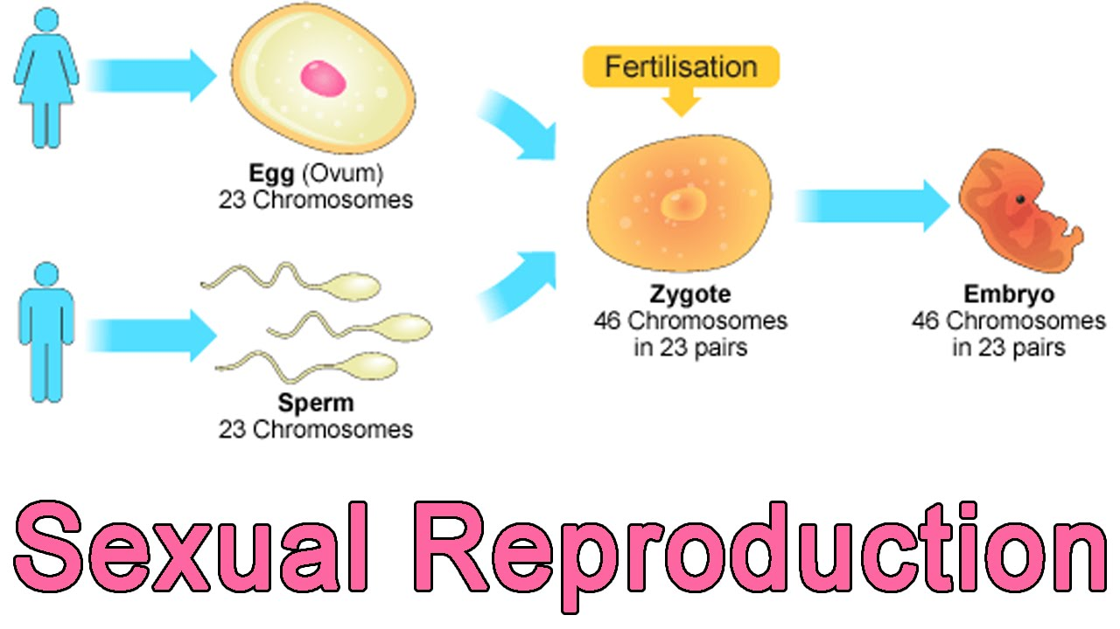
Sexual Reproduction
2 individual create a SIMILAR offspring.

Slide 3
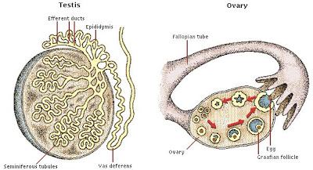
Gonads
Sex Organs (Ovary and Testes)

Slide 4
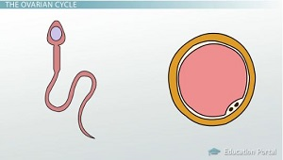
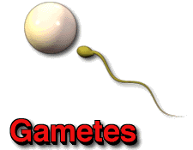
Gametes
Sex Cells (Egg and Sperm)

Slide 5
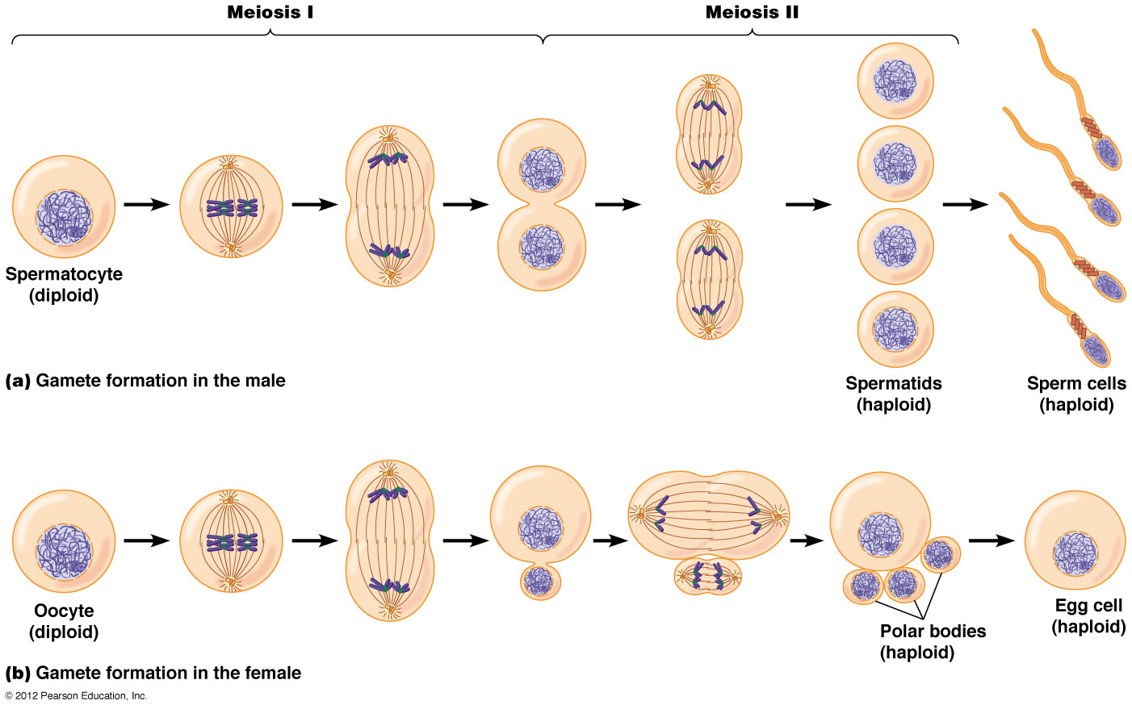
MEIOSIS
When a person makes a sex cell
  Female: eggs
  Mae: sperm
https://www.youtube.com/watch?v=toWK0fIyFlY

Slide 6
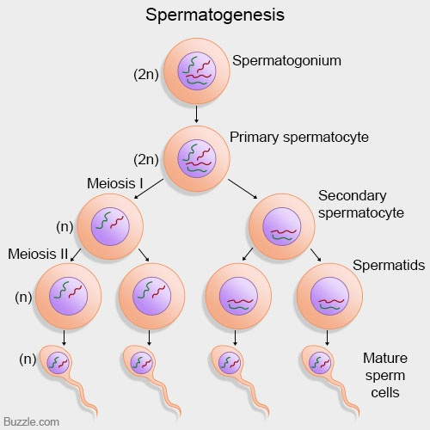
Spermatogenesis
One primary sex cell produces 4 sperm cells

Slide 7
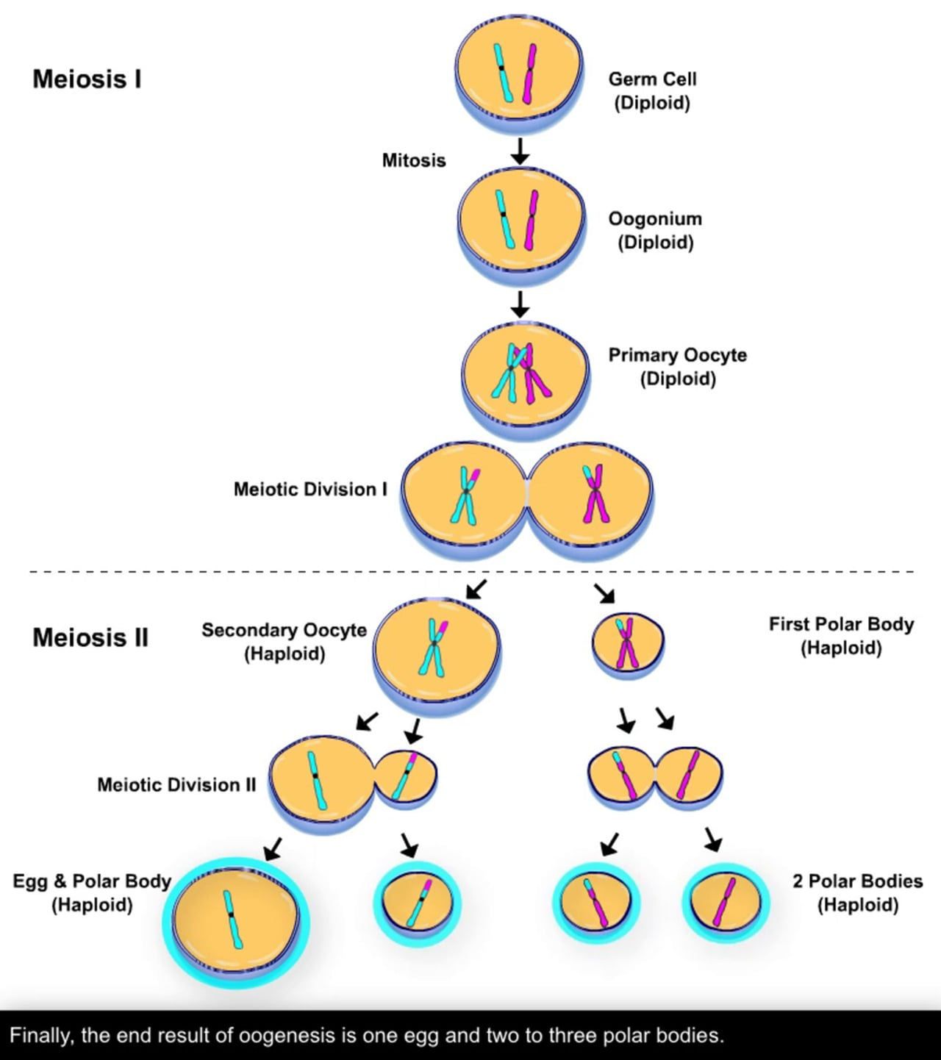
OOgenesis
One primary egg cell produces 1 egg and 3 polar bodies

Slide 8
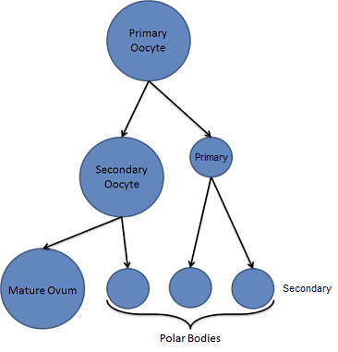
Polar Bodies
Non-viable cells

Slide 9
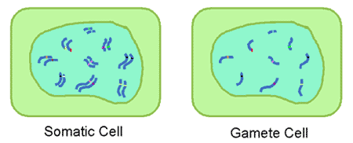
Somatic Cells
Body Cells

Slide 10
Diploid
Full Set / 2n / 46 chromosomes

Slide 11
Haploid
Half Set / n / 23 chromosomes

Slide 12
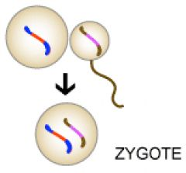
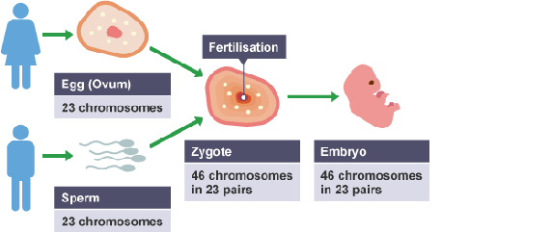
zygote
Egg + Sperm = 1 cell
https://www.youtube.com/watch?v=jsFn-_SC2Q8

Slide 13
Fertilization
Egg and Sperm unite
https://www.youtube.com/watch?v=_5OvgQW6FG4

Slide 14
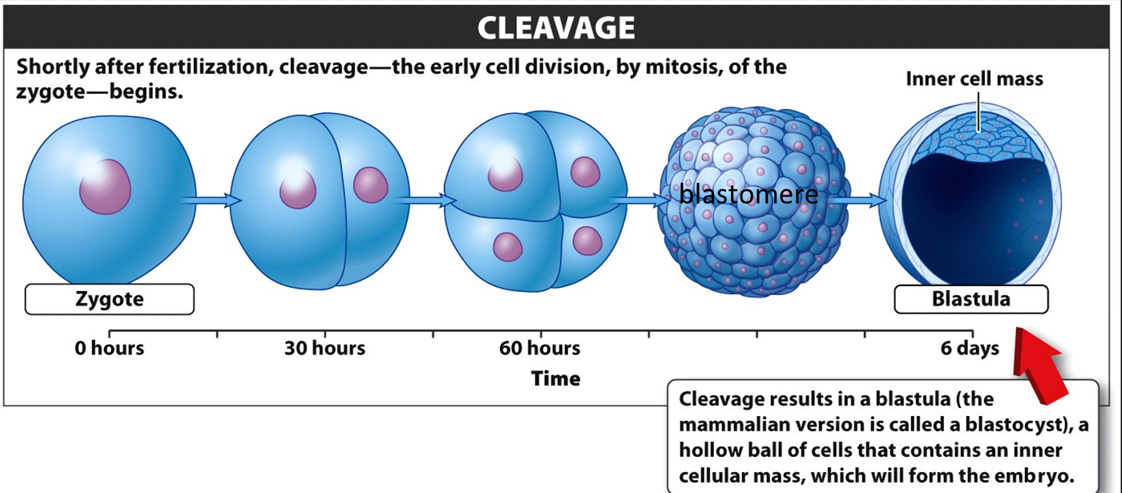
Cleavage
Mitosis (identical cell division)

Slide 15
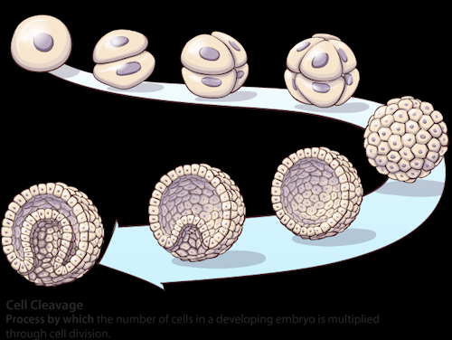
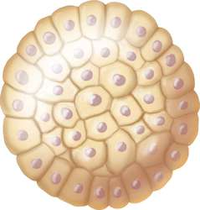
Morula
Solid ball of cells

Slide 16
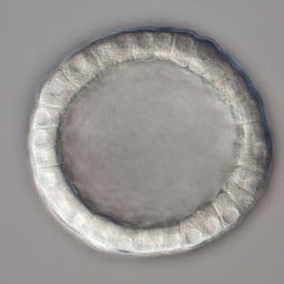
blastula
Hollow ball of cells

Slide 17
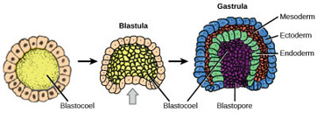
gastrula
Pinches in

Slide 18
gastrulation
Differentiation
Cells / Specialize

Slide 19
Differentiation
Ectoderm – Outside (Skin)
Mesoderm – Middle (Muscle)
Endoderm – Inner (Digestive)

