Slide 1
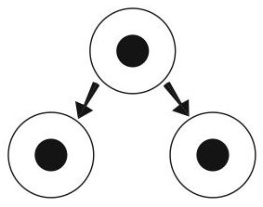
Asexual Reproduction Vocabulary

Slide 2

Asexual Reproduction
One Parent
Identical Offspring

Slide 3
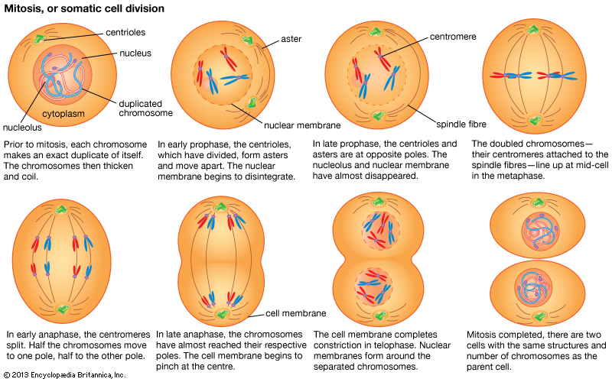
MITOSIS
https://www.youtube.com/watch?v=AhgRhXl7w_g

Slide 4
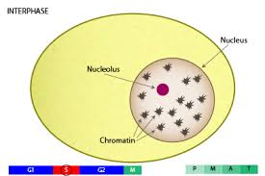
Interphase
Longest phase
Growth and development of cell

Slide 5
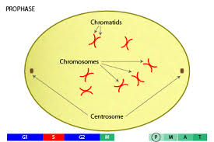
Prophase
Cell prepares to divide
Spindle Fibers appear
Nuclear Membrane Disappear

Slide 6
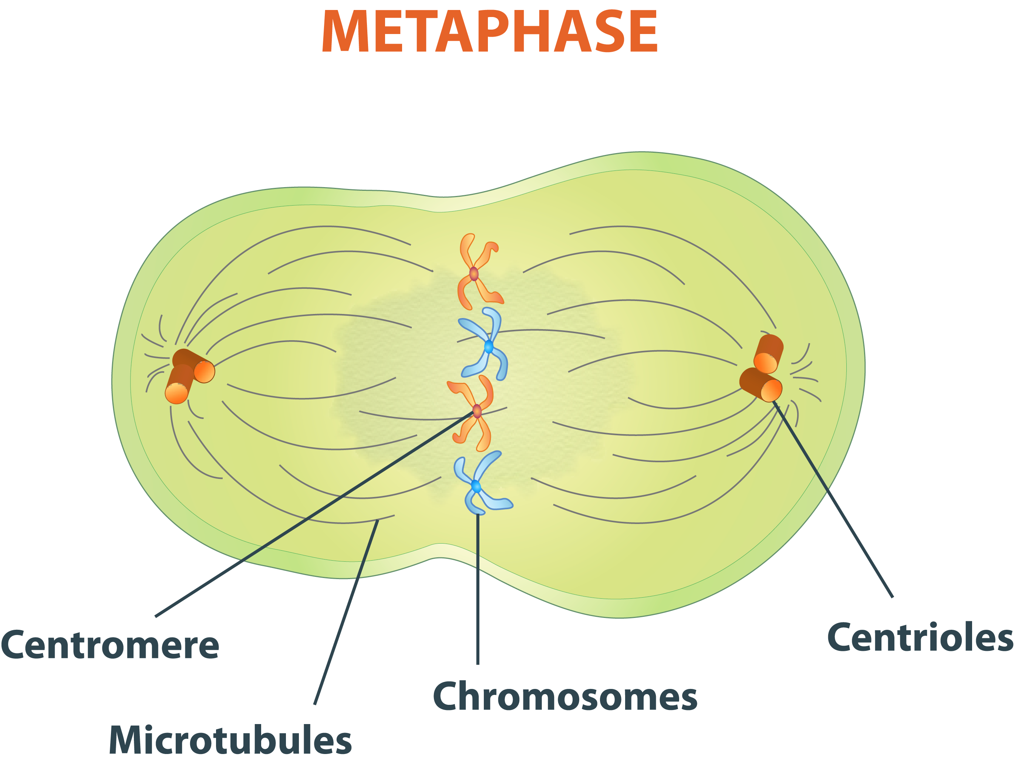
Metaphase
Centrioles at poles
Chromosomes aligned in the MIDDLE
Spindle fibers attached but NOT pulling

Slide 7
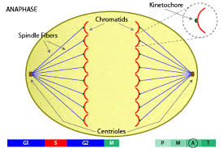
Anaphase
Chromosomes are pulled APART by spindle fibers

Slide 8
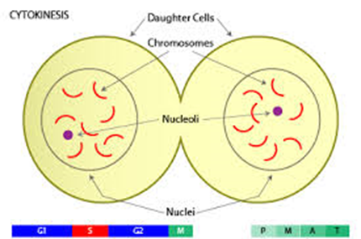
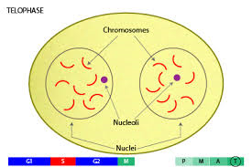
Telophase
Cell splits into two (cytokinesis, cleavage furrow)
Nuclear Membrane reappears

Slide 9
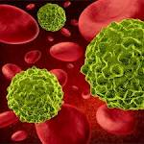

Cancer
Uncontrolled cell division
http://www.cancercenter.com/what-is-cancer/

Slide 10
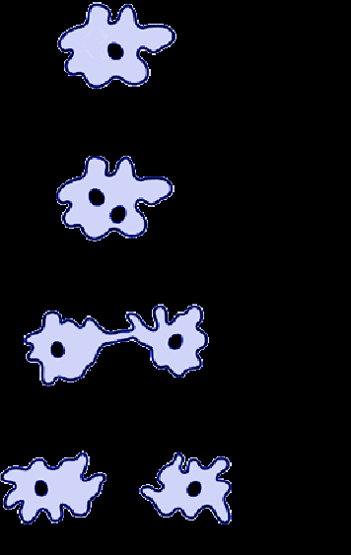
Binary Fission
One cell splits into two cells

Slide 11
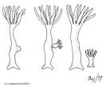

Budding
New individuals produced from outgrowths

Slide 12

Sporulation
Many small cells (spores) are released and are identical.

Slide 13
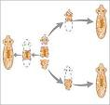
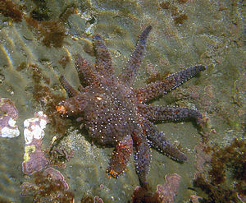
Regeneration
Identical individual grown from a body part of another.

Slide 14
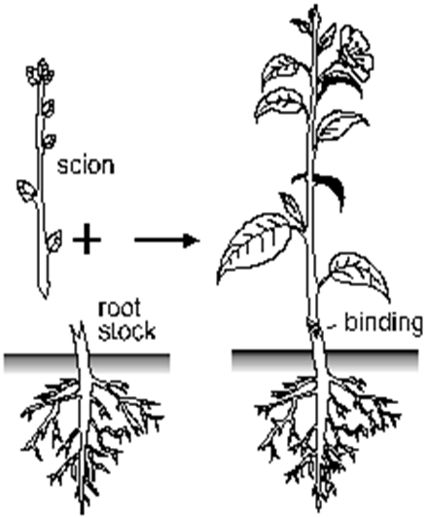
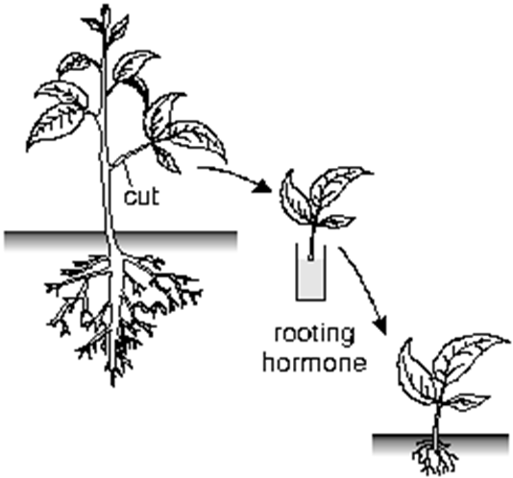
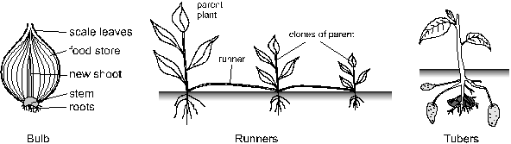
Vegetation Propagation

Slide 15
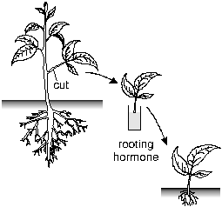
Cutting
Stem is cut and grows into a new plant.

Slide 16
Runners
Stem shoots sideways and produces a new plant.

Slide 17
Bulbs
Underground stem splits and develops into two new plants.

Slide 18
Tubers
A new plant will develop from the skin or eye of another.

Slide 19

Grafting
Stems of plants are connected to others to create a new individual.

