Slide 1
Independence and Development in the Global South
AP World History

Slide 2
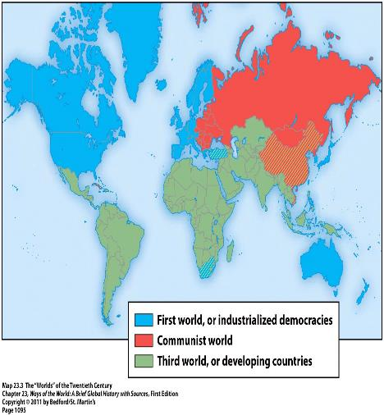
The Global South
“The Global South” = formerly labeled “third-world countries” during the Cold War → now often referred to as “developing nations”
“Decolonization” = term for the Global South’s independence from European rule

Slide 3
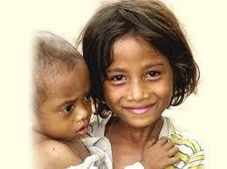
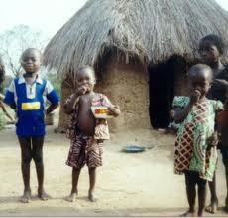
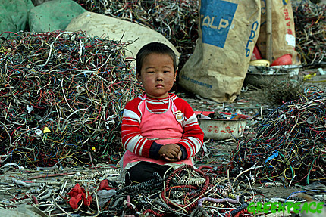
The Global South
Challenges facing the Global South after decolonization:
  The legacies of empire
  Deep divisions of language, ethnicity, religion, and class
  Rapidly growing populations
  Competing demands of the capitalist West and the communist East
  Developing economies, stable politics, and coherent nations all at the same time

Slide 4
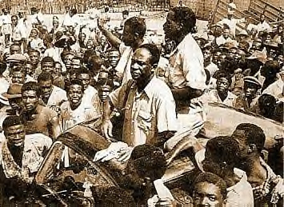
The End of Empire in World History
Dissolution of empires = nothing new
  Think about the end of older empires → Assyrians, Greeks, Romans, Arabs, Mongols, etc.
What’s different about the end of these empires?
  Mobilization of the masses within the colonies around a nationalist ideology
  Creation of a large number of independent nation-states following the empire’s breakdown → each claiming an equal place in the world
Kwame Nkrumah after leaving prison in 1951
Led Ghana to national
independence in 1957

Slide 5
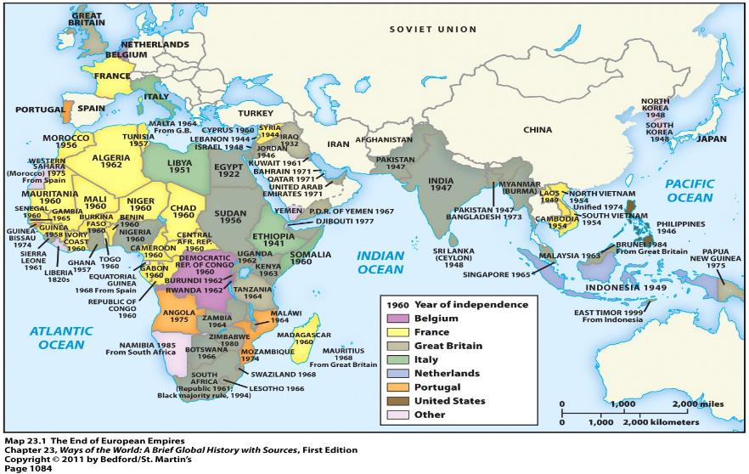
Nation-States Created

Slide 6
Explaining African and Asian Independence
The “Contradictions” Explanation = fundamental contradictions existed within the entire colonial enterprise that made its demise inevitable
Views Held by European Rulers | What’s Happening in their Colonies
Christianity and material progress | Racism, exploitation, and poverty
Increasingly democratic values | Rule by dictatorships
National self-determination | Denied any opportunities to express their own national character

Slide 7
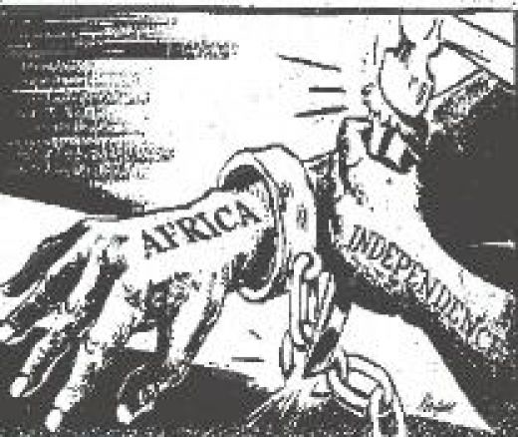
Explaining African and Asian Independence
International circumstances that led to the end of these empires:
  Both world wars = weakened Europe
  Both world wars = discredited any sense of European moral superiority
  U.S. and Soviet Union = new global superpowers = opposed the older European colonial empires
  United Nations = platform from which nations could express anticolonial views

Slide 8
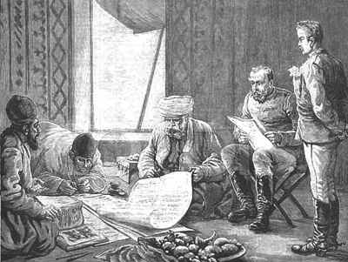
Explaining African and Asian Independence:
Economic and Social Circumstances
  By the mid-20th century = 2nd and 3rd generation Western-educated elites (mostly male) had arisen throughout the colonial world
  Familiar with European culture and aware of the gaps between its values and its practices
  Didn’t see colonial rule as a vehicle for their peoples’ progress
  Increasingly insisted on independence

Slide 9
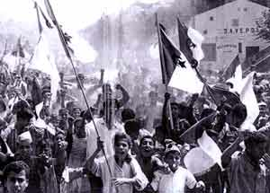
Explaining African and Asian Independence:
Economic and Social Circumstances
Other groups that believed independence held promise:
  Veterans of the world wars
  Young people with some education but no job opportunities
  Urban workers = aware of their exploitation
  Small-scale traders = resentful of European privileges
  Rural dwellers = lost land or suffered from forced labor
  Poor and insecure newcomers to the cities
Decolonization of India

Slide 10
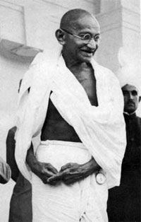
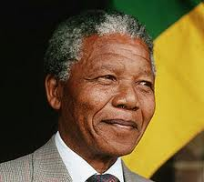
Explaining African and Asian Independence
The “Agency” Explanation = focuses on particular groups or individuals whose deliberate actions brought down the colonial system
  “Agency” = deliberate initiatives of historical actors

Slide 11
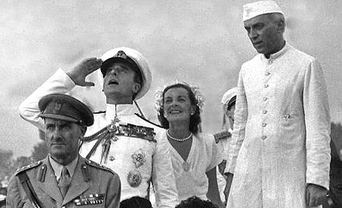
Explaining African and Asian Independence
In some areas, the colonial rulers themselves got involved and actively planned for decolonization
  Negotiated settlements
  Invested in infrastructure
  Helped form constitutions and set up elections
In most areas, however, independence was a struggle
Variations in struggles for independence:
  Length of time = a few years vs. decades
  Approach = nonviolence vs. violent guerrilla warfare
Jawarhalal Nehru and Lord Mountbatten of England

Slide 12
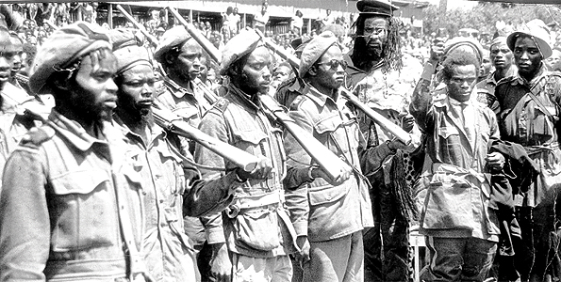
Explaining African and Asian Independence
Commonalities in struggles for independence:
  Gradual involvement of ordinary people, not limited to just the leaders and educated few
  A highly contested process
  Efforts were rarely cohesive movements of uniformly oppressed people
    Conflicting groups and parties
    Different classes, ethnic groups, religions, regions, etc.
    Struggled with one another over leadership, power, strategy, ideology, and the distribution of material gains
Freedom Fighters in Kenya

Slide 13
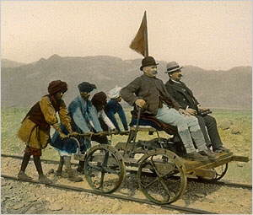
Independence of India
British colonial rulers promoted a growing sense of “Indian” identity:
  British never assimilated into Indian society, unlike rulers in the past → had a sharp sense of racial and cultural distinctiveness
  India’s many regions and peoples bound together by: British railroads, telegraph lines, postal services, administrative networks, newspapers, schools, and the English language

Slide 14
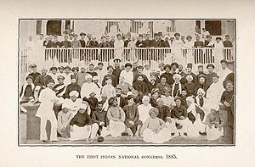
Indian National Congress
Indian National Congress (INC) = established in 1885
Association of English-educated Indians = lawyers, journalists, teachers, businessmen, etc.
Based in the cities
Had difficulty gaining a mass following among the peasants because such an elite organization
Initial goal = to gain greater inclusion within the political, military, and business life of British India
  NOT the overthrow of British rule

Slide 15
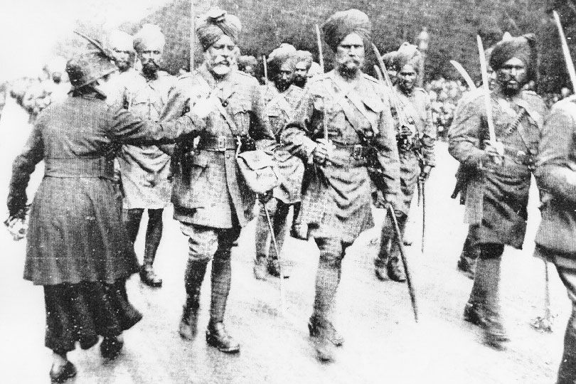
Indian National Congress
More Indians began to join the INC after:
  WWI → the British had promised Indians more self-governing institutions if they helped in WWI
  British attacks on Ottoman Empire in WWI → upset India’s many Muslims
  Flu epidemic hit India after WWI → millions of Indians died
  Repressive actions by British rulers
    Ex: about 400 Indians killed who defied a ban on public meetings
Indian troops fighting on behalf of Great Britain in World War I

Slide 16
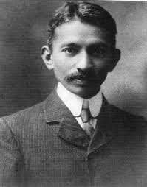
Mohandas Gandhi
1893 = accepted a job with an Indian law firm in South Africa
Witnessed overt racial segregation for the first time
Organized Indians (mostly Muslims) in South Africa to protest these policies of racial segregation
Developed a concept of a free India that included Hindus and Muslims alike
Developed political philosophy called satyagraha (truth force) = confrontational, though nonviolent, approach to political action
Gandhi as a young lawyer in South Africa

Slide 17
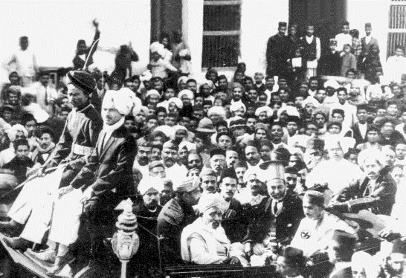
Mohandas Gandhi
1914 = Gandhi returned to India and became a leader in the INC
Gandhi’s simple and unpretentious lifestyle, support of Muslims, frequent reference to Hindu themes, and nonviolent approach drew support from a wide range of Indians:
  Peasants and the urban poor
  Intellectuals and artisans
  Capitalists and socialists
  Hindus and Muslims
The INC became a mass organization
Gandhi back in India (1915)

Slide 18
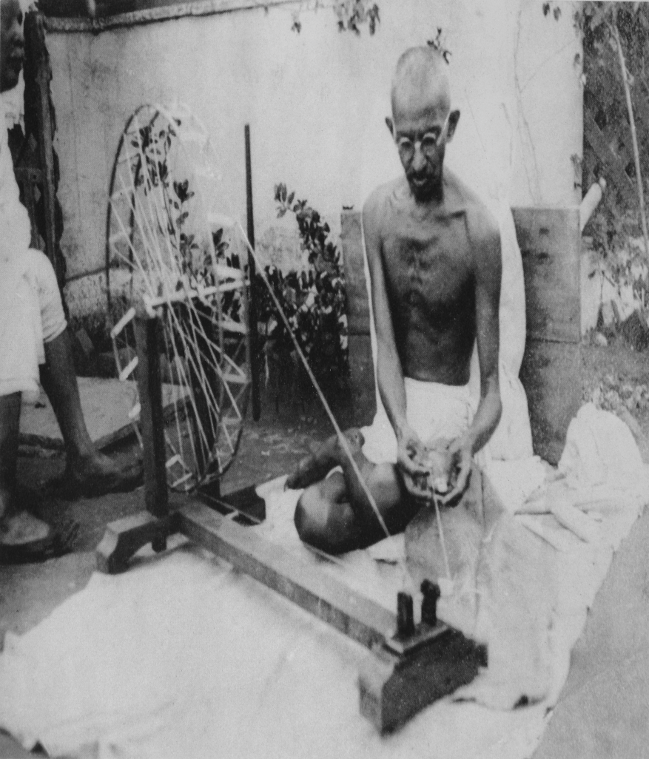
Mohandas Gandhi
Gandhi’s platform:
  Sought the moral transformation of individuals
  Worked to raise the status of India’s untouchables
  Opposed a modern industrial framework for India
  Wanted a society of harmonious and self-sufficient villages drawing on ancient Indian principles of duty and morality

Slide 19
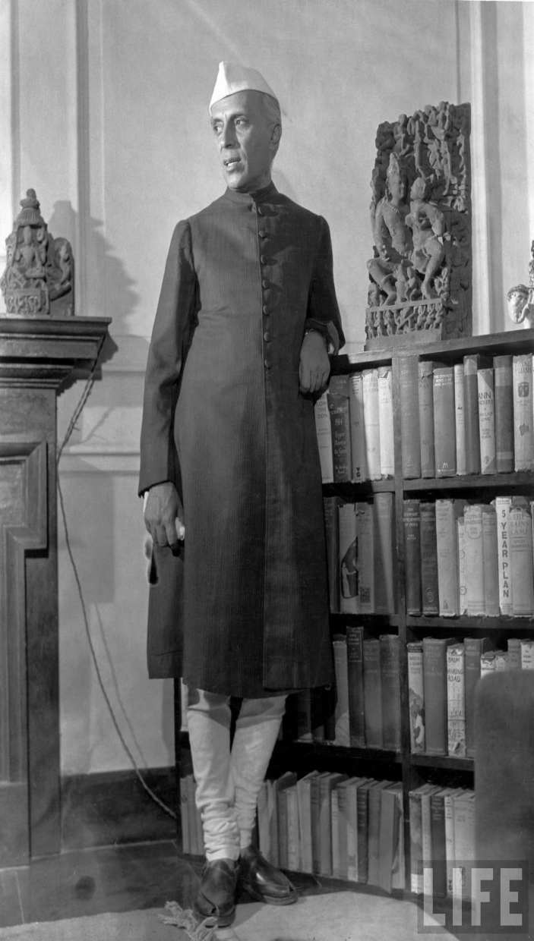
Divisions and Conflict within the INC
Many did believe science, technology, and industry were essential to India’s future
  Like Gandhi’s chief lieutenant = Jawaharlal Nehru
Not everyone embraced nonviolence → existence of Hindu militant groups
Not everyone wanted an “inclusive” India → some Hindu groups expressed hatred of Muslims and wanted India to be a Hindu nation
Many believed focus on the position of women and untouchables distracted from the main goal of independence from Britain
Some favored participation in British-sponsored legislative bodies without complete independence

Slide 20
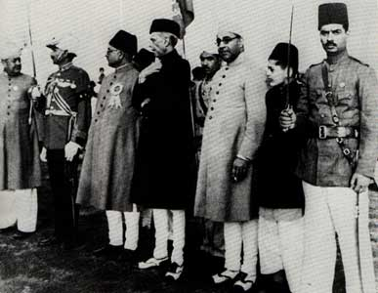
Divisions and Conflict within the INC
Most serious threat to a unified movement = divide between the Hindu and Muslim populations
1906 = formation of the All-India Muslim League
  Feared domination by the Hindu majority
Muslim League argued that the parts of India that had a Muslim majority should have a separate political status
  Wanted to call it Pakistan = “land of the pure”
Members of the All-India Muslim League

Slide 21
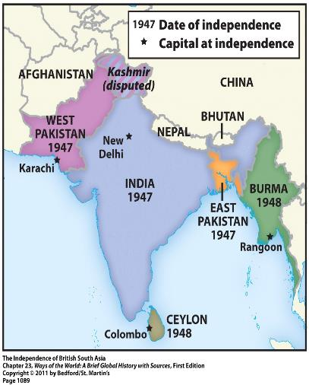
The Partition of India
Gandhi and the INC agreed to partition India when the British declared their intention to leave after WWII
1947 = colonial India became independent as two separate nations
  Hindu India
  Muslim Pakistan (divided into West and East Pakistan)

Slide 22
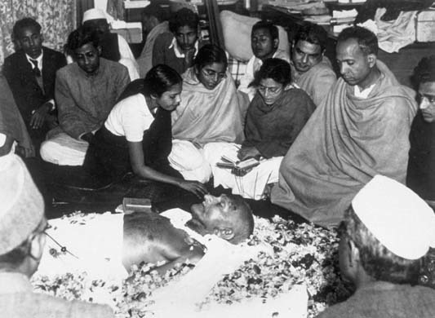
The Partition of India
Partition of India accompanied by severe violence:
  1 million people or more died in the communal violence
  About 12 million refugees moved from one country to another to be with their religious allies
  1948 = Gandhi was assassinated by a Hindu extremist
Gandhi’s Funeral

Slide 23
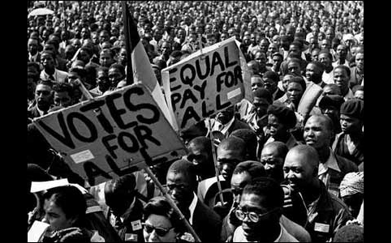
Ending Apartheid in South Africa
Freedom struggle in South Africa = against an internal opponent, NOT an occupying colonial power
South Africa = independent since 1910
  Independence granted to the white settler minority
    Economically prominent = whites of British descent
    Politically dominant = Boers or Afrikaners = white descendants of early Dutch settlers from the 1600s
  Black African majority = had no political rights at all

Slide 24
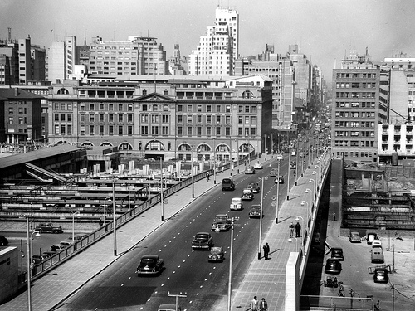
Ending Apartheid in South Africa
Unlike India, South Africa had developed a mature industrial economy by the mid-1900s
  Black Africans dependent upon this white-controlled economy → worked in urban industries, mines, or on white-owned farms
  This dependence made them compliant with repressive actions of the colonial rulers
  Only benefit = could threaten to collectively withdraw their labor
Johannesburg, South Africa (1952)

Slide 25
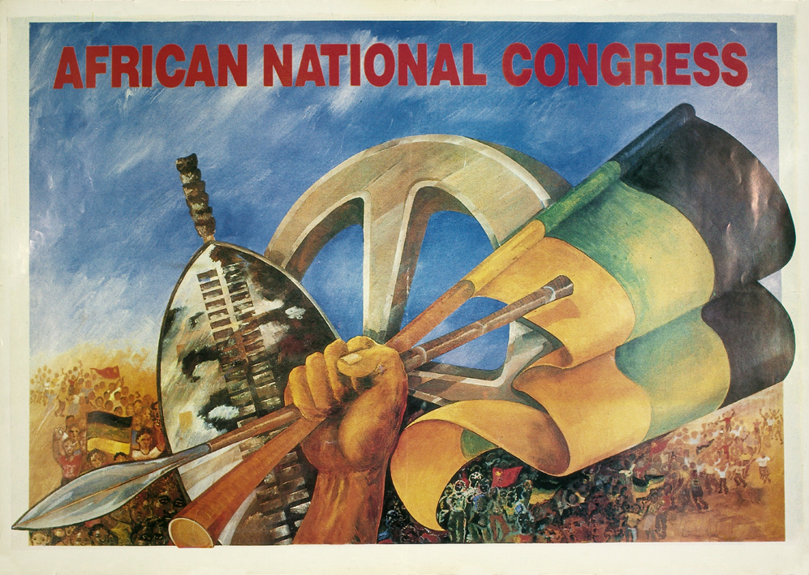
The African National Congress
African National Congress (ANC) = established in 1912
Association of educated, professional, and middle-class Africans
Original goal = to be accepted as “civilized men” within the existing order, NOT to overthrow it
Pursued peaceful and moderate protest for about 40 years = petitions, multiracial conferences, representatives appealing to the authorities
It became clear that these methods weren’t working

Slide 26
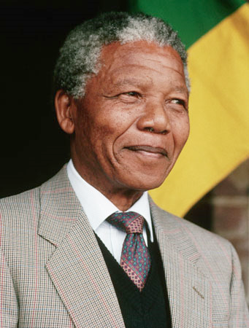
The African National Congress
1950s = ANC had new and younger leadership, which included Nelson Mandela
Broadened base of support
Nonviolent civil disobedience = boycotts, strikes, demonstrations, burning of black African passes

Slide 27
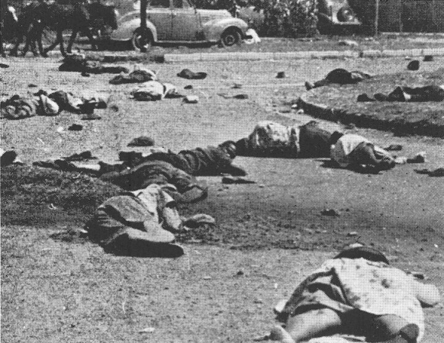
The African National Congress
Responses by the South African government:
  Increased repression → including shooting at unarmed demonstrators
  Banned the ANC
  Imprisoned ANC leaders, including Nelson Mandela
  Banned all other major political parties
Sharpeville, South Africa (1960)
For 2 days, police machine-gunned unarmed crowds protesting apartheid

Slide 28
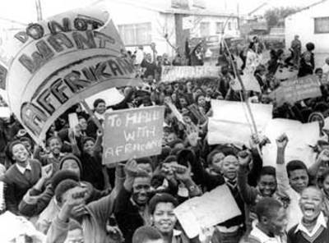
The Freedom Struggle Intensifies
Underground nationalist leaders turned to armed struggle
  Organized acts of sabotage and assassination; prepared for guerrilla warfare
Black Consciousness Movement = an effort to foster pride, unity, and political awareness among South Africa’s black African majority
  Mostly made up of student groups
  1976 = explosion of protest in Soweto (outside of Johannesburg)
    Segregated and impoverished black neighborhood
    Hundreds were killed

Slide 29

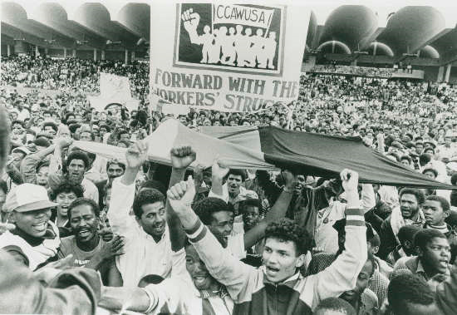
The Freedom Struggle Intensifies
Momentum from the protest in Soweto continued
  Spreading urban violence and radicalization of urban young people
Mid-1980s = government declared a state of emergency
1986 (to commemorate 10th anniversary of Soweto uprising) = Congress of South African Trade Unions organized a mass strike involving about 2 million workers

Slide 30
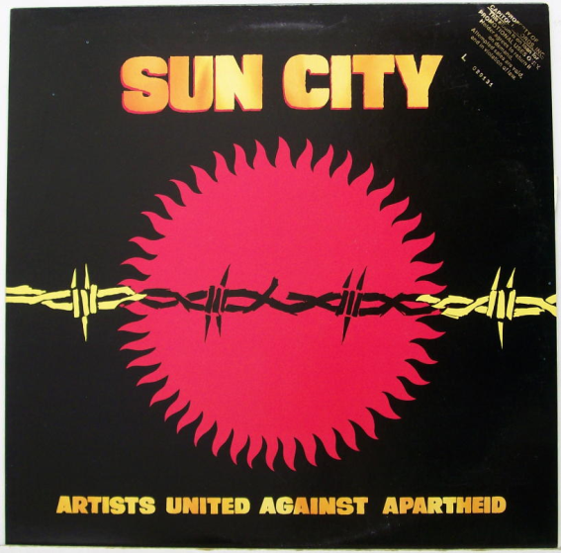
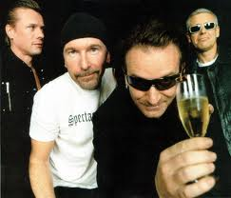
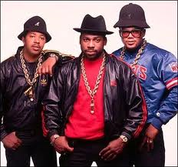
International Pressure to End Apartheid
South Africa was excluded from most international sporting events, including the Olympics
Artists and entertainers refused to perform in South Africa
Many countries enacted economic boycotts
Many countries withdrew their private investment funds
All of these factors isolated South Africa from the world

Slide 31
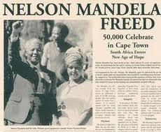
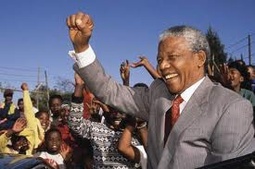
The End of Apartheid
Late 1980s = White South African leaders agreed to a process of negotiations with African nationalist leaders that led to:
  The abandonment of apartheid policies
  The release of Nelson Mandela from prison
  The legalization of the ANC
  National elections in 1994
    Brought the ANC to power
    Nelson Mandela = new president of South Africa

