Slide 1
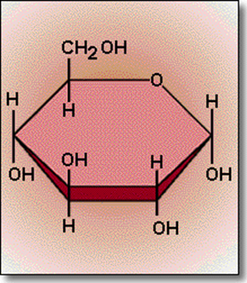
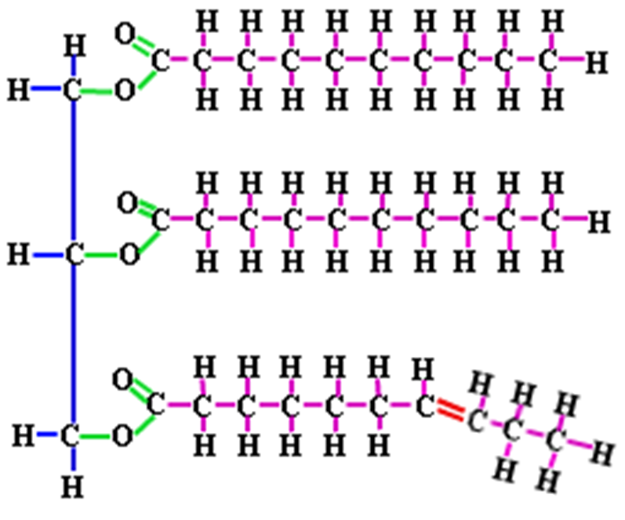
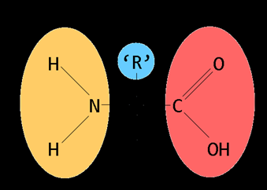
Biochemistry

Slide 2
Organic vs. Inorganic
Organic Compounds (Carbon Containing Substances) MUST contain:
  Carbon (C)
  Hydrogen (H)
Examples of Organic Compounds
    C6H12O6
    CH4
Examples of Inorganic Compounds:
    H2O
    CO2

Slide 3


CARBOHYDRATES – S,
Use: Immediate Energy
Elements: C, H, O (1:2:1 Ratio)
Building Blocks:
Monosaccharide
Glucose (C6H12O6)
Product:
Polysaccharide
Starch

Slide 4

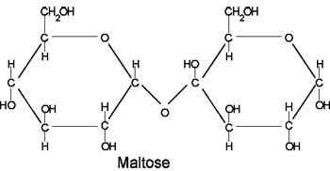
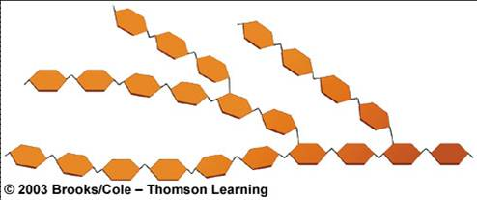
Carbohydrate Structures -
Glucose: Disaccharide:
Polysaccharide:

Slide 5

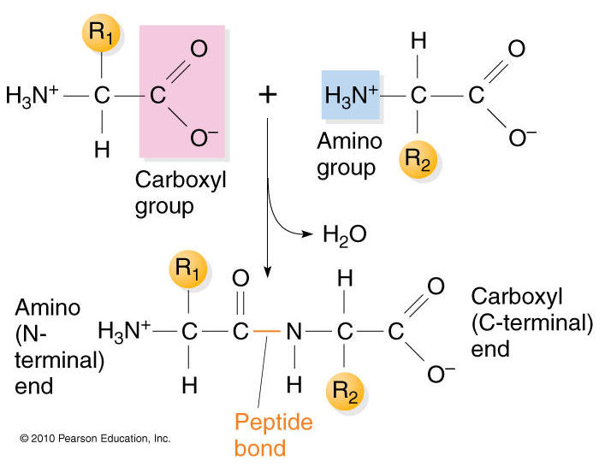
PROTEIN – P, N
Use: Build Muscle and Tissue, Enzymes, Hormones
Elements: C, H, O, N
Building Blocks:
Amino Acid
Peptide
Product:
Protein
Polypeptide

Slide 6
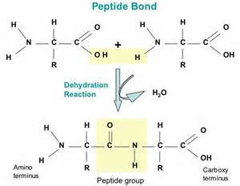
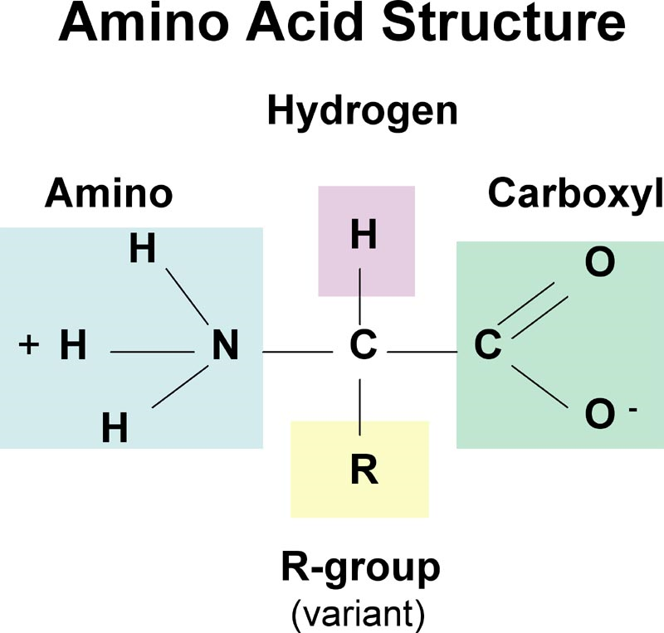
Protein Structures -
Amino Acid / Peptide: Protein / Polypeptide:

Slide 7
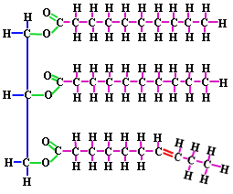
LIPIDS - E
Use: Stored Energy
Elements: C, H, O
Building Blocks:
1 Glycerol
3 Fatty Acids
Product:
Lipid
Fat

Slide 8
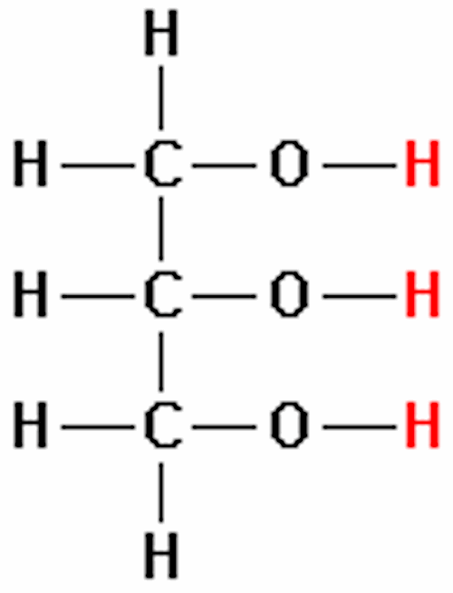
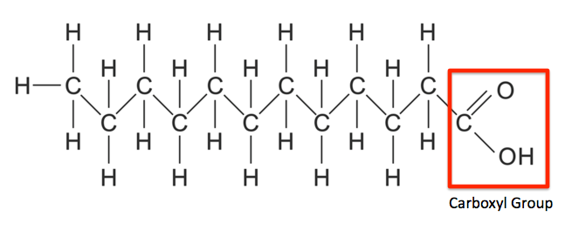
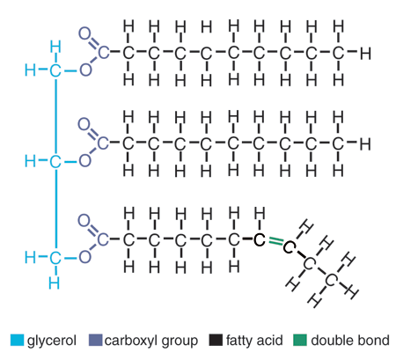
Lipid Structures -
Glycerol: Fatty Acid: Fat / Lipid:

Slide 9
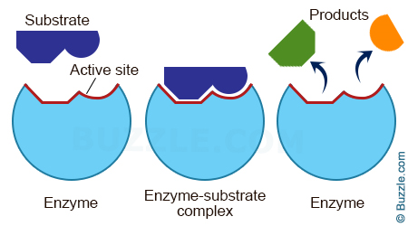
Enzymes / Catalysts -
“Lock and Key”
Specific Shape
Made of proteins

Slide 10
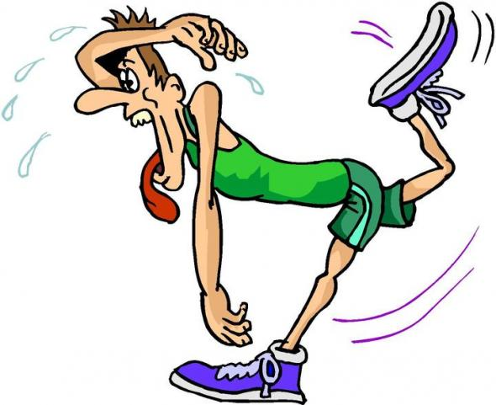
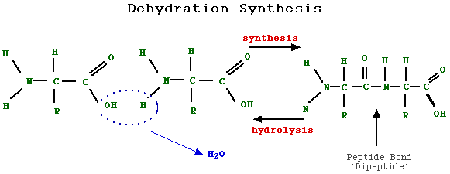
Dehydration Synthesis -
WATER IS REMOVED to bring molecules together.

Slide 11
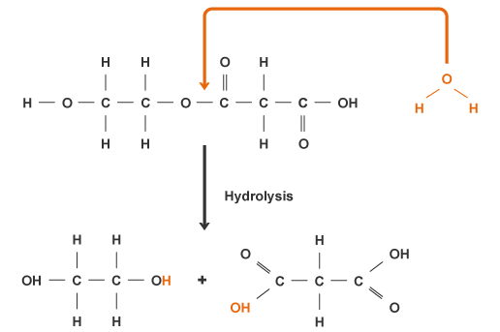
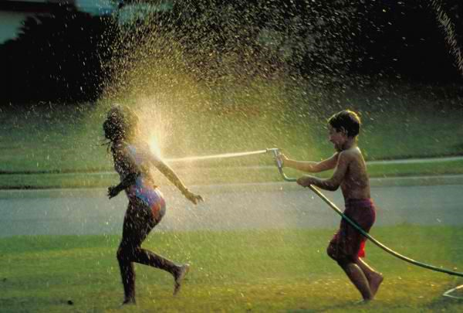
Hydrolysis -
WATER IS ADDED to break molecules apart.

