Slide 1
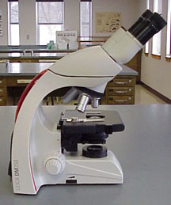
The Microscope

Slide 2
Microscope Videos
Amazing Things Through a Microscope:
  https://www.youtube.com/watch?v=bSieT0KTfp0
The Invention of the Microscope
  https://www.youtube.com/watch?v=Ue-86MDmjns

Slide 3
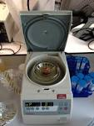
Centrifuge
https://www.youtube.com/watch?v=OvnaH_uNRbs
Spins and separates

Slide 4
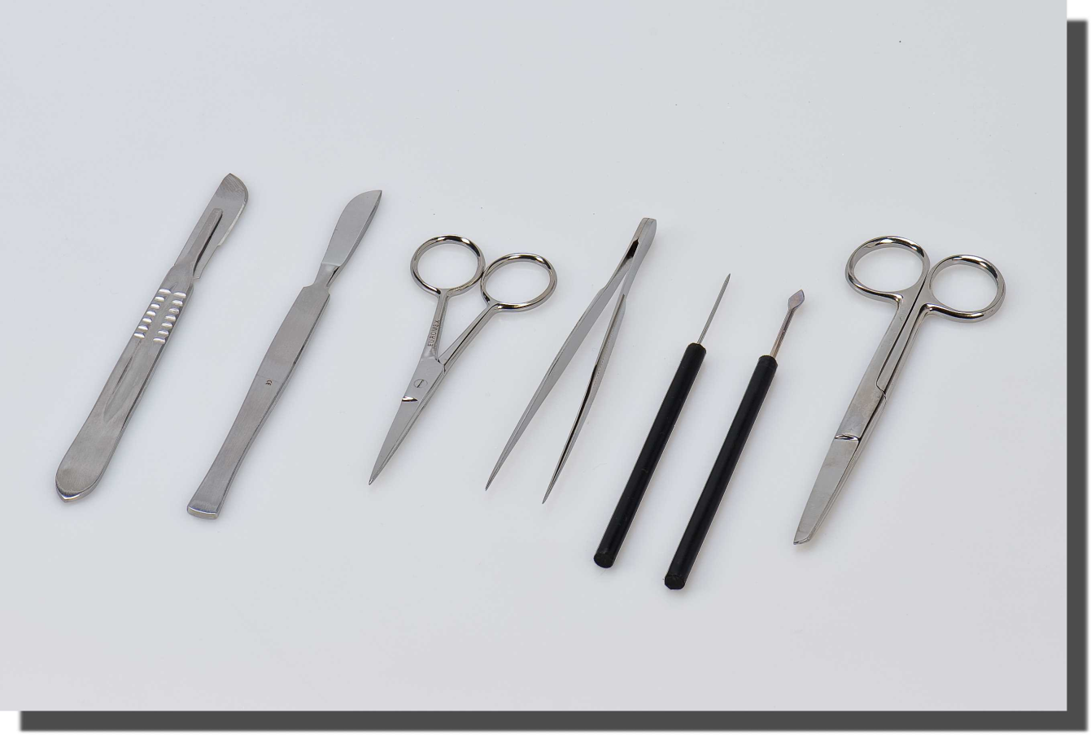
Dissection Equipment
Cuts and separates tissue

Slide 5
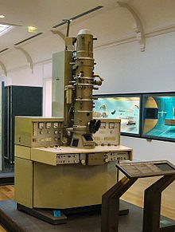
Electron Microscope
Uses beams of electrons to enlarge
https://www.youtube.com/watch?v=a2L3SPb_e1c

Slide 6
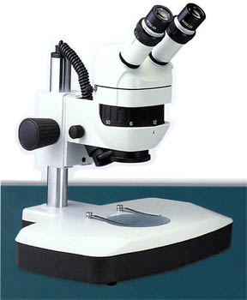
Dissecting Stereoscope
Produces 3-Dimensional Image

Slide 7
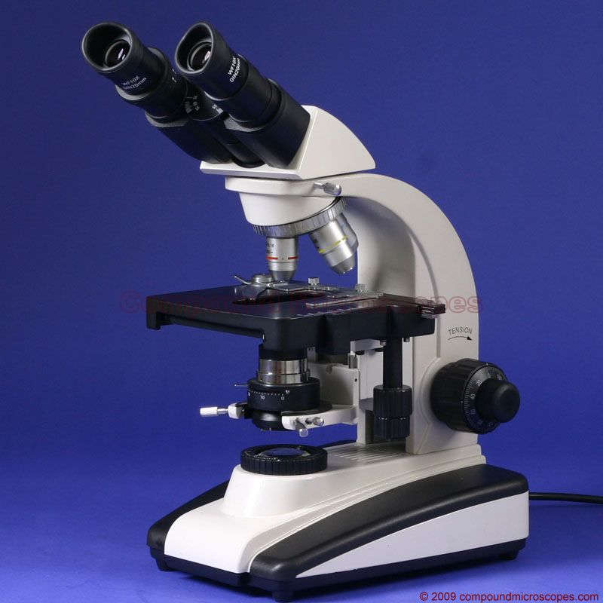
Compound Light Microscope

Slide 8
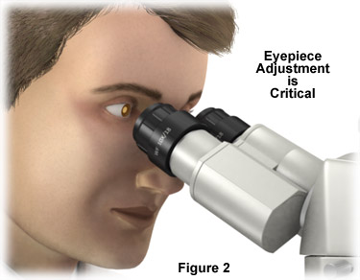
Ocular (Eyepiece)
Begins magnification

Slide 9
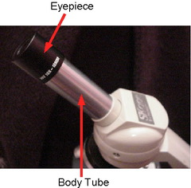
Body Tube
Holds eyepiece and nosepiece

Slide 10
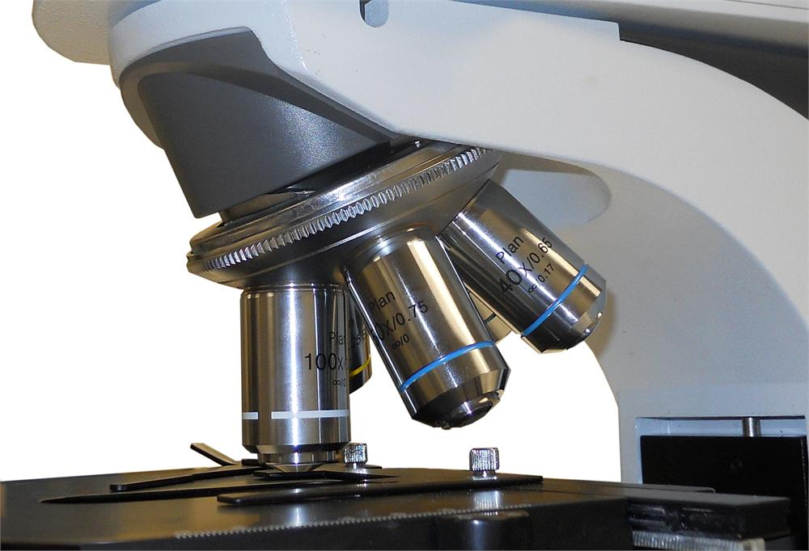
Nosepiece
Holds and rotates objective lenses

Slide 11
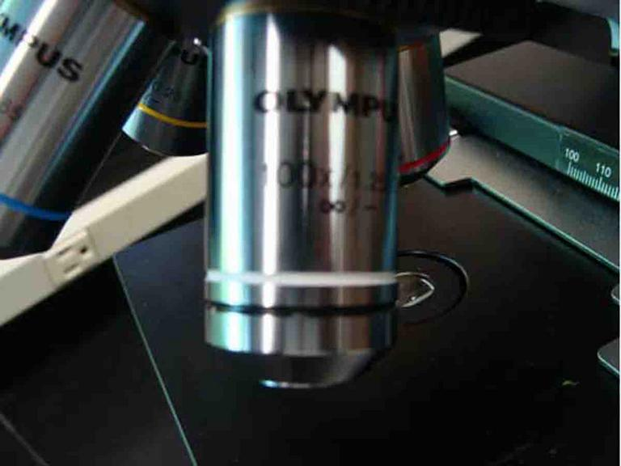
High Power Objective
Magnifies image many times

Slide 12
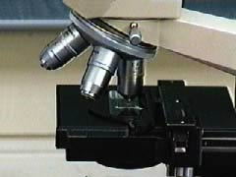
Low Power Objective
Magnifies image slightly

Slide 13
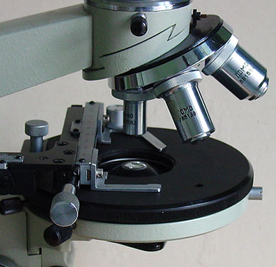
Stage
Platform that holds the slide

Slide 14
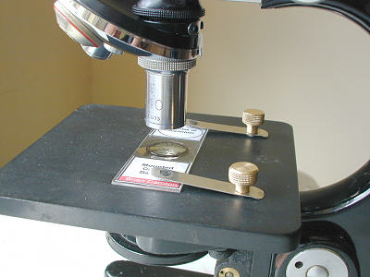
Stage Clips
Holds slide in place

Slide 15
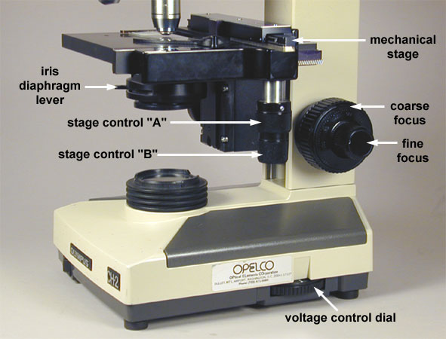
Diaphragm
Controls the amount of light passing through

Slide 16
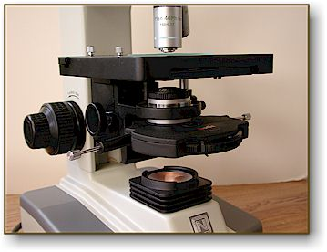
Condensor / Light
Directs light to make specimen visible

Slide 17
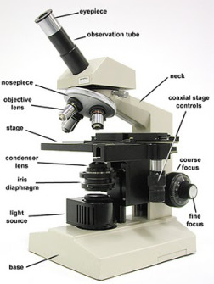
Base
Supports microscope

Slide 18
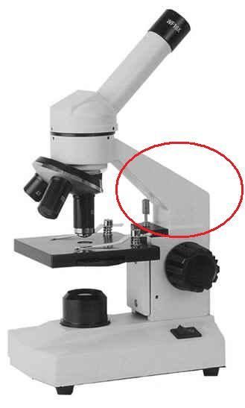
Arm
Supports ocular / eyepiece

Slide 19
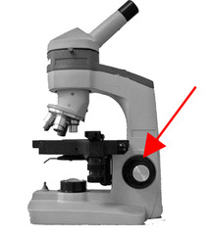
Course Adjustment
Brings specimen into rough focus.
NEVER use under high power.

Slide 20
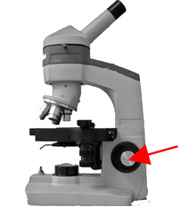
Fine Adjustment
Brings specimen into fine focus

