Slide 1
Bellwork-most days when you walk in, you will be expected to do a “bellwork”. This will be collected when both sides are full and will count as an easy grade if it is complete and correct.
What is one thing you remember about the syllabus or the classroom setup? (Ex- can be a classroom procedure, a grading policy, attendance policy, ‘important place’ in the classroom etc.)

Slide 2
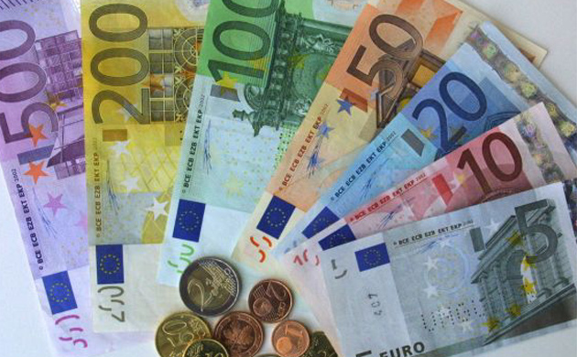
Classroom Management system
How can I earn or lose Euros?

Slide 3
Earning euros
Doing a classroom job: passing out papers, erasing the board, going on an errand for me (+10)
Winning a classroom game (varies)
Filling out an absent sheet (+10)
Bringing in a newspaper article about a French speaking country, reading it, and writing a one paragraph (5-7 sentences) summary about it. (+20)
Any other way I designate!

Slide 4
Losing euros
Having a bad attitude (-10)
Continually interrupting the learning (speaking out of turn, chatting with a friend after being asked to stop) (-10)

Slide 5
Items to buy!
50€ = Add 1 point to a quiz/test/project
                Limit of 10/marking period
600 € = Change a quiz grade to a 100%
                Limit 1/quarter, some quizzes ineligible (max. of 15 points)

