Slide 1
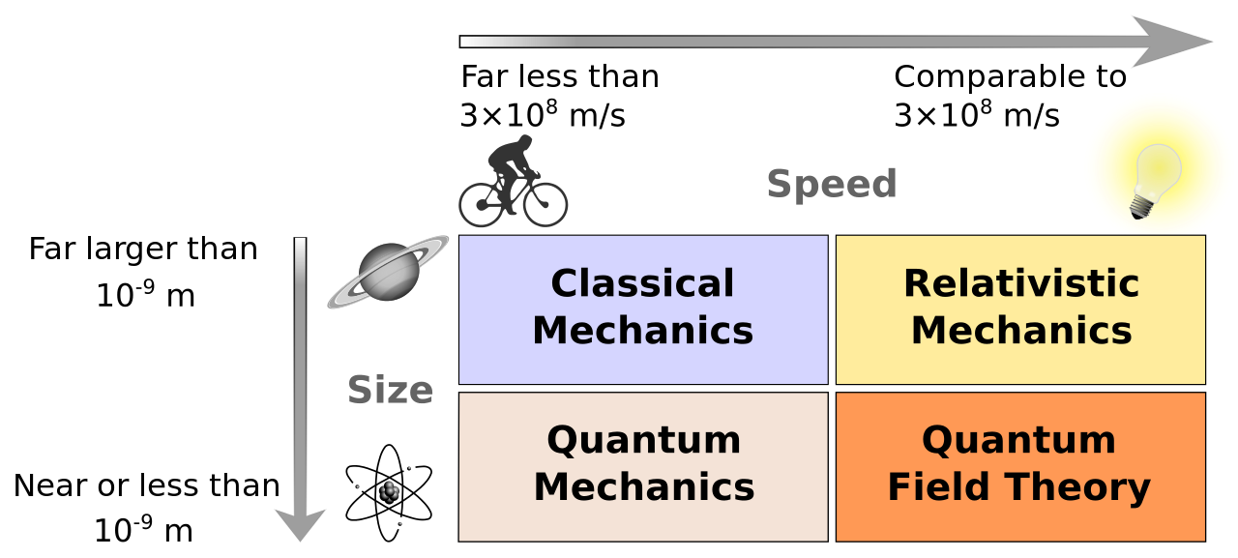
Modern Physics

Slide 2
Wave-Particle Duality
Light behaves as both a wave and a particle.
LIGHT
WAVE
PARTICLE
Identified by frequency, wavelength, amplitude
Kinetic Energy
Exhibits diffraction
Momentum
Exhibits interference
Photoelectric Effect
Exhibits Doppler effect

Slide 3
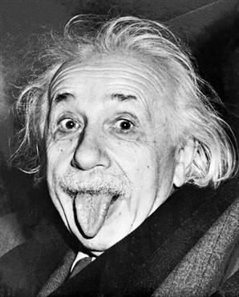
Light acting like a PARTICLE- “particles” of EM radiation are called photons.
In certain interactions light, or any electromagnetic radiation, acts as if it is composed of particles possessing kinetic energy and momentum.
This is what Einstein discovered that won
him his Nobel Prize…not E=mc².

Slide 4
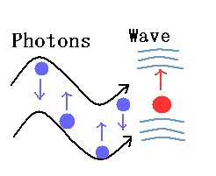
A photon is a massless particle of light that also travels at the speed of light.
3 x 10⁸ m/s

Slide 5
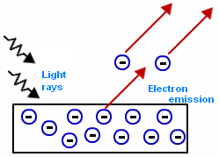
The Photoelectric Effect
When light having a particular frequency is exposed to the surface of certain metals the light energy is absorbed and electrons are emitted. This cannot be explained using the wave model of light.
Let’s take a look at why this happens…

Slide 6
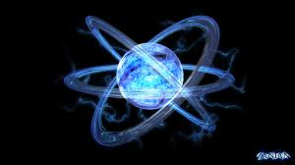
Quantum Theory
Quantum theory assumes that electromagnetic energy is emitted from, and absorbed by, matter in discrete/fixed amounts or packets.
Each packet of electromagnetic energy
emitted, or absorbed, is called a
quantum (quantities) of energy.

Slide 7
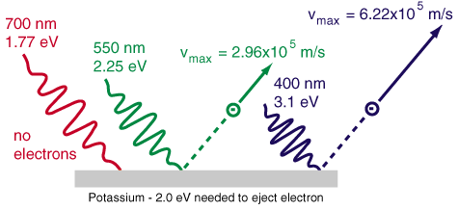
Light is sent out in quanta called photons.
The amount of energy in each packet depends on the
color (frequency) of light being shone on the metal
NOT the brightness of the light.
Energy of a photon of light is:
E_{photon} = hf = hc
λ
h is called Planck’s constant and is 6.63 x 10⁻³⁴ J•s

Slide 8
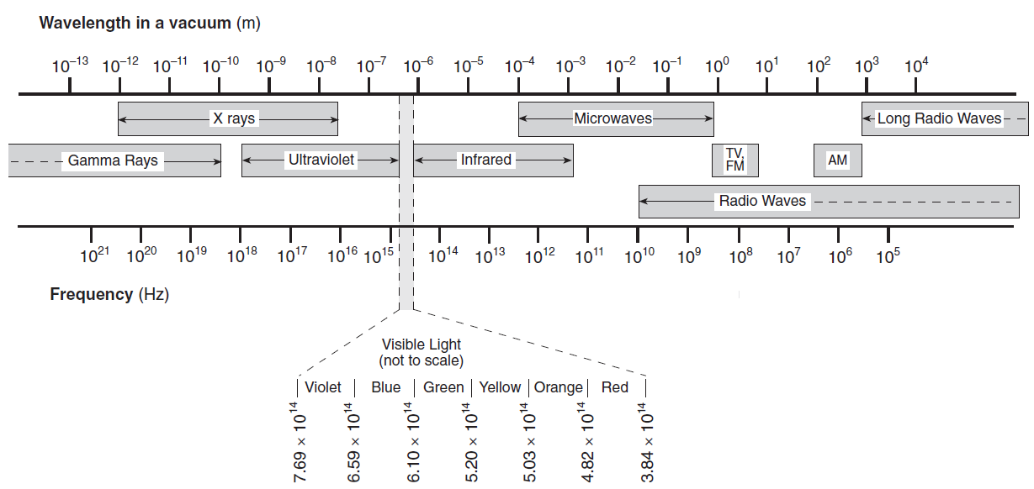
In which part of the electromagnetic spectrum does a photon have the most energy?
E = hf

Slide 9
A photon of orange light has a frequency of about 5 x 10¹⁴ Hz. What is the energy associated with this photon?
E_{photon} = hf
E_{photon} = (6.63 x 10⁻³⁴ J s)(5 x 10¹⁴ Hz)
E_{photon} = 3.3 x 10⁻¹⁹ J

Slide 10
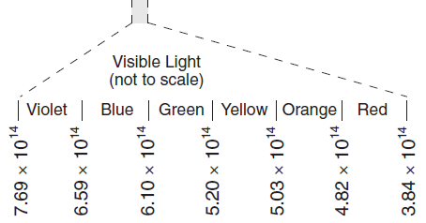
Try this…
The energy of a photon is 2.11 eV.
Determine the energy of the photon in Joules.
Determine the frequency of the photon.
Determine the color of light associated with the photon.
a. 1 eV = 1.60 x 10⁻¹⁹ J
2.11 eV x 1.60 x 10⁻¹⁹ J = 3.38 x 10⁻¹⁹ J
b. E = hf
f = E
h
= 3.38 x 10⁻¹⁹ J
6.63 x 10⁻³⁴ J s
= 5.10 x 10¹⁴ Hz

Slide 11
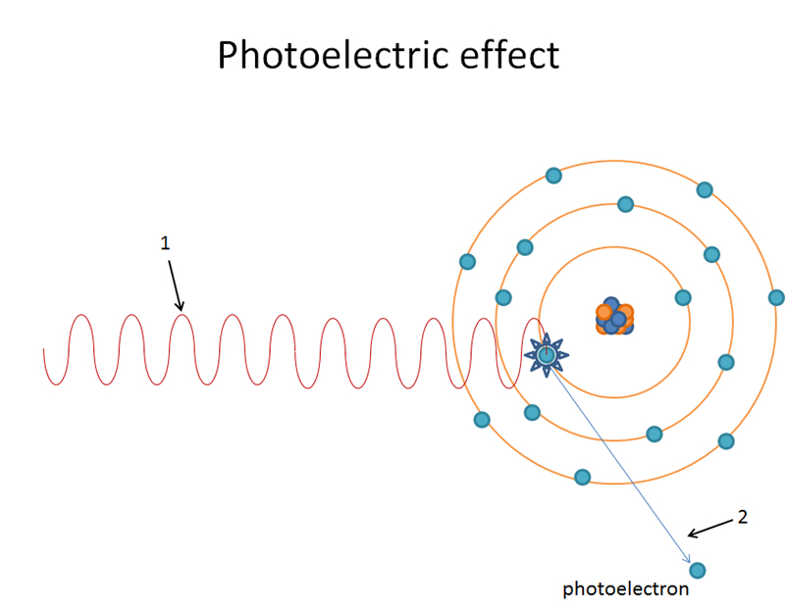
The photoelectric effect demonstrates that when a photon in the visible light range is incident on a metal surface, the photon’s energy is completely absorbed and transferred to the emitted electron (photoelectron).

Slide 12
Freeing electrons:
Electrons in a metal are held there by a binding energy (ionization potential).
Different atoms have specific binding energies (energy levels).
If an electron absorbs that specific amount of energy it will become unbound and free.
This can only happen if the electron absorbs a SINGLE photon, all at once, that posses that amount of energy (work function).
If there is “extra” energy associated with the incoming photon then this becomes the kinetic energy of the free electron.

Slide 13




KE_{leftover}
=
E_{in}
-
E_{needed}
Work function
2
=
10
-
8
KE_{max}
=
hf
-
W_{o}
2
y = mx + b
7
10
Binding energy/work function=
E = 8
Energy levels

Slide 14
KE_{max}
=
hf
-
W_{o}
KE
y = mx + b
h
f
Threshold frequency- minimum frequency needed to
expel electrons
W_{o}
8

Slide 15
Let’s look at the photoelectric effect again…what happens when we increase the intensity of the light?
When the intensity increases the number of electrons emitted increases.
I
# emitted

Slide 16
What happens to the kinetic energy as the intensity increases?
I
KE max
Summary- When a photon (visible light) hits a metal atom at the right frequency it knocks out an electron.

Slide 17
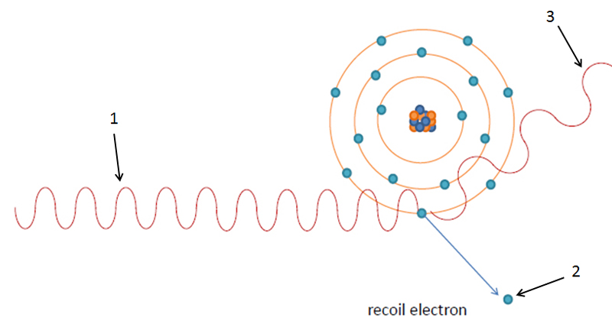
When a very high frequency photon (like X-rays) strike a metal
surface, not only are electrons ejected but electromagnetic
radiation of a lower frequency is also given off. This is called the
Compton Effect.

Slide 18
E ↓
λ↑
P ↑
f ↓
p ↑
E ↑
Energy and momentum are AWLAYS conserved in this collision.
The incident x-ray photon loses energy and momentum while the
electron gains energy and momentum.

Slide 19
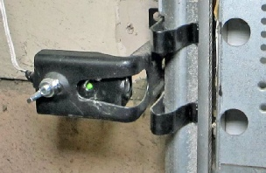
Applications:
Automatic Doors
Many elevators and garage-door systems use a beam of light and a photoelectric device known as a photocell as a safety feature. As long as the beam of light strikes the photocell, the photoelectric effect generates enough ejected electrons to produce a detectable electric current. When the light beam is blocked (by a person) the electric current is interrupted and the doors are signaled to open.

Slide 20
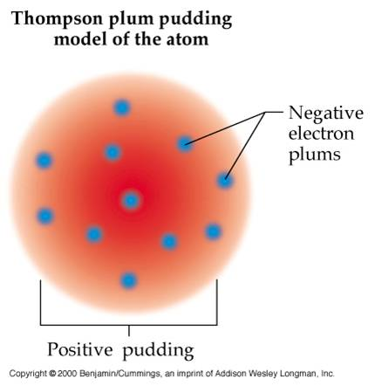
All of this information is going to help us as physicists to better understand the inside of the atom. Let’s review early models of the atom…
1898- Thomson’s Model:
Thomson proposed a model in
which the atom consists of a
uniform distribution of positive
charge in which electrons are
embedded, like raisins in plum
pudding.

Slide 21
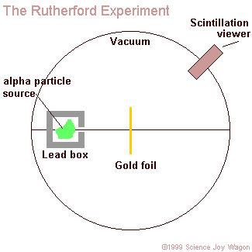
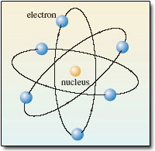
1911: Rutherford’s Model
Discovered the nucleus of an atom and concluded that
most of the atom is empty space. Did you know that if
the atom where the size of a football field the nucleus
would be the size of a marble. He also described the
atom as being like a miniature solar system with negative
electrons orbiting around a positively charged tiny nucleus
due to Coulomb forces of attraction.

Slide 22
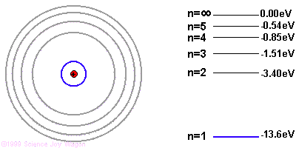
Bohr Model- Energy Levels
Electrons can jump from one orbit to a higher orbit by absorbing, or
lower orbit by emitting, a quantum of energy in the form of a photon.
The orbit nearest the nucleus represents the smallest amount of
energy that the electron can have.

Slide 23
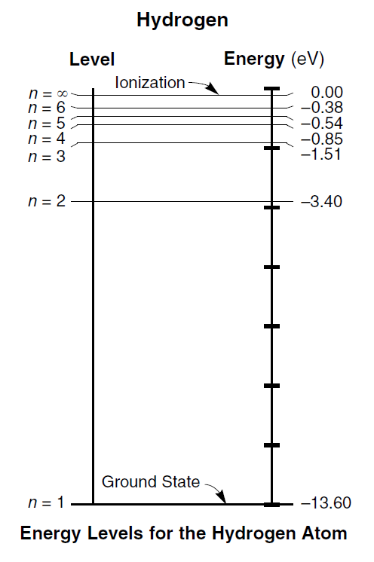
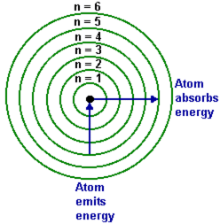
Bohr Model of Hydrogen
Free- photoelectron
Absorbs energy
Emits energy/photons
excited states
closest to nucleus

Slide 24
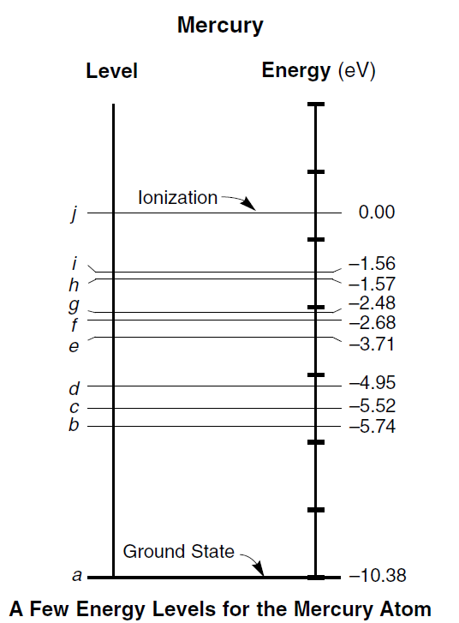
In using mercury for the photoelectric effect:
Electrons need to get out of the negatives
in order for it to be free as a photoelectron.
Negative energy indicate that the electron
is bound to the atom.

Slide 25
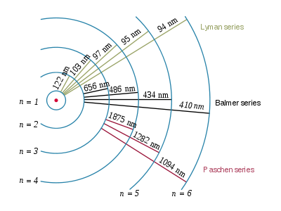
Certain frequency light will have enough energy to bump and electron up an energy level, or more than one energy level, or cause it to completely ionize.
Hydrogen
Ground State
Different combinations of
jumps will produce
different colors which are
shown on an absorption/
emission spectrum.
-13.60
-3.40
-1.51
0.00
-0.85
-0.54
-0.38

Slide 26

Emission (Bright-Line) Spectra
Every energy level transition creates a single
spectral line of a certain frequency specific
to that element.

Slide 27
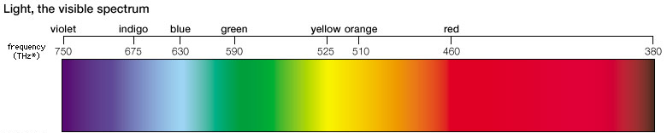

Energy/frequency of photon emitted during
specific transitions in a hydrogen atom:
n=6 to n=2: emits 3.02 eV = f = 7.3 x 10¹⁴ Hz- violet
n=5 to n=2: emits 2.86 eV = f = 6.9 x 10¹⁴ Hz- blue-violet
n=4 to n=2: emits 2.55 eV = f = 6.15 x 10¹⁴ Hz- blue-green
n=3 to n=2: emits 1.89 eV = f = 4.56 x 10¹⁴ Hz- red

Slide 28
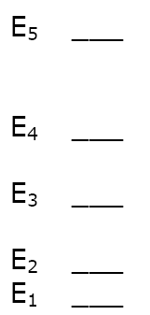
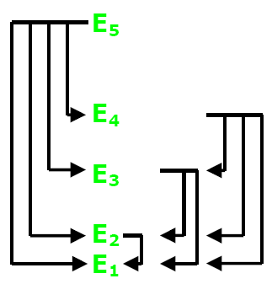
How many different spectral lines can be produced by an atom with 3 energy levels?
3

Slide 29
How many different spectral lines can be produced by an atom with 5 energy levels?
10

Slide 30
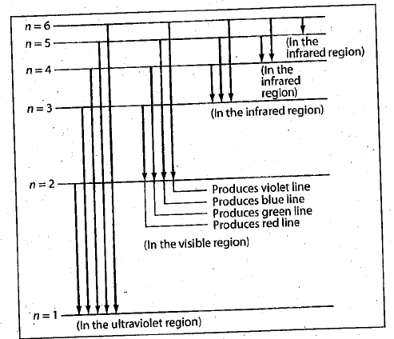
Different frequencies of radiation for emission of elections in hydrogen:

Slide 31
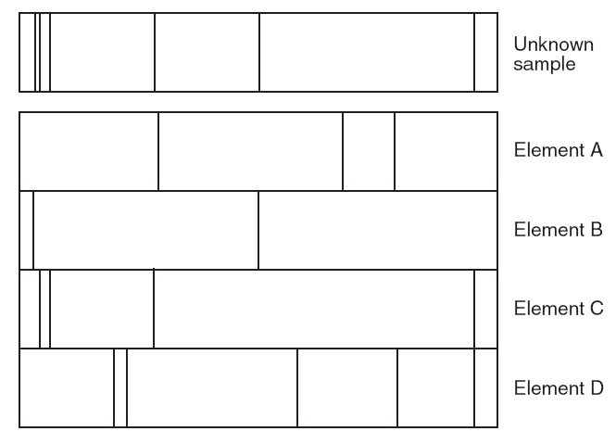
The diagram below represents the bright-line spectra of four elements, A, B, C, and D, and the spectrum of an unknown gaseous sample.
Based on comparisons of these spectra, which two elements are found in the unknown sample?

Slide 32
What color light (frequency) would appear on an emission spectrum for hydrogen if an electron fell from energy level 3 to 2?
E_{photon} = E_{i} - E_{f}
E_{photon} = -1.51 eV - -3.40 eV
---
E_{photon} = 1.89 eV
Before we go any further you
need to change eV into Joules:
1 eV = 1.6 x 10⁻¹⁹ J
1.89 eV x (1.6 x 10⁻¹⁹ J) =
E_{photon} = 3.024 x 10⁻¹⁹ J

Slide 33
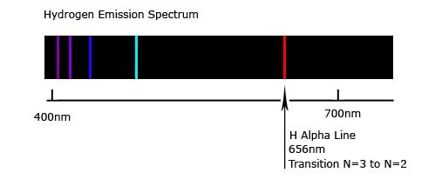
E_{photon} = 3.024 x 10⁻¹⁹ J
E = hf
f = E
h
f = 3.024 x 10⁻¹⁹ J
6.63 x 10⁻³⁴ J•s
f = 4.56 x 10¹⁴ Hz

Slide 34
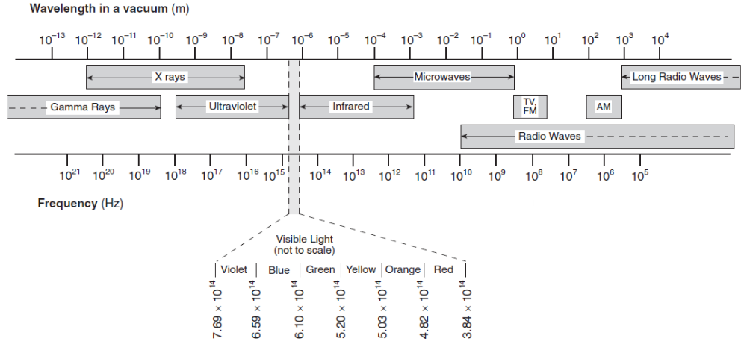
What color is emitted with a fall from energy level 2 to 1?
f = 2.46 x 10¹⁵ Hz
Ultraviolet range- cannot “see” it

Slide 35
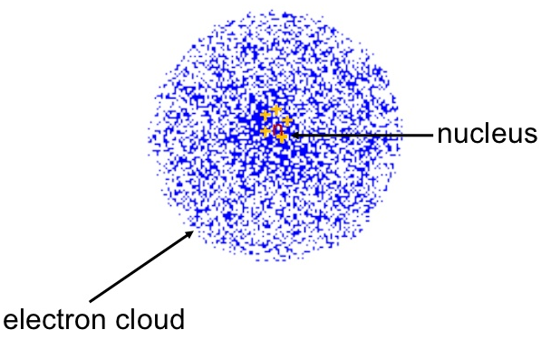
Current Atomic Model- Cloud Model
Electrons not confined to specific orbits
but spread out in space in a form called
an electron cloud- more dense areas =
higher probability of an electron.

Slide 36
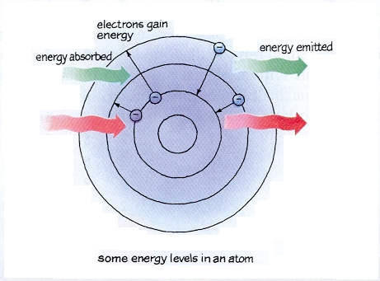
Summary:
Electrons can only absorb, or emit, photons having specific amounts of energy as per their energy level diagrams. These energies are equal to specific differences in their energy levels.
Moving from higher to lower energy levels = emission of a photon (releasing energy) = moving closer to the nucleus.
Moving from lower to higher energy levels = absorption of a photon (absorbing energy) = moving away from the nucleus into an excited state.

Slide 37
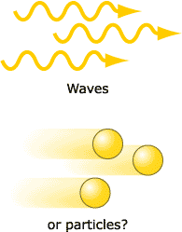
So light can act like a wave and a particle (or matter)…
Matter can also have a wave nature…

Slide 38
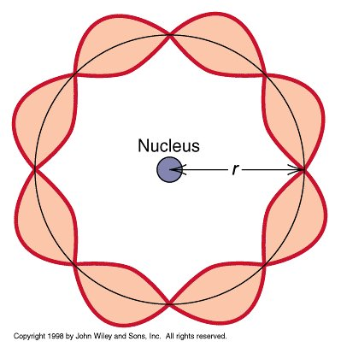
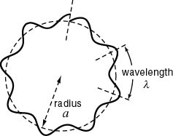
Dr. Quantum
The wavelength of the waves associated with the motion
of ordinary matter objects, like a Frisbee, are too small to
detect. But the waves associated with the motion of
smaller particles (atomic or subatomic scale) like
electrons can be detected. We can actually measure the
wavelength at which these subatomic particles vibrate.
The wavelength of a matter wave is known as the de Broglie wavelength:
λ = h
mv

Slide 39
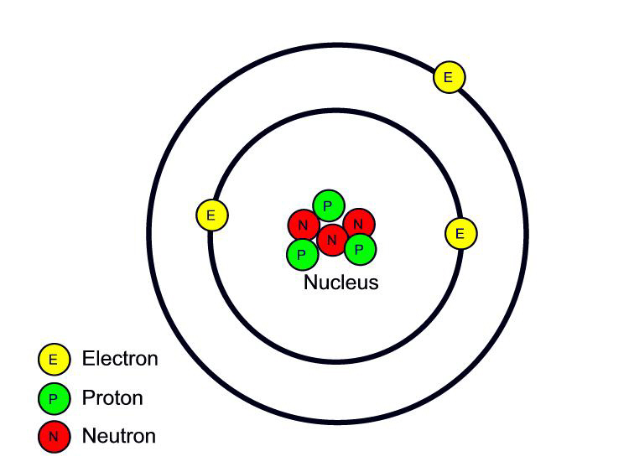
Inside the nucleus…
Most of the time the nucleus contains more than 1 positively charged proton.
The protons are only separated by a distance of 10⁻¹⁵ m.
Don’t two positively charged objects repel? Why doesn’t the nucleus just explode?
There is a VERY strong force between the protons and the neutrons called the STRONG NUCLEAR FORCE.
This is responsible for the stability of the nucleus.

Slide 40
Universal Mass Unit (u)
1 u = 1.66 x 10⁻²⁷ kg.
More convenient then using very very small numbers in kg.
What’s the mass of a Helium nucleus (2 protons, 2 neutrons)?
Protons = 1.0073 u x 2 = 2.0146 u
Neutrons = 1.0087 u x 2 = 2.0174
Mass of proton is 1.0073 u
Mass of neutron is 1.0087 u
Mass of electron 0.0005 u
Expected Total = 4.032 u
Actual Mass of Helium nucleus = 4.016 u

Slide 41
Where is the missing .016 u?
The lost mass is called the mass defect.
When nucleons come together to form a nucleus, energy is released (binding energy) and an equivalent amount of matter is lost.
To break up the nucleus and separate the nucleons, work must be done against the strong nuclear force.
The energy needed to separate the nucleons (binding energy) appears as an equivalent increase in their total mass.

Slide 42
E = mc²

Slide 43
1 u = 1.66 x 10-27 kg. Find the energy equivalent of 1 u in megaelectronvolts (MeV).
E = mc²
E = (1.66 x 10⁻²⁷ kg)(3 x 10⁸ m/s²)
E = 1.49 x 10⁻¹⁰ kg m/s²
1 MeV = 10⁶ eV
E = 1.49 x 10⁻¹⁰ J
E = 9.31 x 10⁸ eV
10⁶ eV
eV = 1.49 x 10⁻¹⁰ J
1.60 x 10⁻¹⁹ J
E = 931 MeV
= 9.31 x 10⁸ eV

Slide 44
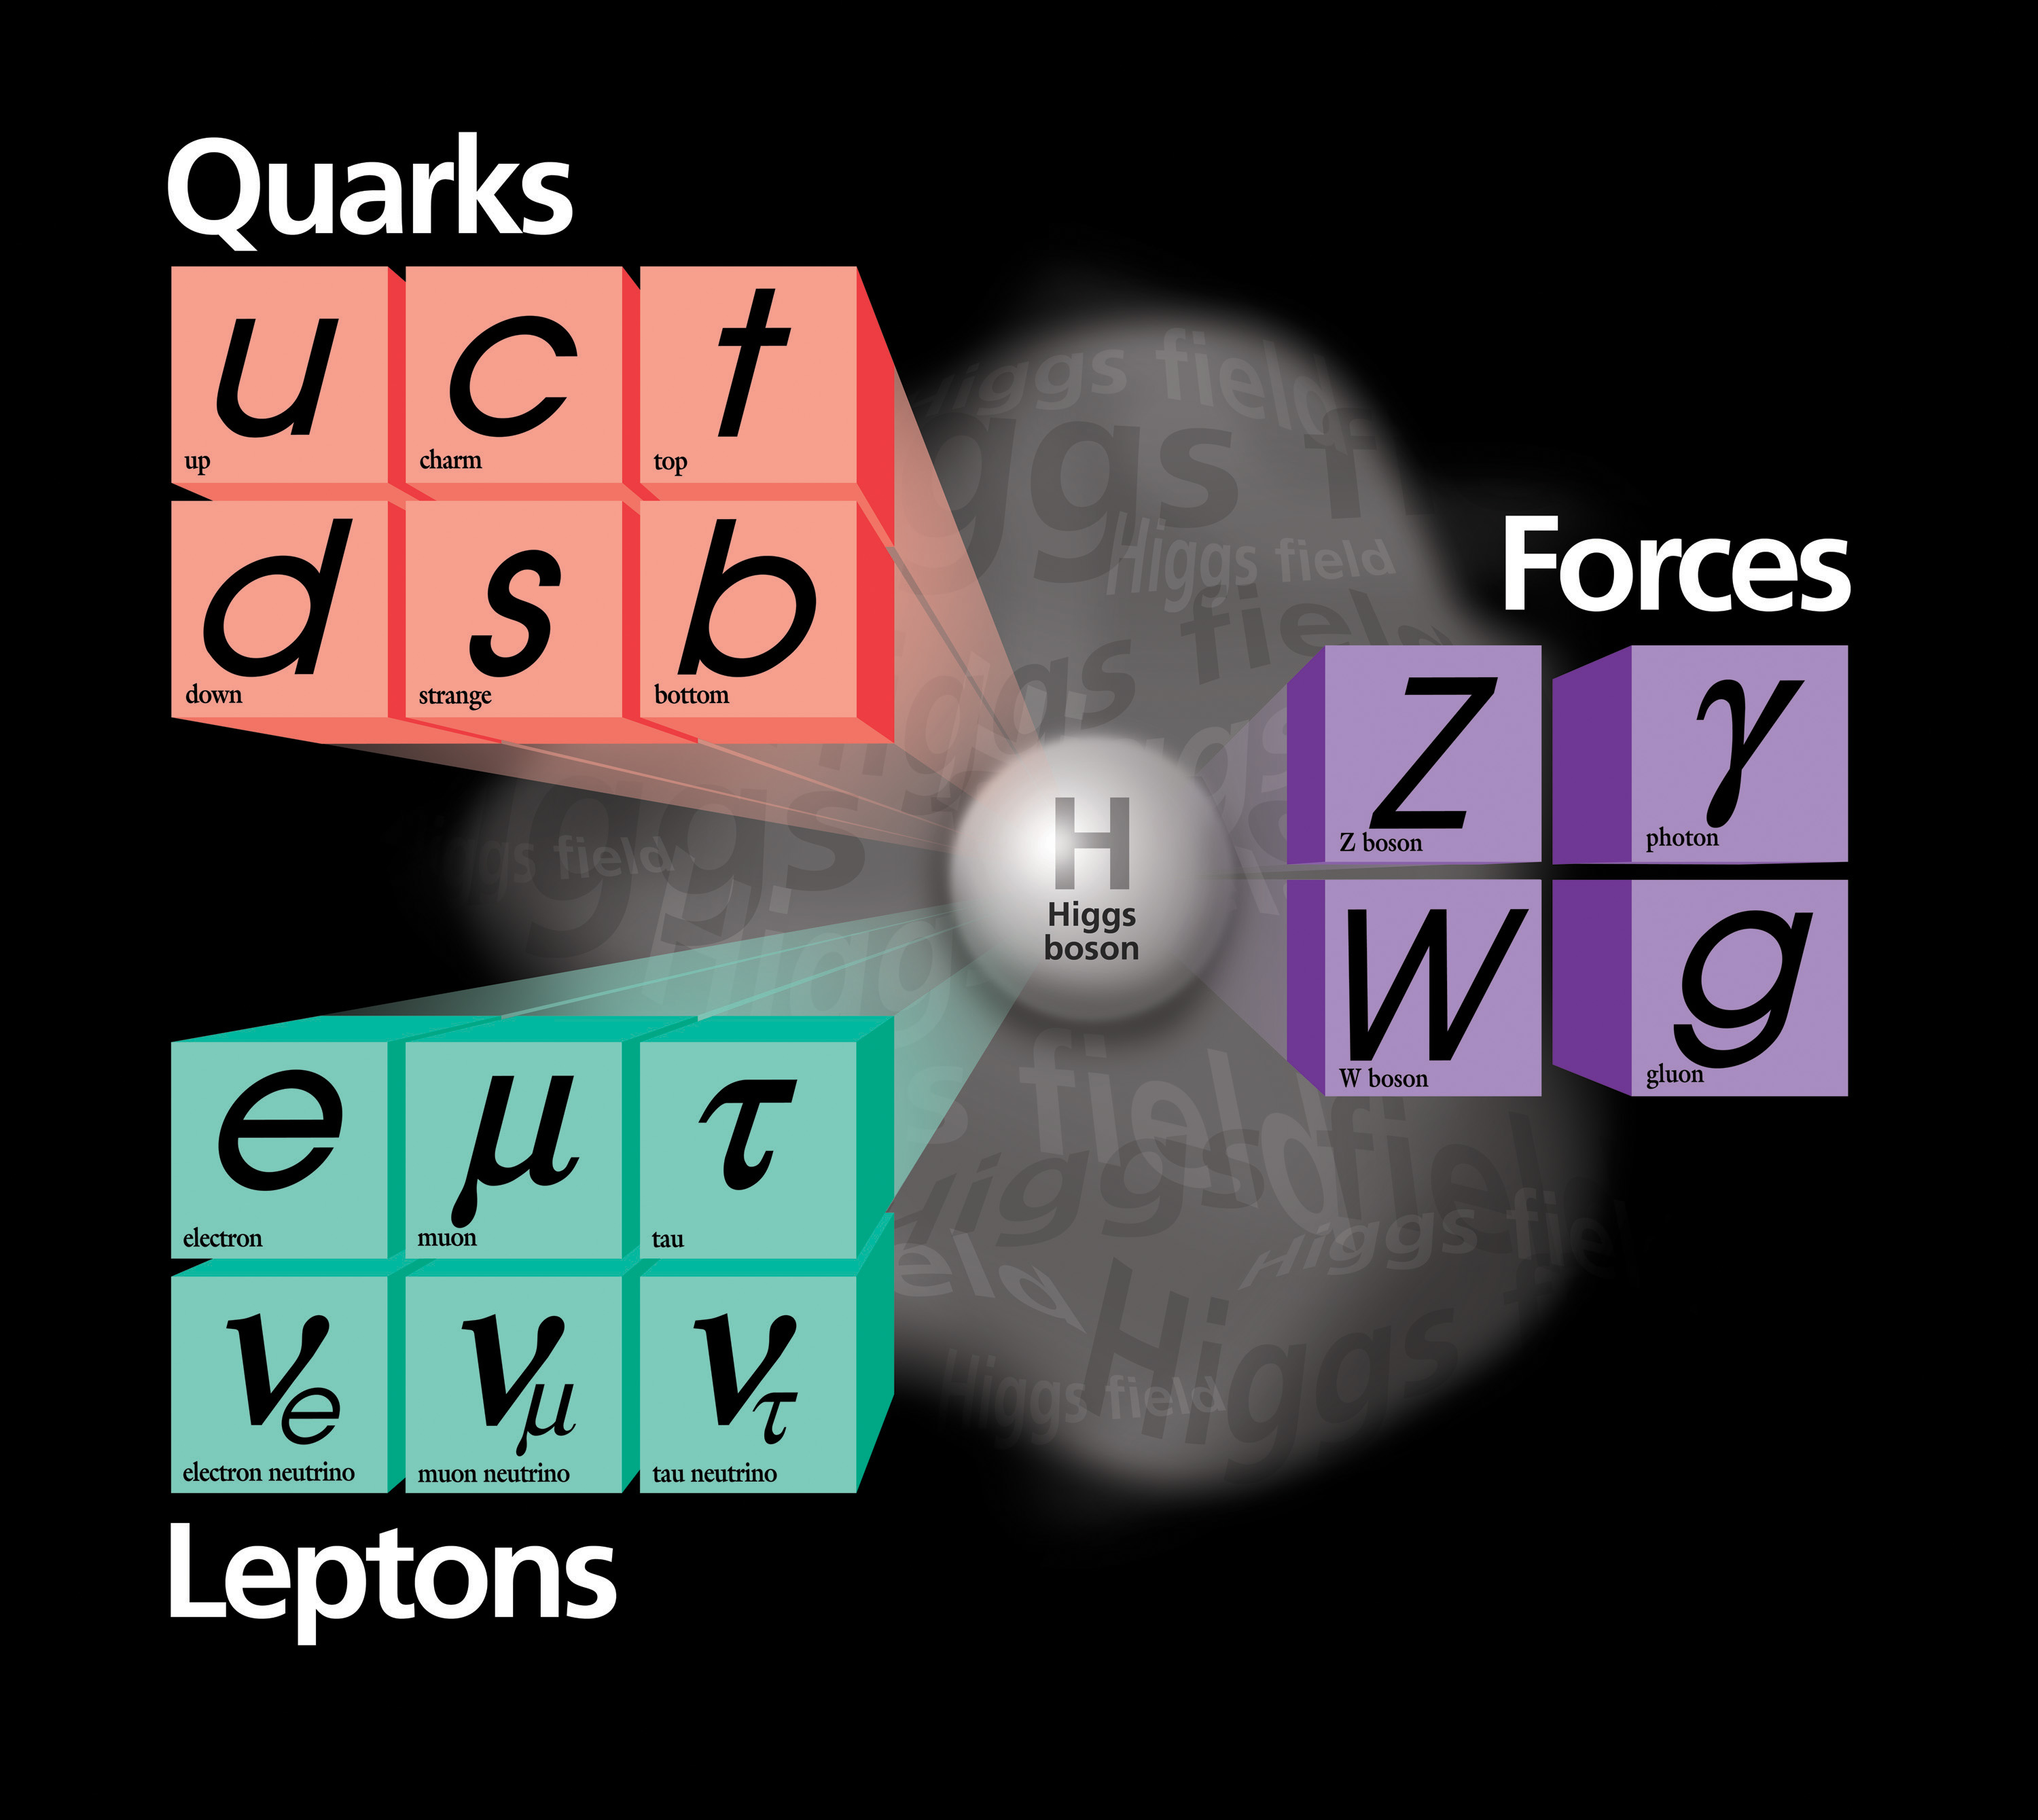
The Standard Model
Current theory used to explain the existence of all the subatomic particles that have been observed and the forces that hold atoms together or lead to their decay.

Slide 45
The Fundamental Forces in Nature
Force | Relative Strength | Range of Force | Force Carrier | Mass | Charge
Strong (nuclear) | 10⁰ (1) | 10⁻¹⁵ m | gluon | 0 | 0
Electro- magnetic | 10⁻² | Proportional to 1/r² | photon | 0 | 0
Weak | 10⁻¹³ | <10⁻¹⁸ m | W boson W boson Z boson | 80.6 eV 80.6 eV 91.2 eV | + e - e 0
Gravitational | 10⁻³⁸ | Proportional to 1/r² | graviton | 0 | 0

Slide 46
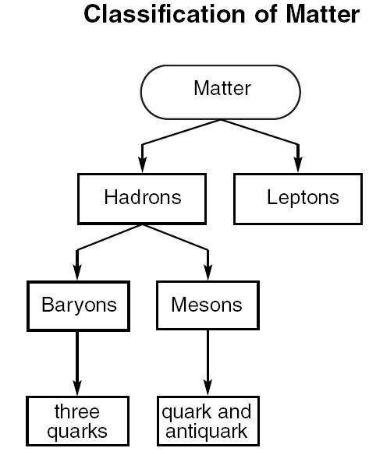
Classification of Particles
They are first classified by the type of interactions they have with other particles:
Particles that interact through
strong, weak, electromag, and
grav forces
Particles that interact through
weak, electromag, and grav
forces (not strong) – mass is
less than a proton
PROTONS AND NEUTRONS
ELECTRONS, POSITRONS, NEUTRINOS

Slide 47
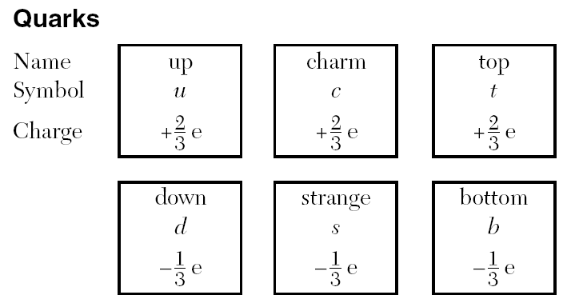
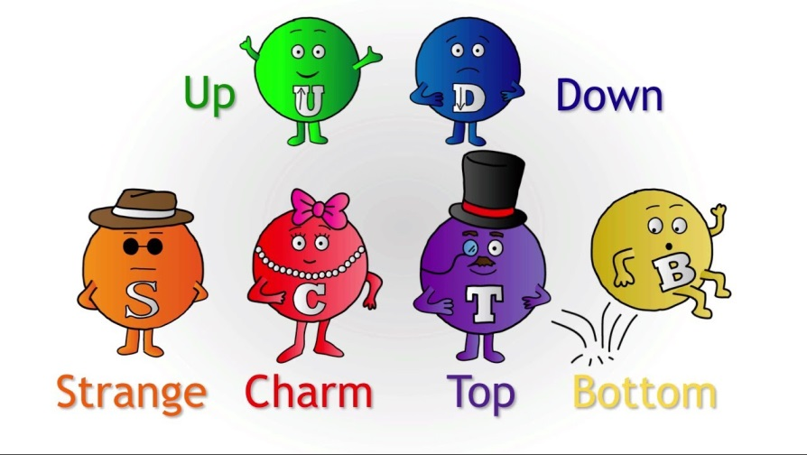
Heavy elementary particles
that are put together to form
protons and neutrons.

Slide 48
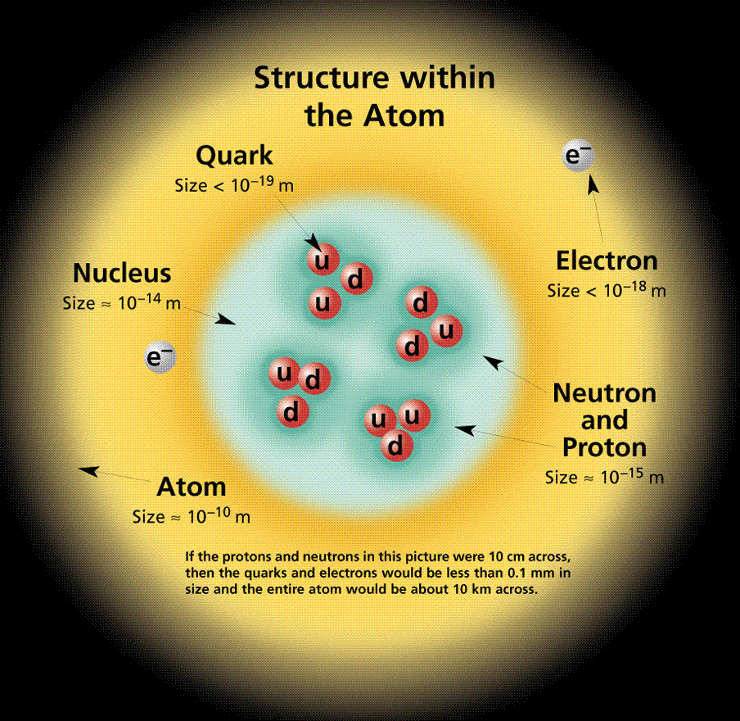
Protons and neutrons are made up of 3 quarks, no more, no less, always 3.
PROTON: uud
“dud”
NEUTRON: udd
When combining quarks
their combined charge
must add up to 0e, +1e,
or -1e.

Slide 49
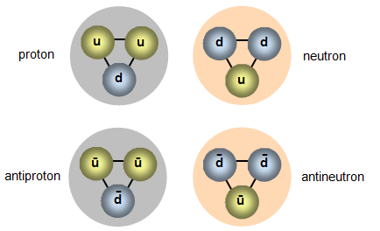
Antimatter- material consisting of
atoms that are composed of
antiparticles (particles having the
same mass, lifetime, and spin as
the associated particle but
opposite in sign). Denoted by a
bar over the symbol.
Example:
an antiproton has all
the same features of
a proton but it is
negatively charged.
Symbol p with bar.

Slide 50
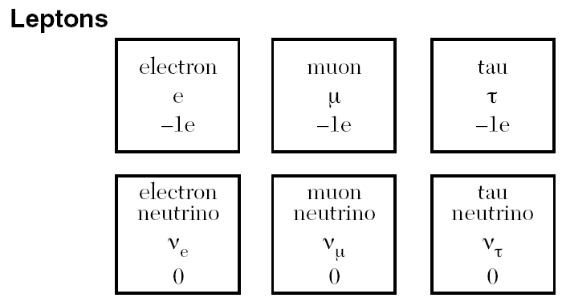
Antiparticle of an
electron is called a
positron.
ELECTRONS AND NEUTRINOS
(neutral particle with little if any
mass yet has energy and
momentum.

Slide 51
A lithium atom consists of 3 protons, 4 neutrons, and 3 electrons. What is the total number of quarks and leptons in this atom?
3 protons = 3 quarks = 9 quarks
4 neutrons = 3 quarks = 12 quarks
3 electrons = 3 leptons
Total = 21 quarks and 3 leptons

Slide 52
Which combination of quarks could produce a neutral baryon?
cdt
cts
cdb
cdu
cdb

Slide 53
What is the electric charge on a particle having quark composition ubb?
0e

