Slide 1
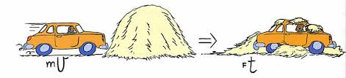
Momentum and Impulse
Conservation of Momentum

Slide 2
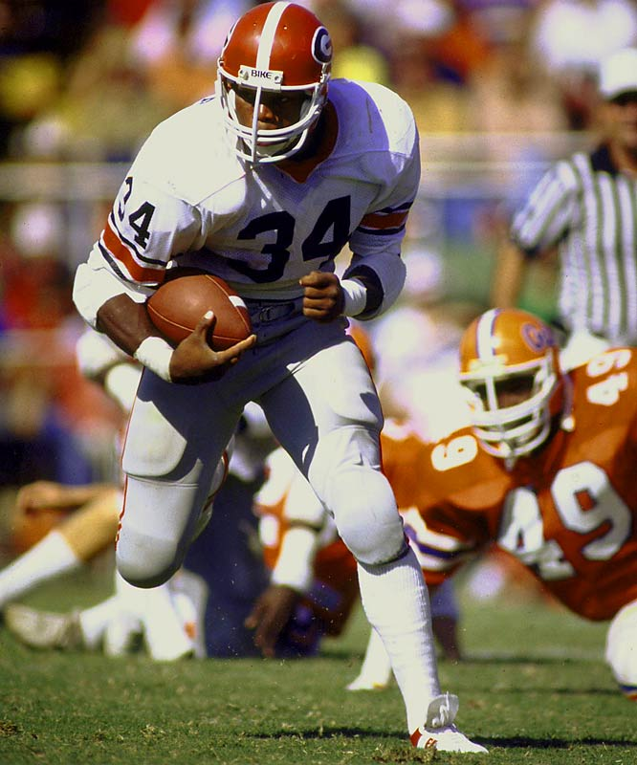
Momentum
Measures how hard it is to stop a moving object.
Momentum can be defined as "mass in motion."
All objects have mass; so if an object is moving, then it has momentum - it has its mass in motion.

Slide 3
So what are the variables that influence how much momentum an object has?
The amount of momentum which an object has is dependent upon two variables: the mass of the object and the velocity of the object.
Momentum = mass • velocity
Momentum is the lower case "p". Thus, the above equation can be rewritten as
p = mv

Slide 4
Determine the momentum of a…
a. 60-kg halfback moving eastward at 9 m/s.
b. 1000-kg car moving northward at 20 m/s.
c. Can the halfback and the car ever have the same momentum? How?
p = mv = 60 kg (9 m/s) = 540 N•s east
Momentum is a vector and has the same direction as velocity
p = mv = 1000 kg (20 m/s) = 20,000 N•s north
The halfback can increase his velocity to 333 m/s, or the car can decrease
it’s velocity to .54 m/s

Slide 5
A car possesses 20,000 kg m/s of momentum. What would be the car's new momentum if ...
its velocity were doubled.
its velocity were tripled.
its mass were doubled (by adding more passengers and a greater load)
both its velocity were doubled and its mass were doubled.
2p
3p
2p
4p

Slide 6
A 100 kg football player runs straight down the field with a velocity of 4 m/s. A 1 kg artillery shell leaves the barrel of a gun with a muzzle velocity of 500 m/s. Which has the greater momentum?
Football Player:
p = mv
p = 100kg(4m/s)
= 400 N•s
Artillery Shell:
p = mv
p = 1kg(500m/s)
= 500 N•s
In this case the lighter, or less massive, shell has the greater momentum.

Slide 7
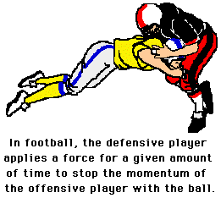
Impulse
The more momentum an object has, the harder it is to stop.
To stop such an object, it is necessary to apply a force against its motion for a given period of time.
J = FΔt
Impulse is a vector that has the same direction as the Force

Slide 8
A force acting on an object causes it to accelerate. This acceleration produces a change in the object’s velocity and thus it’s momentum.
An object with momentum can be stopped if a force is applied against it for a given amount of time.
F = ma
Δv
Δt
ΔtF = mΔvΔt
Δt
FΔt = mΔv
F = mΔv
Δt
IMPULSE = CHANGE IN MOMENTUM
J = Δp

Slide 9
The Affect of Collision Time on Impulse
To keep a constant impulse what has to happen to Force and Time?
J = FΔt
IMPULSE FORCE TIME
100
100
1
100
50
2
10
10
100
100
5
20
The greater the time over which the collision occurs, the smaller the
force acting upon the object.

Slide 10
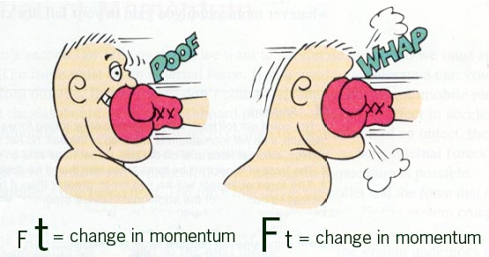

Slide 11
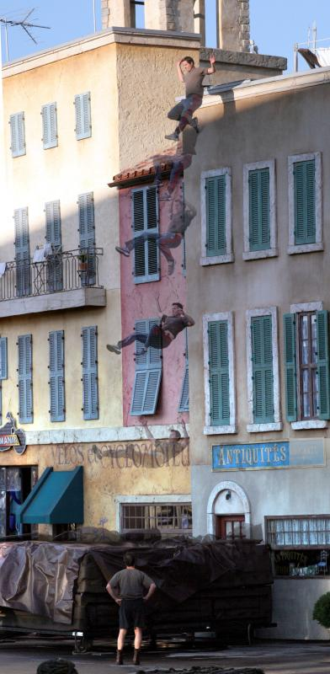
Let’s look at some examples…
When this guy hits the ground he’s
going to stop suddenly (small t) so
the force is going to be greater.
To minimize the affect of the force
on an object involved in a collision,
the time must be increased.
How can we increase the time it’s
going to take to stop this guy?

Slide 12
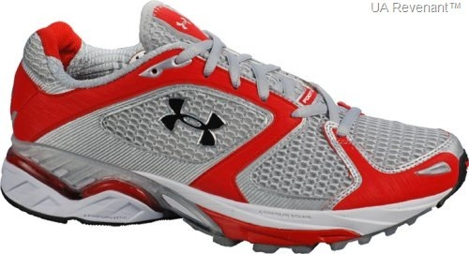
Sneakers…
Sneakers (rubber) reduce the amount of force you step/run/jump with because they increase the amount of time at which your feet hit the ground.

Slide 13
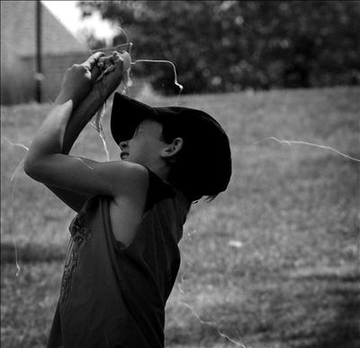
Egg toss…
The person who is catching the egg
should try to prolong the time of
slowing the egg by moving their
hands back in the direction of the
egg’s motion.
By increasing the time during which
the hands act on the egg to reduce
its momentum to zero, the force
needed to produce the necessary
impulse (change in momentum) is
reduced and the egg won’t break.

Slide 14
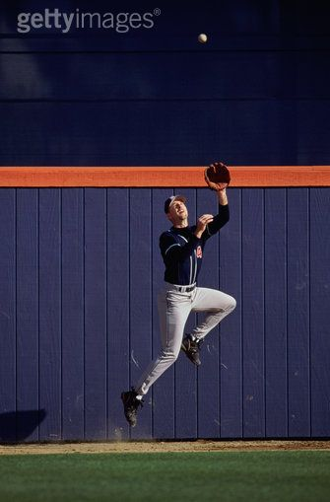
Outfielder…
The outfielder catching the ball also
tries to prolong the time of slowing
the ball by moving the gloved hand
back in the direction of the ball’s
motion so that the force needed to
produce the necessary impulse is
reduced and the “sting” is minimized.

Slide 15
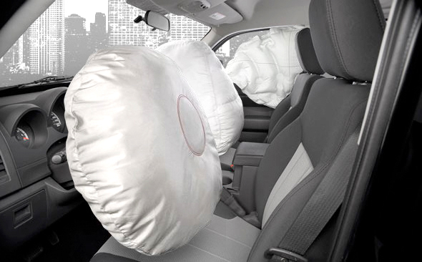
Airbags…
Air bags are used in automobiles because they are able to minimize the affect of the force on an object involved in a collision. Air bags accomplish this by extending the time required to stop the momentum of the driver and passenger (bigger t, less F). Without airbags the driver and passenger tend to keep moving in accord with Newton's first law (inertia). Their motion carries them towards a windshield which results in a large force exerted over a short time in order to stop their momentum.

Slide 16
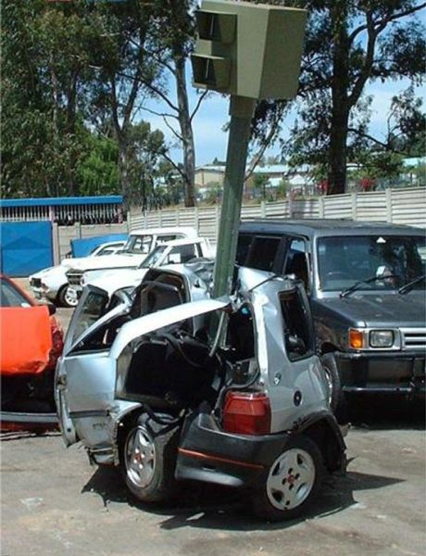
Cars – new vs. old…
http://online.wsj.com/article/SB10001424052970204518504574417212362984366.html#video%3D81C56182-07AA-490A-BB32-60391DE4035D%26articleTabs%3Dvideo
Newer vehicles have crumple zones (usually in the front for head-on collisions) that are designed to slow down the collision (larger t, smaller F).

Slide 17
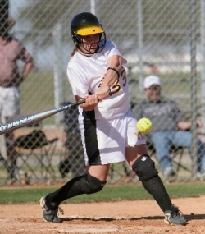
Softball…
When tossed upward and hit horizontally by a batter, a .20 kg softball receives an impulse of 4.0 N • s. With what speed does the ball move away from the bat?
Impulse (J) = change in momentum (Δp)
m = .20 kg
J = Δp
v = J
m
J = 4 N s
J = p_{f} - p_{i}
v = 4 N s
.20 kg
v_{i} = 0 m/s
J = mv_{f} - mv_{i}
v_{f} = ?
J = mv_{f}
m m
v = 20 m/s
v = J
m

Slide 18
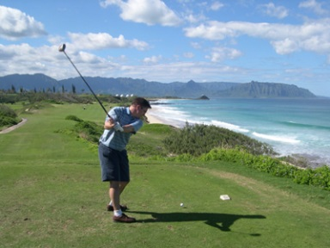
Teeing off:
A golfer drives a .10 kg ball from an elevated tee, giving it a horizontal speed of 40 m/s. The club and the ball are in contact for 1.0 ms (milliseconds- 1.0 x 10 ^{–3} s). What is the average force exerted by the club on the ball during this time?
Impulse (J) = change in momentum (Δp)
m = .10 kg
Ft = Δp
F = .1kg(40m/s) - 0
1.0 x 10 ^{–3} s
v_{f} = 40 m/s
Ft = p_{f} - p_{i}
v_{i} = 0 m/s
Ft = mv_{f} - mv_{i}
F = 4
.001s
t = 1.0 x 10 ^{–3} s
Ft = mv_{f} – mv_{i}
t t
F = 4000 N
F = ?
F = mv_{f} – mv_{i}
t

Slide 19
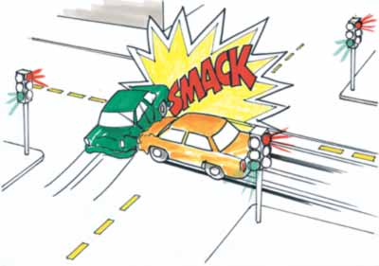
Conservation of Momentum
(applied to objects that are in closed systems- not acted on by an external force- ΣF = 0 – frictionless surface)
When two objects collide they exert a force on each other that is equal in magnitude but opposite in direction (Newton’s 3rd Law).
Such forces often cause one object to speed up (gain momentum) and the other object to slow down (lose momentum).

Slide 20
Because the force acts on both objects for exactly the same amount of time, the magnitude of impulse (J = Ft) on each object is the same.
Remember what impulse is:
So the change in momentum for each object also has the same magnitude but are in opposite directions.
IMPULSE = CHANGE IN MOMENTUM
m₁Δv₁ = - m₂Δv₂

Slide 21
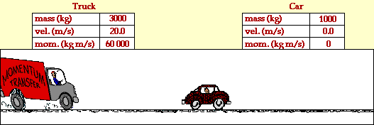
The total change in momentum between two objects is zero (momentum is conserved).
m₁Δv₁ + m₂Δv₂ = 0
p_{before} = p_{after}
p = p’

Slide 22
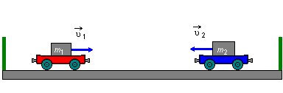
p = p’
A 5 kg cart moving due east at 6 m/s collides with a 10 kg cart moving due west. The carts stick together and come to rest (p = 0) after the collision determine the initial speed of the 10 kg cart.
m₁v₁ + m₂v₂
= 0
m₁v₁ = - m₂v₂
m₁v₁ = - m₂v₂
-m₂ -m₂
m₁v₁ = v₂
-m₂
v₂ = (5kg)(6m/s)
10kg
v₂ = 3 m/s

Slide 23
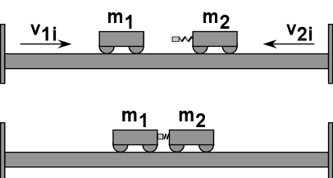
p = p’
m₁v₁ + m₂v₂
= (m₁ + m₂)v_{f}
m₁v₁ + m₂v₂ = (m₁ + m₂)v_{f}
(m₁ + m₂) (m₁ + m₂)
A 2 kg cart traveling at 15 m/s to the right collides with 1 kg cart initially at rest. The carts lock together upon collision. Determine the final velocity of the carts.
v_{f} = m₁v₁ + m₂v₂
(m₁ + m₂)
v_{f} = (2kg)(15m/s) + (1kg)(0)
(2 kg + 1 kg)
v_{f} = 30 kg m/s
3 kg
v_{f} = 10 m/s

Slide 24
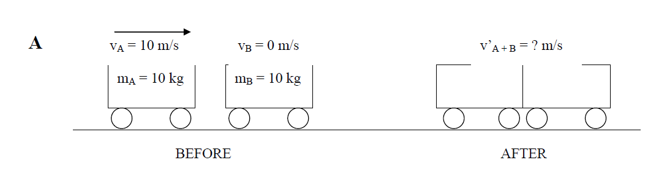
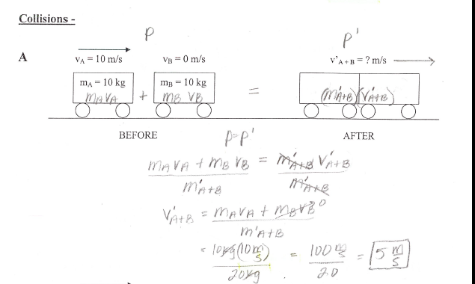

Slide 25
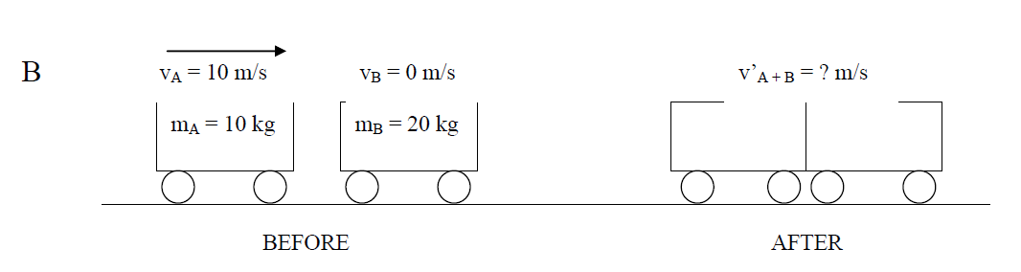
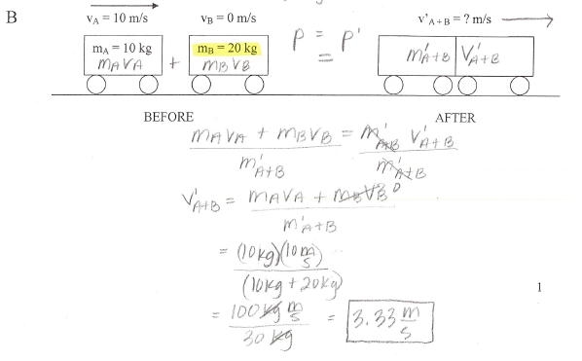

Slide 26
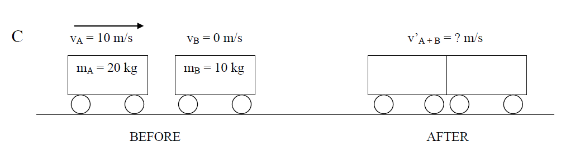
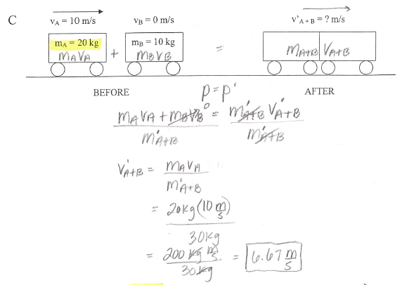

Slide 27
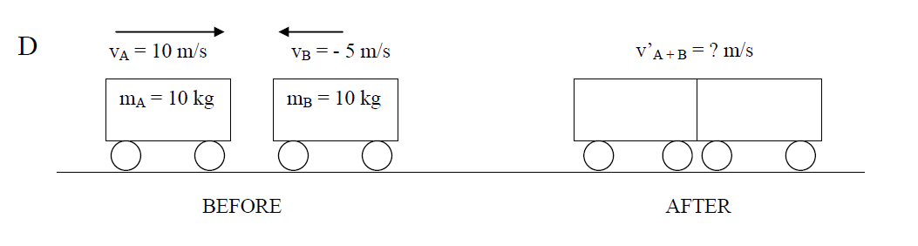
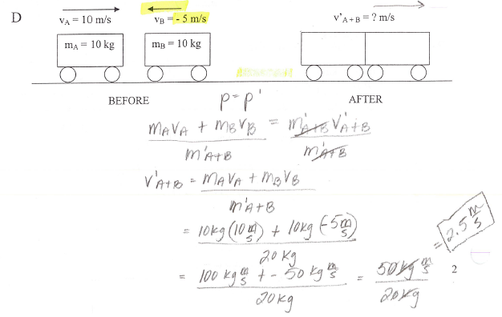

Slide 28
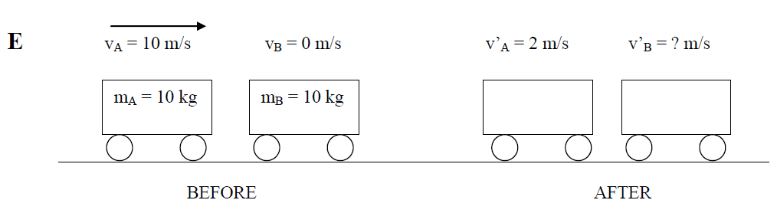
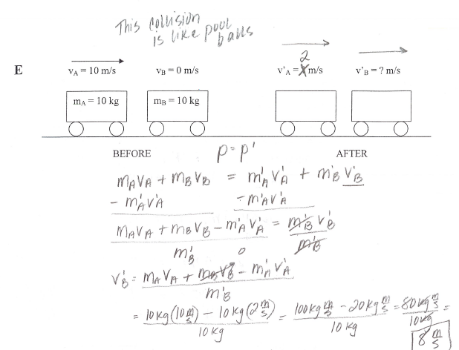

Slide 29
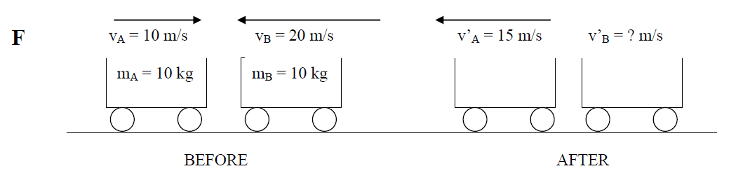
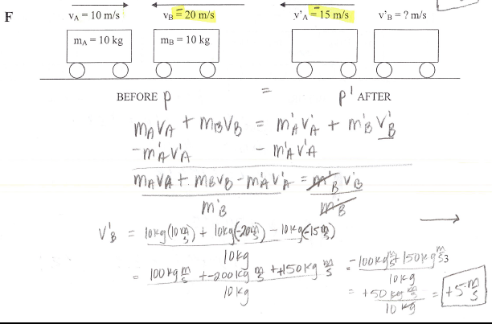

Slide 30
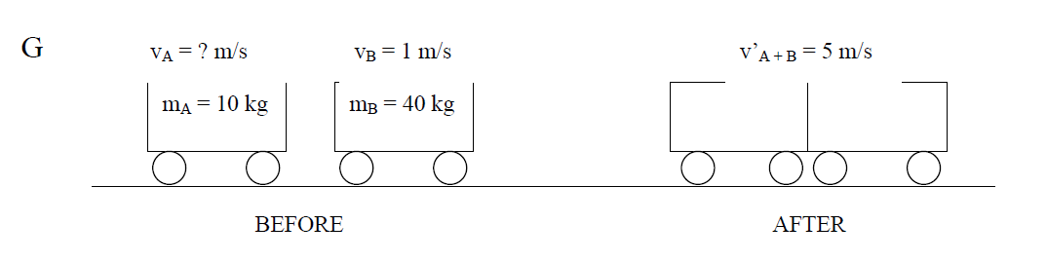
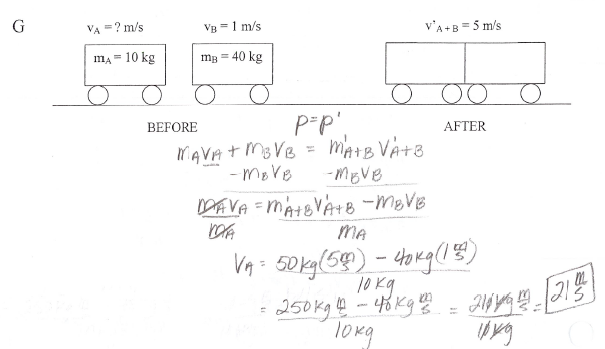

Slide 31
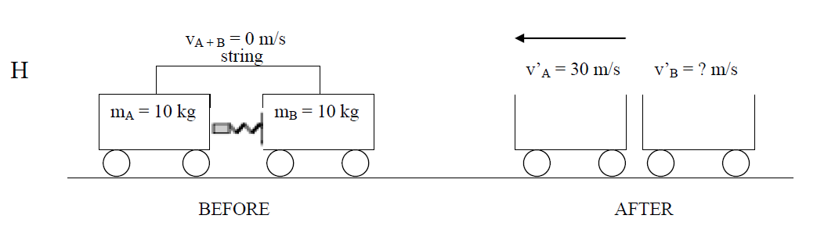
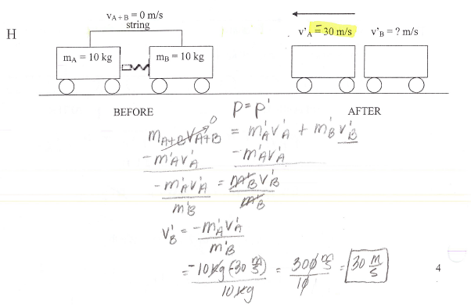

Slide 32
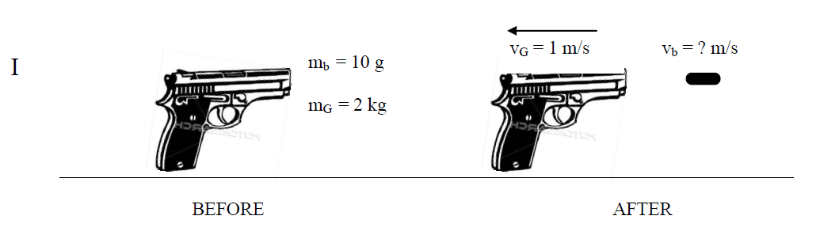
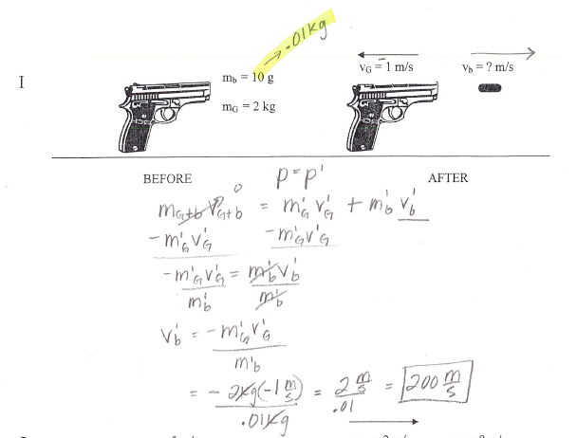

Slide 33
