Slide 1
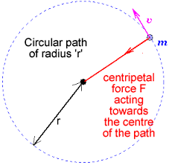
Circular Motion

Slide 2
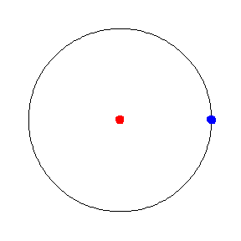
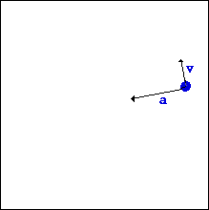
Uniform Circular Motion- UCM
Uniform circular motion can be described as the motion of an object in a circle at a constant speed.
Remember what vectors represent…magnitude and direction.
As an object moves around in a circle the magnitude of it’s velocity remains constant but the direction changes.
This means it’s velocity is in fact changing. A change in velocity means there is an acceleration.

Slide 3
Centripetal Acceleration
An object moving uniformly in a circular path always has a centripetal acceleration.
This acceleration is always directed toward the center of the circle.
r
a_{c} = v²
r

Slide 4
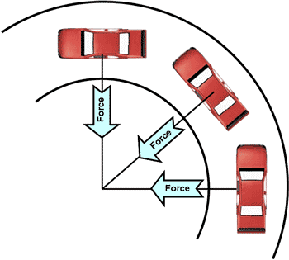
A 900-kg car moving at 10 m/s takes a turn around a circle with a radius of 25 m. Determine the acceleration of the car.
a_{c} = v²
r
Does the mass of the car matter?
a_{c} = (10 m/s)²
25 m
a_{c} = 100 m²/s²
25 m
a_{c} = 4 m/s²

Slide 5
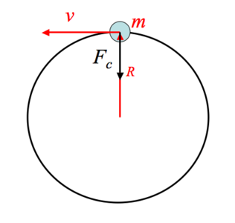
If there’s an acceleration doesn’t that mean there must be a force? Remember Newton’s 2nd?
Applying an unbalanced force
to a mass will cause it to
accelerate.
F_{net} = ma
The force causing an object to move in
a circular motion is called the
CENTRIPETAL FORCE (F_{c}).
F_{c} is a vector that is directed
towards the center of the circle and
it produces centripetal acceleration.
F = ma
F_{c} = ma_{c}
F_{c} = mv²
r
a_{c} = v²
r

Slide 6
A 900-kg car moving at 10 m/s takes a turn around a circle with a radius of 25 m. Determine the centripetal force pulling the car.
F_{c} = mv²
r
Does the mass of the car matter?
F_{c} = 900kg(10 m/s)²
25 m
F_{c} = 3600 N

Slide 7
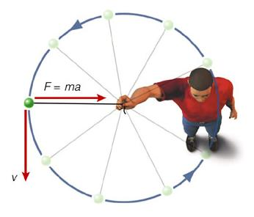
A few things to consider…
There is NO force
pulling the ball outward.
The force of tension from the string
is holding it in a circular path.
The velocity vector
is tangent to the circle.
The velocity of the ball
is in this direction but it
is being force toward the
center of the circle by the F_{c} (tension)
forcing it to follow a curved path.
Notice that the F_{c} vector
is perpendicular to the
velocity vector.

Slide 8
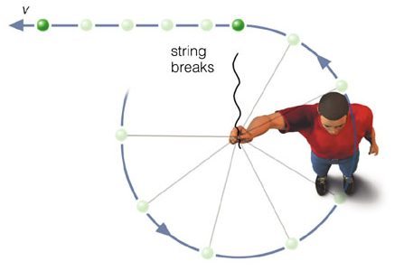
What if there was no force? The string breaks…
Remember Newton’s 1st…an object
in motion will stay in motion
Will the ball continue to follow the path of the circle?
NO. There is no longer a force
pulling it towards the center.
It will follow the path of the
velocity vector, which is tangent
to the circle.
The ball with continue on a straight path.

Slide 9
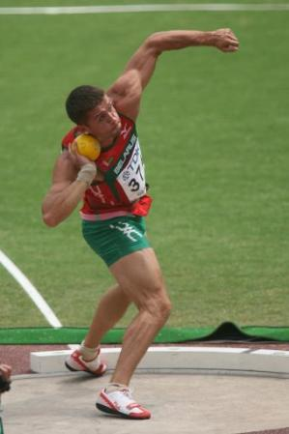
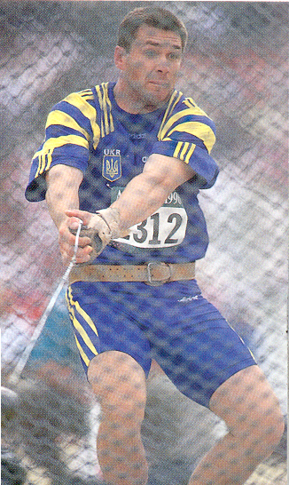
Shot put and hammer throwers use centripetal acceleration to gain speed then when they release the object it moves outward tangent to the circle.

Slide 10
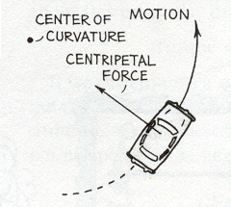
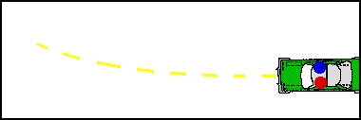
If the centripetal force is ALWAYS directed inward then why do you get forced in the opposite direction during turns?
This is caused again by Newton’s 1st. It’s inertia. Your body is resisting the motion.
This is often mistaken for a force- centrifugal force. Be careful this force is fictitious.

Slide 11
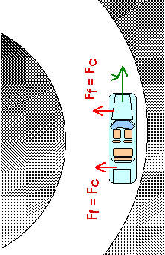
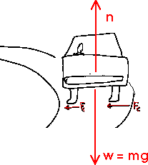
A car approaches a level circular curve with a radius of 300 m.
If the concrete pavement is dry (µ = .9), what is the maximum
speed at which the car can negotiate the curve at a constant
speed without slipping?
The net force on a car traveling around a curve is the F_{c}
and it is directed toward the center of the curve.
The force of friction is the only horizontal force on a
car and provides the centripetal force.
ΣF statement:
ΣF = ma
ΣF = ma_{c}
F_{N}
ΣF = F_{f}
ΣF_{y} = 0
ma_{c}= F_{f}
F_{f} = µF_{N}
ΣF_{y} = F_{f} - w
F_{f}
v²
r
µmg
F_{f} = w = mg
F_{f}
F_{g}
mv² = µmg
r

Slide 12
v = ?
mv² = µmg
r
rmv² = µmgr
r
mv² = µmgr
m m
So the mass of the
car doesn’t matter.
v² = µgr
v² = (.9)(10m/s²)(300m)
√v² = √2700 m²/s²
v = 52 m/s

Slide 13
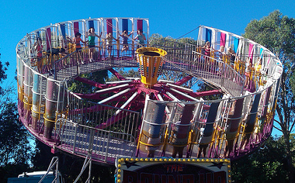
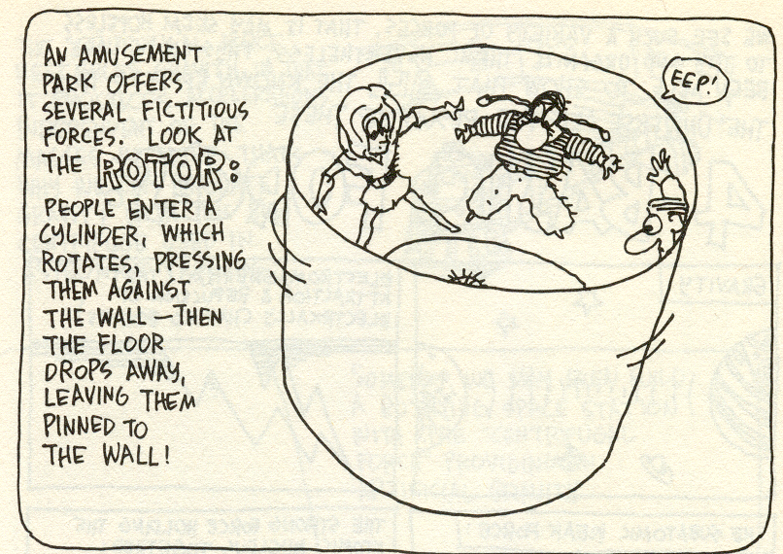
Amusement parks have several rides that show this fictitious force.
F_{f}
F_{N}
F_{g}
What forces are acting on these people?
The normal force is going out of the wall-
the wall is pushing back on them.
There bodies resistance to the spinning
motion (INERTIA) is what causes them
to be pinned up against the wall.

Slide 14
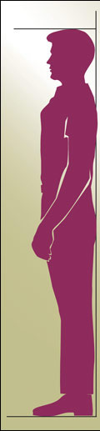
F_{f}
F_{f}
F_{N}
How fast does the
ride need to be
spinning to keep
you pinned against
the wall?
F_{N}
F_{g}
ΣF_{x} = ma_{c}
F_{g}
ΣF_{y} = 0
ΣF_{x} = F_{N}
F_{f} = µF_{N}
ΣF_{y} = F_{f} - w
ma_{c} = F_{N}
F_{N} = F_{f}
µ
F_{f} = w = mg
v² = gr
µ
v²
r
mg
µ
r
v² = g
r µ
mv² = mg
r µ
mv² = mg
mr mµ
r
=
=

Slide 15
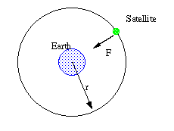
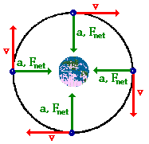

The centripetal force is what allows satellites to stay in orbit around the Earth.
This centripetal force (F_{c}) is the gravitational force (F_{g}) of the Earth. F_{c} = g
The velocity of the satellite would be directed tangent to the circle at every point along its path.
The acceleration of the satellite would be directed towards the center of the Earth.
Satellites are “falling in a circle” around the Earth.
g = GM
r²

Slide 16
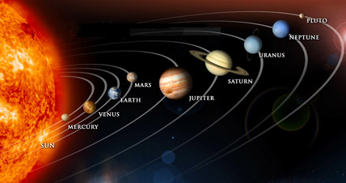
The centripetal force is what allows the planets to stay in orbit around the Sun.
This centripetal force (F_{c}) is the gravitational attraction (F_{g}) of the planet-sun system. F_{c} = F_{g}
The velocity of the planet would be directed tangent to the circle at every point along its orbit.
The acceleration of a planet would be directed towards the center of the its orbit towards the sun.
F_{g} = GmM
r²

Slide 17
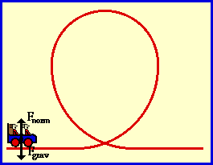
Roller coasters- the feeling of weightlessness and heaviness
This is similar to an elevator ride.
We need to first look at the forces acting on the riders.
The only forces exerted upon the riders are the force of gravity and the normal force (the force of the seat pushing up on the rider).
The force of gravity is at all
times directed downwards and
the normal force is at all times
directed perpendicular to the
seat of the car.

Slide 18
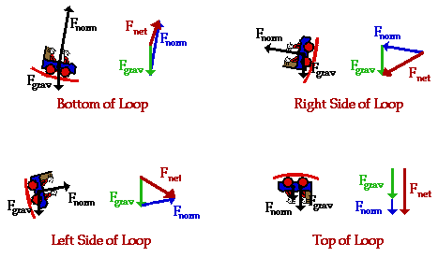
F_{N}
F_{N}
F_{g}
F_{g}
BOTTOM OF LOOP
TOP OF LOOP
F_{N} is greater than F_{g} –
feeling of heaviness
F_{N} is less than F_{g} –
feeling of weightlessness

Slide 19
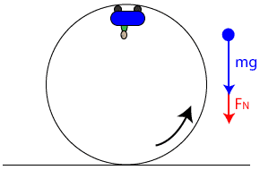
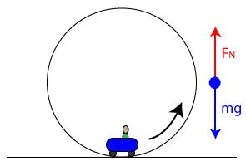

Slide 20
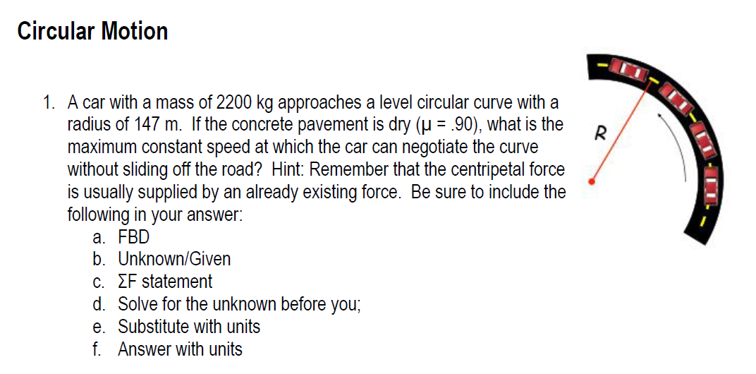

Slide 21
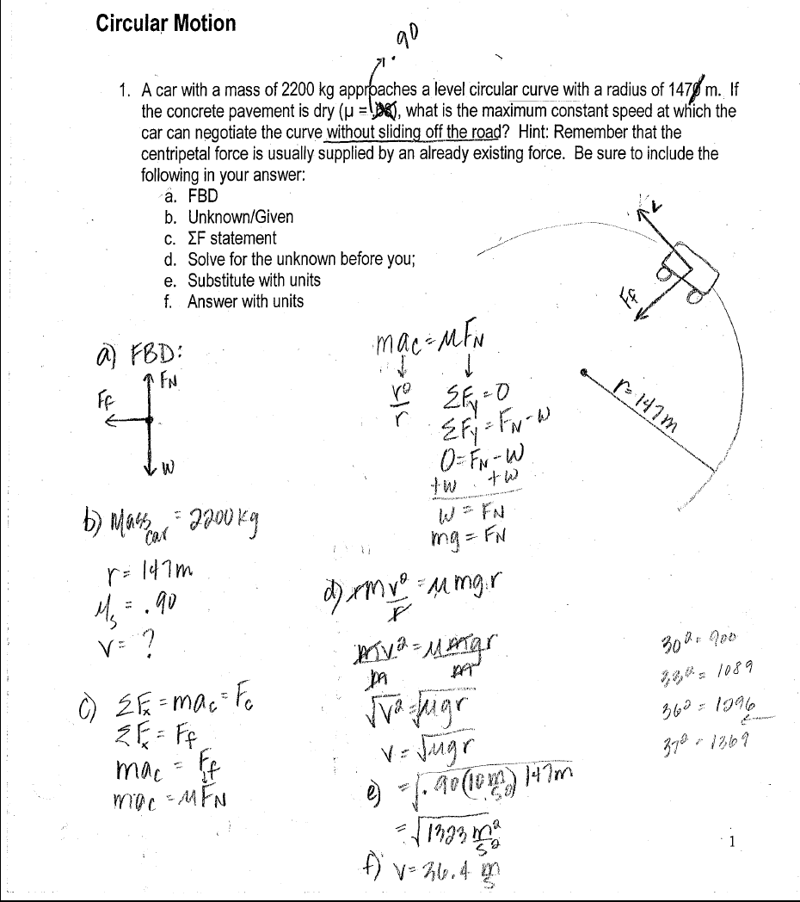

Slide 22
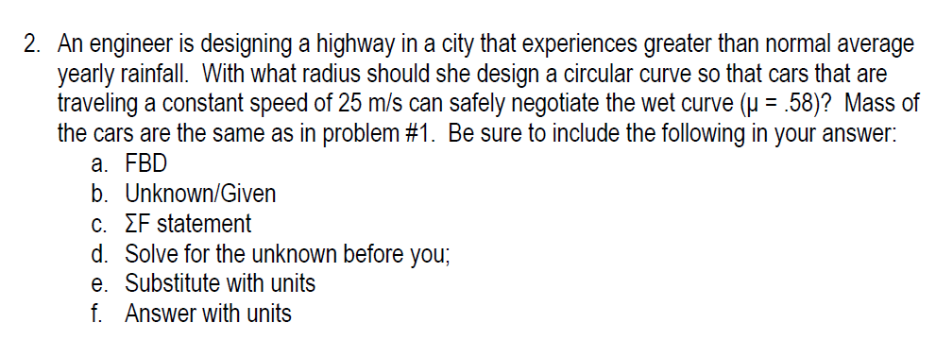

Slide 23
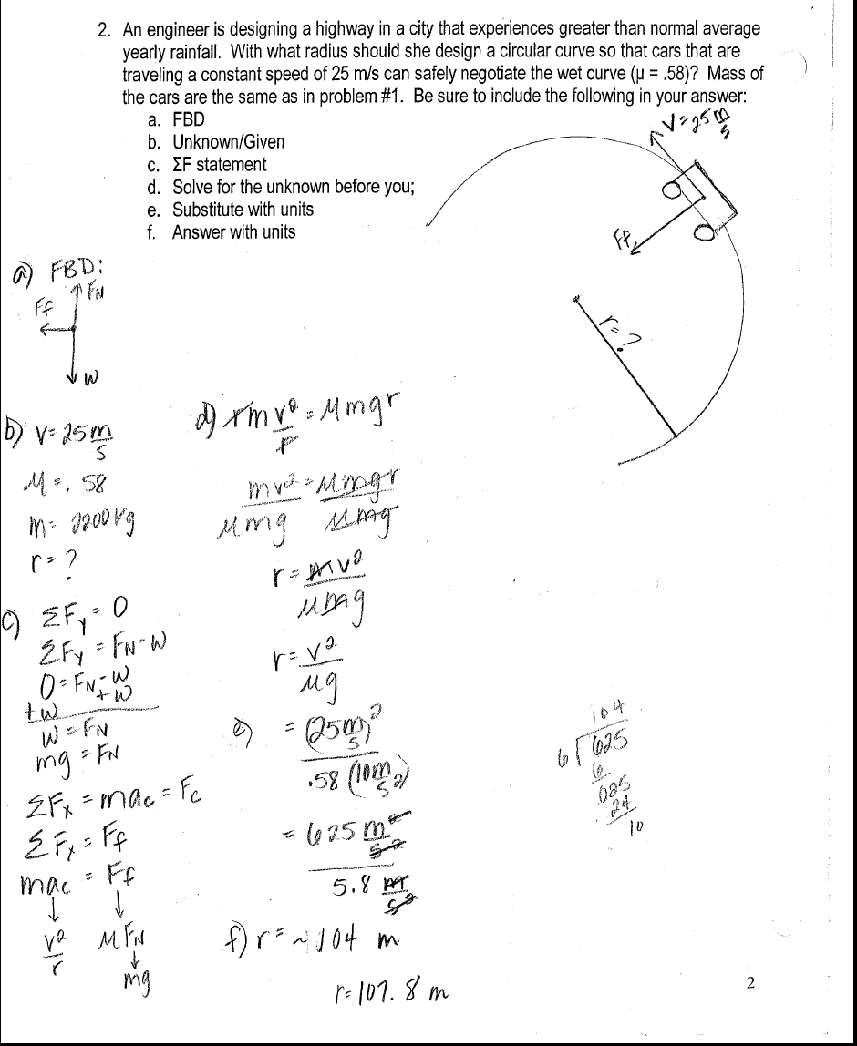

Slide 24
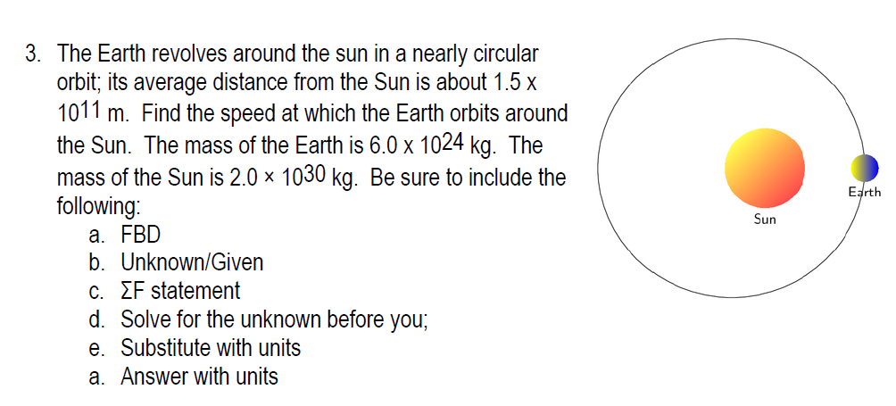

Slide 25
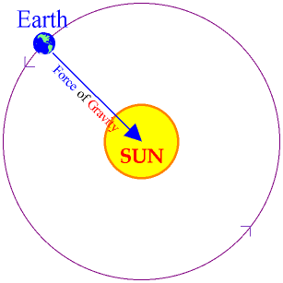
The Earth revolves around the sun in a nearly
circular orbit; it’s average distance from the Sun
is about 1.5 x 10⁸ km. Find the speed at which
the Earth orbits around the sun.
Mass_{Earth} = 6.0 x 10²⁴ kg
Mass_{Sun} = 2.0 × 10³⁰ kg
ΣF = F_{c}
ΣF = F_{g}
Gravitational Force btw
the Earth and the Sun
F_{c} = F_{g}
mv² = GmM
r r²
rmv² = GmMr
r r²
= mv² = GmM
r
= v² = GM
r
m
m

Slide 26
= v² = GM
r
v² = 6.67 x 10⁻¹¹ kg m²/s² (2.0 x 10 ³⁰ kg)
1.5 x 10¹¹ m
v² = 8.89 x 10⁸ m²/s²
v = 29,822 m/s

Slide 27
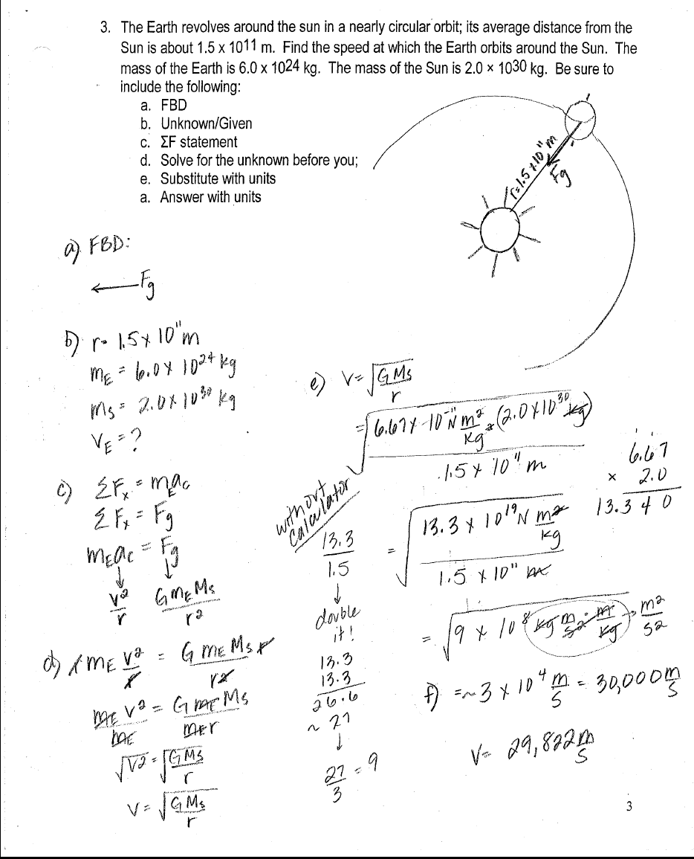

Slide 28
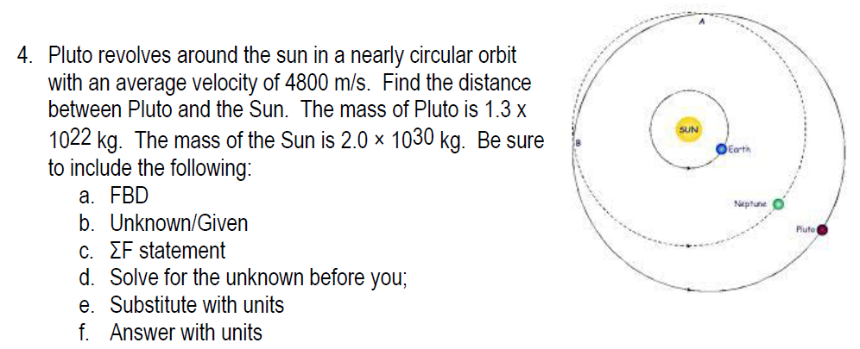

Slide 29
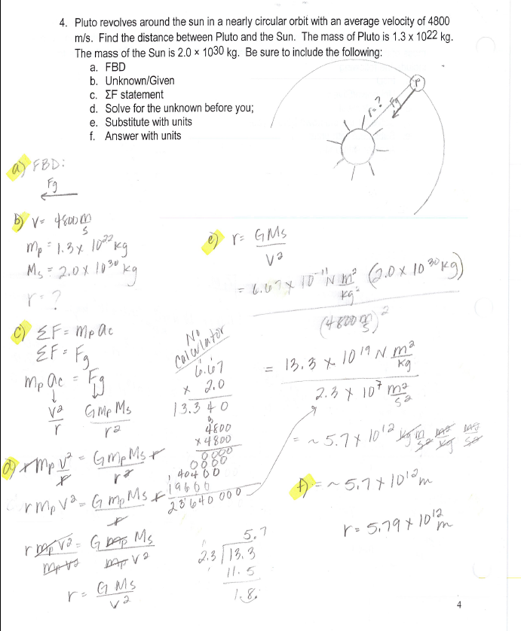

Slide 30
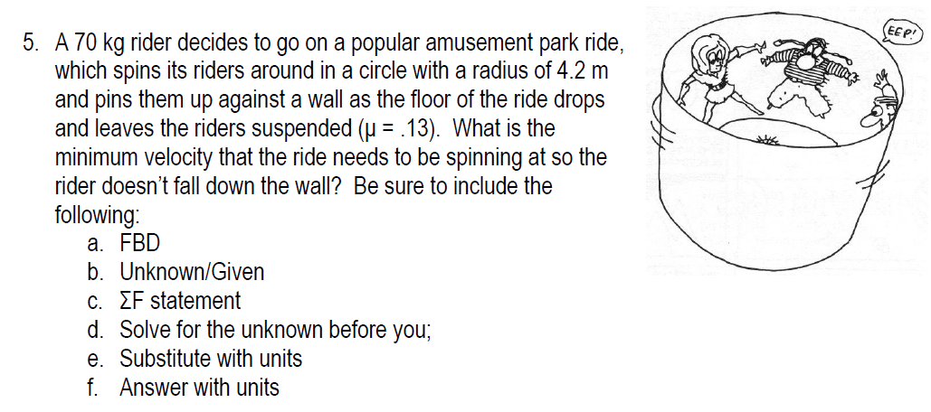

Slide 31
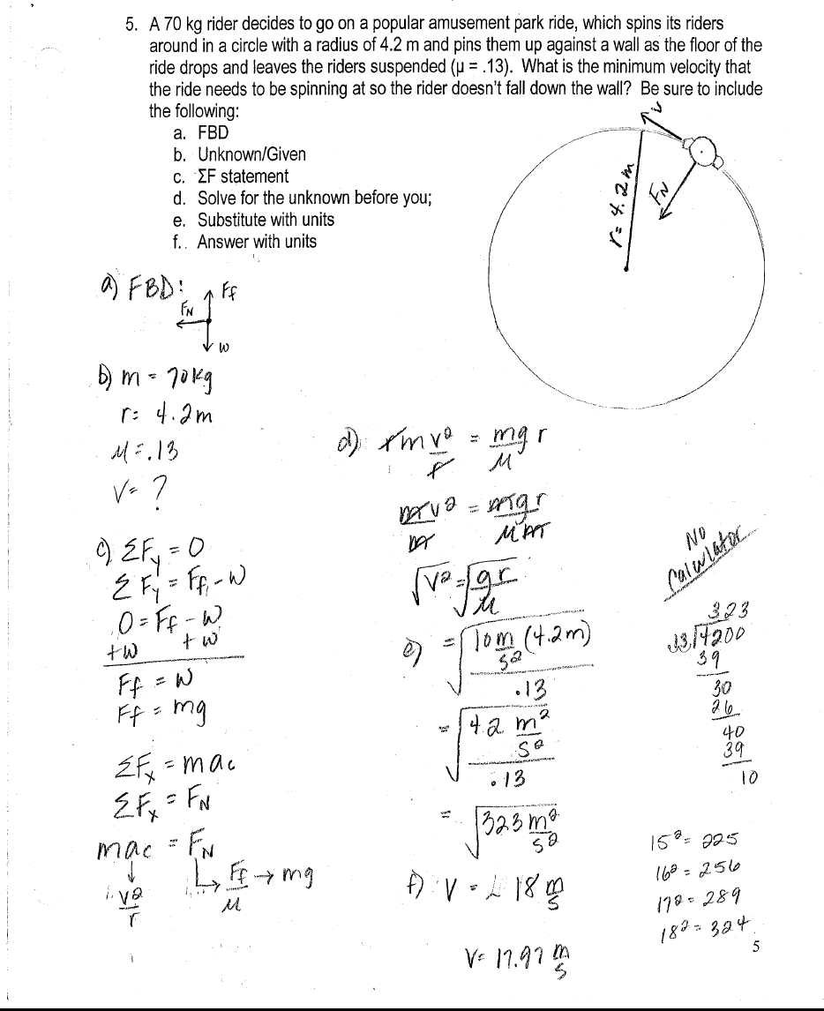

Slide 32
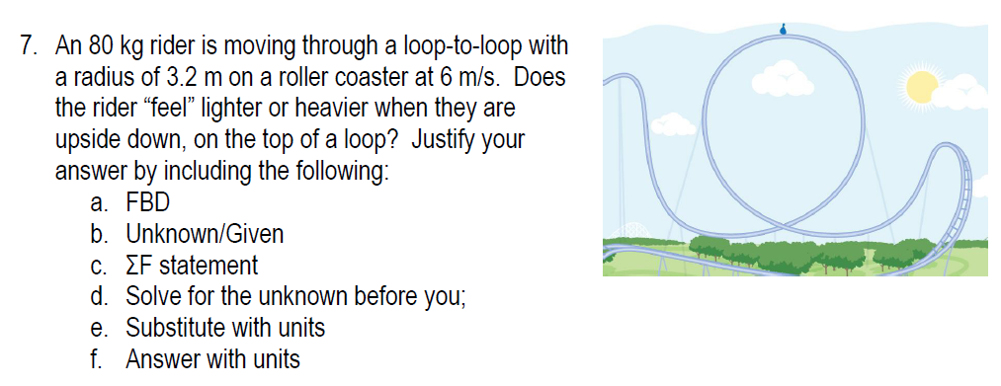

Slide 33
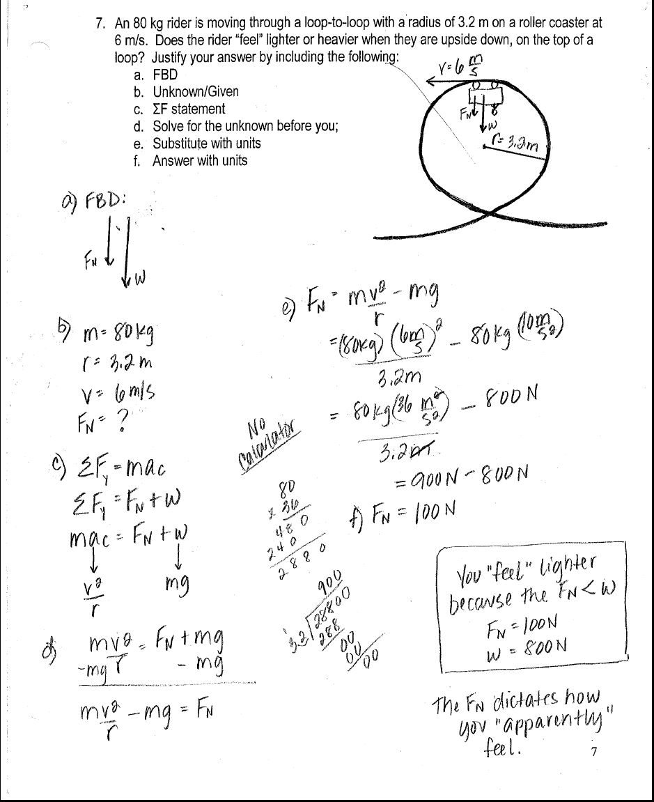

Slide 34
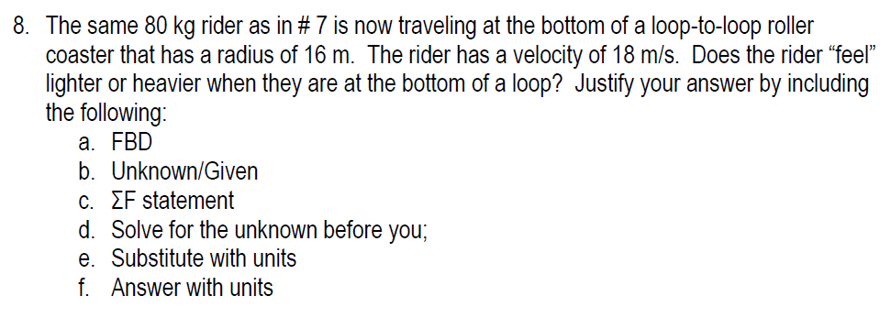

Slide 35
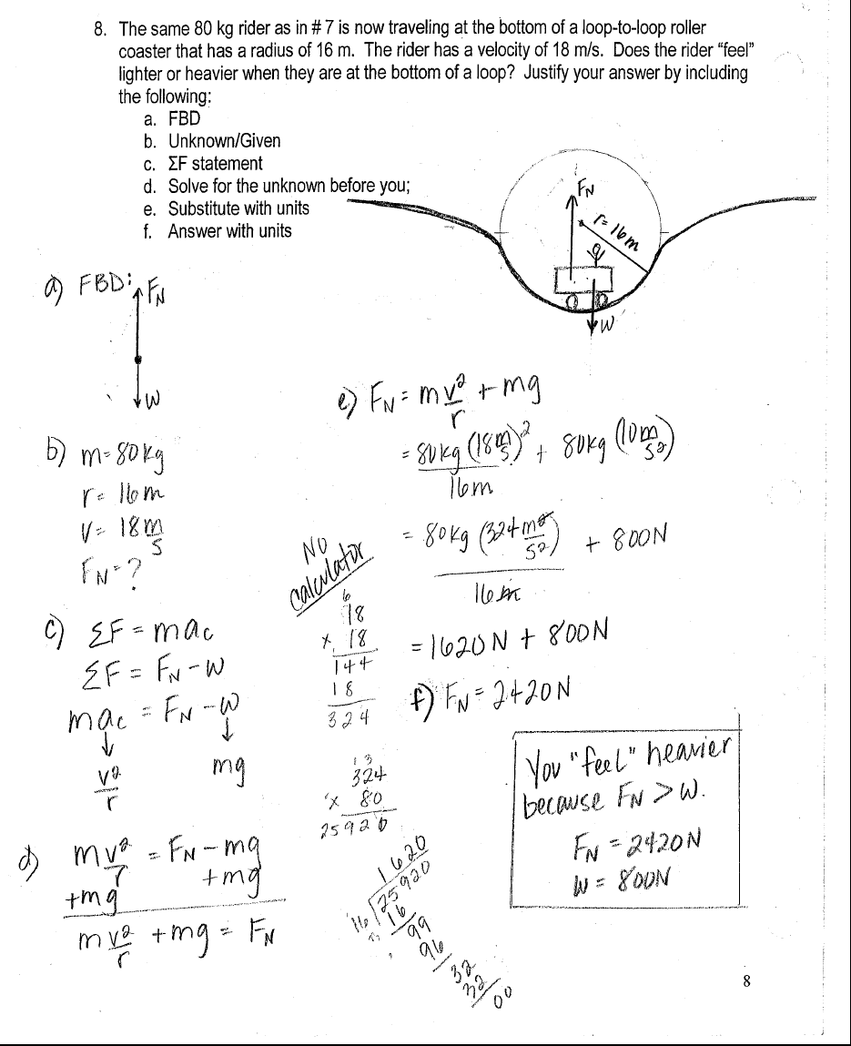

Slide 36
What is the minimum velocity needed to
maintain a satellite’s circular orbit around
the earth if it is located at a height of 500 km
(500,000 m) above the surface of the Earth.
For satellites in circular orbits, the "acceleration due to gravity" supplies the necessary centripetal acceleration to maintain its orbit.
The speed of a satellite in a circular orbit is constant

Slide 37
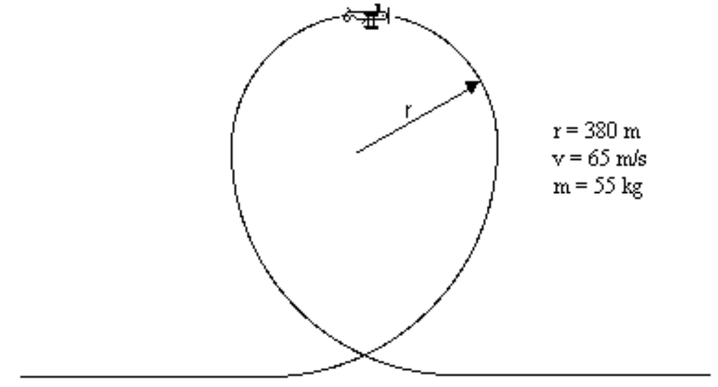
Determine the value of the centripetal force acting on the women flying the airplane when she is at the top of the loop. Does she feel lighter or heavier than normal at this position? Explain.

