Slide 1
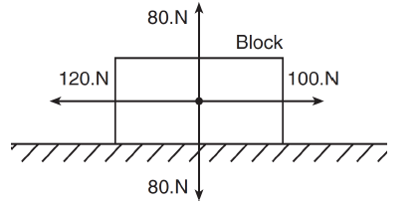
FBD
Horizontal
Incline
Horizontal Pulley
Incline Pulley

Slide 2
Net force:
The net force is a combined total force acting on an object.
Symbol - F_{net}
ΣF- “sum of all forces”
We represent force by using vectors- arrow symbols that represent magnitude and direction by their length and which way they point on FBD.

Slide 3
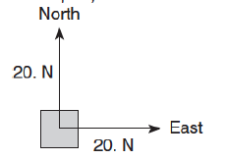
Free Body Diagrams (FBD)
Tool that shows all the forces acting on an object.

Slide 4
How to analyze forces acting on an object making ΣF statements:
You need two statements:
  The first tells what the object is doing:
    Not moving = ΣF =0 (forces balanced/in equilibrium)
    Accelerating = ΣF = ma (forces unbalanced/non-equilibrium)
  Then the next statement explains why it’s not moving or is accelerating. List the forces responsible:
    ΣF = F_{f} (friction opposing movement) – F_{A} (an applied force- push or pull)
  Then because these two statements are describing the same thing (one is “what” is happening, the other is “why”) the two statement can be set equal to each other and missing information can be solved for.
    Lets take a look…

Slide 5
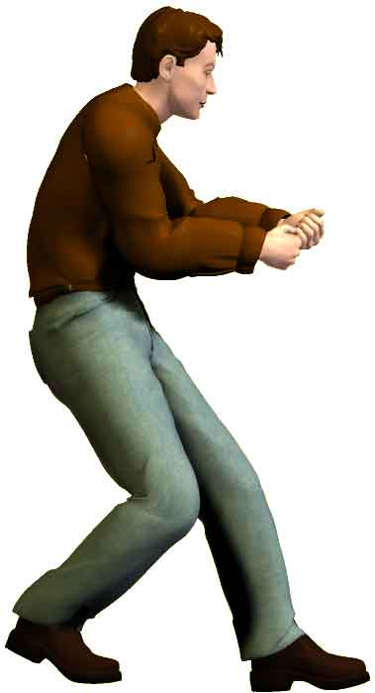
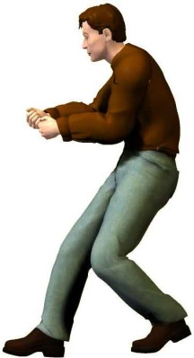
Let’s look at forces acting on this box:
F_{N} – The Normal Force- table pushing up on
the box- THIS IS ALWAYS PERPENDICULAR
TO THE SURFACE AND EQUAL TO THE Fg IF
THERE IS NO ACCELERATION.
Stationary:
F₁ = 20 N
F₂ = 20 N
10 kg
F_{N}
Fg (“mg”)- weight
What is the F_{net} acting on this box horizontally:
F₁
F₂
ΣF = 0 (box not moving/accelerating)
Why not? ΣF = F₂ – F₁
0 = F₂ – F₁
w
+ F₁
+ F₁
F₁ = F₂
FORCES ARE BALANCED

Slide 6
Let’s look at forces acting on this box:
F_{N}
F₁ = 20 N
F₂ = 40 N
F_{N}
10 kg
F₁
F₂
Fg
What is the F_{net} acting on this box horizontally:
w
ΣF = ma (box accelerating)
FORCES ARE UNBALANCED
Why? ΣF = F₂ – F₁
ma = F₂ – F₁
What is the magnitude of acceleration on the box-
solve for a
m
m
a = F₂ – F₁
m

Slide 7
But what if the box had an initial motion:
Moving with a constant velocity:
F_{N}
F_{N}
F₁ = 20 N
10 kg
F₂ = 20 N
F₁
F₂
Fg
w
What is the F_{net} acting on this box:
ΣF = F_{net} = F₁ - F₂ = 20 N - 20 N = 0
FORCES ARE BALANCED
The F_{net} is zero which means there is not a change
in movement or direction. It is moving just not accelerating.
This box will continue to move with a constant velocity.

Slide 8
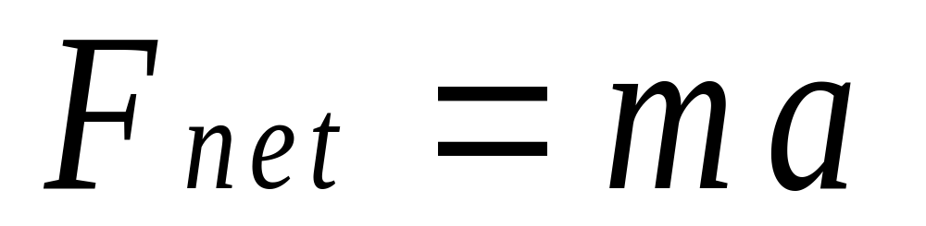
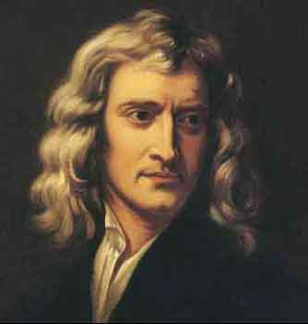
kg
m/s²
kg • m/s² = Newton = N

Slide 9
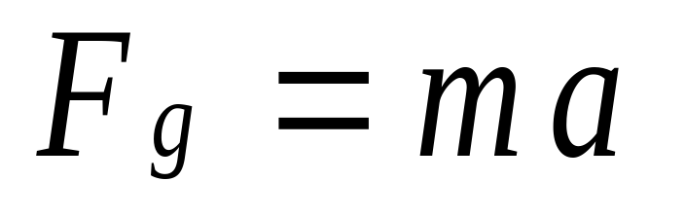
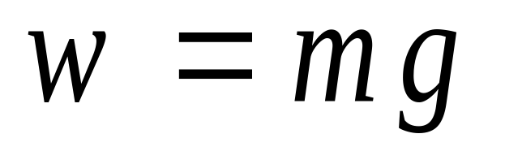
This leads us to the F_{g}:
g = 9.81 m/s² ~ 10 m/s²
What’s mass times the acceleration due to gravity?
THIS IS WEIGHT

Slide 10
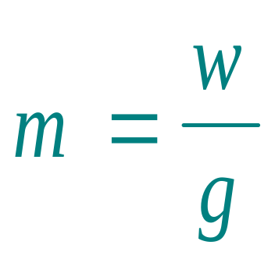
Use the weight equation to find your mass:
This needs to be in N. Use 1 N = .22 lbs

Slide 11
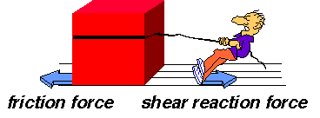
Friction:
Friction is the force that opposes motion.
Without friction a car wouldn’t be able to start or stop (without hitting something).
F_{f}
Vector- shows magnitude and direction.

Slide 12
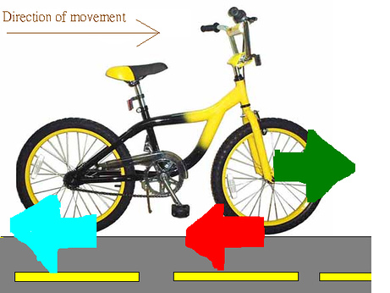
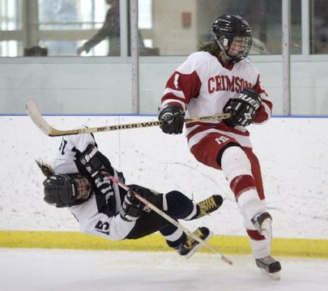
The force of friction is always parallel to the 2 surfaces that are in contact.
The amount of friction depends on the material in contact.
The friction between those surfaces
is going to be different than friction
between metal and ice.
Here the material in contact
is rubber (tires) on concrete.

Slide 13
Two kinds of friction:
Static Friction (F_{fs})
Kinetic Friction (F_{fk})
Not moving friction
moving friction
Opposes the start of motion
Friction between objects when
they are in motion.

Slide 14
F_{f} is proportional to the F_{N}:
F_{f} = µF_{N}
Coefficient of friction = ratio of the F_{f} to the F_{N}-
doesn’t have a unit

Slide 15
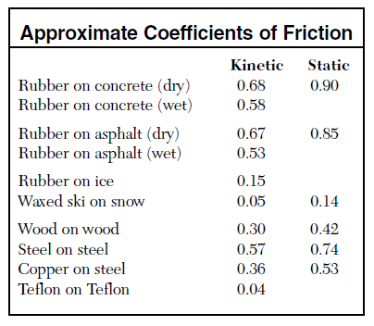

Slide 16
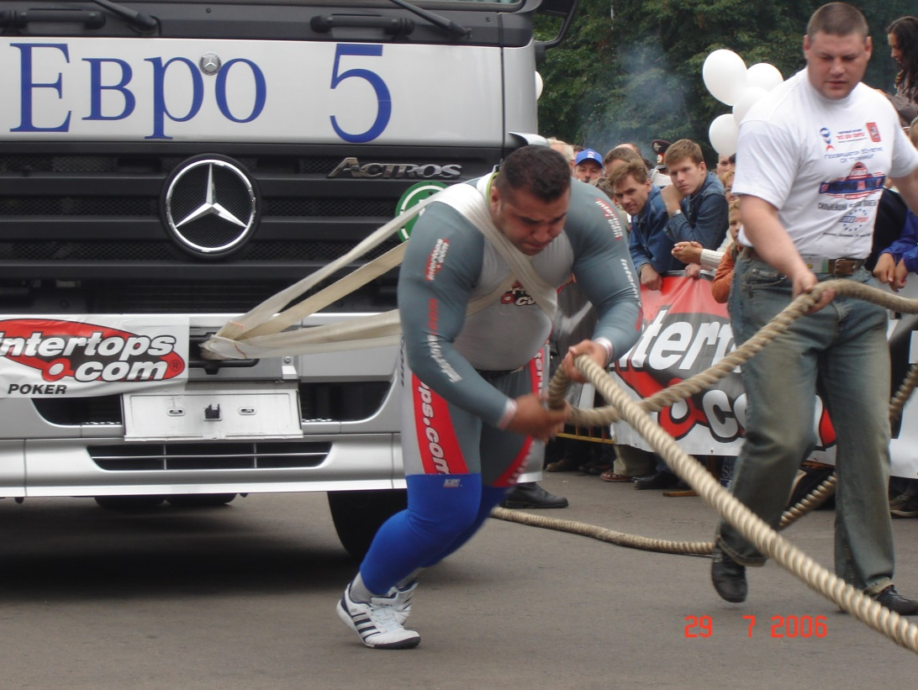
The µ_{k} is less than the µ_{s} so the F_{fk} is less than the F_{fs}.
Think about how much force it would take to initially get a
car to start rolling. But after it starts it’s easier to keep it moving.

Slide 17
FBD-A
v_{i}
0
v_{f}
36 m/s
a
d
t
w
N
F_{A}
180 N
F_{f}
µ
0
m
10 kg
ΣFx
ΣFy

Slide 18
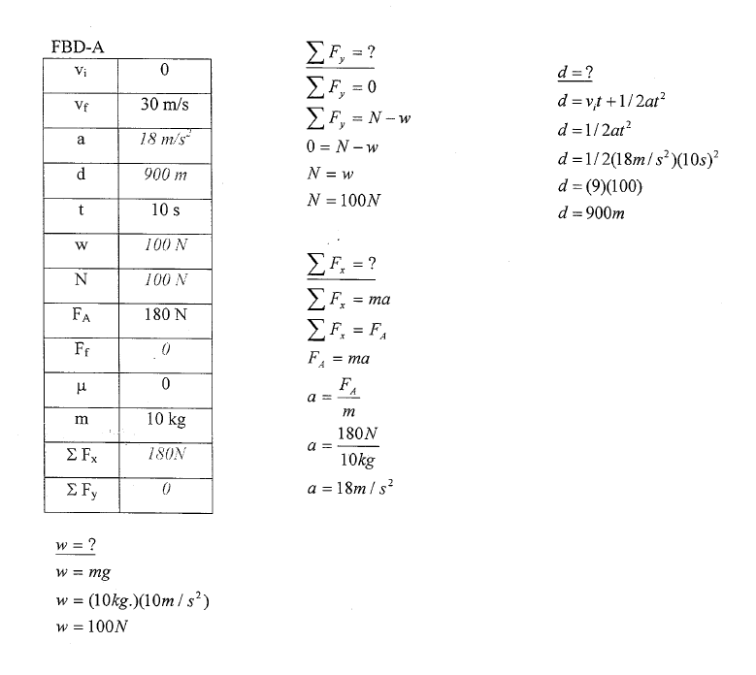

Slide 19
FBD-B
v_{i}
30 m/s
v_{f}
80 m/s
a
d
t
20 s
w
N
F_{A}
F_{f}
µ
0
m
100 kg
ΣFx
ΣFy

Slide 20
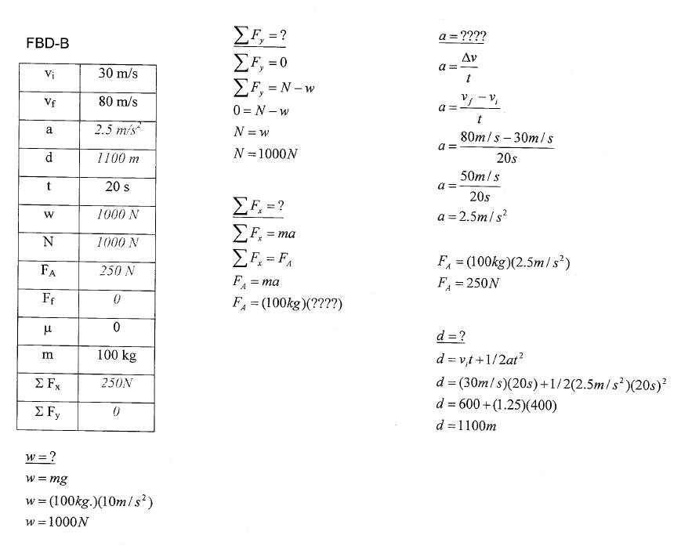

Slide 21
FBD-C
v_{i}
10 m/s
v_{f}
100 N
a
d
t
10 s
Draw a FBD to a scale of 1 cm = 20 N
w
N
F_{A}
F_{f}
µ
0
m
20 kg
ΣFx
ΣFy

Slide 22
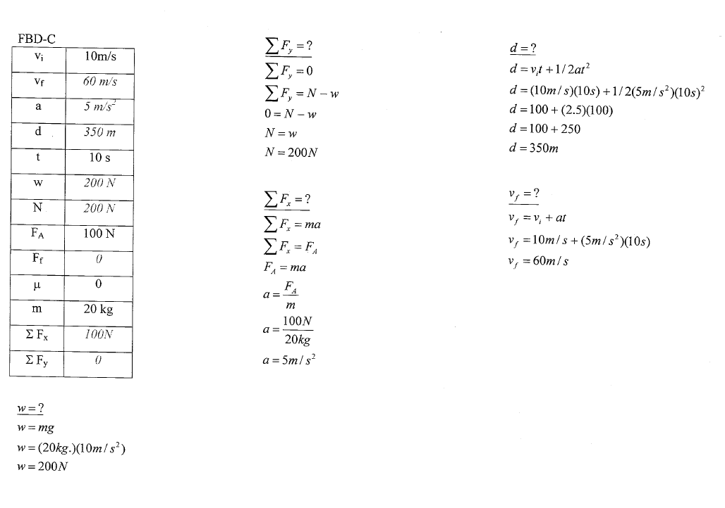

Slide 23
FBD-D
v_{i}
20 m/s
v_{f}
a
d
150 m
t
w
N
F_{A}
40 N
F_{f}
µ
0
m
10 kg
ΣFx
ΣFy

Slide 24
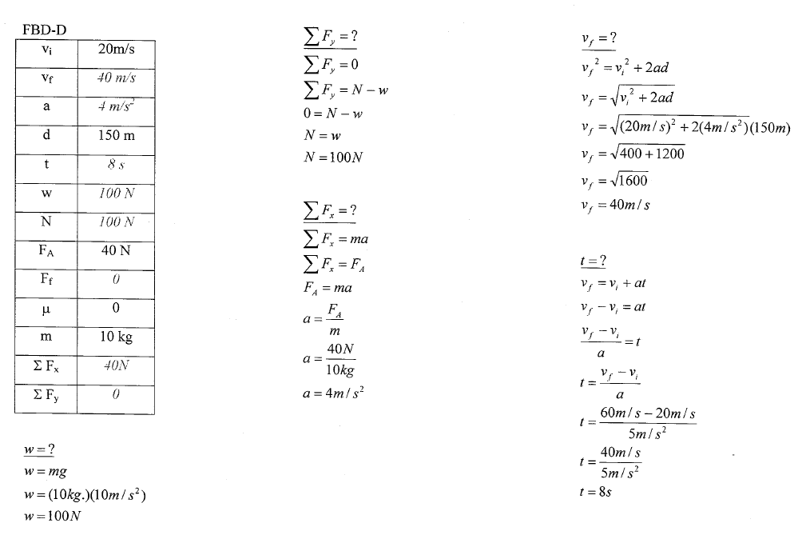

Slide 25
FBD-E
v_{i}
0
v_{f}
a
d
t
10 s
w
N
F_{A}
100 N
F_{f}
µ
0.2
m
30 kg
ΣFx
ΣFy

Slide 26
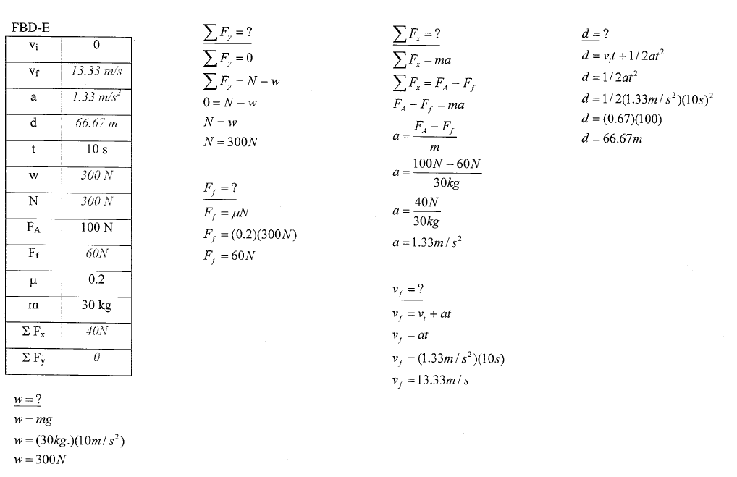

Slide 27
FBD-F
v_{i}
0
v_{f}
F_{A} = 100 N
a
d
t
10 s
w
N
F_{A}
F_{f}
µ
0.1
m
10 kg
ΣFx
ΣFy

Slide 28
FBD-G
v_{i}
0
v_{f}
30 m/s
a
d
t
10 s
w
N
F_{A}
F_{f}
µ
0.4
m
20 kg
ΣFx
ΣFy

Slide 29
v_{i}
30 m/s
w = mg
HORIZONTAL FBD QUIZ
F_{N}
v_{f}
60 m/s
= 100 kg (10 m/s²)
a
= 1000 N
d
ΣF_{y} = 0= equilibrium
F_{f}
F_{A}
t
10 s
ΣF_{y}= F_{N} - w
w
0 = F_{N} - w
N
F_{N} = w
F_{A}
w
F_{N} = 1000 N
ΣF_{x} = ma = non- equilibrium
F_{f}
d = ?
µ
ΣF_{x}= F_{A} - F_{f}
d = vit + 1/2at²
0.4
F_{f} = ?
F_{f} = µF_{N}
F_{A} – F_{f} = ma
d = 30m/s(10s) + ½(3m/s²)(10s)²
m
100 kg
+F_{f}
d = 300m + ½ 300m
ΣFx
= .4(1000 N)
+F_{f}
d = 450 m
ΣFy
= 400 N
F_{A} = F_{f} + ma
F_{A} = 400N + 100kg (3 m/s²)
a = ?
a = v_{f}-v_{i}
t
F_{A} = 700 N
a = 30 m/s = 3 m/s²
10 s

Slide 30
FBD-H
1. NOT MOVING = ΣF = 0
FBD:
F_{T}
F_{N}
F_{N}
F_{T}
30°
w
w
2. What forces are acting on this block?
3. What is the Force due to gravity?
Fg = w = mg
w = 100 kg (10 m/s²)
w = 1000 N

Slide 31
F_{T}
F_{N}
60°
30°
30°
w
4. Draw a skewed/psuedo FBD with x-y axis
y
F_{N}
x
F_{T}
30°
w
5. Transpose the angles

Slide 32
6. Resolve the x and y components of w
y
F_{N}
x
F_{T}
w_{x}
30°
w_{y}
w
SOHCAHTOA
w_{x} = ?
w_{y} = ?
(A)
cos Θ = A
H
30°
w_{y}
sin Θ = O
H
(H)
w
sin Θ = w_{x}
w
cos Θ = w_{y}
w
w_{x}
w_{y} = w cos Θ
w_{x} = w sin Θ
(O)
w_{x} = 1000 N sin 30°
w_{y} = 1000 N cos 30°
w_{x} = 500 N
w_{y} = 866 N

Slide 33
Memorize these:
 | sin | cos
0° | 0 | 1
30° | .5 | .866
45° | .707 | .707
60° | .866 | .5
90° | 1 | 0

Slide 34
7. A simplified FBD helps you solve the rest.
y
F_{N}
x
TO THE RIGHT IS POSITIVE
F_{T}
TO THE LEFT IS NEGATIVE
w_{x} = 500N
w_{y} = 866N
ΣF_{y}=? F_{N} = ?
ΣF_{x}=? F_{T} = ?
NOT MOVING = ΣF_{y} = 0
NOT MOVING = ΣF_{x} = 0
ΣF_{y}= F_{N} - w_{y}
(SIGNS ARE IMPORTANT)
ΣF_{x}= F_{T} - w_{x}
0 = F_{N} - w_{y}
0 = F_{T} - w_{x}
F_{N} = w_{y}
F_{T} = w_{x}
F_{N} = 866 N
F_{T} = 500 N

Slide 35
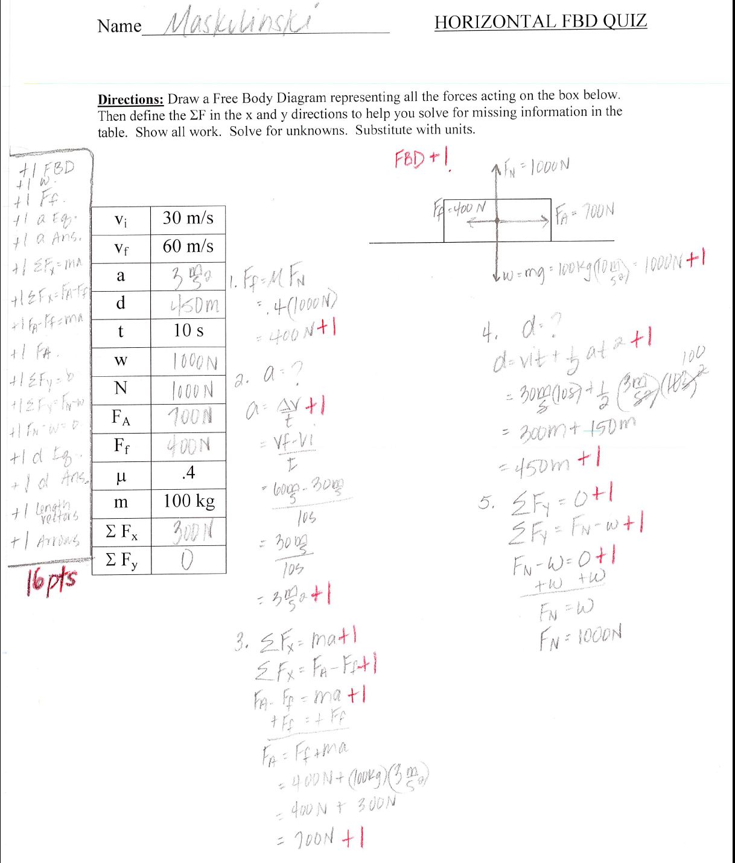

Slide 36
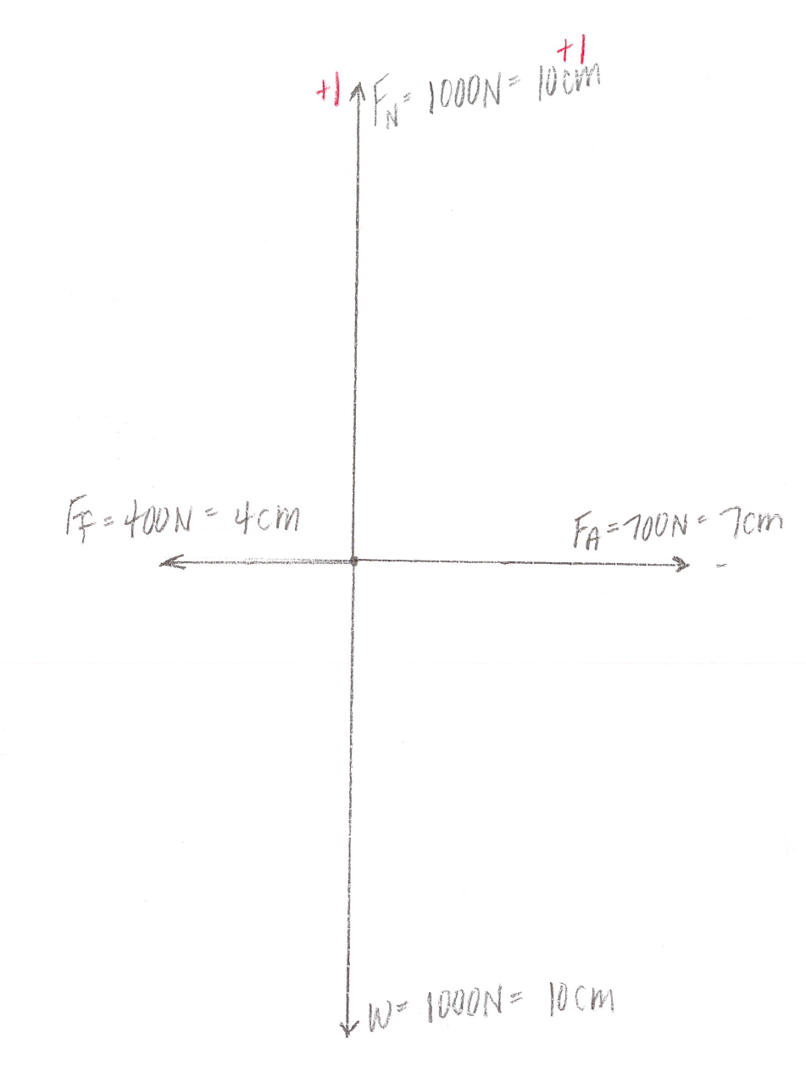

Slide 37
FBD-I
DO FOR HOMEWORK
40°
w_{x} = ?
w_{y} = ?
F_{N}
F_{N}
w_{y} = w cos Θ
F_{T}
F_{T}
sin Θ = O
H
w_{y} = 1000 N cos 40°
w_{x}
w_{y} = 766 N
sin Θ = w_{x}
w
w_{y}
w
w
w_{x} = w sin Θ
w_{x} = 1000 N sin 40°
w_{x} = 643 N

Slide 38
F_{N}
F_{T}
w_{x}
w_{y}
ΣF_{y}=? F_{N} = ?
ΣF_{x}=? F_{T} = ?
ΣF_{y} = 0
ΣF_{x} = 0
ΣF_{y}= F_{N} - w_{y}
ΣF_{x}= F_{T} - w_{x}
0 = F_{N} - w_{y}
0 = F_{T} - w_{x}
F_{N} = w_{y}
F_{T} = w_{x}
F_{N} = 766 N
F_{T} = 643 N

Slide 39
FBD-J
1. MOVING, NO FRICTION = ΣF = ma
F_{N}
30°
F_{g}
2. What forces are acting on this block?
3. What is the Force due to gravity?
Fg = w = mg
w = 100 kg (10 m/s²)
w = 1000 N

Slide 40
F_{N}
60°
30°
30°
w
4. Draw a FBD – skewed graph
F_{N}
y
F_{N}
x
w
30°
w
5. Transpose the angles

Slide 41
6. Resolve the x and y
components of w:
y
F_{N}
x
w_{x}
30°
w_{y}
w
SOHCAHTOA
w_{x} = ?
w_{y} = ?
(A)
cos Θ = A
H
30°
w_{y}
sin Θ = O
H
(H)
w
sin Θ = w_{x}
w
cos Θ = w_{y}
w
w_{x}
w_{y} = w cos Θ
w_{x} = w sin Θ
(O)
w_{x} = 1000 N sin 30°
w_{y} = 1000 N cos 30°
w_{x} = 500 N
w_{y} = 866 N

Slide 42
A simplified FBD helps
you solve the rest:
y
F_{N}
x
TO THE RIGHT IS POSITIVE
B/c it would move
to the left and left
is negative
TO THE LEFT IS NEGATIVE
w_{x} = 500N
w_{y} = 866N
ΣF_{y}=? F_{N} = ?
ΣF_{x}=? a = ?
NOT MOVING up or down = ΣF_{y} = 0
MOVING = ΣF_{x} = -ma
ΣF_{y}= F_{N} - w_{y}
ΣF_{x}= - w_{x}
0 = F_{N} - w_{y}
-ma = - w_{x}
F_{N} = w_{y}
a = w_{x}
-m
F_{N} = 866 N
a = 500 N = 5 m/s²
100 kg

Slide 43
8. Find v_{f} =?
9. Find d =?
v_{i} = 0
d = v_{i}t + ½ at²
a = 5 m/s²
d = ½ at²
t = 10 s
d = 5 m/s² (10 s )²
2
v_{f} = v_{i} + at
d = 250 m
v_{f} = at
v_{f} = 5 m/s² (10 s)
v_{f} = 50 m/s

Slide 44
FBD-K
Now there’s friction. Predict a =?
30°
w_{x} = ?
w_{y} = ?
F_{N}
w_{y} = w cos Θ
F_{f}
sin Θ = O
H
w_{y} = 1000 N cos 30°
sin Θ = w_{x}
w
w_{y} = 866 N
w
w_{x} = w sin Θ
w_{x} = 1000 N sin 30°
w_{x} = 500 N

Slide 45
F_{N}
F_{f}
w_{x}
w_{y}
ΣF_{y}=? F_{N} = ?
F_{f} = ?
ΣF_{x}=? a = ?
ΣF_{y} = 0
F_{f} = µF_{N}
ΣF_{x} = -ma
ΣF_{y}= F_{N} - w_{y}
F_{f} = .1(866 N)
ΣF_{x}= F_{f} - w_{x}
0 = F_{N} - w_{y}
-ma = F_{f} - w_{x}
F_{N} = w_{y}
a = F_{f} - w_{x}
-m
F_{N} = 866 N
a = 86.6 N – 500 N= 4.13 m/s²
-100 kg

Slide 46
Without and with friction:
Find v_{f} =?
Find v_{f} =?
Find d =?
Find d =?
v_{i} = 0
v_{i} = 0
d = v_{i}t + ½ at²
d = v_{i}t + ½ at²
a = 5 m/s²
a = 4.13 m/s²
d = ½ at²
d = ½ at²
t = 10 s
t = 10 s
d = 5 m/s² (10 s )²
2
d = 4.13 m/s² (10 s )²
2
v_{f} = v_{i} + at
v_{f} = v_{i} + at
d = 250 m
d = 206.5 m
v_{f} = at
v_{f} = at
v_{f} = 5 m/s² (10 s)
v_{f} = 4.13 m/s² (10 s)
v_{f} = 50 m/s
v_{f} = 41.3 m/s

Slide 47
FBD-L
Looking for the threshold angle. What is the maximum angle
that we can tilt the box before it starts to move?
F_{N}
F_{f}
ΣF_{x} = 0
Θ = ?
F_{N}
w
F_{f}
SOHCAHTOA
w_{x} = ?
w_{y} = ?
(A)
w_{x} = w sin Θ
w_{y} = w cos Θ
Θ
w_{y}
(H)
w
w
ΣF_{y} = 0
ΣF_{y}= F_{N} - w_{y}
w_{x}
0 = F_{N} - w_{y}
(O)
F_{N} = w_{y}
F_{N} = w cos Θ

Slide 48
w_{x} = w sin Θ
F_{f} = ?
ΣF_{x} = 0
F_{N} = w cos Θ
F_{f} = µF_{N}
ΣF_{x}= F_{f} - w_{x}
F_{f} = .4 F_{N}
F_{f}= w_{x}
F_{N}
F_{f}
F_{f} = .4 w cos Θ
F_{f}= w sin Θ
.4 w cos Θ = w sin Θ
w_{x}
w
w
w_{y}
.4 cos Θ = sin Θ
cos Θ
cos Θ
.4 = sin Θ
cos Θ
.4 = O/H
A/H

Slide 49
FBD-M1
v_{i} | NA
v_{f} | NA
a | 0
F_{N}
F_{f}
20°
F_{N}
w
F_{f}
SOHCAHTOA
w_{x} = ?
w_{y} = ?
w_{y} = w cos Θ
(A)
sin Θ = O
H
w_{y}
w_{y} = 1000 N cos 20°
(H)
w
w
sin Θ = w_{x}
w
w_{y} = 940 N
w_{x}
w_{x} = w sin Θ
(O)
w_{x} = 1000 N sin 20°
w_{x} = 342 N

Slide 50
F_{N}
F_{f}
w_{x}
w_{y}
ΣF_{y}=? F_{N} = ?
ΣF_{x}=? F_{f} = ?
µ = ?
ΣF_{y} = 0
ΣF_{x} = 0
F_{f} = µF_{N}
ΣF_{y}= F_{N} - w_{y}
ΣF_{x}= F_{f} - w_{x}
µ = F_{f}
F_{N}
0 = F_{N} - w_{y}
0 = F_{f} - w_{x}
µ = 342 N
940 N
F_{N} = w_{y}
F_{f} = w_{x}
F_{N} = 940 N
F_{f} = 342 N
µ = .36

Slide 51

FBD-N
v_{i} | 0
t | 10 s
µ | 0
m₁ | 70 kg
m₂ | 30 kg
m₁ = 70 kg
No Friction
m₂ = 30 kg
What is going to happen to these boxes?
Let’s talk about tension of the string.
F_{N}
F_{N}
F_{T}
F_{T}
w
w

Slide 52
What are the forces
acting on this system?
Think of two
separate FBD.
FBD-N
F_{N}
v_{i} | 0
t | 10 s
µ | 0
m₁ | 70 kg
m₂ | 30 kg
F_{T}
m₁ = 70 kg
No Friction
F_{T}
w₇₀
m₂ = 30 kg
= mg
= 70 kg (10 m/s²)
= 700 N
F_{N}
F_{T}
w₃₀
= mg
= 30 kg (10 m/s²)
= 300 N
F_{T}
w₃₀
w₇₀
Treat this as two different
systems and join them later.

Slide 53
F_{N}
F_{T}
m₁ = 70 kg
w₇₀
m₂ = 30 kg
= mg
= 70 kg (10 m/s²)
= 700 N
F_{N}
F_{T}
ΣF_{70y} = ?
ΣF_{70x} = ?
w₇₀
ΣF_{70y} = 0
ΣF_{70x} = m₇₀a
ΣF_{70y} = F_{N} – w₇₀
ΣF_{70y} = F_{T}
0 = F_{N} – w₇₀
m₇₀a = F_{T}
F_{N} = w₇₀
a = ?
F_{N} = 700 N
F_{T} = ?

Slide 54
m₁ = 70 kg
F_{T}
m₂ = 30 kg
F_{T}
w₃₀
= mg
= 30 kg (10 m/s²)
= 300 N
w₃₀
ΣF₃₀ = ?
ΣF₃₀ = - m₃₀a
ΣF₃₀ = F_{T} – w₃₀
-m₃₀a = F_{T} – m₃₀g
a = ?
F_{T} = ?

Slide 55
So what do we know?
F_{N} = 700 N
F_{T} = m₇₀a
-m₃₀a = F_{T} – m₃₀g
Can’t I plug this into here? Here’s where they join.
-m₃₀a = m₇₀a – m₃₀g
-m₇₀a
-m₇₀a
-m₃₀a - m₇₀a = - m₃₀g
a (m₃₀ ₊ m₇₀) = m₃₀g
(m₃₀ ₊ m₇₀)
(m₃₀ ₊ m₇₀)
a = m₃₀g
(m₃₀ ₊ m₇₀)
a = 300 N
100 kg
= 3 m/s²

Slide 56
The F_{T} for both systems
is the same. The tension
in the string pulling
sideways is the same
the tension in the string
hanging downward.
F_{N}
Now we can find F_{T}.
F_{T}
m₁ = 70 kg
F_{T}
w₇₀
m₂ = 30 kg
w₃₀
Let’s check to make sure they are the same for both systems:
ΣF_{70x} = ?
ΣF₃₀ = - m₃₀a
F_{T70} = ?
ΣF_{70x} = m₇₀a
F_{T30} = ?
ΣF₃₀ = F_{T} – w₃₀
ΣF_{70y} = F_{T}
F_{T30} = -m₃₀a + m₃₀g
-m₃₀a = F_{T} – m₃₀g
F_{T70} = m₇₀a
m₇₀a = F_{T}
F_{T30} = -30 kg (3 m/s²) + 30 kg (10 m/s²)
F_{T70} = 70 kg (3 m/s²)
F_{T30} = -90 N + 300 N
F_{T70} = 210 N
same
F_{T30} = 210 N

Slide 57
Find v_{f} =?
Find d =?
v_{i} = 0
d = v_{i}t + ½ at²
a = 3 m/s²
d = ½ at²
t = 10 s
d = 3 m/s² (10 s )²
2
v_{f} = v_{i} + at
d = 150 m
v_{f} = at
v_{f} = 3 m/s² (10 s)
Find ΣF₃₀ = ?
v_{f} = 30 m/s
ΣF₃₀ = - m₃₀a
OR
ΣF₃₀ = F_{T} – w₃₀

Slide 58
Cheating…how to figure this out without all that work!
(Too bad you can’t do this on the test)
F_{N}
F_{T}
F_{N}
= 700 N
F_{T}
combine
w₃₀
w₇₀
w₇₀ +w₃₀
= 1000 N
F_{net} = 300 N
F_{net} = ma
a = F_{net}
m
a = 300 N
100 kg
a = 3 m/s²

Slide 59
Now that we did that…Stop and think:
m₁ = 70 kg
m₂ = 30 kg

Slide 60
FBD-O
DO FOR HOMEWORK
v_{i} | 0
t | 10 s
µ | 0
m₁ | 30 kg
m₂ | 70 kg
m₁ = 30 kg
No Friction
m₂ = 70 kg

Slide 61
FBD-P
F_{N}
v_{i} | 0
t | 10 s
µ | .1
m₁ | 70 kg
m₂ | 30 kg
F_{f}
F_{T}
m₁ = 70 kg
Friction
F_{T}
w₇₀
m₂ = 30 kg
= mg
= 70 kg (10 m/s²)
= 700 N
F_{N}
F_{T}
F_{f}
w₃₀
= mg
= 30 kg (10 m/s²)
= 300 N
F_{T}
w₃₀
w₇₀
What should we expect to happen to the acceleration?

Slide 62
F_{N}
F_{f}
F_{T}
m₁ = 70 kg
w₇₀
m₂ = 30 kg
= mg
= 70 kg (10 m/s²)
= 700 N
F_{N}
F_{f}
F_{T}
ΣF_{70y} = ?
F_{f} = µF_{N}
ΣF_{70x} = ?
w₇₀
F_{f} = (.1) (700 N)
ΣF_{70x} = m₇₀a
ΣF_{70y} = 0
ΣF_{70y} = F_{N} – w₇₀
F_{f} = 70 N
ΣF_{70y} = F_{T} - F_{f}
0 = F_{N} – w₇₀
m₇₀a = F_{T} - F_{f}
F_{N} = w₇₀
a = ?
F_{N} = 700 N
F_{T} = ?

Slide 63
m₁ = 70 kg
F_{T}
m₂ = 30 kg
F_{T}
w₃₀
= mg
= 30 kg (10 m/s²)
= 300 N
w₃₀
ΣF₃₀ = ?
ΣF₃₀ = - m₃₀a
ΣF₃₀ = F_{T} – w₃₀
-m₃₀a = F_{T} – m₃₀g
a = ?
F_{T} = ?

Slide 64
Here’s what we know:
F_{N} = 700 N
F_{T} = m₇₀a + F_{f}
-m₃₀a = F_{T} – m₃₀g
Here’s where they join.
-m₃₀a = m₇₀a + F_{f} – m₃₀g
-m₇₀a
-m₇₀a
-m₃₀a - m₇₀a = F_{f} - m₃₀g
a (m₃₀ ₊ m₇₀) = F_{f} - m₃₀g
(m₃₀ ₊ m₇₀)
(m₃₀ ₊ m₇₀)
a = F_{f} -m₃₀g
(m₃₀ ₊ m₇₀)
a = 70 N - 300 N
100 kg
= 2.3 m/s²

Slide 65
FBD-R
m₁ = 100 kg
m₂ = 100 kg

Slide 66
FBD-R1
Solve for “a” and “F_{T}” using the
variables “m” and “3m”
m
F_{N}
F_{T}
-3ma = ma – 3mg
F_{T}
3m
-ma
-ma
-3ma - ma = - 3mg
3mg
+3ma + ma = + 3mg
mg
a (3m ₊ m) = 3mg
(3m ₊ m)
(3m ₊ m)
ΣF_{mx} = ?
ΣF_{3m} = ?
a = 3mg
(4m)
ΣF_{mx} = ma
ΣF_{3m} = -3ma
ΣF_{mx} = F_{T}
ΣF_{3m} = F_{T} – 3mg
a = 3g
4
= 7.5 m/s²
ma = F_{T}
-3ma = F_{T} – 3mg
F_{T} = ma
= m7.5

Slide 67
FBD-S
v_{i} | 0
t | 10 s
θ | 30°
µ | 0
m₁ | 100 kg
m₂ | 300 kg
m₁ = 100 kg
m₂ = 300 kg
No Friction
30°

Slide 68
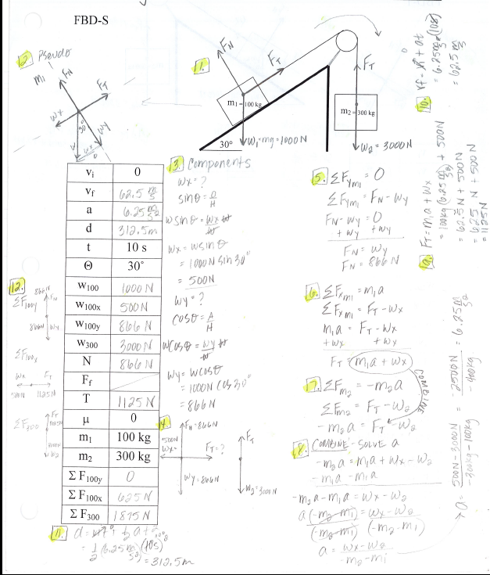

Slide 69
FBD-T
v_{i} | 0
t | 10 s
θ | 30°
µ | .1
m₁ | 100 kg
m₂ | 300 kg
m₁ = 100 kg
m₂ = 300 kg
Friction
30°

Slide 70
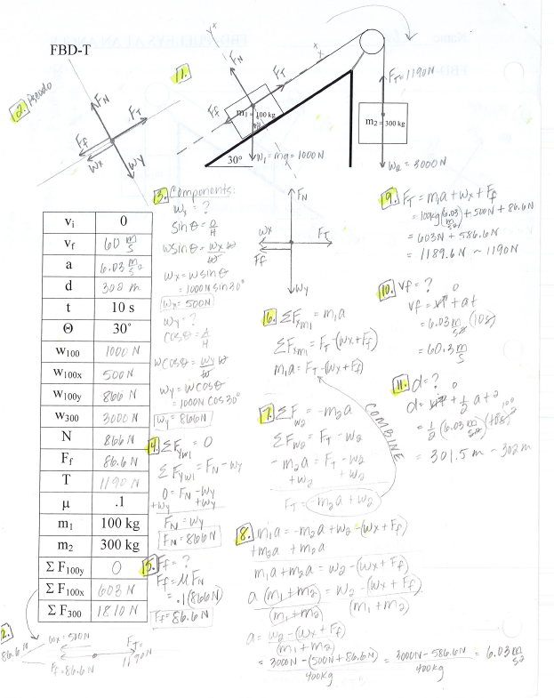

Slide 71
FBD-U
v_{i} | 0
t | 10 s
θ | 30°
µ | .1
m₁ | 300 kg
m₂ | 100 kg
m₁ = 300 kg
m₂ = 100 kg
Friction
30°

Slide 72
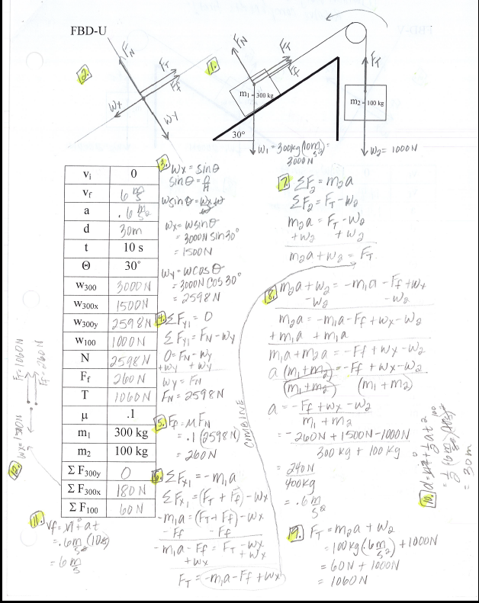

Slide 73
FBD-V
v_{i} | 0
t | 10 s
θ | 40°
µ | .1
m₁ | 200 kg
m₂ | 200 kg
m₁ = 200 kg
m₂ = 200 kg
Friction
40°

Slide 74
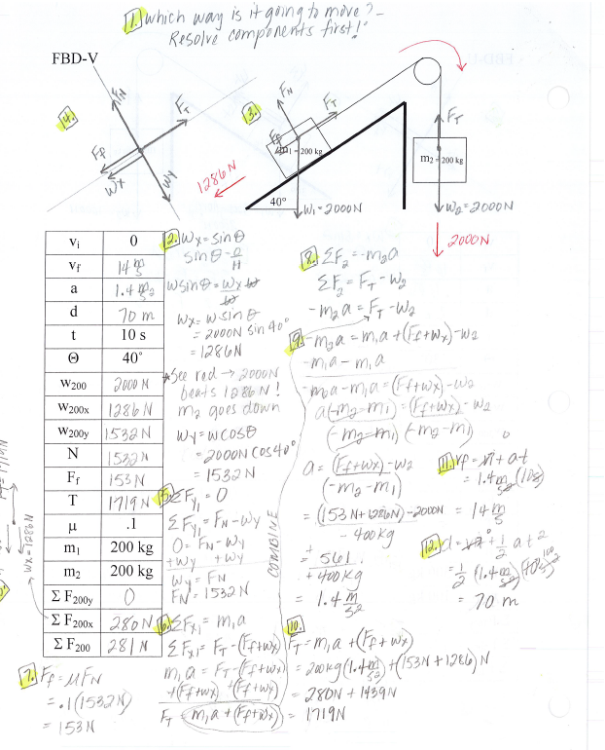

Slide 75
FBD-W
v_{i} | 60 m/s
v_{f} | 0
t_{stop}
θ | 20°
µ | 0
m₁ | 100 kg
m₂ | 200 kg
m₁ = 100 kg
m₂ = 200 kg
40°

Slide 76
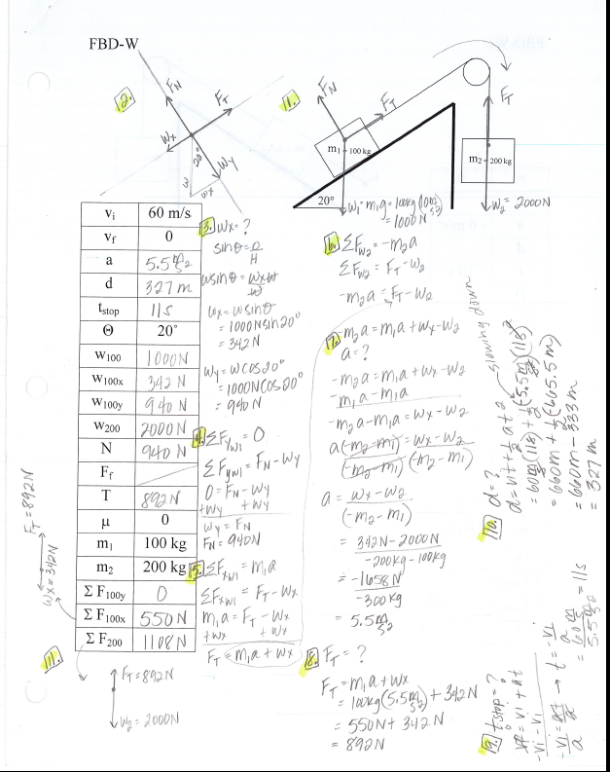

Slide 77
FBD-W1
v_{i} | 0
t | 10 s
a | 6 m/s²
θ | 40°
µ | .2
m₁ | 100 kg
F_{B} | 300 N
m₁ = 200 kg
m₂ = ?
F_{B}
Friction
40°

