Slide 1
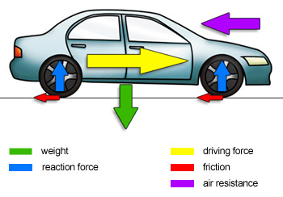
Forces
Newton’s 1st
Newton’s 2nd
Newton’s 3rd
Universal Law of Gravitation
Gravitational Field Strength
Elevator

Slide 2
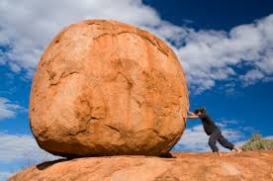
Newton’s 1st Law of Motion:
An object at rest has a natural tendency to stay at rest, or an object in motion will stay in motion, unless a force is acting upon it.
This is also known as the law of INERTIA.
INERTIA is an objects resistance to change in motion.

Slide 3
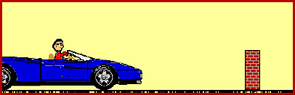
Examples of INERTIA:
1. Not wearing your seatbelt- if you get into an
accident your body wants to keep moving at
the speed you were going.

Slide 4
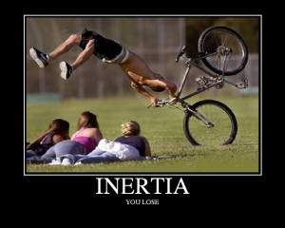
2. The famous tablecloth trick:
3. Sliding Cars:
http://www.youtube.com/watch?v=D-a3kwvY0WM
http://www.youtube.com/watch?v=KyfjZlOSq2A

Slide 5
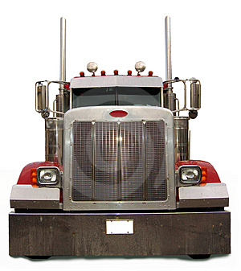
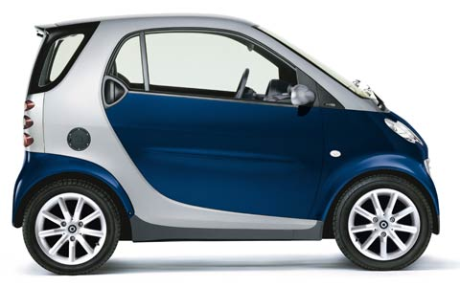
The relationship between mass and inertia:
MASS IS A MEASURE OF INERTIA- the more massive the object, the more that object tends to resist changes in its state of motion.
What would be easier to push a small car or a semi?

Slide 6
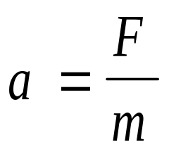
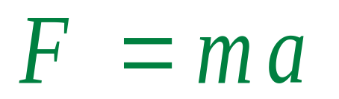
Adding mass into the mix brings us to Newton’s 2nd Law of Motion:
If I push both vehicles with the same amount of force
which one would accelerate more? Why?
Which turns into Newton’s 2nd equation:

Slide 7
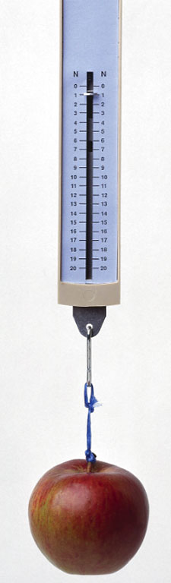
A medium-sized apple weighs about one Newton.
1 N = .22 lbs.

Slide 8
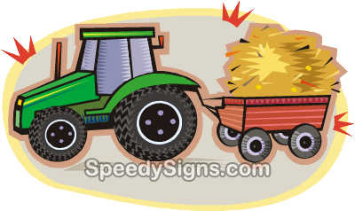
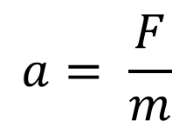
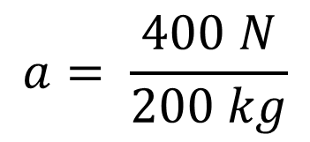
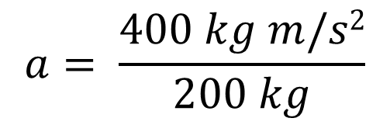

Practice with Newton’s 2nd:
1. A tractor pulls a loaded wagon with a constant force of 400 N. If the total mass of the wagon is 200 kg, what is the wagon’s acceleration?
F = ma
m
m

Slide 9
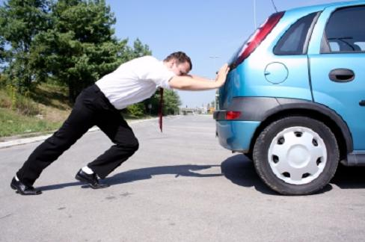
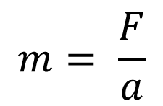
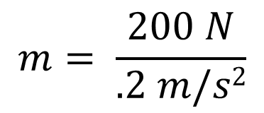
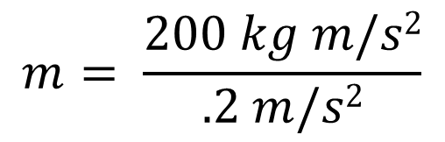

2. A broken down car is being pushed to the side of the road with a force of 200 N which is causing it to accelerate at .2 m/s². What is the mass of the car?
F = ma
a
a

Slide 10
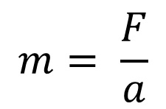
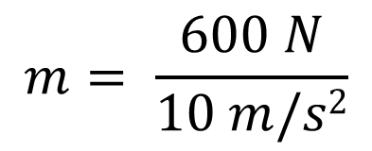
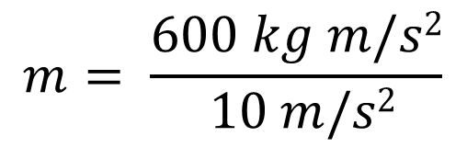

4. A student weighs 600 N. What is his mass?
F = ma
a
a
1 kg = 2.2 lbs
132 lbs

Slide 11
3. The car below was moving with an initial velocity of 50 m/s until F₂ was applied to slow the car down. What is the acceleration of the box?
F₂ = 500 N
10 kg
F₁ = 300 N
How far did the box travel in 10 s?

Slide 12
Remember this guy?
He was pushing that car with a force of 200 N. With how much force is the car pushing on him?
Let’s go back to our box example…

Slide 13
F_{N}
10 kg
Fg
The force of gravity it pulling the box downward with a
force of 100 N.
But the table is also pushing back on the box with the
same amount of force in the opposite direction.

Slide 14
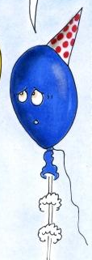
This brings us to Newton’s 3rd Law:
For every action there is an equal and opposite reaction (action/reaction law).
http://www.youtube.com/watch?v=mNM5tHou4IQ
http://www.youtube.com/watch?v=7y7KjanpWOk
The air is moving out of the balloon
in this direction causing it to move in
the opposite direction.

Slide 15
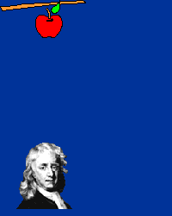
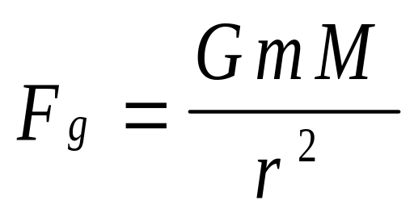
So because of Newton’s 3rd law every body in the universe exerts a force of attraction on every other body.
This is Newton’s Universal Law of Gravitation
The force between two objects, due to their masses,
is called the gravitational force (F_{g})- in this case it’s
not Earth specific and is not 9.81 m/s²).

Slide 16
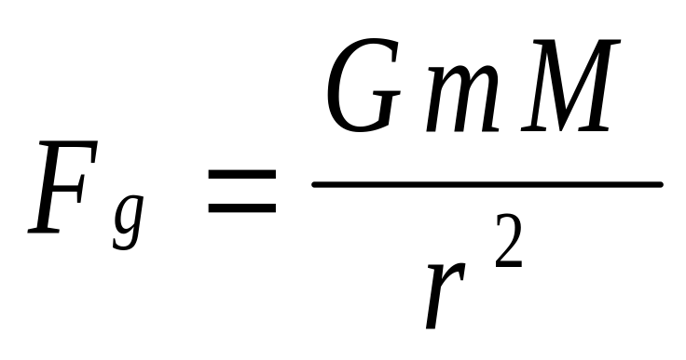
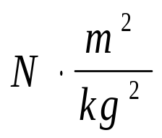
Universal Law of Gravitation
Masses of the 2 objects
Universal
Gravitational
Constant-
6.67 x 10⁻¹¹
Distance between
the objects
The force between two objects, due to their masses,
is called the gravitational force (F_{g})- in this case it’s
not Earth specific and is not 9.81 m/s²).

Slide 17
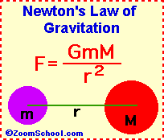
What is the gravitational force between the Earth and the Moon?
m_{Earth} = M = 6.0 x 10²⁴ kg
m_{Moon} = m = 7.4 x 10²² kg
r = 3.8 x 10⁸ m
G = 6.67 x 10⁻¹¹

Slide 18
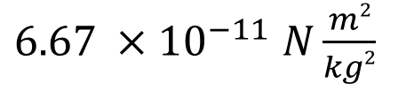
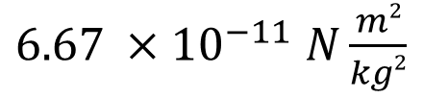
(7.4 x 10²² kg) (6.0 x 10²⁴ kg)
F_{g} =
(3.8 x 10⁸ m)²
(44.4 x 10⁴⁶ kg²)
=
(14.44 x 10¹⁶ m²)
(296.148 x 10³⁵ )
=
N
(14.44 x 10¹⁶ )
F_{g} =
20.5 x 10¹⁹ N
= 2.05 x 10²⁰ N

Slide 19
What if the distance between the Earth and the Moon was doubled?
= 1
r²
= 1
2r²
= 1
4
What if the distance between the Earth and the Moon was tripled?
= 1
r²
= 1
3r²
= 1
9
What if the distance between the Earth and the Moon was
quadrupled?
= 1
r²
= 1
4r²
= 1
16

Slide 20
What is the gravitational force between the Earth and Venus?
m_{Earth} = M = 6.0 x 10²⁴ kg
m_{Venus} = m = 5.0 x 10²⁴ kg
r = 3.8 x 10¹⁰ m
G = 6.67 x 10⁻¹¹

Slide 21
(5.0 x 10²⁴ kg) (6.0 x 10²⁴ kg)
F_{g} =
(3.8 x 10¹⁰ m)²
(3.0 x 10⁴⁹ kg²)
=
(14.44 x 10²⁰ m²)
(20 x 10³⁸)
=
N
(14.44 x 10²⁰ )
F_{g} =
1.38 x 10¹⁸ N

Slide 22
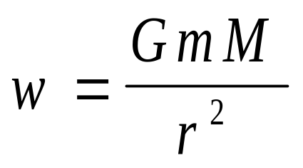
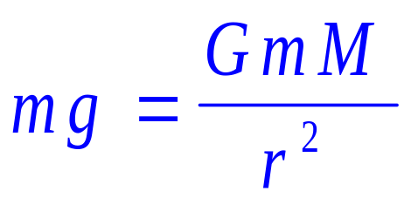
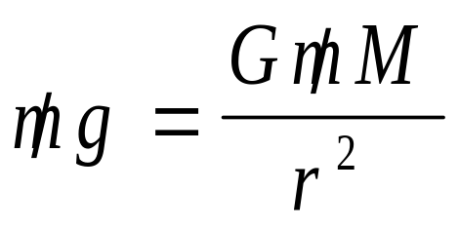
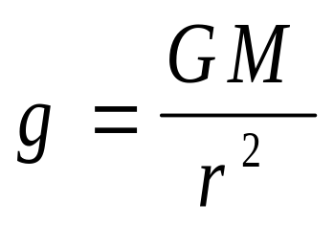
There is also a way to determine the gravitational field around one object:
This is now
the gravitational
Field Strength
For one object this is weight, so this becomes…
=
=

Slide 23
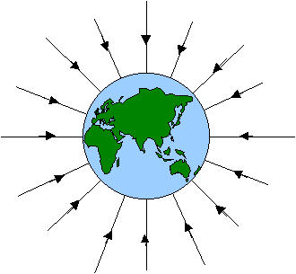
For the Earth the gravitational field strength should be 9.81 m/s²…find it.
Radius of the Earth – 6.37 x 10⁶ m

Slide 24
= (6.67 x 10⁻¹¹ N m²/kg²) (6.0 x 10²⁴ kg)
(6.4 x 10⁶ m)²
= (4.2 x 10¹⁴ N m²/kg)
(4.1 x 10¹³ m²)
= (1 x 10¹ N/kg)
= (10 m/s²)

Slide 25
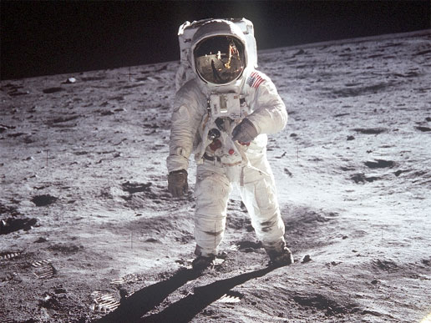
For the Moon the gravitational field strength should be 1.6 m/s²…find it.
Radius of the Moon – 1.7 x 10⁶ m

Slide 26
= (6.67 x 10⁻¹¹ N m²/kg²) (7.35 x 10²² kg)
(1.7 x 10⁶ m)²
= (4.9 x 10¹² N m²/kg)
(2.9 x 10¹² m²)
= (1.7 x 10⁰ N/kg)
= (1.7 m/s²)

Slide 27
Both the ULG and the GFS follow the Inverse square law:
ULG-If the distance between two objects is doubled the gravitational attraction is (1/4) of the original.
OR
GFS-If we travel beyond the Earth by a distance that is double it’s radius than we will only feel a quarter of Earth’s gravitational pull (9.81 m/s²/4 = 2.45 m/s²).

Slide 28

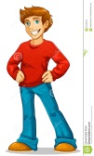
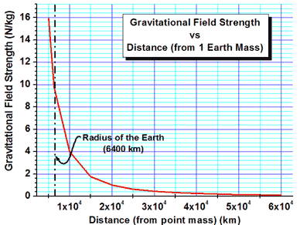
r = 6.4 x 10⁶ m
Mass of the man = 61 kg
150 N
66 N
37N
24 N
600 N
1r
2r
3r
4r
5r
9.81 m/s²
1/4 =
2.45 m/s²
1/9 =
1.09 m/s²
1/16 =
.61 m/s²
1/25 =
.39 m/s²

Slide 29
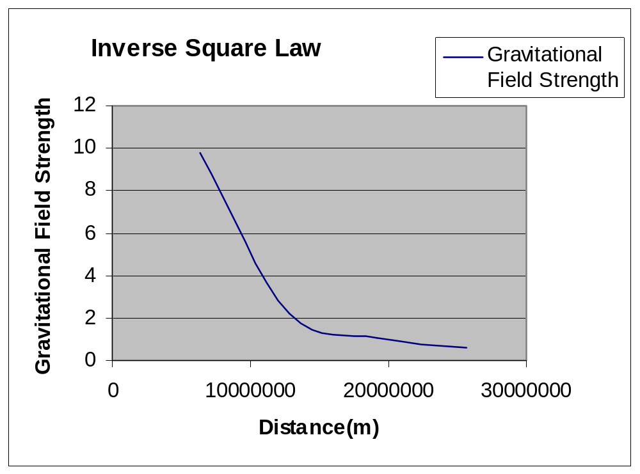

Slide 30
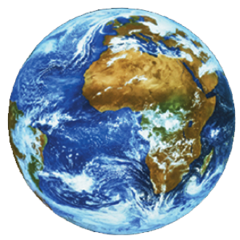
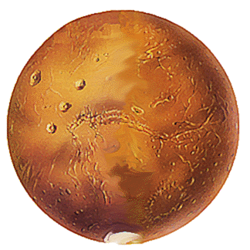
CW:
The gravitational attraction between the Earth and Mars is 8.7 x 10¹⁶ N. The distance between the two planets is 5.5 x 10¹⁰m. Earth has a mass of 6.0 x 10²⁴ kg. What’s the mass of Mars?

Slide 31
r²
r²
F_{g}r² = GmM
GM
GM
m = F_{g}r²
GM
=
(8.7 x 10¹⁶ N) (5.5 x 10¹⁰ m)²
(6.67 x 10⁻¹¹ N m²/kg²)
(6.0 x 10²⁴ kg)
(8.7 x 10¹⁶ N) (3.0 x 10²¹ m²)
=
(6.67 x 10⁻¹¹ N m²/kg²)
(6.0 x 10²⁴ kg)
=
(2.7 x 10³⁸ N m²)
(4.2 x 10¹⁴ N m²/kg)
=
(6.4 x 10²³ kg)

Slide 32
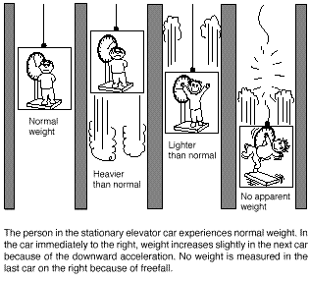
Let’s look at what happens to forces and your apparent weight (F_{N}) on an elevator.
This elevator is either not
moving or moving with a
constant velocity.
F_{T}
F_{N}
The scale reads
your true weight.
This is just like when
the mass was hanging.
100 kg
F_{g} = w
ΣF = 0
ΣF= F_{N} - w
F_{g} = w
0 = F_{N} - w
F_{N} = w

Slide 33
On an elevator that’s accelerating we experience of a change in “weight” which is actually due to a change in the normal force, not weight (mg). Because if you think about it your weight (mg) never changes (your mass remains the same so does gravity).
What happens
to your apparent
“weight” when an
elevator
accelerates
upward?
This elevator is now
accelerating upward.
F_{T}
F_{N}
This is just like when
the mass was
accelerating upward.
100 kg
F_{g} = w
The elevator is
pushing up on
you with more
force, so you
“feel” heavier.
F_{g} = w

Slide 34
This elevator is now
accelerating downward.
What happens
to your apparent
“weight” when an
elevator
accelerates
downward?
F_{T}
This is just like when
the mass was
accelerating
downward.
100 kg
F_{T}
The elevator is
pushing up on
you with less
force, so you
“feel” lighter.
F_{g} = w
F_{g} = w

Slide 35
This elevator has now
snapped and is accelerating downward at the force of gravity.
There is no F_{N}, the
scale is falling as fast
as you are, nothing is
pushing on you.
This is freefall.
a = g
100 kg
This is the feeling of
weightlessness.
F_{g} = w
F_{g} = w

Slide 36
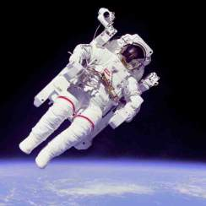
Astronauts in a spacecraft orbiting the Earth or out for a “spacewalk” are seen to “float”
in midair. This is sometimes referred to as weightlessness or zero gravity. Are these terms correct?

Slide 37
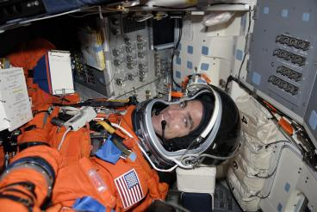
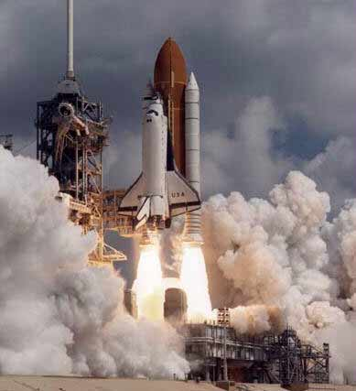
An astronaut experiences as much as 8 g’s of force on blast-off because of the acceleration. This net force (experienced as apparent weight) is exerted on the astronaut by the seat which pushes on the astronaut with a force many times their weight. If the astronaut were sitting upright upon launch, such a force would cause the body to accelerate away from it’s own blood ( Newton’s 1st- object at rest…). Thus the blood appears to go to the legs, where the blood vessels and capillaries would rupture. Consequently, astronauts are in a reclining position for blast-off.
F_{N}
w

