Slide 1
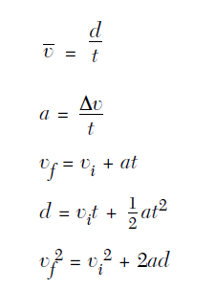
Kinematic Equations
Did you watch the video?
http://aplusphysics.com/courses/regents/videos/KinEqns_Reg/KinEqns_Reg.html

Slide 2
Horizontal Kinematics-
Average velocity another way:
How do you calculate the average of a group of numbers?
v = v_{f} + v_{i}
2
This formula is valid only when acceleration is constant.

Slide 3
Average velocity practice problem:
A car traveled down the thruway for an hour going 40 km/hr. Suddenly a snow storm hit and the care slowed down to 20 km/hr for the last hour of the trip. What was the cars average velocity for the entire 2 hr trip?

Slide 4
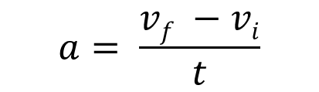
Solving for v_{f} using acceleration:
$$a= \frac{vf −vi}{t}$$
Solve for v_{f}

Slide 5

$$vf=vi+at$$
Practice:
  A car starting at rest accelerates 2 m/s² for 5 sec. What is the car’s final velocity?

Slide 6
Other new kinematic equations:
d = v_{i}t + ½ at²
v_{f}² = v_{i}² + 2ad

Slide 7
Practice:
A car is originally traveling at 15 m/s. The driver applies the brakes, causing the car to decelerate uniformly at 4 m/s² until it comes to rest. Calculate the car’s stopping distance.

Slide 8

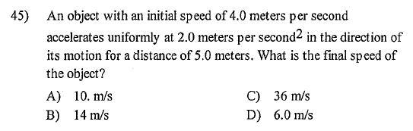
Orange Book Practice:

Slide 9

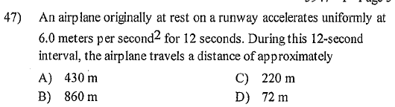

Slide 10
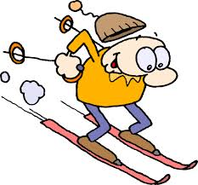
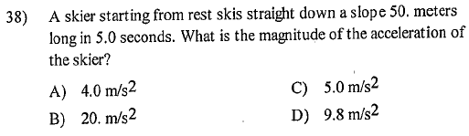

Slide 11

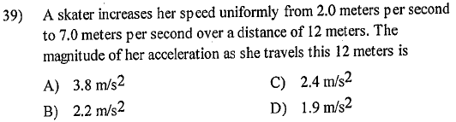

Slide 12
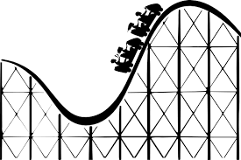
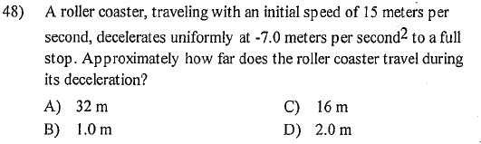

Slide 13

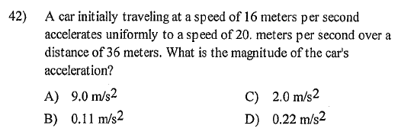

Slide 14

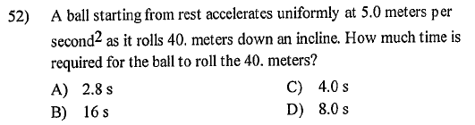

Slide 15
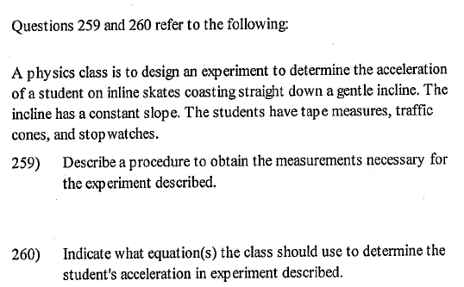

Slide 16
