Slide 1

Defining Motion- Velocity and Acceleration
Did you watch the video?
http://aplusphysics.com/courses/regents/videos/Define_Motion_Reg/Define_Motion_Reg.html

Slide 2
Most of this video you already know:
What does the line mean over the “v”?
  average
What do we use for “d” when calculating speed?
  distance
What do we use for “d” when calculating velocity?
  displacement
What is acceleration?
  Describes how quickly velocity changes- speeding up or slowing down

Slide 3
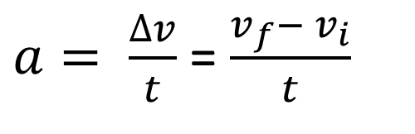
Acceleration Formula
$a= \frac{∆v}{t}$ = $\frac{v_{f}− v_{i}}{t}$
Review the Problem Solving Format:
Unknown/Given
Formula
Solve for unknown (if needed)
Substitute with units
Answer with correct units

Slide 4
Acceleration is a vector.
The direction of the acceleration vector depends on two things:
  whether the object is speeding up or slowing down
  whether the object is moving in the + or - direction
The general principle for determining the acceleration is:
  If an object is slowing down, then its acceleration is in the opposite direction of its motion.

Slide 5
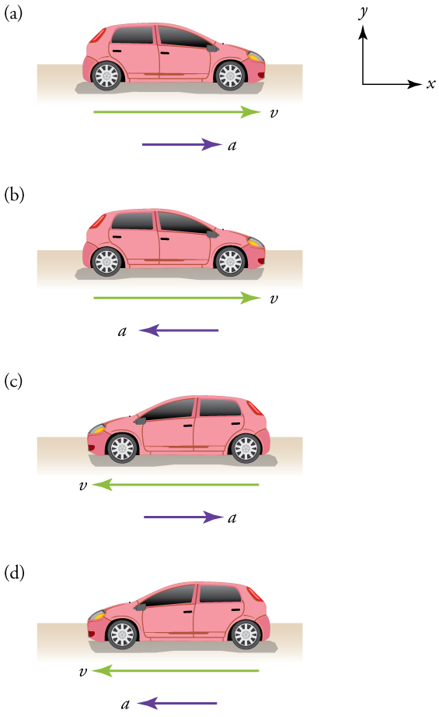
Velocity vector is showing you direction of movement.
Acceleration vector is showing you how that
movement is changing (speeding up or slowing down).

Slide 6
acceleration vector and velocity vector are in the
Same sign direction = positive acceleration =
car speeding up to the right/east
-
+
acceleration vector and velocity vector are in
opposite sign directions = negative acceleration = car is
slowing down as it moves toward the right/east
-
+
acceleration vector and velocity vector are in
opposite sign directions = positive acceleration = car is
slowing down as it moves toward the left/west
-
+
acceleration vector and velocity vector are in the
same sign direction =negative acceleration =
car speeding up to the left/west
-
+

Slide 7
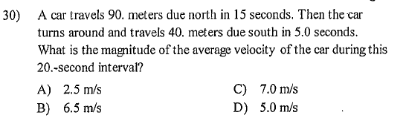
Orange Book Practice:

Slide 8
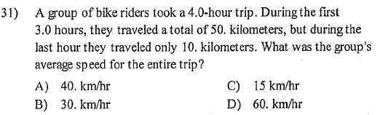

Slide 9
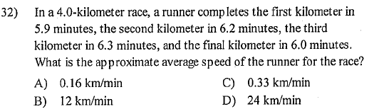

Slide 10
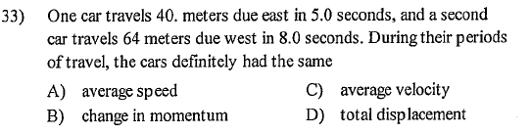
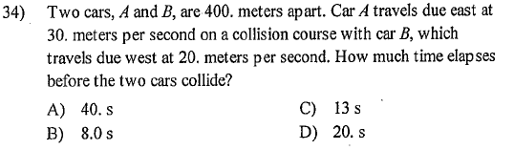

Slide 11
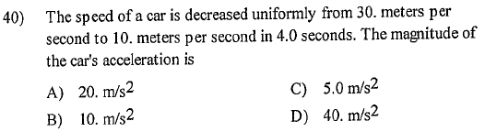

Slide 12
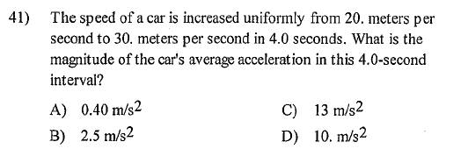

Slide 13
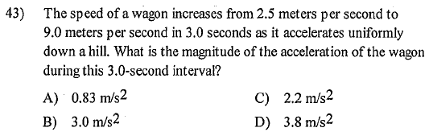

Slide 14
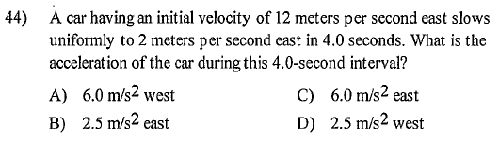

Slide 15
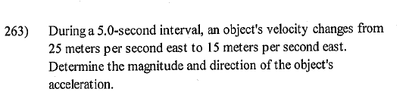

Slide 16
Protractor-Ruler
A cart is concurrently being pushed with a force of 9 Newton's south by one student and
6 Newton's east by another. Use a protractor and ruler to draw a scaled diagram
representing these 2 vector quantities and then determine the resultant vector (direction
and magnitude) of these forces. In other words, towards which direction will the cart end
up moving and with what total force? Be sure to include the scale you used.
Scale: 1 cm = 1 Newton
Vector Addition- tip to tail
Draw in resultant
Measure length of resultant
to get its magnitude
Magnitude of resultant = 10.8 cm = 10.8 Newtons

