Slide 1
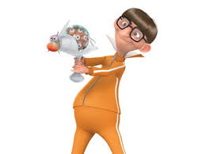
Scalars and Vectors
Did you watch the video?
http://aplusphysics.com/courses/regents/videos/VectorScalar/VectorScalar.html

Slide 2
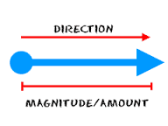
What are scalars?
  Temperature/mass/time/speed/distance
What are vectors?
  Velocity/force/momentum/displacement

Slide 3
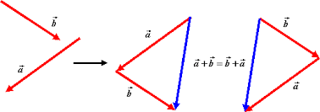
Simple Vocab:
Magnitude?
- Amount
Concurrent?
- acting together/at the same time
Resultant?
–sum of vectors
Equilibrant vector?
– find resultant and switch its direction
Vector addition?
– tip to tail
Vector subtraction?
  Switch direction of b
  and then tip to tail

Slide 4
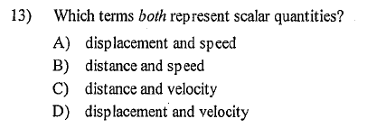
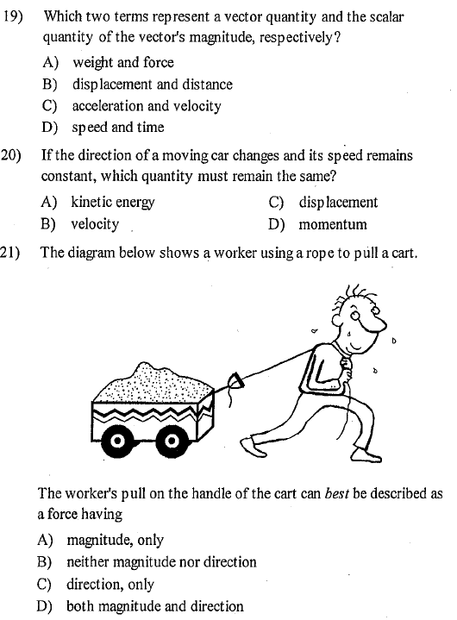
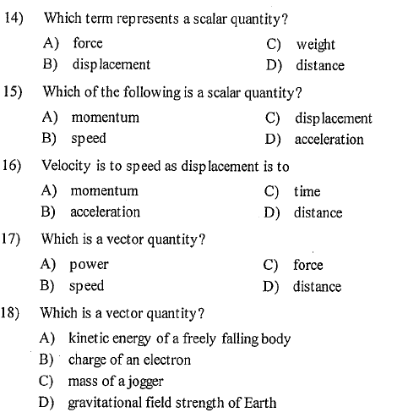
Orange Book Practice:

Slide 5
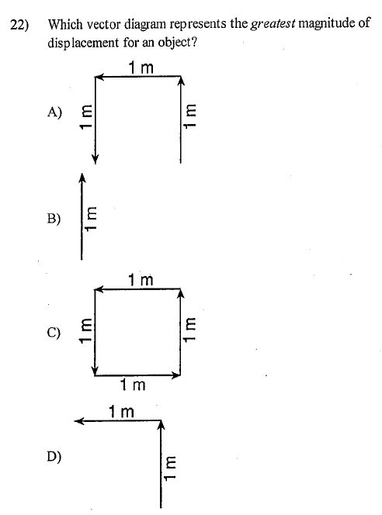
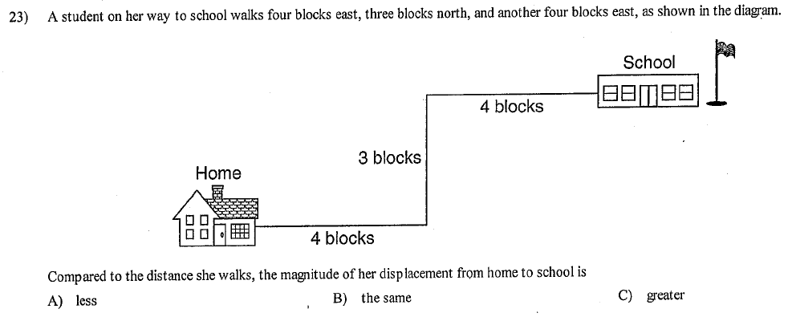

Slide 6

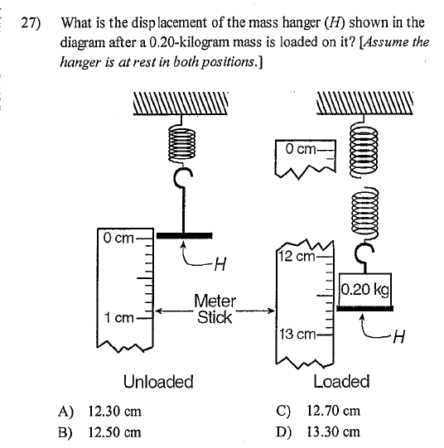
Mark off your “start” and “finish”

Slide 7
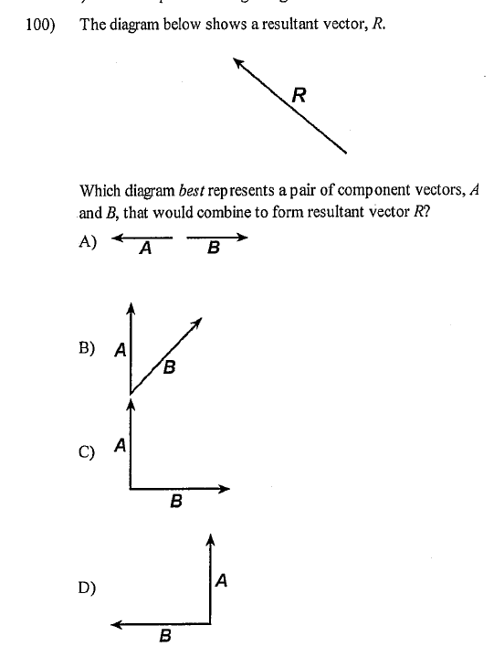
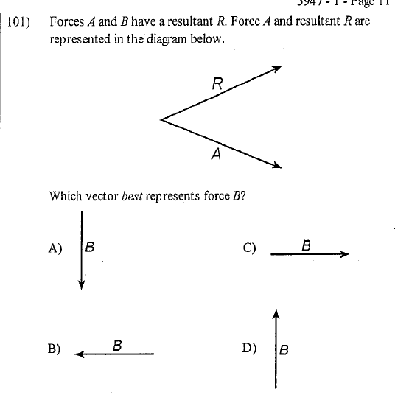
A + B = R
Typically B is the one to move tip to tail with A

Slide 8
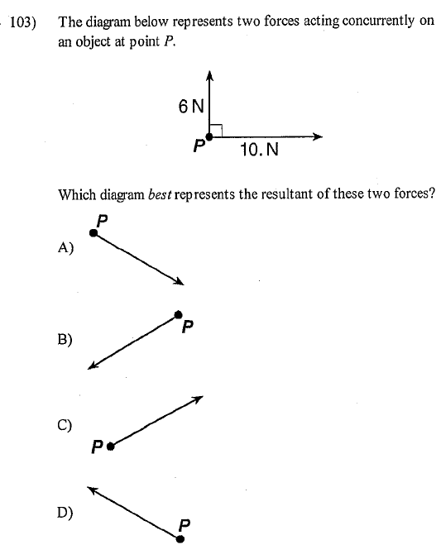
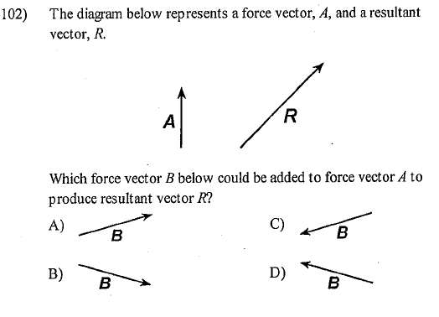

Slide 9
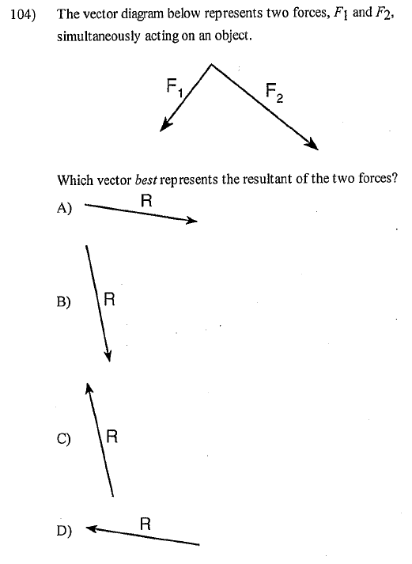
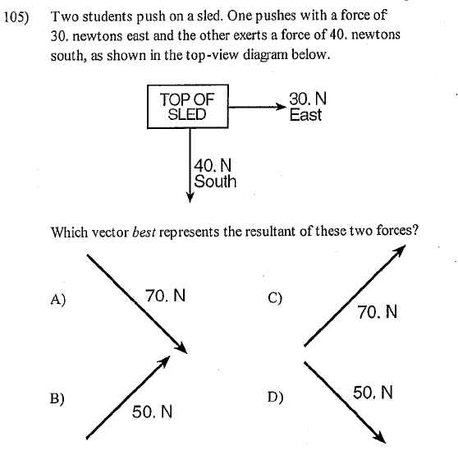

Slide 10
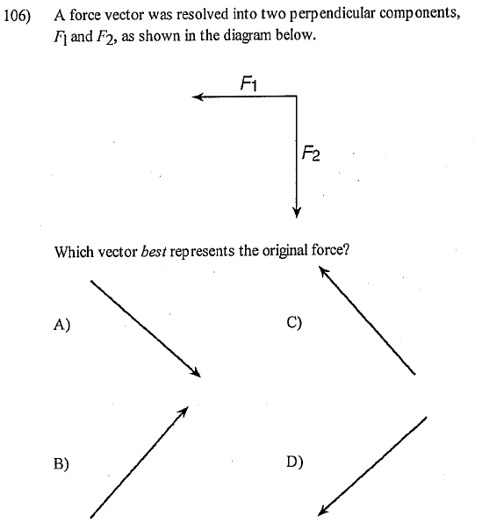
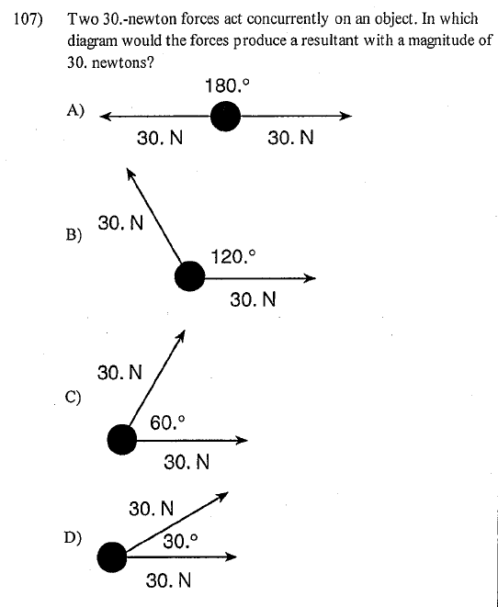

Slide 11
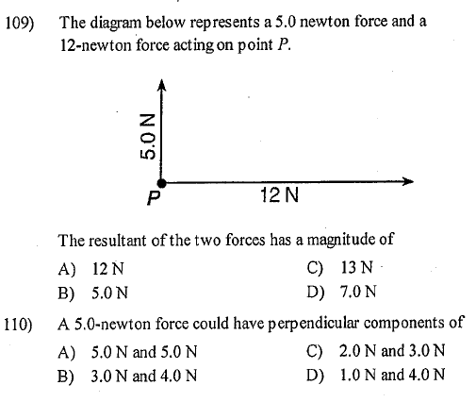
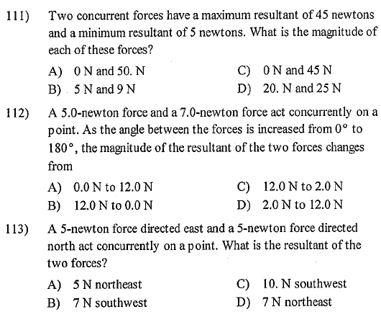

Slide 12
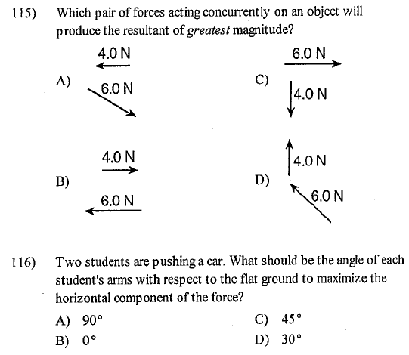

Slide 13

