Slide 1
Modern Physics

Slide 2
Wave-Particle Duality
Light behaves as both a wave and a particle.
LIGHT
WAVE
PARTICLE
Identified by frequency, wavelength, amplitude
Kinetic Energy
Exhibits diffraction
Momentum
Exhibits interference
Exhibits Doppler effect

Slide 3
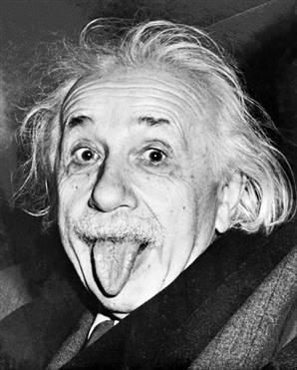
Light acting like a PARTICLE
In certain interactions light, or any electromagnetic radiation, acts as if it is composed of particles possessing kinetic energy and momentum.
This is what Einstein discovered that won
him his Nobel Prize…not E=mc².

Slide 4
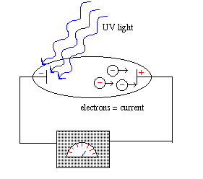
The Photoelectric Effect
When light having a particular frequency is exposed to the surface of certain metals the light energy is absorbed and electrons are emitted. This cannot be explained using the wave model of light.
Let’s take a look at why this happens…

Slide 5
Quantum Theory
Quantum theory assumes that electromagnetic energy is emitted from and absorbed by matter in discrete amounts or packets.
Each packet of electromagnetic energy
emitted or absorbed is called a quantum.
Here’s the relationship between energy and frequency:
E = hf
h is called Planck’s constant and is 6.63 x 10⁻³⁴ J•s

Slide 6
The quantum of electromagnetic energy is called a photon.
Acting like a particle, light, or a photon, carries both kinetic energy (1/2 mv²) and momentum (mv) but…a photon is a massless particle of light.
Energy of a photon of light is:
E_{photon} = hf = hc
λ

Slide 7
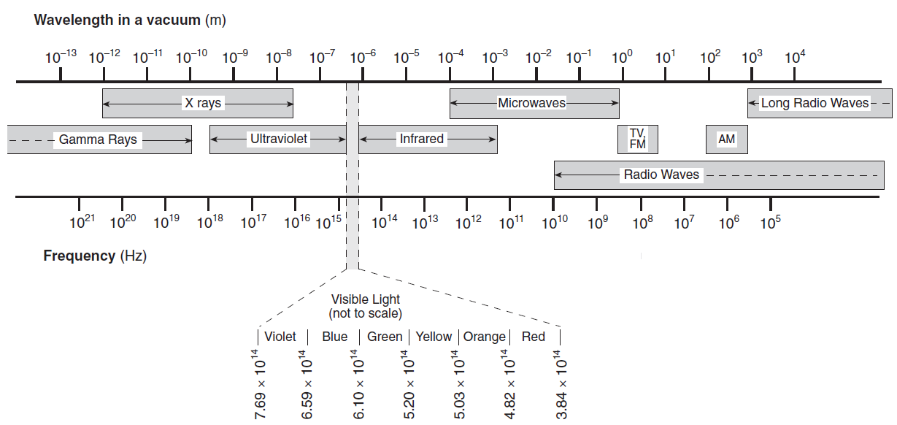
In which part of the electromagnetic spectrum does a photon have the most energy?
E = hf

Slide 8
A photon of orange light has a frequency of about 5 x 10¹⁴ Hz. What is the energy associated with this photon?

Slide 9
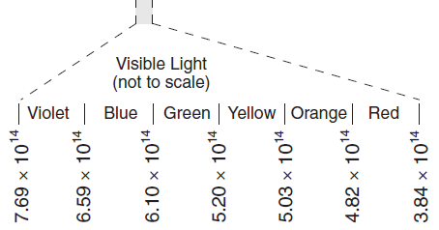
Try this…
The energy of a photon is 2.11 eV. Determine the energy of the photon in Joules. Determine the frequency of the photon. Determine the color of light associated with the photon.
1 eV = 1.60 x 10⁻¹⁹ J
2.11 eV x 1.60 x 10⁻¹⁹ J = 3.38 x 10⁻¹⁹ J
E = hf
f = E
h
= 3.38 x 10⁻¹⁹ J
6.63 x 10⁻³⁴ J s
= 5.10 x 10¹⁴ Hz

Slide 10




2
=
10
-
8
Work function
KE_{leftover}
=
E_{in}
-
E_{needed}
KE_{max}
=
hf
-
W_{o}
2
y = mx + b
7
10
E = 8

Slide 11
KE_{max}
=
hf
-
W_{o}
KE
y = mx + b
h
f
Threshold frequency- minimum frequency needed to
expel electrons
W_{o}
8

Slide 12
Let’s look at the photoelectric effect again…what happens when we increase the intensity of the light?
When the intensity increases the number of electrons emitted increases.
I
# emitted

Slide 13
What happens to the kinetic energy as the intensity increases?
I
KE max
Summary- When a photon (visible light) hits a metal atom at the right frequency it knocks out an electron.

Slide 14
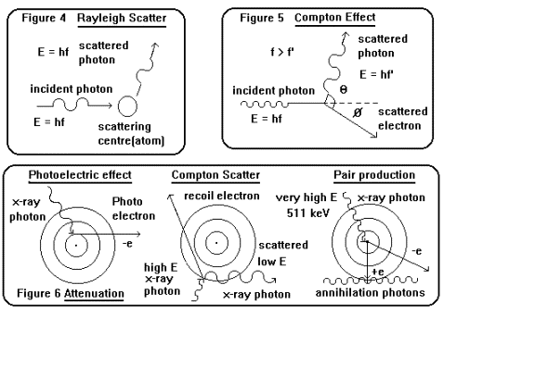
The photoelectric effect is a photon-particle collision.
Energy from the photon
is transmitted and
absorbed by the electron.
When a very high frequency photon (like X-rays) strike a metal
surface, not only are electrons ejected but electromagnetic
radiation of a lower frequency is also given off. This is called the
Compton Effect.

Slide 15
http://www.youtube.com/watch?v=4p47RBPiOCo&feature=player_embedded
p ↑
P ↑
E ↑
E ↓
λ↑
f ↓
Energy and momentum are AWLAYS conserved in this collision.
The incident x-ray photon loses energy and momentum while the
electron gains energy and momentum.

Slide 16
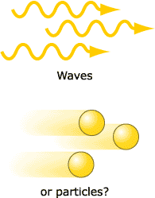
So light can act like a wave and a particle (or matter)…
Matter can also have a wave nature…

Slide 17
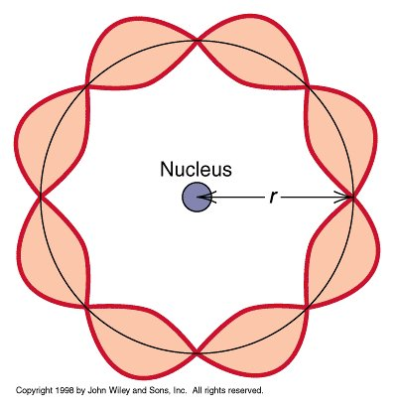
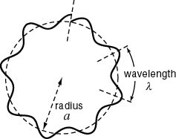
Dr. Quantum
The wavelength of the waves associated with the motion
of ordinary matter objects like a frisbee are too small to
detect. But the waves associated with the motion of
smaller particles (atomic or subatomic scale) like
electrons can be detected. We can actually measure the
wavelength at which these subatomic particles vibrate.
The wavelength of a matter wave is known as the de Broglie wavelength:
λ = h
mv

Slide 18
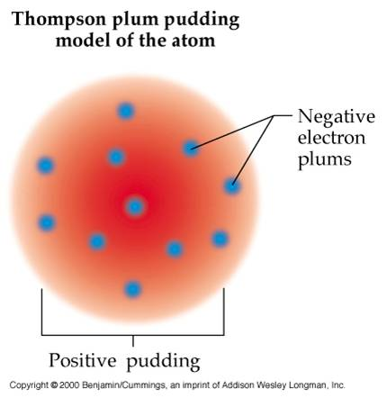
All of this information is going to help us as physicists to better understand the inside of the atom. Let’s review early models of the atom…
1898- Thomson’s Model:
Thomson proposed a model in
which the atom consists of a
uniform distribution of positive
charge in which electrons are
embedded, like raisins in plum
pudding.

Slide 19
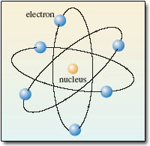
1911: Rutherford’s Model
Discovered the nucleus of an atom and concluded that
most of the atom is empty space. Did you know that if
the atom where the size of a football field the nucleus
would be the size of a marble. He also described the
atom as being like a miniature solar system with negative
electrons orbiting around a positively charged tiny nucleus
due to Coulomb forces of attraction.

Slide 20
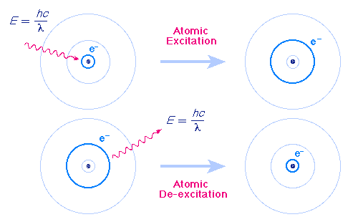
Bohr Model- Energy Levels
Electrons can jump from one orbit to a higher orbit by absorbing, or
lower orbit by emitting, a quantum of energy in the form of a photon.
The orbit nearest the nucleus represents the smallest amount of
energy that the electron can have.

Slide 21
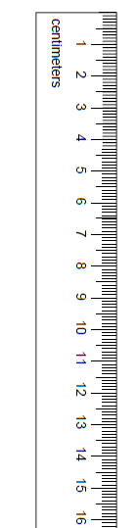

Slide 22
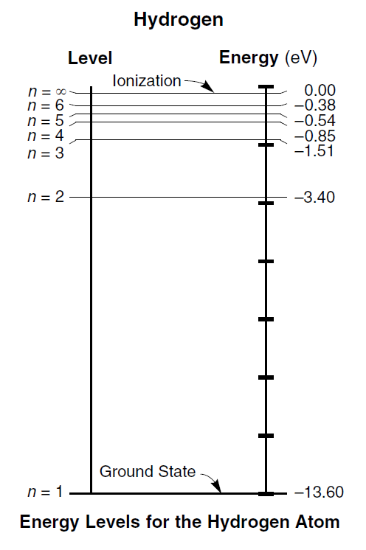
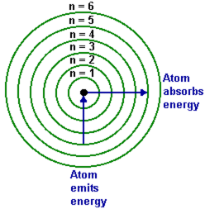
Bohr Model of Hydrogen

Slide 23
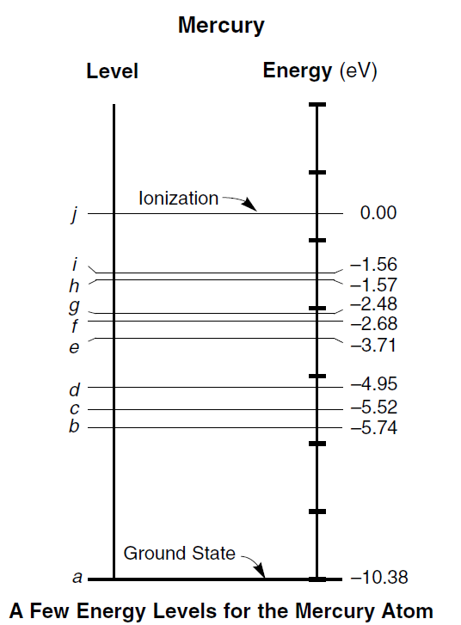

Slide 24

Emission (Bright-Line) Spectra
Every Energy level transition creates a single spectral line.

Slide 25
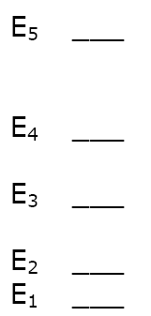
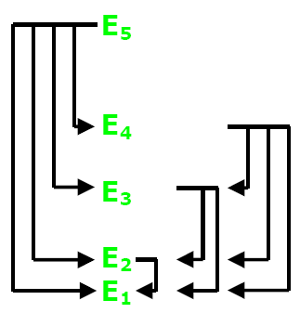
How many different spectral lines can be produced by an atom with 5 energy levels?

Slide 26

The diagram below represents the bright-line spectra of four elements, A, B, C, and D, and the spectrum of an unknown gaseous sample.
Based on comparisons of these spectra, which two elements are found in the unknown sample?

Slide 27
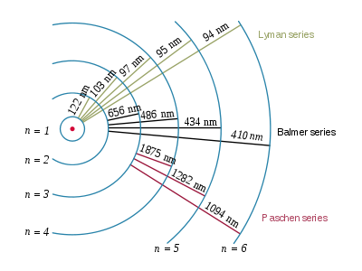
Certain frequency light will have enough energy to bump and electron up an energy level, or more than one energy level, or cause it to completely ionize.
Hydrogen
Ground State
Different combinations of
jumps will produce
different colors which are
shown on an absorption/
emission spectrum.
-13.60
-3.40
-1.51
0.00
-0.85
-0.54
-0.38

Slide 28
What color light (frequency) would appear on an emission spectrum for hydrogen if an electron fell from energy level 3 to 2?
E_{photon} = E_{i} - E_{f}
E_{photon} = -3.40 eV - -1.51 eV
E_{photon} = 1.89 eV
Before we go any further you
need to change eV into Joules:
E_{photon} = 3.024 x 10⁻¹⁹ J

Slide 29
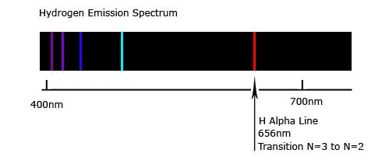
E_{photon} = 3.024 x 10⁻¹⁹ J
E = hf
f = E
h
f = 3.024 x 10⁻¹⁹ J
6.63 x 10⁻³⁴ J•s
f = 4.56 x 10¹⁴ Hz

Slide 30
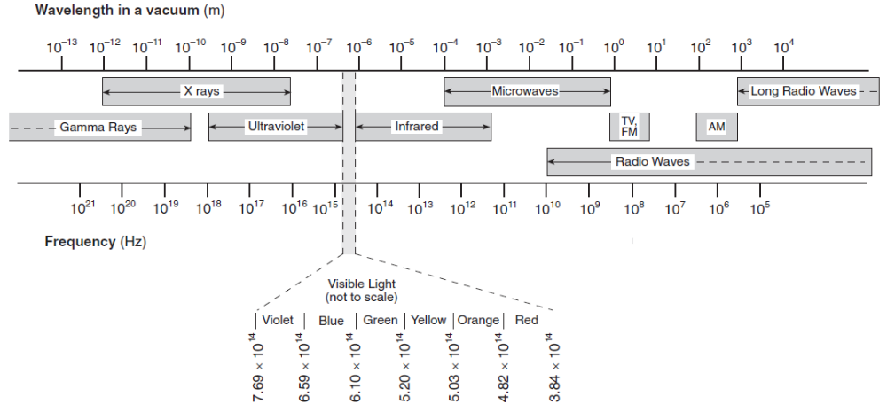
What color is emitted with a fall from energy level 2 to 1?
f = 2.46 x 10¹⁵ Hz

Slide 31
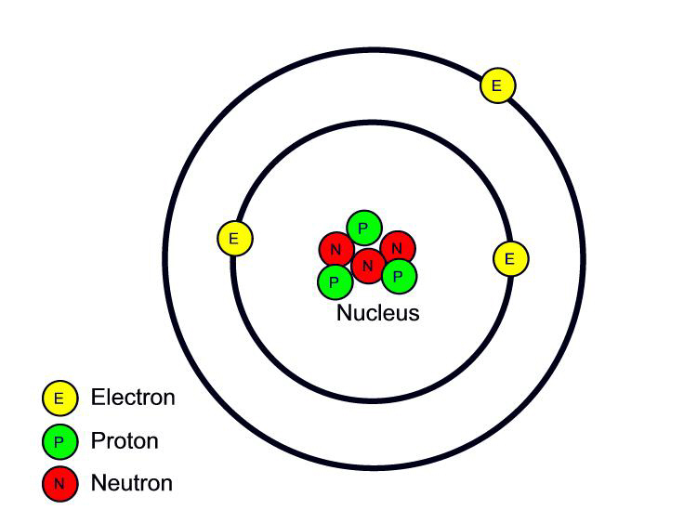
Inside the nucleus…
Most of the time the nucleus contains more than 1 positively charged proton.
The protons are only separated by a distance of 10⁻¹⁵ m.
Don’t two positively charged objects repel? Why doesn’t the nucleus just explode?
There is a VERY strong force between the protons and the neutrons called the STRONG NUCLEAR FORCE.
This is responsible for the stability of the nucleus.

Slide 32
Universal Mass Unit (u)
1 u = 1.66 x 10⁻²⁷ kg.
More convenient then using very very small numbers in kg.
What’s the mass of a Helium nucleus (2 protons, 2 neutrons)?
Protons = 1.0073 u x 2 = 2.0146 u
Neutrons = 1.0087 u x 2 = 2.0174
Mass of proton is 1.0073 u
Mass of neutron is 1.0087 u
Mass of electron 0.0005 u
Expected Total = 4.032 u
Actual Mass of Helium nucleus = 4.016 u

Slide 33
Where is the missing .016 u?
The lost mass is called the mass defect.
When nucleons come together to form a nucleus, energy is released (binding energy) and an equivalent amount of matter is lost.
To break up the nucleus and separate the nucleons, work must be done against the strong nuclear force.
The energy needed to separate the nucleons (binding energy) appears as an equivalent increase in their total mass.

Slide 34
E = mc²

Slide 35
1 u = 1.66 x 10-27 kg. Find the energy equivalent of 1 u in megaelectronvolts (MeV).
E = mc²
E = (1.66 x 10⁻²⁷ kg)(3 x 10⁸ m/s²)
E = 1.49 x 10⁻¹⁰ kg m/s²
1 MeV = 10⁶ eV
E = 1.49 x 10⁻¹⁰ J
E = 9.31 x 10⁸ eV
10⁶ eV
eV = 1.49 x 10⁻¹⁰ J
1.60 x 10⁻¹⁹ J
E = 931 MeV
= 9.31 x 10⁸ eV

Slide 36
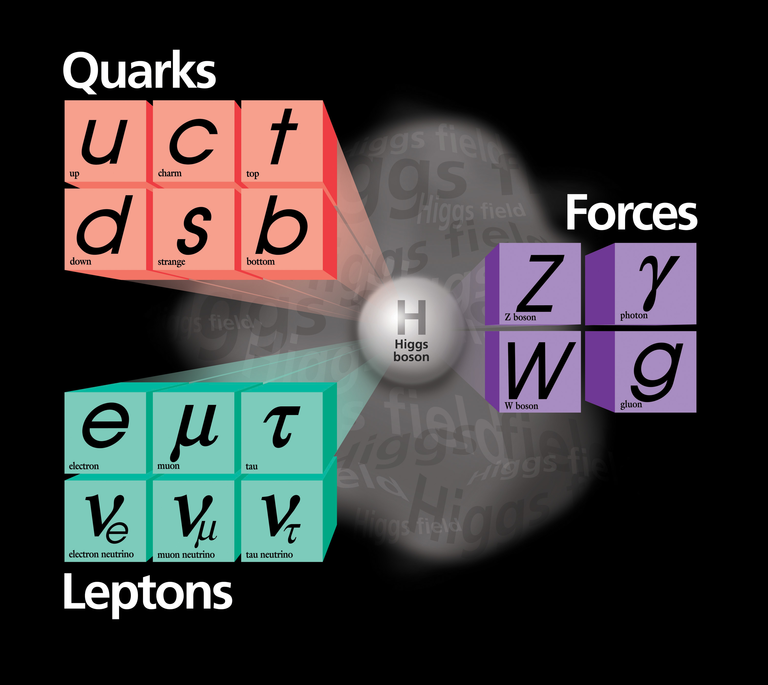
The Standard Model
Current theory used to explain the existence of all the subatomic particles that have been observed and the forces that hold atoms together or lead to their decay.

Slide 37
The Fundamental Forces in Nature
Force | Relative Strength | Range of Force | Force Carrier | Mass | Charge
Strong (nuclear) | 1 | 10⁻¹⁵ m | gluon | 0 | 0
Electro- magnetic | 10⁻² | Proportional to 1/r² | photon | 0 | 0
Weak | 10⁻¹³ | <10⁻¹⁸ m | W boson W boson Z boson | 80.6 eV 80.6 eV 91.2 eV | + e - e 0
Gravitational | 10⁻³⁸ | Proportional to 1/r² | graviton | 0 | 0

Slide 38
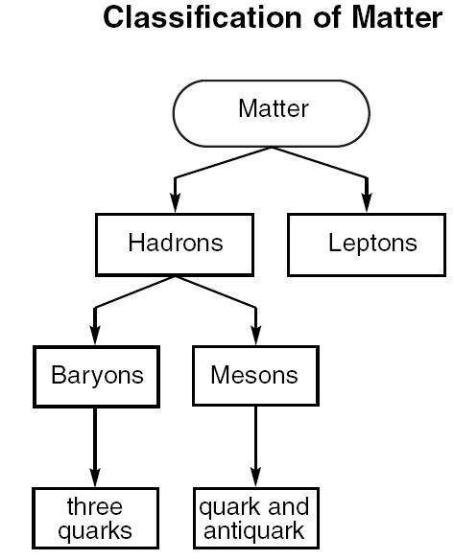
Classification of Particles
They are first classified by the type of interactions they have with other particles:
Particles that interact through
strong, weak, electromag, and
grav forces
Particles that interact through
weak, electromag, and grav
forces (not strong) – mass is
less than a proton
PROTONS AND NEUTRONS
ELECTRONS

Slide 39
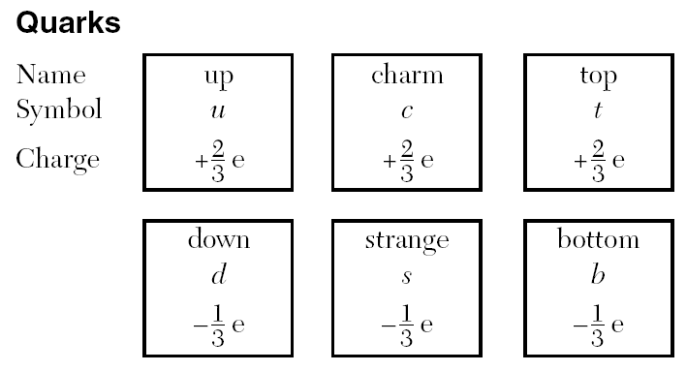
Heavy elementary particles
that are put together to form
protons and neutrons.
Example:
an antiproton has all
the same features of
a proton but it is
negatively charged.
Symbol p.
Antimatter- material consisting of
atoms that are composed of
antiparticles (particles having the
same mass, lifetime, and spin as
the associated particle but
opposite in sign). Denoted by a
bar over the symbol.

Slide 40
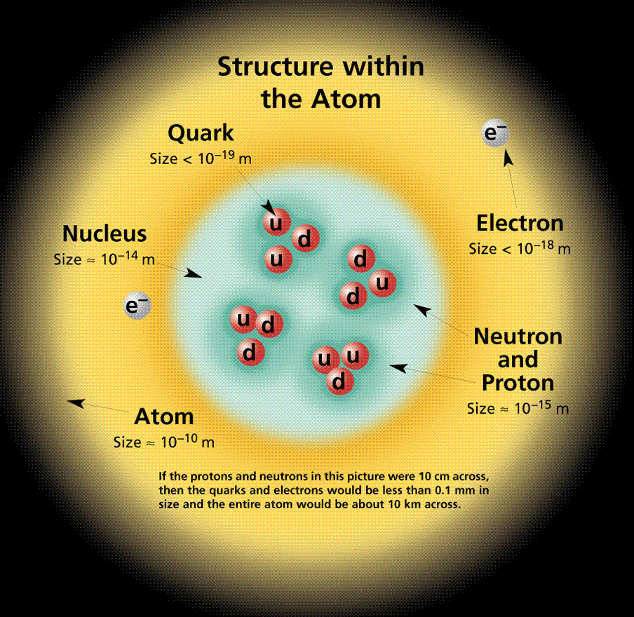
Protons and neutrons are made up of 3 quarks, no more, no less, always 3.
PROTON: uud
“dud”
NEUTRON: udd
When combining quarks
their combined charge
must add up to 0, +1,
or -1.

Slide 41
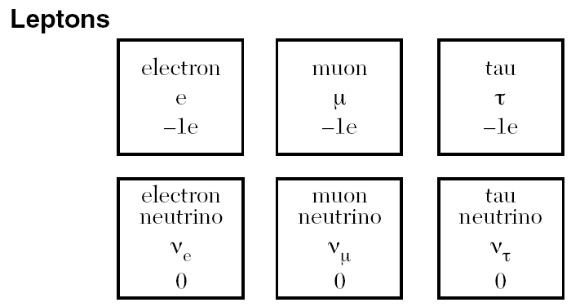
Antiparticle of an
electron is called a
positron.
ELECTRONS AND NEUTRINOS
(neutral particle with little if any
mass yet has energy and
momentum.

Slide 42
A lithium atom consists of 3 protons, 4 neutrons, and 3 electrons. What is the total number of quarks and leptons in this atom?
3 protons = 3 quarks = 9 quarks
4 neutrons = 3 quarks = 12 quarks
3 electrons = 3 leptons
Total = 21 quarks and 3 leptons

Slide 43
Which combination of quarks could produce a neutral baryon?
cdt
cts
cdb
cdu
cdb

Slide 44
What is the electric charge on a particle having quark composition ubb?
0e

