Slide 1
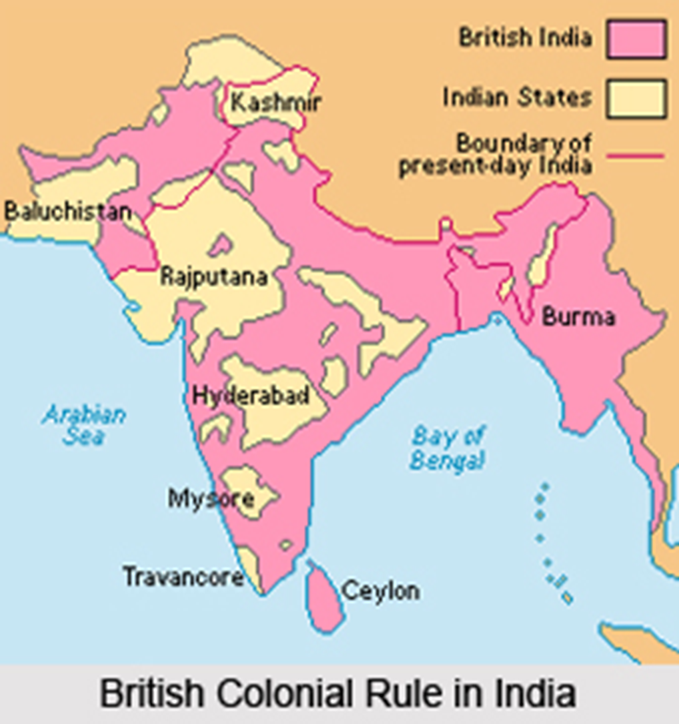
British imperialism in India

Slide 2
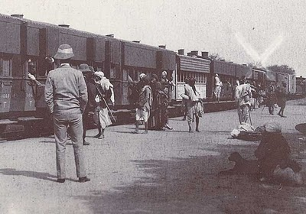
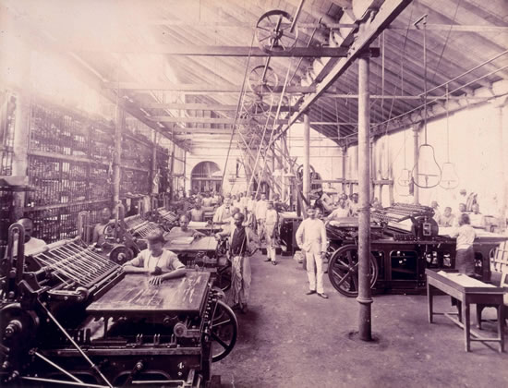
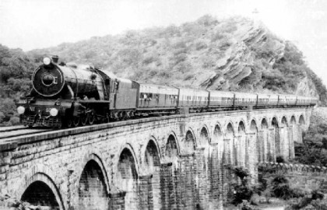

Slide 3
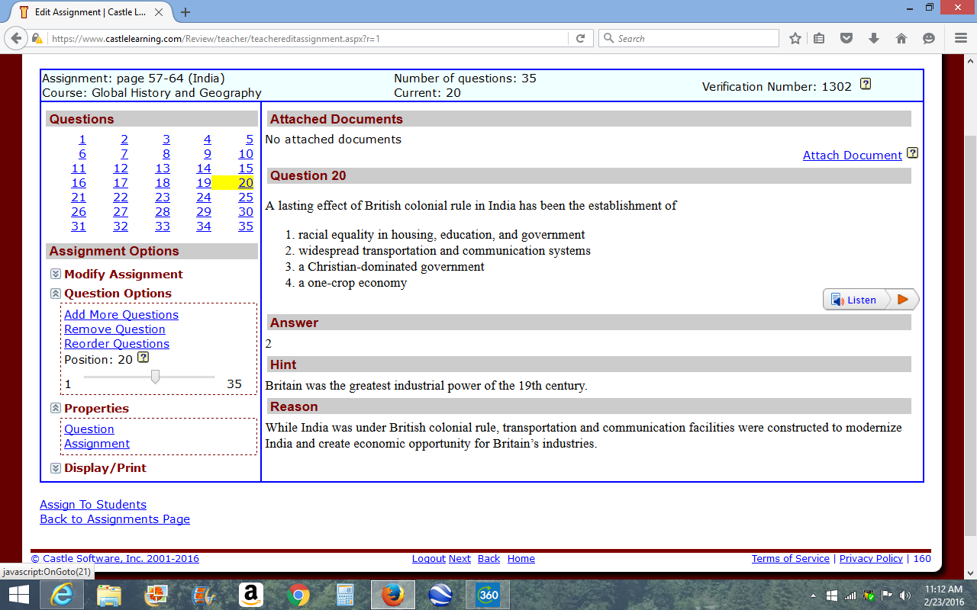

Slide 4
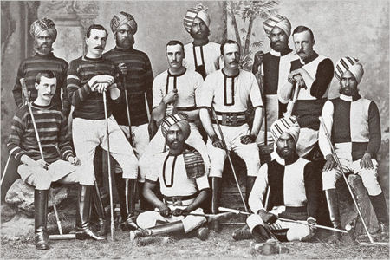
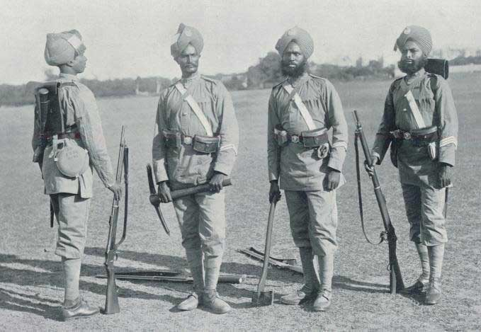
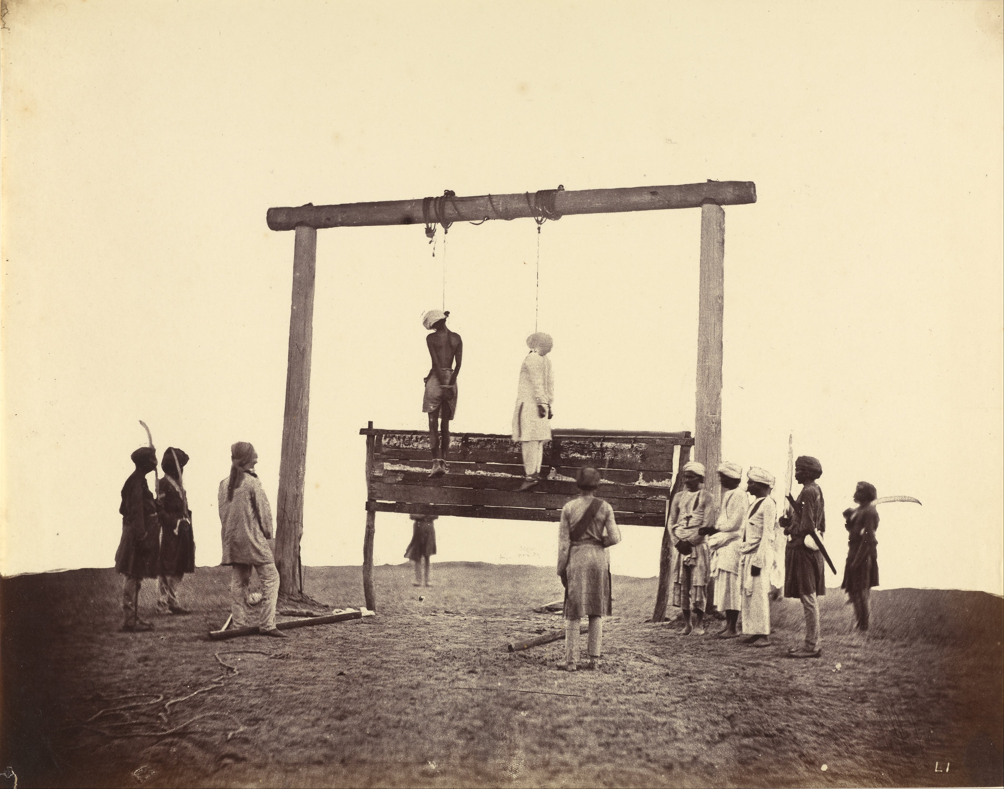

Slide 5
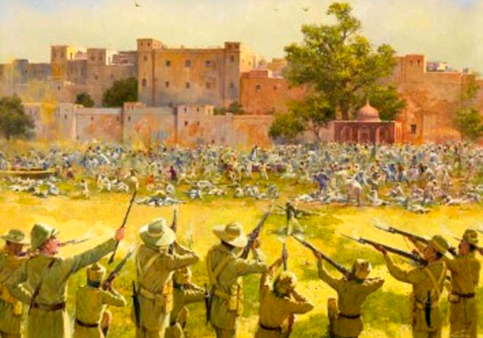
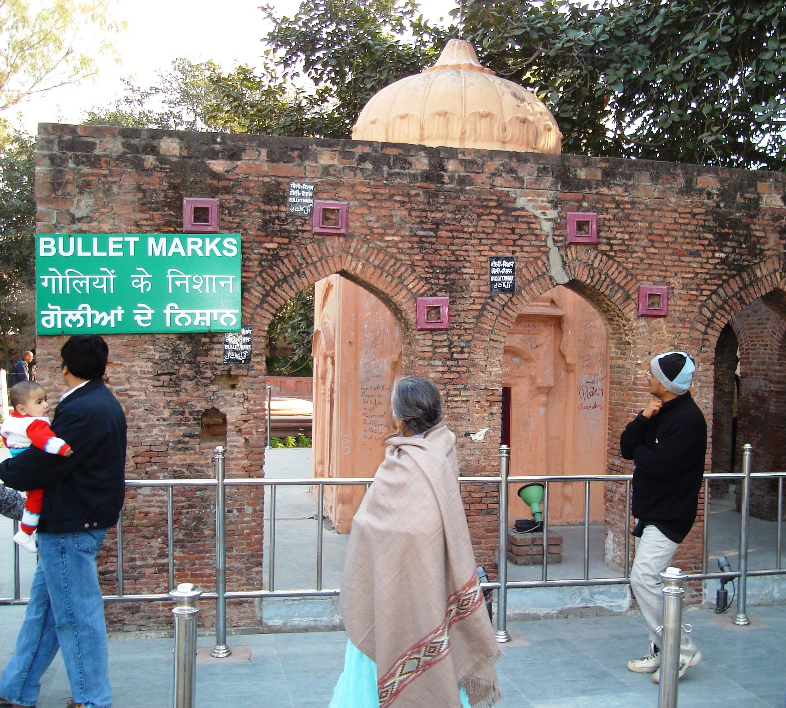
IV. Nationalism in india
One million Indian people had served for England in WWI. Now, they are looking for freedom.
AMRITSAR MASSACRE: 1919, public meeting on independence is attacked by British Troops. 379 Killed, 1200 wounded.

Slide 6
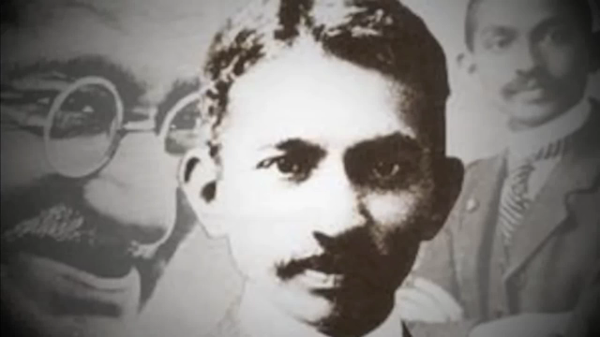
Amritsar Massacre, 1919.

Slide 7
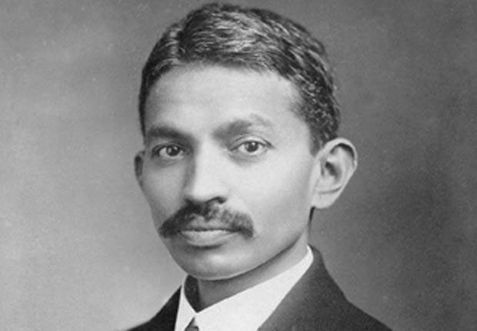
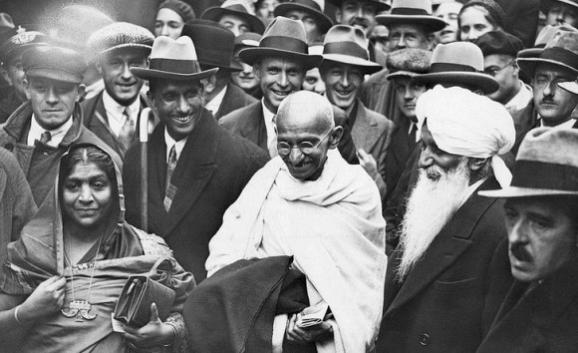
Rise of Gandhi in India
Amritsar Massacre inspires young Indian man Mohandas K. Gandhi (A Lawyer) to act against British rule in India.
Begins a campaign of “Civil Disobedience” to force British to leave.
Protests rising violence between Hindus and Muslims in India.

Slide 8
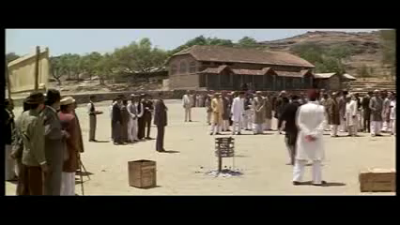
Gandhi in South Africa

Slide 9
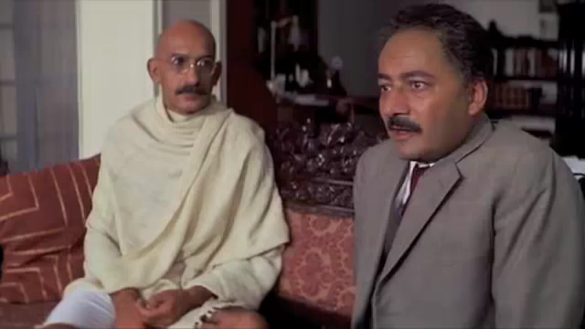
Civil Disobedience
Not following or purposely violating unjust laws
Marches, Fasting, protests. NON-VIOLENT Civil Disobedience.
Works with INDIAN NATIONAL CONGRESS to gain independence.
Great Salt March to the Sea. (march 1930)
Dharasana Salt Factory
Hunger Strikes

Slide 10
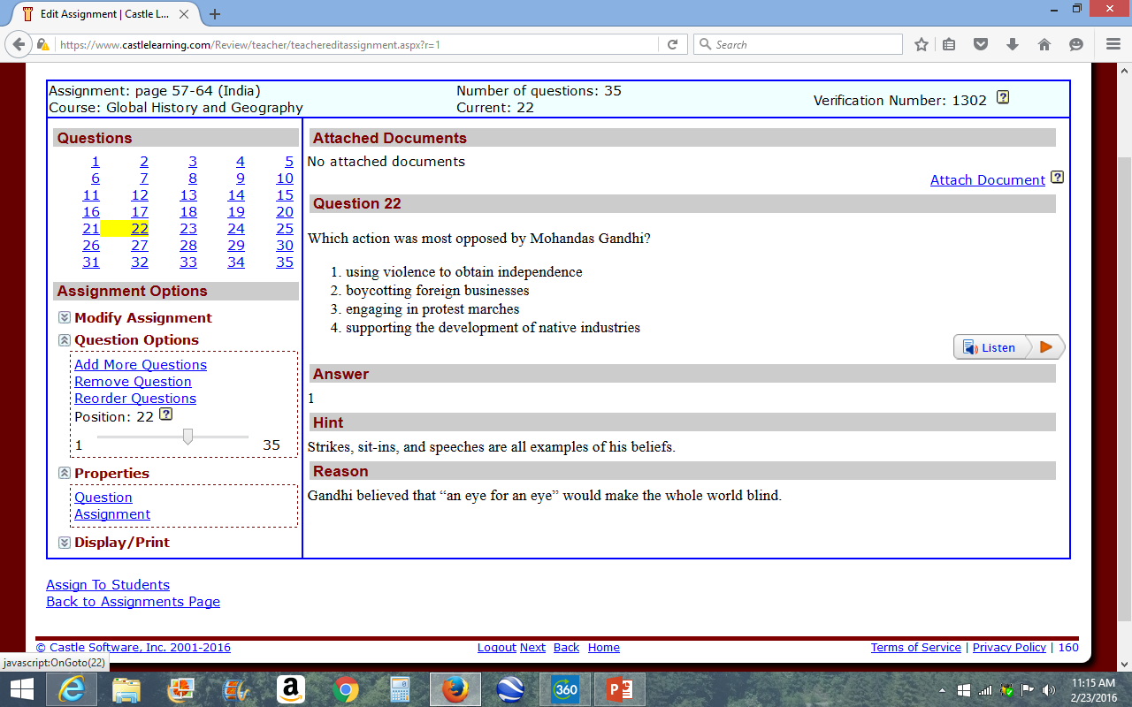

Slide 11
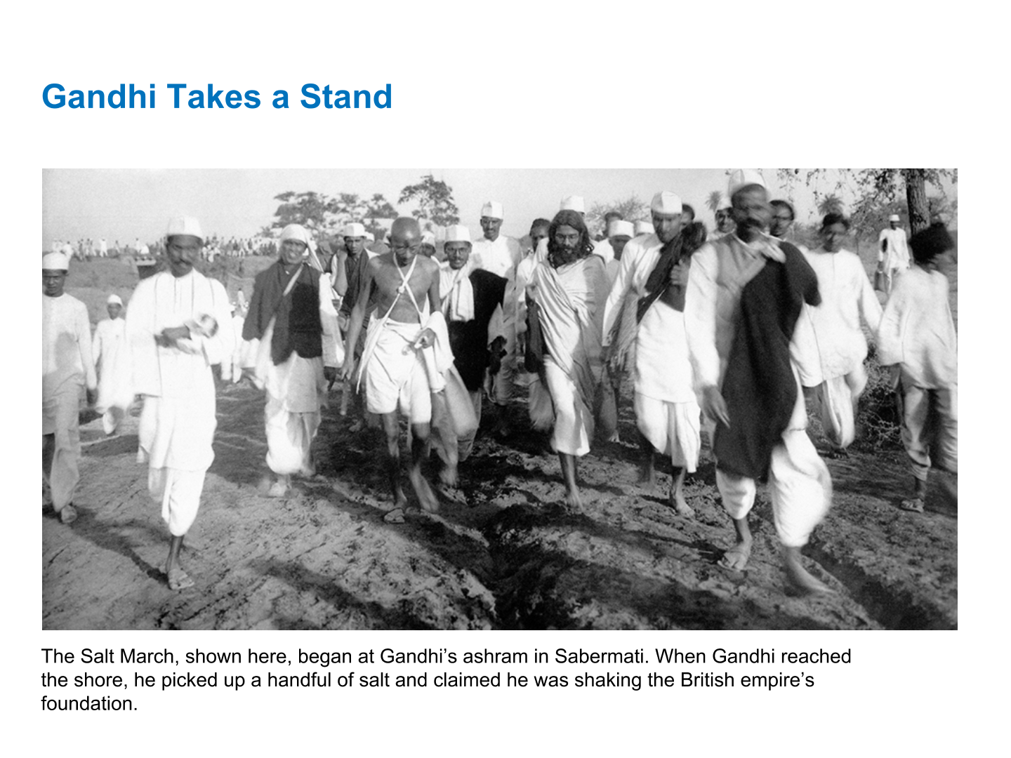

Slide 12
“An Eye for an eye only makes the whole world blind.”
-Gandhi

Slide 13
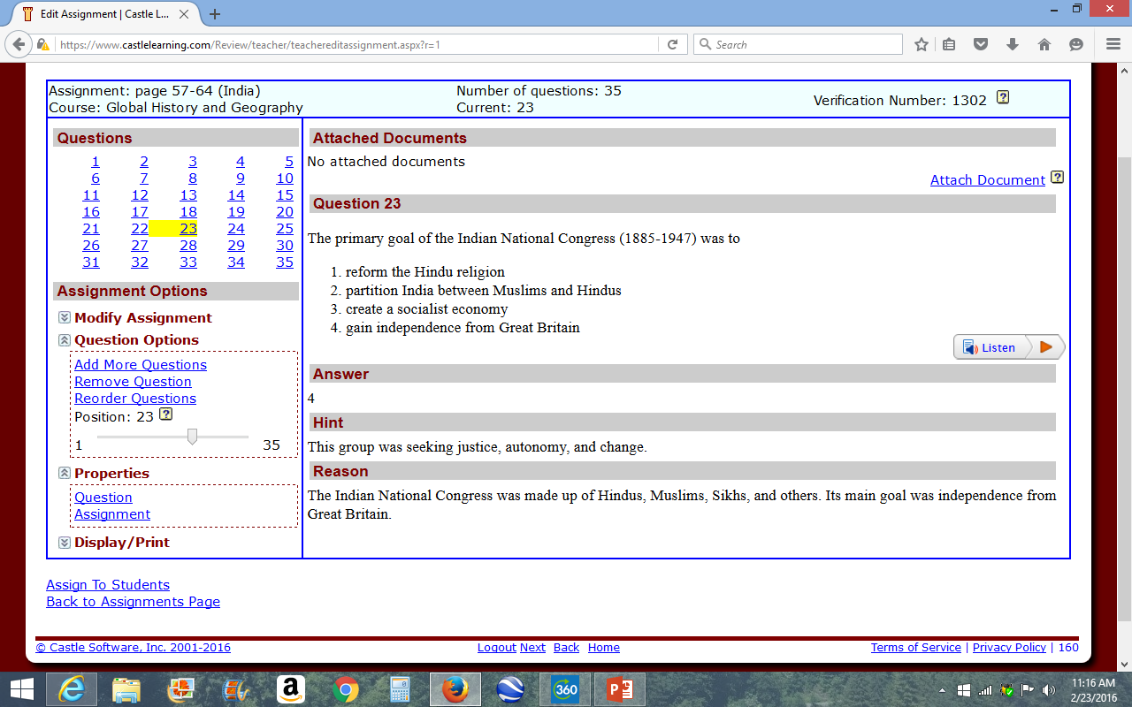

Slide 14
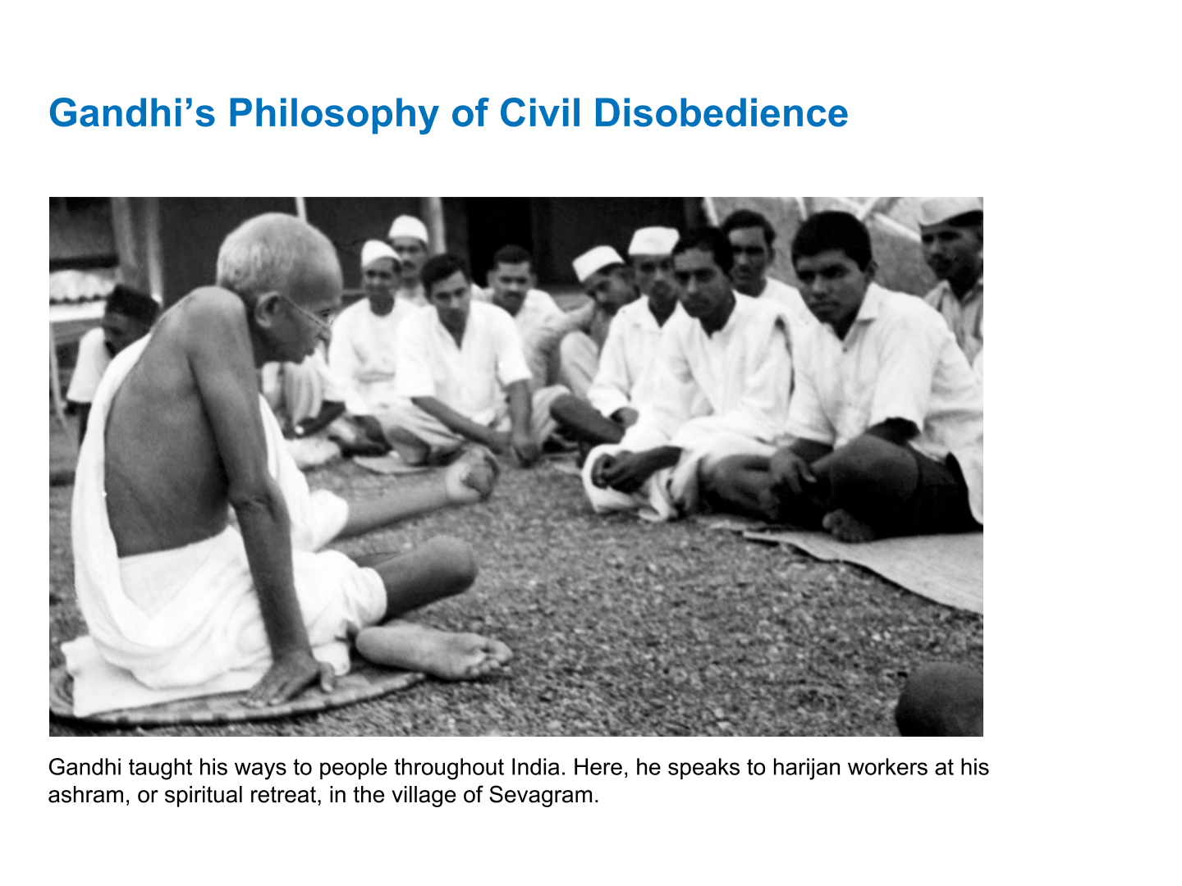

Slide 15
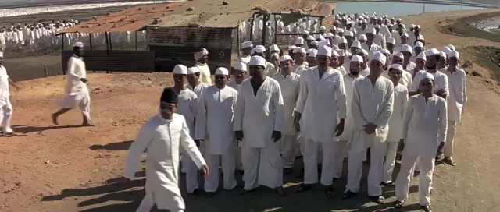
Dharasana Salt Factory

Slide 16
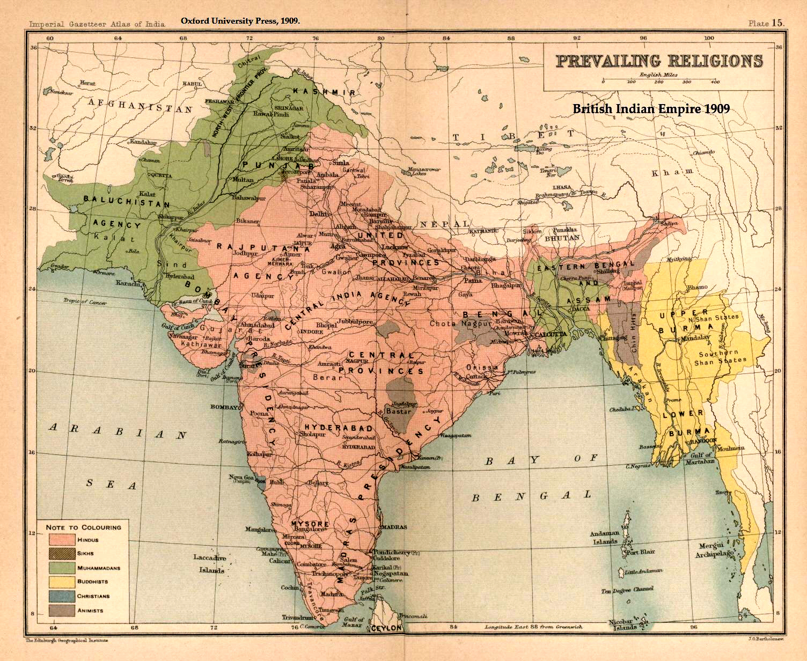
Muslims vs Hindus in India

Slide 17
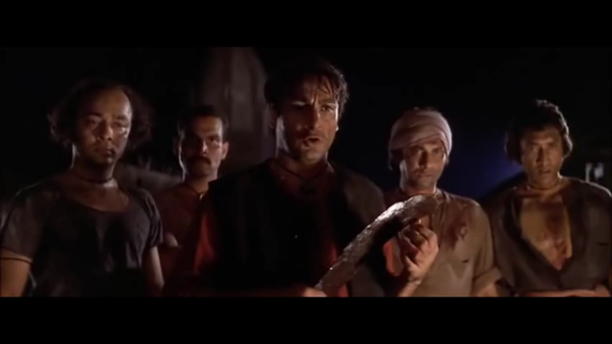
Hunger strike. Protesting violence between hindus and muslims.

Slide 18
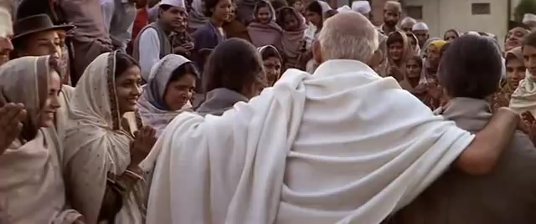
Assassination of Mahatma Gandhi

