Slide 1
Adaptations in Organisms
“Why did the zebra get it stripes?” and answers to other interesting observations…

Slide 2
What is an Adaptation?
- Adaptations are traits that help organisms survive in their ecological niche or habitat
Adaptations can be anatomical, physiological or behavioral
  Anatomical adaptations are physical features such as an animals shape.
  Physiological adaptations – traits that occur within the body of an organism; typically in relation to metabolism and maintaining homeostasis
    include the ability to make venom; but also more general functions such as temperature regulation.
  Behavioral adaptations – include an organisms actions or things that it does to survive
    can be inherited or learned behaviors and include tool use, language, herding etc.

Slide 3
Why Might Traits that Don’t Appear Advantageous Exist?
Look at the evolutionary history of the organism
For example, diabetes in humans
What is diabetes?

Slide 4
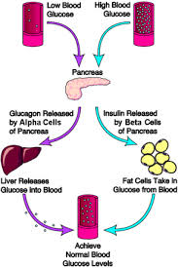
Diabetes
1. What sugar plays a role in diabetes?
  Glucose
2. What hormone helps to maintain a proper balance of this sugar?
  Insulin
3. What disruption in homeostasis occurs in
diabetics?
  The blood sugar (glucose) remains at high levels
  in the bloodstream

Slide 5
Disruption of homeostasis….
4. If left unmanaged, what are the effects that occur from diabetes?
  If left unmanaged, high blood sugars can lead to rapid dehydration, coma, and death.
  Even when it is managed, diabetes can lead to long-term complications including: blindness, heart disease, stroke, and vascular disease

Slide 6
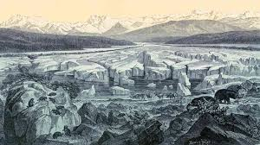
Why is Type 1 diabetes most common in people of Northern European Descent?
12. What environmental condition occurred during the Younger Dryas in Northern Europe?
  In a decade, average yearly temperatures plunged nearly 30 degrees
  Sea levels dropped by hundreds of feet as water froze in the ice caps
  Forests and grasslands went into steep decline and coastlines were surround by hundreds of miles of ice
13. What happens to human tissue when it freezes?
  When human tissue is frozen, the water in our blood freezes, and the ice shards cut blood cells and cause capillaries to burst (like a pipe in an unheated house)

Slide 7
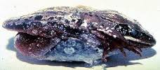
Why would the condition of high blood sugar be beneficial in cold climates?
15. Why might grapes off-load water and have a sharp increase in sugar at the onset of a cold freeze?
  The less water in the grape, the fewer ice crystals to damage the membranes of the fruit
  Ice crystals are only made of pure water – when you add a solute (sugar) water will freeze at a lower temperature. Just like antifreeze
18. How does the wood frog change physiologically when it freezes?
  Just before temperature drops to freezing, it begins to move water out of its organs and blood
  Instead of urinating it pools water in abdomen – this will eventually freeze and keep the rest of the vital organ cool
  Liver dumps massive amounts of sugar into bloodstream to lower the freezing point of water remaining in bloodstream
How does this relate to the environmental
condition during the Younger Dryas and diabetes in
humans?

Slide 8
Let’s look at some other adaptations…

Slide 9
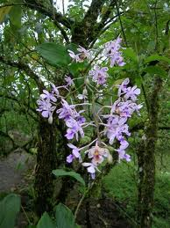
Anatomical Adaptations
Orchids – Mimicry and more!
Orchids are examples of Epiphytes
  They grow in the canopy layer of tropical rainforests
  Need to have adaptations for obtaining water, enough sunlight and nutrients and reproduction
Roots: In addition to anchoring the plants, the roots contain chloroplast and can perform photosynthesis
Flowers
  Brightly colored flowers will attract certain insect pollinators
  Some species flowers mimic their pollinators
Seeds
  Very light so that they may be carried by the wind
  Lack the endosperm and will receive nutrients from fungi in the area
Stems are enlarged and called pseudo-bulbs
  Used for water and carbohydrate storage
https://www.youtube.com/watch?v=-h8I3cqpgnA

Slide 10
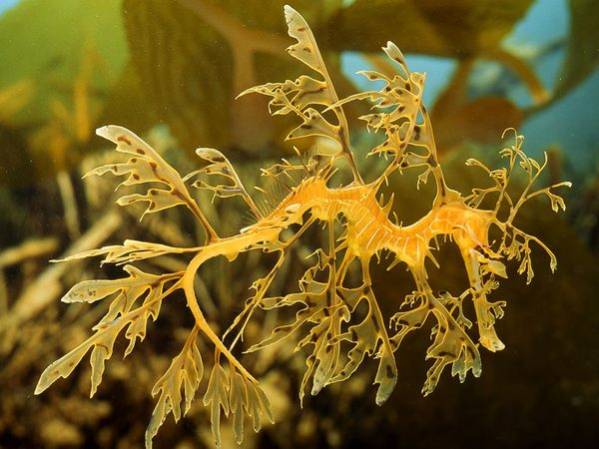
Leafy Sea Dragon - Camouflage
Marine organisms - Adapted to hiding in the seaweed and kelp.
The leaf-like protrusions that make it so distinctive give it the appearance of seaweed.
This helps to trick predators as well as the small fish and crustaceans that the Leafy Sea dragon likes to eat.
The Leafy Sea dragon uses tiny translucent fins on its head to steer while similar fins on its back propel it gently through the water, creating the illusion of a piece of floating seaweed.
It can even change color to blend in with its surroundings.
During reproduction, like it’s cousin the sea horse, the male looks after the eggs!
The female produces up to 250 bright pink eggs and deposits them on to the male's tail.
The eggs then attach themselves to a ‘brood patch’,
which keeps them supplied with oxygen until the hatch
https://www.youtube.com/watch?v=25sHr44Xy9M at 5:18

Slide 11
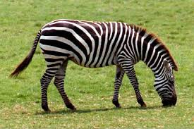
Zebra - Stripes
Stripes
  - Dazzle effect - it breaks up his outline and makes it harder for predators to judge distances -- throwing off their strikes when hunting
  - Stripes might confuse certain parasitic flies, since the zebra's patterns don't resemble other mammals from a fly's-eye-view.
Teeth
  - Unlike other mammals, zebras feature large, high-crowned grinding teeth, since many of the grasses they eat feature a high silica content that can wear down teeth.
  - Males have enlarged canine teeth for fighting. This adaptation is the result of sexual selection; males that perform better in fights have a better chance of getting a mate and reproducing
Herding Behavior
  - Zebra often herd with other animals as well, such as giraffes - more eyes to spot predators -- living in groups enhances some other zebra adaptions.
https://youtu.be/JDxvzDLWH4c

Slide 12
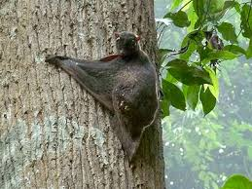
Colugo - Gliding
Live in the tropical rainforest in Southeast Asia – competition is very high
Are nocturnal
  Eyes are large and front-facing
Have a flap of skin called the patagium – extends from front paw to rear paw. Also webbing between their fingers and toes
  Of all the gliding mammals, colugos are most skilled
  Expend little energy
Are herbivores – eat leaves, shoots, sap, fruits and flowers
  Intestine is very long in proportion to body size- allows them to extract all the nutrients from their food
https://www.youtube.com/watch?v=QkKDHkwq59Y

Slide 13
Physiological Adaptations

Slide 14
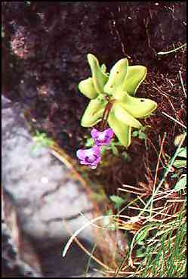
Butterwort – Deadly Leaves
The Butterwort also known as the Pinguicula vulgaris,
feeds itself by trapping insects.
Bright purple flowers are used to attract the insects along with the sticky mucilage on the yellowish bear-haired star shaped leafs.
Once the insect is stuck, the leaf edge slowly rolls over. When the insect is digested the leaf unrolls and becomes nearly flat.
The plant has to feed on insects to pollinate.
These plants are usually found in sunny, open and wet areas where there is less nutrients (nitrogen) in the soil, so the plant has adapted to eating insects, to supplement it’s diet.
The Genus name Pinguicula means "little fat one" in Latin; this is because of the "fatty" glossy leaves.
The common name Steepgrass originated in Europe (Ireland in particular), where it was steeped in milk to curdle it.
https://www.youtube.com/watch?v=aladpRIVdRI

Slide 15
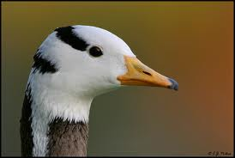
Bar-headed Geese – High Altitudes
Migratory birds over the Himalayas – exposed to very high altitudes
Structural - Bar-headed geese have a slightly larger wingspan and lower wing loading than other similar goose species yielding greater lift and reducing the power required for flight
Bird lungs are superior to mammalian lungs, having a counter exchange system, which extracts O2 much more efficiently and they are larger in bar-headed geese than in other species of waterfowl
In hypoxic conditions, bar-headed geese can hyperventilate 7.2 times faster than their rate at sea level, and suffer no ill effects as a result of this (which increases blood pH – in humans this makes us restrict blood flow to the brain, causing a dizzy sensation).
Their hemoglobin is also adapted to load more O2 to the blood than most other vertebrates
Complete most of their journeys not during the day with the uplifting winds at their backs, but during the night or early morning, when headwinds are likely
  The cooler night and early-morning temperatures would help dissipate body heat and increase oxygen availability, may be more helpful than any tailwind assist

Slide 16
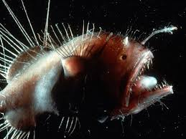
Angler Fish – Bioluminescence
Live in the Atlantic and Antarctic Oceans – 3,000 feet below the surface (benthic)
Dark, water is about freezing temperature, not many organisms found at this depth
Spine with a flashing rod that is bioluminescent
  This light will attract other organisms and is how they catch their prey
  Spine of the dorsal fin acts as a “fishing rod” – this is how the species got its common name
Sexual Dimorphism – 2 distinct body forms to distinguish sexes
  Males are much smaller in comparison to females
  When a male finds a female, the small male ill put himself to her body by biting her belly. His teeth and jaw ill recedes and the skin and blood system will fuse as the animals merge
https://www.youtube.com/watch?v=UXl8F-eIoiM

Slide 17
Behavioral Adaptations

Slide 18
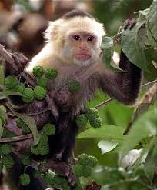
Capuchin – Tool Use
Live in the rain forests of Central and South America
Intelligence
  Considered the most intelligent of the New World monkeys
  Will collect rocks , store them, and use them as tools to open hard nuts and shellfish
  Use twigs to collect honey and insects from trees
  Learned behavior – as they grow older, their ability to use tools effectively increases
https://www.washingtonpost.com/news/speaking-of-science/wp/2018/07/06/these-tiny-monkeys-have-entered-their-stone-age-with-a-bang/?utm_term=.d4aa1e081b16

Slide 19
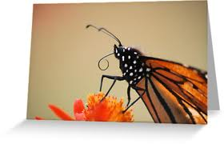
Monarch Butterflies - Migration
Habitat is open fields and meadows
Adult butterflies consume nectar from flowers – strictly liquid diet
  Proboscis – coiled straw that is underneath the head most of the time aids in obtaining nectar
Larvae will eat the milkweed plants in which
they hatch upon
Colorful pattern that makes them easy to
Identify- will warn predators away
  Majority of poison toxin is in the wings and exoskeleton
  Abdomen is a rough, leathery texture which makes it difficult for predators to bit into
Migrate up to 3,000 miles from Southern Canada to Mexico each fall

Slide 20
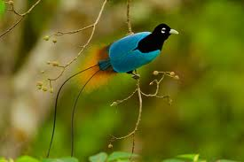
Birds of Paradise –
Mating Behaviors
Live in tropical rainforests – require a humid forest to live
Males have spectacular plumage to attract mates
Males within some species will put on special displays and dances
This species will also produce loud, harsh vocalizations
  Blue Bird of Paradise will produce a sound that resembles an “electric motor humming”
  King of Saxony Bird of Paradise will produce a radio-static sound
  Females tend to be very quiet
https://www.youtube.com/watch?v=L54bxmZy_NE

