Slide 1
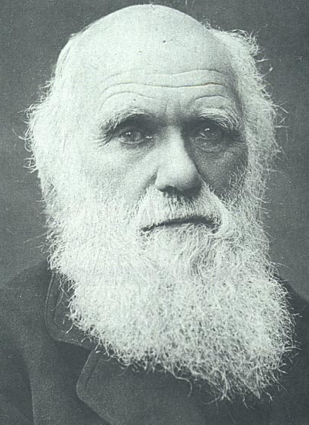
Evolution: Diversity of Life
Evolution
“Nothing in biology makes sense EXCEPT in the light of evolution.” Theodosius Dobzhansky
Charles Darwin in later years
1
Notes:
1

Slide 2
Reading Quiz 16.1/16.2
1. During his voyage on the Beagle, Charles Darwin made many observations
  A. In England
  B. In Asia
  C. In North America
  D. On the Galapagos Islands

Slide 3
2. How did the tortoises differ among the islands of the Galapagos?
3. Thomas Malthus proposed an idea that human population was limited in size because of three different factors. Name ONE of Malthus’ factors that would limit the size of the population.

Slide 4
4. Define: Evolution

Slide 5
5. Lamarck’s theory of evolution includes the concept that new organs in a species appear as a result of
  A. An unchanging local environment
  B. Continual increases in population size
  C. The actions of organisms as they use or fail to use body structures
  D. The natural variation already present within the population of organisms

Slide 6
History of Evolutionary Thought
6
Notes:
6

Slide 7
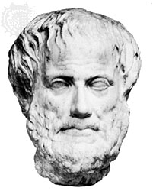
Early Ideas On Earth’s Organisms (Pre-Darwinian Beliefs)
1. Plato & Aristotle believed species were fixed & could be arranged according to their complexity
Aristotle believed species were fixed creations arranged by their complexity
Idea lasted 2000 years
7
Notes:
7

Slide 8
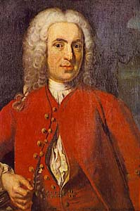
2. In the mid eighteenth century, Carolus Linnaeus developed a system of classification that called binomial nomenclature
Linnaeus – 1st to group similar organisms and assign them Latin names
Two word name (Genus species)
Known as Binomial nomenclature
8
Notes:
8

Slide 9
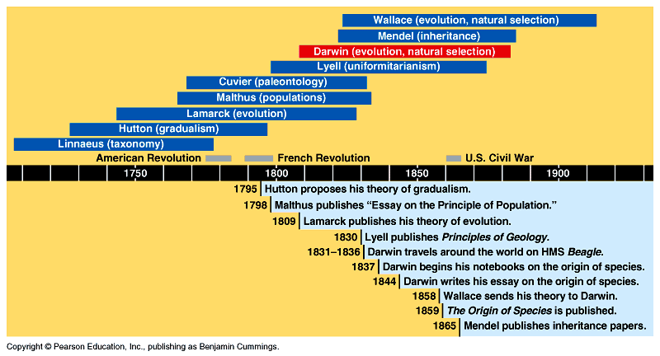
Evolutionary Timeline
9
Notes:
9

Slide 10
3. George Cuvier, in the eighteenth century, explained changes in the fossil record by proposing that a whole series of catastrophes (extinctions) and re-populations from other regions had occurred giving the appearance of change over time
Studied fossil in sedimentary rock strata of Paris
Found some species completely disappeared in more recent layers
10
Notes:
10

Slide 11
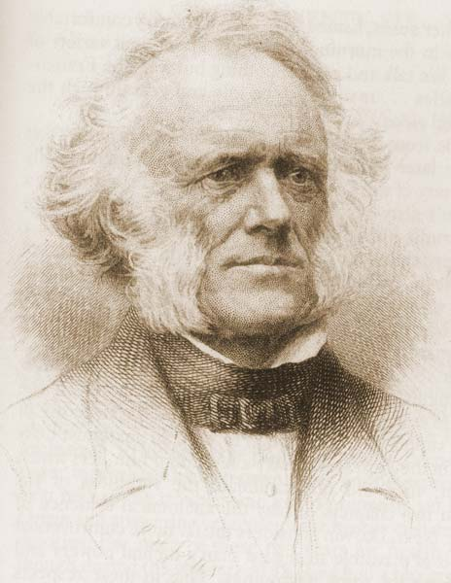
Charles Lyell
Proposed theory of Uniformintarianism
Geological processes at uniform rates building & wearing down Earth’s crust
Proposed that the Earth was millions of years instead of a few thousand years old
11
Notes:
11

Slide 12
Principles of Geology
Published by Lyell Just Before The Beagle Set Sail & read by Darwin
Explained Geological Processes That Shaped The Earth
Helped Darwin Understand Sea Shells In The Andes Mountains At 12,000+ Feet
  Expanded Earth’s Age
12
Notes:
12

Slide 13
4. Prior to Darwin, it was thought that the world was young & species did not change

Slide 14
Lamarck (1744-1829)
5. Lamarck (1744-1829) was first to state that descent with modification occurs and that organisms become adapted to their environments
6. Inheritance of acquired characteristics was the Lamarckian belief that organisms become adapted to their environment during their lifetime and pass on these adaptations to their offspring
7. Lamarck believed that the long necks of giraffes evolved as generations of giraffes reached for ever higher leaves; known as the Law of Use & Disuse

Slide 15
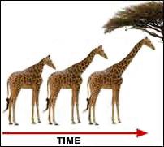
Lamarck’s Theory of Evolution
Idea called Law of Use and Disuse
If a body part were used, it got stronger
If body part NOT used, it deteriorated
15
Notes:
15

Slide 16
Lamarck’s Theory of Evolution
16
Inheritance of Acquired Characteristics
Proposed That By Selective Use Or Disuse Of Organs, Organisms Acquired Or Lost Certain Traits During Their Lifetime
These Traits Could Then Be Passed On To Their Offspring
Over Time This Led To New Species
Notes:
16

Slide 17
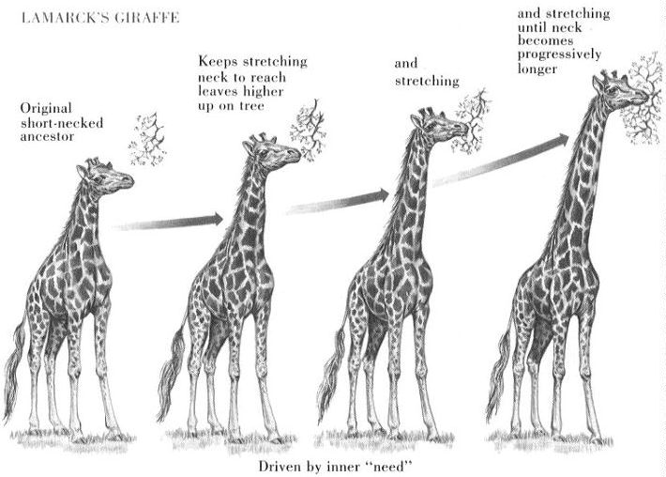
copyright cmassengale
17
Notes:
17

Slide 18
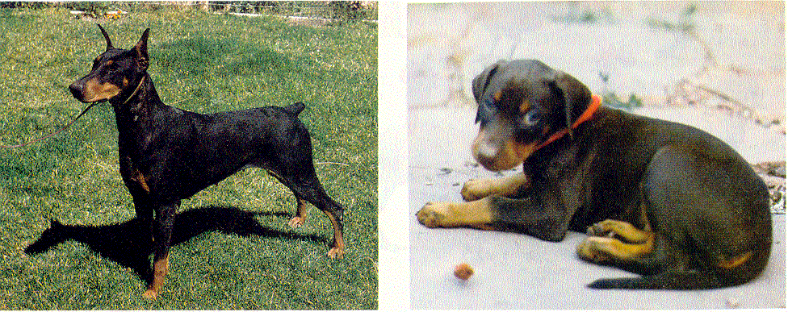
Lamarck’s Theory of Evolution
18
Clipped ears of dogs could be passed to offspring!
Inheritance Of Acquired Traits
  Traits Acquired During Ones Lifetime Would Be Passed To Offspring
Notes:
18

Slide 19
Lamarck’s Theory of Evolution
19
Tendency Toward Perfection
Organisms Are Continually Changing and Acquiring Features That Help Them Live More Successfully In Their Environment
Example: Bird Ancestors Desired To Fly So They Tried Until Wings Developed
Notes:
19

Slide 20
Lamarck’s Mistakes
20
Lamarck Did NOT Know how traits were inherited (Traits are passed through genes)
Genes Are NOT Changed By Activities In Life
Change Through Mutation Occurs Before An Organism Is Born
Notes:
20

Slide 21
Because it is supported by so many lines of evidence, evolution is no longer considered a hypothesis.
Evolution is one of the great unifying theories of biology

Slide 22
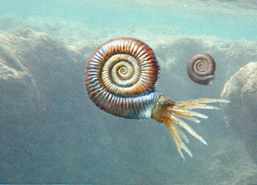
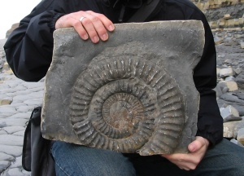
Charles Darwin the Naturalist
22
Notes:
22

Slide 23
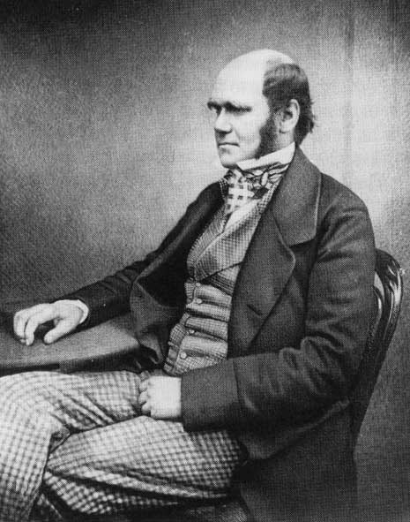
Voyage of the Beagle
Charles Darwin
Born Feb. 12, 1809
Joined Crew of HMS Beagle, 1831
Naturalist
5 Year Voyage around world
Avid Collector of Flora & Fauna
Astounded By Variety of Life
23
Notes:
23

Slide 24
http://www.youtube.com/watch?v=xOl0tHVV6Ck

Slide 25
Darwin's Background & Voyage
1. His nature was too sensitive to become a doctor like his father so he studied divinity
2. He attended biology and geology lectures and was tutored by the Reverend John Henslow who arranged his trip on the HMS Beagle
3. In 1831, at the age of 22, Charles Darwin accepted a naturalist position aboard the ship HMS Beagle & began a five-year voyage around the world

Slide 26
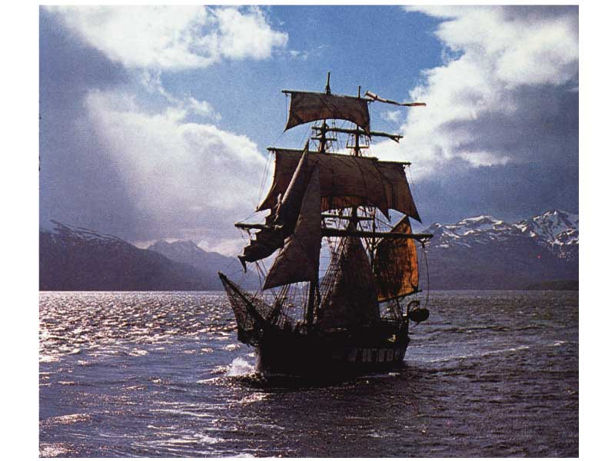
Darwin’s Voyage of Discovery
A reconstruction of the HMS Beagle sailing off Patagonia.
26
Notes:
26

Slide 27
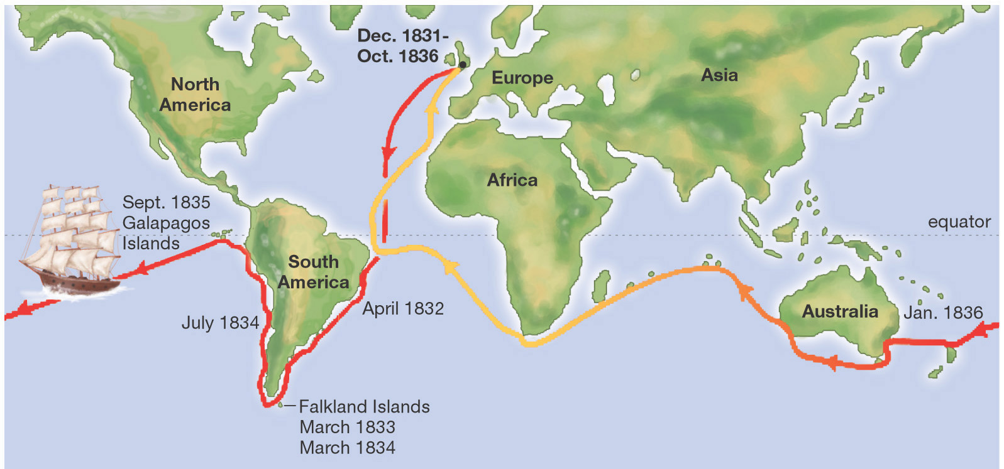
Darwin Left England in 1831
Darwin returned 5 years later in 1836
27
Notes:
27

Slide 28
He read Principles of Geology by Charles Lyell that stated that the observed massive geological changes were caused by slow, continuous processes (erosion, uplifting...)
Darwin carried this book with him on his voyage as he witnessed Argentina coast earthquakes raising the earth several feet, & marine shells occurring far inland and at great heights in the Andes
Darwin's many observations led him to the idea that species slowly change over time

Slide 29
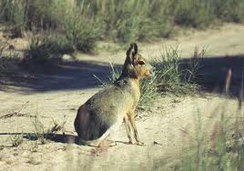
Darwin's comparison of the animals of South America and the Galapagos Islands caused him to conclude that adaptation to the environment can cause diversification, including origin of new species
Examples: Patagonian hares replaced rabbits in the South American grasslands

Slide 30
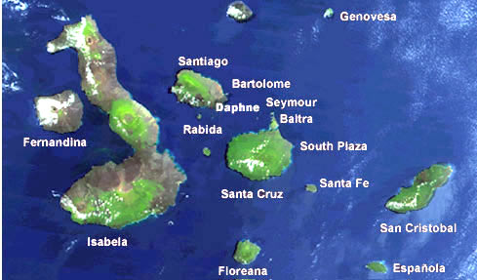
The Galapagos Islands
1. Volcanic islands off the coast of South America
2. Island species varied from mainland species & from island-to-island species
3. Each island had long or short neck tortoises depending on the islands vegetation
30
Notes:
30

Slide 31
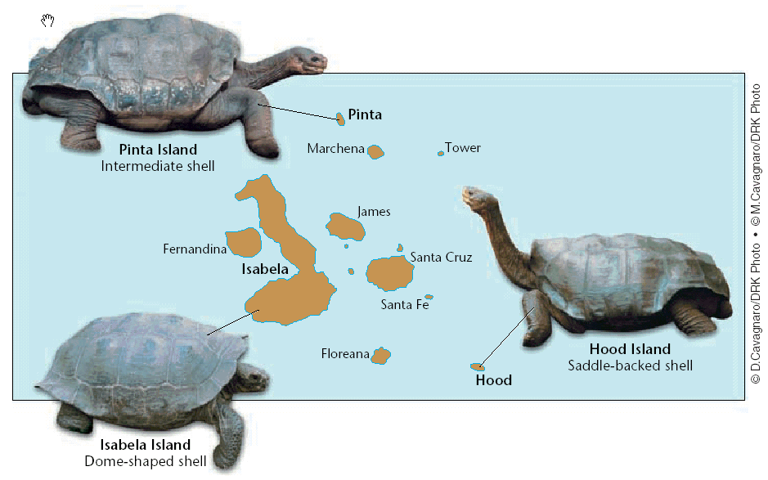
31
Notes:
31

Slide 32
The Galapagos Islands
32
4. Finches on the islands resembled a mainland finch but there were more types
More types of finches appeared on the islands where the available food was different (seeds, nuts, berries, insects…)
Finches had different types of beaks adapted to their type of food gathering
Notes:
32

Slide 33
5. Bill shapes are adaptations to different means of gathering food.
6. Galapagos finch species varied by nesting site, beak size, and eating habits

Slide 34
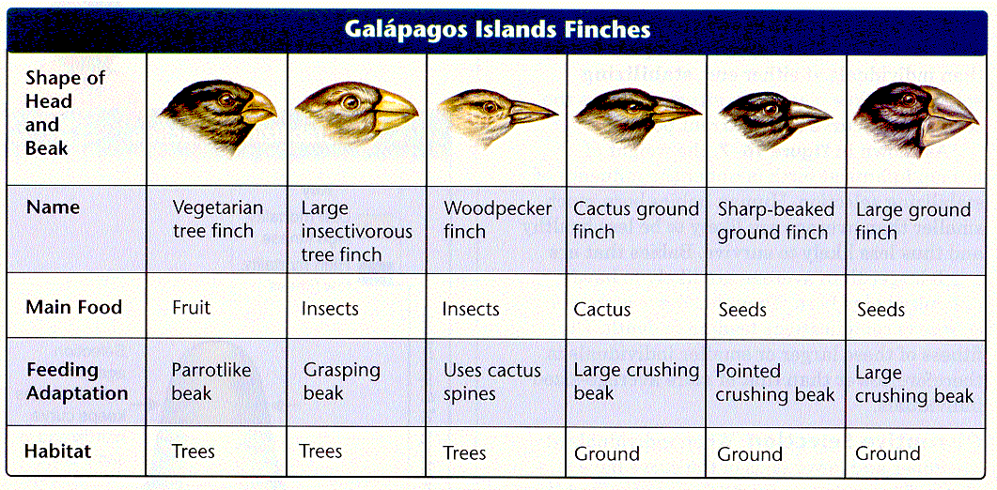
34
Notes:
34

Slide 35
Reading Quiz 16.3
1. What is the difference between Natural Selection and Artificial Selection?
2. What is an adaptation?
3. Select an organism that Darwin observed on the Galapagos Islands or one that you have observed in nature. Name one adaptation that organism has and how that adaptation helps the organism survive.

Slide 36
Reading Quiz 16.3
4. What is meant by “fitness” in relation to evolution?
5. What idea did Darwin take from Thomas Malthus and use in his theory of evolution?

Slide 37
Overview of Darwin’s Theory of Evolution
1. An adaptation is a trait that helps an organism be more suited to its environment
2. Darwin decided adaptations develop over time
3. Natural selection was proposed by both Alfred Russell Wallace and Darwin as a driving mechanism of evolution
4. Darwin and Wallace both read an essay by Thomas Malthus that proposed that human populations outgrow resources so there is a constant struggle for existence

Slide 38
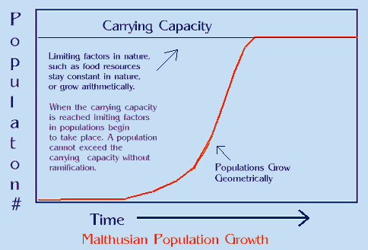

Slide 39
5. Fitness is a measure of an organism's reproductive success
6. Organisms most fit to reproduce are selected by environment which results in adaptation of the population
7. Natural selection is also called "survival of the fittest"

Slide 40
8. Conditions for natural selection include:
a. Variations exist among members of a population
b. Many more individuals are produced each generation than will survive
c. Some individuals are better adapted so they survive & reproduce
d. Members of a population compete for food, space, mates...

Slide 41
9. Variations that make adaptation possible are those that are passed on generation to generation
10. Extinction occurs when previous adaptations are no longer suitable to a changed environment

Slide 42
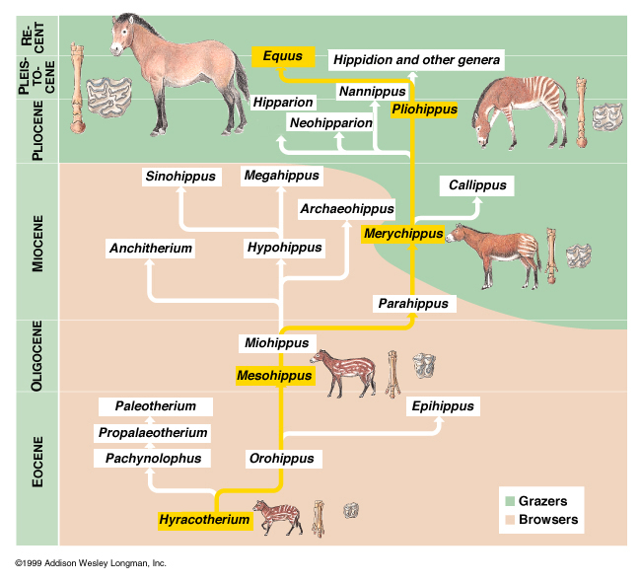
Darwin’s Conclusion
Individuals who inherit characteristics most fit for their environment are likely to leave more offspring than less fit individuals
Called Natural Selection
42
Notes:
42

Slide 43
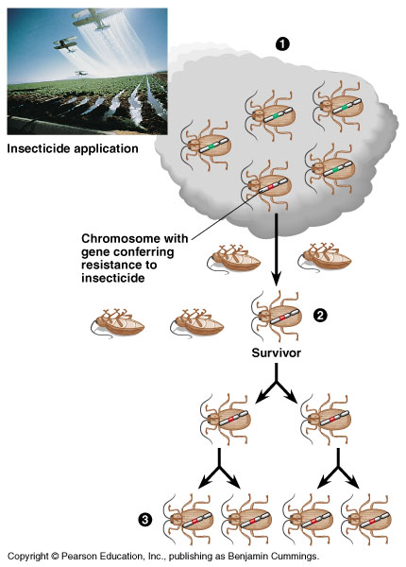
Natural Selection
Driving force for evolution
During the struggle for resources, strongest survive & reproduce
Idea that at least some of the differences between individuals, which impact their survival and fertility, are inheritable
.
43
Notes:
43

Slide 44
Origin of Species
Darwin Presents His Case
44
Notes:
44

Slide 45
On The Origin of Species
1. After the HMS Beagle returned to England in 1836, Darwin waited over 20 years to publish
2. Darwin was forced to publish Origin of Species after reading a similar hypothesis by Alfred Russell Wallace
3. Both men concluded that life forms arose by descent from a common ancestor, and that natural selection is the mechanism by which species change and new species arise

Slide 46
Origin of Species
Concepts and Controversy
46
Notes:
46

Slide 47
Evolution By Natural Selection Concepts
The Struggle for Existence (compete for food, mates, space, water, etc.)
Survival of the Fittest (strongest able to survive and reproduce)
Descent with Modification (new species arise from common ancestor replacing less fit species)
47
Notes:
47

Slide 48
Survival of the Fittest
48
Fitness
  Ability of an Individual To Survive & Reproduce
Adaptation
  Inherited Characteristic That Increases an Organisms Chance for Survival
Notes:
48

Slide 49
Survival of the Fittest
49
Adaptations Can Be:
  Physical
    Speed, Camouflage, Claws, Quills, etc.
  Behavioral
    Solitary, Herds, Packs, Activity, etc.
Notes:
49

Slide 50
Survival of the Fittest
50
Fitness Is Central To The Process Of Evolution
Individuals With Low Fitness
  Die
  Produce Few Offspring
Survival of the Fittest
AKA Natural Selection
Notes:
50

Slide 51
Descent With Modification
51
Takes Place Over Long Periods of Time
Natural Selection Can Be Observed As Changes In
  Body Structures
  Ecological Niches
  Habitats
Notes:
51

Slide 52
Descent With Modification
52
Species Today Look Different From Their Ancestors
Each Living Species Has
  Descended
  With Changes
  From Other Species
  Over Time
Notes:
52

Slide 53
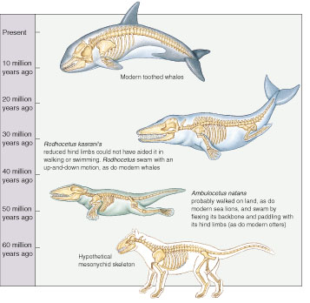
Descent With Modification
copyright cmassengale
53
Notes:
53

Slide 54
Descent With Modification
Implies
  All Living Organisms Are Related
  Single Tree of Life
    DNA, Body Structures, Energy Sources
Common Descent
  All Species, Living & Extinct, Were Derived From Common Ancestors
54
Notes:
54

Slide 55
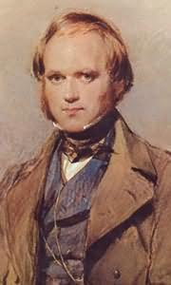
Major Problem in Darwin’s Theory
No mechanism to explain natural selection
How could favorable variations be transmitted to later generations?
With the rediscovery of Mendel’s work in the first half of the 20th century, the missing link in evolutionary theory was found
.
55
Notes:
55

Slide 56
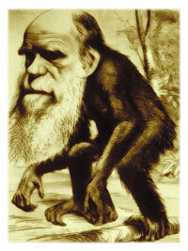
Opposition to Evolution
The upheaval surrounding evolution began with Darwin’s publication of On the Origin of Species By Means of Natural Selection
The debate continues nearly 150 years later
56
Notes:
56

Slide 57
Theory of Evolution Today
Supporting Evidence
57
Notes:
57

Slide 58
Fossil Record
58
Earth is Billions of Years Old
Fossils In Different Layers of Rock (sedimentary Rock Strata) Showed Evidence Of Gradual Change Over Time
Notes:
58

Slide 59
Fossil Evidence
1. Fossils are relics or impressions of ancient organisms
2. Most fossils are found in layers (strata) of sedimentary rock

Slide 60
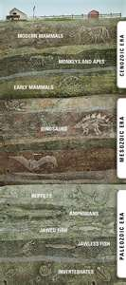
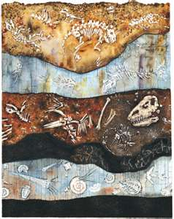
Law of Superposition
Fossil found in lower layers are older than fossils found in higher layers

Slide 61
The fossil record traces history of life and allows us to study history of particular organisms
Through radioactive dating, geologists estimate the age of the earth at about 4.6 billion years

Slide 62
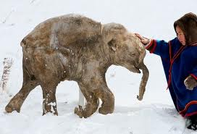
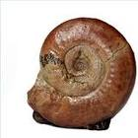
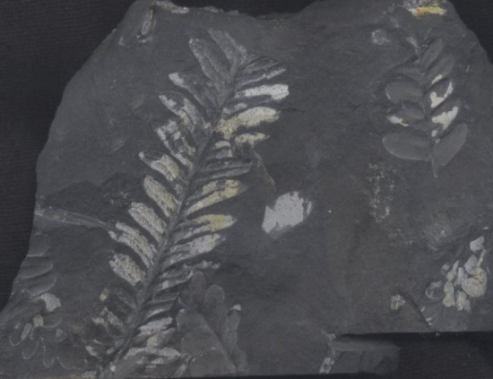
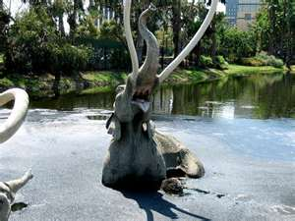
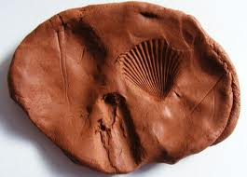
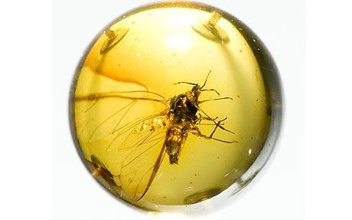
5. Fossils are at least 10,000 years old and include skeletons, shells, seeds, insects trapped in amber, imprints of organisms, organisms frozen in ice (wooly mammoth), or trapped in tar pits (saber-toothed tiger)

Slide 63
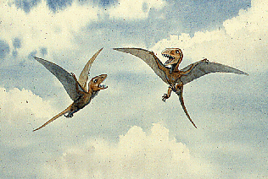
Transitional Fossils
7. Transitional forms reveal links between groups (Example: Therapsids were mammal-like reptiles and Pterosaurs were bird like reptiles)

Slide 64
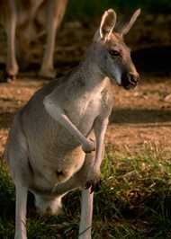
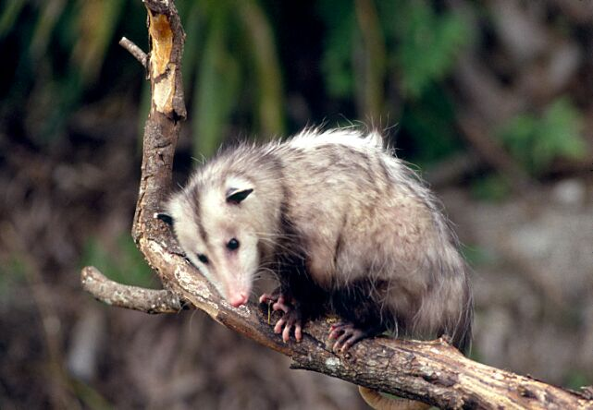
Geographic Distribution of Living Species
Different Animals On Different Continents But Similar Adaptations To Shared Environments
64
Notes:
64

Slide 65
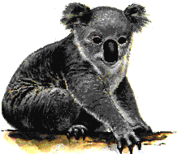
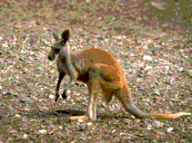
Biogeographical Evidence
1. Biogeography is the study of the geographic distribution of life forms on earth
2. Physical factors, such as the location of continents, determine where a population can spread
3. Example: Placental mammals arose after Australia separated from the other continents, so only marsupials diversified in Australia

Slide 66
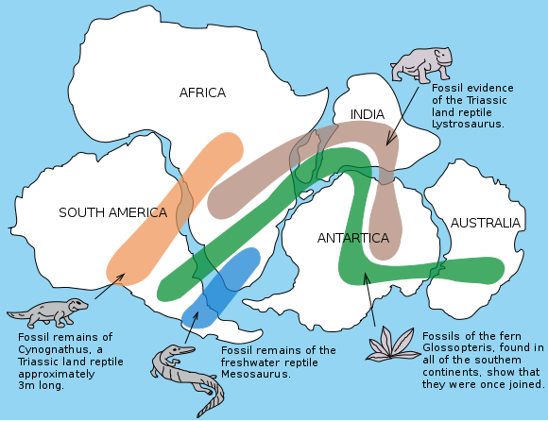

Slide 67
Anatomical Evidence
1. Organisms have anatomical similarities when they are closely related because of common descent (ancestor)
2. Homologous structures in different organisms are inherited from a common ancestor have similar structures

Slide 68
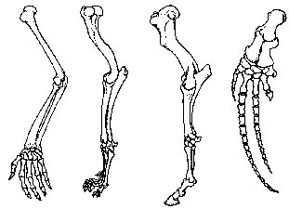
Example : Vertebrate forelimbs contain the same sets of bones organized in similar ways, despite their dissimilar functions

Slide 69
Homologous Body Structures
69
Scientists Noticed Animals With Backbones (Vertebrates) Had Similar Bone Structure
May Differ In Form or Function
Limb Bones Develop In Similar Patterns
    Arms, Wings, Legs, Flippers
Notes:
69

Slide 70
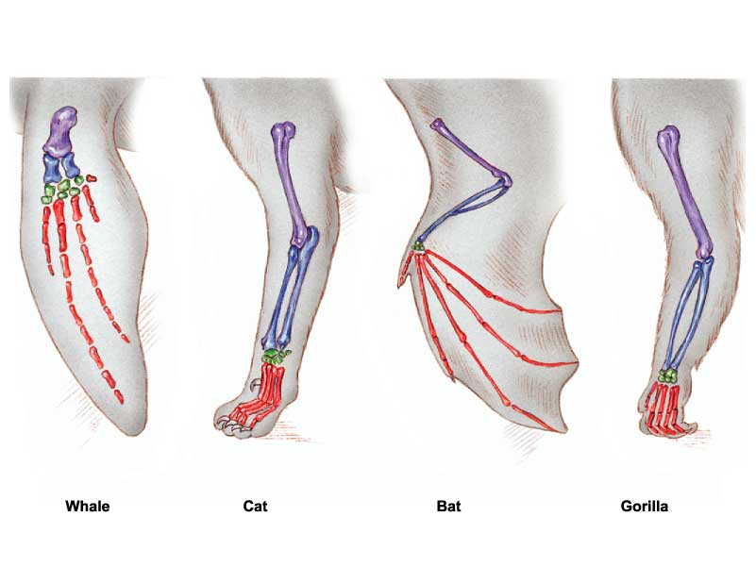

Slide 71
Homologous Body Structures
71
Structures That Have Different Mature Forms But Develop From The Same Embryonic Tissues
Strong Evidence That All Four-Limbed Animals With Backbones Descended, With Modification, From A Common Ancestor
Help Scientist Group Animals
Notes:
71

Slide 72
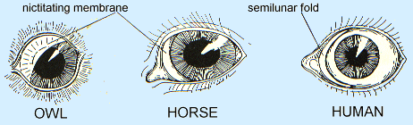
Homologous Structures = Common Ancestor

Slide 73
Analogous Structures
Analogous structures are inherited from different ancestors and have come to resemble each other because they serve a similar function
Organisms with analogous structures do not have to be be closely related

Slide 74
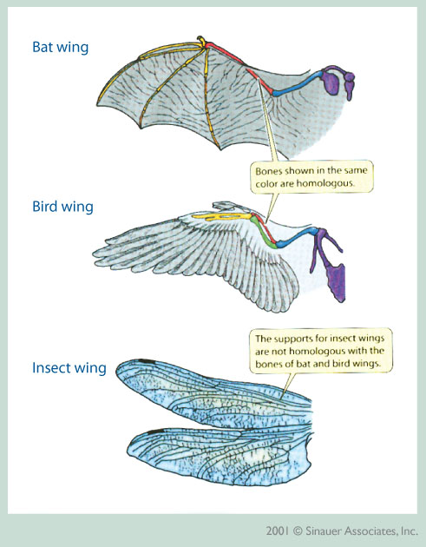
Example: Bird wings & insect wings are both for flight but they are structurally different

Slide 75
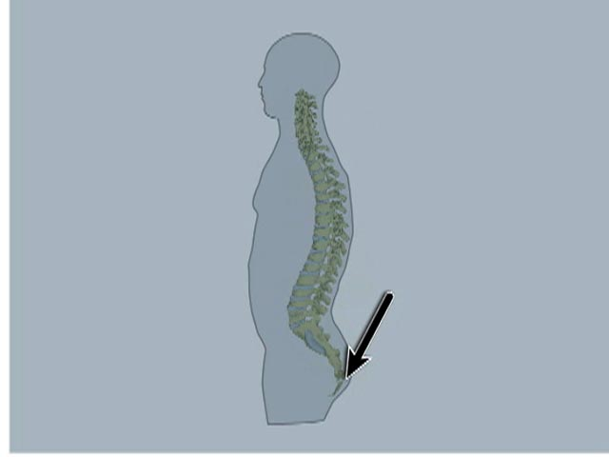
Vestigial Structures
Vestigial Structures are remains of a structure that is no longer functional but show common ancestry
2. Example: Humans have a tailbone but no tail

Slide 76
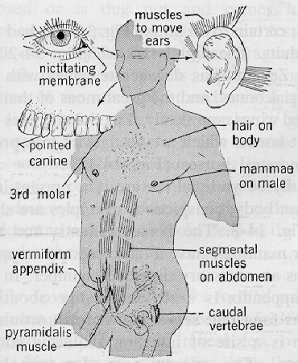
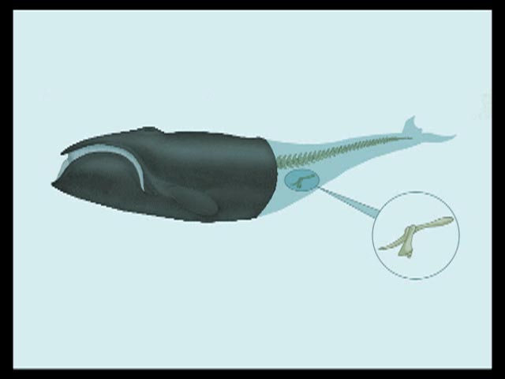
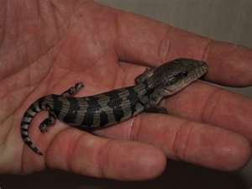
76
Not All Serve Important Functions
  Vestigial Organs
    Appendix In Man
    Legs On Skinks
    Pelvic Bone in Whales
Notes:
76

Slide 77
Embyrological Development
1. During development, all vertebrates have a post-anal tail and paired pharyngeal pouches
2. Organisms that show similarities in their embryonic development may have a common ancestry

Slide 78
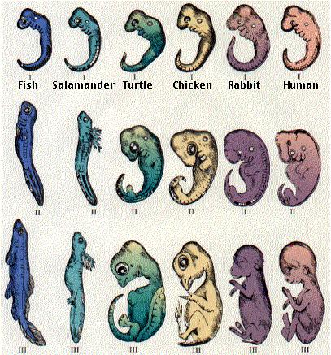

Slide 79
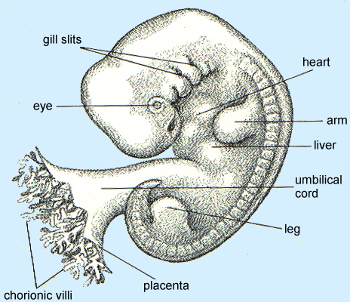
Human Fetus – 5 weeks
copyright cmassengale
79
Notes:
79

Slide 80
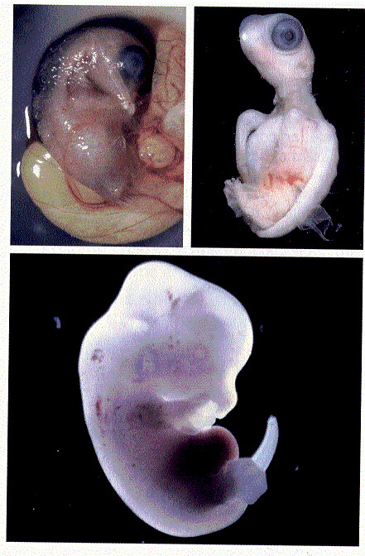
Chicken
Turtle
Rat
copyright cmassengale
80
Notes:
80

Slide 81
Biochemical Evidence
Almost all living organisms use the same basic biochemical molecules, e.g., DNA, ATP, enzymes ...
2. Similarities in amino acid sequences, DNA codes, etc. can be explained by descent from a common ancestor

Slide 82
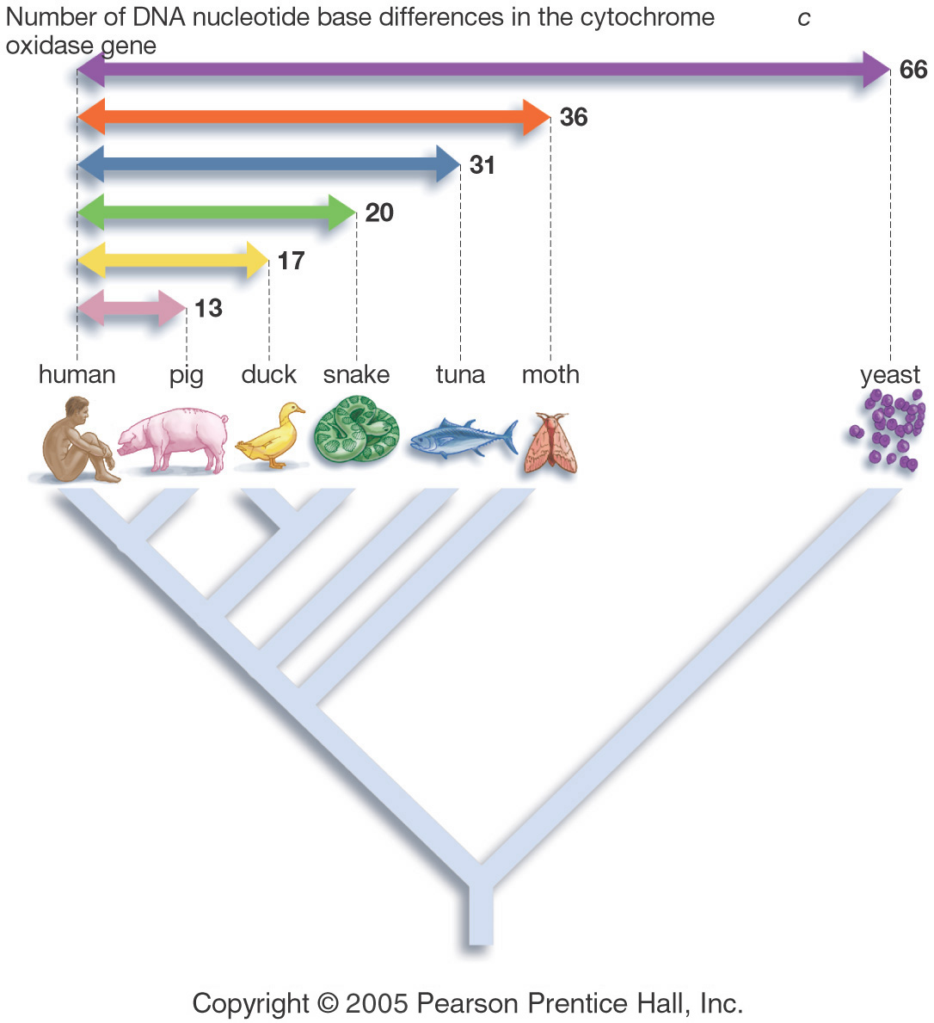
Similarities in DNA Sequence
82
Notes:
82

