Slide 1
Introduction to Human Disease
An Introduction to Pathology

Slide 2
Disease

Slide 3
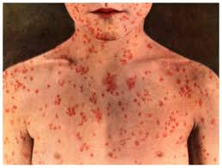
What is Disease
Disease – structural or functional change in the body that is harmful to the organism
Occurs when cellular environment changes to such a degree that tissues are no longer able to perform their function optimally
Child with measles

Slide 4
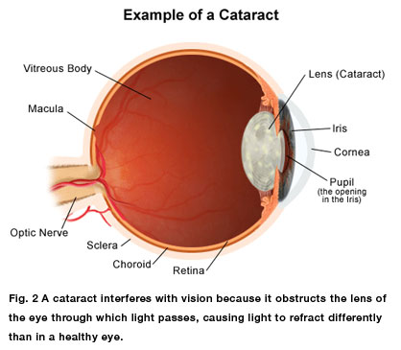
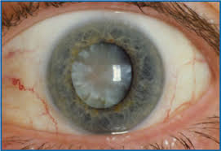
Cataracts
Crystalline lens of the eye undergoes degenerative changes, becomes cloudy, obstructs the passage of light and causes decreased visual acuity
Occurs over time

Slide 5
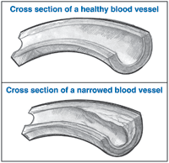
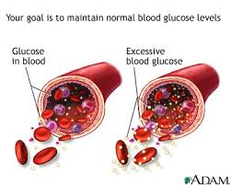
Diabetes
Extracellular tissue of blood vessel walls undergoes changes that lead to narrowing of blood vessels
This leads to decreased blood flow, decreased oxygen delivery and eventual irreversible damage to tissues such as the retina, skin, heart, and kidney

Slide 6
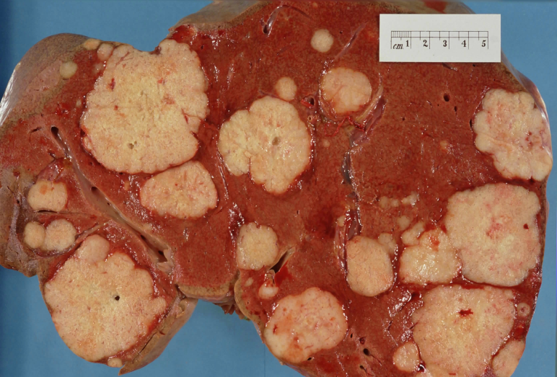
Cancer
Mutations accumulate in the nucleic acids of cells which result in the distorted function and structure of proteins
This affects the way the cells interact with or react to other cells, growth factors, hormones, and the extracellular matrix of the environment
Pancreatic
                Cancer

Slide 7
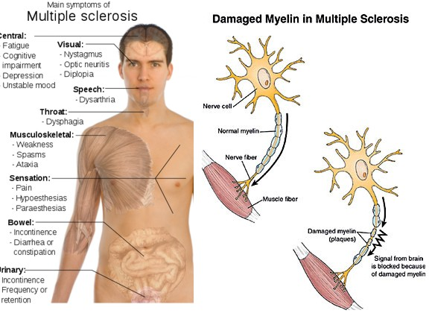
Multiple Sclerosis
Destruction of the protective myelin sheath around axons in the brain which results in decreased electrical conduction
Signs and symptoms include weakness, double vision and incoordination

Slide 8
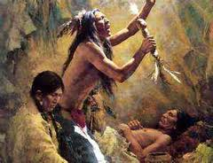

Cellular basis for disease
With the Enlightenment, people began to look at workings of the body in a scientific manner
Scientifically oriented doctors formed idea that disease is not caused by an external force that takes possession of the body, but arises from organs and tissues and leaves visible traces there

Slide 9

Clinicopathologic observations
Physicians gained insights by closely observing the course of disease on a patient’s body
Concluded that diseases can be traced to deranged structures or functions of organs, tissues, or cells (has been extended to molecular level of proteins and genes)
Called allopathic medicine, biomedicine, Western medicine

Slide 10
Pathology

Slide 11
Pathology
Definition – the study of disease
  Includes:
  the basic structural and functional changes associated with disease
  The study of causes that leads to these changes
  Sequence of events that leads from structural and functional abnormalities to clinical manifestations

Slide 12
Etiology
Definition – the study of causes, the cause of disease
  Involves – environment, vectors (host), pathogen

Slide 13
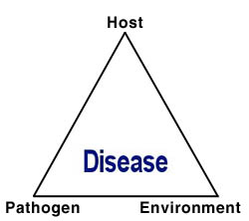
The Disease Paradigm (simplified)

Slide 14
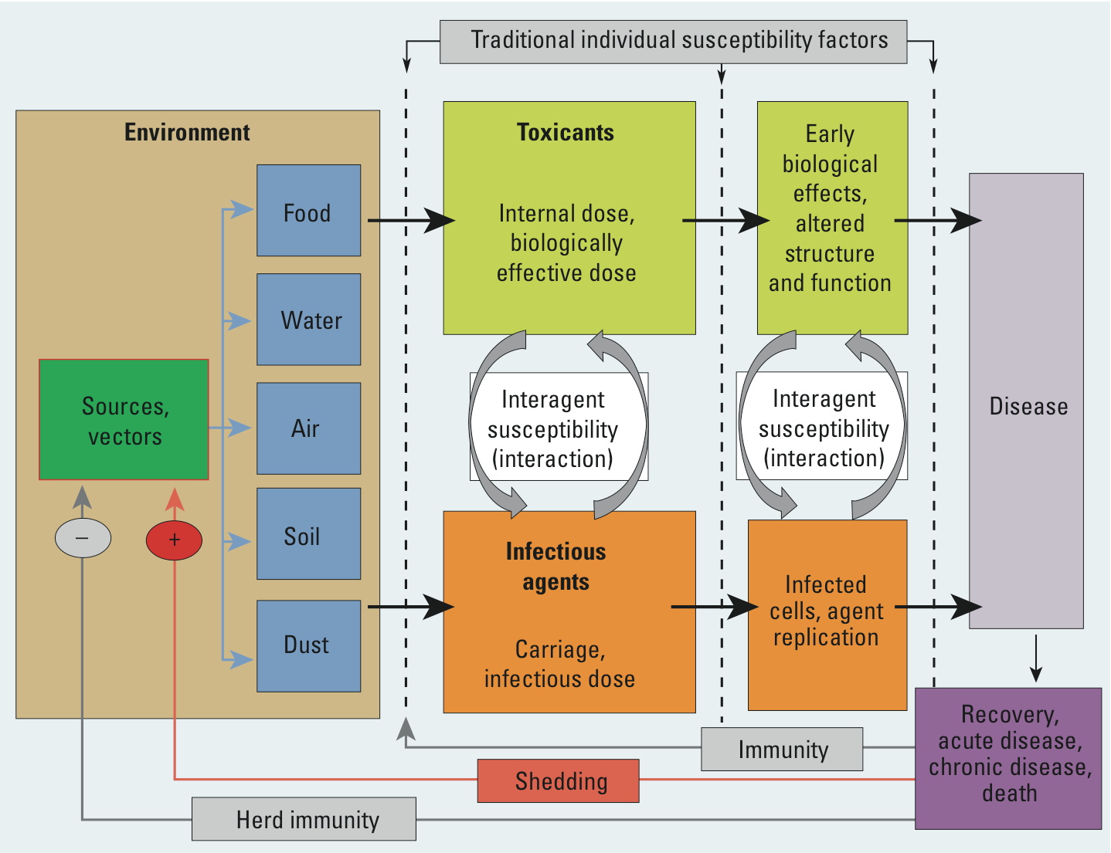
The Disease Paradigm (Complex)

Slide 15
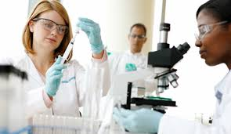
Subdivision of Pathologists
Experimental pathologists – scientists spending most of their time in research
  Investigate cause and mechanisms of disease
  Jobs include – research and teaching

Slide 16
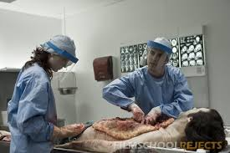
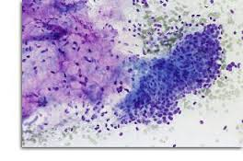
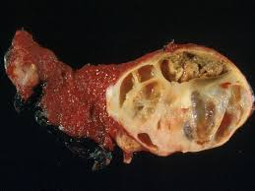
Anatomic Pathologists
Perform autopsies, examine all tissues removed from live patients, and examine cell preparations to look for cancer cells
  Includes:
    Autopsy pathology
    Surgical pathology
    Cytopathology
    Molecular (DNA, RNA) diagnosis

Slide 17
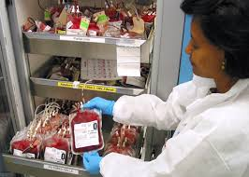
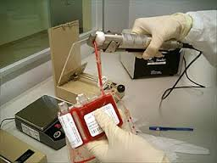
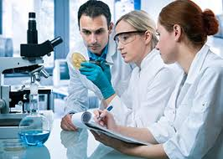
Clinical Pathologists
Analyze various specimens removed from patients, such as blood, urine, feces, spinal fluid, or sputum for chemical substances, microorganism, antigens and antibodies, nucleic acids, atypical blood cells, and coagulation factors
  Includes:
    Chemistry
    Microbiology
    Hematology
    Blood Banking
    Immunopathy
    Molecular Diagnosis

Slide 18
Manifestations of Disease

Slide 19
Symptoms
Evidence of disease perceived by patients
  i.e. pain, lump, diarrhea
Health practitioners elicit these during an interview with the patient and record them in the patient’s chart as the history

Slide 20
Signs
Physical observations made by the person who examines the patient
  i.e tenderness, a mass, abnormal heart sounds
Elicited and observed during the physical examination
Results are recorded in the patient’s chart.

Slide 21
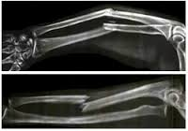
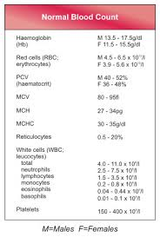
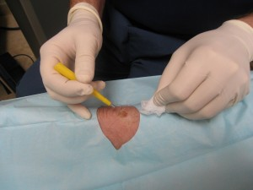
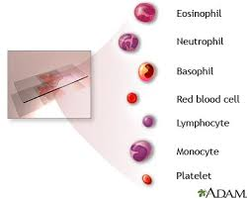
Laboratory Findings
Observations made by the application of tests or special procedures
  X-rays, blood counts, biopsies

Slide 22
Diagnosis
Assimilating the information from patient’s history, physical examination, and laboratory findings to identify the condition causing the disease.
Also refers to the name given to the disease
  i.e. Diabetes, multiple sclerosis

Slide 23
Structural vs. Functional Disease

Slide 24
Structural Diseases
Also called organic disease
Characterized by structural changes within the body, called lesions
Lesions can be visually identified
With molecular medicine and technology, they can also now be identified at the molecular level of proteins and genes
Three broad categories:
  Genetic diseases
  Degenerative and Inflammatory diseases
  Hyperplastic and Neoplastic diseases

Slide 25
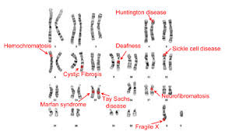
Genetic Diseases
Caused by abnormalities in the genetic makeup at the chromosomal or genetic (gene) level
Developmental diseases develop during embryonic or fetal development
Range of abnormalities very broad
  Deformities can be preset at birth (congenital abnormalities)
  Biochemical changes caused by genes but influenced by the environment can appear later on (i.e diabetes)

Slide 26
Degenerative and Inflammatory Disease
Caused by forces or agents that destroy cells, or intercellular substances, deposit abnormal substances in tissues or cells, or cause the body to injure itself by means of the inflammatory process
External agents of injury
  Chemical substances and microbes
Internal mechanisms of injury
  Vascular insufficiency, immunologic reactions, metabolic disturbances

Slide 27
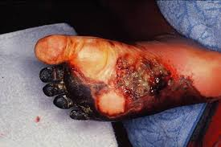
Direct Effects of Injury
Necrosis – if cells are killed in injured area
Sublethal cell injury – if injured cells are capable of recovery

Slide 28
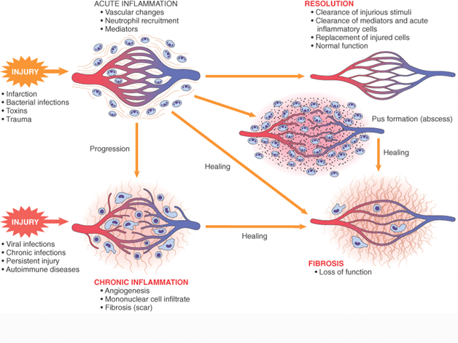
General Reactions to Injury
Inflammation – a vascular and cellular reaction
  Attempts to localize the injury, destroy the offending agent, remove damaged cells and other materials
Repair- replacement of damaged tissue by new tissue
  Greatly influenced by the type of tissue or organ that has been injured

Slide 29
Hyperplastic and Neoplastic Diseases
Basic abnormality is an increase in cell populations
Hyperplasia – proliferation (division and reproduction) of cells with exposure to a prolonged stimulus. Regresses or stops when stimulus is removed
Neoplasia – results from genetic changes that favor the growth of a single population of cells
  Two groups – benign and malignant (ability to localize or spread)

Slide 30
Functional Diseases
Diseases in which there are no visible lesions, at least not at the onset of the disease
The basic change away from homeostasis is a physiologic or functional one
More common functional disorders:
  Tension headache
  Functional bowel syndrome
  Hypertension
  Mental illnesses

Slide 31
Causes of Disease

Slide 32
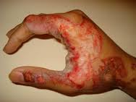
Exogenous – agents causing injury acting from outside the body
Direct Physical injury is called TRAUMA
  Physical agents causing disease include:
    Heat and cold
    Electricity
    Atmospheric Pressure changes
    Radiation (electromagnetic and particulate)

Slide 33
Chemical Injuries
Subdivided into the manner of injury
Poisoning (accidental, homicidal, or suicidal)
Drug Reactions
  Toxic effects of prescription or proprietary drugs taken to treat disease)

Slide 34
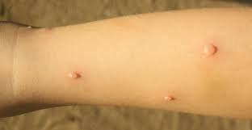
Microbiologic Injuries
Usually classified by the type of offending organism
  Bacteria
  Fungi
  Protozoa
  Viruses
  These are called infections and diseases caused are infectious diseases

Slide 35
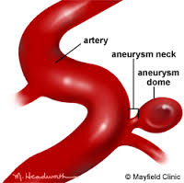
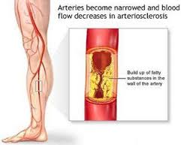
Endogenous diseases – Acting from within the body
Vascular Diseases
  Obstruction to blood supply to an organ or tissue (myocardial ischemia caused by arteriosclerosis)
  Hemorrhage (ruptured abdominal aortic aneurysm)
  Altered blood flow (microvascular changes in diabetes or hypertension)

Slide 36
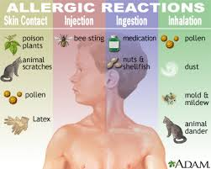
Immunologic Diseases
Caused by aberrations to the immune system
Failure of the immune system to work = immunodeficiency disease
Overreaction of the immune system causes allergic or hypersensitivity diseases
Abnormal reaction of the immune system to substances that the body produces = autoimmune diseases

Slide 37
Class Time
Work on the Body Systems Poster – due Monday, February 9th (no exceptions)
When finished work on….
Emergency Room Report in your Medical Terminology Packet – due Monday

