Slide 1
Medical Terminology

Slide 2
Prefix | Root | Medical Term | Definition
Dextro- Right | -Gastric Stomach | dextrogastric | Pertaining to the right side of the stomach

Slide 3
Prefix | Root | Medical Term | Definition
Ecto – Out; outside | Derm Skin | ectoderm | Outer skin

Slide 4
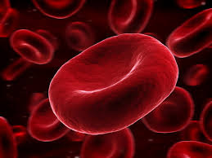
Prefix | Root | Medical Term | Definition
Erythro – Red | Cyte Cell | erythrocyte | Red Cell (referring to red blood cells)

Slide 5
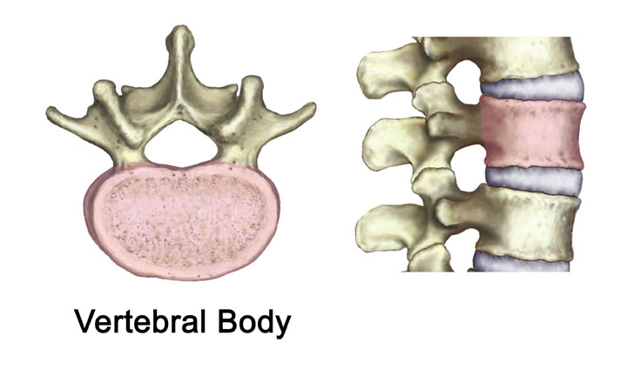
Prefix | Root | Medical Term | Definition
Inter – Between | Vertebral Vertebra | intervertebral | Between the vertebra (backbone)

Slide 6
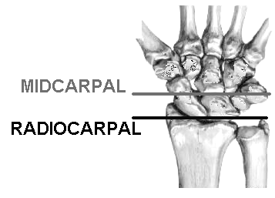
Prefix | Root | Medical Term | Definition
Mid- middle | Carpal Wrist bones | midcarpal | Pertaining to the middle of the bones in the wrist

Slide 7
Prefix | Root | Medical Term | Definition
Per – Deformed | Oral Mouth | peroral | Deformity of the mouth

Slide 8
Prefix | Root | Medical Term | Definition
Sub- Under; below | Hepatic liver | subhepatic | Below the liver

Slide 9
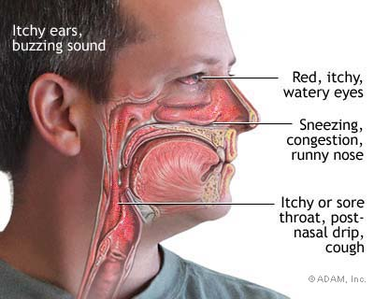
Prefix | Root | Medical Term | Definition
Post- After; behind | -nasal nose | postnasal | Behind the nose; nasal cavity

Slide 10
Prefix | Root | Medical Term | Definition
Pro- Before; forward | Chondral cartilage | prochondral | Before the formation of cartilage

Slide 11
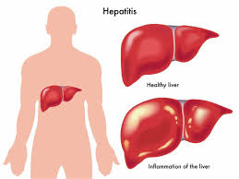
Root | Suffix | Medical Term | Definition
Hepat- Liver | -it is Inflammation of | hepatitis | Inflammation of the liver

Slide 12
Root | Suffix | Medical Term | Definition
Arthr- Joint | -algia Pain | arthralgia | Joint pain

Slide 13
Root | Suffix | Medical Term | Definition
My- Muscle | -asthenia Lack of strength | myasthenia | Lack of strength in the muscle

Slide 14
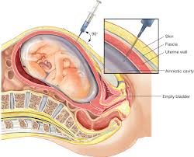
Root | Suffix | Medical Term | Definition
Amnio- Amnion (fluid surrounding the embryo | Centesis Surgical puncture to remove fluid | amniocentesis | Surgical puncture to remove amnionic fluid

Slide 15
Root | Suffix | Medical Term | Definition
Urethra- Urethra | Tresia Opening | urethratresia | Opening of the urethra

Slide 16
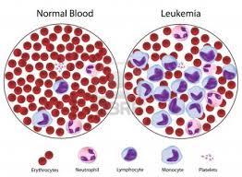
Root | Suffix | Medical Term | Definition
Leuko- white | Emia Blood condition | leukemia | Blood condition involving the white blood cells

Slide 17
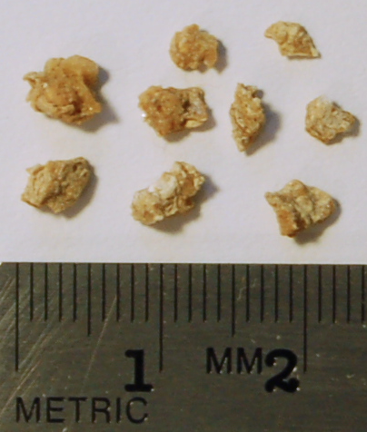
Root | Suffix | Medical Term | Definition
Nephro- Kidney | Lith Stone | nephrolith | Kidney stone

Slide 18
Root | Suffix | Medical Term | Definition
Osteo- Bone | Malacia Softening | osteomalacia | Softening of the bone

Slide 19
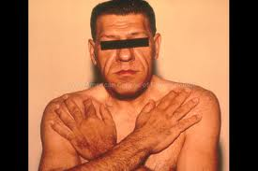
Root | Suffix | Medical Term | Definition
Acro- extremities | Megaly enlargement | acromegaly | Enlargement of the extremities

Slide 20
Root | Suffix | Medical Term | Definition
rhino- Nose | Rrhea Flow; discharge | rhinorrhea | Discharge from the nose

Slide 21
Prefix | Root | Suffix | Medical Term | Definition
Ortho- straight | odont tooth | -ist specialist | orthodontist | Specialist in straightening teeth

Slide 22
Prefix | Root | Suffix | Medical Term | Definition
Poly- many | Aden- Glands | It is inflammation | polyadenitis | Inflammation/swelling of many glands

Slide 23
Prefix | Root | Suffix | Medical Term | Definition
Hypo below | Chondr- Cartilage | Aic- Pertaining to | hypochondraic | Pertaining to below the cartilage

Slide 24
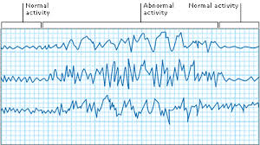
Prefix | Root | Suffix | Medical Term | Definition
Electro electricity | Encephalo- Brain | Gram measurement | Electroencephalo-gram | Measurement of brain’s electrical activity

Slide 25
Prefix | Root | Suffix | Medical Term | Definition
Erythro- red | Cyto Cell | Penia deficiency | erythrocytopenia | Deficiency of red blood cells

Slide 26
Prefix | Root | Suffix | Medical Term | Definition
Hyper above | Glyc Glucose/ sugar | Emia Blood condition | hyperglycemia | Blood condition of high levels of blood sugar

Slide 27
Prefix | Root | Suffix | Medical Term | Definition
hydro Water | nephro- Kidney | Sis State of | hydronephrosis | Condition of water on the kidney

Slide 28
Prefix | Root | Suffix | Medical Term | Definition
Megalo- enlargement | Cephal Head | It is Inflammation | Megalocephal-itis | Inflammation causing the enlargement of the head

Slide 29
Prefix | Root | Suffix | Medical Term | Definition
Fibro fiber | My- Muscle | Algia Pain | fibromyalgia | Pain of muscle fibers

Slide 30
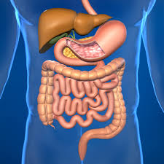
Root | Root | Medical Term | Definition
Gastro Stomach | Intestinal Intestine | Gastrointestinal | Pertaining to the stomach and intestinal region

Slide 31
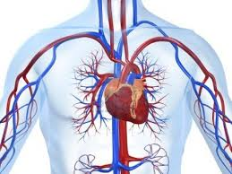
Root | Root | Medical Term | Definition
Cardio Heart | Vascular Blood vessels | Cardiovascular | System of the heart and blood vessels

Slide 32
Root | Root | Medical Term | Definition
Arterio Artery | Sclerosis Hardening | arteriosclerosis | Hardening of the arteries

Slide 33
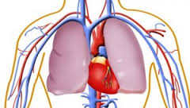
Root | Root | Medical Term | Definition
Cardio Heart | Pulmonary Lung | cardiopulmonary | Pertaining to the heart and lungs (circulation)

Slide 34
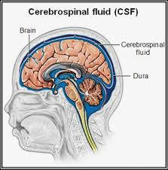
Root | Root | Medical Term | Definition
Cerebro Cerebrum | Spinal Spinal cord | cerebrospinal | Pertaining to the cerebrum (brain) and spine

Slide 35
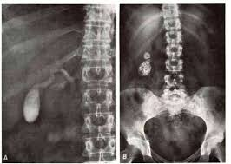
Root | Root | Medical Term | Definition
Cholecysto- Gallbladder | Gram Measurment | cholecystogram | Measurement of the gallbladder

Slide 36
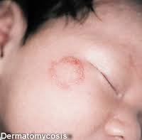
Root | Root | Medical Term | Definition
Dermato Skin | Mycosis Fungal | dermatomycosis | Fungal infection of the skin

Slide 37
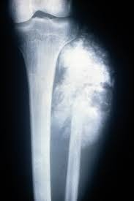
Root | Root | Medical Term | Definition
Osteo Bone | Sarcoma Fleshy/ Connective tissue | osteosarcoma | Fleshy bone, cancerous tumor of the bone

Slide 38
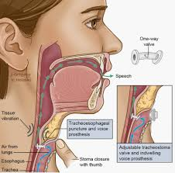
Root | Root | Medical Term | Definition
Pharyngeal- Throat | Esophageal Esophagus | pharyngealesophageal | Pertaining to the throat and esophagus

Slide 39
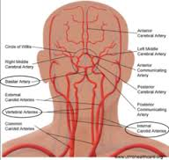
Prefix | Root | Medical Term | Definition
Cerebro Cerebrum | Vascular Blood vessels | cerebrovascular | Pertaining to the blood vessels of the cerebrum (brain)

Slide 40
Prefix | Root | Medical Term | Definition

Slide 41
Prefix | Root | Medical Term | Definition

Slide 42
Prefix | Root | Medical Term | Definition

Slide 43
Prefix | Root | Medical Term | Definition

Slide 44
Prefix | Root | Medical Term | Definition

Slide 45
