Slide 1
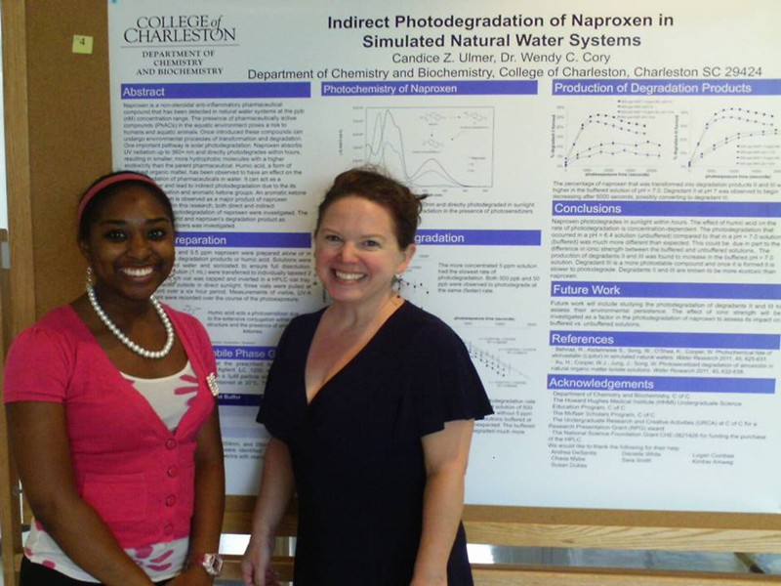
Scholar’s Days:
Poster Presentations

Slide 2
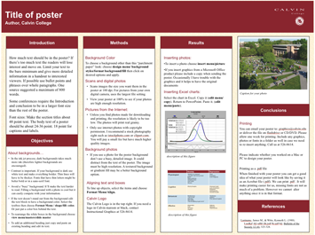
INTRODUCTION, PURPOSE, METHODS, RESULTS, CONCLUSIONS, REFERENCES.

Slide 3
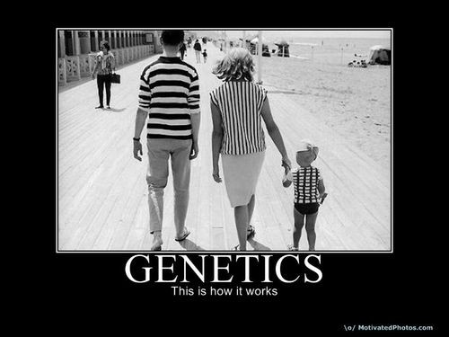

Slide 4
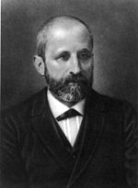
Fredrick Meischer (1868)
First to isolate DNA
Notes:
Discovered DNA: isolated it from pus (nuclei of wbc); named it nuclein (later nucleic acid) and discovered high in P and N. Importance of his discovery went unnoticed for next 100 years.

Slide 5
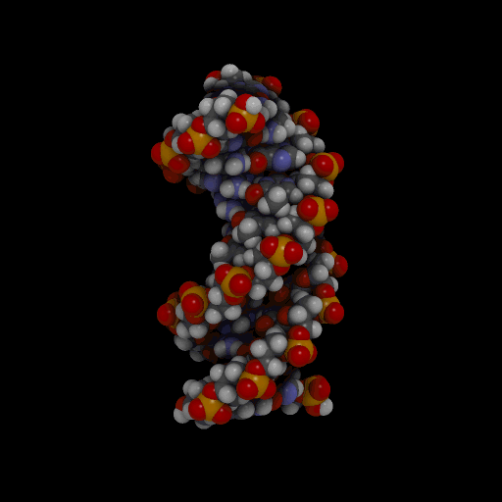
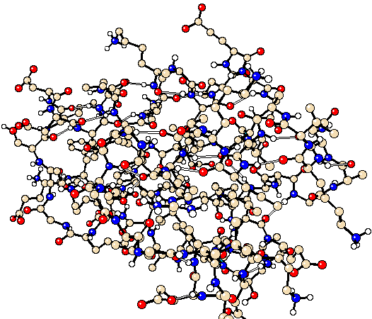
1950’s: What is the material of heredity?
Protein?
DNA?

Slide 6
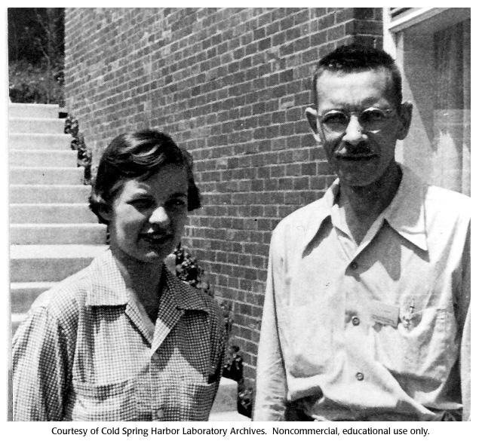
Martha Chase, Alfred Hershey
Notes:
Alfred Hershey and Martha Chase experiments with bacteriophages helped confirm DNA as genetic information

Slide 7
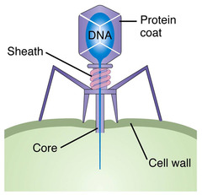
Bacteriophage- virus that attacks bacteria

Slide 8
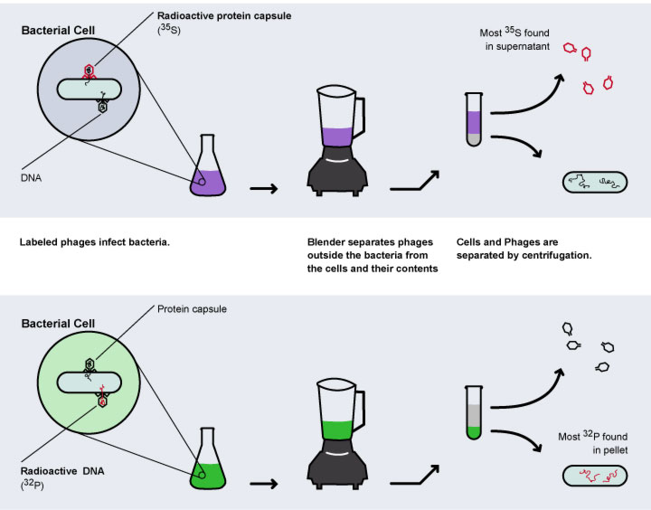
Notes:
Hershey, chase experiment

Slide 9
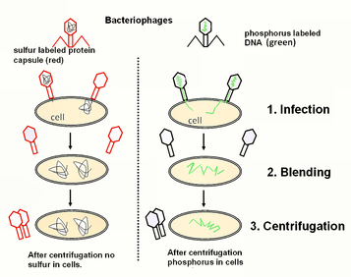

Slide 10
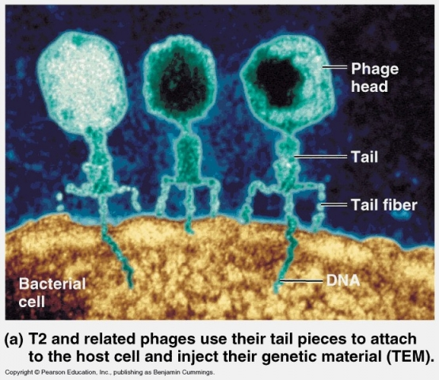

Slide 11
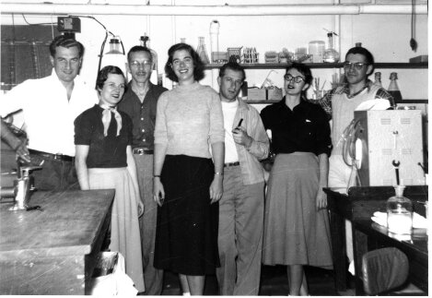
What did the Hershey-Chase Experiment prove in 1952?

Slide 12
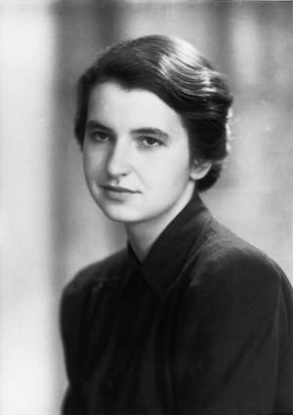
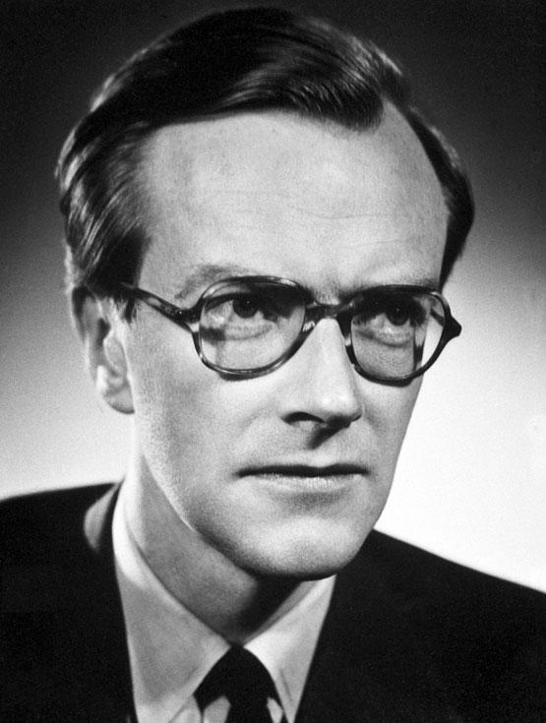
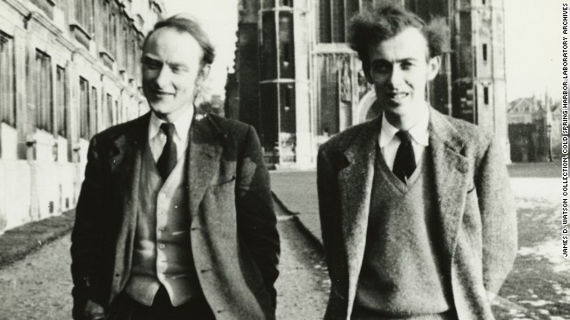
STRUCTURE OF DNA
Rosalind Franklin
Maurice
Wilkins
James Watson, Francis Crick

Slide 13
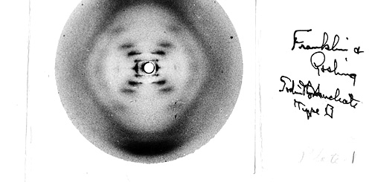
Franklin’s photograph (1953)

Slide 14
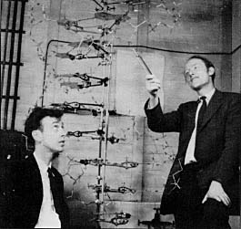
Watson and Crick Model (1953)

Slide 15
Let’s look at DNA!

Slide 16
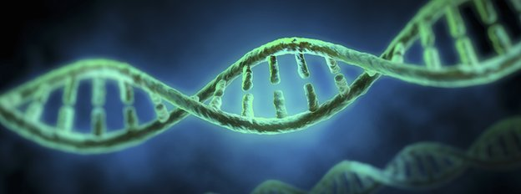
ISOLATION OF DNA
DNA is a very thin molecule. However, it was able to be visualized in this investigation. How is this possible?
DNA in a single human cell totals 3 m in length! How can it all fit in the nucleus?

Slide 17
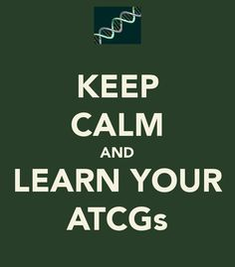
DETAILS of DNA building blocks base pairing replication

Slide 18
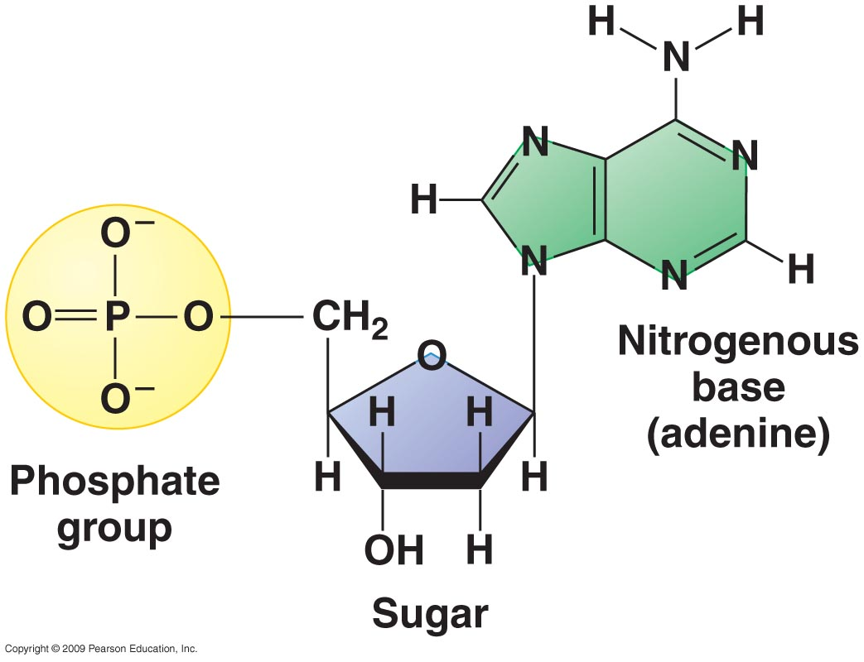
Monomers of DNA
Phosphate
Sugar
Base

Slide 19
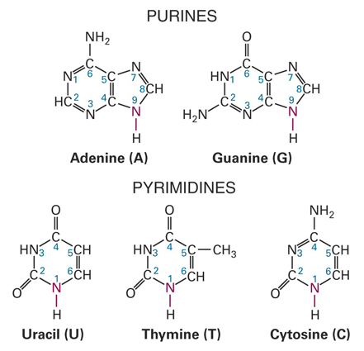
BASES:

Slide 20
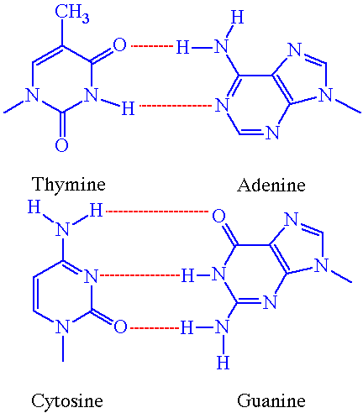
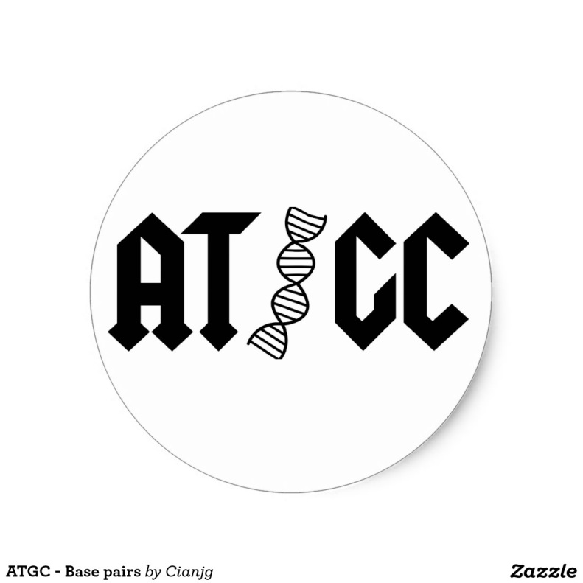
BASE PAIRING

Slide 21
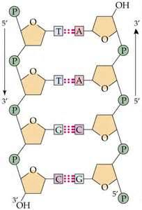
Directionality: 5’, 3’

Slide 22
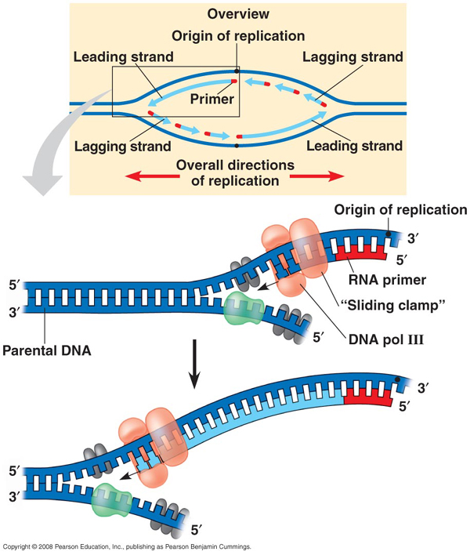
INITIATION

Slide 23
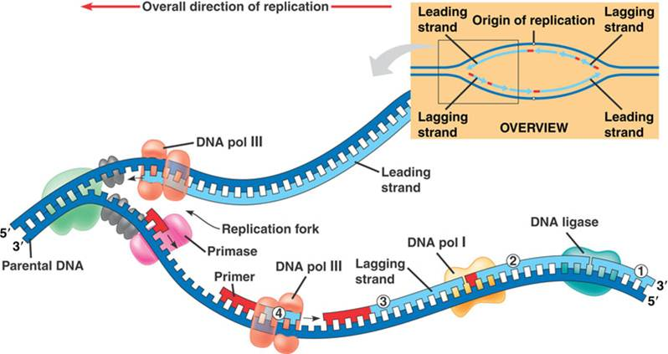
SYNTHESIS

Slide 24
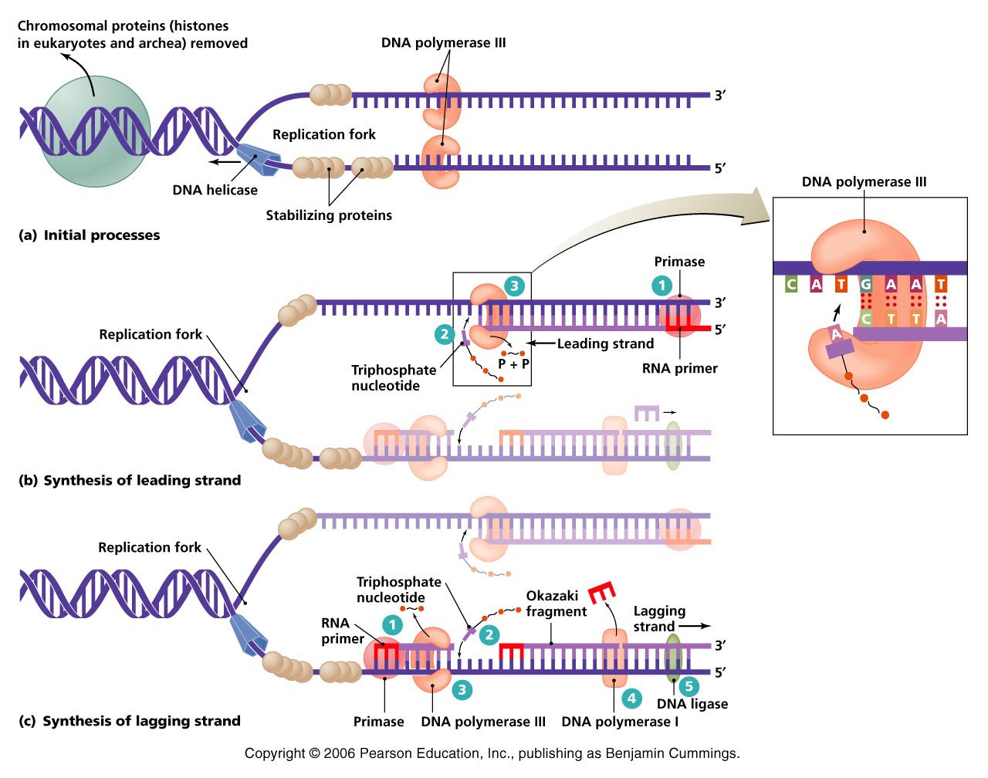
DNA REPLICATION summary

Slide 25
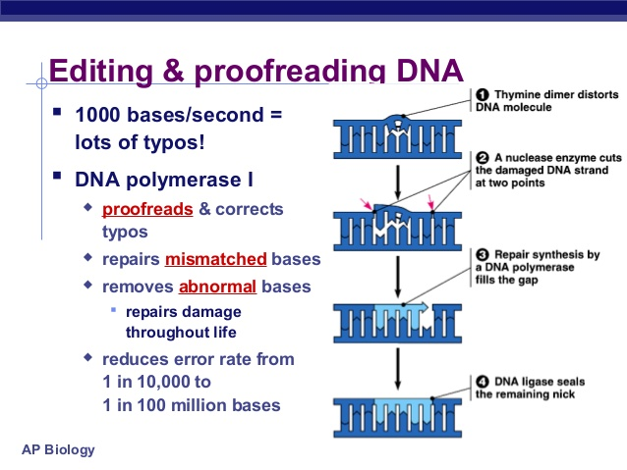

Slide 26
http://highered.mheducation.com/sites/0072943696/student_view0/chapter3/animation__dna_replication__quiz_1_.html

Slide 27
dna replication animation http://www.bing.com/videos/search?q=dna+replication&view=detail&mid=CAF485D216DC2A95A7ABCAF485D216DC2A95A7AB&first=21&adlt=strict

Slide 28
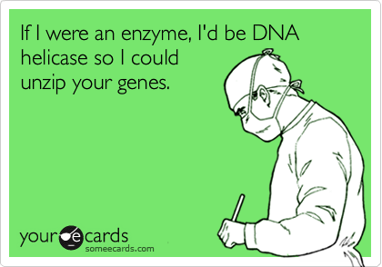

Slide 29
REPLICATION REVIEW: talk it over!
Initiation
Enzymes involved
Leading strand formation
Lagging strand formation
proofreading

Slide 30
DNA to Protein
DNA is packaged with proteins
Chromatin that is extended is called euchromatin, and is available for transcription
Chromatin that is condensed is called heterochromatin, and is inaccessible.

Slide 31
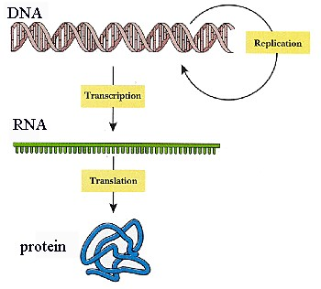
“Central Dogma” of Biology

Slide 32
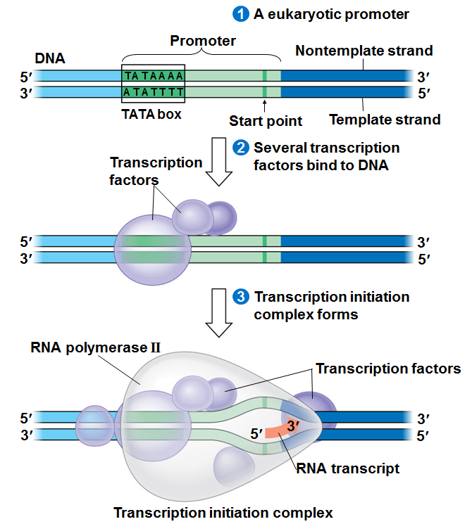

Slide 33
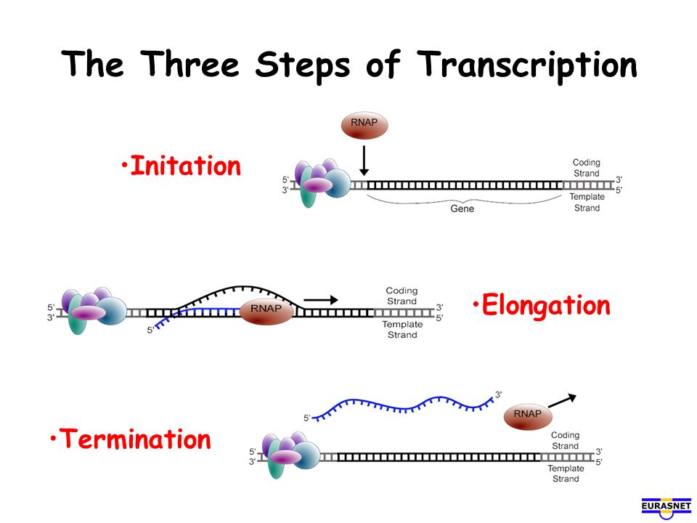

Slide 34
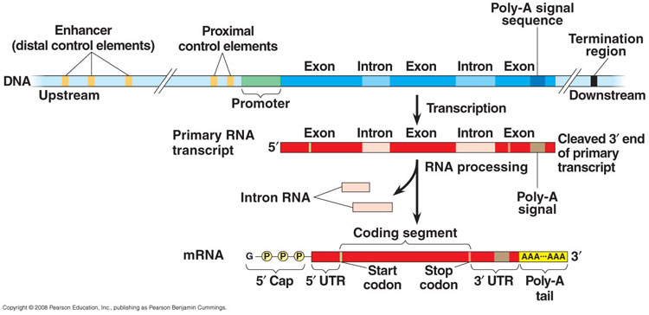
RNA processing

Slide 35
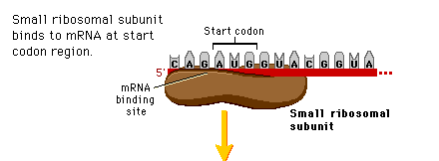
translation

Slide 36
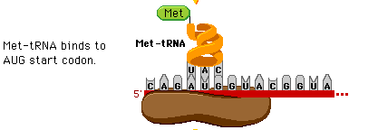

Slide 37
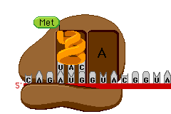

Slide 38
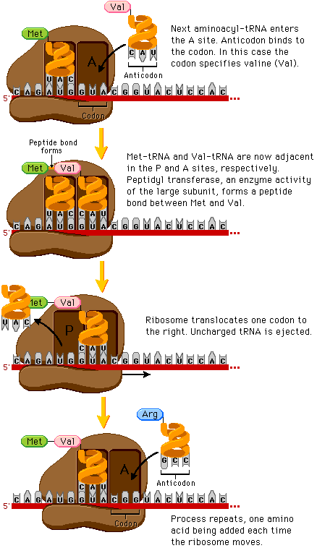

Slide 39
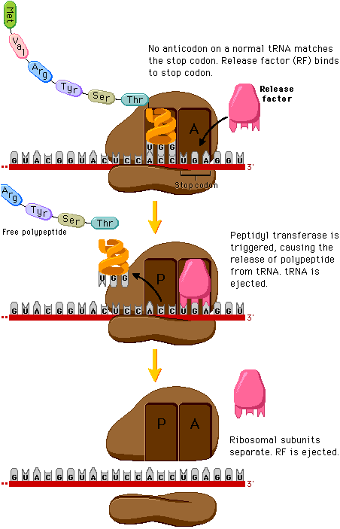

Slide 40
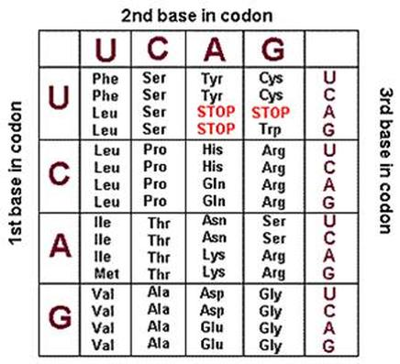

Slide 41
http://www.bing.com/videos/search?q=protein+transcription+translation+video&&view=detail&mid=B08A110C954A59179FA1B08A110C954A59179FA1&rvsmid=B08A110C954A59179FA1B08A110C954A59179FA1&FORM=VDMCNL&fsscr=0 transcription in prokaryotes

Slide 42
Pearson biocoach..
http://www.phschool.com/science/biology_place/biocoach/

Slide 43
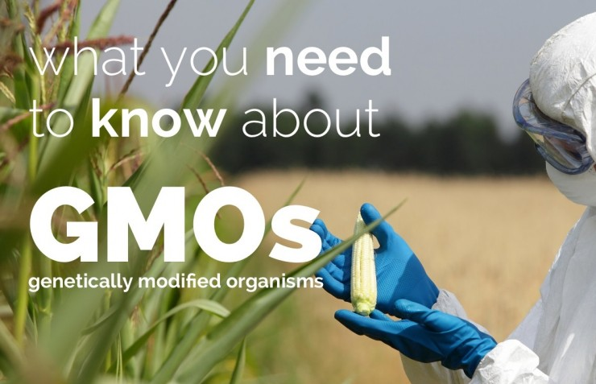
What do you know?

Slide 44
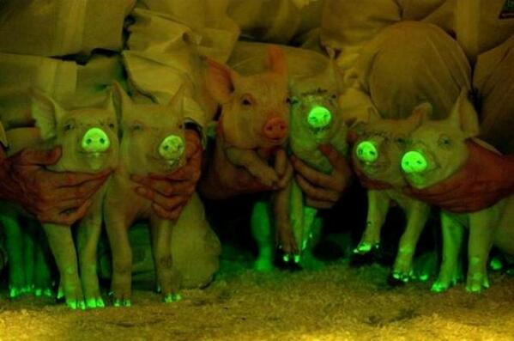
What’s this??!

Slide 45
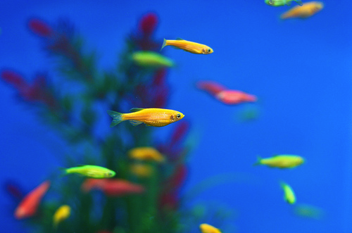
APPLICATIONS OF GENETIC KNOWLEDGE
APPLICATIONS:
DNA TECHNOLOGY

Slide 46
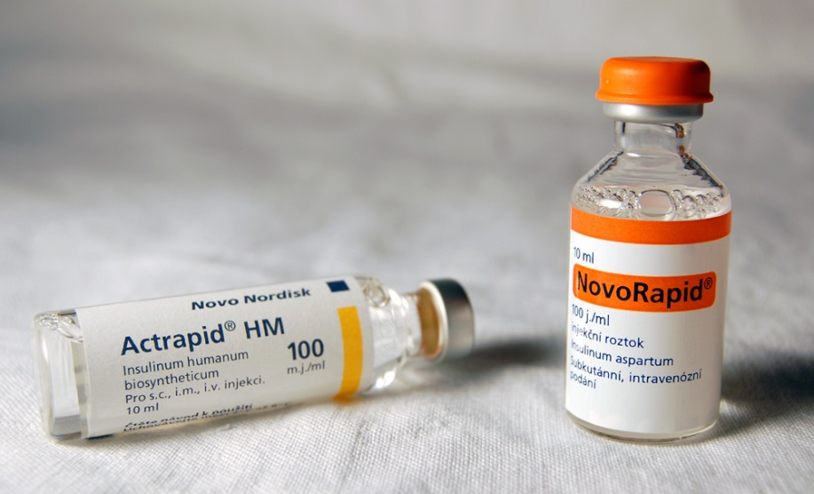
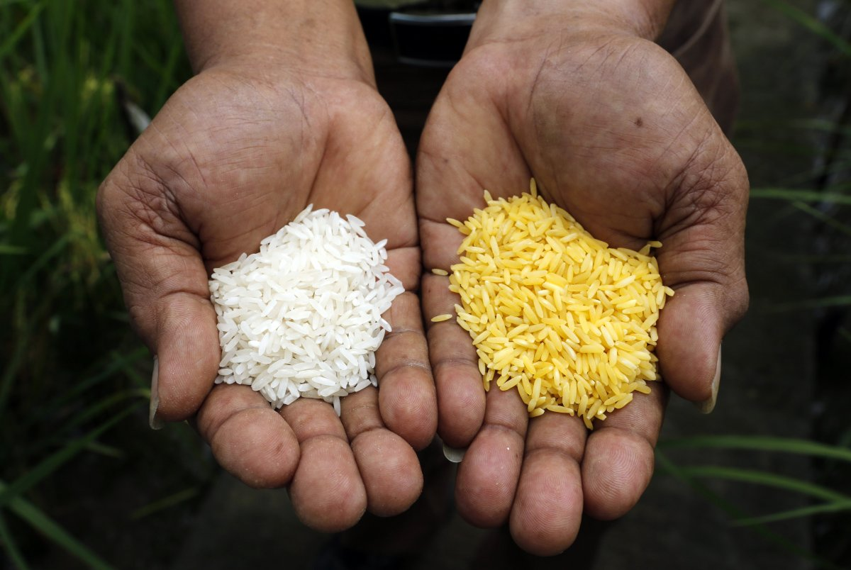
Genetic engineering involves the modification of DNA in organisms to produce new genes within an organism, giving that individual new characteristics.

Slide 47
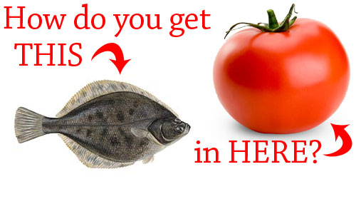
RECOMBINANT DNA
All organisms share same genetic code: DNA; with universal base pair rule
Recombinant DNA brings together genes (DNA) from multiple sources

Slide 48
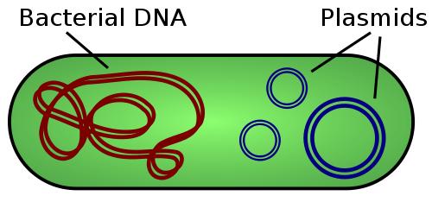
“tools in the tool box”

Slide 49
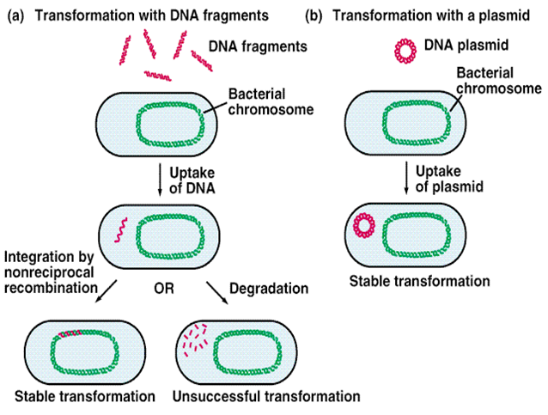
Bacterial transformation

Slide 50
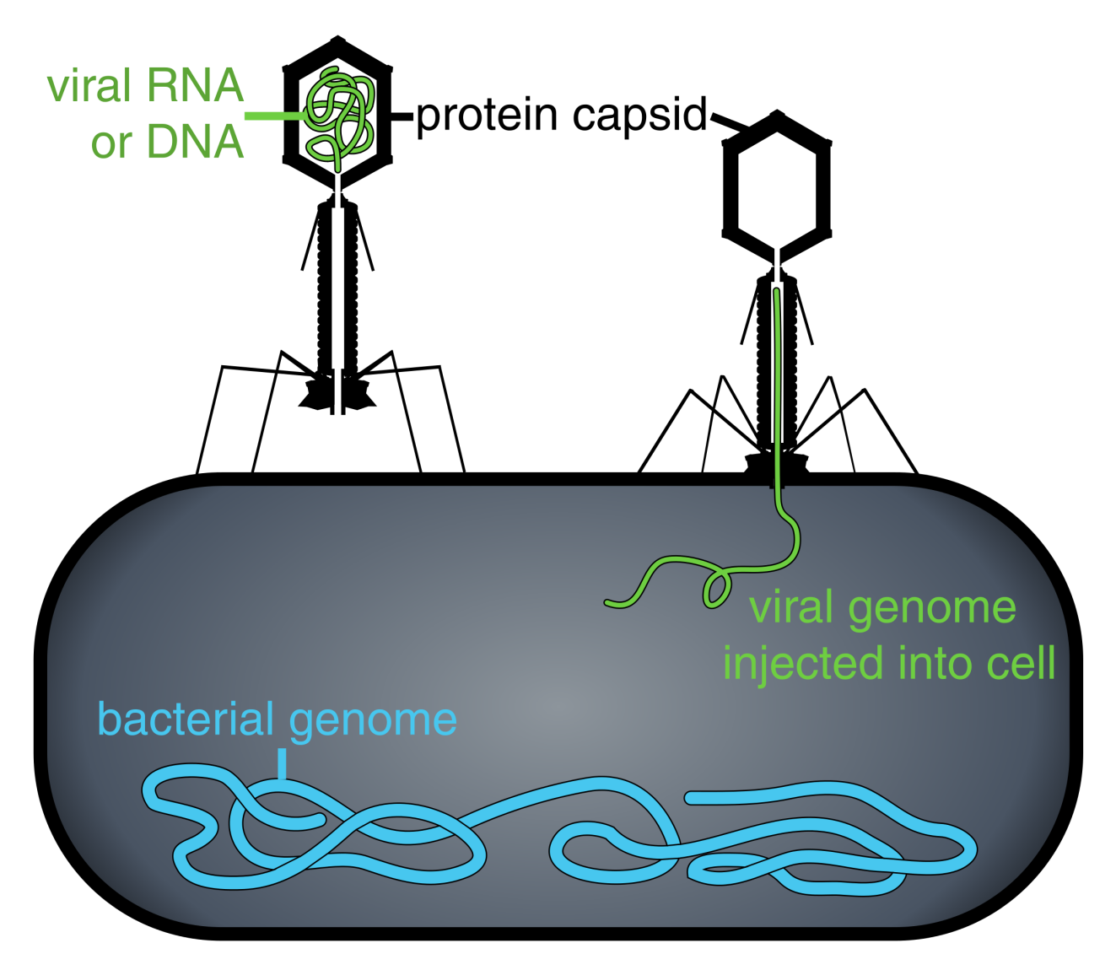
Viruses as vectors

Slide 51
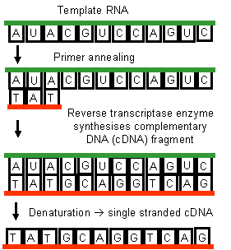
Reverse transcriptase

Slide 52
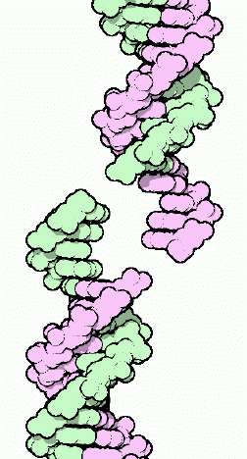
Restriction enzymes

Slide 53

What’s the puzzle?
EYE
DON’T NOD
NEVER ODD OR EVEN
DO GEESE SEE GOD?

Slide 54

DNA PALINDROMES

Slide 55

RESTRICTION ENZYMES: cut DNA at specific palindromes

Slide 56


Slide 57

RESTRICTION ENZYMES
RESTRICTION ENZYMES: CUT DNA IN SPECIFIC PLACES (restriction sites)
DNA CAN BE “BLUNT CUT” OR HAVE “STICKY ENDS”

Slide 58
So what to do with cut up DNA?
Allows for identification of unknown DNA
  DNA fingerprinting (100 m bases cut with EcoR1 yields 750,000 fragments)
  Evidence in criminal and paternity cases
  Determine prenatal conditions and diseases
Used as a research tool to map DNA

Slide 59
How do we use this to make recombinant DNA?
WE CAN CUT DNA FROM TWO DIFFERENT SOURCES
THEY MAKE THE SAME STICKY ENDS
THE TWO PIECES OF DNA WILL ANNEAL WHEN WE USE LIGASE

Slide 60


Slide 61
Uses of Recombinant DNA
Genetically engineered organisms (GMO)
  Food- golden rice, disease resistant, etc
  Pets-glo fish, glo mice
Gene therapy
research
Cloned genes (inserted into bacteria)
  Medication- insulin, GH, antibodies, etc

Slide 62


Slide 63
Plasmids
Plasmids
Plasmids are small, circular, extrachromosomal DNA molecules found in bacteria, which can
replicate on their own, outside of a host cell. They have a cloning limit of 100 to 10,000 base pairs or
0.1-10 kilobases (kb). A plasmid vector is made from natural plasmids by removing unnecessary
segments and adding essential sequences. Plasmids make excellent cloning vectors for various
laboratory techniques, including recombinant DNA.
Transformation is the modification of the genotype of a cell (usually prokaryotic) by introducing DNA
from another source. During transformation, genetic information is transferred via the uptake of
free DNA. Often these sources of DNA come from plasmids that are deliberately introduced into a
cell, transforming the cell with its genes. Transformation occurs naturally, and the resulting uptake
of foreign DNA by the cell is not typically considered recombinant DNA.
If the plasmid being introduced to the cell has not been genetically altered, in vitro, then the plasmid
is not considered to contain recombinant DNA.
Plasmids that have been genetically altered, such as by the insertion of an antibiotic resistance gene,
do contain recombinant DNA because the original genetic composition of the plasmid has been
artificially altered. These plasmids can be used to incorporate bacterial cells with the antibiotic
resistance gene via transformation.

Slide 64
How to construct a plasmid map
https://www.youtube.com/watch?v=8FqMUF96cPE
https://www.youtube.com/watch?v=v2T8Y3-8674

