Slide 1
BI2: Organelles
2.b.3: Eukaryotic cells maintain internal membranes that partition the cell into specialized regions.
Text: Ch. 6 (6.2-6.5)

Slide 2
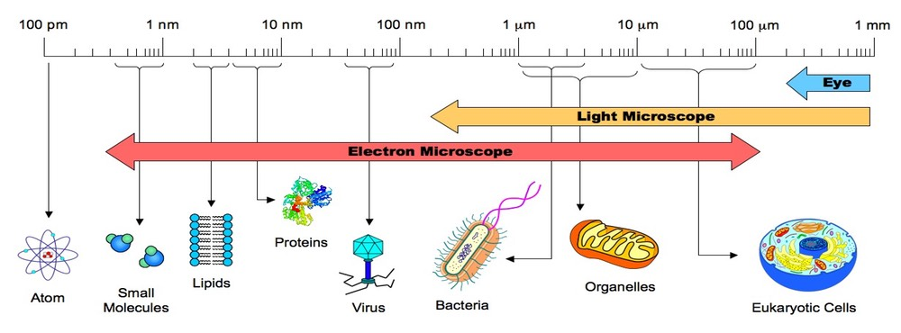
The basic unit of life is the cell.
There are two basic types of cells: prokaryotes and eukaryotes.
Viruses are much smaller than cells, and do not share similar structures.

Slide 3
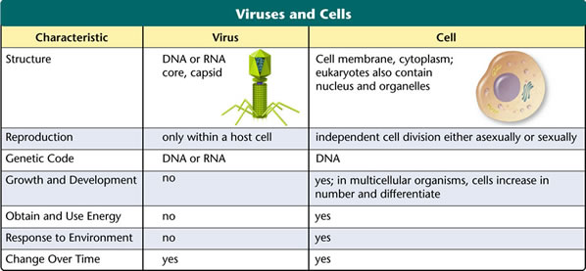
While viruses are not considered by many to be alive, they interact with life on many different levels, and have influenced the evolution of life.

Slide 4
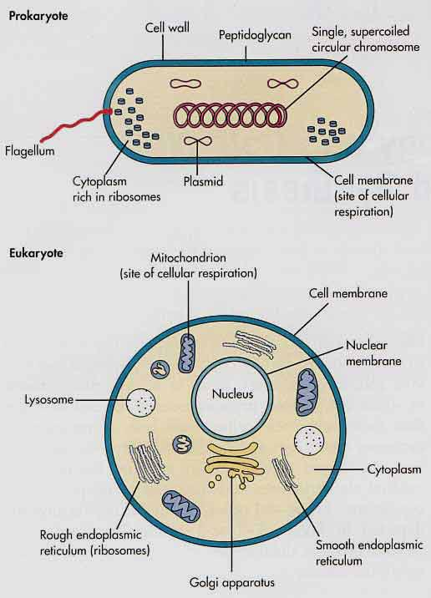
All cells have the following basic structures:
Cell (plasma) membrane
Cytoplasm
Ribosomes
DNA

Slide 5
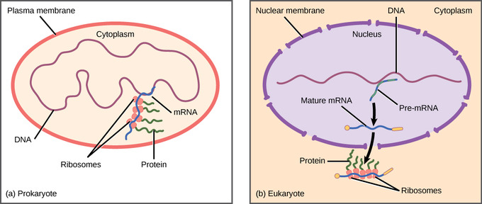
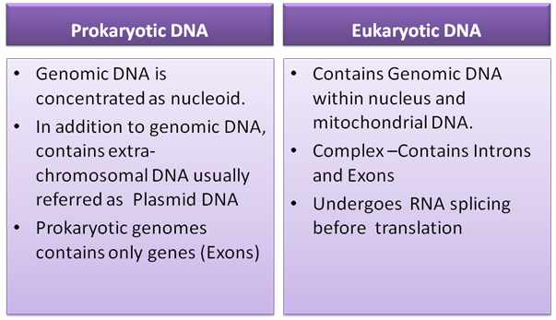
DNA in prokaryotes and Eukaryotes
(and in plants, in the chloroplasts)

Slide 6
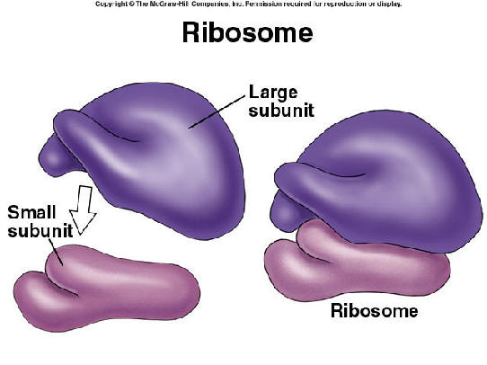
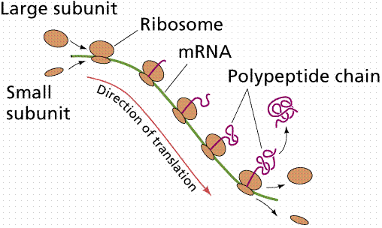
Ribosomes are composed of two subunits of rRNA and protein (no membrane surrounds them).
Ribosomes are used for protein synthesis.
Ribosomes:
In cytoplasm (free)
  Make proteins that remain in the cytosol.
Attached to ER (rough ER)
  Make proteins that are used within the membrane or expelled from the cell.

Slide 7
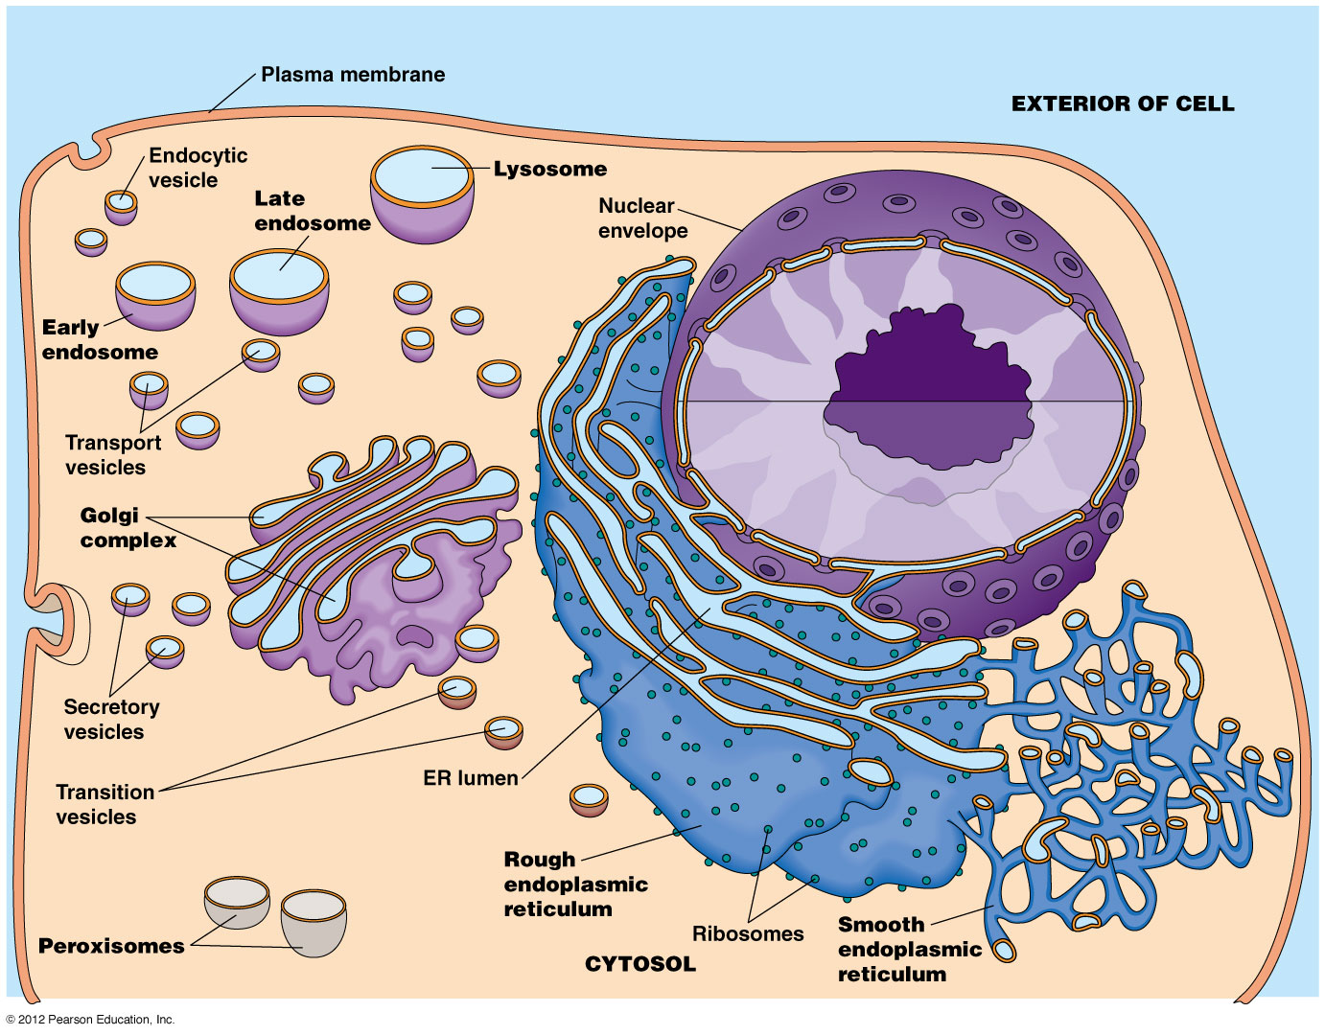
ENDOMEMBRANE SYSTEM: Internal membranes compartmentalize the cell for various functions. The interconnected inner membranes increase surface area for metabolic processes.
Includes: nuclear membrane, ER, Golgi, Vesicles, lysosomes, and plasma membrane

Slide 8
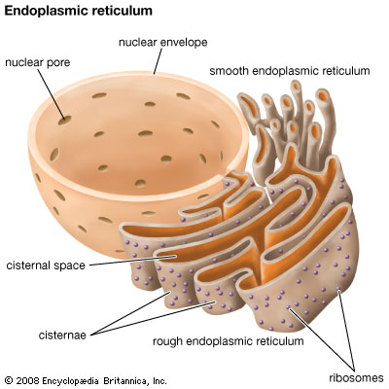
Smooth ER:
Chemical synthesis and modification of small molecules, lipid and steroid synthesis. Also, drug detox, hydrolysis of glycogen to glucose
Rough ER:
Ribosomes attached; makes proteins for transport (export) and for the membrane

Slide 9
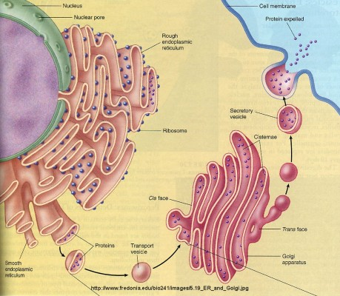
Golgi Complex
Packages, sorts and modifies molecules received on cis side and released on trans side in vesicles.
Cells that export (secrete) a lot of molecules have many golgi complexes.
Lysosomes are one type of vesicle made by the golgi
Notes:
The Golgi complex is very polar. Membranes at one end of the stack differ in both composition and in thickness from those at the other end. One end (cis face) acts as the "receiving" department while the other (trans face) acts as the "shipping" department. The cis face is closely associated with the ER.

Slide 10
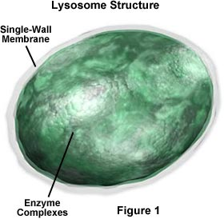
VESICLES and VACUOLES
Lysosomes:
Made by golgi; filled with hydolytic enzymes that digest macromolecules.
Important in apoptosis and autophagy
Vacuoles include:
Food vacuole
Contractile vacuole (protists)
Cental vacuole (plants)
Peroxisomes:
Form H₂O₂ used for oxidative purposes

Slide 11
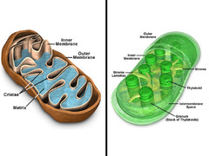
MITOCHONDRIA AND CHLOROPLASTS
These have their own DNA (plasmids), own ribosomes, and a double plasma membrane.
Mitochondria are the site of aerobic respiration
Chloroplasts are the site of photosynthesis

