Slide 1
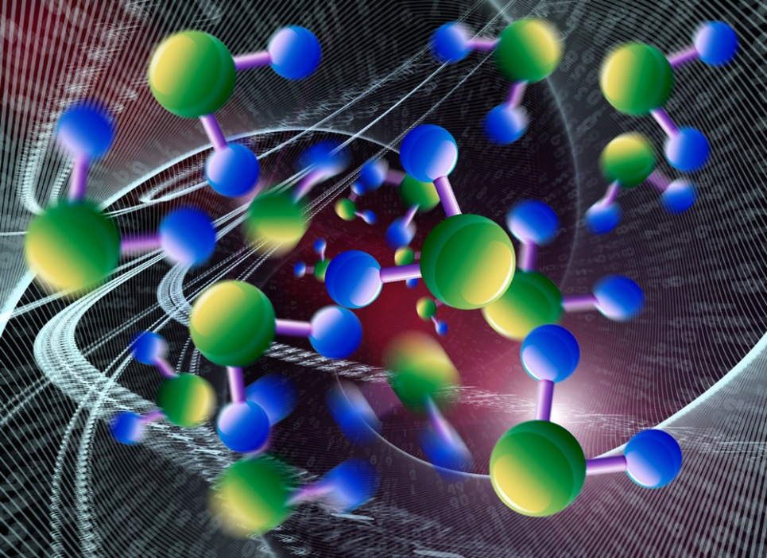
MOLECULES AND ATOMS

Slide 2
Hydrocarbons
CH₄
O₂
H₂
2H₂O

Slide 3
Which ones are symmetrical?
Which ones are nonpolar?
Which ones are polar?
So, how does symmetry relate to polarity?

Slide 4
Make C5H12
Compare to others.
How is it different?
How is it the same?
What is it called?
Why is this important?

Slide 5
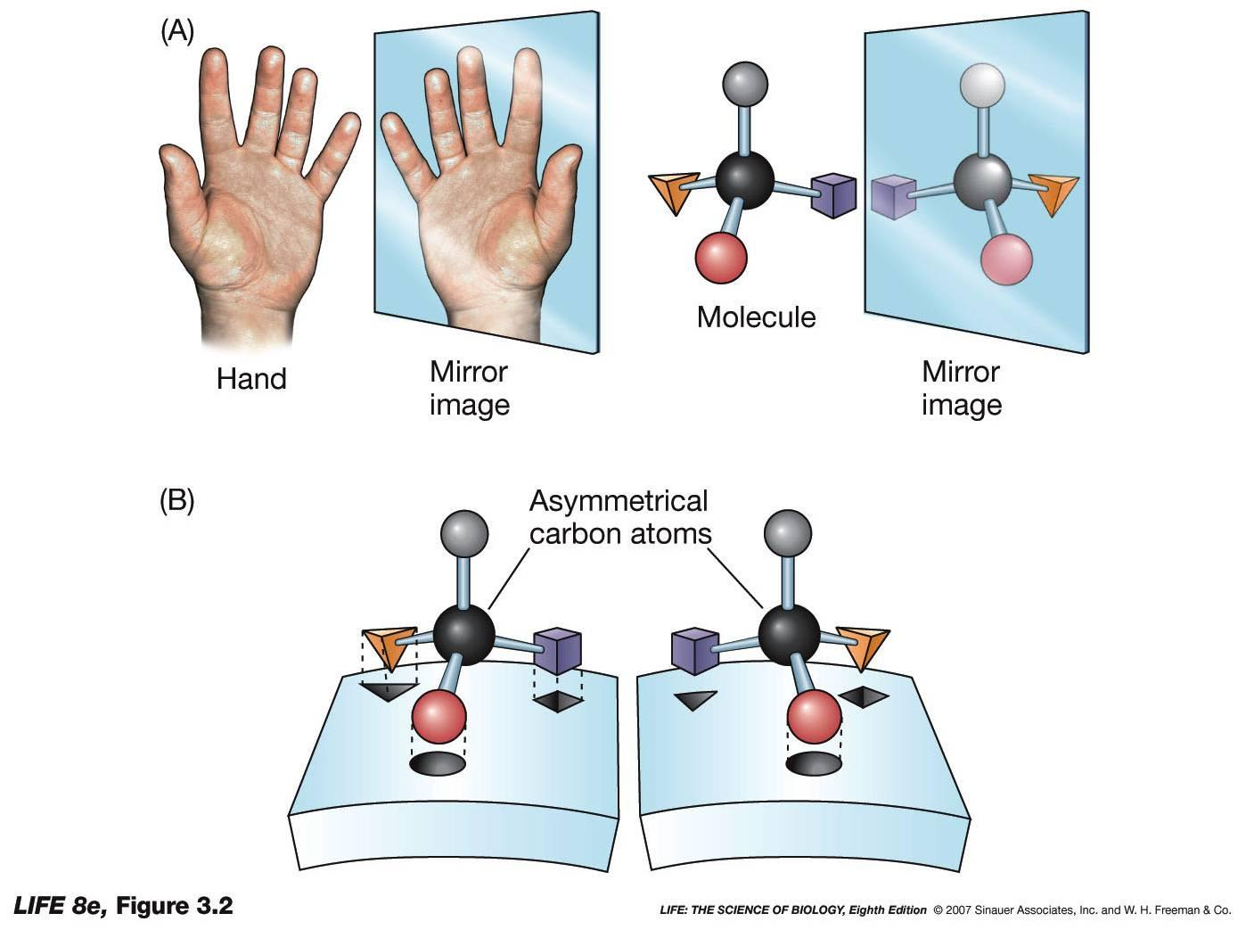

Slide 6
Make CHIBrCl, two ways.
How are they related?
How are they different?
What are they called?
Who cares?

Slide 7
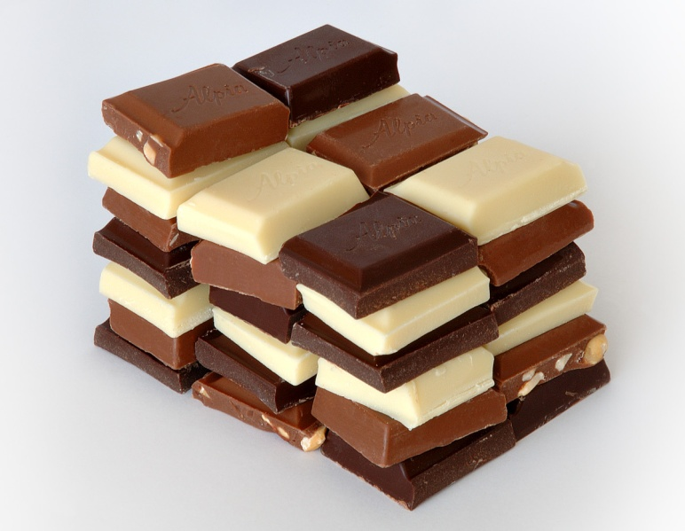
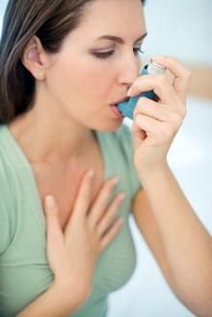
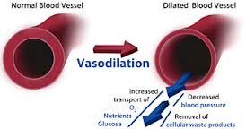
Theobromine or theophylline?

Slide 8
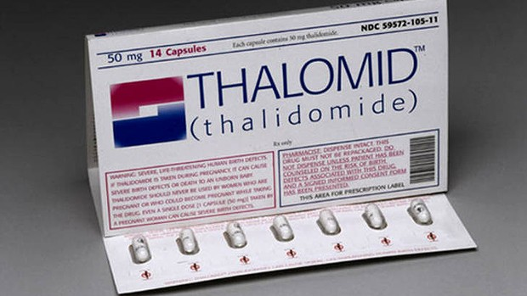
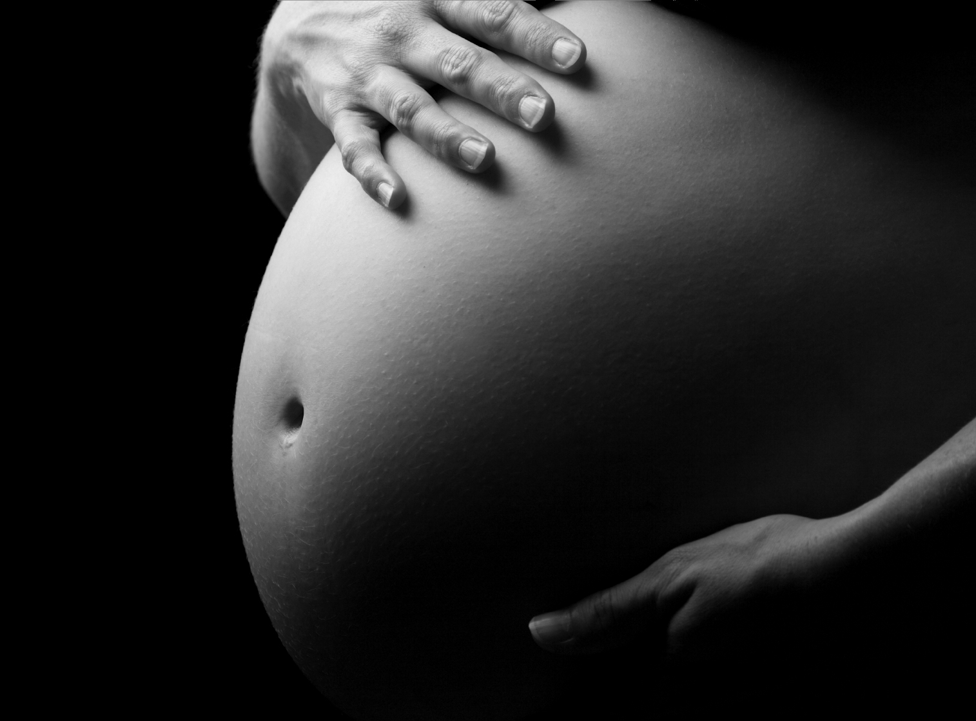
Enantiomers react differently.

Slide 9
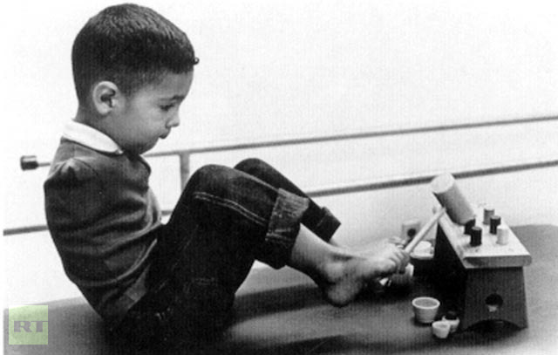
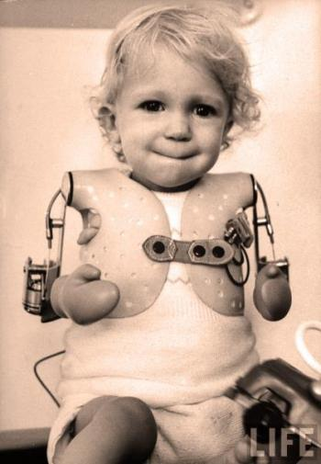
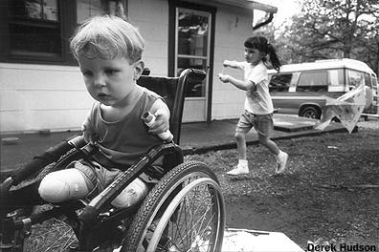
10,000 children were born between 1957-1961 with thalidomide effects.

Slide 10
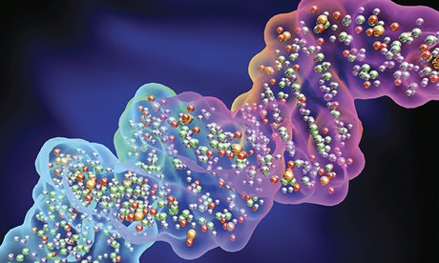
KNOW YOUR BIOCHEMISTRY!

Slide 11
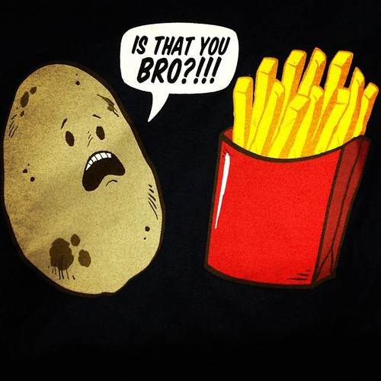

Slide 12
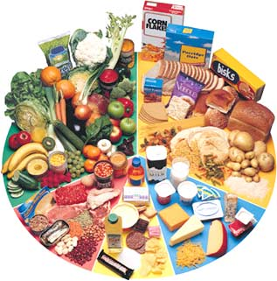
WHAT’s ON YOUR PLATE?!

Slide 13
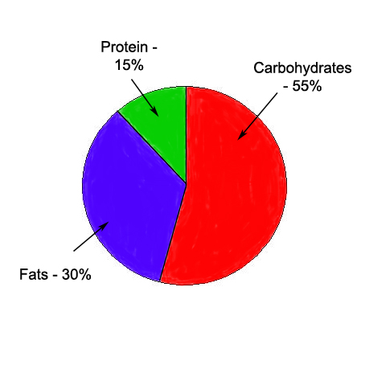
HOW DOES YOUR DIET STACK UP TO THE RECOMMENDATIONS?

Slide 14
Why does our body need those things anyhow?
CARBS
PROTEINS
FATS

Slide 15
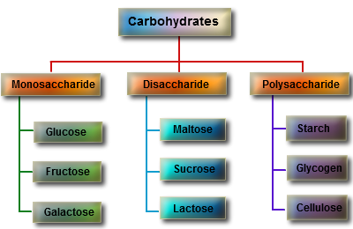
CARBOHYDRATES

Slide 16
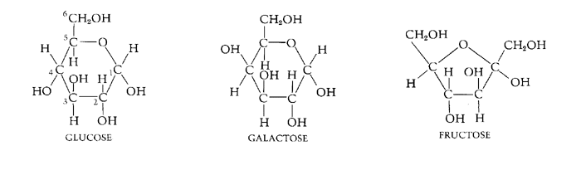
Monosaccharides: The building blocks

Slide 17
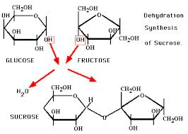
Disaccharides: formed by dehydration synthesis

Slide 18
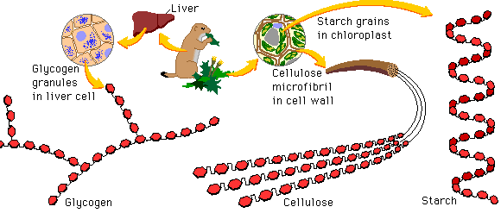
polysaccharides

Slide 19
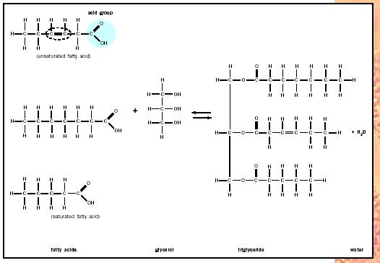
LIPIDS

Slide 20
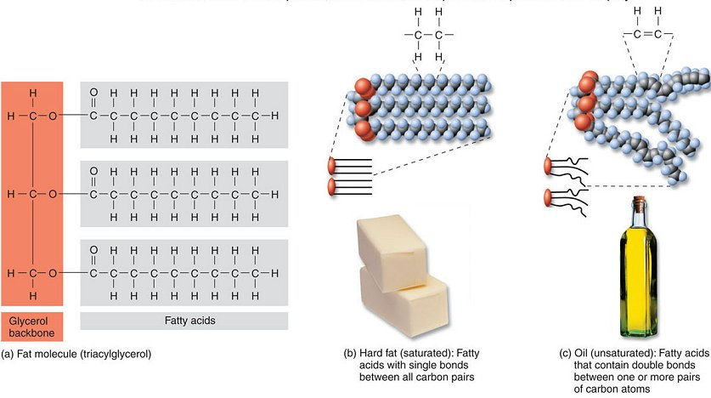
Saturated or unsaturated?

Slide 21
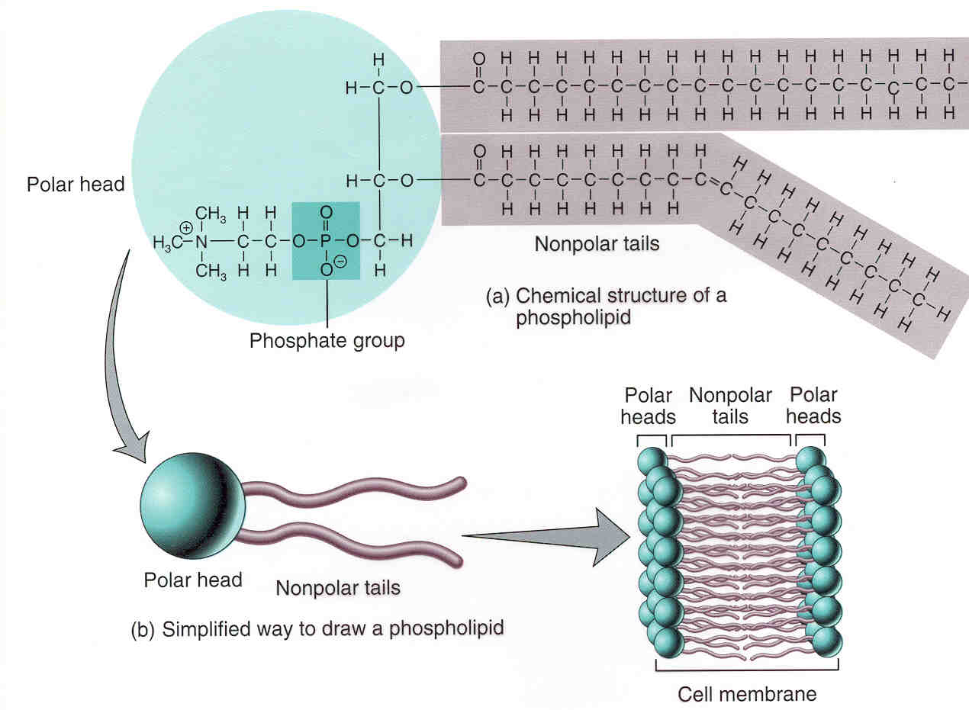
phospholipids

Slide 22
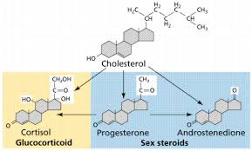
Cholesterol, steroids

Slide 23
PROTEINS

Slide 24
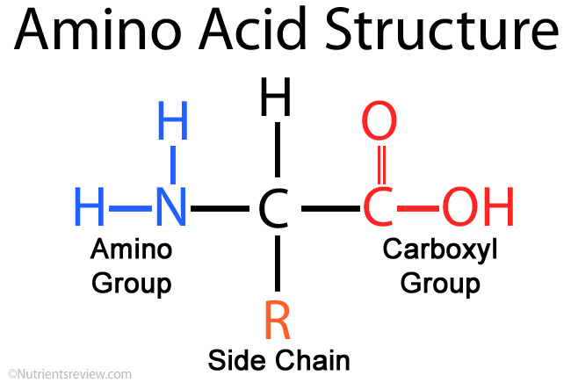
THE BUILDING BLOCKS

Slide 25
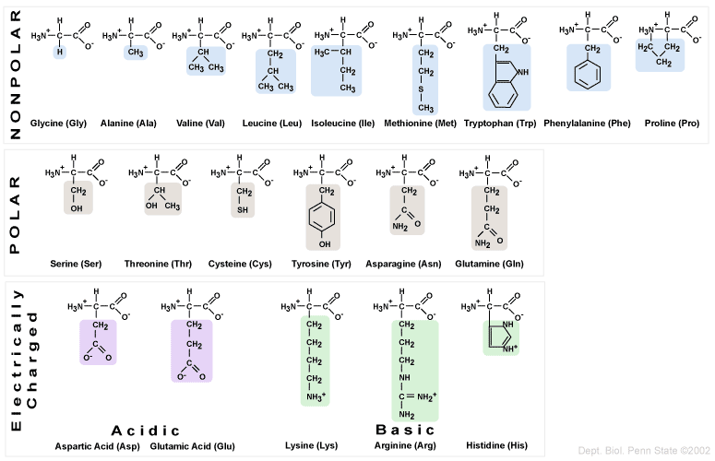

Slide 26
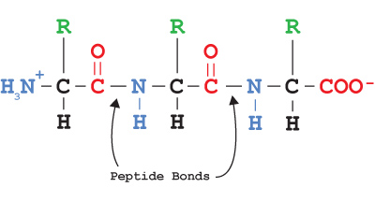
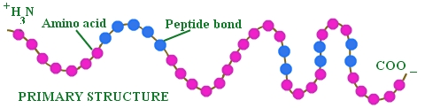
Protein conformation

Slide 27
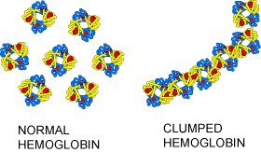
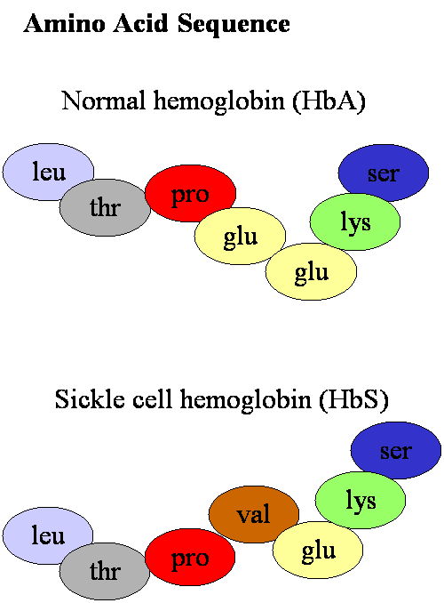
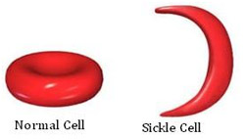

Slide 28
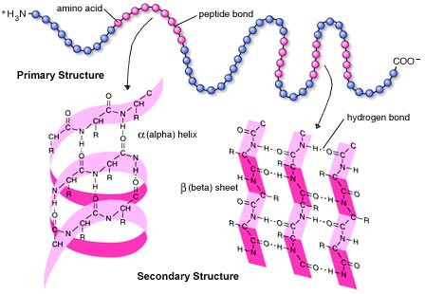
Secondary structure alpha helix; beta sheet

Slide 29
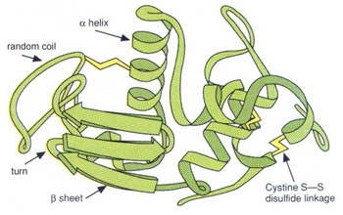
Tertiary structure
Globular
H-H bonds, ionic bonds, Hydrophobic interactions,
Disulfide bridges
If this is denatured, it may refold at this stage.

Slide 30
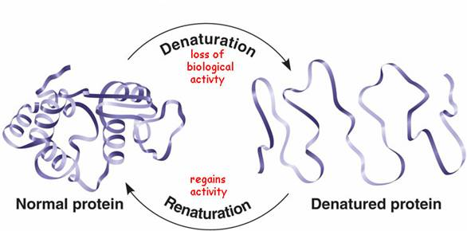

Slide 31
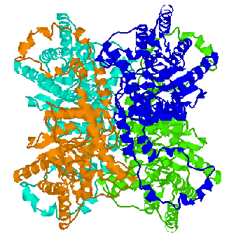
Quaternary structure

Slide 32
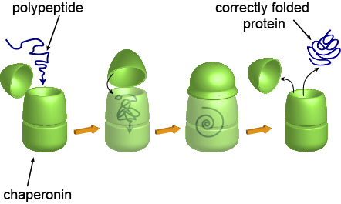
What is a chaparonin?

Slide 33
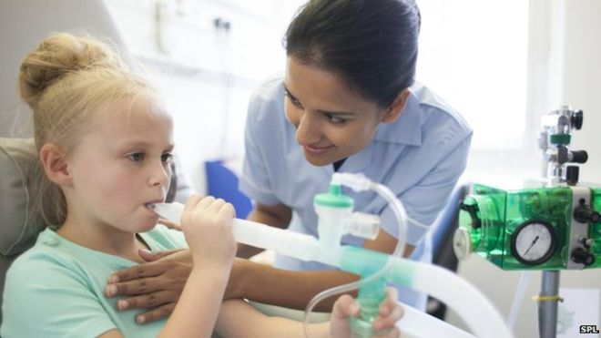
Cystic fibrosis: correct amino acid sesquence; improper folding

Slide 34
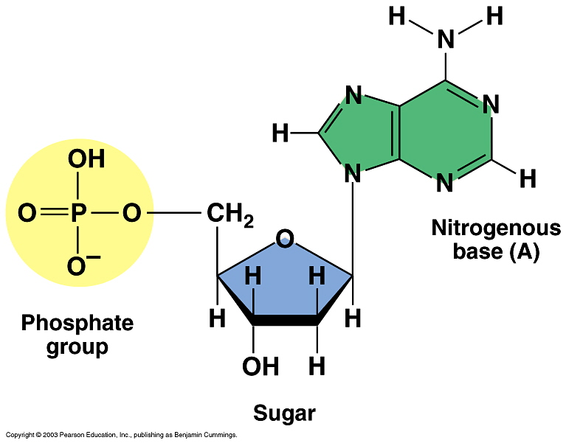
NUCLEIC ACIDS

Slide 35
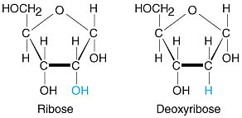
5 carbon sugar

Slide 36
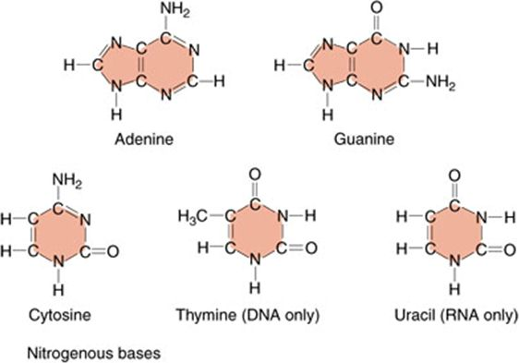
Nitrogenous base

Slide 37
