Slide 1
Essential Questions
Why do growth, reproduction, and maintenance of the organization of living systems require free energy and matter?
What mechanisms and structural features of cells allow organisms to capture, store, and use free energy?

Slide 2
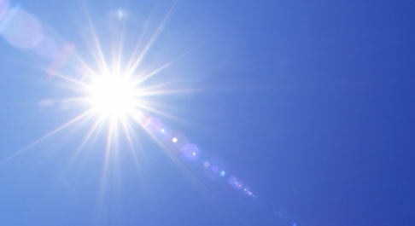
What is energy?
Energy can be described as the capacity for change.

Slide 3
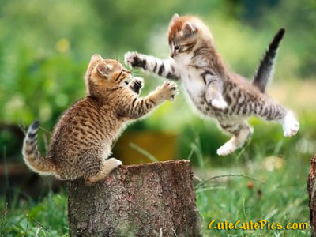
Biological systems utilize free energy

Slide 4
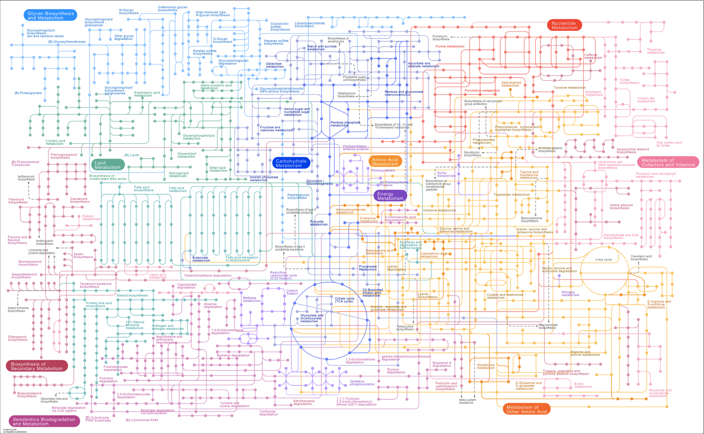
Metabolism is the sum of chemical reactions that occur in a biological system.
  Metabolic activity involves changes in energy

Slide 5
Two basic types of metabolism:
ANABOLIC REACTIONS
CATABOLIC REACTIONS
Build molecules
Use energy
“uphill”
Ex: photosynthesis; building proteins from amino acids
Break down molecules
Releases energy
“downhill”
Ex: cell respiration breaks down glucose to produce ATP

Slide 6
Biochemical changes involve changes in energy.
Expressed as energy available to do work or free energy (G)
The change in free energy = ΔG

Slide 7
ΔG = ΔH - TΔS
ΔG = change in free energy
ΔH = change in total energy
ΤΔS = energy lost to system
      Τ = kelvin (C + 273)
      S = entropy
      Goose Hunters Take Shots…

Slide 8
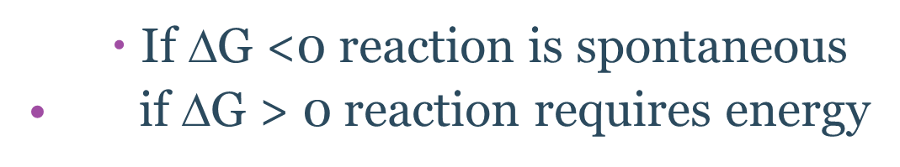
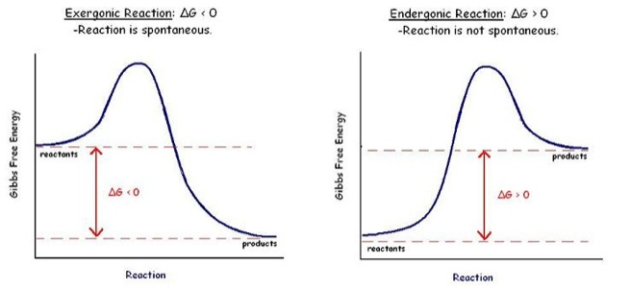

Slide 9
Exergonic or endergonic if temp is 298K?
Reaction 1: A+B→AB
ΔH = +245 KJ/mol
ΔS = -.02 KJ/K
ΔG = +250.96
Reaction 2: CD→ C + D
ΔH = -334 KJ/mol
ΔS = +.12 KJ/K
ΔG = -396.76

Slide 10
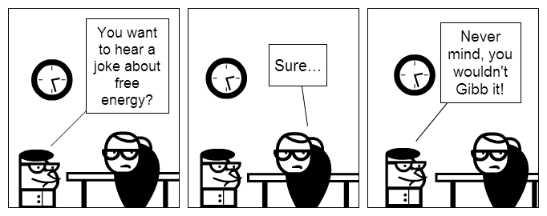

Slide 11
http://www.youtube.com/watch?v=nDCxIpiI7-Y
Bozeman Biology explains Bioenergetics

Slide 12
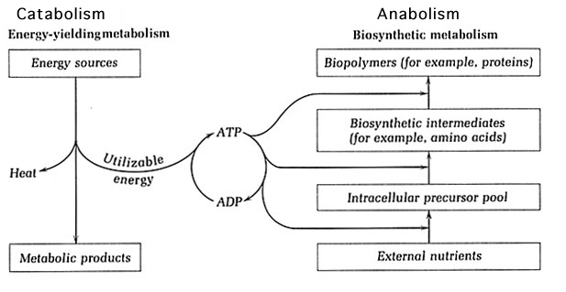
Catabolic and anabolic reactions are often linked

Slide 13
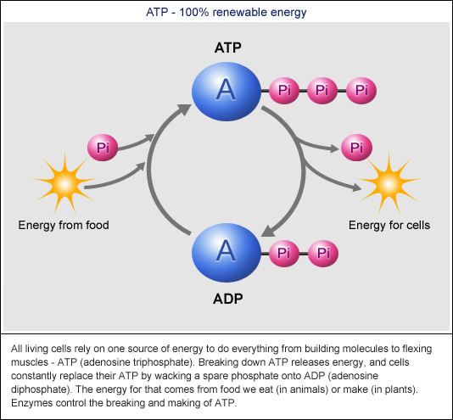
Take 5 –explain:
Energy coupling
ATP
ADP
Phosphorylation
hydrolysis

Slide 14
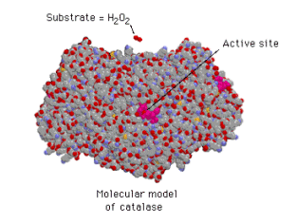
Enzymes

Slide 15
Take 5: explain:
Catalyst
Substrate
Active site
Induced fit
Product
reactant

Slide 16
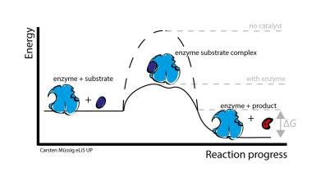

Slide 17
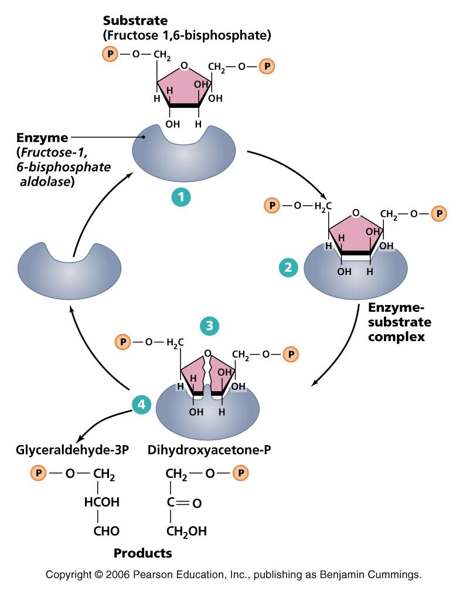

Slide 18
