Slide 1
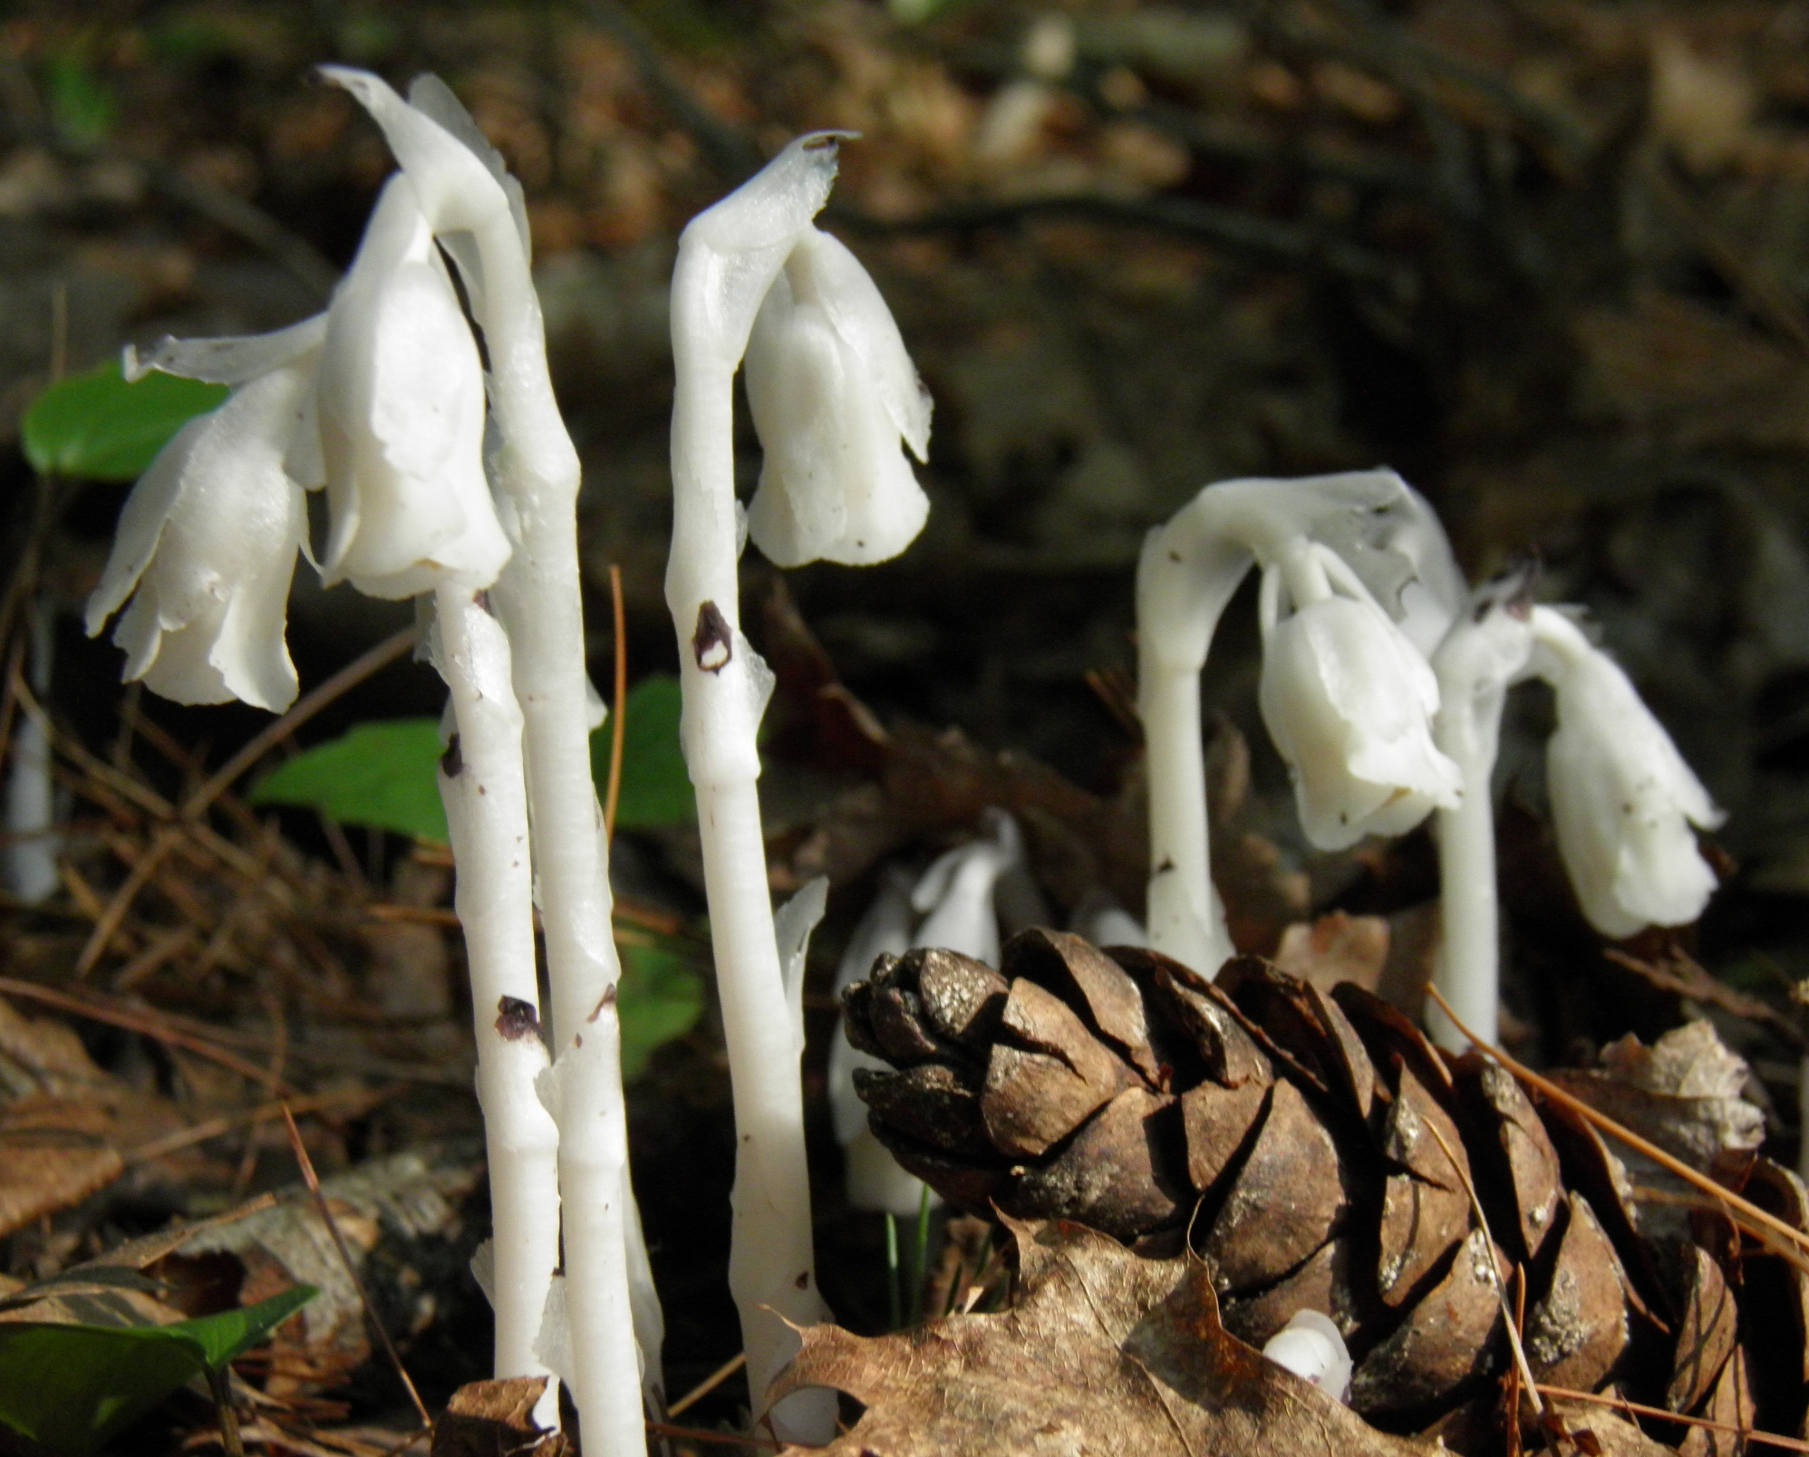

Slide 2
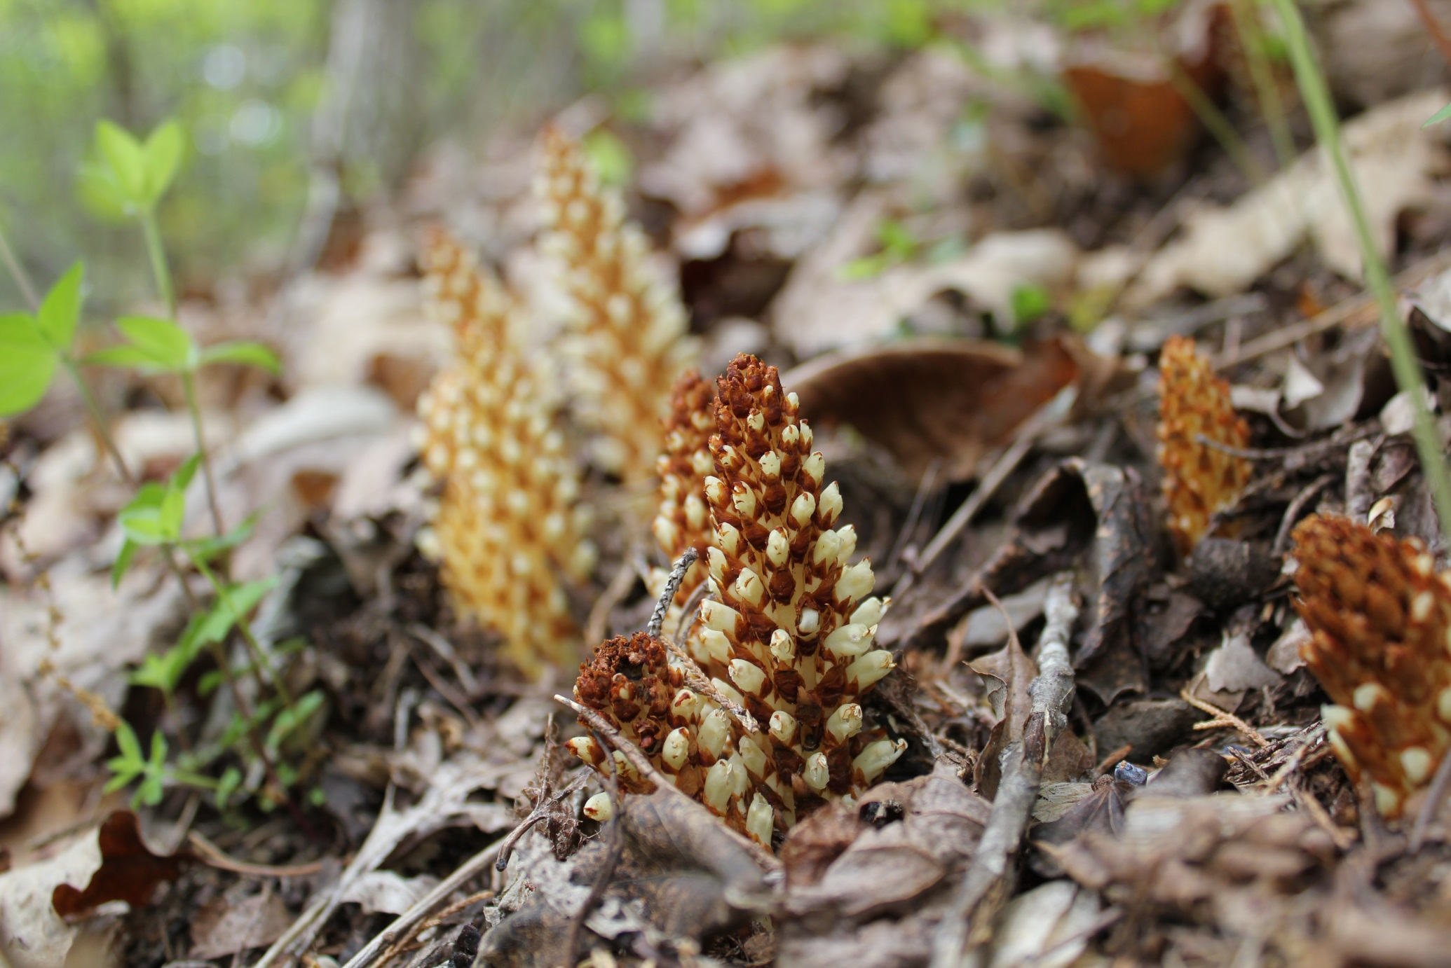

Slide 3
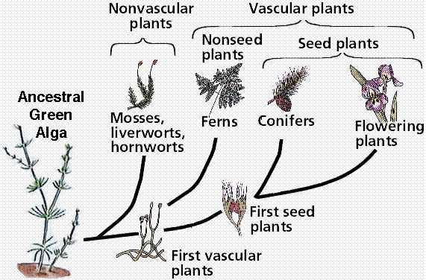

Slide 4
Living Things Need Energy:
PHOTOSYNTHESIS

Slide 5
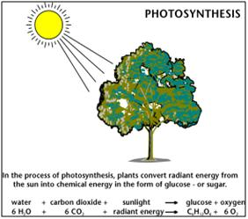

Slide 6
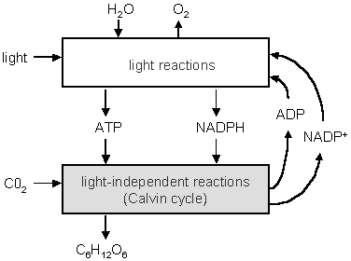
Photosynthesis requires 2 steps.

Slide 7
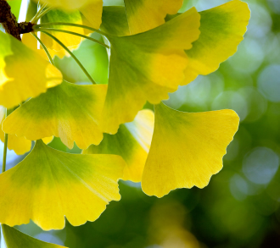
How are leaves good photosynthetic factories?

Slide 8
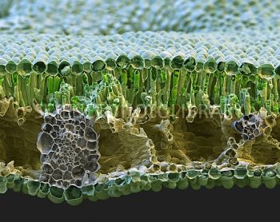
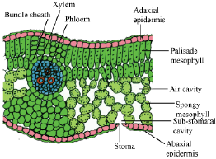
SEM; 200X

Slide 9
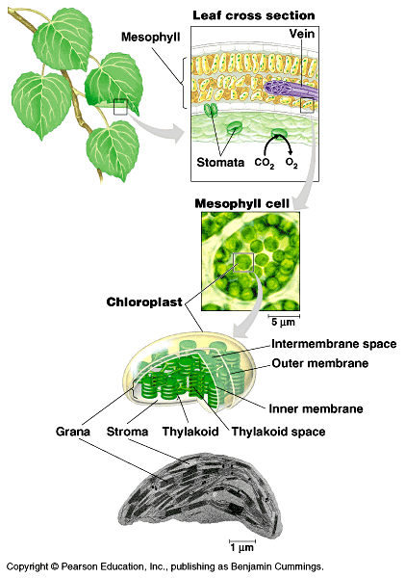
Plant cells contain an organelle called a chloroplast.
This is where light energy is transformed into chemical energy.

Slide 10
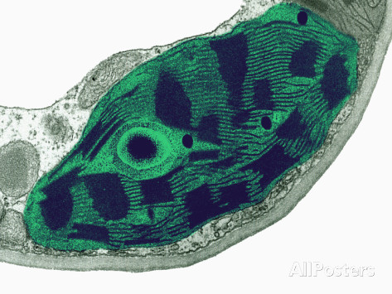
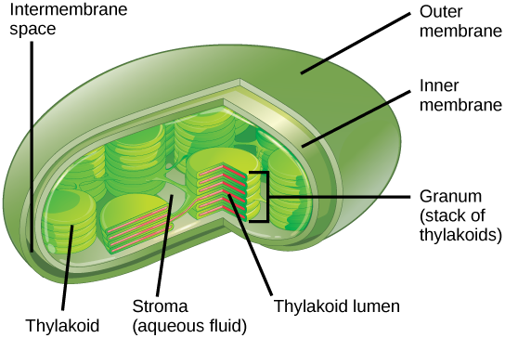
Structure of a Chloroplast

Slide 11
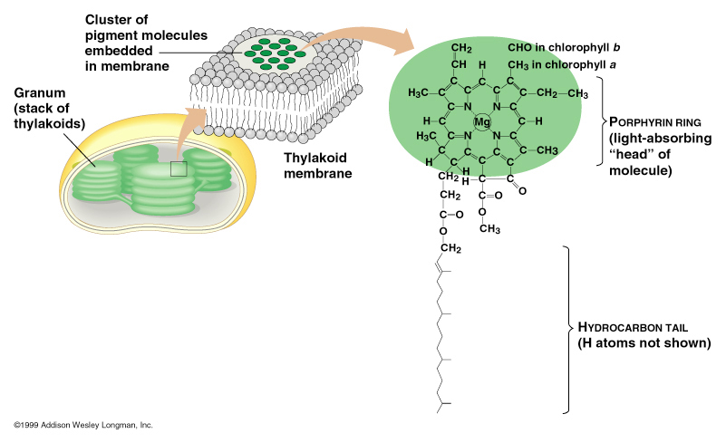
Inside a chloroplast are folded membranes. Imbedded in the membranes are molecules of chlorophyll.
Chlorophyll is the molecule that absorbs light energy. Chlorophyll is part of a photosystem.

Slide 12
The Light Reaction

Slide 13
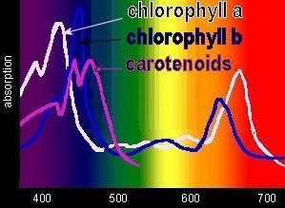
Relative rate of photosynthesis
Wavelength of light (nanometers)

Slide 14
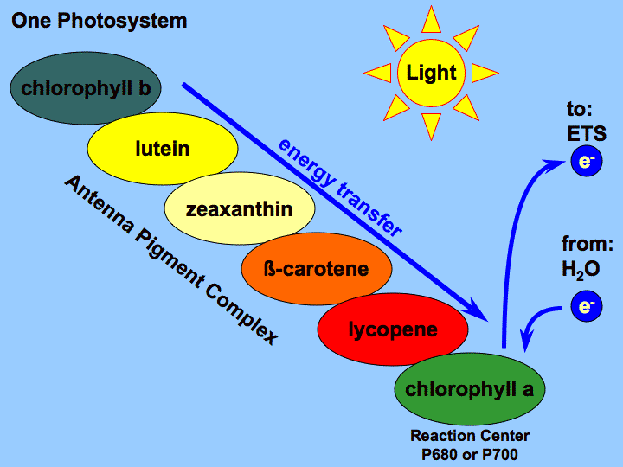
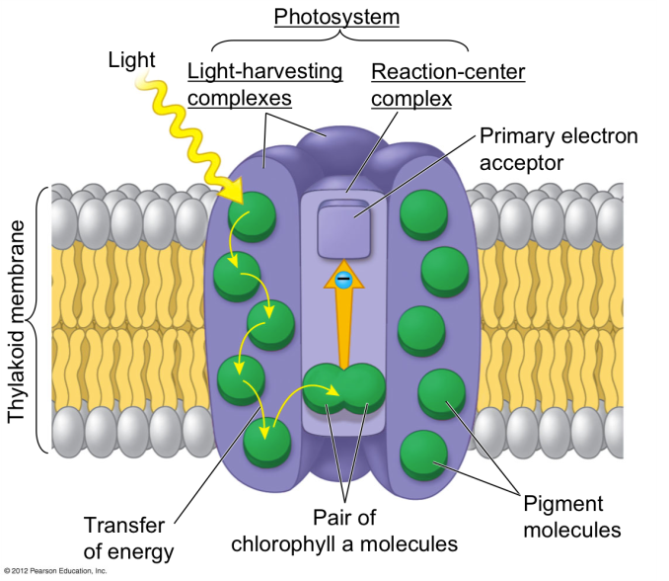
Antennae pigments pass energy to chlorophyll a in the photosystem.

Slide 15
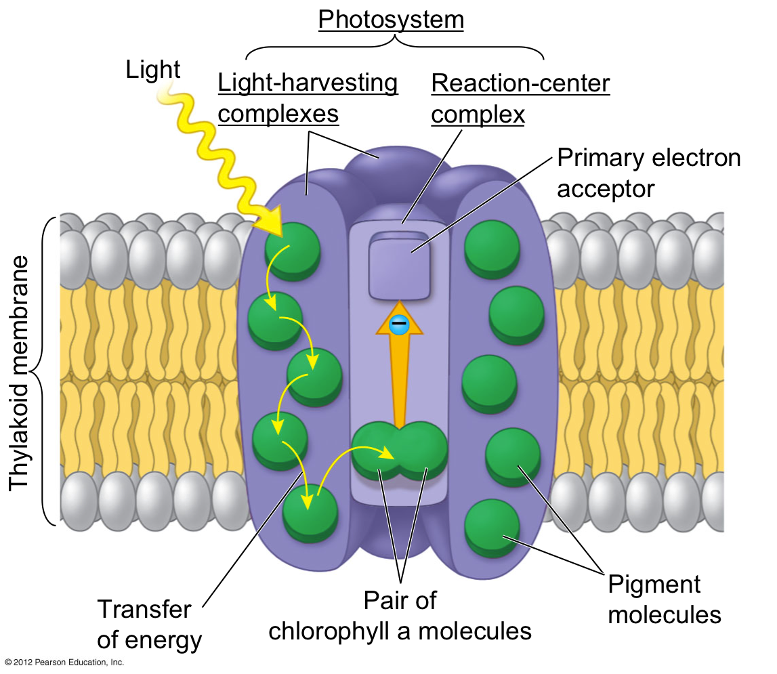

Slide 16
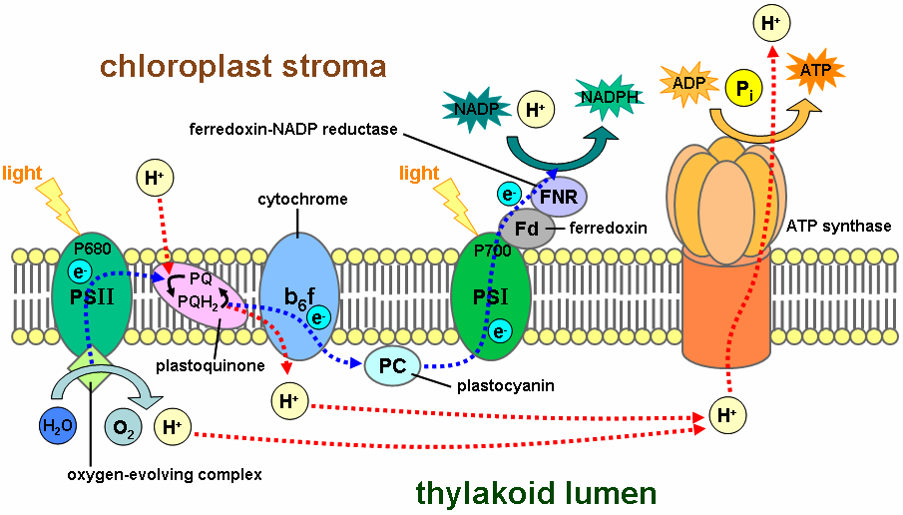
PSII:
Excited electron moves to electron acceptor.
Chl a donates a high E electron to the electron acceptor
Water is split; its electron replaces that lost from chlorophyll
oxygen is released to atmosphere.
Excited electron moves to electron transport chain

Slide 17
ETC
The electron transport chain is a series of membrane bound molecules that pass the electron to a final electron acceptor. As the electrons are passed along, H+ ions are pumped into the lumen. (Chemiosmosis)

Slide 18
PSI
The electrons from the ETC are accepted by PSI.
Solar energy is absorbed, and the electrons are passed to NADP.
NADP+ +2e- + H+ → NADPH. (needed in next rxn)
NADPH is the final electron acceptor.

Slide 19
Phosphorylation and ATP Synthesis:
ATP Synthase uses energy from the H+ gradient to produce ATP. This is called phosphorylation.

Slide 20
SUMMARIZE:
PSII, ETC, PSI, ATP Synthase.
What is needed, what happens, what is made?

Slide 21
Noncyclic Electron Flow
1. PSII absorbs light E.
Excited e- moves to e- acceptor
water is split to replace lost e-. Oxygen released.
NADP+ +2H+e- → NADPH
2. Chemiosmosis and phosphorylation:
ETC pumps H+ into lumen.
H+ gradient used to synthesize ATP
3. PS1
light E absorbed and reexcited e-. NADPH is final e- acceptor.

Slide 22
http://www.youtube.com/watch?v=joZ1EsA5_NY

Slide 23
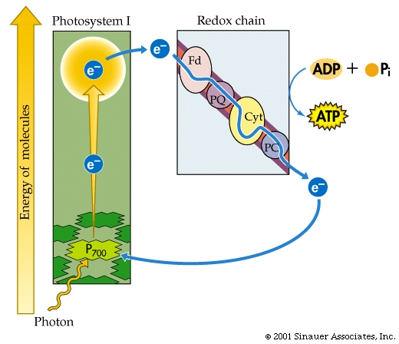
Cyclic Electron Flow
PSI only
  Electron donated by PSI and returns to PSI
  Maintains H+ gradient; makes ATP w/ATP Synthase
  No Oxygen released
  Seen in some bacteria; probably evolved first

Slide 24
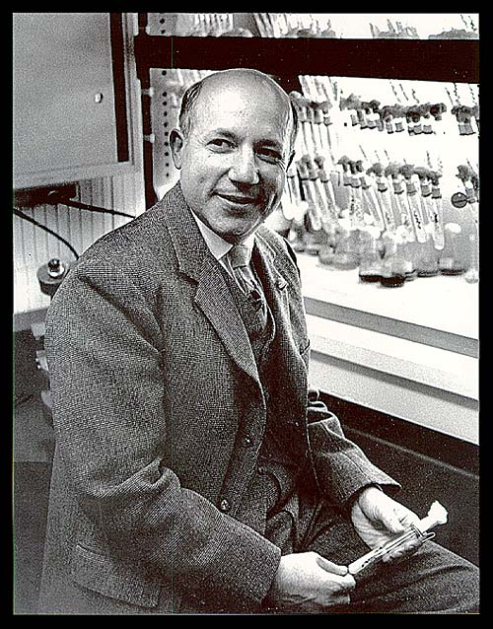
PART II: THE CALVIN CYCLE!

Slide 25
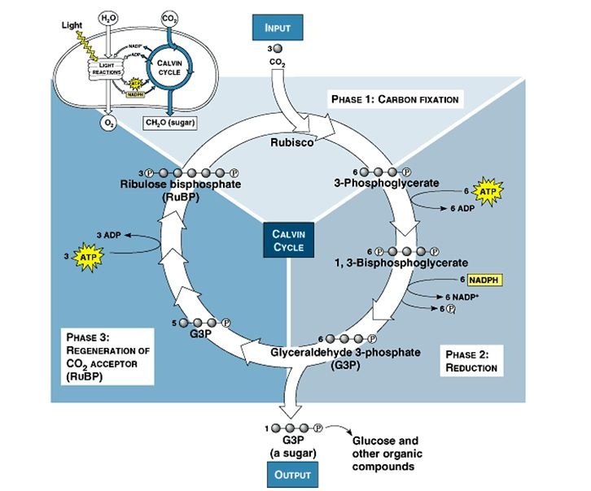
Calvin Cycle
Carbon from carbon dioxide is “fixed” into a 3-C sugar, G3P (precursor for glucose)
-In the stroma
-carbon enters as CO2 and leaves as sugar.

Slide 26
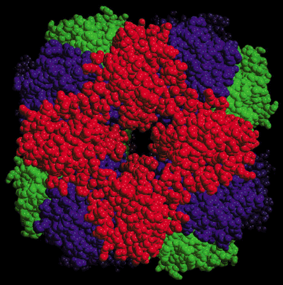
PHASE 1: Rubisco attaches C from CO2 to a 5-C molecule called RuBP (ribulose bisphosphate)
Rubisco- the most abundant protein in plants, and possibly on the planet.

Slide 27
Phase 2 Reduction: NADPH and ATP are used to convert 3PGA to g3P

Slide 28
Phase 3 Regeneration: G3P’s and ATP regenerate the RuBP/
For every three molecules of CO₂ that enter the cycle, the net output is one G3P.
For each G3P synthesized, the cycle spends nine molecules of ATP and six molecules of NADPH₂.
The light reactions sustain the Calvin cycle by regenerating the ATP and NADPH₂.

Slide 29
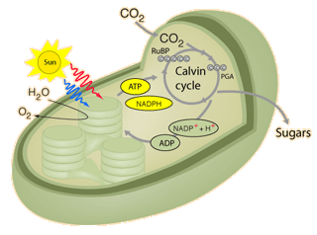
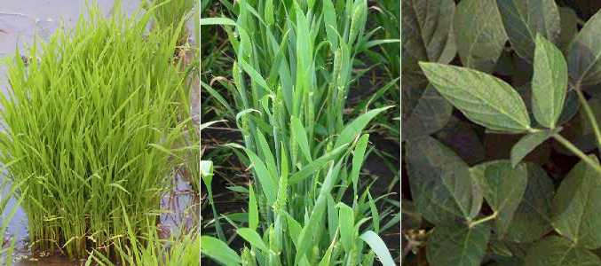
In C3 plants the photosynthesis, carbon fixation and Calvin cycle all occur in a single chloroplast.

Slide 30
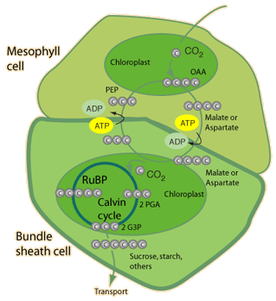
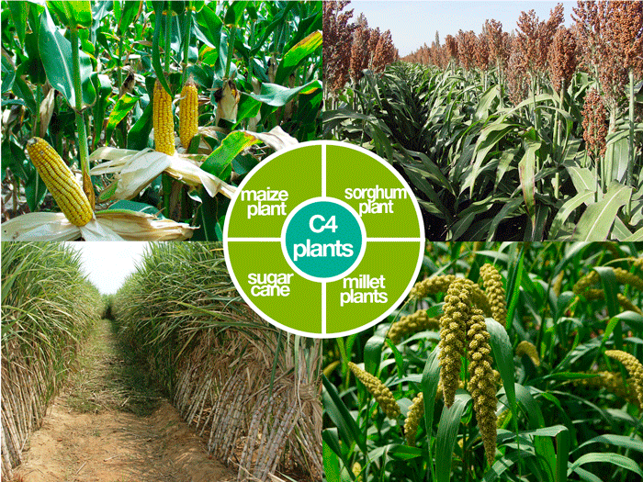
In C4 plants the photosynthesis takes place in a chloroplast of a thin-walled mesophyll cell and a 4-carbon acid is handed off to a thick-walled bundle sheath cell where the Calvin cycle occurs in a chloroplast of that second cell. This protects the Calvin cycle from the effects of photorespiration

Slide 31
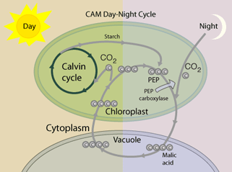
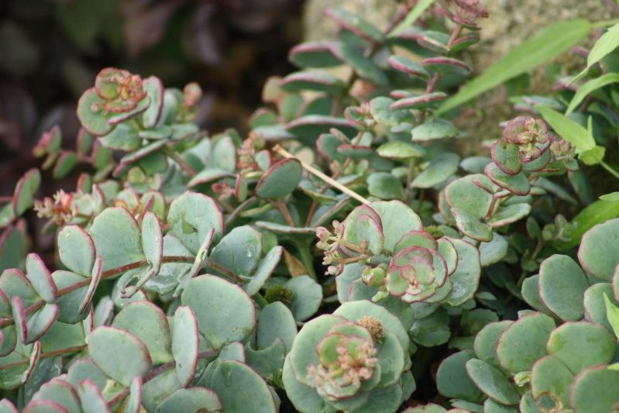
In CAM plants the photosynthesis and initial carbon fixation occur at night and a 4-carbon acid is stored in the cell's vacuole. During the day, the Calvin cycle operates in the same chloroplasts.

