Slide 1
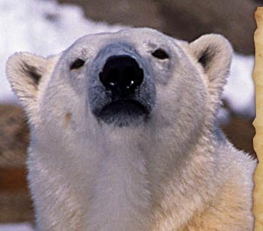
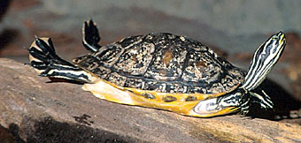
All living systems need energy
ENDOTHERM
ECTOTHERM

Slide 2
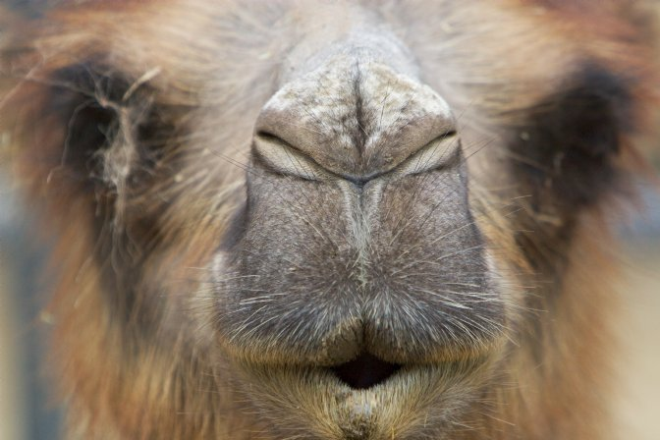
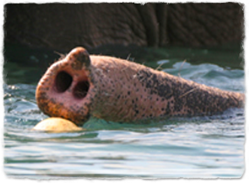
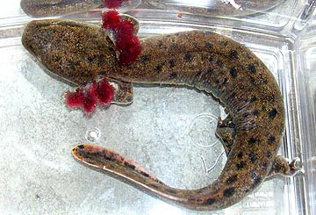
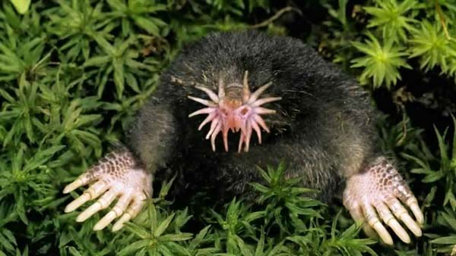

Slide 3
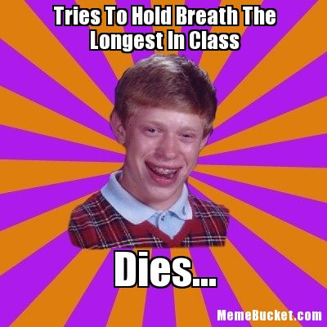
Do this: hold your breath.
How long can you do so?
…but don’t be this guy!
p.s.: time to beat is 2 min 15 sec (Emer) seconds…and he did not die.

Slide 4
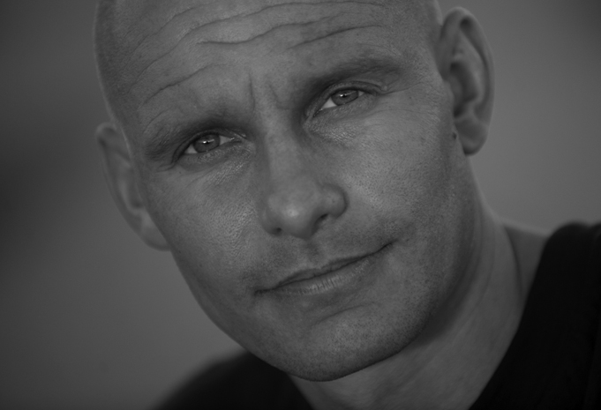
Who is Stig Severinsen?

Slide 5
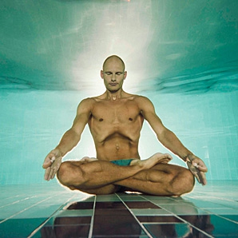
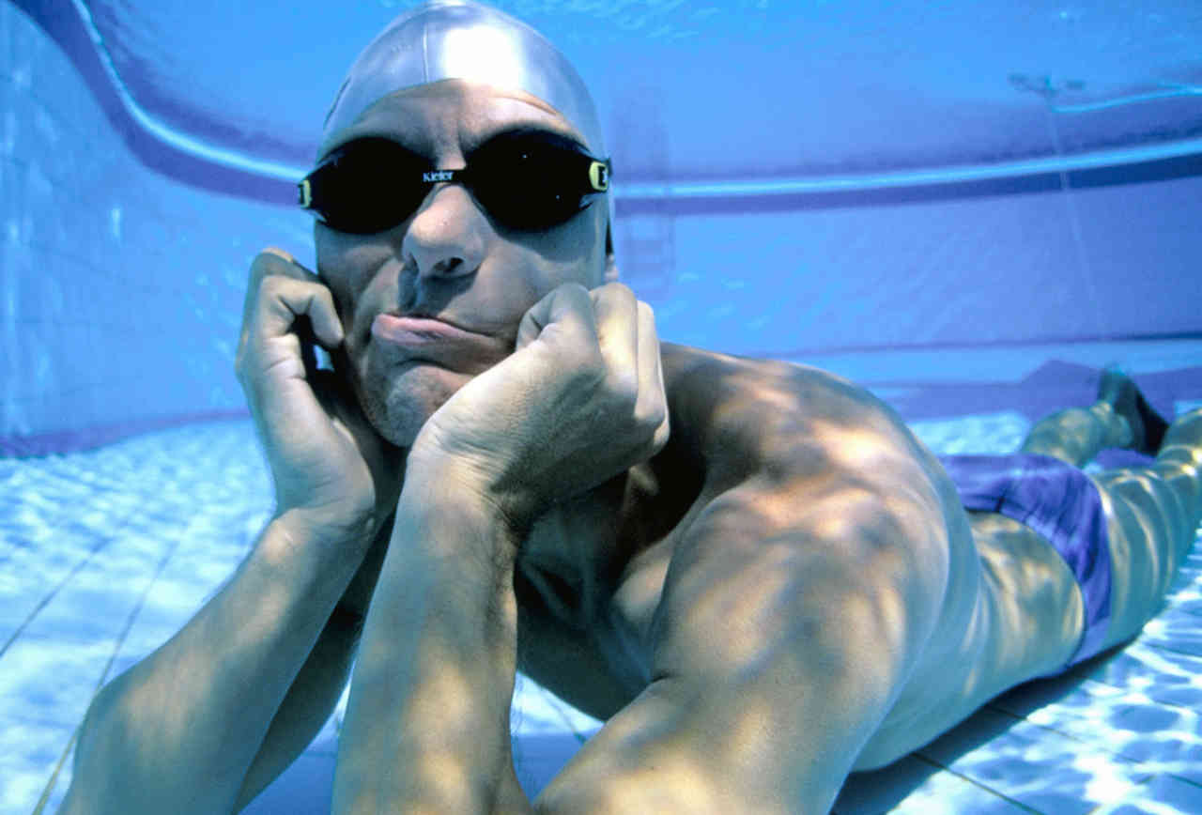
22 minutes 00 seconds
May 2012
Notes:
Record holder for freediving. Has learned to control breathing and heart rate to stay under water for long periods of time.

Slide 6
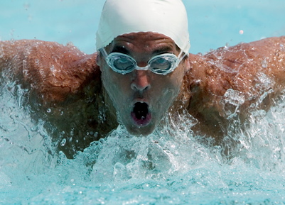
Why do living things need oxygen???

Slide 7
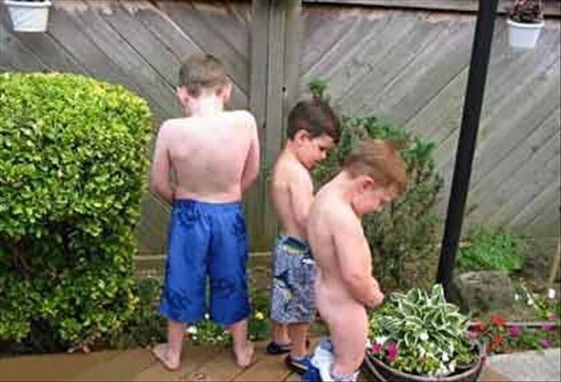
Think about this…
“What you breathe in, you urinate out.
What you eat, you breathe out.”

Slide 8
Aerobic
CELLULAR RESPIRATION

Slide 9
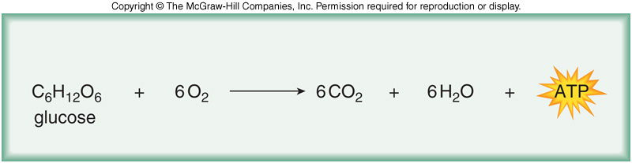
Cellular Respiration
The process of releasing the chemical energy in glucose to make ATP
Delta G = -686 kcal/mole

Slide 10
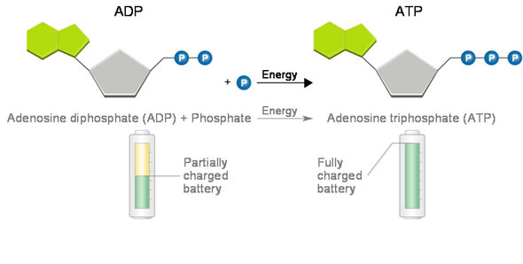
ATP
Adenosine tri phosphate
Made in mitochondria of eukaryotic cells.

Slide 11
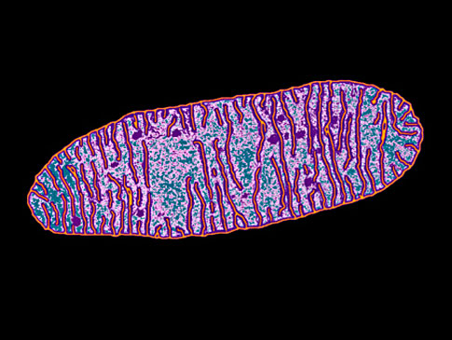
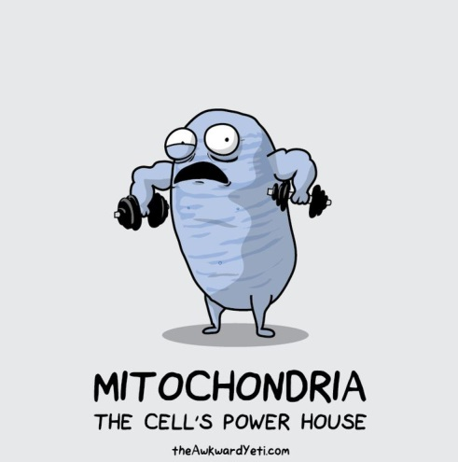
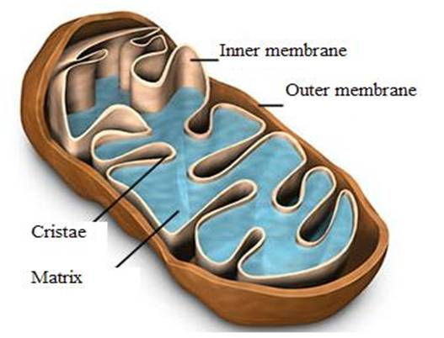
Interesting side-note: all your mitochondria are the same as your mother’s. Why is that?

Slide 12
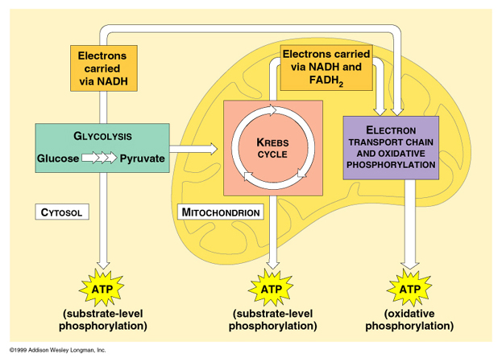
Cell respiration occurs in three main stages
Notes:
GLYCOLYSIS: glucose is broken down to two smaller molecules (pyruvic acid) and 2 ATP are produced.
KREBS CYCLE: pyruvic acid is broken down and carbon dioxide is released. Electron carriers capture the energy from the chemical bonds.
ELECTRON TRANSPORT CHAIN: The electron carriers give up their energy to make a proton gradient, and this is used to make 34 ATP molecules.

Slide 13
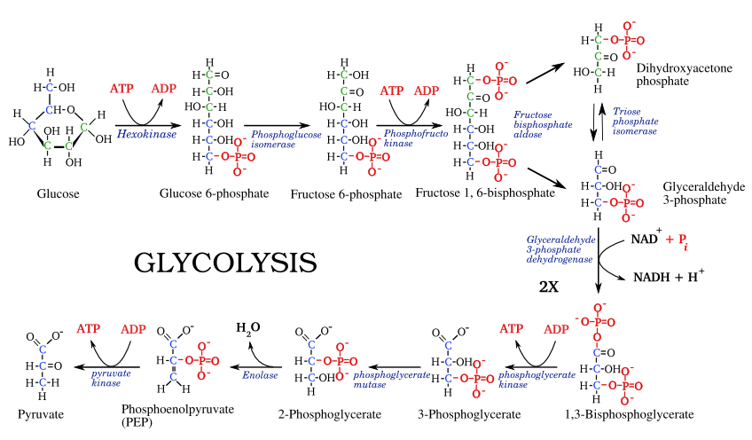
STEP 1: GLYCOLYSIS - “BREAK SUGAR”

Slide 14
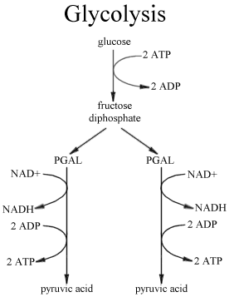

Slide 15
IN: OUT:
___ glucose ____ PYRUVATE
___ ATP ____ ATP
____ NADH
Color-code your notes!
ATP:
NADH:
PYRUVIC ACID:

Slide 16
KREBS CYCLE

Slide 17
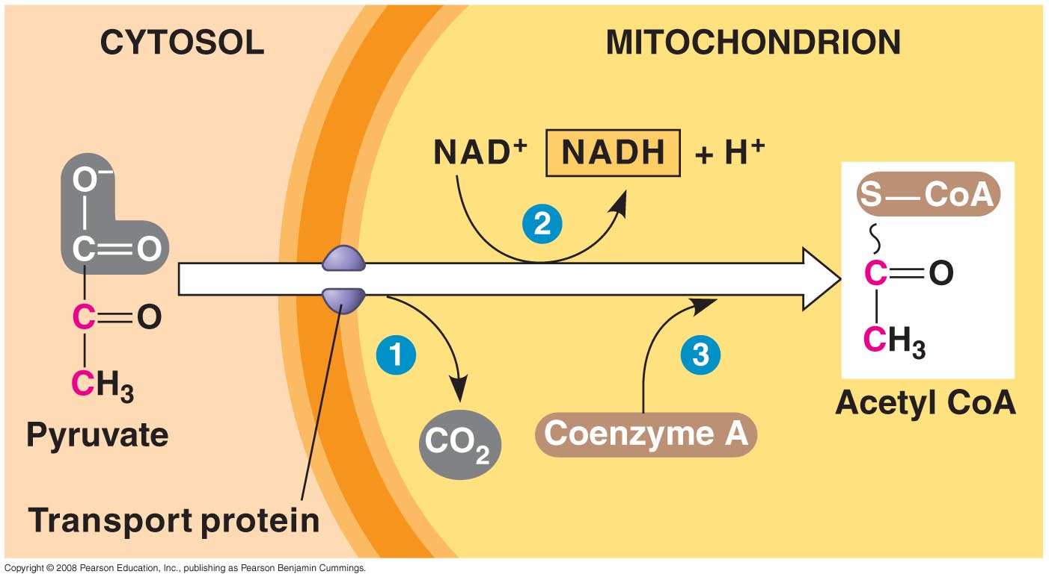

Slide 18
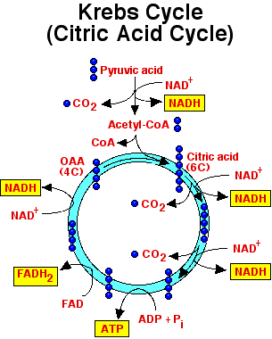
2. Kreb’s Cycle
Energy!
Energy!
Energy!

Slide 19
Summary Kreb’s
IN
OUT
For 1 acetyl CoA in…
(two per glucose)
____ CO2
____ NADH
____ FADH2
____ ATP
  Note: GTP first

Slide 20
ETC

Slide 21
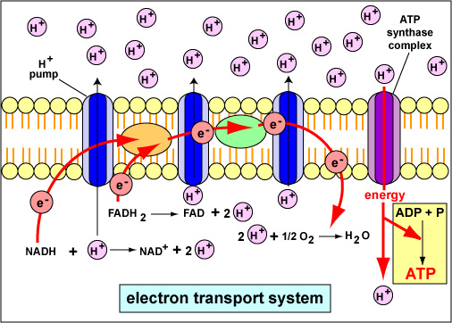

Slide 22
NADH donates e-; H+ to intermembrane space
CoQ transfers e- to next complex (progressively more electronegative)
Complex III accepts e- from FADH2, H+ to intermembrane space
Cyt c is e- carrier to complex IV
Oxygen acts as final e- acceptor
ATP Synthase uses chemiosmosis to generate ATP
  (oxidative phosphorylation)
Transport protein moves ATP to cytoplasm

Slide 23
3. ETC
IN
OUT
NADH
FADH2
Oxygen
32-34 ATP
water

Slide 24
So, now, does this make sense?
“What you breathe in, you urinate out.
What you eat, you breathe out.”
Biologists are so clever and funny!

Slide 25

So, Breathe! You need your oxygen for..
CELLULAR RESPIRATION’s ETC!

Slide 26
We’ve Done it!
…now you do it! POSTER to summarize all parts of cell respiration.
Use “cheat sheet” to include all molecules and labels on parts.

Slide 27
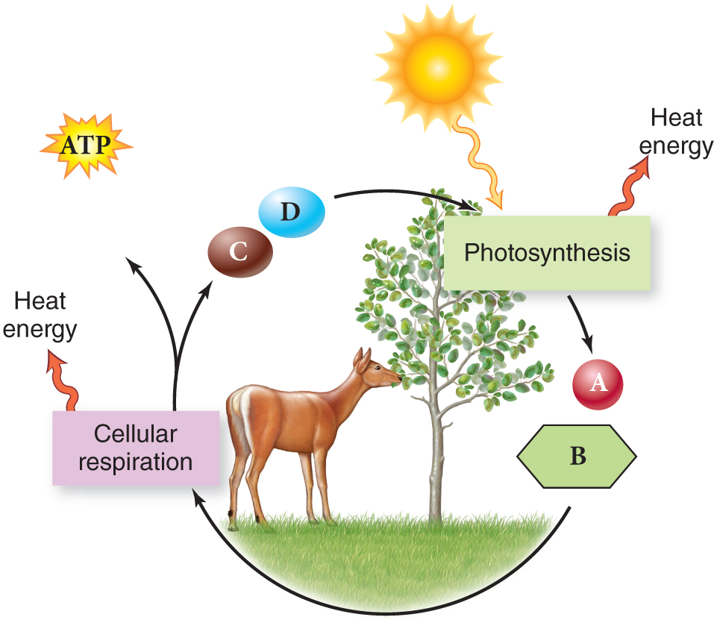

Slide 28
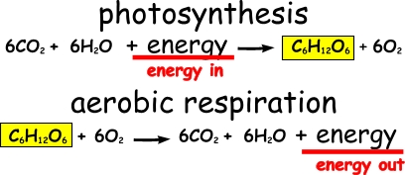

Slide 29
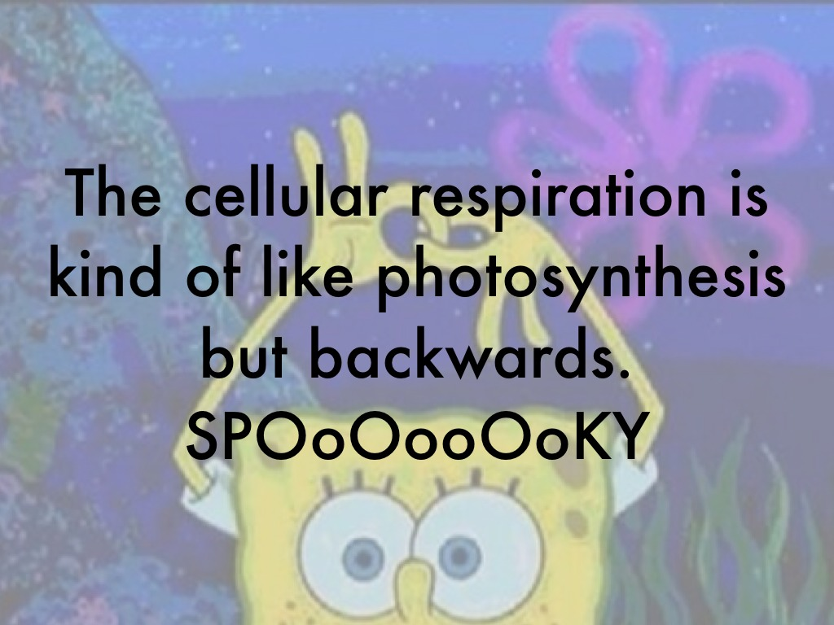

Slide 30

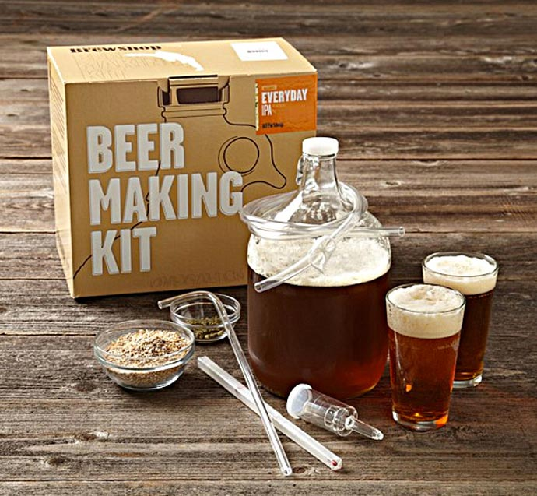
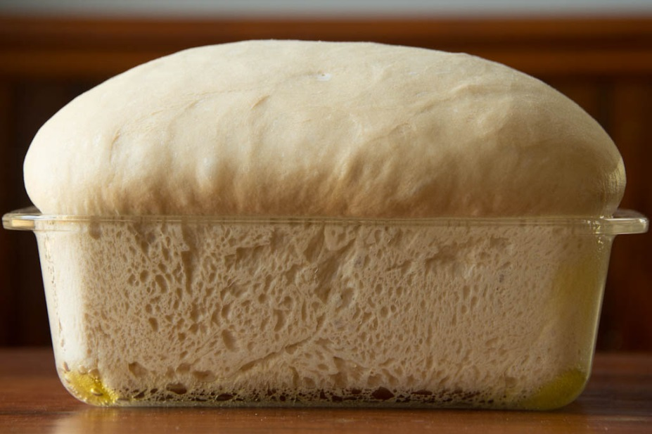
WHAT DO THESE PRODUCTS HAVE IN COMMON?

Slide 31
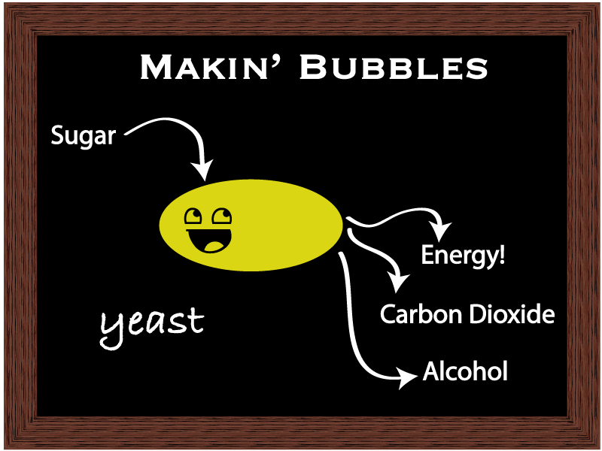

Slide 32
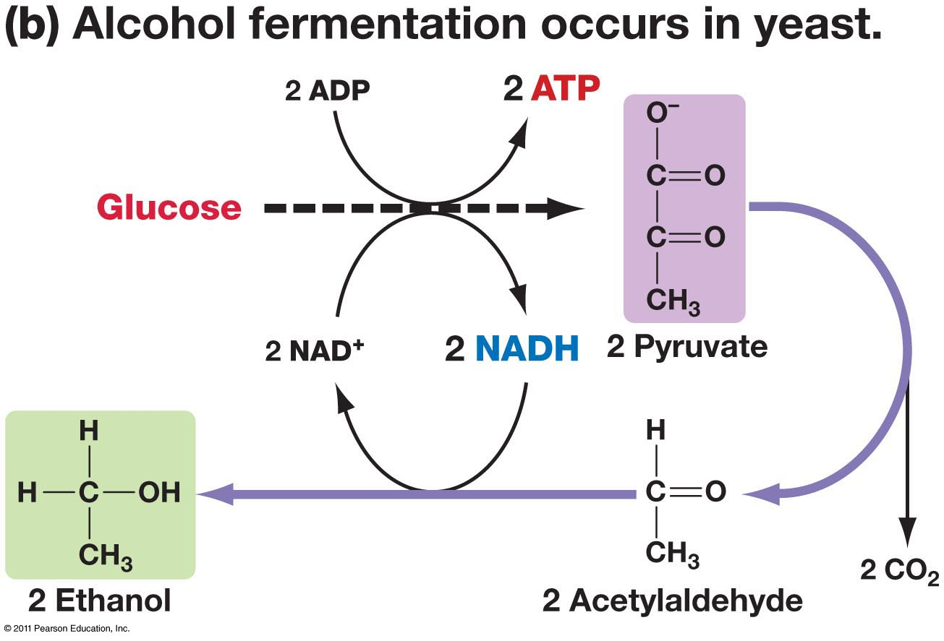

Slide 33
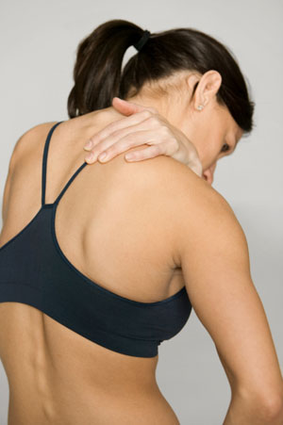
WHY DO WE GET SORE MUSCLES DURING/AFTER A HARD WORK-OUT?

Slide 34
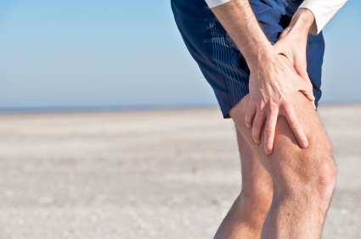
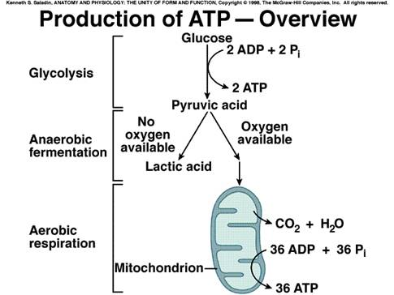
LACTIC ACID PRODUCTION: REVERSIBLE OXYGEN DEBT

Slide 35
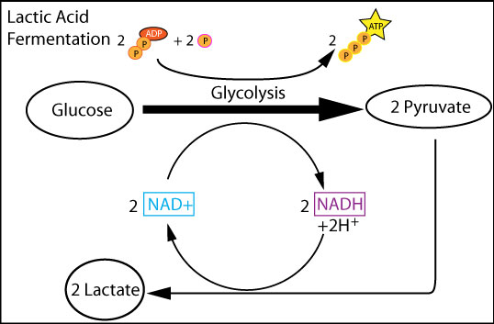

Slide 36
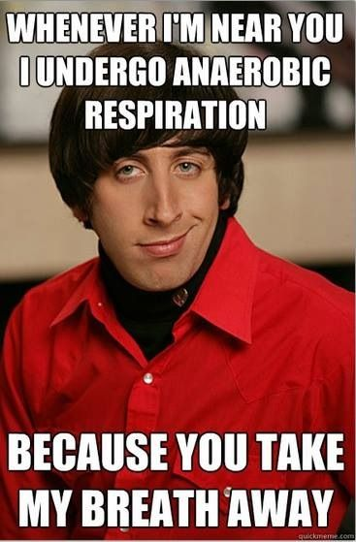

Slide 37
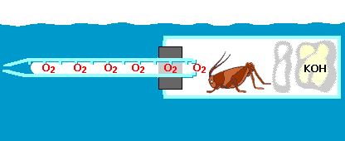
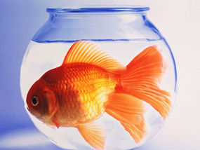
Metabolic Rates are Studied
INDIRECT MEASURING: OXYGEN CONSUMED or CARBON DIOXIDE PRODUCED
Q10: (temp coefficient) relationship between temp and metabolic rates
BMR: Relationship between activity and metabolic rate

