Slide 1

Faculty Satisfaction Survey 2022-2023
General Faculty Meeting 12/1/2023

Slide 2
Survey Instrument and Analysis
RNL Survey – 4 sections
  Campus Culture and Policies
  Institutional Goals
  Involvement in Planning and Decision-Making
  Work Environment
1-5 (low-high) on Importance and Satisfaction
Summary in terms of averages
Gap scores
Peer comparisons
MU custom questions
Strengths and Challenges

Slide 3
Data
Response Rates
Demographics
2013-14 | 2014-15 | 2015-16 | 2016-17 | 2020-21 | 2022-23
75% | 65% | 74% | 62% | 58% | 50%
How long have you worked at this institution? | Percent
Less than 1 Year | 2%
1 to 5 Years | 23%
6 to 10 Years | 19%
11 to 20 Years | 32%
More than 20 Years | 24%
Which college do you work for? | Percent
College of Arts & Sciences | 40%
College of Business | 5%
College of Health Sciences & Education | 55%

Slide 4
Survey Sections
Campus Culture and Policies
Institutional Goals
Involvement in Planning and Decision-Making
Work Environment

Slide 5
Section 1:
Campus Culture and Policies

Slide 6
Campus Culture and Policies
Importance
Most Important to MU Faculty
The leadership of this institution has a clear sense of purpose (4.81)
This institution plans carefully (4.79)
This institution promotes excellent employee-student relationships (4.76)
This institution treats students as its top priority (4.76)
Faculty take pride in their work (4.75)
Notes:
On a scale of 1-5-Importance and Satisfaction.
Importance: 5 very Important; 4-Important; 3=Somewhat Important; 2=Not Very Important; 1=Not Important at All
Satisfaction: 5=Very Satisfied; 4=Satisfied; 3=Somewhat Satisfied; 2=Not Very Satisfied; 1=Not Satisfied at all.

Slide 7
Campus Culture and Policies
Satisfaction
MU Faculty Most Satisfied
MU Faculty Least Satisfied
Faculty take pride in their work (3.95)
The mission, purpose, and values of this institution are well understood by most employees (3.90)
Staff take pride in their work (3.86)
This institution promotes excellent employee-student relationships (3.80)
Most employees are generally supportive of the mission, purpose, and values of this institution (3.71)
The institution conducts periodic assessment of the effectiveness of governance, leadership, and administration (2.45)*
This institution does a good job of meeting the needs of its faculty (2.39)
Employee suggestions are used to improve our institution (2.39)
This institution plans carefully (2.36)
There is good communication between the faculty and the administration at this institution (2.32)
Notes:
* Additional MU Faculty Question

Slide 8
Campus Culture and Policies
Importance – Satisfaction Gap
Largest Gap Areas Between Importance and Satisfaction
This institution plans carefully (2.43)
There is good communication between the faculty and the administration at this institution (2.40)
This institution does a good job of meeting the needs of its faculty (2.32)
This institution involves its employees in planning for the future (2.15)
The leadership of this institution has a clear sense of purpose (2.17)
The reputation of this institution continues to improve (2.09)
Employee suggestions are used to improve our institution (2.09)
This institution makes sufficient budgetary resources available to achieve important objectives (2.08)
There is a spirit of teamwork and cooperation at this institution (2.03)
Efforts to improve quality are paying off at this institution (2.00)
Notes:
Gap calculation – Performance gap means are calculated by taking the difference between the (mean) importance rating and the (mean) satisfaction rating.

Slide 9
Campus Culture and Policies
Comparison Data on Satisfaction
(p-value=.001)
 | MU Faculty Mean | Comparison Group Mean
There is good communication between the faculty and the administration at this institution | 2.32 | 3.38
This institution does a good job of meeting the needs of its faculty | 2.39 | 3.44
This institution plans carefully | 2.36 | 3.37
The leadership of this institution has a clear sense of purpose | 2.64 | 3.64
Notes:
comparison school list = 4-year Private who participated in the survey

Slide 10
Campus Culture and Policies
Additional MU Faculty Questions
 | Importance Mean | Satisfaction Mean | Gap
The institution conducts periodic assessment of the effectiveness of governance, leadership, and administration | 4.56 | 2.45 | 2.11
Administrators provide adequate notice to faculty when changes are made that affect teaching loads, # of sections, course caps, etc. | 4.63 | 2.66 | 1.97
The institution possesses and demonstrates a clearly articulated and transparent governance structure that outlines roles, responsibilities, and accountability for decision making by each constituency, including governing body, administration, faculty, staff and students | 4.64 | 2.76 | 1.88
Administrators consult with faculty before making changes including course offerings, course caps, # of sections, etc. | 4.55 | 2.75 | 1.80
The university's administration uses fair and impartial practices in the hiring, evaluation, promotion, discipline, and separation of employees | 4.67 | 2.89 | 1.78
The university's administration demonstrates honesty and truthfulness in public relations announcements, advertisements, recruiting and admissions materials and practices, as well as in internal communications | 4.62 | 2.85 | 1.77
The institution provides support for course development | 4.48 | 2.88 | 1.60
The university administration fosters a climate of respect among students, faculty, staff, and administration from a range of diverse backgrounds, ideas, and perspectives | 4.60 | 3.07 | 1.53

Slide 11
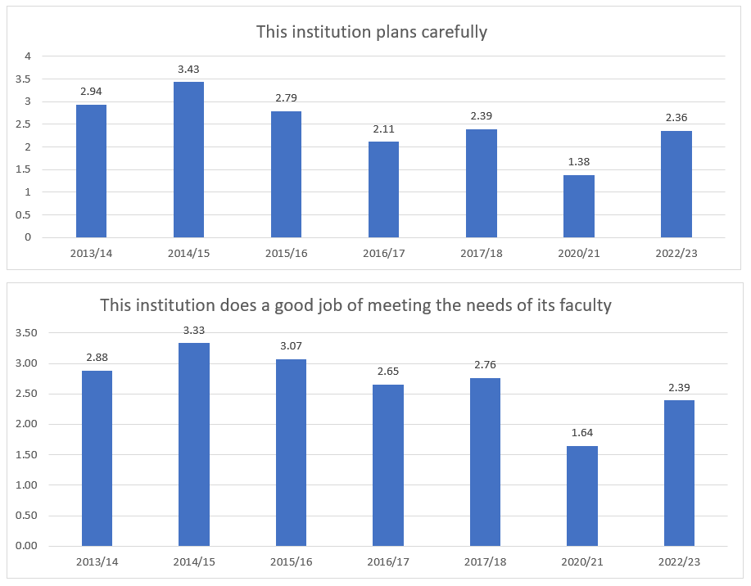
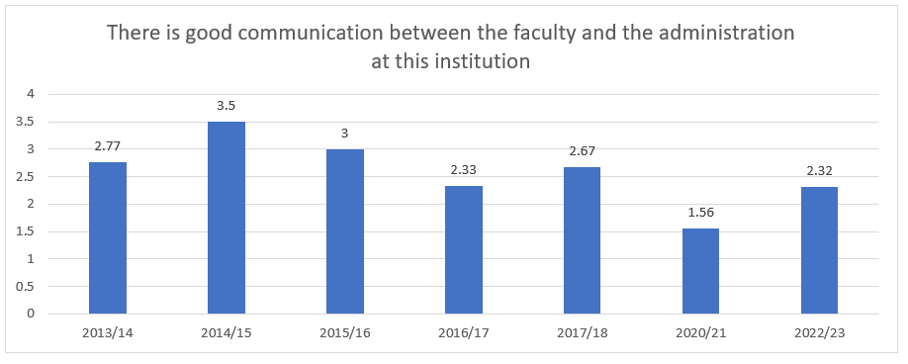
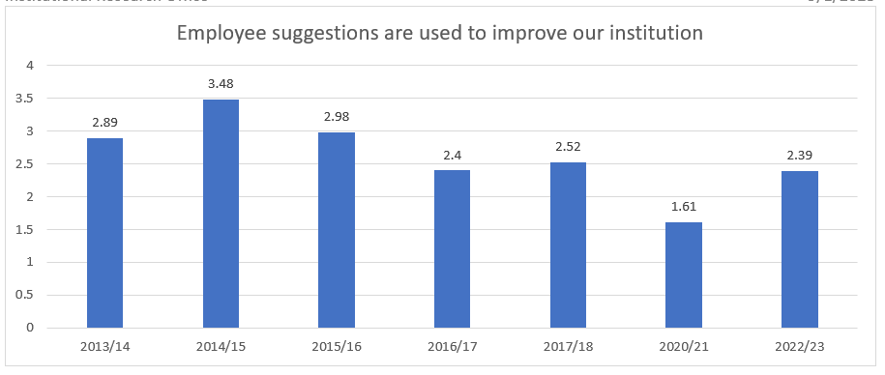
Trends
Select Questions in Campus Culture and Policies

Slide 12
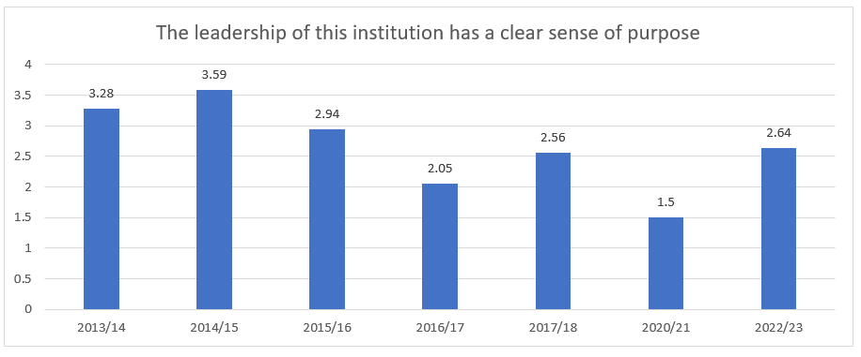
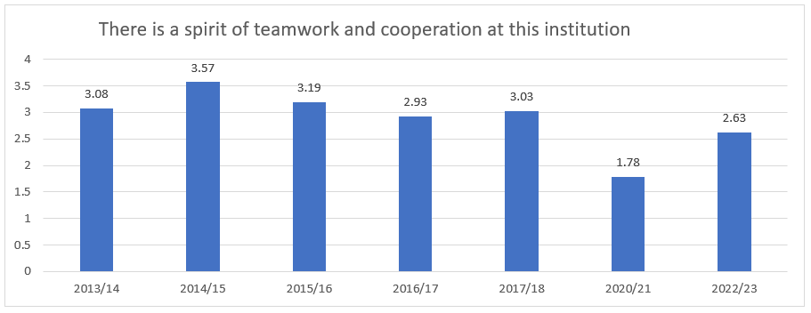
Trends
Select Questions in Campus Culture and Policies

Slide 13
Campus Culture and Policies
Comments
My perception is that a focus on student learning, student needs, and academic quality (mission) has been replaced by a focus only on $ and enrollment (this is not new- has been occurring since COVID). Both are important and should receive equal attention. Many faculty feel overworked, devalued, and uninspired and morale is low. We don't have enough faculty to support students.
The decimation of faculty lines since 2020 is having a destructive impact on students' education.
No promotions or raise in compensation if NTT. Pay is inequitable within the same departments which has caused a lot of issues. Unable to switch from NTT to TT lines. Practice doctorates not recognized for Tenure or TT.

Slide 14
Section 2:
Institutional Goals

Slide 15
Institutional Goals
Total “Votes” for Each Goal | Percent
Increase the enrollment of new students | 22.8%
Retain more of its current students to graduation | 7.8%
Improve the academic ability of entering student classes | 5.4%
Recruit students from new geographic markets | 4.2%
Increase the diversity of racial and ethnic groups represented among the student body | 6.6%
Develop new academic programs | 3.0%
Improve the quality of existing academic programs | 15.0%
Improve the appearance of campus buildings and grounds | 0.6%
Improve employee morale | 18.6%
The institution practices shared governance according to the AAUP statement on shared governance* | 3.6%
The institution has a balanced perspective on academic quality and financial goals* | 10.2%
Some other goal | 2.4%
All responses | 100.0%
Notes:
This section had employees rank goals as top priories – 1st, 2nd, 3rd.
* Additional MU Faculty Questions

Slide 16
Institutional Goals
Comments
Each academic program should have a formalized written marketing plan developed by marketing/enrollment management. This might include a specific modest budget for marketing activities and a realistic plan/timeline for implementation. If we focus on increasing enrollment where there is the most market demand in programs with room for increased capacity, this would be an excellent initial focus, possibly building from there.
We need to figure out how to overcome our financial deficit without reducing faculty and replacing lost faculty to the point where department chairs can be comfortable in offering the amount and types of classes that are needed.
We need to re-evaluate and provide sufficient support for programs that directly support students, such as counseling (CAPS center), FYE (ensure program is effectively catering to the needs of incoming students), and other programs/services.

Slide 17
Section 3:
Involvement in Planning and Decision-Making

Slide 18
Involvement in Planning and Decision-Making
Involvement 1=‘Not Enough’ 3=‘Just the Right Amount’ 5=‘Too Much Involvement’ | MU Faculty Mean | Comparison Group Mean | Significant Difference
How involved are: Faculty | 2.05 | 2.86 | ***
How involved are: Staff | 2.32 | 2.42 | NS
How involved are: Deans or directors of administrative units | 2.62 | 3.27 | ***
How involved are: Deans or chairs of academic units | 2.37 | 3.24 | ***
How involved are: Senior administrators (VP, Provost level or above) | 4.04 | 3.64 | ***
How involved are: Students | 2.50 | 2.51 | NS
How involved are: Trustees | 4.04 | 3.37 | ***
How involved are: Alumni | 2.74 | 2.67 | NS
Additional MU Faculty Questions 2022-23
Involvement 1=‘Not Enough’ 3=‘Just the Right Amount’ 5=‘Too Much Involvement’ | MU Staff Mean
How involved are: Registrar | 3.64
How involved are: Department chairs or Program directors | 2.42
How involved are: VPAA | 3.77
Notes:
*p-value of .05 - the two scores are significantly different, and such a difference would only be due to a chance of 5% of the time.
** p-value of .01 - the two scores are significantly different, and such a difference would only be due to a chance of 1% of the time.
*** p-value of .001 - the two scores are significantly different, and such a difference would only be due to a chance of 0.1% of the time.

Slide 19
Section 4:
Work Environment

Slide 20
Work Environment
Importance
Most Important to MU Faculty
My supervisor pays attention to what I have to say (4.69)
The institution employs an appropriate number of full-time tenure-track faculty to meet department and curricular needs* (4.67)
The employee benefits available to me are valuable (4.64)
I am paid fairly for the work I do (4.63)
The type of work I do on most days is personally rewarding (4.63)
I trust the actions of senior administrators* (4.63)
The work I do is valuable to the institution (4.61)
My department has the staff needed to do its job well (4.60)

Slide 21
Work Environment
Satisfaction
MU Faculty Most Satisfied
MU Faculty Least Satisfied
My department meets as a team to plan and coordinate work (4.25)
My department or work unit has written, up-to-date objectives (4.26)
My supervisor pays attention to what I have to say (4.16)
The work I do is appreciated by my supervisor (4.13)
My supervisor helps me improve my job performance (4.02)
The institution employs an appropriate number of full-time tenure-track faculty to meet department and curricular needs* (1.87)
I trust the actions of senior administrators* (2.37)
I have the information I need to do my job well (2.45)
It is easy for me to get information at this institution (2.73)
I am paid fairly for the work I do (2.76)
I have adequate opportunities for advancement (2.76)
I learn about important campus events in a timely manner (2.95)
I am empowered to resolve problems quickly (2.95)

Slide 22
Work Environment
Importance – Satisfaction Gap
Gap Areas Between Importance and Satisfaction
The institution employs an appropriate number of full-time tenure-track faculty to meet department and curricular needs* (2.80)
I trust the actions of senior administrators* (2.26)
My department has the staff needed to do its job well (2.05)
Notes:
Gap calculation – Performance gap means are calculated by taking the difference between the (mean) importance rating and the (mean satisfaction rating.

Slide 23
Work Environment
Comparison Data on Satisfaction
(p-value of .001)
 | MU Faculty Mean | Comparison Group Mean
It is easy for me to get information at this institution | 2.73 | 3.42
I learn about important campus events in a timely manner | 2.95 | 3.64
I am empowered to resolve problems quickly | 2.95 | 3.60
My department or work unit has written, up-to-date objectives | 4.26 | 3.71
I am proud to work at this institution | 3.59 | 4.15

Slide 24
Work Environment
Comments
My work is appreciated within my program.
I have no pathway for promotion as NTT, but look forward to the opportunity when it becomes available.
The institution lacks shared governance when it comes to communication between faculty and the VPAA and VPFA.
Departments across the board are under-staffed and, with the ongoing departures, this is only getting worse.

Slide 25
Work Environment
Additional MU Faculty Questions
 | Importance Mean | Satisfaction Mean | Gap
The institution employs an appropriate number of full-time tenure-track faculty to meet department and curricular needs | 4.67 | 1.87 | 2.80
I trust the actions of senior administrators | 4.63 | 2.37 | 2.26
Communication with the VPAA is adequate​ | 4.43 | 3.20 | 1.23
The institution provides adequate office/classroom/ lab space | 4.57 | 3.41 | 1.16
I have adequate technology to meet my needs​ | 4.36 | 3.73 | 0.63
Communication with my college Dean is adequate | 4.41 | 3.84 | 0.57

Slide 26
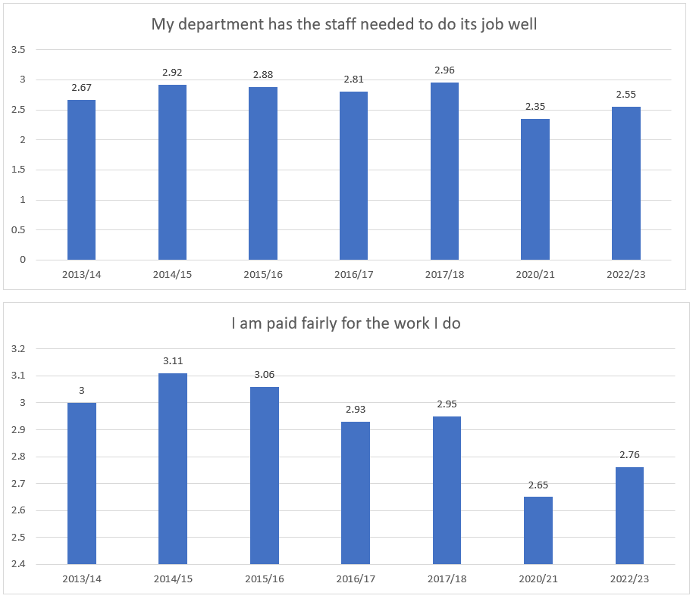
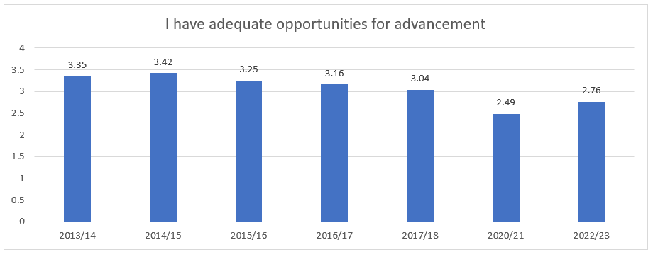
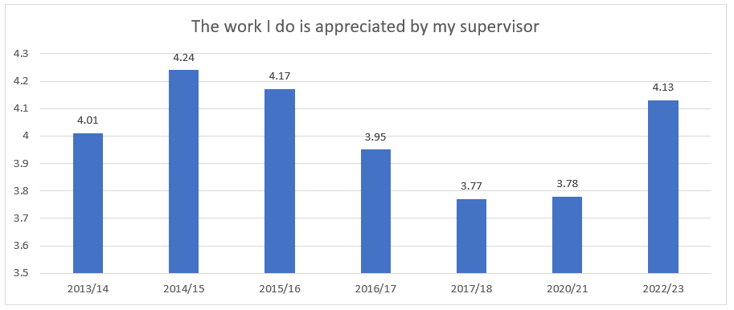
Trends
Select Questions in Work Environment

Slide 27
Overall Satisfaction

Slide 29
Institutional Strengths
We agree that increasing enrollment of new students is a top goal
MU promotes excellent employee-student relationships
Departments meet as a team to plan and coordinate work
Departments or work units have written, up-to-date objectives
Supervisors pay attention to what we have to say
Work is appreciated by supervisors
Supervisors help improve our job performance
Faculty and staff take pride in their work
The mission, purpose, and values of this institution are well understood by most employees
Most employees are generally supportive of the mission, purpose, and values of this institution

Slide 30
Institutional Challenges
Lack of communication between faculty and administration
Feeling that the leadership does not have a clear sense of purpose
Lack of sufficient budgetary resources available to achieve important objectives
No real spirit of teamwork and cooperation
Not an appropriate number of full-time tenure-track faculty to meet department and curricular needs*
Lack of trust with the actions of senior administrators*
Lack of information and ease to obtain it to do my job well
Lack for adequate opportunities for advancement

Slide 31

Questions?
For more information, please contact the
Institutional Research Office at vtaylor@misericordia.edu.

