Slide 1

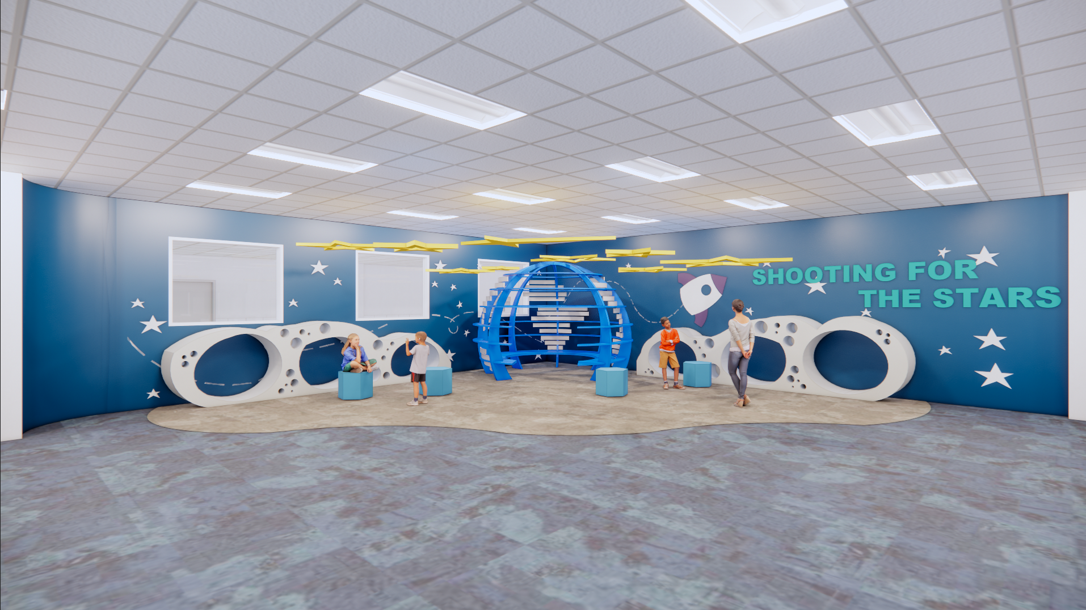



Improvements
Spark STEM Academy Improvements
Collaboration Spaces
Exterior Upgrades
Interior Upgrades
Mechanical, Electrical, Plumbing System Upgrades
New Marquee
Landscaping Improvements
Safety and Security
Access control and cameras at cameras at selected exterior doors
Bollards and hardened shell at main entry
Fire sprinkler system upgrades
Permanent walls and door installation
Secure Entry Vestibule
Technology
Secure and climate – controlled server space at each campus
Cabling
Wireless upgrades
Phone system Upgrades
Rainwater ES
cfbbond.com

Slide 2
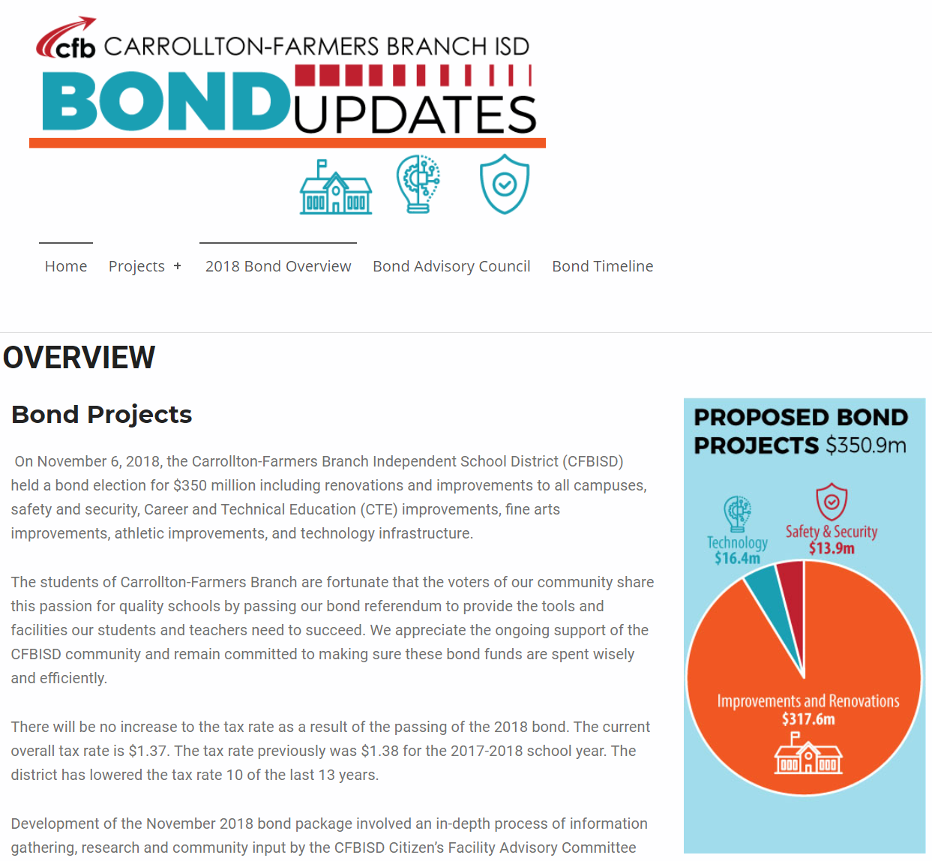
Improvements
Safety & Security
Collaboration Spaces
  Collaboration Spaces
  New Maker / STEM Space
Exterior Upgrades
  New landscaping
  New Perimeter Mow Strip Concrete
  Restored Crawlspace
Mechanical, Electrical, Plumbing, Systems Upgrades
  New HVAC and Controls
  New LED Lighting in Gym
  New LED Lighting in Parking Lots
  Replaced Damaged Drinking Fountains
  Replaced Freezer / Cooler
  New Water Heaters
  Upgraded Fire Alarm
  Maintained Existing Digital Marquee
Landscape Improvements
  Replaced Playground Fall Protection
  Restriped Parking Lot
Access Control
  Video Intercom
  Card Readers
  New Camera System
  Intrusion Alarm
  Impact Resistant Film (Completed prior to Bond Project)
Fire Sprinkler System Upgrades
Bollards (Completed prior to Bond Project)
Secure Entry Vestibule
Technology
Secure and Climate Controlled Server Space
Cabling & Wireless Upgrades
Public Announcement System
Bells
Clocks
Phone System
PROMISES MADE
PROMISES KEPT
PROMISES MADE
PROMISES KEPT

Slide 3
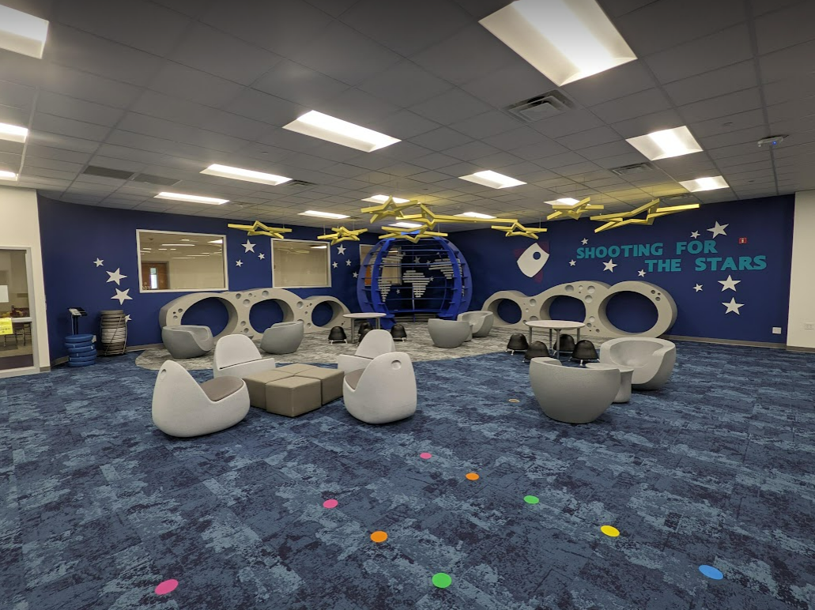
Improvements
Improvements
Collaboration Spaces
  Collaboration Spaces
  New Maker / STEM Space
Exterior Upgrades
  New landscaping
  New Perimeter Mow Strip Concrete
  Restored Crawlspace
Mechanical, Electrical, Plumbing, Systems Upgrades
  New HVAC and Controls
  New LED Lighting in Gym
  New LED Lighting in Parking Lots
  Replaced Damaged Drinking Fountains
  Replaced Freezer / Cooler
  New Water Heaters
  Upgraded Fire Alarm
  Maintained Existing Digital Marquee
Landscape Improvements
  Replaced Playground Fall Protection
  Restriped Parking Lot
PROMISES MADE
PROMISES KEPT
PROMISES MADE
PROMISES KEPT

Slide 4
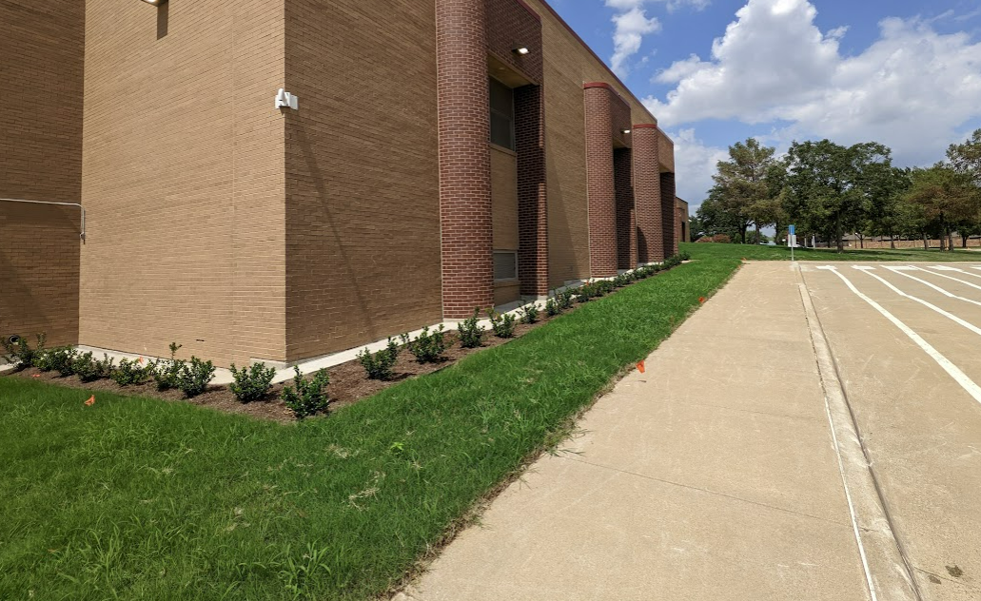
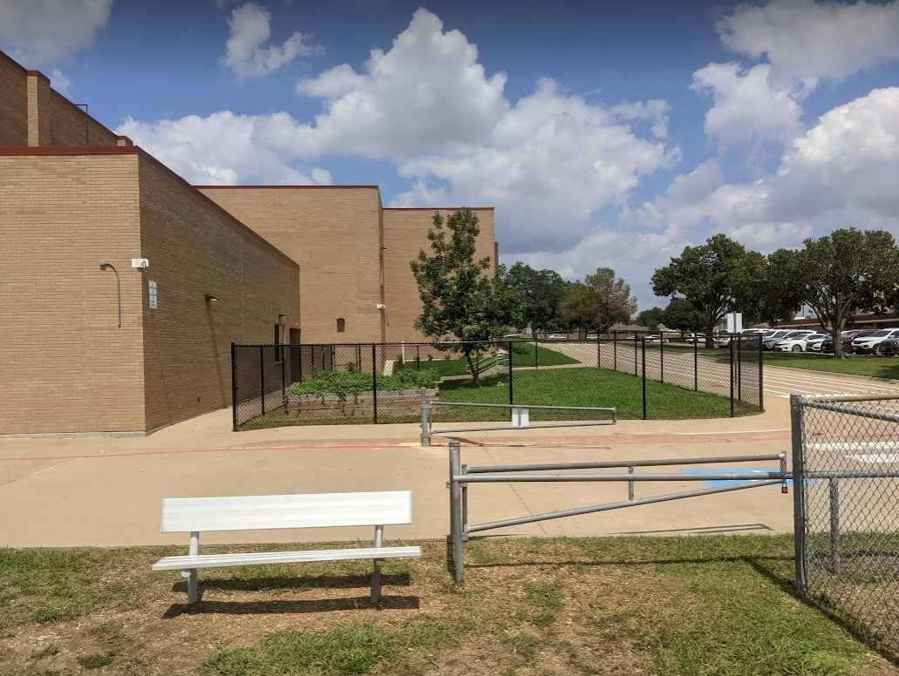
Improvements
Improvements
Collaboration Spaces
  Collaboration Spaces
  New Maker / STEM Space
Exterior Upgrades
  New landscaping
  New Perimeter Mow Strip Concrete
  Restored Crawlspace
Mechanical, Electrical, Plumbing, Systems Upgrades
  New HVAC and Controls
  New LED Lighting in Gym
  New LED Lighting in Parking Lots
  Replaced Damaged Drinking Fountains
  Replaced Freezer / Cooler
  New Water Heaters
  Upgraded Fire Alarm
  Maintained Existing Digital Marquee
Landscape Improvements
  Replaced Playground Fall Protection
  Restriped Parking Lot
Landscaping & Mow Strip
PROMISES MADE
PROMISES KEPT
PROMISES MADE
PROMISES KEPT
Site Fencing

Slide 5
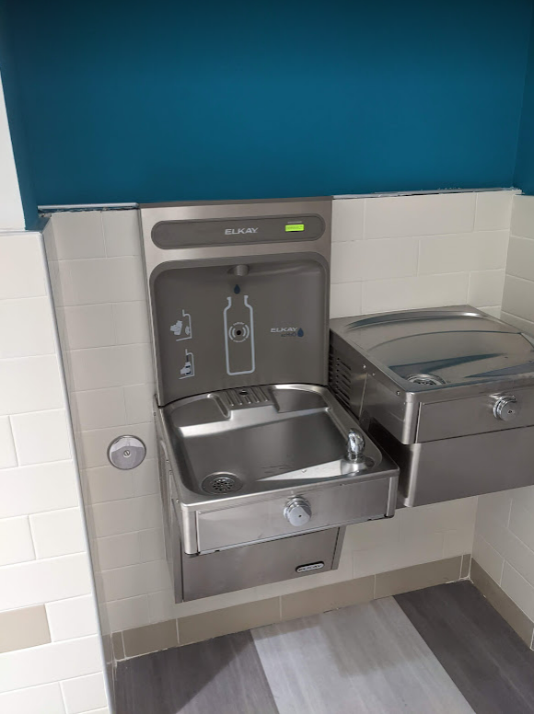
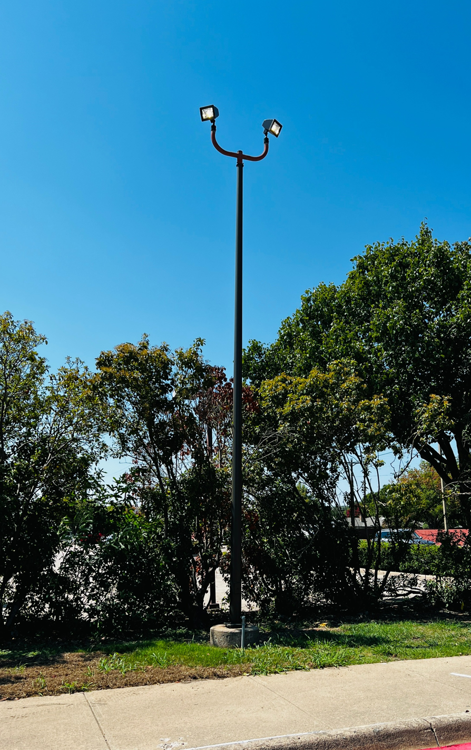
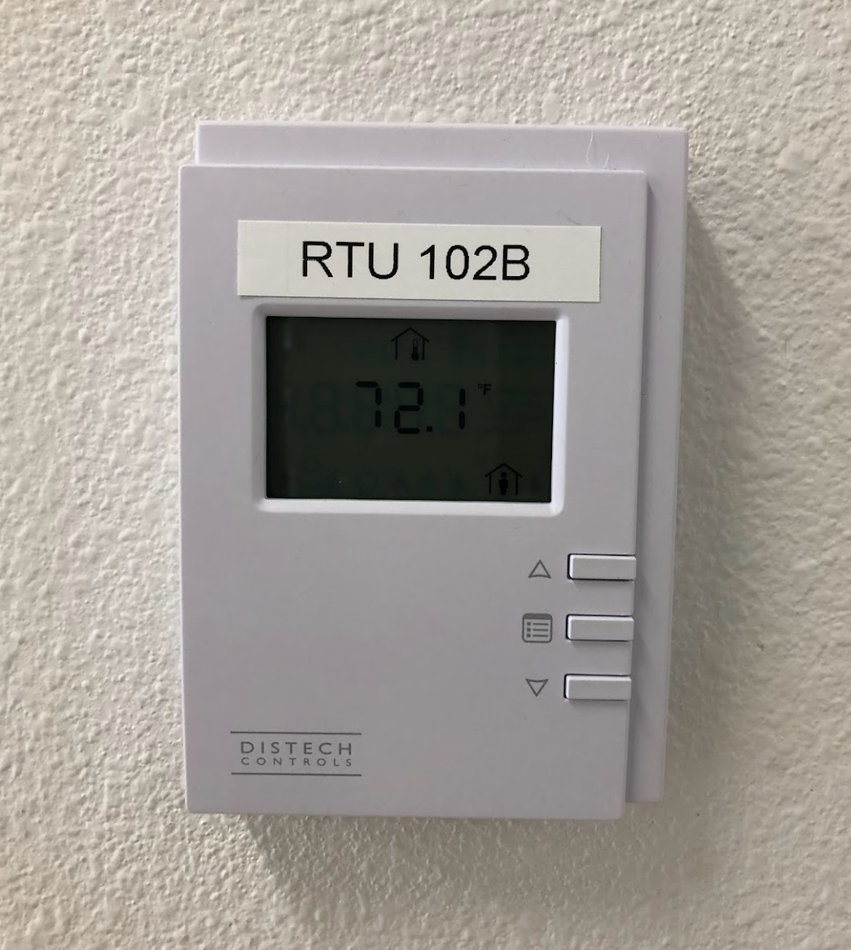
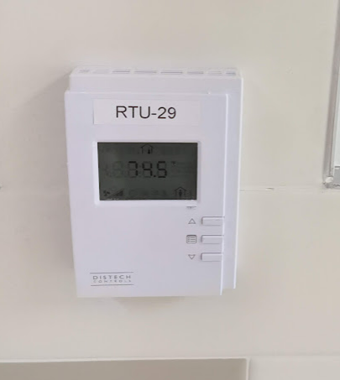
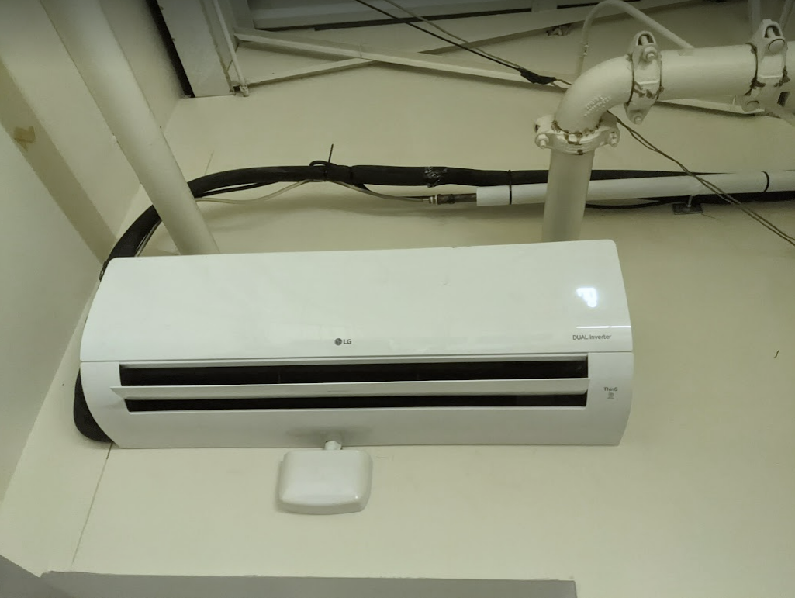
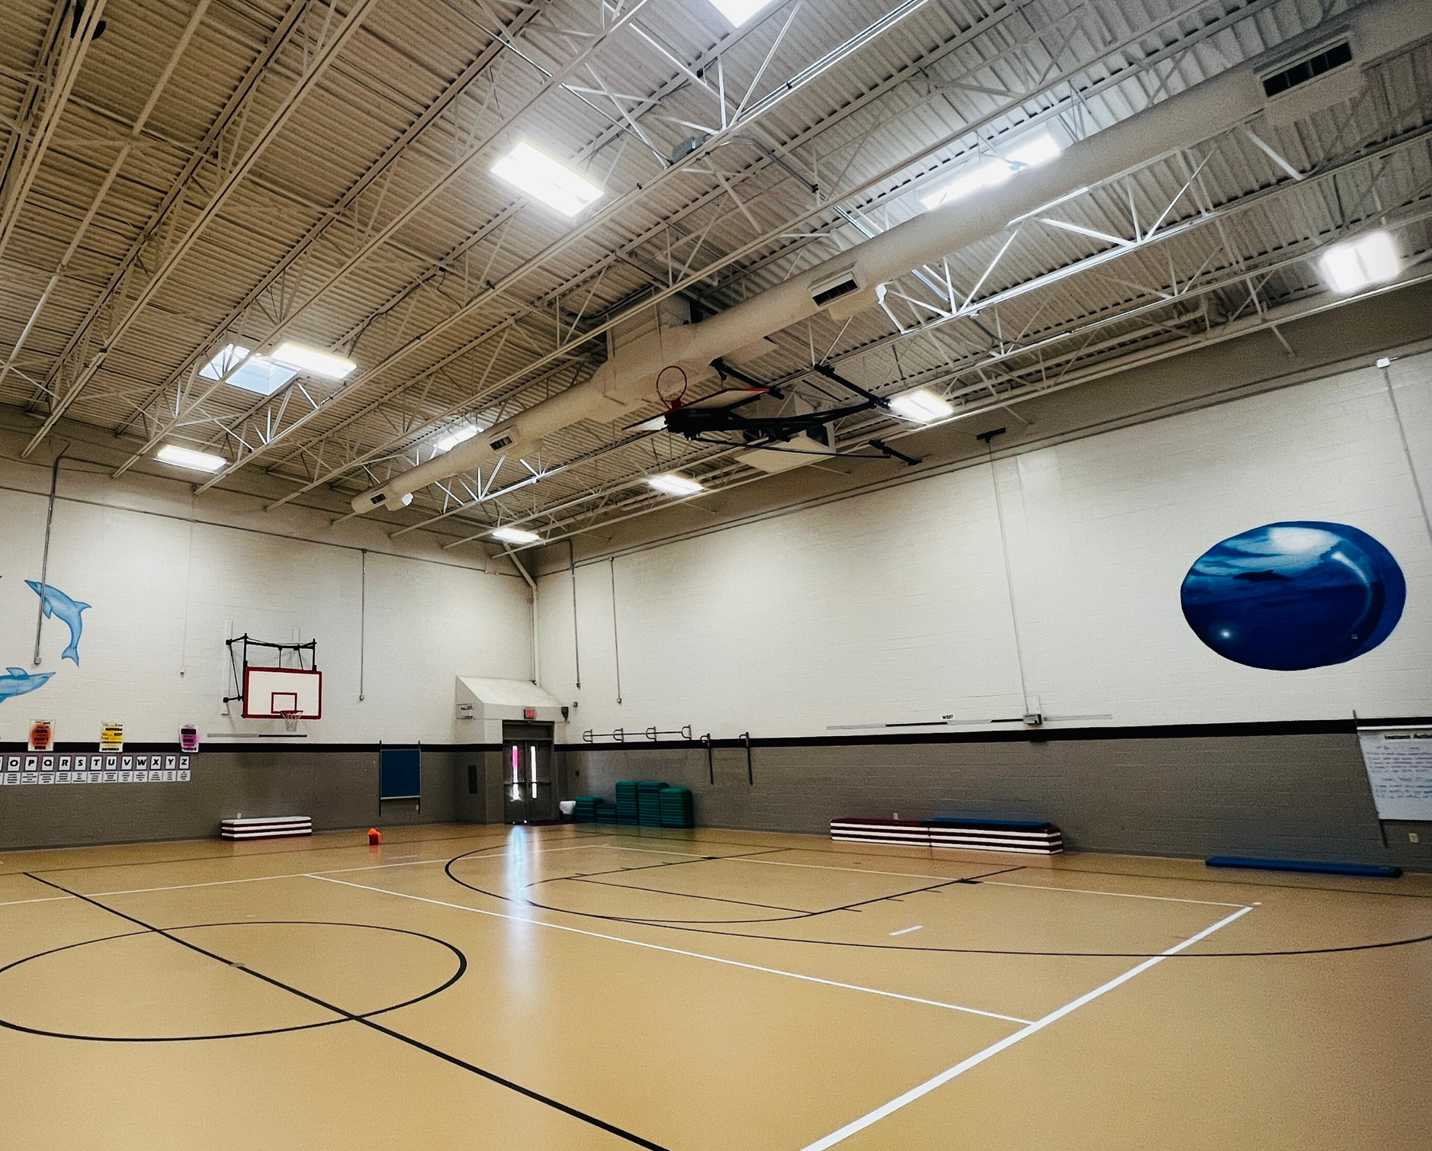
Improvements
Improvements
Collaboration Spaces
  Collaboration Spaces
  New Maker / STEM Space
Exterior Upgrades
  New landscaping
  New Perimeter Mow Strip Concrete
  Restored Crawlspace
Mechanical, Electrical, Plumbing, Systems Upgrades
  New HVAC and Controls
  New LED Lighting in Gym
  New LED Lighting in Parking Lots
  Replaced Damaged Drinking Fountains
  Replaced Freezer / Cooler
  New Water Heaters
  Upgraded Fire Alarm
  Maintained Existing Digital Marquee
Landscape Improvements
  Replaced Playground Fall Protection
  Restriped Parking Lot
LED Lighting in
Parking Lot
Drinking Fountains
HVAC Controls
PROMISES MADE
PROMISES KEPT
PROMISES MADE
PROMISES KEPT
HVAC – Mini Split
LED Lighting in Gym

Slide 6
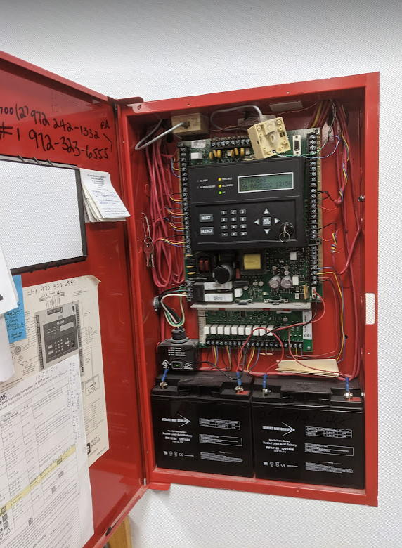
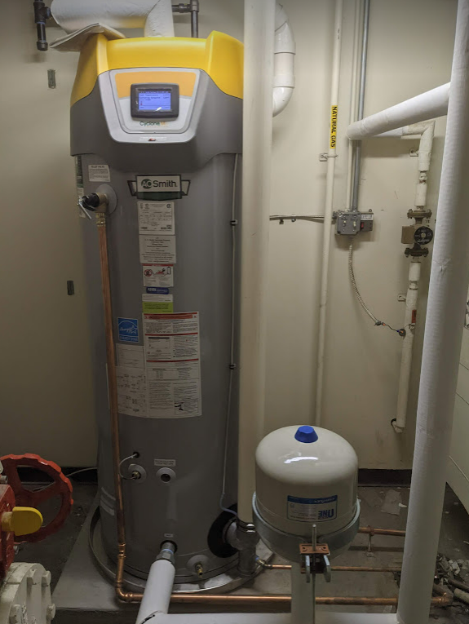
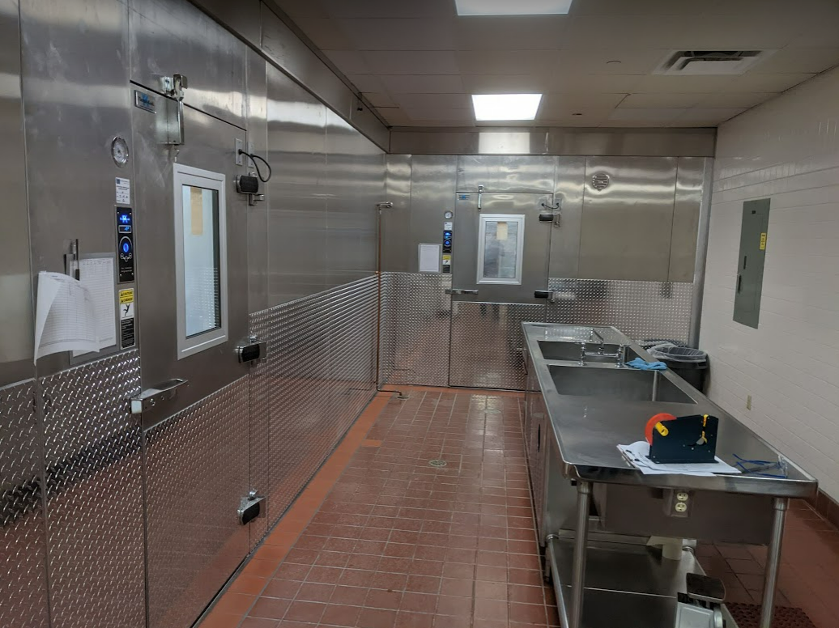
Improvements
Improvements
Collaboration Spaces
  Collaboration Spaces
  New Maker / STEM Space
Exterior Upgrades
  New landscaping
  New Perimeter Mow Strip Concrete
  Restored Crawlspace
Mechanical, Electrical, Plumbing, Systems Upgrades
  New HVAC and Controls
  New LED Lighting in Gym
  New LED Lighting in Parking Lots
  Replaced Damaged Drinking Fountains
  Replaced Freezer / Cooler
  New Water Heaters
  Upgraded Fire Alarm
  Maintained Existing Digital Marquee
Landscape Improvements
  Replaced Playground Fall Protection
  Restriped Parking Lot
Fire Alarm
PROMISES MADE
PROMISES KEPT
PROMISES MADE
PROMISES KEPT
Replaced Freezer / Cooler
Water Heater

Slide 7
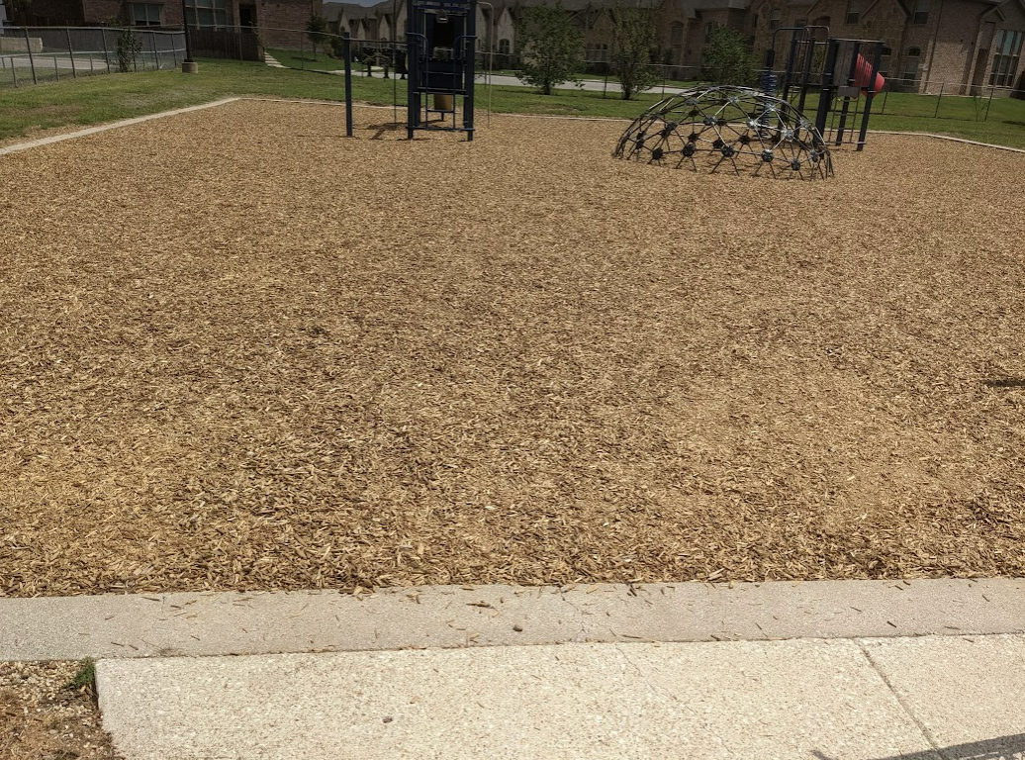
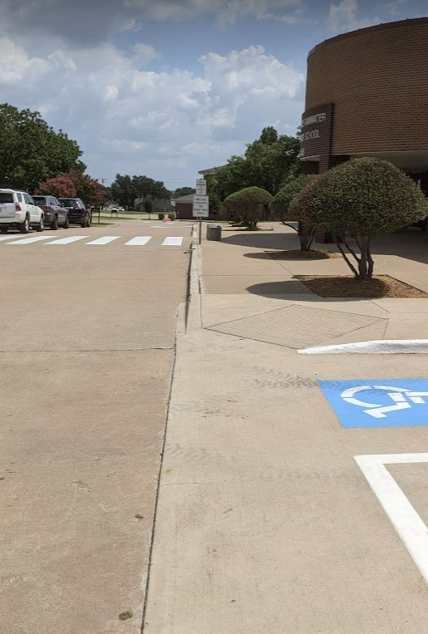
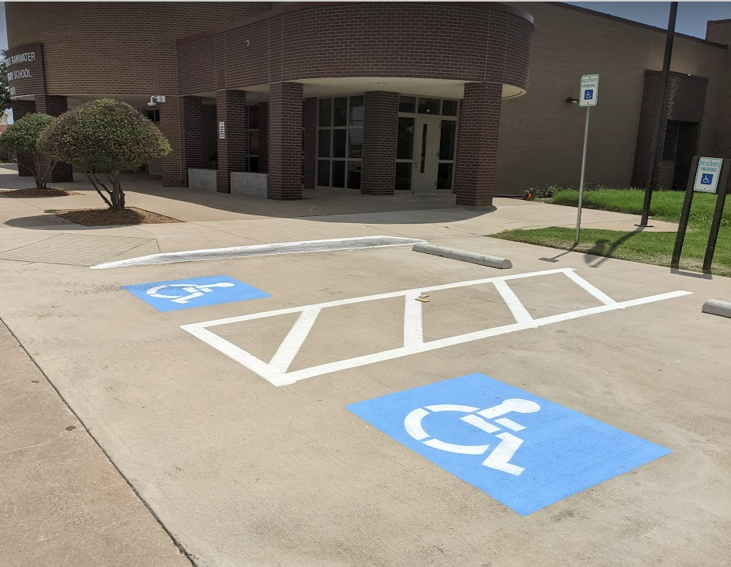
Improvements
Improvements
Collaboration Spaces
  Collaboration Spaces
  New Maker / STEM Space
Exterior Upgrades
  New landscaping
  New Perimeter Mow Strip Concrete
  Restored Crawlspace
Mechanical, Electrical, Plumbing, Systems Upgrades
  New HVAC and Controls
  New LED Lighting in Gym
  New LED Lighting in Parking Lots
  Replaced Damaged Drinking Fountains
  Replaced Freezer / Cooler
  New Water Heaters
  Upgraded Fire Alarm
  Maintained Existing Digital Marquee
Landscape Improvements
  Replaced Playground Fall Protection
  Restriped Parking Lot
New Playground Fall Protection
PROMISES MADE
PROMISES KEPT
PROMISES MADE
PROMISES KEPT
Restriped Parking Lot
Restriped Parking Lot

Slide 8
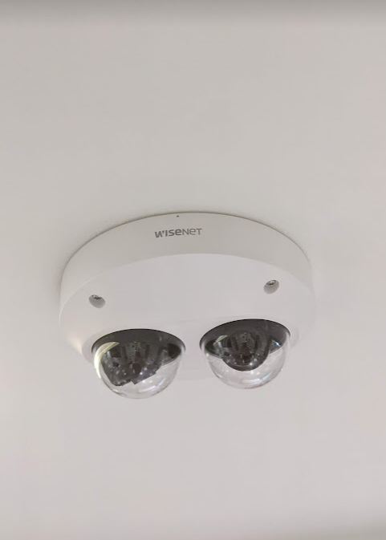
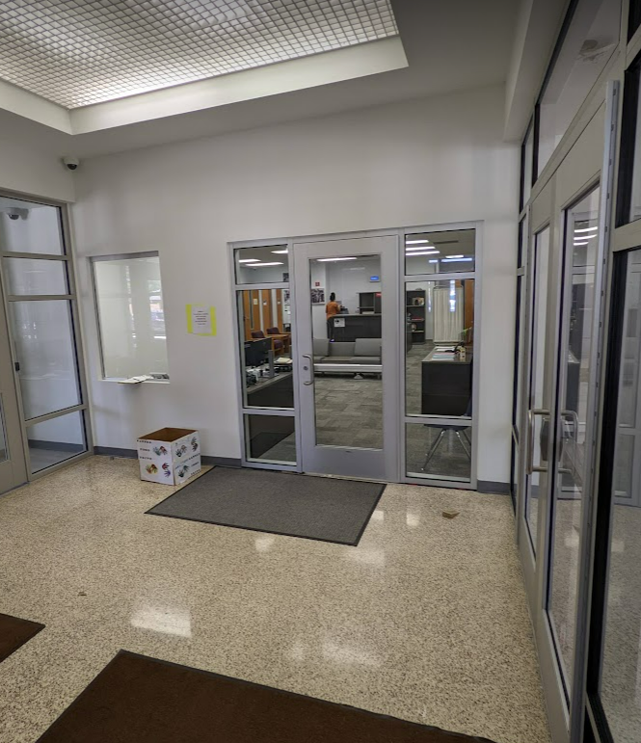
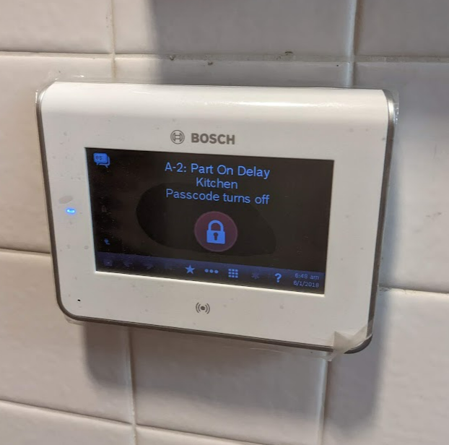
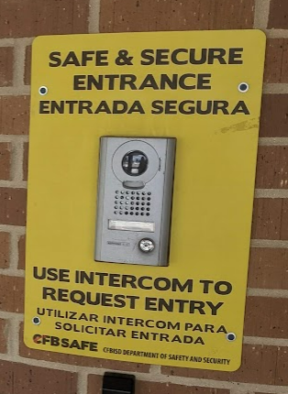
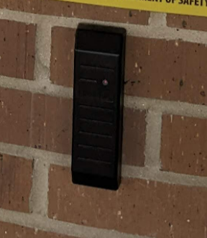
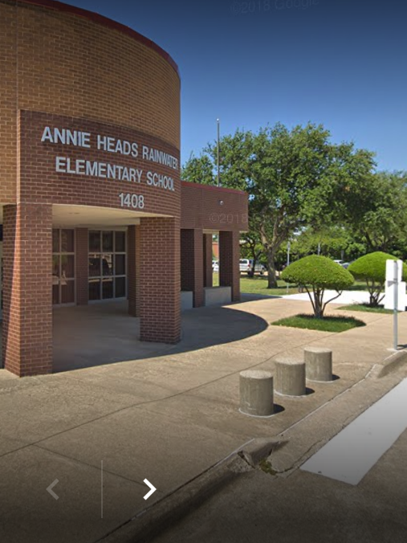
Safety and Security
Access Control
  Video Intercom, Card Readers, & New Camera System
  Intrusion Alarm
  Impact Resistant Film (Completed prior to Bond Project)
Fire Sprinkler System Upgrades
Bollards (Completed prior to Bond Project)
Secure Entry Vestibule
Cameras
Secure Vestibule
Intrusion Alarm
PROMISES MADE
PROMISES KEPT
Existing Intercom
Existing Card Reader
Bollards

Slide 9
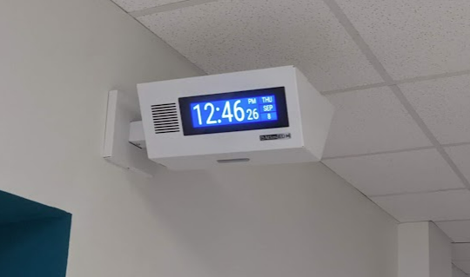
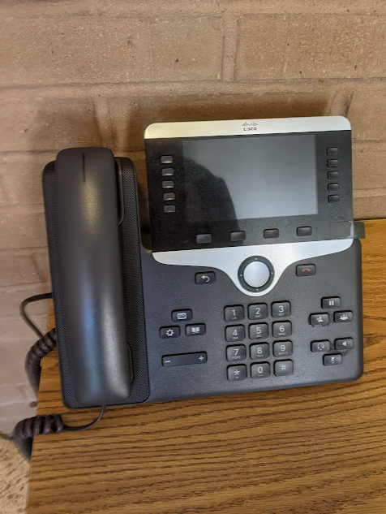
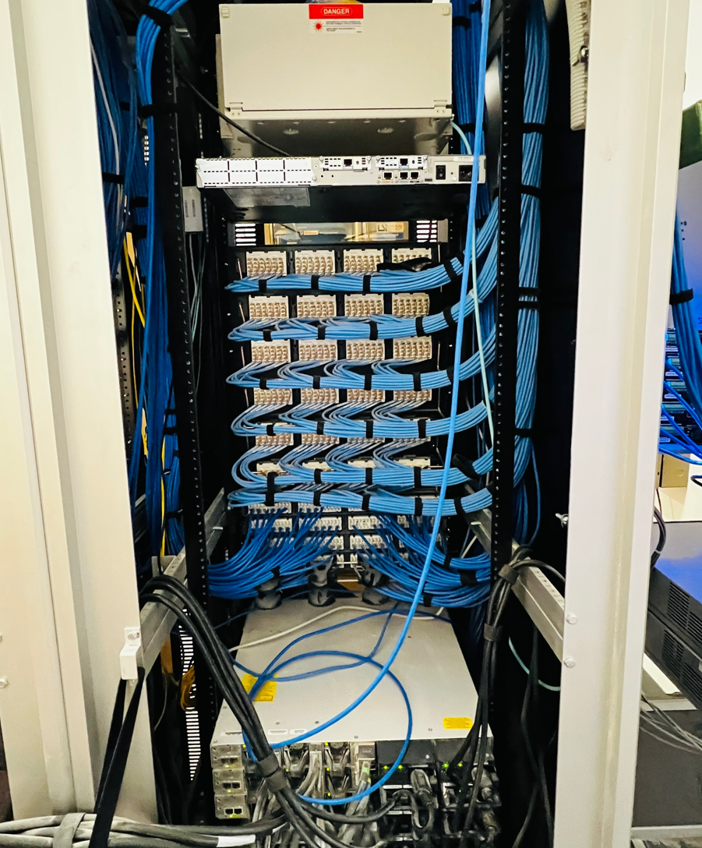
Technology
Secure and Climate Controlled Server Space
Cabling & Wireless Upgrades
Public Announcement System
Bells
Clocks
Phone System
Clocks/Bells
PROMISES MADE
PROMISES KEPT
Phone System
Cabling

Slide 10
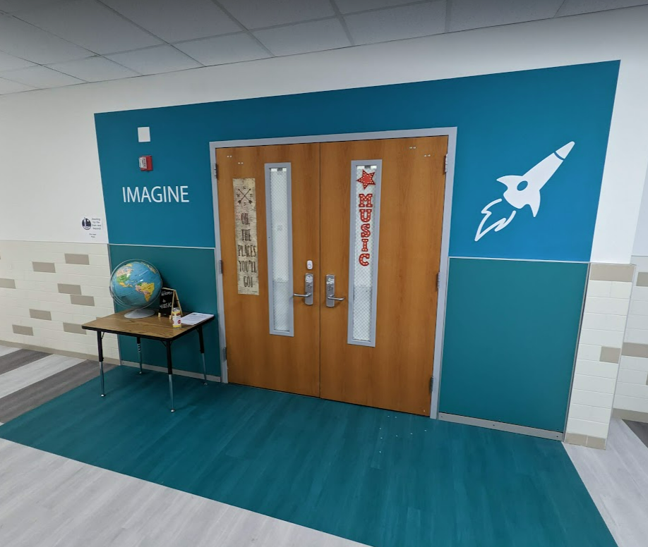
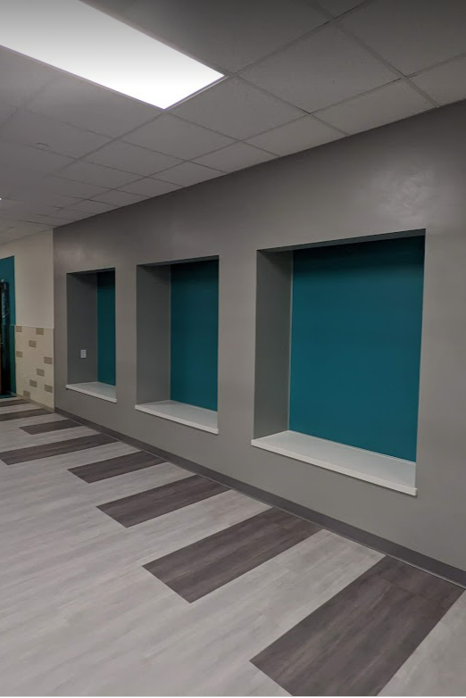
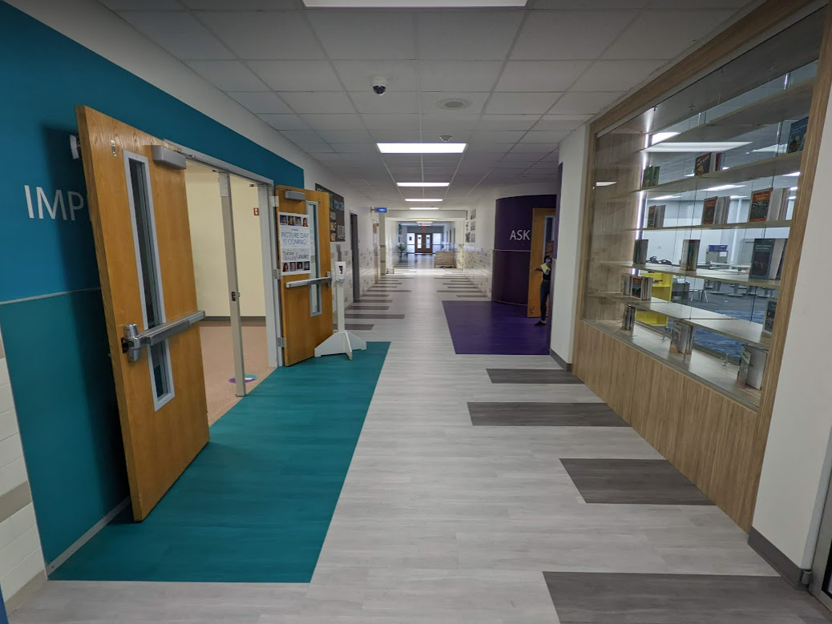
Improvements
FCI Improvements
  Finish Upgrades
  New Carpet in Select Areas
  Wayfinding on Upper Floor
  New Stage Curtain
  Hallway Finish Refresh on Upper Floor
Select Wayfinding
PROMISES MADE
PROMISES KEPT
Hallway Flooring
Hallway Seating

Slide 11
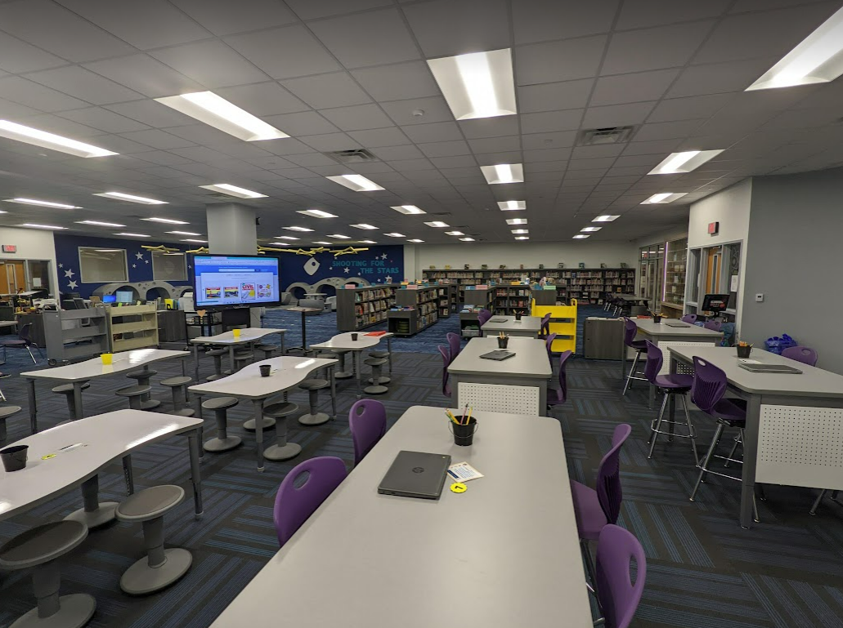
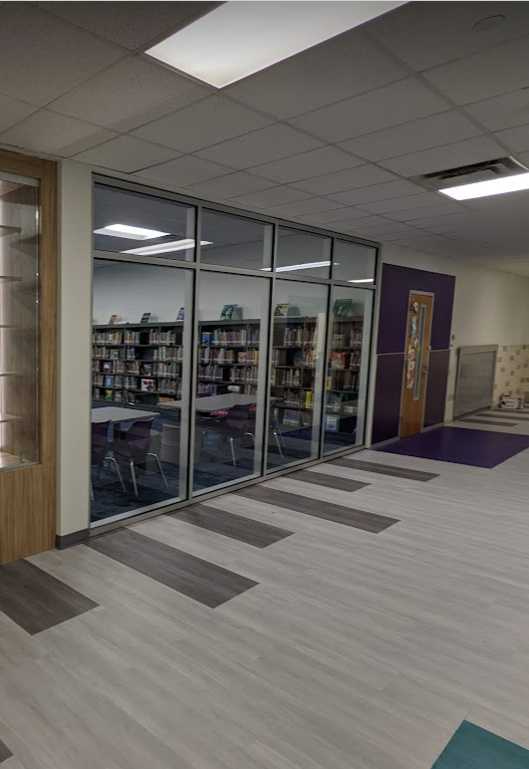
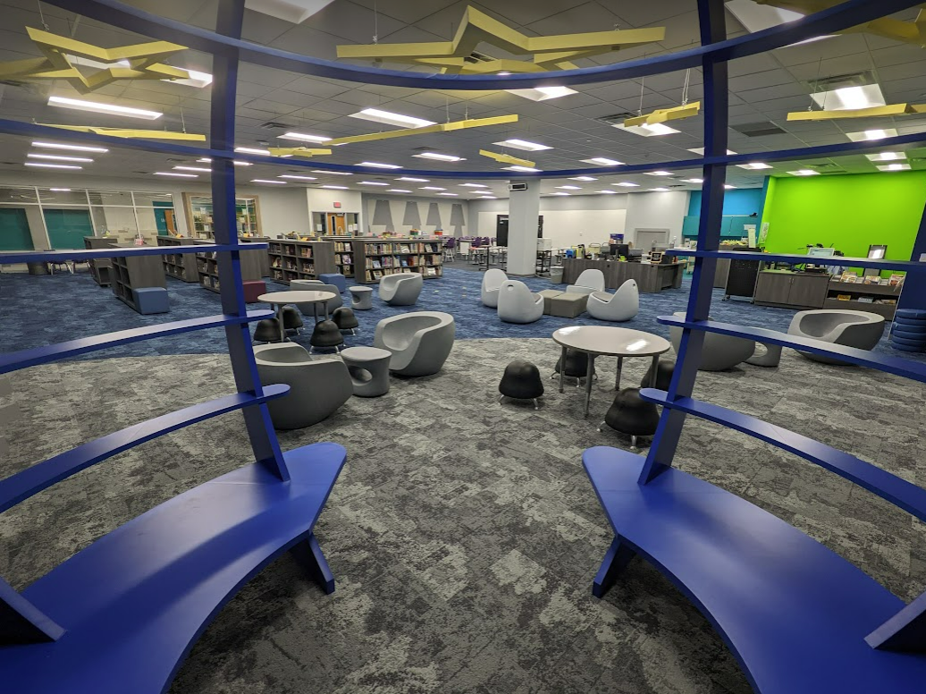
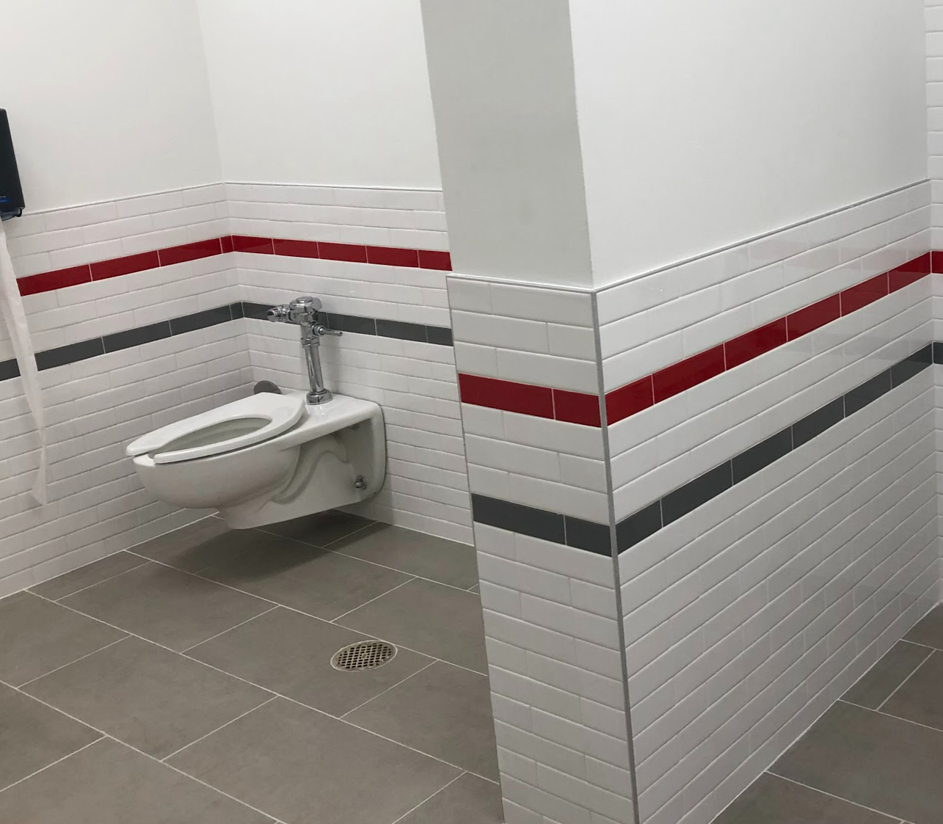
Improvements
FCI Improvements
  Finish Upgrades
  New Carpet in Select Areas
  Wayfinding on Upper Floor
  New Stage Curtain
  Hallway Finish Refresh on Upper Floor
Maker Space
PROMISES MADE
PROMISES KEPT
Upgraded Hallway
Materials
Maker Space
Pre-K Restroom

Slide 12
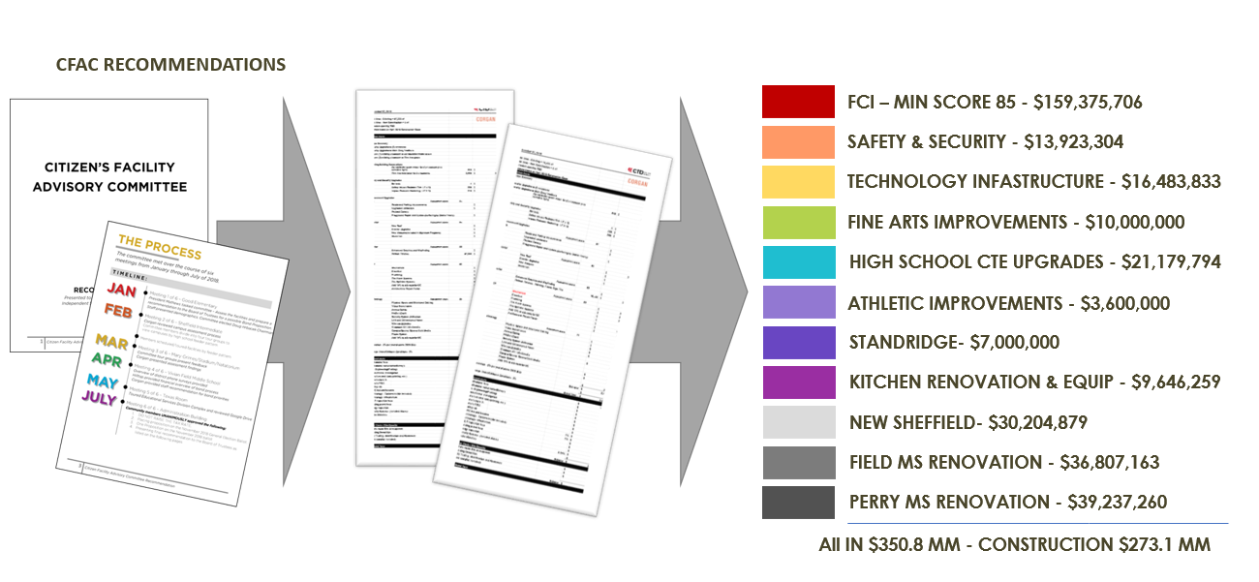
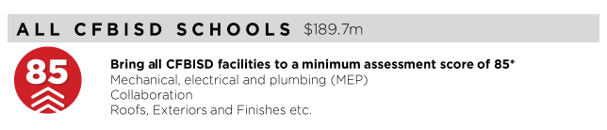
FCI Update
PROMISES MADE
PROMISES KEPT

Slide 13
FCI Update
 |  | Building Element |  |  |  |  |  | Type/Material | Previous Condition | Current Condition | Description | Additional Comments | Additional Comments | 2021 Reno Comments | 2021 Reno Comments
 |  | On-Site Utilities & Drainage
 |  |  | Site Drainage / Erosion Control |  |  |  |  |  | Good | Good | Positive slope away from building, no visible signs of erosion or ponding water. | Exit from kitchen on east side has drainage problems | Exit from kitchen on east side has drainage problems
 |  |  | Site Lighting - Parking Lots |  |  |  |  |  | Good | Good
 |  |  | Exterior Concrete Pads & Pavement-Around building |  |  |  |  |  | Good | Good
 |  |  | Fire Hydrants / Utility Vaults / Misc. |  |  |  |  |  | Fair | Fair
 |  |  | Grease Trap |  |  |  |  |  | Fair | Fair
 |  | Site Parking & Drives
 |  |  | Pavement - Roads / Drives / Parking Areas | Pavement - Roads / Drives / Parking Areas |  |  |  |  | Good | Good | Clean and clear of cracks, heaving, potholes. Joint Sealer is properly in place.
 |  |  | Fire Lanes | Fire Lanes |  |  |  |  | Good | Good | Fire lane paint striping in good condition.Clean and clear of cracks, heaving, potholes. Joint Sealer is properly in place.
 |  |  | Striping - Parking lot and fire lane | Striping - Parking lot and fire lane |  |  |  |  | Fair | Good | Minor to moderate signs of age and deterioration but still visible. |  |  | Repainted | Repainted
 |  |  | Curbs | Curbs |  |  |  |  | Good | Good | Free of cracks, damage and almost new in appearance.
 |  | Site Lighting
 |  |  | Site Lighting |  |  |  |  |  | Good | Good | All fixtures are working properly and have no visible damage. Lighting is appropriate for security.
 |  | Site Security
 |  |  | Security Cameras |  |  |  |  |  | Fair | Good
 |  |  | Chain Link Fencing / Gates |  |  |  |  |  | Good | Good | No damage to material and poles, gates are working properly.
 |  | Misc. Structures
 |  |  | Site Walls - Retaining / Screen |  |  | Material: | Material: | N/A | N/A | N/A
 |  |  | Dumpster Service Area |  |  |  |  |  | Good | Good | Dumpster walls have no sign of damage. Gates properly function.
 |  |  | Bollards |  |  | Material: | Material: | Concrete | N/A | Good |  |  |  | Inclusion of new concrete bollards at entry vestibule | Inclusion of new concrete bollards at entry vestibule
 |  |  | Site Signage - Directional / Handicapped |  |  |  |  |  | Good | Good
 |  |  | Misc. Site work / Site Structures |  |  |  |  |  | Fair | Good |  | Playground | Playground | Resurfaced playground and equipment | Resurfaced playground and equipment
 |  | Circulation
 |  |  | Sidewalks |  |  |  |  |  | Good | Good | Clean and clear of cracks or heaving. Joint Sealer is properly in place.
 |  |  | Stairs |  |  |  |  |  | Good | Good | Clean and clear of cracks or heaving. Joint Sealer is properly in place. Rise and Run is compliant. Handrails (if present) are compliant & finish is in good standing.
 |  |  | Ramps |  |  |  |  |  | Good | Good | Clean and clear of cracks or heaving. Joint Sealer is properly in place. Slope is compliant. Handrails (if present) are compliant & finish is in good condition.
 |  | ADA Compliance / Accessibility
 |  |  | Compliant Sidewalks/Curbs |  |  |  |  |  | Good | Good
 |  |  | Compliant Ramps & Handrails |  |  |  |  |  | Good | Good
 |  |  |  |  |  |  |  | Scored Categories | 20 | 21
 |  |  |  |  |  |  |  | Good | 15 | 19 | Assessment Score: | 92 | 92
 |  |  |  |  |  |  |  | Fair | 5 | 2 | Score After Bond Improvements: | 97 | 97
 |  |  |  |  |  |  |  | Poor | 0 | 0 | *Original Assessment did not evaluate video cameras on site. Assigned a value of fair which decreased the assessment score from 95 to 92
 |  |  |  |  |  |  |  | N/A | 2 | 1
UPDATE
Site

Slide 14
FCI Update
 | Building Element |  |  |  |  | Type/Material | Prior Condition | Current Condition | Description | Previous Comments | 2021 Reno Comments
 | Building Structure/Foundation
 |  | Foundation |  |  | Type: | Crawlspace | Good | Good | No signs of cracking or heaving.
 |  | Substructure - Slab - on - Grade
 |  |  | Basement / Below Grade Exterior Walls |  |  |  | N/A | N/A
 |  |  | Miscellanous |  |  |  | N/A | N/A
 |  | Superstructure
 |  |  | Fireproofing |  |  |  | Good | Good
 |  |  | Pre-Engineered Metal building |  |  |  | N/A | N/A
 | Building Exterior Shell
 |  | Roofing |  |  |  | CTEM
 |  |  | General Roof Condition (Visual Inspection) |  |  |  | Fair | Good | Roof is nearing the end of it's expected useful life. Some leaks are reported with areas of ponding. Some sealants and flashings are in need of repair or replacement. |  | Repaired roofing as needed
 |  |  | Roof Warranty Status |  |  |  |  |  | N/A
 |  |  |  | Roofing Manufacturer / Warranty Issuer |  |  |  |  | Hyload Armko
 |  |  |  | Years Remaining in Warranty Period |  |  |  |  | N/A | warranty began 05/15/2007
 |  |  | Skylights |  |  |  | N/A | N/A
 |  |  | Roof Curbs / Openings / Misc. |  |  |  | Fair | Good |  |  | Replaced curbs and adapters as needed with RTU replacement
 |  | Exterior Walls
 |  |  | Exterior Wall Material |  | Material: | Brick | Good | Good | Veneer is free of cracks, signs of settling, rotation or damage.
 |  |  | Building Caulking/Sealant |  |  |  | Good | Good | Almost new condition.
 |  |  | Exterior Painting |  |  |  | N/A | N/A
 |  | Windows/Glazed Walls
 |  |  | Windows
 |  |  |  |  | Glazing Type: | Single Pane | Good | Good | No visible damage, proper weatherproofing apparent.
 |  |  |  |  | Frame Type: | Aluminum
 |  |  |  |  | Frame Type: | Aluminum
 |  | Exterior Doors Systems
 |  |  | Exterior Doors
 |  |  |  |  | Frame Type: | Aluminum Storefront | Good | Good | No visible damage, proper weatherproofing/threshold apparent, door hardware compliant and functioning properly.
 |  |  |  |  | Panel Type: | Aluminum Storefront
 |  |  | Exterior Overhead Doors |  | Type: | Manual | N/A | N/A
 |  |  | Card Access Reader |  |  | Yes
 |  |  | Door Bell |  |  | Yes
 |  |  | Peep Hole |  |  | No
 |  | Canopies
 |  |  | Canopy |  | Type: | Attached to Building | Fair | Fair | Minor scratches or signs of wear, may need a refresh of finish (if applicable). No signs of water leaking, settling or movement.
 |  | Loading Area
 |  |  | Raised Loading Dock |  |  |  | N/A | N/A
 |  |  | Independent Loading Area |  |  |  | Good | Good | No visible damage, no signs of settling or movement.
 |  | Misc. Exterior
 |  |  | Exterior Soffit - Material |  | Material: | Plaster | Good | Good | Almost new in appearance, no visible fading or stains.
 |  |  | Exterior Louvers / Sunscreens |  |  |  | N/A | N/A
 |  |  |  |  |  | Scored Categories | 11 | 11
 |  |  |  |  |  | Good | 8 | 10 | Assessment Score: | 91
 |  |  |  |  |  | Fair | 3 | 1 | Score After Bond Improvements: | 97
 |  |  |  |  |  | Poor | 0 | 0
 |  |  |  |  |  | N/A | 8 | 8
UPDATE
Exterior

Slide 15
FCI Update
 |  | Building Element |  |  |  |  | Type/Material | Prior Condition | Current Condition | Description | Previous Comments | 2021 Reno Comments
 |  | Interior Finishes
 |  |  | Interior Ceiling Finishes
 |  |  |  | Acoustical Ceilings - 2x2 Tiles |  | Scrubbable Finish | Yes | Good | Good | Almost new in appearance, no signs of sagging, damage, leaks, or stains. | Scrbbable in kitchen
 |  |  |  | Acoustical Ceilings - 2x4 Tiles |  | Scrubbable Finish | N/A | N/A | N/A
 |  |  |  | Plaster Ceilings |  |  |  | N/A | N/A
 |  |  |  | Painted Gypsum Ceiling |  |  |  | Good | Good | Almost new in appearance, no signs of sagging, damage, leaks, or stains.
 |  |  |  | Metal Ceilings |  |  |  | N/A | N/A
 |  |  |  | Exposed / Painted Ceilings |  |  |  | N/A | N/A
 |  |  |  | Soffit / Bulkhead Walls |  |  |  | N/A | N/A
 |  |  |  | Special/Misc. |  |  |  | N/A | N/A
 |  |  | Interior Floor Finishes
 |  |  |  | Resilient Flooring - Cooridor, Cafeteria |  |  |  | Fair | Good | Minor signs of aging with minimal apparent stains or damage, may need to be resealed. |  | Replaced flooring
 |  |  |  | Resilient Flooring - Hallways, Classrooms |  |  |  | Good | Good
 |  |  |  | Quarry Tile |  |  |  | Fair | Fair | Minor signs of aging with minimal apparent stains or damage, may need to be resealed.
 |  |  |  | Ceramic Tile |  |  |  | Good | Good | Almost new in appearance, no signs of damage or stains, properly sealed and finished.
 |  |  |  | Terrazzo |  |  |  | N/A | N/A
 |  |  |  | Poured Resinous Epoxy |  |  |  | N/A | N/A
 |  |  |  | Finish Concrete - (sealed) |  |  |  | N/A | N/A
 |  |  |  | Carpet - Library, Makerspace, Admin Suite |  |  |  | Fair | Good | Minor signs of aging with minimal apparent stains or damage, may need to be resealed. |  | Replaced Carpet
 |  |  |  | Carpet - Classrooms |  |  |  | Fair | Fair
 |  |  |  | Natural Stone |  |  |  | N/A | N/A
 |  |  |  | Wood |  |  |  | N/A | N/A
 |  |  |  | Special/Misc. |  |  |  | N/A | N/A
 |  |  | Interior Wall Finishes
 |  |  |  | Painted Gypsum Board - Full Height |  |  |  | Good | Good | Almost new in appearance, no signs of damage, stains or cracking.
 |  |  |  | Painted CMU - Full Height |  |  |  | Good | Good | Almost new in appearance, no signs of damage, stains or cracking. | Gym
 |  |  |  | Painted Gypsum Board + Tile Wainscot |  |  |  | Good | Good | Almost new in appearance, no signs of damage, stains or cracking.
 |  |  |  | Full Height Tile |  |  |  | Good | Good | Almost new in appearance, no signs of damage, stains or cracking. | Restrooms
 |  |  |  | PLAM |  |  |  | N/A | N/A
 |  |  |  | FRP |  |  |  | N/A | N/A
 |  |  |  | Wood Panels |  |  |  | N/A | N/A
UPDATE
Interior

Slide 16
FCI Update
 | Interior Wall Base & Trim
 |  | Rubber Base |  |  |  | Good | Good | Almost new in appearance, no signs of damage and properly installed.
 |  | Quarry Tile |  |  |  | Good | Good | Almost new in appearance, no signs of damage and properly installed.
 |  | Ceramic Tile |  |  |  | N/A | N/A
 |  | Terrazzo |  |  |  | N/A | N/A
 |  | Poured Resinous Epoxy |  |  |  | N/A | N/A
 |  | Wood Base |  |  |  | N/A | N/A
 | Misc. Interior
 |  | Interior Door Systems
 |  |  | Frame Type: |  | Hollow Metal | Good | Good | No visible damage, proper weatherproofing/threshold apparent, door hardware compliant and functioning properly.
 |  |  | Panel Type: |  | Hollow Metal
 |  | Interior Overhead Door/Grille |  | Type: | N/A | N/A | N/A
 |  | Specialty Doors |  | Type: | N/A | N/A | N/A
 |  | Millwork Cabinets |  |  |  | Good | Good |  |  | Replaced aging millwork in STEM classrooms
 |  | Corner Guards |  | Type: | N/A | N/A | N/A
 |  | Interior Signage |  |  |  | Good | Good
 |  | Digital Clocks |  |  |  | Good | Good |  |  | Replaced Digital Clocks
 |  | Operable Partitions |  |  |  | N/A | Good |  |  | Added Operable Wall to STEM classroom
 |  | Marker & Tack Boards |  |  |  | Good | Good | No cracking or warping of the board surface.
 |  | Projection Screens |  |  |  | N/A | N/A
 |  | A/V Equipment |  |  |  | Good | Good
 |  | Lockers |  |  |  | N/A | N/A
 |  | Railings |  |  |  | N/A | N/A
 |  | Elevator Cab Finishes |  |  |  | N/A | N/A
 |  | Wireless Access |  |  |  | Fair | Good
 |  | Toilet Partitions |  | Material Type: | Plastic | Good | Good
 |  | Toilet Accessories |  |  |  | Good | Good | Almost new condition, proper installation.
 |  | Interior Window Blinds/Shades |  | Type of Blinds: | Metal | Good | Good | No visible damage, motor properly functions (if applicable).
 |  |  |  | Type of Shades: | N/A
 |  |  |  | Operation: | Manual
 | Food Service Area
 |  | Equipment Condition |  |  |  | Good | Good
 |  | Digital Menu Boards |  |  |  | N/A | N/A
 |  | Restrooms open to Kitchen? |  |  |  | No | No
 |  | Drinking Fountains in Cafeteria? |  |  |  | No | No
 | Accessibility
 |  | Restrooms |  |  |  | Good | Good | Compliant
 |  | Drinking Fountains |  |  |  | Good | Good | Compliant
 |  | Ramps |  |  |  | N/A | N/A
 |  | Signage |  |  |  | Good | Good | Compliant
 |  | Doors |  |  |  | Good | Good | Compliant
 |  | Millwork |  |  |  | Good | Good | Compliant
 |  |  |  |  | Scored Categories | 32 | 33
 |  |  |  |  | Good | 25 | 29 | Assessment Score: | 89
 |  |  |  |  | Fair | 5 | 2 | Score After Bond Improvements: | 92
 |  |  |  |  | Poor | 0 | 0
 |  |  |  |  | N/A | 29 | 28
UPDATE
Interior

Slide 17
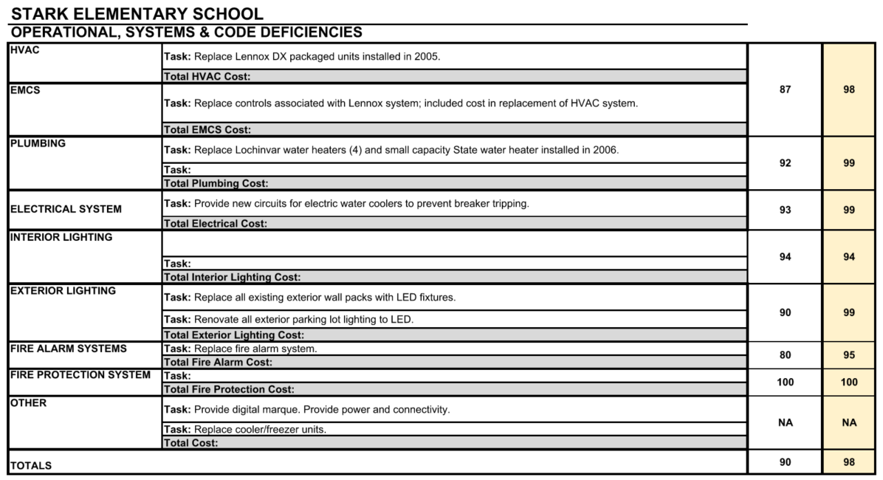

FCI Update
MEP

Slide 18

FCI Update
Blair ES Technology and Security Status
System | Possible Score | Corgan Score (2018) | Score (2022) | Notes
Cabling Infrastructure | 10 | 8 | ? | Upgrades done for wireless and major systems.
Local Area Network | 15 | 11 | ?
Wireless LAN | 15 | 11 | ?
Unified Comm (Phone) System | 10 | 8 | ? | New phones installed and active
Video Management System | 10 | 7 | ? | New High resolution cameras installed
Public Address | 10 | 7 | ? | New Informacast PA System. Great Condition
Premise Access Control | 10 | 8 | ? | Access controls at primary entrances and front office
Intercom System | 5 | 5 | ? | New video intercom integrated to phone system
Special Space AV | 5 | 5 | ?
Instruction Space Presentation | 10 | 10 | ? | New interactive displays matching district standard.
Total Score | 100 | 80 | 96
Technology
UPDATE

Slide 19
FCI Update
Blair ES
Assessment
Site : 90
Exterior: 91
Interior: 88
MEP: 91
Technology: 85
Score: 89
After Bond
Improvements
Site : 93
Exterior: 94
Interior: 95
MEP: 98
Technology: 96
Score: 95
UPDATE
UPDATE
PROMISES MADE
PROMISES KEPT

Slide 20

Be the exception
Together we can

