Slide 1



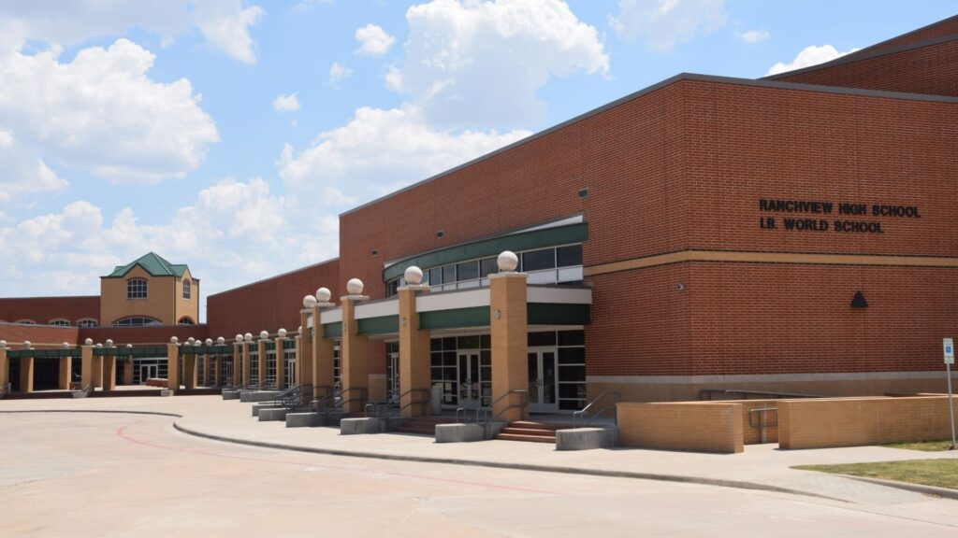

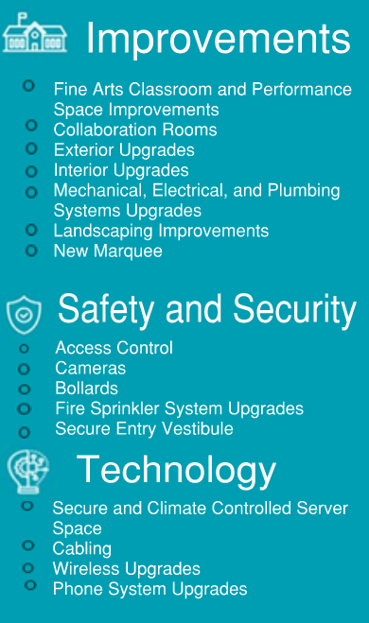
RANCHVIEW HIGH SCHOOL
cfbbond.com

Slide 2

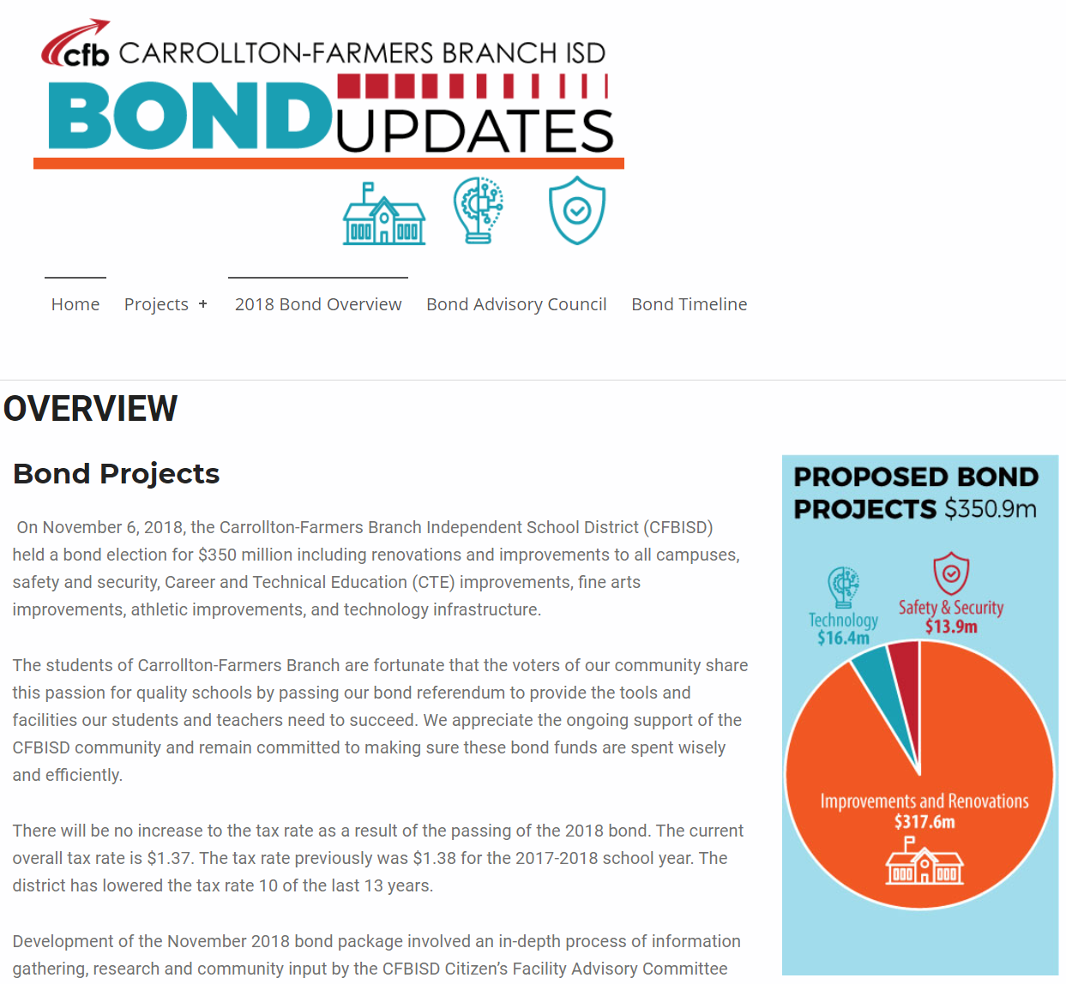
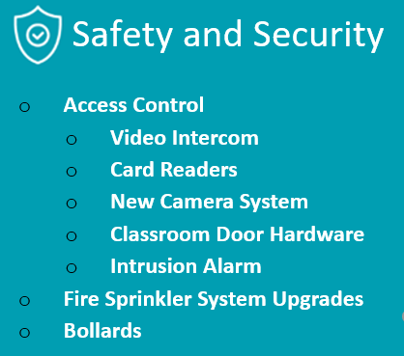
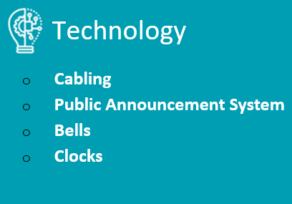
Improvements
Fine Arts Classroom and Performance Space Improvements
  TIFF Funding – Renovation Work is Coming Soon
Collaboration Rooms
TIFF Funding – Renovation Work is Coming Soon
Exterior Upgrades
  Roof Replacement/Repair
  Parking Lot Striping
Interior Upgrades
  Library Renovation
  ITA
  Culinary
  Floral
Mechanical, Electrical, and Plumbing Systems Upgrades
  New LED Site Lighting and Controls
  RTU Replacement
  Water Bottle Fillers
Landscape Improvements
  Exterior Concrete Replacement
Marquee – Existing Digital Marquee
Access Control
  Intercom
  Card Readers
  Security Alarm
Cameras
Bollards
Fire Sprinkler System Upgrades
Secure Entry Vestibule
Secure Climate Controlled Server Space
Cabling
Wireless Upgrades
Phone System Upgrades
PROMISES MADE
PROMISES KEPT
PROMISES MADE
PROMISES KEPT

Slide 3
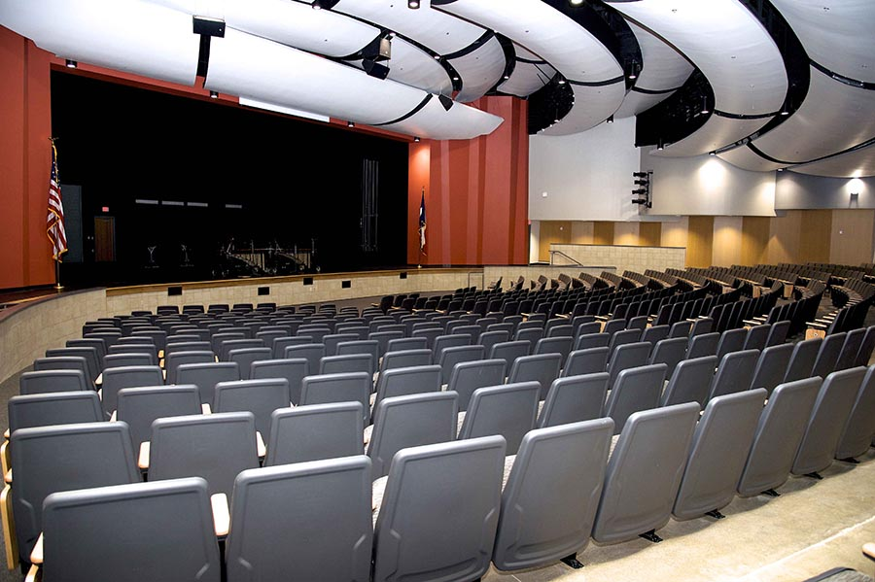
Improvements
Fine Arts Classroom and Performance Space Improvements
  TIFF Funding – Existing Auditorium Meets District Standards
Collaboration Rooms
  TIFF Funding – Renovation Work is Coming Soon
Exterior Upgrades
  Roof Replacement/Repair
  Parking Lot Striping
Interior Upgrades
  Library Renovation
  ITA
  Culinary
  Floral
Mechanical, Electrical, and Plumbing Systems Upgrades
  New LED Site Lighting and Controls
  RTU Replacement
  Water Bottle Fillers
Landscape Improvements
  Exterior Concrete Replacement
Marquee – Existing Digital Marquee
PROMISES MADE
PROMISES KEPT

Slide 4
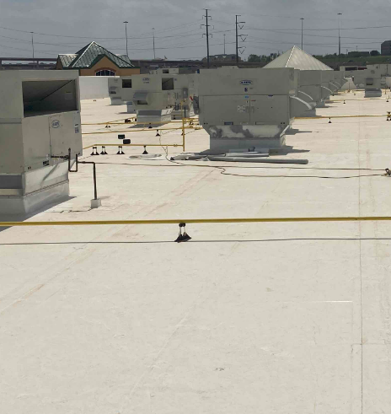
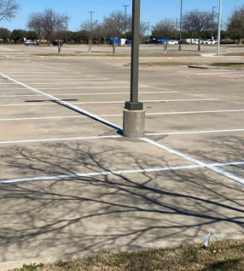
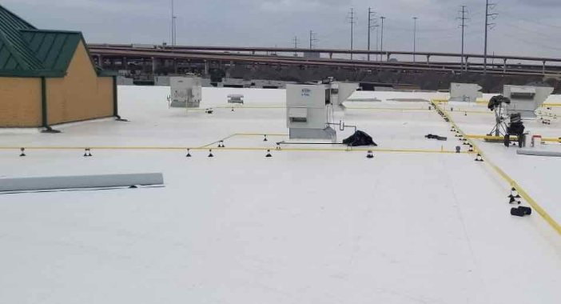
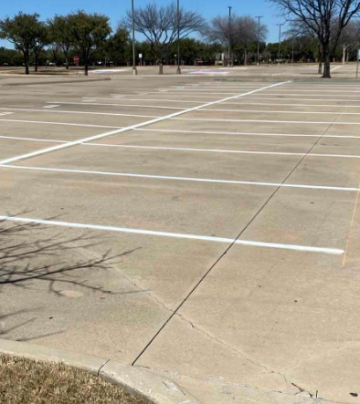
Improvements
Fine Arts Classroom and Performance Space Improvements
  TIFF Funding – Existing Auditorium Meets District Standards
Collaboration Rooms
  TIFF Funding – Renovation Work is Coming Soon
Exterior Upgrades
  Roof Replacement/Repair
  Parking Lot Striping
Interior Upgrades
  Library Renovation
  ITA
  Culinary
  Floral
Mechanical, Electrical, and Plumbing Systems Upgrades
  New LED Site Lighting and Controls
  RTU Replacement
  Water Bottle Fillers
Landscape Improvements
  Exterior Concrete Replacement
Marquee – Existing Digital Marquee
Roof Replacement
Parking Lot Restriping
PROMISES MADE
PROMISES KEPT
Roof Replacement
Parking Lot Restriping

Slide 5
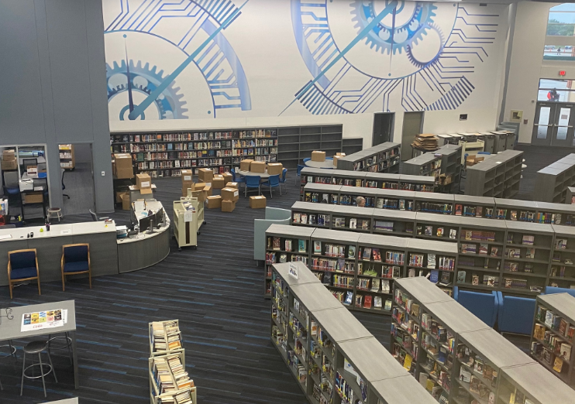
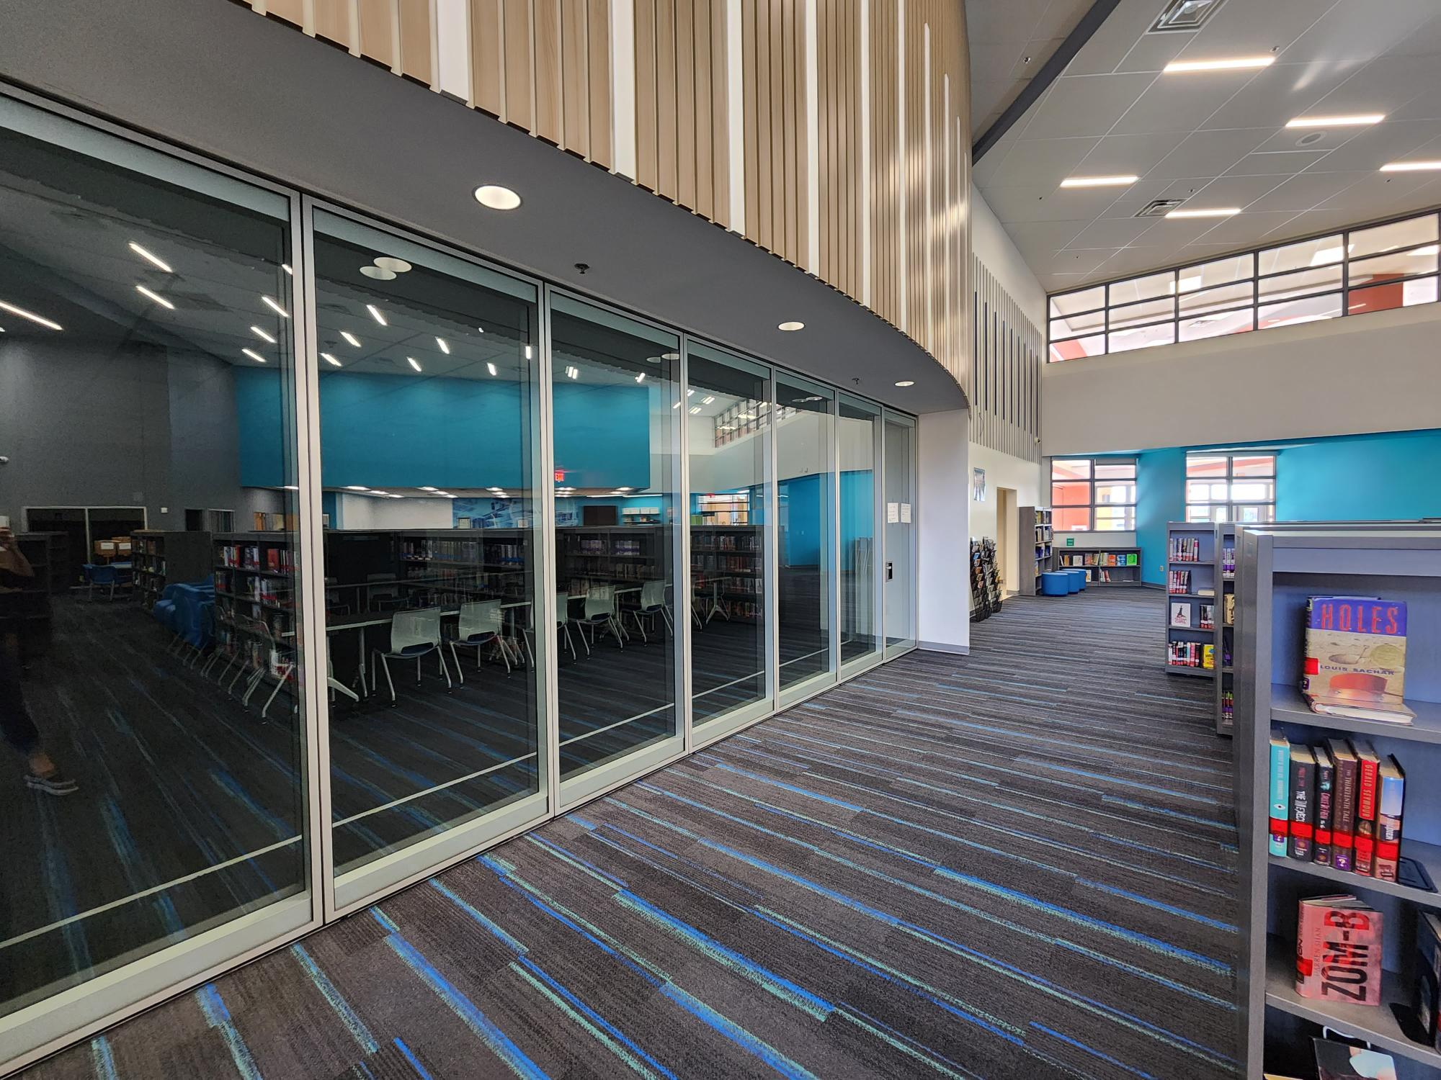
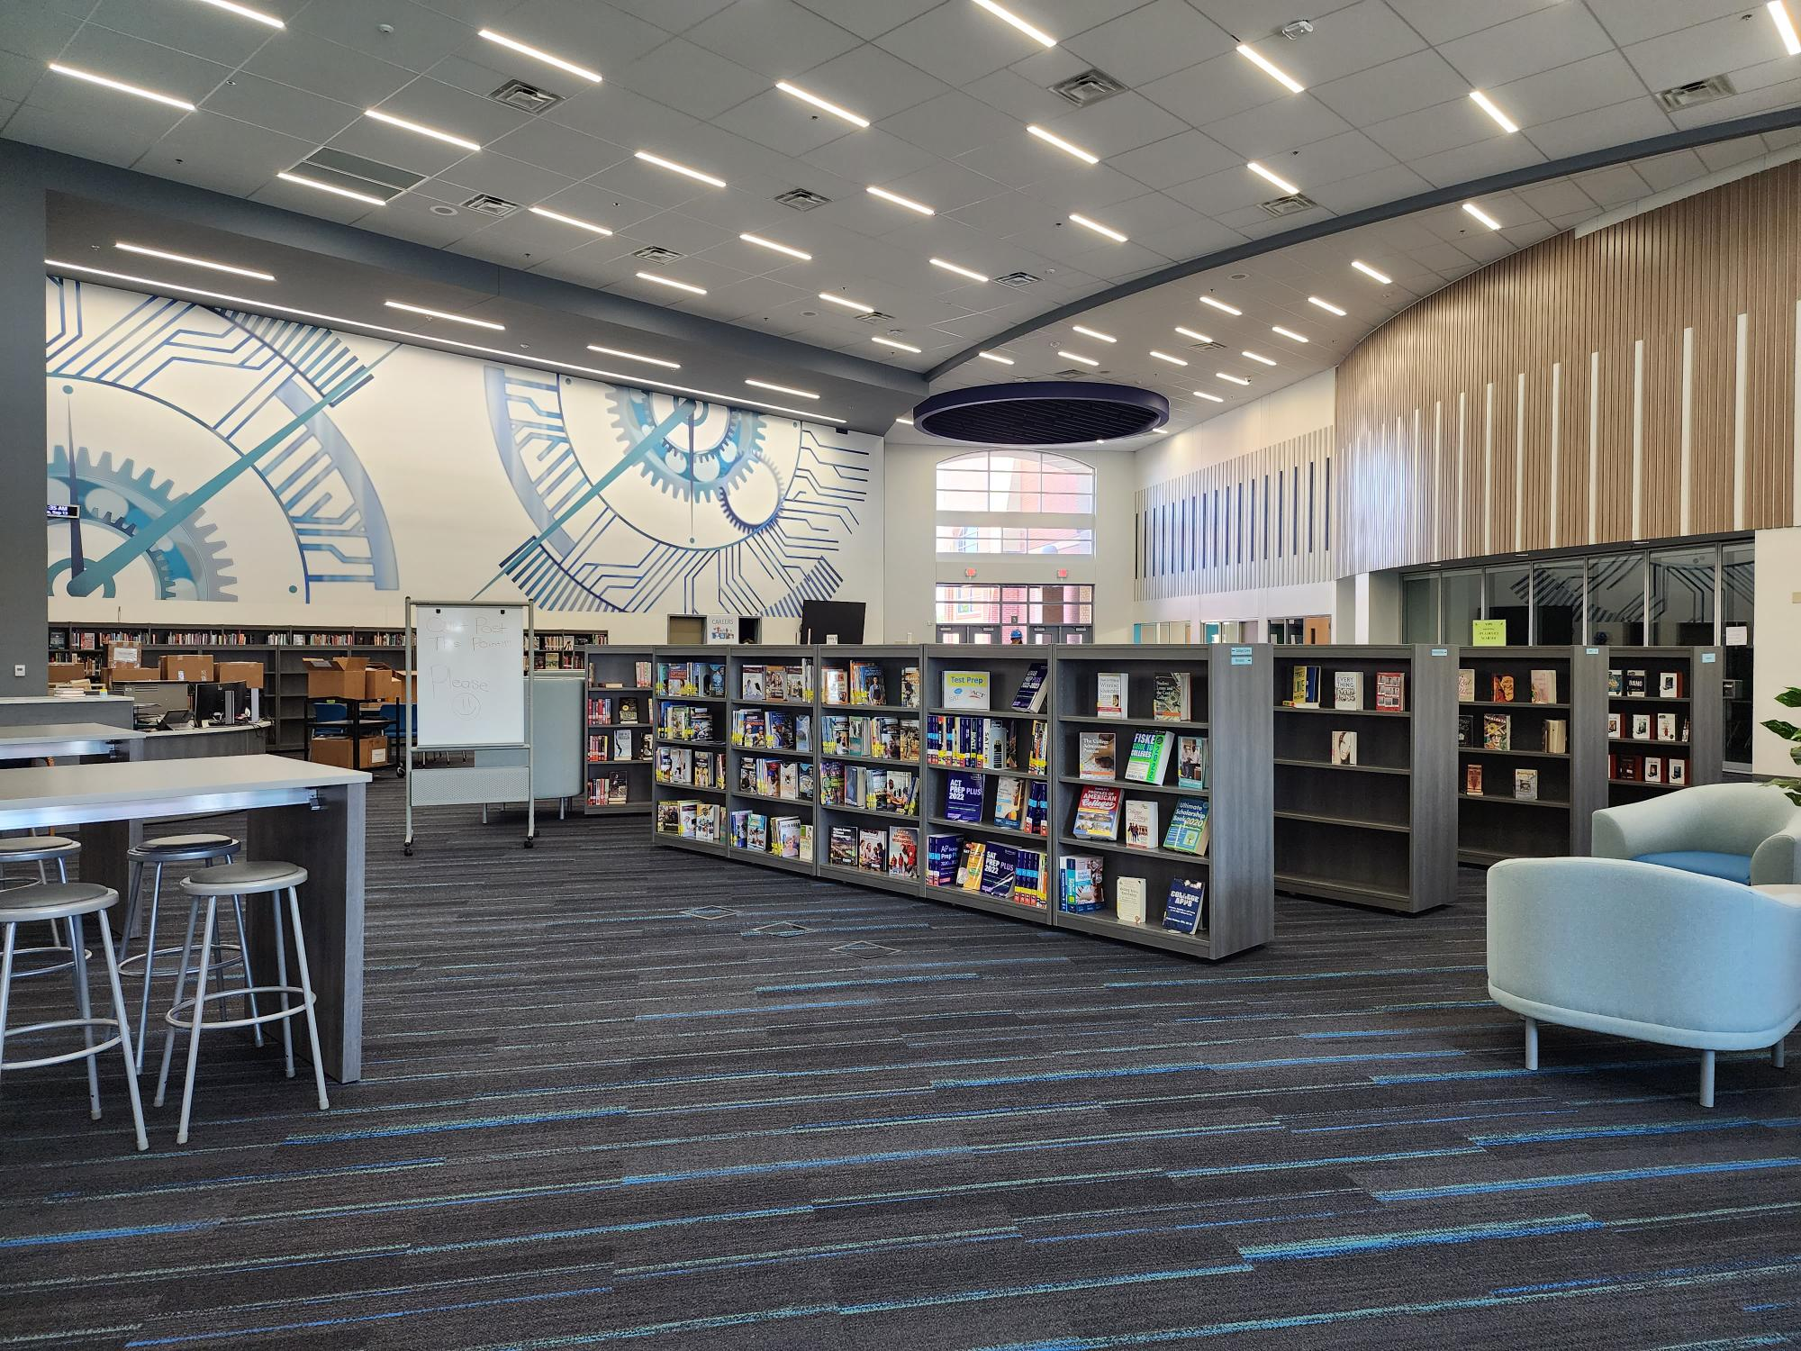
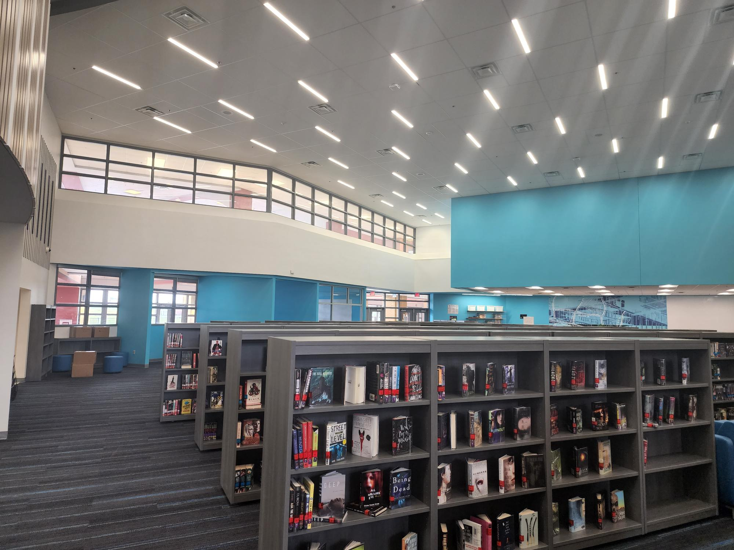
Improvements
Fine Arts Classroom and Performance Space Improvements
  TIFF Funding – Existing Auditorium Meets District Standards
Collaboration Rooms
  TIFF Funding – Renovation Work is Coming Soon
Exterior Upgrades
  Roof Replacement/Repair
  Parking Lot Striping
Interior Upgrades
  Library Renovation
  ITA
  Culinary
  Floral
Mechanical, Electrical, and Plumbing Systems Upgrades
  New LED Site Lighting and Controls
  RTU Replacement
  Water Bottle Fillers
Landscape Improvements
  Exterior Concrete Replacement
Marquee – Existing Digital Marquee
PROMISES MADE
PROMISES KEPT

Slide 6
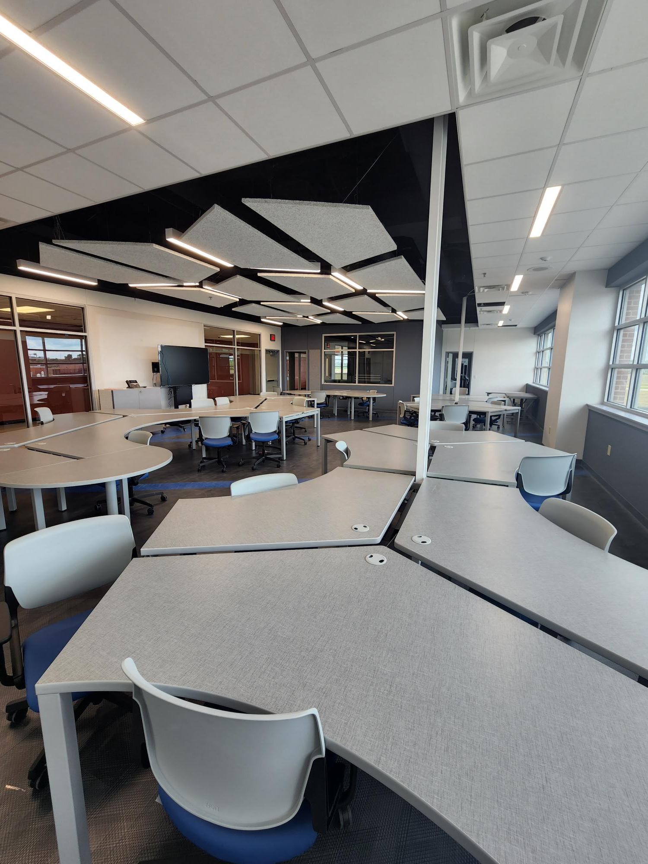
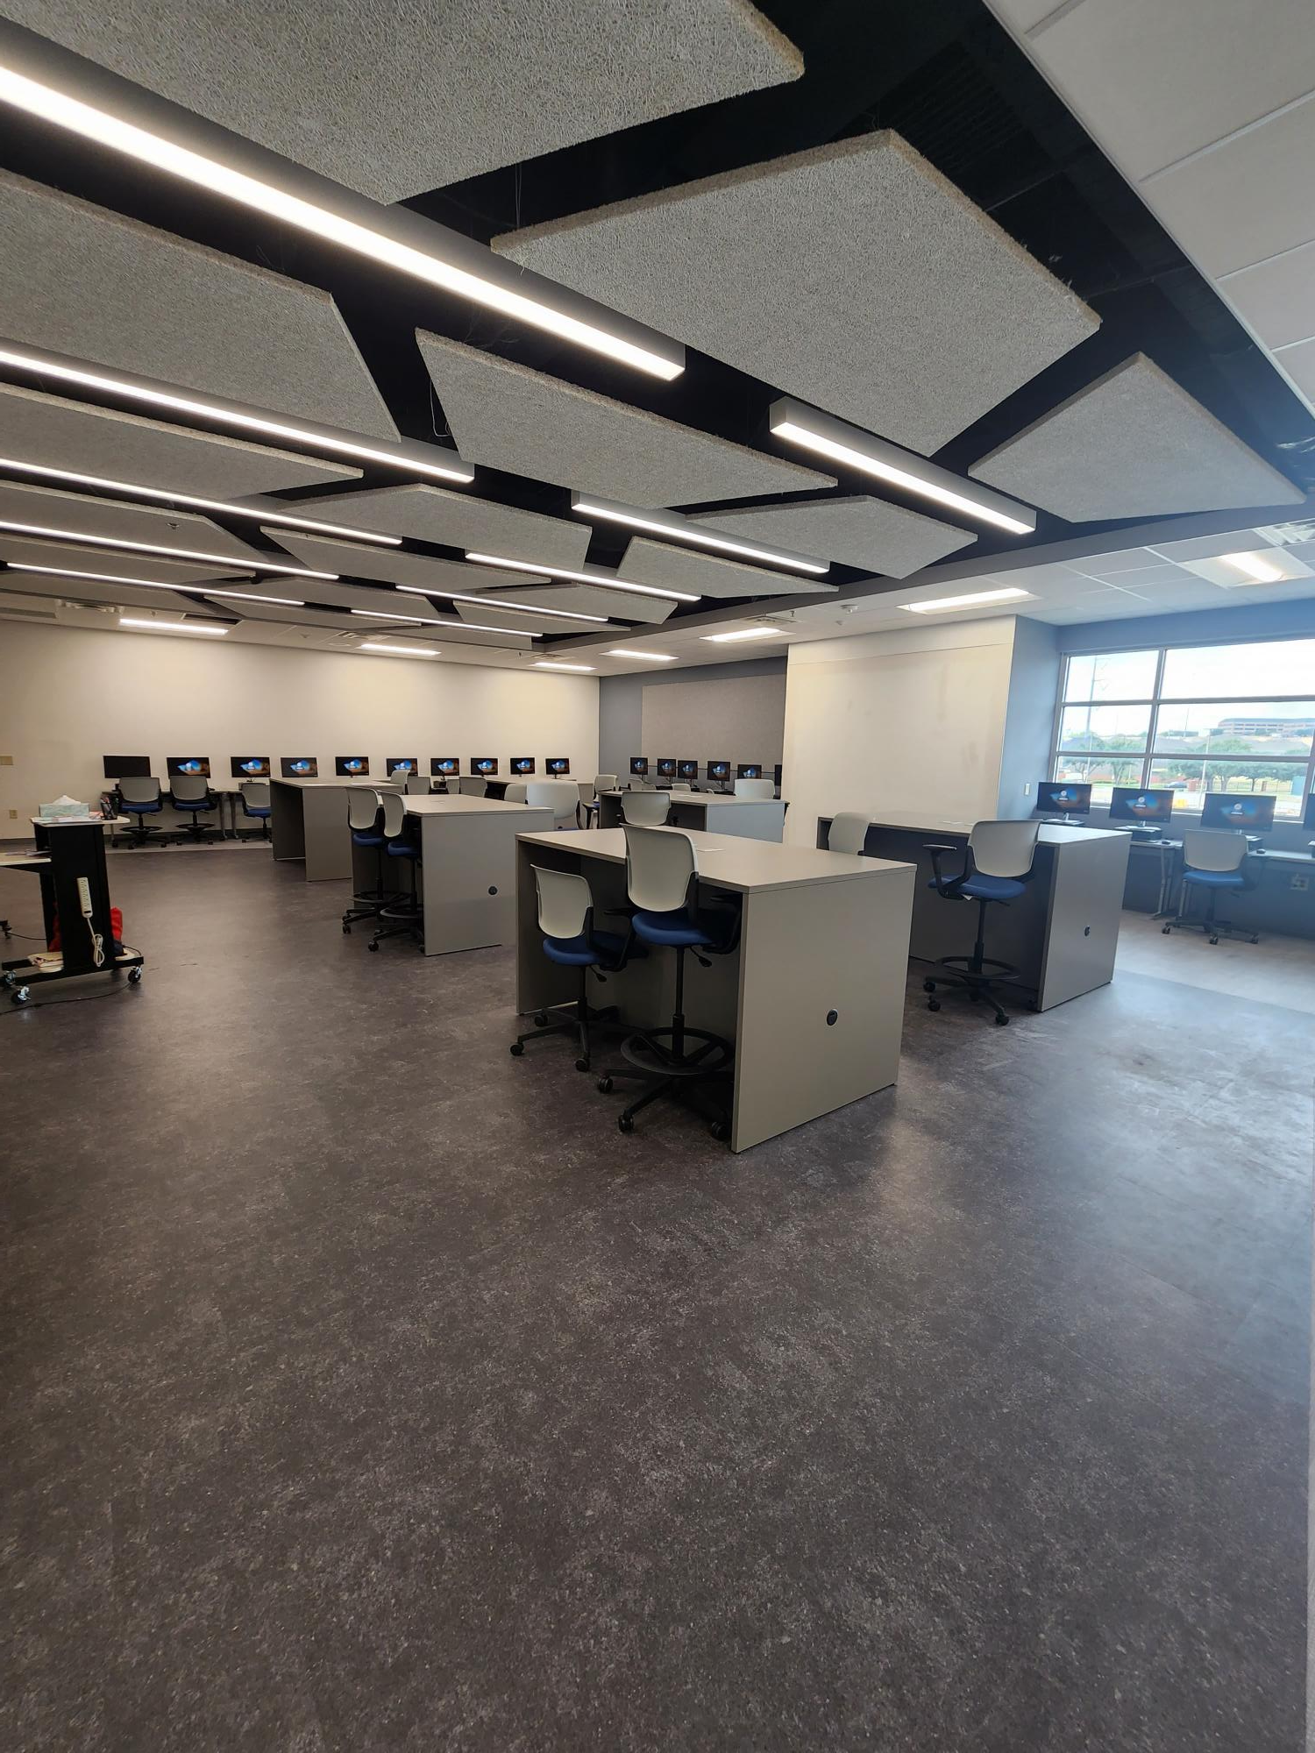
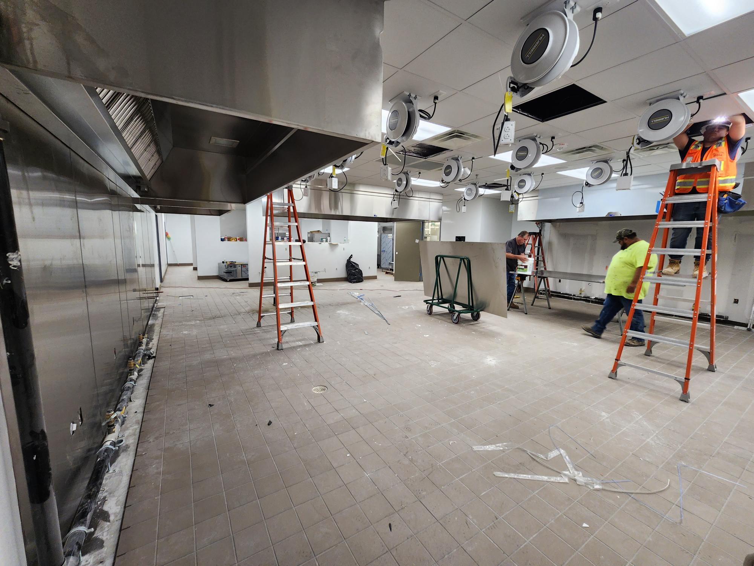
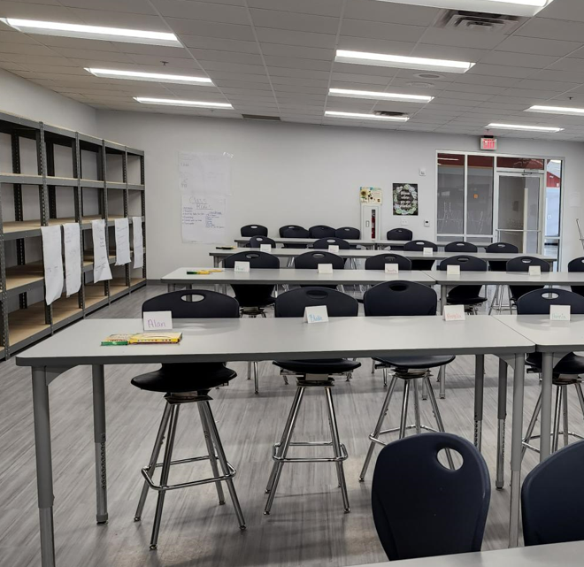
Improvements
Fine Arts Classroom and Performance Space Improvements
  TIFF Funding –Existing Auditorium Meets District Standards
Collaboration Rooms
  TIFF Funding – Renovation Work is Coming Soon
Exterior Upgrades
  Roof Replacement/Repair
  Parking Lot Striping
Interior Upgrades
  Library Renovation
  ITA
  Culinary
  Floral
Mechanical, Electrical, and Plumbing Systems Upgrades
  New LED Site Lighting and Controls
  RTU Replacement
  Water Bottle Fillers
Landscape Improvements
  Exterior Concrete Replacement
Marquee – Existing Digital Marquee
Computer Maintenance
Cyber Security
Law Academy
JROTC
PROMISES MADE
PROMISES KEPT
Autoshop
Auto Tech Class
Culinary
Floral

Slide 7
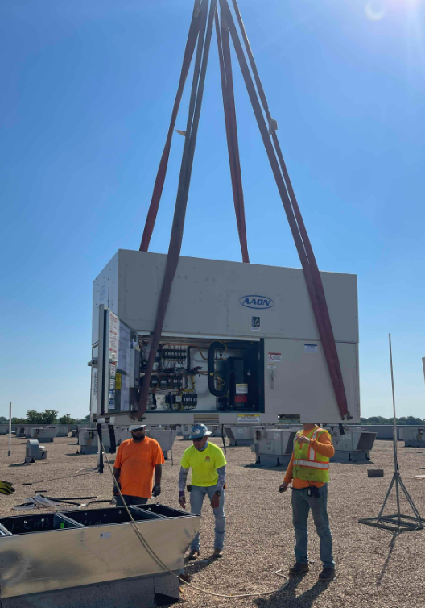
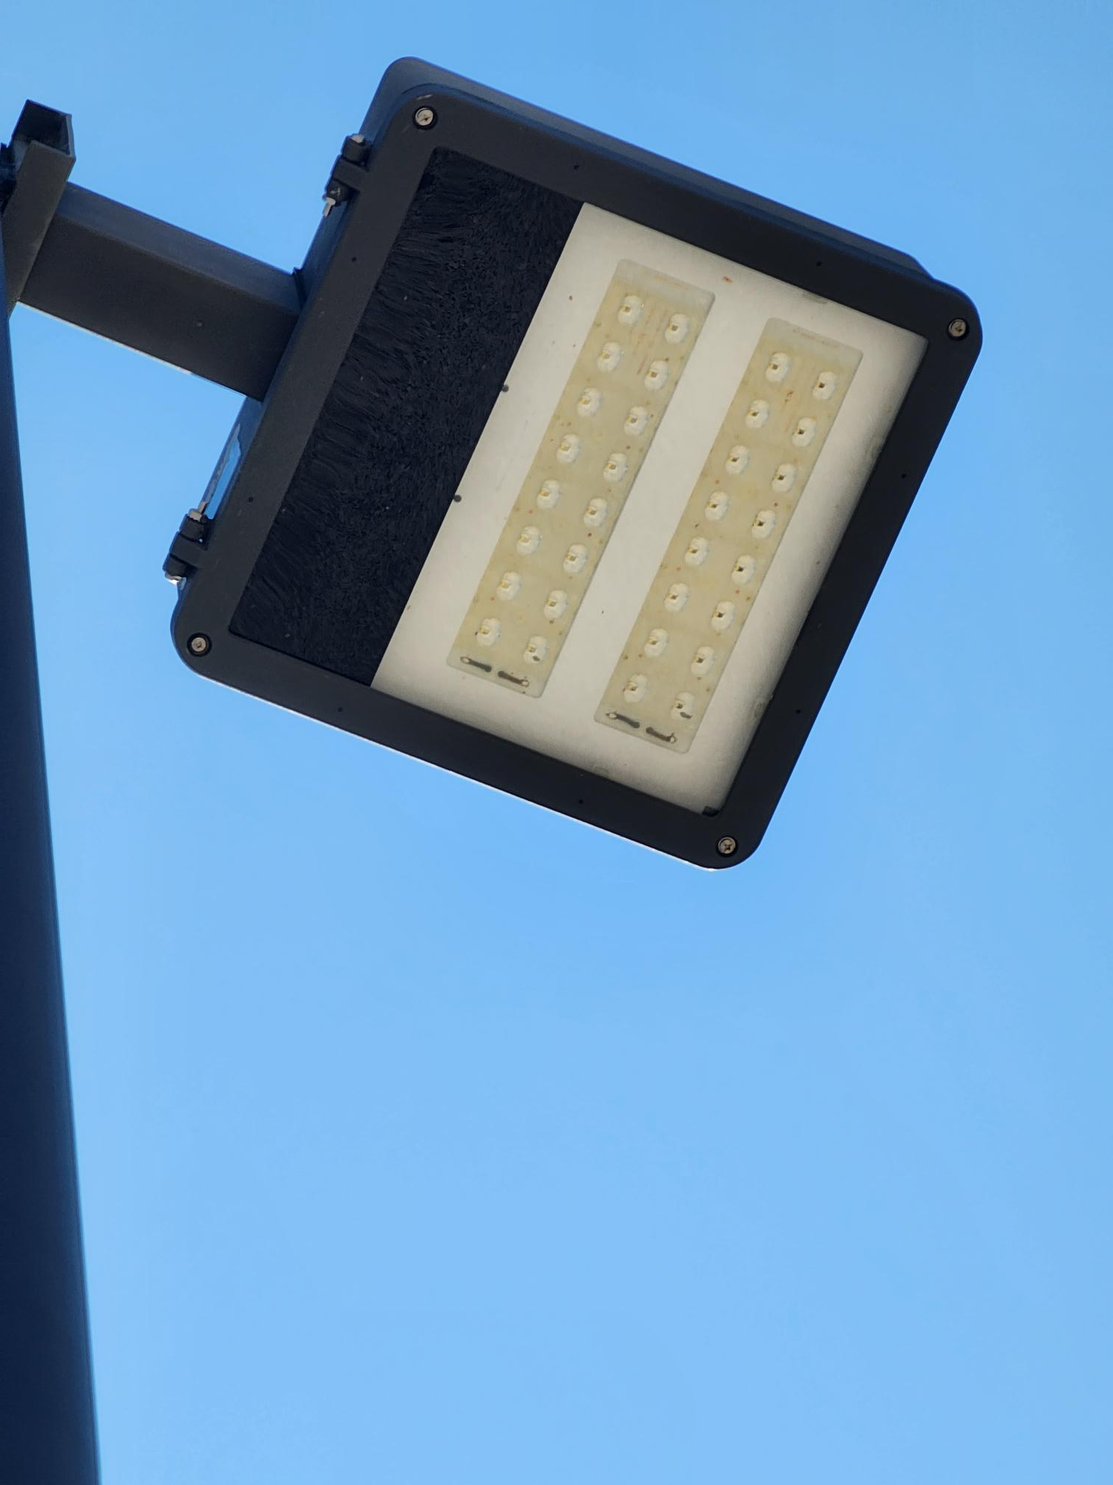
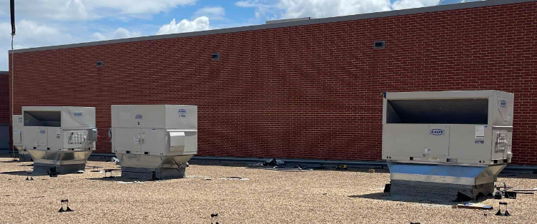
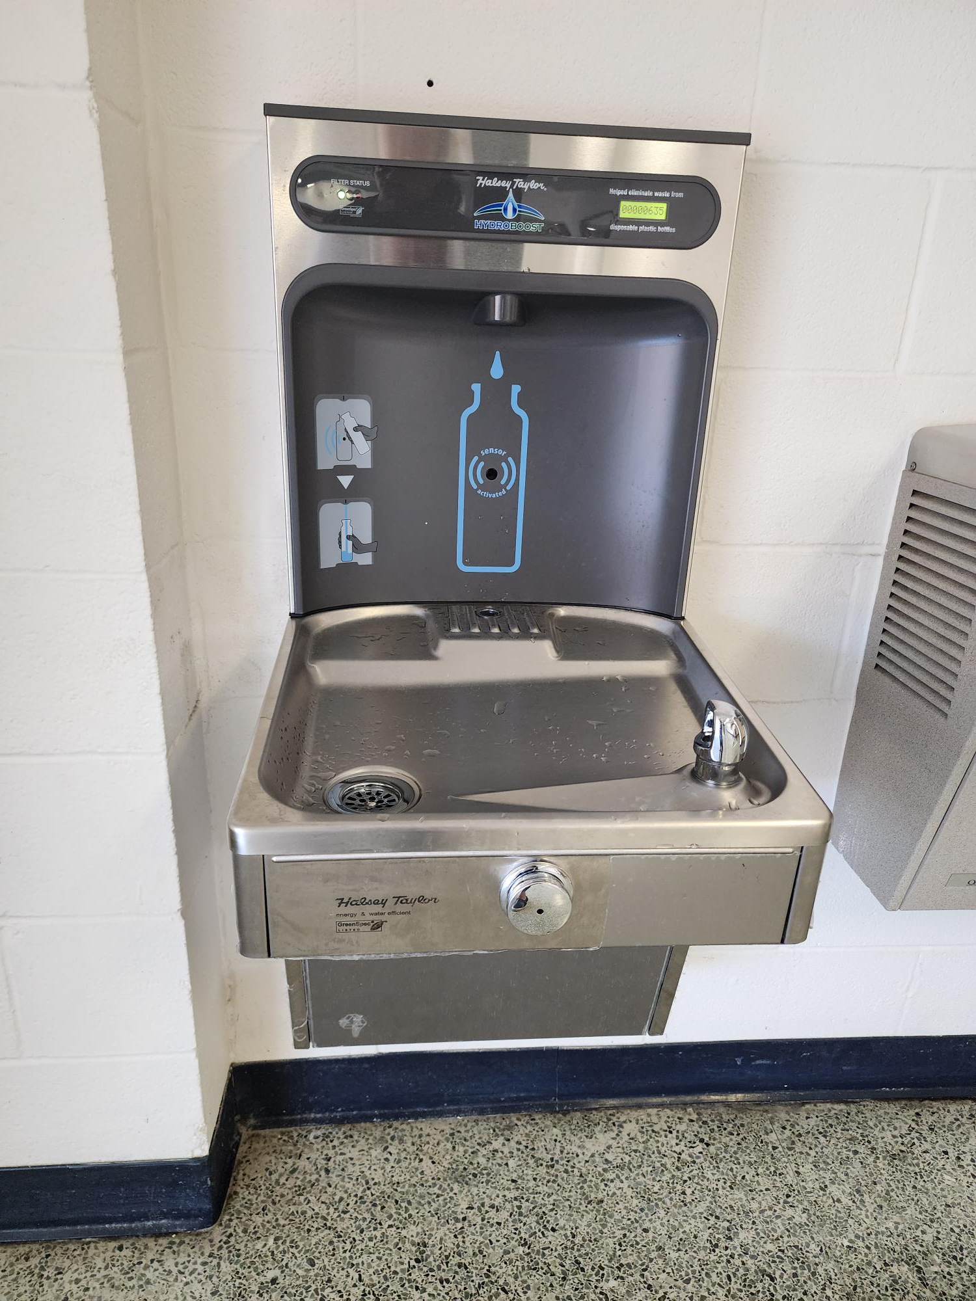
Improvements
Fine Arts Classroom and Performance Space Improvements
  TIFF Funding – Existing Auditorium Meets District Standards
Collaboration Rooms
  TIFF Funding – Renovation Work is Coming Soon
Exterior Upgrades
  Roof Replacement/Repair
  Parking Lot Striping
Interior Upgrades
  Library Renovation
  ITA
  Culinary
  Floral
Mechanical, Electrical, and Plumbing Systems Upgrades
  New LED Site Lighting and Controls
  RTU Replacement
  Water Bottle Fillers
Landscape Improvements
  Exterior Concrete Replacement
Marquee – Existing Digital Marquee
RTU Replacement
Site Lighting
PROMISES MADE
PROMISES KEPT
RTU Replacement
Water Bottle Fillers

Slide 8
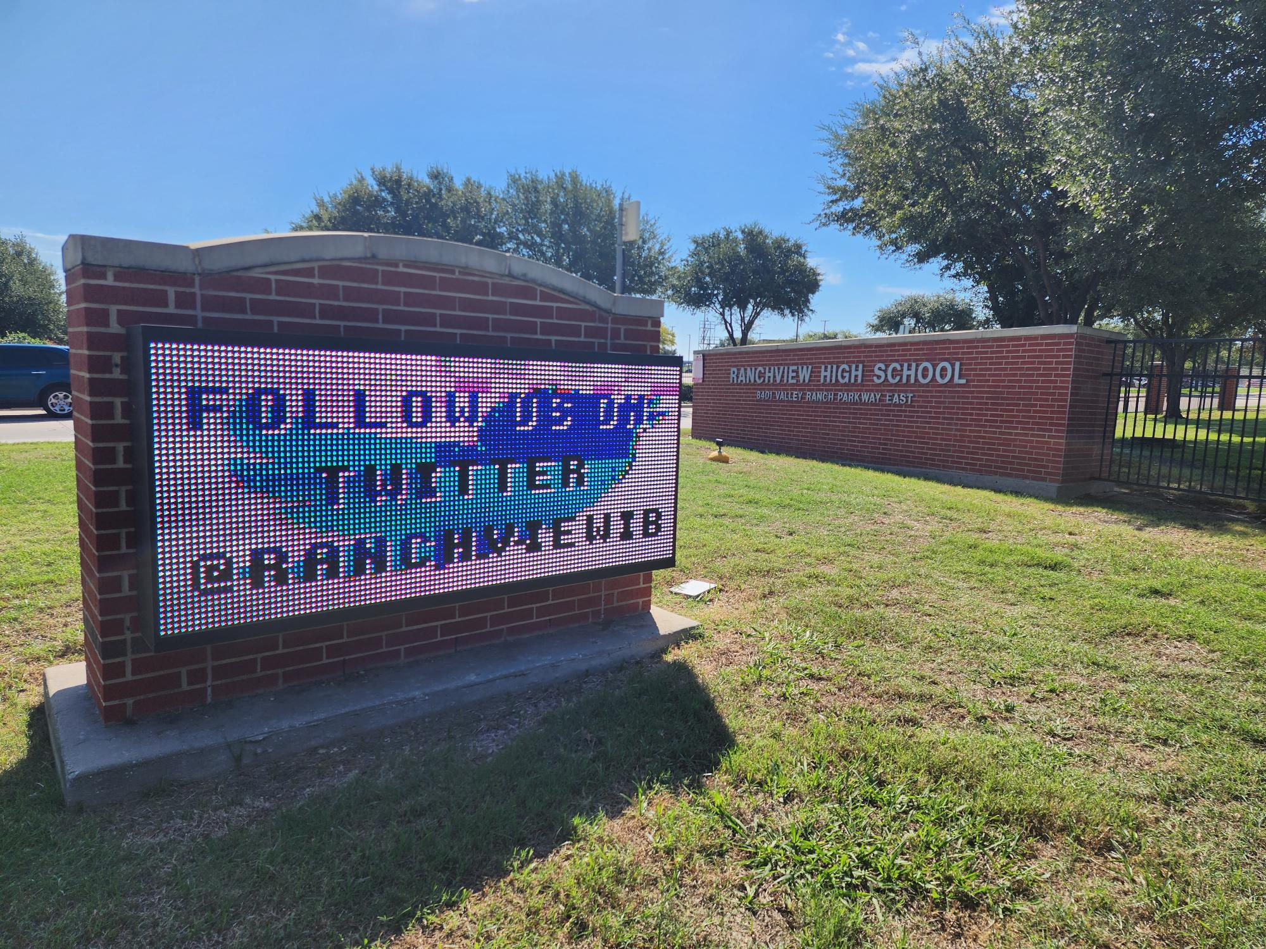
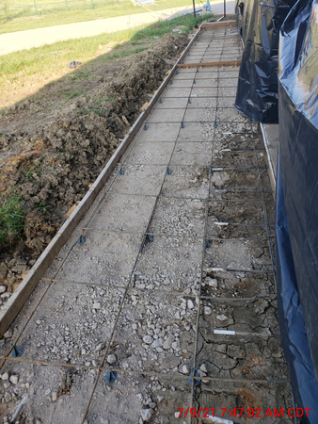
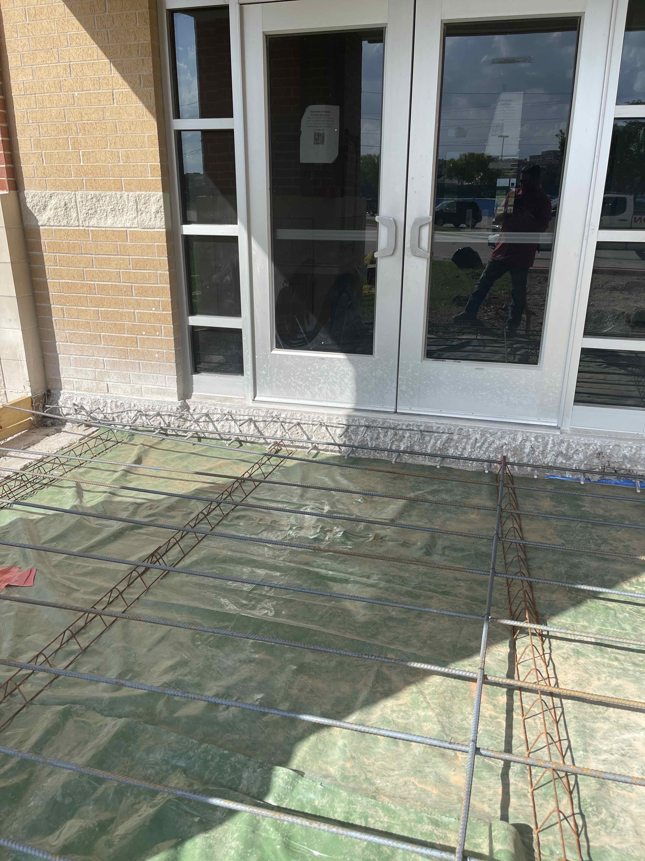
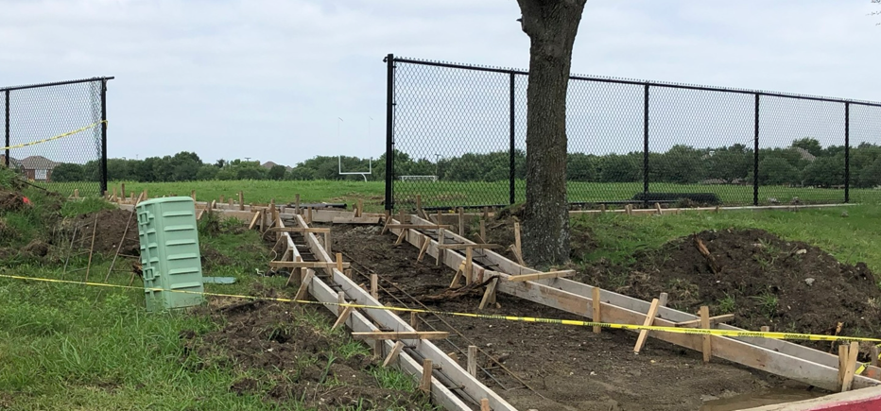
Improvements
Fine Arts Classroom and Performance Space Improvements
  TIFF Funding – Existing Auditorium Meets District Standards
Collaboration Rooms
  TIFF Funding – Renovation Work is Coming Soon
Exterior Upgrades
  Roof Replacement/Repair
  Parking Lot Striping
Interior Upgrades
  Library Renovation
  ITA
  Culinary
  Floral
Mechanical, Electrical, and Plumbing Systems Upgrades
  New LED Site Lighting and Controls
  RTU Replacement
  Water Bottle Fillers
Landscape Improvements
  Exterior Concrete Replacement
Marquee – Existing Digital Marquee
Exterior Concrete
Existing Digital Marquee
PROMISES MADE
PROMISES KEPT
Exterior Concrete
Exterior Concrete

Slide 9
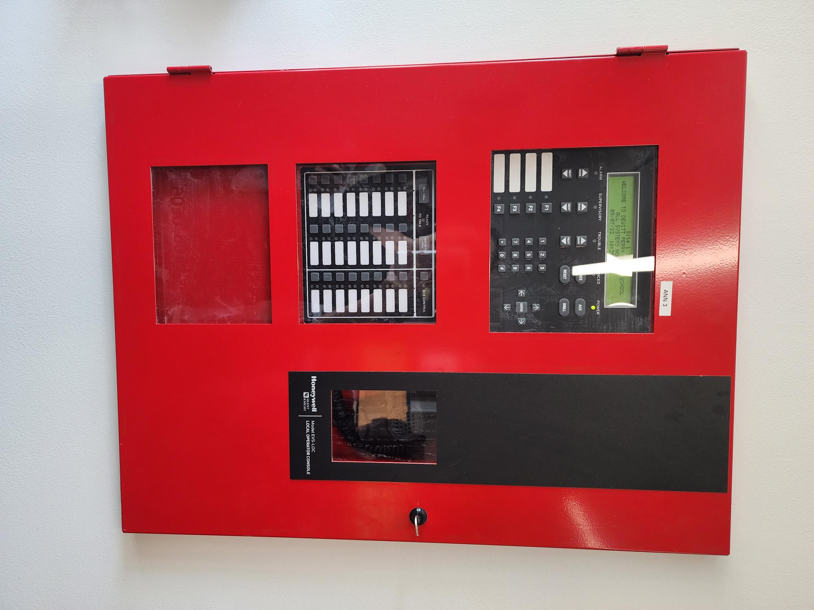

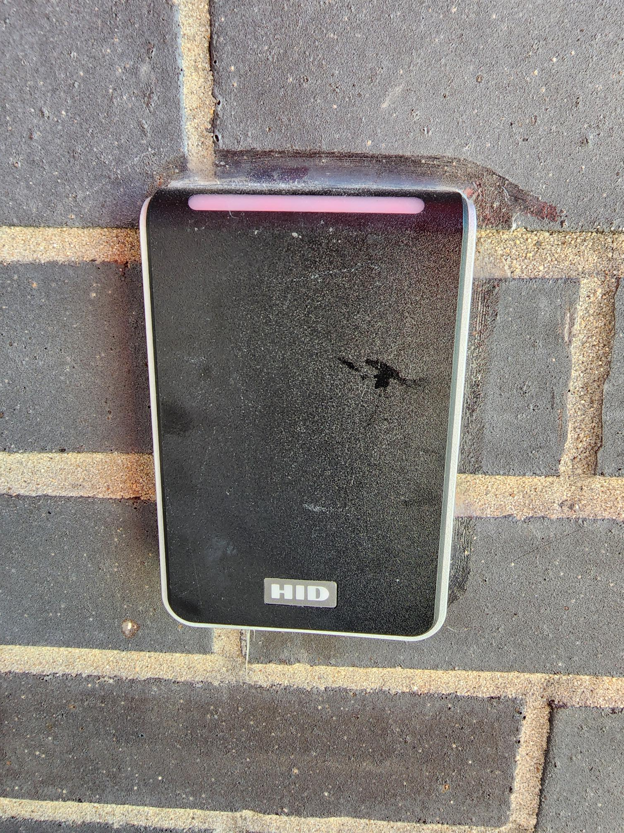
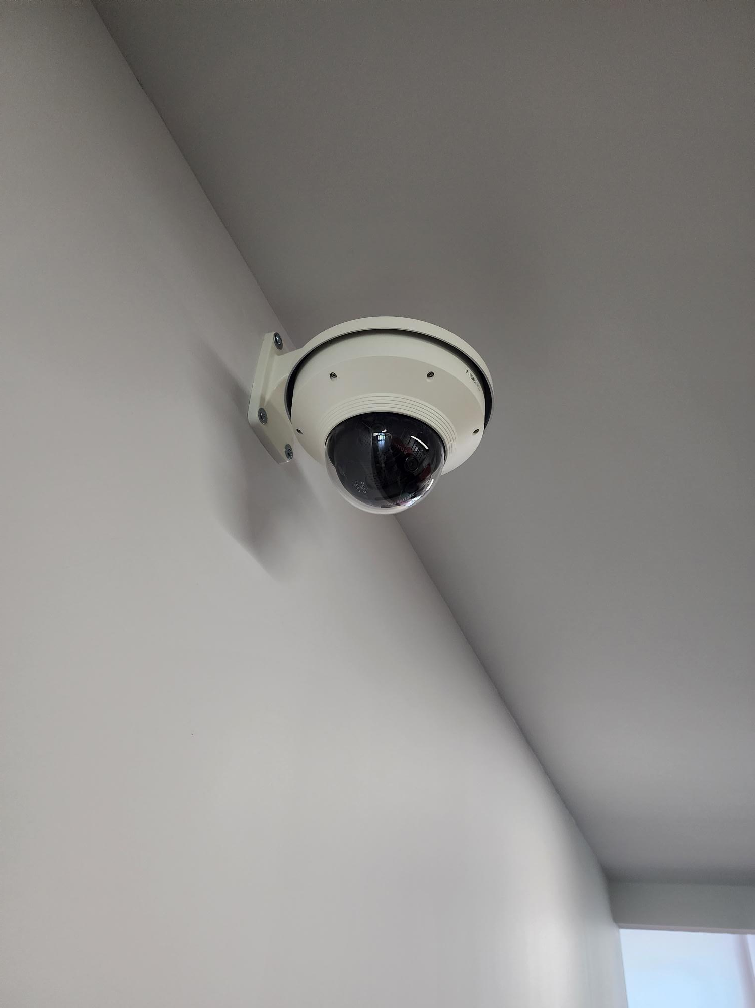
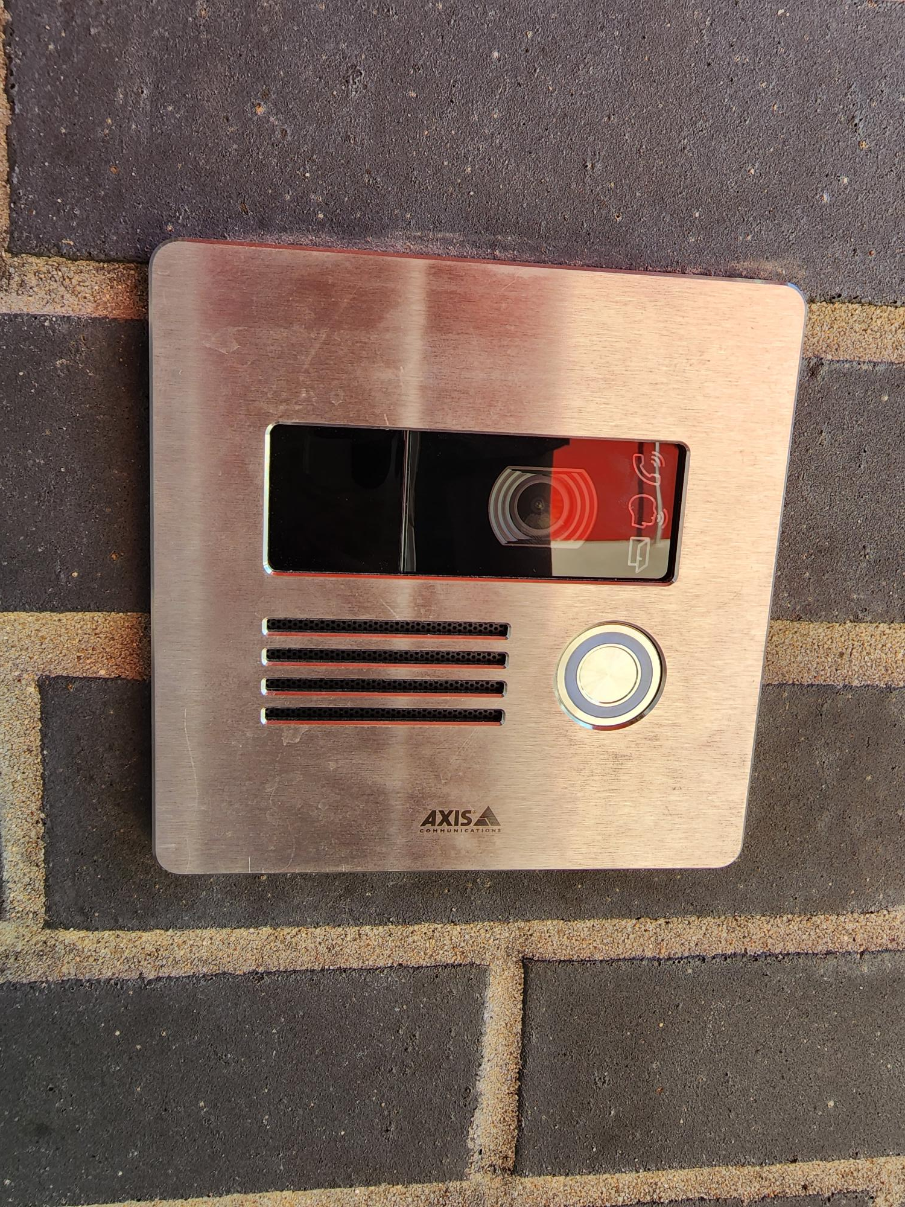
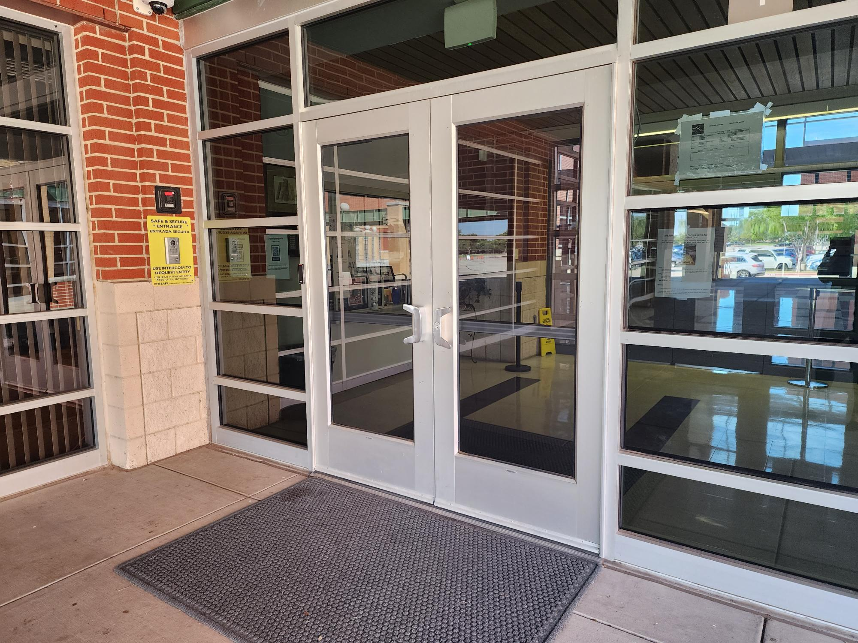
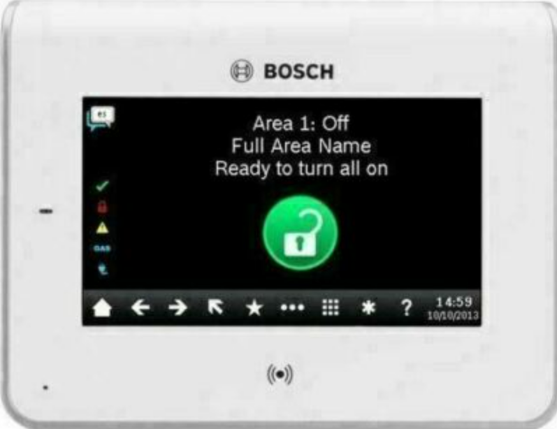
Safety and Security
Access Control
  Intercom
  Card Readers
  Intrusion
Cameras
Bollards
Fire Sprinkler System Upgrades
Secure Vestibule
Card Readers
Cameras
Fire Alarm
Card Reader
Intercom
PROMISES MADE
PROMISES KEPT
Intrusion
Secure Vestibule

Slide 10
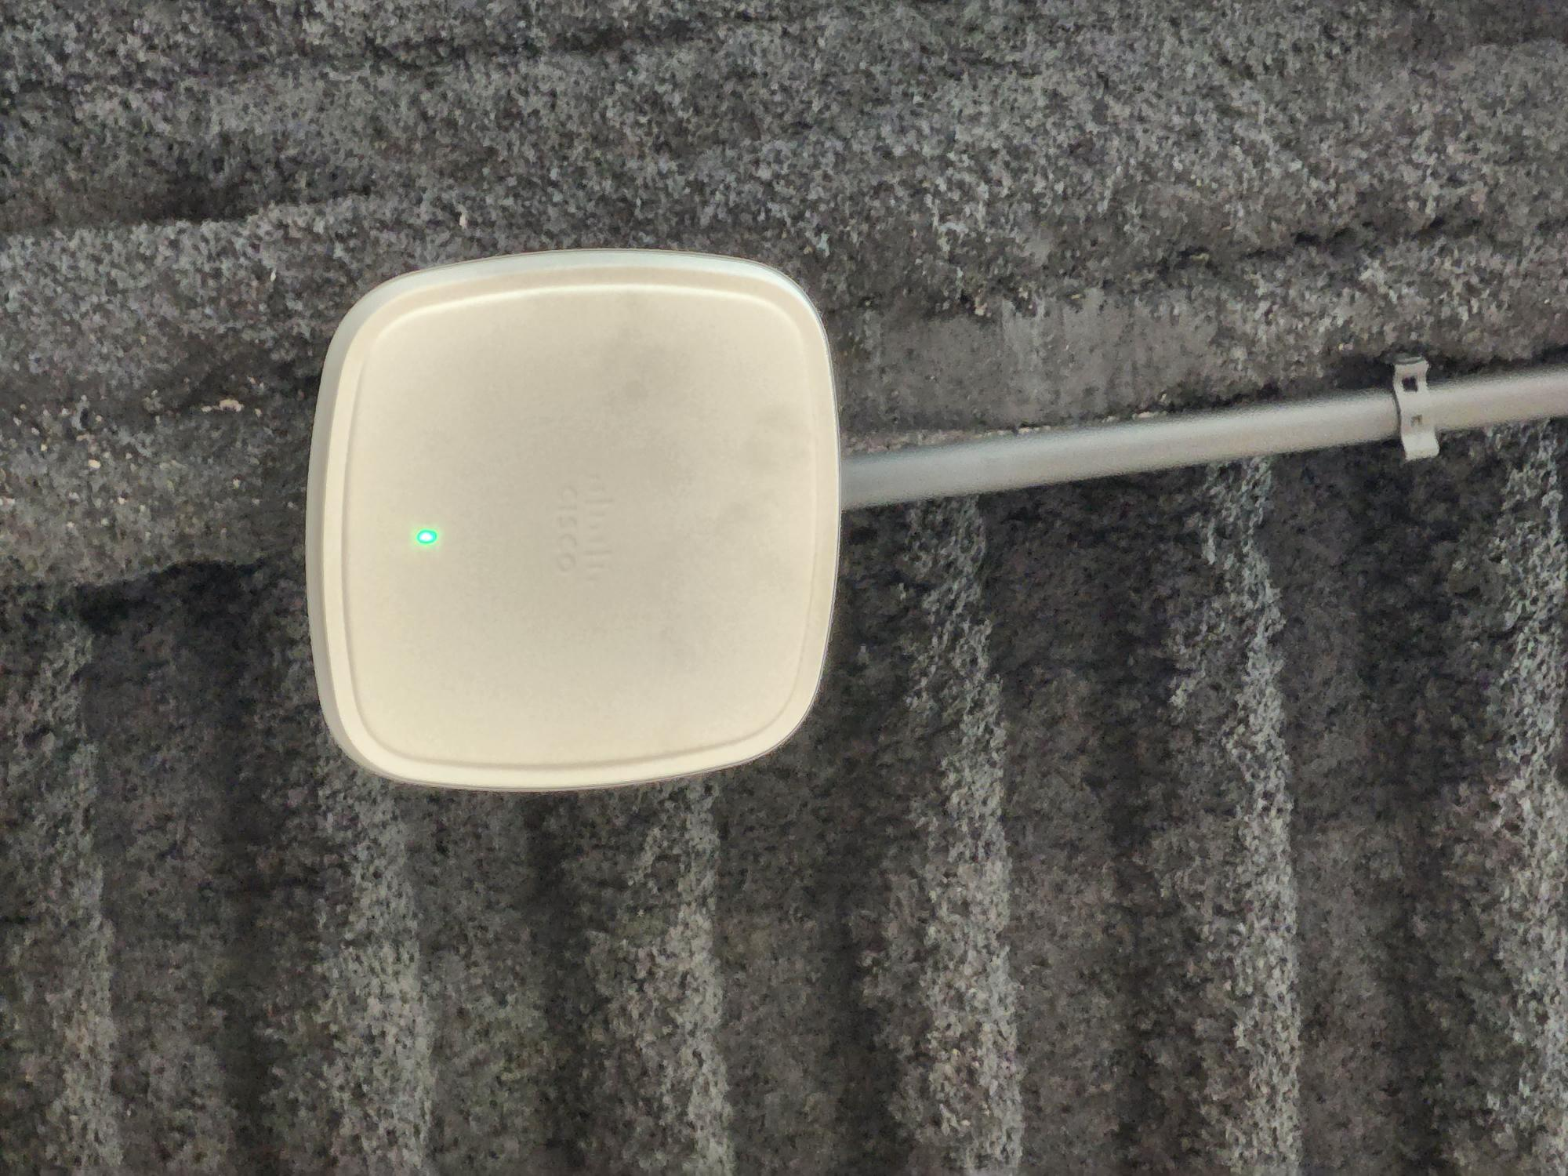

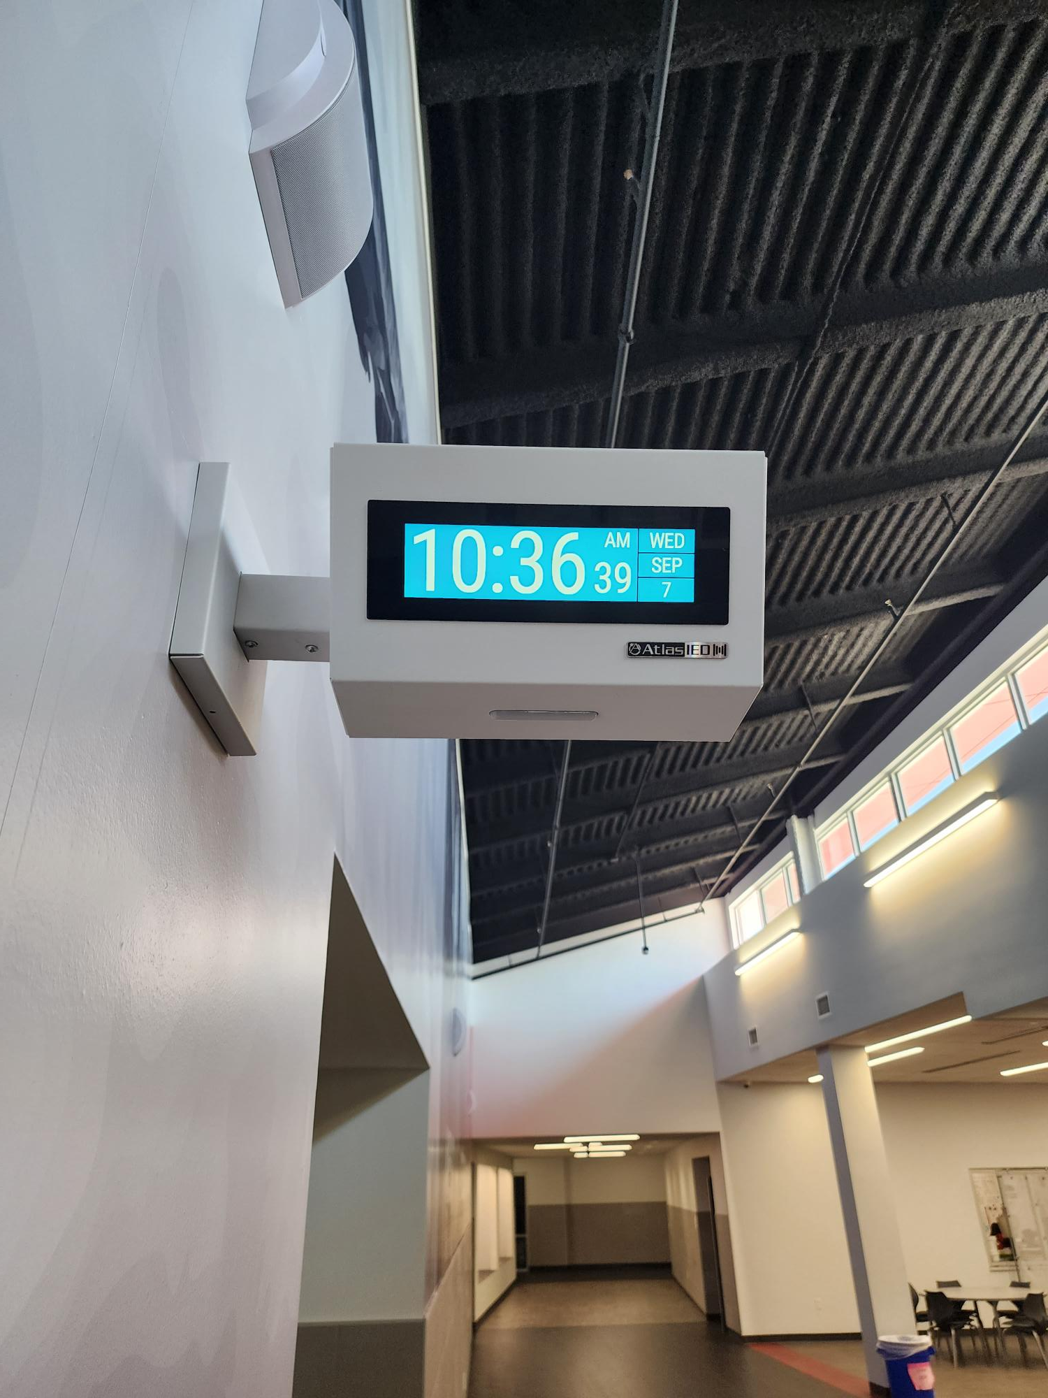
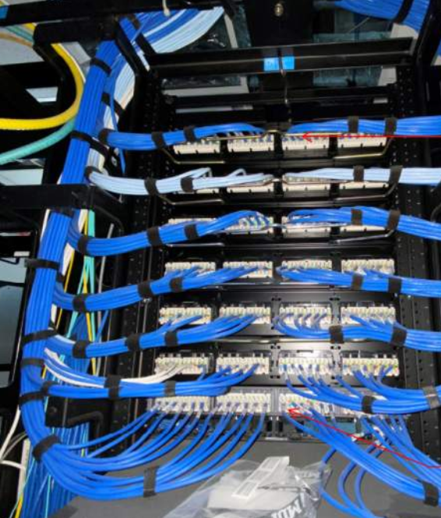
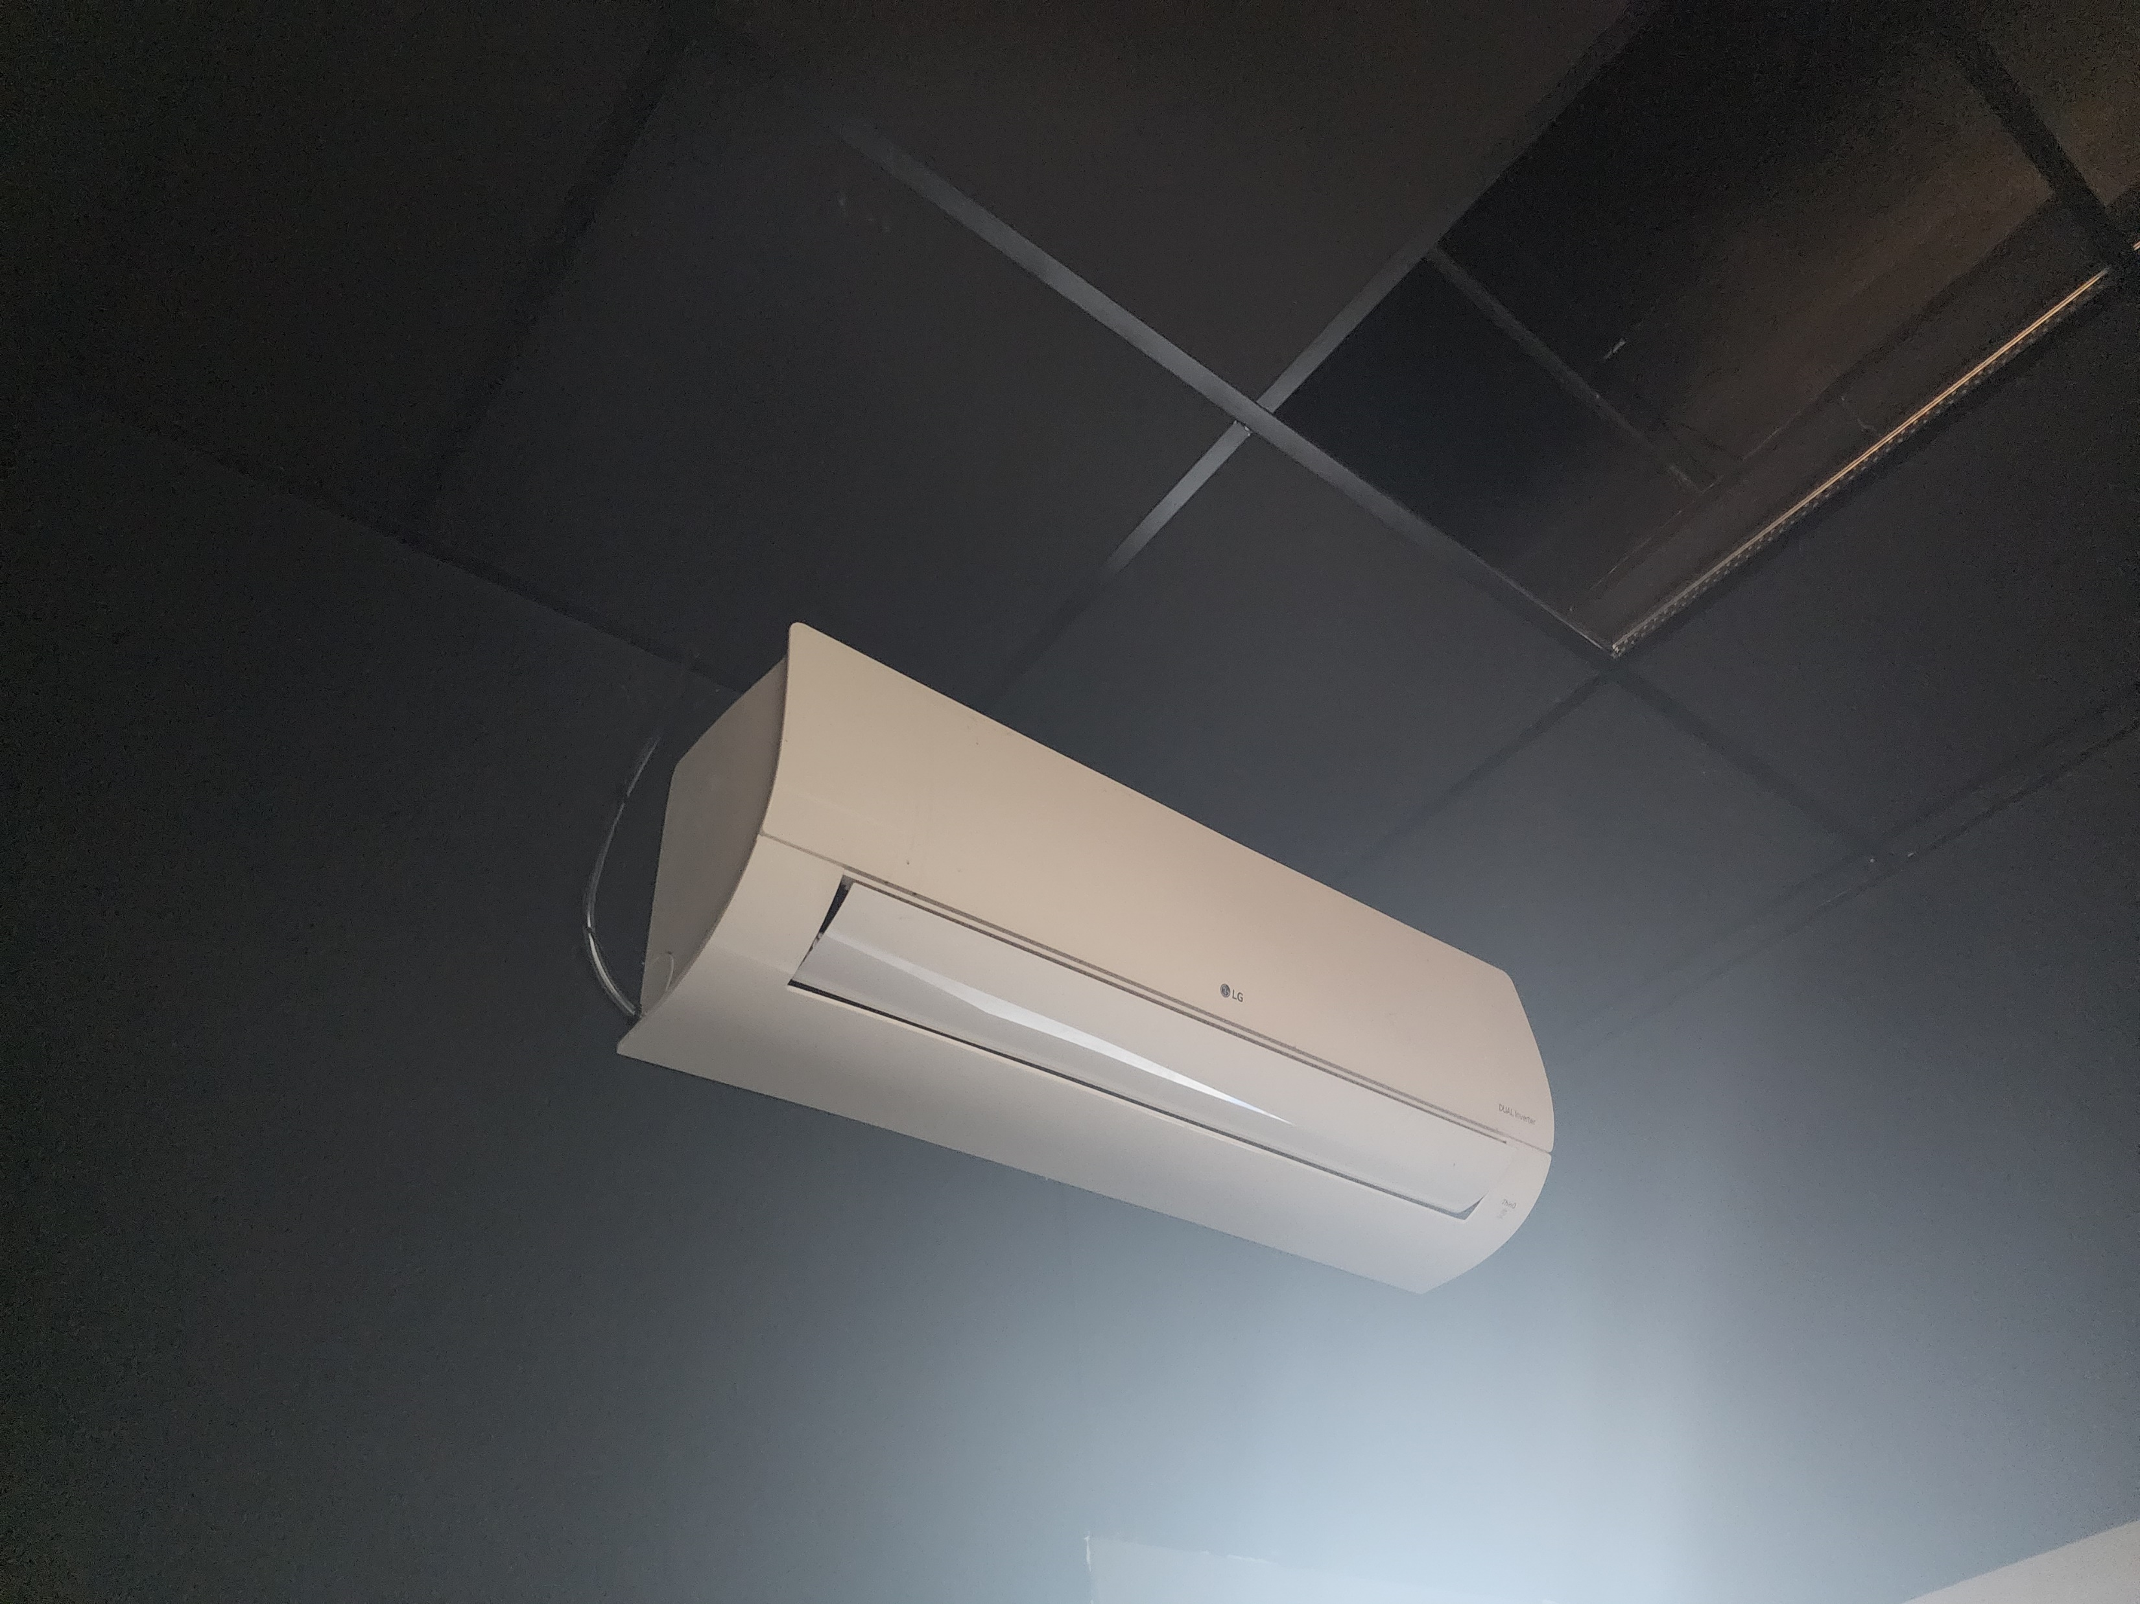
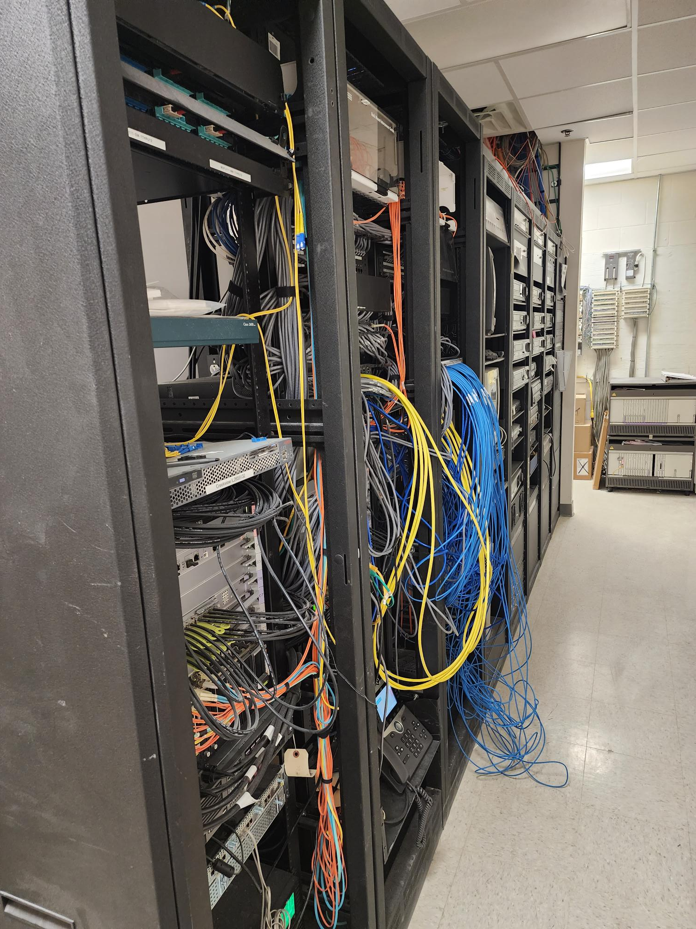
Technology
Secure Climate Controlled Server Space
Cabling
Wireless Upgrades
Phone System Upgrades
Wireless Upgrades
Clocks
PROMISES MADE
PROMISES KEPT
Cabling
Climate Control
Server Space

Slide 11
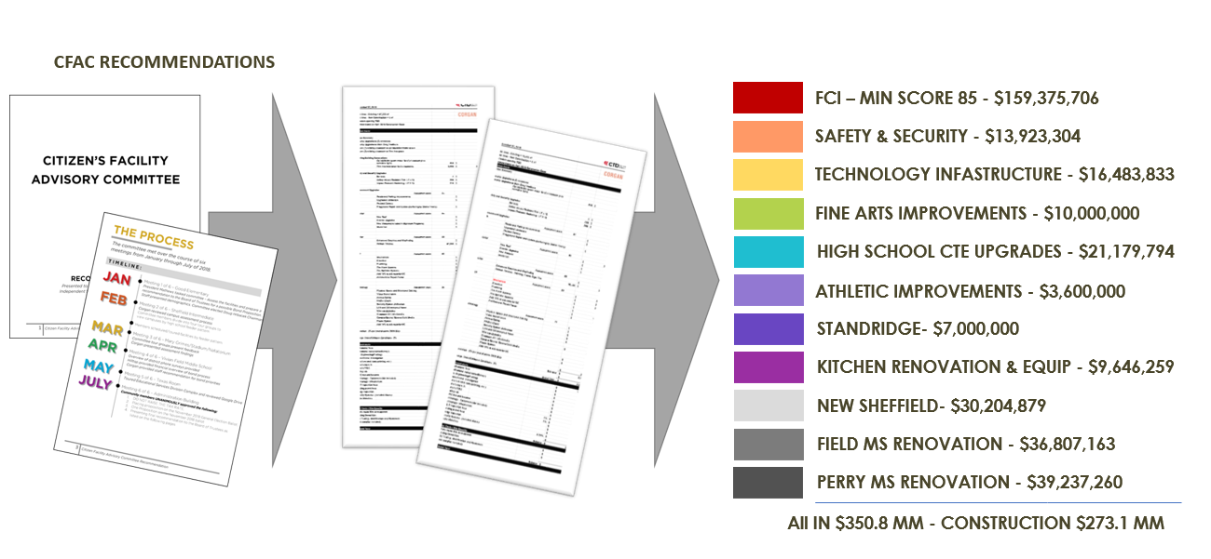
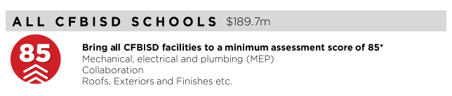
FCI Update
PROMISES MADE
PROMISES KEPT

Slide 12
FCI Update
Building Element |  |  |  |  | Type/Material | Prior Condition | Current | Prior Description | 2022 Reno Comments
On-Site Utilities & Drainage
 | Site Drainage / Erosion Control |  |  |  |  | Fair | Good | Minor signs of erosion & ponding water. | Managed areas of Site Drainage and Erosion
 | Site Lighting - Parking Lots |  |  |  |  | Good | Good
 | Exterior Concrete Pads & Pavement-Around building, mechanical yards |  |  |  |  | Fair | Good |  | Reaplced concrete pads on exterior
 | Fire Hydrants / Utility Vaults / Misc. |  |  |  |  | Fair | Fair
 | Grease Trap |  |  |  |  | Fair | Fair
Site Parking & Drives
 | Pavement - Roads / Drives / Parking Areas |  |  |  |  | Good | Good | Clean and clear of cracks, heaving, potholes. Joint Sealer is properly in place.
 | Fire Lanes |  |  |  |  | Good | Good | Fire lane paint striping in good condition.Clean and clear of cracks, heaving, potholes. Joint Sealer is properly in place.
 | Striping - Parking lot and fire lane |  |  |  |  | Fair | Good | Minor to moderate signs of age and deterioration but still visible. Handicapped spaces incorrectly marked or striped. | Restriped Parking Lots
 | Curbs |  |  |  |  | Fair | Fair | Minor to moderate signs of age and deterioration, no major damage.
Site Lighting
 | Site Lighting |  |  |  |  | Good | Good | All fixtures are working properly and have no visible damage. Lighting is appropriate for security.
Site Security
 | Security Cameras |  |  |  | Megapixels of Resolution | 15 | 851 |  | Replaced all low resolution cameras and doubled coverage
 | Chain Link Fencing / Gates |  |  |  |  | Good | Good | No damage to material and poles, gates are working properly.
Misc. Stuctures
 | Site Walls - Retaining / Screen |  | Material: | Material: | Stone | Good | Good | No signs of damage, settling or rotation.
 | Dumpster Service Area |  |  |  |  | Good | Good | Dumpster walls have no sign of damage. Gates properly function.
 | Bollards |  | Material: | Material: | Steel | Fair | Good | Minor to moderate signs of age and deterioration but still visible. | Replaced Bollards
 | Site Signage - Directional / Handicapped |  |  |  |  | Good | Good
 | Misc. Site work / Site Structures
Circulation
 | Sidewalks |  |  |  |  | Good | Good | Clean and clear of cracks or heaving. Joint Sealer is properly in place.
 | Stairs |  |  |  |  | Good | Good | Clean and clear of cracks or heaving. Joint Sealer is properly in place. Rise and Run is compliant. Handrails (if present) are compliant & finish is in good standing.
 | Ramps |  |  |  |  | Good | Good | Clean and clear of cracks or heaving. Joint Sealer is properly in place. Slope is compliant. Handrails (if present) are compliant & finish is in good condition.
ADA Compliance / Accessiblity
 | Compliant Sidewalks/Curbs |  |  |  |  | Good | Good
 | Compliant Ramps & Handrails |  |  |  |  | Good | Good
 |  |  |  |  | Scored Categories | 20 | 20
 |  |  |  |  | Good | 13 | 17
 |  |  |  |  | Fair | 7 | 3 | Previous Aggregate Score: | 88
 |  |  |  |  | Poor | 0 | 0 | Reno Aggregate Score: | 95
 |  |  |  |  | N/A | 0 | 0
Site

Slide 13
FCI Update
Building Element |  |  |  |  | Type/Material | Prior Condition | Current | Prior Description | 2022 Reno Comments
Building Structure/Foundation
 | Foundation |  |  | Type: | Crawlspace | Good | Good | No signs of cracking or heaving.
 | Substructure - Slab - on - Grade
 |  | Basement / Below Grade Exterior Walls |  |  |  | Good | Good
 |  | Miscellanous |  |  |  | N/A | N/A | 0
 | Superstructure
 |  | Fireproofing |  |  |  | Good | Good
 |  | Pre-Engineered Metal building |  |  |  | Good | Good |  | Athletic Facility
Building Exterior Shell
 | Roofing
 |  | General Roof Condition (Visual Inspection) |  |  |  | Fair | Good | Roof is nearing the end of it's expected useful life. Some leaks are reported with areas of ponding. Some sealants and flashings are in need of repair or replacement. | Replaced Roof
 |  | Roof Warranty Status |  |  |  |  |  |  | New Roof
 |  |  | Roofing Manufacturer / Warranty Issuer |  |  |  |  | CBS ('01), Addition completed in '16 | Duro-Last
 |  |  | Years Remaining in Warranty Period |  |  |  |  | 4 years on original roof, 19 years on addition
 |  | Skylights |  |  |  | N/A | N/A
 |  | Roof Curbs / Openings / Misc. |  |  |  | Fair | Good |  | Replaced as Part of Renovation
 | Exterior Walls
 |  | Exterior Wall Material |  | Material: | Brick | Good | Good | Veneer is free of cracks, signs of settling, rotation or damage.
 |  | Building Caulking/Sealant |  |  |  | Poor | Poor | Major signs of wear or are missing.
 |  | Exterior Painting |  |  |  | N/A | N/A
 | Windows/Glazed Walls
 |  | Windows
 |  |  |  | Glazing Type: | Single Pane | Good | Good | No visible damage, proper weatherproofing apparent. | Double pane in addition
 |  |  |  | Frame Type: | Aluminum
 | Exterior Doors Systems
 |  | Exterior Doors
 |  |  |  | Frame Type: | Hollow Metal | Good | Good | No visible damage, proper weatherproofing/threshold apparent, door hardware compliant and functioning properly. | Paint needed
 |  |  |  | Panel Type: | Hollow Metal
 |  |  |  | Panel Type: | Hollow Metal
 |  | Exterior Overhead Doors |  | Type: | Manual | Good | Good | No visible damage, proper weatherproofing/threshold installed, door hardware compliant and functioning properly, motor works as required (if applicable).
 |  | Card Access Reader |  |  | Yes
 |  | Door Bell |  |  | Yes
 |  | Peep Hole |  |  | No
 | Canopies
 |  | Canopy |  | Type: | Attached to Building | Fair | Fair | Minor scratches or signs of wear, may need a refresh of finish (if applicable). No signs of water leaking, settling or movement.
 | Loading Area
 |  | Raised Loading Dock |  |  |  | Good | Good | No visible damage, no signs of settling or movement. Dock bumpers present and almost new in appearance.
 |  | Independent Loading Area |  |  |  | Good | Good | No visible damage, no signs of settling or movement.
 | Misc. Exterior
 |  | Exterior Soffit - Material |  | Material: | Plaster | Good | Good | Almost new in appearance, no visible fading or stains.
 |  | Exterior Louvers / Sunscreens |  |  |  | N/A | N/A
 |  |  |  |  | Scored Categories | 15 | 15
 |  |  |  |  | Good | 11 | 13
 |  |  |  |  | Fair | 3 | 1 | Previous Aggregate Score: | 89
 |  |  |  |  | Poor | 1 | 1 | Reno Aggregate Score: | 93
 |  |  |  |  | N/A | 4 | 4
Exterior

Slide 14
FCI Update
Interior

Slide 15
FCI Update
Interior

Slide 16
FCI Update
RANCHVIEW HIGH SCHOOL |  | AGE:15 YEARS |  | 282,445 SF
ITEM | DESCRIPTION | DESCRIPTION |  |  |  |  | PRIOR GRADE | CURRENT
OPERATIONAL, SYSTEMS & CODE DEFICIENCIES | Assessed Scope | Performed Scope
HVAC | Task: Replace Trane packaged RTUs installed in 2000-2001 | Replaced |  |  |  |  | 75 | 98
 | Task: Replace Mitsubishi DX mini-split system installed in 2001 | Replaced
 | Total HVAC Cost:
EMCS | Task: Replace controls installed with 2001 system, included in cost of RTU replacement. | Replaced
 | Total EMCS Cost:
PLUMBING | Task: Replace (2) Lochinvar 200 gallon domestic boiler and storage tank installed in 2001. | Replaced |  |  |  |  | 89 | 95
 | Task: Replace State 6 gallon electric water heater installed in 2001. | Replaced
 | Task: Replace and repipe 2 acid basins systems. Replace cleanouts and discharge piping. | Not in Scope
 | Task: Provide new electric water coolers with bottle fillers. | Replaced
 | Total Plumbing Cost:
ELECTRICAL SYSTEM | Task: |  |  |  |  |  | 95 | 95
 | Total Electrical Cost:
INTERIOR LIGHTING | Task: Provide tunable lighting for special education classrooms. | Not in Scope |  |  |  |  | 93 | 93
 | Task:
 | Total Interior Lighting Cost:
EXTERIOR LIGHTING | Task: Replace all existing exterior wall packs with LED fixtures. | Replaced |  |  |  |  | 90 | 98
 | Task: Renovate all exterior parking lot lighting to LED. | Replaced
 | Total Exterior Lighting Cost:
FIRE ALARM SYSTEMS | Task: Replace FCI system installed in 2002. | Not in Scope |  |  |  |  | 70 | 70
 | Total Fire Alarm Cost:
FIRE PROTECTION SYSTEM | Task: |  |  |  |  |  | 96 | 96
 | Total Fire Protection Cost:
OTHER | Task: Replace sound systems. |  |  |  |  |  | NA | NA
 | Task:
 | Total Cost:
TOTALS |  |  |  |  |  |  | 85 | 93
MEP

Slide 17
FCI Update
Ranchview HS Technology and Security Status
System | Possible Score | Corgan Score (2018) | TNCG Score (2022) | Notes
Cabling Infrastructure | 10 | 8 | 8 | Small improvements to renovation areas.
Local Area Network | 15 | 14 | 14 | No upgrade (that True North is aware of)
Wireless LAN | 15 | 14 | 14 | Wireless could use a refresh in the next few years but in good condition right now.
Unified Comm (Phone) System | 10 | 10 | 10 | Upgraded prior to renovation project
Video Management System | 10 | 7 | 10 | Complete upgrade to Genetec
Public Address | 10 | 8 | 10 | Complete upgrade to Informacast
Premise Access Control (and Intrusion) | 10 | 8 | 10 | Complete upgrade to Genetec
Intercom System | 5 | 4 | 5 | Replaced front intercom and added to Kitchen receiving door
Special Space AV | 5 | 4 | 4 | District item. AV upgrade as part of technology package
Instruction Space Presentation | 10 | 8 | 9 | New Interactive Displays in renovation areas matching distirct standard
Total Score | 100 | 85 | 94
Technology

Slide 18
FCI Update
Ranchview HS
Assessment
Site : 88
Exterior: 89
Interior: 92
MEP: 85
Technology: 85
Score: 88
After Bond
Improvements
Site : 95
Exterior: 93
Interior:
MEP: 93
Technology: 94
Score:
PROMISES MADE
PROMISES KEPT

Slide 19


