Slide 1




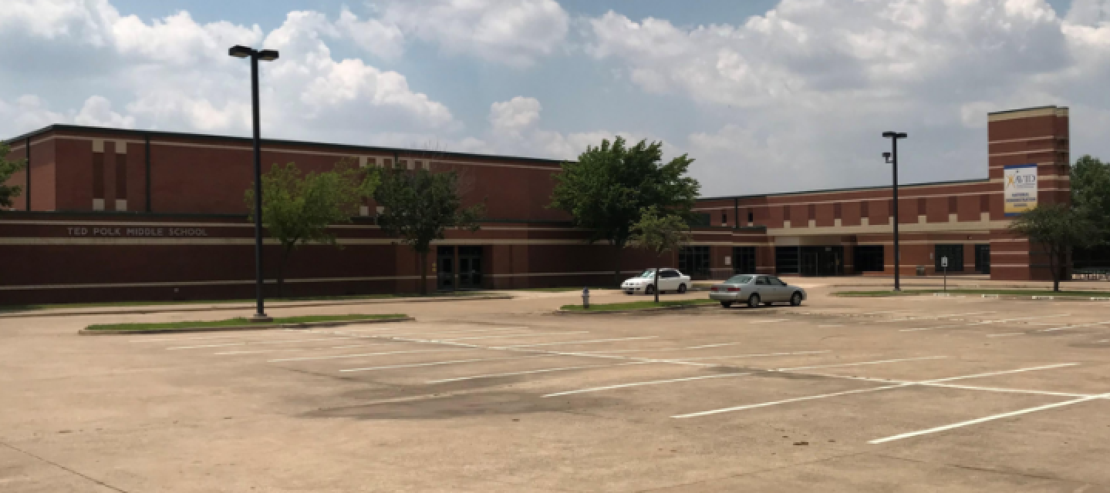
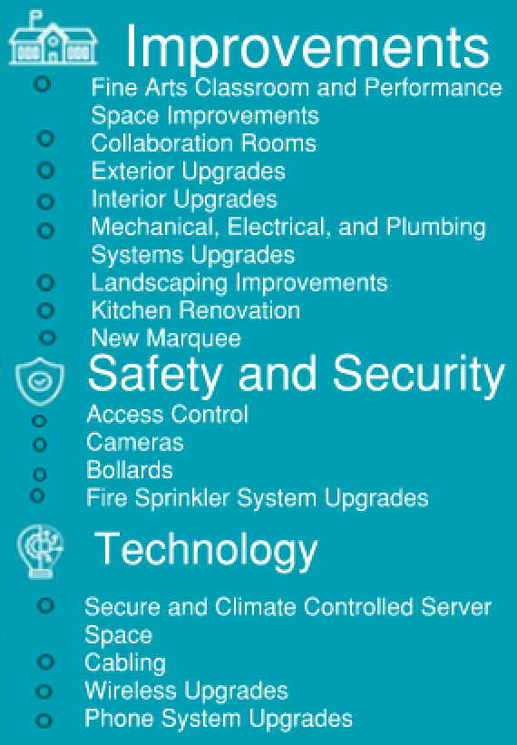
TED POLK MIDDLE SCHOOL
cfbbond.com

Slide 2

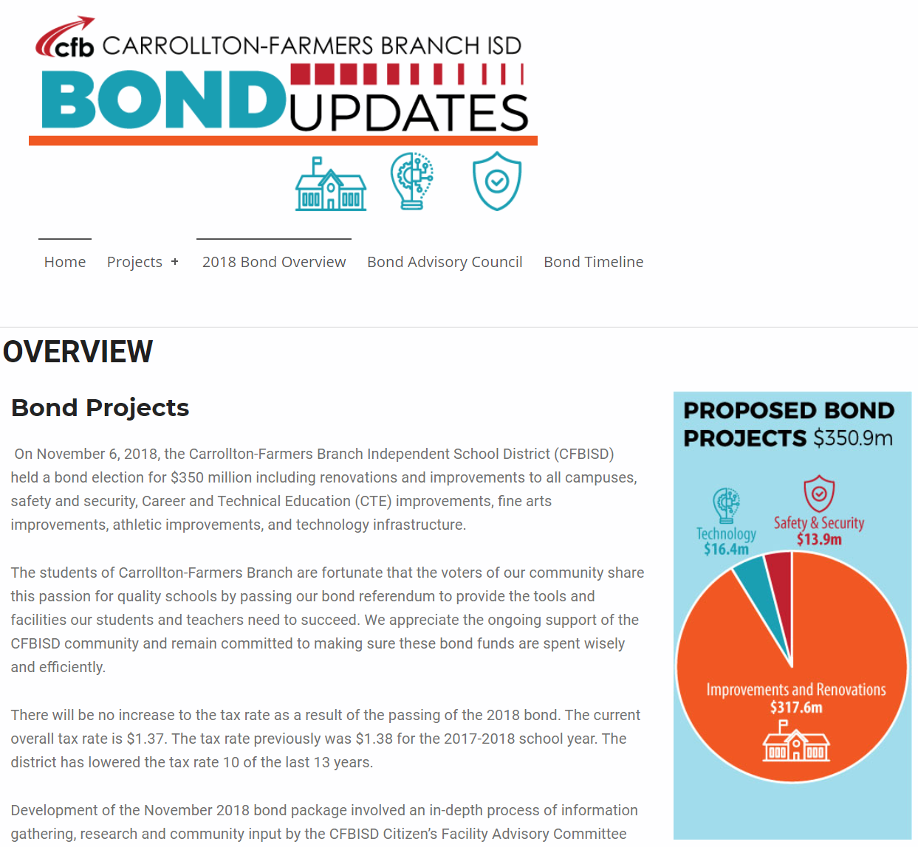
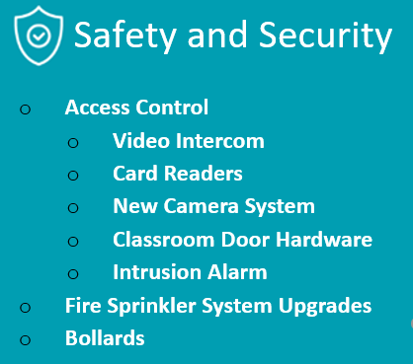

Improvements
Fine Arts Classroom and Performance Space Improvements
  Band, Orchestra, Choir, Theater, and Percussion Hall Renovations
Collaboration Rooms
  Practice Rooms in Fine Arts
Exterior Upgrades
  Roof Replacement and Repair
Interior Upgrades
  Makerspace /Engineering Room Renovation
  Structural Joist Reinforcement
Mechanical, Electrical, and Plumbing Systems Upgrades
  New LED Site Lighting and Controls
  New Rooftop Units and Controls
  Water Bottle Fillers
  Water Heater Replacement
Landscape Improvements
  Exterior Concrete Replacement
Kitchen Renovation
  New Kitchen Equipment
New Marquee – Coming Soon
Access Control
  Intercom
  Card Readers
  Security Alarm
Cameras
Bollards
Fire Sprinkler System Upgrades
Secure Climate Controlled Server Space
Cabling
Wireless Upgrades
Phone System Upgrades
PROMISES MADE
PROMISES KEPT
PROMISES MADE
PROMISES KEPT

Slide 3
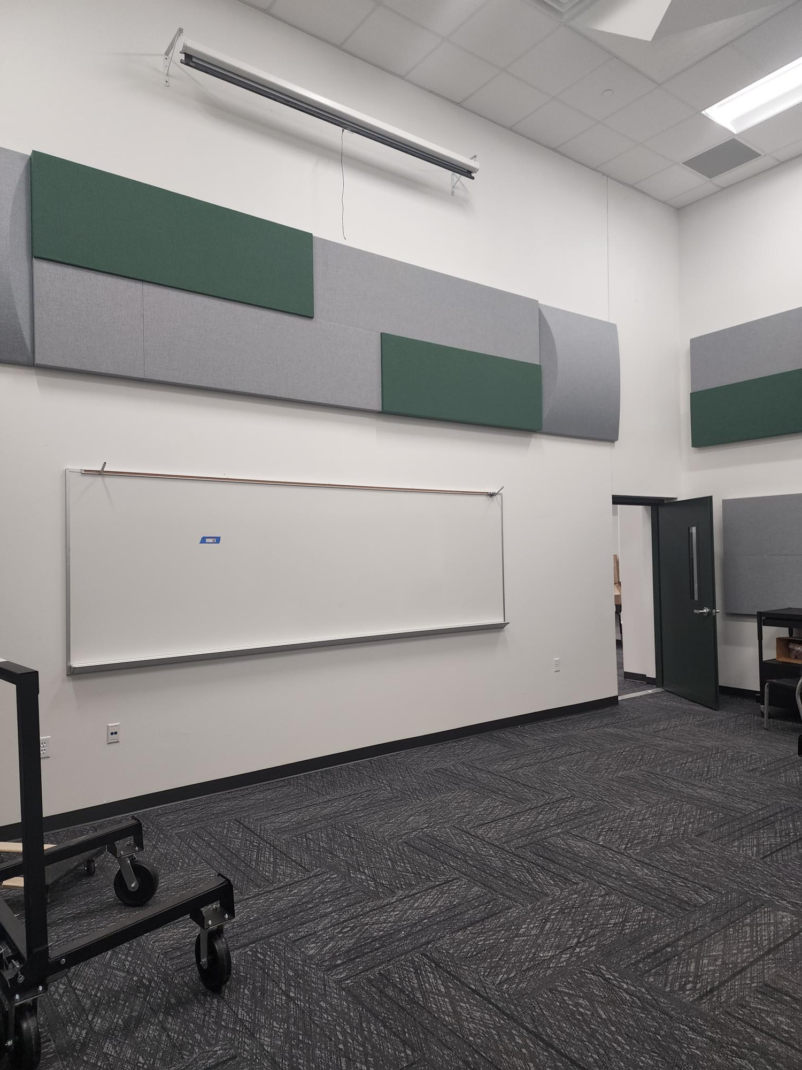
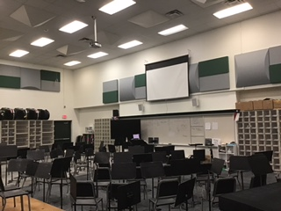
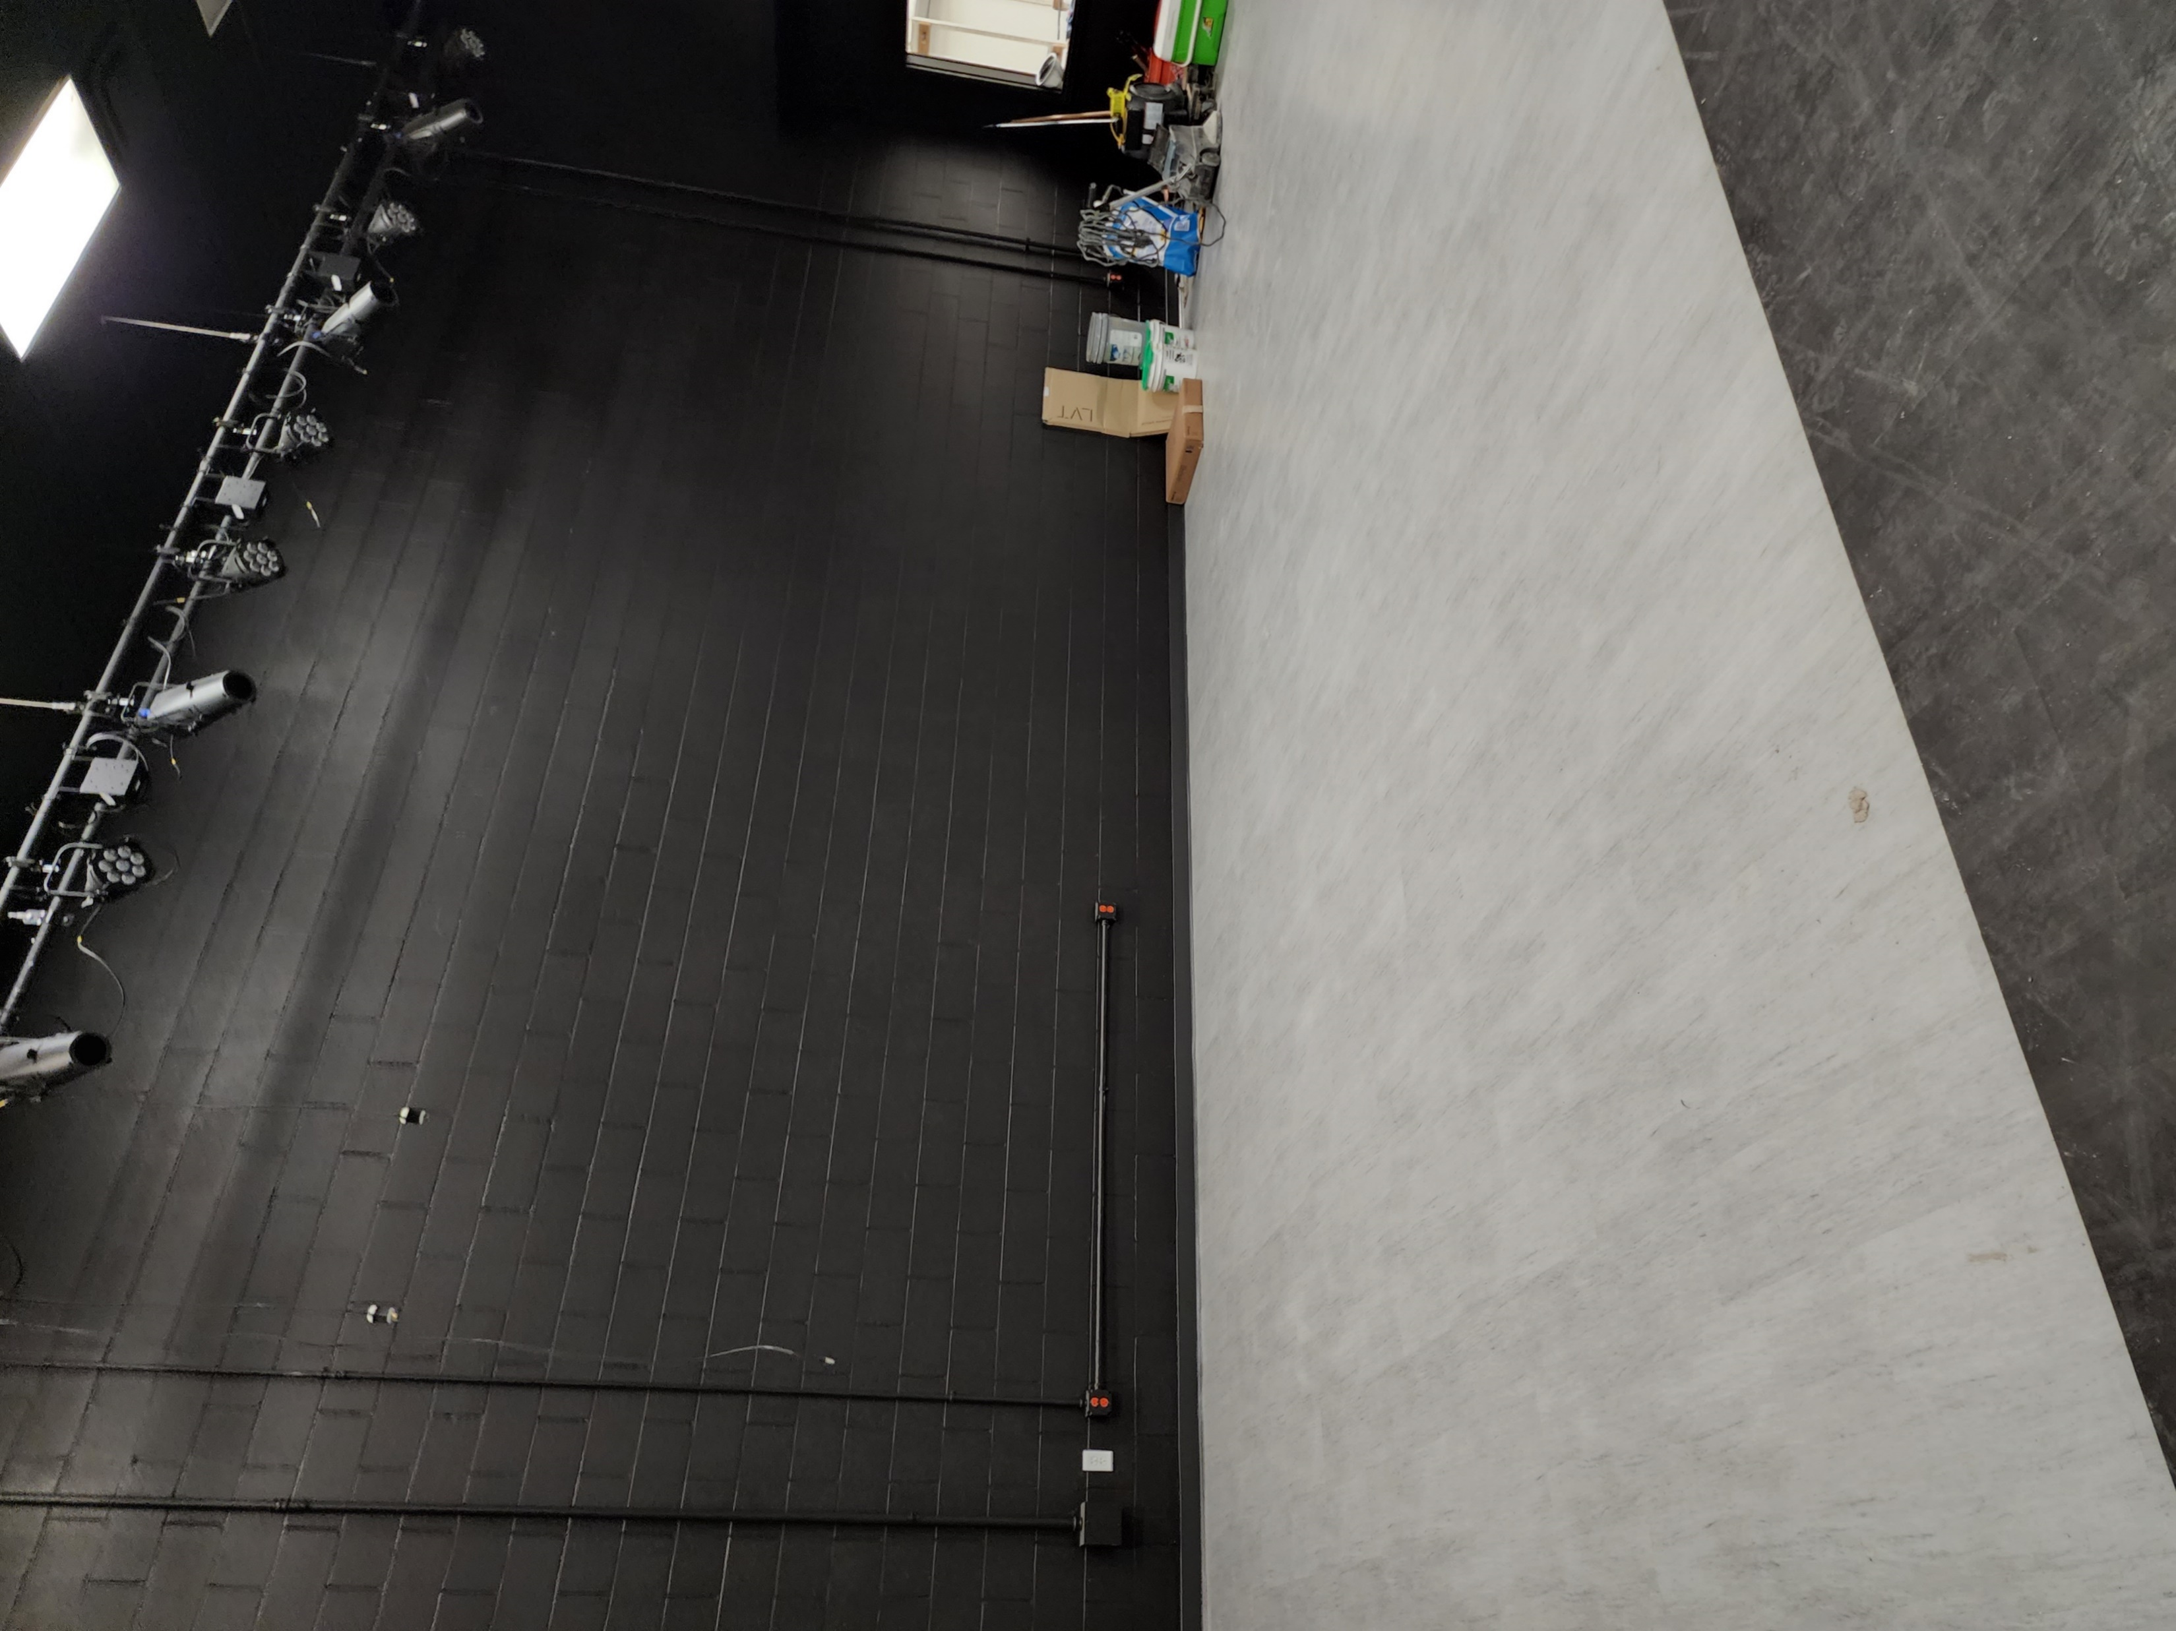
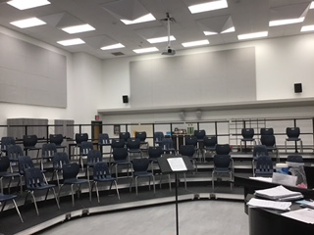
Improvements
Fine Arts Classroom and Performance Space Improvements
  Band, Orchestra, Choir, Theater, and Percussion Hall Renovations
Collaboration Rooms
  Ensemble/Practice Rooms in Fine Arts
Exterior Upgrades
  Roof Replacement and Repair
Interior Upgrades
  Makerspace /Engineering Room Renovation
  Structural Joist Reinforcement
Mechanical, Electrical, and Plumbing Systems Upgrades
  New LED Site Lighting and Controls
  New Rooftop Units and Controls
  Water Bottle Fillers
  Water Heater Replacement
Landscape Improvements
  Exterior Concrete Replacement
Kitchen Renovation
  New Kitchen Equipment
New Marquee – Coming Soon
New Ensemble Room
New Band Hall
PROMISES MADE
PROMISES KEPT
New Theater Space
New Choir Hall

Slide 4
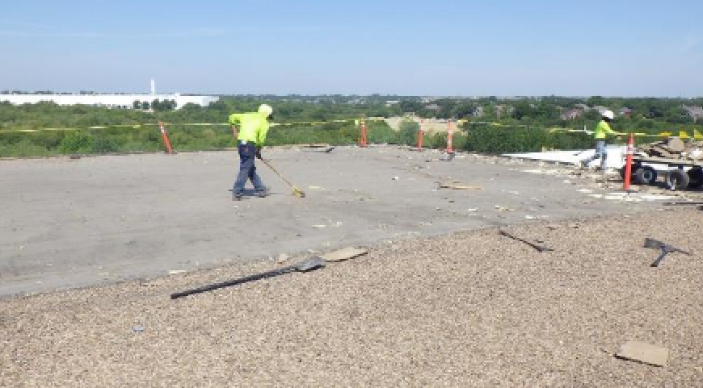
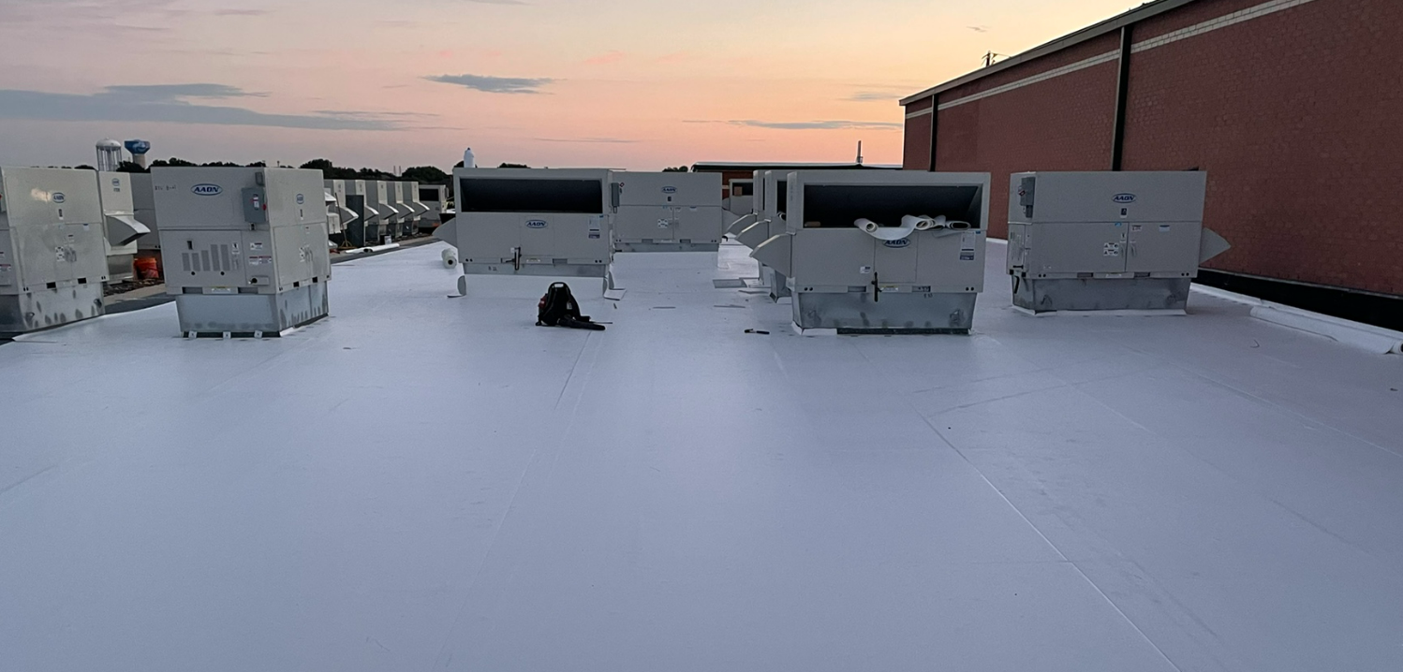
Improvements
Improvements
Fine Arts Classroom and Performance Space Improvements
  Band, Orchestra, Choir, Theater, and Percussion Hall Renovations
Collaboration Rooms
  Practice Rooms in Fine Arts
Exterior Upgrades
  Roof Replacement and Repair
Interior Upgrades
  Makerspace /Engineering Room Renovation
  Structural Joist Reinforcement
Mechanical, Electrical, and Plumbing Systems Upgrades
  New LED Site Lighting and Controls
  New Rooftop Units and Controls
  Water Bottle Fillers
  Water Heater Replacement
Landscape Improvements
  Exterior Concrete Replacement
Kitchen Renovation
  New Kitchen Equipment
New Marquee – Coming Soon
Before
PROMISES MADE
PROMISES KEPT
PROMISES MADE
PROMISES KEPT
After

Slide 5
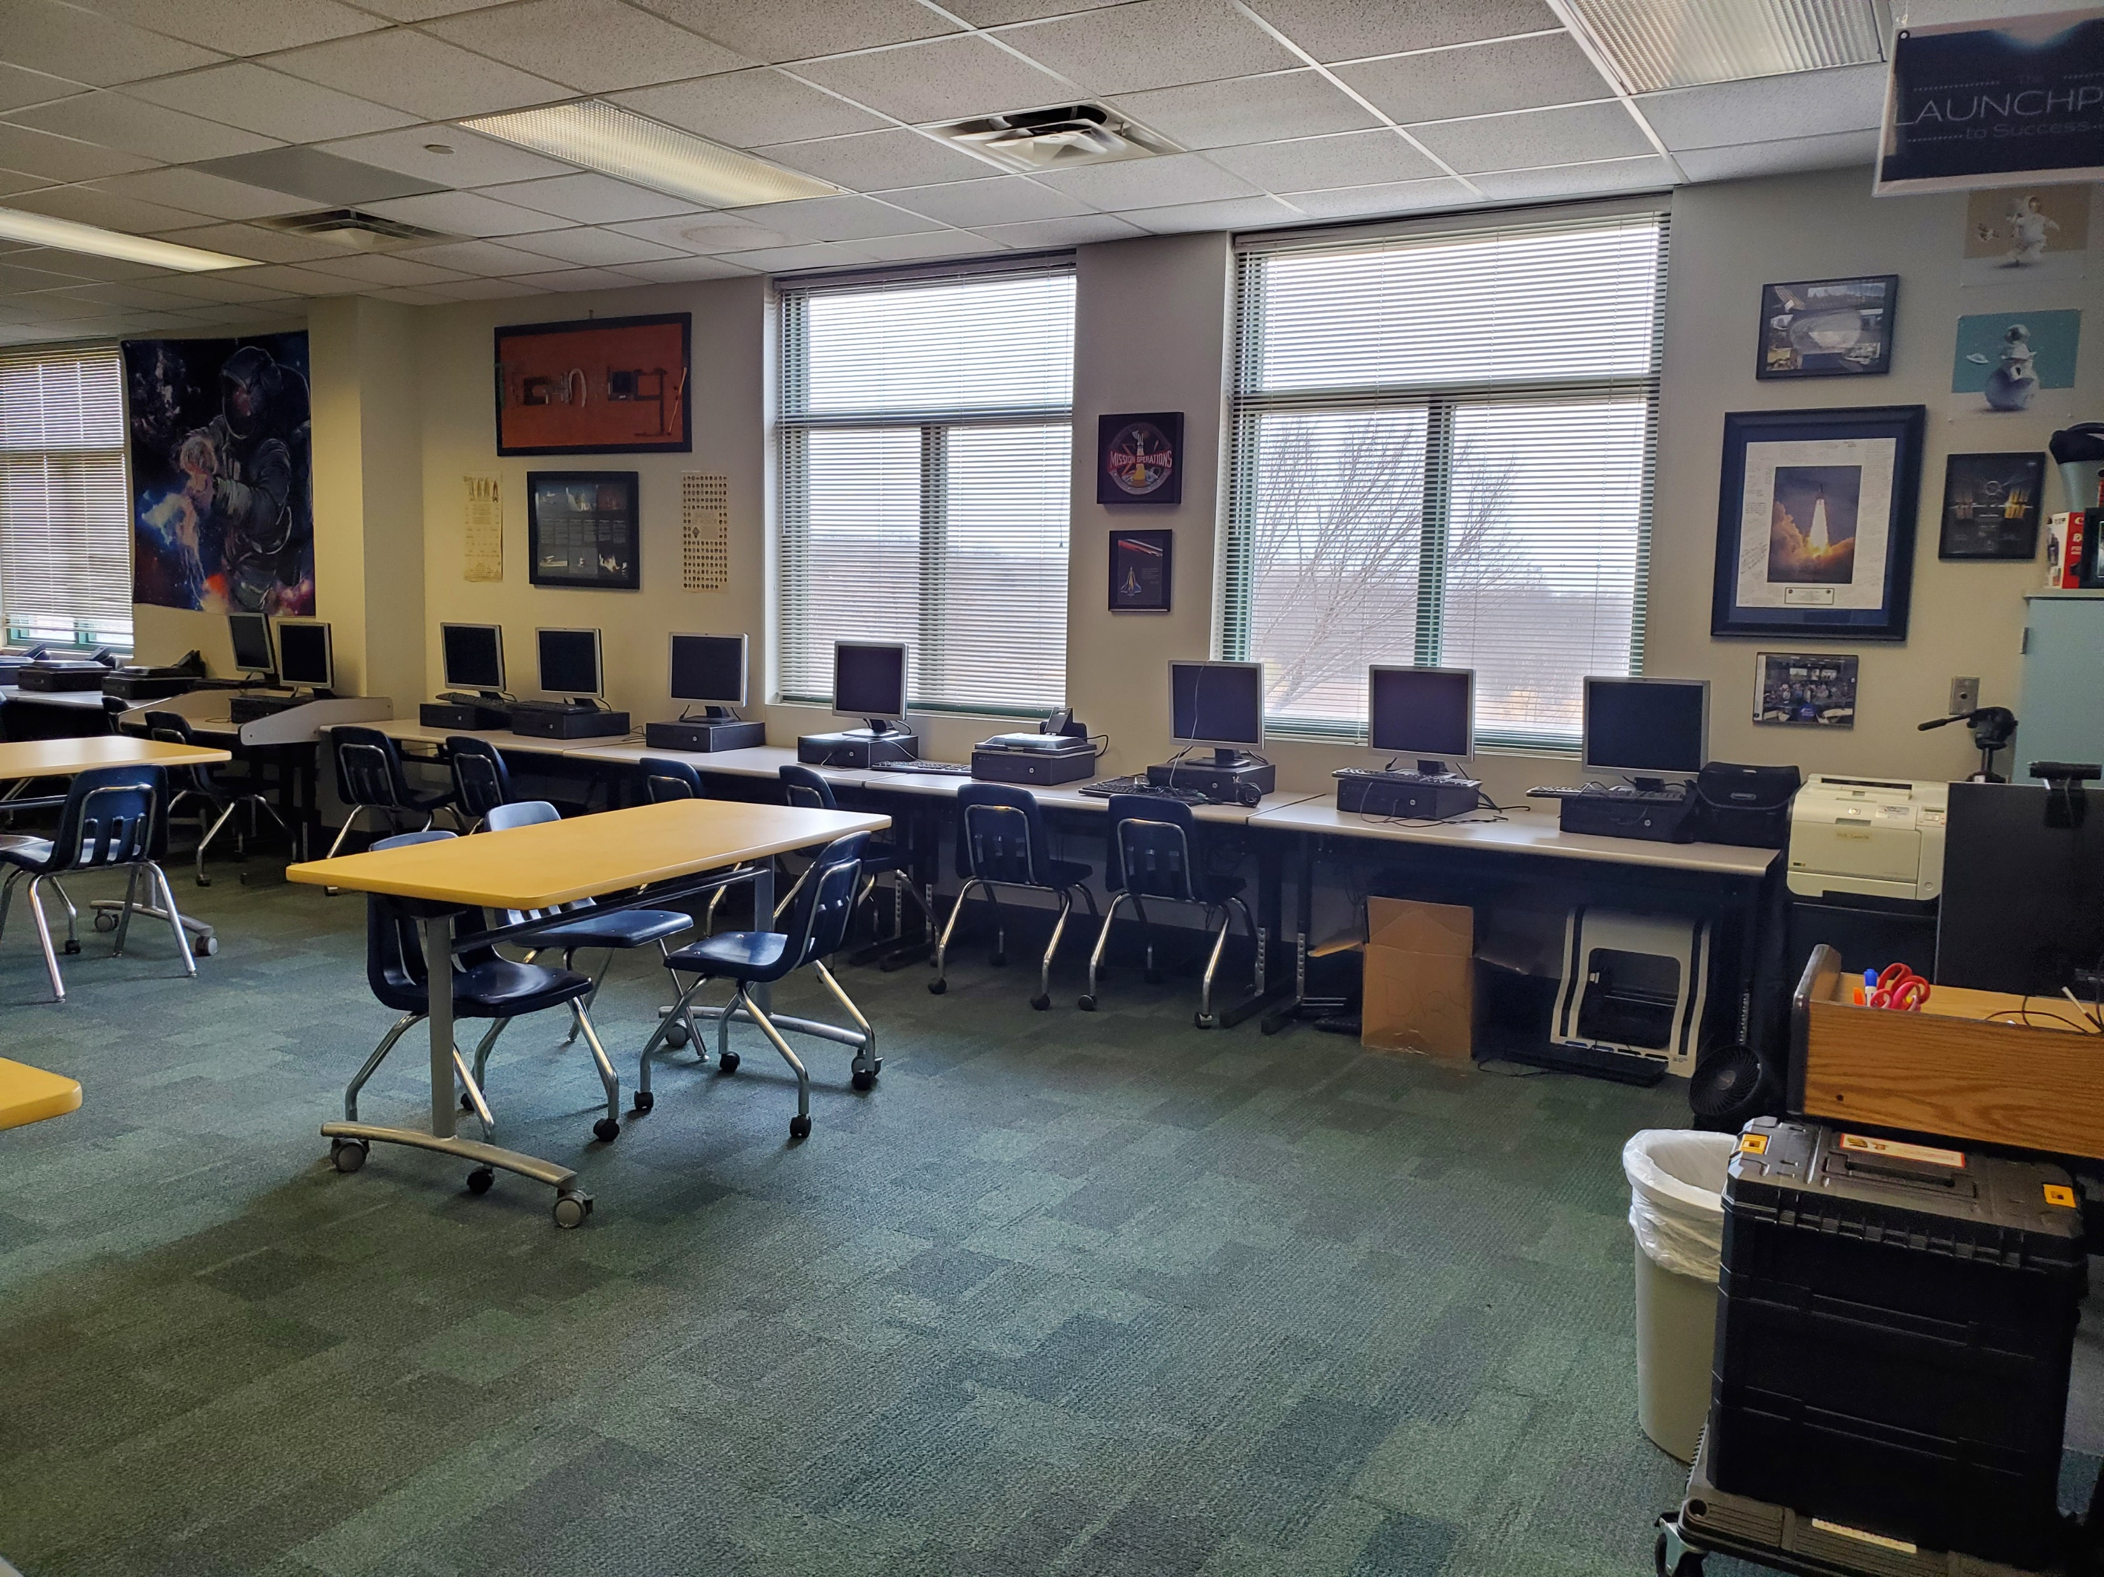
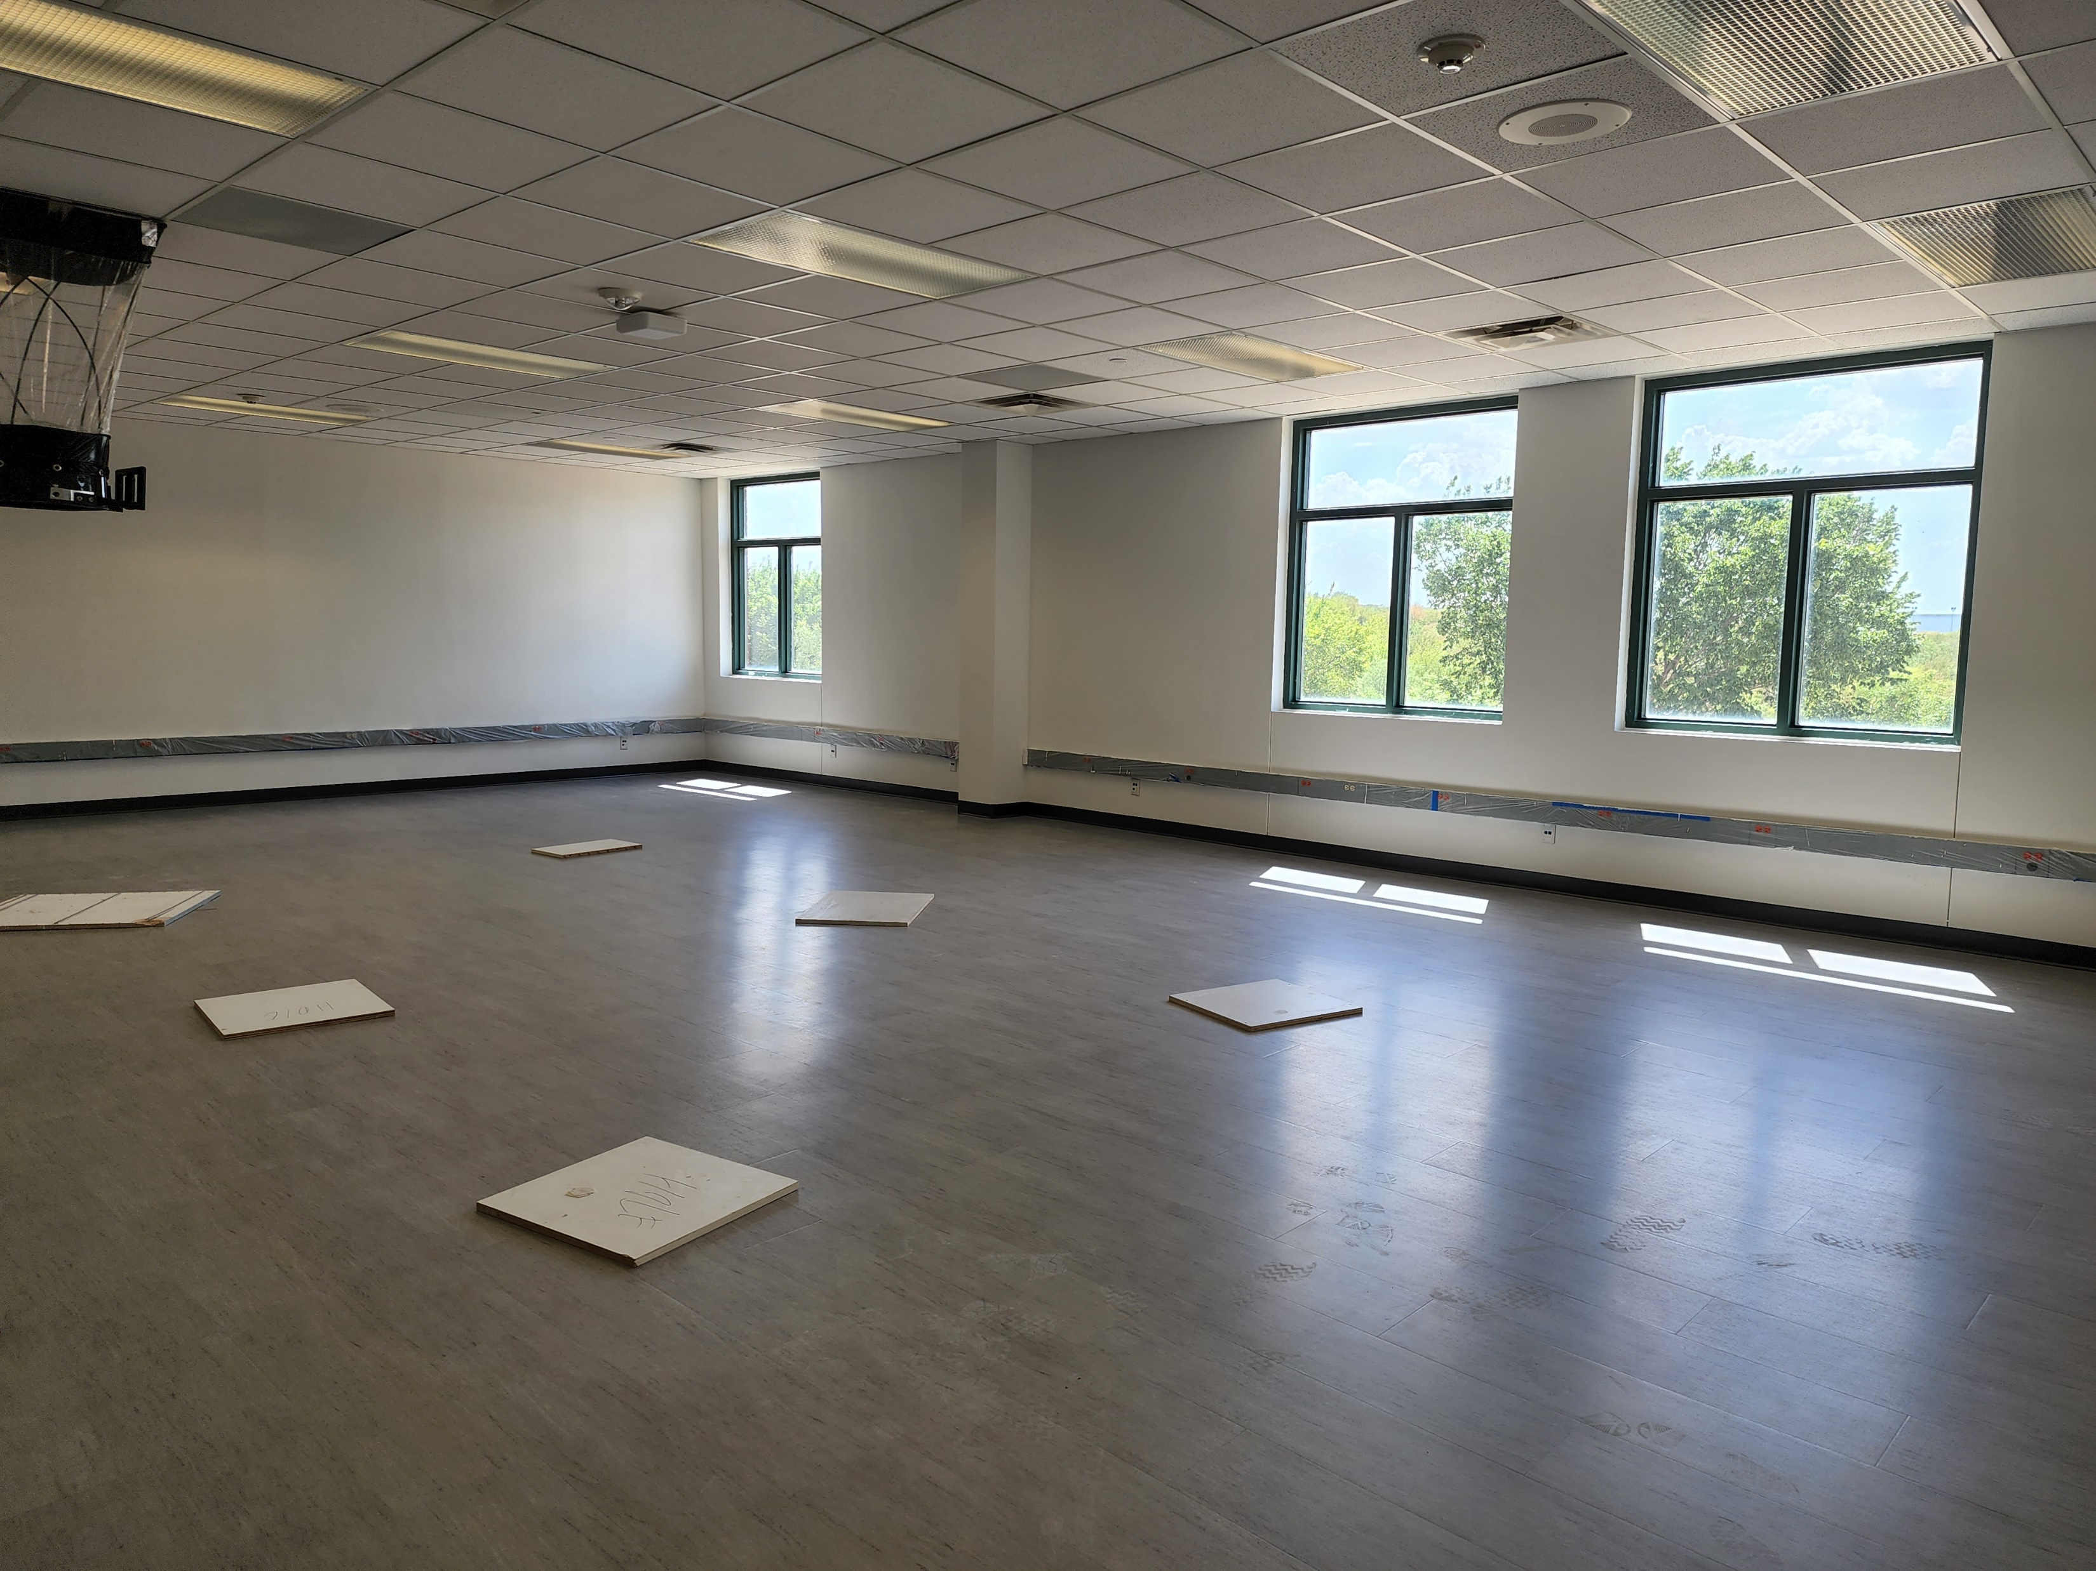
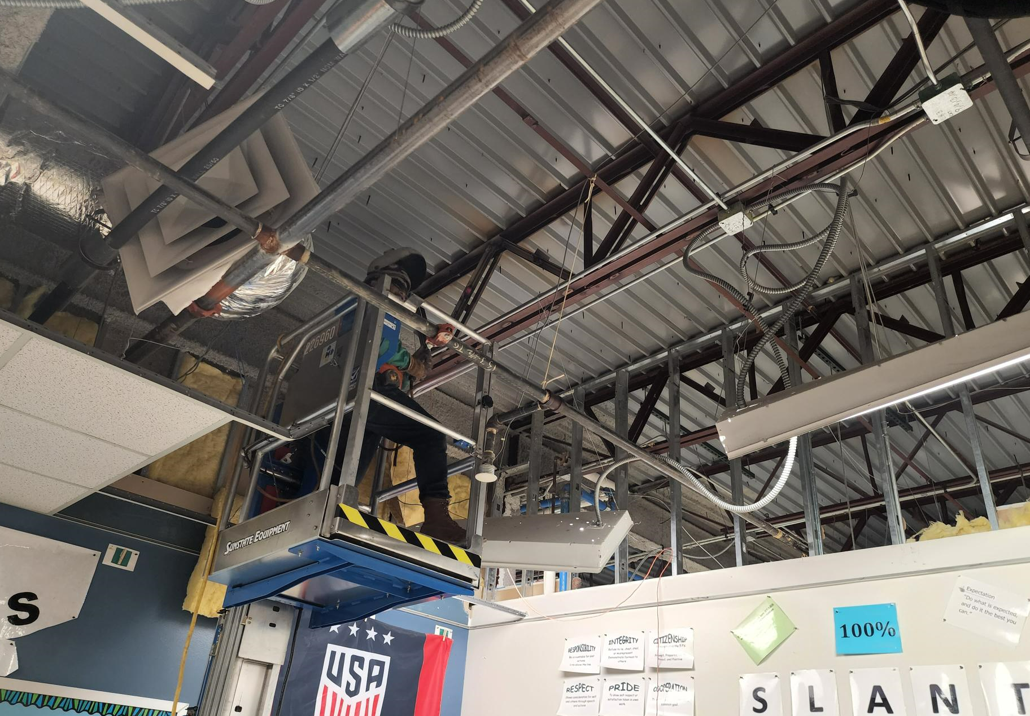
Improvements
Improvements
Improvements
Fine Arts Classroom and Performance Space Improvements
  Band, Orchestra, Choir, Theater, and Percussion Hall Renovations
Collaboration Rooms
  Practice Rooms in Fine Arts
Exterior Upgrades
  Roof Replacement and Repair
Interior Upgrades
  Makerspace /Engineering Room Renovation
  Structural Joist Reinforcement
Mechanical, Electrical, and Plumbing Systems Upgrades
  New LED Site Lighting and Controls
  New Rooftop Units and Controls
  Water Bottle Fillers
  Water Heater Replacement
Landscape Improvements
  Exterior Concrete Replacement
Kitchen Renovation
  New Kitchen Equipment
New Marquee – Coming Soon
Before
After
Structural Joist Reinforcement
PROMISES MADE
PROMISES KEPT
PROMISES MADE
PROMISES KEPT

Slide 6
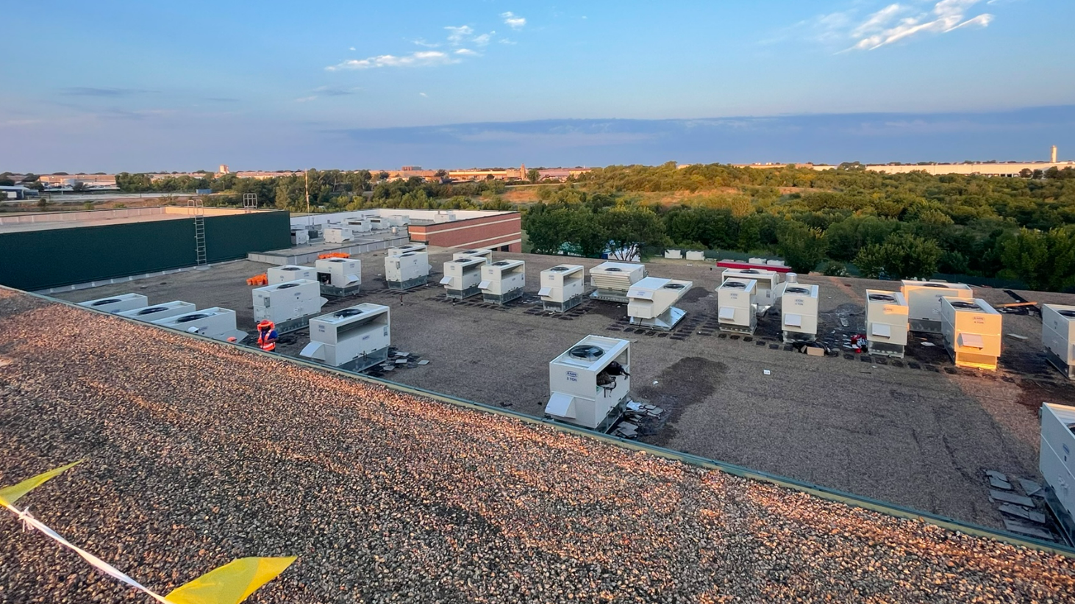
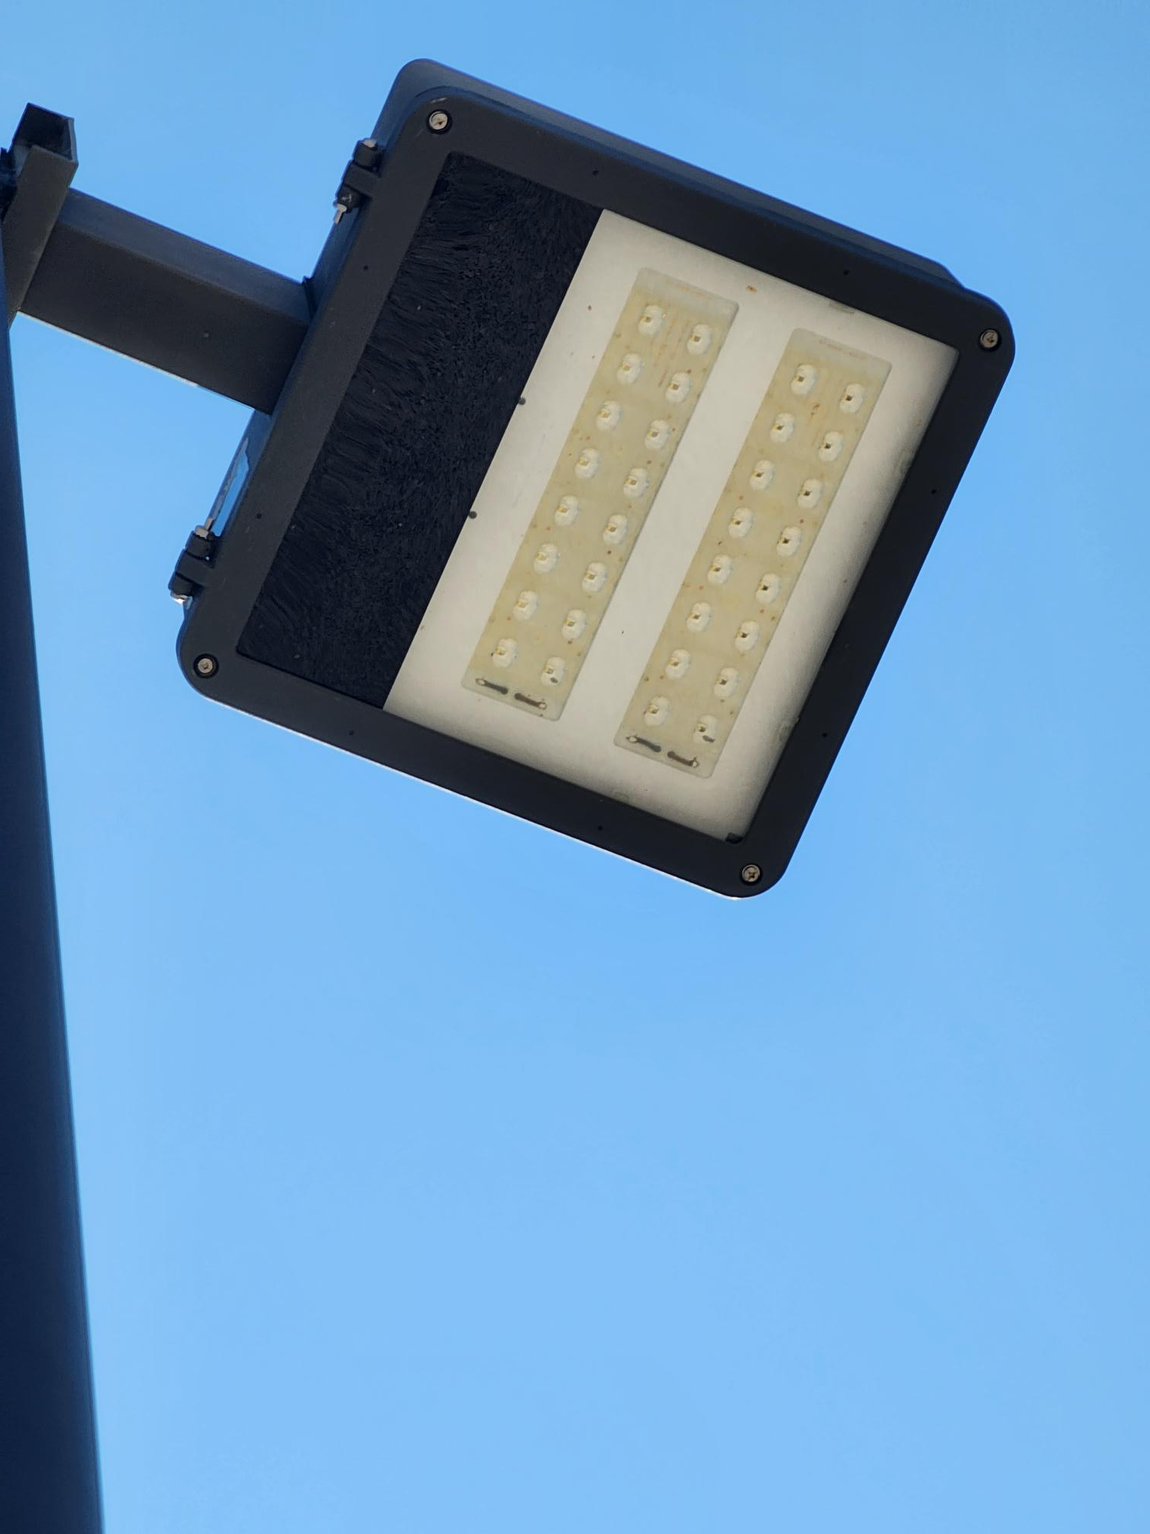
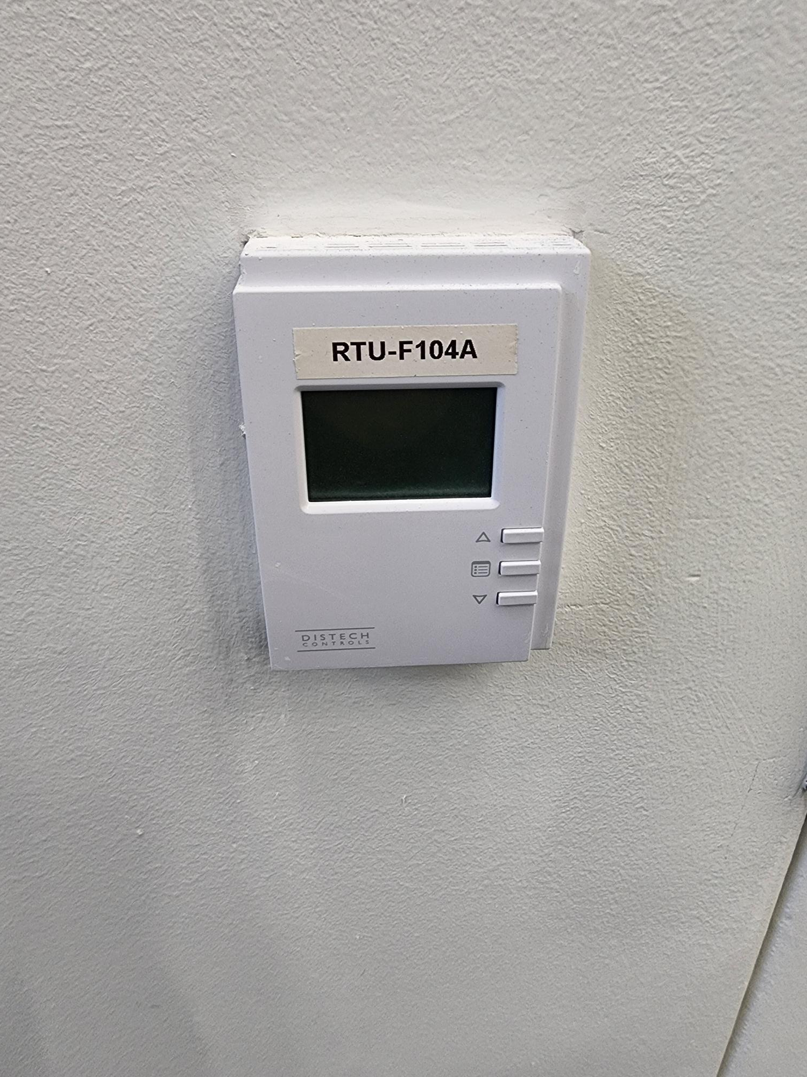
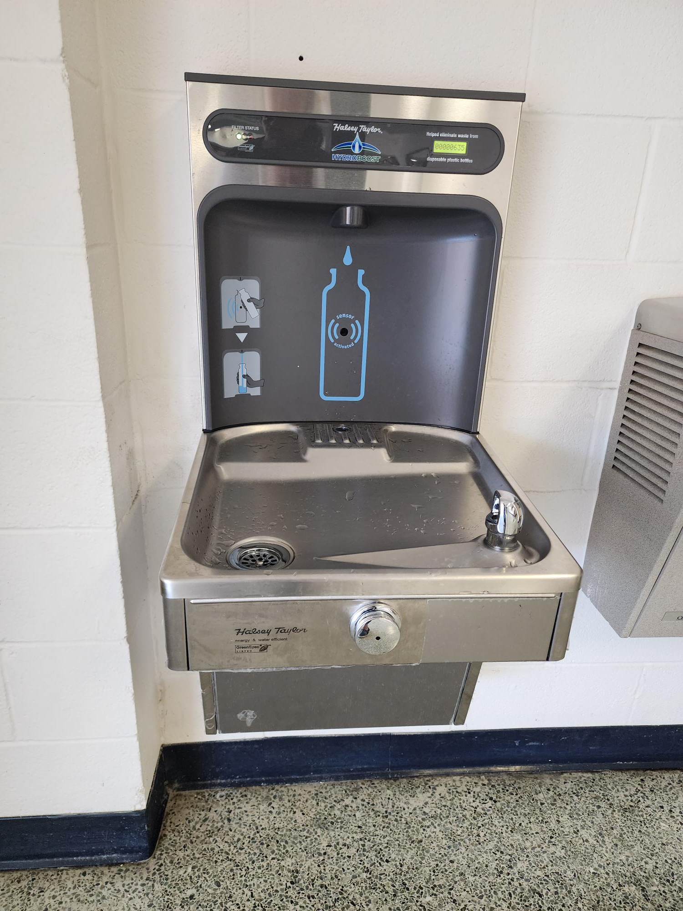
Improvements
Improvements
Improvements
Improvements
Fine Arts Classroom and Performance Space Improvements
  Band, Orchestra, Choir, Theater, and Percussion Hall Renovations
Collaboration Rooms
  Practice Rooms in Fine Arts
Exterior Upgrades
  Roof Replacement and Repair
Interior Upgrades
  Makerspace /Engineering Room Renovation
  Structural Joist Reinforcement
Mechanical, Electrical, and Plumbing Systems Upgrades
  New LED Site Lighting and Controls
  New Rooftop Units and Controls
  Water Bottle Fillers
  Water Heater Replacement
Landscape Improvements
  Exterior Concrete Replacement
Kitchen Renovation
  New Kitchen Equipment
New Marquee – Coming Soon
Site Lighting
Rooftop Units
PROMISES MADE
PROMISES KEPT
PROMISES MADE
PROMISES KEPT
Water Bottle Fillers
HVAC Controls

Slide 7
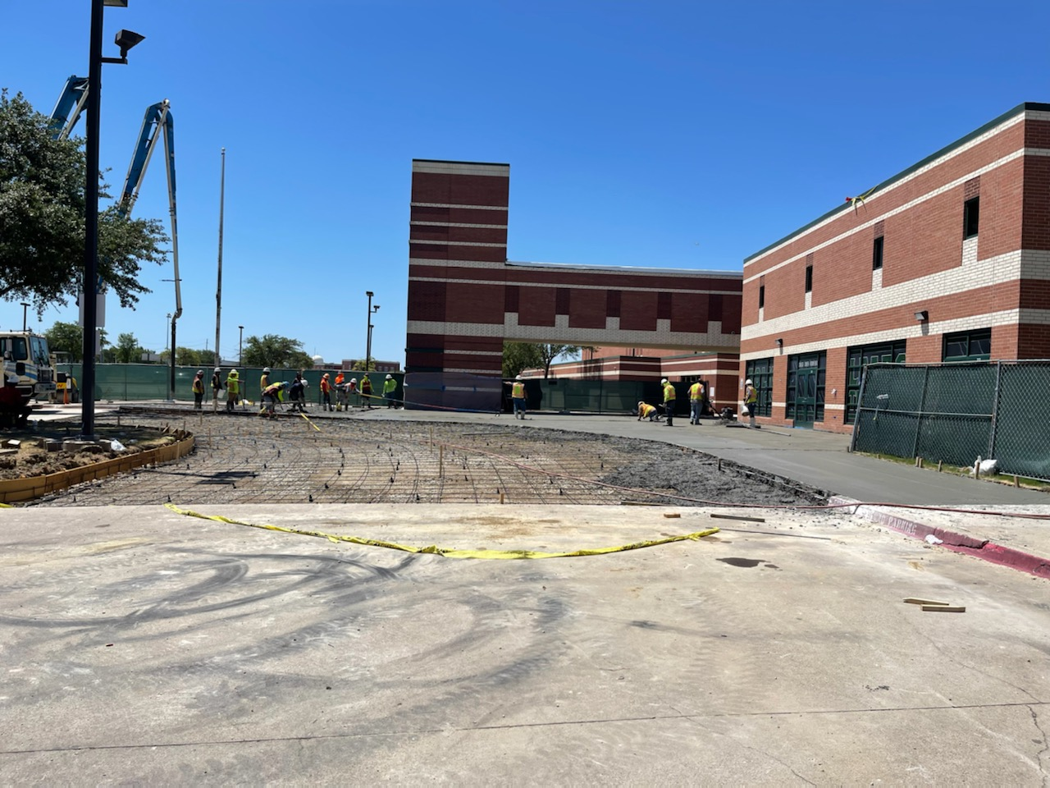
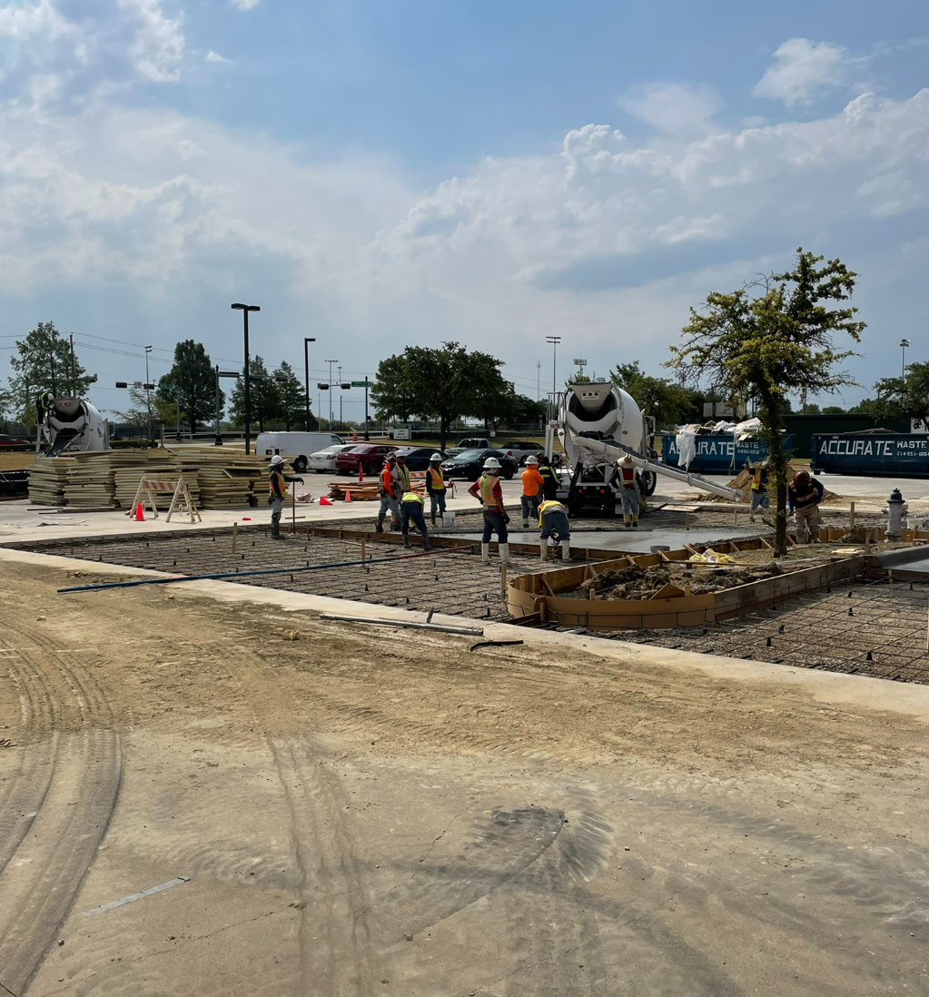
Improvements
Improvements
Improvements
Improvements
Improvements
Fine Arts Classroom and Performance Space Improvements
  Band, Orchestra, Choir, Theater, and Percussion Hall Renovations
Collaboration Rooms
  Practice Rooms in Fine Arts
Exterior Upgrades
  Roof Replacement and Repair
Interior Upgrades
  Makerspace /Engineering Room Renovation
  Structural Joist Reinforcement
Mechanical, Electrical, and Plumbing Systems Upgrades
  New LED Site Lighting and Controls
  New Rooftop Units and Controls
  Water Bottle Fillers
  Water Heater Replacement
Landscape Improvements
  Exterior Concrete Replacement
Kitchen Renovation
  New Kitchen Equipment
New Marquee – Coming Soon
Concrete Replacement
PROMISES MADE
PROMISES KEPT
Concrete Replacement

Slide 8
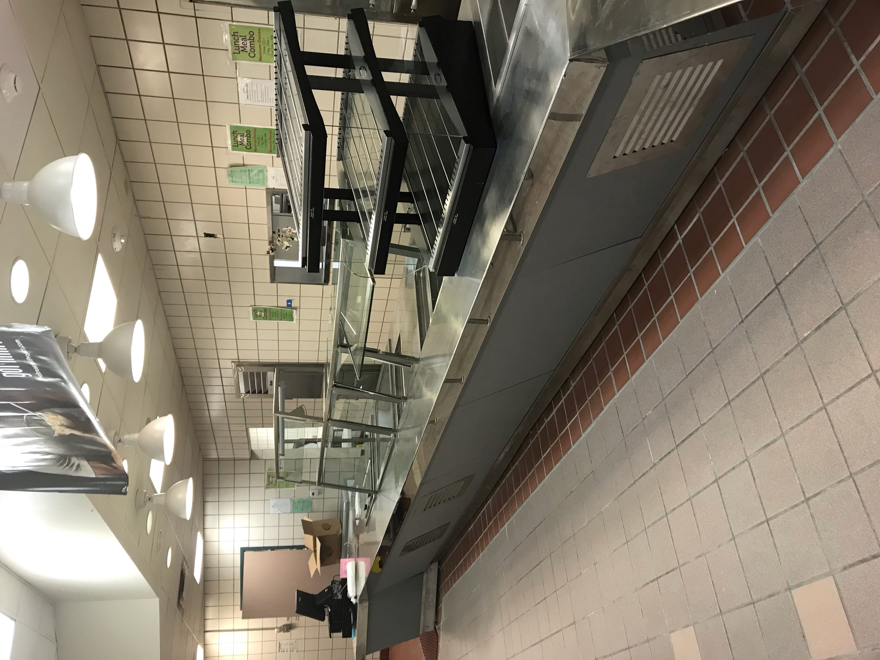
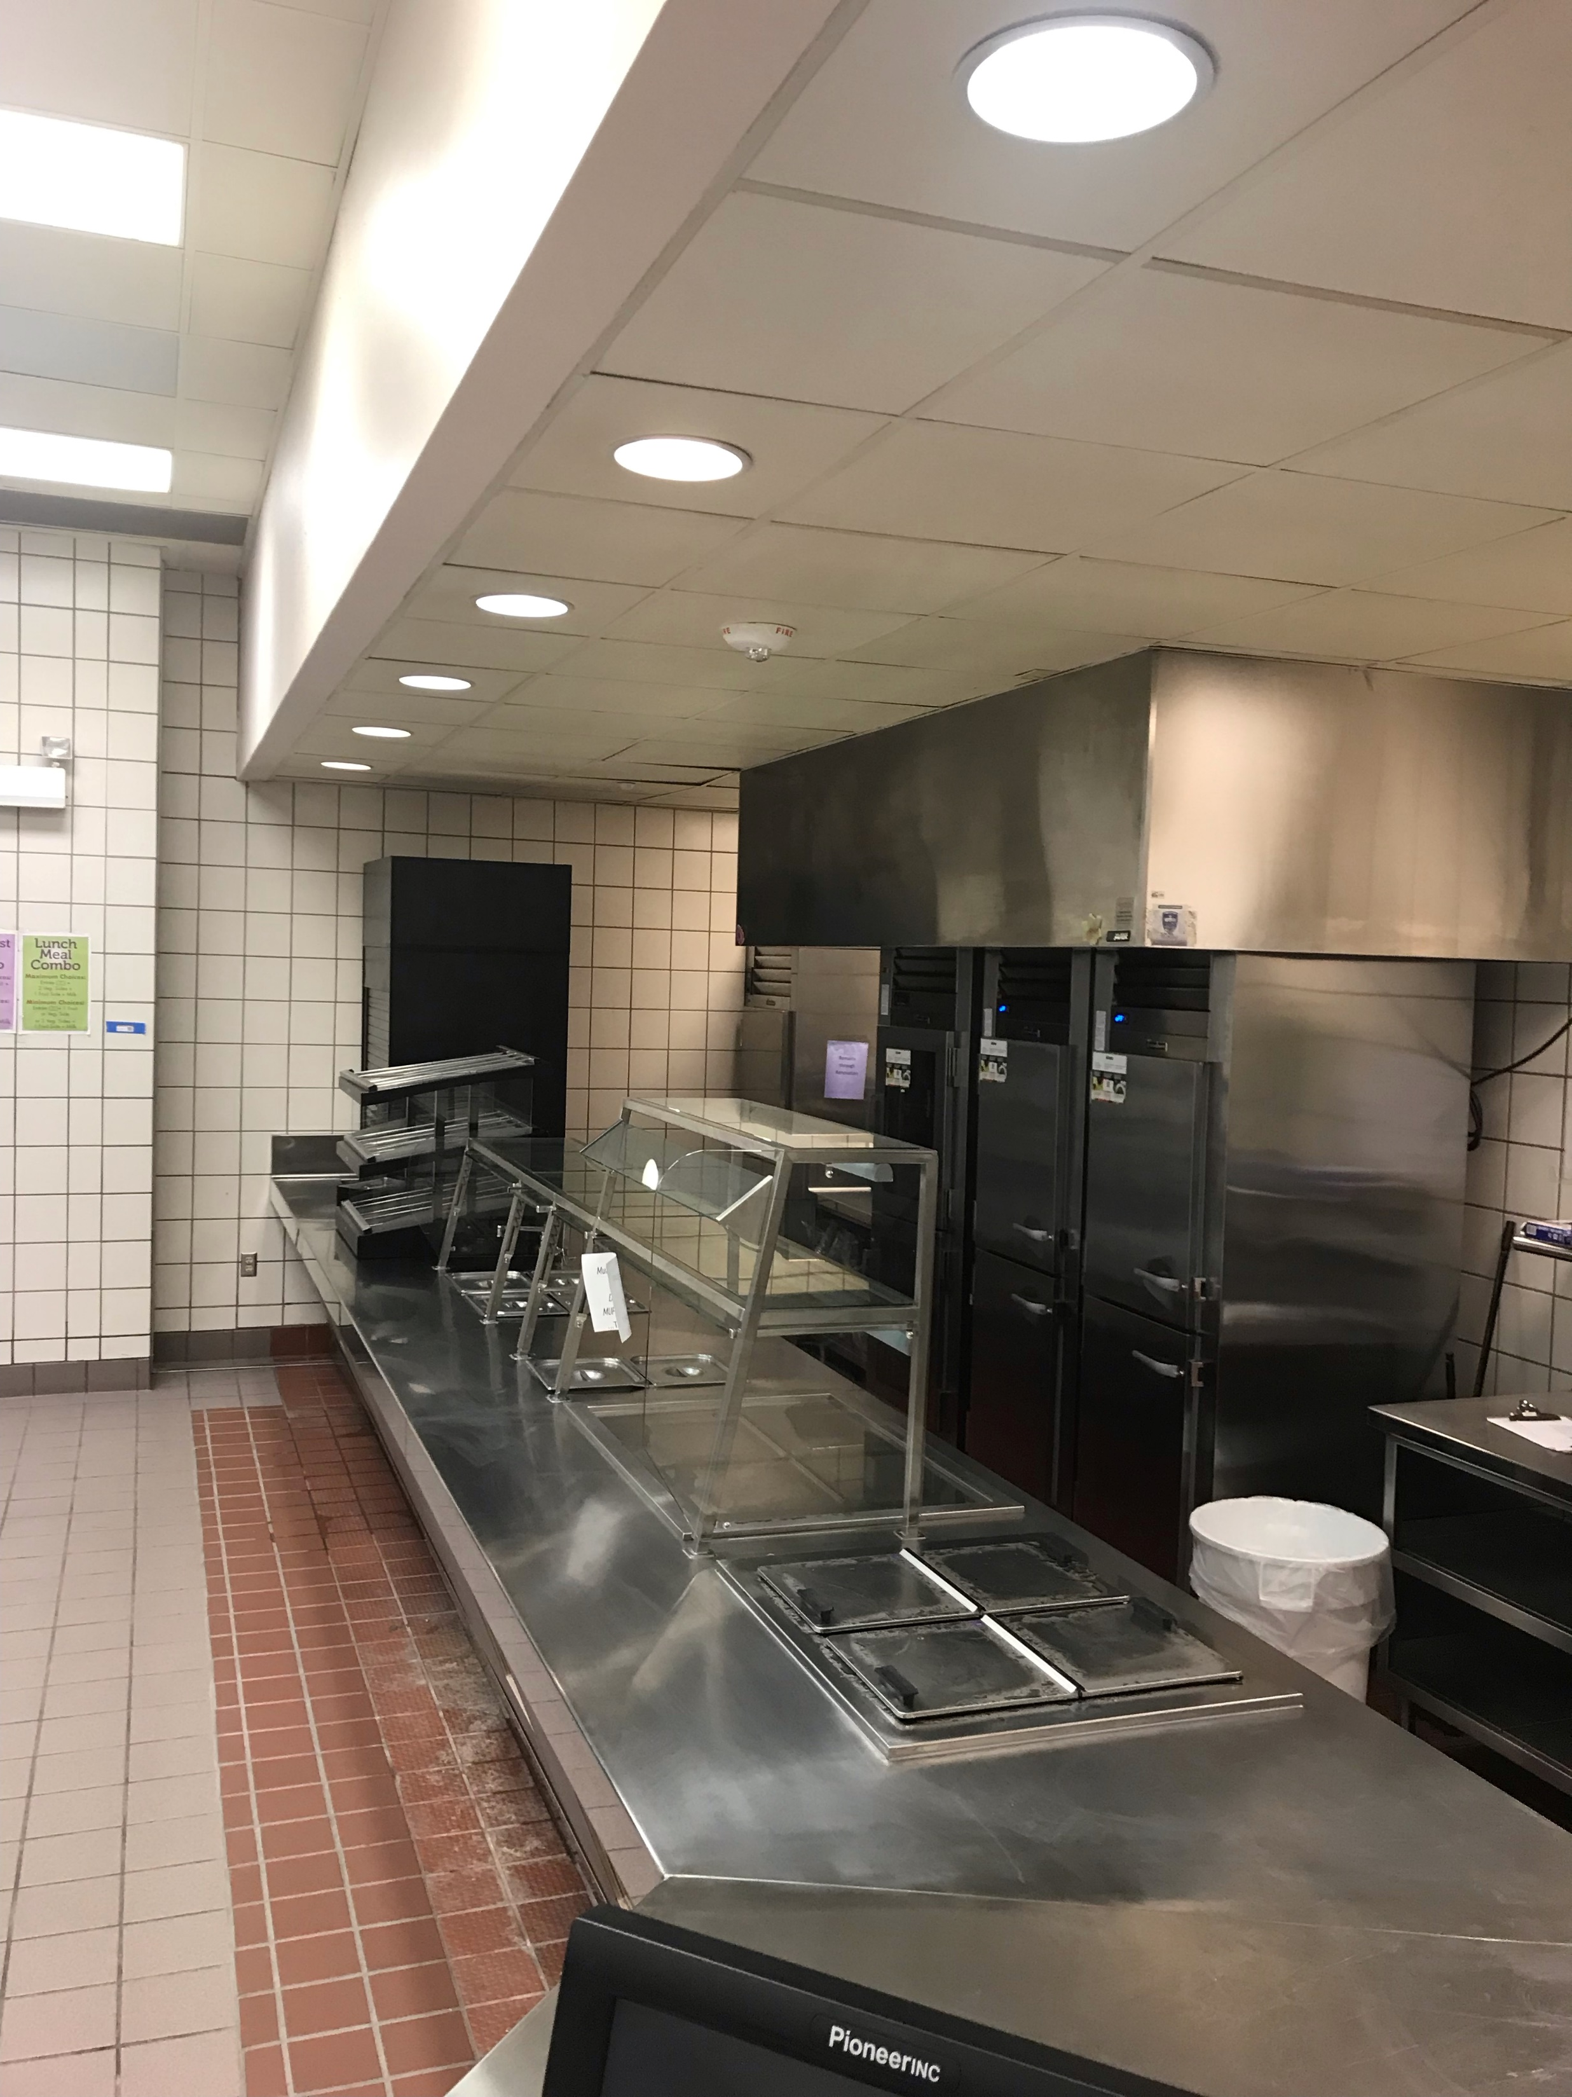
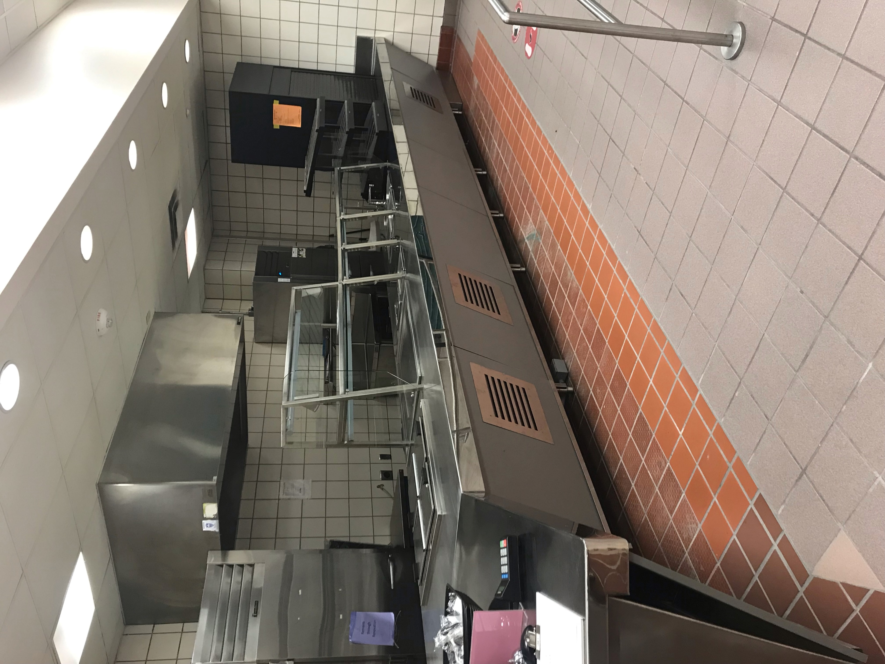
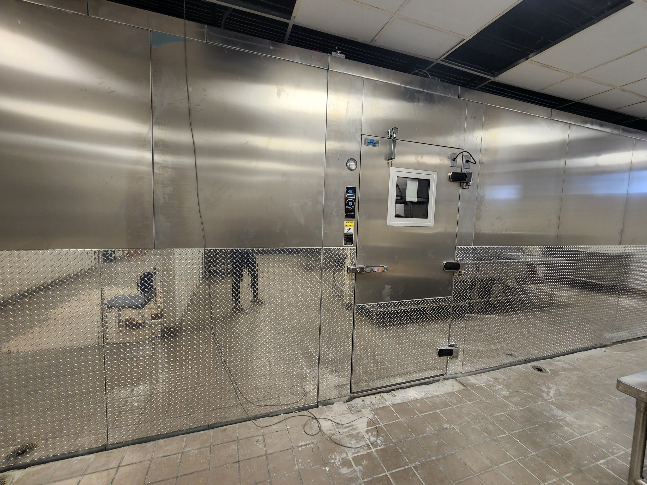
Improvements
Improvements
Improvements
Improvements
Improvements
Fine Arts Classroom and Performance Space Improvements
  Band, Orchestra, Choir, Theater, and Percussion Hall Renovations
Collaboration Rooms
  Practice Rooms in Fine Arts
Exterior Upgrades
  Roof Replacement and Repair
Interior Upgrades
  Makerspace /Engineering Room Renovation
  Structural Joist Reinforcement
Mechanical, Electrical, and Plumbing Systems Upgrades
  New LED Site Lighting and Controls
  New Rooftop Units and Controls
  Water Bottle Fillers
  Water Heater Replacement
Landscape Improvements
  Exterior Concrete Replacement
Kitchen Renovation
  New Kitchen Equipment
New Marquee – Coming Soon
Serving Lines
Serving Lines
PROMISES MADE
PROMISES KEPT
Serving Lines
Cooler/Freezer Replacement

Slide 9
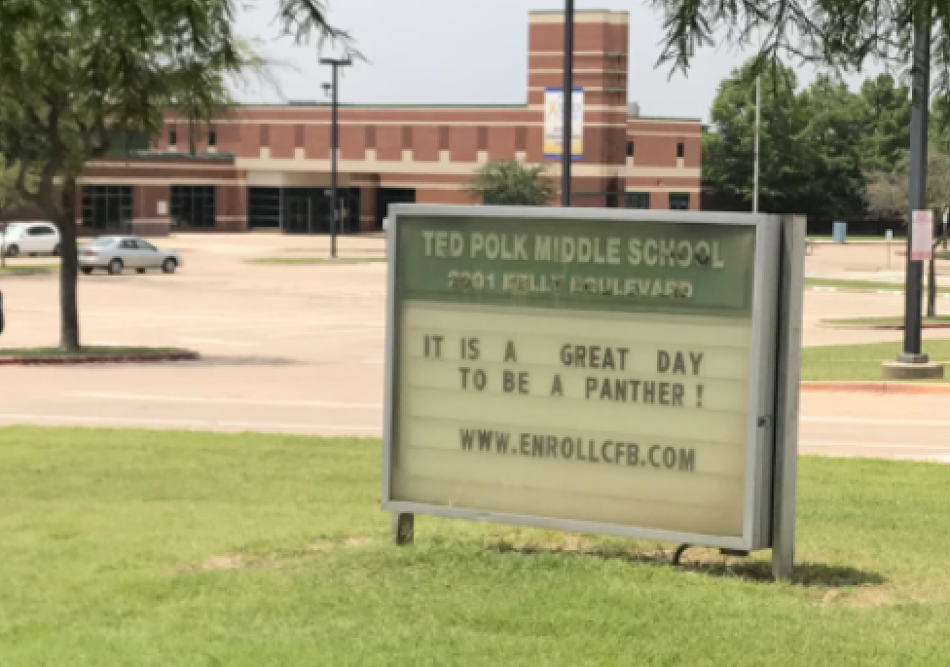
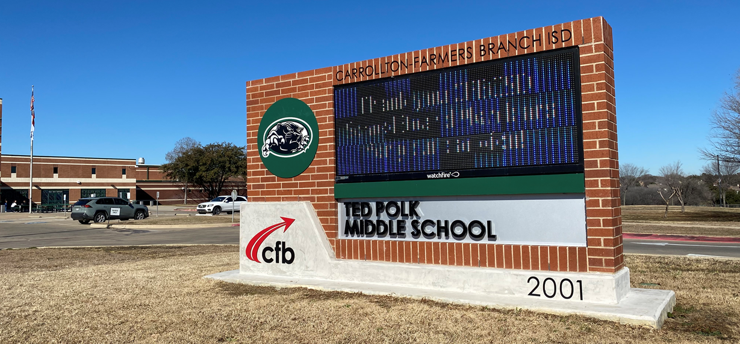
Improvements
Improvements
Improvements
Improvements
Improvements
Fine Arts Classroom and Performance Space Improvements
  Band, Orchestra, Choir, Theater, and Percussion Hall Renovations
Collaboration Rooms
  Practice Rooms in Fine Arts
Exterior Upgrades
  Roof Replacement and Repair
Interior Upgrades
  Makerspace /Engineering Room Renovation
  Structural Joist Reinforcement
Mechanical, Electrical, and Plumbing Systems Upgrades
  New LED Site Lighting and Controls
  New Rooftop Units and Controls
  Water Bottle Fillers
  Water Heater Replacement
Landscape Improvements
  Exterior Concrete Replacement
Kitchen Renovation
  New Kitchen Equipment
New Marquee
PROMISES MADE
PROMISES KEPT

Slide 10
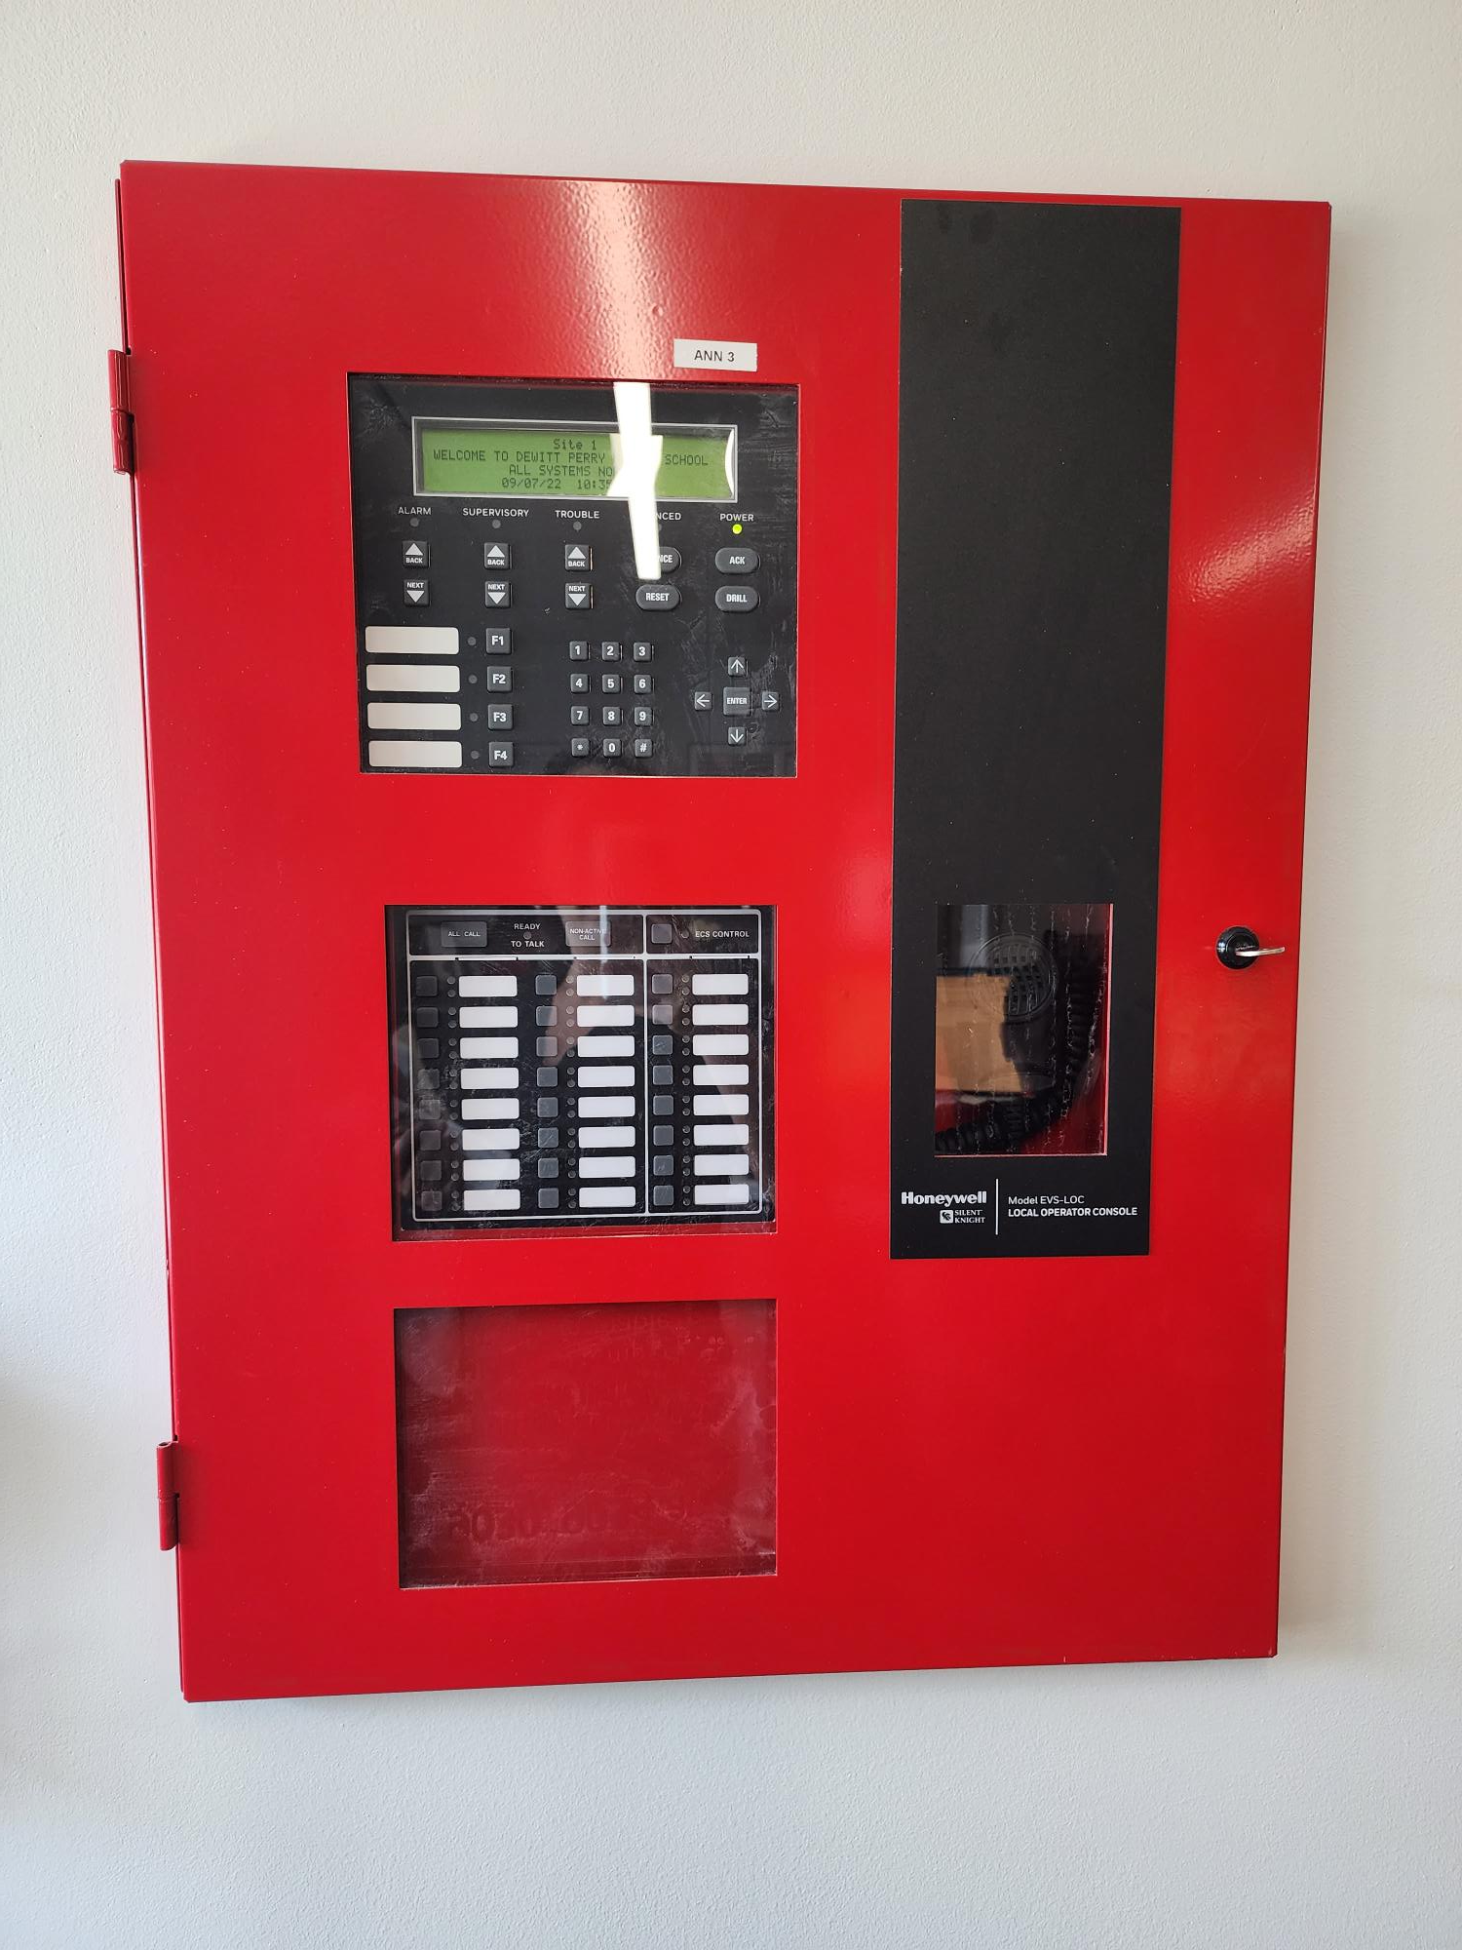

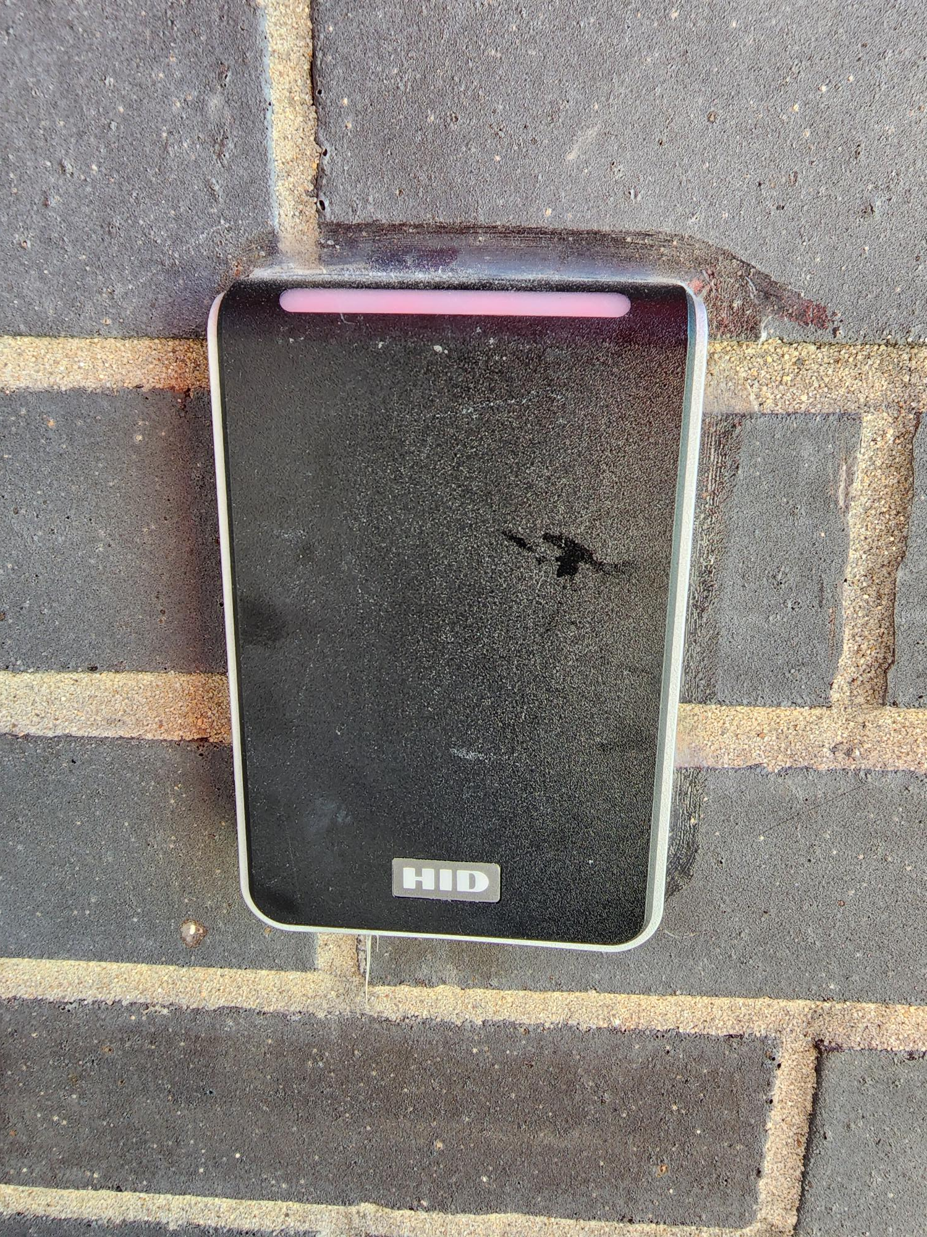
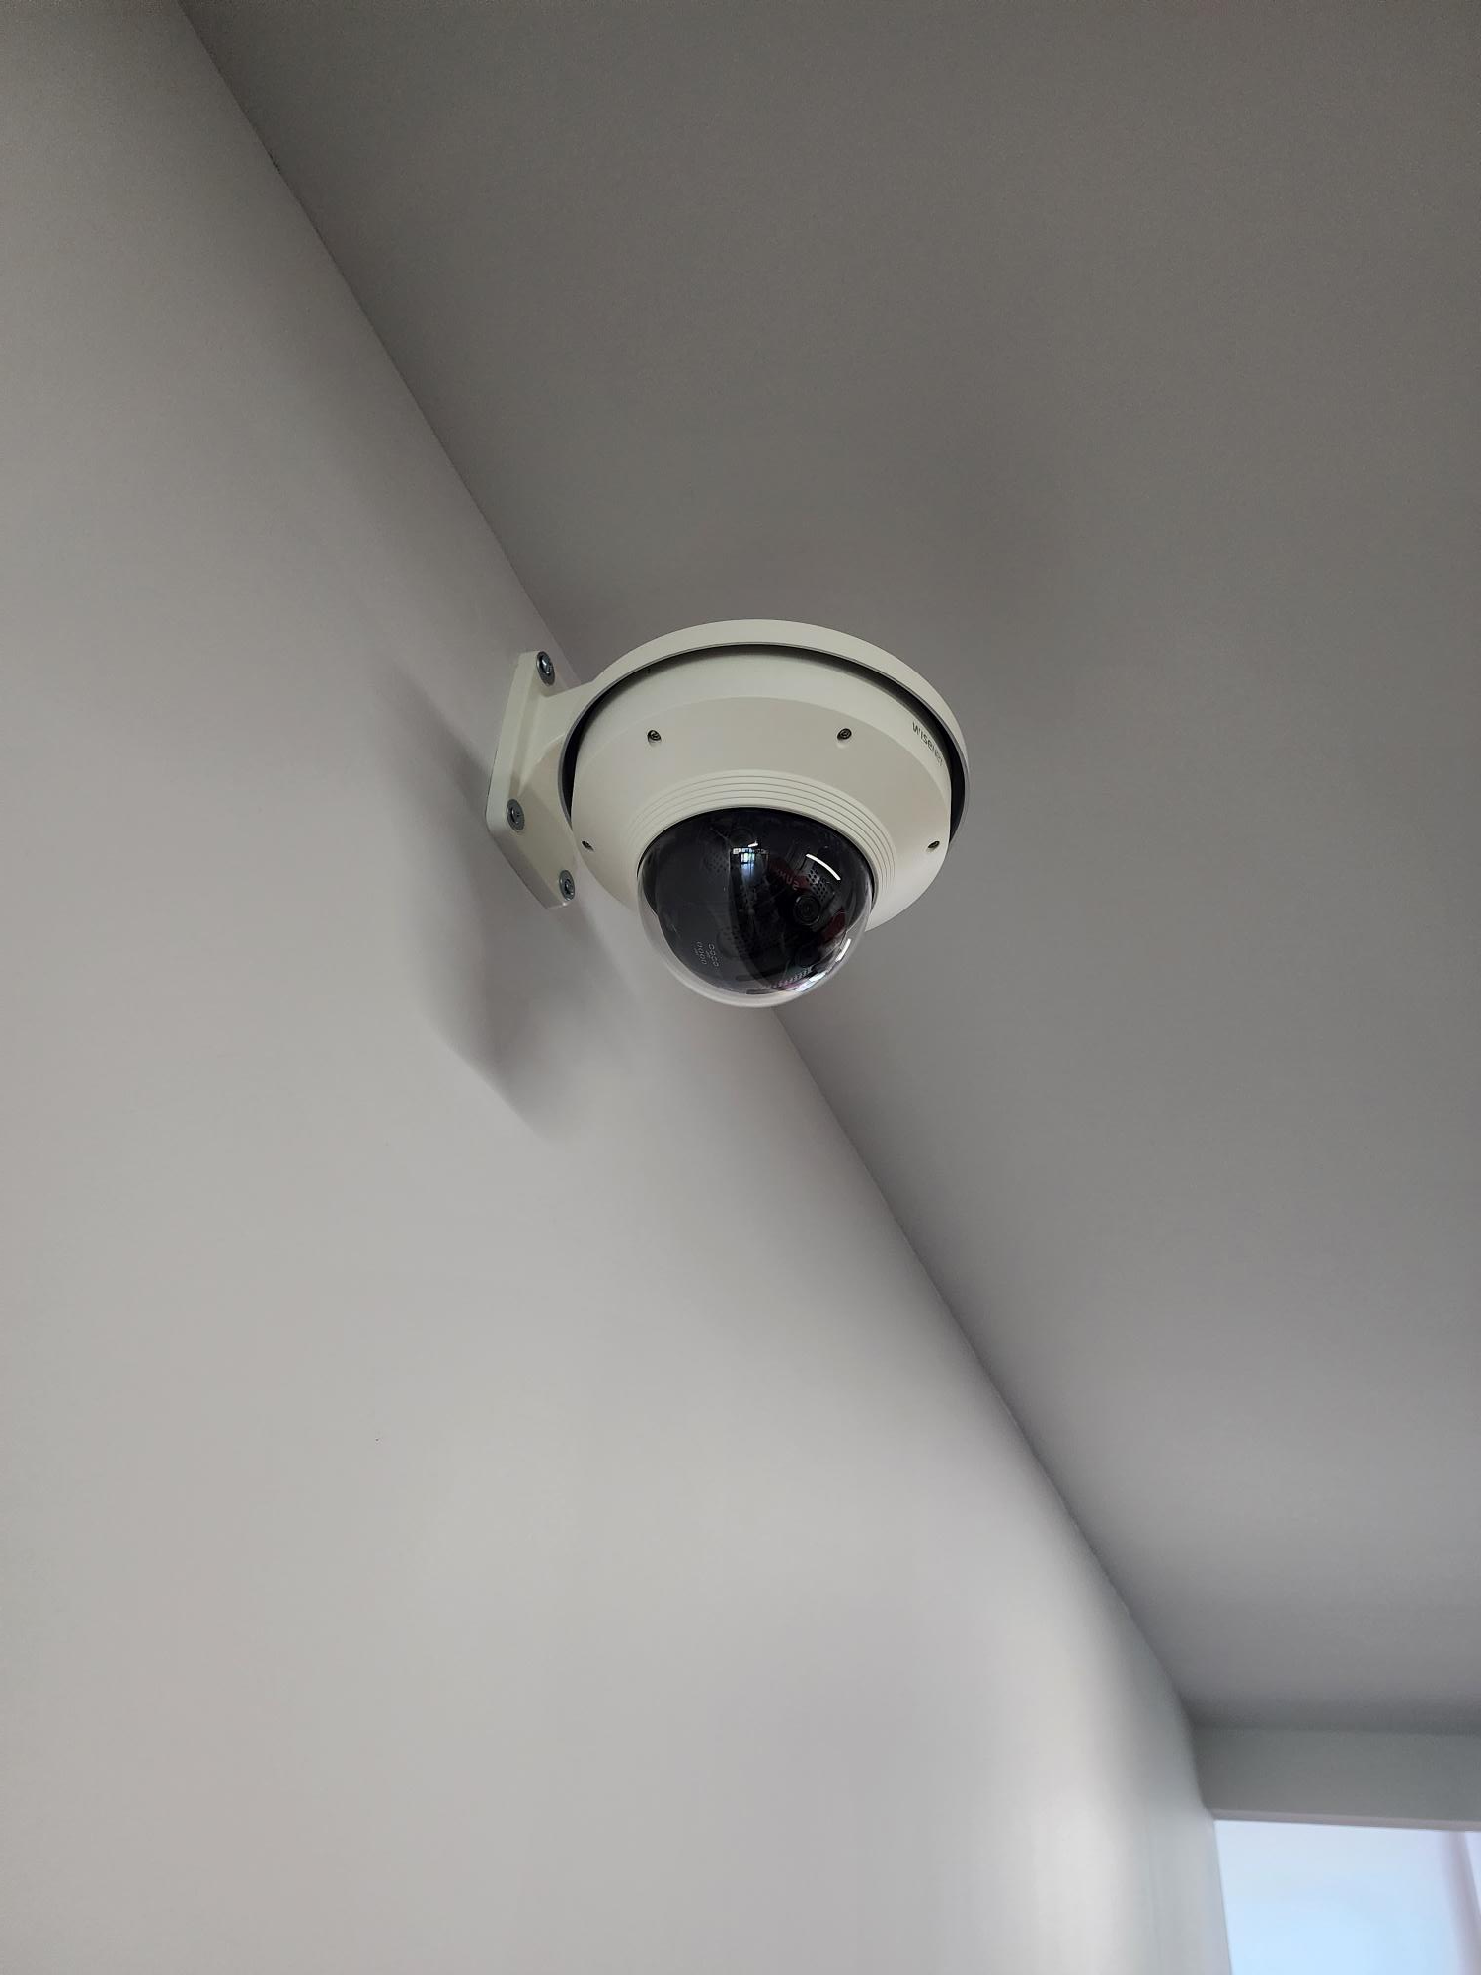
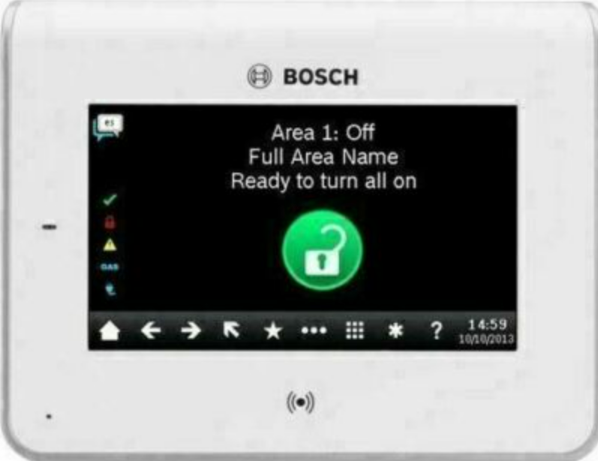
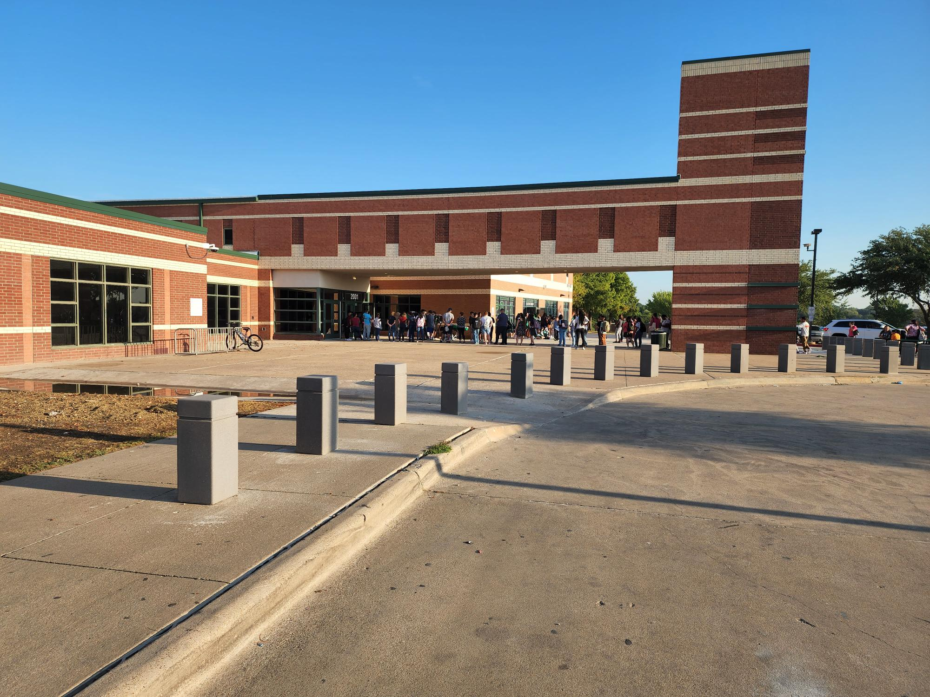
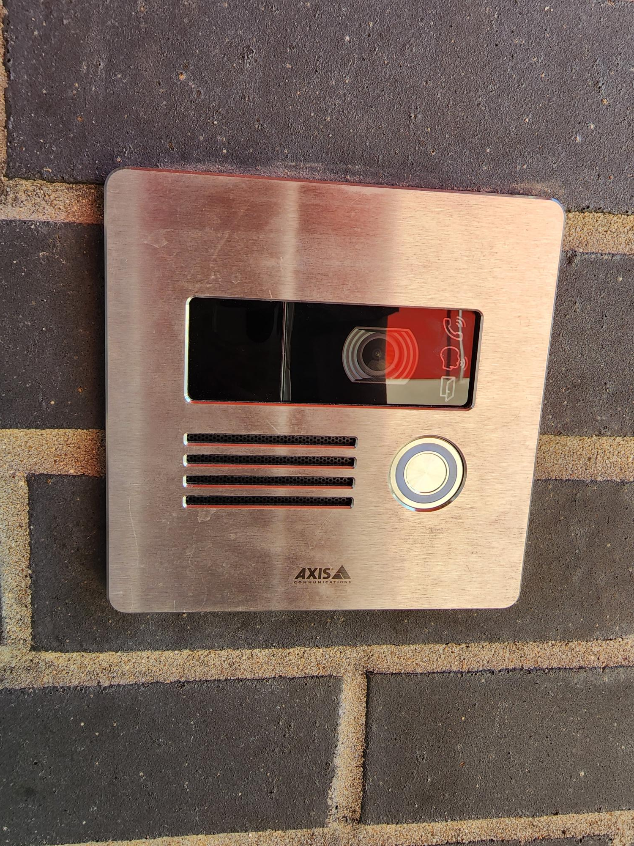
Safety and Security
Access Control
  Intercom
  Card Readers
  Security Alarm
Cameras
Bollards
Fire Sprinkler System Upgrades
Card Readers
Cameras
Fire Alarm
Card Reader
Video Intercom
Exterior Camera
Fire Alarm Panel
PROMISES MADE
PROMISES KEPT
Intercom
Bollards/Benches
Access Control

Slide 11
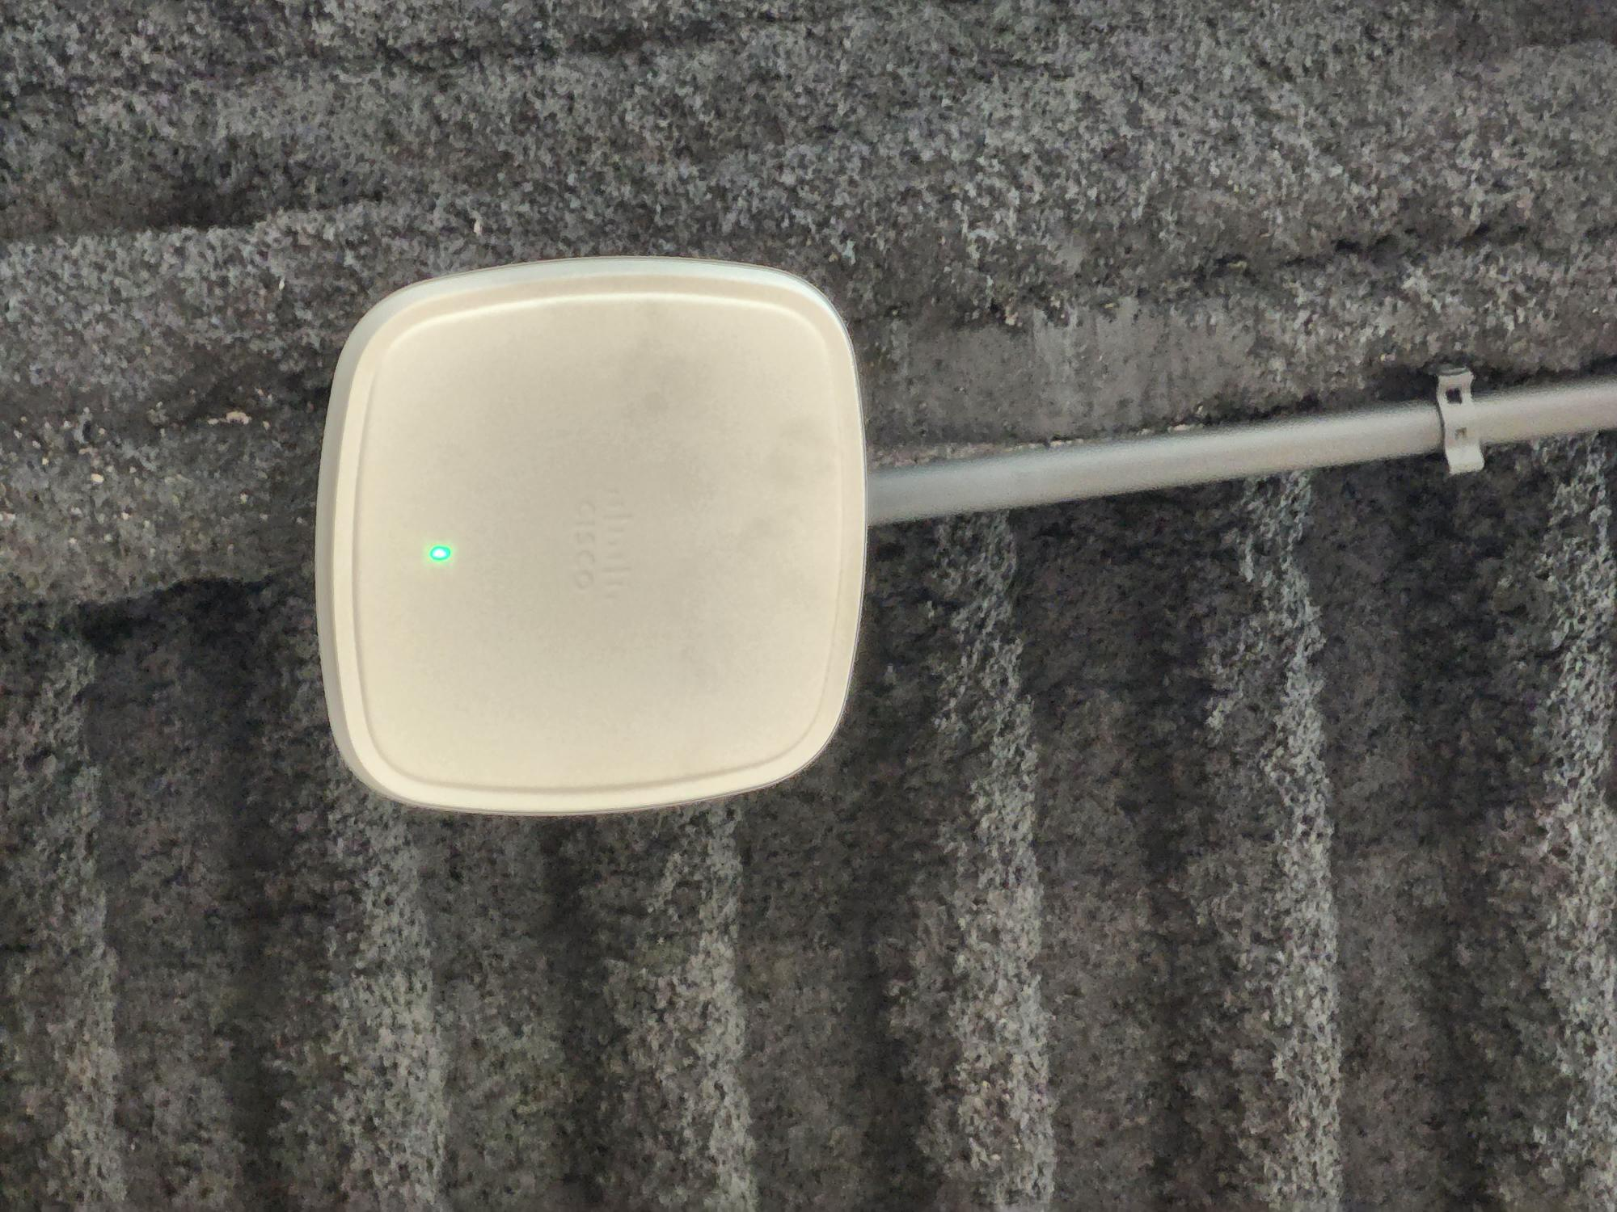

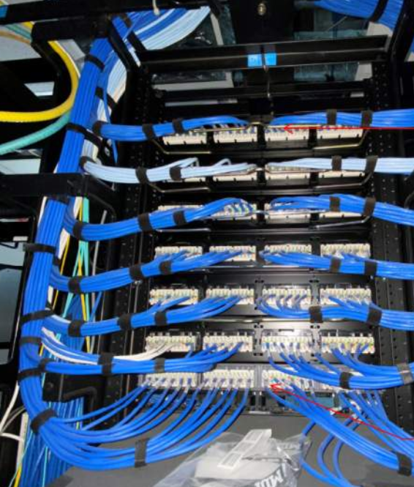
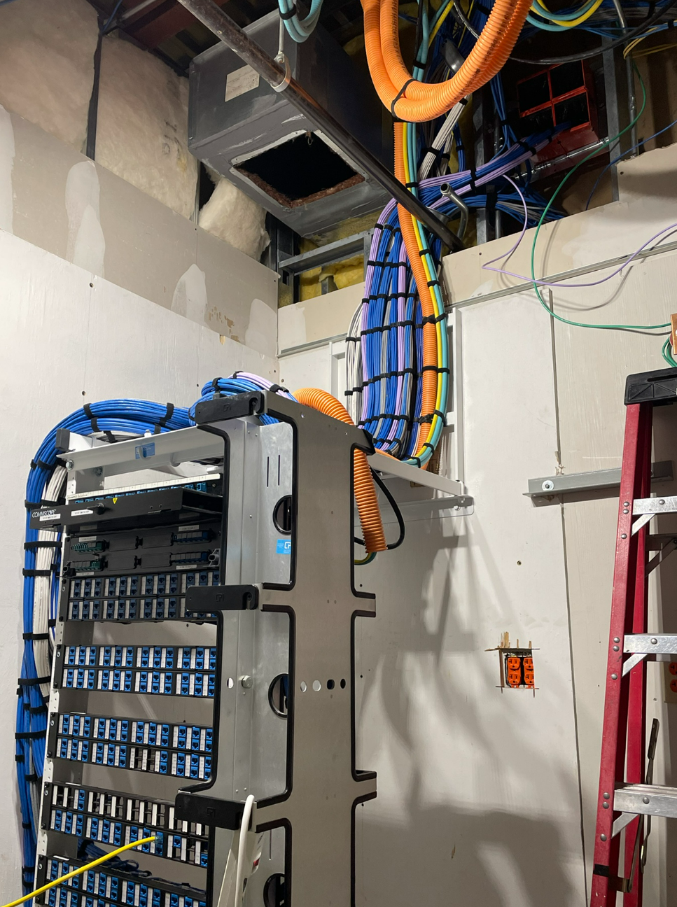
Technology
Secure Climate Controlled Server Space
Cabling
Wireless Upgrades
Phone System Upgrades
Wireless Upgrades
PROMISES MADE
PROMISES KEPT
Cabling
Secure Climate Controlled Server Space

Slide 12
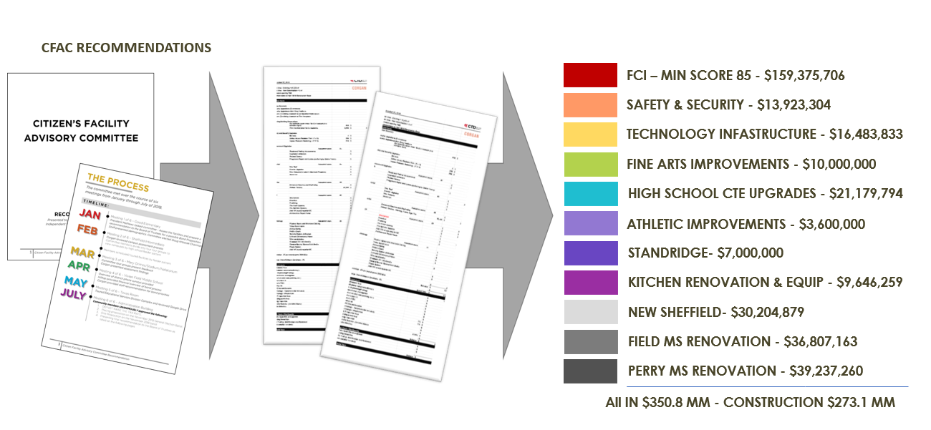
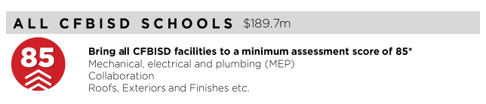
FCI Update
PROMISES MADE
PROMISES KEPT

Slide 13
FCI Update
 | Building Element |  |  |  | Type/Material |  | Prior Condition | Current | Prior Description | 2022 Reno Comments
 | On-Site Utilities & Drainage
 |  | Site Drainage / Erosion Control |  |  |  |  | Fair | Good | Minor signs of erosion & ponding water. | Repoured concrete to address areas of ponding and erosion
 |  | Site Lighting - Parking Lots |  |  |  |  | Good | Good
 |  | Exterior Concrete Pads & Pavement-Around building, mechanical yards |  |  |  |  | Good | Good
 |  | Fire Hydrants / Utility Vaults / Misc. |  |  |  |  | Good | Good
 |  | Grease Trap |  |  |  |  | Fair | Fair |  | No Scope
 | Site Parking & Drives
 |  | Pavement - Roads / Drives / Parking Areas |  |  |  |  | Good | Good | Clean and clear of cracks, heaving, potholes. Joint Sealer is properly in place.
 |  | Fire Lanes |  |  |  |  | Fair | Good | Minor to Moderate cracking visible, joint sealer showing minor signs of wear. Little to no heaving. Striping in fair condition. | Repoured concrete and restriped fire lane
 |  | Striping - Parking lot and fire lane |  |  |  |  | Poor | Good | Incomplete, missing or severely deteriorated/aged. No handicapped parking spaces provided. | Restriped Parking Lot
 |  | Curbs |  |  |  |  | Good | Good | Free of cracks, damage and almost new in appearance.
 | Site Lighting
 |  | Site Lighting |  |  |  |  | Good | Good | All fixtures are working properly and have no visible damage. Lighting is appropriate for security.
 | Site Security
 |  | Security Cameras |  |  | Megapixels of Resolution | Megapixels of Resolution | 13 | 356 | Very few low resolution cameras installed | Doubled the count and upgraded to high resolution cameras
 |  | Chain Link Fencing / Gates |  |  |  |  | Fair | Fair | Little to no damage to material, poles & gates. Some signs of age. | No Scope
 | Misc. Stuctures
 |  | Site Walls - Retaining / Screen |  | Material: | Stone | Stone | Good | Good | No signs of damage, settling or rotation.
 |  | Dumpster Service Area |  |  |  |  | Fair | Fair | Moderate to Minor signs of damage to dumpster walls, may need a refresh of finish paint if applicable and additional bollards. Gates function as required. | No Scope
 |  | Bollards |  | Material: | Steel | Steel | Fair | Good | Minor to moderate signs of age and deterioration but still visible. | Newly installed bollards
 |  | Site Signage - Directional / Handicapped |  |  |  |  | Good | Good
 |  | Misc. Site work / Site Structures |  |  |  |  | Good | Good | Bleachers in good condition
 | Circulation
 |  | Sidewalks |  |  |  |  | Fair | Good | Minor to Moderate cracking visable, joint sealer showing minor signs of wear. Little to no heaving. | Repoured Concrete sidewalks showing signs of wear
 |  | Stairs |  |  |  |  | Fair | Fair | Little to no signs of cracks or heaving. Joint Sealer has minor wear. Rise and Run is compliant. Handrails (if present) are compliant & finish is in ok standing. | Not in Scope
 |  | Ramps |  |  |  |  | Good | Good | Clean and clear of cracks or heaving. Joint Sealer is properly in place. Slope is compliant. Handrails (if present) are compliant & finish is in good condition.
 | ADA Compliance / Accessiblity
 |  | Compliant Sidewalks/Curbs |  |  |  |  | Fair | Fair |  | Not in Scope
 |  | Compliant Ramps & Handrails |  |  |  |  | Fair | Fair | No ADA rear entry. Ramp only on north entry | Not in Scope
 |  |  |  |  | Scored Categories | Scored Categories | 21 | 21
 |  |  |  |  | Good | Good | 10 | 15
 |  |  |  |  | Fair | Fair | 10 | 6 | Previous Aggregate Score: | 81
 |  |  |  |  | Poor | Poor | 1 | 0 | Reno Aggregate Score: | 91
 |  |  |  |  | N/A | N/A | 0 | 0
Site

Slide 14
FCI Update
 | Building Element |  |  |  |  |  |  |  | Type/Material | Prior Condition | Current | Prior Description | 2022 Reno Comments
 | Building Structure/Foundation
 |  |  | Foundation |  |  |  |  | Type: | Crawlspace | Good | Good | No signs of cracking or heaving.
 |  |  | Substructure - Slab - on - Grade
 |  |  |  |  | Basement / Below Grade Exterior Walls |  |  |  |  | Good | Good
 |  |  |  |  | Miscellanous |  |  |  |  | N/A | N/A
 |  |  | Superstructure
 |  |  |  |  | Fireproofing |  |  |  |  | N/A | N/A | Sprinkled
 |  |  |  |  | Pre-Engineered Metal building |  |  |  |  | N/A | N/A
 | Building Exterior Shell
 |  | Roofing | Roofing |  |  |  |  |  | GAF
 |  |  |  | General Roof Condition (Visual Inspection) | General Roof Condition (Visual Inspection) |  |  |  |  | Fair | Good | Roof is nearing the end of it's expected useful life. Some leaks are reported with areas of ponding. Some sealants and flashings are in need of repair or replacement. | Roof replaced with Durolast Single-Ply Membrane
 |  |  |  | Roof Warranty Status | Roof Warranty Status |  |  |  |  |  |  | N/A
 |  |  |  |  |  | Roofing Manufacturer / Warranty Issuer | Roofing Manufacturer / Warranty Issuer |  |  |  |  | GAF
 |  |  |  |  |  | Years Remaining in Warranty Period | Years Remaining in Warranty Period |  |  |  |  | roof built 11/02/1997
 |  |  |  | Skylights | Skylights |  |  |  |  | N/A | N/A
 |  |  |  | Roof Curbs / Openings / Misc. | Roof Curbs / Openings / Misc. |  |  |  |  | Fair | Good |  | Roof Curbs Replaced at All Newly Installed RTUs
 |  | Exterior Walls | Exterior Walls
 |  |  |  |  | Exterior Wall Material |  |  | Material: | Brick | Fair | Fair | Minor cracks apparent, but no signs of settling, rotation or damage. | Not in Scope
 |  |  |  |  | Building Caulking/Sealant |  |  |  |  | Fair | Fair | May show minor signs of aging, minor fading or stains. | Not in Scope
 |  |  |  |  | Exterior Painting |  |  |  |  | Fair | Fair | Minor wear or fading, minimal stains apparent. | Not in Scope
 |  | Windows/Glazed Walls | Windows/Glazed Walls
 |  |  |  |  | Windows
 |  |  |  |  |  |  |  | Glazing Type: | Single Pane | Fair | Fair | Minor scratches or signs of wear. | Addition has aluminum. Good condition double pane in addition
 |  |  |  |  |  |  |  | Frame Type: | Painted Hollow Metal |  |  |  | Paint
 |  | Exterior Doors Systems | Exterior Doors Systems
 |  |  |  |  | Exterior Doors
 |  |  |  |  |  |  |  | Frame Type: | Hollow Metal | Fair | Fair | Minor scratches or signs of wear, may need a refresh of finish, door hardware is compliant and functioning properly. | Addition has aluminum. Good condition
 |  |  |  |  |  |  |  | Panel Type: | Hollow Metal
 |  |  |  |  | Exterior Overhead Doors |  |  | Type: |  | Good | Good | No visible damage, proper weatherproofing/threshold installed, door hardware compliant and functioning properly, motor works as required (if applicable).
 |  |  |  |  | Card Access Reader |  |  |  |  | Yes | Yes |  | Upgraded Card Access System
 |  |  |  |  | Door Bell
 |  |  |  |  | Peep Hole
 |  | Canopies | Canopies
 |  |  |  |  | Canopy |  |  | Type: | Attached to Building | Good | Good | No visible damage, proper weather coverage, finishes are almost new in appearance. No signs of settling or movement.
 |  | Loading Area | Loading Area
 |  |  |  |  | Raised Loading Dock |  |  |  |  | Good | Good | No visible damage, no signs of settling or movement. Dock bumpers present and almost new in appearance.
 |  |  |  |  | Independent Loading Area |  |  |  |  | N/A | N/A | 0
 |  | Misc. Exterior | Misc. Exterior
 |  |  |  |  | Exterior Soffit - Material |  |  | Material: | Plaster | Fair | Fair | Minor to moderate signs of age/wear, minimal stains or corrosion visible.
 |  |  |  |  | Exterior Louvers / Sunscreens |  |  |  |  | N/A | N/A
 |  |  |  |  |  |  |  |  | Scored Categories | 14 | 14
 |  |  |  |  |  |  |  |  | Good | 5 | 7
 |  |  |  |  |  |  |  |  | Fair | 8 | 6 | Previous Aggregate Score: | 74
 |  |  |  |  |  |  |  |  | Poor | 0 | 0 | Reno Aggregate Score: | 79
 |  |  |  |  |  |  |  |  | N/A | 6 | 6
Exterior

Slide 15
FCI Update
 | Building Element |  |  |  |  | Type/Material | Prior Condition | Current | Prior Description | 2022 Reno Notes
 | Interior Finishes
 |  | Interior Ceiling Finishes
 |  |  | Acoustical Ceilings - 2x2 Tiles |  | Scrubbable Finish | Yes | Fair | Good | Minor signs of aging with minimal apparent stains, leaks, sagging or damage. | Replaced in the kitchen
 |  |  | Acoustical Ceilings - 2x4 Tiles |  | Scrubbable Finish
 |  |  | Plaster Ceilings |  |  |  | Good | Good | Almost new in appearance, no signs of sagging, damage, leaks, or stains.
 |  |  | Painted Gypsum Ceiling |  |  |  | N/A | N/A
 |  |  | Metal Ceilings |  |  |  | N/A | N/A
 |  |  | Exposed / Painted Ceilings |  |  |  | Good | Good | Almost new in appearance, no signs of sagging, damage, leaks, or stains.
 |  |  | Soffit / Bulkhead Walls |  |  |  | Good | Good | Almost new in appearance, no signs of sagging, damage, leaks, or stains.
 |  |  | Special/Misc. |  |  |  | N/A | N/A
 |  | Interior Floor Finishes
 |  |  | Resilient Flooring - VCT |  |  |  | Fair | Fair | Minor signs of aging with minimal apparent stains or damage, may need to be resealed. | Not in scope to replace VCT Flooring
 |  |  | Quarry Tile |  |  |  | Good | Good | Almost new in appearance, no signs of damage or stains, properly sealed and finished.
 |  |  | Ceramic Tile |  |  |  | N/A | N/A
 |  |  | Terrazzo |  |  |  | N/A | N/A
 |  |  | Poured Resinous Epoxy |  |  |  | N/A | N/A
 |  |  | Finish Concrete - (sealed) |  |  |  | Good | Good | Almost new in appearance, no signs of damage or stains, properly sealed and finished.
 |  |  | Carpet (Classrooms, Administration, Library) |  |  |  | Good | Good | Almost new in appearance, no signs of damage or stains, properly sealed and finished.
 |  |  | Carpet (Fine Arts Wing) |  |  |  | Fair | Good
 |  |  | Natural Stone |  |  |  | N/A | N/A
 |  |  | Wood |  |  |  | Good | Good | Almost new in appearance, no signs of damage or stains, properly sealed and finished.
 |  |  | Special/Misc. |  |  |  | Fair | Fair | Minor signs of aging with minimal apparent stains or damage, may need to be resealed. | Not in scope to replace treading on stairs
 |  | Interior Wall Finishes
 |  |  | Painted Gypsum Board - Full Height |  |  |  | Fair | Fair | Minor signs of aging with minimal apparent stains, cracking or damage, may need minor touch up on finishes. | Not in scope to renovate hallways
 |  |  | Painted CMU - Full Height |  |  |  | Fair | Fair | Minor signs of aging with minimal apparent stains, cracking or damage, may need minor touch up on finishes. | Not in scope to renovate hallways
 |  |  | Painted Gypsum Board + Tile Wainscot |  |  |  | Fair | Fair | Minor signs of aging with minimal apparent stains, cracking or damage, may need minor touch up on finishes. | Not in scope to renovate hallways
 |  |  | Full Height Tile |  |  |  | Fair | Fair | Minor signs of aging with minimal apparent stains, cracking or damage, may need minor touch up on finishes. | Not in scope to renovate hallways
 |  |  | PLAM |  |  |  | N/A | N/A
 |  |  | FRP |  |  |  | N/A | N/A
 |  |  | Wood Panels |  |  |  | N/A | N/A
 |  | Interior Wall Base & Trim
 |  |  | Rubber Base (Classrooms, Administration, Library) |  |  |  | Fair | Fair | Minor signs of aging with minimal damage and properly installed. | Not in scope to replace all existing rubber base
 |  |  | Rubber Base (Fine Arts Wing |  |  |  | Fair | Good | Minor signs of aging with minimal damage and properly installed. | Replaced Rubber Base in Areas of Renovation
 |  |  | Quarry Tile |  |  |  | Fair | Fair | Minor signs of aging with minimal damage and properly installed. | Not in Scope
 |  |  | Ceramic Tile |  |  |  | Good | Good | Almost new in appearance, no signs of damage and properly installed.
 |  |  | Terrazzo |  |  |  | N/A | N/A
 |  |  | Poured Resinous Epoxy |  |  |  | N/A | N/A
 |  |  | Wood Base |  |  |  | N/A | N/A
Interior

Slide 16
FCI Update
 |  | Misc. Interior
 |  |  | Interior Door Systems
 |  |  |  | Frame Type: |  | Hollow Metal | Good | Good | No visible damage, proper weatherproofing/threshold apparent, door hardware compliant and functioning properly.
 |  |  |  | Panel Type: |  | Hollow Metal
 |  |  | Interior Overhead Door/Grille |  | Type: | Manual | Good | Good | No visible damage, proper weatherproofing/threshold installed, door hardware compliant and functioning properly, motor works as required (if applicable).
 |  |  | Specialty Doors |  | Type: | Custom 1 (Enter on Data Definition_Interior) | Good | Good
 |  |  | Millwork Cabinets |  |  |  | Fair | Fair | Outdated Millwork in Classrooms
 |  |  | Corner Guards |  | Type: |  | N/A | N/A
 |  |  | Interior Signage |  |  |  | Fair | Fair
 |  |  | Digital Clocks |  |  |  | N/A | Good |  | Installed New Digital Clocks
 |  |  | Operable Partitions |  |  |  | Good | Good
 |  |  | Marker & Tack Boards |  |  |  | Good | Good | No cracking or warping of the board surface. | Replaced in Areas of Renovation
 |  |  | Projection Screens |  |  |  | N/A | N/A
 |  |  | A/V Equipment |  |  |  | Good | Good |  | Added in Areas of Renovation
 |  |  | Lockers |  | Required Number of Lockers: |  | Good | Good
 |  |  |  |  | Provided Number of Lockers:
 |  |  | Railings |  |  |  | Good | Good
 |  |  | Elevator Cab Finishes |  |  |  | Poor | Poor |  | Not in Scope
 |  |  | Wireless Access |  |  |  | Good | Good |  | Wired for additional coverage
 |  |  | Toilet Partitions |  | Material Type: | Plastic | Good | Good
 |  |  | Toilet Accessories |  |  |  | Good | Good | Almost new condition, proper installation.
 |  |  | Interior Window Blinds/Shades |  | Type of Blinds: | Metal | Good | Good | No visible damage, motor properly functions (if applicable).
 |  |  |  |  | Type of Shades:
 |  |  |  |  | Operation:
 |  | Food Service Area
 |  |  | Equipment Condition |  |  |  | Poor | Good |  | Replaced Serving Lines, and Freezer/Cooler Equipment
 |  |  | Digital Menu Boards |  |  |  | N/A | N/A
 |  |  | Restrooms open to Kitchen?
 |  |  | Drinking Fountains in Cafeteria? |  |  |  | Yes | Yes
 |  | Accessibility
 |  |  | Restrooms |  |  |  | Good | Good | Compliant
 |  |  | Drinking Fountains |  |  |  | Good | Good | Compliant
 |  |  | Ramps |  |  |  | Good | Good | Compliant
 |  |  | Signage |  |  |  | Good | Good | Compliant
 |  |  | Doors |  |  |  | Good | Good | Compliant
 |  |  | Millwork |  |  |  | N/A | N/A
 |  |  |  |  |  | Scored Categories | 41 | 42
 |  |  |  |  |  | Good | 25 | 30
 |  |  |  |  |  | Fair | 13 | 10 | Previous Aggregate Score: | 84
 |  |  |  |  |  | Poor | 2 | 1 | Reno Aggregate Score: | 88
 |  |  |  |  |  | N/A | 18 | 17 | *Separated out Fine Arts Flooring From Original Scoring Metrics to Capture Replacement
Interior

Slide 17
FCI Update
POLK MIDDLE SCHOOL |  | AGE: 20 YEARS | 159,578 SF
ITEM | DESCRIPTION | DESCRIPTION |  |  |  | Prior Grade | Current
OPERATIONAL, SYSTEMS & CODE DEFICIENCIES | Assessed Scope | Performed Scope
HVAC | Task: Replace York DX packaged units installed in 1996. Remove Carnes makeup air units installed in 1996. | Replaced as Part of Renovation |  |  |  | 65 | 95
 | Task: Replace exhaust fans in crawl space. | Not in Scope
 | Total HVAC Cost:
EMCS | Task: Replace CSI energy management control system installed with 1996 system; included in price of HVAC replacement. | Replaced as Part of Renovation
 | Total EMCS Cost:
PLUMBING | Task: Replace AO Smith (2) 50-gallon and (1) 20-gallon electric water heaters installed in 1996. | Not in Scope |  |  |  | 88 | 92
 | Task: Replace State 99-gallon natural gas water heater installed in 2004. | Replaced as Part of Renovation
 | Total Plumbing Cost:
ELECTRICAL SYSTEM | Task: |  |  |  |  | 88 | 88
 | Total Electrical Cost:
INTERIOR LIGHTING | Task: Provide tunable lighting for special education classrooms. | Not in Scope |  |  |  | 90 | 98
 | Task: Replace metal halide fixtures in gym with LED fixtures. | Replaced as Part of Renovation
 | Total Interior Lighting Cost:
EXTERIOR LIGHTING | Task: Replace all existing exterior wall packs with LED fixtures. | Replaced as Part of Renovation |  |  |  | 85 | 95
 | Task: Renovate all exterior parking lot lighting to LED. | Replaced as Part of Renovation
 | Total Exterior Lighting Cost:
FIRE ALARM SYSTEMS | Task: |  |  |  |  | 90 | 90
 | Total Fire Alarm Cost:
FIRE PROTECTION SYSTEM | Task: |  |  |  |  | 100 | 100
 | Total Fire Protection Cost:
OTHER | Task: Provide digital marque. Provide power and connectivity. | Will be replaced as part of This Renovation |  |  |  | NA | NA
 | Task: Replace cooler/freezer units. | Replaced as Part of Renovation
 | Total Cost:
TOTALS |  |  |  |  |  | 83 | 94
MEP

Slide 18
FCI Update
Polk MS Technology and Security Status
System | Possible Score | Corgan Score (2018) | TNCG Score (2022) | Notes
Cabling Infrastructure | 10 | 8 | 9 | Small improvements to renovation areas and all new wireless access point cabling prior to the renovations handled by CFBISD
Local Area Network | 15 | 13 | 13 | No upgrade (that True North is aware of)
Wireless LAN | 15 | 13 | 15 | Upgraded before renovation projects
Unified Comm (Phone) System | 10 | 10 | 10 | Upgraded prior to renovation project
Video Management System | 10 | 7 | 10 | Complete upgrade to Genetec
Public Address | 10 | 7 | 10 | Complete upgrade to Informacast
Premise Access Control (and Intrusion) | 10 | 7 | 10 | Complete upgrade to Genetec
Intercom System | 5 | 3 | 5 | Added new intercom stations with renovation
Special Space AV | 5 | 4 | 4 | District item. AV upgrade as part of technology package
Instruction Space Presentation | 10 | 8 | 9 | New Interactive Displays in renovation areas matching distirct standard
Total Score | 100 | 80 | 95
Technology

Slide 19
FCI Update
Ted Polk MS
Assessment
Site : 81
Exterior: 74
Interior: 84
MEP: 83
Technology: 80
Score: 80
After Bond
Improvements
Site : 91
Exterior: 79
Interior: 88
MEP: 94
Technology: 95
Score: 89
PROMISES MADE
PROMISES KEPT

Slide 20


