Slide 1




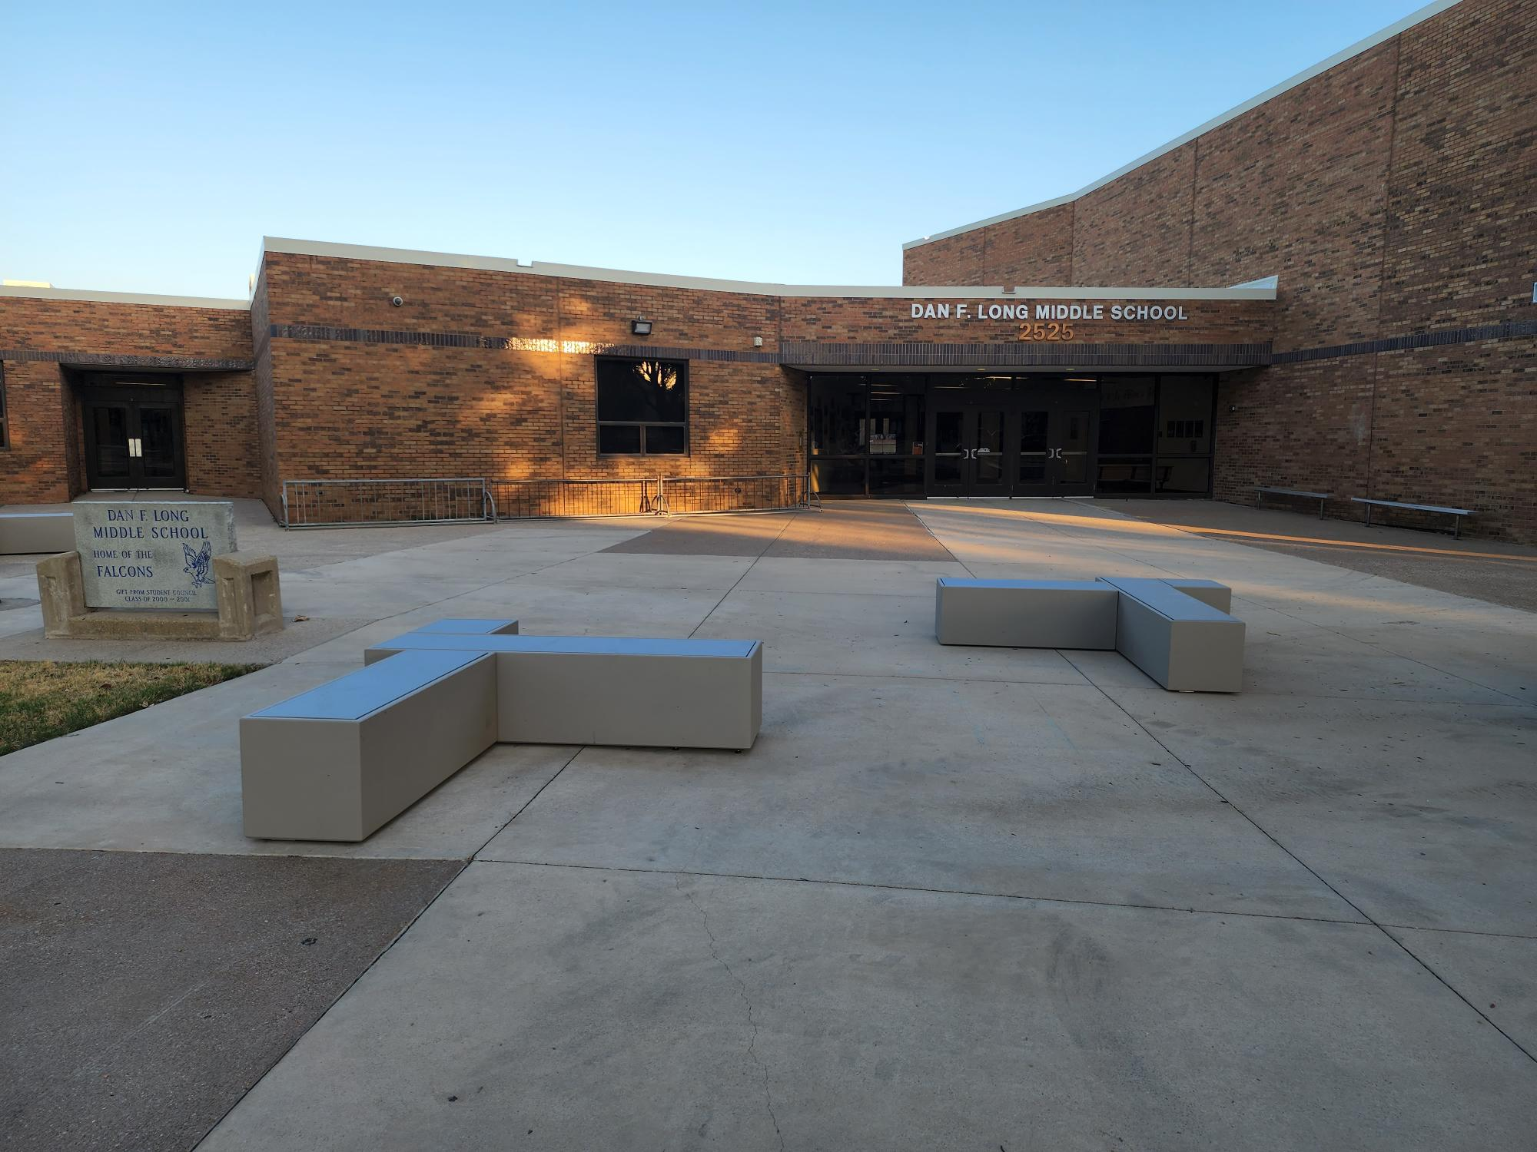
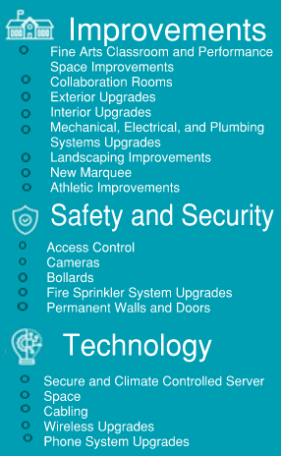
DAN F. LONG MIDDLE SCHOOL
cfbbond.com

Slide 2

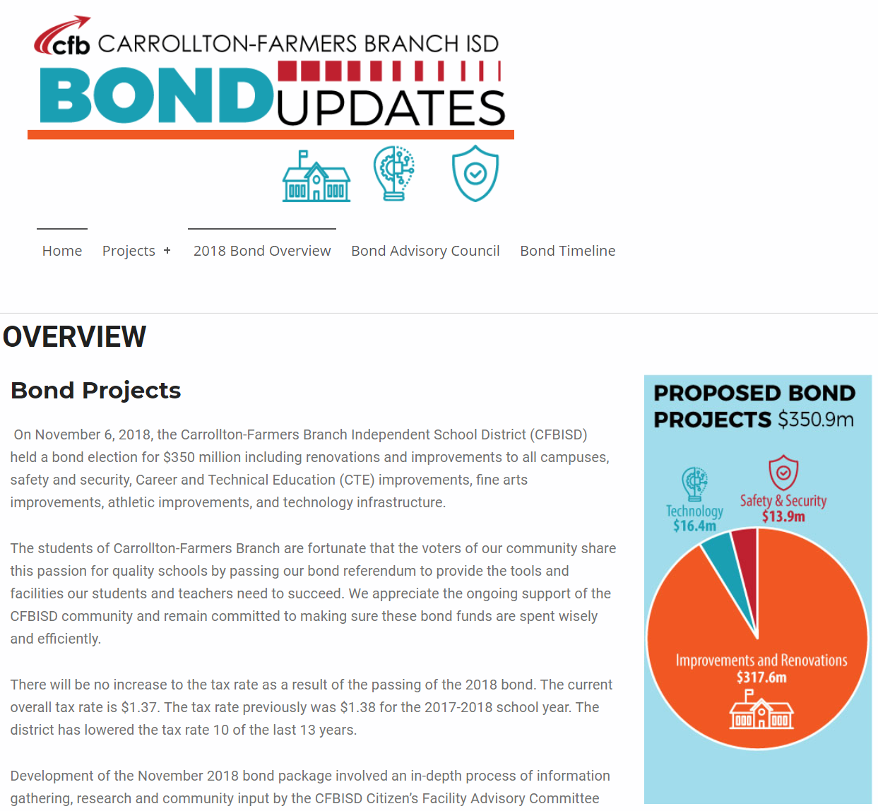
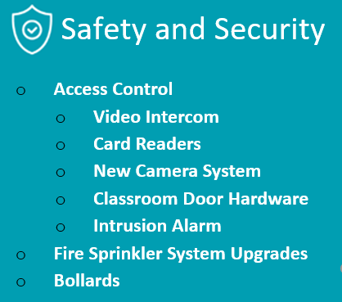
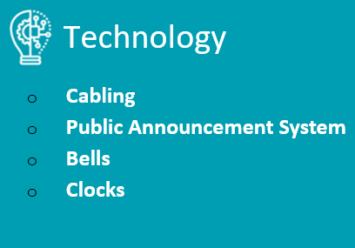
Improvements
Fine Arts Classroom and Performance Space Improvements
  Band, Orchestra, Choir, Theater, and Percussion Hall Renovations
Collaboration Rooms
  Practice Rooms in Fine Arts
Exterior Upgrades
  Exterior Concrete Replacement
  Courtyard Upgrades
Interior Upgrades
  Makerspace /Engineering Room Renovation
  Library Extension
Mechanical, Electrical, and Plumbing Systems Upgrades
  New LED Site Lighting and Controls
  Water Bottle Fillers
Landscape Improvements
  Exterior Concrete Replacement
  Exterior Benches
New Marquee – Coming Soon
Athletics Improvements
  Track Resurfacing
Access Control
  Intercom
  Card Readers
  Security Alarm
Cameras
Bollards
Fire Sprinkler System Upgrades
Permanent Walls and Doors
Secure Climate Controlled Server Space
Cabling
Wireless Upgrades
Phone System Upgrades
PROMISES MADE
PROMISES KEPT
PROMISES MADE
PROMISES KEPT

Slide 3
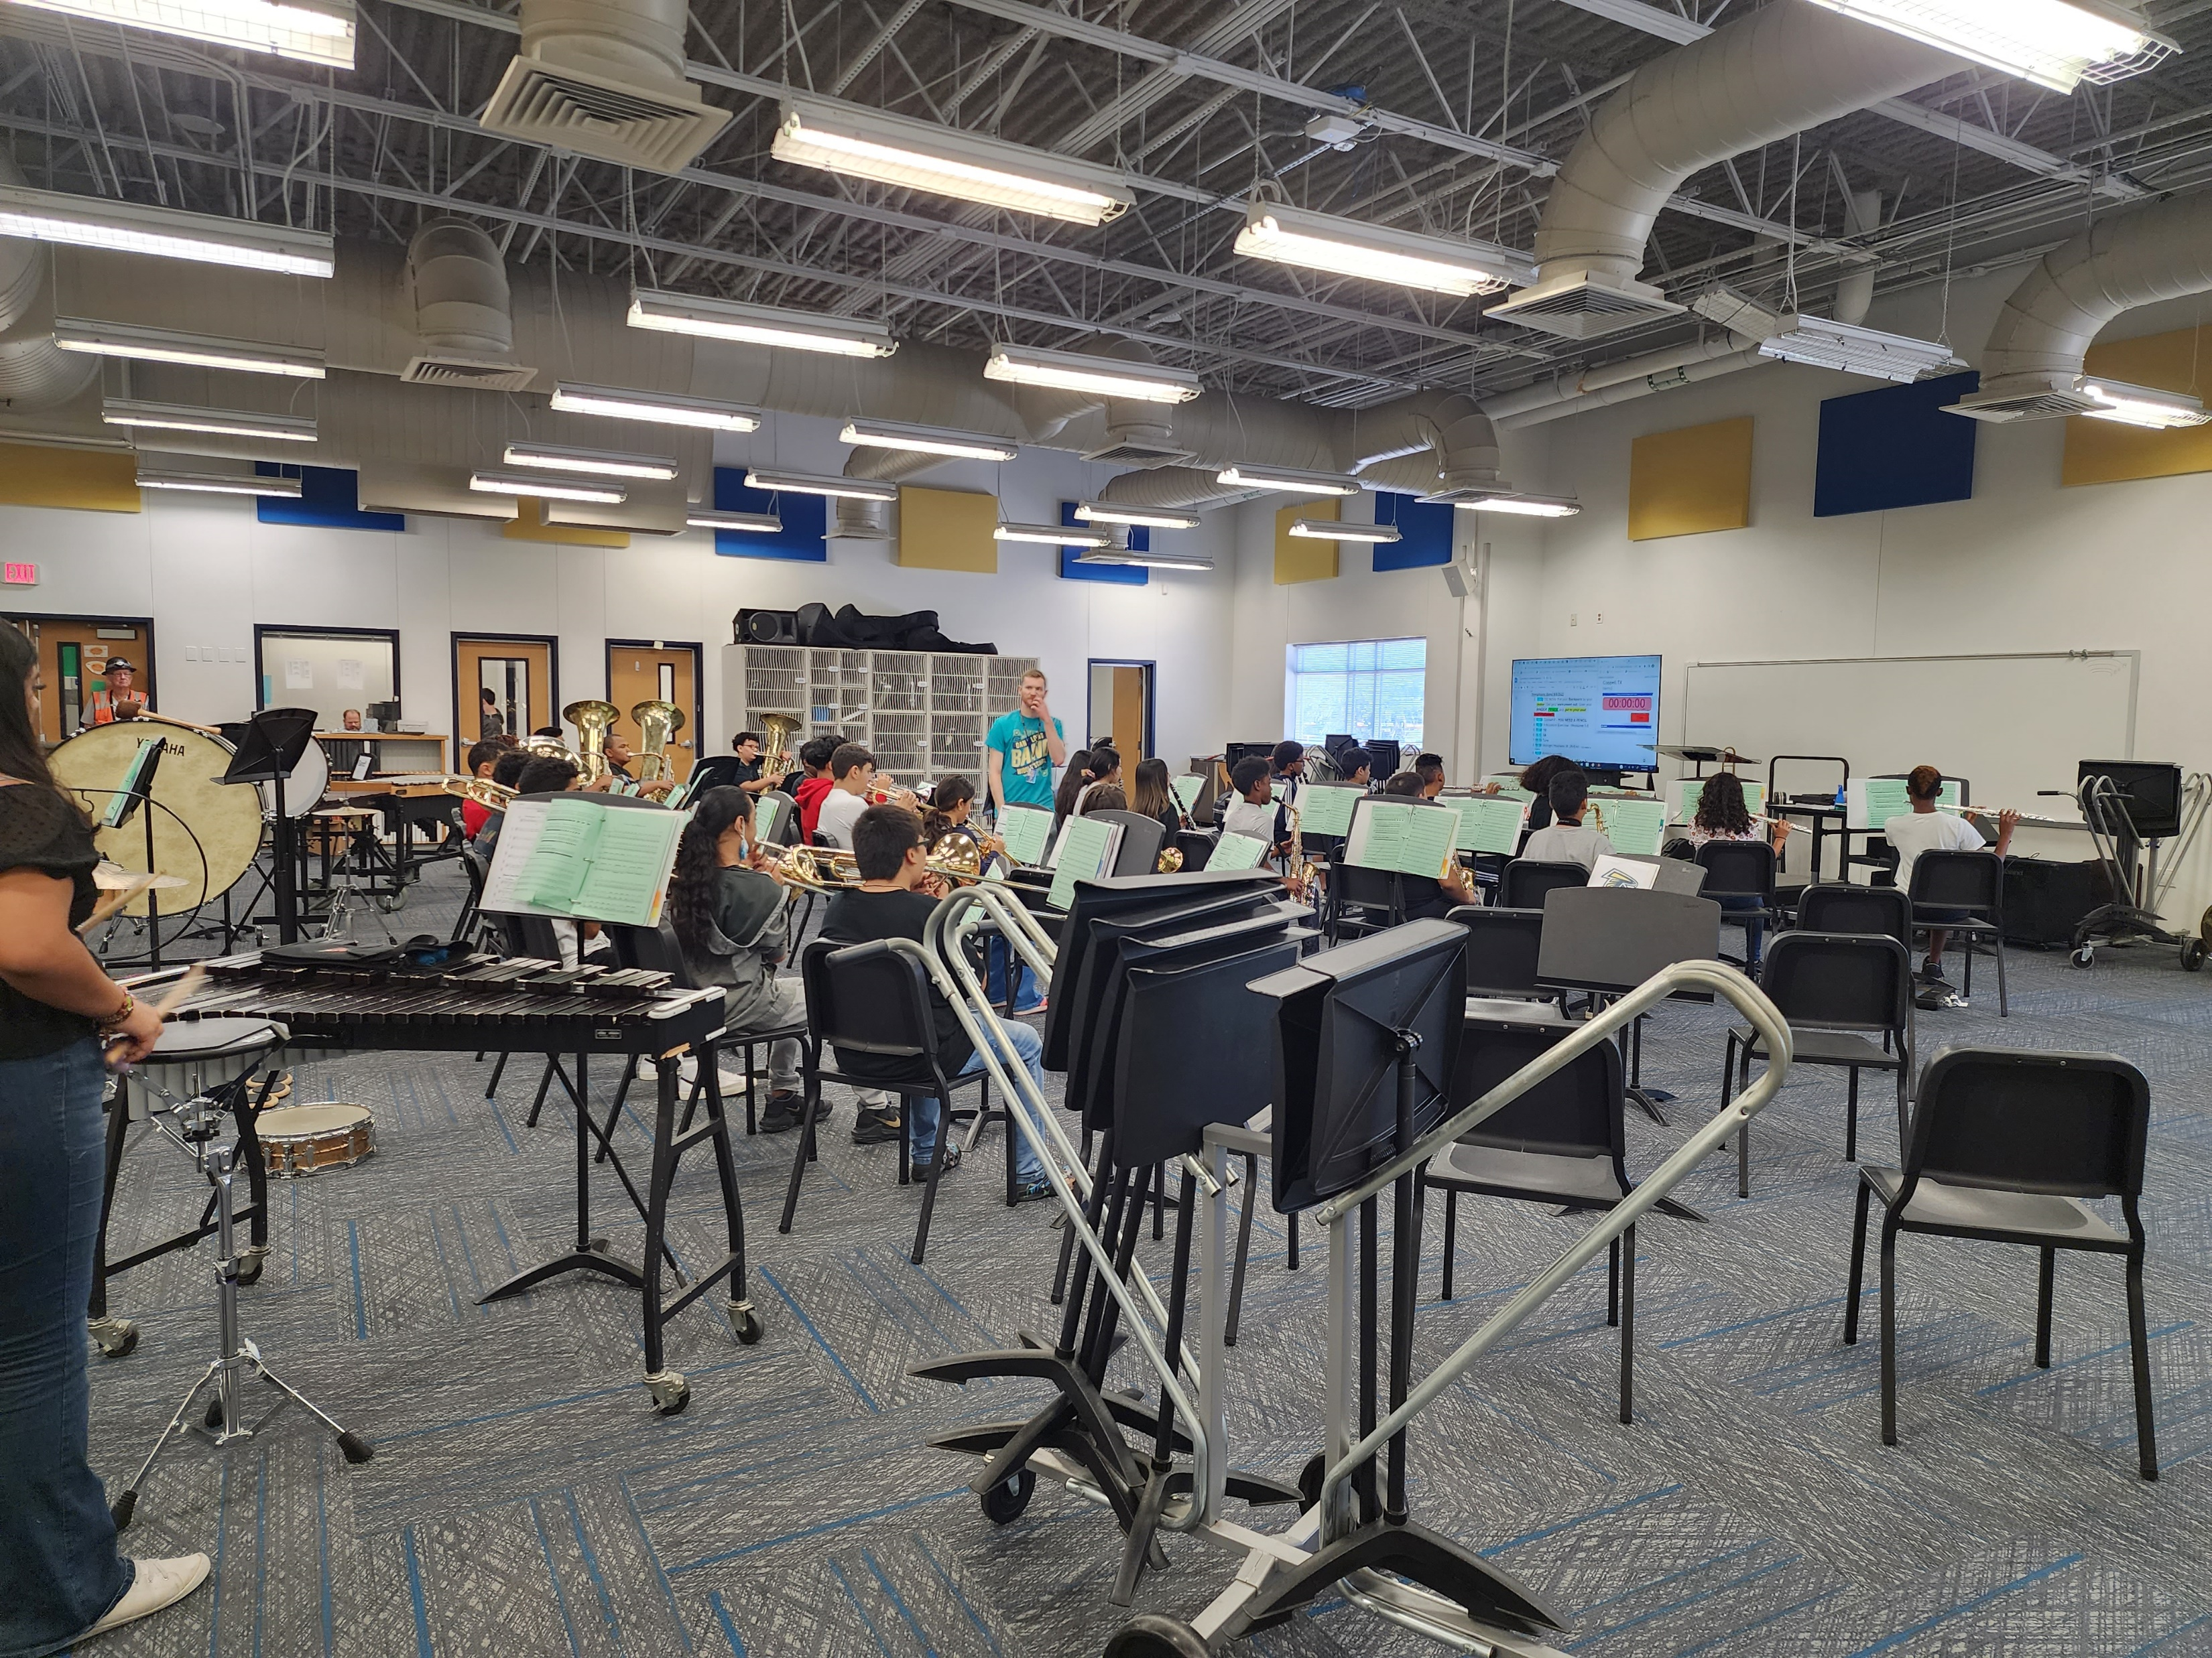
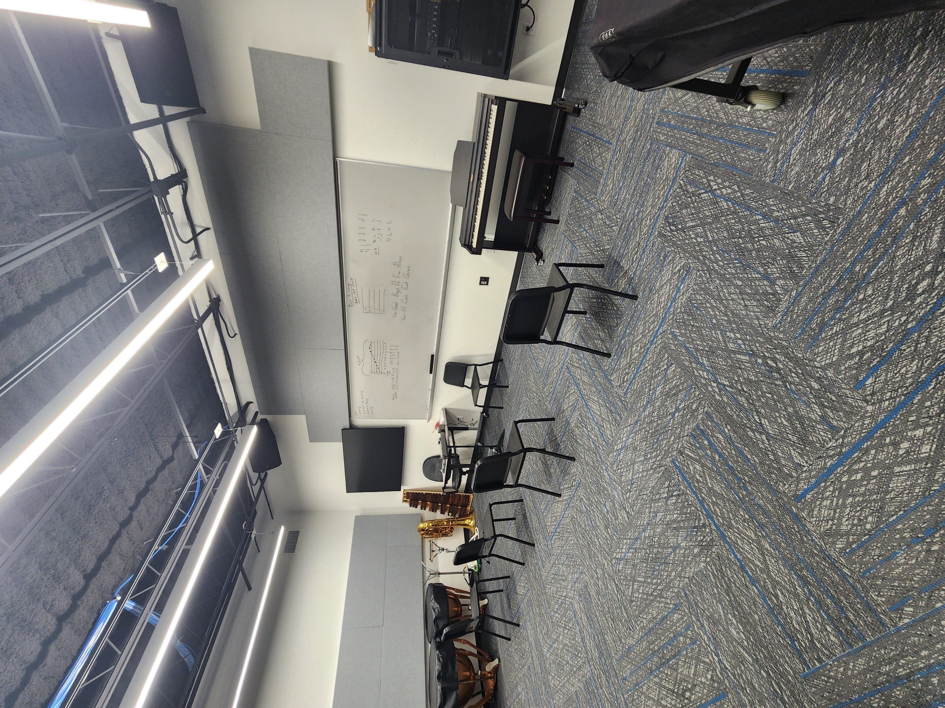
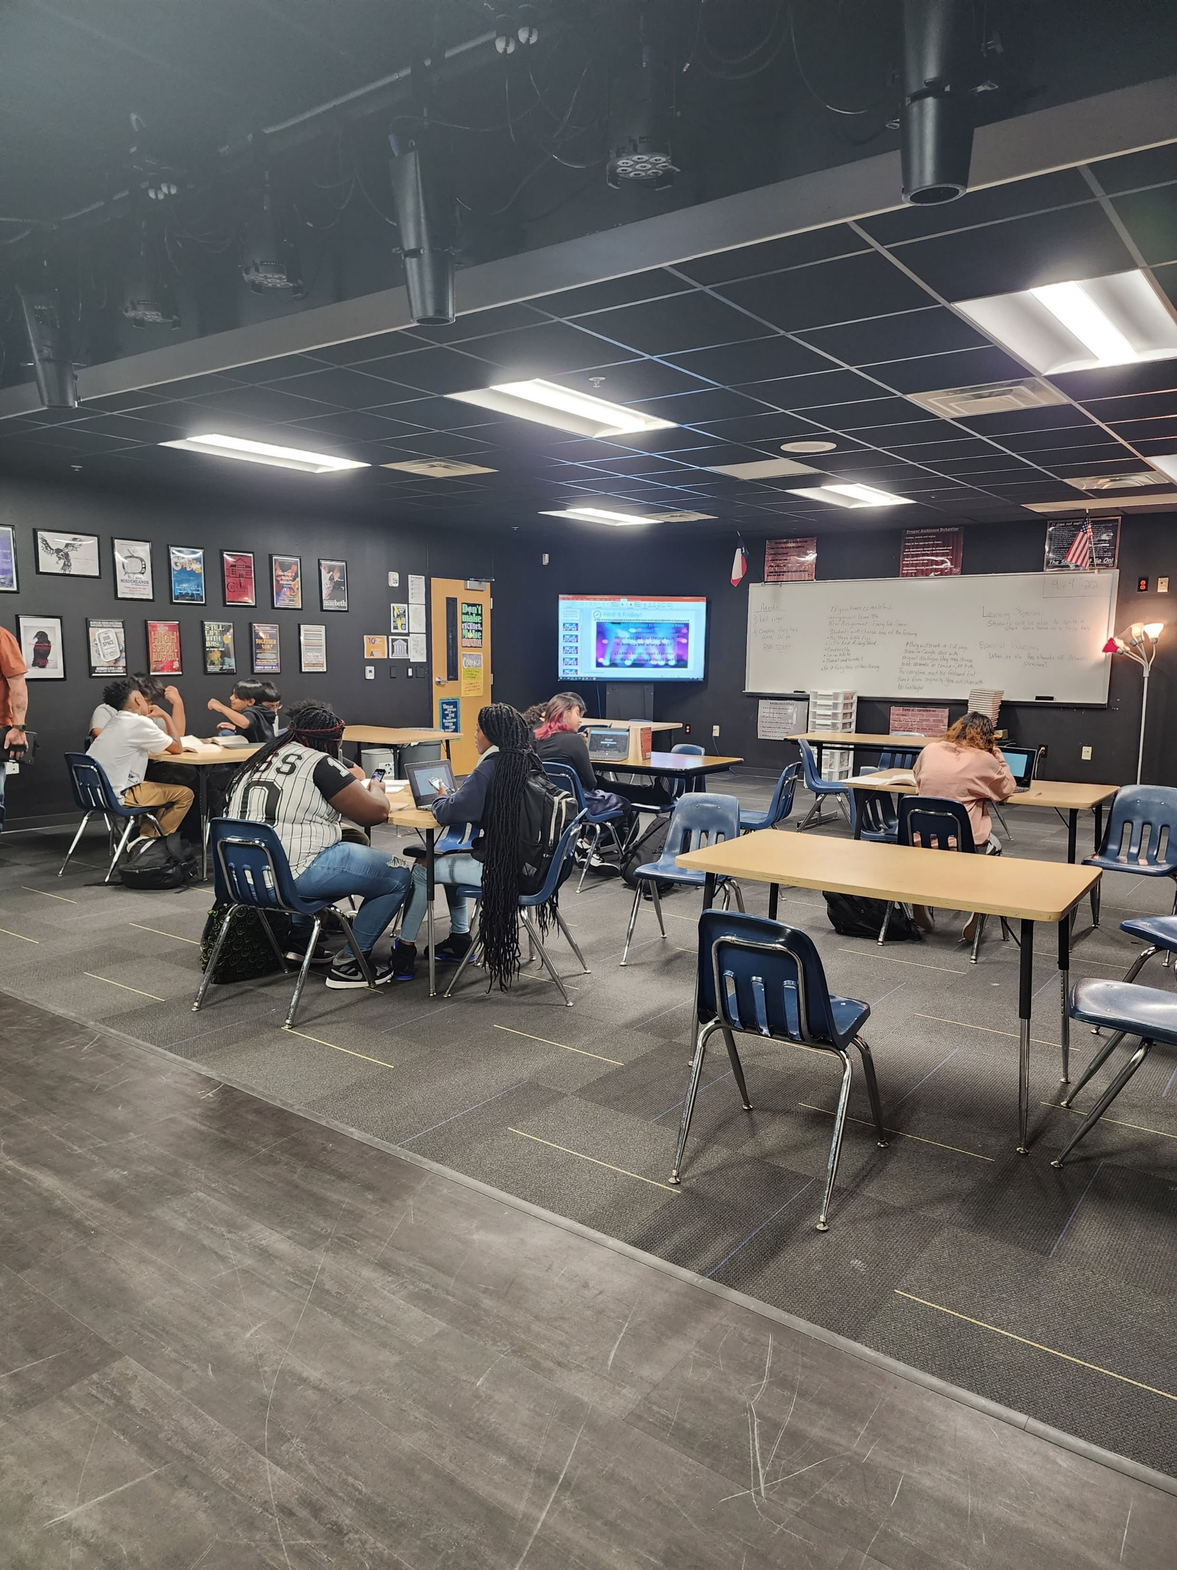
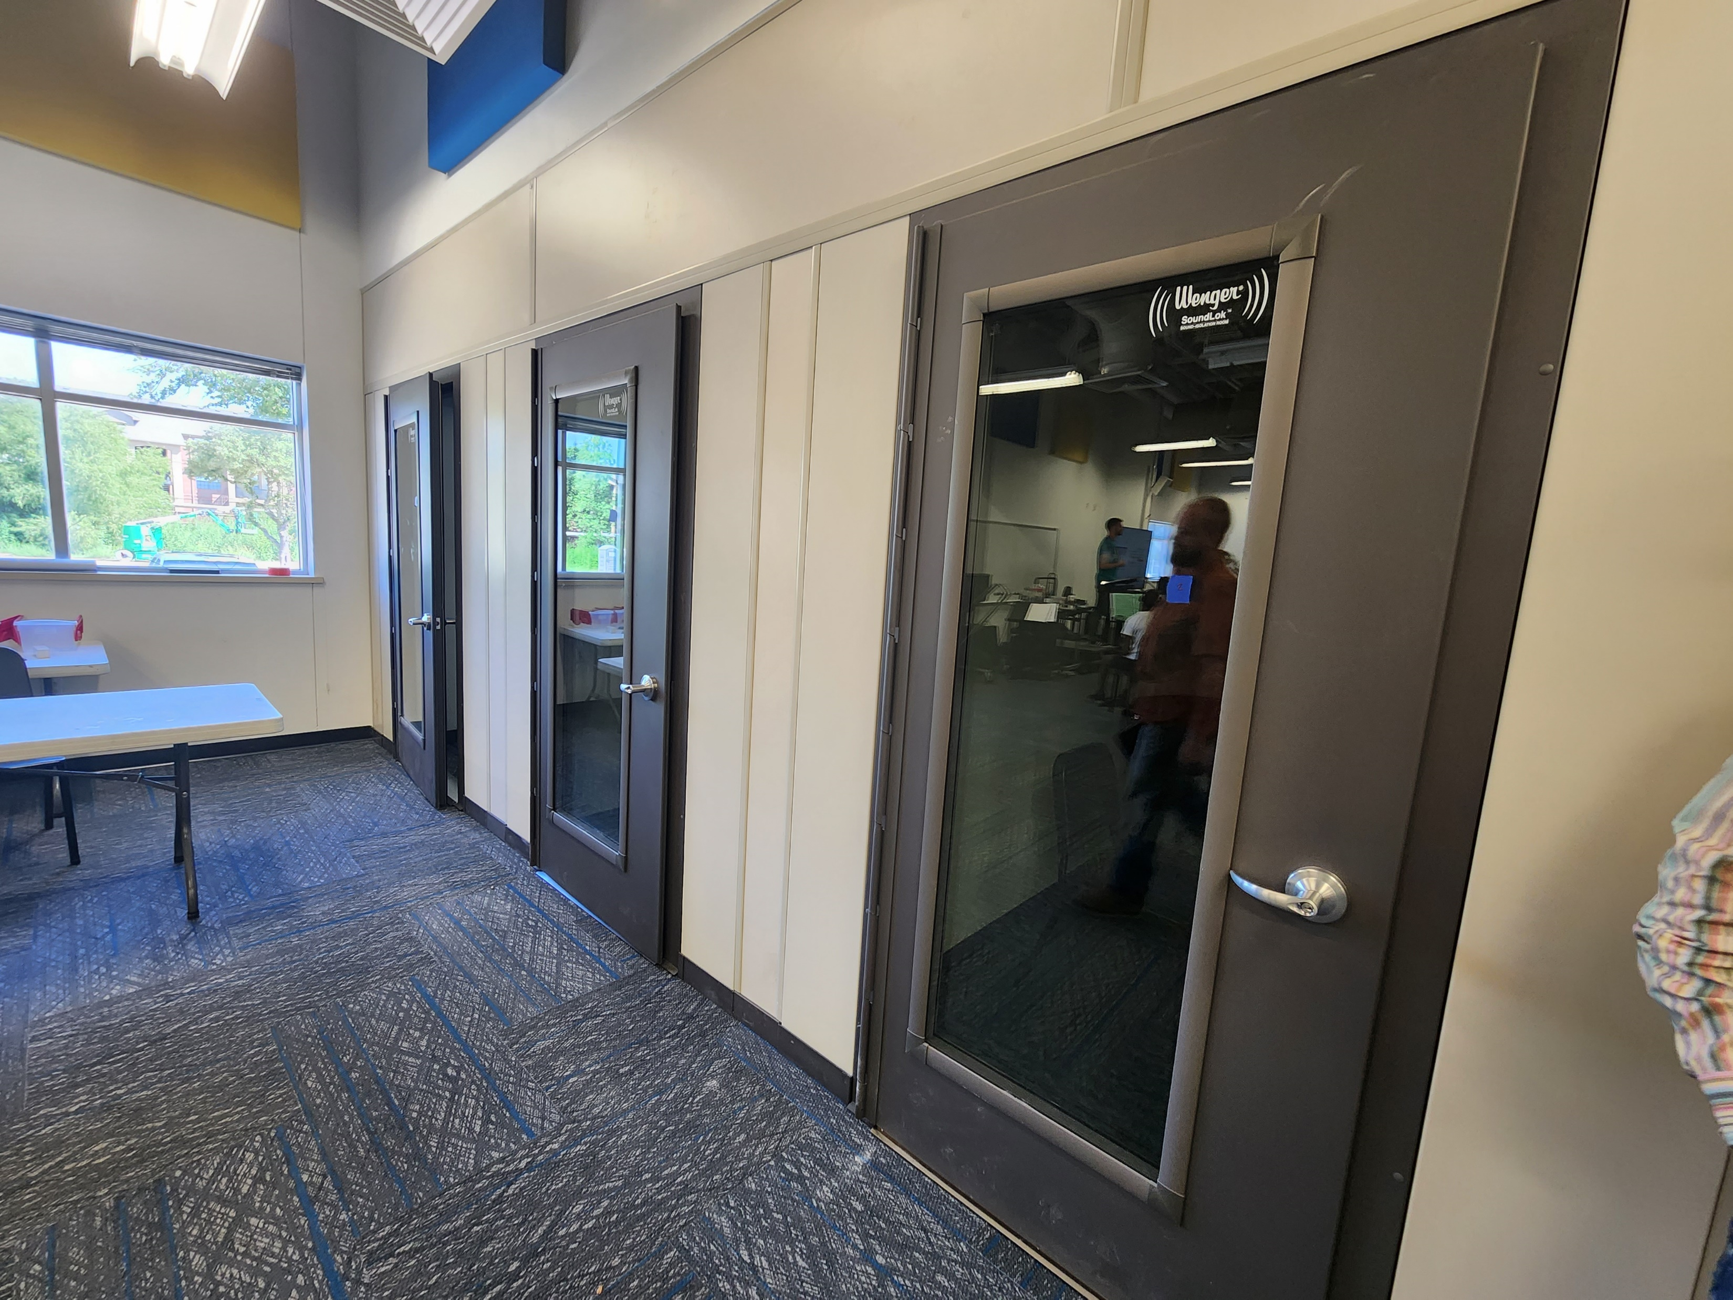
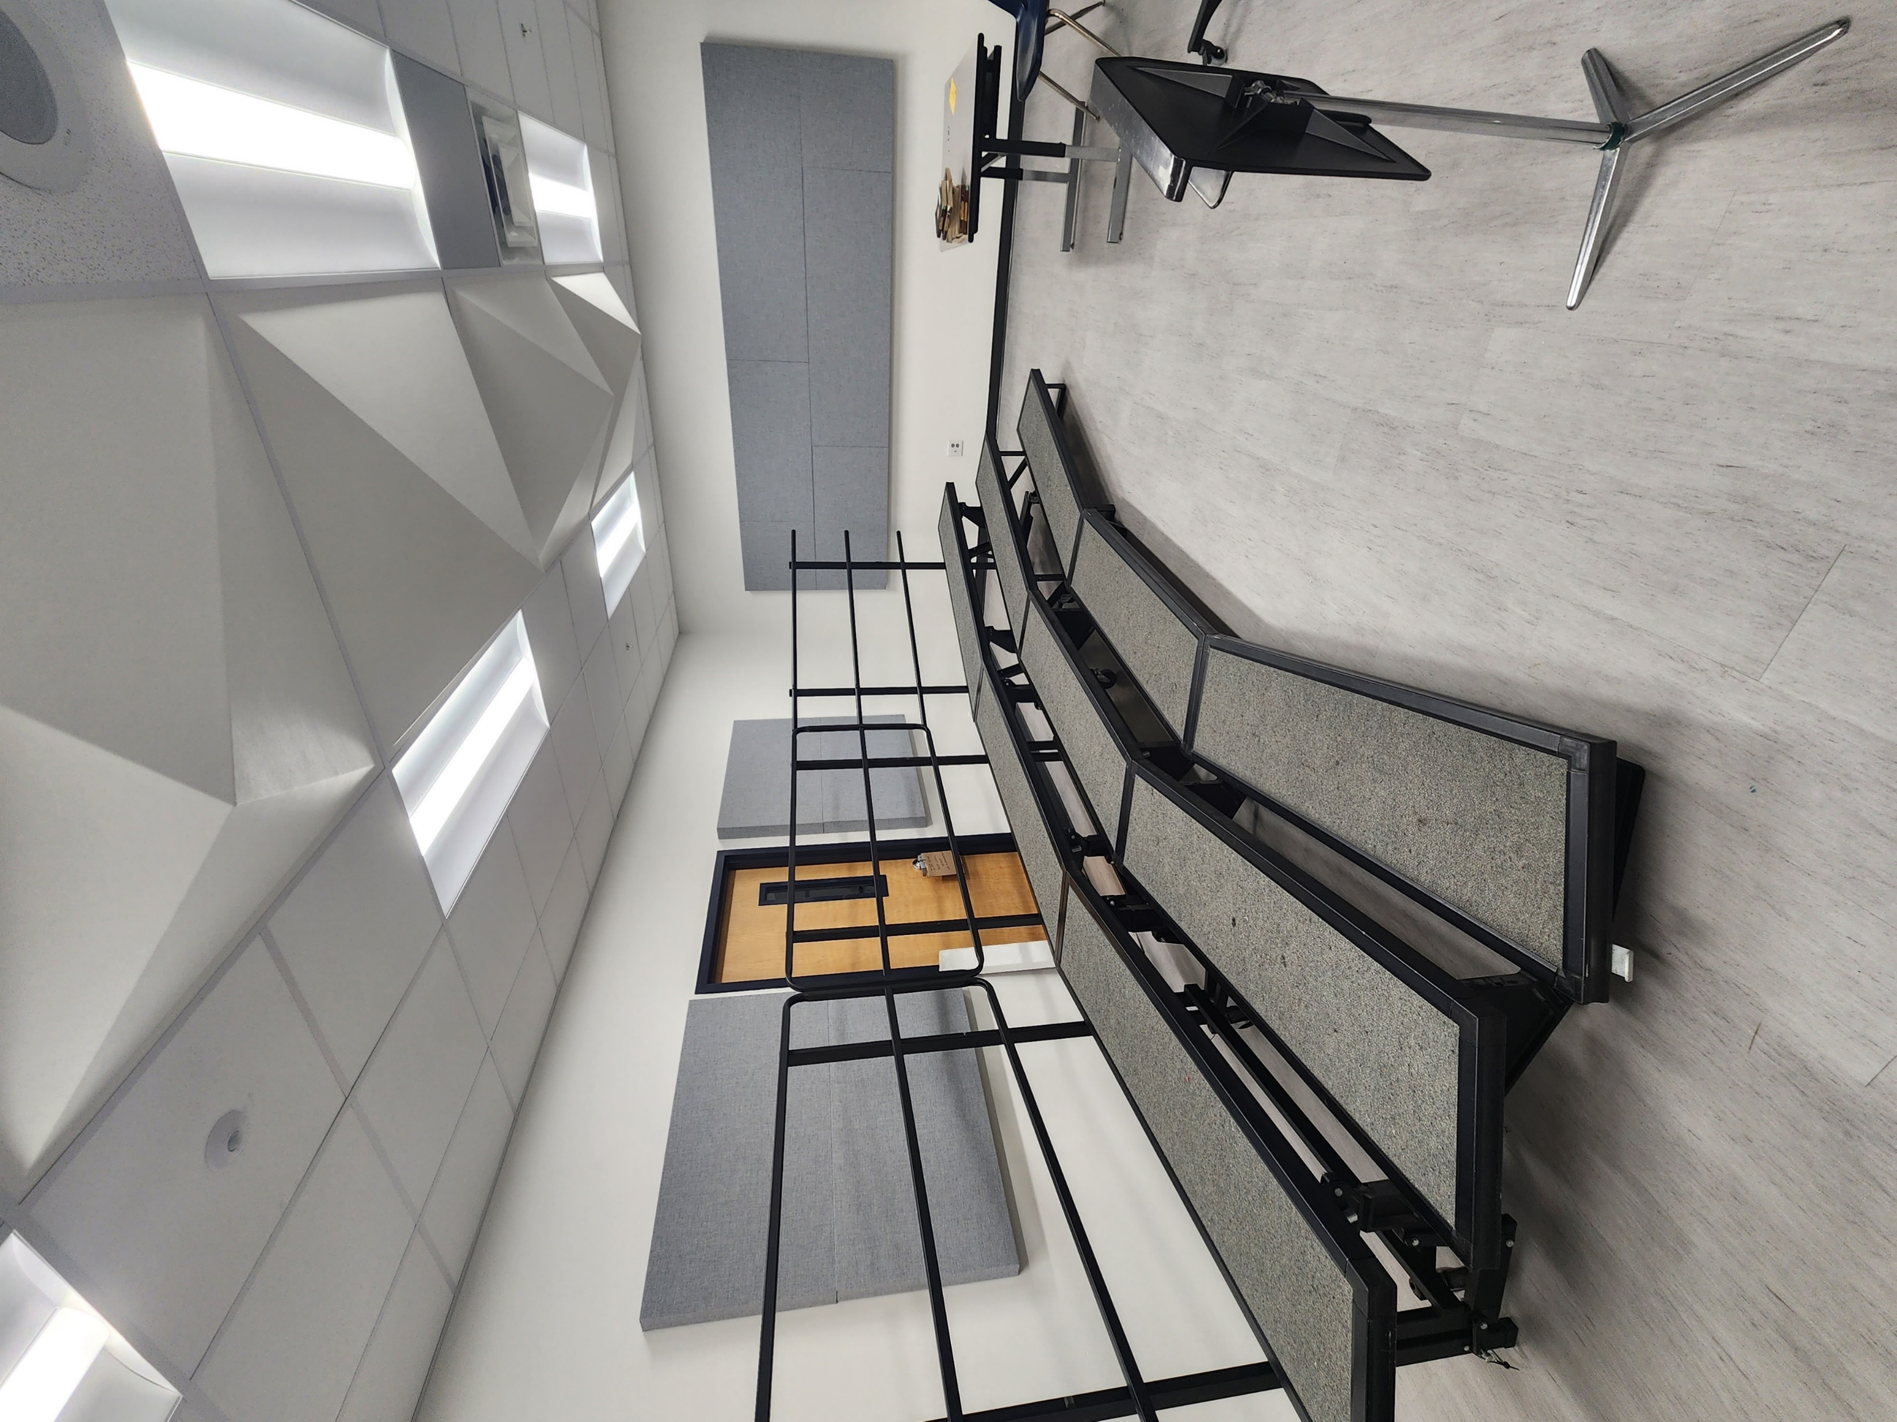
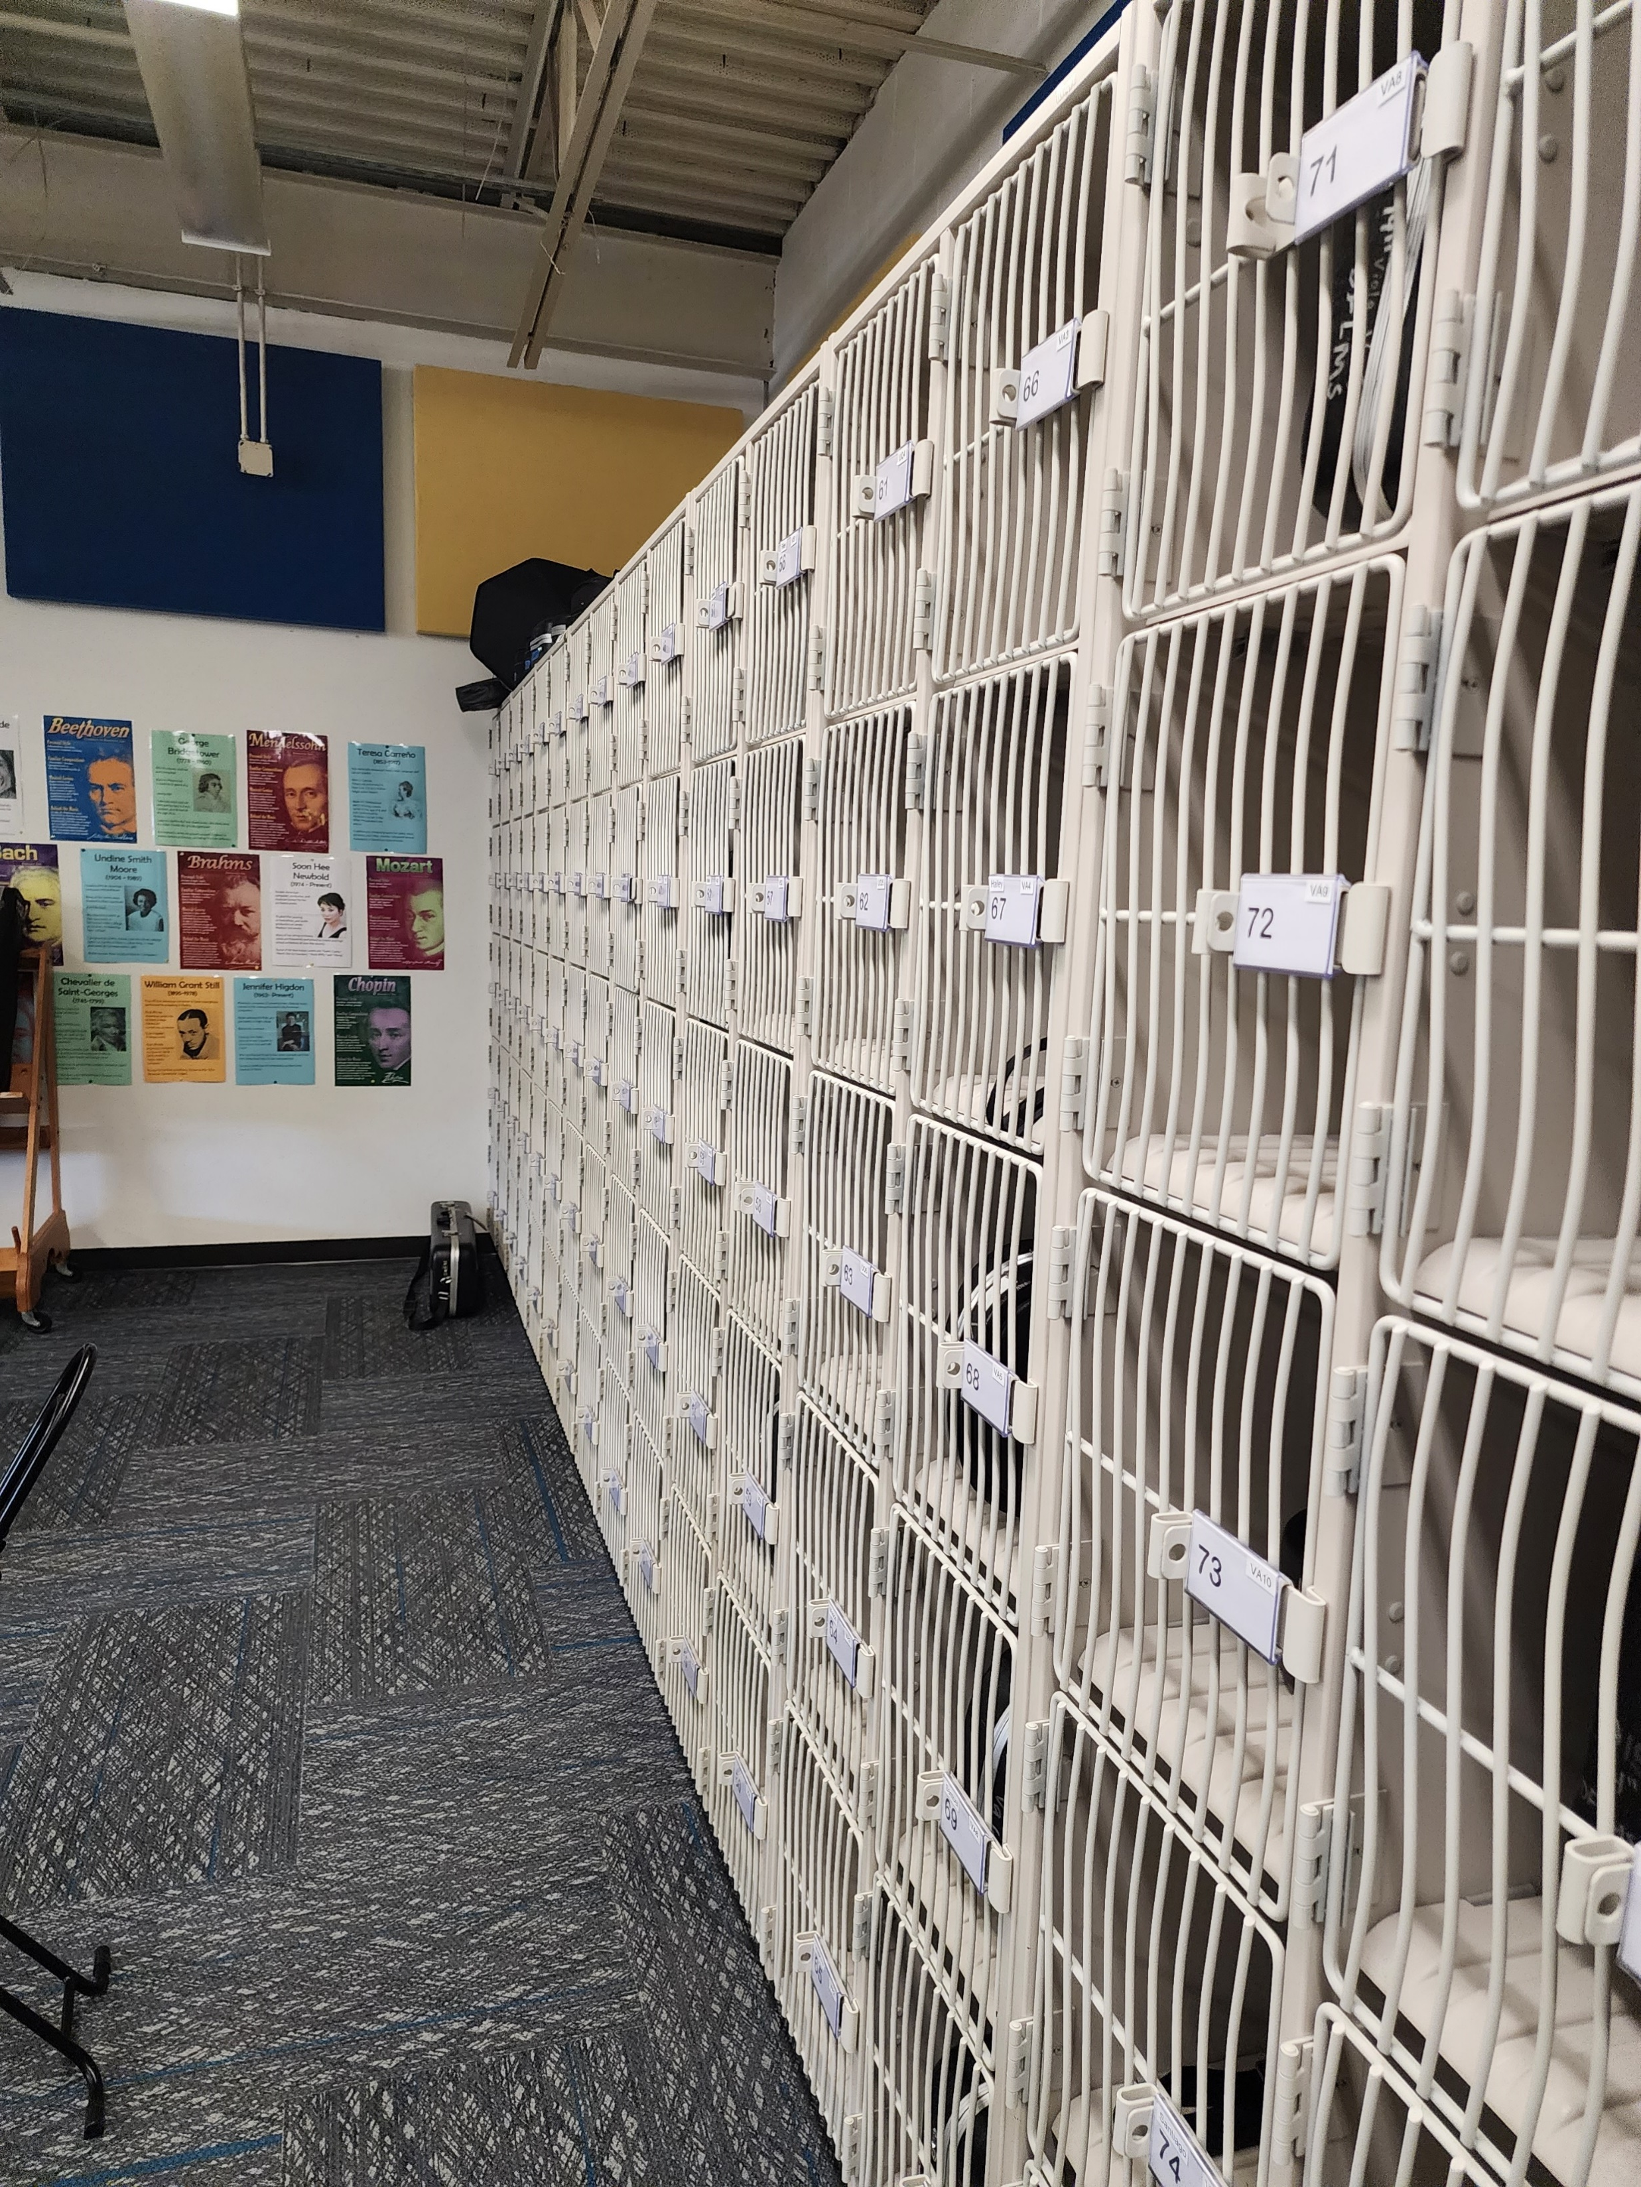
Improvements
Fine Arts Classroom and Performance Space Improvements
  Band, Orchestra, Choir, Theater, and Percussion Hall Renovations
Collaboration Rooms
  Practice Rooms in Fine Arts
Exterior Upgrades
  Exterior Concrete Replacement
  Courtyard Upgrades
Interior Upgrades
  Makerspace /Engineering Room Renovation
  Library Extension
Mechanical, Electrical, and Plumbing Systems Upgrades
  New LED Site Lighting and Controls
  Water Bottle Fillers
Landscape Improvements
  Exterior Concrete Replacement
  Exterior Benches
New Marquee – Coming Soon
Athletics Improvements
  Track Resurfacing
Band Hall
Percussion Hall
Theater
PROMISES MADE
PROMISES KEPT
Wenger Cabinets
Ensemble Rooms
Practice Rooms

Slide 4
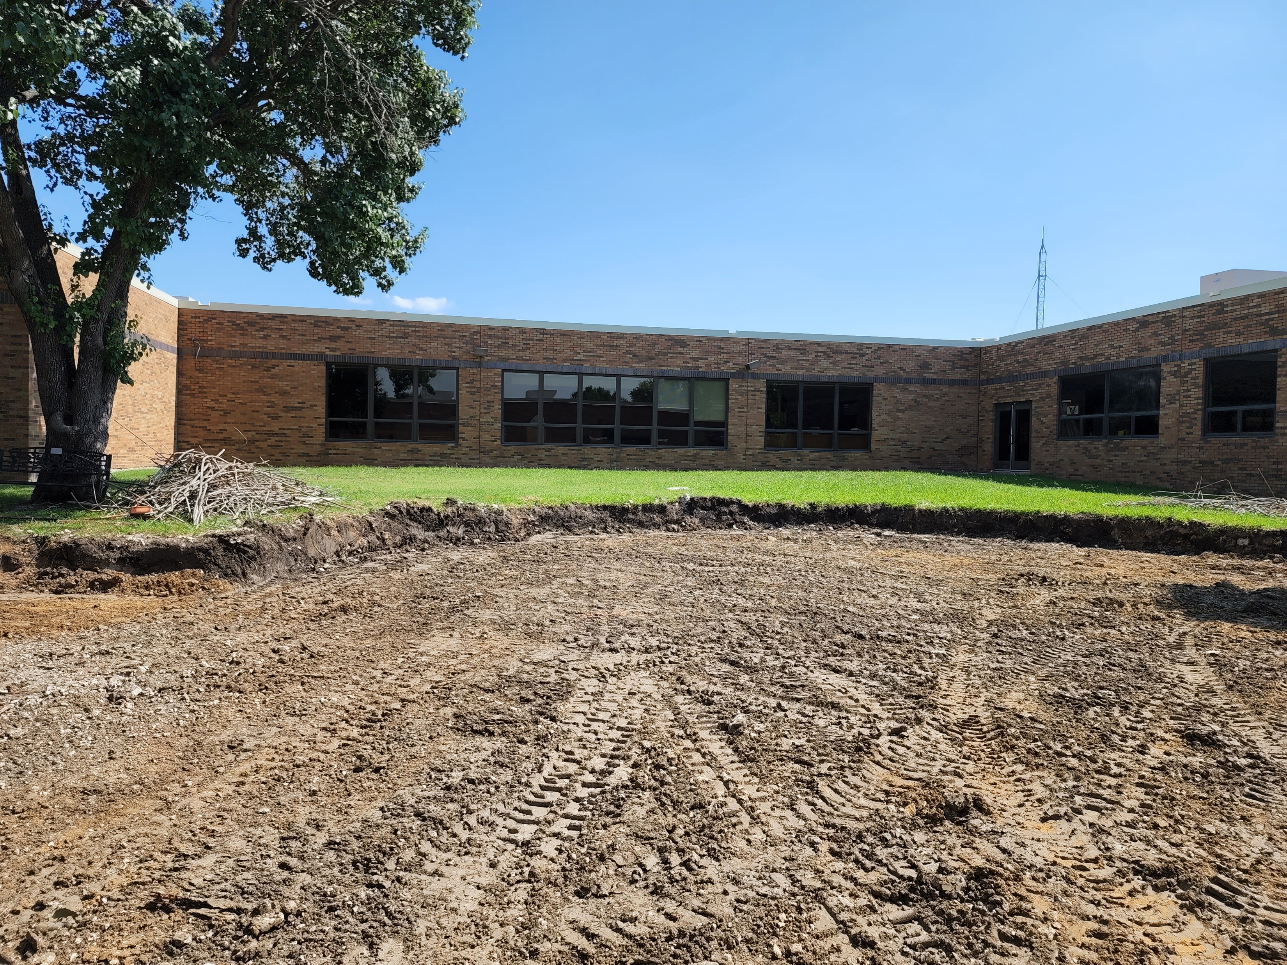
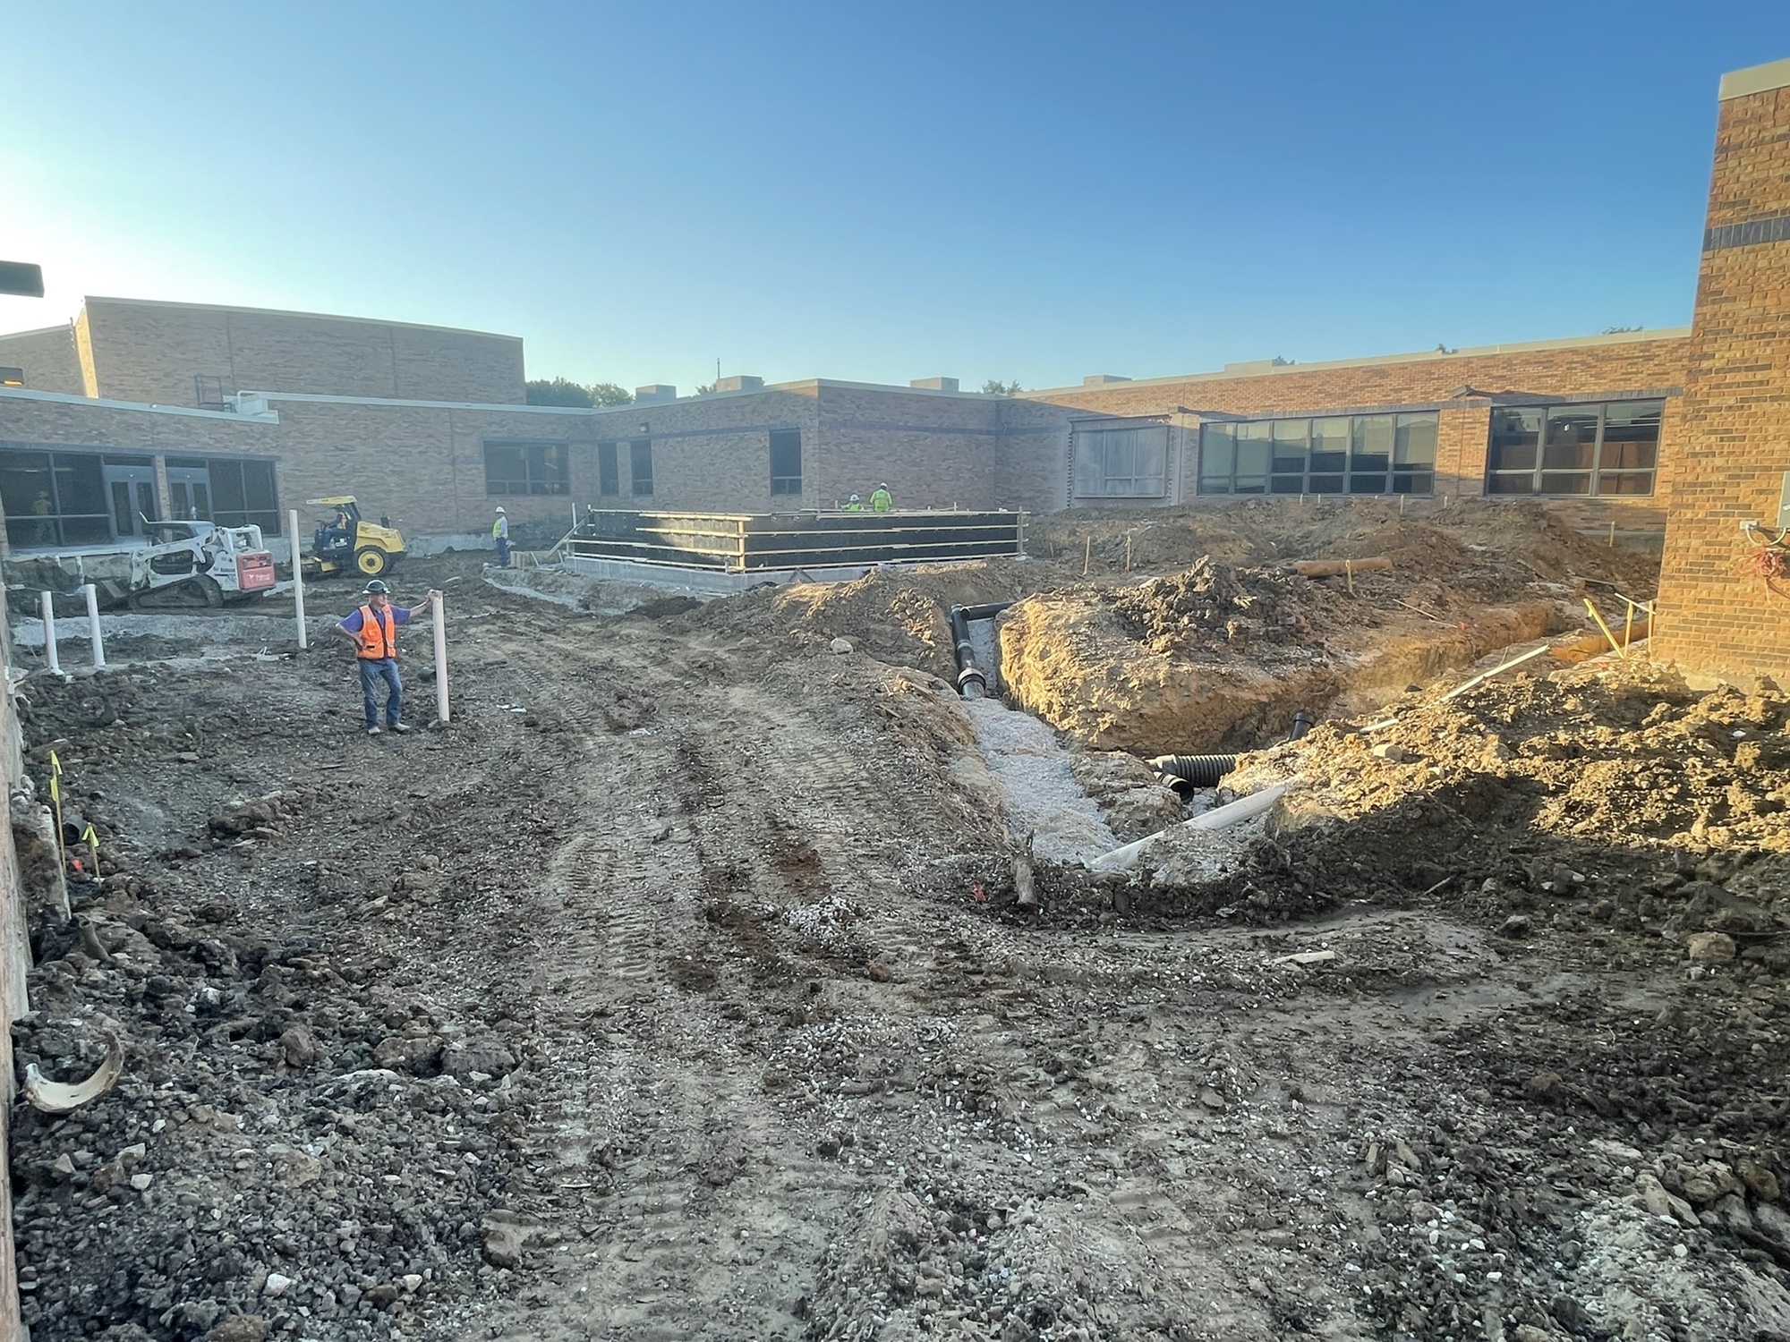
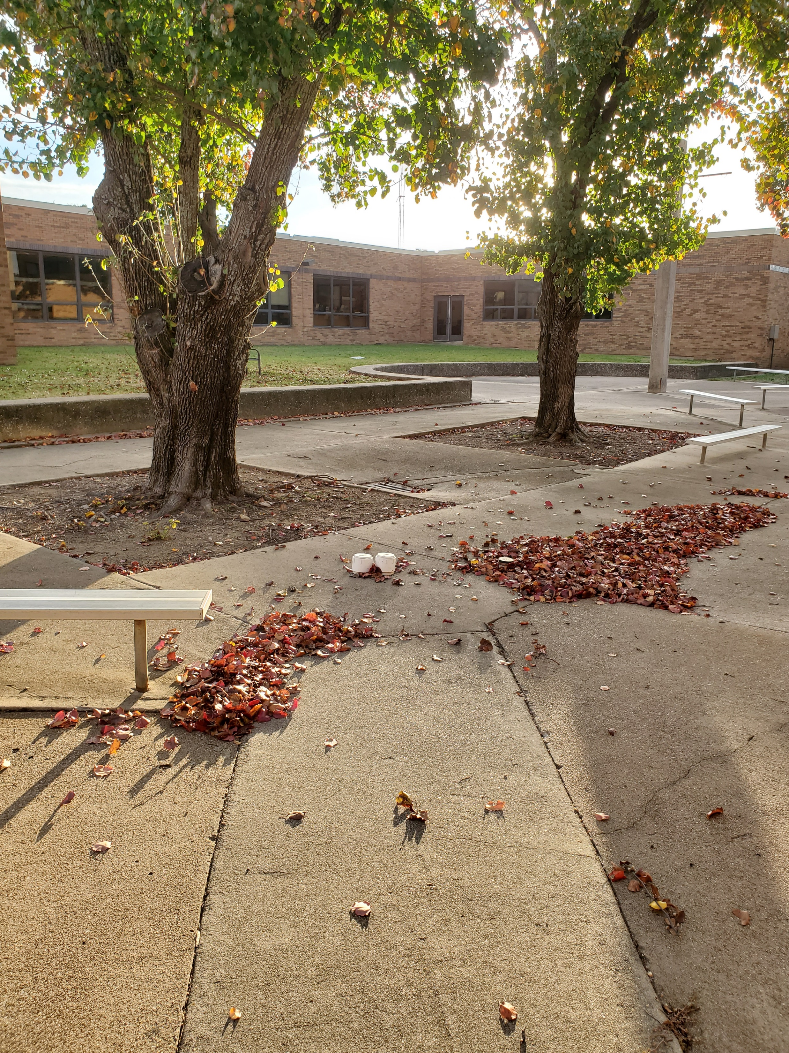
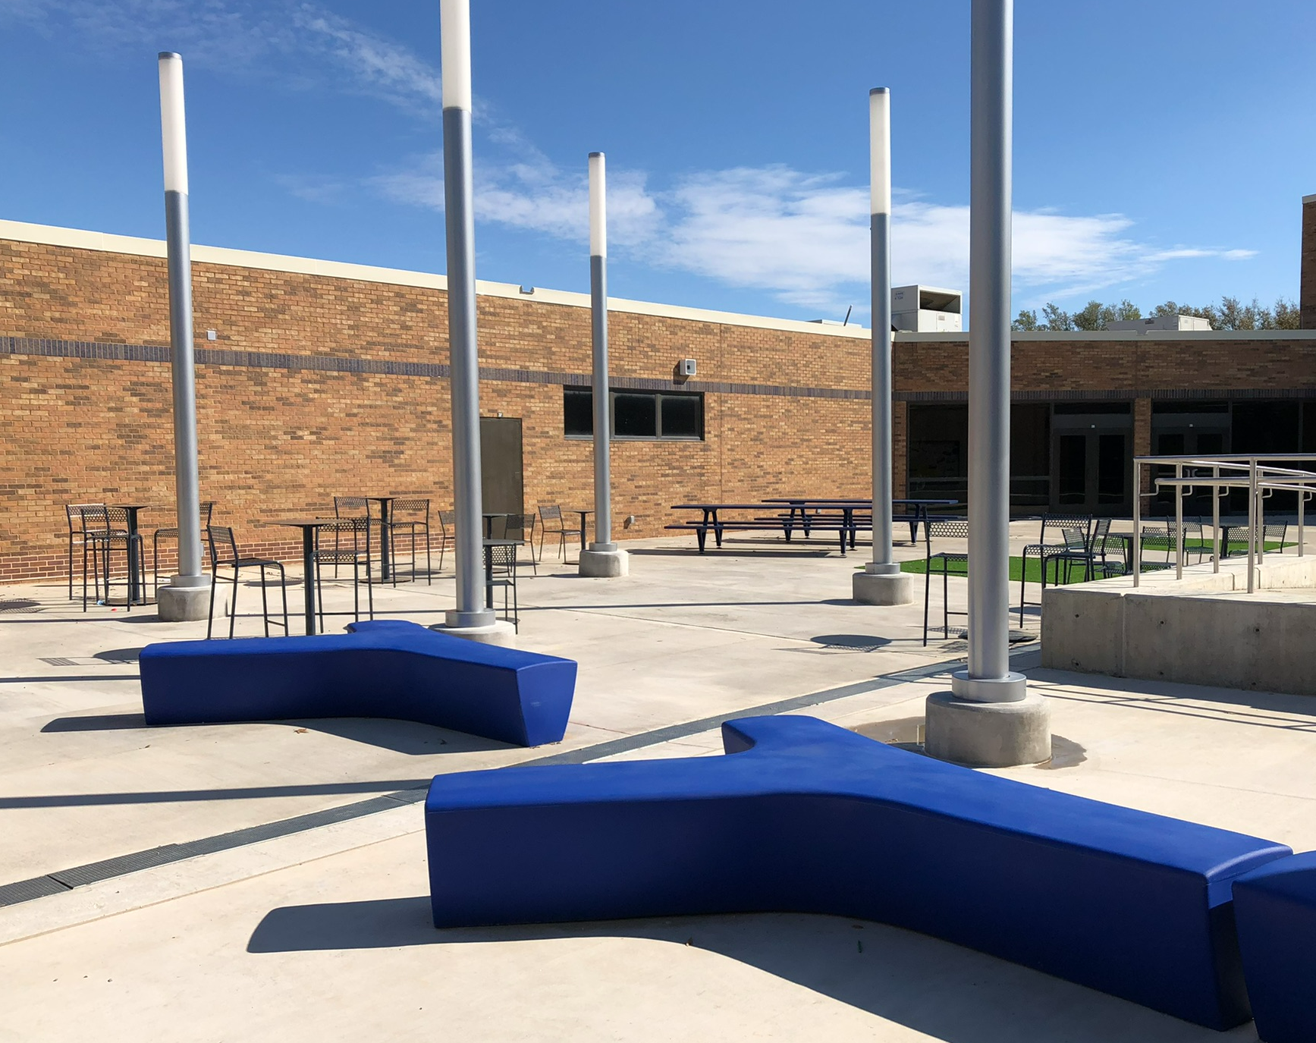
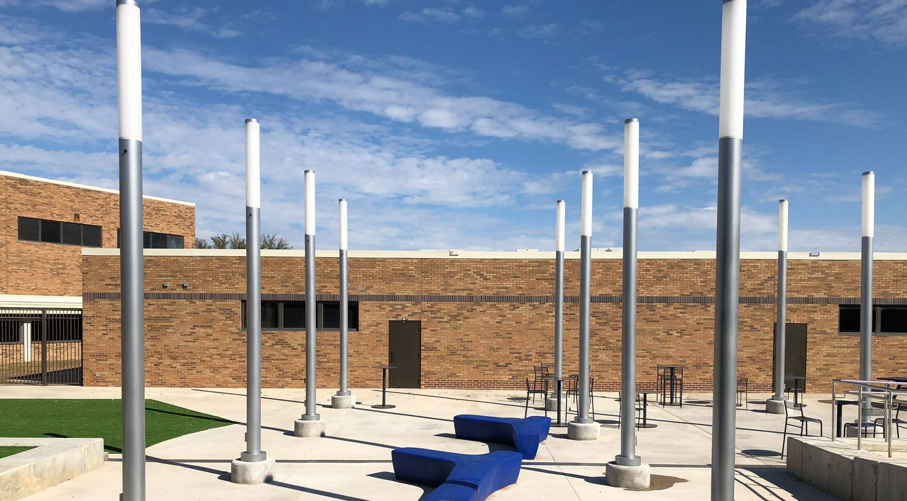
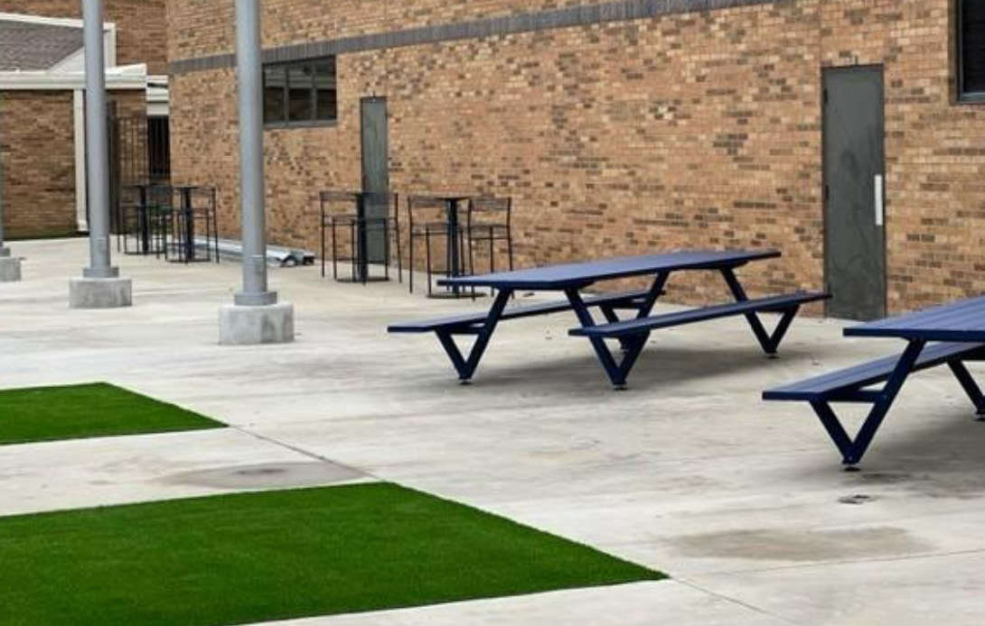
Improvements
Fine Arts Classroom and Performance Space Improvements
  Band, Orchestra, Choir, Theater, and Percussion Hall Renovations
Collaboration Rooms
  Practice Rooms in Fine Arts
Exterior Upgrades
  Exterior Concrete Replacement
  Courtyard Upgrades
Interior Upgrades
  Makerspace /Engineering Room Renovation
  Library Extension
Mechanical, Electrical, and Plumbing Systems Upgrades
  New LED Site Lighting and Controls
  Water Bottle Fillers
Landscape Improvements
  Exterior Concrete Replacement
  Exterior Benches
New Marquee – Coming Soon
Athletics Improvements
  Track Resurfacing
Before
Before
Before
After
After
PROMISES MADE
PROMISES KEPT
After

Slide 5
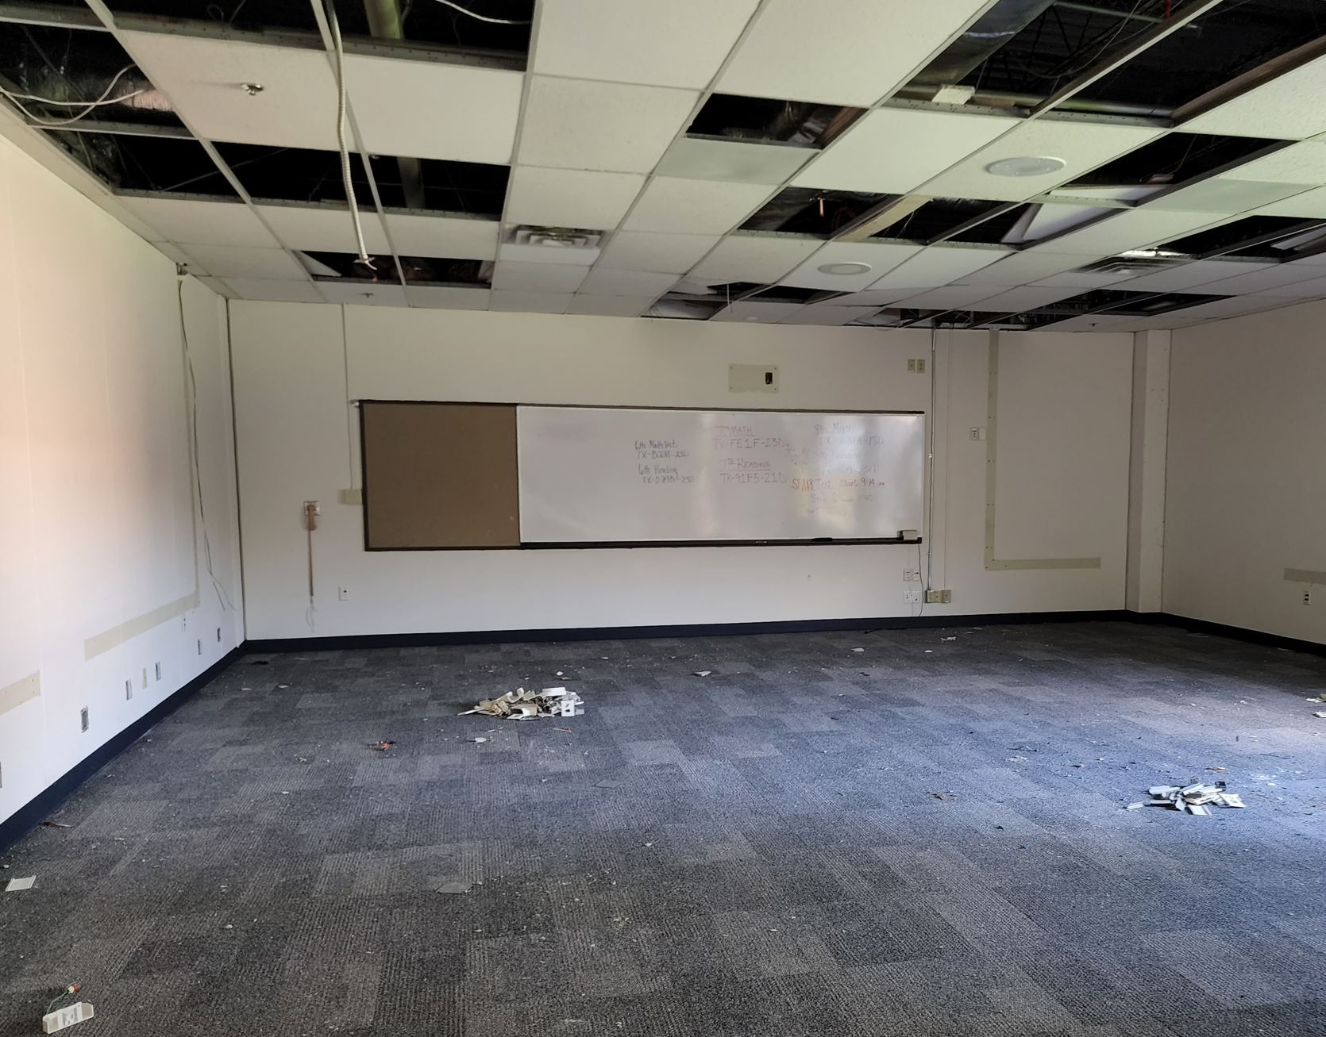
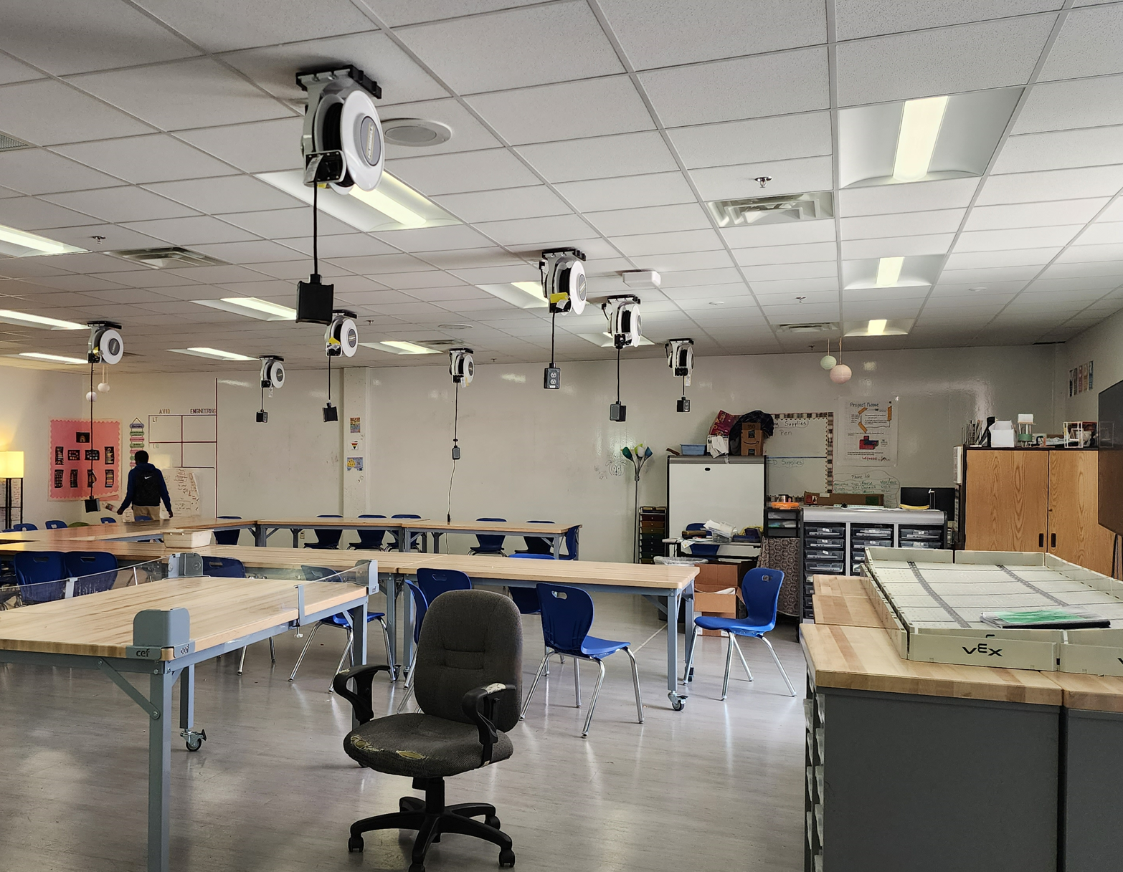
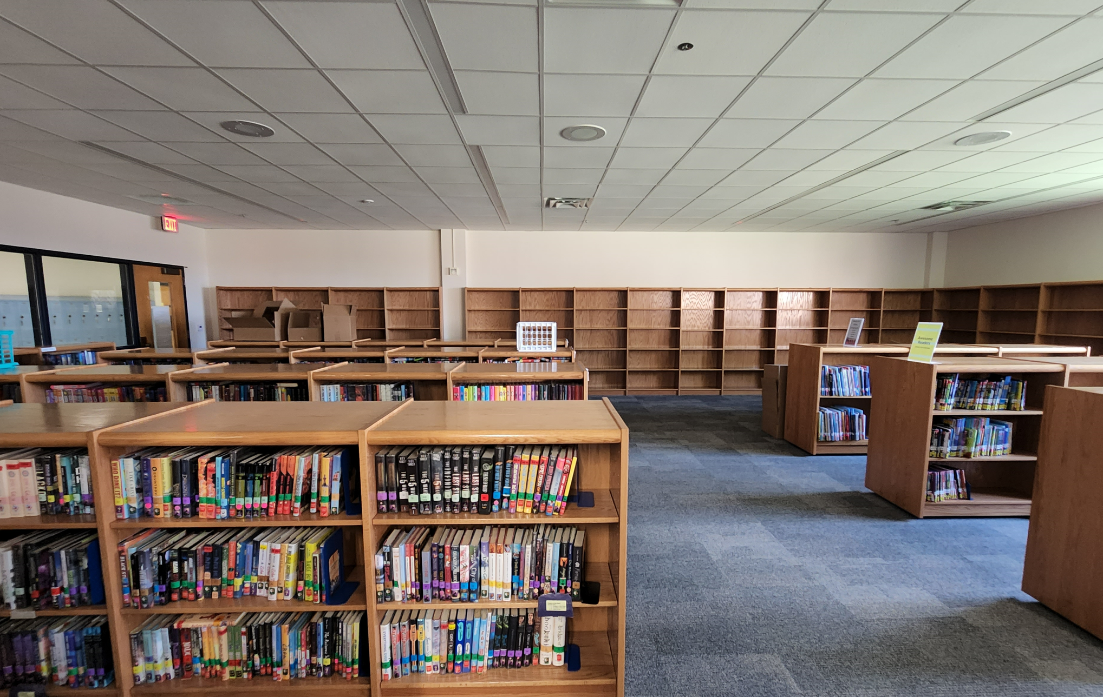
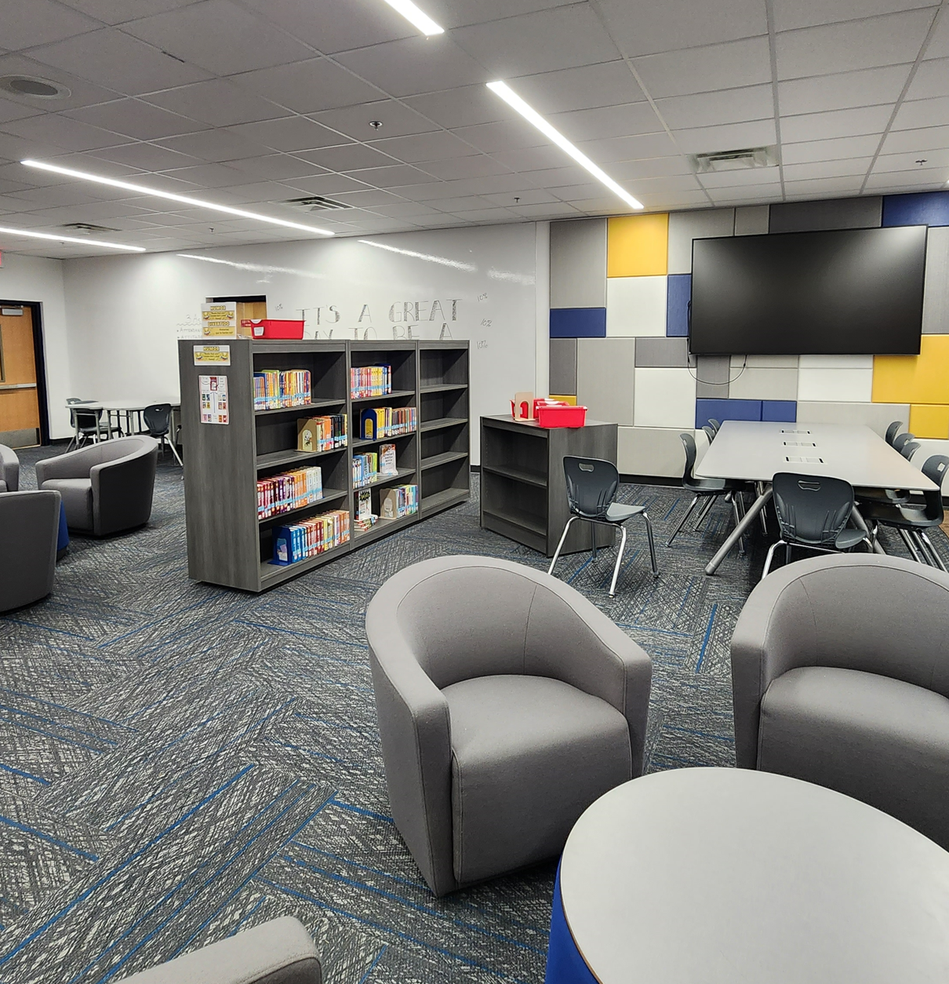
Improvements
Fine Arts Classroom and Performance Space Improvements
  Band, Orchestra, Choir, Theater, and Percussion Hall Renovations
Collaboration Rooms
  Practice Rooms in Fine Arts
Exterior Upgrades
  Exterior Concrete Replacement
  Courtyard Upgrades
Interior Upgrades
  Makerspace /Engineering Room Renovation
  Library Extension
Mechanical, Electrical, and Plumbing Systems Upgrades
  New LED Site Lighting and Controls
  Water Bottle Fillers
Landscape Improvements
  Exterior Concrete Replacement
  Exterior Benches
New Marquee – Coming Soon
Athletics Improvements
  Track Resurfacing
Before
Before
After
PROMISES MADE
PROMISES KEPT
Makerspace
Library Extension
Before
After

Slide 6
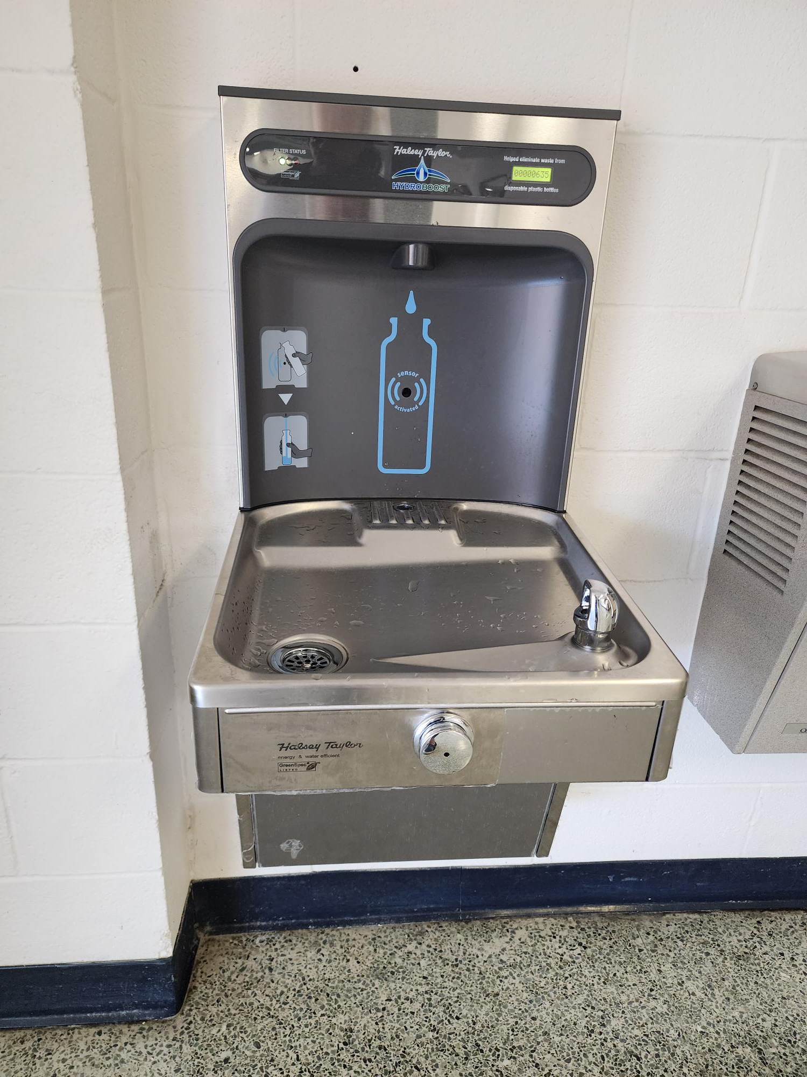
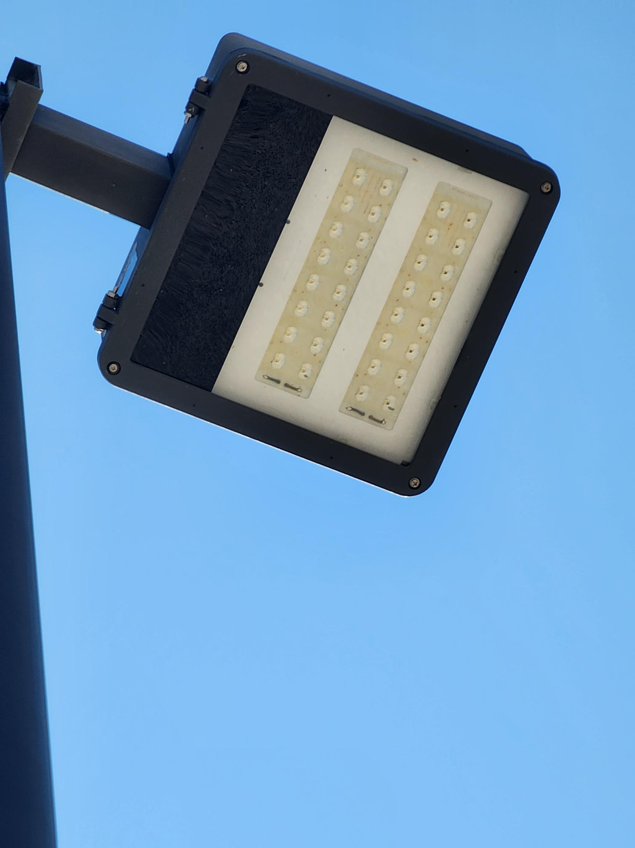
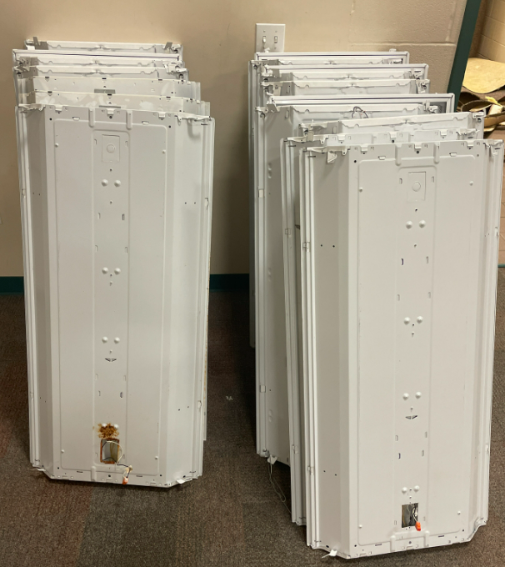
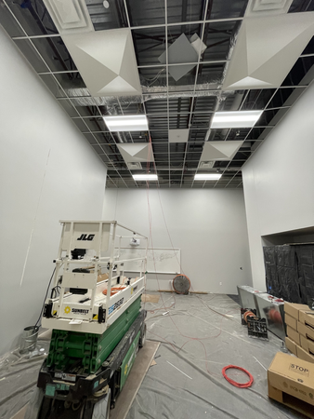
Improvements
Fine Arts Classroom and Performance Space Improvements
  Band, Orchestra, Choir, Theater, and Percussion Hall Renovations
Collaboration Rooms
  Practice Rooms in Fine Arts
Exterior Upgrades
  Exterior Concrete Replacement
  Courtyard Upgrades
Interior Upgrades
  Makerspace /Engineering Room Renovation
  Art Room Renovation
Mechanical, Electrical, and Plumbing Systems Upgrades
  New LED Site Lighting and Controls
  Water Bottle Fillers
Landscape Improvements
  Exterior Concrete Replacement
  Exterior Benches
New Marquee – Coming Soon
Athletics Improvements
  Track Resurfacing
Water Bottle Fillers
Site Lighting
PROMISES MADE
PROMISES KEPT
Before - Lighting
After - LED Lighting

Slide 7
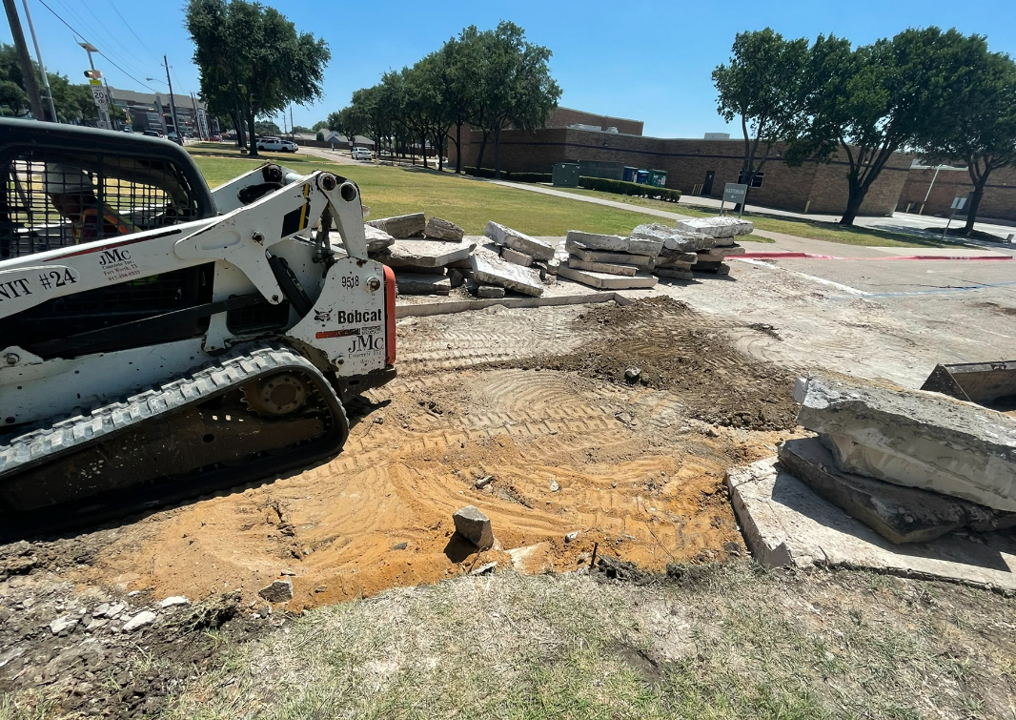
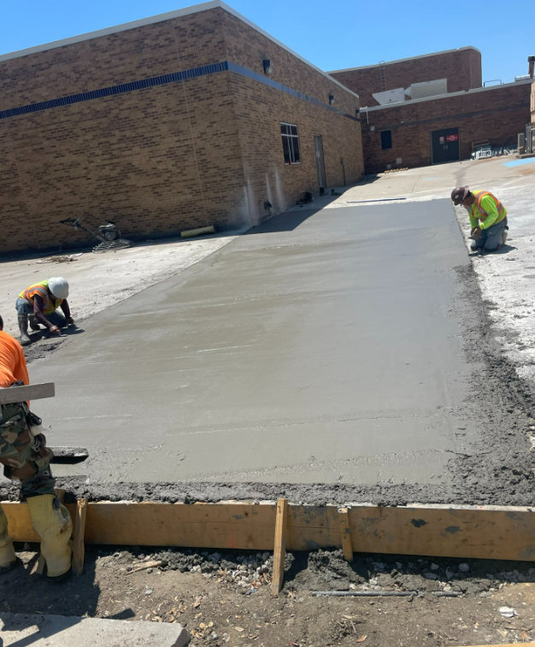
Improvements
Fine Arts Classroom and Performance Space Improvements
  Band, Orchestra, Choir, Theater, and Percussion Hall Renovations
Collaboration Rooms
  Practice Rooms in Fine Arts
Exterior Upgrades
  Exterior Concrete Replacement
  Courtyard Upgrades
Interior Upgrades
  Makerspace /Engineering Room Renovation
  Art Room Renovation
Mechanical, Electrical, and Plumbing Systems Upgrades
  New LED Site Lighting and Controls
  Water Bottle Fillers
Landscape Improvements
  Exterior Concrete Replacement
  Exterior Benches
New Marquee – Coming Soon
Athletics Improvements
  Track Resurfacing
Exterior Concrete
Exterior Concrete
PROMISES MADE
PROMISES KEPT
Exterior Benches

Slide 8
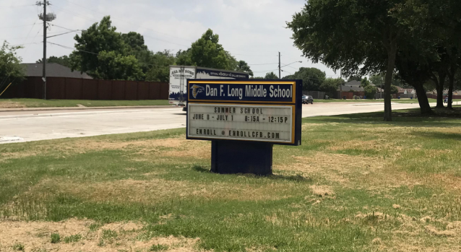
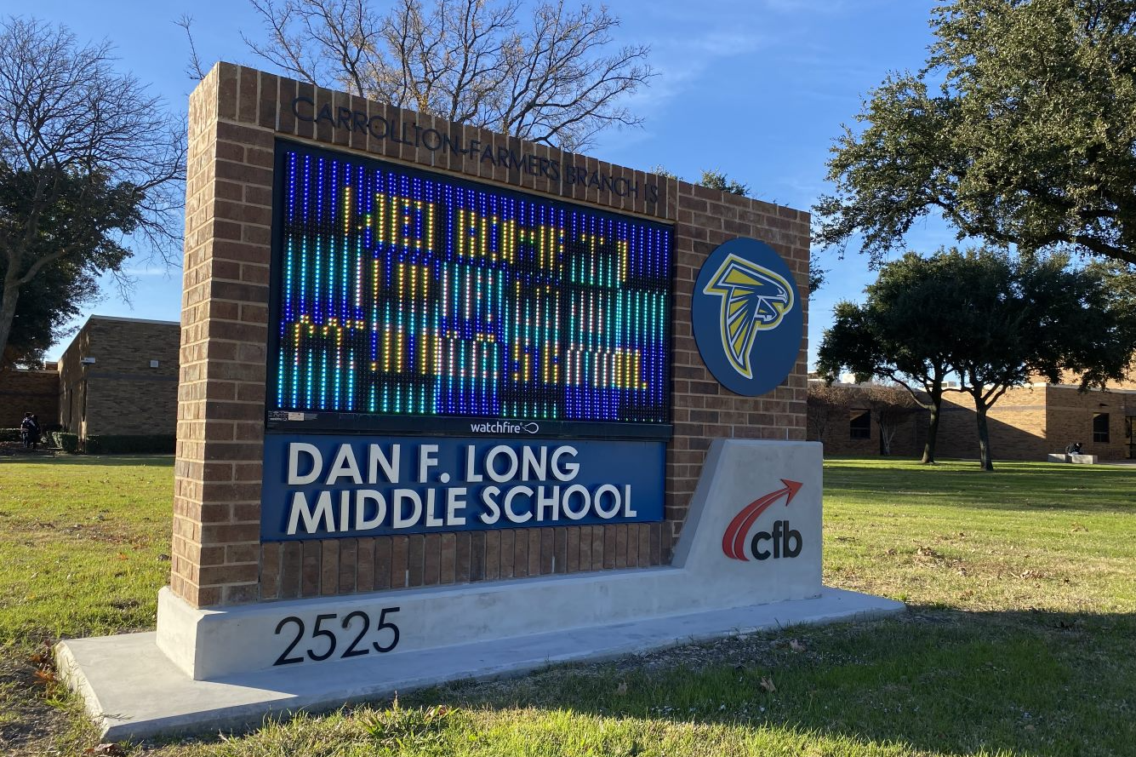
Improvements
Fine Arts Classroom and Performance Space Improvements
  Band, Orchestra, Choir, Theater, and Percussion Hall Renovations
Collaboration Rooms
  Practice Rooms in Fine Arts
Exterior Upgrades
  Exterior Concrete Replacement
  Courtyard Upgrades
Interior Upgrades
  Makerspace /Engineering Room Renovation
  Art Room Renovation
Mechanical, Electrical, and Plumbing Systems Upgrades
  New LED Site Lighting and Controls
  Water Bottle Fillers
Landscape Improvements
  Exterior Concrete Replacement
  Exterior Benches
New Marquee
Athletics Improvements
  Track Resurfacing
PROMISES MADE
PROMISES KEPT

Slide 9
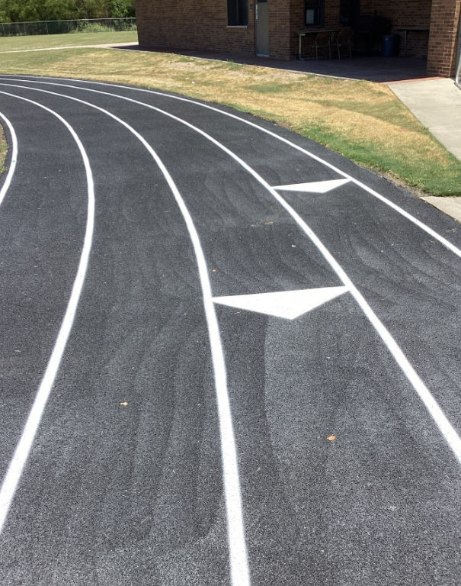
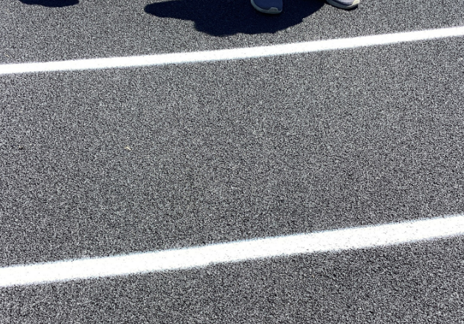
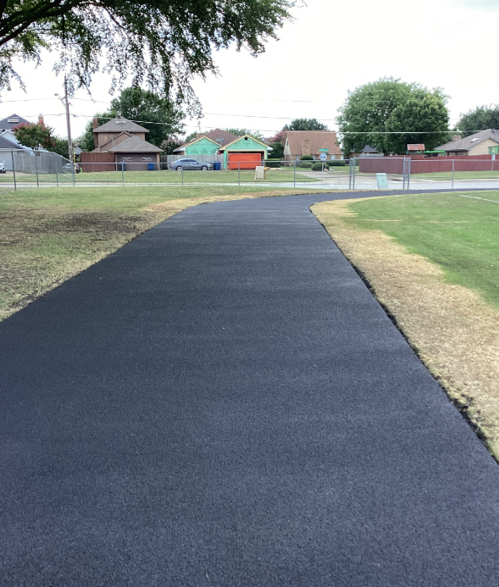
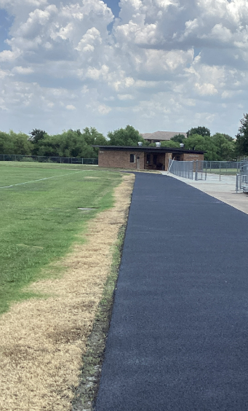
Improvements
Fine Arts Classroom and Performance Space Improvements
  Band, Orchestra, Choir, Theater, and Percussion Hall Renovations
Collaboration Rooms
  Practice Rooms in Fine Arts
Exterior Upgrades
  Exterior Concrete Replacement
  Courtyard Upgrades
Interior Upgrades
  Makerspace /Engineering Room Renovation
  Art Room Renovation
Mechanical, Electrical, and Plumbing Systems Upgrades
  New LED Site Lighting and Controls
  Water Bottle Fillers
Landscape Improvements
  Exterior Concrete Replacement
  Exterior Benches
New Marquee – Coming Soon
Athletics Improvements
  Track Resurfacing
Track Striping
Track Striping
PROMISES MADE
PROMISES KEPT
Track Resurfacing
Track Resurfacing

Slide 10
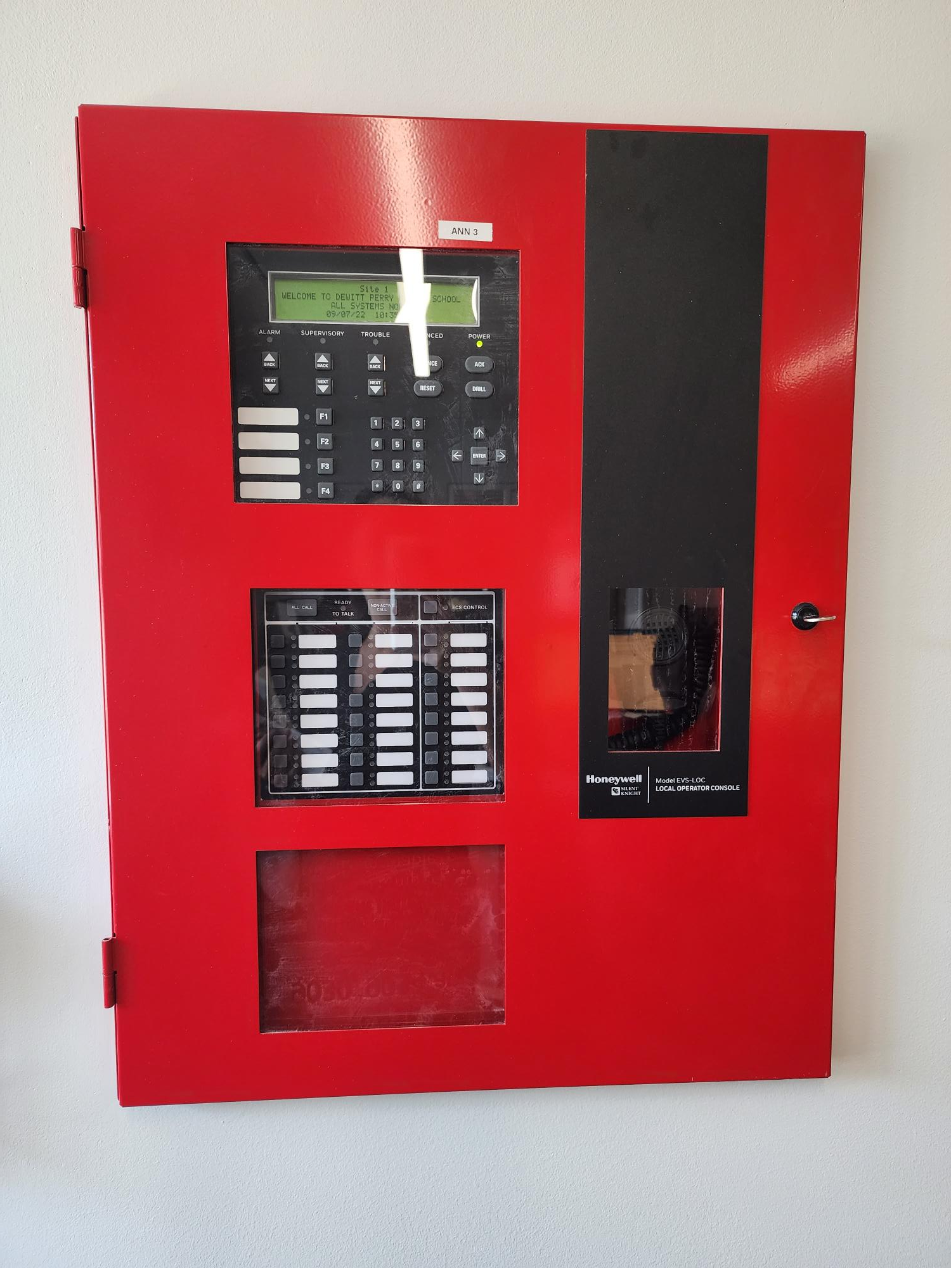

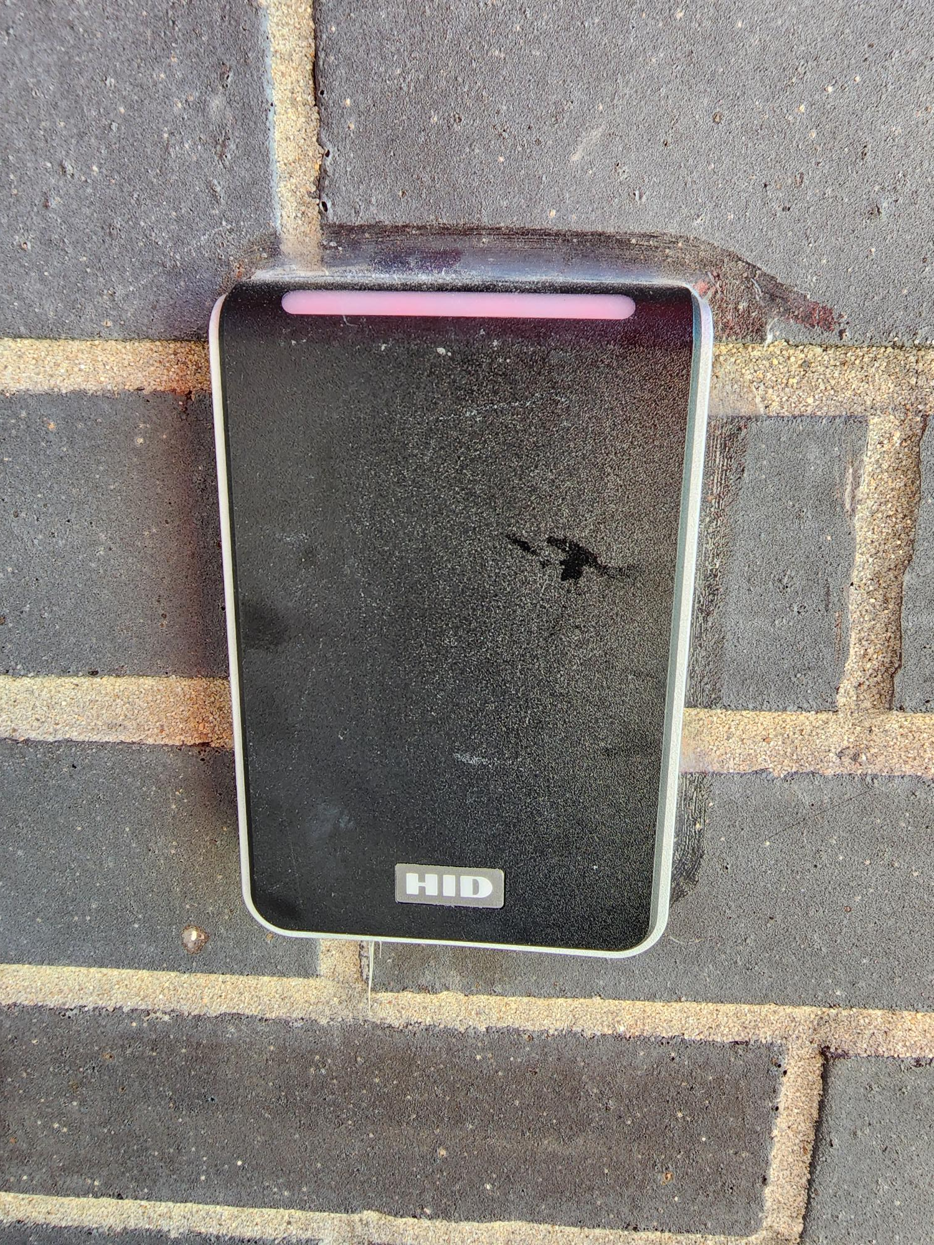
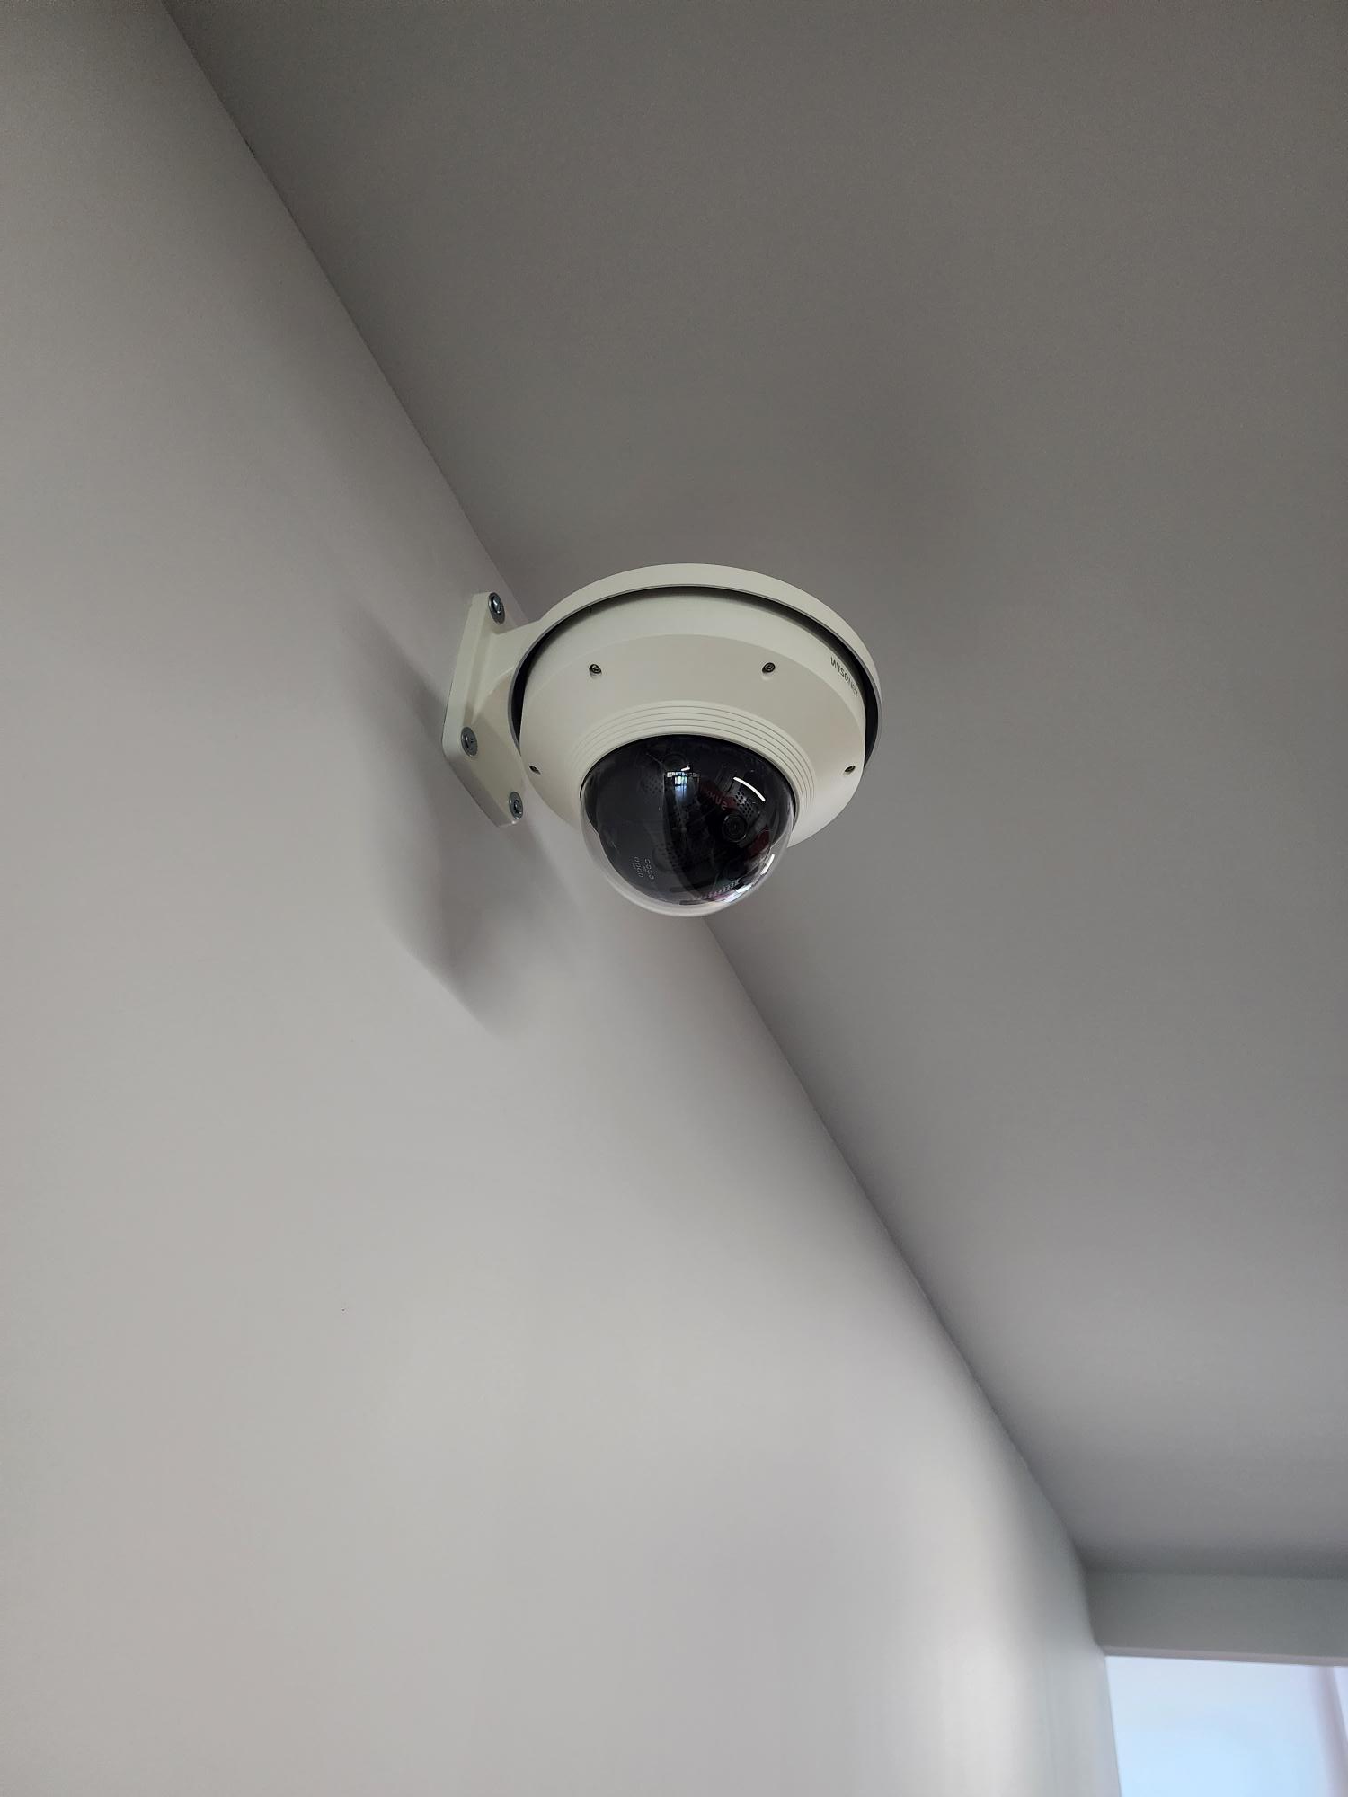
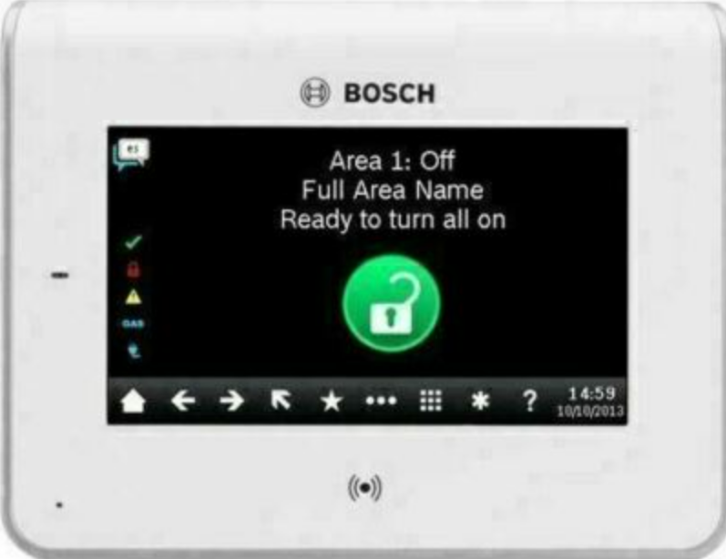
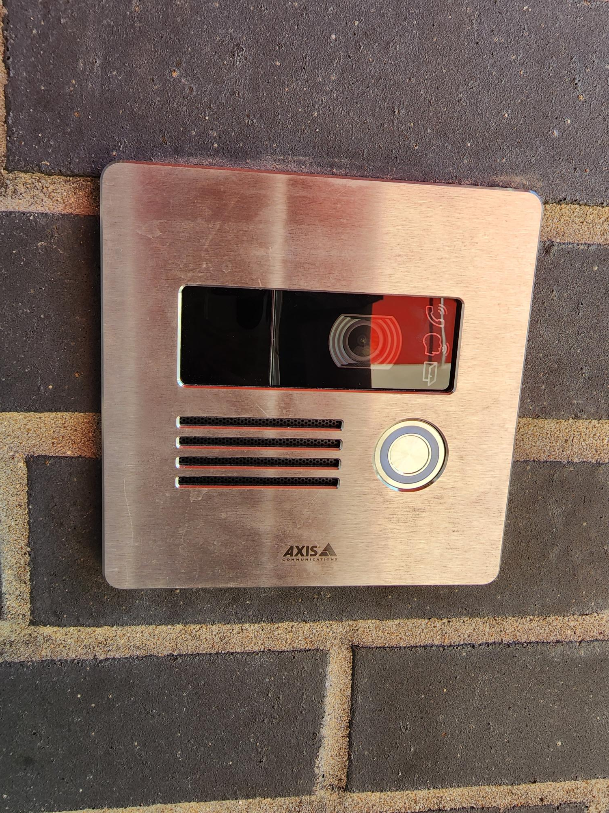
Safety and Security
Access Control
  Intercom - 2023
  Card Readers- 2023
  Security Alarm
Cameras
Bollards
Fire Sprinkler System Upgrades
Coming Soon
Card Readers
Cameras
Fire Alarm
Card Reader
Video Intercom
Exterior Camera
Fire Alarm Panel
Coming Soon
PROMISES MADE
PROMISES KEPT
Intercom
Bollards/Benches
Access Control

Slide 11
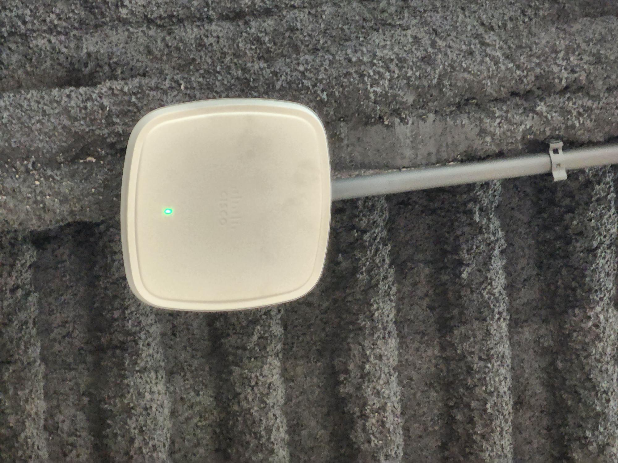

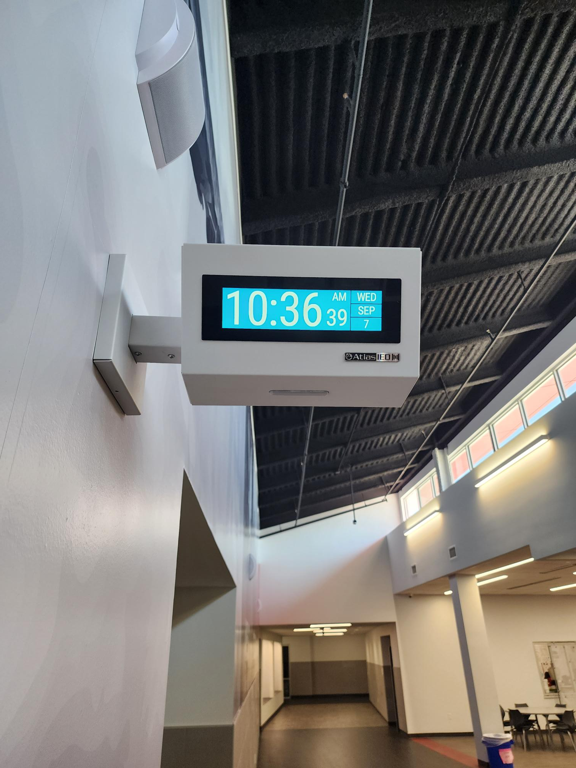
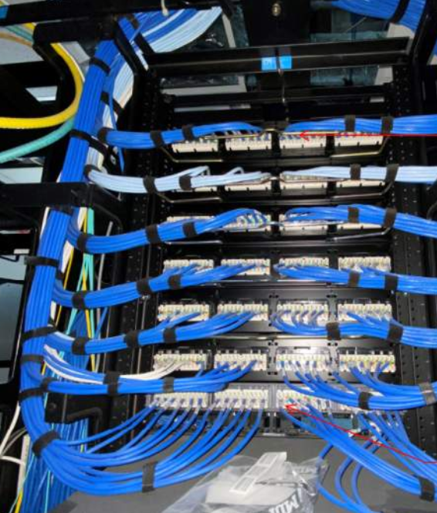
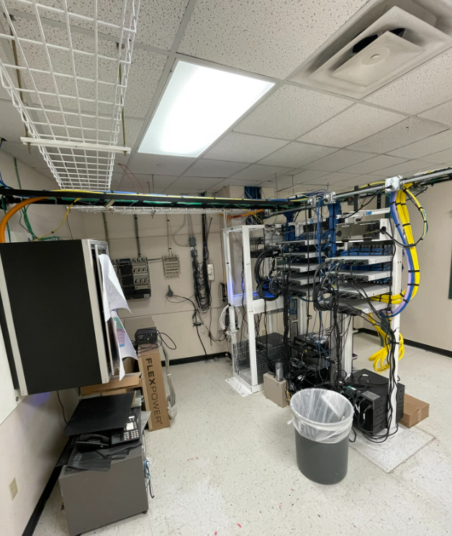
Technology
Secure Climate Controlled Server Space
Cabling
Wireless Upgrades
Phone System Upgrades
Wireless Upgrades
Clocks
PROMISES MADE
PROMISES KEPT
Cabling
Secure Climate Controlled Server Space

Slide 12
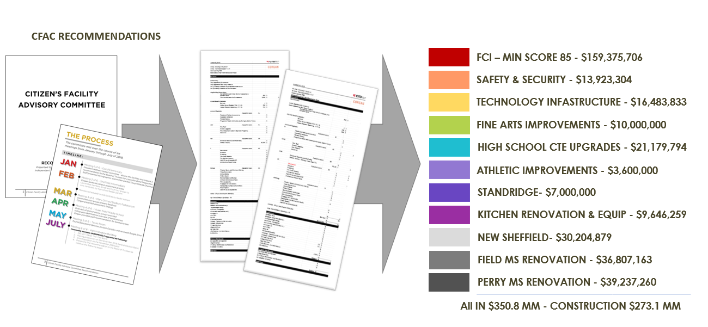
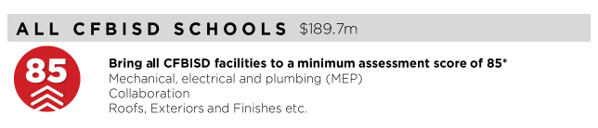
FCI Update
PROMISES MADE
PROMISES KEPT

Slide 13
FCI Update
 | Building Element |  |  |  |  | Type/Material | Prior Condition | Current | Prior Description | 2022 Reno Comments
 | On-Site Utilities & Drainage
 |  | Site Drainage / Erosion Control |  |  |  |  | Good | Good | Positive slope away from building, no visible signs of erosion or ponding water.
 |  | Site Lighting - Parking Lots |  |  |  |  | Fair | Good |  | Replaced Exterior Lighting with LED
 |  | Exterior Concrete Pads & Pavement-Around building, mechanical yards |  |  |  |  | Good | Good
 |  | Fire Hydrants / Utility Vaults / Misc. |  |  |  |  | Fair | Fair
 |  | Grease Trap |  |  |  |  | Fair | Fair
 | Site Parking & Drives
 |  | Pavement - Roads / Drives / Parking Areas |  |  |  |  | Fair | Good | Minor to Moderate cracking visible, joint sealer showing minor signs of wear. Little to no heaving. | Replaced Exterior Concrete
 |  | Fire Lanes |  |  |  |  | Good | Good | Fire lane paint striping in good condition.Clean and clear of cracks, heaving, potholes. Joint Sealer is properly in place.
 |  | Striping - Parking lot and fire lane |  |  |  |  | Fair | Fair | Minor to moderate signs of age and deterioration but still visible. Handicapped spaces incorrectly marked or striped.
 |  | Curbs |  |  |  |  | Fair | Fair | Minor to moderate signs of age and deterioration, no major damage.
 | Site Lighting
 |  | Site Lighting |  |  |  |  | Fair | Good | Very few fixtures have minor damage or are not working. Lighting is adequate for security. | Replaced Exterior Lighting
 | Site Security
 |  | Security Cameras |  |  |  | Megapixels of Resolution | 14 | 503 |  | Doubled coverage and resolution of cameras
 |  | Chain Link Fencing / Gates |  |  |  |  | Fair | Fair | Little to no damage to material, poles & gates. Some signs of age.
 | Misc. Stuctures
 |  | Site Walls - Retaining / Screen |  |  | Material: | Stone | Good | Good | No signs of damage, settling or rotation.
 |  | Dumpster Service Area |  |  |  |  | Fair | Fair | Moderate to Minor signs of damage to dumpster walls, may need a refresh of finish paint if applicable and additional bollards. Gates function as required.
 |  | Bollards |  |  | Material: | Steel | Fair | Good | Minor to moderate signs of age and deterioration but still visible. | New bollards added
 |  | Site Signage - Directional / Handicapped |  |  |  |  | Good | Good
 |  | Misc. Site work / Site Structures |  |  |  |  | Good | Good
 | Circulation
 |  | Sidewalks |  |  |  |  | Fair | Fair | Minor to Moderate cracking visable, joint sealer showing minor signs of wear. Little to no heaving.
 |  | Stairs |  |  |  |  | Good | Good | Clean and clear of cracks or heaving. Joint Sealer is properly in place. Rise and Run is compliant. Handrails (if present) are compliant & finish is in good standing.
 |  | Ramps |  |  |  |  | Good | Good | Clean and clear of cracks or heaving. Joint Sealer is properly in place. Slope is compliant. Handrails (if present) are compliant & finish is in good condition.
 | ADA Compliance / Accessiblity
 |  | Compliant Sidewalks/Curbs |  |  |  |  | Fair | Fair
 |  | Compliant Ramps & Handrails |  |  |  |  | Fair | Fair
 |  |  |  |  |  | Scored Categories | 21 | 21
 |  |  |  |  |  | Good | 8 | 12
 |  |  |  |  |  | Fair | 13 | 9 | Prior Aggregate Score: | 80
 |  |  |  |  |  | Poor | 0 | 0 | Reno Aggregate Score: | 86
 |  |  |  |  |  | N/A | 0 | 0
Site

Slide 14
FCI Update
Building Element |  |  |  |  |  |  |  | Type/Material | Prior Condition | Current | Prior Description | 2022 Reno Comments
Building Structure/Foundation
 | Foundation |  |  |  |  |  | Type: |  | Good | Good | No signs of cracking or heaving.
 | Substructure - Slab - on - Grade
 |  | Basement / Below Grade Exterior Walls |  |  |  |  |  |  | N/A | N/A
 |  | Miscellanous |  |  |  |  |  |  | N/A | N/A
 | Superstructure
 |  | Fireproofing |  |  |  |  |  |  | N/A | N/A
 |  | Pre-Engineered Metal building |  |  |  |  |  |  | N/A | N/A
Building Exterior Shell
 | Roofing |  |  |  |  |  |  | built up roof
 |  | General Roof Condition (Visual Inspection) | General Roof Condition (Visual Inspection) |  |  |  |  |  | Fair | Fair | Roof is nearing the end of it's expected useful life. Some leaks are reported with areas of ponding. Some sealants and flashings are in need of repair or replacement. | Not in Scope
 |  | Roof Warranty Status | Roof Warranty Status |  |  |  |  |  |  |  | N/A
 |  |  |  | Roofing Manufacturer / Warranty Issuer |  | Roofing Manufacturer / Warranty Issuer |  |  |  |  | Johns Manville
 |  |  |  | Years Remaining in Warranty Period |  | Years Remaining in Warranty Period |  |  |  |  | 5 and 13 years out of warranty
 |  | Skylights | Skylights |  |  |  |  |  | N/A | N/A
 |  | Roof Curbs / Openings / Misc. | Roof Curbs / Openings / Misc. |  |  |  |  |  | Fair | Fair |  | Not in Scope
 | Exterior Walls
 |  | Exterior Wall Material |  |  |  |  | Material: | Brick | Good | Good | Veneer is free of cracks, signs of settling, rotation or damage.
 |  | Building Caulking/Sealant |  |  |  |  |  |  | Poor | Poor | Major signs of wear or are missing. | Not in Scope
 |  | Exterior Painting |  |  |  |  |  |  | Fair | Fair | Minor wear or fading, minimal stains apparent. | Not in Scope
 | Windows/Glazed Walls
 |  | Windows
 |  |  |  |  |  |  | Glazing Type: | Single Pane | Fair | Fair | Minor scratches or signs of wear. | New aluminum windows in good condition
 |  |  |  |  |  |  | Frame Type: | Painted Hollow Metal |  |  |  | Not in Scope
 |  |  |  |  |  |  | Frame Type: | Painted Hollow Metal
 | Exterior Doors Systems
 |  | Exterior Doors
 |  |  |  |  |  |  | Frame Type: | Hollow Metal | Fair | Fair | Minor scratches or signs of wear, may need a refresh of finish, door hardware is compliant and functioning properly. | Not in Scope
 |  |  |  |  |  |  | Panel Type: | Hollow Metal
 |  | Exterior Overhead Doors |  |  |  |  | Type: |  | Good | Good | No visible damage, proper weatherproofing/threshold installed, door hardware compliant and functioning properly, motor works as required (if applicable).
 |  | Card Access Reader |  |  |  |  |  |  | Fair | Good |  | New Card Readers Added
 |  | Door Bell
 |  | Peep Hole
 | Canopies
 |  | Canopy |  |  |  |  | Type: |  | N/A | Good |  | New Exterior Canopy in Courtyard
 | Loading Area
 |  | Raised Loading Dock |  |  |  |  |  |  | N/A | N/A
 |  | Independent Loading Area |  |  |  |  |  |  | Good | Good | No visible damage, no signs of settling or movement.
 | Misc. Exterior
 |  | Exterior Soffit - Material |  |  |  |  | Material: | Plaster | Good | Good | Almost new in appearance, no visible fading or stains.
 |  | Exterior Louvers / Sunscreens |  |  |  |  |  |  | N/A | N/A
 |  |  |  |  |  |  |  | Scored Categories | 12 | 13
 |  |  |  |  |  |  |  | Good | 5 | 7
 |  |  |  |  |  |  |  | Fair | 6 | 5 | Prior Aggregate Score: | 78
 |  |  |  |  |  |  |  | Poor | 1 | 1 | Reno Aggregate Score: | 82
 |  |  |  |  |  |  |  | N/A | 8 | 7
Exterior

Slide 15
FCI Update
 | Building Element |  |  |  |  |  | Type/Material | Prior Condition | Current | Description | Additional Comments
 | Interior Finishes
 |  | Interior Ceiling Finishes
 |  |  | Acoustical Ceilings - 2x2 Tiles |  |  | Scrubbable Finish | Yes | Good | Good | Almost new in appearance, no signs of sagging, damage, leaks, or stains.
 |  |  | Acoustical Ceilings - 2x4 Tiles |  |  | Scrubbable Finish |  | Poor | Good | Major stains, leaks, sagging or damage, missing portions of ceiling. | Replaced during construction
 |  |  | Plaster Ceilings |  |  |  |  | N/A | N/A
 |  |  | Painted Gypsum Ceiling |  |  |  |  | Good | Good | Almost new in appearance, no signs of sagging, damage, leaks, or stains.
 |  |  | Metal Ceilings |  |  |  |  | N/A | N/A
 |  |  | Exposed / Painted Ceilings |  |  |  |  | N/A | N/A
 |  |  | Soffit / Bulkhead Walls |  |  |  |  | N/A | N/A
 |  |  | Special/Misc. |  |  |  |  | N/A | N/A
 |  | Interior Floor Finishes
 |  |  | Resilient Flooring - VCT |  |  |  |  | Good | Good | Almost new in appearance, no signs of damage or stains, properly sealed and finished.
 |  |  | Quarry Tile |  |  |  |  | Good | Good | Almost new in appearance, no signs of damage or stains, properly sealed and finished.
 |  |  | Ceramic Tile |  |  |  |  | Good | Good | Almost new in appearance, no signs of damage or stains, properly sealed and finished.
 |  |  | Terrazzo |  |  |  |  | Fair | Fair | Minor signs of aging with minimal apparent stains or damage, may need to be resealed.
 |  |  | Poured Resinous Epoxy |  |  |  |  | N/A | N/A
 |  |  | Finish Concrete - (sealed) |  |  |  |  | N/A | N/A
 |  |  | Carpet (Classrooms, Library, Admninistration) |  |  |  |  | Good | Good | Almost new in appearance, no signs of damage or stains, properly sealed and finished.
 |  |  | Carpet (Fine Arts Wing) |  |  |  |  | Fair | Good |  | Replaced as Part of Renovation
 |  |  | Natural Stone |  |  |  |  | N/A | N/A
 |  |  | Wood |  |  |  |  | Good | Good | Almost new in appearance, no signs of damage or stains, properly sealed and finished.
 |  |  | Special/Misc. |  |  |  |  | N/A | N/A
 |  | Interior Wall Finishes
 |  |  | Painted Gypsum Board - Full Height |  |  |  |  | Good | Good | Almost new in appearance, no signs of damage, stains or cracking.
 |  |  | Painted CMU - Full Height |  |  |  |  | Good | Good | Almost new in appearance, no signs of damage, stains or cracking.
 |  |  | Painted Gypsum Board + Tile Wainscot |  |  |  |  | Good | Good | Almost new in appearance, no signs of damage, stains or cracking.
 |  |  | Full Height Tile |  |  |  |  | Good | Good | Almost new in appearance, no signs of damage, stains or cracking.
 |  |  | PLAM |  |  |  |  | N/A | N/A
 |  |  | FRP |  |  |  |  | N/A | N/A
 |  |  | Wood Panels |  |  |  |  | N/A | N/A
 |  | Interior Wall Base & Trim
 |  |  | Rubber Base (Classrooms, Library, and Administration) |  |  |  |  | Good | Good | Almost new in appearance, no signs of damage and properly installed.
 |  |  | Rubber Base (Fine Arts Wing) |  |  |  |  | Fair | Good |  | Renovated Areas Received New Carpet
 |  |  | Quarry Tile |  |  |  |  | Good | Good | Almost new in appearance, no signs of damage and properly installed.
 |  |  | Ceramic Tile |  |  |  |  | Good | Good | Almost new in appearance, no signs of damage and properly installed.
 |  |  | Terrazzo |  |  |  |  | Fair | Fair | Minor signs of aging with minimal damage and properly installed.
 |  |  | Poured Resinous Epoxy |  |  |  |  | N/A | N/A
 |  |  | Wood Base |  |  |  |  | N/A | N/A
Interior

Slide 16
FCI Update
 | Misc. Interior
 |  | Interior Door Systems
 |  |  | Frame Type: |  |  |  | Hollow Metal | Good | Good | No visible damage, proper weatherproofing/threshold apparent, door hardware compliant and functioning properly.
 |  |  | Panel Type:
 |  | Interior Overhead Door/Grille |  |  |  | Type: |  | N/A | N/A
 |  | Specialty Doors |  |  |  | Type: |  | N/A | N/A
 |  | Millwork Cabinets |  |  |  |  |  | Fair | Fair
 |  | Corner Guards |  |  |  | Type: |  | N/A | N/A
 |  | Interior Signage |  |  |  |  |  | Good | Good
 |  | Digital Clocks |  |  |  |  |  | Fair | Good |  | Replaced in Renovation
 |  | Operable Partitions |  |  |  |  |  | Fair | Fair
 |  | Marker & Tack Boards |  |  |  |  |  | Good | Good | No cracking or warping of the board surface. | Replacecd in Areas of Renovation
 |  | Projection Screens |  |  |  |  |  | Fair | Fair
 |  | A/V Equipment |  |  |  |  |  | Good | Good |  | Upgraded in Areas of Renovation
 |  | Lockers |  |  |  | Required Number of Lockers: |  | Fair | Fair
 |  |  |  |  |  | Provided Number of Lockers:
 |  | Railings |  |  |  |  |  | N/A | N/A
 |  | Elevator Cab Finishes |  |  |  |  |  | N/A | N/A
 |  | Wireless Access |  |  |  |  |  | Good | Good |  | Wiring completed as part of renovation
 |  | Toilet Partitions |  |  |  | Material Type: | Plastic | Poor | Poor
 |  | Toilet Accessories |  |  |  |  |  | Poor | Poor | Visibly damaged or missing.
 |  | Interior Window Blinds/Shades |  |  |  | Type of Blinds: | Metal | Good | Good | No visible damage, motor properly functions (if applicable).
 |  |  |  |  |  | Type of Shades:
 |  |  |  |  |  | Operation: | Manual
 | Food Service Area
 |  | Equipment Condition |  |  |  |  |  | Good | Good
 |  | Digital Menu Boards |  |  |  |  |  | N/A | N/A
 |  | Restrooms open to Kitchen? |  |  |  |  |  | Yes | Yes
 |  | Drinking Fountains in Cafeteria? |  |  |  |  |  | No | No
 | Accessibility
 |  | Restrooms |  |  |  |  |  | Poor | Poor | Many compliance items
 |  | Drinking Fountains |  |  |  |  |  | Poor | Poor | Many compliance items
 |  | Ramps |  |  |  |  |  | Good | Good | Compliant
 |  | Signage |  |  |  |  |  | Good | Good | Compliant
 |  | Doors |  |  |  |  |  | Poor | Poor | Many compliance items
 |  | Millwork |  |  |  |  |  | Poor | Poor | Many compliance items
 |  |  |  |  |  |  | Scored Categories | 41 | 41
 |  |  |  |  |  |  | Good | 23 | 27
 |  |  |  |  |  |  | Fair | 9 | 6 | Prior Aggregate Score: | 76
 |  |  |  |  |  |  | Poor | 7 | 6 | Reno Aggregate Score: | 80
 |  |  |  |  |  |  | N/A | 20 | 20
Interior

Slide 17
FCI Update
DAN LONG MIDDLE SCHOOL |  | AGE: 36 YEARS |  | 164,500 SF
ITEM | DESCRIPTION | DESCRIPTION |  |  |  |  | Prior Grade | Current
OPERATIONAL, SYSTEMS & CODE DEFICIENCIES | Assessed Scope | Performed Scope
HVAC |  |  |  |  |  |  | 99 | 99
EMCS | Task:
PLUMBING | Task: Replace Oasis electric water coolers in poor condition. Add bottle fillers at unit. | Not in Scope |  |  |  |  | 85 | 85
 | Task: Provide new EWCs With bottle fillers in select locations. | Not in Scope
 | Task: Replace Lochinvar domestic boiler and 200 gallon tank installed in 2002. | Not in Scope
ELECTRICAL SYSTEM | Task: Replace Gould ITE electrical distribution equipment installed in 1980. | Replaced as Part of Renovation |  |  |  |  | 78 | 95
INTERIOR LIGHTING | Task: Provide tunable lighting for special education classrooms. | Not in Scope |  |  |  |  | 75 | 92
 | Task: Replace T12 magnetic ballast fluorescent fixtures. | Replaced in Areas of Renovation
EXTERIOR LIGHTING | Task: Replace all existing exterior wall packs with LED fixtures. | Replaced as Part of Renovation |  |  |  |  | 80 | 95
 | Task: Renovate all exterior parking lot lighting to LED. | Replaced as Part of Renovation
FIRE ALARM SYSTEMS | Task: |  |  |  |  |  | 99 | 99
FIRE PROTECTION SYSTEM | Task: |  |  |  |  |  | 99 | 99
OTHER | Task: Provide digital marque. Provide power and connectivity. | Will be Replaced as Part of Renovation |  |  |  |  | NA | NA
 | Task:
TOTALS |  |  |  |  |  |  | 90 | 95
MEP

Slide 18
FCI Update
Long MS Technology and Security Status
System | Possible Score | Corgan Score (2018) | TNCG Score (2022) | Notes
Cabling Infrastructure | 10 | 8 | 9 | Small improvements to renovation areas and all new wireless access point cabling
Local Area Network | 15 | 13 | 13 | No upgrade (that True North is aware of)
Wireless LAN | 15 | 13 | 13 | Wireless could use a refresh in the next few years but in good condition right now. New cabling in place to support refresh.
Unified Comm (Phone) System | 10 | 10 | 10 | Upgraded prior to renovation project
Video Management System | 10 | 5 | 10 | Complete upgrade to Genetec
Public Address | 10 | 5 | 10 | Complete upgrade to Informacast
Premise Access Control (and Intrusion) | 10 | 6 | 10 | Complete upgrade to Genetec
Intercom System | 5 | 3 | 5 | Added new intercom stations with renovation
Special Space AV | 5 | 4 | 4 | District item. AV upgrade as part of technology package
Instruction Space Presentation | 10 | 8 | 9 | New Interactive Displays in renovation areas matching distirct standard
Total Score | 100 | 75 | 93
Technology

Slide 19
FCI Update
Dan F. Long MS
Assessment
Site : 80
Exterior: 78
Interior: 76
MEP: 90
Technology: 75
Score: 80
After Bond
Improvements
Site : 86
Exterior: 82
Interior: 80
MEP: 95
Technology: 93
Score: 87
PROMISES MADE
PROMISES KEPT

Slide 20


