Slide 1

NEW LABELLE
HIGH SCHOOL

Slide 2
EXISTING SITE

Slide 3
SERVICE
DRIVE
PARENT DROP
±450 PARKING SPACES
BUS
PARKING
PROPOSED SITE

Slide 4
CTE
SERVICE
DRIVE
FUTURE
CLASSROOMS
CAFETERIA
ESE
GYM
CLASSROOMS
CLASSROOMS
ADMIN
AUDITORIUM
PARENT DROP
BUS
PARKING
±450 PARKING SPACES
1st FLOOR PLAN

Slide 5
CLASSROOMS
CAFETERIA
CTE
TECH
GYM
CLASSROOMS
CLASSROOMS
ADMIN
AUDITORIUM
2ND FLOOR PLAN

Slide 6
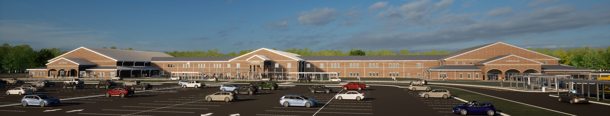
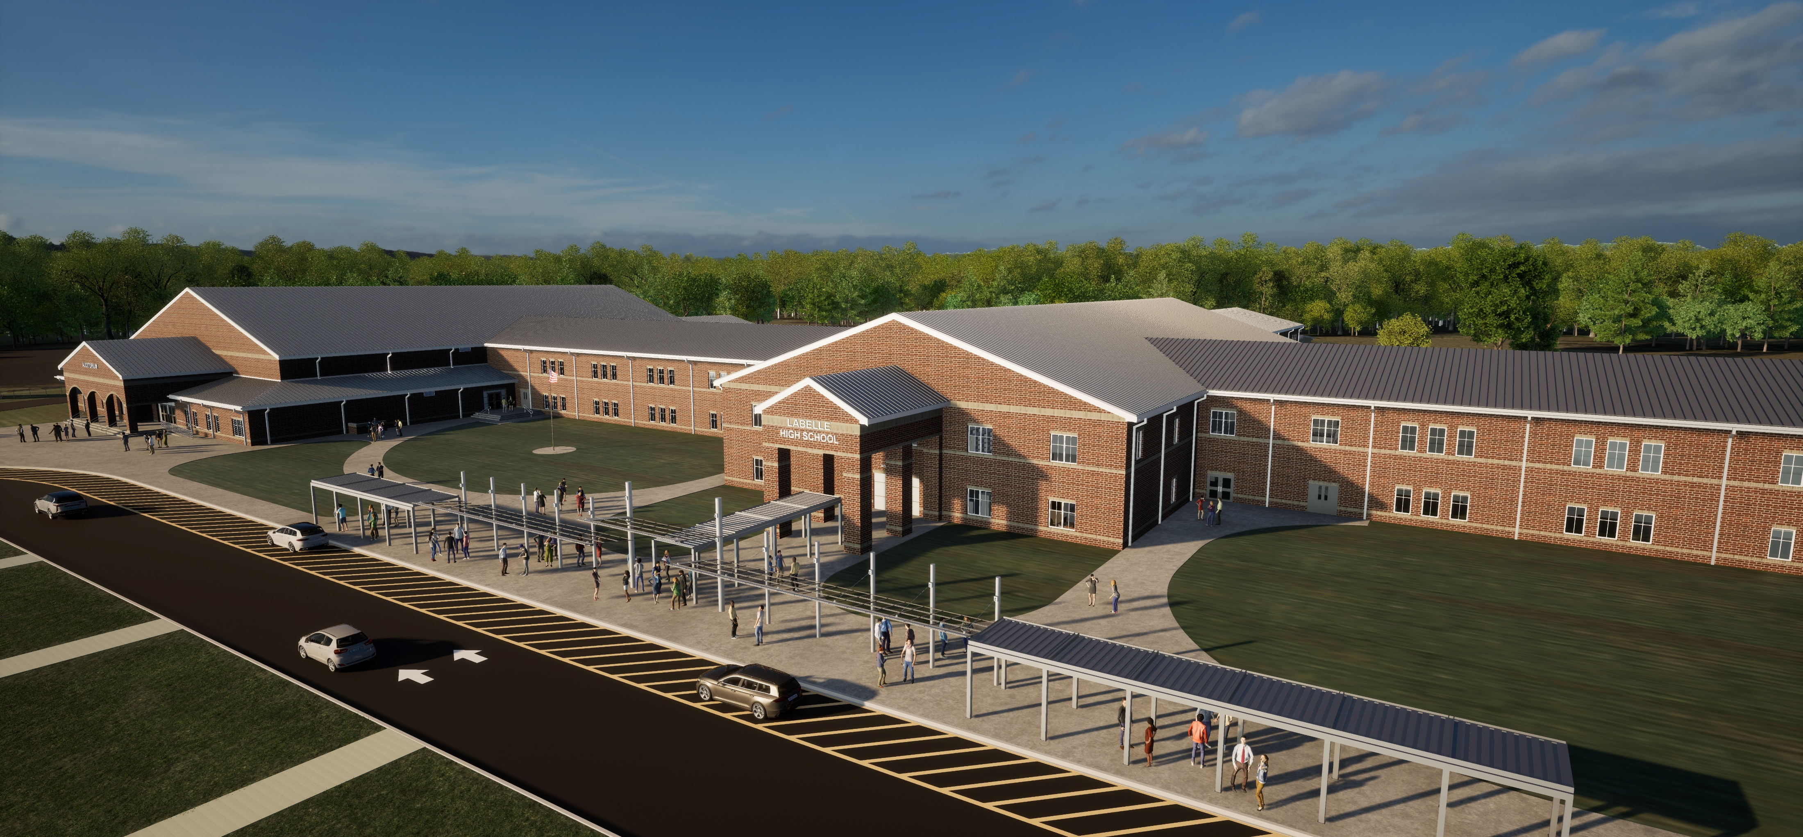
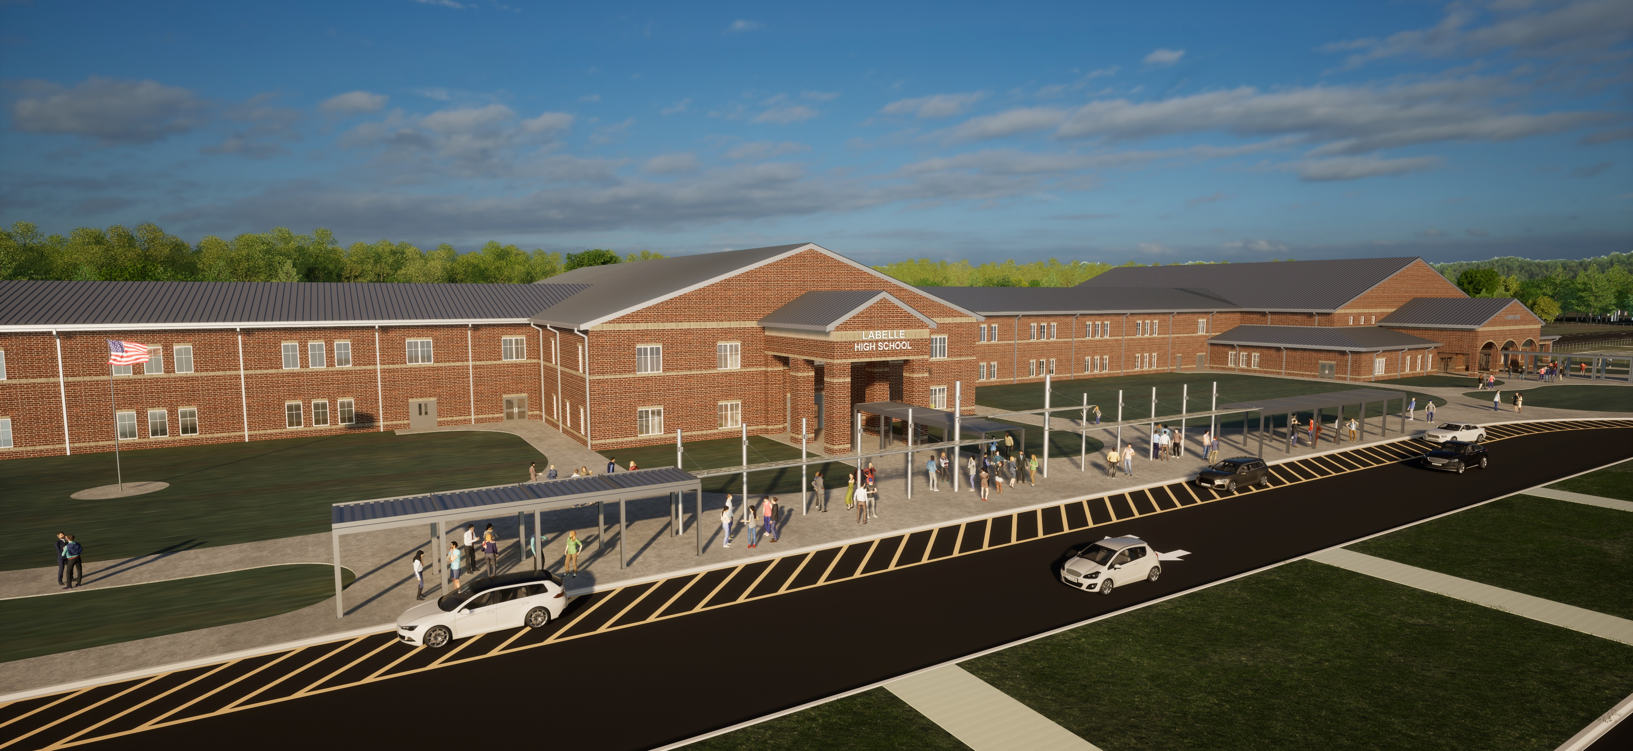

Slide 7



Slide 8
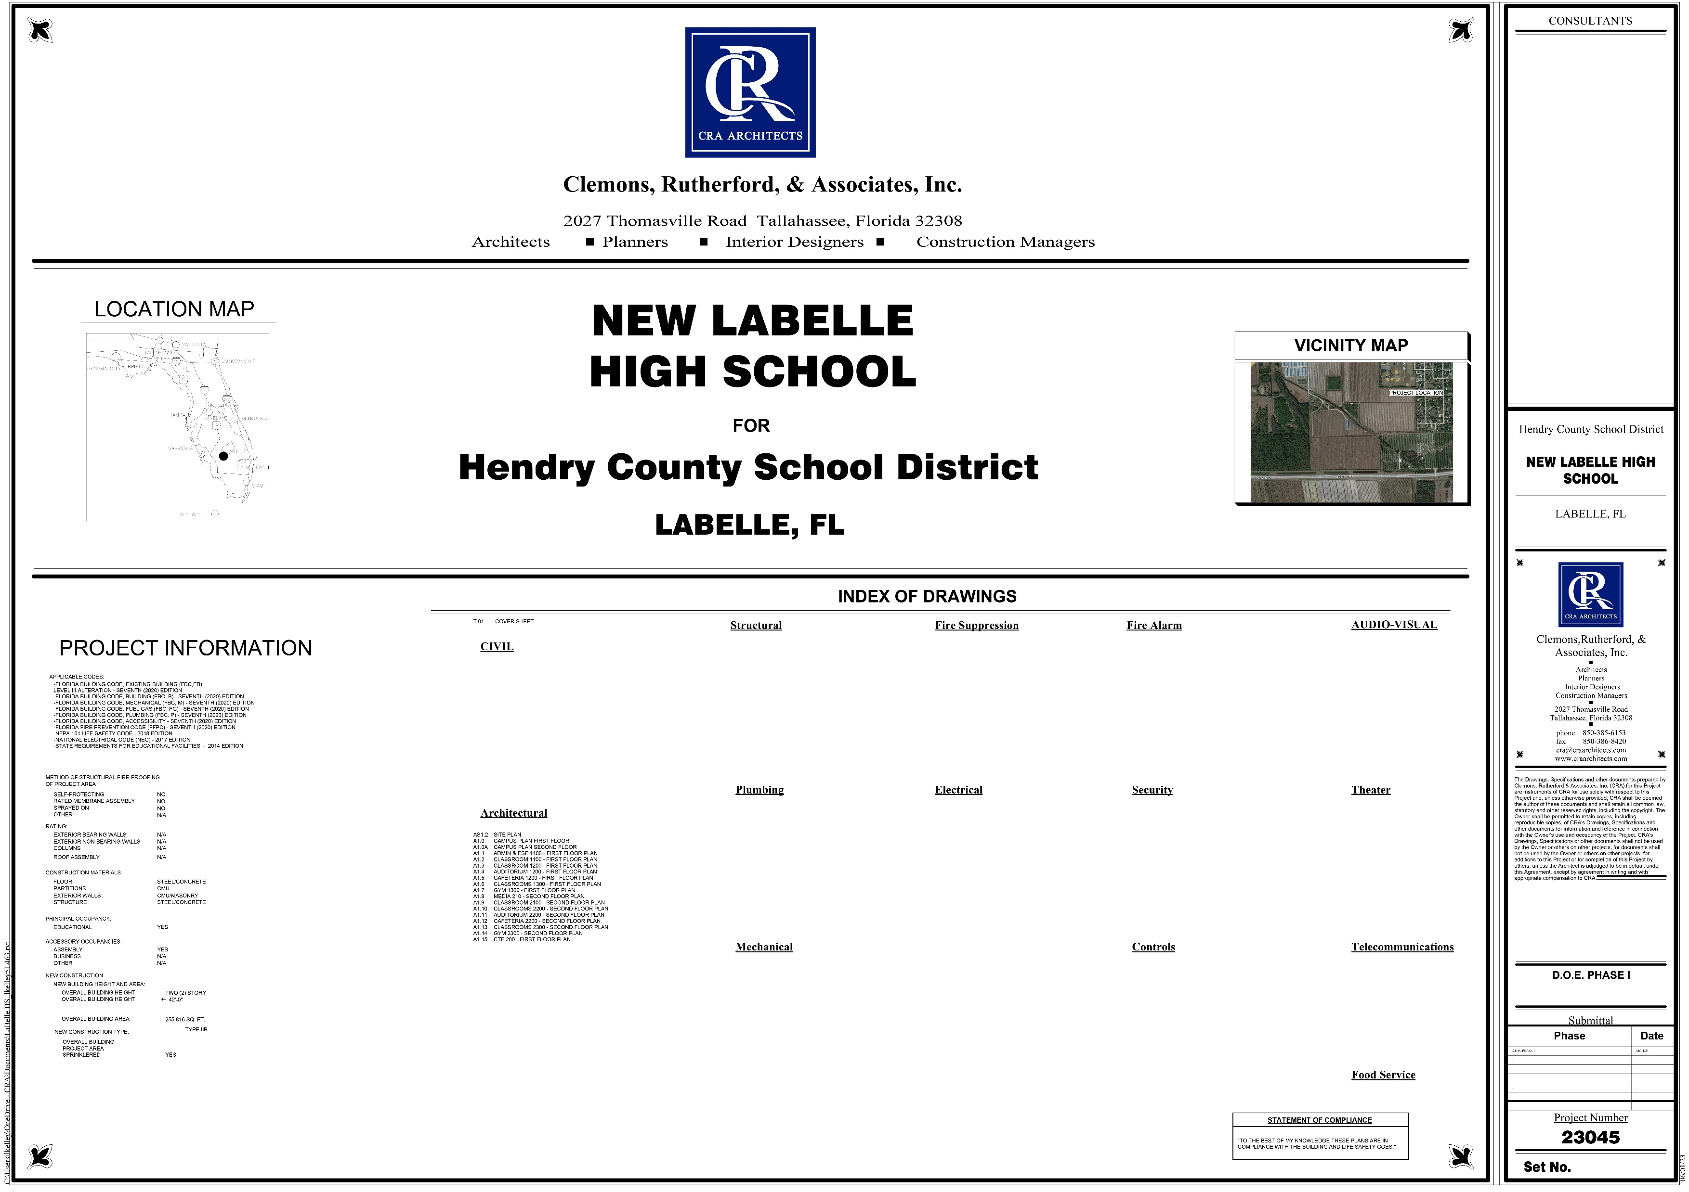

Slide 9
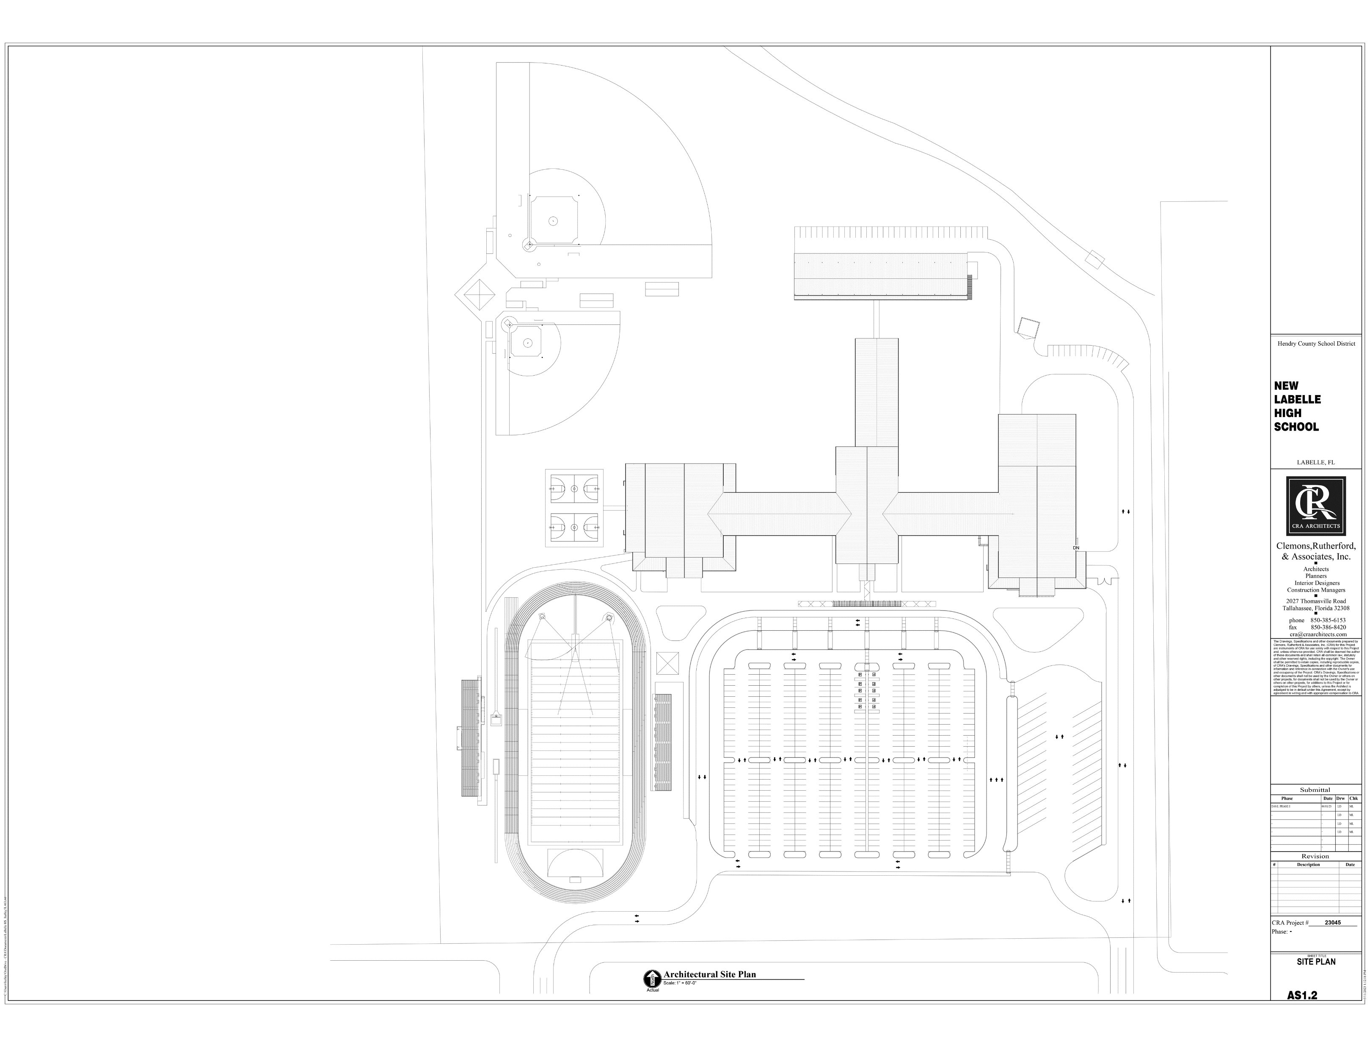

Slide 10
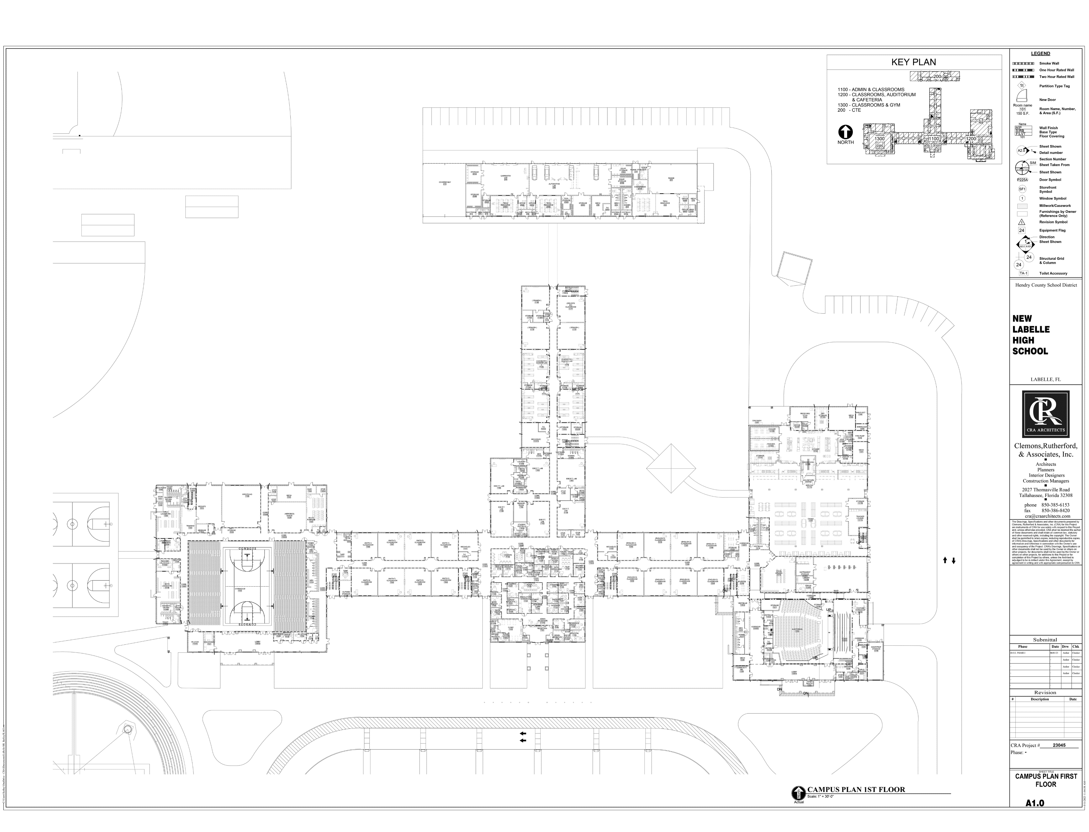

Slide 11
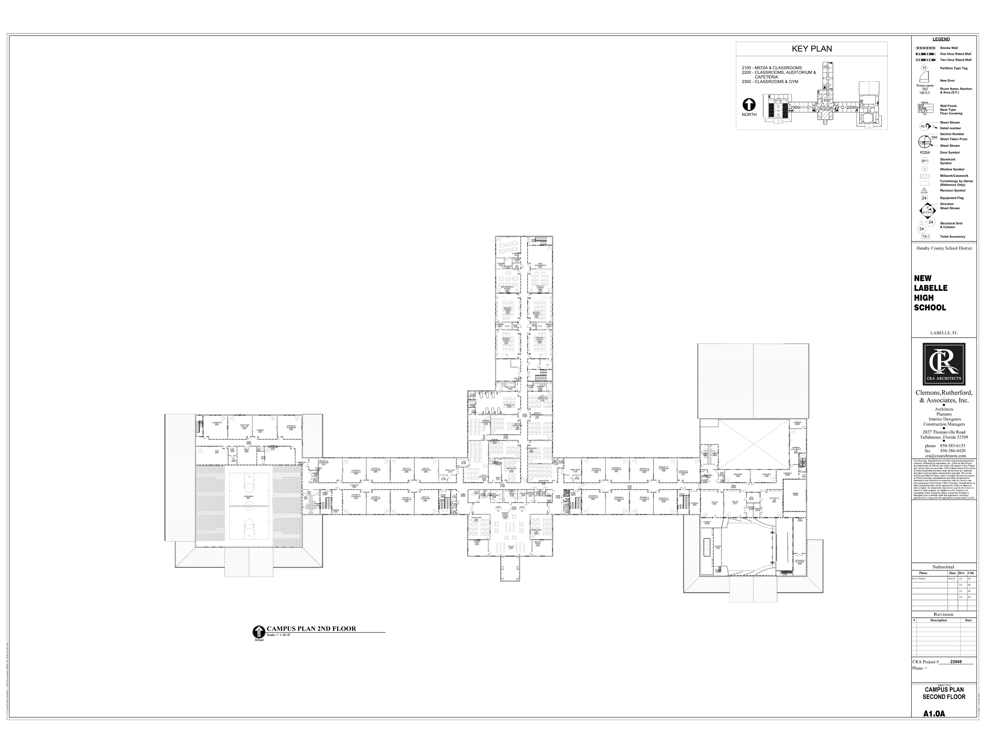

Slide 12
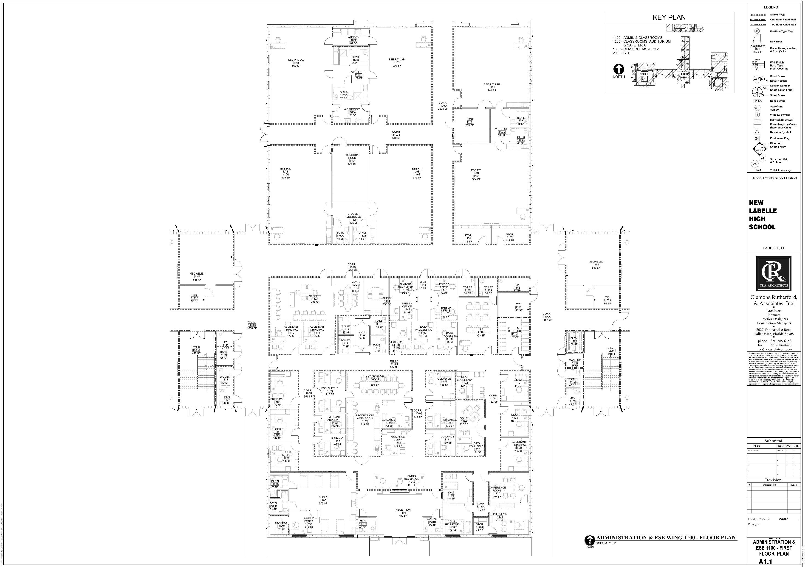

Slide 13
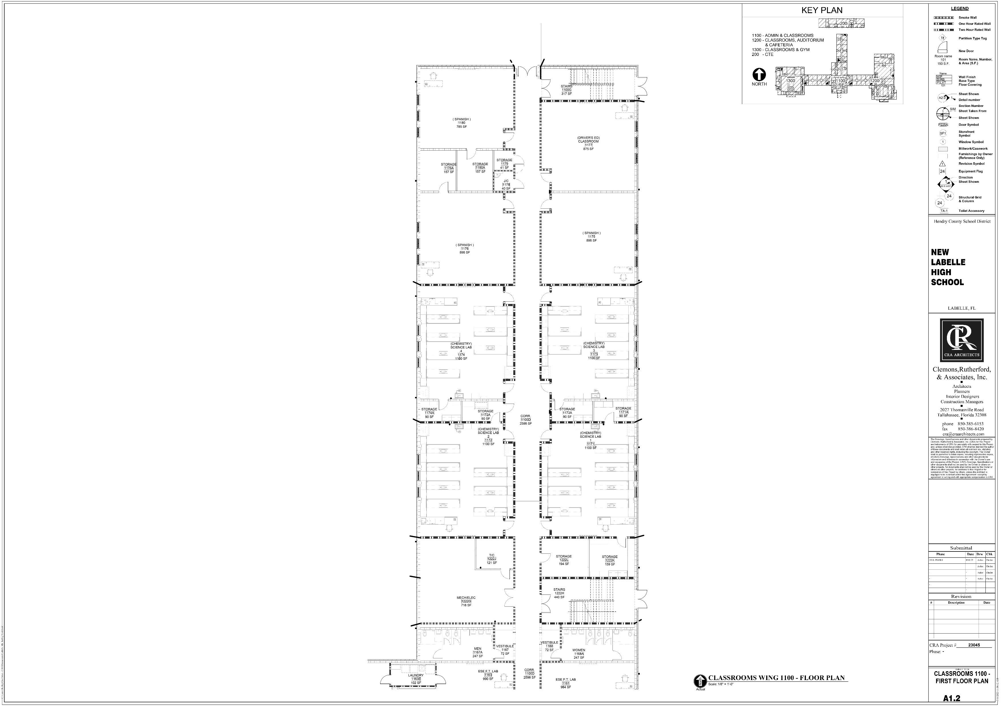

Slide 14
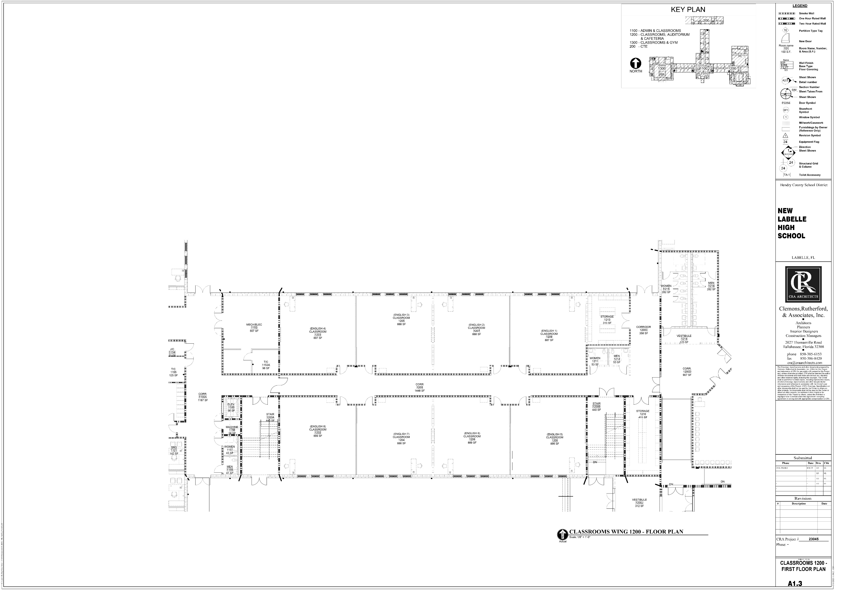

Slide 15
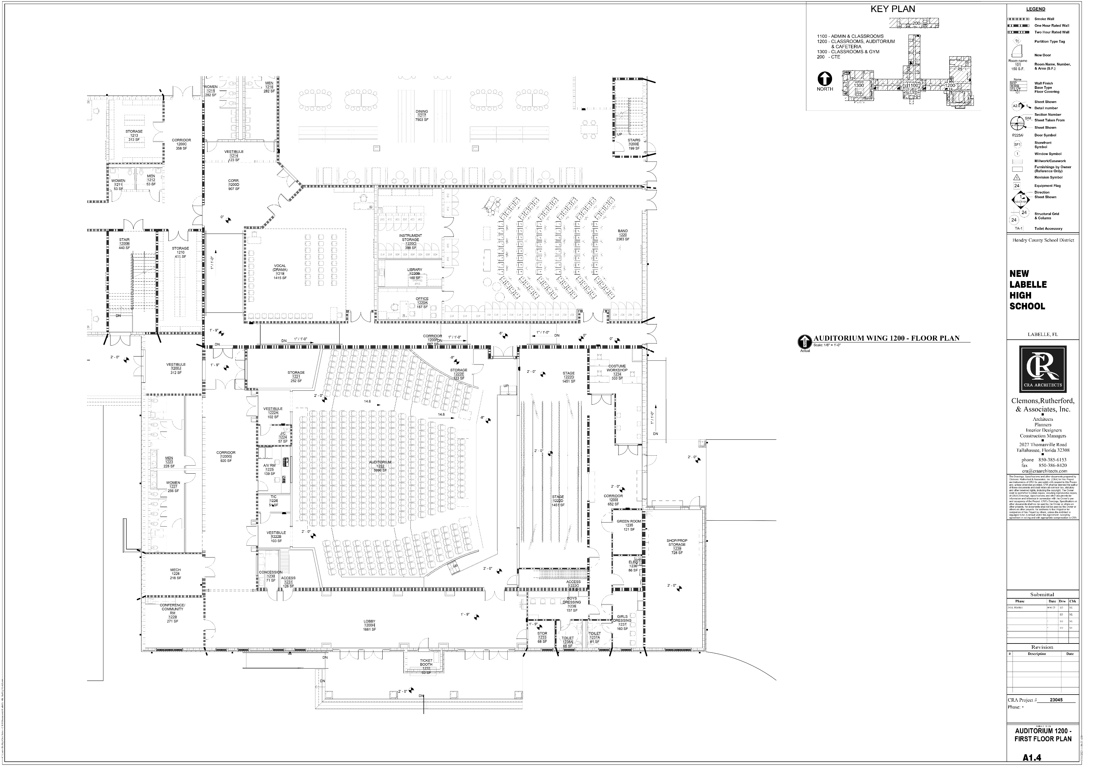

Slide 16
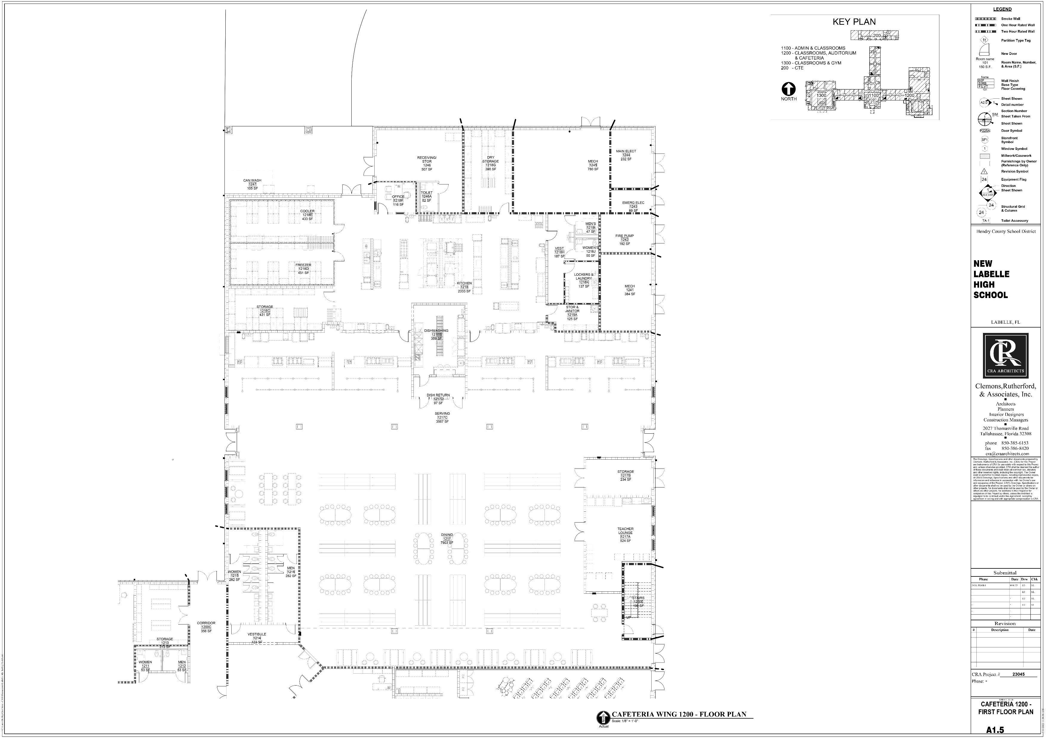

Slide 17
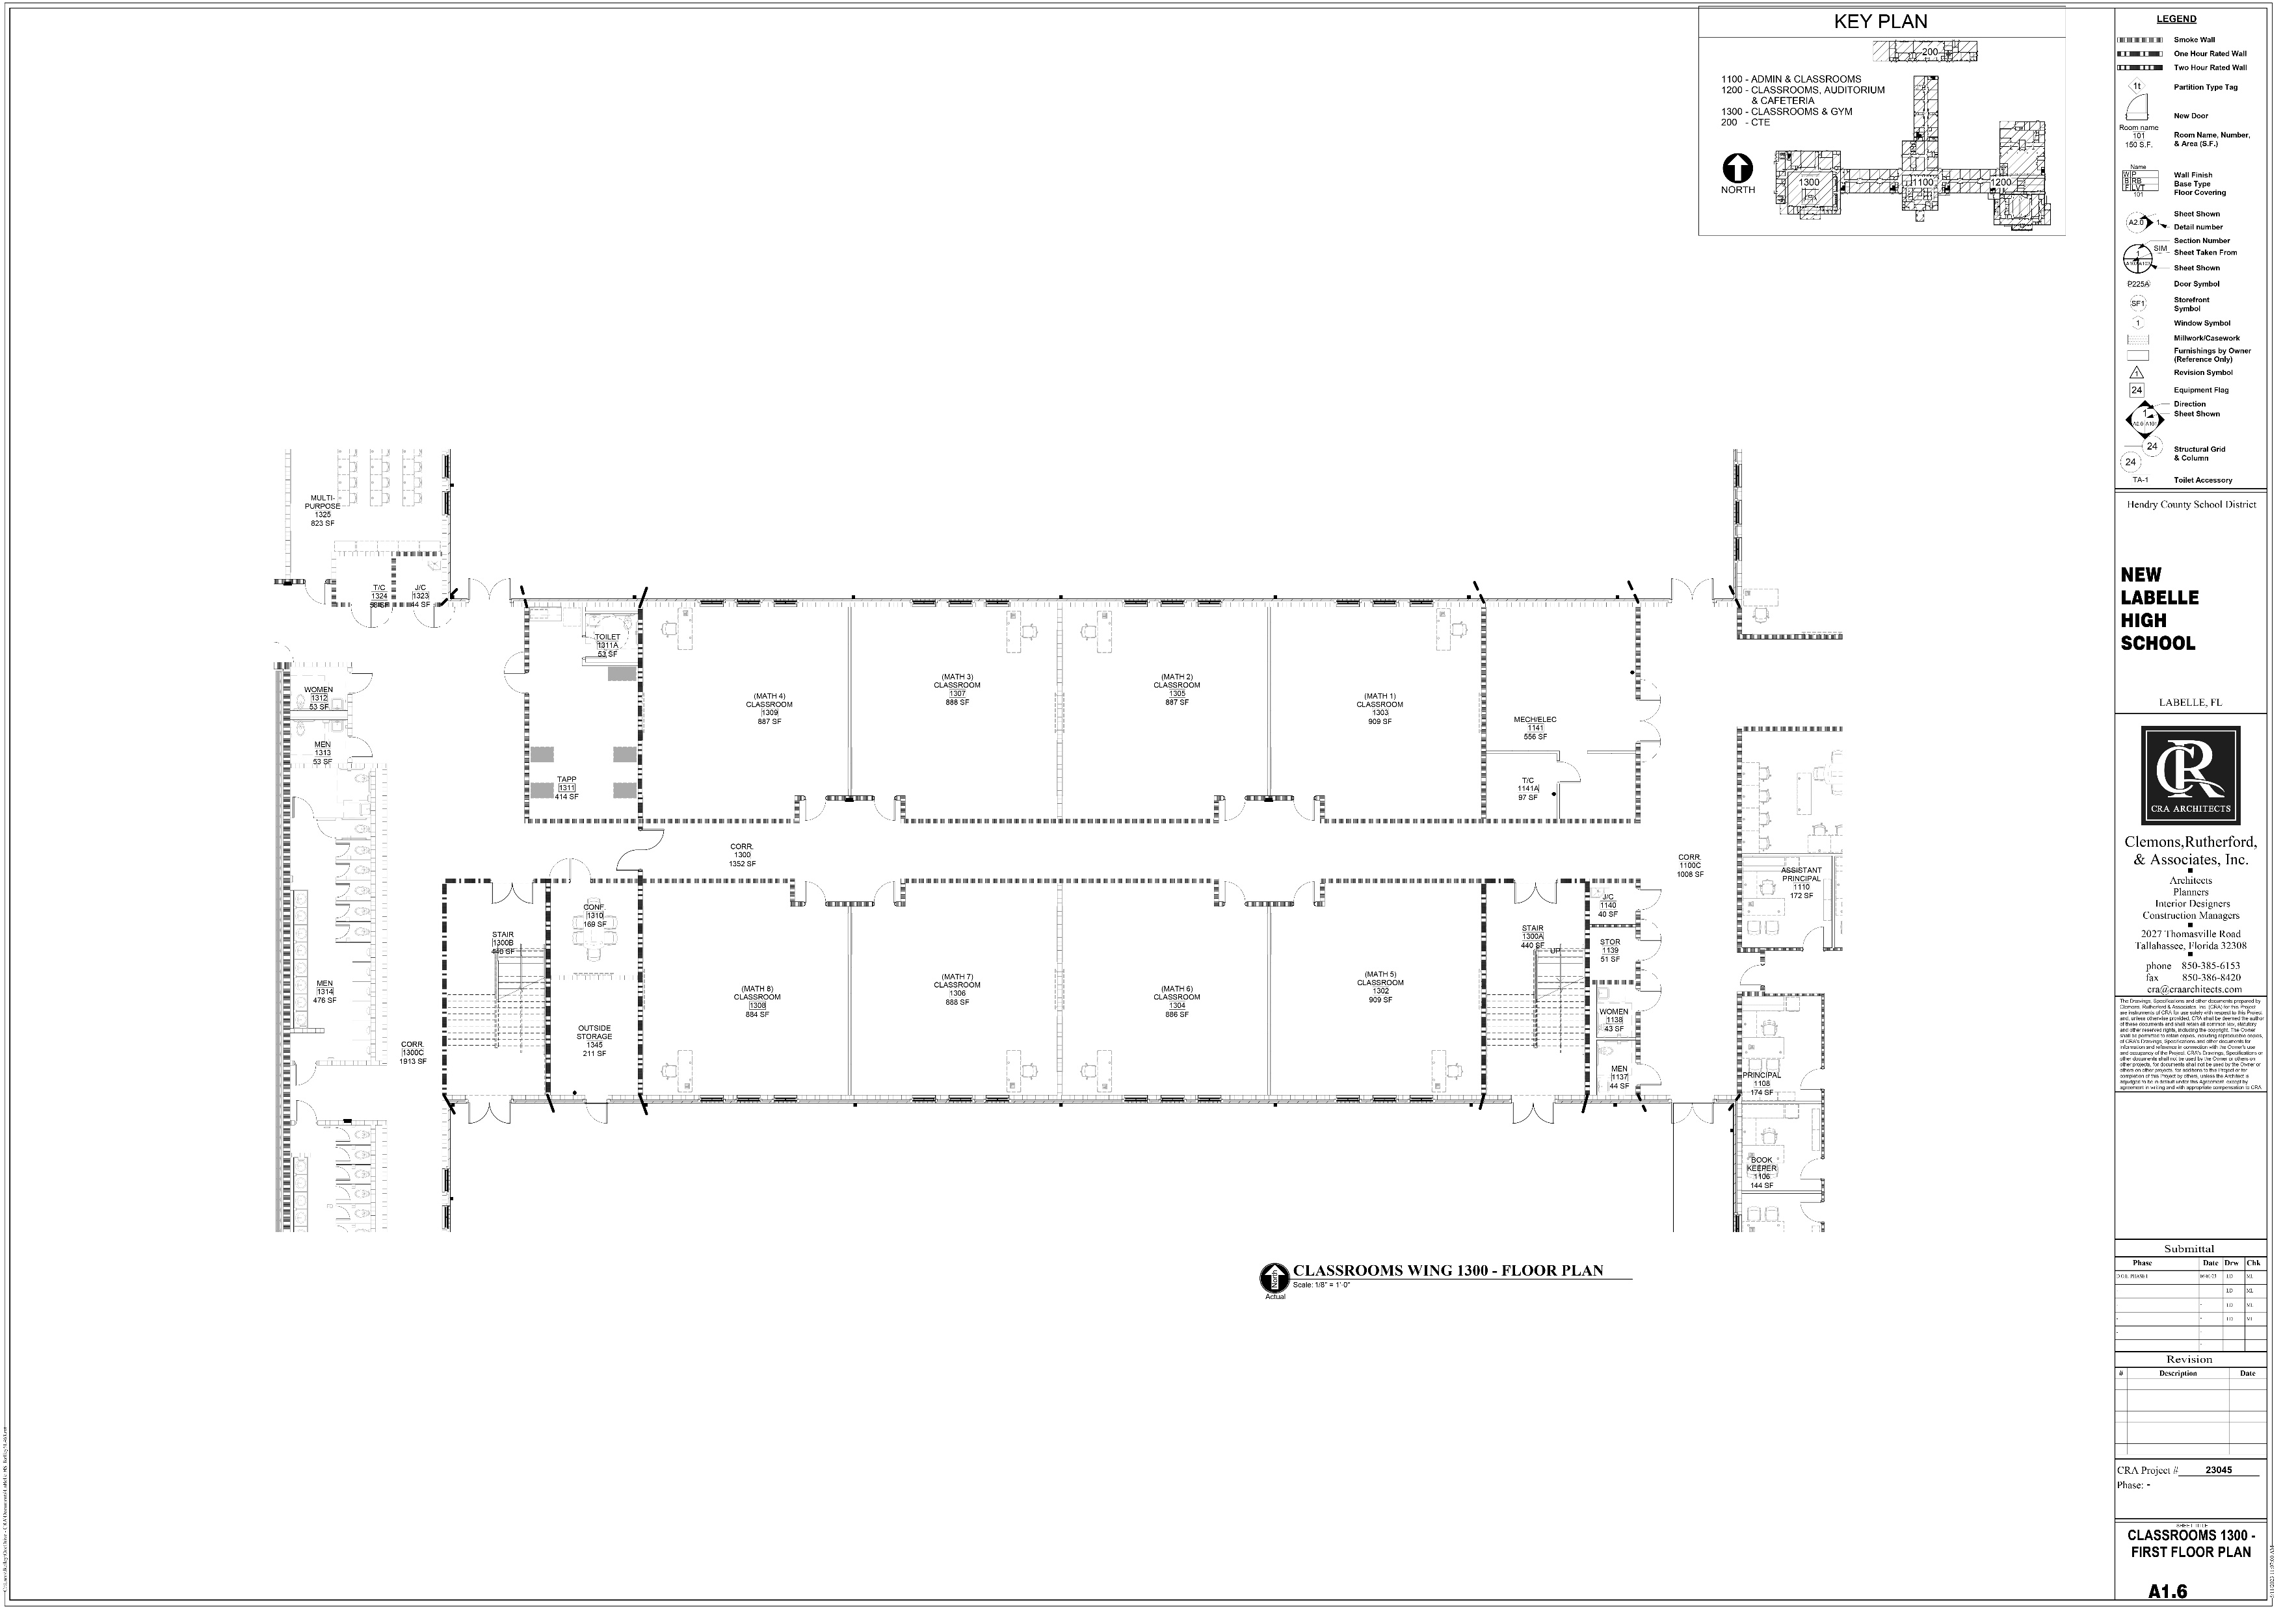

Slide 18
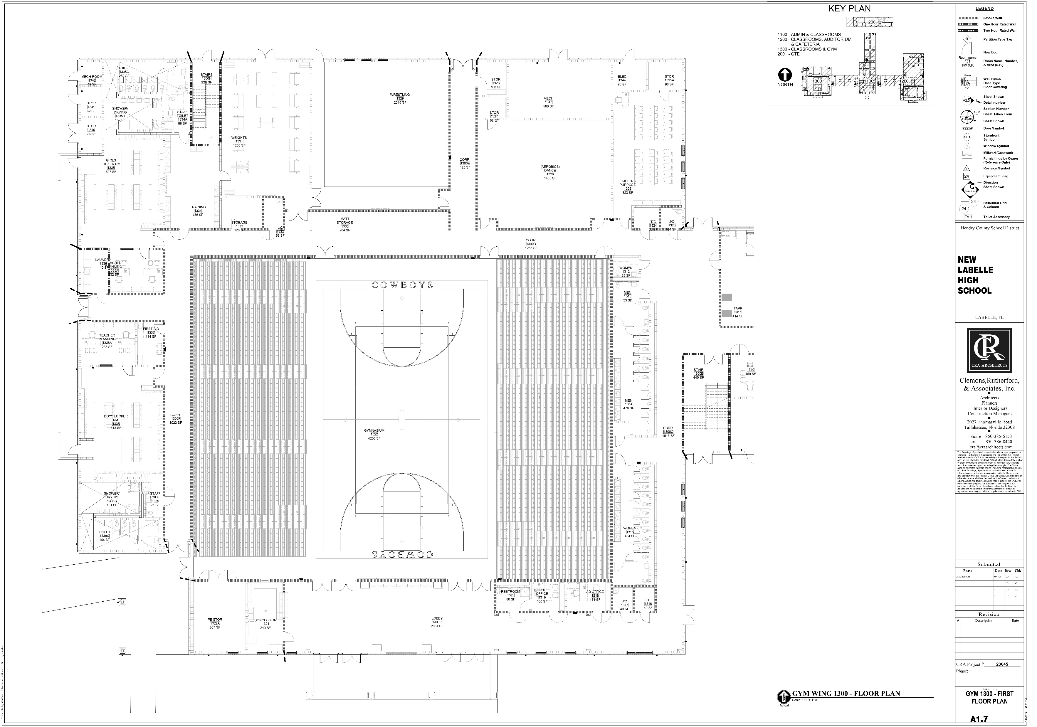

Slide 19
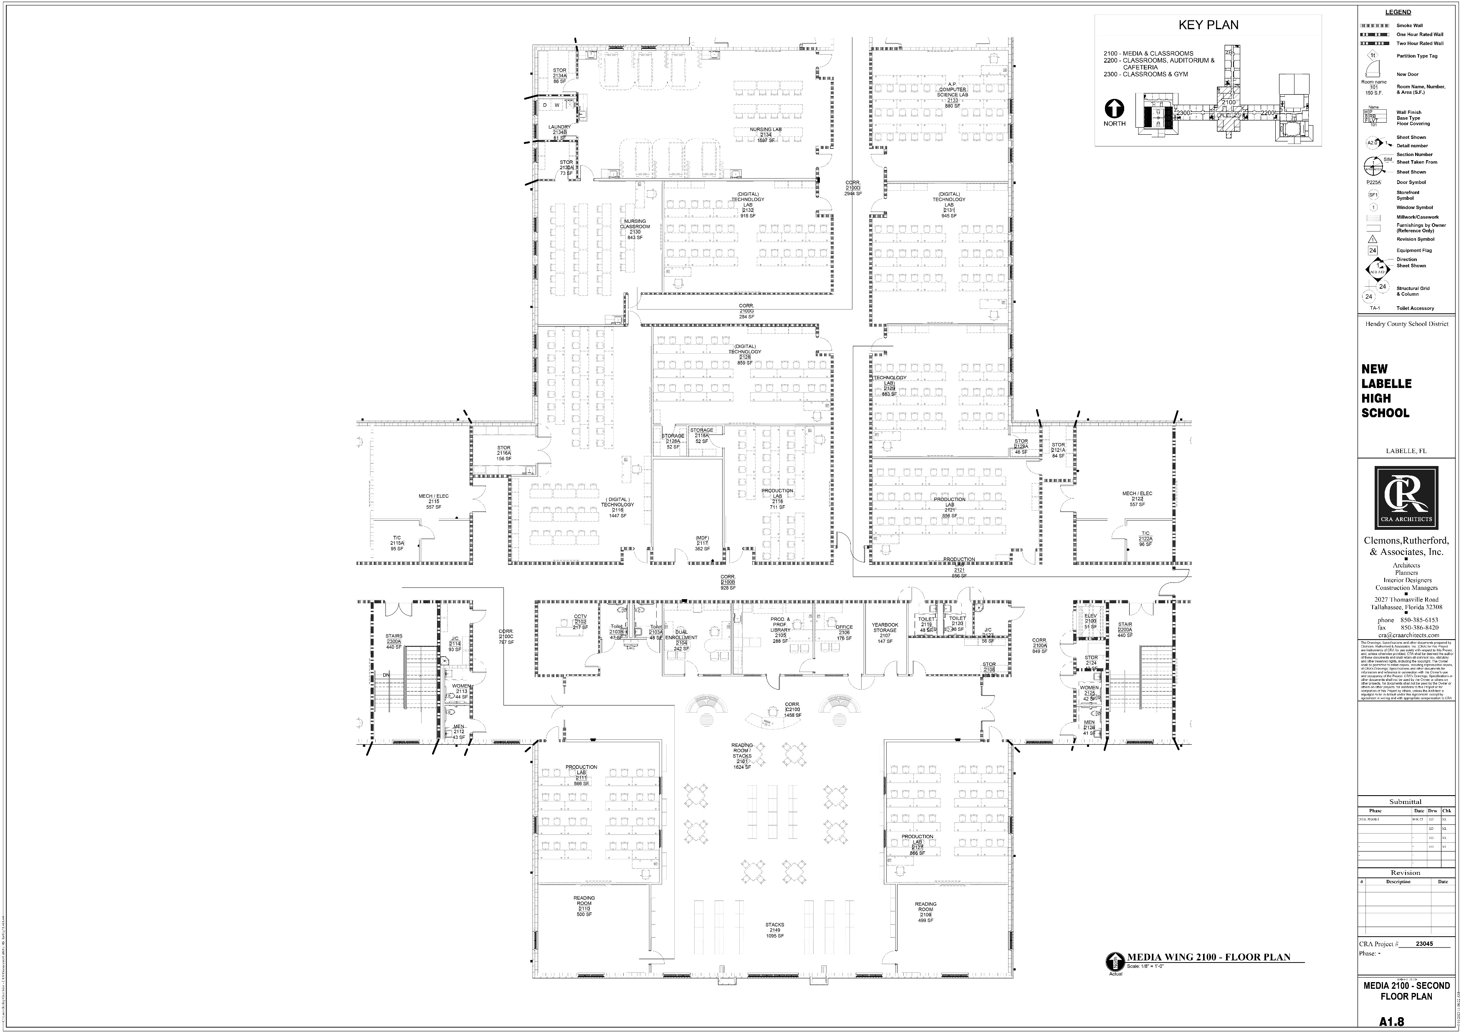

Slide 21
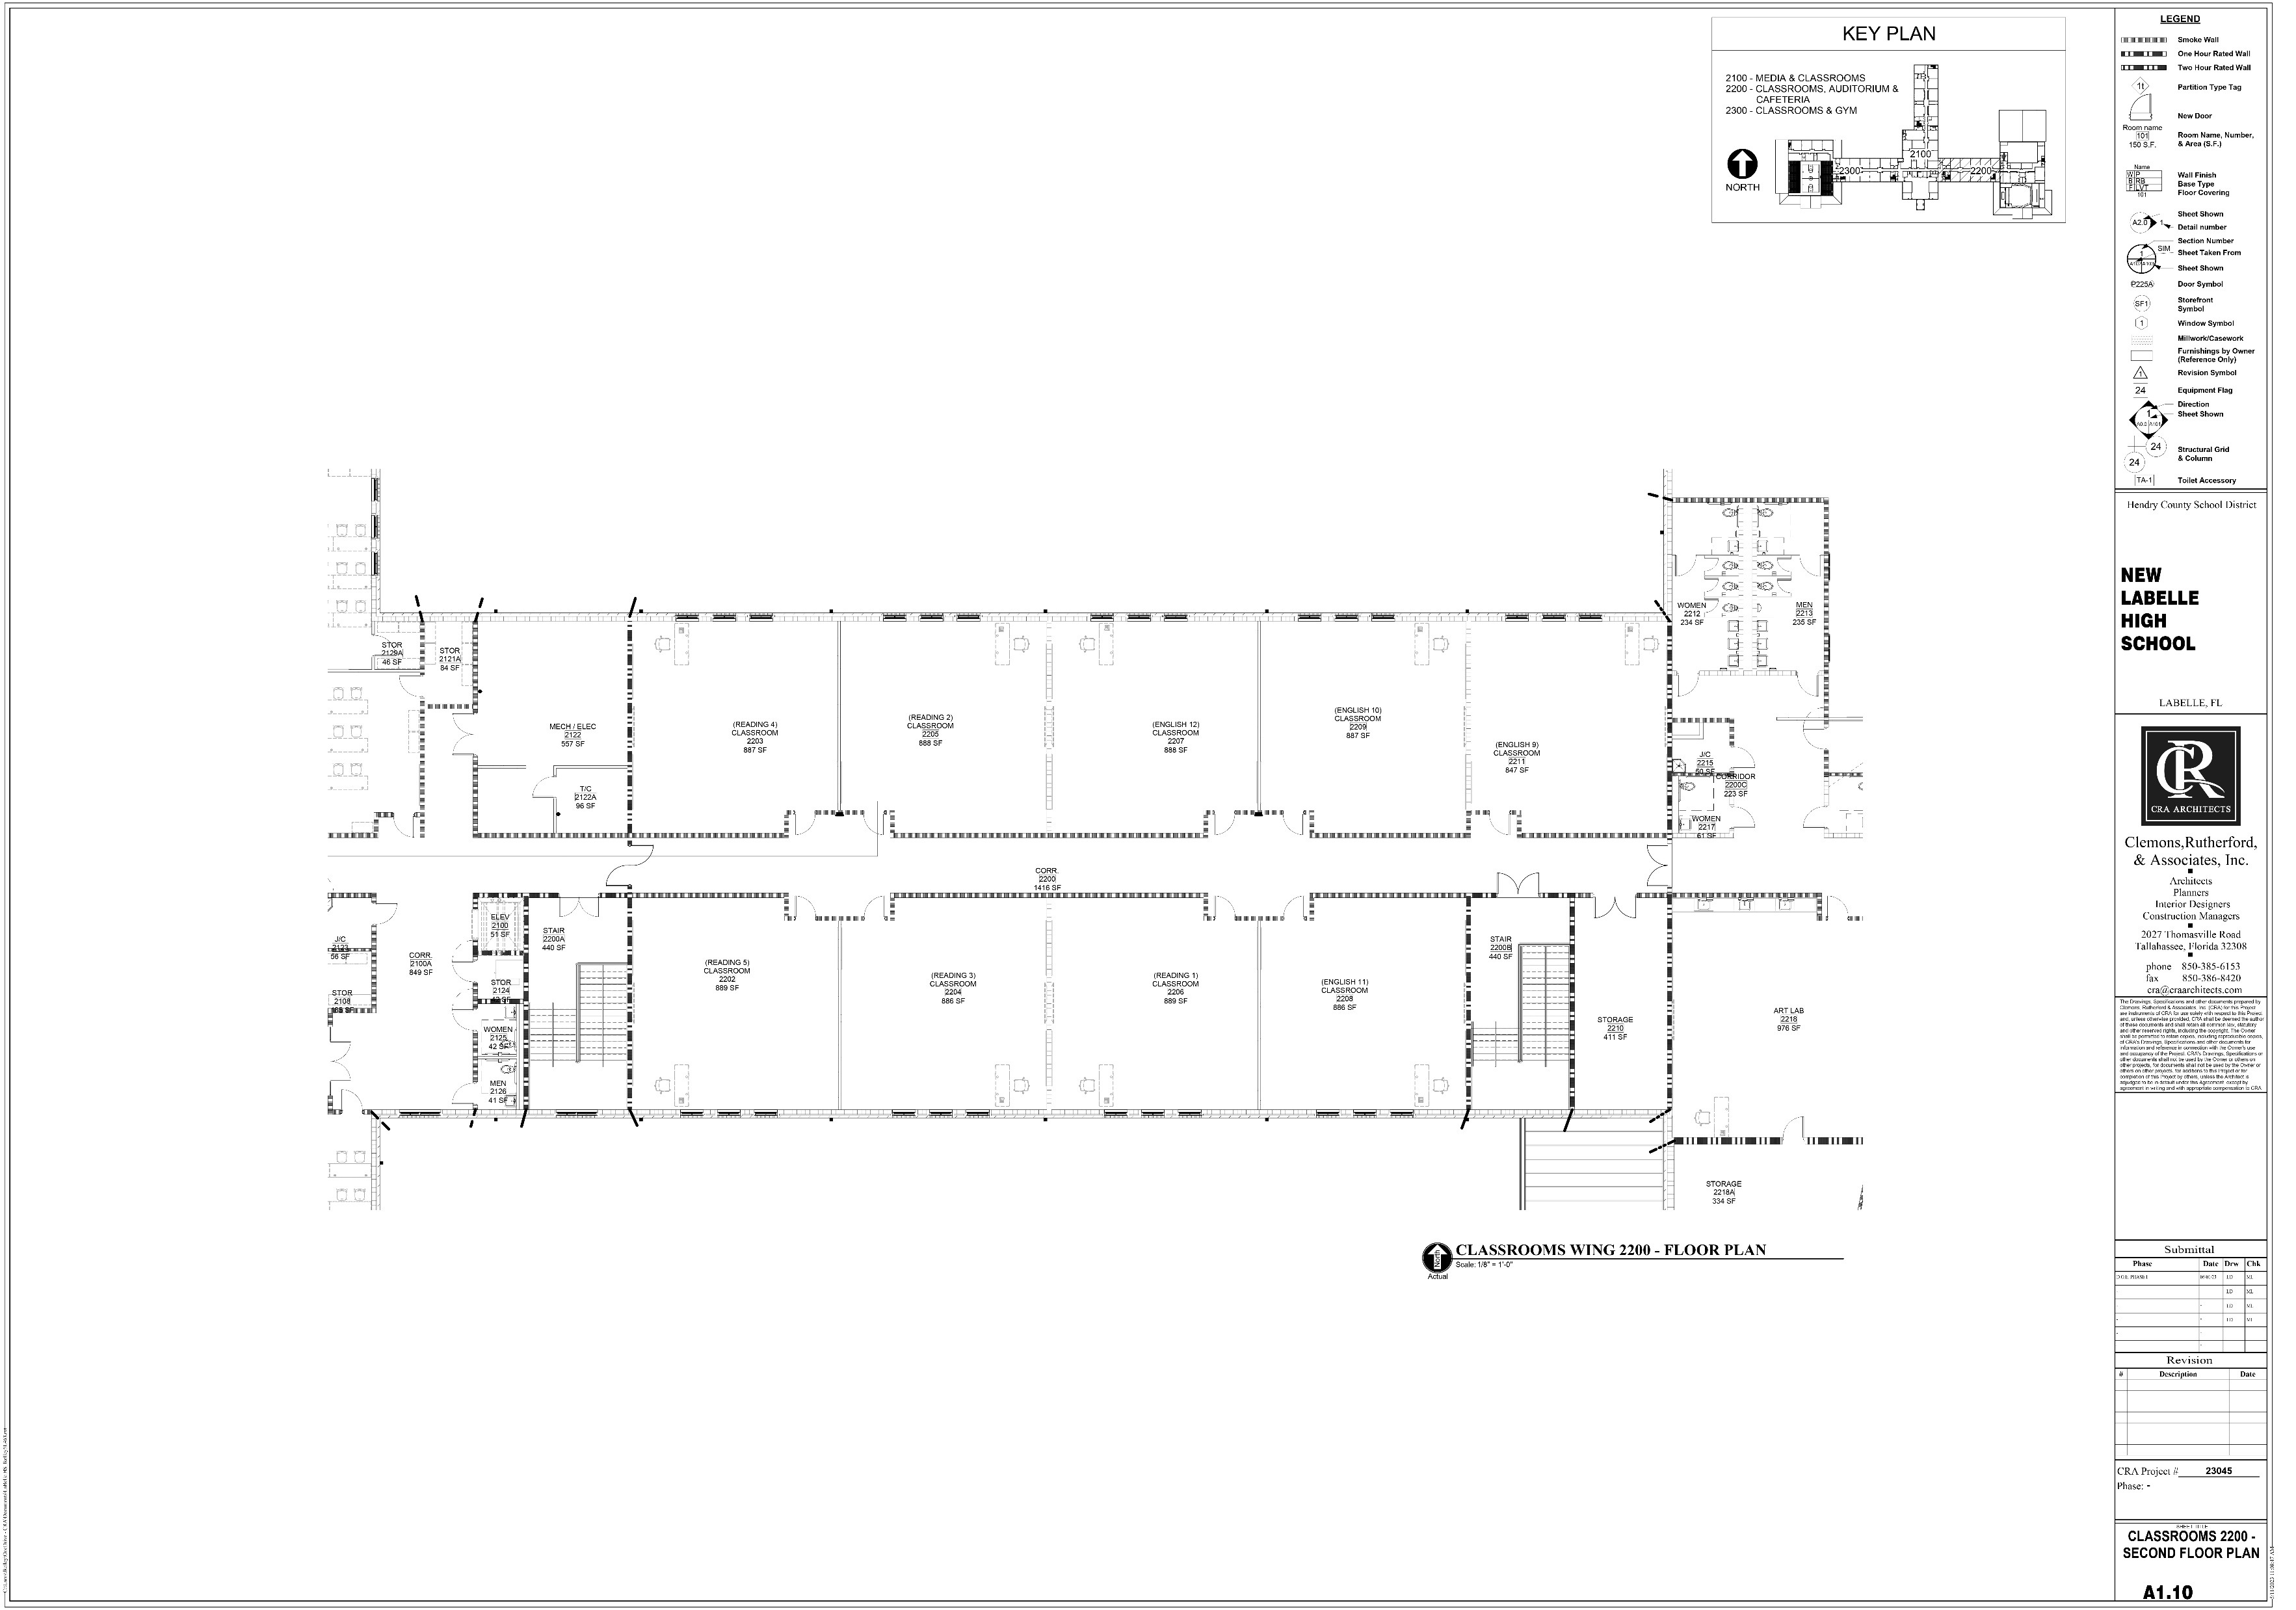

Slide 22
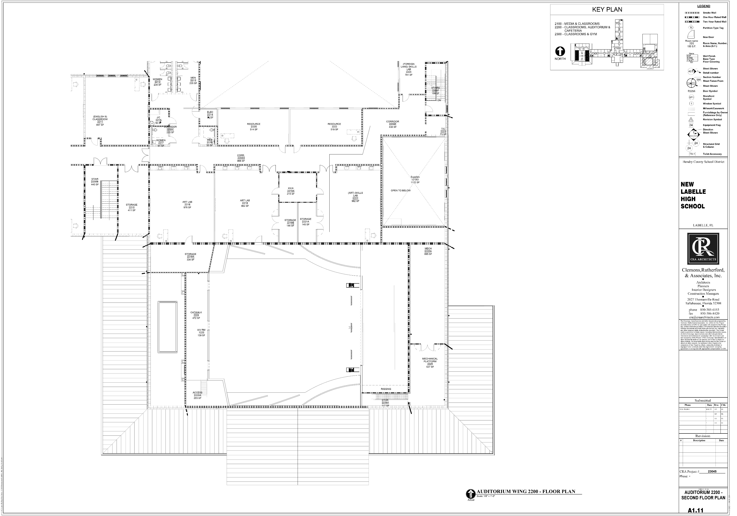

Slide 23
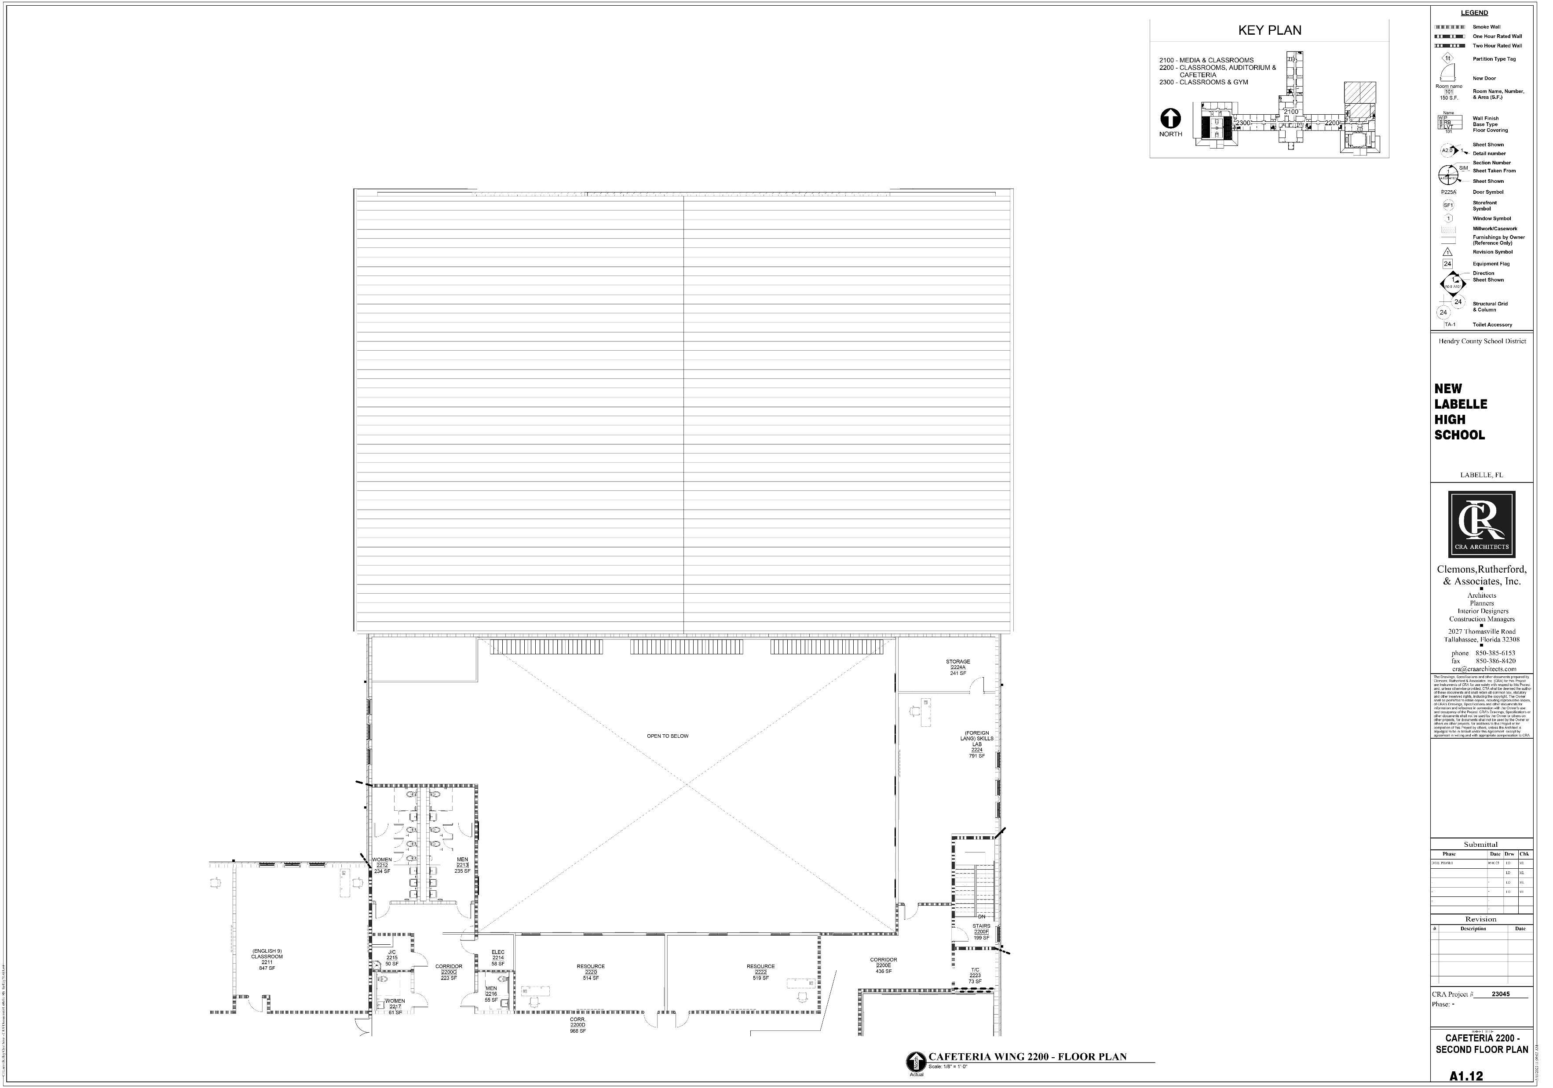

Slide 25
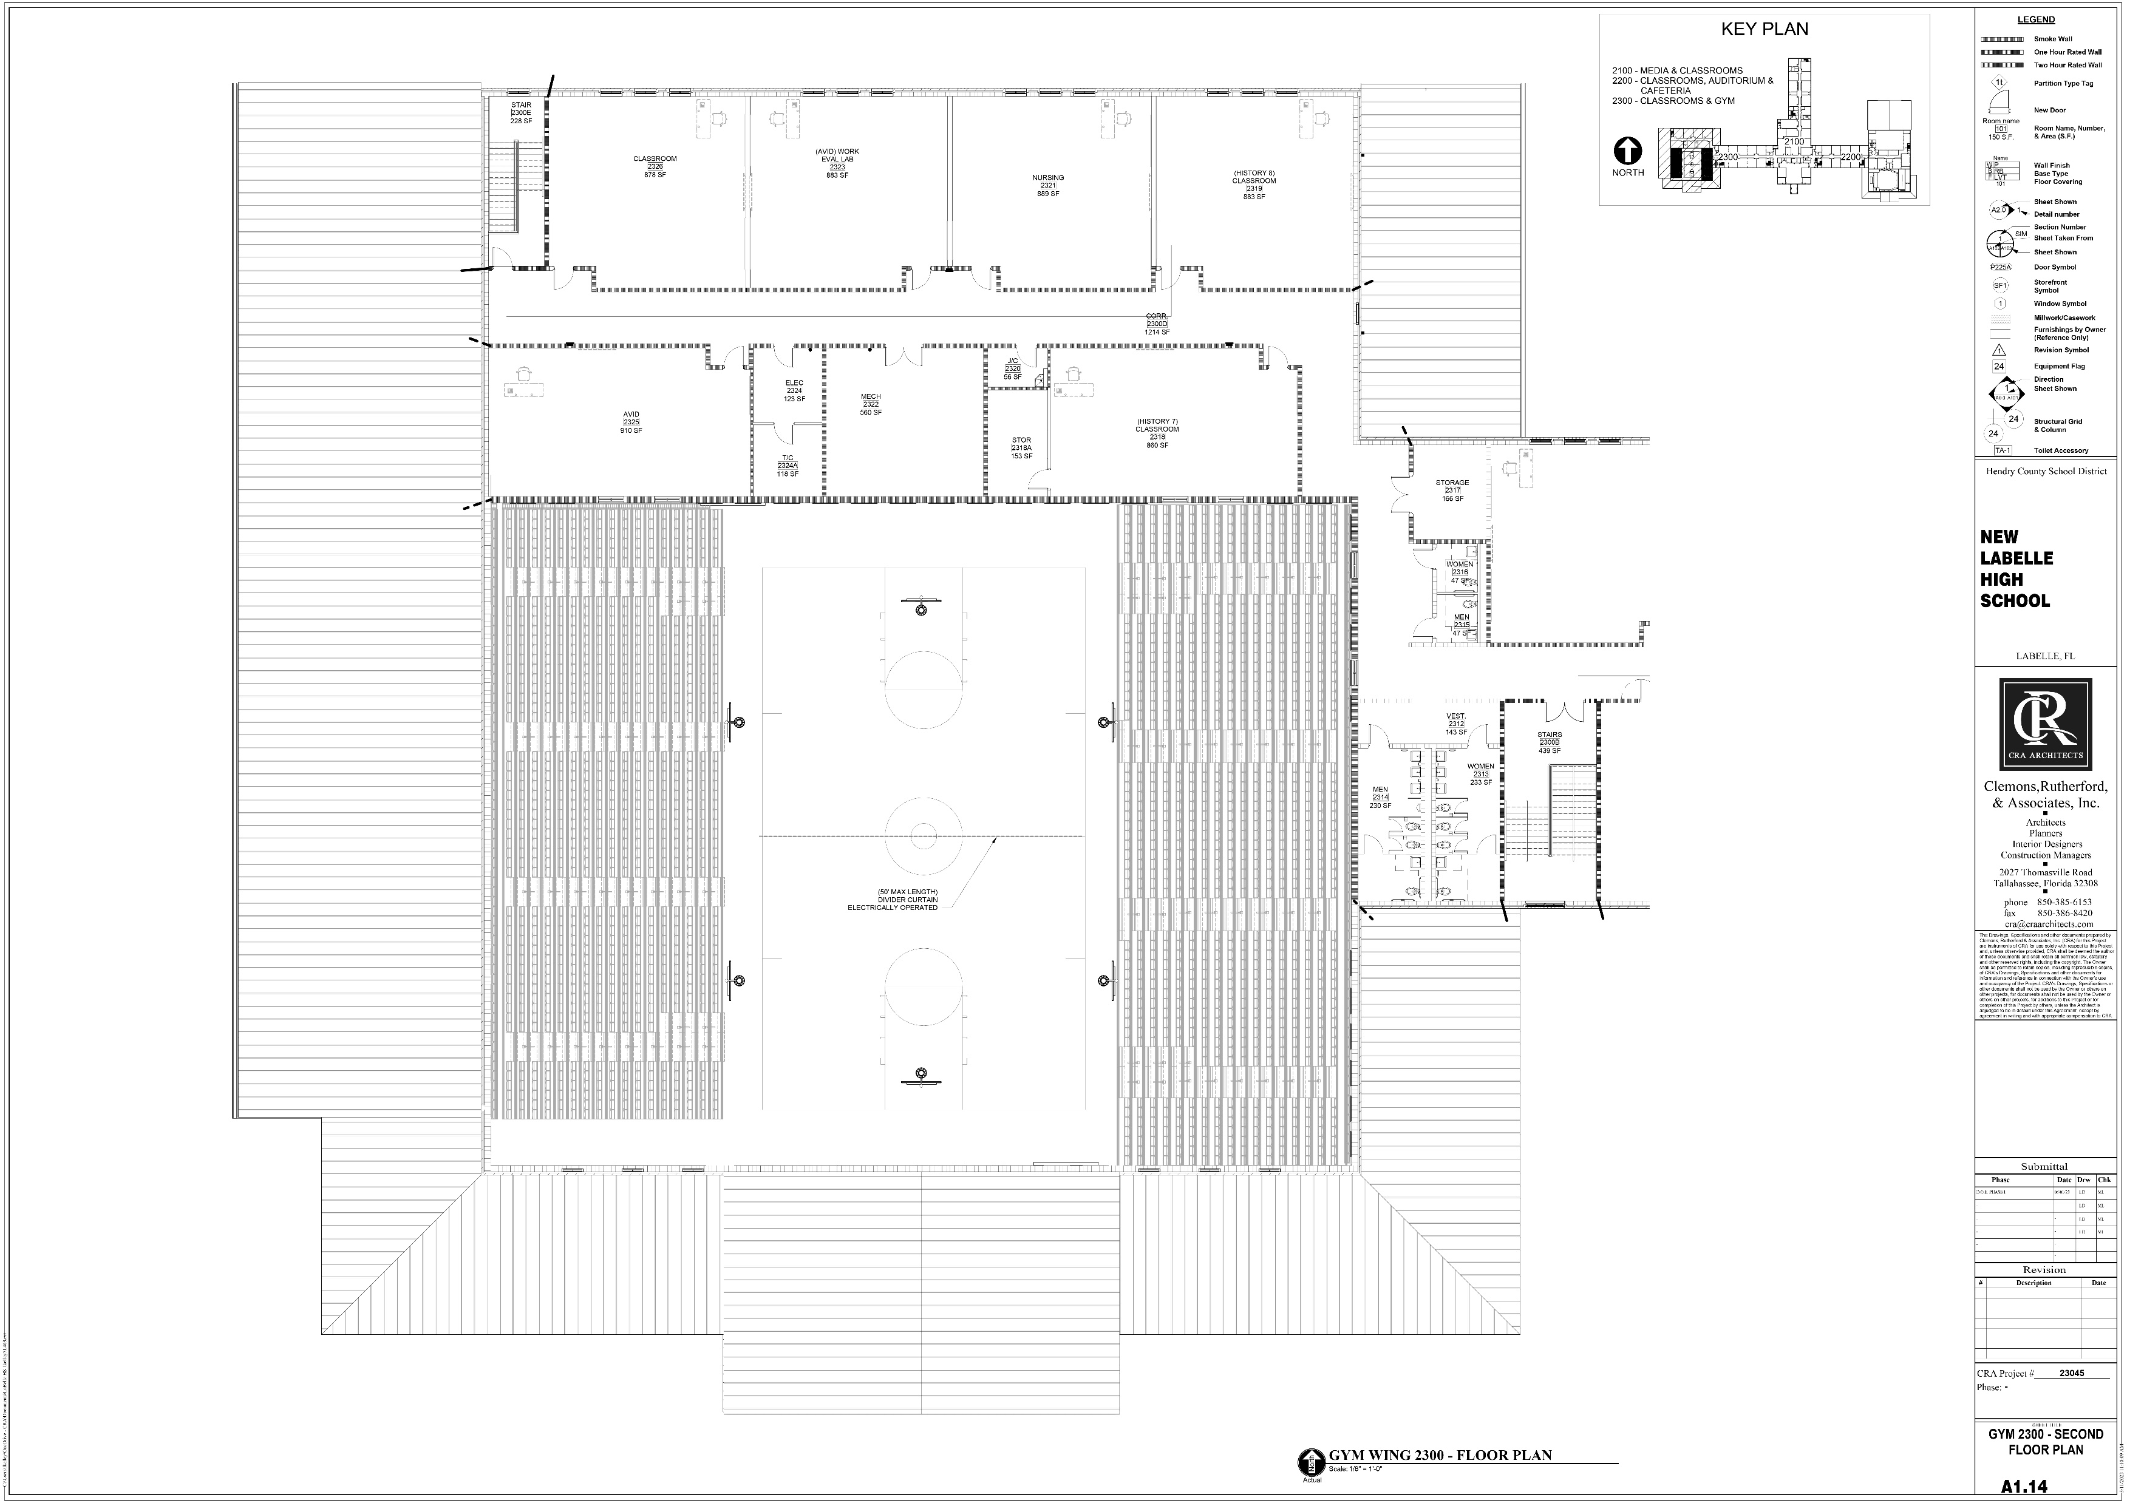

Slide 26
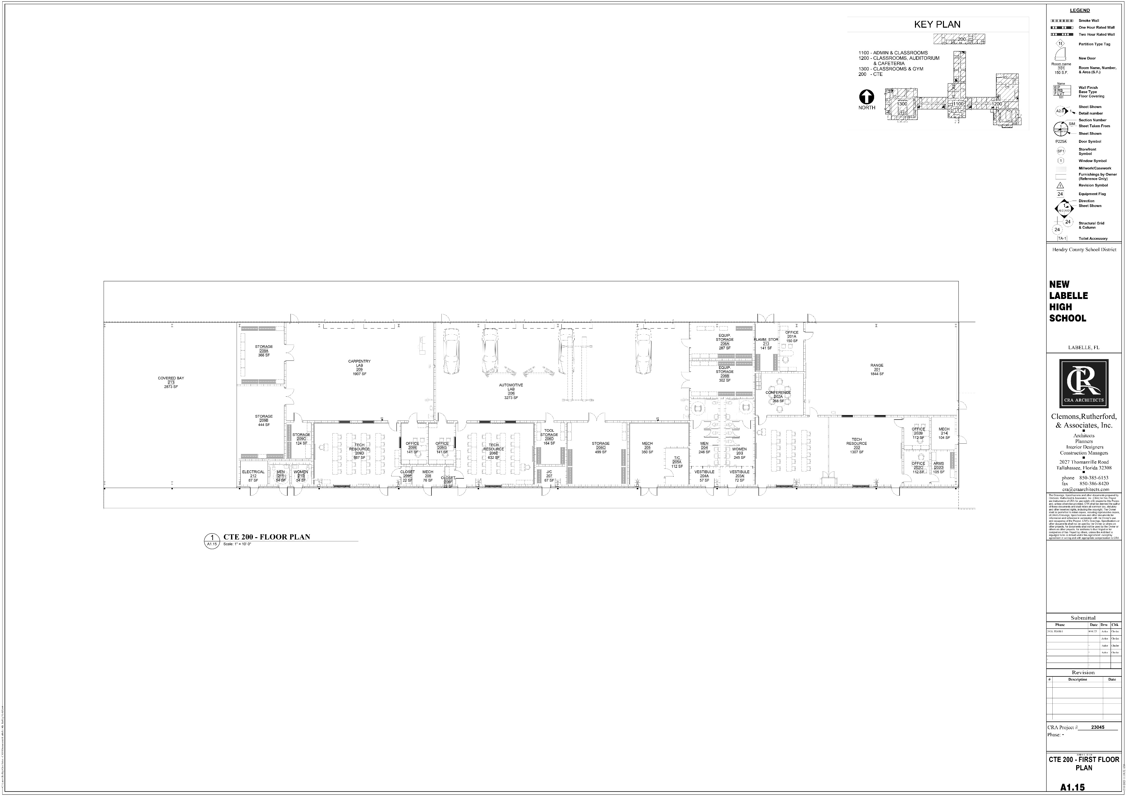

Slide 27
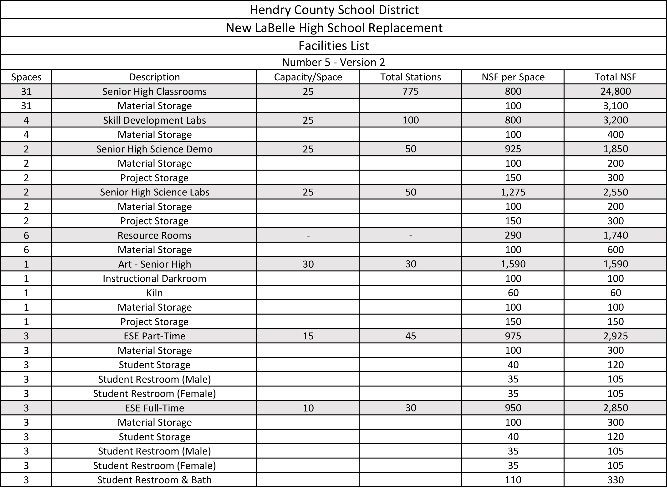

Slide 28
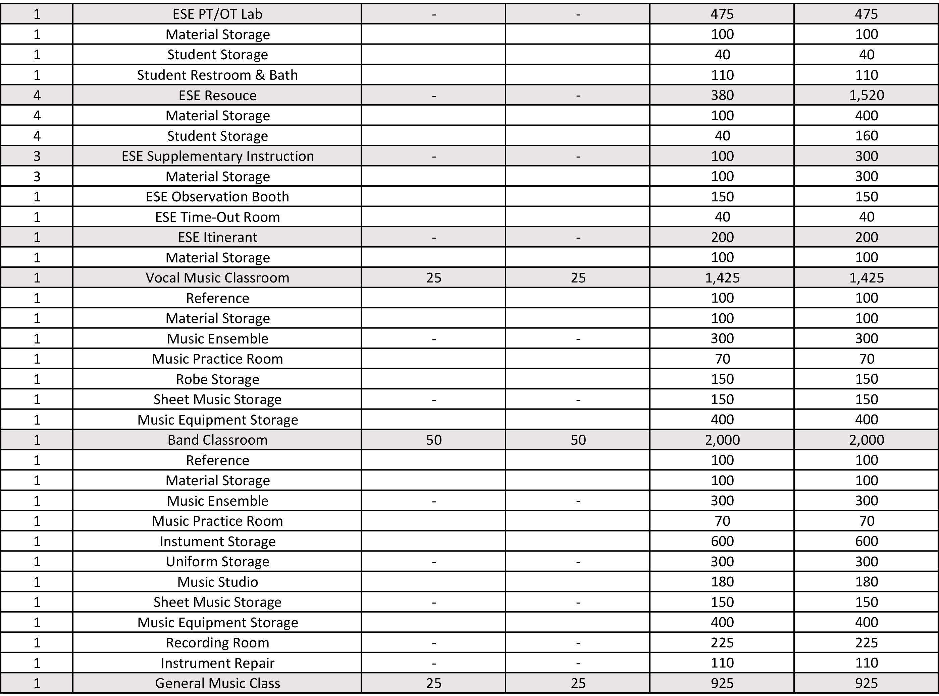

Slide 29
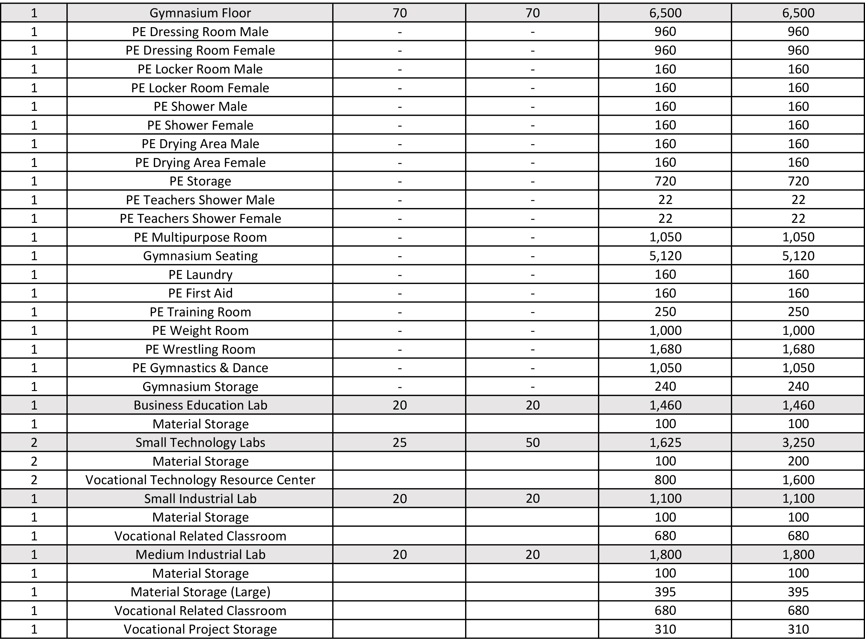

Slide 30
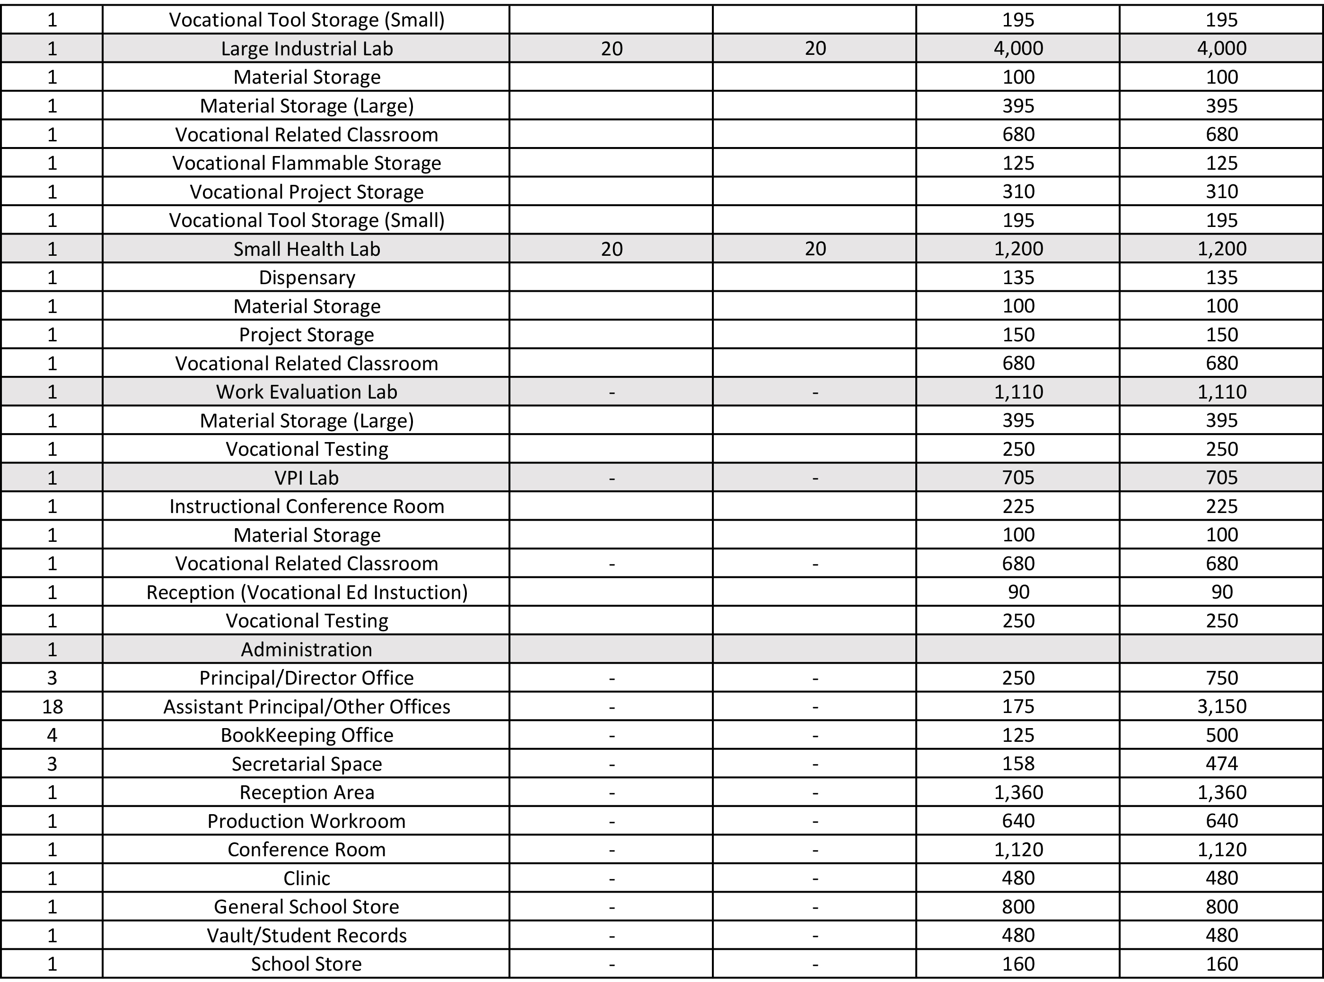

Slide 31
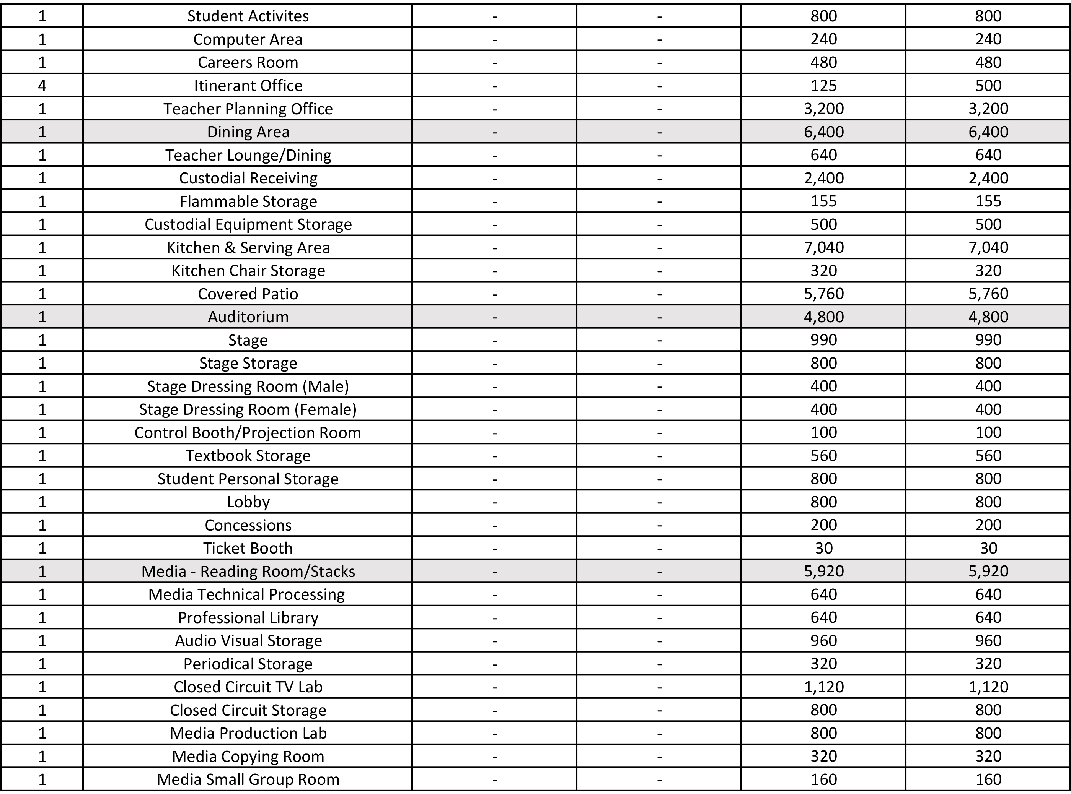

Slide 32
