Slide 1




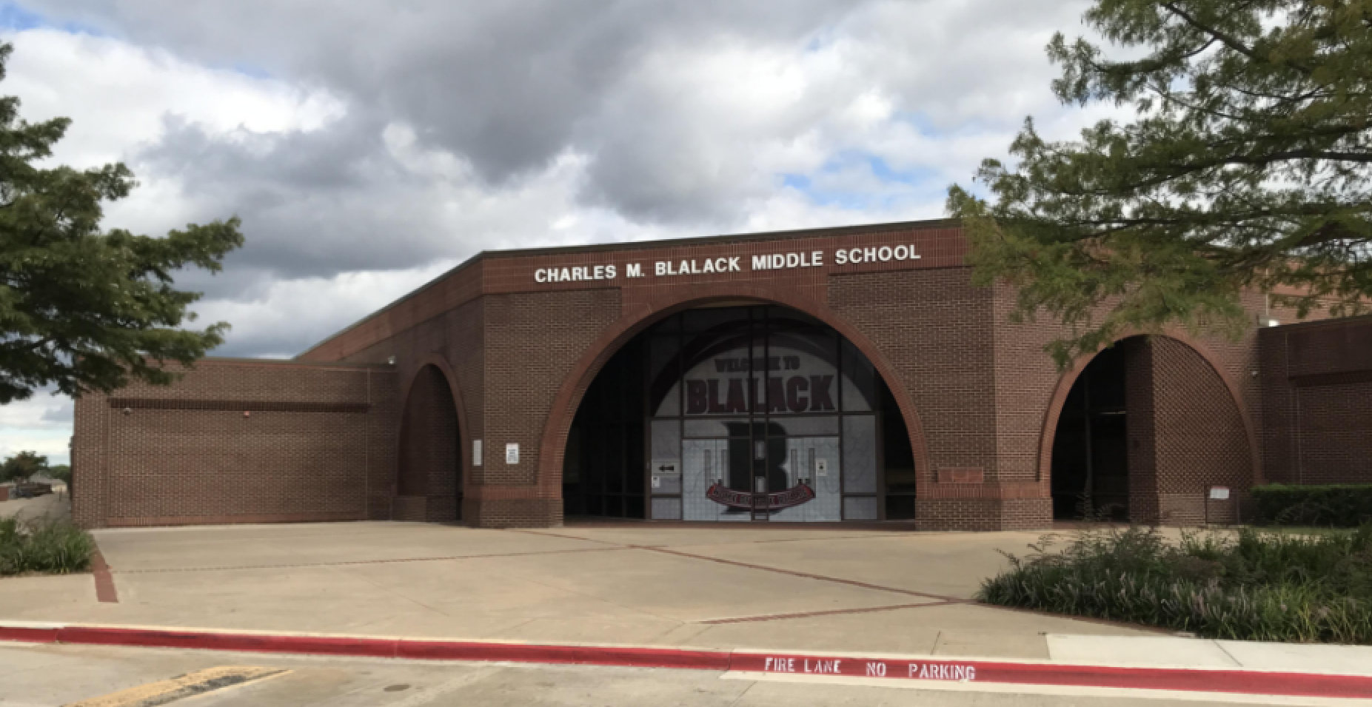
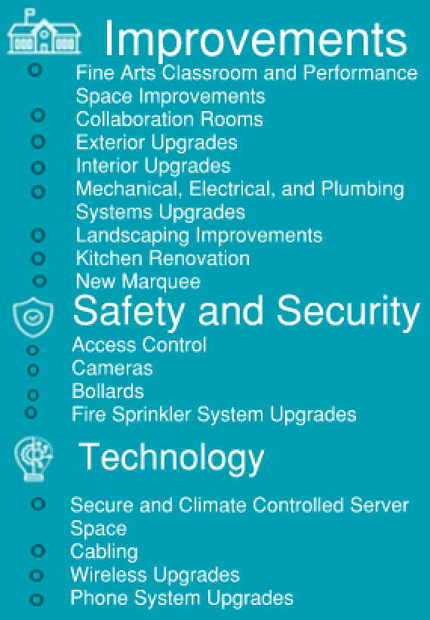
BLALACK MIDDLE SCHOOL
cfbbond.com

Slide 2

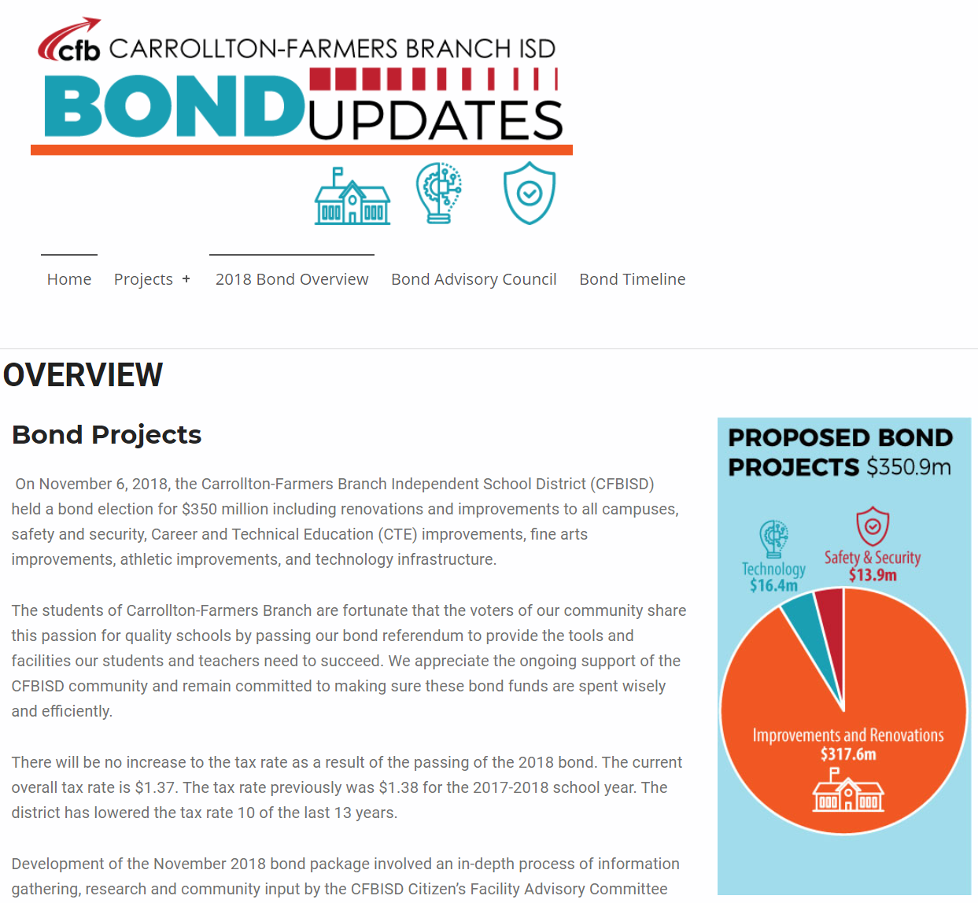
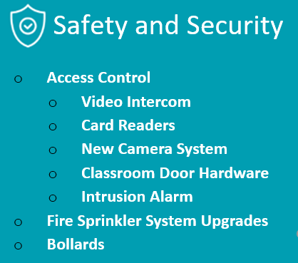

Improvements
Fine Arts Classroom and Performance Space Improvements
  Band, Orchestra, Choir, Theater, and Percussion Hall Renovations
Collaboration Rooms
  Practice Rooms in Fine Arts
Exterior Upgrades
  Roof Replacement and Repair
Interior Upgrades
  Makerspace /Engineering Room Renovation
  Structural Joist Reinforcement
Mechanical, Electrical, and Plumbing Systems Upgrades
  New LED Site Lighting and Controls
  New Rooftop Units and Controls
  Water Bottle Fillers
Landscape Improvements
  Exterior Concrete Replacement
  Exterior Benches
Kitchen Renovation
  New Kitchen Equipment
New Marquee – Coming Soon
Access Control
  Intercom
  Card Readers
  Security Alarm
Cameras
Bollards
Fire Sprinkler System Upgrades
Secure Climate Controlled Server Space
Cabling
Wireless Upgrades
Phone System Upgrades
PROMISES MADE
PROMISES KEPT
PROMISES MADE
PROMISES KEPT

Slide 3
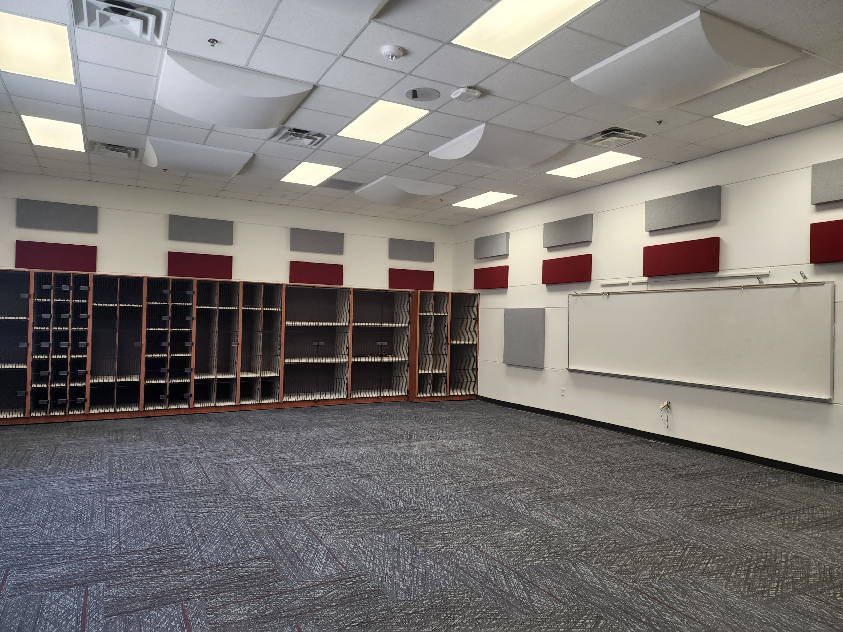
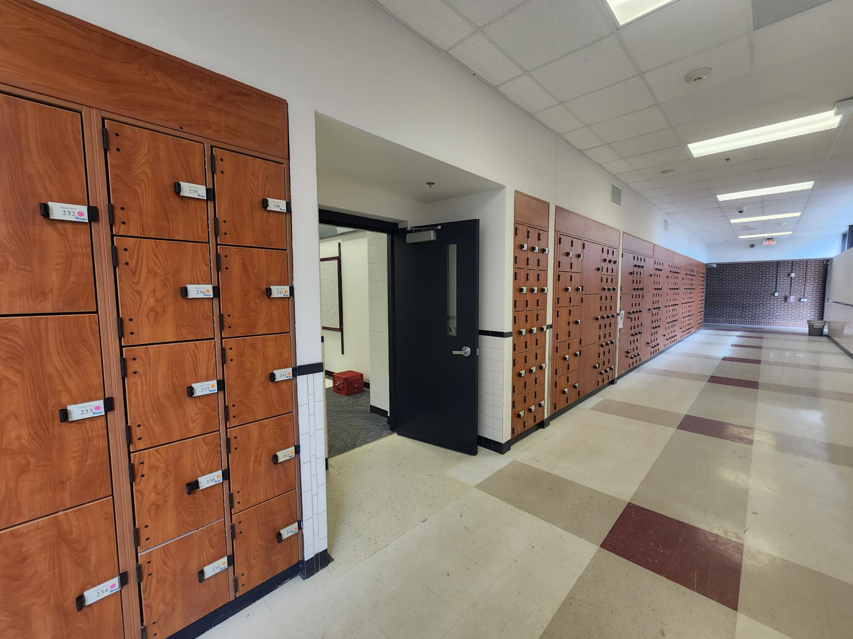
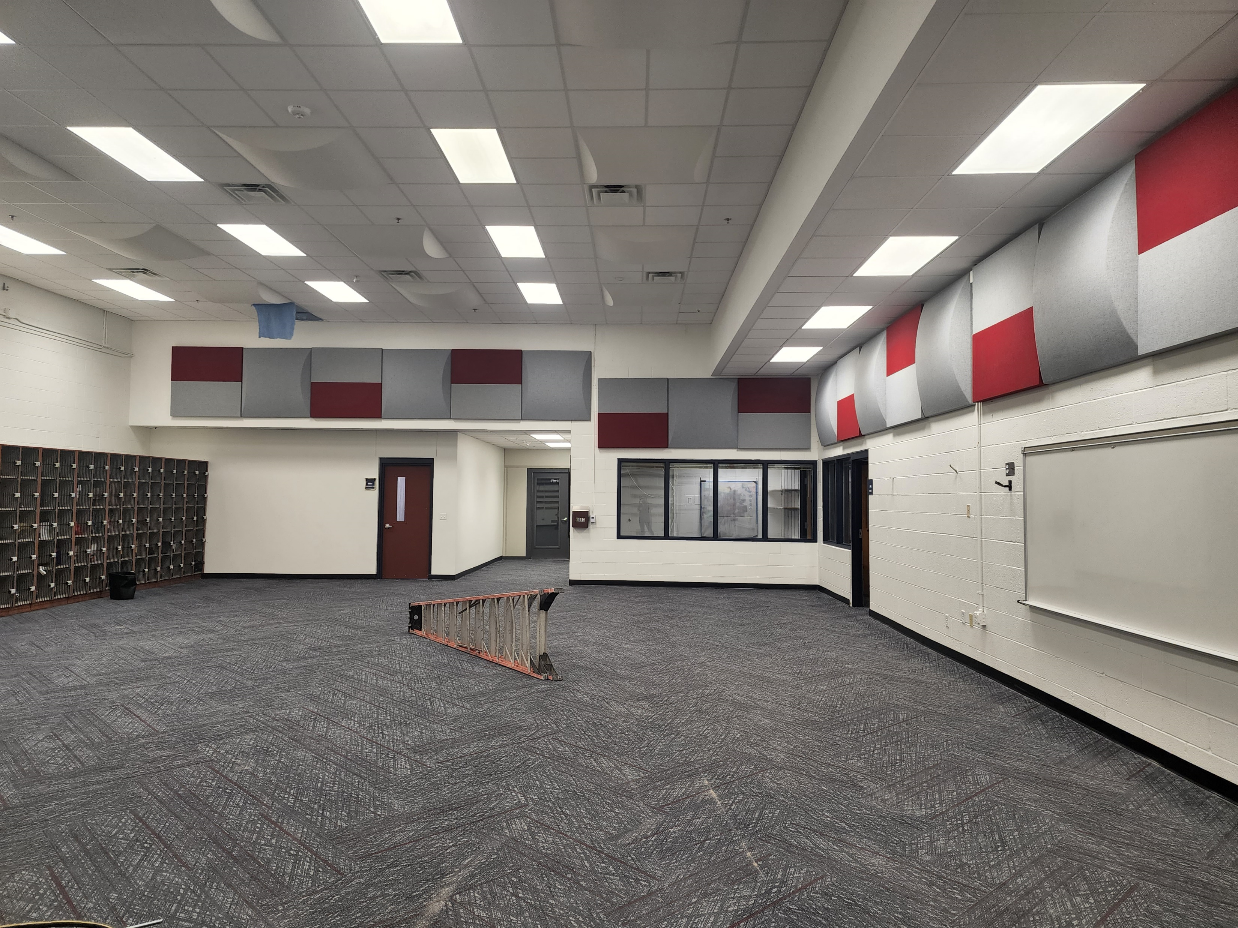
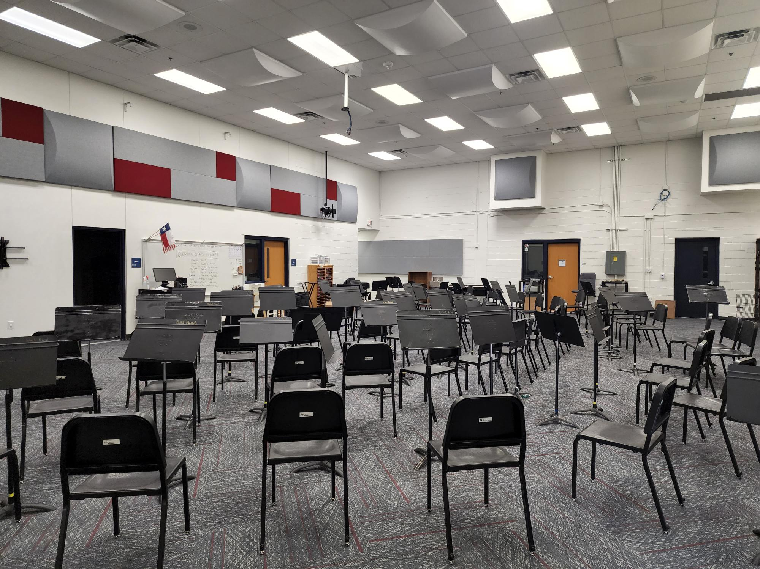
Improvements
Fine Arts Classroom and Performance Space Improvements
  Band, Orchestra, Choir, Theater, and Percussion Hall Renovations
Collaboration Rooms
  Practice Rooms in Fine Arts
Exterior Upgrades
  Roof Replacement and Repair
Interior Upgrades
  Makerspace /Engineering Room Renovation
  Structural Joist Reinforcement
Mechanical, Electrical, and Plumbing Systems Upgrades
  New LED Site Lighting and Controls
  New Rooftop Units and Controls
  Water Bottle Fillers
Landscape Improvements
  Exterior Concrete Replacement
  Exterior Benches
Kitchen Renovation
  New Kitchen Equipment
New Marquee – Coming Soon
New Ensemble Room
Wenger Cabinets
PROMISES MADE
PROMISES KEPT
Band Hall
Orchestra Hall

Slide 4
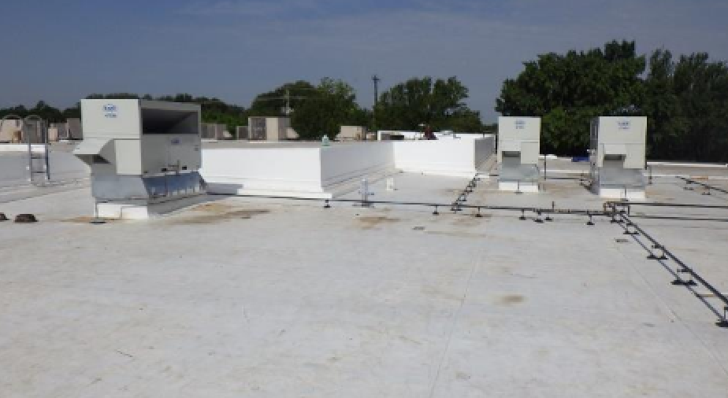
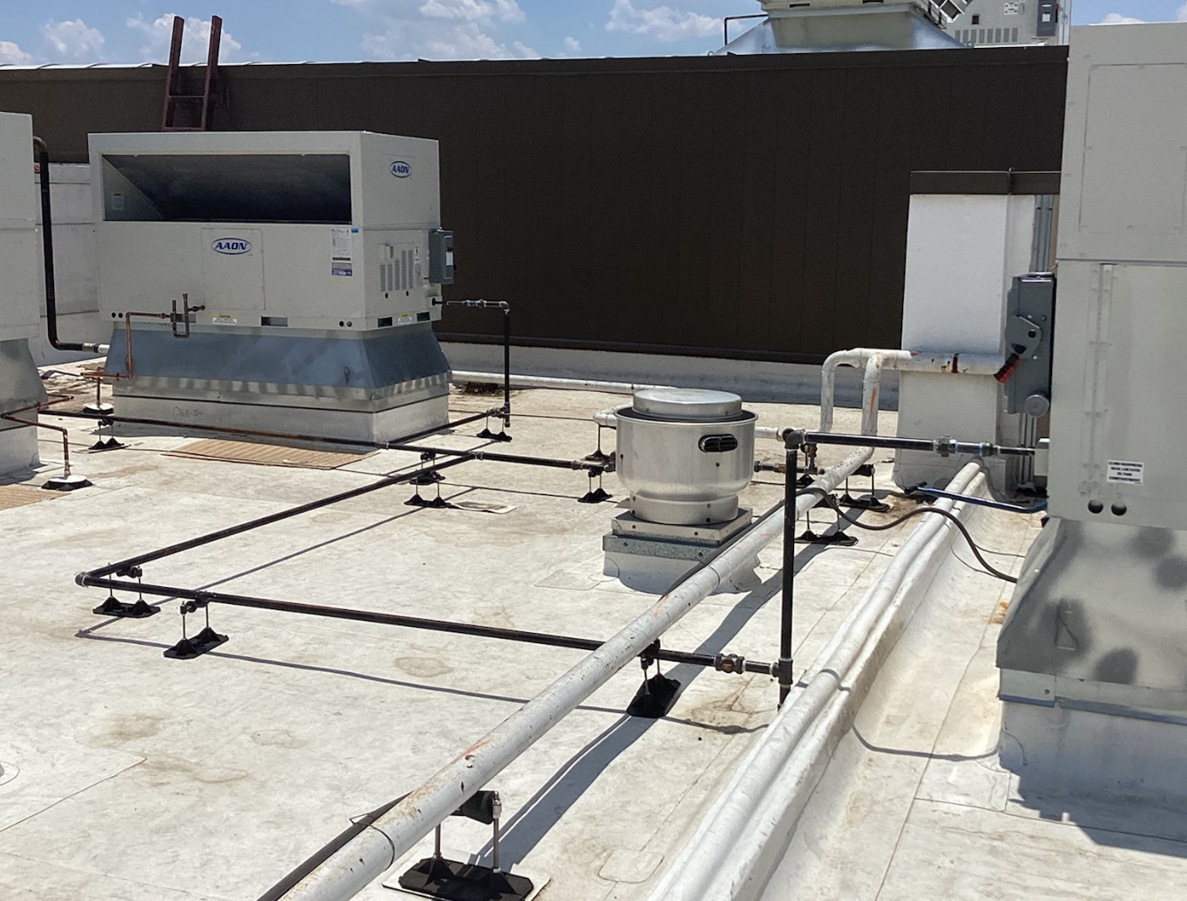
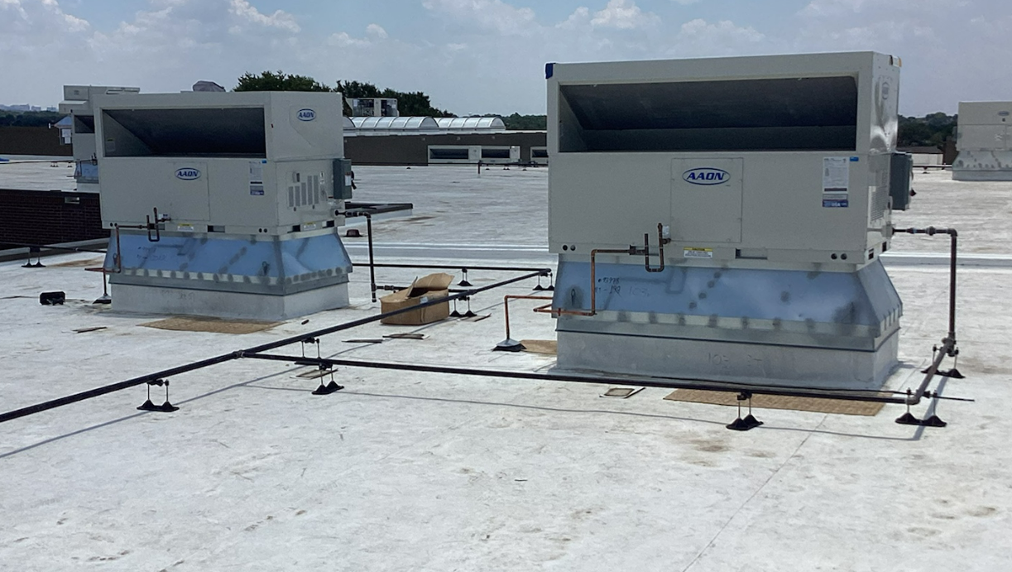
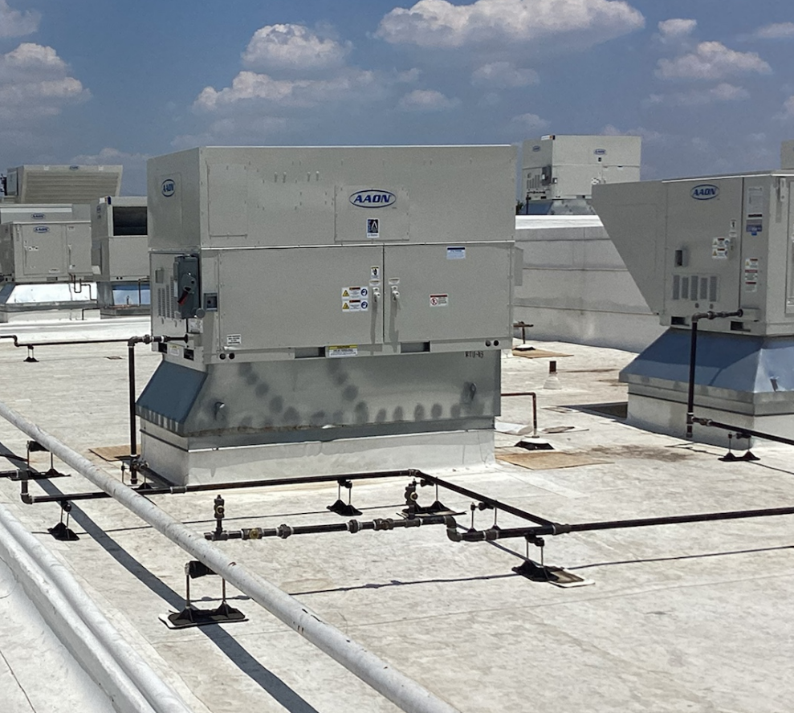
Improvements
Fine Arts Classroom and Performance Space Improvements
  Band, Orchestra, Choir, Theater, and Percussion Hall Renovations
Collaboration Rooms
  Practice Rooms in Fine Arts
Exterior Upgrades
  Roof Replacement and Repair
Interior Upgrades
  Makerspace /Engineering Room Renovation
  Structural Joist Reinforcement
Mechanical, Electrical, and Plumbing Systems Upgrades
  New LED Site Lighting and Controls
  New Rooftop Units and Controls
  Water Bottle Fillers
Landscape Improvements
  Exterior Concrete Replacement
  Exterior Benches
Kitchen Renovation
  New Kitchen Equipment
New Marquee – Coming Soon
New Roof
New Roof
PROMISES MADE
PROMISES KEPT
New Roof
New Roof

Slide 5
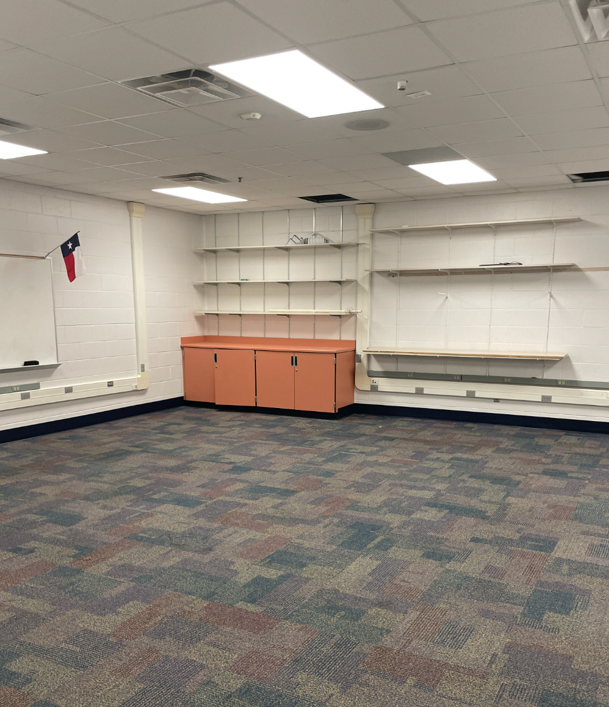
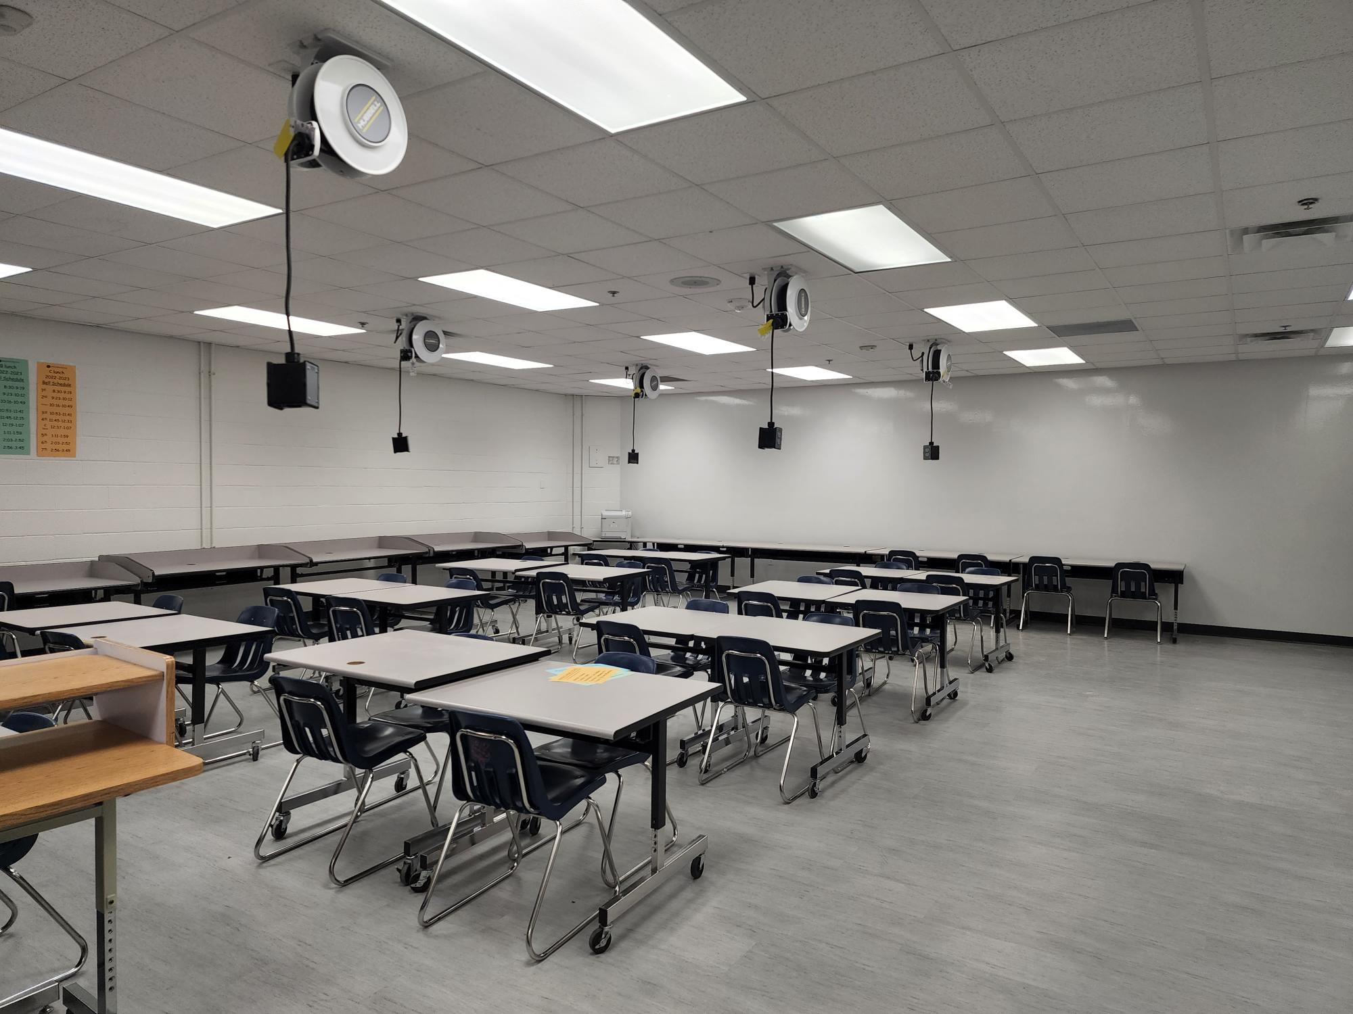
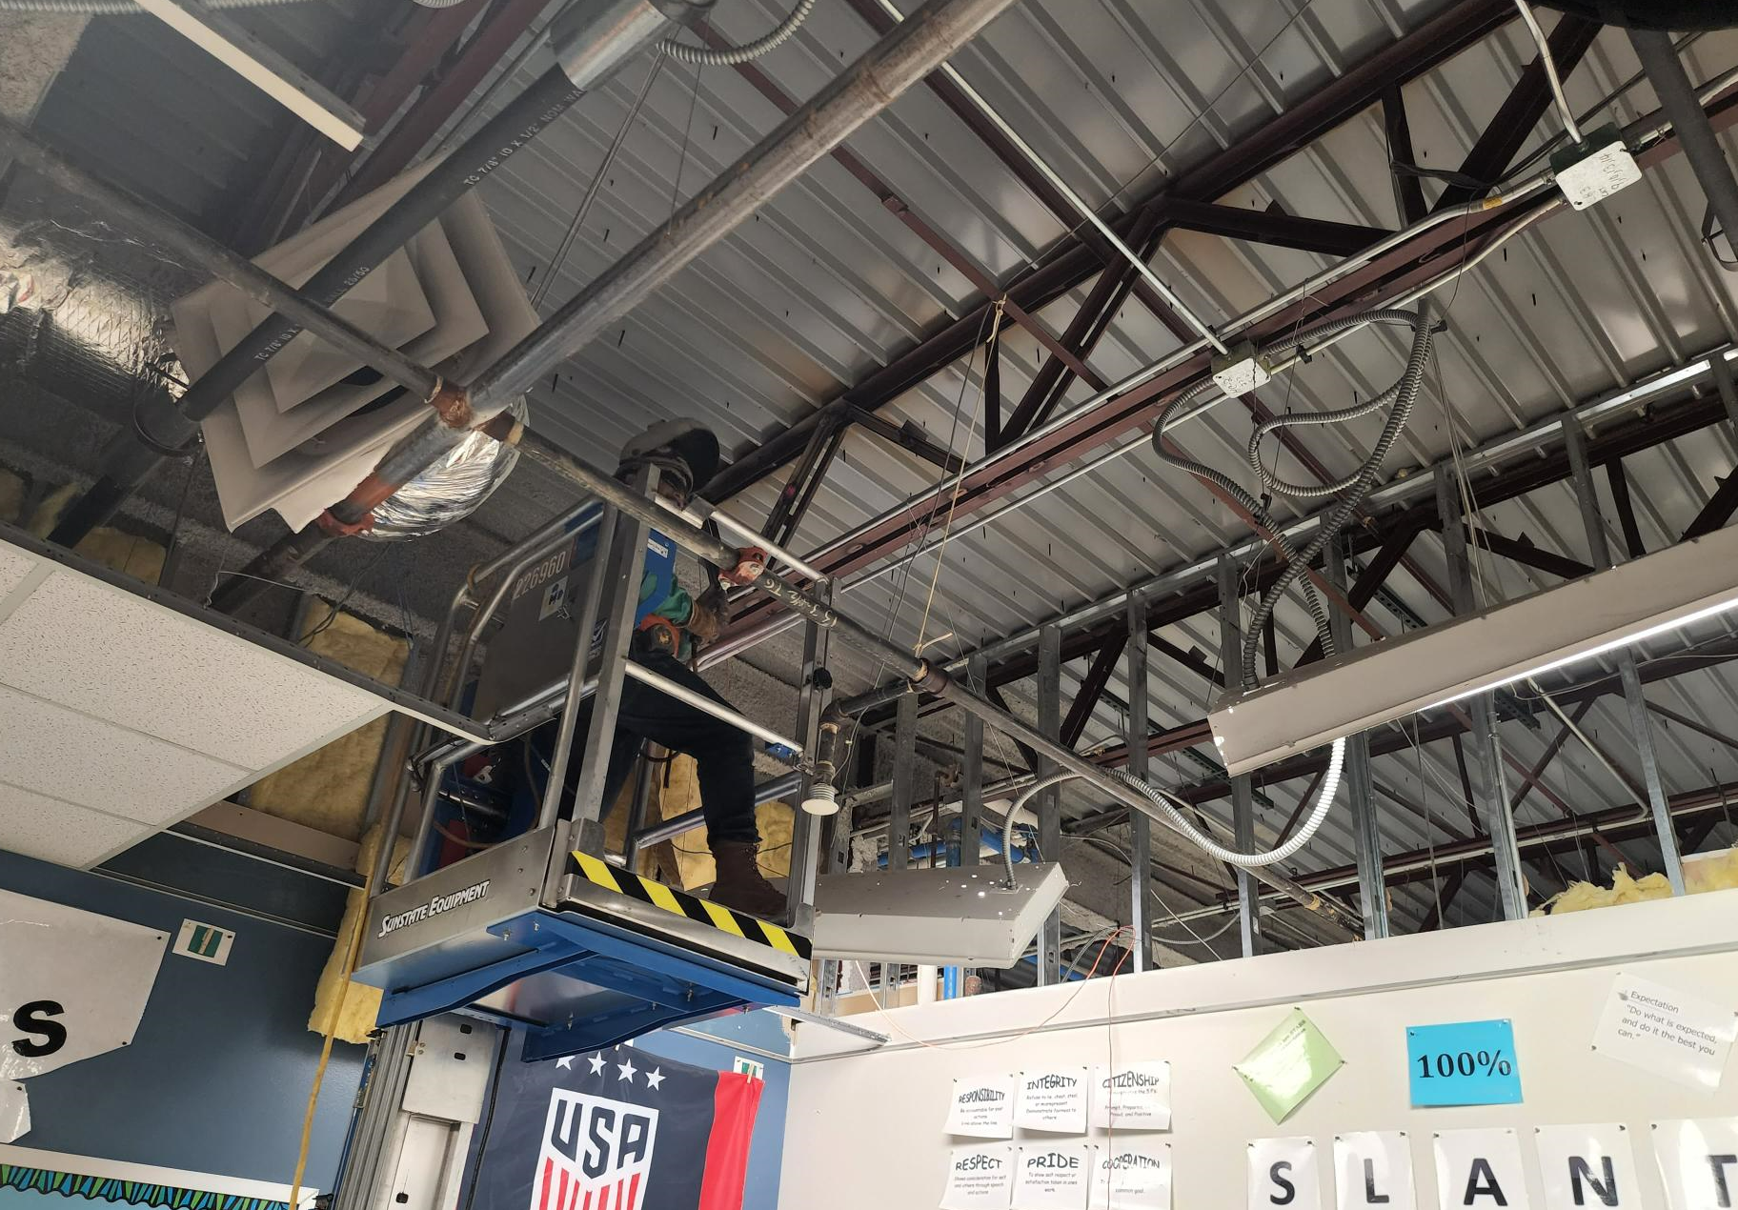
Improvements
Fine Arts Classroom and Performance Space Improvements
  Band, Orchestra, Choir, Theater, and Percussion Hall Renovations
Collaboration Rooms
  Practice Rooms in Fine Arts
Exterior Upgrades
  Roof Replacement and Repair
Interior Upgrades
  Makerspace /Engineering Room Renovation
  Structural Joist Reinforcement
Mechanical, Electrical, and Plumbing Systems Upgrades
  New LED Site Lighting and Controls
  New Rooftop Units and Controls
  Water Bottle Fillers
Landscape Improvements
  Exterior Concrete Replacement
  Exterior Benches
Kitchen Renovation
  New Kitchen Equipment
New Marquee – Coming Soon
Engineering Room #1
Before
After
Structural Joist Reinforcement
PROMISES MADE
PROMISES KEPT

Slide 6
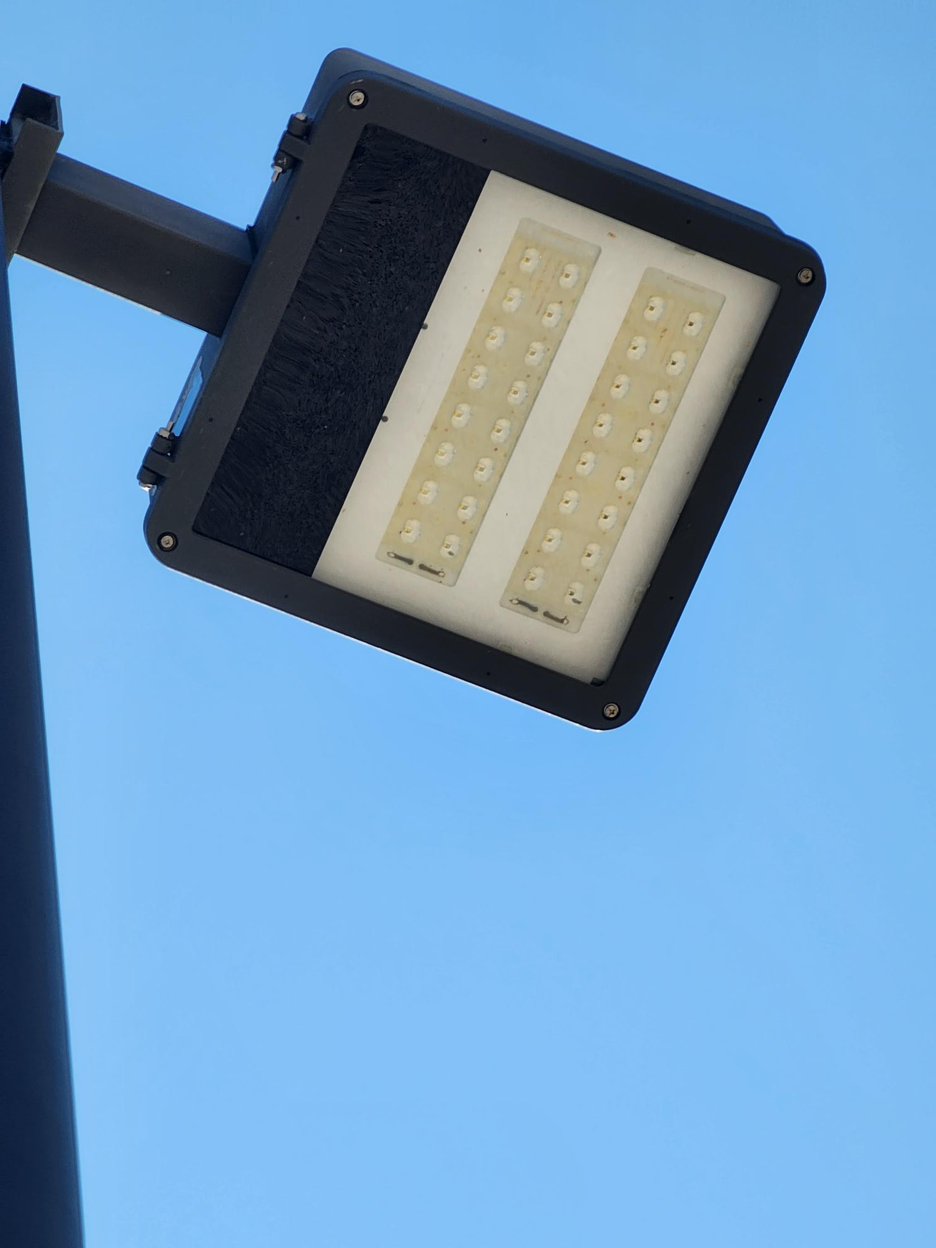
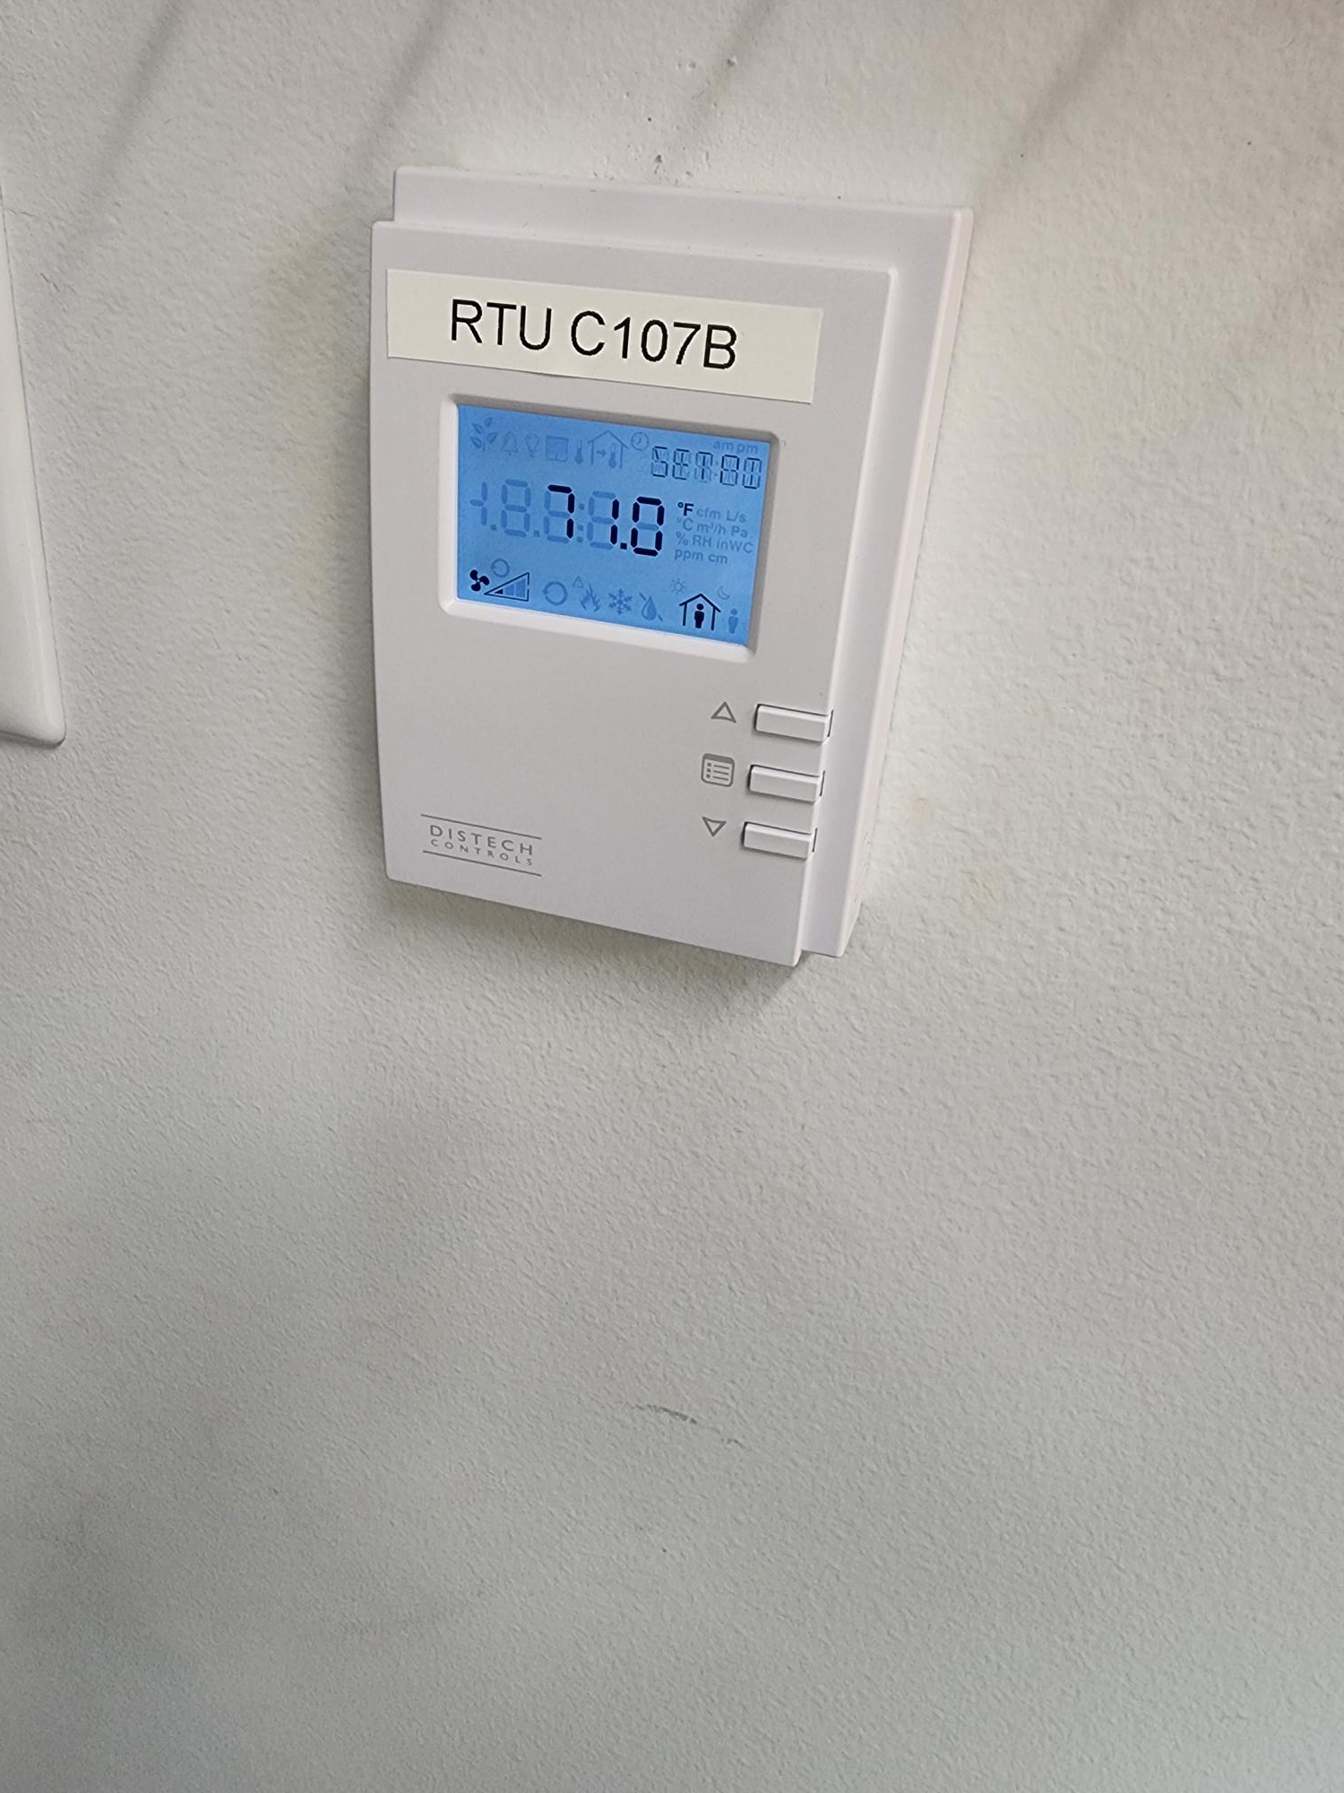
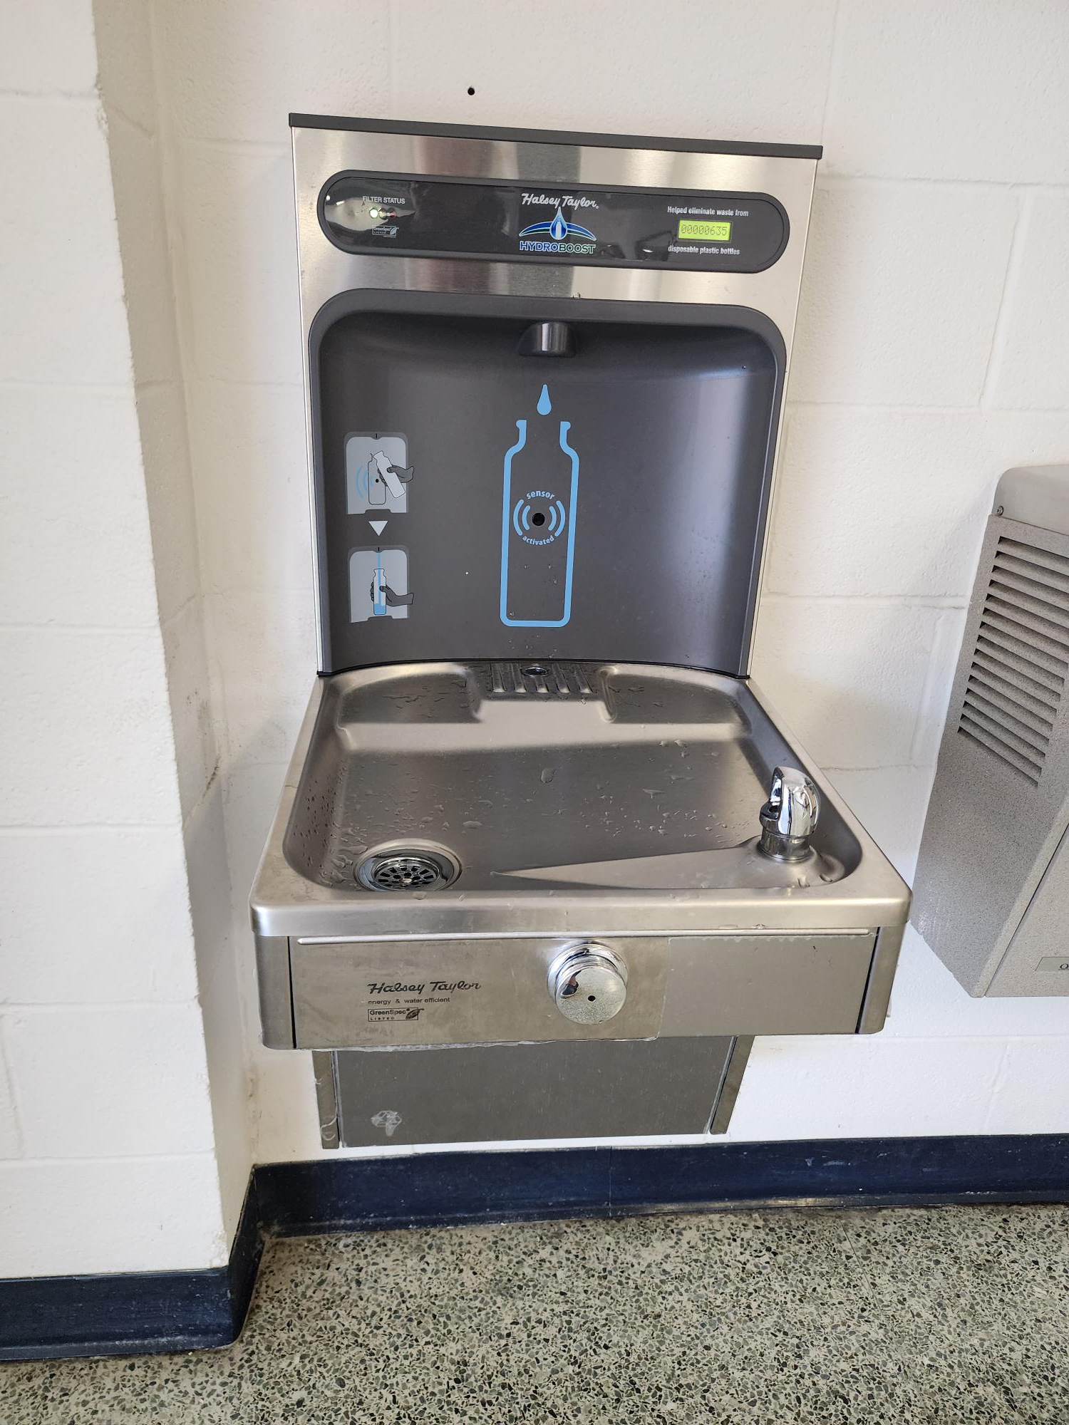
Improvements
Fine Arts Classroom and Performance Space Improvements
  Band, Orchestra, Choir, Theater, and Percussion Hall Renovations
Collaboration Rooms
  Practice Rooms in Fine Arts
Exterior Upgrades
  Roof Replacement and Repair
Interior Upgrades
  Makerspace /Engineering Room Renovation
  Structural Joist Reinforcement
Mechanical, Electrical, and Plumbing Systems Upgrades
  New LED Site Lighting and Controls
  New Rooftop Units and Controls
  Water Bottle Fillers
Landscape Improvements
  Exterior Concrete Replacement
  Exterior Benches
Kitchen Renovation
  New Kitchen Equipment
New Marquee – Coming Soon
Rooftop Units
Site Lighting
PROMISES MADE
PROMISES KEPT
HVAC Controls
Water Bottle Fillers

Slide 7
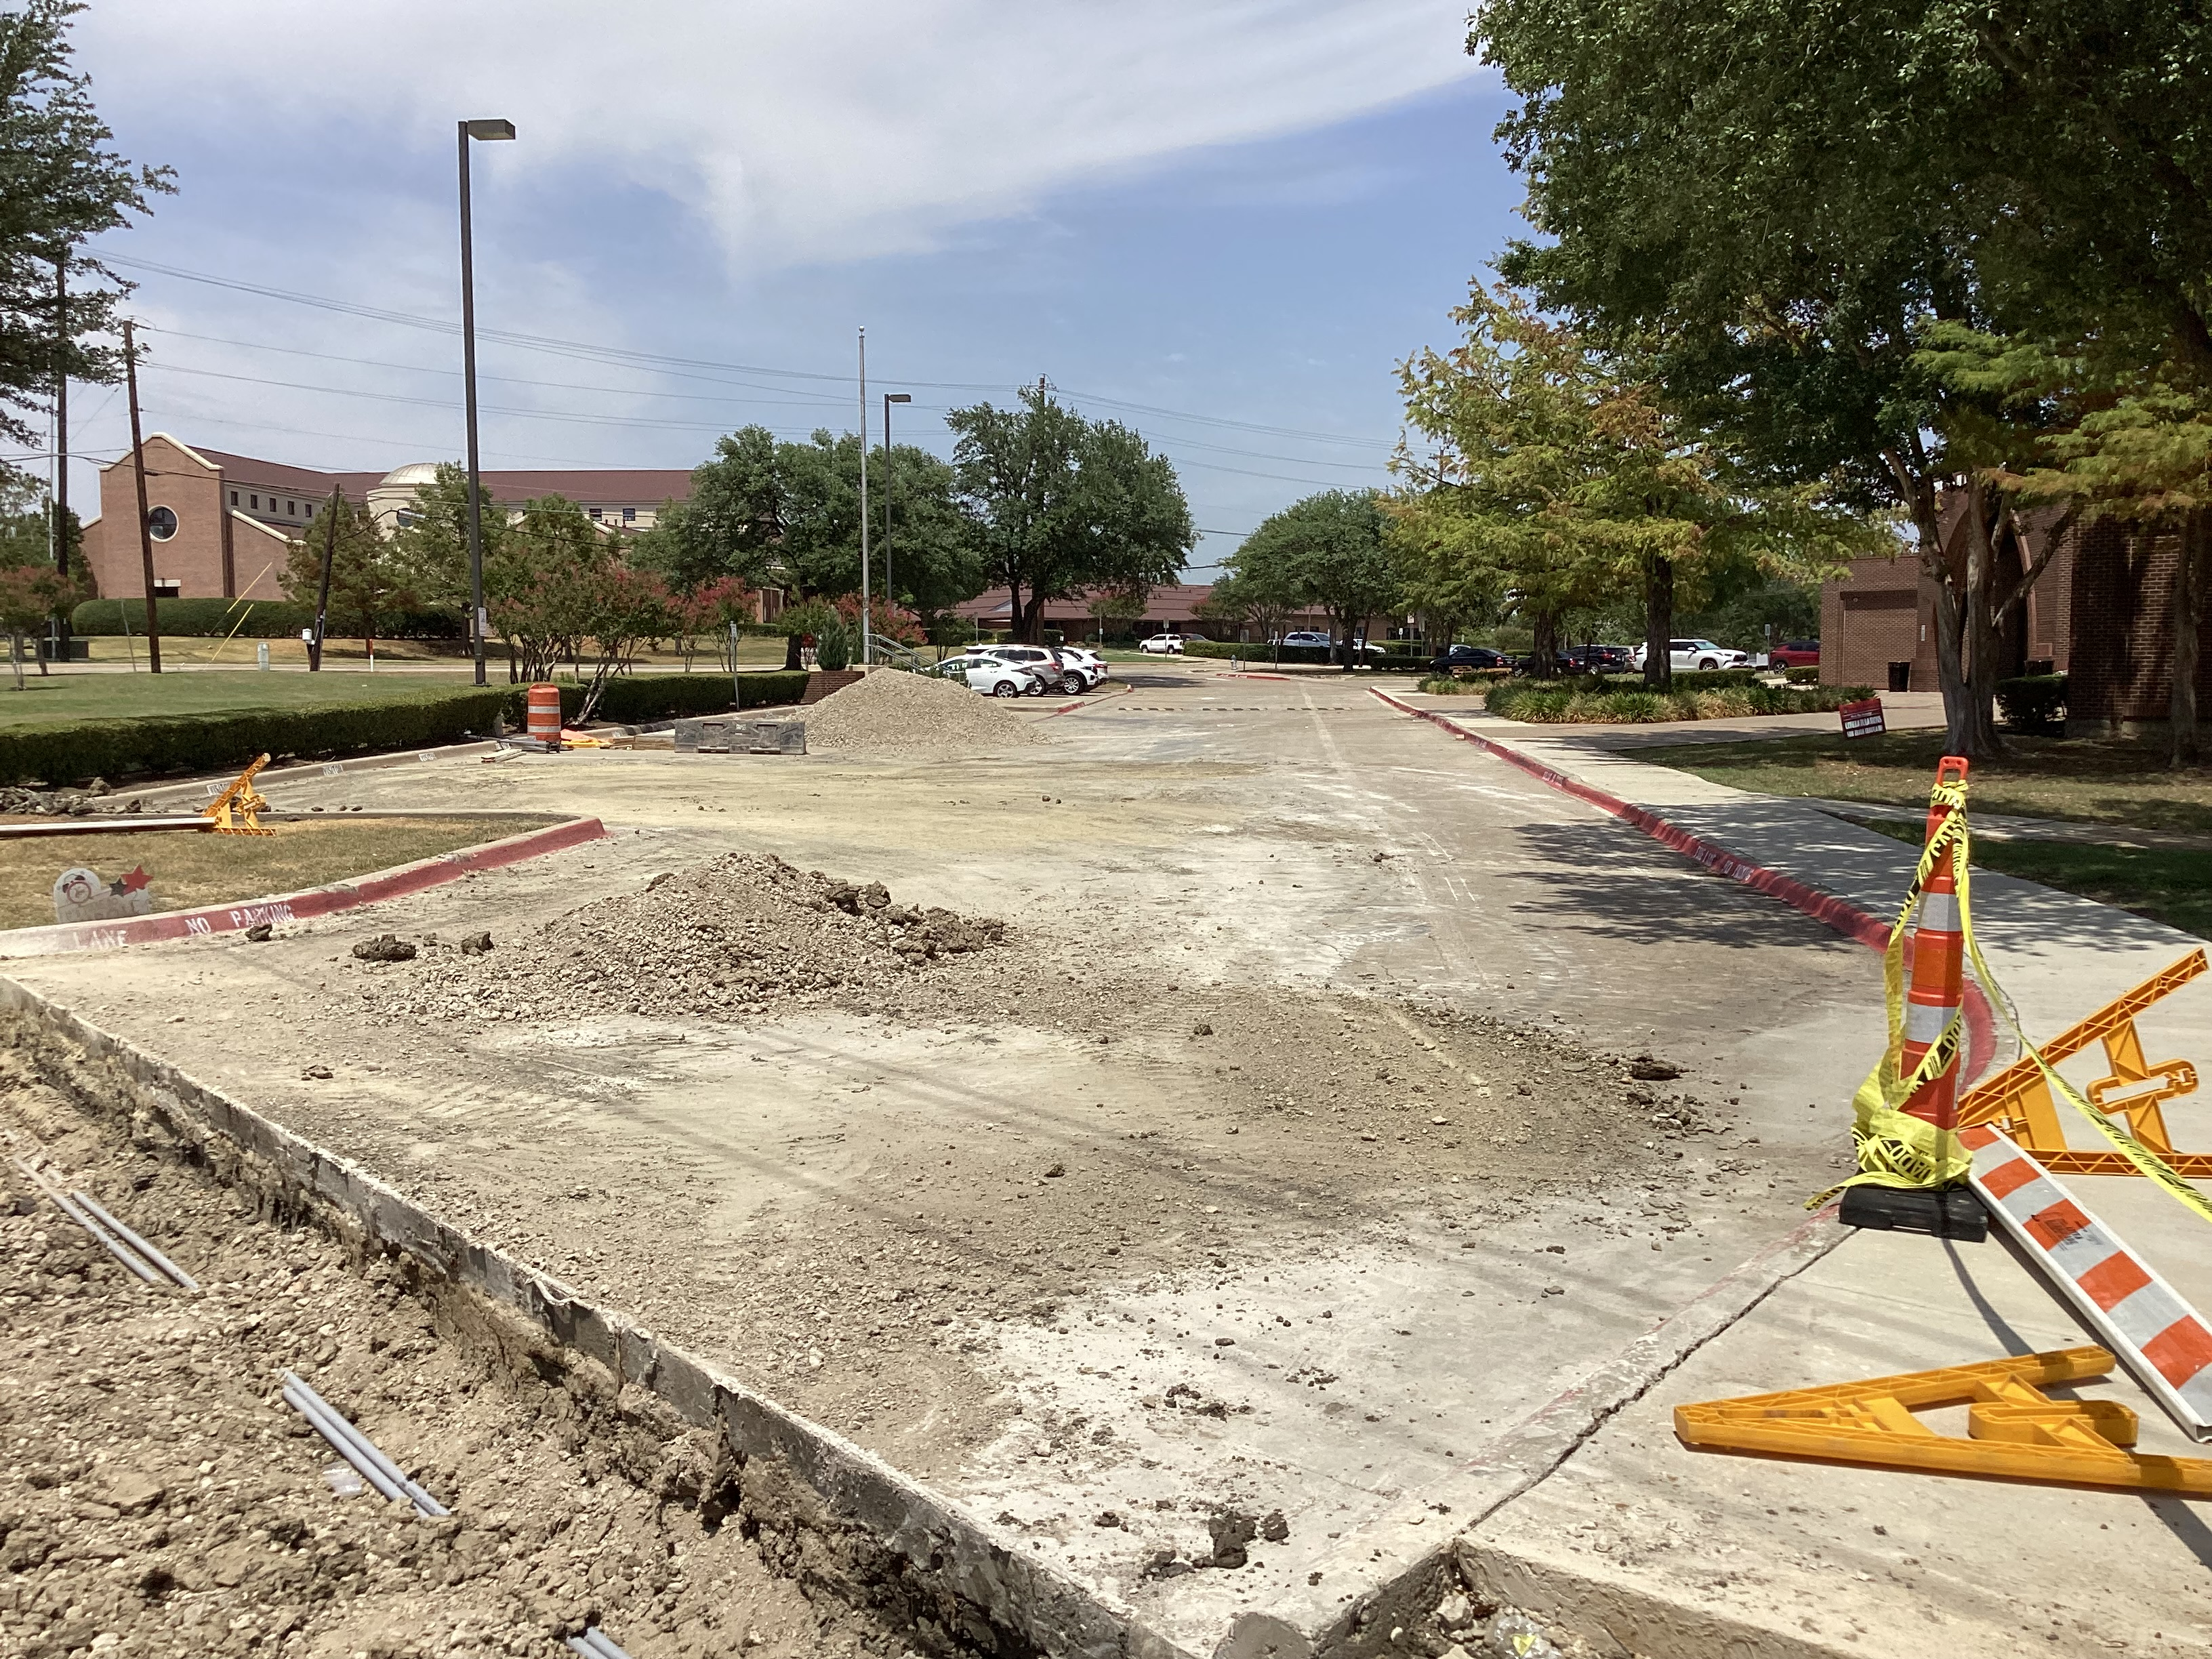
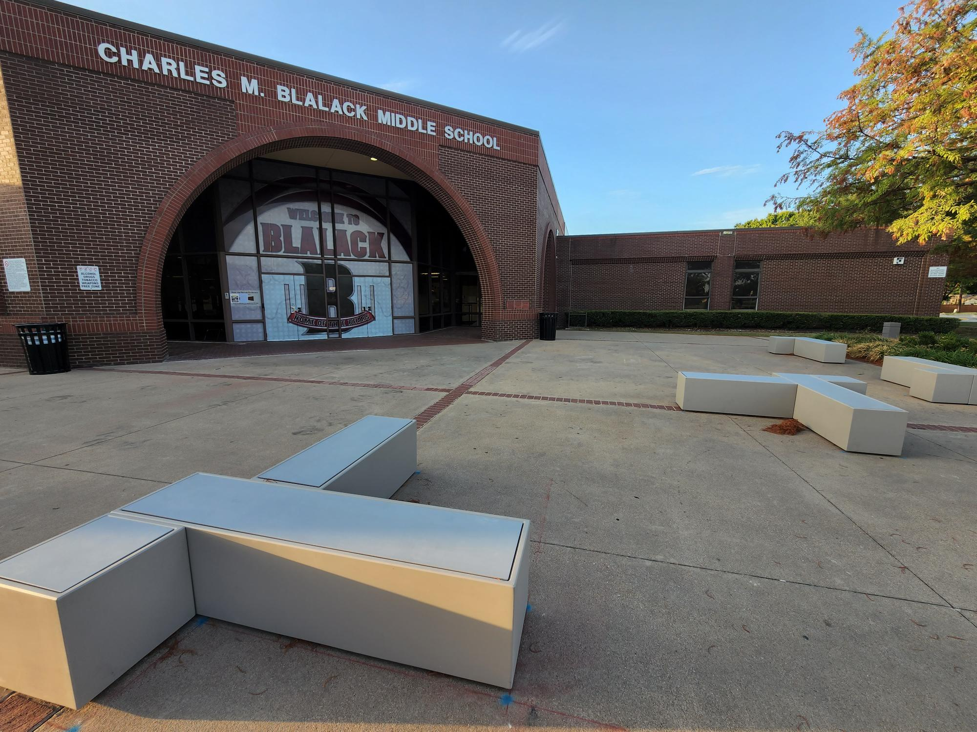
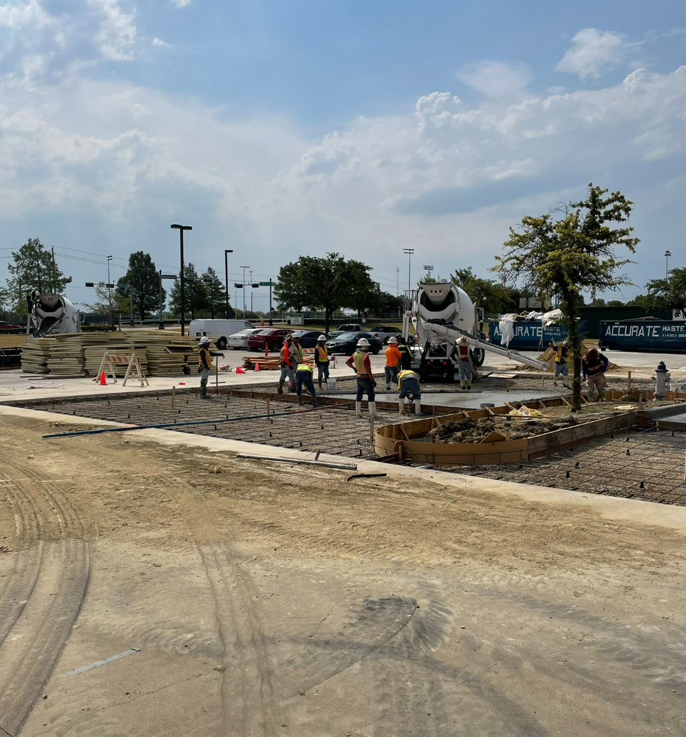
Improvements
Fine Arts Classroom and Performance Space Improvements
  Band, Orchestra, Choir, Theater, and Percussion Hall Renovations
Collaboration Rooms
  Practice Rooms in Fine Arts
Exterior Upgrades
  Roof Replacement and Repair
Interior Upgrades
  Makerspace /Engineering Room Renovation
  Structural Joist Reinforcement
Mechanical, Electrical, and Plumbing Systems Upgrades
  New LED Site Lighting and Controls
  New Rooftop Units and Controls
  Water Bottle Fillers
Landscape Improvements
  Exterior Concrete Replacement
  Exterior Benches
Kitchen Renovation
  New Kitchen Equipment
New Marquee – Coming Soon
Exterior Concrete
PROMISES MADE
PROMISES KEPT
Exterior Benches
Exterior Concrete

Slide 8
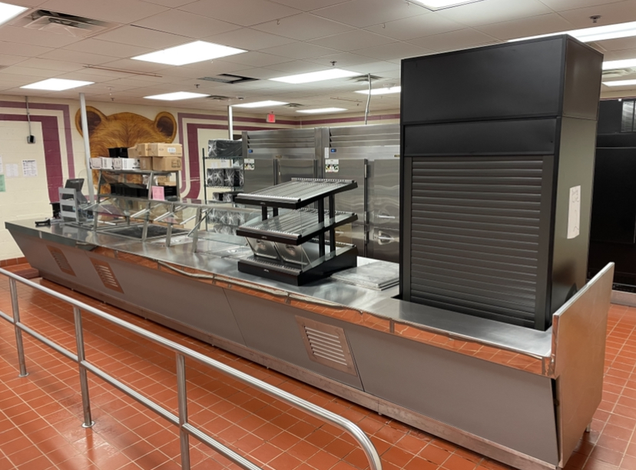
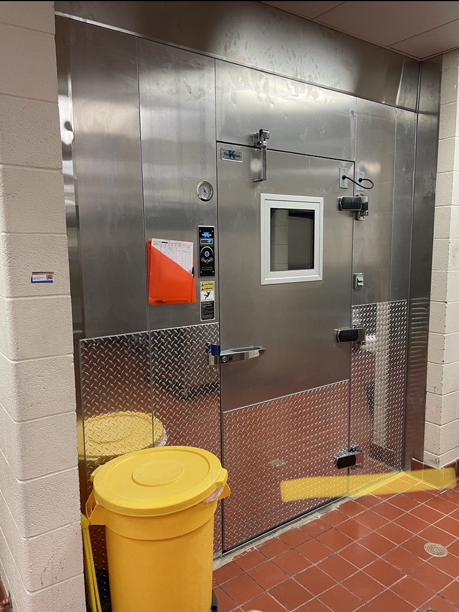
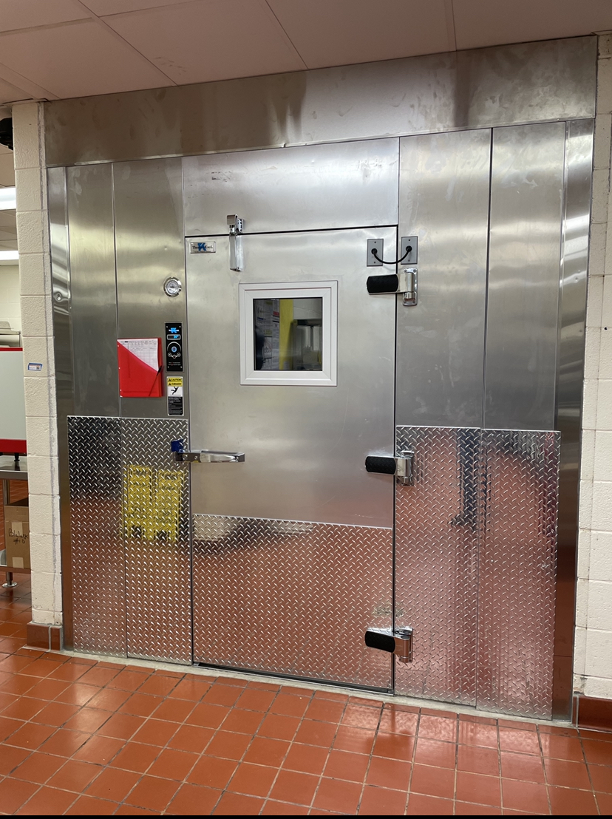
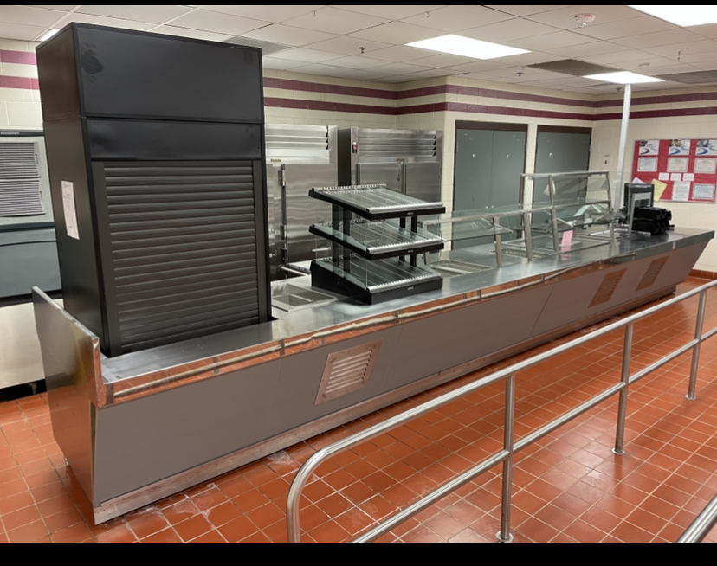
Improvements
Fine Arts Classroom and Performance Space Improvements
  Band, Orchestra, Choir, Theater, and Percussion Hall Renovations
Collaboration Rooms
  Practice Rooms in Fine Arts
Exterior Upgrades
  Roof Replacement and Repair
Interior Upgrades
  Makerspace /Engineering Room Renovation
  Structural Joist Reinforcement
Mechanical, Electrical, and Plumbing Systems Upgrades
  New LED Site Lighting and Controls
  New Rooftop Units and Controls
  Water Bottle Fillers
Landscape Improvements
  Exterior Concrete Replacement
Kitchen Renovation
  New Kitchen Equipment
New Marquee – Coming Soon
New Serving Lines
New Cooler
PROMISES MADE
PROMISES KEPT
New Serving Lines
New Freezer

Slide 9
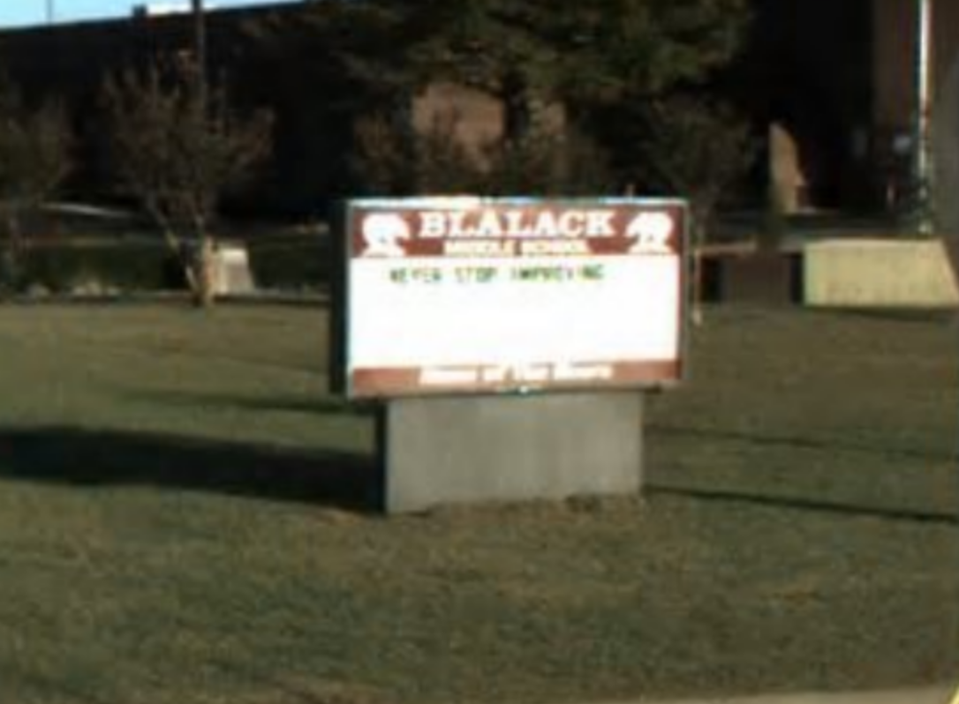
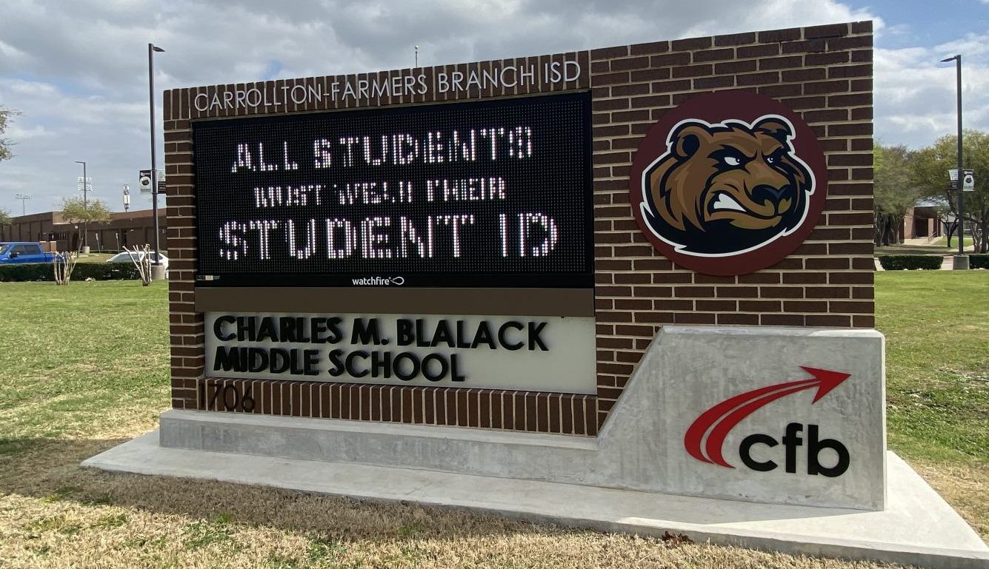
Improvements
Fine Arts Classroom and Performance Space Improvements
  Band, Orchestra, Choir, Theater, and Percussion Hall Renovations
Collaboration Rooms
  Practice Rooms in Fine Arts
Exterior Upgrades
  Roof Replacement and Repair
Interior Upgrades
  Makerspace /Engineering Room Renovation
  Structural Joist Reinforcement
Mechanical, Electrical, and Plumbing Systems Upgrades
  New LED Site Lighting and Controls
  New Rooftop Units and Controls
  Water Bottle Fillers
Landscape Improvements
  Exterior Concrete Replacement
Kitchen Renovation
  New Kitchen Equipment
New Marquee
PROMISES MADE
PROMISES KEPT

Slide 10
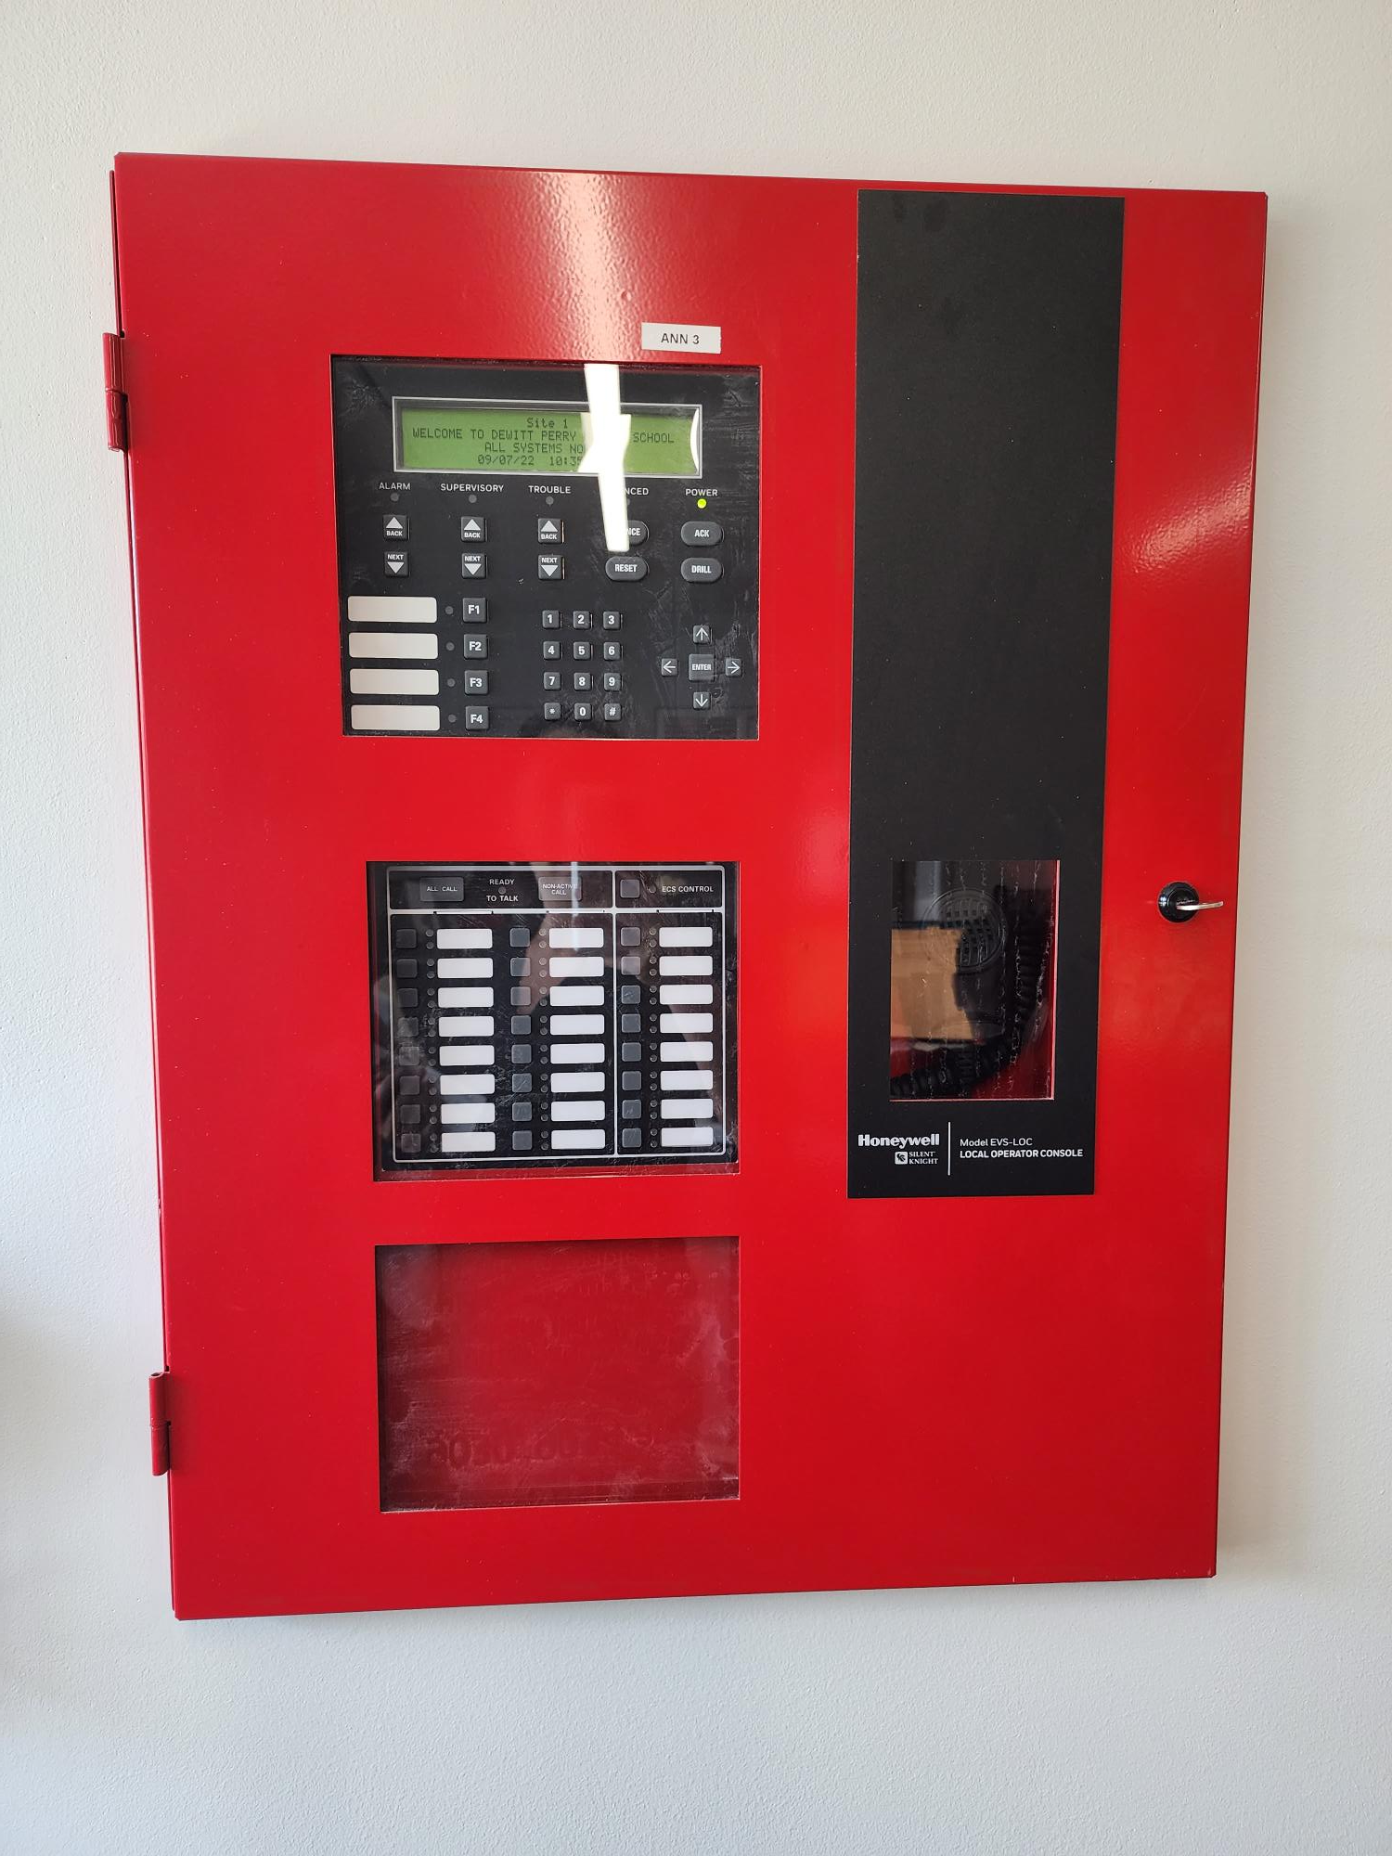

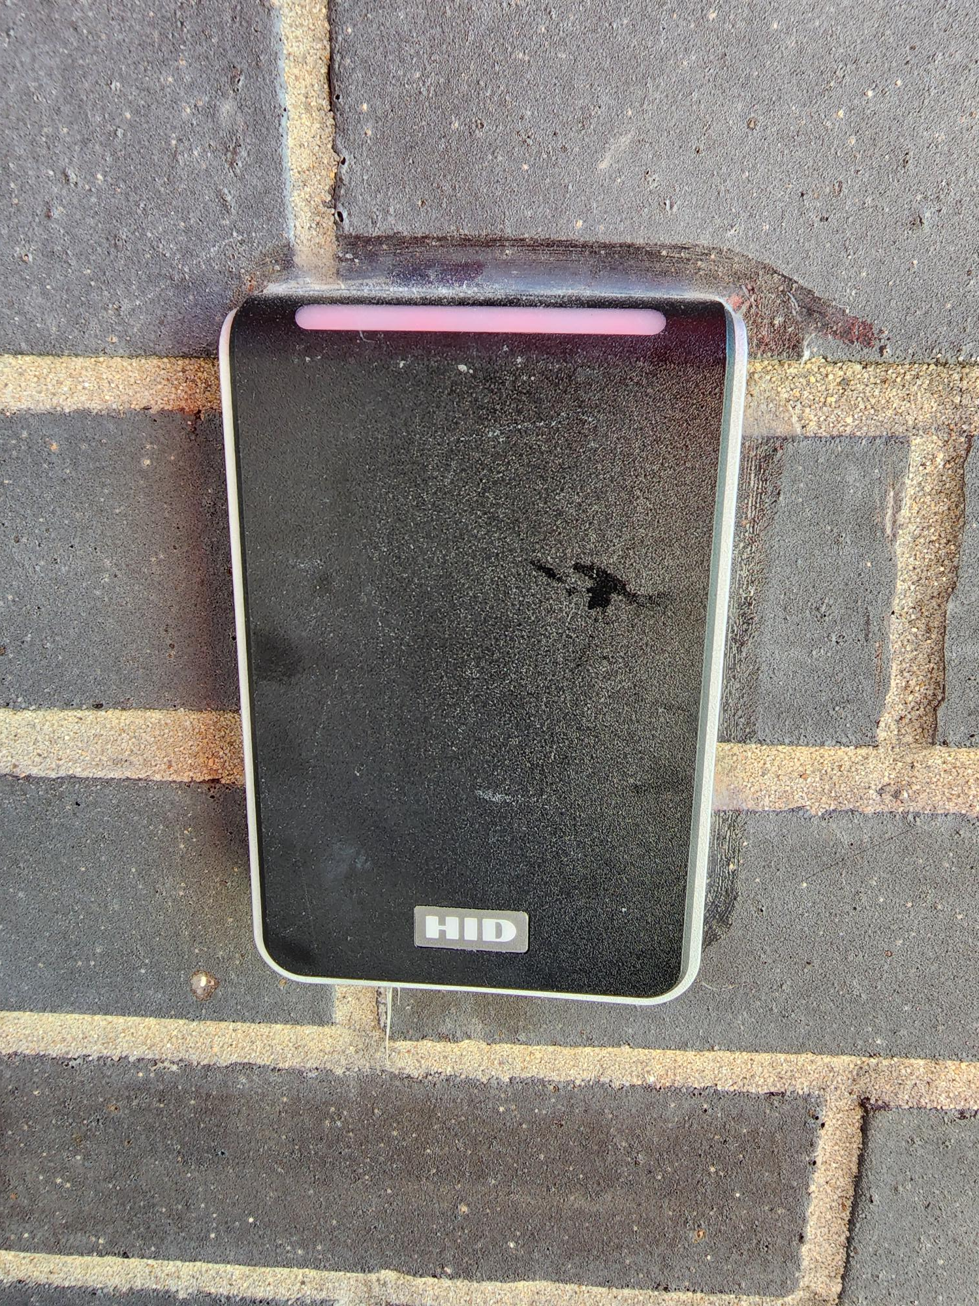
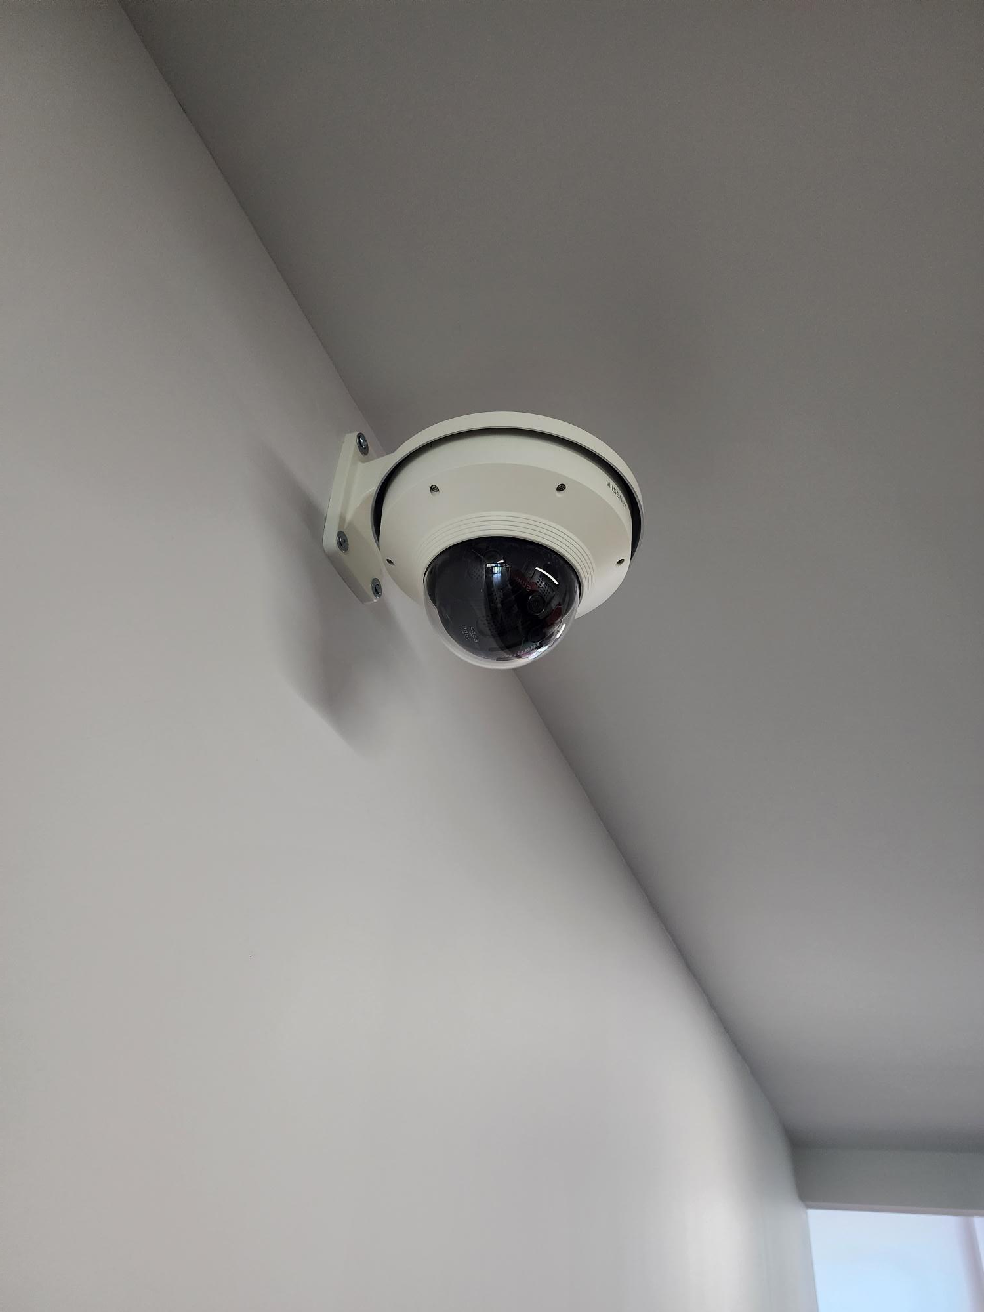
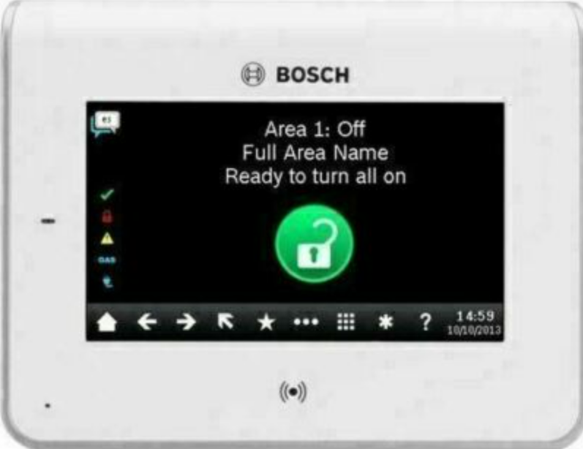
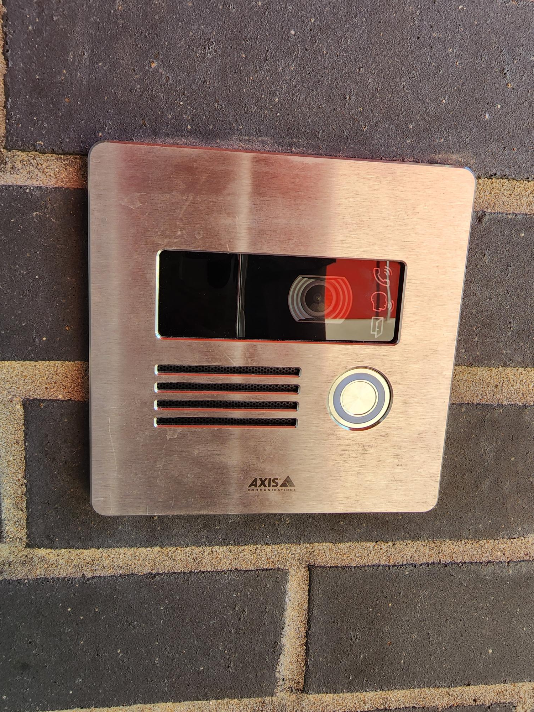
Safety and Security
Access Control
  Intercom
  Card Readers
  Security Alarm
Cameras
Bollards
Fire Sprinkler System Upgrades
Card Readers
Cameras
Fire Alarm
Card Reader
Video Intercom
Exterior Camera
Fire Alarm Panel
PROMISES MADE
PROMISES KEPT
Intercom
Bollards/Benches
Access Control

Slide 11
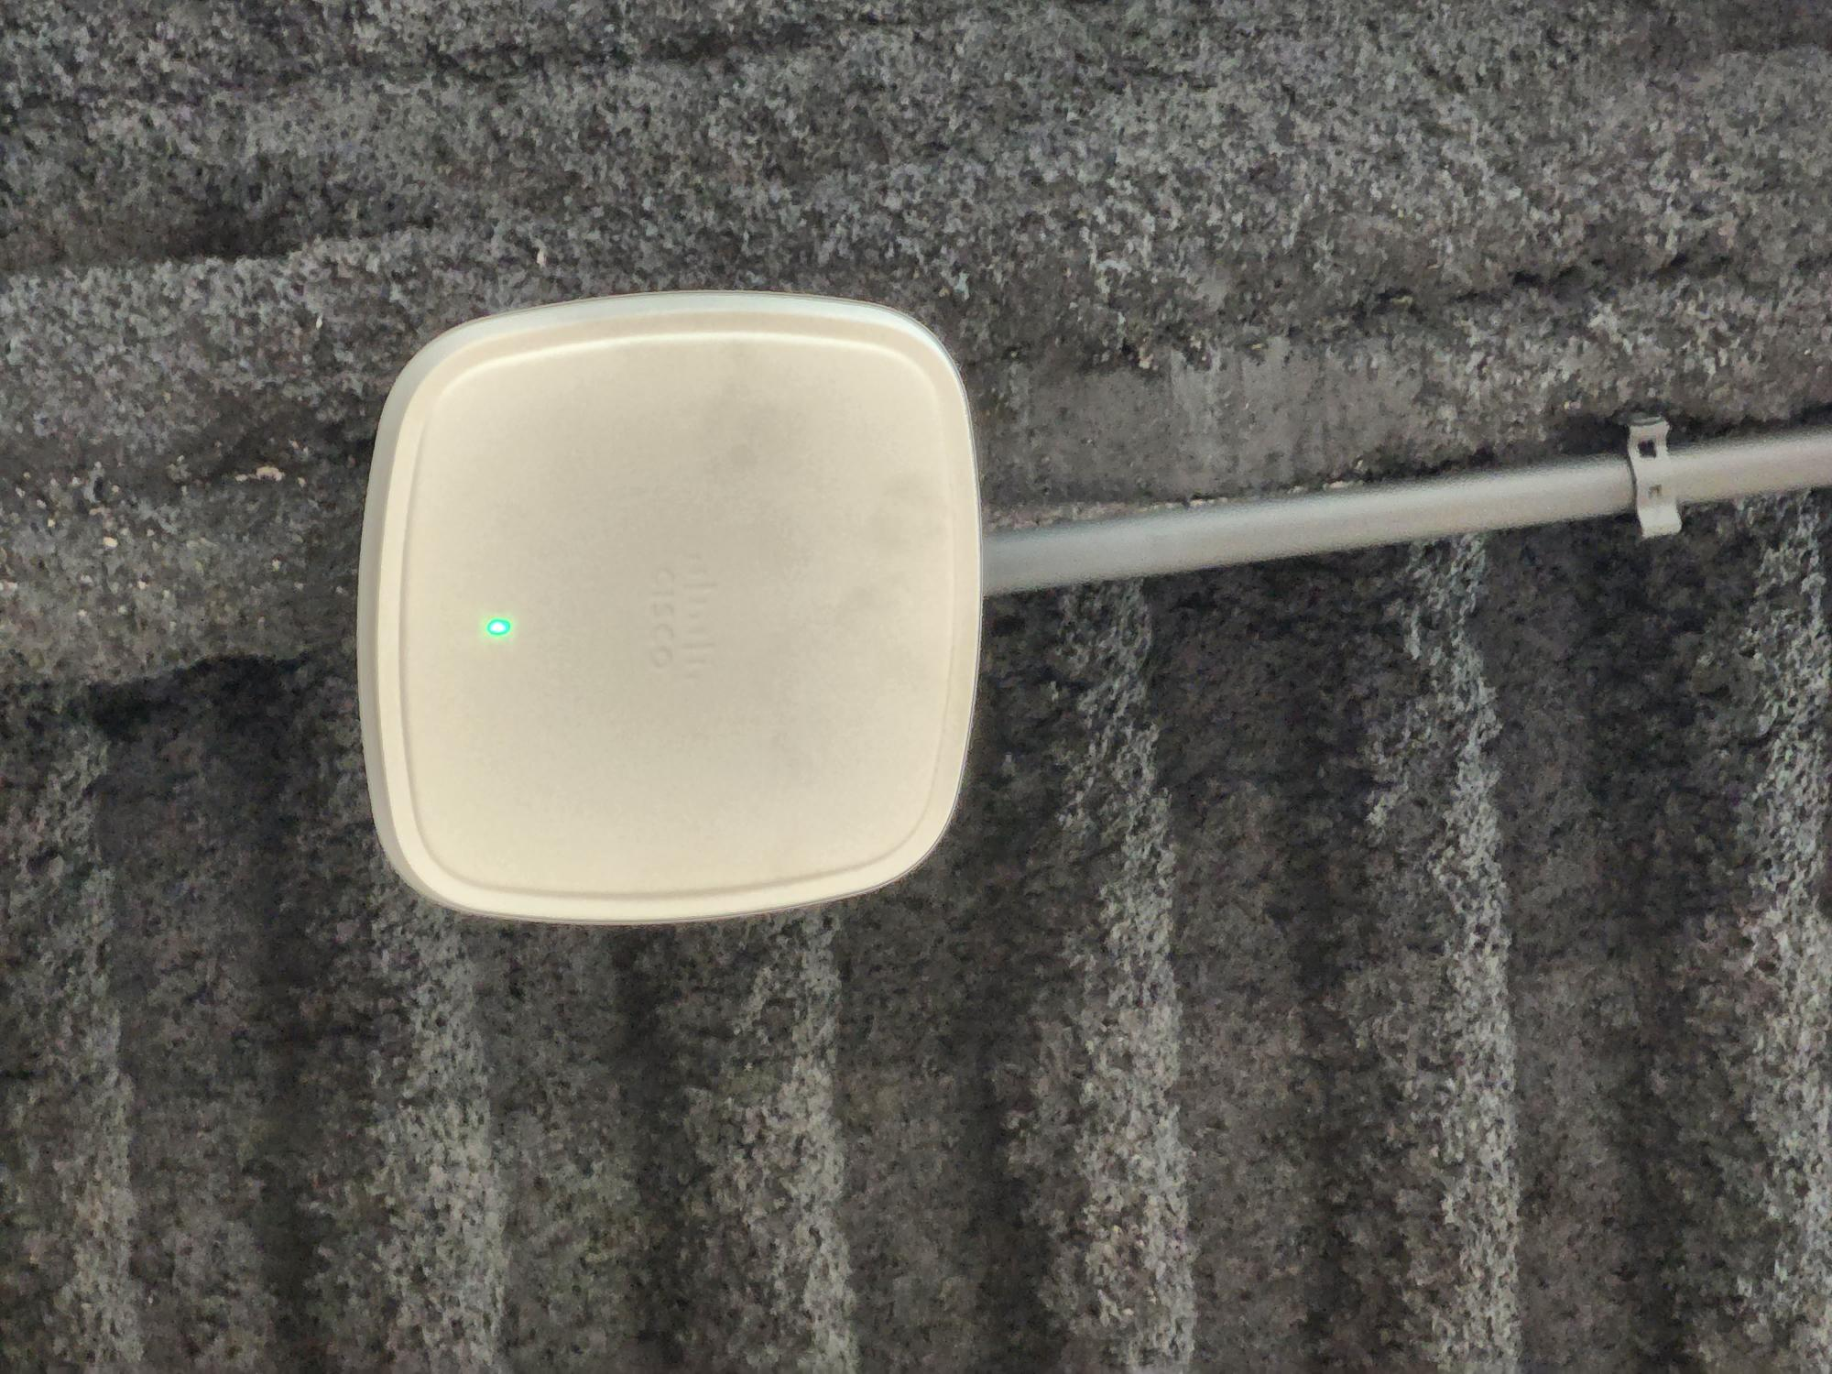

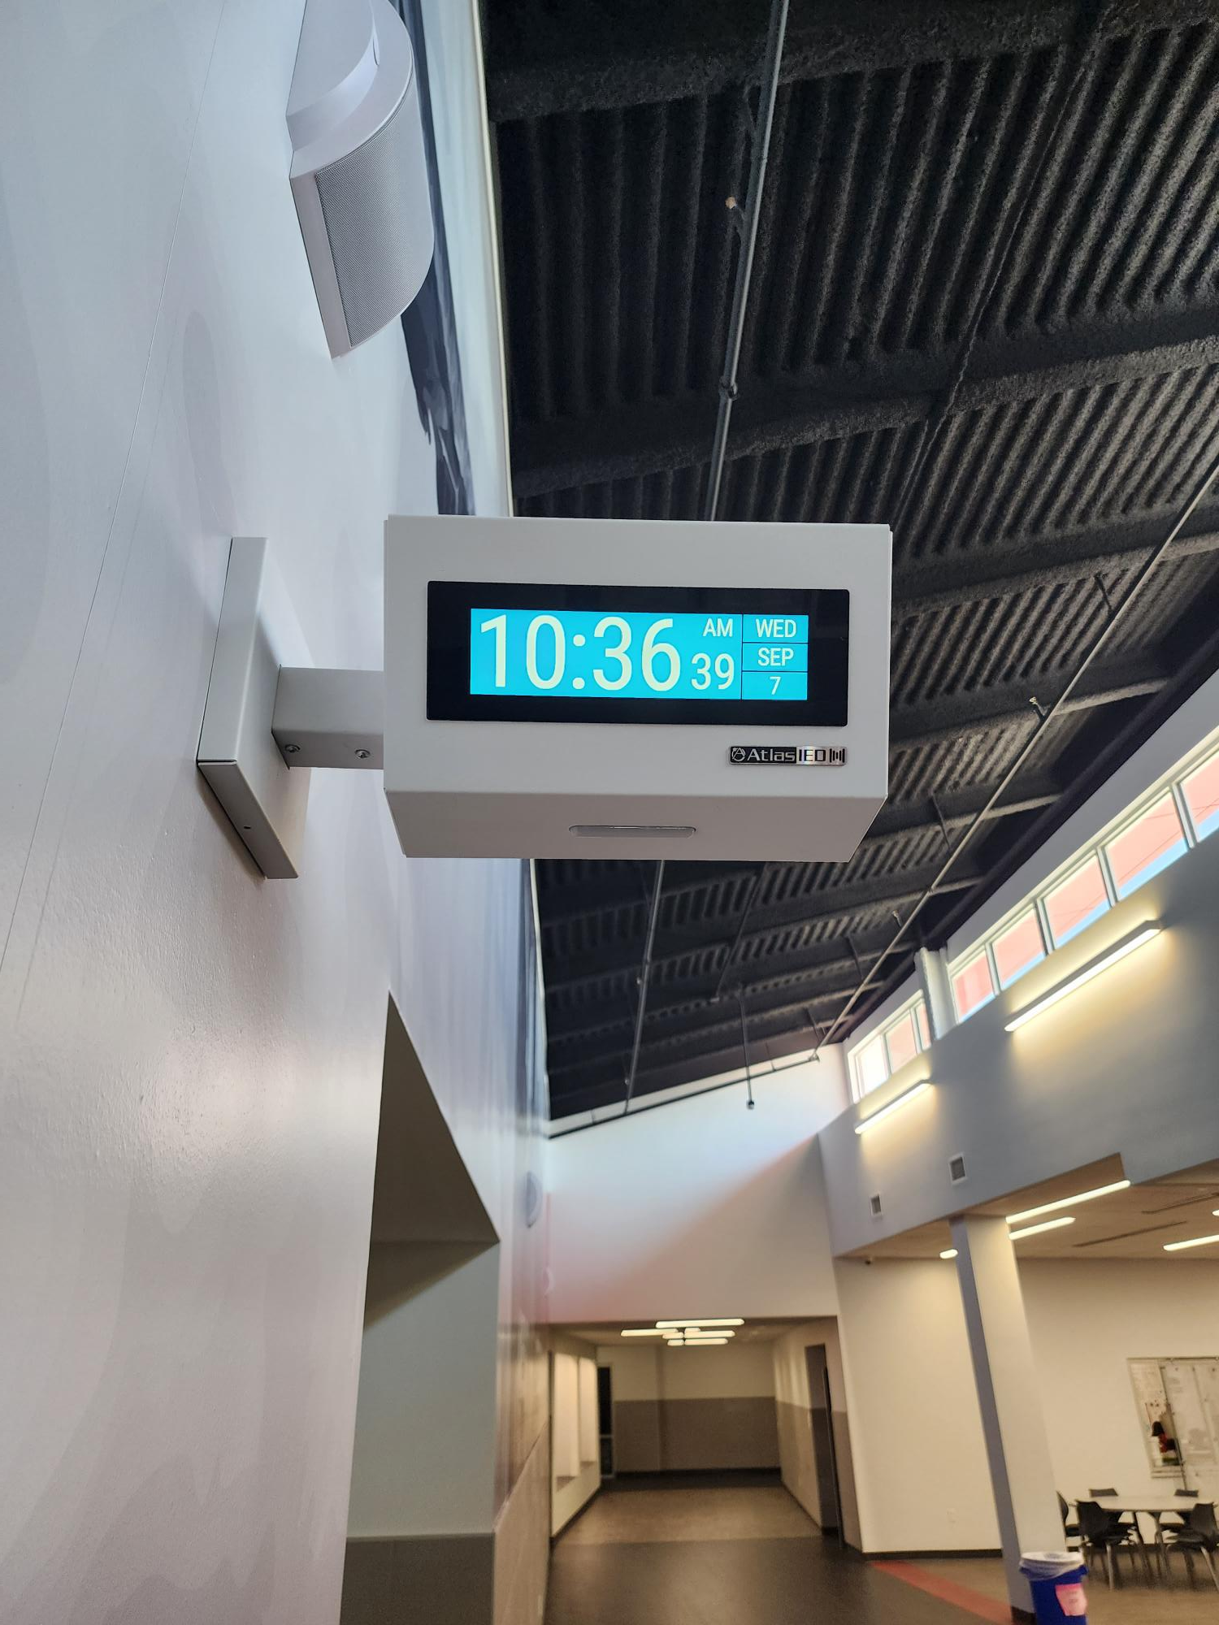
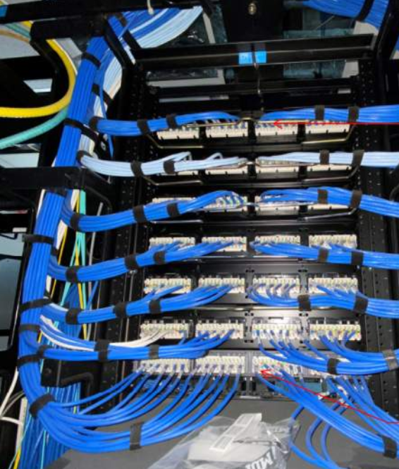
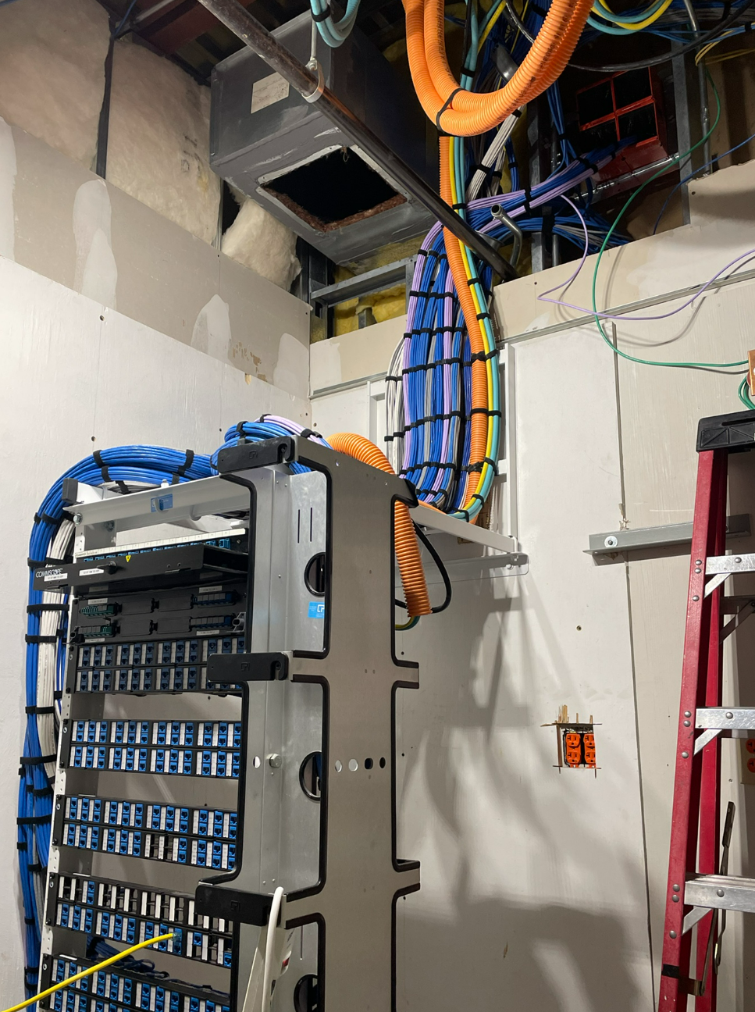
Technology
Secure Climate Controlled Server Space
Cabling
Wireless Upgrades
Phone System Upgrades
Wireless Upgrades
Clocks
PROMISES MADE
PROMISES KEPT
Cabling
Secure Climate Controlled Server Space

Slide 12
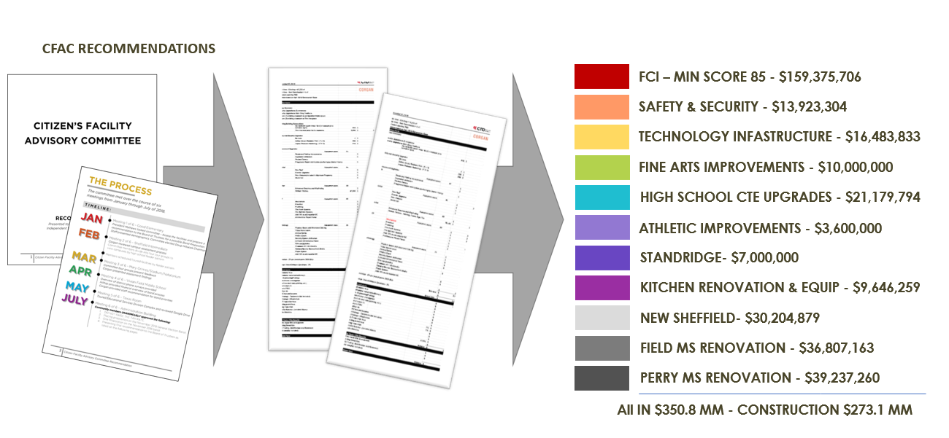
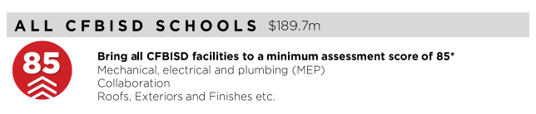
FCI Update
PROMISES MADE
PROMISES KEPT

Slide 13
FCI Update
` | Building Element |  |  |  |  | Type/Material | Prior Condition | Current | Prior Description | 2022 Reno Comments
 | On-Site Utilities & Drainage
 |  | Site Drainage / Erosion Control |  |  |  |  | Good | Good | Positive slope away from building, no visible signs of erosion or ponding water.
 |  | Site Lighting - Parking Lots |  |  |  |  | Good | Good
 |  | Exterior Concrete Pads & Pavement-Around building, mechanical yards |  |  |  |  | Good | Good
 |  | Fire Hydrants / Utility Vaults / Misc. |  |  |  |  | Fair | Fair |  | Not in Scope
 |  | Grease Trap |  |  |  |  | Fair | Fair |  | Not in Scope
 | Site Parking & Drives
 |  | Pavement - Roads / Drives / Parking Areas | Pavement - Roads / Drives / Parking Areas |  |  |  | Good | Good | Clean and clear of cracks, heaving, potholes. Joint Sealer is properly in place.
 |  | Fire Lanes | Fire Lanes |  |  |  | Good | Good | Fire lane paint striping in good condition.Clean and clear of cracks, heaving, potholes. Joint Sealer is properly in place.
 |  | Striping - Parking lot and fire lane | Striping - Parking lot and fire lane |  |  |  | Poor | Good | Incomplete, missing or severely deteriorated/aged. No handicapped parking spaces provided. | Restiped Parking Lot
 |  | Curbs | Curbs |  |  |  | Good | Good | Free of cracks, damage and almost new in appearance.
 | Site Lighting
 |  | Site Lighting |  |  |  |  | Fair | Good | Very few fixtures have minor damage or are not working. Lighting is adequate for security. | Upgraded all Site Lighting to LED
 | Site Security
 |  | Security Cameras |  |  |  | Megapixels | 11 | 388 |  | Upgraded camera resolution and doubled camera count
 |  | Chain Link Fencing / Gates |  |  |  |  | Fair | Fair | Little to no damage to material, poles & gates. Some signs of age. | Not in Scope
 | Misc. Stuctures
 |  | Site Walls - Retaining / Screen |  |  | Material: |  | N/A | N/A
 |  | Dumpster Service Area |  |  |  |  | Fair | Fair | Moderate to Minor signs of damage to dumpster walls, may need a refresh of finish paint if applicable and additional bollards. Gates function as required.
 |  | Bollards |  |  | Material: | Steel | Fair | Good | Minor to moderate signs of age and deterioration but still visible. | Added New Concrete Bollards
 |  | Site Signage - Directional / Handicapped |  |  |  |  | Good | Good
 |  | Misc. Site work / Site Structures |  |  |  |  | N/A | N/A
 | Circulation
 |  | Sidewalks |  |  |  |  | Fair | Good | Sinking at curb by front entrance, front plaza has lots of cracking | Repoured sinking curb by front entrance
 |  | Stairs |  |  |  |  | N/A | N/A
 |  | Ramps |  |  |  |  | Good | Good | Clean and clear of cracks or heaving. Joint Sealer is properly in place. Slope is compliant. Handrails (if present) are compliant & finish is in good condition.
 | ADA Compliance / Accessiblity
 |  | Compliant Sidewalks/Curbs |  |  |  |  | Good | Good
 |  | Compliant Ramps & Handrails |  |  |  |  | Good | Good
 |  |  |  |  |  | Scored Categories | 18 | 18
 |  |  |  |  |  | Good | 10 | 14
 |  |  |  |  |  | Fair | 7 | 4 | Previous Aggregate Score: | 83
 |  |  |  |  |  | Poor | 1 | 0 | Reno Aggregate Score: | 93
 |  |  |  |  |  | N/A | 3 | 3
Site

Slide 14
FCI Update
Building Element |  |  |  |  |  |  | Type/Material | Prior Condition | Current | Prior Description | 2022 Reno Comments
Building Structure/Foundation
 | Foundation |  |  |  |  | Type: | Slab on Grade | Fair | Fair | Minor cracks visible, no signs of heaving. | Not in Scope
 | Substructure - Slab - on - Grade
 |  |  | Basement / Below Grade Exterior Walls |  |  |  |  | Fair | Fair |  | Not in Scope
 |  |  | Miscellanous |  |  |  |  | N/A | N/A
 | Superstructure
 |  |  | Fireproofing |  |  |  |  | N/A | N/A
 |  |  | Pre-Engineered Metal building |  |  |  |  | N/A | N/A
Building Exterior Shell
 | Roofing | Roofing
 |  |  | General Roof Condition (Visual Inspection) |  |  |  |  | Fair | Good | Roof is nearing the end of it's expected useful life. Some leaks are reported with areas of ponding. Some sealants and flashings are in need of repair or replacement. | Replaced roofing in areas reaching the end
 |  |  | Roof Warranty Status |  |  |  |  |  |  | Valid
 |  |  |  |  | Roofing Manufacturer / Warranty Issuer |  |  |  |  | additions- Johns Manville, new- Flex Membrane Int. Inc.
 |  |  |  |  | Years Remaining in Warranty Period |  |  |  |  | new- 12 years
 |  |  | Skylights |  |  |  |  | Fair | Fair
 |  |  | Roof Curbs / Openings / Misc. |  |  |  |  | Fair | Good |  | Reaplced roof curbs as part of RTU replacement
 | Exterior Walls | Exterior Walls
 |  |  | Exterior Wall Material |  |  | Material: | Brick | Good | Good | Veneer is free of cracks, signs of settling, rotation or damage.
 |  |  | Building Caulking/Sealant |  |  |  |  | Fair | Fair | May show minor signs of aging, minor fading or stains.
 |  |  | Exterior Painting |  |  |  |  | N/A | N/A
 | Windows/Glazed Walls | Windows/Glazed Walls
 |  |  | Windows | Windows
 |  |  |  |  |  | Glazing Type: | Single Pane | Fair | Fair | Minor scratches or signs of wear. | Not in Scope
 |  |  |  |  |  | Frame Type: | Aluminum |  |  |  | Not in Scope
 | Exterior Doors Systems | Exterior Doors Systems
 |  |  | Exterior Doors
 |  |  |  |  |  | Frame Type: | Hollow Metal | Fair | Fair | Minor scratches or signs of wear, may need a refresh of finish, door hardware is compliant and functioning properly. | Not in Scope
 |  |  |  |  |  | Panel Type: | Hollow Metal |  |  |  | Not in Scope
 |  |  | Exterior Overhead Doors |  |  | Type: |  | N/A | N/A
 |  |  | Card Access Reader |  |  |  |  | Fair | Good |  | Replaced all Existing Card Readers
 |  |  | Door Bell
 |  |  | Peep Hole
 | Canopies | Canopies
 |  |  | Canopy |  |  | Type: | Attached to Building | Good | Good | No visible damage, proper weather coverage, finishes are almost new in appearance. No signs of settling or movement.
 | Loading Area | Loading Area
 |  |  | Raised Loading Dock |  |  |  |  | Good | Good | No visible damage, no signs of settling or movement. Dock bumpers present and almost new in appearance.
 |  |  | Independent Loading Area |  |  |  |  | N/A | N/A
 | Misc. Exterior | Misc. Exterior
 |  |  | Exterior Soffit - Material |  |  | Material: | Plaster | Good | Good | Almost new in appearance, no visible fading or stains.
 |  |  | Exterior Louvers / Sunscreens |  |  |  |  | N/A | N/A
 |  |  |  |  |  |  | Scored Categories | 13 | 13
 |  |  |  |  |  |  | Good | 4 | 7
 |  |  |  |  |  |  | Fair | 9 | 6 | Previous Aggregate Score: | 77
 |  |  |  |  |  |  | Poor | 0 | 0 | Reno Aggregate Score: | 85
 |  |  |  |  |  |  | N/A | 7 | 7 | *Adjusted Previous Score for Roofing, as grade only reflected evaluation over addition. Remainder of roof had reached the end of it's useful life
Exterior

Slide 15
FCI Update
 | Building Element |  |  |  |  |  |  | Type/Material | Prior Condition | Current | Prior Description | 2022 Reno Comments
 | Interior Finishes
 |  | Interior Ceiling Finishes
 |  |  | Acoustical Ceilings - 2x2 Tiles |  |  |  | Scrubbable Finish | Yes | Good | Good | Almost new in appearance, no signs of sagging, damage, leaks, or stains.
 |  |  | Acoustical Ceilings - 2x4 Tiles |  |  |  | Scrubbable Finish |  | N/A | N/A
 |  |  | Plaster Ceilings |  |  |  |  |  | N/A | N/A
 |  |  | Painted Gypsum Ceiling |  |  |  |  |  | Good | Good | Almost new in appearance, no signs of sagging, damage, leaks, or stains.
 |  |  | Metal Ceilings |  |  |  |  |  | N/A | N/A
 |  |  | Exposed / Painted Ceilings |  |  |  |  |  | N/A | N/A
 |  |  | Soffit / Bulkhead Walls |  |  |  |  |  | Fair | Fair | Minor signs of aging with minimal apparent stains, leaks, sagging or damage. | Not In Scope
 |  |  | Special/Misc. |  |  |  |  |  | N/A | N/A
 |  | Interior Floor Finishes
 |  |  | Resilient Flooring - VCT |  |  |  |  |  | Good | Good | Almost new in appearance, no signs of damage or stains, properly sealed and finished.
 |  |  | Quarry Tile |  |  |  |  |  | Good | Good | Almost new in appearance, no signs of damage or stains, properly sealed and finished.
 |  |  | Ceramic Tile |  |  |  |  |  | Good | Good | Almost new in appearance, no signs of damage or stains, properly sealed and finished.
 |  |  | Terrazzo |  |  |  |  |  | Good | Good | Almost new in appearance, no signs of damage or stains, properly sealed and finished.
 |  |  | Poured Resinous Epoxy |  |  |  |  |  | N/A | N/A
 |  |  | Finish Concrete - (sealed) |  |  |  |  |  | N/A | N/A
 |  |  | Carpet (Classrooms, Library, and Administration) |  |  |  |  |  | Good | Good | Almost new in appearance, no signs of damage or stains, properly sealed and finished.
 |  |  | Carpet (Fine Arts Wing) |  |  |  |  |  | Fair | Good
 |  |  | Natural Stone |  |  |  |  |  | N/A | N/A
 |  |  | Wood |  |  |  |  |  | Good | Good | Almost new in appearance, no signs of damage or stains, properly sealed and finished.
 |  |  | Special/Misc. |  |  |  |  |  | N/A | N/A
 |  | Interior Wall Finishes
 |  |  | Painted Gypsum Board - Full Height |  |  |  |  |  | Good | Good | Almost new in appearance, no signs of damage, stains or cracking.
 |  |  | Painted CMU - Full Height |  |  |  |  |  | Good | Good | Almost new in appearance, no signs of damage, stains or cracking.
 |  |  | Painted Gypsum Board + Tile Wainscot |  |  |  |  |  | Good | Good | Almost new in appearance, no signs of damage, stains or cracking.
 |  |  | Full Height Tile |  |  |  |  |  | Good | Good | Almost new in appearance, no signs of damage, stains or cracking.
 |  |  | PLAM |  |  |  |  |  | N/A | N/A
 |  |  | FRP |  |  |  |  |  | N/A | N/A
 |  |  | Wood Panels |  |  |  |  |  | N/A | N/A
 |  | Interior Wall Base & Trim
 |  |  | Rubber Base (Classrooms, Library, and Administration) |  |  |  |  |  | Good | Good | Almost new in appearance, no signs of damage and properly installed.
 |  |  | Rubber Base (Fine Arts Wing) |  |  |  |  |  | Fair | Good |  | Replaced in Areas of Renovation
 |  |  | Quarry Tile |  |  |  |  |  | Good | Good | Almost new in appearance, no signs of damage and properly installed.
 |  |  | Ceramic Tile |  |  |  |  |  | N/A | N/A
 |  |  | Terrazzo |  |  |  |  |  | Good | Good | Almost new in appearance, no signs of damage and properly installed.
 |  |  | Poured Resinous Epoxy |  |  |  |  |  | N/A | N/A
 |  |  | Wood Base |  |  |  |  |  | N/A | N/A
Interior

Slide 16
FCI Update
 | Misc. Interior
 |  | Interior Door Systems | Interior Door Systems
 |  |  |  | Frame Type: |  |  |  | Hollow Metal | Good | Good | No visible damage, proper weatherproofing/threshold apparent, door hardware compliant and functioning properly.
 |  |  |  | Panel Type:
 |  | Interior Overhead Door/Grille | Interior Overhead Door/Grille |  |  |  | Type: |  | Fair | Fair | Minor scratches or signs of wear, may need a refresh of finish, door hardware is compliant and functioning properly, motor works as required (if applicable). | Not In Scope
 |  | Specialty Doors | Specialty Doors |  |  |  | Type: |  | N/A | N/A
 |  | Millwork Cabinets | Millwork Cabinets |  |  |  |  |  | Good | Good
 |  | Corner Guards | Corner Guards |  |  |  | Type: | Stainless Steel | Good | Good | Almost new in appearance.
 |  | Interior Signage | Interior Signage |  |  |  |  |  | Good | Good
 |  | Digital Clocks | Digital Clocks |  |  |  |  |  | N/A | Good |  | New Digital Clocks Installed
 |  | Operable Partitions | Operable Partitions |  |  |  |  |  | N/A | N/A
 |  | Marker & Tack Boards | Marker & Tack Boards |  |  |  |  |  | Good | Good | No cracking or warping of the board surface. | Replaced in All Areas of Renovation
 |  | Projection Screens | Projection Screens |  |  |  |  |  | N/A | N/A
 |  | A/V Equipment | A/V Equipment |  |  |  |  |  | Good | Good |  | Upgraded in Areas of Renovation
 |  | Lockers | Lockers |  |  |  | Required Number of Lockers: |  | Good | Good
 |  |  |  |  |  |  | Provided Number of Lockers:
 |  | Railings | Railings |  |  |  |  |  | Good | Good
 |  | Elevator Cab Finishes | Elevator Cab Finishes |  |  |  |  |  | N/A | N/A
 |  | Wireless Access | Wireless Access |  |  |  |  |  | Fair | Good |  | Wired Building for new Wireless Access Points
 |  | Toilet Partitions | Toilet Partitions |  |  |  | Material Type: | Plastic | Good | Good
 |  | Toilet Accessories | Toilet Accessories |  |  |  |  |  | Good | Good | Almost new condition, proper installation.
 |  | Interior Window Blinds/Shades | Interior Window Blinds/Shades |  |  |  | Type of Blinds: | Metal | Good | Good | No visible damage, motor properly functions (if applicable).
 |  |  |  |  |  |  | Type of Shades:
 |  |  |  |  |  |  | Operation: | Manual
 | Food Service Area
 |  | Equipment Condition |  |  |  |  |  |  | Fair | Good |  | Replaced Kitchen Equipment and Freezer/Cooler Units
 |  | Digital Menu Boards |  |  |  |  |  |  | N/A | N/A
 |  | Restrooms open to Kitchen? |  |  |  |  |  |  | No | No
 |  | Drinking Fountains in Cafeteria? |  |  |  |  |  |  | No | No
 | Accessibility
 |  | Restrooms |  |  |  |  |  |  | Good | Good | Compliant
 |  | Drinking Fountains |  |  |  |  |  |  | Good | Good | Compliant
 |  | Ramps |  |  |  |  |  |  | Good | Good | Compliant
 |  | Signage |  |  |  |  |  |  | Good | Good | Compliant
 |  | Doors |  |  |  |  |  |  | Good | Good | Compliant
 |  | Millwork |  |  |  |  |  |  | Fair | Fair | Few compliance items | Not in Scope
 |  |  |  |  |  |  |  | Scored Categories | 40 | 41
 |  |  |  |  |  |  |  | Good | 31 | 36
 |  |  |  |  |  |  |  | Fair | 7 | 3 | Previous Aggregate Score: | 89
 |  |  |  |  |  |  |  | Poor | 0 | 0 | Reno Aggregate Score: | 93
 |  |  |  |  |  |  |  | N/A | 21 | 20 | *Separated out Building Element by Area to Capture upgraded finishes in area of renovation
Interior

Slide 17
FCI Update
BLALACK MIDDLE SCHOOL |  | AGE: 31 Years |  | 171,150 sf
ITEM | DESCRIPTION | DESCRIPTION |  |  |  |  | Prior Grade | Current
OPERATIONAL, SYSTEMS & CODE DEFICIENCIES | Assessed Scope | Performed Scope
HVAC | Task: Replace 1998 York packaged units. | Replaced as part of renovation |  |  |  |  | 60 | 98
EMCS | Task: Replace CSI controls system. Cost included in 1998 York unit replacement. | Replaced as part of renovation
PLUMBING | Task: Replace and repipe grease trap. | Not in Scope |  |  |  |  | 86 | 95
 | Task: Provide new EWCs With bottle fillers in select locations. | Replaced as part of renovation
 | Task: Replace two 2008 Lochinvar electric water heaters. | Not in Scope
ELECTRICAL SYSTEM | Task: |  |  |  |  |  | 86 | 86
INTERIOR LIGHTING | Task: Provide tunable lighting for special education classrooms. | Not in Scope |  |  |  |  | 93 | 93
EXTERIOR LIGHTING | Task: Replace all existing exterior wall packs with LED fixtures. | Replaced as part of renovation |  |  |  |  | 80 | 95
 | Task: Renovate all exterior parking lot lighting to LED. | Replaced as part of renovation
FIRE ALARM SYSTEMS | Task: Replace the FCI fire alarm system that was installed in 2006. | Replaced as part of renovation |  |  |  |  | 70 | 95
FIRE PROTECTION SYSTEM | Task: |  |  |  |  |  | 93 | 93
OTHER | Task: Provide digital marque. Provide power and connectivity. | Will be replaced as part of this renovation |  |  |  |  | NA | NA
TOTALS |  |  |  |  |  |  | 78 | 94
MEP

Slide 18
FCI Update
Blalack MS Technology and Security Status
System | Possible Score | Corgan Score (2018) | TNCG Score (2022) | Notes
Cabling Infrastructure | 10 | 8 | 9 | Small improvements to renovation areas and all new wireless access point cabling
Local Area Network | 15 | 13 | 13 | No upgrade (that True North is aware of)
Wireless LAN | 15 | 13 | 13 | Wireless could use a refresh in the next few years but in good condition right now. New cabling in place to support refresh.
Unified Comm (Phone) System | 10 | 10 | 10 | Upgraded prior to renovation project
Video Management System | 10 | 5 | 10 | Complete upgrade to Genetec
Public Address | 10 | 5 | 10 | Complete upgrade to Informacast
Premise Access Control (and Intrusion) | 10 | 6 | 10 | Complete upgrade to Genetec
Intercom System | 5 | 3 | 5 | Added new intercom stations with renovation
Special Space AV | 5 | 4 | 4 | District item. AV upgrade as part of technology package
Instruction Space Presentation | 10 | 8 | 9 | New Interactive Displays in renovation areas matching district standard
Total Score | 100 | 75 | 93
Technology

Slide 19
FCI Update
Blalack MS
Assessment
Site : 83
Exterior: 77
Interior: 89
MEP: 78
Technology: 75
Score: 80
After Bond
Improvements
Site : 93
Exterior: 85
Interior: 93
MEP: 94
Technology: 93
Score: 92
PROMISES MADE
PROMISES KEPT

Slide 20


