Slide 1




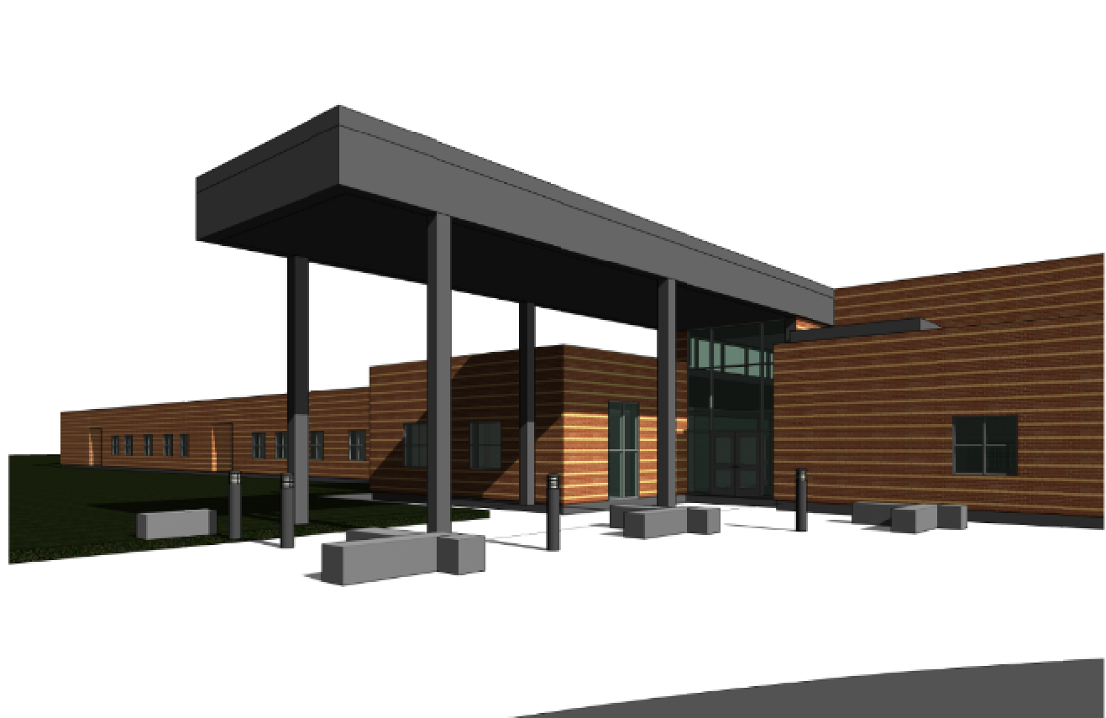
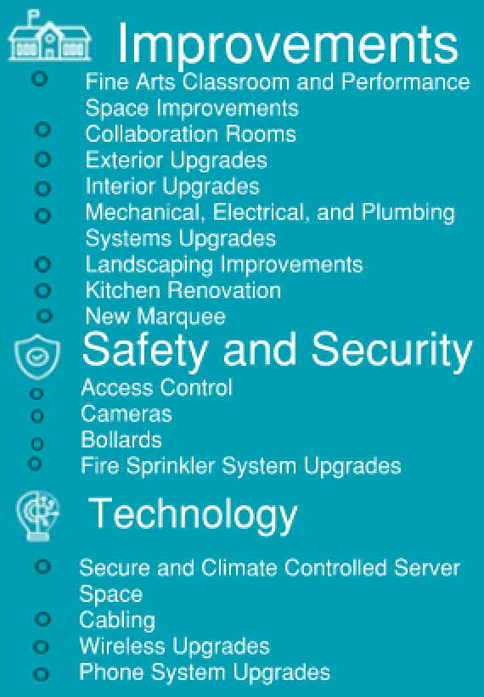
BARBARA BUSH MIDDLE SCHOOL
cfbbond.com

Slide 2

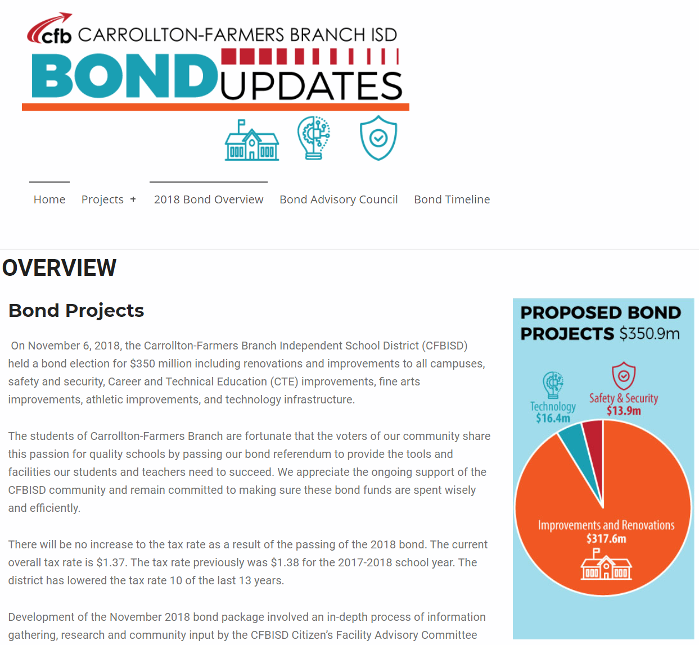
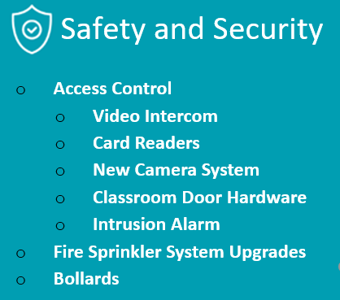

Improvements
Fine Arts Classroom and Performance Space Improvements
  Band, Orchestra, Choir, Theater, and Percussion Hall Renovations
Collaboration Rooms
  Practice Rooms in Fine Arts
Exterior Upgrades
  Roof Replacement and Repair
  Parking Lot Restriping
Interior Upgrades
  Makerspace /Engineering Room Renovation
Mechanical, Electrical, and Plumbing Systems Upgrades
  New LED Site Lighting and Controls
  Water Bottle Fillers
Landscape Improvements
  Exterior Concrete Replacement
  Exterior Benches
Kitchen Renovation
  New Kitchen Equipment
New Marquee – Coming Soon
Access Control
  Intercom
  Card Readers
  Security Alarm
Cameras
Bollards
Fire Sprinkler System Upgrades
Secure Climate Controlled Server Space
Cabling
Wireless Upgrades
Phone System Upgrades
PROMISES MADE
PROMISES KEPT
PROMISES MADE
PROMISES KEPT

Slide 3
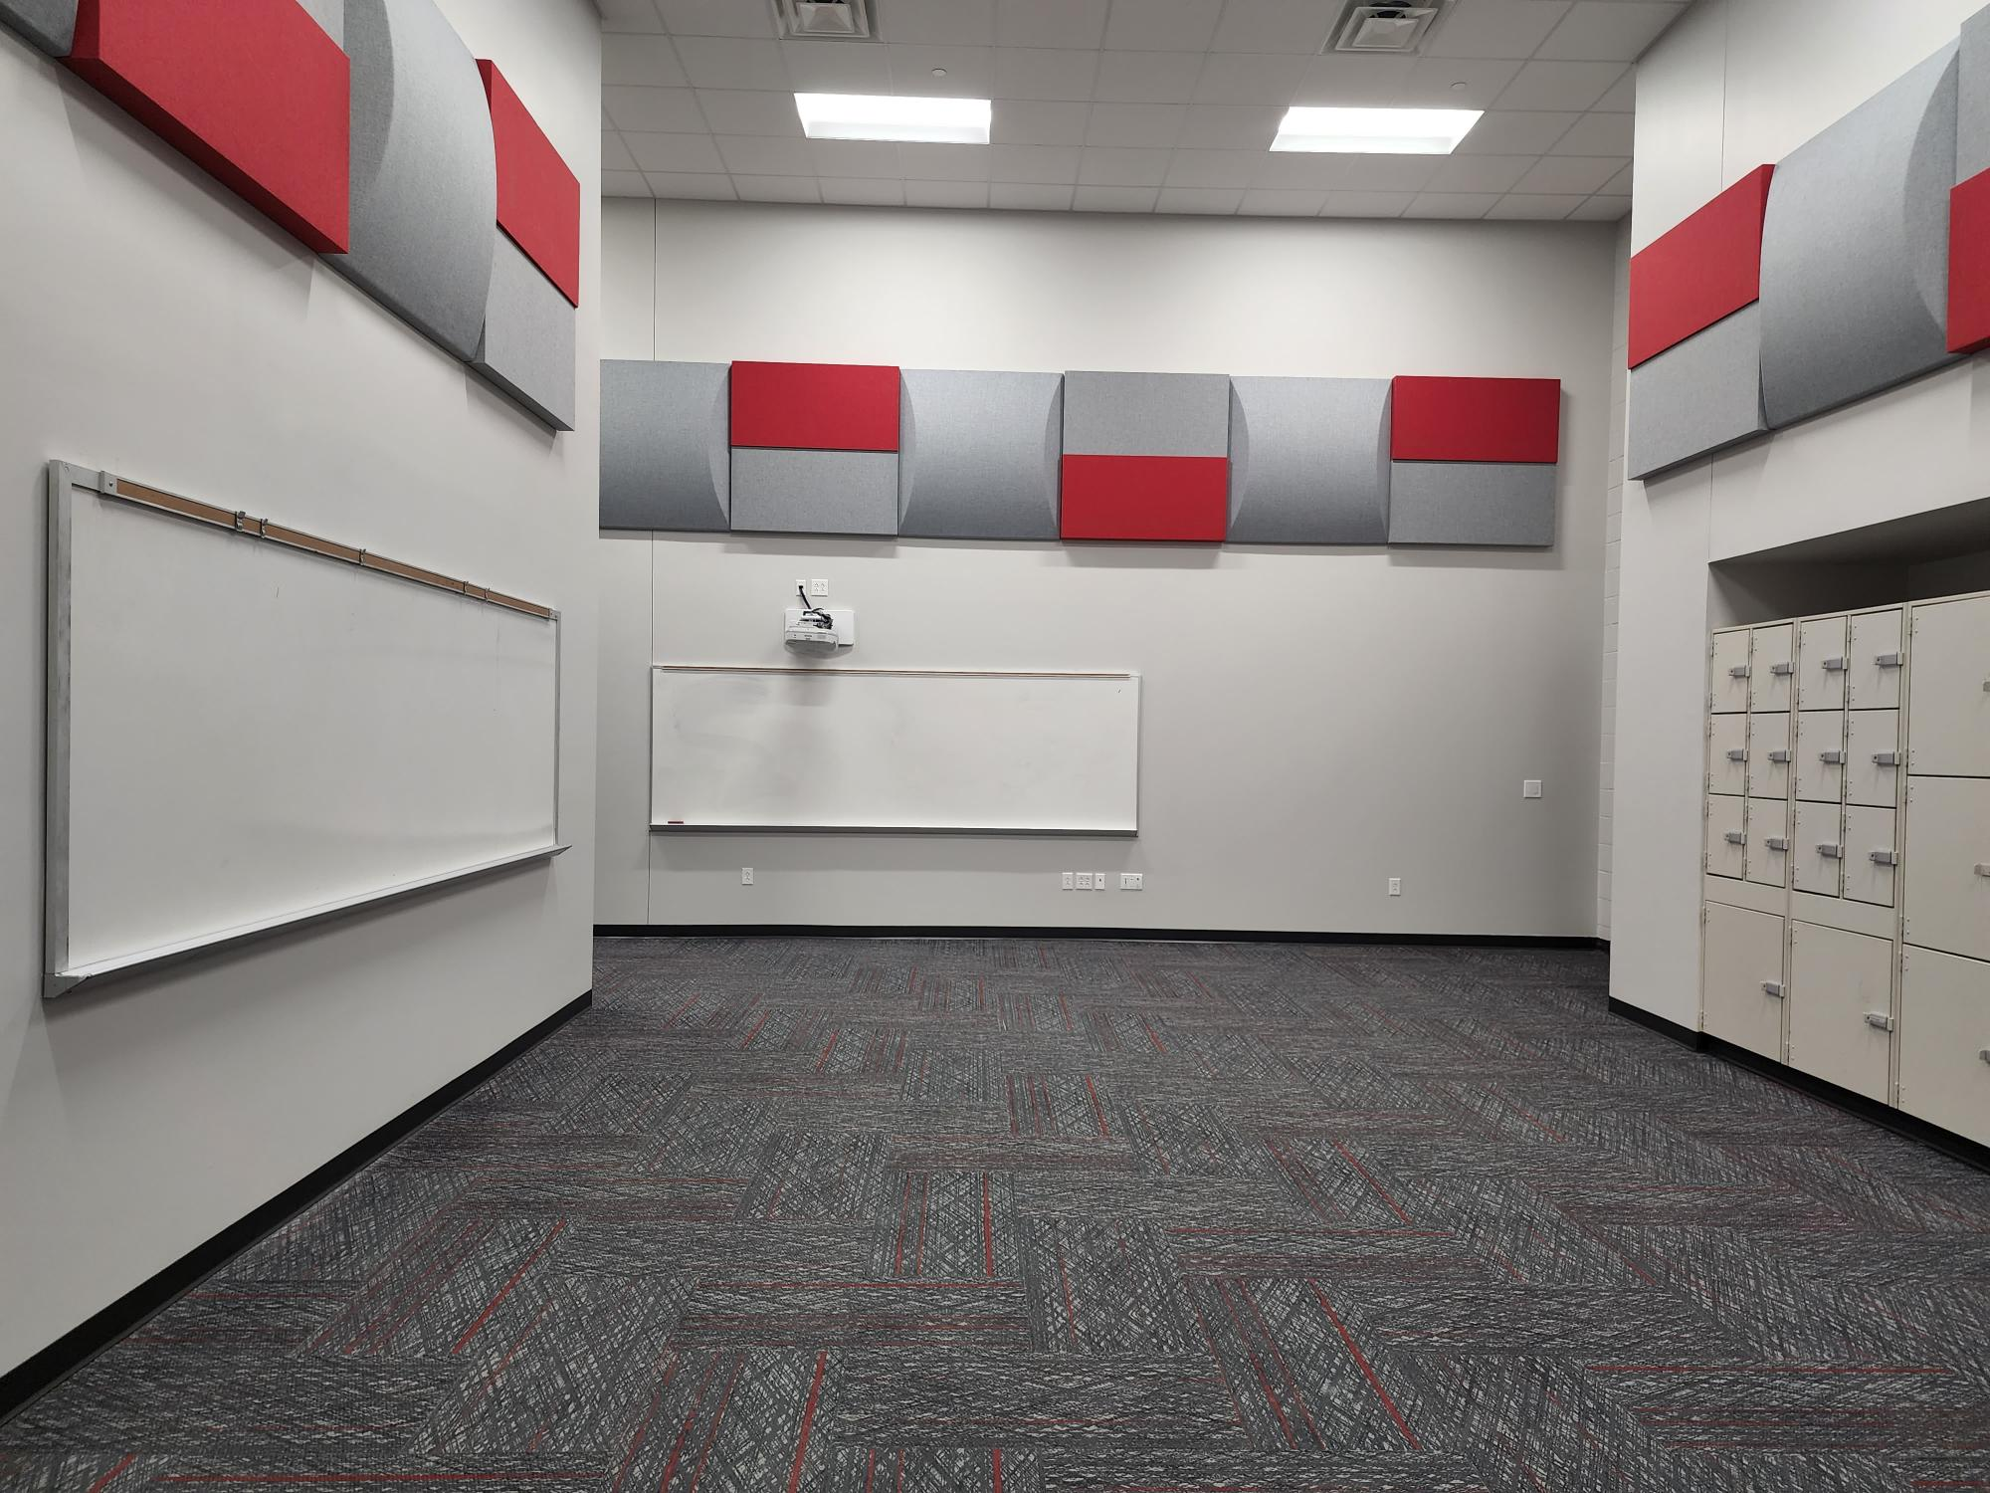
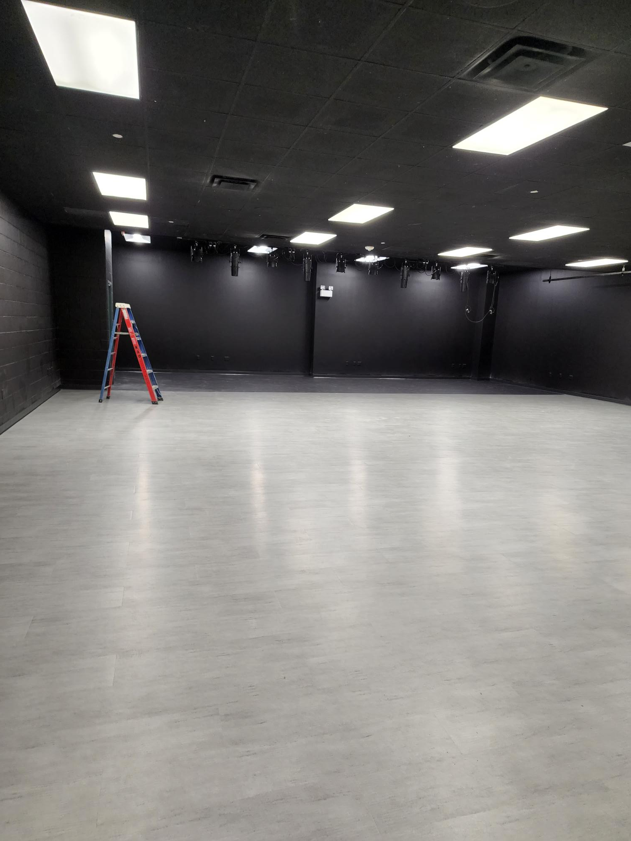
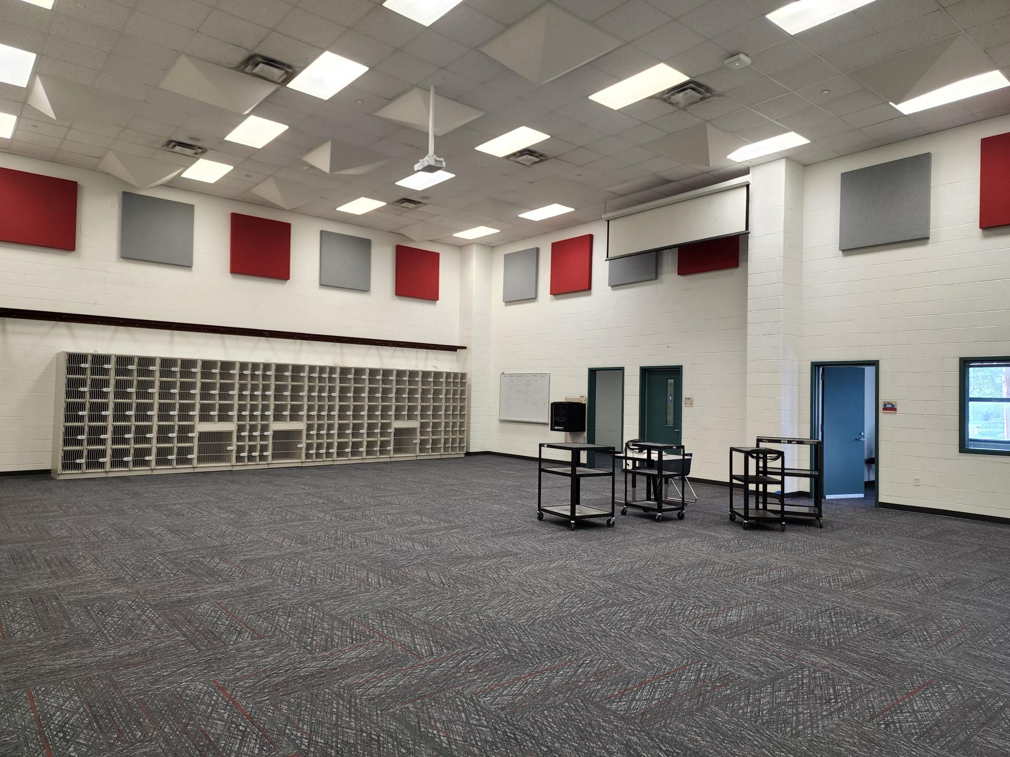
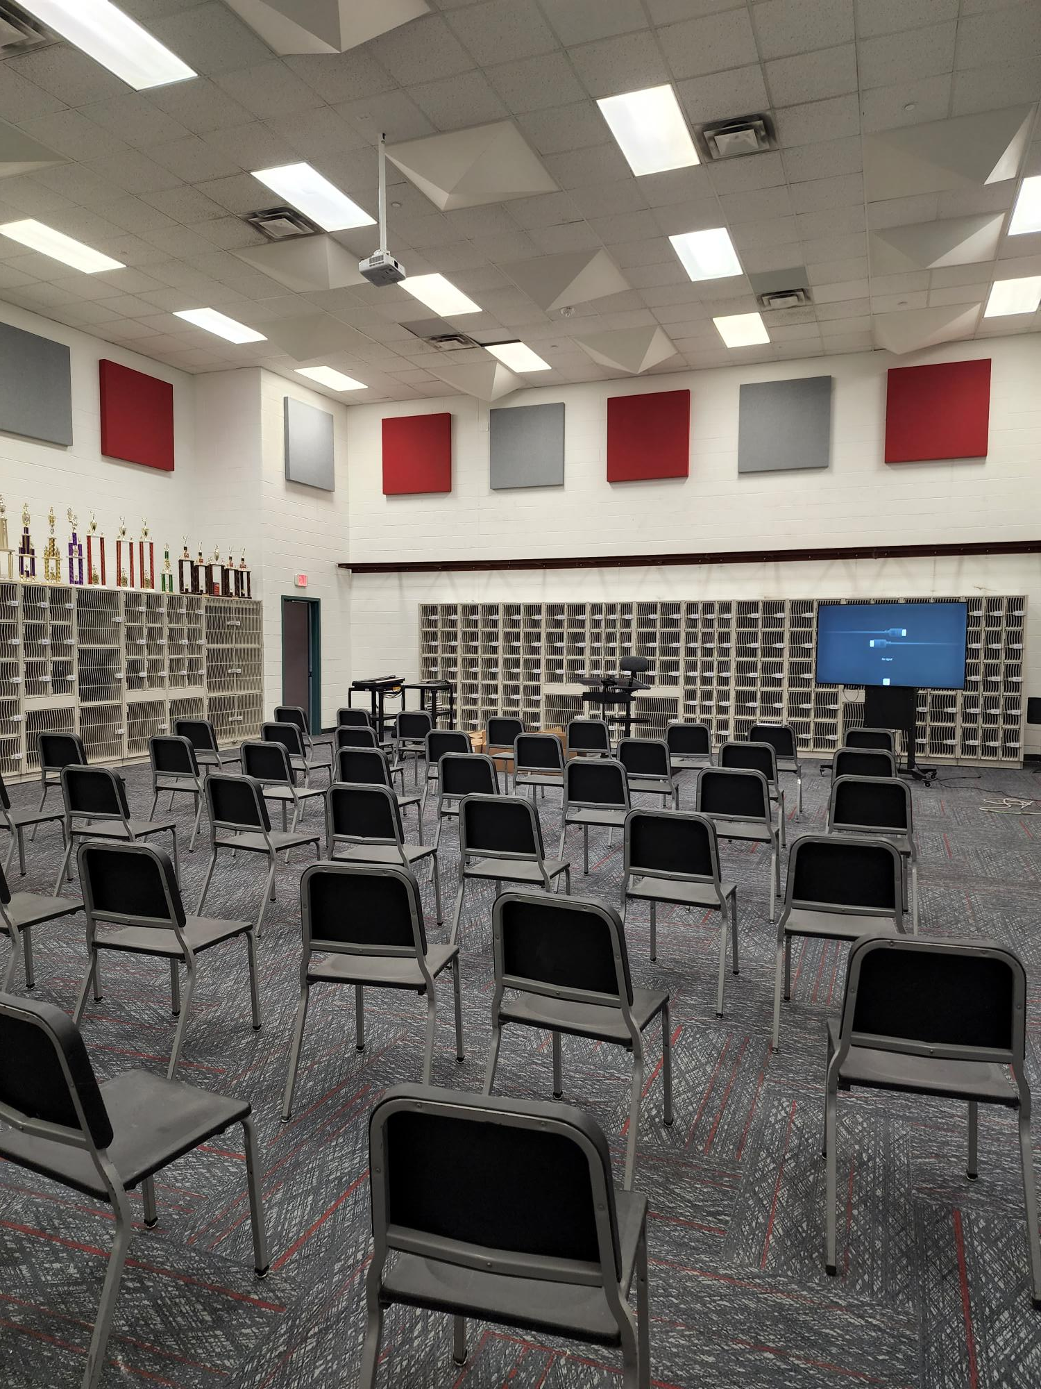
Improvements
Fine Arts Classroom and Performance Space Improvements
  Band, Orchestra, Choir, Theater, and Percussion Hall Renovations
Collaboration Rooms
  Practice Rooms in Fine Arts
Exterior Upgrades
  Roof Replacement and Repair
  Parking Lot Restriping
Interior Upgrades
  Makerspace /Engineering Room Renovation
Mechanical, Electrical, and Plumbing Systems Upgrades
  New LED Site Lighting and Controls
  Water Bottle Fillers
Landscape Improvements
  Exterior Concrete Replacement
  Exterior Benches
Kitchen Renovation
  New Kitchen Equipment
New Marquee – Coming Soon
New Theater Arts
New Practice/Ensemble Room
PROMISES MADE
PROMISES KEPT
Orchestra Hall
Band Hall

Slide 4
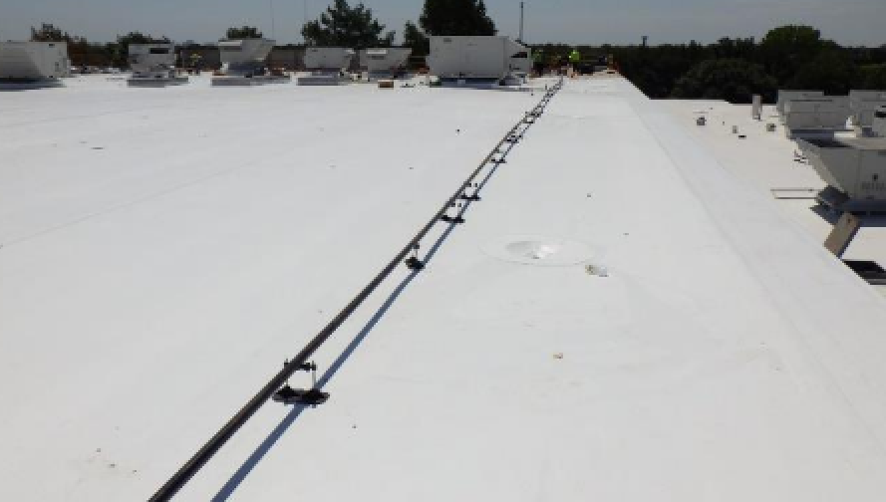
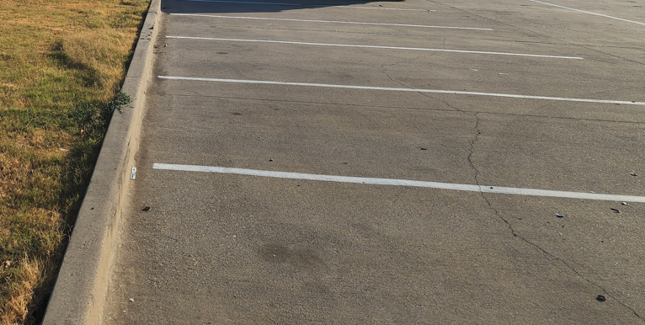
Improvements
Fine Arts Classroom and Performance Space Improvements
  Band, Orchestra, Choir, Theater, and Percussion Hall Renovations
Collaboration Rooms
  Practice Rooms in Fine Arts
Exterior Upgrades
  Roof Replacement and Repair
  Parking Lot Restriping
Interior Upgrades
  Makerspace /Engineering Room Renovation
Mechanical, Electrical, and Plumbing Systems Upgrades
  New LED Site Lighting and Controls
  Water Bottle Fillers
Landscape Improvements
  Exterior Concrete Replacement
  Exterior Benches
Kitchen Renovation
  New Kitchen Equipment
New Marquee – Coming Soon
New Roofing
PROMISES MADE
PROMISES KEPT
Parking Lot Re-striping

Slide 5
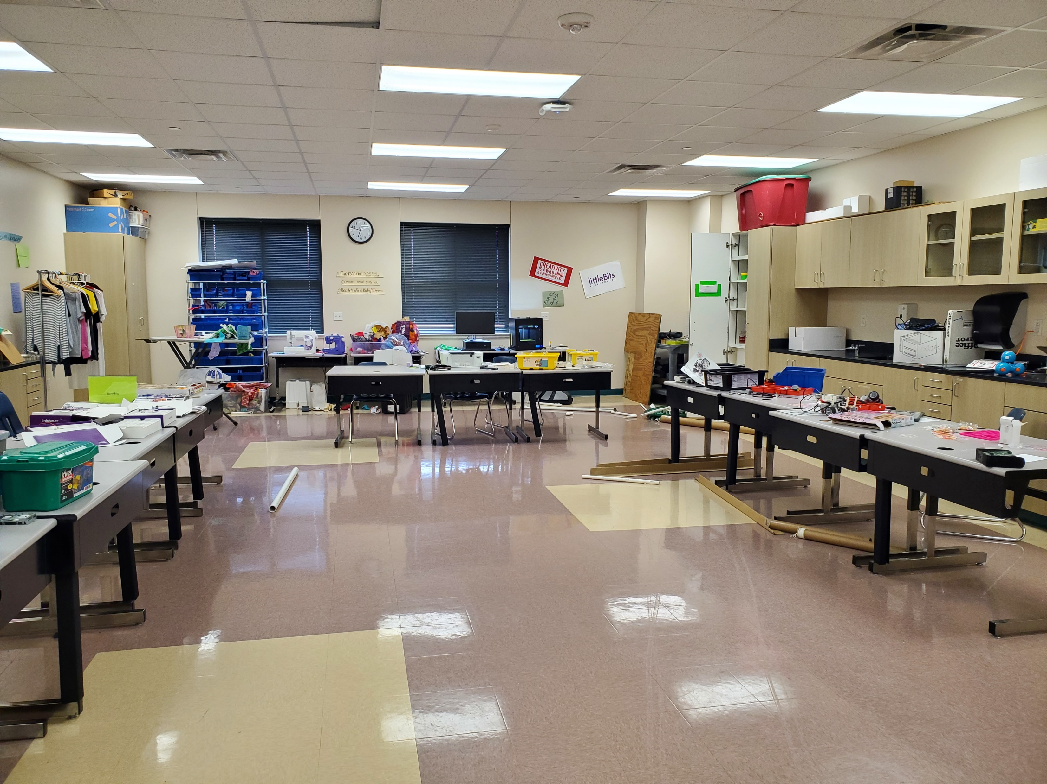
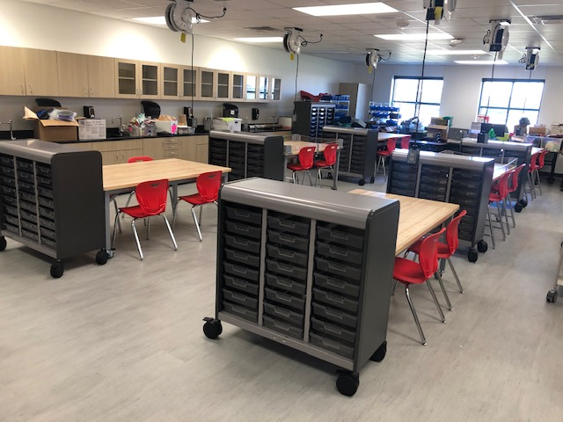
Improvements
Fine Arts Classroom and Performance Space Improvements
  Band, Orchestra, Choir, Theater, and Percussion Hall Renovations
Collaboration Rooms
  Practice Rooms in Fine Arts
Exterior Upgrades
  Roof Replacement and Repair
  Parking Lot Restriping
Interior Upgrades
  Makerspace /Engineering Room Renovation
Mechanical, Electrical, and Plumbing Systems Upgrades
  New LED Site Lighting and Controls
  Water Bottle Fillers
Landscape Improvements
  Exterior Concrete Replacement
  Exterior Benches
Kitchen Renovation
  New Kitchen Equipment
New Marquee – Coming Soon
Before
PROMISES MADE
PROMISES KEPT
After

Slide 6
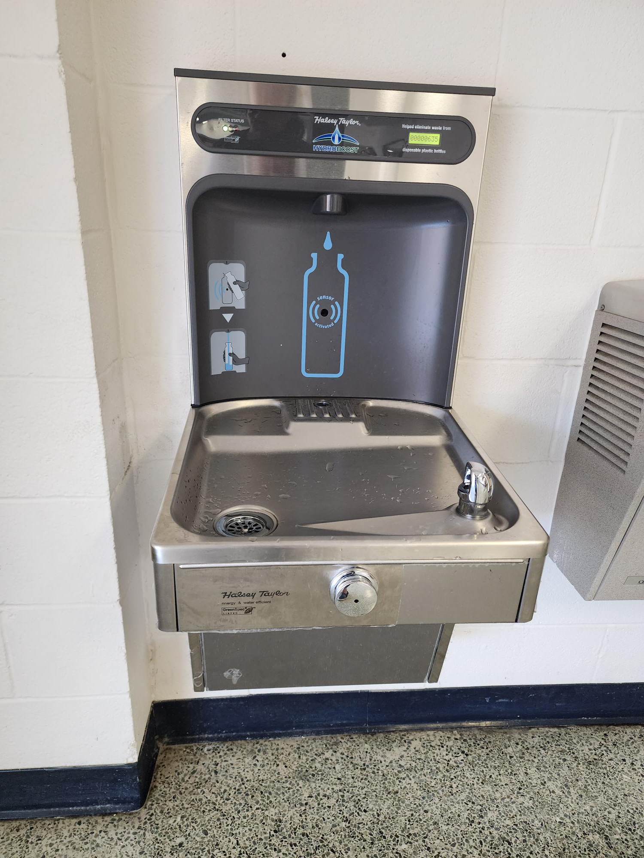
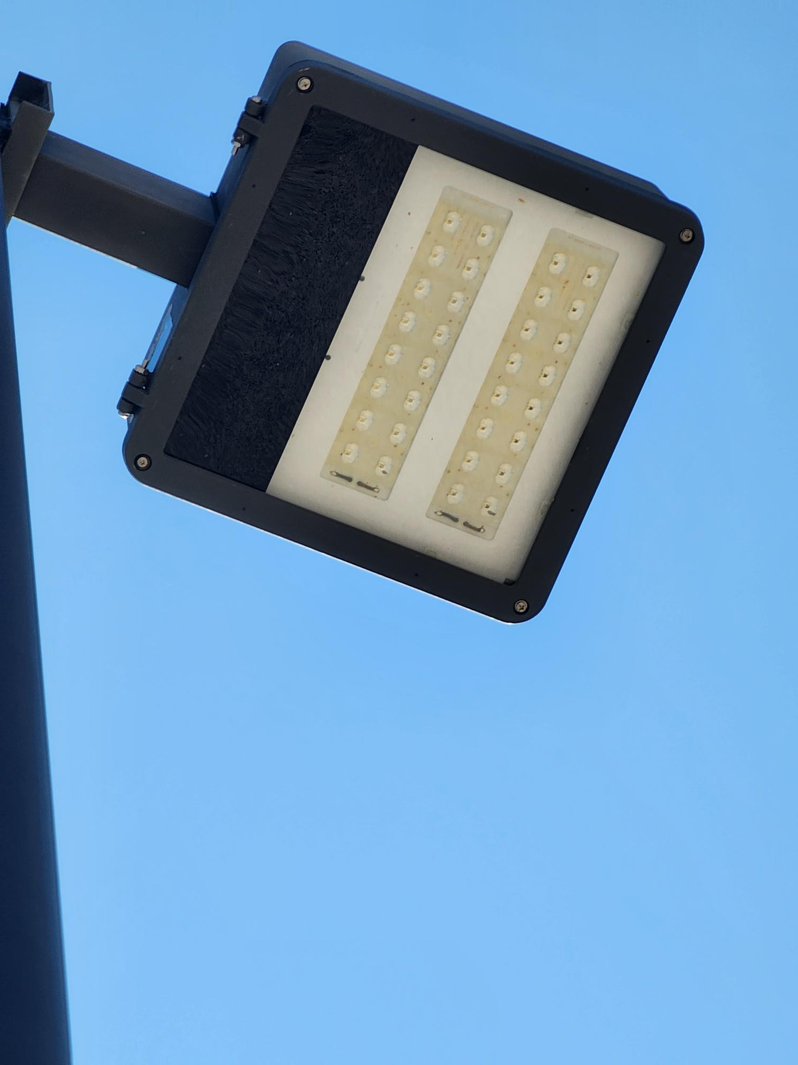
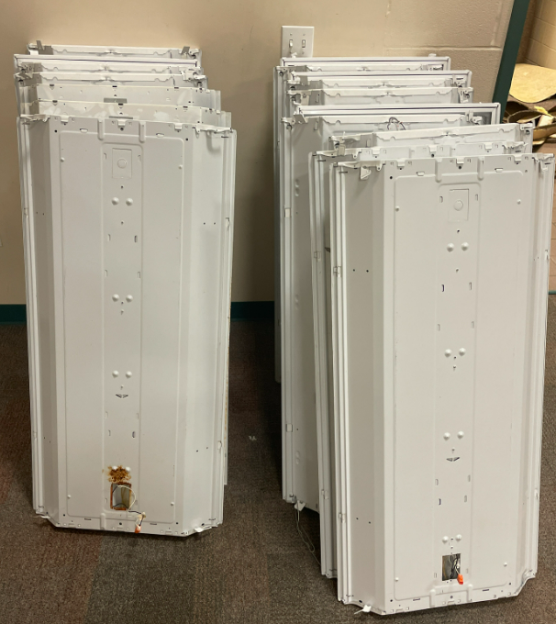
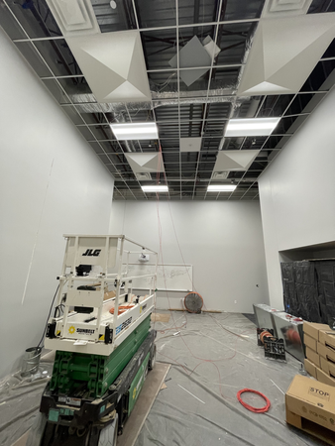
Improvements
Fine Arts Classroom and Performance Space Improvements
  Band, Orchestra, Choir, Theater, and Percussion Hall Renovations
Collaboration Rooms
  Practice Rooms in Fine Arts
Exterior Upgrades
  Roof Replacement and Repair
  Parking Lot Restriping
Interior Upgrades
  Makerspace /Engineering Room Renovation
Mechanical, Electrical, and Plumbing Systems Upgrades
  New LED Site Lighting and Controls
  Water Bottle Fillers
Landscape Improvements
  Exterior Concrete Replacement
  Exterior Benches
Kitchen Renovation
  New Kitchen Equipment
New Marquee – Coming Soon
Water Bottle Fillers
Site Lighting
PROMISES MADE
PROMISES KEPT
Before - Lighting
After - LED Lighting

Slide 7
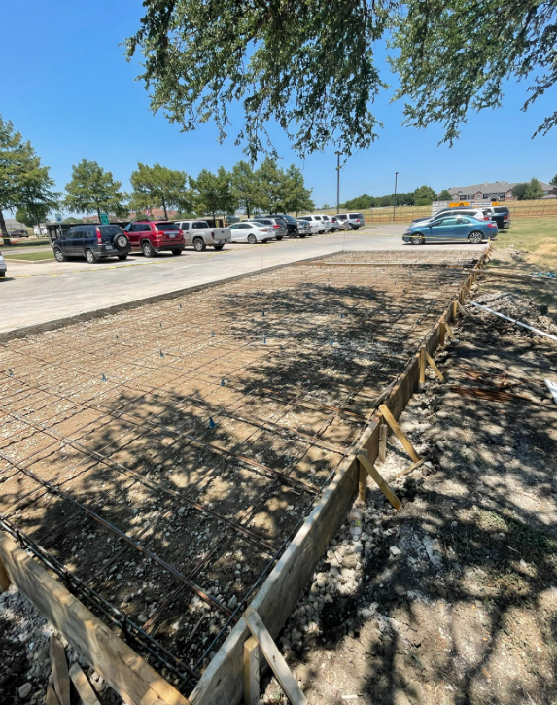
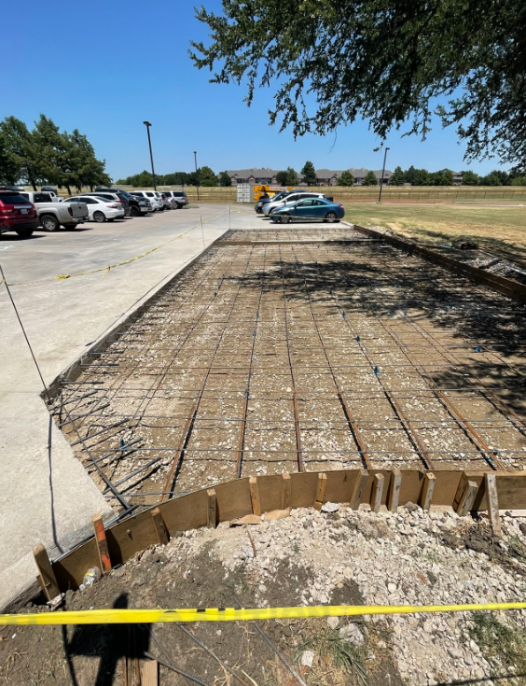
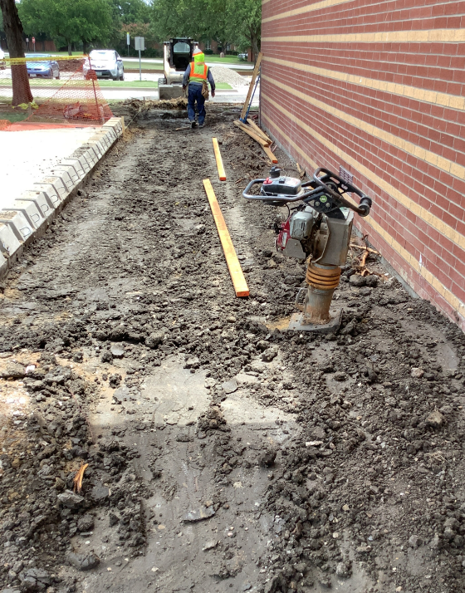
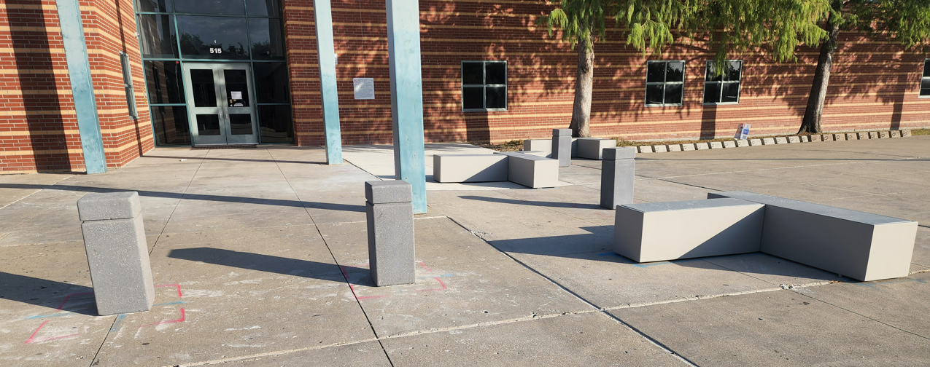
Improvements
Fine Arts Classroom and Performance Space Improvements
  Band, Orchestra, Choir, Theater, and Percussion Hall Renovations
Collaboration Rooms
  Practice Rooms in Fine Arts
Exterior Upgrades
  Roof Replacement and Repair
  Parking Lot Restriping
Interior Upgrades
  Makerspace /Engineering Room Renovation
Mechanical, Electrical, and Plumbing Systems Upgrades
  New LED Site Lighting and Controls
  Water Bottle Fillers
Landscape Improvements
  Exterior Concrete Replacement
  Exterior Benches
Kitchen Renovation
  New Kitchen Equipment
New Marquee – Coming Soon
Site Concrete
Site Concrete
Site Concrete
PROMISES MADE
PROMISES KEPT
Exterior Benches

Slide 8
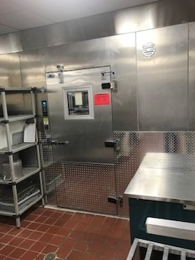
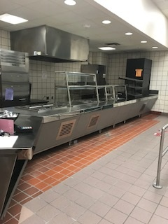
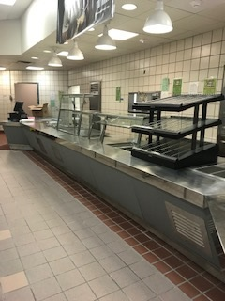
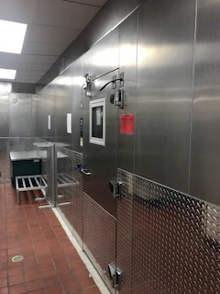
Improvements
Fine Arts Classroom and Performance Space Improvements
  Band, Orchestra, Choir, Theater, and Percussion Hall Renovations
Collaboration Rooms
  Practice Rooms in Fine Arts
Exterior Upgrades
  Roof Replacement and Repair
  Parking Lot Restriping
Interior Upgrades
  Makerspace /Engineering Room Renovation
Mechanical, Electrical, and Plumbing Systems Upgrades
  New LED Site Lighting and Controls
  Water Bottle Fillers
Landscape Improvements
  Exterior Concrete Replacement
  Exterior Benches
Kitchen Renovation
  New Kitchen Equipment
New Marquee – Coming Soon
New Freezer
New Serving Line
PROMISES MADE
PROMISES KEPT
New Serving Line
New Cooler

Slide 9
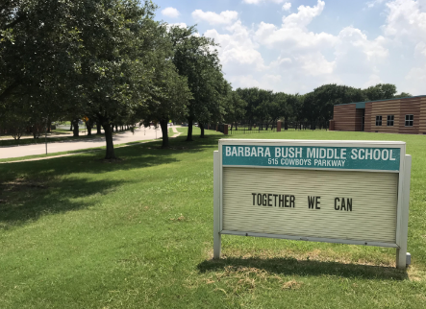
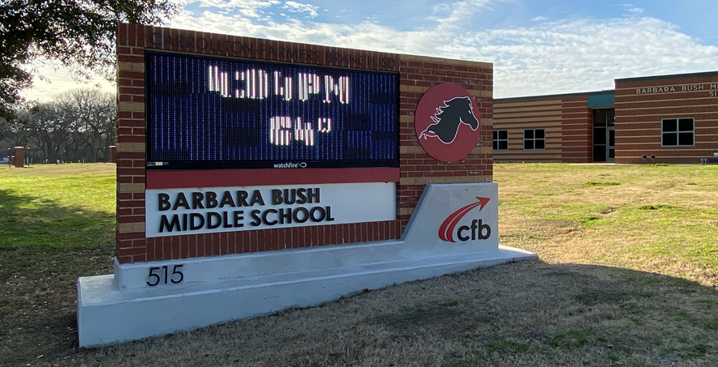
Improvements
Fine Arts Classroom and Performance Space Improvements
  Band, Orchestra, Choir, Theater, and Percussion Hall Renovations
Collaboration Rooms
  Practice Rooms in Fine Arts
Exterior Upgrades
  Roof Replacement and Repair
  Parking Lot Restriping
Interior Upgrades
  Makerspace /Engineering Room Renovation
Mechanical, Electrical, and Plumbing Systems Upgrades
  New LED Site Lighting and Controls
  Water Bottle Fillers
Landscape Improvements
  Exterior Concrete Replacement
  Exterior Benches
Kitchen Renovation
  New Kitchen Equipment
New Marquee
PROMISES MADE
PROMISES KEPT

Slide 10
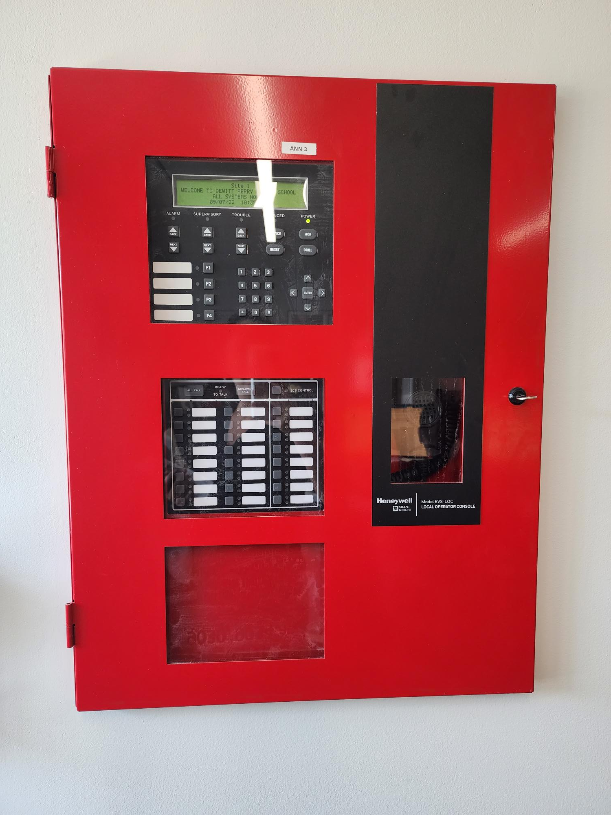

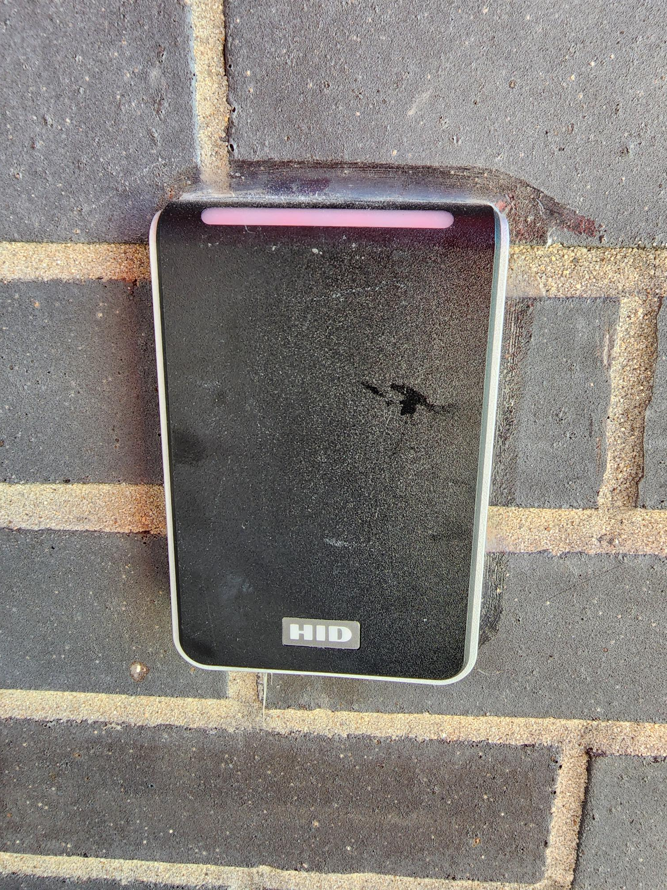
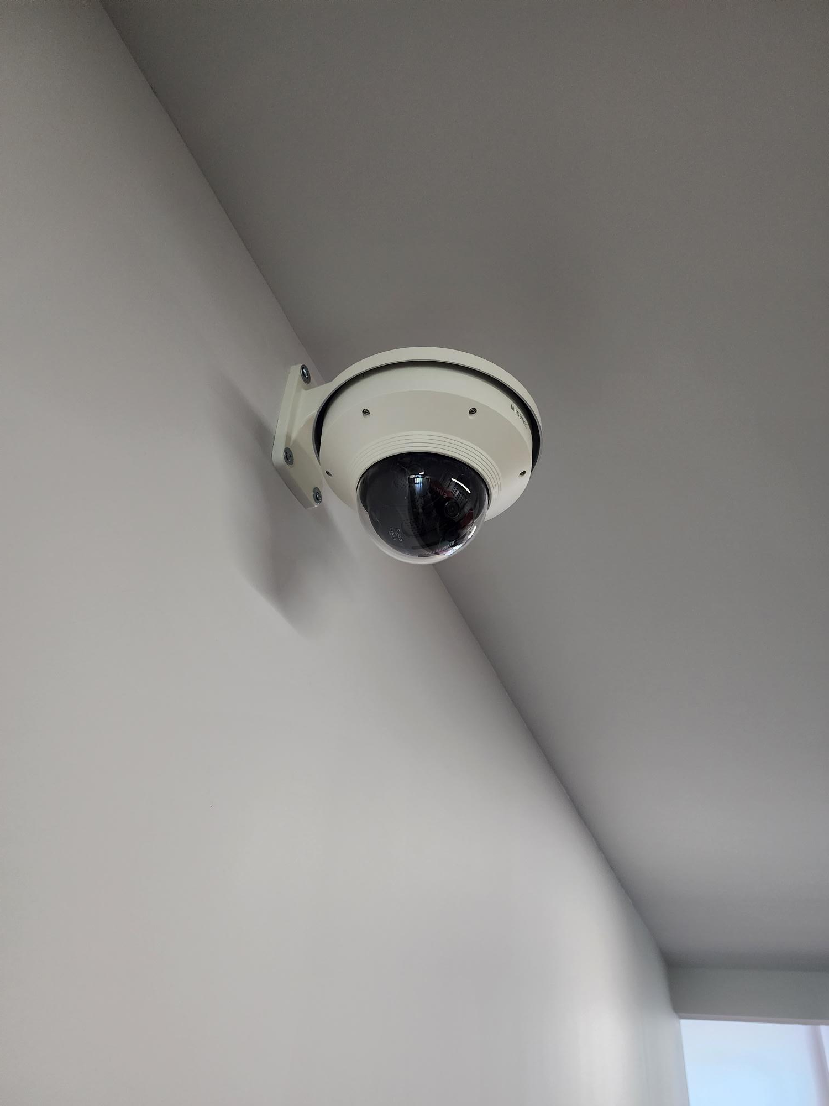
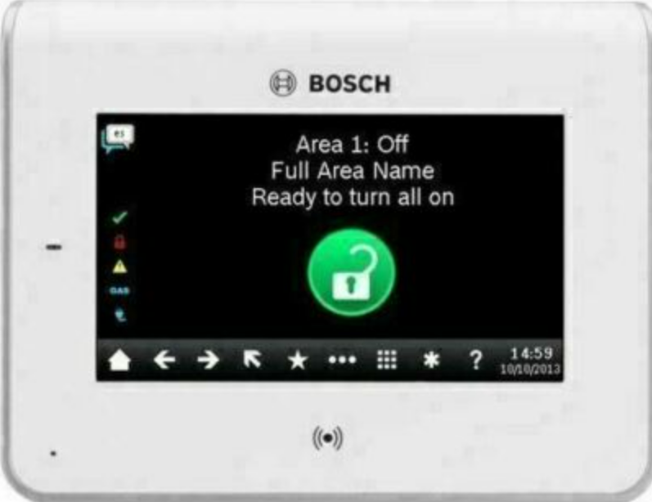
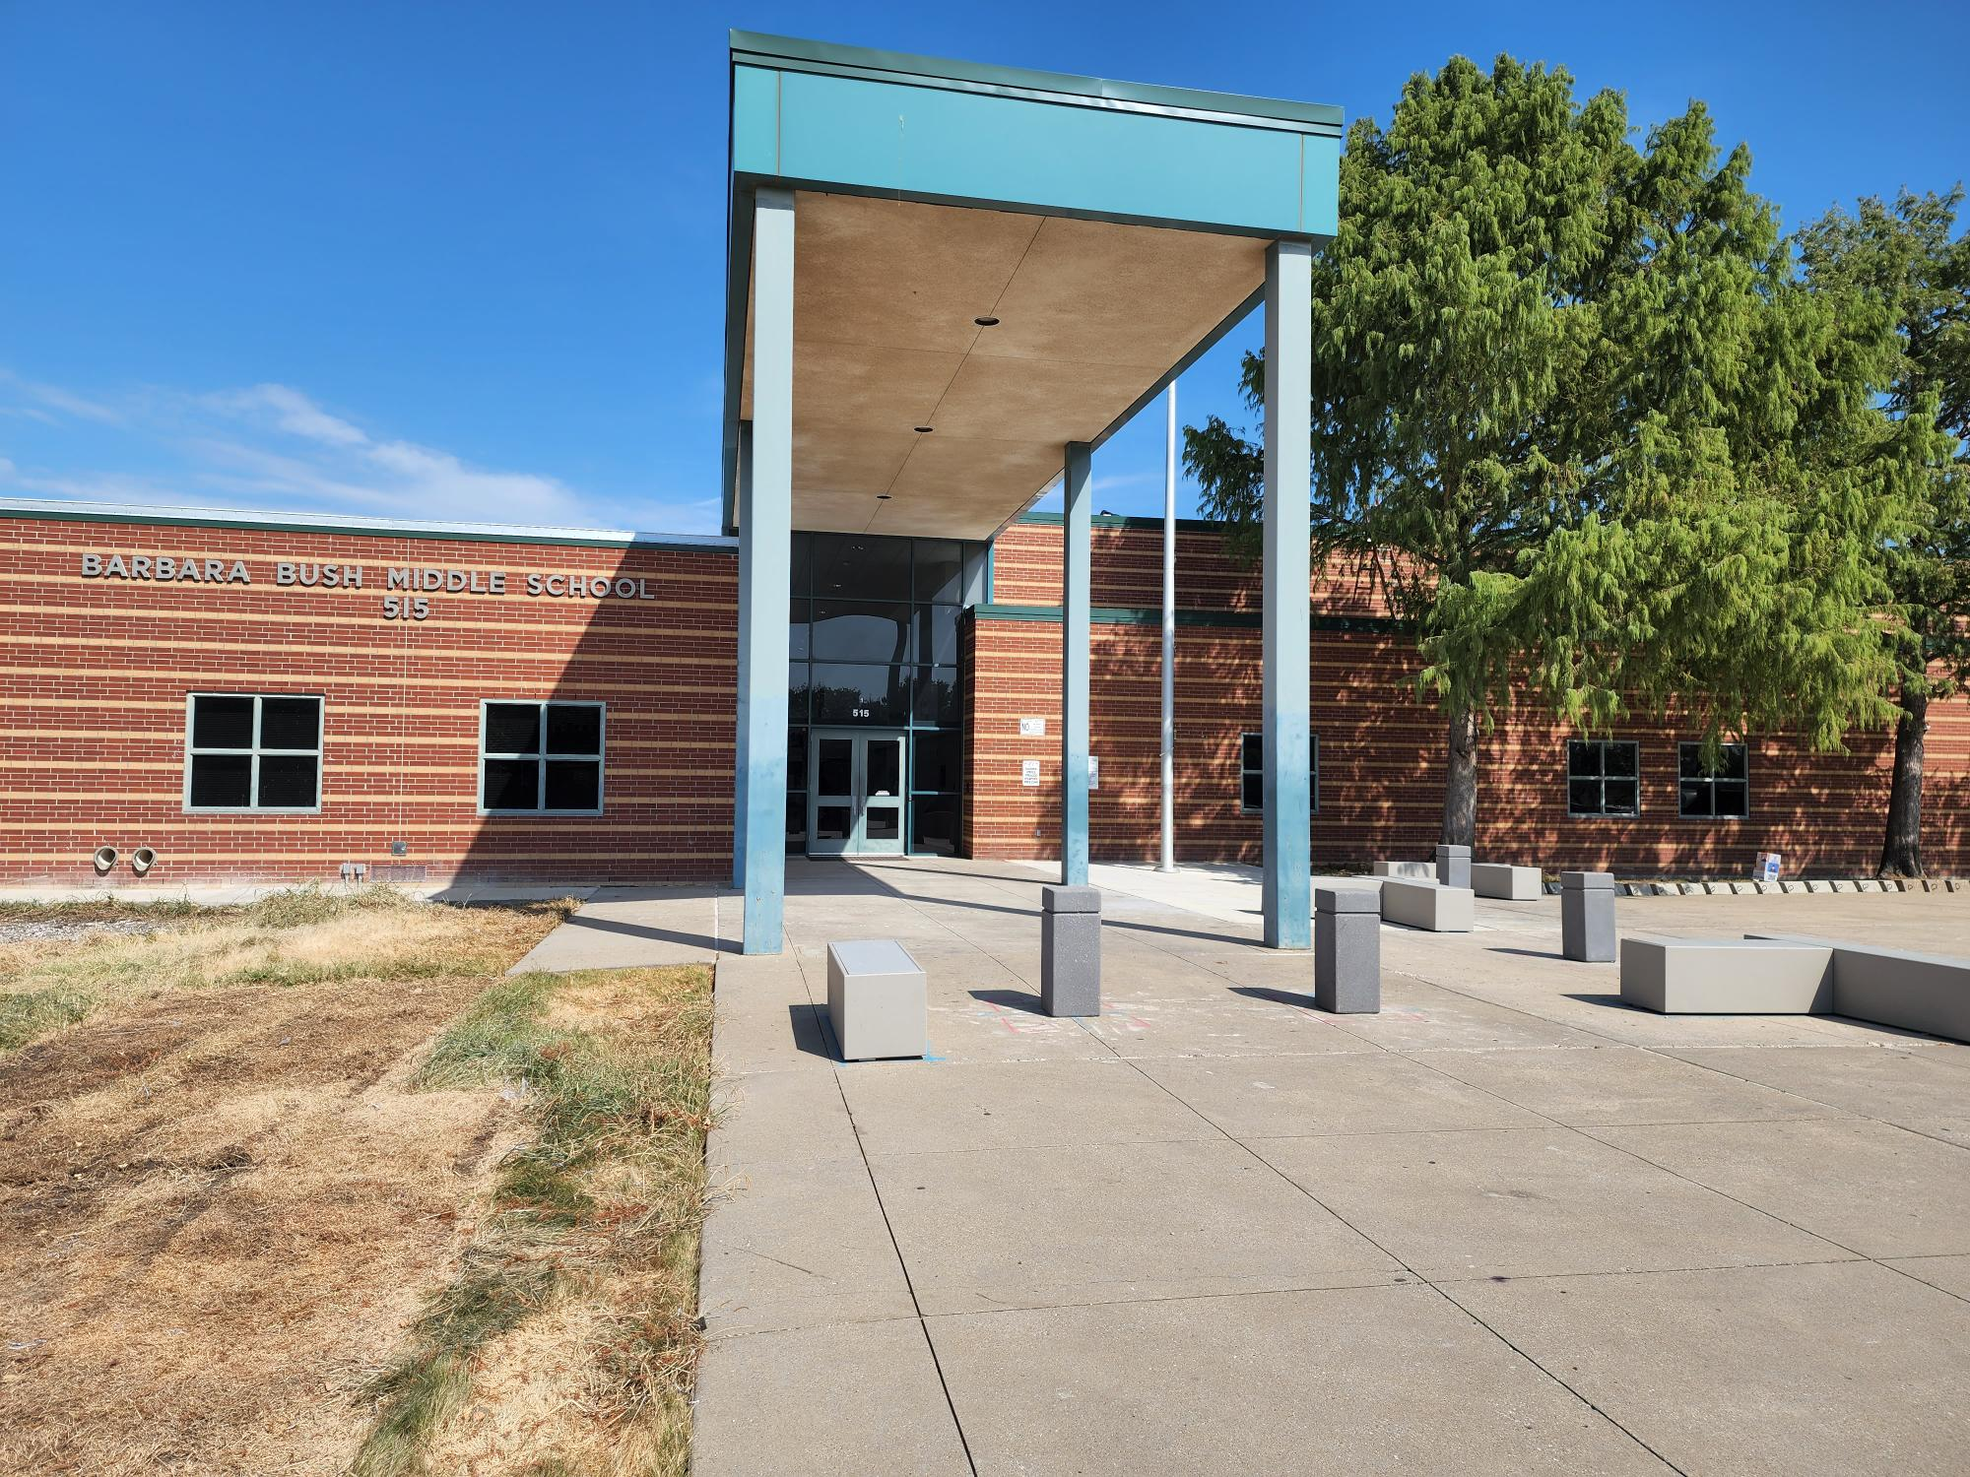
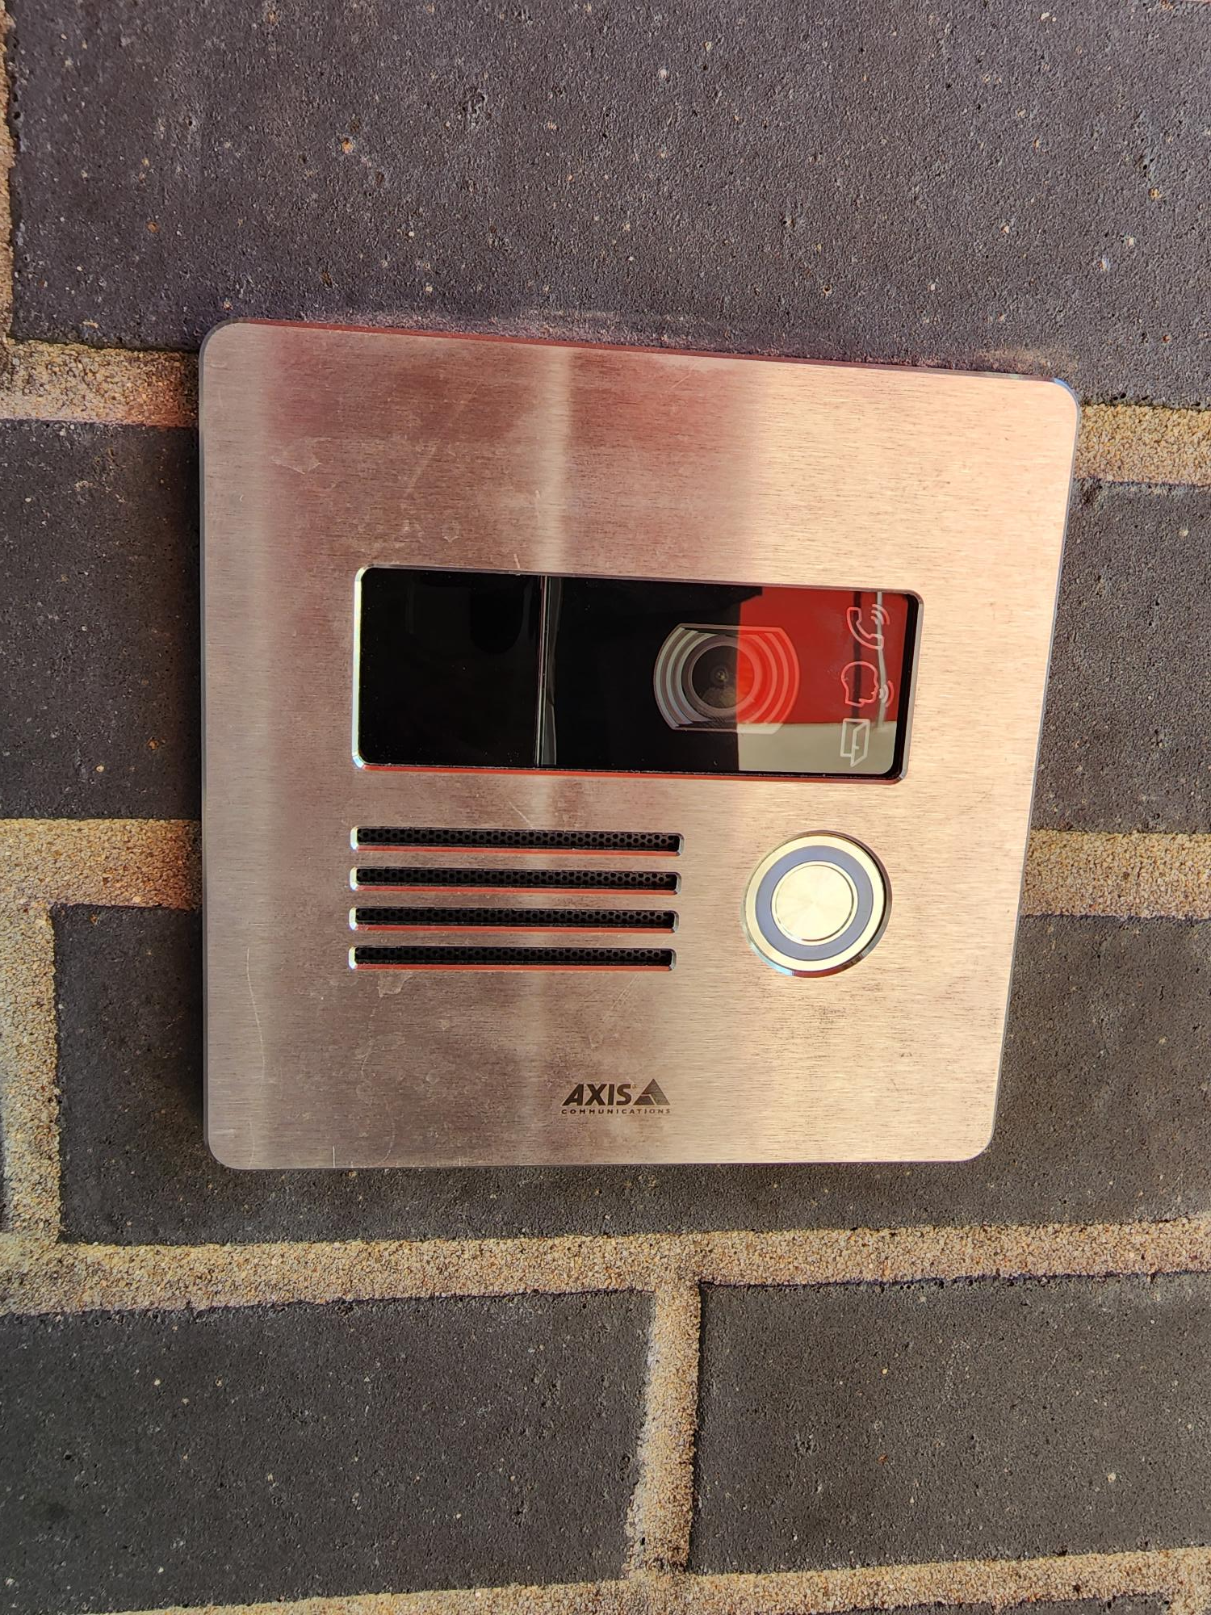
Safety and Security
Access Control
  Intercom
  Card Readers
  Security Alarm
Cameras
Bollards
Fire Sprinkler System Upgrades
Card Readers
Cameras
Fire Alarm
Card Reader
Video Intercom
Exterior Camera
Fire Alarm Panel
PROMISES MADE
PROMISES KEPT
Intercom
Bollards/Benches
Access Control

Slide 11
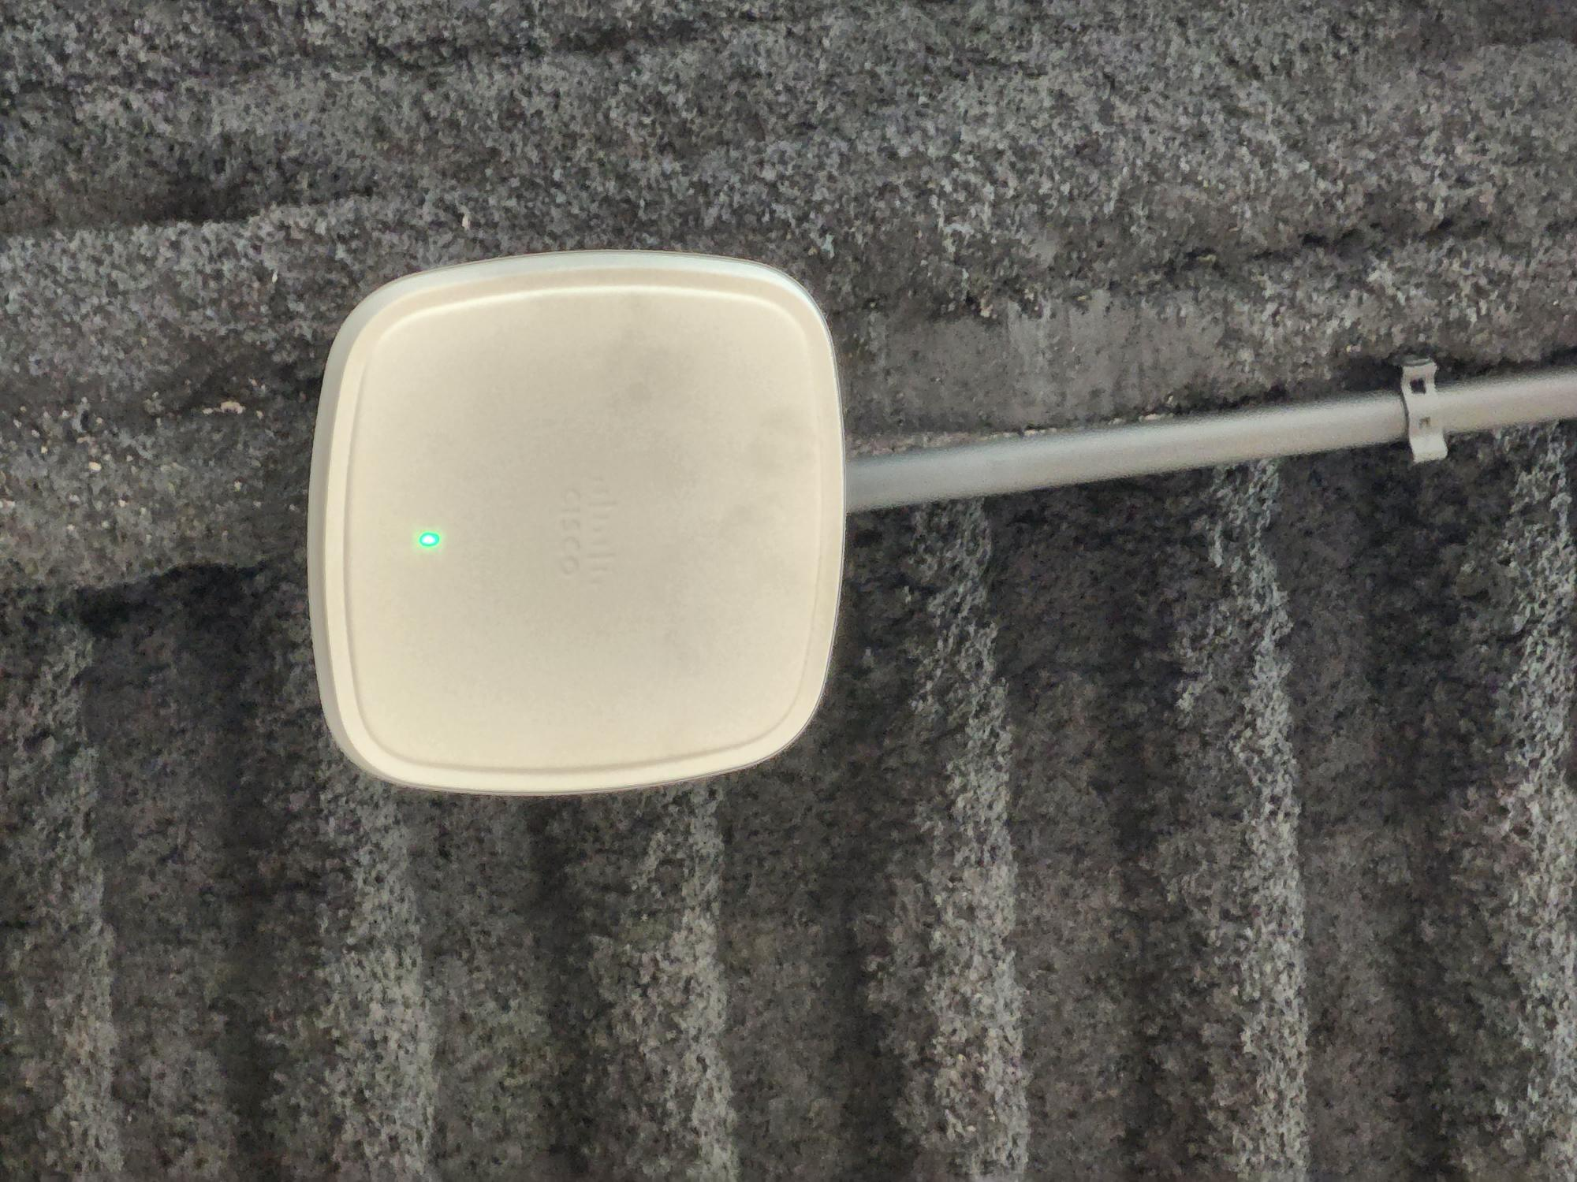

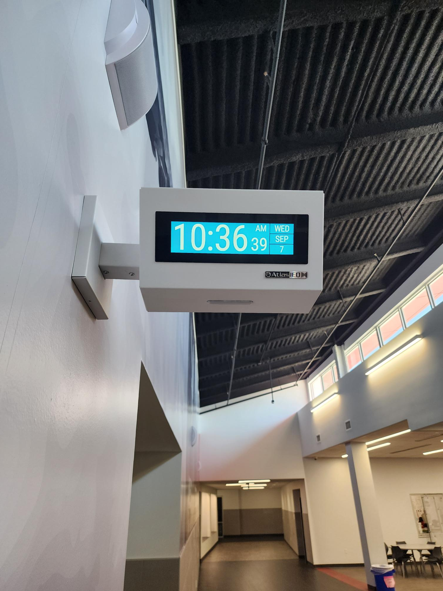
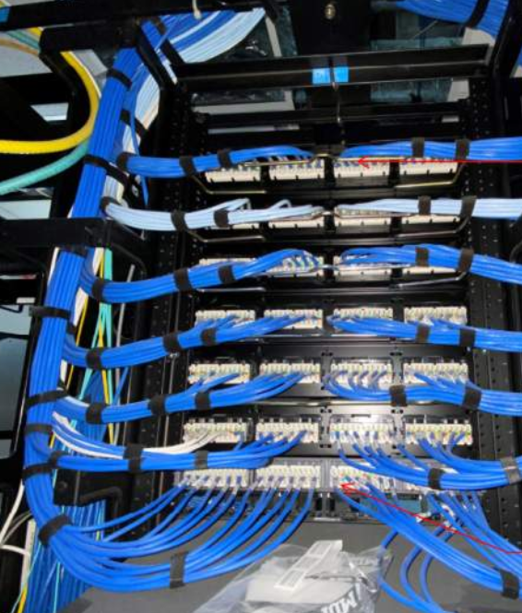
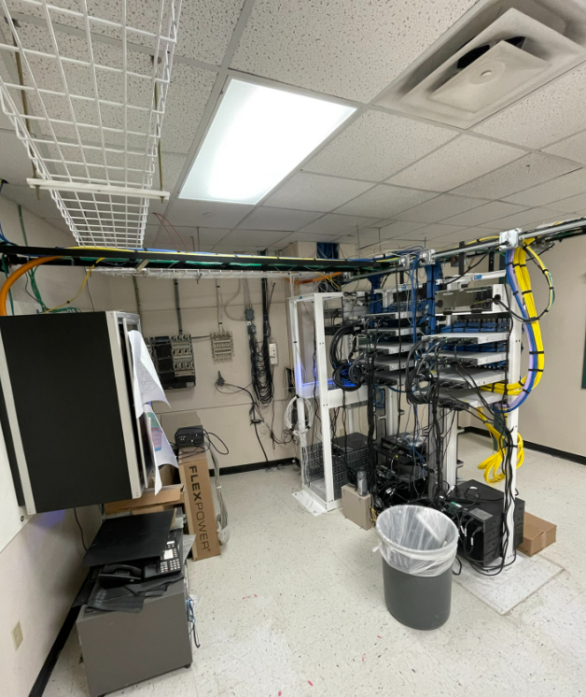
Technology
Secure Climate Controlled Server Space
Cabling
Wireless Upgrades
Phone System Upgrades
Wireless Upgrades
Clocks
PROMISES MADE
PROMISES KEPT
Cabling
Secure Climate Controlled Server Space

Slide 12
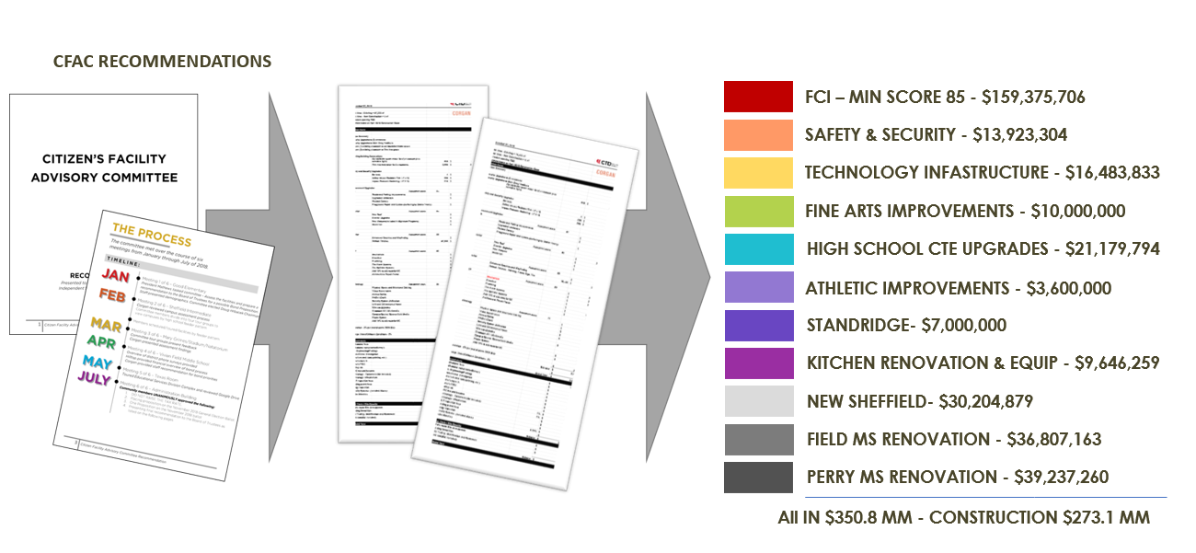
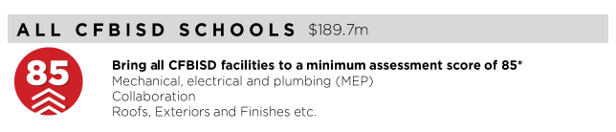
FCI Update
PROMISES MADE
PROMISES KEPT

Slide 13
FCI Update
 | Building Element |  |  |  |  | Type/Material | Prior Condition | Current | Prior Description | 2022 Reno Comments
 | On-Site Utilities & Drainage
 |  | Site Drainage / Erosion Control |  |  |  |  | Good | Good | Positive slope away from building, no visible signs of erosion or ponding water.
 |  | Site Lighting - Parking Lots |  |  |  |  | Good | Good
 |  | Exterior Concrete Pads & Pavement-Around building, mechanical yards |  |  |  |  | Fair | Fair
 |  | Fire Hydrants / Utility Vaults / Misc. |  |  |  |  | Fair | Fair
 |  | Grease Trap |  |  |  |  | Fair | Fair
 | Site Parking & Drives
 |  | Pavement - Roads / Drives / Parking Areas |  |  |  |  | Good | Good | Clean and clear of cracks, heaving, potholes. Joint Sealer is properly in place.
 |  | Fire Lanes |  |  |  |  | Good | Good | Fire lane paint striping in good condition.Clean and clear of cracks, heaving, potholes. Joint Sealer is properly in place.
 |  | Striping - Parking lot and fire lane |  |  |  |  | Fair | Good | Minor to moderate signs of age and deterioration but still visible. Handicapped spaces incorrectly marked or striped. | Parking Lots Re-striped
 |  | Curbs |  |  |  |  | Good | Good | Free of cracks, damage and almost new in appearance.
 | Site Lighting
 |  | Site Lighting |  |  |  |  | Good | Good | All fixtures are working properly and have no visible damage. Lighting is appropriate for security.
 | Site Security
 |  | Security Cameras |  |  |  | Megapixels of Resolution | 12 | 93 |  | Updated camera system
 |  | Chain Link Fencing / Gates |  |  |  |  | Good | Good | No damage to material and poles, gates are working properly.
 | Misc. Stuctures
 |  | Site Walls - Retaining / Screen |  |  | Material: | Stone | Good | Good | No signs of damage, settling or rotation.
 |  | Dumpster Service Area |  |  |  |  | Fair | Fair | Moderate to Minor signs of damage to dumpster walls, may need a refresh of finish paint if applicable and additional bollards. Gates function as required. | No Scope
 |  | Bollards |  |  | Material: | Concrete | Good | Good | Clearly marked and strongly visible. Almost new in appearance.
 |  | Site Signage - Directional / Handicapped |  |  |  |  | Good | Good
 |  | Misc. Site work / Site Structures |  |  |  |  | Good | Good | Bleachers
 | Circulation
 |  | Sidewalks |  |  |  |  | Good | Good | Clean and clear of cracks or heaving. Joint Sealer is properly in place.
 |  | Stairs |  |  |  |  | Good | Good | Clean and clear of cracks or heaving. Joint Sealer is properly in place. Rise and Run is compliant. Handrails (if present) are compliant & finish is in good standing.
 |  | Ramps |  |  |  |  | Good | Good | Clean and clear of cracks or heaving. Joint Sealer is properly in place. Slope is compliant. Handrails (if present) are compliant & finish is in good condition.
 | ADA Compliance / Accessiblity
 |  | Compliant Sidewalks/Curbs |  |  |  |  | Good | Good
 |  | Compliant Ramps & Handrails |  |  |  |  | Good | Good
 |  |  |  |  |  | Scored Categories | 21 | 21
 |  |  |  |  |  | Good | 16 | 17
 |  |  |  |  |  | Fair | 5 | 4 | Previous Aggregate Score: | 92
 |  |  |  |  |  | Poor | 0 | 0 | Reno Aggregate Score: | 94
 |  |  |  |  |  | N/A | 0 | 0
Site

Slide 14
FCI Update
 | Building Element |  |  |  |  |  |  |  | Type/Material | Prior Condition | Current | Prior Description | 2022 Reno Comments
 | Building Structure/Foundation
 |  | Foundation | Foundation |  |  |  |  | Type: | Slab on Grade | Good | Good | No signs of cracking or heaving.
 |  | Substructure - Slab - on - Grade | Substructure - Slab - on - Grade
 |  |  |  | Basement / Below Grade Exterior Walls |  |  |  |  |  | N/A | N/A
 |  |  |  | Miscellanous |  |  |  |  |  | N/A | N/A
 |  | Superstructure | Superstructure
 |  |  |  | Fireproofing |  |  |  |  |  | N/A | N/A
 |  |  |  | Pre-Engineered Metal building |  |  |  |  |  | N/A | N/A
 | Building Exterior Shell
 |  | Roofing |  |  |  |  |  |  | built up roof
 |  |  |  | General Roof Condition (Visual Inspection) | General Roof Condition (Visual Inspection) |  |  |  |  | Fair | Good | Roof is nearing the end of it's expected useful life. Some leaks are reported with areas of ponding. Some sealants and flashings are in need of repair or replacement. | Roof replaced. Single Ply Membrane
 |  |  |  | Roof Warranty Status | Roof Warranty Status |  |  |  |  |  |  | N/A | New
 |  |  |  |  |  | Roofing Manufacturer / Warranty Issuer | Roofing Manufacturer / Warranty Issuer |  |  |  |  | UNA-Clad | Duro-Last
 |  |  |  |  |  | Years Remaining in Warranty Period | Years Remaining in Warranty Period |  |  |  |  | N/A
 |  |  |  | Skylights | Skylights |  |  |  |  | N/A | N/A
 |  |  |  | Roof Curbs / Openings / Misc. | Roof Curbs / Openings / Misc. |  |  |  |  | N/A | N/A
 |  | Exterior Walls
 |  |  |  | Exterior Wall Material |  |  |  | Material: | Brick | Good | Good | Veneer is free of cracks, signs of settling, rotation or damage.
 |  |  |  | Building Caulking/Sealant |  |  |  |  |  | Fair | Fair | May show minor signs of aging, minor fading or stains. | Not in Scope
 |  |  |  | Exterior Painting |  |  |  |  |  | N/A | N/A
 |  | Windows/Glazed Walls
 |  |  |  | Windows
 |  |  |  |  |  |  |  | Glazing Type: | Single Pane | Fair | Fair | Addition aluminum double glazed | Not in Scope
 |  |  |  |  |  |  |  | Frame Type: | Painted Hollow Metal |  |  | Paint needed at original HM | Not in Scope
 |  | Exterior Doors Systems
 |  |  |  | Exterior Doors
 |  |  |  |  |  |  |  | Frame Type: | Hollow Metal | Fair | Fair | Minor scratches or signs of wear, may need a refresh of finish, door hardware is compliant and functioning properly. | Not in Scope
 |  |  |  |  |  |  |  | Panel Type: | Hollow Metal
 |  |  |  | Exterior Overhead Doors |  |  |  | Type: | Manual | Fair | Fair | Minor scratches or signs of wear, may need a refresh of finish, door hardware is compliant and functioning properly, motor works as required (if applicable). | Not in Scope
 |  |  |  | Card Access Reader |  |  |  |  |  | Fair | Good |  | Replaced with all new card readers
 |  |  |  | Door Bell
 |  |  |  | Peep Hole
 |  | Canopies
 |  |  |  | Canopy |  |  |  | Type: | Attached to Building | Good | Good | No visible damage, proper weather coverage, finishes are almost new in appearance. No signs of settling or movement.
 |  | Loading Area
 |  |  |  | Raised Loading Dock |  |  |  |  |  | N/A | N/A
 |  |  |  | Independent Loading Area |  |  |  |  |  | Good | Good | No visible damage, no signs of settling or movement.
 |  | Misc. Exterior
 |  |  |  | Exterior Soffit - Material |  |  |  | Material: | Plaster | Good | Good | Almost new in appearance, no visible fading or stains.
 |  |  |  | Exterior Louvers / Sunscreens |  |  |  |  |  | N/A | N/A
 |  |  |  |  |  |  |  |  | Scored Categories | 11 | 11
 |  |  |  |  |  |  |  |  | Good | 5 | 7
 |  |  |  |  |  |  |  |  | Fair | 6 | 4 | Previous Aggregate Score: | 82
 |  |  |  |  |  |  |  |  | Poor | 0 | 0 | Reno Aggregate Score: | 88
 |  |  |  |  |  |  |  |  | N/A | 9 | 9 | *Original score didn't review card readers, previous score added to original score to capture condition
Exterior

Slide 15
FCI Update
Building Element |  |  |  |  |  | Type/Material | Prior Condition | Current Condition | Prior Description | 2022 Reno Comments
Interior Finishes
 | Interior Ceiling Finishes
 |  | Acoustical Ceilings - 2x2 Tiles |  |  | Scrubbable Finish | Yes | Fair | Good | Minor signs of aging with minimal apparent stains, leaks, sagging or damage. | Replaced in Kitchen Renovation
 |  | Acoustical Ceilings - 2x4 Tiles |  |  | Scrubbable Finish |  | N/A | N/A
 |  | Plaster Ceilings |  |  |  |  | N/A | N/A
 |  | Painted Gypsum Ceiling |  |  |  |  | Fair | Fair | Minor signs of aging with minimal apparent stains, leaks, sagging or damage.
 |  | Metal Ceilings |  |  |  |  | N/A | N/A
 |  | Exposed / Painted Ceilings |  |  |  |  | N/A | N/A
 |  | Soffit / Bulkhead Walls |  |  |  |  | Good | Good | Almost new in appearance, no signs of sagging, damage, leaks, or stains.
 |  | Special/Misc. |  |  |  |  | Good | Good | Almost new in appearance, no signs of sagging, damage, leaks, or stains.
 | Interior Floor Finishes
 |  | Resilient Flooring - VCT |  |  |  |  | Good | Good | Almost new in appearance, no signs of damage or stains, properly sealed and finished.
 |  | Quarry Tile |  |  |  |  | Good | Good | Almost new in appearance, no signs of damage or stains, properly sealed and finished.
 |  | Ceramic Tile |  |  |  |  | Good | Good | Almost new in appearance, no signs of damage or stains, properly sealed and finished.
 |  | Terrazzo |  |  |  |  | N/A | N/A
 |  | Poured Resinous Epoxy |  |  |  |  | N/A | N/A
 |  | Finish Concrete - (sealed) |  |  |  |  | N/A | N/A
 |  | Carpet (Classrooms, Library, and Administration) |  |  |  |  | Fair | Fair | Minor signs of aging with minimal apparent stains or damage, may need to be resealed.
 |  | Carpet (Fine Arts Wing) |  |  |  |  | Fair | Good |  | Replaced as part of renovation
 |  | Natural Stone |  |  |  |  | N/A | N/A
 |  | Wood |  |  |  |  | Good | Good | Almost new in appearance, no signs of damage or stains, properly sealed and finished.
 |  | Special/Misc.
 | Interior Wall Finishes
 |  | Painted Gypsum Board - Full Height |  |  |  |  | Good | Good | Almost new in appearance, no signs of damage, stains or cracking.
 |  | Painted CMU - Full Height |  |  |  |  | Good | Good | Almost new in appearance, no signs of damage, stains or cracking.
 |  | Painted Gypsum Board + Tile Wainscot |  |  |  |  | Good | Good | Almost new in appearance, no signs of damage, stains or cracking.
 |  | Full Height Tile |  |  |  |  | Good | Good | Almost new in appearance, no signs of damage, stains or cracking.
 |  | PLAM |  |  |  |  | N/A | N/A
 |  | FRP |  |  |  |  | Good | Good | Almost new in appearance, no signs of damage, stains or cracking.
 |  | Wood Panels |  |  |  |  | N/A | N/A
 | Interior Wall Base & Trim
 |  | Rubber Base (Classrooms, Library, Administration) |  |  |  |  | Fair | Fair | Minor signs of aging with minimal damage and properly installed.
 |  | Rubber Base (Fine Arts Wing) |  |  |  |  | Fair | Good |  | Replaced in Fine Arts Wing
 |  | Quarry Tile |  |  |  |  | Good | Good | Almost new in appearance, no signs of damage and properly installed.
 |  | Ceramic Tile |  |  |  |  | N/A | N/A | 0
 |  | Terrazzo |  |  |  |  | N/A | N/A | 0
 |  | Poured Resinous Epoxy |  |  |  |  | N/A | N/A | 0
 |  | Wood Base |  |  |  |  | N/A | N/A | 0
Interior

Slide 16
FCI Update
 | Misc. Interior
 |  | Interior Door Systems
 |  |  | Frame Type: |  |  |  | Hollow Metal | Fair | Fair | Minor scratches or signs of wear, may need a refresh of finish, door hardware is compliant and functioning properly. | Not in Scope
 |  |  | Panel Type:
 |  | Interior Overhead Door/Grille |  |  |  | Type: | Manual | Good | Good | No visible damage, proper weatherproofing/threshold installed, door hardware compliant and functioning properly, motor works as required (if applicable).
 |  | Specialty Doors |  |  |  | Type: | N/A | N/A | N/A
 |  | Millwork Cabinets |  |  |  |  |  | Good | Good
 |  | Corner Guards |  |  |  | Type: | Stainless Steel | Good | Good | Almost new in appearance.
 |  | Interior Signage |  |  |  |  |  | Good | Good
 |  | Digital Clocks |  |  |  |  |  | Fair | Good |  | Upgraded existing clocks to new digital clocks
 |  | Operable Partitions |  |  |  |  |  | N/A | N/A
 |  | Marker & Tack Boards |  |  |  |  |  | Good | Good | No cracking or warping of the board surface. | Replaced in Areas of Renovation
 |  | Projection Screens |  |  |  |  |  | Good | Good
 |  | A/V Equipment |  |  |  |  |  | Good | Good |  | Upgraded in Areas of Renovation
 |  | Lockers |  |  |  | Required Number of Lockers: |  | Good | Good
 |  |  |  |  |  | Provided Number of Lockers:
 |  | Railings |  |  |  |  |  | Good | Good
 |  | Elevator Cab Finishes |  |  |  |  |  | Good | Good
 |  | Wireless Access |  |  |  |  |  | Fair | Good |  | Upgraded as Part of Renovation
 |  | Toilet Partitions |  |  |  | Material Type: | Plastic | Good | Good
 |  | Toilet Accessories |  |  |  |  |  | Good | Good | Almost new condition, proper installation.
 |  | Interior Window Blinds/Shades |  |  |  | Type of Blinds: | Metal | Good | Good | No visible damage, motor properly functions (if applicable).
 |  |  |  |  |  | Type of Shades: | N/A
 |  |  |  |  |  | Operation: | Manual
 | Food Service Area
 |  | Equipment Condition |  |  |  |  |  | Good | Good |  | Replaced as Part of Renovation
 |  | Digital Menu Boards |  |  |  |  |  | N/A | N/A
 |  | Restrooms open to Kitchen? |  |  |  |  |  | No | No
 |  | Drinking Fountains in Cafeteria? |  |  |  |  |  | No | No
 | Accessibility
 |  | Restrooms |  |  |  |  |  | Good | Good | Compliant
 |  | Drinking Fountains |  |  |  |  |  | Good | Good | Compliant
 |  | Ramps |  |  |  |  |  | Good | Good | Compliant
 |  | Signage |  |  |  |  |  | Good | Good | Compliant
 |  | Doors |  |  |  |  |  | Good | Good | Compliant
 |  | Millwork |  |  |  |  |  | Fair | Fair | Few compliance items
 |  |  |  |  |  |  | Scored Categories | 43 | 43
 |  |  |  |  |  |  | Good | 31 | 36 | Previous Aggregate Score: | 88
 |  |  |  |  |  |  | Fair | 10 | 5 | Reno Aggregate Score: | 92
 |  |  |  |  |  |  | Poor | 0 | 0
 |  |  |  |  |  |  | N/A | 17 | 17 | * Separated out Finishes to capture what was replaced in renovation. Provided initial scoring for clocks and wireless access as they weren't originally evaluated
Interior

Slide 17
FCI Update
BARBARA BUSH MIDDLE SCHOOL |  | AGE: 19 Years |  | 142,000 sf
ITEM | DESCRIPTION | DESCRIPTION |  |  |  |  | Prior Grade | Current
OPERATIONAL, SYSTEMS & CODE DEFICIENCIES | Assessed Scope | Performed Scope
HVAC | Task: Replace 4 ton Carrier split system installed in 2000. | No Scope Performed |  |  |  |  | 98 | 98
EMCS | Task: | No Scope Performed
PLUMBING | Task: Replace poor condition Oasis electric water coolers. Provide new electric water coolers with bottle fillers. | Scope Completed |  |  |  |  | 87 | 95
 | Task: Replace 1997 A.O. Smith electric hot water heater. | No Scope Performed
 | Task: Provide new electric water coolers with bottle fillers. | Scope Completed
ELECTRICAL SYSTEM | Task: |  |  |  |  |  | 95 | 95
INTERIOR LIGHTING | Task: Provide tunable lighting for special education classrooms. | No Scope Performed |  |  |  |  | 90 | 95
 | Task: Replace metal halide fixtures in gym with LED fixtures. | Scope Completed
EXTERIOR LIGHTING | Task: Replace all existing exterior wall packs with LED fixtures. | Scope Completed |  |  |  |  | 85 | 95
 | Task: Renovate all exterior parking lot lighting to LED. | Scope Completed
FIRE ALARM SYSTEMS | Task: Replace the Honeywell fire alarm system was installed in 2006. | Scope Completed |  |  |  |  | 70 | 95
FIRE PROTECTION SYSTEM | Task: | No Scope |  |  |  |  | 90 | 90
OTHER | Task: Provide digital marque. Provide power and connectivity. | Scope to Be Completed 2023 |  |  |  |  | NA | NA
 | Task: Replace cooler/freezer units. | Scope Completed
TOTALS |  |  |  |  |  |  | 91 | 95
MEP

Slide 18
FCI Update
Bush MS Technology and Security Status
System | Possible Score | Corgan Score (2018) | TNCG Score (2022) | Notes
Cabling Infrastructure | 10 | 8 | 9 | Small improvements to renovation areas and all new wireless access point cabling
Local Area Network | 15 | 13 | 13 | No upgrade (that True North is aware of)
Wireless LAN | 15 | 13 | 13 | Wireless could use a refresh in the next few years but in good condition right now. New cabling in place to support refresh.
Unified Comm (Phone) System | 10 | 10 | 10 | Upgraded prior to renovation project
Video Management System | 10 | 7 | 10 | Complete upgrade to Genetec
Public Address | 10 | 7 | 10 | Complete upgrade to Informacast
Premise Access Control (and Intrusion) | 10 | 7 | 10 | Complete upgrade to Genetec
Intercom System | 5 | 3 | 5 | Added new intercom stations with renovation
Special Space AV | 5 | 4 | 4 | District item. AV upgrade as part of technology package
Instruction Space Presentation | 10 | 8 | 9 | New Interactive Displays in renovation areas matching District standard
Total Score | 100 | 80 | 93
Technology

Slide 19
FCI Update
Barbara Bush MS
Assessment
Site : 92
Exterior: 82
Interior: 88
MEP: 91
Technology: 80
Score: 87
After Bond
Improvements
Site : 94
Exterior: 88
Interior: 92
MEP: 95
Technology: 93
Score: 92
PROMISES MADE
PROMISES KEPT

Slide 20


