Slide 1
New Teacher Training
August 14, 2017
8:00 AM to 3:30 PM

Slide 2
Welcome
Today will be about:
  Becoming acquainted with your new employer
  Learning how we communicate at GFPS
  Discovering what to do and who to go to when you have questions
  Getting to know some of your co-workers
  All other items employment related

Slide 3
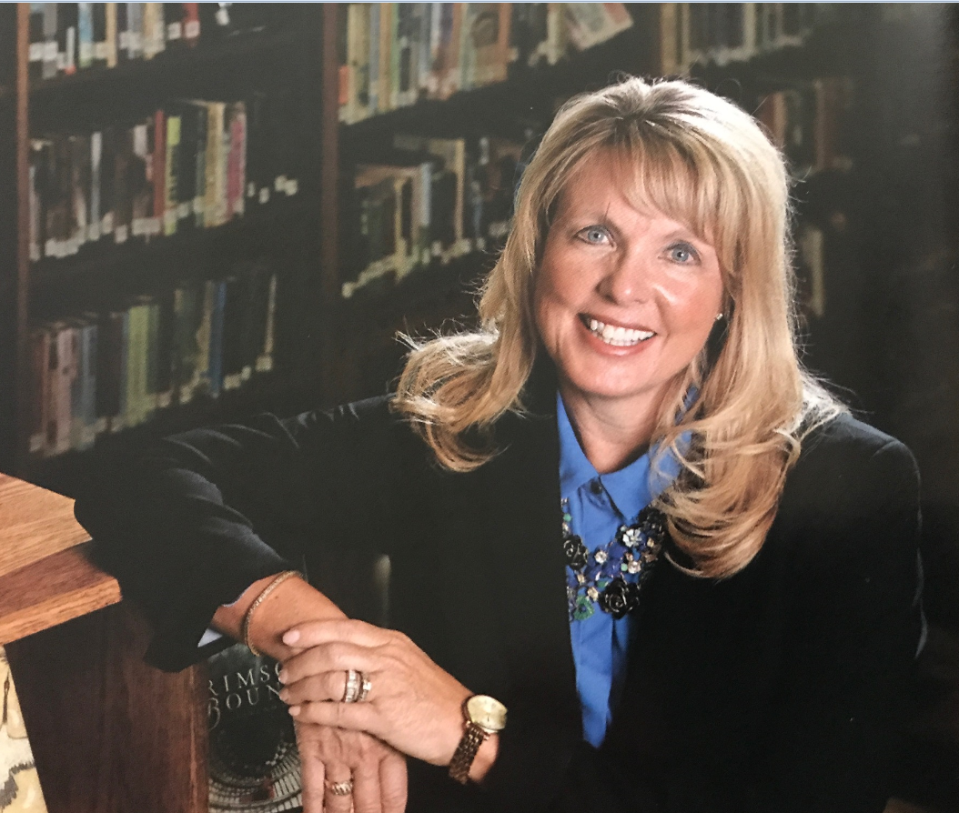
Superintendent Lacey
& Cabinet
Notes:
Superintendent Lacey started working in the GFPS system in
She is a product of this school system as well.
Avid Grizzly fan, but don’t hold that against her
On many Boards including . . . (Chairperson of the Board for
Superintendent Lacey is an incredible leader and mentor. You will see her a lot out in the schools and in our community. She’s a great representative for our District. She talks the talk and walks the walk.
It is my pleasure to introduce our Superintendent of GFPS, Superintendent Tammy Lacey.

Slide 4
Introducing District Leadership
  Superintendent’s Cabinet:
  Assistant Superintendent K-6: Ruth Uecker
  Assistant Superintendent 7-12: Tom Moore
  Director of Business Operations: Brian Patrick
  Director of Human Resources: Mindy Kiser
  Director of Instructional Technology: Tom Hering
  Director of Student Services: Dale Lambert
  Community Connections Manager: Dave Crum

Slide 5

Mission:
We successfully educate students to navigate their futures.
Vision:
All kids engaged in learning today…
for life tomorrow.
Leadership:
The capacity to translate vision/mission into reality.

Slide 6


My preferred reality:
STUDENT
CENTERED
for
STUDENT
SUCCESS

Slide 7
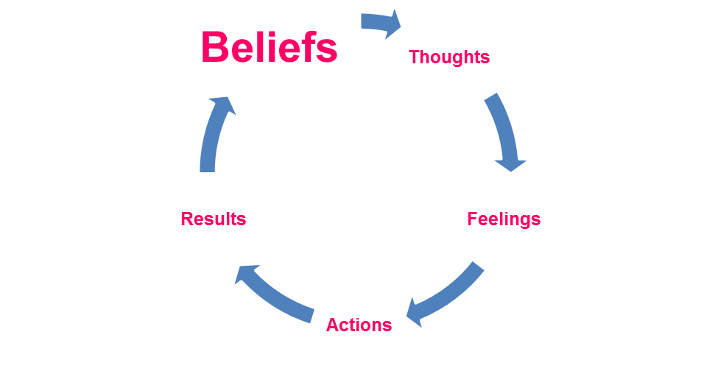


Slide 8

Belief Statements
All students deserve teachers and staff who thrive on student success.
Each student will have fair and equitable opportunity for quality instruction and academic success.
All students learn when their individual needs are met through a personalized school experience.
All students and staff learn and work best in a safe, secure, and nurturing environment.
Highly skilled and committed personnel are our greatest asset.
Quality education is a partnership of students, staff, family, and community engagement.
Dedication to acknowledging, affirming, and including diversity enriches the educational experiences for all.
District resources, programs and staff are flexible, adaptable and provide choice to meet the changing needs of all students.
A well-educated community is the foundation of our democracy.
District resources and staff are public assets requiring responsible stewardship and community involvement.
All students will graduate college, career and citizenship ready.

Slide 9



Strategic Plan
Student Achievement—Our Kids
Goal: Increase student achievement for all students while closing the achievement gap.
The Board is committed to ensuring that all students graduate and are college and/or career ready. Every school must improve teaching and learning with a focus on the Montana Content Standards (MCS). Our expectation is that every student will make at least one year of academic growth in each school year.
Stewardship and Accountability—Our Community
Goal: Provide prudent stewardship and accountability of public resources to best support educational opportunity and student success.
The Board is committed to directing District resources to providing educational opportunity through both an instructional core and comprehensive programming while maximizing operational efficiency and public accountability within a sustainable budget. The District must recognize a need for a 21st Century learning environment, changing student population with more diverse needs, uncertain revenue streams and escalating costs.
Healthy, Safe and Secure Schools—Our Future
Goal: The District will provide all students a healthy, safe, and secure school environment in which to learn
The Board recognizes its responsibility to protect the health, safety and welfare of all students within the District. The Board is committed to ensuring that plans and supporting resources are available to carry out this important responsibility.

Slide 10
Today’s agenda
Get to know GFPS
Get to know your co-workers
Communication at GFPS
Who to go to for help, assistance, etc.
Safety
Security
GFEA
Technology
Tips, Tricks & Off we Go!

Slide 11
Missing paperwork
If you had a note with your nametag please go to HR at the next break. We are missing new hire paperwork from you and we must have it for you to start employment.

Slide 12
Pay or pir for today
Pick one of two options.
Pay for today OR
PIR for today
The teacher contract is 187 days.
Of those 187 days, 180 days are student contact day.
The other 7 days of your contract are PIR days.
2 days of PIR are August 28 and 29
2 days are “swapped” for parent/teacher conferences
And you must complete 3 PIR days “on your own” – today can count for 1 PIR Day (PIR Catalog)

Slide 13
SENDING AROUND SIGNATURE FORM
(PICK AN OPTION)
PAY ONLY – also need to sign Time Record Form
PIR CREDIT

Slide 14
Connect Great Falls Event
All new teachers are cordially invited to a “Connect Great Falls” event.
Scheduled for August 22, 2017 at Centene Stadium (Voyagers).

Slide 15
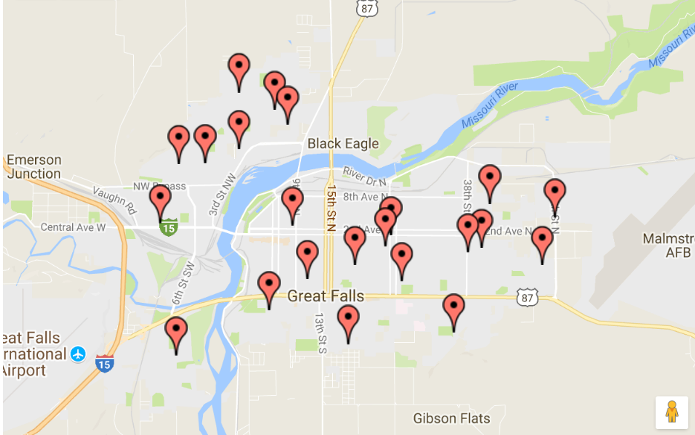
About GFPS
Map of the District

Slide 16
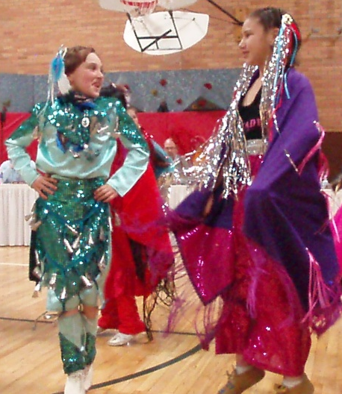
Our Schools, Staff and Students…
Schools:
  Early Learning Center at Skyline—Pre-School
  15 Elementary Schools
  2 Middle School
  2 High Schools
  1 Alternative Learning Center at Paris Gibson Ed. Center
  Over 10,000 students
Staff:
  Approximately 1900 employees
  3rd largest employer in Great Falls

Slide 17
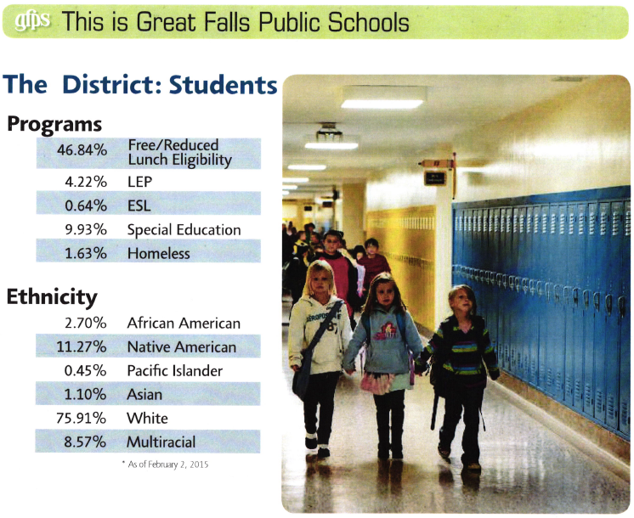
Notes:
It takes a village
Diversity (IEFA
Total District Demographics
(10,145 students)
Programs
44.86%
Free/Reduced
3.78%
LEP
0.56%
ESL
10.06%
Special Education
1.05%
Homeless
Ethnicity
2.35%
African American
10.78%
Native American
0.40%
Pacific Islander
1.04%
Asian
75.64%
White
9.79%
Multiracial
training)

Slide 18
Our Staff: | FTE | People
Aide-Library/Teacher | 43.3 | 106
Clerical | 76.0 | 77
Crafts | 11.0 | 11
District Admin | 15.0 | 15
Engineers | 92.0 | 92
Food Service | 63.1 | 84
Hourly Classified | 139.3 | 213
Medical Related | 20.9 | 21
Medically Related Hrly | 6.4 | 9
Principals | 29.0 | 29
Psychologists | 9.0 | 9
Supervisors | 6.0 | 40
Support | 23.9 | 7
Teachers | 743.9 | 747
Technology Specialists | 12.0 | 12
Warehouse | 8.0 | 8
Total | 1298.8 | 1479.0
Substitutes | People
Teacher Sub | 299
Aide Sub | 65
Para Educator Sub | 34
Clerical Sub | 12
Food Service Sub | 16
Crossing Guard Sub | 11
Nurse Sub | 1
TOTAL | 438

Slide 19

Getting Acquainted with the District
Convocation
August 28th
8:00 AM at GFHS
Notes:
You have a unique opportunity to help continue to make Great Falls a great community to live and work. Your involvement educating our youth is a lifelong adventure. Everyone remembers at least one teacher that made a difference in their life.
Don’t get discouraged. There are many resources for you. Someone somewhere has been faced with the same or similar situation that you may be faced with and if not more brains are better than one.
Convocation date and time. September 2, 2014 8:00 AM
Introduce cabinet

Slide 20
HOW COMMUNICATION WORKS AT gFPS

Slide 21


Newsbits
Tammy’s Top Ten on Tuesdays
Facebook
Twitter (#TammyLLacey)
Webpage
Twitter-GFPublicSchools (only used for time critical/crisis situations)
My Neighbor in Need (.org)
My Student in Need
Notes:
My Neighbor In Need
United Way
Connect Great Falls
Great Falls Development Authority
GFPS Foundation
Did You Know You Can Contribute to the GFPS Foundation without Costing You a Penny?
That's right. You can contribute to the GFPS foundation by using Amazon Smile for your purchases. It won't cost you anything extra to use smile.Amazon.com instead of amazon.com to make purchases. Just designate Great Falls Public Schools Foundation as your charity and Amazon will contribute 1% of your sales. Or use this link to directly benefit the foundation every time you make a purchase: Amazon Smile

Slide 22
Getting to know each other
Bingo

Slide 23
About you
Your name
Where are you from & what school did you graduate from?
How long have you been teaching?
Where & what will you be teaching next year?

Slide 24
Who to go to for help
HR Department 268-6010
Help Desk (Staff, Bookmarks, Help Desk OR call 268-7393)
Emotional Support (Principal, Co-workers, EAP, HR)
Physical Support
  Engineers – 1st Engineer day, 2nd Engineer afternoon (light moving help etc.)
  Moving Computers, etc. – help desk ticket please
  Wellness – workout facility at Paris, free pool passes for GFHS, workout classes, lots more (Staff, Wellness)
Secretaries – supplies, paperwork, etc.

Slide 25
Who to go to for help instructional Support
Instructional Coaches
Marni Napierala serves all elementary schools
Barbi Foster – Instructional Coach for LF, MS, MV, SAC, SS
Kelsey Brown – Instructional Coach for CJ, LY, ML, VV, WT
Rachael Kelley – Instructional Coach for LC, LN, RS, RV, WH
Charlene Ammons is the Technology Integration Coach for elementary schools
Jana Mora is the Technology Integration Coach for secondary schools
Kayte Howell – Instructional Coach for GFHS and EMS
Sarah Milling – Instructional Coach for CMR and NMS

Slide 26
Policies/procedures
Videos
Worker’s compensation
Harassment & Respect for all
Other Items
Mandatory Reporters

Slide 27
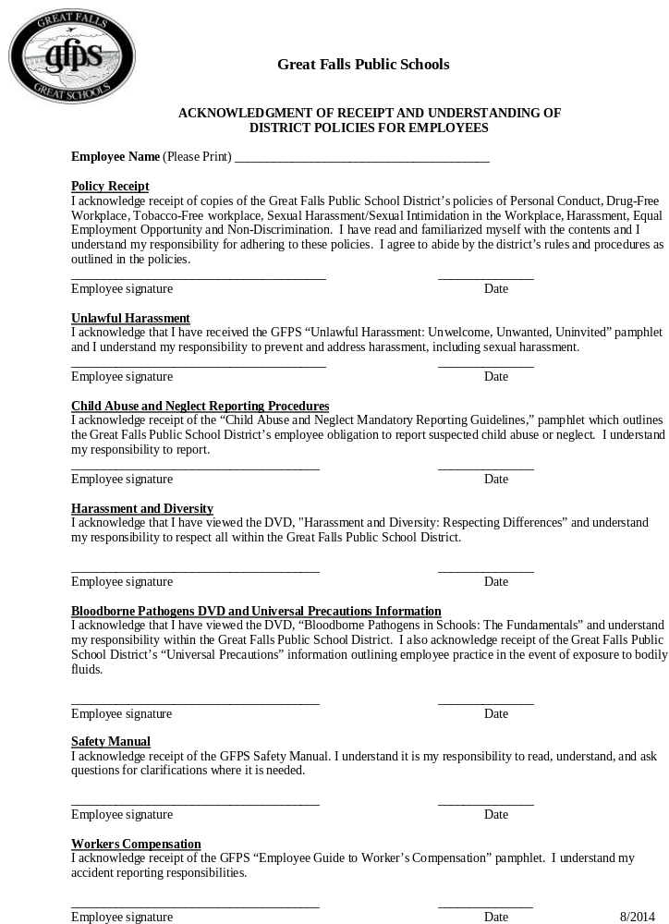
Part of new hire paper work.

Slide 28

Activity- Teacher Traits
Good Teacher Not So Good Teacher
Notes:
By sucker types break into groups, discuss among the groups for a few minutes all the traits of a good teacher and have a person write them down.
Discuss among the group all the traits of a not so good teacher and have a designated spokesperson write it down.
Use flip chart or white board to write down all the ideas and get them documented.

Slide 29

In the eyes of a child you will see...the world as it should be.
- Unknown

Slide 30


Group Share-Teacher Traits
Good Teacher Not So Good Teacher
Notes:
Look at these lists.
May want to write these down and reflect on this throughout the year.
You aspire to be this teacher . . . Don’t become this teacher.
Remember your strengths and don’t forget your weaknesses

Slide 31
Professional educators recognize and accept their responsibility to create learning environments to help all students reach their full potential. They understand the trust and confidence placed in them by students, families, colleagues, and the community. To achieve their professional purpose, educators strive to maintain the highest ethical standards. The Professional Educators of Montana Code of Ethics sets out these fundamental principles which guide their behavior and will be used to judge their actions.
Professional Educators of Montana Code of Ethics
Notes:
Left side of packet

Slide 32
Professional Image Guidelines
Employees are expected to maintain a well-groomed, business-like appearance at all times and to wear appropriate dress for work. Dress should be modest, in good taste and suitable for the job at hand.
Following is a summary of guidelines set forth by Great Falls Public Schools. Any exceptions to the dress code for special events at school will be announced in advance.
Guidelines
All clothing should cover undergarments.
Clothing will provide adequate coverage of the back, midriff and chest at all times whether sitting, reaching, standing or bending.
Apparel and body art that feature words, symbols, or logos regarding tobacco products, alcohol products, drug references, sexual references, or other messages are prohibited.
Clothing, piercings and body art that is disruptive to the educational process or creates a safety issue, will be addressed.
Notes:
Presenting a professional image is important in the educational workplace. Staff members are role models to the students of Great Falls Public Schools and there is important value in presenting a positive image to the students, parents and the public.

Slide 33

5450F Code of Ethics for Electronic Mail and On-Line Services
Great Falls Public Schools
Code of Ethics for Electronic Mail and On-Line Services
PUBLIC
Notes:
PUBLIC!!!!
Emails can be requested from public and you have to provide.

Slide 34
Payroll/benefits
Pay Day – the 20th of the month (option of 10 pay or 12 pay)
Sick Leave
Personal Business
Aesop (recording of absences)

Slide 35
2017-2018 Insurance Meetings
Spouses invited to participate in wellness this year for the incentive!
Tuesday, August 22, 2017 | DOB | Aspen | 1:00 PM
Tuesday, August 22, 2017 | DOB | Aspen | 4:00 PM
Thursday, August 24, 2017 | DOB | Aspen | 10:00 AM
Thursday, August 24, 2017 | DOB | Aspen | 1:00 PM
Thursday, August 24, 2017 | DOB | Aspen | 3:00 PM
Thursday, September 7, 2017 | CMR | Bill Will Hall | 3:45 PM
Monday, September 11, 2017 | GFHS | Auditorium | 3:45 PM
Tuesday, September 12, 2017 | PGEC | Hub | 3:45 PM
Thursday, September 14, 2017 | NMS | Cafeteria | 3:45 PM
Monday, September 18, 2017 | EMS | Room D-2 | 3:45 PM
Deadline for elections September 19th!

Slide 36
Sick leave long term benefits
At the end of employment (sometime far, far away . . . ) you will want to think about retirement
Your accrued sick leave can help tremendously with your retirement benefits
33% payout after 10 years in the District and $50 for each day after 2 years in the District.
Example: you work here 3 years – accumulate the max sick days, have not used any pb days and then sadly (sad face ☹) you have to move away. When you leave employment you get paid out $2,250

Slide 37

Using sick leave
Aesop (www.gfps.k12.mt.us Staff – Bookmarks – Aesop
  On-line substitute teacher and absence system
Preparing for a substitute
  Good, clear lesson plans (please don’t just throw in a movie)
  Emergency lesson plans
Does anyone have any tried and true methods they have used?

Slide 38
How your performance is evaluated

Slide 39

Notes:
Handout
Formal and informal observations by principals
Final evaluation

Slide 40
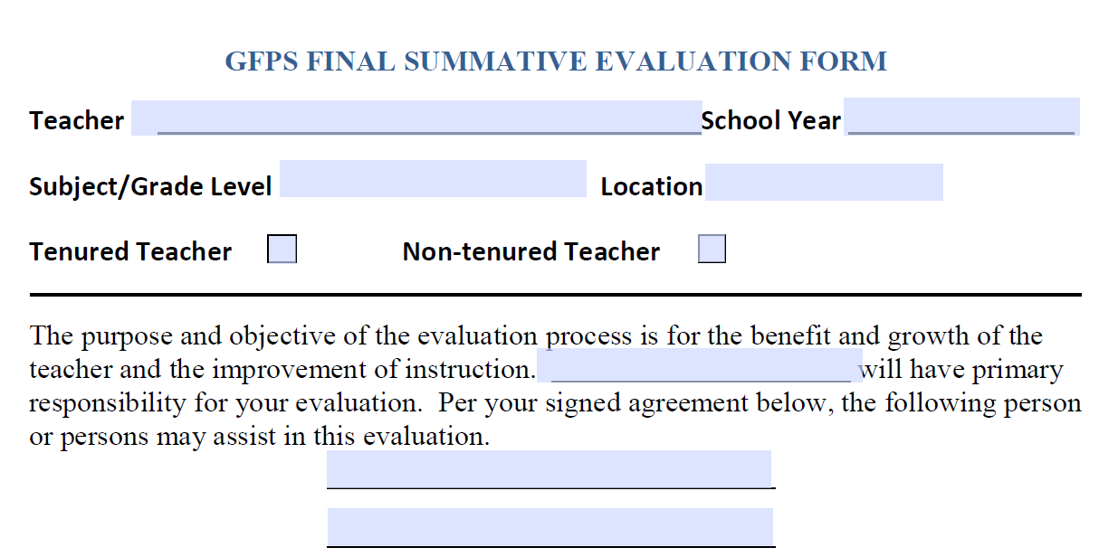

Slide 41
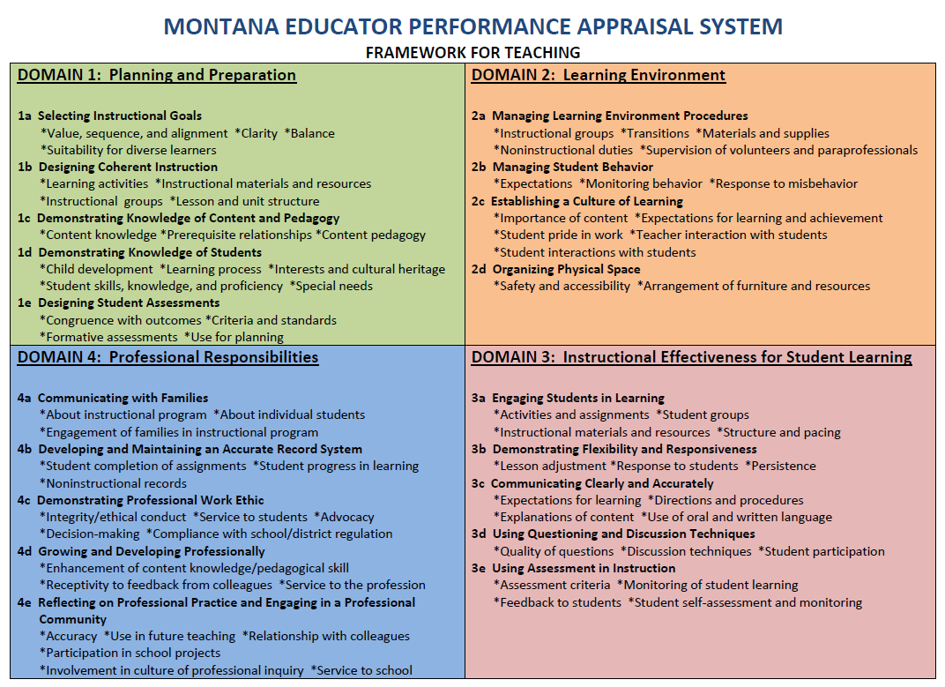
Notes:
Handout 4 Domains

Slide 42
What’s one thing you learned from previous experience (either the easy way or the hard way) that you either will or will not apply to your first year teaching with GFPS?
Notes:
In your GFPS maroon goodie bag you will find a white notebook and pen. This is for your use. For this activity you will simply write down one thing you’ve learned in your current teaching experience that you’ll use in the following year. For example, I learned that the first week of school is critical in establishing procedures for your classroom.

Slide 43
People will not remember what you said, but they will remember how you made them feel.
Notes:
9:45 restart
People will not remember what you said, but they will remember how you made them feel.
Good decisions come from experience, and experience comes from bad decisions.

Slide 44
Share your a-ha moment
What’s one thing you learned from previous experience (either the easy way or the hard way) that you will or will not apply this year?
Notes:
What was your A-HA moment?
I am a teacher, I am a mentor, I can be kind, but I am not their friend.
It’s important to get to know the office staff and the custodians. They have skills and abilities that you can only imagine and they can help in ways you can’t imagine.
I got after a girl who was one of my cheerleaders for not returning a paint can so we could have matching paint for the next year’s cheerleaders. What I didn’t know and didn’t ask is that her family had had a fire that year and a paint can was her last priority. Sometimes if you just take 2 minutes and ask why and care enough it will make all the difference.
Students do want to learn and they rely on you to keep the classroom managed and to teach them!
It’s ok to ask for help.
It’s ok to take care of yourself first.
I can’t learn it for them and if I’m working harder than them I need to reevaluate my classroom management and grading style.
Never underestimate the power of a good call home.

Slide 45
Safety
ID Badges (get one today for the start of school in HR)
Greeting visitors

Slide 46
School Resource Officers
Nick Taylor (CMR) – 564-8718
Cory Reeves (GFHS and Paris) – 781-8918
Aaron Frick (NMS and Westside Elementary Schools) – 781-8919
Scott Bambenek (EMS and Eastside Elementary Schools) – 781-8917

Slide 47
gfea

Slide 48
lunch

Slide 49
technology
2 to 3:30

Slide 50
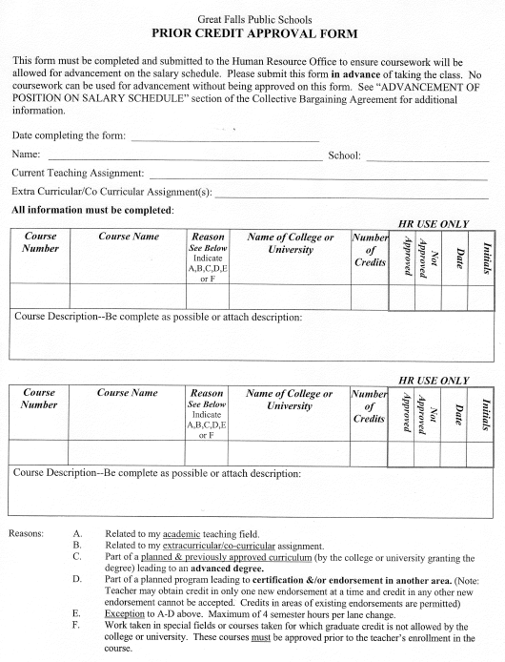




Prior Credit Approval Form
Movement on the teacher salary schedule.

Slide 51
Teacher’s Compensation Schedule
SCHOOL YEAR 2014-2015
BACHELOR'S DEGREE |  |  |  | MASTER'S DEGREE
STEP | B.A. | B.A.+10 | B.A.+20 | M.A. | M.A.+10 | M.A.+20 | M.A.+30
 | $32,062 | $33,087 | $34,146 | $35,171 | $36,212 | $37,240 | $38,281
1
 | $33,248 | $34,387 | $35,540 | $36,678 | $37,817 | $38,955 | $40,093
2
 | $34,434 | $35,684 | $36,934 | $38,185 | $39,420 | $40,669 | $41,906
3
 | $35,620 | $36,982 | $38,330 | $39,693 | $41,020 | $42,385 | $43,716
4
 | $36,807 | $38,281 | $39,724 | $41,200 | $42,626 | $44,099 | $45,527
5
 | $37,993 | $39,581 | $41,118 | $42,705 | $44,228 | $45,815 | $47,338
6
 | $39,179 | $40,879 | $42,514 | $44,212 | $45,832 | $47,531 | $49,150
7
 | $40,365 | $42,176 | $43,909 | $45,719 | $47,434 | $49,246 | $50,961
8
 | $41,552 | $43,474 | $45,302 | $47,226 | $49,038 | $50,961 | $52,772
9
 | $42,738 | $44,772 | $46,698 | $48,735 | $50,641 | $52,677 | $54,584
10
Notes:
Example 1:
Teacher Al works for 35 years for GFPS. He decides to obtain his Masters plus 30 extra credits as quickly as possible. Logically, it probably takes him 3 years to get his Masters degree so he moved across a lane every year.
= $2.0 Million
Teacher Bud works for 35 years for GFPS. He decides to just do the minimum of 3 semester credits every 5 years as required by Administrative Rules of Montana.
=$1.7
= Difference = $300,000 (Note if only 25 years with same scenario, difference is $170K)

Slide 52
Teacher’s Compensation Schedule
SCHOOL YEAR 2014-2015
BACHELOR'S DEGREE |  |  |  | MASTER'S DEGREE
STEP | B.A. | B.A.+10 | B.A.+20 | M.A. | M.A.+10 | M.A.+20 | M.A.+30
 | $43,924 | $46,073 | $48,093 | $50,240 | $52,243 | $54,392 | $56,397
11
 | $45,111 | $47,371 | $49,488 | $51,747 | $53,847 | $56,107 | $58,207
12
 | $45,111 | $48,669 | $50,882 | $53,253 | $55,450 | $57,823 | $60,019
13
 | $45,111 | $48,669 | $52,277 | $54,761 | $57,053 | $59,537 | $61,830
14
 | $45,111 | $48,669 | $53,321 | $56,267 | $58,659 | $61,253 | $63,644
15
 | $45,111 | $48,669 | $54,367 | $56,267 | $58,659 | $61,253 | $64,919
16
 | $45,111 | $48,669 | $55,415 | $56,267 | $58,659 | $61,253 | $66,188
17
 | $45,111 | $48,669 | $55,415 | $56,267 | $58,659 | $61,253 | $67,461
18+
Notes:
Example 1:
Teacher Al works for 35 years for GFPS. He decides to obtain his Masters plus 30 extra credits as quickly as possible. Logically, it probably takes him 3 years to get his Masters degree so he moved across a lane (and down a step) every year.
= $2.0 Million
Teacher Bud works for 35 years for GFPS. He decides to just do the minimum of 3 semester credits every 5 years as required by Administrative Rules of Montana.
=$1.7
= Difference = $300,000 (Note if only 25 years with same scenario, difference is $170K)

Slide 53
Moral of the Story . . .
Get your Masters and as many credits as you can to get to the top of the salary schedule as quickly as possible.
It will pay off!
Notes:
Example 1:
Teacher Al works for 35 years for GFPS. He decides to obtain his Masters plus 30 extra credits as quickly as possible. Logically, it probably takes him 3 years to get his Masters degree so he moved across a lane (and down a step) every year.
= $2.0 Million

Slide 54



Loan Forgiveness
Loan forgiveness Programs
Montana Loan Forgiveness
Quality Educator Loan Assistance Program
The Quality Educator Loan Assistance Program was established by the Montana state legislature and is administered by MGSLP.
Federal Loan Forgiveness
Office of Postsecondary Education
Annual publication of the Teacher Shortage Area Nationwide Listing designated by the Department of Education
https://www.nslds.ed.gov/nslds_SA/
Loan forgiveness Program through Stafford Loan
Notes:
Right side of packet
Sac, RV, Loy and ML are NOT title schools
NMS and CMR are not title schools either

Slide 55
Other policies to be aware of

Slide 56

Board Policies
5225 PERSONNEL
Tobacco Free Policy
The District maintains tobacco-free buildings and grounds.
Smokeless tobacco electronic cigarettes and any other tobacco/nicotine innovation.
Prohibited
Parking lots
Lawn
Playgrounds
Violation of the policy by students and staff will be subject to actions outlined in District discipline policies.
Notes:
5000 personnel policies
Highlight a few
Harassment
Mandatory Reporting

Slide 57
5227 PERSONNEL - DRUG-FREE WORKPLACE
Drug-Free Workplace
All District workplaces are drug- and alcohol-free workplaces. All employees are prohibited from:
Unlawful manufacture, dispensing, distribution, possession, use, or being under the influence of a controlled substance while on District premises or while performing work for the District.
Distribution, consumption, use, possession, or being under the influence of alcohol while on District premises or while performing work for the District.
For purposes of this policy, a controlled substance is one which is:
not legally obtainable;
being used in a manner different than prescribed;
legally obtainable, but has not been legally obtained; or
referenced in federal or state controlled substance acts.
Notes:
Mention EAP again with this policy

