Slide 1
Financial Aid 101
An Investigation Into Financing
a College Career
Melissa Lacombe
Associate Director of Financial Aid
Roanoke College

Slide 2

What Are We Going To Talk About?
College Costs for the Future
Applying for Financial Aid
Types of Financial Aid
Additional Notes

Slide 3
College Costs for the Future

Slide 4
How much did you say it was going to
cost my student?
College costs are continuing to rise at rates greater than inflation
Estimated 3% to 5% increase each year
Since the early 00’s, cost of attendance at four-year public colleges has risen dramatically
    To get an idea of what college might cost by the time you get ready to matriculate, visit the College Board’s College Cost Calculator online at: http://apps.collegeboard.com/fincalc/college_cost.jsp
To find out how much a specific college costs, go to their website and search there.
But wait... there is good news!

Slide 5

As costs are going up, colleges are doing more to try and keep these costs in line for families
  At Roanoke College, 85% of our enrolled students receive aid
  At Radford University, 70% of their students receive aid
So remember, very few families will be expected to foot the whole college bill with no financial assistance at all!
Be careful that your student does not dismiss an institution right away just because of “sticker price”!

Slide 6
Applying for Financial Aid

Slide 7

College/Academic Merit Aid
College grants and scholarships are gifts
They do not need to be repaid
May require separate application
  Some institutions require the completion of the College Board Financial Aid Profile (CSS Profile)
  Series of 200 questions
  There is a $5.00 fee to register and another $18.00 charge per school
  Common among the more expensive schools (In Virginia: Hampden Sydney and W & L)
Awarded for a variety of reasons
  Proven High School performance
  Scholarship Competition/Honors Program
  Athletic
  Music/Choral ability
Roanoke College automatically awards students upon their acceptance to the college
  High School GPA (recalculated to include core classes only)
  CollegeBoard Test scores (SAT/ACT)

Slide 8
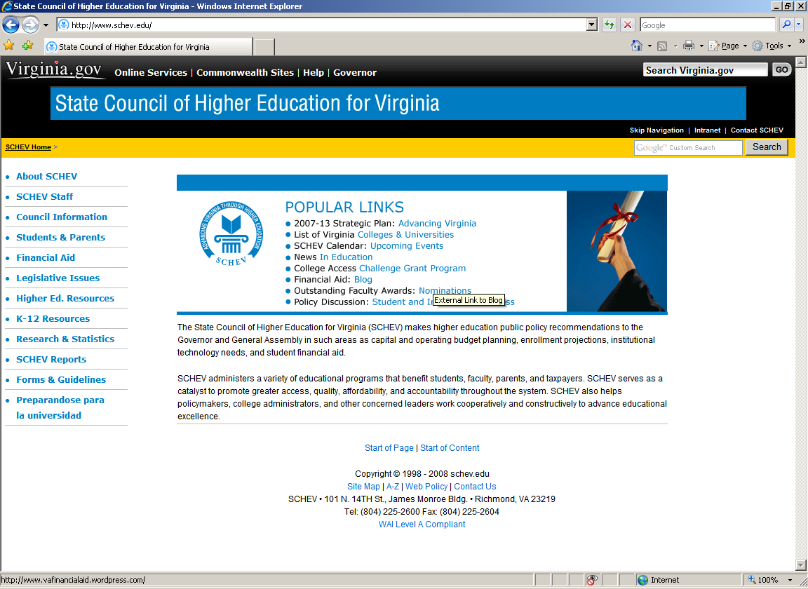
Federal/Need-Based Aid
Completion of the Free Application for Federal Student Aid (FAFSA) is recommended for everyone!
  Applications available OCTOBER 1 online at https://studentaid.gov/
  Deadlines for states or colleges will vary
    State Council of Higher Education for Virginia website www.schev.edu
  Check with a Financial Aid Office at the college about state and institutional sources of student aid and their specific deadlines

Slide 9
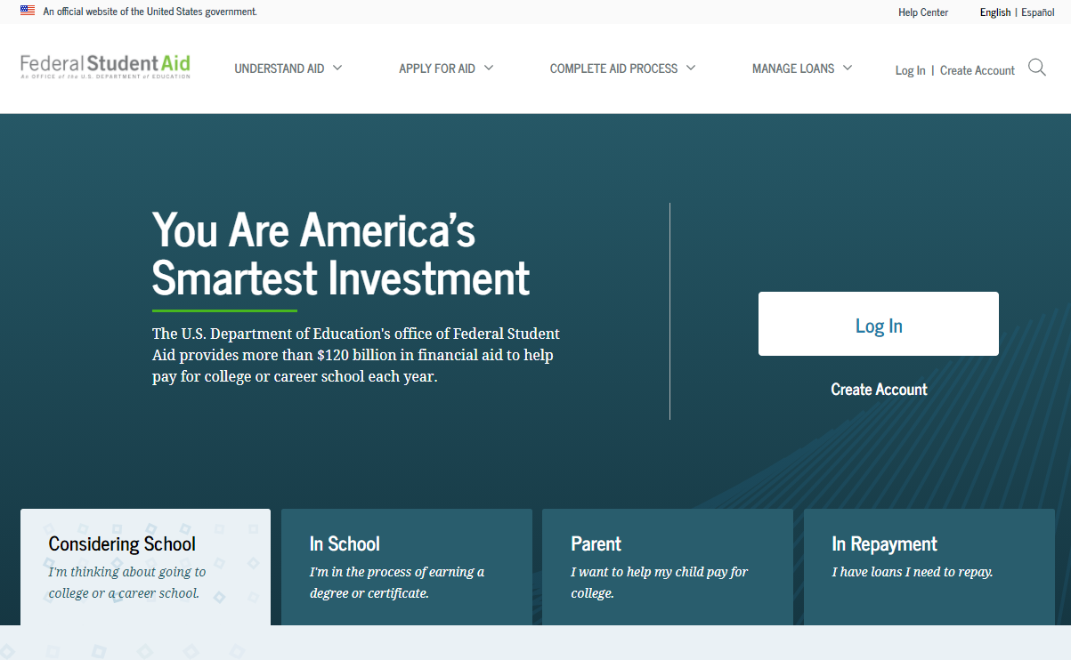
How Does the Student File the FAFSA?
FAFSA can be filed via paper or the web at https://studentaid.gov/
If filing online, students and parents need a U.S. Department of Education Federal Student Aid (FSA) ID and password
FSA ID and password can be used for:
  FAFSA on the Web (FAFSA and submission of corrections)
  Submission of loan documents for student and parent
  National Student Loan Data System
  Direct Loan Servicing Options
  If filing online, results will be received faster

Slide 10
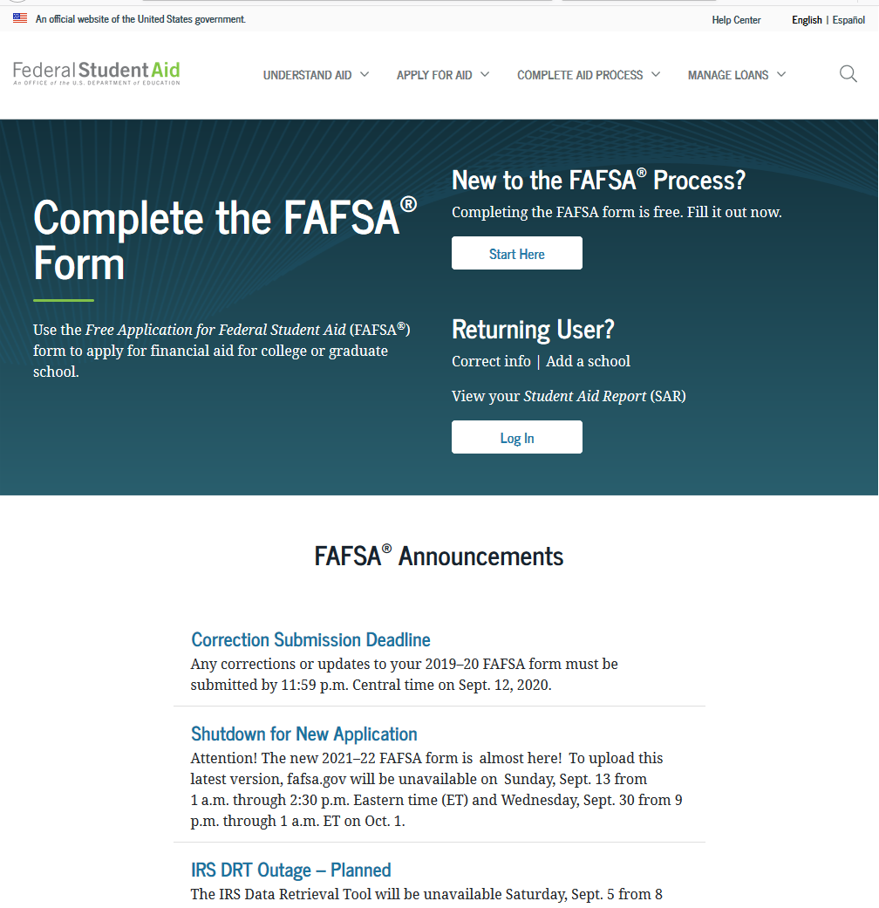
FAFSA on the Web
https://studentaid.gov/
Free U.S. Department of Education Web site where you can complete a FAFSA online
Submits data directly to
the U.S. Department of
Education’s Central
Processing System (CPS)
CPS will process your
application within 72
hours

Slide 11
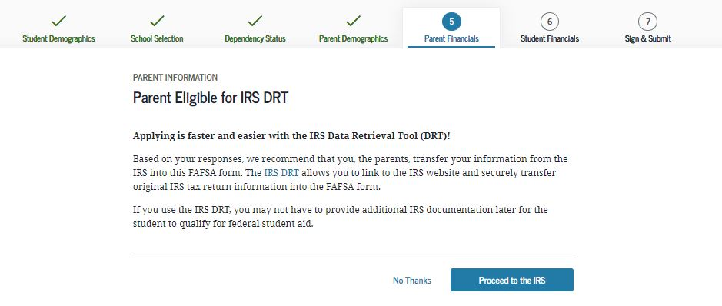
Utilizing the IRS Data Retrieval Tool (DRT)
If eligible to utilize the DRT tool, you will be prompted to “Proceed to the IRS”
Utilize the tool whenever possible
  Ensures accurate entry of financial information (for student and parent)
Make no changes to imported data

Slide 12
What Happens After the Student Completes the FAFSA?
Application sent to Mount Vernon, Illinois for processing
Calculation of Expected Family Contribution (EFC) Begins!
  FAFSA is the means by which the Department of Education officially compiles an income/asset evaluation
  Determines how much a family can contribute to the cost of college (EFC)
  Principles of Need Analysis
    To the extent they are able, parents have primary responsibility to pay for their dependent children’s education
    Students also have a responsibility to contribute to the educational costs
    Families should be evaluated in their present financial condition
    A family’s ability to pay for educational costs must be evaluated in an equitable and consistent manner, recognizing that special circumstances can and do affect its ability to pay

Slide 13

How Does the Department of Education Come Up With an EFC?
Not a random process
Based on a calculation that is composed by Congress
(Federal Methodology)
Formula created by Congress to determine the EFC
  Parent Income
    Taxed and Untaxed
    Protection allowance for taxes and basic living expenses
  Parent Assets
    Stocks, bonds, trusts, savings and business assets
    Allows for an asset protection allowance
  Student Income
    Taxed and Untaxed
    Protection allowance (must contribute 50% of everything above this amount)
  Student Assets
-

Slide 14
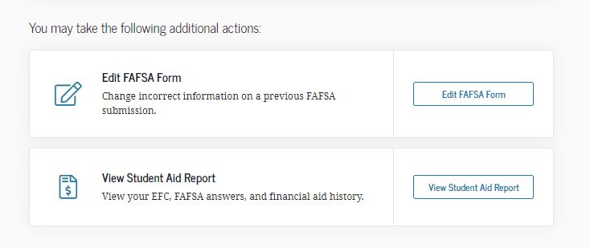
After the calculation is completed, what’s next?
The student will receive a Student Aid Report (SAR) from the processor
  Notification will be emailed to student
  Check SPAM folders
  Link is only active for a short period of time

Slide 15
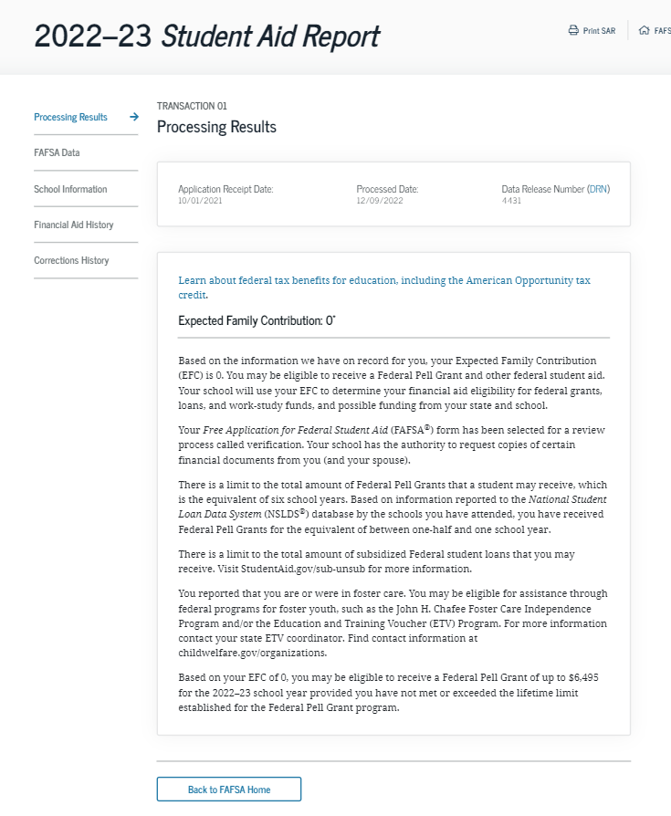
The student will receive a Student Aid Report (SAR) from the processor
  Displays the EFC
  Shows any edit errors
Students will receive the SAR approximately 2 - 4 weeks after submission

Slide 16
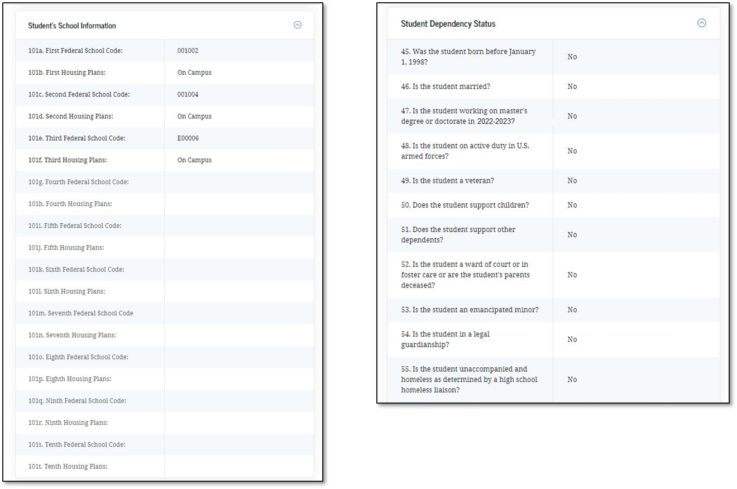
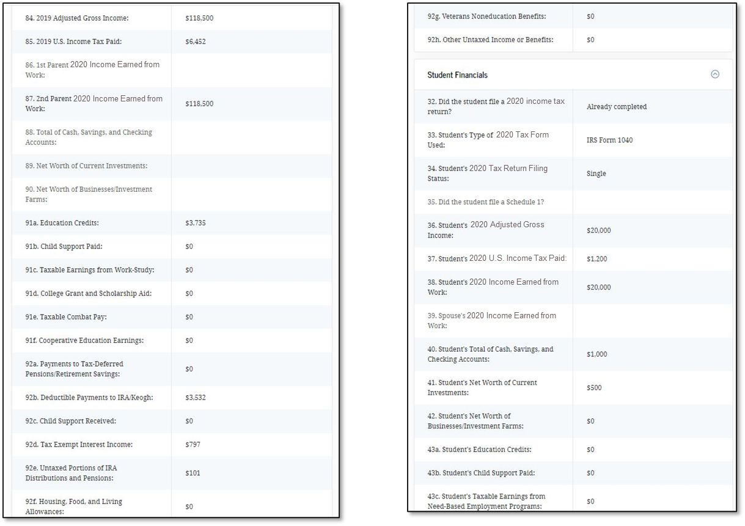
Additional Things to Note About the SAR
All institutions listed on the FAFSA will receive an electronic copy of the same SAR
Each school will then initiate the awarding of federal and/or state funds.
It is VERY IMPORTANT that the information on this form is accurate!
  Be sure to check your SAR over carefully for errors!
  Both parent and student should review entire form, paying particular attention to the first page

Slide 17

Common Errors to be Aware of When Filing the FAFSA
Common errors to be aware of:
  Incorrect demographic information (especially social security numbers).
  Student or parent income information or signatures are missing.
  Number of family members in the household and in college do not correspond. (Example- A parent in college cannot be counted.)
  Income figures were reported twice or not placed on the correct line.
  Parents are divorced but both incomes were listed or a step-parent’s information was not reported.
  It is important to make sure that numbers are correctly entered on the application. The computer will not pick up any decimals. Round all figures. (Example- If you enter $299.00 in the five spaces, it will be read as $29,900)
Other issues to be aware of (highlighted on the first page of the SAR):
    Citizenship Issue
    Social Security Conflict

Slide 18

Now that I’ve checked my SAR, how does the school use this information to calculate an award?
  Cost of Attendance
    Tuition and fees
    Room and board
    Books and supplies, equipment, transportation,
    and miscellaneous/personal expenses
    Cost of a Computer
    Loan fees
    Study abroad costs
    Dependent care expenses
    Expenses related to a disability
    Expenses for cooperative education program
    Financial Need
    Cost of Attendance – EFC
    Varies between schools due to cost differences

Slide 19

How Does Need Vary Based Upon Cost?
EXAMPLE: Sally is interested in three different universities but she is unsure what type of financial aid she may be eligible for. She completed a FAFSA and received her results on the SAR. Her EFC is $5,000. What would her financial need look like at each college if their cost of attendance were the following: $30,000 (College 1), $15,000 (College 2), and $10,000 (College 3)?
    College 1: $30,000 - $5,000 = Financial Need of $25,000
    College 2: $15,000 - $5,000 = Financial Need of $10,000
    College 3: $10,000 - $5,000 = Financial Need of $5,000
Each school then awards financial aid based upon this figure
In the example, Sally has a great eligibility for aid at College 1 and will probably get a better financial aid package as a result

Slide 20
Types of Financial Aid

Slide 21

The Academic Merit Scholarships/Grants
Grants and Scholarships are gifts
They do not need to be repaid
May require separate application
  Roanoke College automatically awards students upon their acceptance to the college
Awarded to students based on proven academic performance
Look at such factors as high school GPA, class rank, SAT/ACT scores
Depending upon the institution, may have funds available for musicians, athletes or other talented individuals
Many institutions also offer scholarship competitions and/or honors programs, that may require a separate application
Many of these awards are offered for up to 4 years assuming the recipient maintains the required GPA

Slide 22

Need-Based Programs
You will need to complete the Free Application for Federal Student Aid (FAFSA) to determine eligibility for federal programs and other aid opportunities. It can be completed anytime after October 1.
The Federal Pell Grant Program
  Made to undergraduates with high need.
  Awards for 2021-2022 range from $672 to $6,495.
  Eligibility and the actual amount are determined by the U.S. Department of Education.
  Federal Supplemental Educational Opportunity Grant (SEOG)
    Provides grants to students with high financial need, with consideration given to Federal Pell Grant recipients.
    The typical Roanoke College award ranges from $200 to $400.

Slide 23

Need-Based Programs
Supplemental Grant
  Awarded to students who can demonstrate financial need.
  Designed to help middle class families.
Virginia Commonwealth Award
  High need, Federal Pell Grant recipients from Virginia
  Must attend a PUBLIC University in VA
  Undergraduate and Graduate students
  Students with the greatest need receive the largest awards
  Amount: Varies by institution
  Renewal requires Satisfactory Academic Progress

Slide 24

Need-Based Programs
  Federal Stafford Loans
    Subsidized
      Available to all students who demonstrate financial need
      Government pays the interest, principle deferred
    Unsubsidized
      Available to all students who do not demonstrate financial need
      Student pays interest, principle deferred.
    Loan amounts:
      Freshmen: $5,500 (no more than $3,500 Sub)
      Sophomore: $6,500 (no more than $4,500 Sub)
      Junior/Senior: $7,500 (no more than $5,500 Sub)
    Interest Rate: 3.73% fixed for 21/22
    6 month grace period, 10 year repayment

Slide 25

Need-Based Programs
    Federal Work-Study Program
  Allows students to earn money while working in a campus job.
  Awards may range depending on institution
    Roanoke’s average award is $1,500
  How do student’s find jobs?
    Some institutions may assign positions to students
    Others will leave it up to the student to find employment on their own
      Interview
      Application
  Where might I work?
    Commonly on campus
    Select off campus locations
      America Reads
      Community Service Organization
      Must be an approved location – decision made by school

Slide 26

Entitlement Funds
Entitlement funds are awarded according to either geographical location or religious affiliation.
Institutional Awards (Lutheran Grant)
Virginia Tuition Assistance Grant
  Bona-fide residents of Virginia who are enrolled in a VA Private college
Virginia Guaranteed Assistance Program (VGAP)
  Graduates of Virginia HS (2.5 GPA) who are enrolled in a Public VA University
  Awards Range by institution
  Renewed for up to 3 additional years
  Virginia Transfer Grant Program
  Recipient must be a first-time transfer minority student from an accredited institution
  Award amount is $1,000 per academic year
  Requires applicants to have a cumulative transfer GPA of at least 2.0
  Minimum number of college-level courses prior to transfer

Slide 27

Outside Funding
Gates Millennium Scholars Program
United Negro College Fund
  Provides scholarships for outstanding low-income minority students
National Merit Scholarships
Military Scholarships
  Air Force
  Army
  Navy
  Marine Corps
Robert C Byrd Scholarships
  Awarded to students based on academic achievement and excellence
  Recipients may receive up to $1,500 a year
  Students will be judged on GPA, test scores, letters of recognition, extra curricula activities, and community involvement
  To apply, students should contact the Department of Education in their
  home state

Slide 28
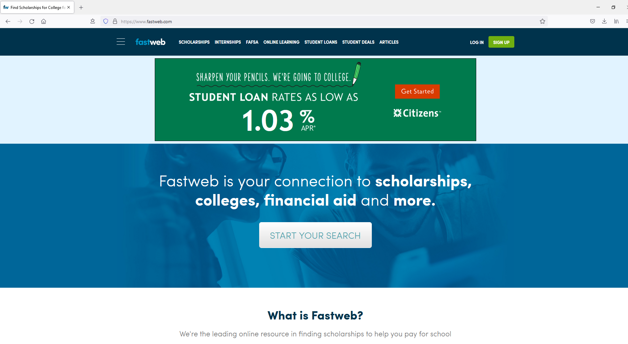
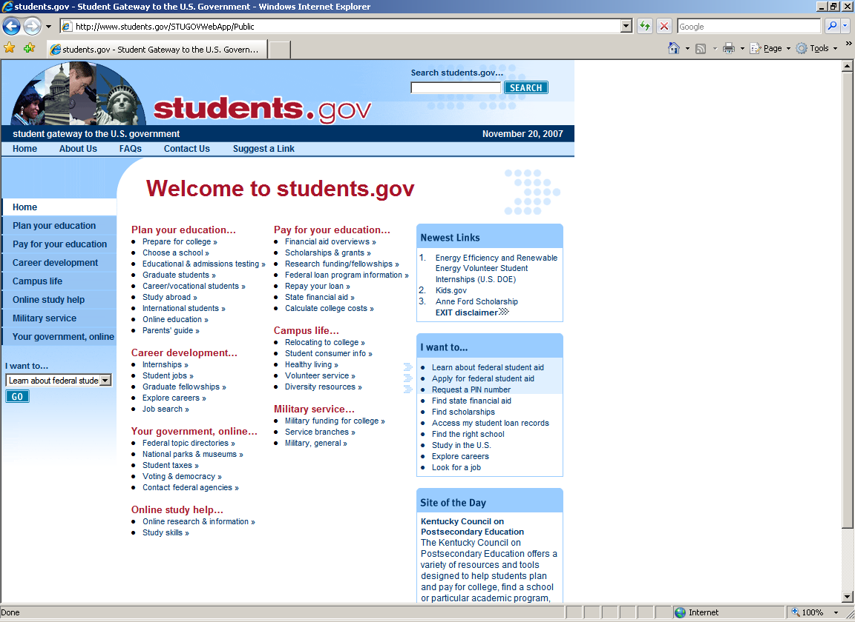
Scholarship Search Engines
www.fastweb.com
www.students.gov

Slide 29

Payment Schedules
  Cash Payment
  Credit Card Payment
  Monthly Payment Plan
  Parent Loan for Undergraduate Students
    Provides non-need-based loans to assist parents of dependent students
    Credit check required
    Interest rate: Fixed 6.28% begins within 60 days of full disbursement
  Alternative Loans Student Loan.
    Co-signer is required.
    Credit check will be done.
    Wide variety of lenders and
    interest rates

Slide 30
Additional Notes

Slide 31
Use the Financial Aid Office as a resource!
Visit campus AND talk with Financial Aid while you are there
Use the financial aid calculators on each website
Communicate Special Circumstances
  Send each Financial Aid Office a detailed letter explaining your individual circumstances
  Send appropriate documentation (copies of W-2’s, tax returns, projections of income)
  Examples:
    Loss of job or benefit
    Separation or divorce after you have already filed the FAFSA
    Death of a parent after you have already filed the FAFSA
    Extraordinary out-of-pocket medical expenses (not covered by insurance)
    Sibling Educational Expenses
    Parent Educational Expenses

Slide 32
Use the Financial Aid Office as a resource!
Respond to all requests in a timely manner
Comply with all “verification” requests
  What is it?
  Who can select my file for verification?
      Department of Education
      Financial Aid Office
  Why was I selected?
    Random process. (Requirement to verify 35% of our student body)
    Reasons may include: Reporting the same figure more than once; Reporting an unusually low tax figure; Reporting an incorrect tax amount
  What do I need to supply?
    Copy of BOTH the Student’s and Parent’s 2020 Federal Tax Return Transcript
      Only needed if the IRS DRT was not utilized or if figures were changed after data was transferred
    Copies of BOTH the Student’s and Parent’s 2020 W-2’s
    Completed Verification W/S
    Other documents as requested (EX: Schedule 1, 2, 3 or K-1)

Slide 33
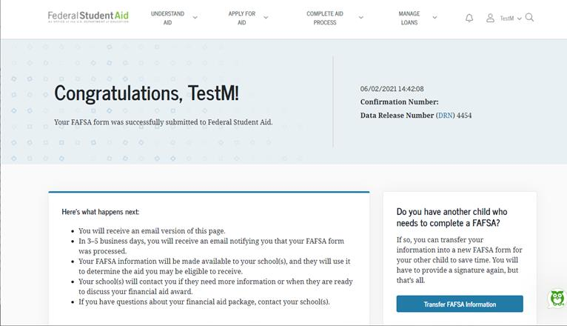
Other Helpful Notes
  Meet the deadlines put into place!
      Late filing may mean missing out on aid opportunities
  Utilize IRS Education Credits
      American Opportunity Credit
      Lifetime Learning Credit
  Parents with multiple students
      Separate FAFSAs need to be submitted on each student
      Parents may be eligible to transfer their FAFSA information into a new application from the original student’s confirmation page.

Slide 34




Questions,
Melissa Lacombe
Associate Director of Financial Aid
Roanoke College
mlacombe@roanoke.edu
or
(540) 375-2235

