Slide 1
Roanoke County Schools
Budget Work Session – FY 2018-2019
December 14, 2017
Student Enrollment

Slide 2
Agenda
Budget Timeline
Student Enrollment
School Nurse Coverage Options

Slide 3
Budget Timeline
December:
11th – Employee Advisory Committee – Budget Update
14th – Work session (Enrollment, School Nurse Committee report)
January:
10th – General Assembly convenes
11th – Work session (Governor’s Budget, Budget Initiatives)
25th – Public Hearing, Work Session (Technology Plan)
February:
8th – SB meeting, Work Session (Other fund budgets, Bus plan)
12th – EAC meeting – Budget Update
14th – GA Crossover Day
22nd – Work session – Compensation, Insurance, Crossover Budgets (if available)
Notes:
Quick review of important dates for the budget process.
Similar to past years, will be 1st year of new biennium for state budget.

Slide 4
Budget Timeline
March:
6th – Work session – Crossover budgets
8th – SB meeting
10th – General Assembly adjourns (revenues may not be available until March 17th)
13th – Work session (TBD)
15th – Work session (TBD)
17th – Work session (Superintendent’s Budget if possible)
20th – Work session (TBD)
22nd – SB adopts FY19 budget
April:
1st – FY19 Budget due to Board of Supervisors
Notes:
Several work session dates set to ensure that budget adoption deadline can be met within constraints of getting final budget numbers from VDOE after GA adjourns.

Slide 5
ADM – 25 Years of History
ADM is average enrollment eligible for SOQ funding from 1st day of school through March 31st of each year.
Notes:
In a picture…. This is 25 years of history
Lowest in 1994-95 with 13,652 --- approaching that level again for 2018-19
Highest in 2007-08 with 14,802
Pace of decline seems to have slowed significantly

Slide 6
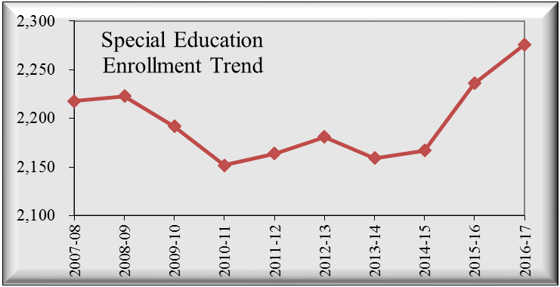
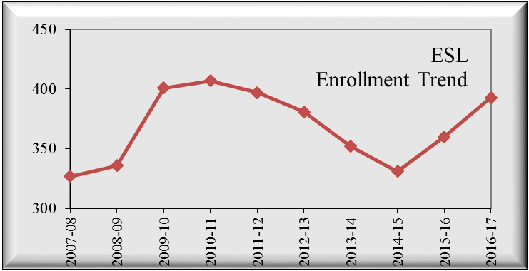
ADM – Enrollment Trends
Notes:
Other enrollment trends that impact budget development either through revenue allocation from the state and federal government or through additional support service expenditures being needed in the budget.

Slide 7
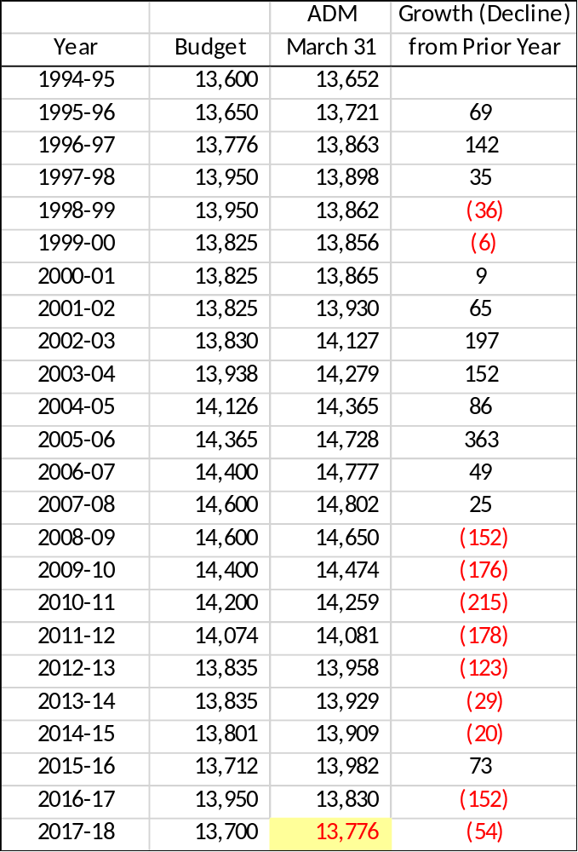
ADM – History
 | Spring 5th Grade | Fall 6th Grade | Difference
FY 2018 | 1060 | 1106 | 46
FY 2017 | 1062 | 1102 | 40
FY 2016 | 1018 | 1064 | 46
FY 2015 | 1029 | 1070 | 41
 | Spring 8th Grade | Fall 9th Grade | Difference
FY 2018 | 1089 | 1147 | 58
FY 2017 | 1147 | 1188 | 41
FY 2016 | 1099 | 1190 | 91
FY 2015 | 1174 | 1236 | 62
 |  | Combined Increase
 | FY 2018 | 104
 | FY 2017 | 81
 | FY 2016 | 137
 | FY 2015 | 103
Average Increase in Grades 6 & 9
over past 4 years: |  |  | 106
Actual enrollment in grades 6 and 9 outpaces grade progression; students moving back to public schools from private schools and home school programs?
Notes:
For those that like to see the numbers….
Interestingly, growth in rising 6th and 9th grades appears to be consistently occurring.

Slide 8
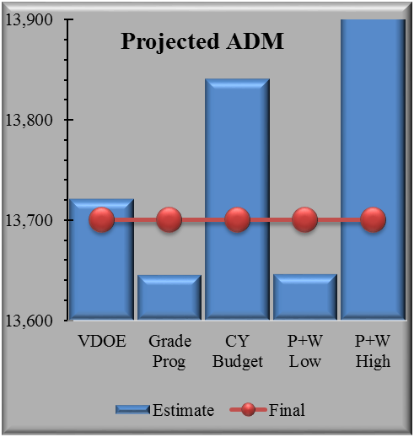
ADM – Projection Methods
VDOE (Weldon Cooper Center)
13,645
13,570 plus Grade 6/9 increase of approx. 106 = 13,676
Demographics Study
13,646 to 13,924
13,609 to 13,887
Adopted by School Board
13,700
TBD
Estimated ADM for 3/31/18
13,776
TBD in April 2019
13,721
To be released by VDOE on Dec 18th
Grade Progression
This Year
Next Year
Smaller kindergarten enrollments
  100 fewer in 2017 versus 2013
Increase in 6th and 9th enrollments
  Home school, private, other
Predicting enrollment 15 months in advance
Determines about 50% of budget revenues
Notes:
Which leads to how we project enrollment for the following budget year…
Review comparison of current year and the methods that were used.
Review projection data available to date for use in projecting the 2018-2019 enrollment (essentially 15 months in advance)
Not guesswork but also not an exact science. Refer to the trend graph as support for the year to year variability in student enrollment.
Very important to be in the ballpark as roughly 50% of school revenues are tied in some way to enrollment.

Slide 9
Enrollment Safety Net – Policy 4.28
Excerpt from Policy 4.28 School Operating Fund Unappropriated Balance:
“Purpose:
The School Board is ensuring the long-term economic stability of the Roanoke County Public Schools, by establishing a policy that maintains a prudent level of financial resources to protect against mid-year reductions in staffing or service levels because of temporary revenue shortfalls or unforeseen expenditures.”
“The School Operating Fund Unappropriated Balance is available for:
Unexpected revenue shortfalls.
Unplanned significant expenditure increases.
Emergency appropriations.
​It is the intent of the School Board that the School Operating Fund Unappropriated Balance will be reserved for financial emergencies and when appropriations are necessary, the balance will be replenished with the next available year end funds from school operations.”
Notes:
However, due to past board actions and strong financial planning, the School Board retains a safety net.
Contingency has not been accessed – even during the Great Recession.
Why? Because year to year financial stressors were planned for in the budget process, there is always a year-end surplus although that is not planned when building the budget.
Surpluses result from measures taken by budget holders (departments) and by occurrences that are unforeseen when the budget is developed.
Lapse and turnover related to staffing which result in salary and fringe benefit cost savings (can fluctuate significantly from year to year and always occurs with large salary bases (FY18 is $108M).
Department head action to reduce non-salary accounts.
Unanticipated savings in fuel and/or utilities due to rate changes, usage, or weather conditions.
Surplus ranged from 1% to 3% over past 6 years (within expected and reasonable parameters).

Slide 10
Questions & Comments
www.rcs.k12.va.us

