Slide 1
Roanoke County Schools
2018-2019 Budget Work Session
January 11, 2018
Enrollment
Governor’s Proposed Revenue Budget
Budget Focus and Initiatives

Slide 2
Agenda
Student Enrollment Projections
Governor’s 2018-2019 Budget Proposal
County Funding for Schools
Budget Increases
Superintendent Focus
School Board Feedback

Slide 3
Student Enrollment Projections
VDOE (Weldon Cooper Center)
13,645
13,570 plus Grade 6/9 increase of approx. 106 = 13,676
Demographics Study
13,646 to 13,924
13,609 to 13,887
Adopted by School Board
13,700
Recommended by Supt – 13,700
Estimated ADM for 3/31/18
13,776
TBD in April 2019
13,721
13,652
Grade Progression
This Year
Next Year
Predicting enrollment 15 months in advance
Determines about 50% of budget revenues
Superintendent recommends 13,700 for 2018-2019
Notes:
Which leads to how we project enrollment for the following budget year…
Review comparison of current year and the methods that were used.
Review projection data available to date for use in projecting the 2018-2019 enrollment (essentially 15 months in advance)
Not guesswork but also not an exact science. Refer to the trend graph as support for the year to year variability in student enrollment.
Very important to be in the ballpark as roughly 50% of school revenues are tied in some way to enrollment.

Slide 4
Governor’s Budget Proposal (HB30/SB30)
2018-2019
No salary increase funded in FY18-19
Updated local wealth index (slight increase in county ability to pay)
Reduction in VRS teacher rate
2019-2020
2% salary increase funded as of Dec 1, 2019 (58% of year)
Full-time principal for elem schools >300
 | FY16-18 | FY18-20 | Difference
Bedford | 0.3132 | 0.3132 | 0.0000
Roanoke City | 0.3443 | 0.3416 | (0.0027)
Roanoke | 0.3587 | 0.3620 | 0.0033
Salem | 0.3704 | 0.3715 | 0.0011
Botetourt | 0.3766 | 0.3856 | 0.0090
Montgomery | 0.3832 | 0.3920 | 0.0088
Franklin | 0.3948 | 0.3954 | 0.0006

Slide 5
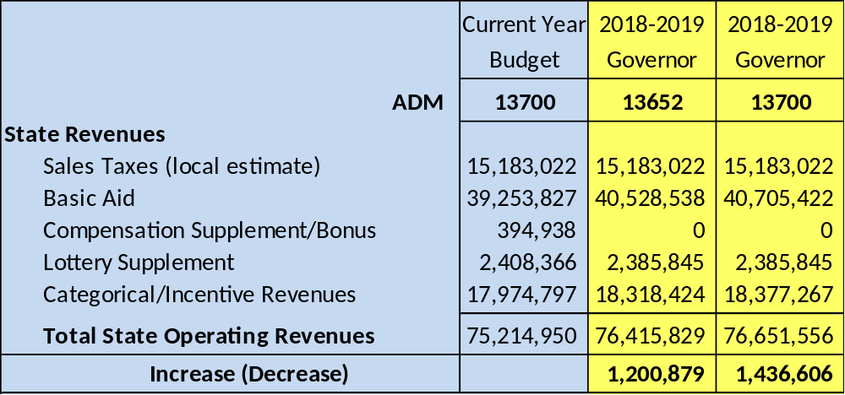
Governor’s Budget Proposal (HB30/SB30)
Sales tax YTD running 1.25% below current year budget
Current year estimated ADM of 13776
VDOE ADM estimated at 13652 for 2018-2019

Slide 6
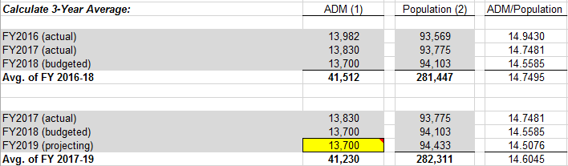
Preliminary Estimate of County Funding for School Budget
Very Early Estimate of Increase in Allocation to Schools
$250,000 - $300,000

Slide 7
Total New Funds - ESTIMATED
State
$1.2 to 1.4M
Roanoke County
$.2 to .3M
ESTIMATED TOTAL
$2M
VRS Reduction
$.5M
What is our focus? Where should we go from here?

Slide 8
Types of Budget Increases
Investment in Sustainability – these increases are related to budgets that are required to maintain the current program level and/or preserve the taxpayer investment in school property
Investment in People – these increases are directly related to the compensation of school employees and the provision of related employee benefits
Investment in Program Enhancements – these increases reflect requests from principals, department heads, board members, and other stakeholders to expand existing programs or add new programs
Key Code for Estimated Costs
$$$$ | Over $1,000,000
$$$ | $500,000 to $999,999
$$ | $100,000 to $499,999
$ | Under $100,000
Each budget request is scored with this key code indicating estimated cost. The list is subject to change as the budget process progresses and further information is obtained. Estimates are presented for purposes of perspective.

Slide 9
Investment in Sustainability
$$$ CSA mandatory cost increases
$$ Technology replacement plan
$$ AED units and/or battery replacements
$$ Cave Spring High staffing positions during construction
$$ Contractual increase in contracts for custodial, grounds, HR software
$$ School bus replacements
$ Diesel rate increase
$ Fiduciary investment policy premium (new)
$ Property and flood insurance rate increases
$ Medicaid revenue reduction (FAMIS)
$ WBHS artificial turf replacement reserve
$ Workers compensation claims increase
Key Code for Estimated Costs
$$$$ | Over $1,000,000
$$$ | $500,000 to $999,999
$$ | $100,000 to $499,999
$ | Under $100,000

Slide 10
Investment in People
$$$$ Step increase on pay plan
$$$ New employee positions
$$ Health insurance increase
$$ Stipend & supplement (Phase 2)
$$ Substitute pay increase
Positions requested:
Special education region supervisor
Full-time speech and OT
Preschool teachers and IA’’s
EMT and site athletic trainers
Middle school reading specialists
ISD therapeutic
Additional high school assistant principal (WBH)
Elementary SRO
Additional indoor track coach
Middle school guidance counselor
Elementary math coaches
IA’s
Floating elementary assistant principal
Additional elective sections
CSHS staffing during construction
Full-time testing coordinator (GHS)
Middle school administrator/dean of students
Guidance supervisor
Key Code for Estimated Costs
$$$$ | Over $1,000,000
$$$ | $500,000 to $999,999
$$ | $100,000 to $499,999
$ | Under $100,000

Slide 11
Investment in Program Enhancements
$$$ Expand health benefits for part-time employees
$$ New Alternative education program
$$ Expand nurse coverage in schools
$$ New In School Detention program
$$ New pool cars or additional travel budget
$$ Reduce non-resident tuition charges
$ CPR training employee reimbursements
$ Expand allotments to schools
$ Governor's School student transportation
$ Remove church rental income from Operating Budget
$ Remove parking fees from Operating Budget
Key Code for Estimated Costs
$$$$ | Over $1,000,000
$$$ | $500,000 to $999,999
$$ | $100,000 to $499,999
$ | Under $100,000

Slide 12
Superintendent’s Focus and Board Feedback
Superintendent’s Recommended Focus:
Investment in sustainability (necessary, essential, mandatory)
Investment in people
  Step increase on pay plan
  Substitute pay increase
  Stipend & supplement increase (Phase 2)
  Health insurance premium increase
CSHS staff positions during construction
In School Detention and guidance positions
School Board Feedback to the Superintendent

Slide 13
Next Steps
Work session – January 25, 2018
  Technology Plan
  Public hearing on FY19 School Budget
Work session – February 8, 2018
  Bus replacement plan
  Other fund budgets
Work session – February 22, 2018
  Compensation, Benefits, Health Insurance
  House & Senate Crossover Budgets (if available)
Work session – March 6, 2018
  Crossover budgets (if not available for 2/22 work session)
Work session – March 13, 2018
  TBD (General Assembly adjourns on March 10 but revenue allocations may not be available yet)
Work session – March 15, 2018
  TBD
Work session – March 20, 2018
  Last date for Presentation of Superintendent’s Budget
Work session – March 22, 2018
  SB adopts FY19 budget
FY19 Budget due to Board of Supervisors – April 1, 2018

Slide 14
Questions & Comments

