Slide 1

Technology Investment Work Session 2018
Strategic planning for sustainability

Slide 2

Pieces of the Puzzle
Technology

Slide 3

Strategic Framework & Technology Plan
Communication
Collaboration
Critical Thinking
Creativity
Citizenship
Technology Plan

Slide 4
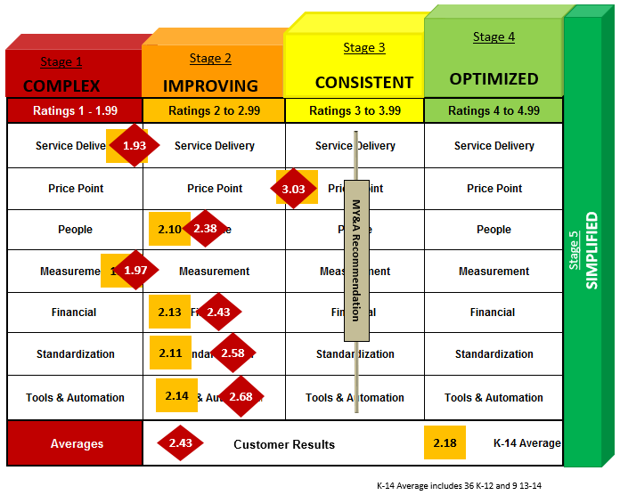
2015 Technology Assessment
IT Maturity Ratings Compared to the Education Industry

Slide 5

Executive Summary
Adoptions to Increase Security/Dependability
Implemented district backup solution.
Continue standardization of hardware and software.
Installed network operations center for improved network visibility.
Implement staff password policy for security.
Conducted network security assessment.

Slide 6

Executive Summary
Notable Adoptions to Reduce Costs
Increased virtual server deployment to 84% ($90,000 savings).
Increased WAN and Internet connections to 10 GB ($60,000 savings).
Reduced servers in schools from 3 to 1 ($486,000 savings).
Implemented Microsoft Office 365 email for staff ($200,000 savings).
Expanded 1:1 program to middle school students ($36,000 savings in networking for one school; more to come).
Estimated savings $872,000
(Since 2015)

Slide 7

Instructional Technology
2018-2019 Technology Budget

Slide 8

2017-2018 E-Rate Update

Slide 9
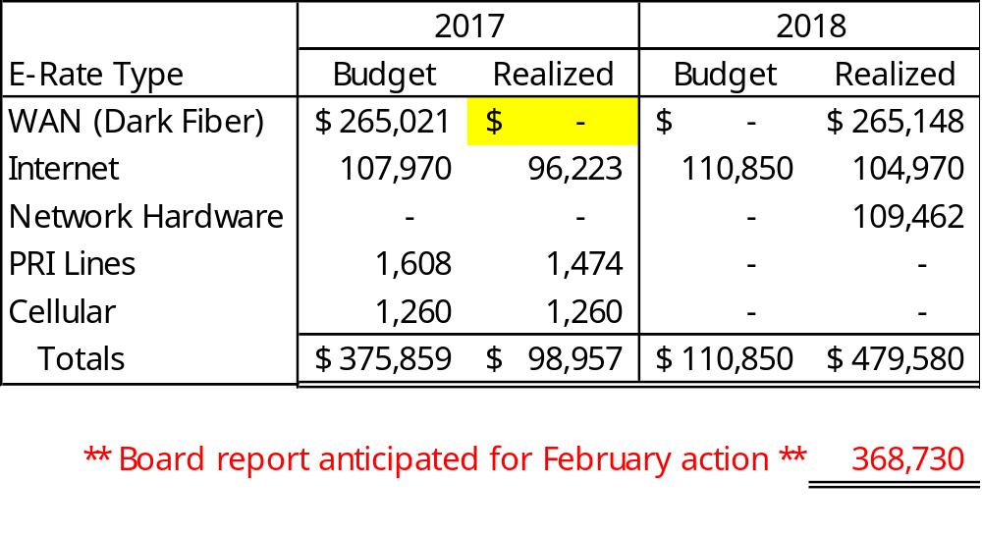
2017-2018 E-Rate Update

Slide 10
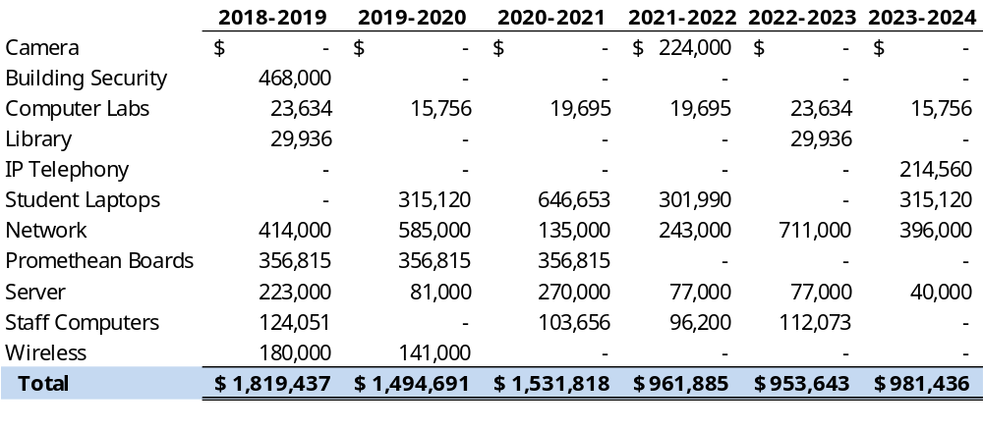
6-Year Technology Budget Plan

Slide 11
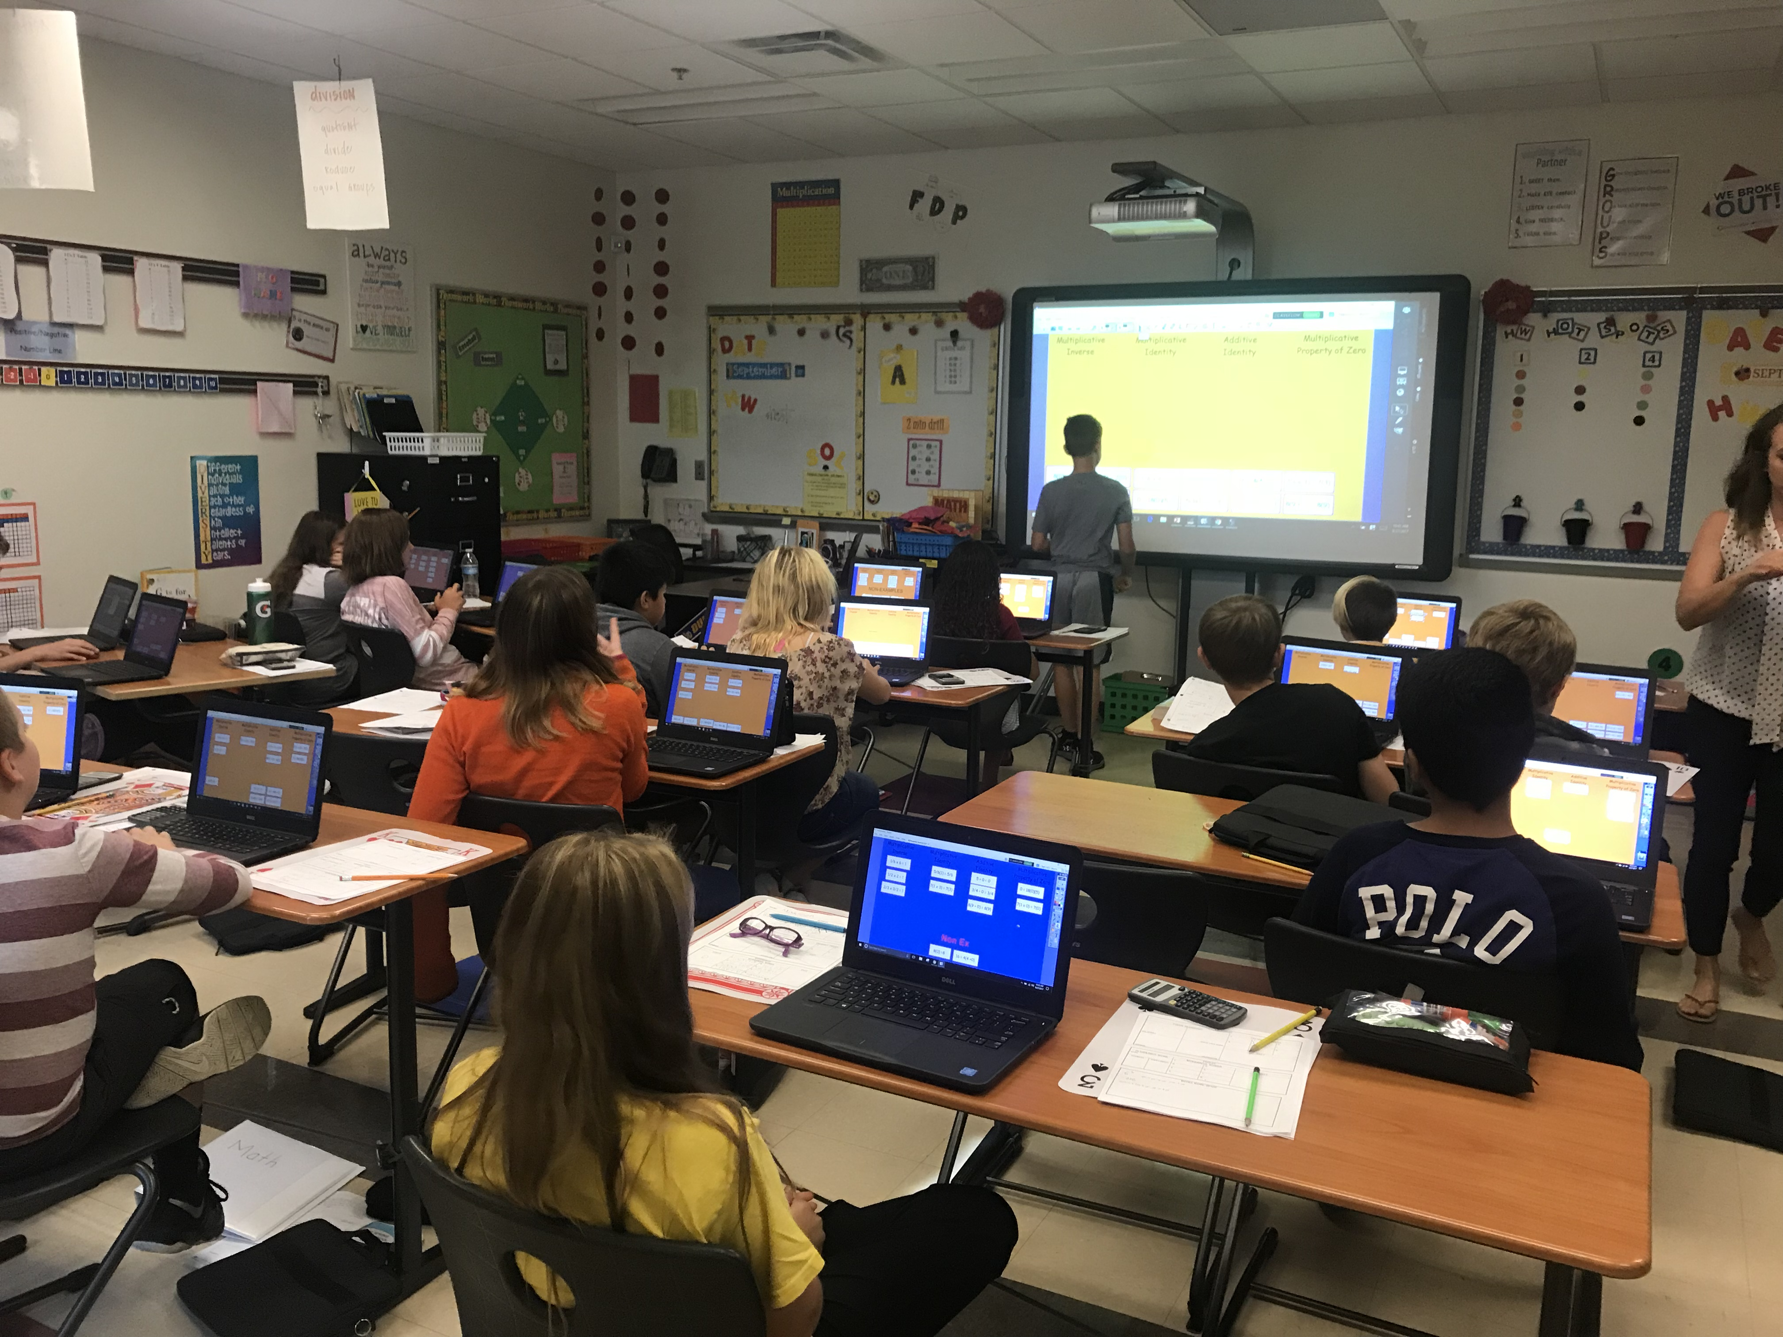

Executive Summary
2018 Student Laptop Program
6th grade students will receive current 8th grade laptops
9th grade students will receive current 12th grade laptops
New bags for rotated laptops are budgeted items

Slide 12
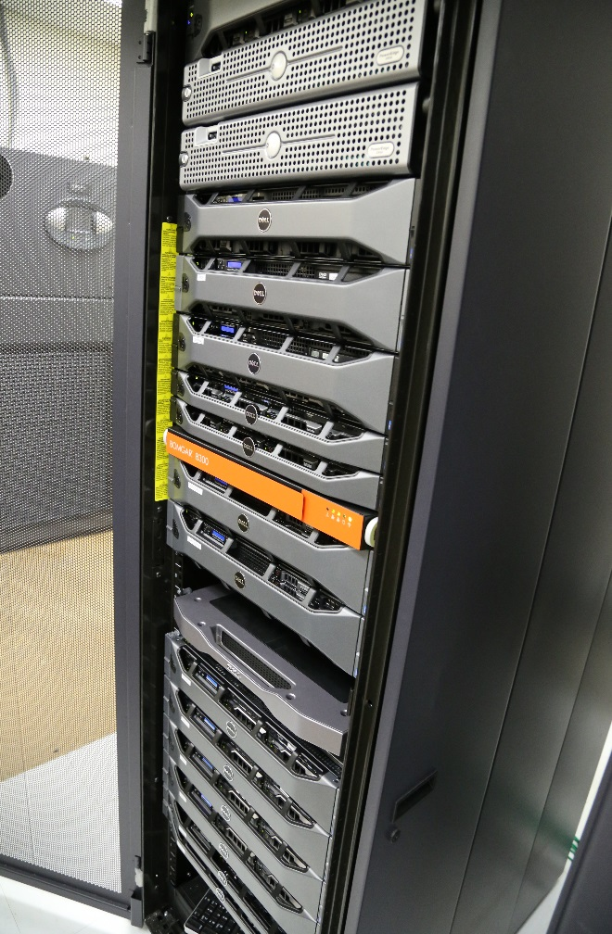
Executive Summary
Technology Budgeted Items
Blackboard Learn
Microsoft/Adobe Agreements
Website/emergency notification
Lock down browser
Classlink
Laser printer program
Telephony/video systems
WAN/Internet
Email journaling
Umbrella (filtering at home)
Card access/security support
Network monitoring
Network warranty

Slide 13
Executive Summary
2018-2019 Technology Budget Focus
ActivPanel
Network Security
Building Security Systems

Slide 14
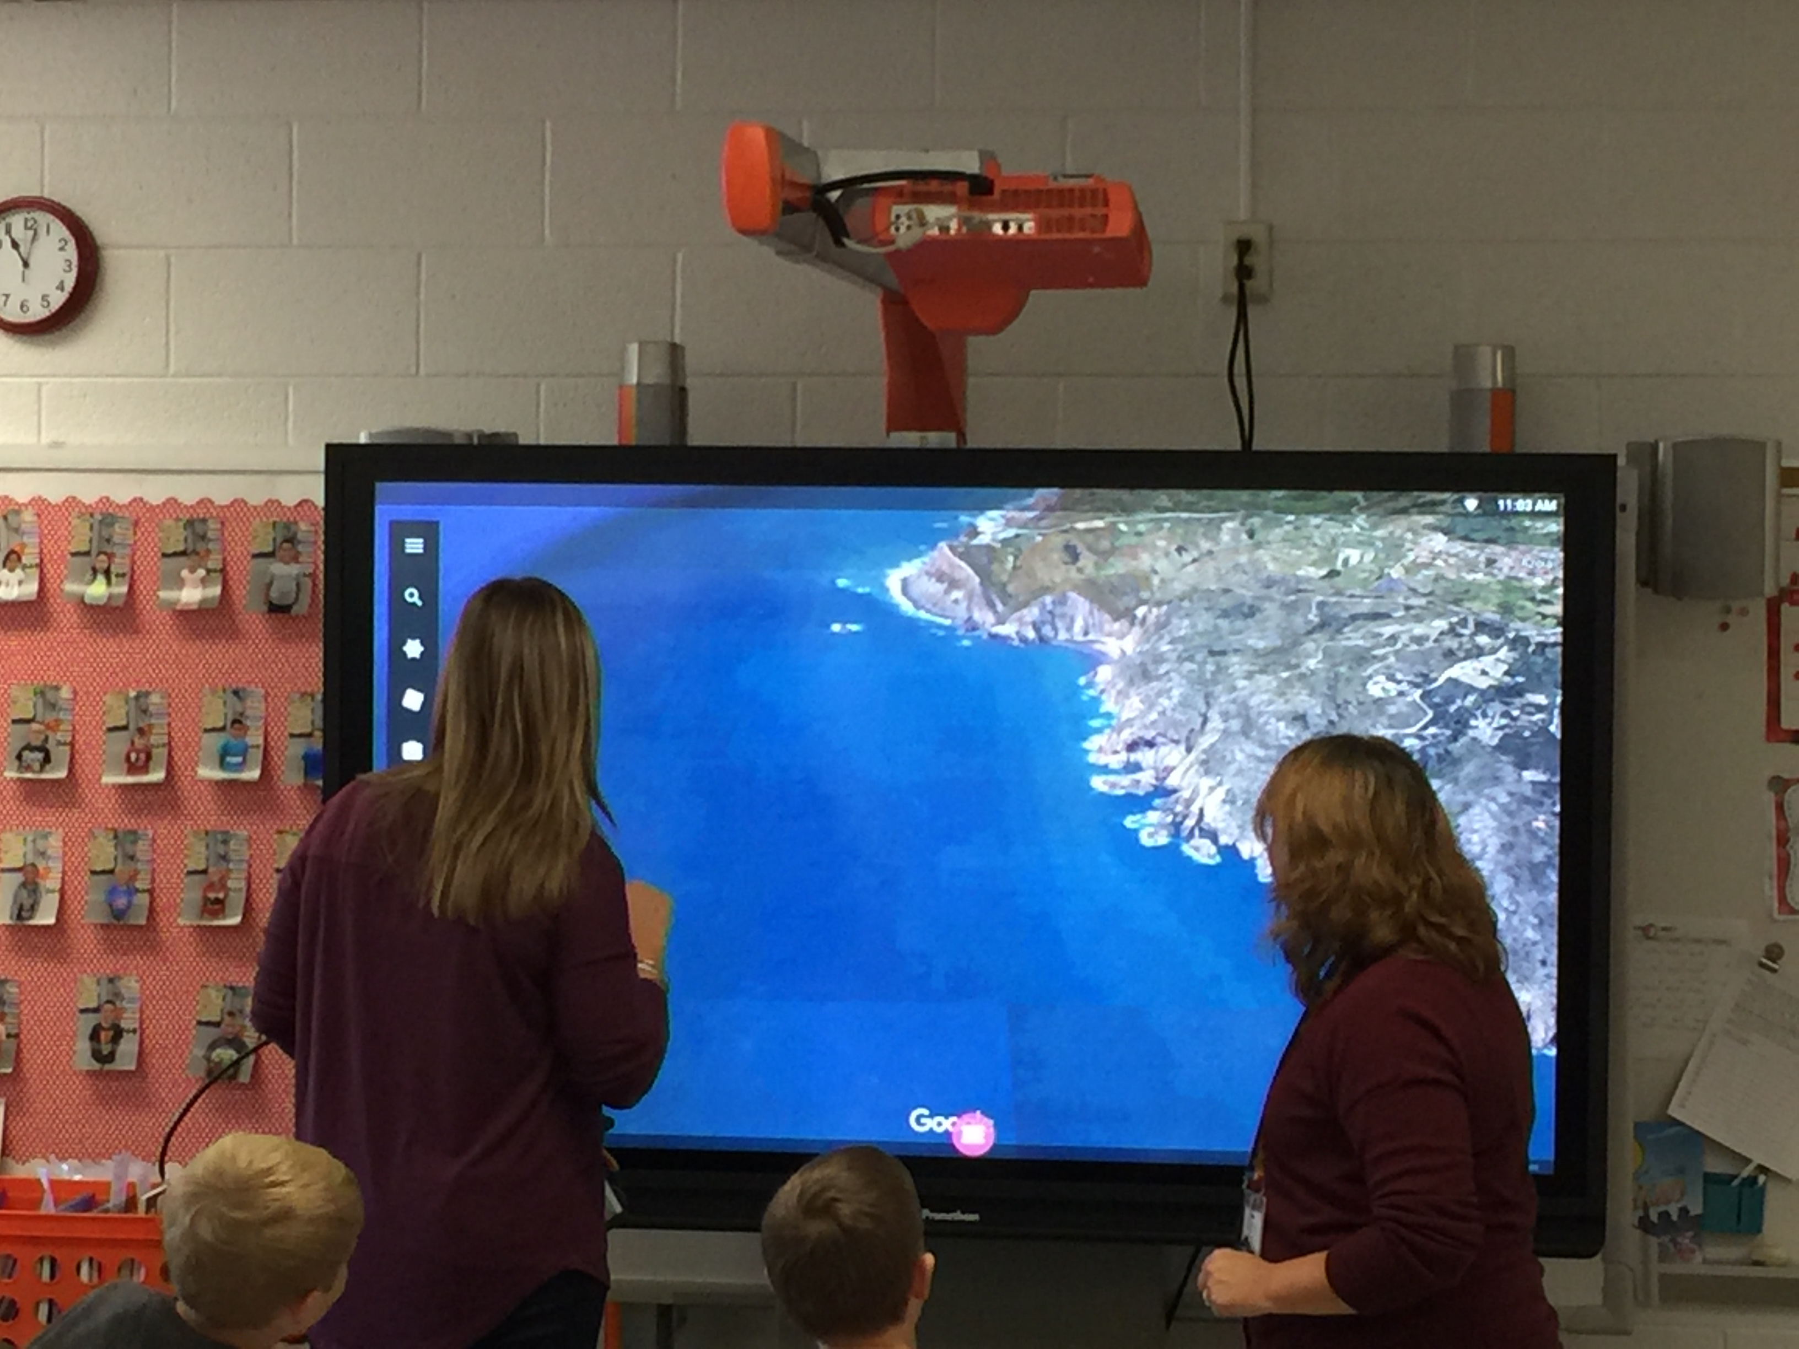
Executive Summary
2018-2019 Technology Budget Needs
ActivPanel 3 year phase-in lease plan

Slide 15
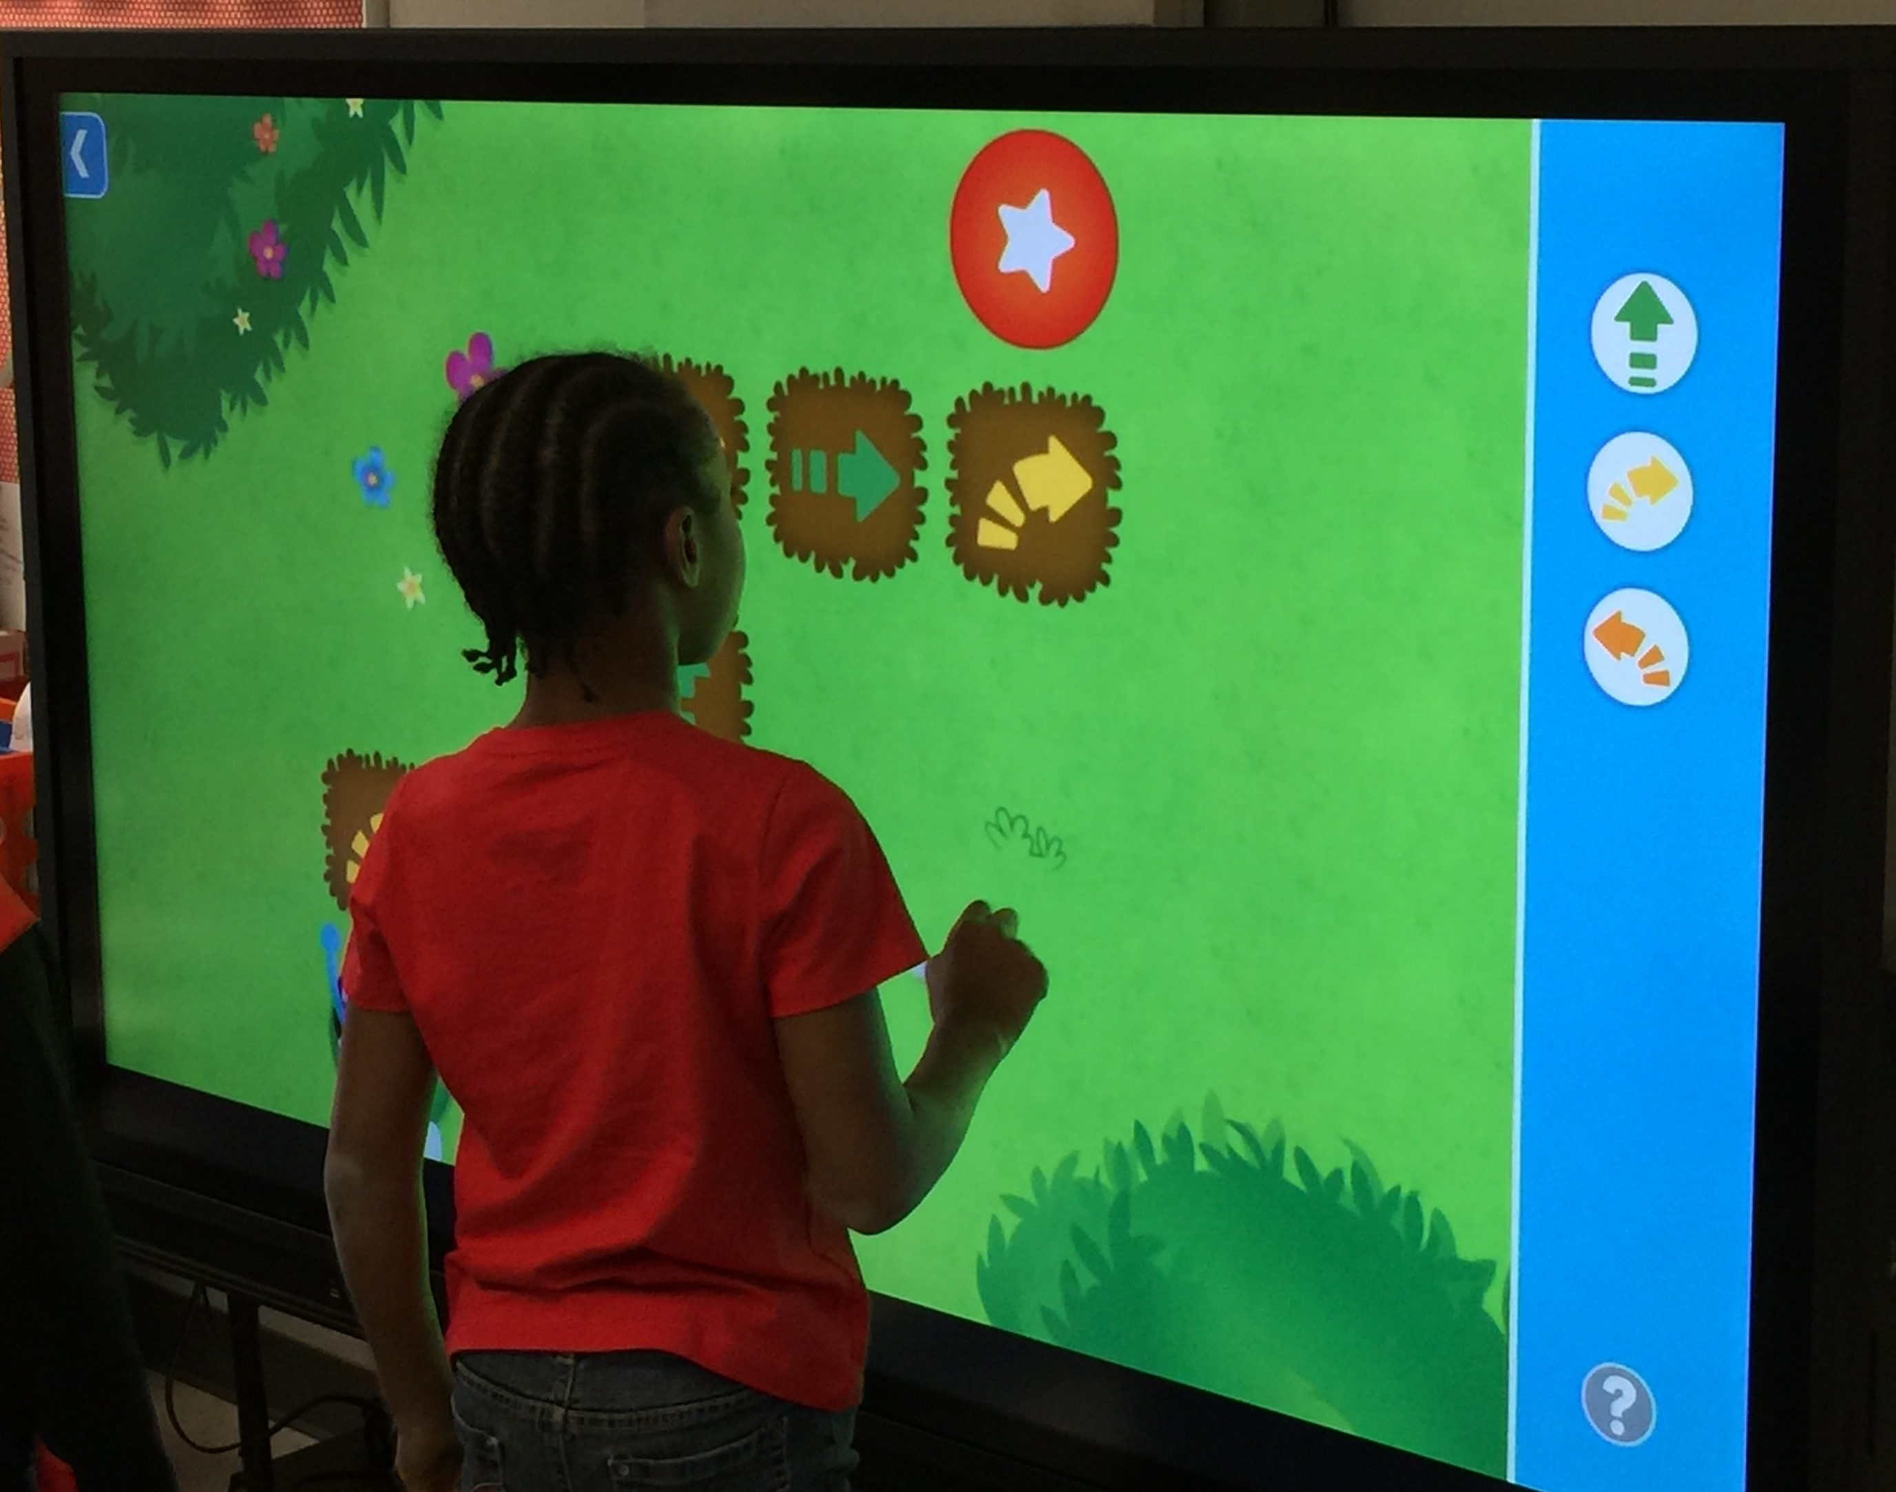
Executive Summary
ActivPanel Deployment Plan
Replace oldest models
Focus on classrooms
Non-classroom spaces considered in 3rd year
Scavenge parts on older boards
All panels on stands

Slide 16
Executive Summary
3 Year ActivPanel Phase-In Plan
Phasing Considerations
Elementary were 1st adopters (year 1)
All media centers with panels (year 1)
Projectors available for phases 2 and 3
Deployment and PD for team RCPS
CSH and GHS panels in renovation

Slide 17

Information Technology
2018-2019 Network Security

Slide 18

Executive Summary
2017 Network Assessment
Continuous network penetration testing
Eliminate email spoofing
Staff password policy
Security awareness training
Patch management

Slide 19

2018-2019 Technology Focus
Train our Network Users

Slide 20
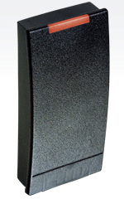


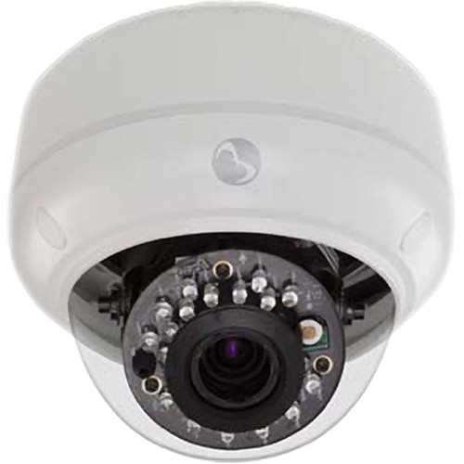
Executive Summary
Building Security Systems Tour
Card Access
Cameras
Panic System
LobbyGuard

Slide 21

2018-2019 Replacement Plan

Slide 22

Executive Summary
Technology Budget Needs Summary
ActivPanel funds needed – under construction
Network Security - $0 (built in budget)
Building Security - $468,000

Slide 23

Executive Summary
Current Year Funding Opportunity
Building Security System Components (Expiring September 2018) | $ 468,000
Current Year Funding Opportunity
E-Rate Revenue Not Budgeted | (368,730)
Transfer from Laptop Insurance Reserve | ( 99,270)
Funding Needed from 2018-2019 Budget | $ -0-

Slide 24
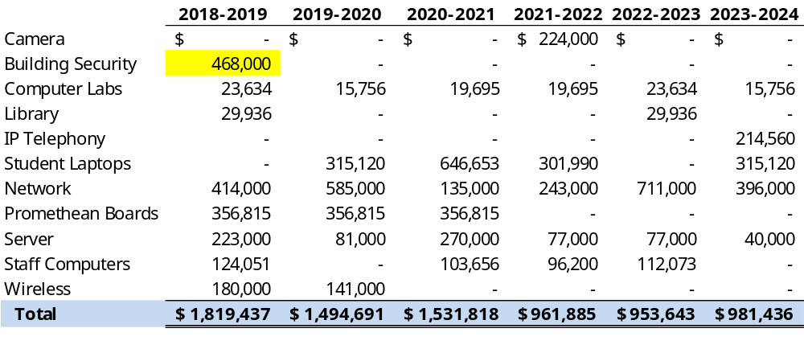
6-Year Technology Budget Plan
Possible Funding Sources:
Excess E-rate Funding 2017-2018
Transfer from Laptop Insurance Reserve
Expiring Laptop Lease
Student Insurance Fee
E-rate Estimates for 2018-2019
VDOE Technology Initiative Grant
New General Fund Allocation
**This cost can be shifted to the current year using the option on the previous slide.

Slide 25


Next Steps
Request appropriation for 2017-2018 (E-Rate not budgeted $368,730)+ ($99,270 laptop reserves) for security purchases
Work session – February 8, 2018
  Bus replacement plan
  Other fund budgets
Work session – February 22, 2018
  Compensation, Benefits, Health Insurance
  House & Senate Crossover Budgets (if available)
Work session – March 6, 2018
  Crossover budgets (if not available for 2/22 work session)
Work session – March 13, 2018
  TBD (General Assembly adjourns on March 10 but revenue allocations may not be available yet)
Work session – March 15, 2018
  TBD
Work session – March 20, 2018
  Last date for Presentation of Superintendent’s Budget
Work session – March 22, 2018
  SB adopts FY19 budget
FY19 Budget due to Board of Supervisors – April 1, 2018

Slide 26
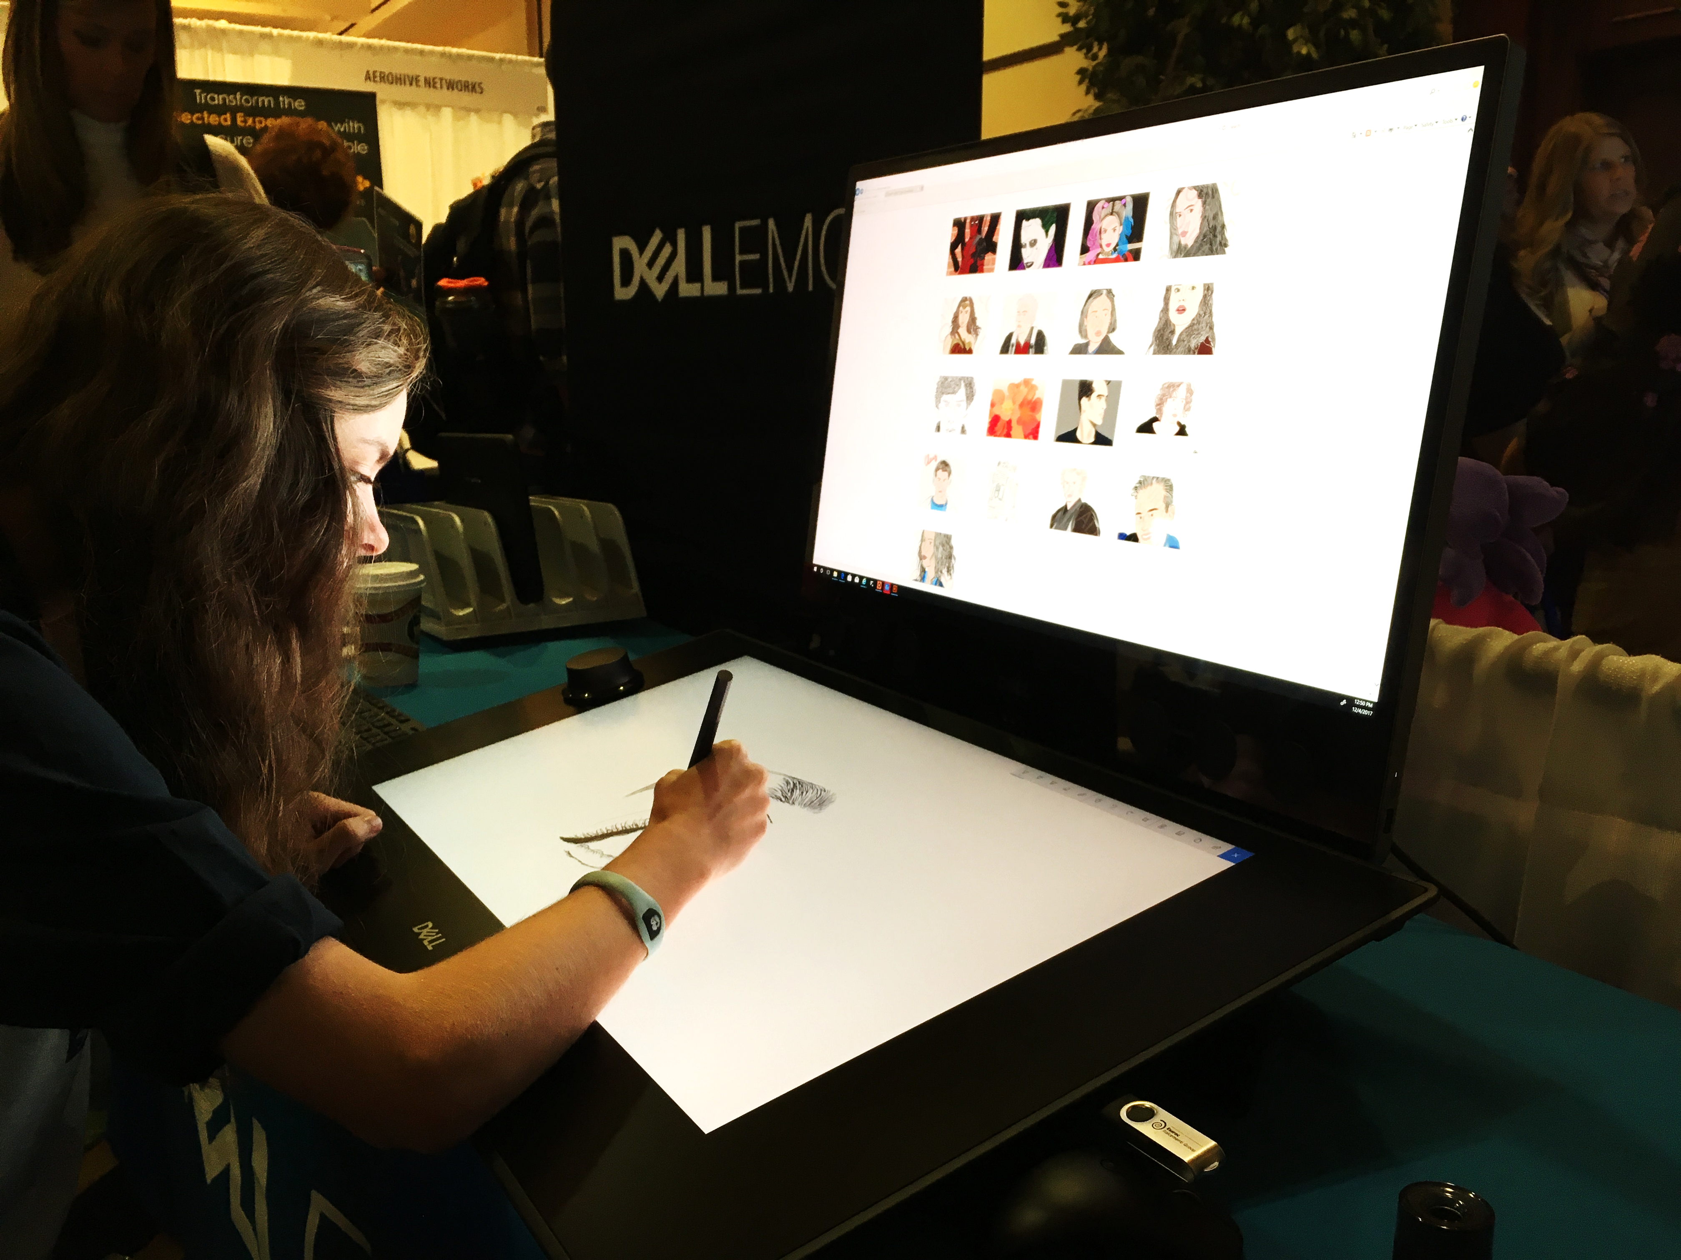
Executive Summary
Instructional Technology
Questions?

