Slide 1
Roanoke County Schools
2018-2019 Budget Work Session
February 8, 2018
Other Fund Budgets
Capital Improvement Program Schedules

Slide 2
Agenda
Instructional Resources Fund
Bus Replacement Fund
  Bus Replacement Schedule
Laptop Insurance Fund (dissolving)
Technology Replacement Fund (new)
  Technology Replacement Schedule (updated from 1/25/18)
Grant Fund
Capital Projects Fund
  Capital Improvement Plan (approved 1/11/18)
  Capital Maintenance Plan
Nutrition Fund
Questions and Comments

Slide 3
What is an “Other Fund”
All of the funds other than the General Fund.
They are self-balancing.
They maintain year-end balances.
Instructional Resources Fund
Bus Replacement Fund
Laptop Insurance Fund (dissolving)
Technology Replacement Fund (new)
Grant Fund
Capital Projects Fund
Nutrition Fund

Slide 4

Instructional Resources Fund
The Instructional Resources Fund is used to account for the purchase of student textbooks (in paper or digital format) and other consumable instructional materials.
Revenues are primarily from State funds and the school general fund.

Slide 5
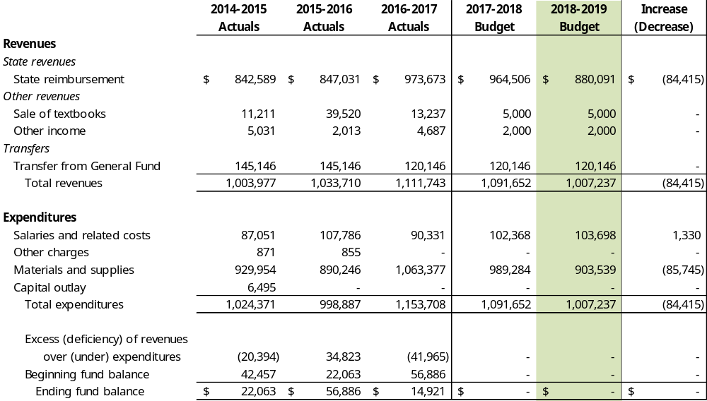
Instructional Resources Fund

Slide 6
Instructional Resources Fund
Textbook Review & Approval Schedule Based on the seven-year revision cycle for the Standards of Learning
 | Anticipated SOL Adoption | SOL Curriculum Framework Adoption | State Textbook/ Instructional Materials Review | LEA Textbook/ Materials Review | New Contract Date
History & Social Science | 2015 | 2016 | 2016-2017 | 2017 | 2017
Mathematics | 2016 | 2016 | 2017-2018 | 2018 | 2018
English (K-5 Reading and 6-12 English & Literature) | 2017 | 2017 | 2018-2019 | 2019-2020 | 2024-2025
Science | 2018 | 2018 | 2018-2019 | 2019 | 2019

Slide 7
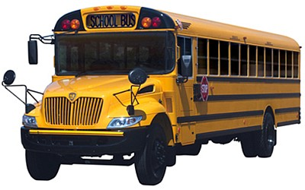
Bus Replacement Fund
The Bus Replacement Fund is used to account for the replacement of school buses on a 15-year cycle.
Revenues are primarily from the school general fund and investment income.

Slide 8
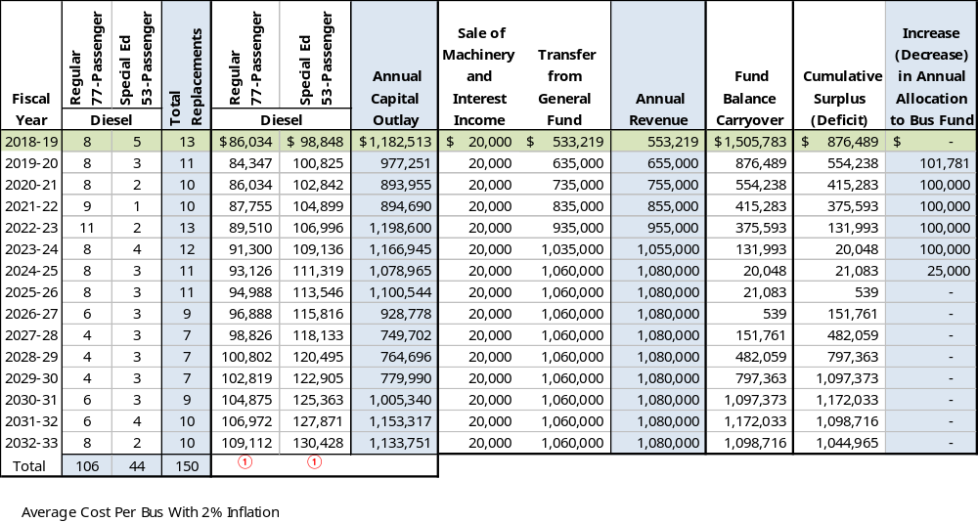
Bus Replacement Schedule

Slide 9
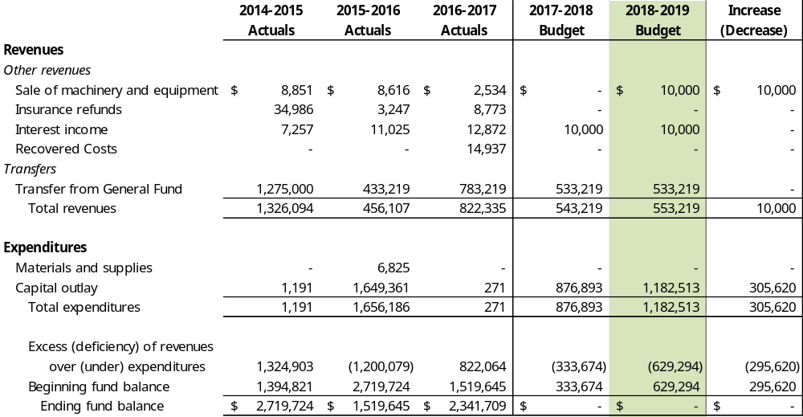
Bus Replacement Fund

Slide 10

Laptop Insurance Fund (dissolving)
The Laptop Insurance Fund was a self-insured fund used to account for the repair and replacement of student laptops.
This fund will be dissolved and replaced by a new fund, the Technology Replacement Fund.
Warranty repair work will be transferred to the General Fund, other items will be transferred to the Technology Replacement Fund.

Slide 11
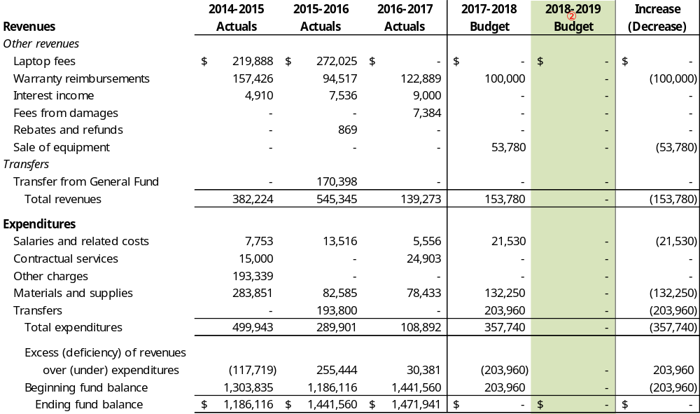
Laptop Insurance Fund (dissolving)
① During 2016-2017 the Student Laptop Fees were moved from the Laptop Fund to the General Fund.
② During 2018-2019 the Laptop Insurance Fund is being dissolved.

Slide 12

Technology Replacement Fund (new)
The Technology Replacement Fund is a re-engineering of the Laptop Insurance Fund to isolate purchasing and financing of technology replacements.
Revenues will generate primarily from the school general fund, state grant revenue, and federal E-rate reimbursements.
Laptop reserves will remain isolated for self-insurance needs.

Slide 13
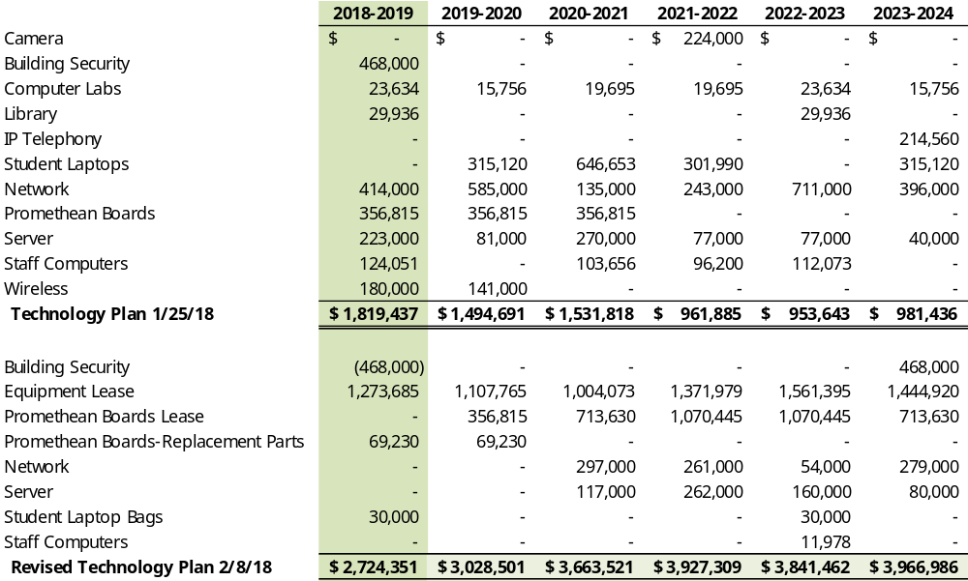
Technology Replacement Schedule (revised)

Slide 14
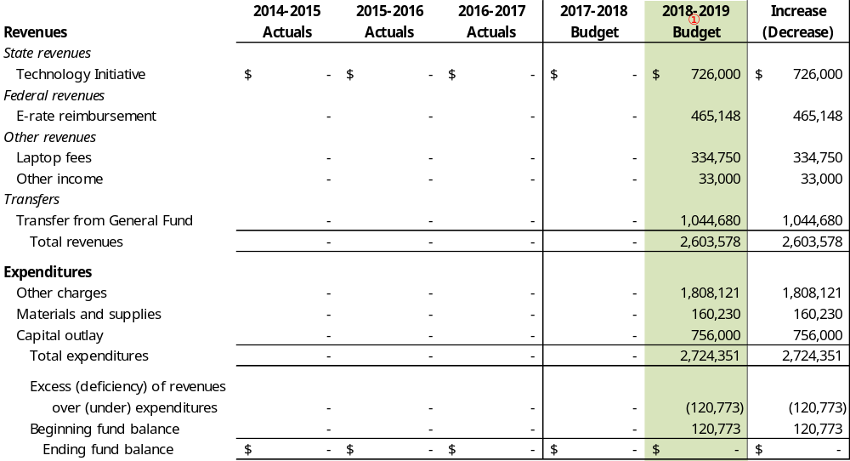
Technology Replacement Fund (new)
① During 2018-2019 the Technology Replacement Fund replaces the Laptop Insurance Fund.

Slide 15

Grant Fund
The Grant Fund is used to account for transactions related to federal, state, and private grants that are not reported in another fund.
Grants are typically 27 months or less.
Matching requirements are accounted for in the school general fund.

Slide 16
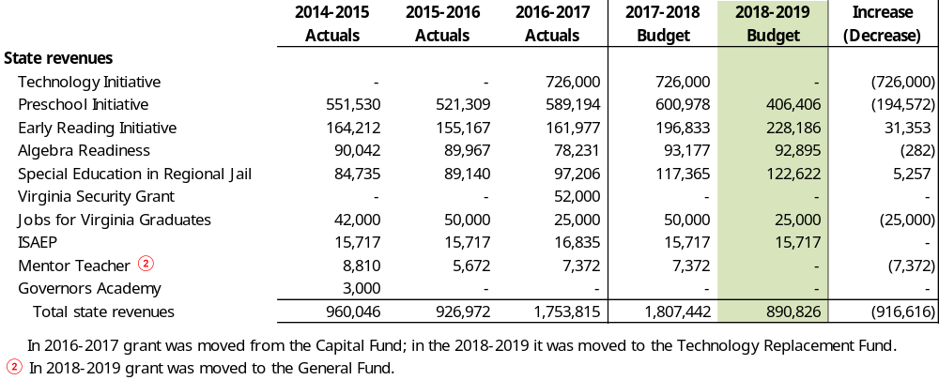
Grant Fund: State Revenues
Preschool Initiative – Educational programs for unserved, at-risk 4-year old children
Early Reading Initiative – Provides assistance to reduce the number of students needing remedial reading services
Algebra Readiness – Serves 7th and 8th grade students who are at risk of failing the Algebra I end-of-course SOL
Special Education in Regional Jail – Provides special education instruction to children with disabilities in jail
Jobs for Virginia Graduates – Assists disadvantaged and at-risk students to graduate and transition to work
ISAEP – Program offering an alternative education plan for a student at risk of dropping-out of school

Slide 17
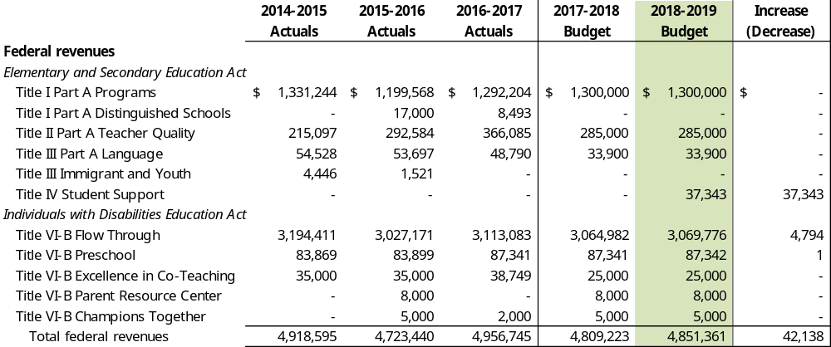
Grant Fund: Federal Revenues
Title I – Supports 4 elementary schools with high disadvantaged population
Title II – Supports professional development for teachers and principals
Title III Language – Supports students who do not speak English as their primary language
Title III Immigrant and Youth – Supports new students who have immigrated
Title IV – Supports student and academic enrichment
Title VI-B – Supports students with disabilities in K-12
Title VI-B Preschool – Supports programs for students with disabilities 2 years to KG

Slide 18
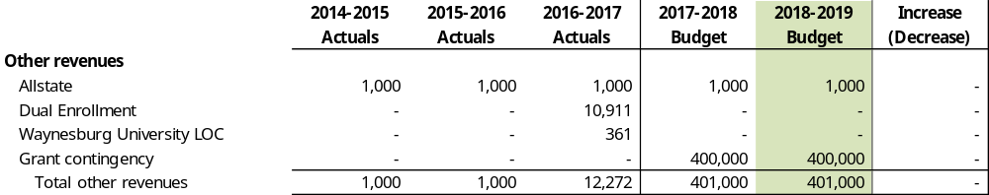
Grant Fund: Other Revenues
Allstate – Provides funding to assist in transforming teens into safer drivers
Grant contingency – Reserves set aside to accommodate changes in grant awards or unexpected grants

Slide 19
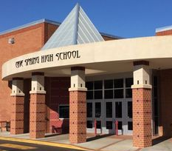
Capital Projects Fund
The Capital Projects Fund is used to account for the financing of capital outlay for construction and other projects.
Revenues are primarily from bond issues and allocations from the Major and Minor Capital reserves maintained by the School Board.

Slide 20
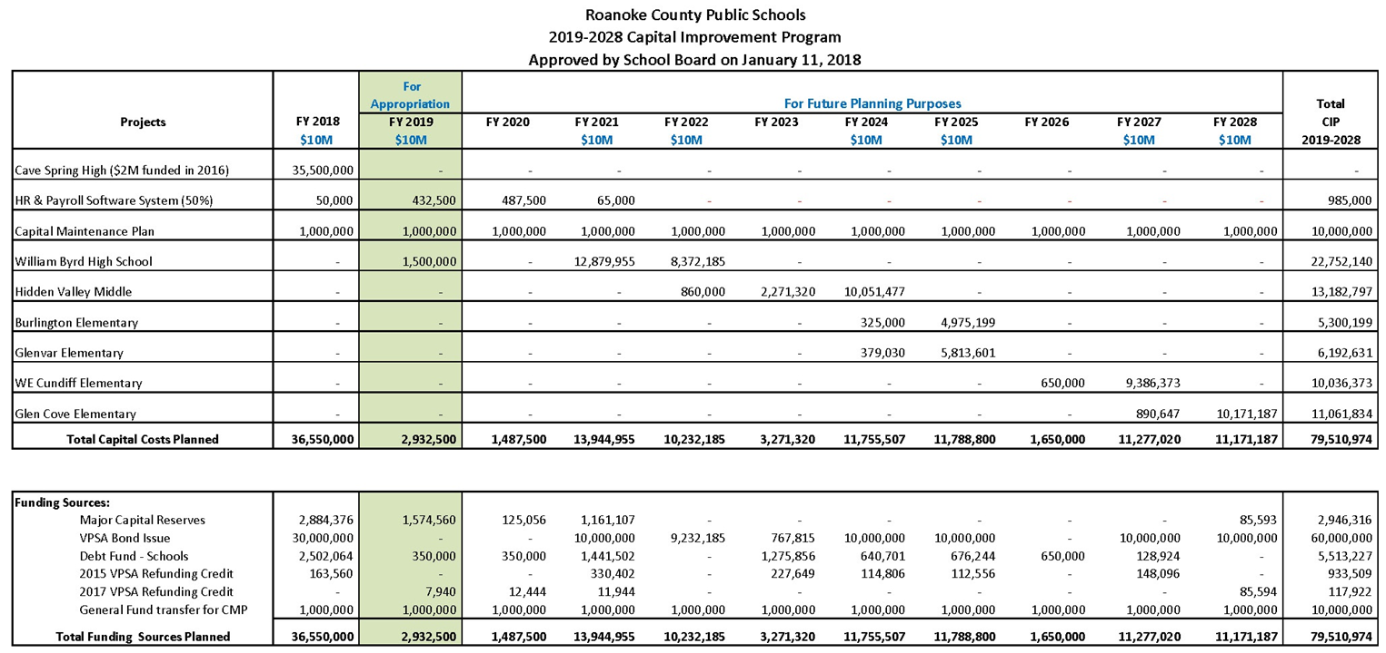
Capital Improvement Plan
The Capital Improvement Plan contains a 10-year plan for large major capital improvements that
will require a significant amount of resources to fund.

Slide 21
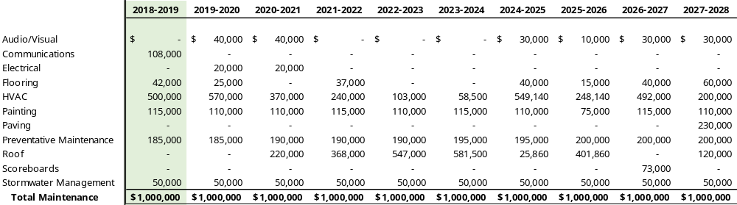
Capital Maintenance Plan
The Capital Maintenance Plan contains a 10-year plan for preventative maintenance projects to maintain the condition and longevity of school-owned buildings.
On January 14, 2016 the School Board established an annual transfer from the Operating Fund to the Minor Capital Fund of $1,000,000 to fund these on-going preventative maintenance needs. This is included as part of the Capital improvement Plan.

Slide 22
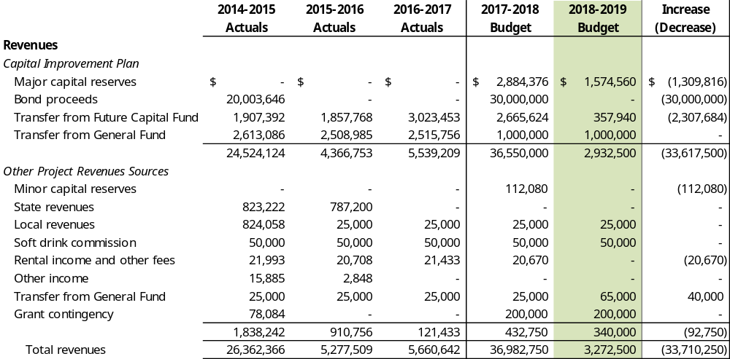
Capital Projects Fund

Slide 23
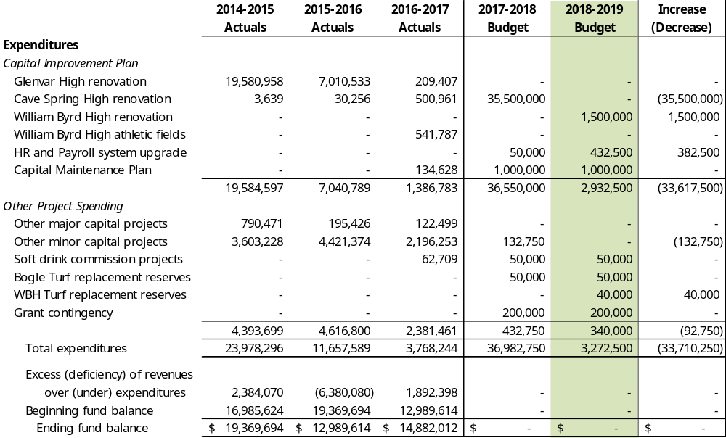
Capital Projects Fund

Slide 24
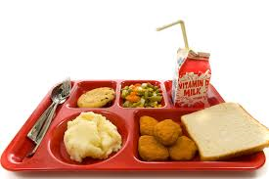
Nutrition Fund
The Nutrition Fund is used to account for procurement, preparation, and serving of student breakfasts, snacks, and lunches.
Revenues are primarily from food sales and subsidies from federal and state breakfast and lunch programs.

Slide 25
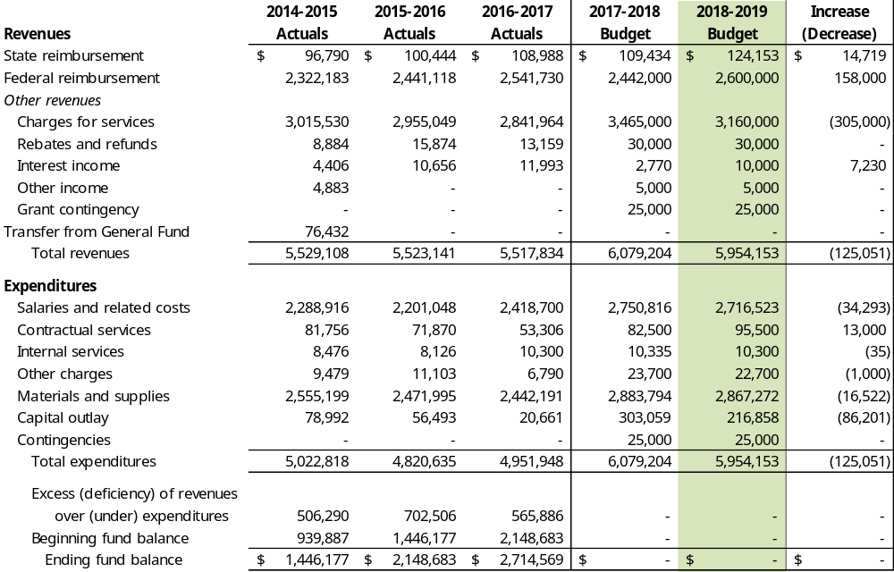
Nutrition Fund

Slide 26
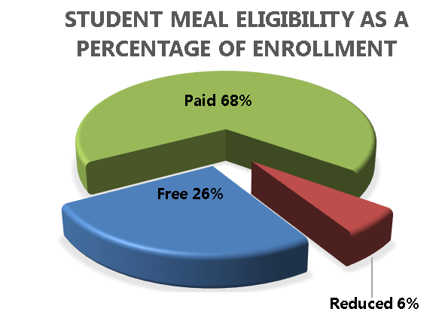
Nutrition Fund
Student Fees
Federal and State Reimbursement Rates
 | Breakfast | Elementary Lunch | Secondary Lunch
2010 | $1.00 | $2.00 | $2.00
2011 | 1.00 | 2.00 | 2.00
2012 | 1.00 | 2.05 | 2.05
2013 | 1.00 | 2.15 | 2.15
2014 | 1.10 | 2.25 | 2.25
2015 | 1.15 | 2.35 | 2.35
2016 | 1.25 | 2.35 | 2.60
2017 | 1.25 | 2.45 | 2.70
2018 | 1.35 | 2.55 | 2.80
2019* | 1.45 | 2.65 | 2.90
Reduced | $0.30 | $0.40 | $0.40
 | Breakfast | Lunch
Federal Paid | $ 0.30 | $ 0.31
Federal Reduced | 1.45 | 2.83
Federal Free | 1.75 | 3.29
State Lunch | na | 0.05
*Roanoke County Public Schools preference is no change, the Federal Government requires a 10¢ increase annually.

Slide 27
Next Steps
Work session – February 22, 2018
  Compensation, Benefits, Health Insurance
  House & Senate Crossover Budgets (if available)
Work session – March 6, 2018
  Crossover budgets (if not available for 2/22 work session)
Work session – March 13, 2018
  TBD (General Assembly adjourns on March 10 but revenue allocations may not be available yet)
Work session – March 15, 2018
  TBD
Work session – March 20, 2018
  Last date for Presentation of Superintendent’s Budget
Work session – March 22, 2018
  SB adopts FY19 budget
FY19 Budget due to Board of Supervisors – April 1, 2018

Slide 28
Questions & Comments

