Slide 1
Roanoke County Schools
2018-2019 Budget Work Session
February 22, 2018
Compensation & Benefits

Slide 2
Agenda
Employee Compensation
Employee Benefits
  Health Insurance Plan
  Virginia Retirement System
Budget Requests
  Superintendent’s Focus
  Considerations for Future Budgets
  Superintendent’s Focus with Budget Gap
Next Steps
Questions & Comments

Slide 3
Employee Compensation

Slide 4
Components of Total Compensation
When employee is valued, satisfied and engaged in work
When employee engaged in work, organization meets performance objectives
Employer offers compensation in return for time, skill, efforts
Salary
Pay provided in return for services
Development & Professional
Enhance competency
Performance & Recognition
Alignment to business goals
Work-Life Satisfaction
Balance
Benefits
Mandated and value added

Slide 5
Compensation Philosophy
Recruitment and retention of high quality employees
Internal equity and market comparability
Compensation consistent with fiscal constraints
Balance total compensation between pay and benefits

Slide 6
Workforce Demographics – All Contracted Employees
Category | Total
Full-Time Contracted Employees | 1,831
Part-Time Contracted Employees | 318
Gender: Male | 24%
Gender: Female | 76%
Age Range | 19 – 85
Median Age | 48
Years of Service Range | 0 – 48
Median Years of Service | 12
Median Salary | $43,466

Slide 7
Workforce Demographics

Slide 8
Compensation History
 | FY 2009 | FY 2010 | FY 2011 | FY 2012 | FY 2013 | FY 2014 | FY 2015 | FY 2016 | FY 2017 | FY 2018
Pay Adjustment | 4.0% | ----- | ----- | ----- | 3.0% | ----- | 2.0% | 2.5% | 2.0% + market adjustment (if applicable) | 1-step
Inflation* | 3.8% | -0.4% | 1.6% | 3.2% | 2.1% | 1.5% | 1.6% | 0.1% | 1.3% | +/- 2.0%
Using Salary of New Teacher in 2009
Note:
FY 2013 also included a hold harmless 5.75% increase for VRS Plan 1 employees due to state mandate that all employees pay their share of VRS contribution
Non-recurring bonuses were received in FY 2010 ($500) and FY 2012 ($500 - $2,500)
Evergreen Market Study conducted and implemented in FY 2017; market adjustments averaging 5% based on Evergreen study results
One step increase on Evergreen recommended Pay Plan provided to all contract employees
*Source: U.S. Bureau of Labor Statistics, www.bls.gov

Slide 9
Review of Compensation Study in 2016
Ensure internal equity and market comparability
Ensure recruitment and retention of high quality employees
Compensation philosophy that is consistent with fiscal constraints
Balance total compensation between pay and benefits
Evergreen Compensation Study provided:
Salary comparisons to peer school divisions
Salary comparisons to other competitors in our market
Identification of RCPS positions that are not at market salary rates
Recommendations for moving positions to market salary rates
Plan to address inequities in salary rates
FY2016-17 budget - funded “market adjustments” identified in study and approved by School Board in FY2016-17 Budget
FY2017-18 budget - moved employees up one step on plan (average 1.55%)
Recommends COLA applied to Pay Plan every 3-5 years (employees cap at top of scale unless COLA applied to pay plan)

Slide 10
Total Compensation
Significant percentage of total budget 84%
Salaries and wages 61%
Mandated Benefits 15%
  Social Security/Medicare
  Virginia Retirement System (VRS)
  VRS Life Insurance
  VRS Health Credit
  VRS Short Term Disability
  Workers Compensation
  Unemployment Insurance
Non-Mandated Benefits 8%
  Health and Dental Insurance
  Paid Leave and Holidays
  Academic and Athletic Supplements
  Marathon Wellness Center
  National Board Teacher Bonus
  Voluntary Retirement Plans (403b and 457)

Slide 11
Investment in Our People - Salaries
  Budget Action supporting Investment in People:
  2016-17 Implemented new pay plan from market study
  2017-18 Employees move up one step on pay plan
  2018-19 Proposal to move employees up one step (2229 employees) Does not include COLA adjustment to pay plan (no increase at top of scale)
Cost of Step Increase on Pay Plan | $1,583,000

Slide 12
Investment in Our People – Supplements
Phase II of Evergreen Pay Study - Supplements
Supplements for additional duties in academics and athletics outside the standard employment hours (club sponsors, department chairs, band/choir directors, academic and athletic coaches)
Deferred for future funding in past two budgets
Move supplements to minimum market average (grandfather employees receiving higher supplement)
Academic supplement increase | 220 employees | $219,902
Under market minimum | 87%
Over market minimum | 13%
Athletic supplement increase | 305 employees | $205,932
Under market minimum | 78%
Over market minimum | 22%

Slide 13
Investment in People – Substitutes
Recommending new rate structure to:
  Allow teaching substitutes with high school degrees (expands available pool)
  Rate differential between 4-year degrees and less than 4-year degreed teacher substitutes
  Increase in IA substitute rates
Types of Substitutes | Current Rate | Proposed Rate | Budget Impact
Teacher with high school/associates degree | $80 day | $80 day | $0
Teacher with 4-year degree | $80 day | $100 day | $185,000
IA without degree – Elementary | $54 day | $64 day | $6,500
IA without degree – Secondary | $58 day | $68 day | $4,400
IA with degree – Elementary | $67.50 day | $75 day | $6,750
IA with degree – Secondary | $72.50 day | $82 day | $4,500
Nurse | $80 day | $100 day | $2,800
Administrative Assistant | $8 hour | $10 hour | $1,000

Slide 14
Employee Benefits
Health Insurance

Slide 15
Health Insurance - Background
Joint health insurance program for County, Schools, WVRJA, and RVRA
  Enrollment of approximately 2,800 employees (all 4 entities) with over 1600 RCPS employees enrolled
Contracts with:
  Anthem (medical)
  Symetra (reinsurance on claims > $200,000)
  WellDyneRx (pharmacy)
  Flexible Benefits Administrators (HRA administration)
Medical and Rx plans are self-funded (pay claims as incurred)
  Plan purchases administrative services, access to the network physicians and facilities, and claims administration from Anthem
  Reinsurance to minimize the financial risk - specific stop loss of $200,000 (protects plan from catastrophic claims)

Slide 16
Health Insurance – Demographics
443 enrollees moved from KC200 to KC1000 (46% of KC200) in 2017-18
  Significant shift in enrollment in 2017-18 from KC200 to KC1000
  Positive impact on claims due to increase in employee deductible ($1000-$500 HRA vs $200)
  Negative impact on premium collections because employees paying lower premiums for higher deductible plan (employee paying $1,052 to $2,133 per year less in KC1000 vs KC200)
  Potential Current Year Health Insurance Deficit

Slide 17
Health Insurance – 2017 Claims
RCPS Claims for past 12 months:
  5 claims over $200,000 ($1,000,000 paid by school funds and $1,061,000 paid by reinsurance); rates typically set based on 2-3 catastrophic claims per year
  Increase in number of claims over $100K (above market average)
  Bottom line, rates must be set to cover projected claims liability for next year
 | Claims over $200K | Paid By RCPS | Claims between $100K and $200K | Paid By RCPS | Minimum Claims Paid for High Cost Claims
2018 renewal | 5 | $1,000,000 | 12 | $1,200,000+ | $2.2M for 17 claims
2017 renewal | 5 | $1,000,000 | 9 | $900,000+ | $1.9M for 14 claims
2016 renewal | 6 | $1,200,000 | 6 | $600,000+ | $1.8M for 12 claims
2015 renewal | 5 | $1,000,000 | 10 | $1,000,000+ | $2.0M for 15 claims

Slide 18
Health Insurance – Annual Rate History
Note:
National medical trends historically average 10% and higher; plan design changes have contained RCPS annual increases well below national trends despite higher medical costs in Roanoke Valley in comparison to much of Virginia.
Not passing health plan increases to employees in past years has resulted in lower lifetime earnings.

Slide 19
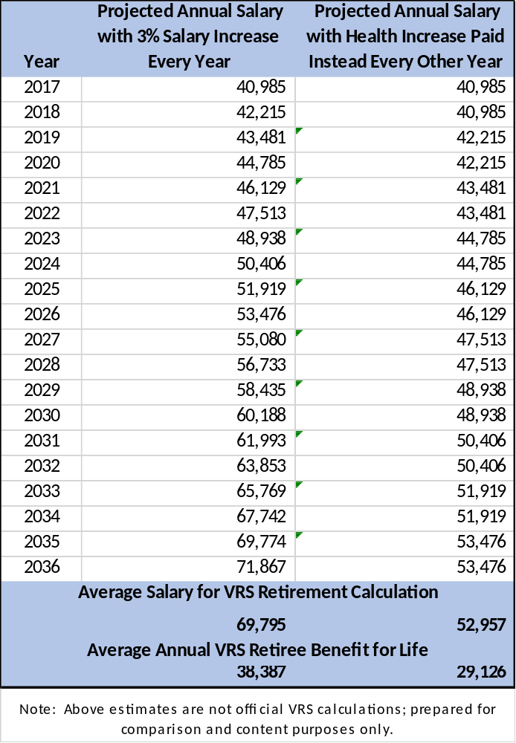
Health Insurance – Lifetime Earnings
Increases in salary are more advantageous to employees in the long-term than increases in benefits
  Retiree benefit based on average of 3 or 5 highest salary years
  Salary increases are cumulative (each building upon the last)
  In this example, the employee would receive $9,261 more in VRS payouts every year for life with annual salary increases instead of employer paid health insurance increases

Slide 20
Health Insurance – Other School Districts

Slide 21
Health Insurance – Other School Districts

Slide 22
Health Insurance – Budget Options from Last Year
Options | 2017-2018 Action | 2018-2019 Options
Increase EE share of employee only premium | Increased | Continue to increase employee share
Increase EE share of spouse/family coverage | Increased | Increase employee share for dependent coverage above 28%/35%
Increase differential between wellness and non-wellness | Increased | Increase differential further to incentivize participation in wellness
Increase differential between KC200 and KC1000 plans | Increased | Eliminate KC200 plan (32% remaining in plan and risk to overall plan for unknown employee shift in 2018-19 due to premiums)
Spouse surcharge if coverage available through another employer | Deferred to 2018-2019 | Consider administrative costs to implement and enforce; may want to align with RFP process in 2018
Eliminate lower deductible plan (KC200) | Deferred to 2018-2019 | Eliminate KC200 plan (32% remaining in plan and risk to overall plan for unknown employee shift in 2018-19 due to premiums)
Shift to higher deductible plan (larger than KC1000) | Deferred to 2018-2019 | RFP process to be conducted during 2018-19; consider alternative plans in competitive negotiations with carriers including high deductible plans with HSA’s

Slide 23
Health Insurance – Rate Setting Standards
Proposal #1:
  Employee pays portion of KC1000 total premium as follows:
    8% of employee only (up from 4%)
    28% of employee plus one child (same)
    35% of employee plus spouse (up from 34%)
    35% of family (up from 34%)
  School Board health benefit frozen at 2017-18 rate for KC200 plan and employee pays higher portion of KC200 total premium as follows:
    29% of employee only (up from 17%)
    45% of employee plus one child (up from 36%)
    48% of employee plus spouse (up from 40%)
    49% of family (up from 40%)
  Assume 50% will move from KC200 to KC1000
  Employee pays more if electing not to participate in the wellness program
  Budget impact = $1,099,503
Proposal #2:
  KC200 plan is eliminated
  Employee pays portion of KC1000 total premium as follows:
    10% of employee only (up from 4%)
    30% of employee plus one child (up from 28%)
    40% of employee plus spouse (up from 34%)
    40% of family (up from 34%)
  Employee pays more if electing not to participate in the wellness program
  Budget impact = $666,635
$432,858 Lower Impact on School Budget if Eliminate KC200

Slide 24
Health Insurance – Keep KC200 and KC1000
DRAFT RATES FOR DISCUSSION ONLY
Roanoke County Schools
Health Insurance Renewal Rates - 12 Month Rates
2018-19 -- KEEP BOTH PLANS (level fund KC200 benefit) and assume 50% move from KC200 to KC1000
CURRENT RATES |  |  |  |  |  |  | RENEWAL RATES
 | Key Care 1000 Plan - WELLNESS |  |  |  |  |  |  | Key Care 1000 Plan - WELLNESS |  |  |  |  | Increase
 | Monthly | School | HRA | Employee | Employee |  |  | Monthly | School | HRA | Employee | Employee | (Decrease) |  | Per Check
Current 2017-18 | Premium | Benefit | Contribution | Rate | Pays |  | Renewal 2018-19 | Premium | Benefit | Contribution | Rate | Pays | Employee |  | 10 Months | 12 Months
Subscriber Only | 523.47 | 461.79 | 41.68 | 20.00 | 4% |  | Subscriber Only | 607.23 | 516.97 | 41.68 | 48.58 | 8% | 28.58 |  | 17.15 | 14.29
Subscriber + 1 minor | 708.65 | 426.88 | 83.34 | 198.43 | 28% |  | Subscriber + 1 minor | 822.03 | 508.52 | 83.34 | 230.17 | 28% | 31.74 |  | 19.04 | 15.87
Employee + Spouse | 1,070.42 | 623.14 | 83.34 | 363.94 | 34% |  | Employee + Spouse | 1,241.69 | 723.76 | 83.34 | 434.59 | 35% | 70.65 |  | 42.39 | 35.33
Family | 1,269.01 | 754.21 | 83.34 | 431.46 | 34% |  | Family | 1,472.05 | 873.49 | 83.34 | 515.22 | 35% | 83.76 |  | 50.25 | 41.88
 | Key Care 1000 Plan - NO WELLNESS |  |  |  |  |  |  | Key Care 1000 Plan - NO WELLNESS |  |  |  |  | Increase
 | Monthly | School | HRA | Employee | Employee |  |  | Monthly | School | HRA | Employee | Employee | (Decrease) |  | Per Check
Current 2017-18 | Premium | Benefit | Contribution | Rate | Pays |  | Renewal 2018-19 | Premium | Benefit | Contribution | Rate | Pays | Employee |  | 10 Months | 12 Months
Subscriber Only | 617.52 | 483.21 | 41.68 | 92.63 | 15% |  | Subscriber Only | 716.32 | 545.71 | 41.68 | 128.94 | 18% | 36.31 |  | 21.78 | 18.15
Subscriber + 1 minor | 850.66 | 486.6 | 83.34 | 280.72 | 33% |  | Subscriber + 1 minor | 986.77 | 528.45 | 83.34 | 374.97 | 38% | 94.25 |  | 56.55 | 47.13
Employee + Spouse | 1,212.55 | 644.19 | 83.34 | 485.02 | 40% |  | Employee + Spouse | 1,406.56 | 690.27 | 83.34 | 632.95 | 45% | 147.93 |  | 88.76 | 73.97
Family | 1,411.03 | 763.28 | 83.34 | 564.41 | 40% |  | Family | 1,636.79 | 816.90 | 83.34 | 736.56 | 45% | 172.15 |  | 103.29 | 86.07
 | Key Care 200 Plan - WELLNESS |  |  |  |  |  |  | Key Care 200 Plan - WELLNESS |  |  |  |  | Increase
 | Monthly | School | HRA | Employee | Employee |  |  | Monthly | School | HRA | Employee | Employee | (Decrease) |  | Per Check
Current 2017-18 | Premium | Benefit | Contribution | Rate | Pays |  | Renewal 2018-19 | Premium | Benefit | Contribution | Rate | Pays | Employee |  | 10 Months | 12 Months
Subscriber Only | 627.70 | 520.03 | - | 107.67 | 17% |  | Subscriber Only | 728.13 | 520.03 | - | 208.10 | 29% | 100.43 |  | 60.26 | 50.22
Subscriber + 1 minor | 886.35 | 565.81 | - | 320.54 | 36% |  | Subscriber + 1 minor | 1,028.17 | 565.81 | - | 462.36 | 45% | 141.82 |  | 85.09 | 70.91
Employee + Spouse | 1,286.76 | 775.79 | - | 510.97 | 40% |  | Employee + Spouse | 1,492.64 | 775.79 | - | 716.85 | 48% | 205.88 |  | 123.53 | 102.94
Family | 1,506.71 | 897.46 | - | 609.25 | 40% |  | Family | 1,747.78 | 897.46 | - | 850.32 | 49% | 241.07 |  | 144.64 | 120.54
 | Key Care 200 Plan - NO WELLNESS |  |  |  |  |  |  | Key Care 200 Plan - NO WELLNESS |  |  |  |  | Increase
 | Monthly | School | HRA | Employee | Employee |  |  | Monthly | School | HRA | Employee | Employee | (Decrease) |  | Per Check
Current 2017-18 | Premium | Benefit | Contribution | Rate | Pays |  | Renewal 2018-19 | Premium | Benefit | Contribution | Rate | Pays | Employee |  | 10 Months | 12 Months
Subscriber Only | 673.76 | 472.26 | - | 201.50 | 30% |  | Subscriber Only | 781.56 | 472.26 | - | 309.30 | 40% | 107.80 |  | 64.68 | 53.90
Subscriber + 1 minor | 932.19 | 504.67 | - | 427.52 | 46% |  | Subscriber + 1 minor | 1,081.34 | 504.67 | - | 576.67 | 53% | 149.15 |  | 89.49 | 74.58
Employee + Spouse | 1,332.82 | 709.69 | - | 623.13 | 47% |  | Employee + Spouse | 1,546.07 | 709.69 | - | 836.38 | 54% | 213.25 |  | 127.95 | 106.63
Family | 1,552.77 | 826.18 | - | 726.59 | 47% |  | Family | 1,801.21 | 826.18 | - | 975.03 | 54% | 248.44 |  | 149.07 | 124.22
Budget Impact $1,099,503

Slide 25
Health Insurance –Eliminate KC200
DRAFT RATES FOR DISCUSSION ONLY
Roanoke County Schools
Health Insurance Renewal Rates - 12 Month Rates
2018-19 -- ELIMINATE KC200 PLAN
CURRENT RATES |  |  |  |  |  |  | RENEWAL RATES
 | Key Care 1000 Plan - WELLNESS |  |  |  |  |  |  | Key Care 1000 Plan - WELLNESS |  |  |  |  | Increase
 | Monthly | School | HRA | Employee | Employee |  |  | Monthly | School | HRA | Employee | Employee | (Decrease) |  | Per Check
Current 2017-18 | Premium | Benefit | Contribution | Rate | Pays |  | Renewal 2018-19 | Premium | Benefit | Contribution | Rate | Pays | Employee |  | 10 Months | 12 Months
Subscriber Only | 523.47 | 461.79 | 41.68 | 20.00 | 4% |  | Subscriber Only | 610.89 | 508.12 | 41.68 | 61.09 | 10% | 41.09 |  | 24.65 | 20.54
Subscriber + 1 minor | 708.65 | 426.88 | 83.34 | 198.43 | 28% |  | Subscriber + 1 minor | 826.99 | 495.56 | 83.34 | 248.10 | 30% | 49.67 |  | 29.80 | 24.83
Employee + Spouse | 1,070.42 | 623.14 | 83.34 | 363.94 | 34% |  | Employee + Spouse | 1,249.18 | 666.17 | 83.34 | 499.67 | 40% | 135.73 |  | 81.44 | 67.87
Family | 1,269.01 | 754.21 | 83.34 | 431.46 | 34% |  | Family | 1,480.93 | 805.22 | 83.34 | 592.37 | 40% | 160.91 |  | 96.55 | 80.46
 | Key Care 1000 Plan - NO WELLNESS |  |  |  |  |  |  | Key Care 1000 Plan - NO WELLNESS |  |  |  |  | Increase
 | Monthly | School | HRA | Employee | Employee |  |  | Monthly | School | HRA | Employee | Employee | (Decrease) |  | Per Check
Current 2017-18 | Premium | Benefit | Contribution | Rate | Pays |  | Renewal 2018-19 | Premium | Benefit | Contribution | Rate | Pays | Employee |  | 10 Months | 12 Months
Subscriber Only | 617.52 | 483.21 | 41.68 | 92.63 | 15% |  | Subscriber Only | 720.65 | 534.84 | 41.68 | 144.13 | 20% | 51.50 |  | 30.90 | 25.75
Subscriber + 1 minor | 850.66 | 486.6 | 83.34 | 280.72 | 33% |  | Subscriber + 1 minor | 992.72 | 512.29 | 83.34 | 397.09 | 40% | 116.37 |  | 69.82 | 58.18
Employee + Spouse | 1,212.55 | 644.19 | 83.34 | 485.02 | 40% |  | Employee + Spouse | 1,415.05 | 624.18 | 83.34 | 707.52 | 50% | 222.50 |  | 133.50 | 111.25
Family | 1,411.03 | 763.28 | 83.34 | 564.41 | 40% |  | Family | 1,646.67 | 740.00 | 83.34 | 823.34 | 50% | 258.93 |  | 155.36 | 129.46
 | Key Care 200 Plan - WELLNESS |  |  |  |  |  |  | Key Care 1000 Plan - WELLNESS |  |  |  |  | Increase
 | Monthly | School | HRA | Employee | Employee |  |  | Monthly | School | HRA | Employee | Employee | (Decrease) |  | Per Check
Current 2017-18 | Premium | Benefit | Contribution | Rate | Pays |  | Renewal 2018-19 | Premium | Benefit | Contribution | Rate | Pays | Employee |  | 10 Months | 12 Months
Subscriber Only | 627.70 | 520.03 | - | 107.67 | 17% |  | Subscriber Only | 610.89 | 508.12 | 41.68 | 61.09 | 10% | (46.58) |  | (27.95) | (23.29)
Subscriber + 1 minor | 886.35 | 565.81 | - | 320.54 | 36% |  | Subscriber + 1 minor | 826.99 | 495.56 | 83.34 | 248.10 | 30% | (72.44) |  | (43.46) | (36.22)
Employee + Spouse | 1,286.76 | 775.79 | - | 510.97 | 40% |  | Employee + Spouse | 1,249.18 | 666.17 | 83.34 | 499.67 | 40% | (11.30) |  | (6.78) | (5.65)
Family | 1,506.71 | 897.46 | - | 609.25 | 40% |  | Family | 1,480.93 | 805.22 | 83.34 | 592.37 | 40% | (16.88) |  | (10.13) | (8.44)
 | Key Care 200 Plan - NO WELLNESS |  |  |  |  |  |  | Key Care 1000 Plan - NO WELLNESS |  |  |  |  | Increase
 | Monthly | School | HRA | Employee | Employee |  |  | Monthly | School | HRA | Employee | Employee | (Decrease) |  | Per Check
Current 2017-18 | Premium | Benefit | Contribution | Rate | Pays |  | Renewal 2018-19 | Premium | Benefit | Contribution | Rate | Pays | Employee |  | 10 Months | 12 Months
Subscriber Only | 673.76 | 472.26 | - | 201.50 | 30% |  | Subscriber Only | 720.65 | 534.84 | 41.68 | 144.13 | 20% | (57.37) |  | (34.42) | (28.69)
Subscriber + 1 minor | 932.19 | 504.67 | - | 427.52 | 46% |  | Subscriber + 1 minor | 992.72 | 512.29 | 83.34 | 397.09 | 40% | (30.43) |  | (18.26) | (15.22)
Employee + Spouse | 1,332.82 | 709.69 | - | 623.13 | 47% |  | Employee + Spouse | 1,415.05 | 624.18 | 83.34 | 707.52 | 50% | 84.39 |  | 50.64 | 42.20
Family | 1,552.77 | 826.18 | - | 726.59 | 47% |  | Family | 1,646.67 | 740.00 | 83.34 | 823.34 | 50% | 96.75 |  | 58.05 | 48.37
Budget Impact $666,635

Slide 26
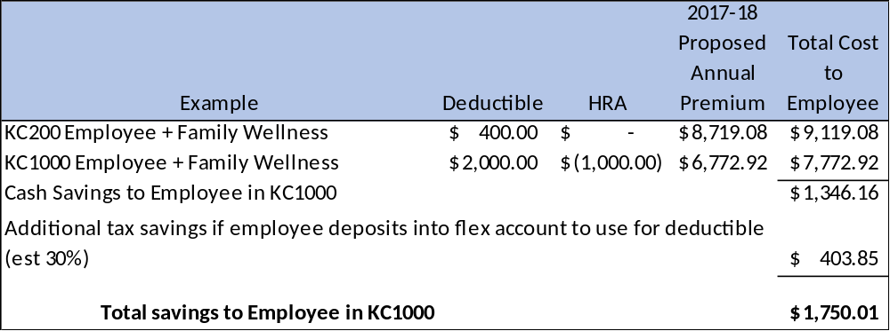
Health Insurance – KC1000 Makes Sense
  Lower premium than KC200 (ranges from $1,052/yr to $2,133/yr)
  $500 HRA cash contribution at beginning of year ($1000 for employee plus dependents)
  Lower out of pocket maximum ($3500/$7000 vs $4000/$8000)
  Lower drug co-pays ($10/25/40 vs $10/30/50)

Slide 27
Employee Benefits
Virginia Retirement System

Slide 28
VRS Fiscal Impact
VRS Plan | Current Rate | Governor’s Rate | Rate Change | Estimated Increase (Decrease) in Budget
VRS – Professional | 16.32% | 15.68% | -0.64% | $(494,429)
VRS – Non-Professional | 4.83% | 1.92% | -2.91% | (88,160)
Retiree Health Credit | 1.23% | 1.20% | -0.03% | 23,176
Life Insurance | 1.31% | 1.31% | No change | 0
Net Budgetary Impact for FY19 |  |  |  | $(605,765)
Employee contribution to VRS remains at 5%

Slide 29
Budget Requests

Slide 30
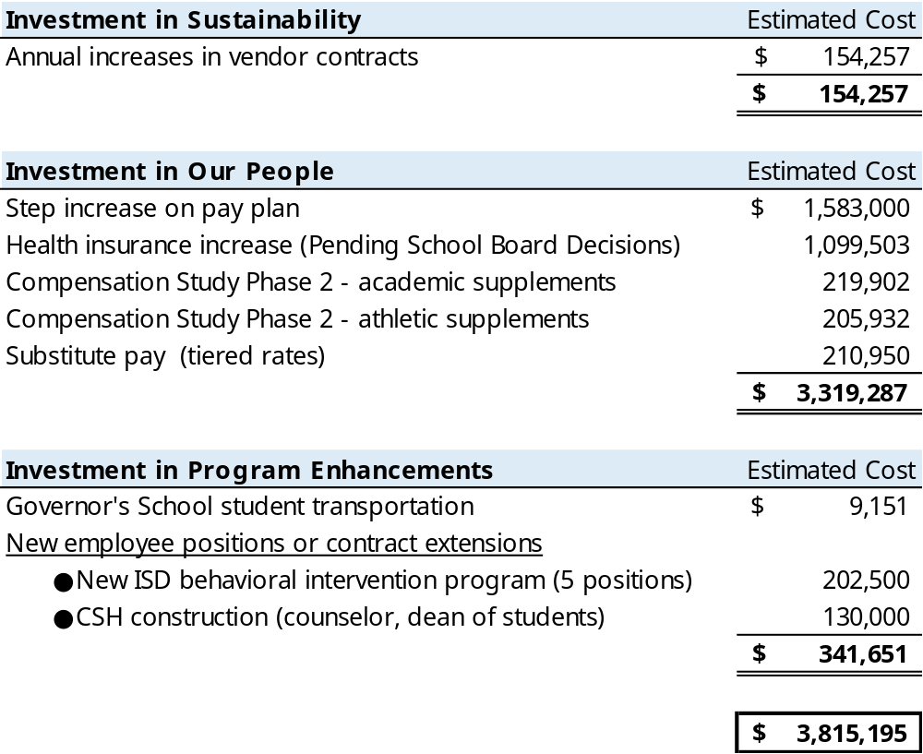
Budget Requests – Superintendent’s Focus

Slide 31
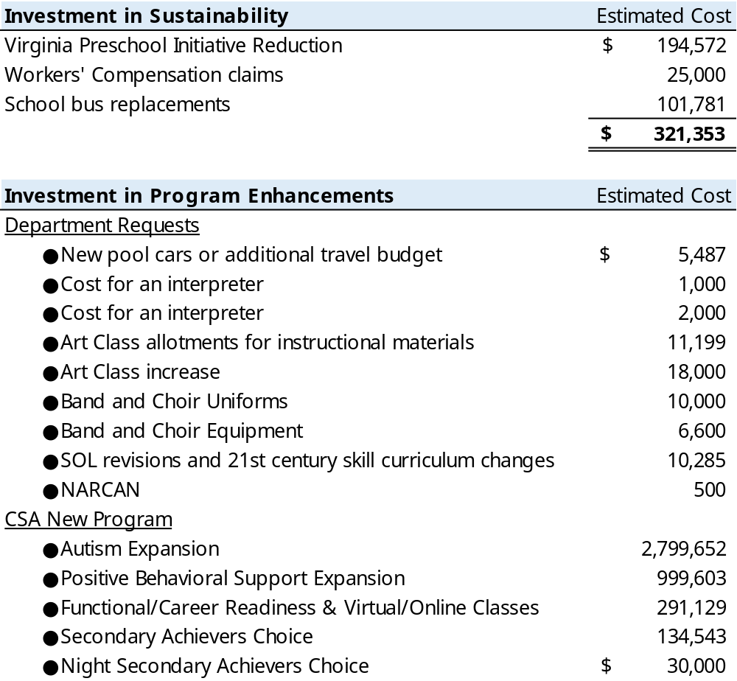
Budget Requests – Consider in Future Budgets

Slide 32
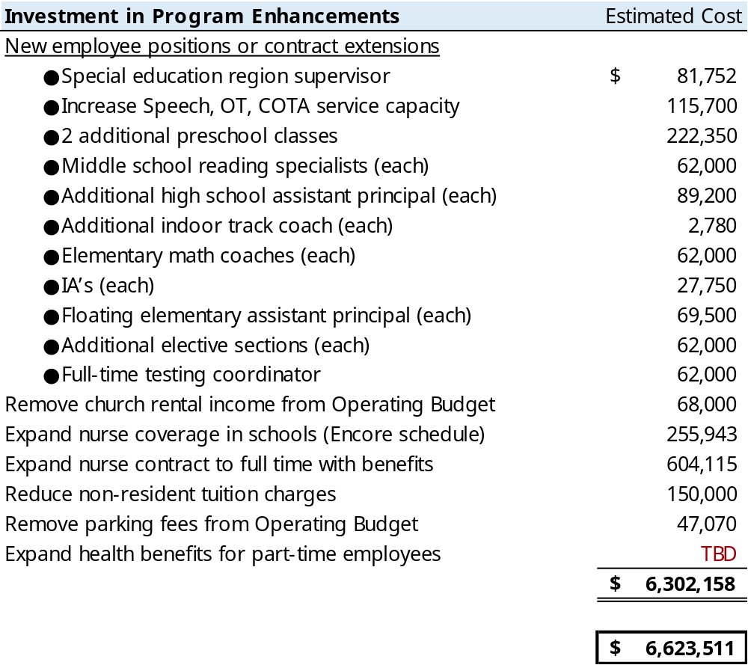
Budget Requests – Consider in Future Budgets
*Note that not all requests have been quantified*

Slide 33
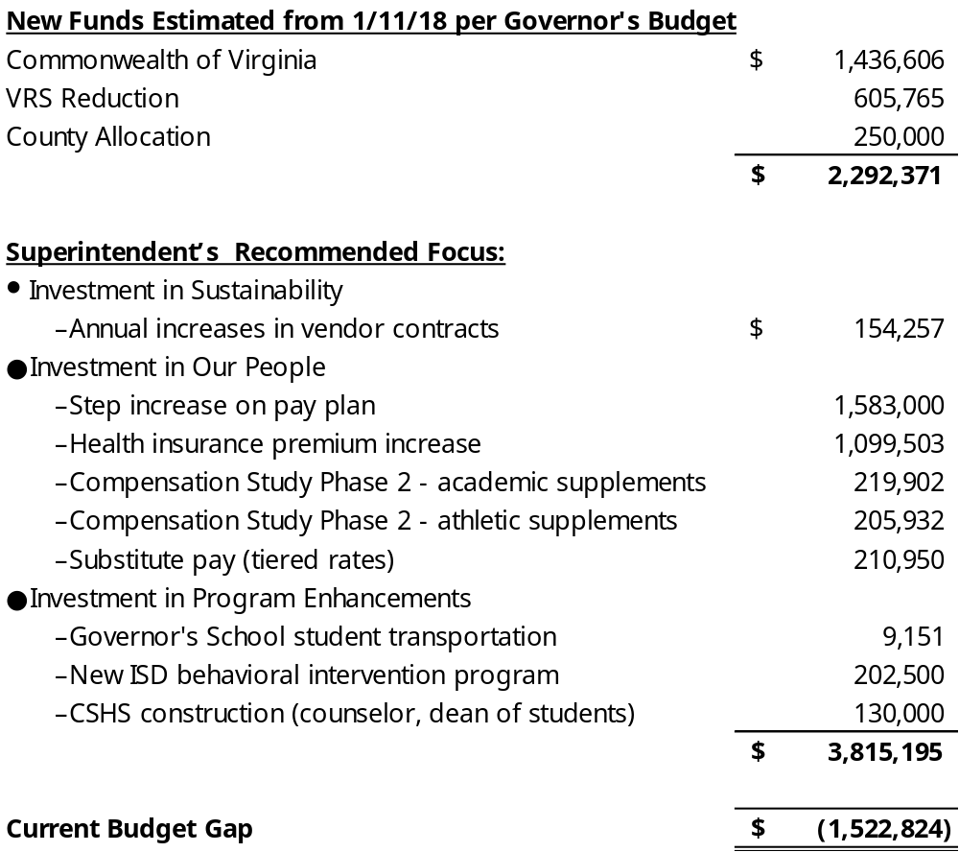
Superintendent’s Focus With Budget Gap

Slide 34
Next Steps
Work session – March 6, 2018
  House & Senate Crossover Budgets
Work session – March 13, 2018
  TBD (General Assembly adjourns on March 10 but revenue allocations may not be available yet)
Work session – March 15, 2018
  TBD
Work session – March 20, 2018
  Last date for Presentation of Superintendent’s Budget
Work session – March 22, 2018
  SB adopts FY19 budget
FY19 Budget due to Board of Supervisors – April 1, 2018

Slide 35
Questions & Comments

