Slide 1
Roanoke County Schools
2018-2019 Budget Work Session
March 8, 2018
Revenues
Employee Compensation Update
Superintendent’s Proposed Budget Focus

Slide 2
agenda
Agenda
Revenues
  Commonwealth of Virginia
  Revenue Sharing – County of Roanoke
  All General Fund Revenues
Employee Compensation Update
  Compensation Option for Teachers
  Health Insurance Change
Superintendent’s Budget Quick Math
Next Steps for Staff and School Board
Questions & Comments

Slide 3
Revenues
Commonwealth of Virginia

Slide 4
Differences from governor’s proposed budget
Differences from Governor’s Proposed Budget
 | Governor | Senate | House
State funds for employee salary increase in FY19 | NO | NO | NO
Increase in “local ability to pay” factor (reduces state funding) | YES | YES | YES
Move baseline year for Breakfast Incentive funding from 2004 to 2009 | NO | YES | NO
Remove cost of School Board members from SOQ funding | NO | YES | NO
Reduce Project Graduation funding by 50% | NO | YES | NO
Increase in lottery funds without supplanting | NO | NO | YES
Decrease in mandatory VRS retirement rates | YES | YES | YES
Notes:
House version has 2% in 2nd year of biennium; Senate stripped out of 2nd year of biennium

Slide 5
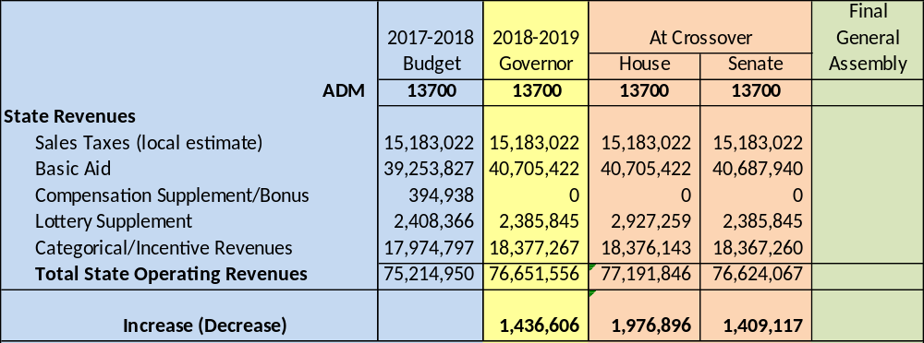
House and senate budgets
House and Senate Budgets
New state revenue for FY 2019 is likely to be between $1.4M and $1.9M with ADM of 13700
-- Pending final General Assembly action --

Slide 6
Revenue Sharing
County of Roanoke

Slide 7
Revenue sharing formula
Revenue Sharing Formula
Required Local Match | Local Aid in 2016-17 | % of RLE
$33,727,340 | $67,839,376 | 201.14%
Accounts for shifting dynamic between school enrollment and total population
Provides a stable and verifiable allocation method
Key Elements of Calculation:
  Establish ADM/Population Index
  Calculate Net Allocation Change that determines % of shared local revenue
  Offset new county revenues with CSA and economic development incentives
  Apply updated % to total local tax revenue
  Recalculate and apply Net Allocation Change each year
  Formula applies allocation change to prior year baseline transfer plus new county revenues
Note: 2016-17 is latest available RLE ranking
Notes:
Local funding was at 201% of the Required Local Match for 2016-17

Slide 8
Proposed county transfer
Proposed Transfer from County of Roanoke
 |  |  |  | 2017-2018 |  | 2018-2019
Property and Local Taxes |  |  |  | 163,210,385 |  | 166,146,122
Adjustments:
Lodging Tax-Roanoke Valley Convention and Visitors Bureau |  |  |  | (514,894) |  | (585,686)
New Treasurer Position for Delinquent Tax Collection |  |  |  | - |  | (42,473)
Increase in CSA Costs |  |  |  | (660,000) |  | (1,935,000)
Economic Development (William Byrd Apartments) |  |  |  | - |  | (100,000)
Economic Development (Roland E Cook Apartments) |  |  |  | - |  | (15,000)
Economic Development Incentive (South Peak CDA) |  |  |  | (560,000) |  | (635,000)
Economic Development Incentive (Allstate) |  |  |  | (150,000) |  | -
Economic Development Incentive (Ardagh) |  |  |  | (650,000) |  | -
Net total taxes |  |  |  | $ 160,675,491 |  | $ 162,832,963 | $ 2,157,472
Portion allocated to Roanoke County Schools for 2018-19 |  |  |  |  |  |  | $ 570,208
Total Transfer from County of Roanoke for 2018-19 |  |  |  |  |  |  | $ 68,649,145

Slide 9
Revenues
All General Fund

Slide 10
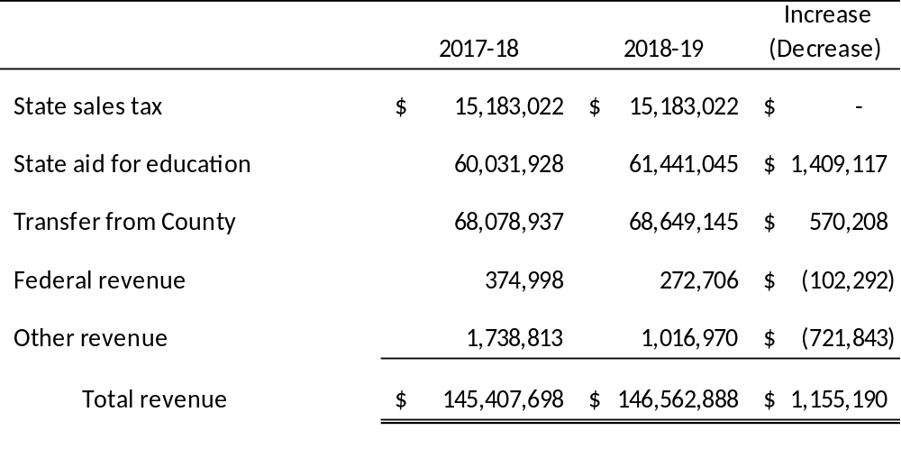
Total general fund revenue
Total General Fund Revenue
This summary uses the Senate Budget which is the lowest of the two state budgets, with expectations that the final General Assembly budget will not be lower. The House budget is $567,000 higher.

Slide 11
stewardship
Stewardship of Local Taxpayer Funding
Notes:
Only 1 school division has higher scores with lower per pupil costs.
5 school divisions have higher scores with higher per pupil costs.

Slide 12
Employee Compensation Update

Slide 13
Investment in salaries
Investment in Our People - Salaries
  Budget Actions supporting Investment in People:
  2016-17 Implemented new pay plan from market study
  2017-18 Employees move up one step on pay plan
  2018-19 Proposal to move employees up one step (2229 employees) Does not include COLA adjustment to pay plan (no increase at top of scale)
  UPDATE: 1% COLA adjustment to Teacher Scale only (with option to fund 1% stipend for teachers above step 30). If both a step and the scale shift are funded, teachers would receive a total of 2.5% on steps 1-30 (exclusive of degree supplements). If the stipend for teachers above step 30 is funded, teachers above step 30 would receive a 1% stipend.
Cost of Step Increase for all Employees | $1,583,000
Cost of 1% COLA shift in Teacher Scale only – this will move the entire scale and increase the minimum and maximum salary on the teacher scale (1086 teachers) without adding a step. | $643,764
Cost of 1% stipend for Teachers above step 30 – this will increase the salaries for teachers who are beyond the top of the teacher scale (63 teachers) with a one-time stipend. | $43,921

Slide 14
Health Insurance – Rate Setting Standards
Proposal #1:
  Employee pays portion of KC1000 total premium as follows:
    8% of employee only (up from 4%)
    28% of employee plus one child (same)
    35% of employee plus spouse (up from 34%)
    35% of family (up from 34%)
  School Board health benefit frozen at 2017-18 rate for KC200 plan and employee pays higher portion of KC200 total premium as follows:
    29% of employee only (up from 17%)
    45% of employee plus one child (up from 36%)
    48% of employee plus spouse (up from 40%)
    49% of family (up from 40%)
  Assume 50% will move from KC200 to KC1000
  Employee pays more if electing not to participate in the wellness program
  Budget impact = $1,099,503
Proposal #2: (Direction of School Board at February 22nd work session)
  KC200 plan is eliminated
  Employee pays portion of KC1000 total premium as follows:
    10% of employee only (up from 4%)
    30% of employee plus one child (up from 28%)
    40% of employee plus spouse (up from 34%)
    40% of family (up from 34%)
  Employee pays more if electing not to participate in the wellness program
  Budget impact = $666,635

Slide 15
Health Insurance – Eliminate KC200
DRAFT RATES FOR DISCUSSION ONLY
Roanoke County Schools
Health Insurance Renewal Rates - 12 Month Rates
2018-19 -- ELIMINATE KC200 PLAN
CURRENT RATES |  |  |  |  |  |  | RENEWAL RATES
 | Key Care 1000 Plan - WELLNESS |  |  |  |  |  |  | Key Care 1000 Plan - WELLNESS |  |  |  |  | Increase
 | Monthly | School | HRA | Employee | Employee |  |  | Monthly | School | HRA | Employee | Employee | (Decrease) |  | Per Check
Current 2017-18 | Premium | Benefit | Contribution | Rate | Pays |  | Renewal 2018-19 | Premium | Benefit | Contribution | Rate | Pays | Employee |  | 10 Months | 12 Months
Subscriber Only | 523.47 | 461.79 | 41.68 | 20.00 | 4% |  | Subscriber Only | 610.89 | 508.12 | 41.68 | 61.09 | 10% | 41.09 |  | 24.65 | 20.54
Subscriber + 1 minor | 708.65 | 426.88 | 83.34 | 198.43 | 28% |  | Subscriber + 1 minor | 826.99 | 495.56 | 83.34 | 248.10 | 30% | 49.67 |  | 29.80 | 24.83
Employee + Spouse | 1,070.42 | 623.14 | 83.34 | 363.94 | 34% |  | Employee + Spouse | 1,249.18 | 666.17 | 83.34 | 499.67 | 40% | 135.73 |  | 81.44 | 67.87
Family | 1,269.01 | 754.21 | 83.34 | 431.46 | 34% |  | Family | 1,480.93 | 805.22 | 83.34 | 592.37 | 40% | 160.91 |  | 96.55 | 80.46
 | Key Care 1000 Plan - NO WELLNESS |  |  |  |  |  |  | Key Care 1000 Plan - NO WELLNESS |  |  |  |  | Increase
 | Monthly | School | HRA | Employee | Employee |  |  | Monthly | School | HRA | Employee | Employee | (Decrease) |  | Per Check
Current 2017-18 | Premium | Benefit | Contribution | Rate | Pays |  | Renewal 2018-19 | Premium | Benefit | Contribution | Rate | Pays | Employee |  | 10 Months | 12 Months
Subscriber Only | 617.52 | 483.21 | 41.68 | 92.63 | 15% |  | Subscriber Only | 720.65 | 534.84 | 41.68 | 144.13 | 20% | 51.50 |  | 30.90 | 25.75
Subscriber + 1 minor | 850.66 | 486.6 | 83.34 | 280.72 | 33% |  | Subscriber + 1 minor | 992.72 | 512.29 | 83.34 | 397.09 | 40% | 116.37 |  | 69.82 | 58.18
Employee + Spouse | 1,212.55 | 644.19 | 83.34 | 485.02 | 40% |  | Employee + Spouse | 1,415.05 | 624.18 | 83.34 | 707.52 | 50% | 222.50 |  | 133.50 | 111.25
Family | 1,411.03 | 763.28 | 83.34 | 564.41 | 40% |  | Family | 1,646.67 | 740.00 | 83.34 | 823.34 | 50% | 258.93 |  | 155.36 | 129.46
 | Key Care 200 Plan - WELLNESS |  |  |  |  |  |  | Key Care 1000 Plan - WELLNESS |  |  |  |  | Increase
 | Monthly | School | HRA | Employee | Employee |  |  | Monthly | School | HRA | Employee | Employee | (Decrease) |  | Per Check
Current 2017-18 | Premium | Benefit | Contribution | Rate | Pays |  | Renewal 2018-19 | Premium | Benefit | Contribution | Rate | Pays | Employee |  | 10 Months | 12 Months
Subscriber Only | 627.70 | 520.03 | - | 107.67 | 17% |  | Subscriber Only | 610.89 | 508.12 | 41.68 | 61.09 | 10% | (46.58) |  | (27.95) | (23.29)
Subscriber + 1 minor | 886.35 | 565.81 | - | 320.54 | 36% |  | Subscriber + 1 minor | 826.99 | 495.56 | 83.34 | 248.10 | 30% | (72.44) |  | (43.46) | (36.22)
Employee + Spouse | 1,286.76 | 775.79 | - | 510.97 | 40% |  | Employee + Spouse | 1,249.18 | 666.17 | 83.34 | 499.67 | 40% | (11.30) |  | (6.78) | (5.65)
Family | 1,506.71 | 897.46 | - | 609.25 | 40% |  | Family | 1,480.93 | 805.22 | 83.34 | 592.37 | 40% | (16.88) |  | (10.13) | (8.44)
 | Key Care 200 Plan - NO WELLNESS |  |  |  |  |  |  | Key Care 1000 Plan - NO WELLNESS |  |  |  |  | Increase
 | Monthly | School | HRA | Employee | Employee |  |  | Monthly | School | HRA | Employee | Employee | (Decrease) |  | Per Check
Current 2017-18 | Premium | Benefit | Contribution | Rate | Pays |  | Renewal 2018-19 | Premium | Benefit | Contribution | Rate | Pays | Employee |  | 10 Months | 12 Months
Subscriber Only | 673.76 | 472.26 | - | 201.50 | 30% |  | Subscriber Only | 720.65 | 534.84 | 41.68 | 144.13 | 20% | (57.37) |  | (34.42) | (28.69)
Subscriber + 1 minor | 932.19 | 504.67 | - | 427.52 | 46% |  | Subscriber + 1 minor | 992.72 | 512.29 | 83.34 | 397.09 | 40% | (30.43) |  | (18.26) | (15.22)
Employee + Spouse | 1,332.82 | 709.69 | - | 623.13 | 47% |  | Employee + Spouse | 1,415.05 | 624.18 | 83.34 | 707.52 | 50% | 84.39 |  | 50.64 | 42.20
Family | 1,552.77 | 826.18 | - | 726.59 | 47% |  | Family | 1,646.67 | 740.00 | 83.34 | 823.34 | 50% | 96.75 |  | 58.05 | 48.37
Budget Impact $666,635

Slide 16
Superintendent’s Budget Focus

Slide 17
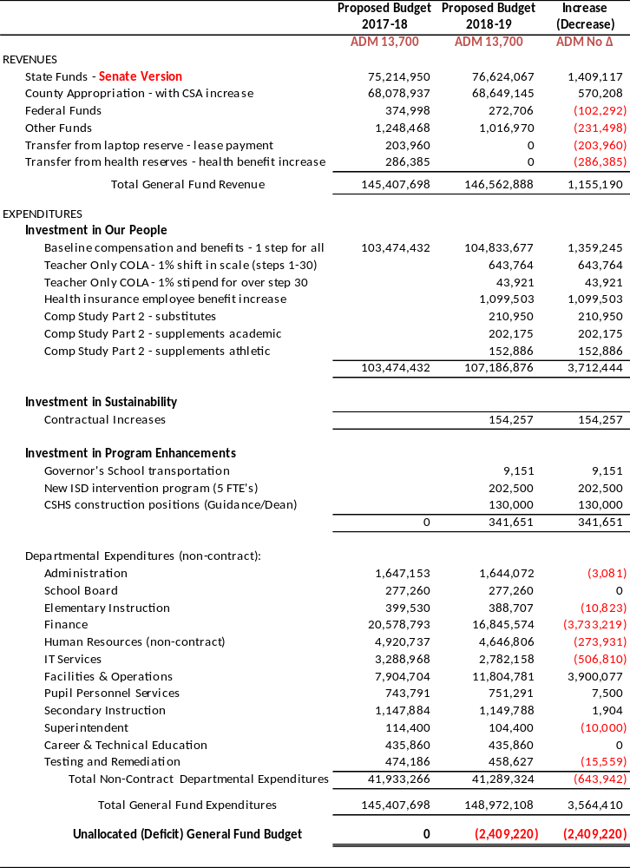
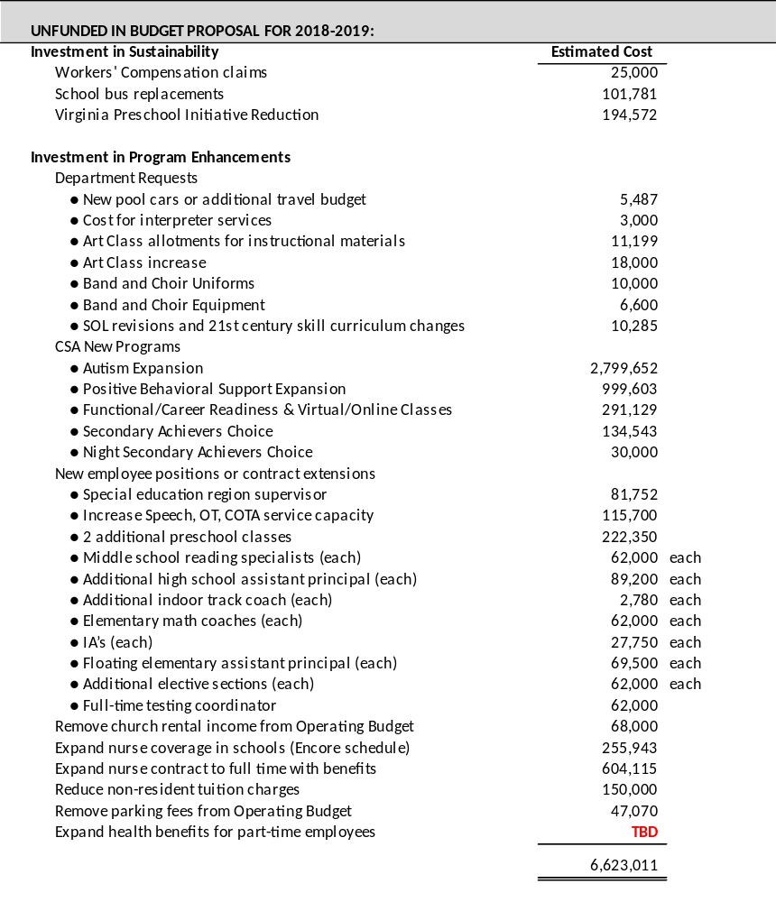
Superintendent’s Budget – Out of Balance

Slide 18
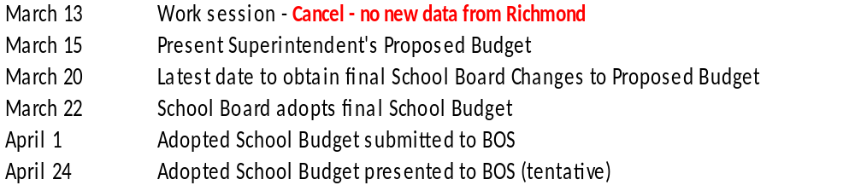
Next Steps for Staff and School Board
Update revenues for final General Assembly budget (adjournment on March 10 but Calc Tool may not be available for 7-10 days)
Finalize staffing and employee contract database (March 12-13)
Cancel work session scheduled for March 13 (no new data expected from General Assembly)
Finalize and present Superintendent’s Proposed Budget to the School Board (March 15)
Incorporate School Board recommended changes to the Superintendent’s Proposed Budget (March 15-20)
Adopt final School Budget (March 22)
Submit Adopted School Budget to Board of Supervisors (April 1)
Present Adopted School Budget and VPSA bond resolutions for Cave Spring High at Board of Supervisor Meeting (tentatively April 24)

Slide 19
Questions & Comments

