Slide 1
Roanoke County Schools
2018-2019 Budget Work Session
March 15, 2018
Superintendent’s Proposed Budget
2018-2019

Slide 2
Agenda
Superintendent’s Proposed Budget for 2018-2019
  All School Funds
  General Fund
  Other Funds
Next Steps
Attachments
  Capital Plans
  Health Plan Rates

Slide 3
Superintendent’s Proposed Budget
2018-2019

Slide 4
Superintendent’s Focus
Superintendent’s Focus:
Investment in sustainability (necessary, essential, mandatory)
Investment in our people
  Step increase on pay plan
  Substitute pay increase
  Stipend & supplement increase (Phase 2)
  Health insurance premium increase
CSHS staff positions during construction
In School Detention and guidance positions

Slide 5
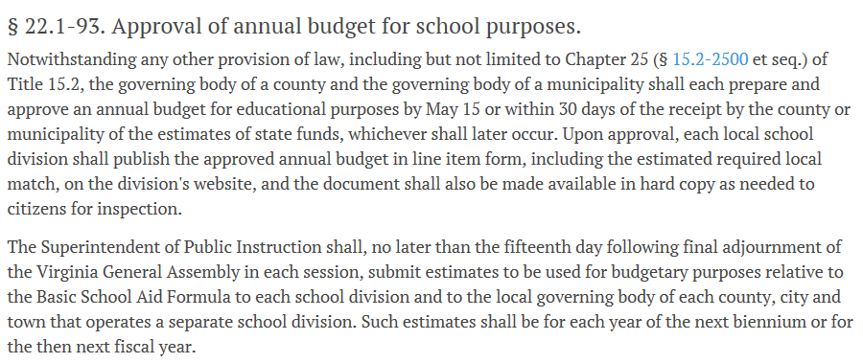
State Code – Approval of School Budget

Slide 6
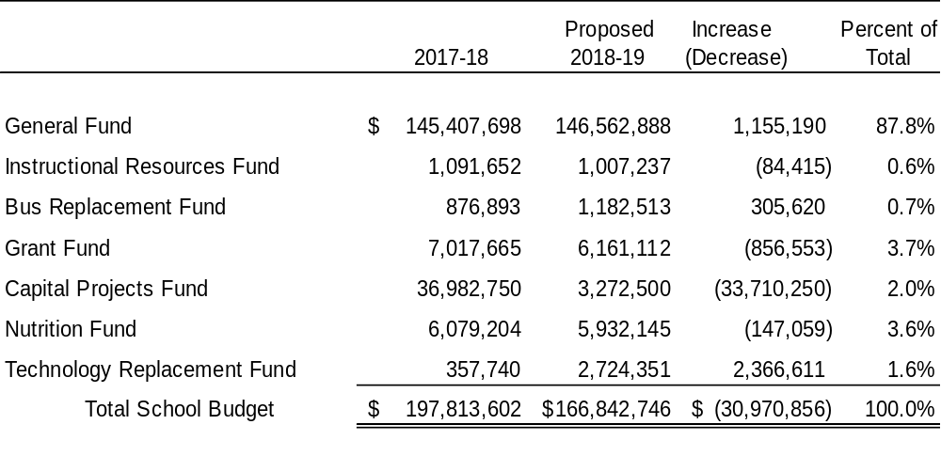
Total Budget – All School Funds

Slide 7
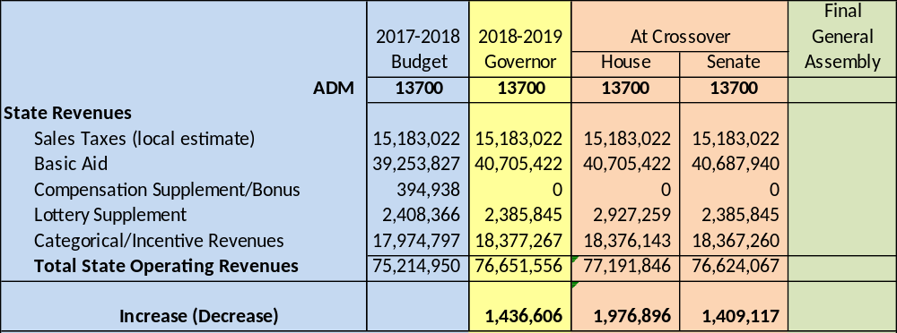

House and Senate Budgets
-- General Assembly adjourned on March 10, 2018 without adopting state budget –
-- General Assembly Special Session scheduled for April 11th –
House and Senate budget bills are technically dead.
Governor will submit a new budget bill and General Assembly will amend.
Likely to be similar to amendments in House and Senate budgets.
Superintendent’s Proposed Budget uses lowest of 3 budgets submitted to date.

Slide 8
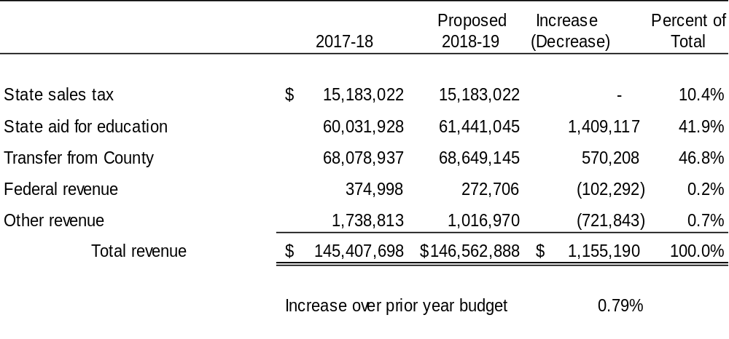
Total General Fund Revenue
This summary uses the Senate Budget which is the lowest of the Governor’s, House, and Senate budgets.

Slide 9
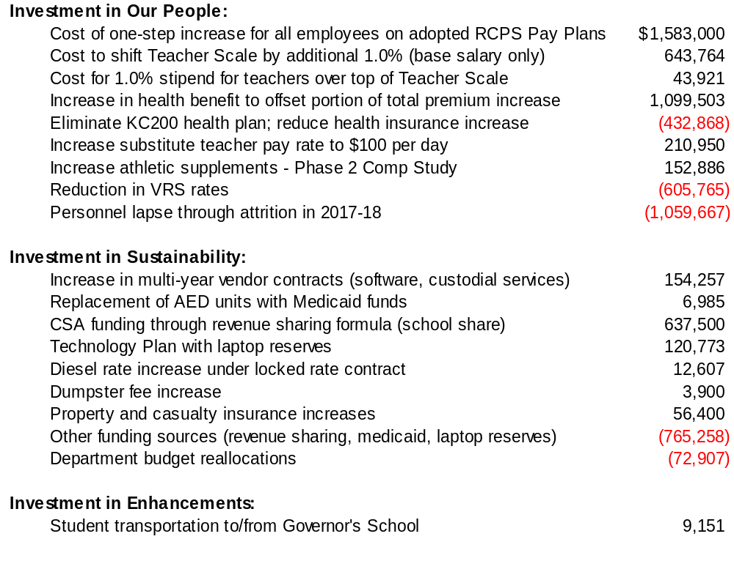
What’s Included in the Proposed 2018-2019 Budget

Slide 10
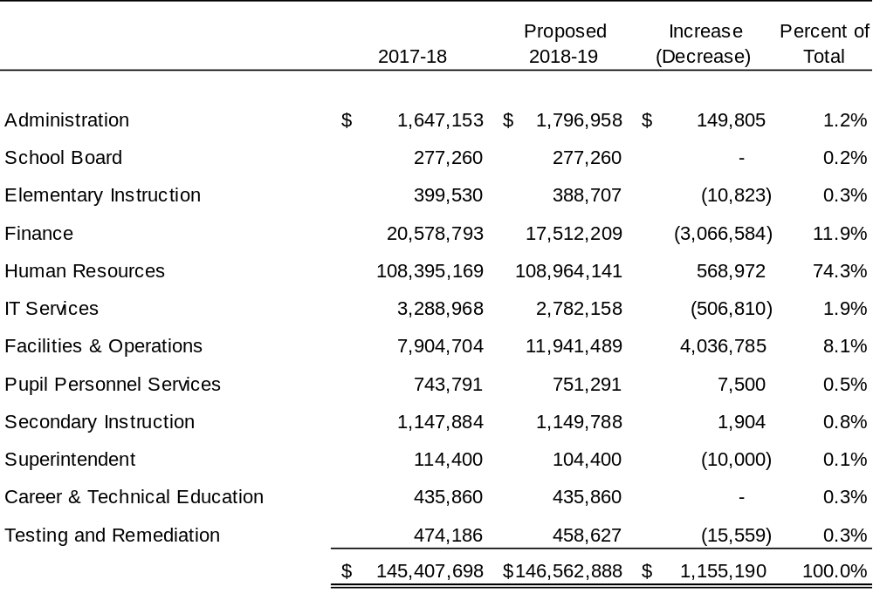
Total General Fund Expenditures

Slide 11
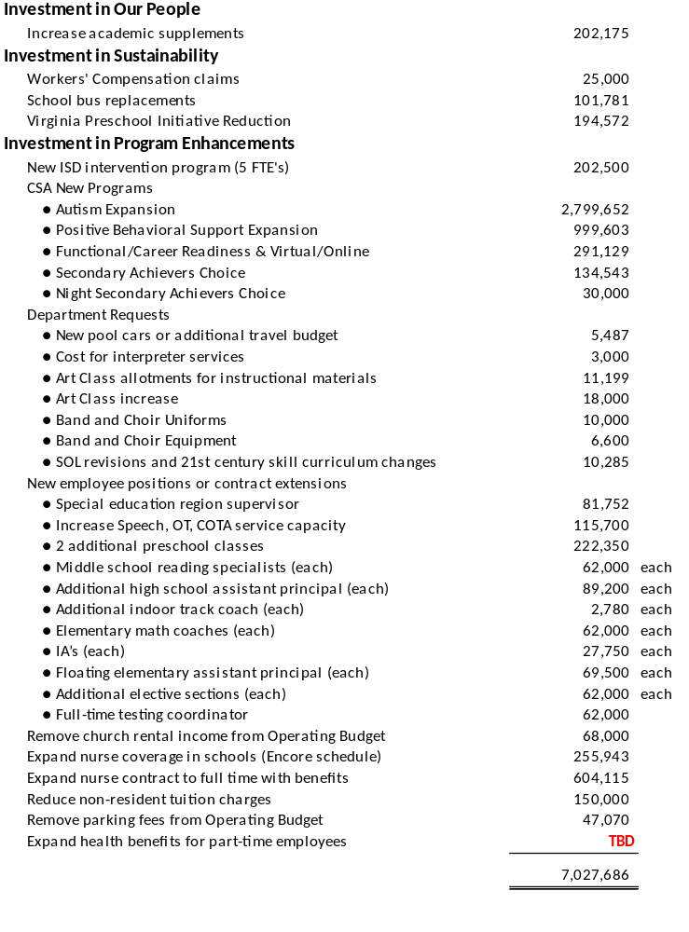
Unfunded Requests – Future Budgets
Superintendent’s Recommended Budget Addback Priorities:
Academic supplements – Phase 2 | $202,175
Increase speech/OT service capacity | $115,700
Additional IA positions | $27,750 each
CSA – Secondary Achievers Choice | $134,543
CSA – Night Secondary Achievers Choice | $30,000

Slide 12
Stewardship of Local Taxpayer Funding
Notes:
Only 1 school division has higher scores with lower per pupil costs.
5 school divisions have higher scores with higher per pupil costs.

Slide 13
Other Fund Budgets
Self-balancing funds other than the General Fund which maintain year-end fund balances for multi-year expenditures.

Slide 14
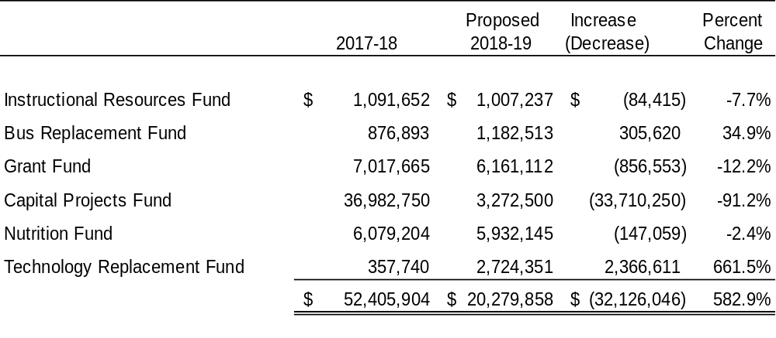
Other Fund Budgets
Notes:
Bus Fund – increase based on scheduled bus replacements (age and mileage)
Capital Projects Fund – p/y included funding for CSHS project; no big capital project to begin in FY18-19
Tech Fund – collapsed funding from general fund (e-rate and student laptop fee) into new fund for tech replacement plan

Slide 15
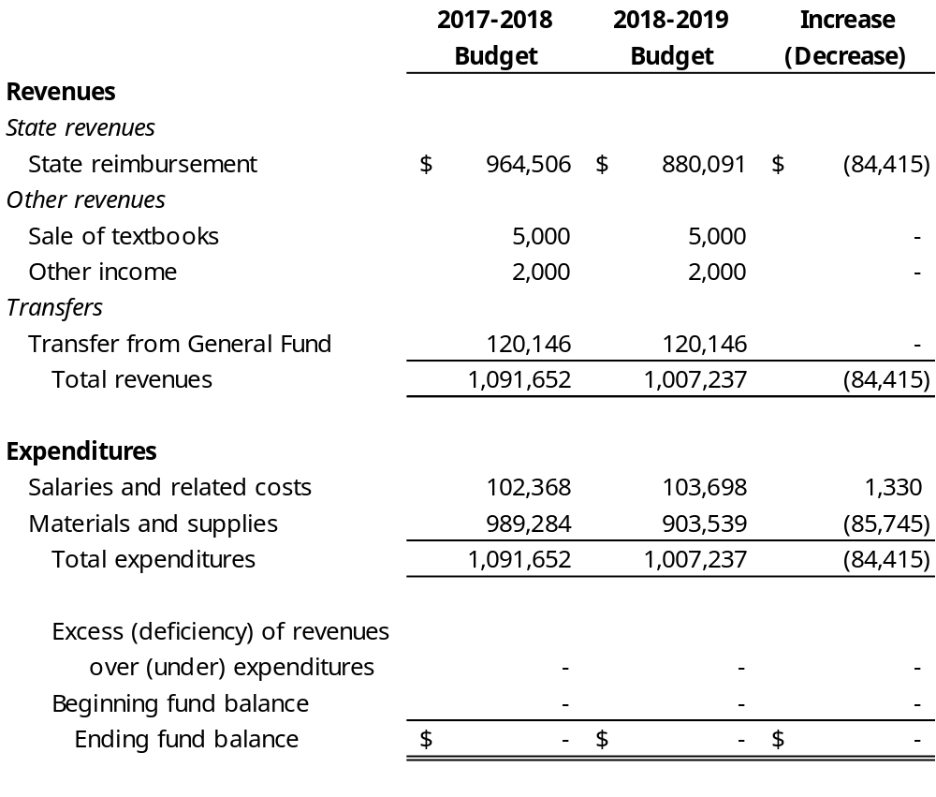
Instructional Resources Fund
No changes from February 8, 2018 Work Session

Slide 16
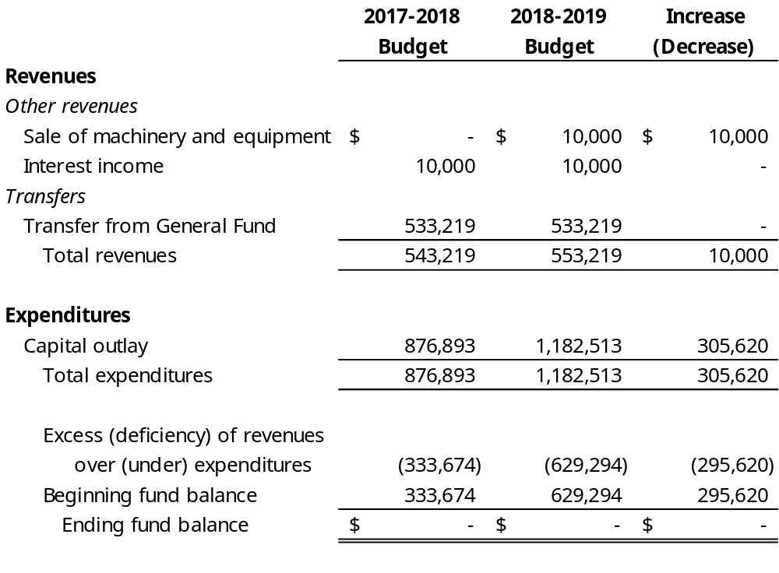
Bus Replacement Fund
No changes from February 8, 2018 Work Session

Slide 17
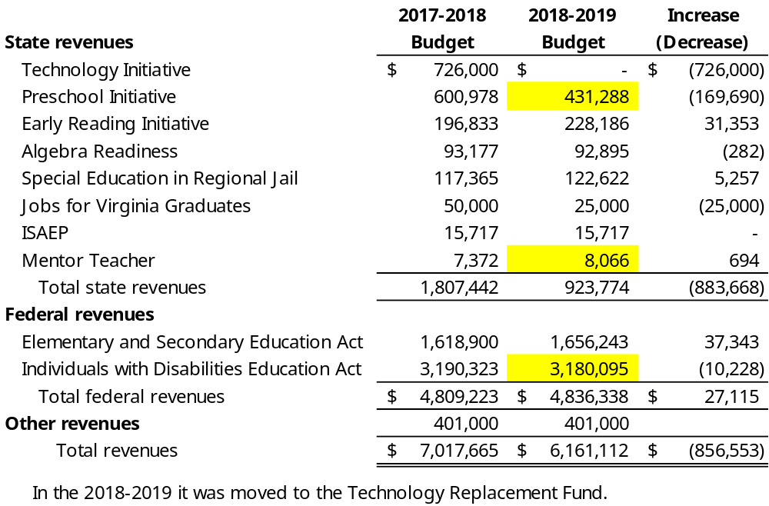
Grant Fund
Changes from February 8, 2018 Work Session for:
Senate increase of Preschool Initiative Reimbursement by $24,882
Addition of Mentor Grant of $8,066
Reduction of Title VI-B Flow Through by $10,228

Slide 18
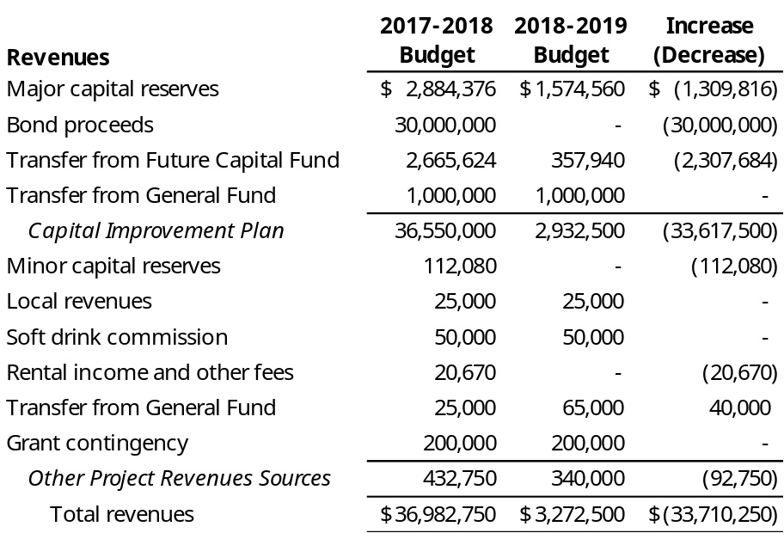
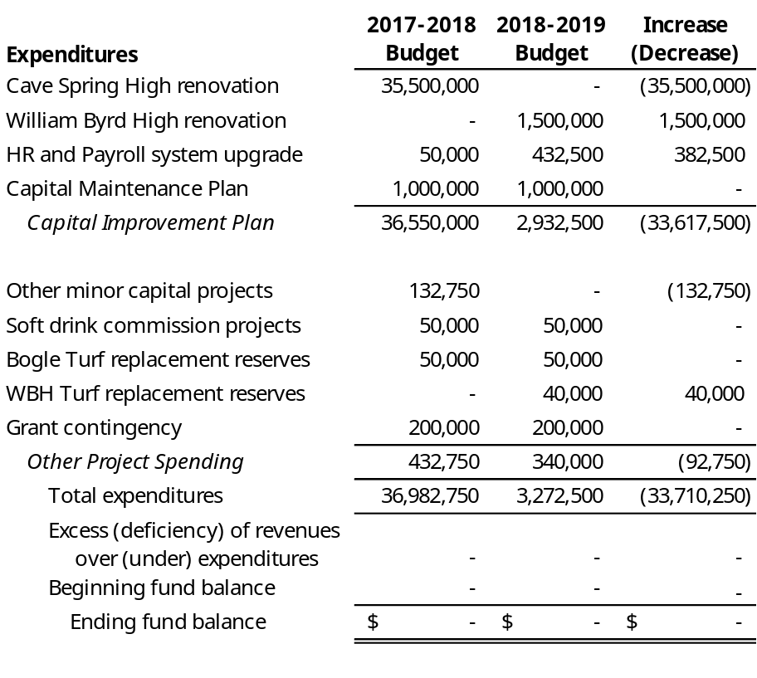
Capital Projects Fund
No changes from February 8, 2018 Work Session

Slide 19
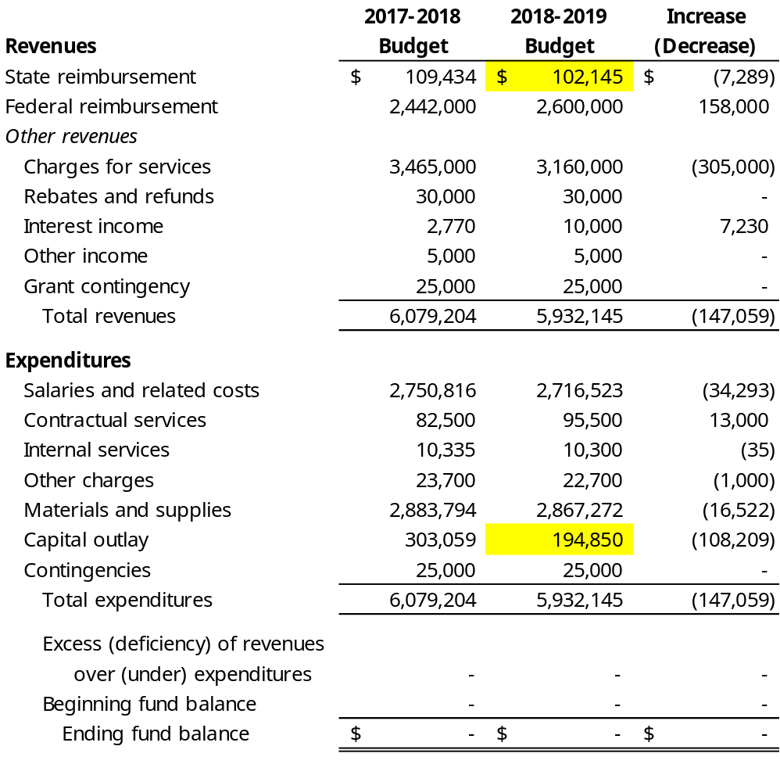
Nutrition Fund
Changes from February 8, 2018 Work Session for:
Senate reduction of School Breakfast by $22,008.

Slide 20
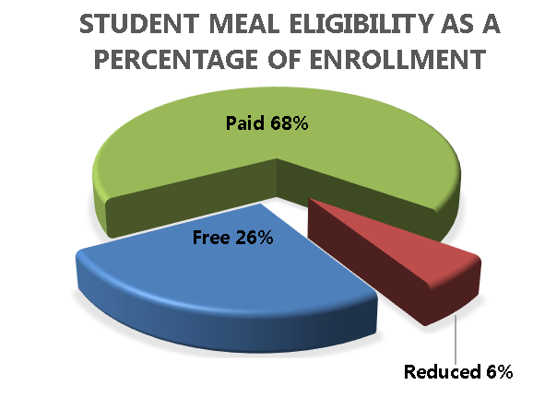
Nutrition Fund
Student Meal Prices
Federal and State Reimbursement Rates
 | Breakfast | Elementary Lunch | Secondary Lunch
2010 | $1.00 | $2.00 | $2.00
2011 | 1.00 | 2.00 | 2.00
2012 | 1.00 | 2.05 | 2.05
2013 | 1.00 | 2.15 | 2.15
2014 | 1.10 | 2.25 | 2.25
2015 | 1.15 | 2.35 | 2.35
2016 | 1.25 | 2.35 | 2.60
2017 | 1.25 | 2.45 | 2.70
2018 | 1.35 | 2.55 | 2.80
2019* | 1.45 | 2.65 | 2.90
Reduced | $0.30 | $0.40 | $0.40
 | Breakfast | Lunch
Federal Paid | $ 0.30 | $ 0.31
Federal Reduced | 1.45 | 2.83
Federal Free | 1.75 | 3.29
State Lunch | N/A | 0.05

Slide 21
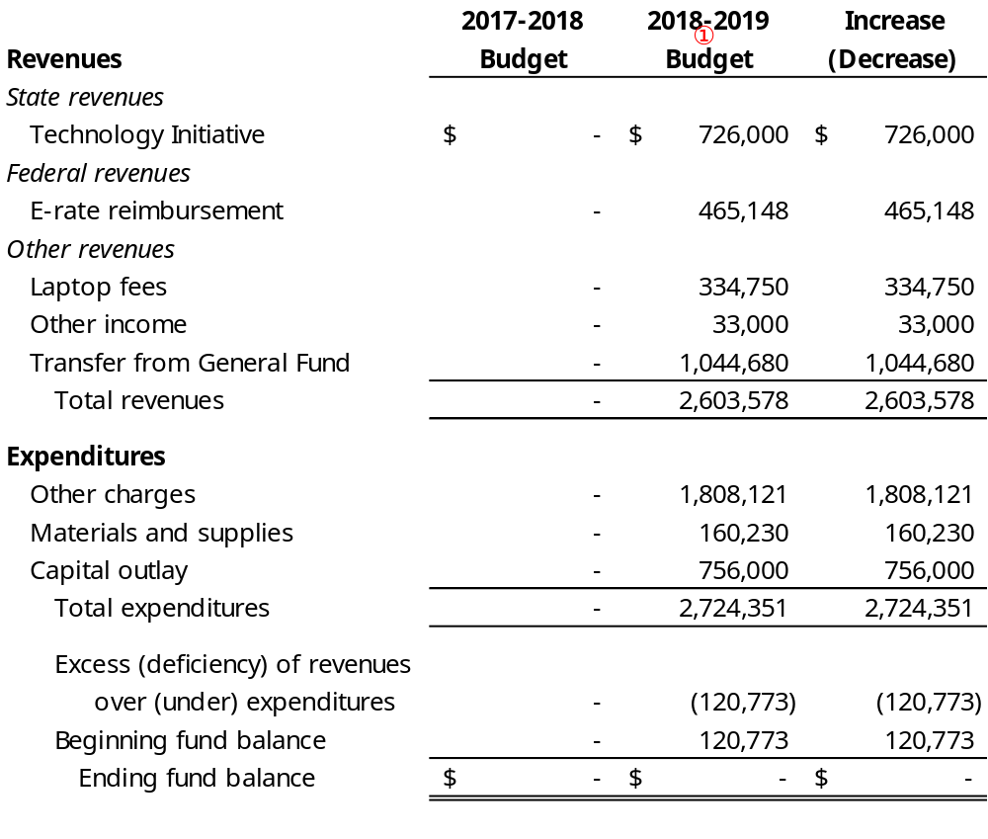
Technology Replacement Fund (new)
① During 2018-2019 the Technology Replacement Fund replaces the Laptop Insurance Fund.
No changes from February 8, 2018 Work Session

Slide 22
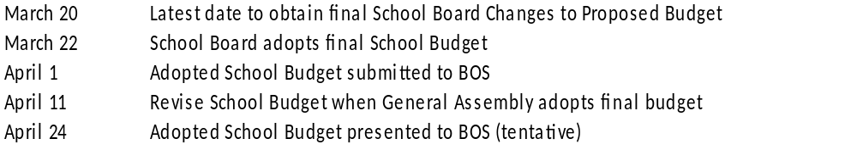
Next Steps for Staff and School Board
Obtain School Board recommended changes to the Superintendent’s Proposed Budget (March 15-20)
School Board adopts final School Budget based on Senate version (March 22)
School Board submits Adopted School Budget to Board of Supervisors (April 1)
School Board amends School Budget when General Assembly adopts final state budget (after April 11)
School Board presents Adopted School Budget and VPSA bond resolutions for Cave Spring High at Board of Supervisor Meeting (tentative work session with BOS on April 24)

Slide 23
Attachments
Bus, Capital, Technology, and Health Plans

Slide 24
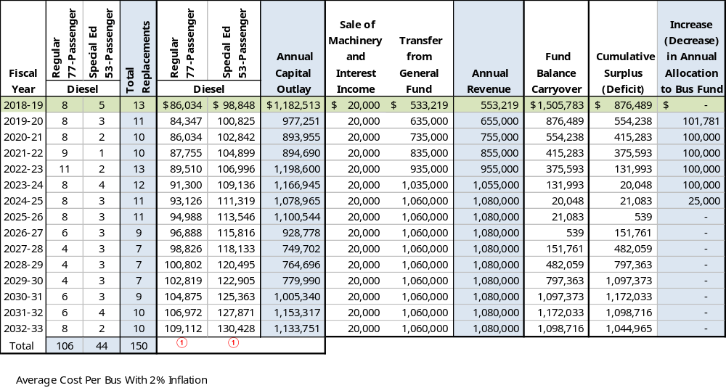
Bus Replacement Schedule

Slide 25
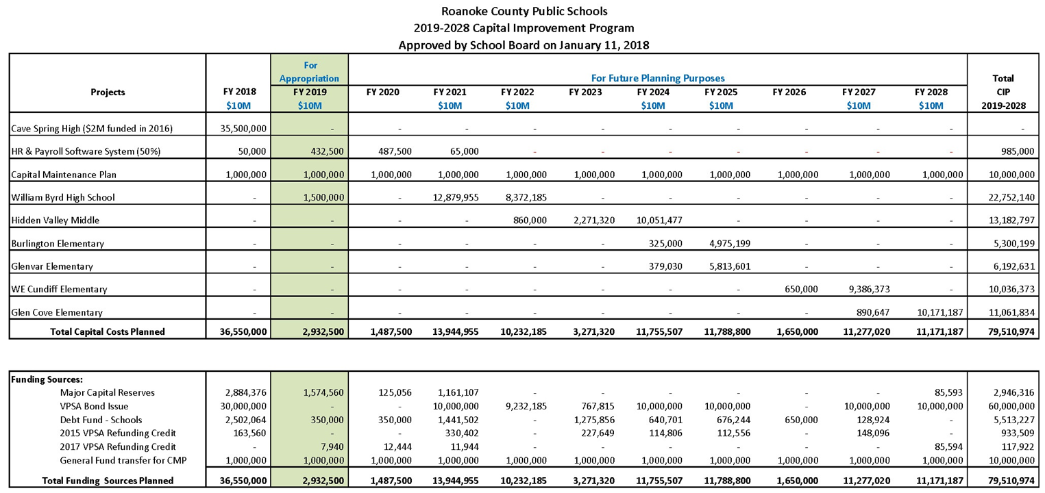
Capital Improvement Plan
The Capital Improvement Plan contains a 10-year plan for large major capital improvements that
will require a significant amount of resources to fund.

Slide 26
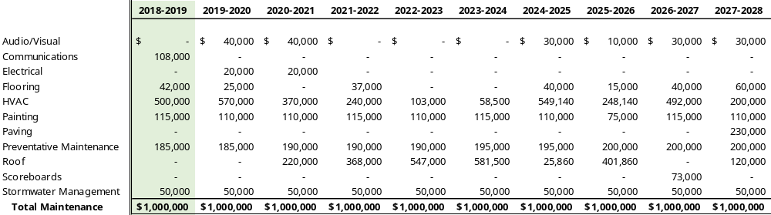
Capital Maintenance Plan
The Capital Maintenance Plan contains a 10-year plan for preventative maintenance projects to maintain the condition and longevity of school-owned buildings.
On January 14, 2016 the School Board established an annual transfer from the Operating Fund to the Minor Capital Fund of $1,000,000 to fund these on-going preventative maintenance needs. This is included as part of the Capital improvement Plan.

Slide 27
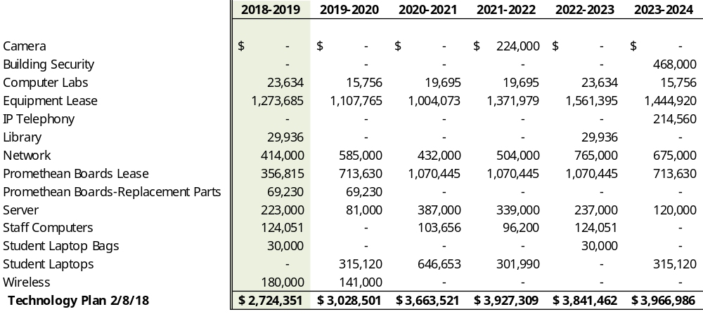
Technology Replacement Schedule

Slide 28
Health Insurance – Eliminate KC200
DRAFT RATES PRESENTED FOR APPROVAL ON 3/22/18
Roanoke County Schools
Health Insurance Renewal Rates - 12 Month Rates
2018-19 -- ELIMINATE KC200 PLAN
CURRENT RATES |  |  |  |  |  |  | RENEWAL RATES
 | Key Care 1000 Plan - WELLNESS |  |  |  |  |  |  | Key Care 1000 Plan - WELLNESS |  |  |  |  | Increase
 | Monthly | School | HRA | Employee | Employee |  |  | Monthly | School | HRA | Employee | Employee | (Decrease) |  | Per Check
Current 2017-18 | Premium | Benefit | Contribution | Rate | Pays |  | Renewal 2018-19 | Premium | Benefit | Contribution | Rate | Pays | Employee |  | 10 Months | 12 Months
Subscriber Only | 523.47 | 461.79 | 41.68 | 20.00 | 4% |  | Subscriber Only | 610.89 | 508.12 | 41.68 | 61.09 | 10% | 41.09 |  | 24.65 | 20.54
Subscriber + 1 minor | 708.65 | 426.88 | 83.34 | 198.43 | 28% |  | Subscriber + 1 minor | 826.99 | 495.56 | 83.34 | 248.10 | 30% | 49.67 |  | 29.80 | 24.83
Employee + Spouse | 1,070.42 | 623.14 | 83.34 | 363.94 | 34% |  | Employee + Spouse | 1,249.18 | 666.17 | 83.34 | 499.67 | 40% | 135.73 |  | 81.44 | 67.87
Family | 1,269.01 | 754.21 | 83.34 | 431.46 | 34% |  | Family | 1,480.93 | 805.22 | 83.34 | 592.37 | 40% | 160.91 |  | 96.55 | 80.46
 | Key Care 1000 Plan - NO WELLNESS |  |  |  |  |  |  | Key Care 1000 Plan - NO WELLNESS |  |  |  |  | Increase
 | Monthly | School | HRA | Employee | Employee |  |  | Monthly | School | HRA | Employee | Employee | (Decrease) |  | Per Check
Current 2017-18 | Premium | Benefit | Contribution | Rate | Pays |  | Renewal 2018-19 | Premium | Benefit | Contribution | Rate | Pays | Employee |  | 10 Months | 12 Months
Subscriber Only | 617.52 | 483.21 | 41.68 | 92.63 | 15% |  | Subscriber Only | 720.65 | 534.84 | 41.68 | 144.13 | 20% | 51.50 |  | 30.90 | 25.75
Subscriber + 1 minor | 850.66 | 486.6 | 83.34 | 280.72 | 33% |  | Subscriber + 1 minor | 992.72 | 512.29 | 83.34 | 397.09 | 40% | 116.37 |  | 69.82 | 58.18
Employee + Spouse | 1,212.55 | 644.19 | 83.34 | 485.02 | 40% |  | Employee + Spouse | 1,415.05 | 624.18 | 83.34 | 707.52 | 50% | 222.50 |  | 133.50 | 111.25
Family | 1,411.03 | 763.28 | 83.34 | 564.41 | 40% |  | Family | 1,646.67 | 740.00 | 83.34 | 823.34 | 50% | 258.93 |  | 155.36 | 129.46
 | Key Care 200 Plan - WELLNESS |  |  |  |  |  |  | Key Care 1000 Plan - WELLNESS |  |  |  |  | Increase
 | Monthly | School | HRA | Employee | Employee |  |  | Monthly | School | HRA | Employee | Employee | (Decrease) |  | Per Check
Current 2017-18 | Premium | Benefit | Contribution | Rate | Pays |  | Renewal 2018-19 | Premium | Benefit | Contribution | Rate | Pays | Employee |  | 10 Months | 12 Months
Subscriber Only | 627.70 | 520.03 | - | 107.67 | 17% |  | Subscriber Only | 610.89 | 508.12 | 41.68 | 61.09 | 10% | (46.58) |  | (27.95) | (23.29)
Subscriber + 1 minor | 886.35 | 565.81 | - | 320.54 | 36% |  | Subscriber + 1 minor | 826.99 | 495.56 | 83.34 | 248.10 | 30% | (72.44) |  | (43.46) | (36.22)
Employee + Spouse | 1,286.76 | 775.79 | - | 510.97 | 40% |  | Employee + Spouse | 1,249.18 | 666.17 | 83.34 | 499.67 | 40% | (11.30) |  | (6.78) | (5.65)
Family | 1,506.71 | 897.46 | - | 609.25 | 40% |  | Family | 1,480.93 | 805.22 | 83.34 | 592.37 | 40% | (16.88) |  | (10.13) | (8.44)
 | Key Care 200 Plan - NO WELLNESS |  |  |  |  |  |  | Key Care 1000 Plan - NO WELLNESS |  |  |  |  | Increase
 | Monthly | School | HRA | Employee | Employee |  |  | Monthly | School | HRA | Employee | Employee | (Decrease) |  | Per Check
Current 2017-18 | Premium | Benefit | Contribution | Rate | Pays |  | Renewal 2018-19 | Premium | Benefit | Contribution | Rate | Pays | Employee |  | 10 Months | 12 Months
Subscriber Only | 673.76 | 472.26 | - | 201.50 | 30% |  | Subscriber Only | 720.65 | 534.84 | 41.68 | 144.13 | 20% | (57.37) |  | (34.42) | (28.69)
Subscriber + 1 minor | 932.19 | 504.67 | - | 427.52 | 46% |  | Subscriber + 1 minor | 992.72 | 512.29 | 83.34 | 397.09 | 40% | (30.43) |  | (18.26) | (15.22)
Employee + Spouse | 1,332.82 | 709.69 | - | 623.13 | 47% |  | Employee + Spouse | 1,415.05 | 624.18 | 83.34 | 707.52 | 50% | 84.39 |  | 50.64 | 42.20
Family | 1,552.77 | 826.18 | - | 726.59 | 47% |  | Family | 1,646.67 | 740.00 | 83.34 | 823.34 | 50% | 96.75 |  | 58.05 | 48.37

Slide 29
Health Insurance – Other School Districts
Proposed FY18-19 rates for RCPS (12 month rates):
$61.09 Employee Only
$592.37 Employee plus Family
Notes:
Discuss how RCPS compares in the high deductible market and the low deductible market.
Understanding that the deductibles vary by district which also impacts the rate setting.
Show financial gap between what RCPS employees are paying and what neighboring school district employees are paying – reflects need for employee increase in share of premium.

Slide 30
Questions & Comments

