Slide 1
Roanoke County Schools
School Board Meeting
March 22, 2018
Proposed School Budget
for
2018-2019

Slide 2

Superintendent Comments

Slide 3
Budget Challenges and Priorities for 2018-2019
Budget Challenges:
Limited state revenue growth
Continued lack of state funding for teacher raises
  Only funded raise of 0.76% in the prior year (Feb 15, 2018-June 30, 2018)
Limited new funding from the County of Roanoke revenue sharing formula
Maintain integrity of market rated Compensation Plan for retention and recruitment of high quality school employees
Significant increase in employee health insurance claims
Disproportionate benefit funding for health coverage compared to other school districts
Equity in total compensation between pay and benefits
Budget Priorities:
Investment in sustainability (necessary, essential, mandatory)
Investment in our people
  Step increase on pay plan
  Health insurance premium increase
  Substitute pay increase
  Athletic supplement increase (Comp Plan Phase 2)
  Academic supplement increase (Comp Plan Phase 2)
CSHS staff positions during construction (dean, guidance, construction manager)

Slide 4
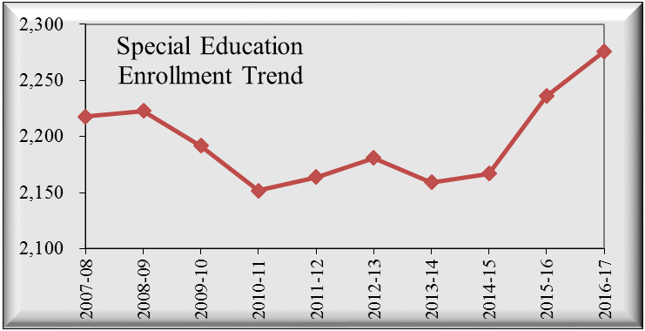
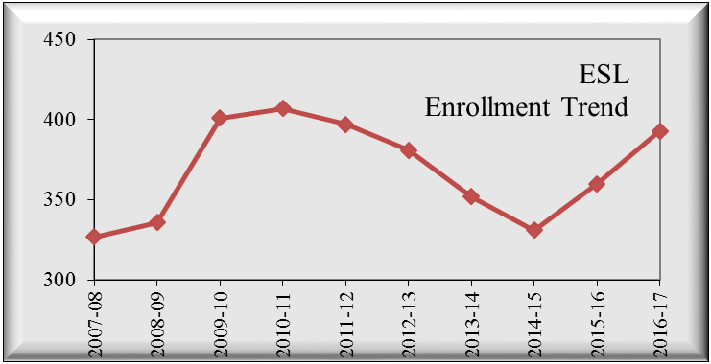
Student Enrollment (ADM)
ADM is average enrollment eligible for SOQ funding from 1st day of school through March 31st of each year.
2018-2019 Budgeted ADM = 13,700
Notes:
In a picture…. This is 25 years of history
Lowest in 1994-95 with 13,652 --- approaching that level again for 2018-19
Highest in 2007-08 with 14,802
Pace of decline seems to have slowed significantly

Slide 5
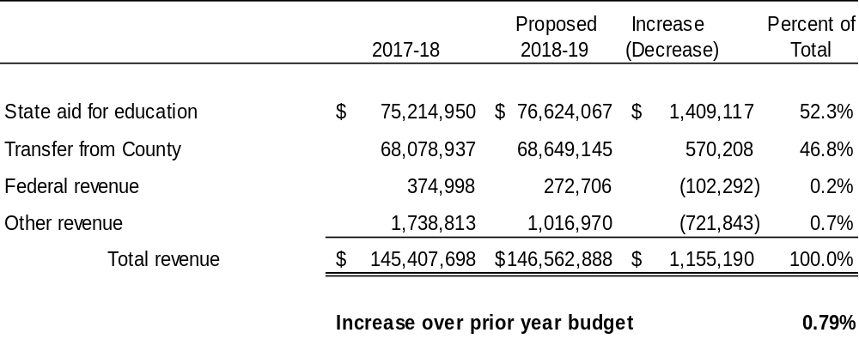
Total General Fund Revenue
This summary uses the Senate Budget which is the lowest of the Governor’s, House, and Senate budgets.

Slide 6
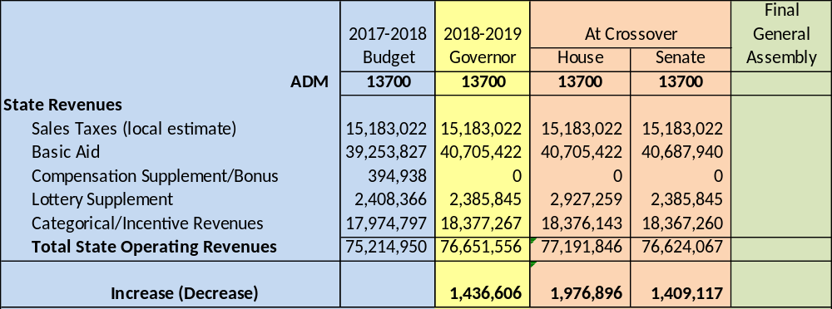

State Aid for Education - TBD
-- General Assembly adjourned on March 10, 2018 without adopting state budget –
-- General Assembly Special Session scheduled for April 11th –
House and Senate budget bills are technically dead.
Governor will submit a new budget bill and General Assembly will amend.
Likely to be similar to amendments in House and Senate budgets.
Proposed Budget uses lowest of 3 General Assembly budgets submitted to date.

Slide 7
Proposed Transfer from County of Roanoke
 |  |  |  | 2017-2018 |  | 2018-2019
Property and Local Taxes |  |  |  | 163,210,385 |  | 166,146,122
Adjustments:
Lodging Tax-Roanoke Valley Convention and Visitors Bureau |  |  |  | (514,894) |  | (585,686)
New Treasurer Position for Delinquent Tax Collection |  |  |  | - |  | (42,473)
Increase in CSA Costs |  |  |  | (660,000) |  | (1,935,000)
Economic Development (William Byrd Apartments) |  |  |  | - |  | (100,000)
Economic Development (Roland E Cook Apartments) |  |  |  | - |  | (15,000)
Economic Development Incentive (South Peak CDA) |  |  |  | (560,000) |  | (635,000)
Economic Development Incentive (Allstate) |  |  |  | (150,000) |  | -
Economic Development Incentive (Ardagh) |  |  |  | (650,000) |  | -
Net total taxes |  |  |  | $ 160,675,491 |  | $ 162,832,963 | $ 2,157,472
Portion allocated to Roanoke County Schools for 2018-19 |  |  |  |  |  |  | $ 570,208
Total Transfer from County of Roanoke for 2018-19 |  |  |  |  |  |  | $ 68,649,145

Slide 8
Compensation Philosophy
Recruitment and retention of high quality employees
Internal equity and market comparability
Compensation consistent with fiscal constraints
Balance total compensation between pay and benefits

Slide 9
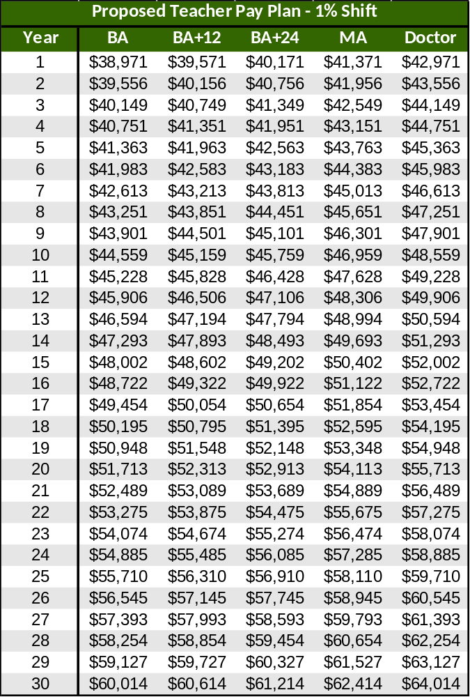
Investment in Our People - Salaries
  Proposed Budget for 2018-2019 includes the following:
  One-step increase on Pay Plan for all employees,
  1% shift in Teacher Scale only,
  1% stipend increase in salary (exclusive of degree supplements) for Teachers over step 30.
Cost of Step Increase for all Employees | $1,583,000
Cost of 1% COLA shift in Teacher Scale only – this will move the entire scale and increase the minimum and maximum salary on the teacher scale (1086 teachers) without adding a step. | $643,764
Cost of 1% stipend for Teachers above step 30 – this will increase the salaries for teachers who are beyond the top of the teacher scale (63 teachers) with a one-time stipend. | $43,921

Slide 10
Investment in Our People – Substitutes
  Proposed Budget for 2018-2019 includes the following:
  Allow teaching substitutes with high school degrees (expands available pool)
  Create rate differential between 4-year degrees and less than 4-year degreed teacher substitutes
  Increase in substitute rates for the following:
Types of Substitutes | Current Rate | Proposed Rate
Teacher with high school/associates degree | $80 day | $80 day
Teacher with 4-year degree | $80 day | $100 day
IA without degree – Elementary | $54 day | $64 day
IA without degree – Secondary | $58 day | $68 day
IA with degree – Elementary | $67.50 day | $75 day
IA with degree – Secondary | $72.50 day | $82 day
Nurse | $80 day | $100 day
Administrative Assistant | $8 hour | $10 hour

Slide 11
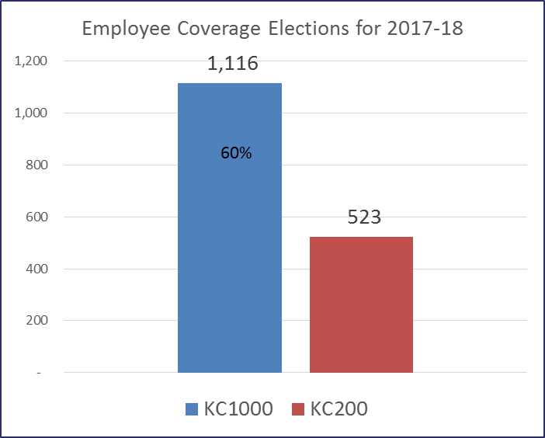
Health Insurance Proposal for 2018-2019
  Eliminate KC200 Plan ($200 deductible)
  Retain KC1000 Plan ($1000 deductible with $500/$1000 cash HRA)
  Employee pays portion of KC1000 total premium as follows:
    10% of employee only (up from 4%)
    30% of employee plus one child (up from 28%)
    40% of employee plus spouse (up from 34%)
    40% of family (up from 34%)
  Employee pays more if electing not to participate in the wellness program
  Budget impact = $666,635
  ($1,099,503 if retain KC200 plan)
443 enrollees moved from KC200 to KC1000 (46% of KC200) in 2017-18
Notes:
Cost is $1,035,000 for renewal based on following assumptions:
13.3% increase (no margin)
Increase EE only rate from $20 to $30
Retain EE share of other coverage levels at same percent as last year
Retaining both KC200 and KC1000 plans

Slide 12
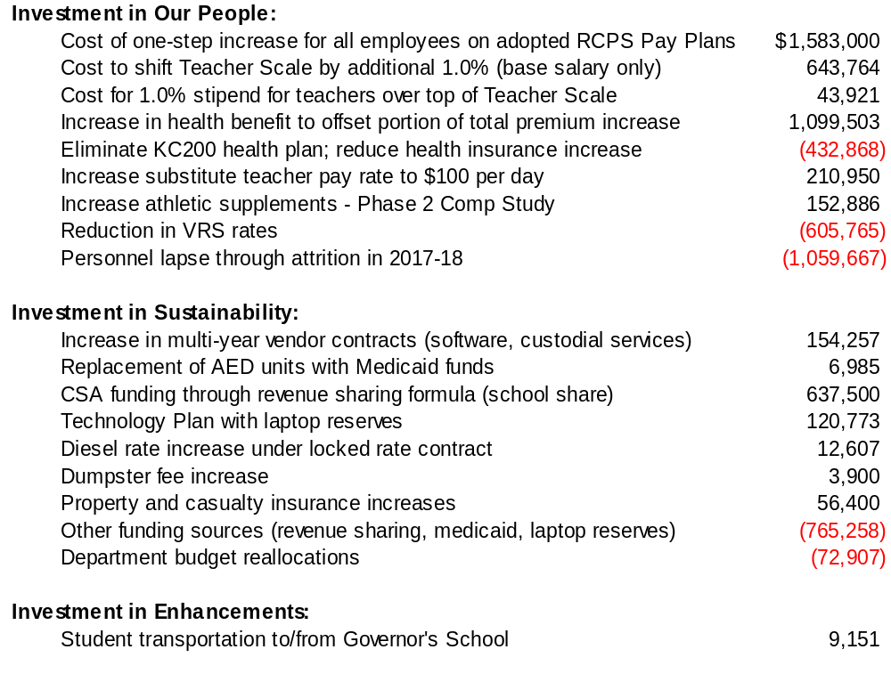
What’s Included in the Proposed 2018-2019 Budget

Slide 13
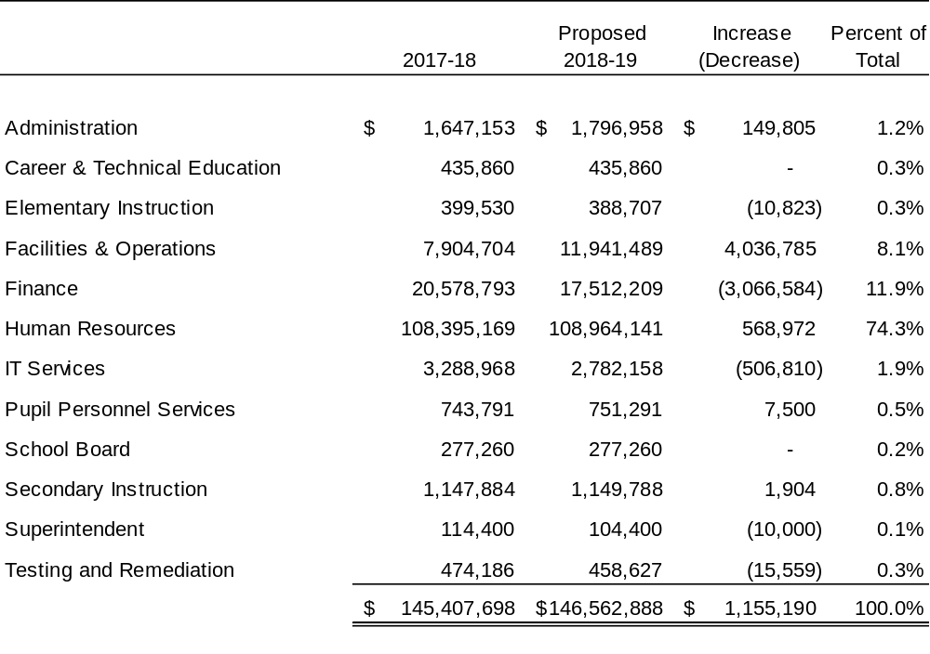
Total General Fund Expenditures

Slide 14
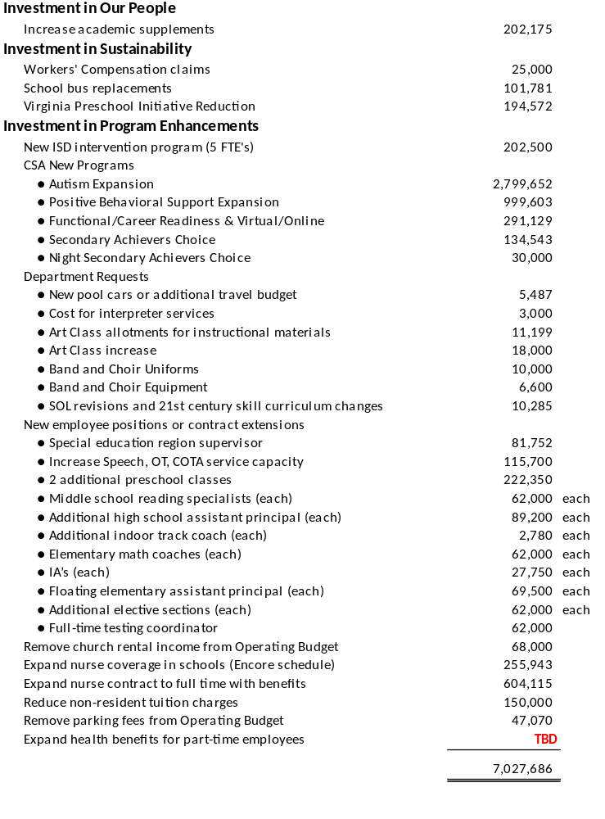
Unfunded Requests – Future Budgets
Superintendent’s Recommended Budget Addback Priorities:
Academic supplements – Phase 2 | $202,175
Increase speech/OT service capacity | $115,700
Additional IA positions | $27,750 each
CSA – Secondary Achievers Choice | $134,543
CSA – Night Secondary Achievers Choice | $30,000

Slide 15
Other Fund Budgets
Self-balancing funds other than the General Fund which maintain year-end fund balances for multi-year expenditures.

Slide 16
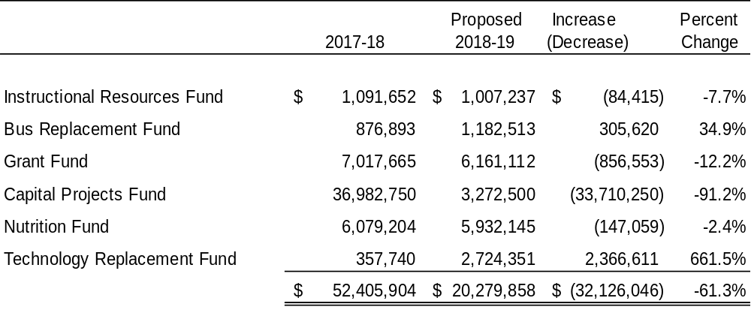
Other Fund Budgets
Notes:
Bus Fund – increase based on scheduled bus replacements (age and mileage)
Capital Projects Fund – p/y included funding for CSHS project; no big capital project to begin in FY18-19
Tech Fund – collapsed funding from general fund (e-rate and student laptop fee) into new fund for tech replacement plan

Slide 17
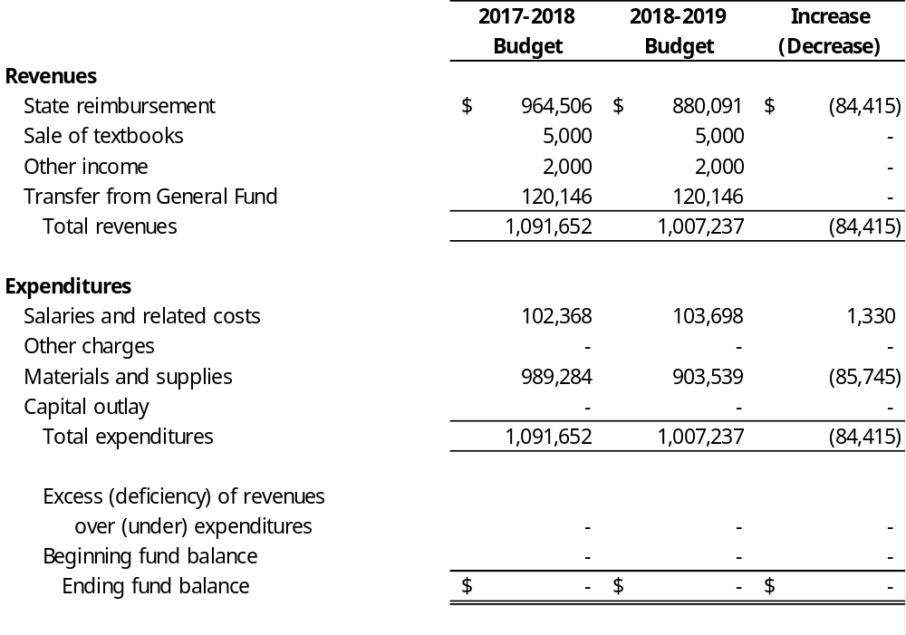
Instructional Resources Fund

Slide 18
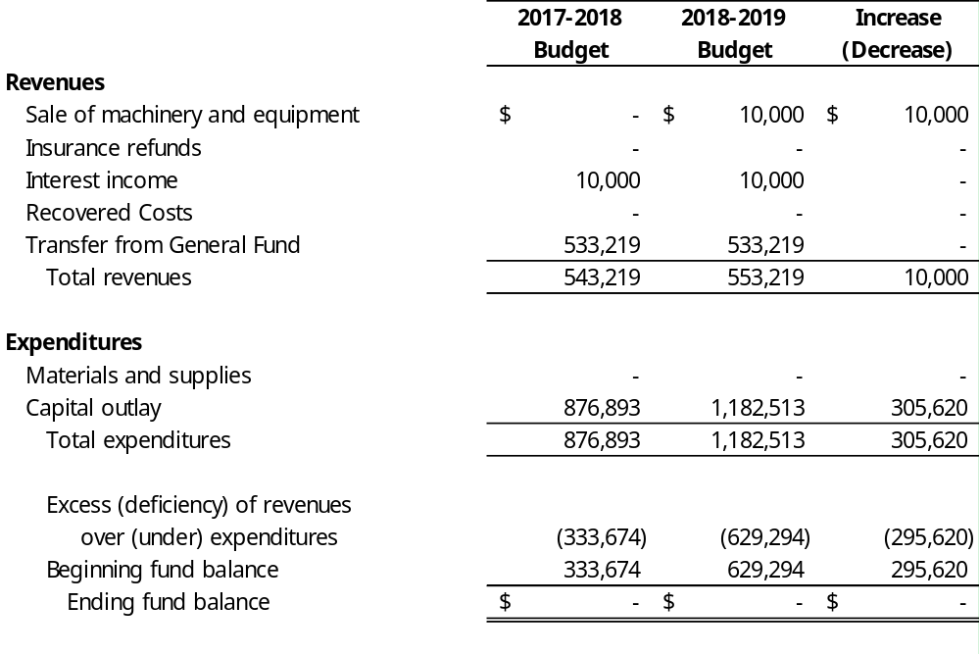
Bus Replacement Fund

Slide 19
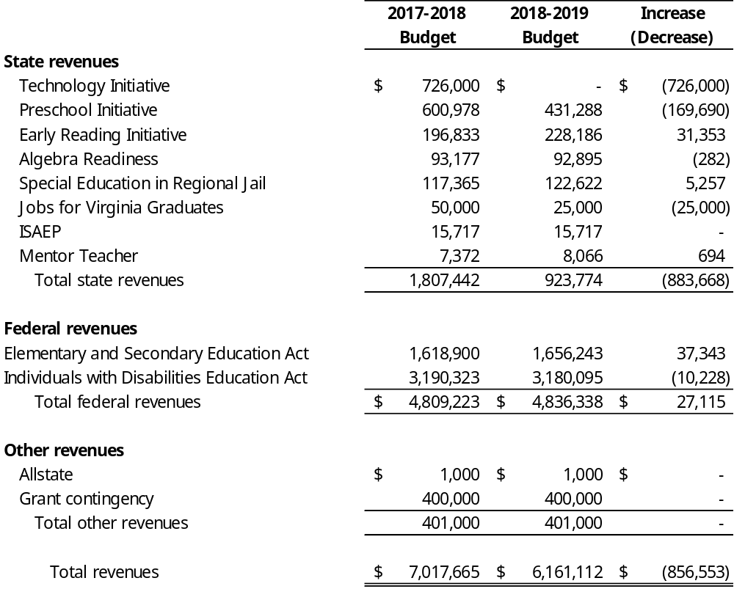
Grant Fund

Slide 20
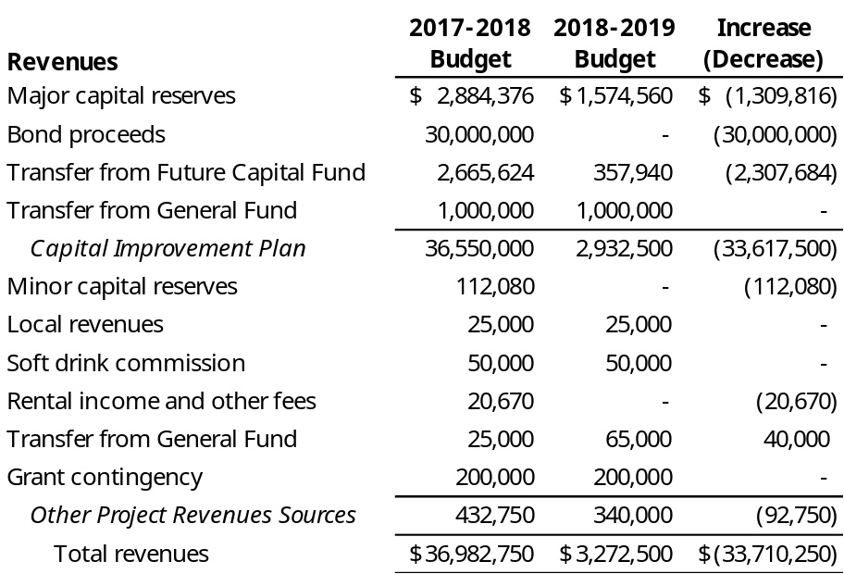
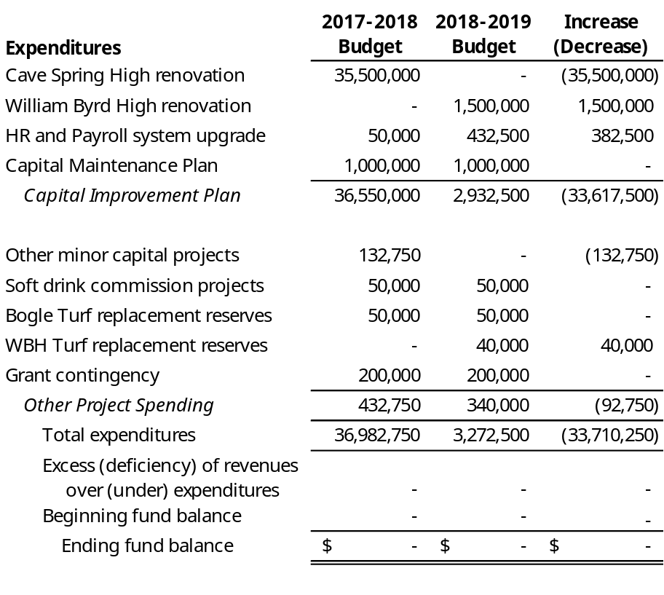
Capital Projects Fund

Slide 21
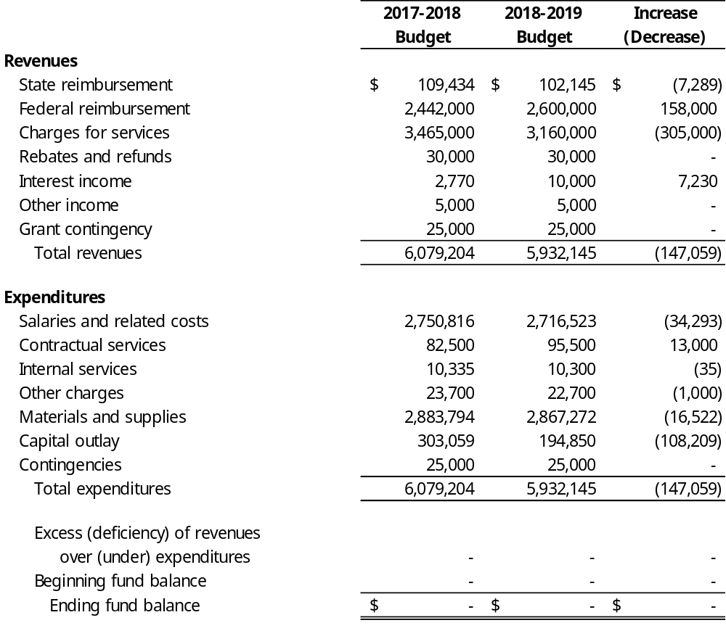
Nutrition Fund

Slide 22
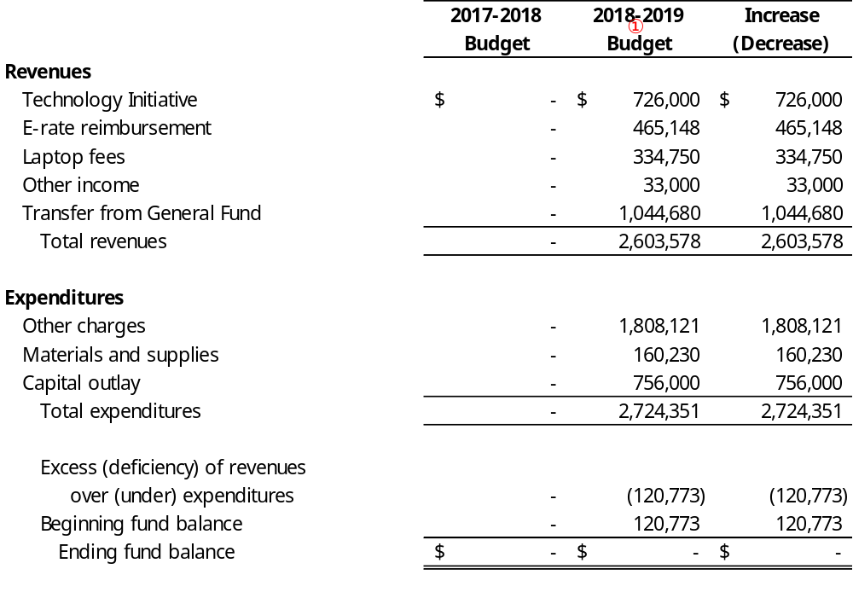
Technology Replacement Fund (new)
① During 2018-2019 the Technology Replacement Fund replaces the Laptop Insurance Fund.

Slide 23
Attachments
Replacement Plans – Buses, Capital, and Technology
Employee Insurance Renewal Rates & Local Comparison
Nutrition Fund Rates

Slide 24
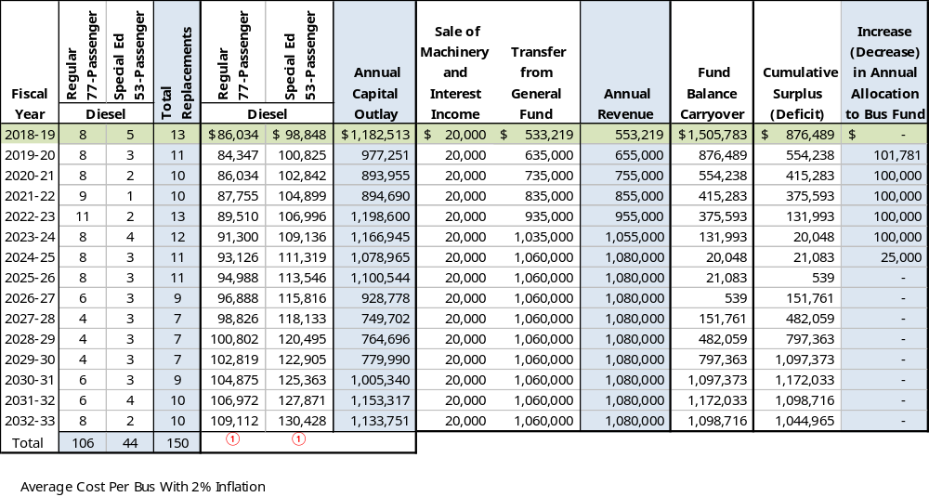
Bus Replacement Schedule

Slide 25
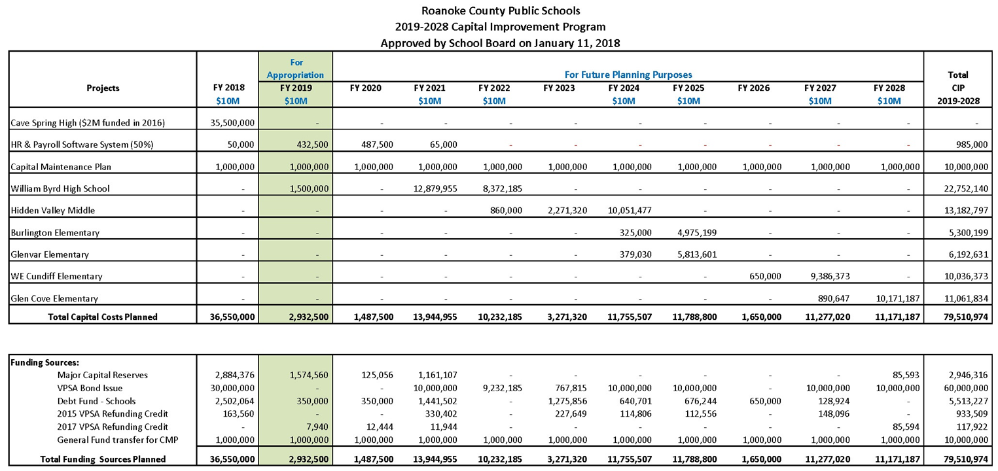
Capital Improvement Plan
The Capital Improvement Plan contains a 10-year plan for large major capital improvements that
will require a significant amount of resources to fund.

Slide 26
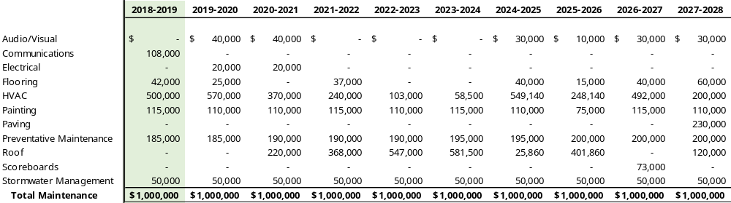
Capital Maintenance Plan
The Capital Maintenance Plan contains a 10-year plan for preventative maintenance projects to maintain the condition and longevity of school-owned buildings.
On January 14, 2016 the School Board established an annual transfer from the Operating Fund to the Minor Capital Fund of $1,000,000 to fund these on-going preventative maintenance needs. This is included as part of the Capital improvement Plan.

Slide 27
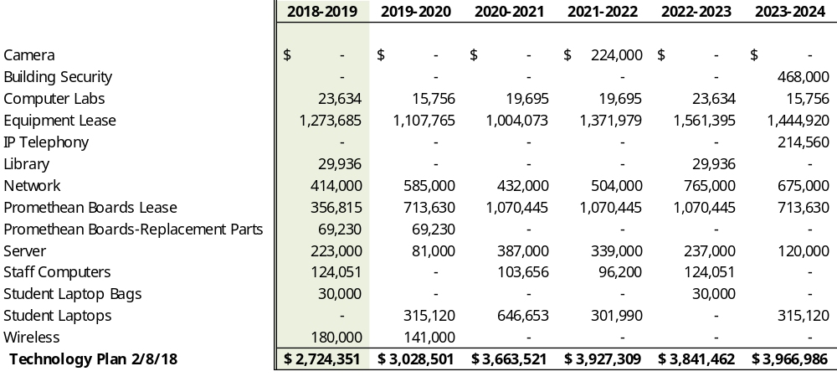
Technology Replacement Schedule

Slide 28
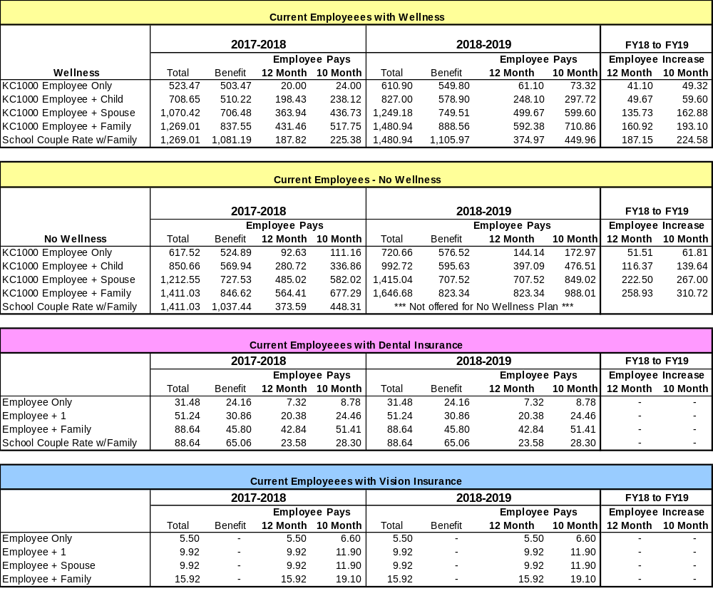
Health Insurance – Proposed Rates for 2018-2019

Slide 29
Health Insurance – Other School Districts
Proposed 2018-2019 rates for RCPS (12 month rates):
$61.09 Employee Only
$592.37 Employee plus Family

Slide 30
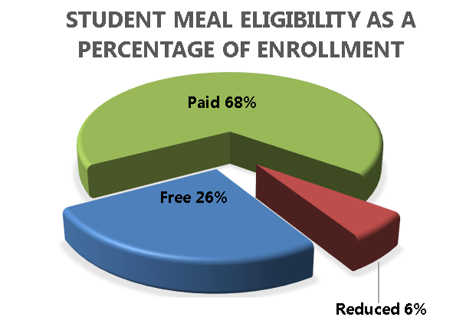
Nutrition Fund Rates
Student Meal Prices
Federal and State Reimbursement Rates
 | Breakfast | Elementary Lunch | Secondary Lunch
2010 | $1.00 | $2.00 | $2.00
2011 | 1.00 | 2.00 | 2.00
2012 | 1.00 | 2.05 | 2.05
2013 | 1.00 | 2.15 | 2.15
2014 | 1.10 | 2.25 | 2.25
2015 | 1.15 | 2.35 | 2.35
2016 | 1.25 | 2.35 | 2.60
2017 | 1.25 | 2.45 | 2.70
2018 | 1.35 | 2.55 | 2.80
2019* | 1.45 | 2.65 | 2.90
Reduced | $0.30 | $0.40 | $0.40
 | Breakfast | Lunch
Federal Paid | $ 0.30 | $ 0.31
Federal Reduced | 1.45 | 2.83
Federal Free | 1.75 | 3.29
State Lunch | N/A | 0.05

Slide 31
Recommendation to Adopt
School Budget for 2018-2019

Slide 32
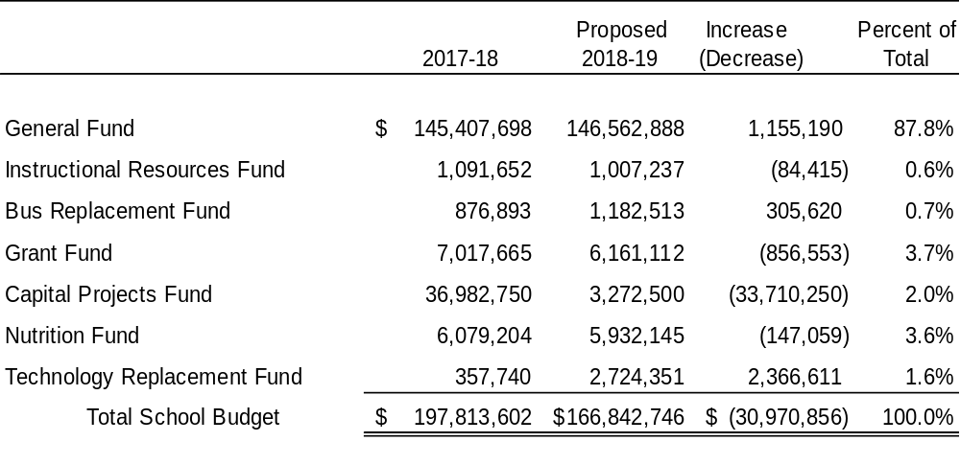
Total Budget – All School Funds

Slide 33
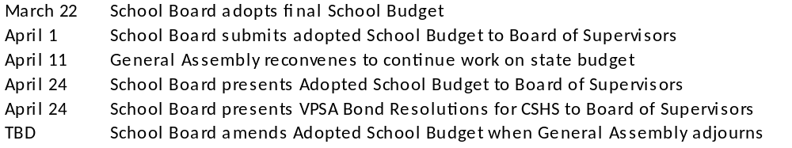
Next Steps

