Slide 1
Study Skills
Presented by
RVGS Counseling
Kathy Sebolt

Slide 2
Study Tips for Students
Use your planner
Make a “to do” list every day
Use spare minutes wisely
It’s okay to say “No”
Find the time of day you do your best work and are most alert
Review notes daily
Get a good night’s sleep
Communicate your schedule to family and friends
Become a task master
Eat healthy and exercise

Slide 3

Note taking
Stay Organized
  Keep all notes for one class in one place
  Date and number pages to keep them in order
  Review materials/notes before class
  During class:
  Write down main points only, not every word
  Leave blanks so you can add to notes later
  Jot down key vocabulary and important facts
  Ask questions

Slide 4
Study tips
Testing or quizzing yourself is key to learning – flashcards can help
Giving your brain time to forget the information will make the act of studying more effortful and will help the information stick longer in your memory
Studying a little every day will give your brain the time it needs to forget between study sessions
Just because you seem to know something doesn’t mean you should stop reviewing it….circle back to it along with the other material
Learning isn’t supposed to be easy or comfortable….and rereading and recognizing isn’t the same as knowing and remembering

Slide 5

Preparing Emotionally and Physically for tests
The most important equipment you have:
  Your body
  Your mind

Slide 6
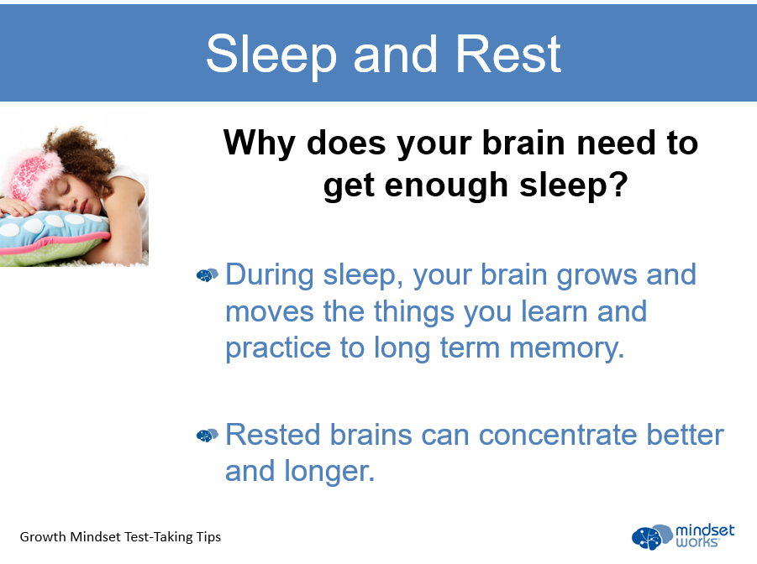

Slide 7
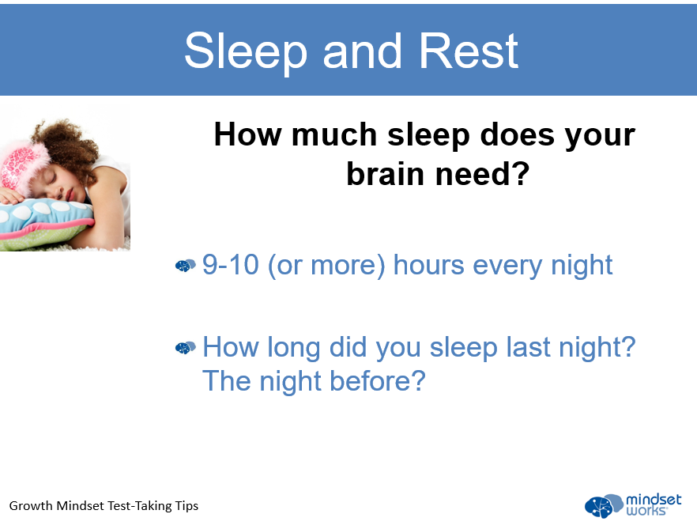

Slide 8
What can you do on test day?
Get a good night’s sleep
Wake up early
Simple exercise and a shower will help wake you up
Eat a healthy breakfast – avoid too much caffeine
Briefly review your notes
Keep a positive attitude
Be early – you don’t want to have to rush
Deal with any test anxiety – breathe, relax, focus

Slide 9

THANK YOU
For more information or help, please see Mrs. Sebolt

