Slide 1
Puberty Education

Slide 2
Puberty
Time of growth and change
9 - 16 years of age for girls
Glands in the body start making hormones
Hormones cause
  Body changes
  Ups and downs of feelings
Notes:
TEACHER SCRIPT:
Puberty is a time of growth and change. It can start anytime between the ages of 9 and 16 for girls and 10 and 17 for boys. During puberty the glands in the body start making hormones that cause many changes. The body begins to grow and mature, your emotions have a tendency to go up and down, and young people may begin to have sexual feelings.
ACOG Adolescent Sexuality, 4th ed.

Slide 3
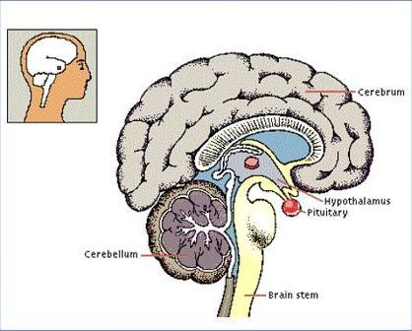
The Hypothalamus &
Pituitary Gland
These areas of the brain begin all the changes!
Notes:
TEACHER SCRIPT:
During puberty the hypothalamus in the brain releases substances called hormones that travel to the pituitary gland. The pituitary gland at the bottom of the brain releases other hormones that travel through the blood and signal the reproductive glands (ovaries & testicles) to begin making what we call the sex hormones (estrogen & testosterone).

Slide 4

In Females
Growth spurt
Adult height
Weight gain
Pubic hair appears
Armpit hair grows
Acne can appear
Body Odor
Breast begin to appear and mature
Emotional changes
Periods begin
Notes:
TEACHER SCRIPT:
These are all changes that happen during puberty in girls. Notice that many of the changes are the same for both boys and girls. Once again, when these changes begin and how quickly and to what extent they develop depends on when hormones from the brain, pituitary gland, ovaries, and other glands in the body begin to be released. These changes are also directed by our genetics which come from our parents’ genes. Our genetic code directs all the actions in our body, including the changes of puberty.

Slide 5
Menstruation or Periods
A period happens because of changes in hormones in the body.
Hormones are chemical messengers.
The ovaries release the female hormones estrogen and progesterone .
These hormones cause the lining of the uterus (or womb) to build up.
The built-up lining is ready for a fertilized egg to attach to and start developing.
If there is no fertilized egg, the lining breaks down and bleeds.
Then the same process happens all over again.
It usually takes about a month for the lining to build up, then break down. That is why most girls and women get their periods around once a month.
Notes:
TEACHER SCRIPT:
The female hormones, estrogen and progesterone made by the ovaries, prepare the lining of the uterus for pregnancy. The lining of the uterus thickens and is rich in nutrients and blood vessels necessary to nourish the baby and to provide oxygen at the very beginning of pregnancy. When pregnancy does not occur, the lining of the uterus is not needed and is shed—this is referred to as menstruation or “having a period.” The lining is composed of blood and tissue and passes from the uterus, through the cervix and vagina to the outside of the body. Tampons (inserted in the vagina) or sanitary pads (attached to underwear) are used to absorb this material. Menstruation for most females is about once a month. When young ladies begin having a period, their cycle is usually not very regular. A girl could have her period and then not have it again for several months. Some females will not have any problems with their period while others may experience cramps, heavy bleeding, headaches, or moodiness.
If pregnancy does occur that month because an egg and sperm unite after vaginal intercourse, the fertilized egg will implant on the uterine lining and it will not be shed that month (i.e. you will not have a period because this lining is needed to nourish the baby). If you are having sex and miss a period, you could be pregnant.

Slide 6
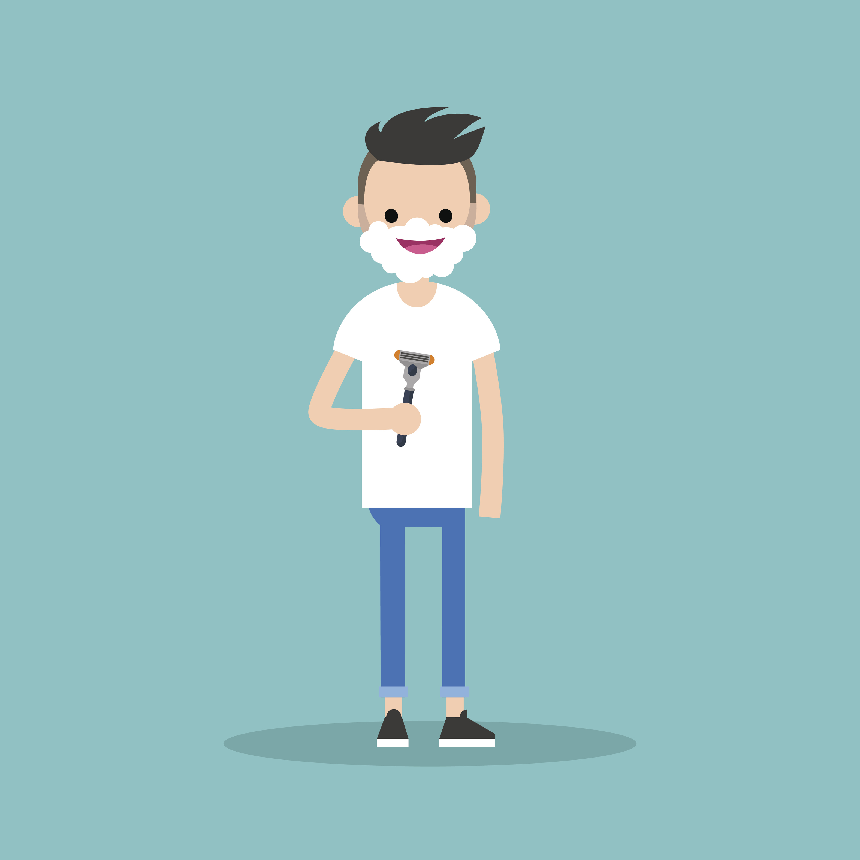
Body Hair
During puberty there are usually changes to body hair that include:
arm and leg hair growing and thickening
pubic hair growing
Body hair is completely natural and normal and serves a number of body functions.
Some people choose to remove some or all of their body hair in places that is unwanted. Hair can be removed using a number of methods, such as: shaving, waxing, hair removal creams, plucking, trimming, threading and lasering.

Slide 7
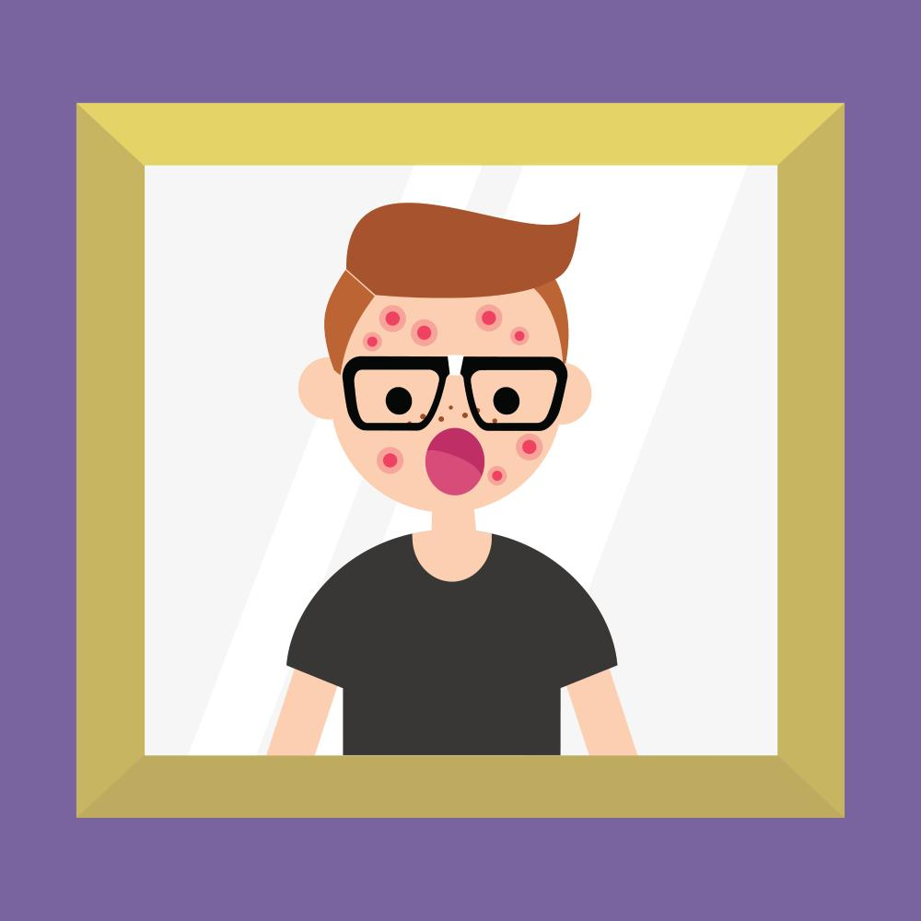
Skin Changes, Pimples and Acne
Puberty increases the production of oils in the skin which can cause pimples.
Some young people going through puberty can get acne.
There are a number of treatment options available, so students should seek advice if they find their experiences with acne to be a problem.

Slide 8
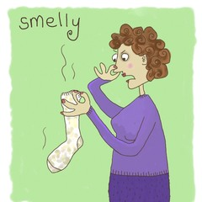
Potential Body Odor
Many young people going through puberty find they produce more oil and sweat than when they were younger.
To prevent body odor, washing and using deodorants, antiperspirants and wearing clean clothes is recommended.
There are certain areas of the body that contain more sweat glands than others - under arms, groin, feet. These areas are also often hidden away from the air which allows bacteria to grow more easily. Washing these areas of the body more frequently is required.
Exercise and hot weather also increase sweating and the potential for body odor, so washing more often during these times is important!

Slide 9
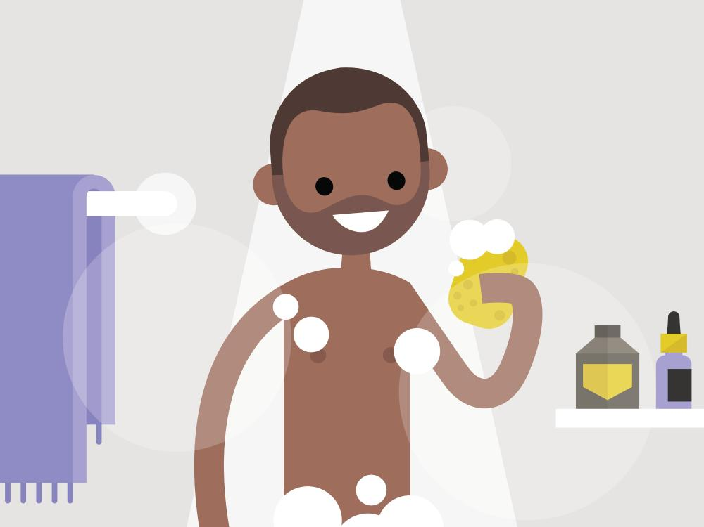
Bathing and showering
Bathing, washing or showering is important on a daily basis to remove dirt, sweat and odor from the skin's surface.
Using a cleansing agent/body wash/soap to clean the skin assists with keeping excess skin oils under control.
Rinse the skin well from cleansing agents/body wash/soap to prevent irritation before drying the skin.
Use clean towels to dry the skin, pay attention to drying skin creases e.g. under arms, feet, between toes and groin areas.
Brush, and wash hair regularly with shampoo and a conditioner to keep it clean and oil free.

Slide 10
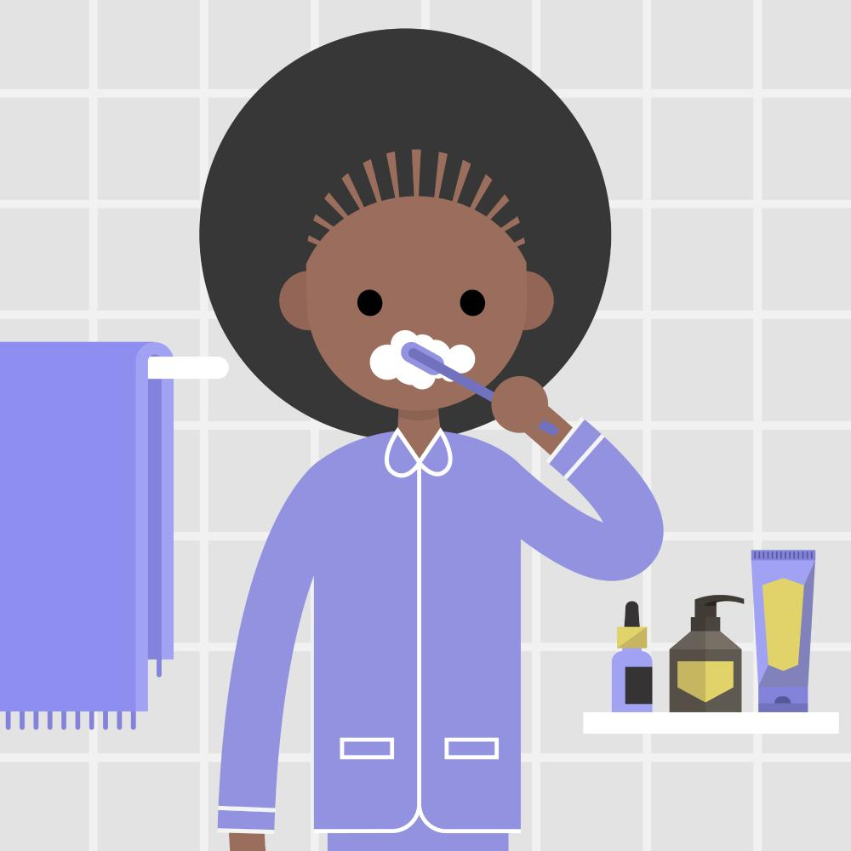
Oral Hygiene
Good oral hygiene practices should be part of everyday life.
Brush teeth, gums and tongue twice daily - morning and evening after eating to maintain healthy teeth and mouth.
Drink plenty of fresh water daily.
Floss teeth regularly to reduce the debris between teeth and gums.
Mouth wash may be used to rinse after brushing/flossing teeth.
Visit the dentist regularly for check-ups to maintain healthy teeth, gums and mouth.

Slide 11

Eat well-balanced diet
Drink plenty of water
Get rest and relaxation
Exercise regularly
Maintain appropriate personal hygiene.

