Slide 1
Puberty Education

Slide 2
Puberty
Time of growth and change
10 - 17 years of age for boys
Glands in the body start making hormones
Hormones cause
  Body changes
  Ups and downs of feelings
Notes:
TEACHER SCRIPT:
Puberty is a time of growth and change. It can start anytime between the ages of 9 and 16 for girls and 10 and 17 for boys. During puberty the glands in the body start making hormones that cause many changes. The body begins to grow and mature, your emotions have a tendency to go up and down, and young people may begin to have sexual feelings.
ACOG Adolescent Sexuality, 4th ed.

Slide 3
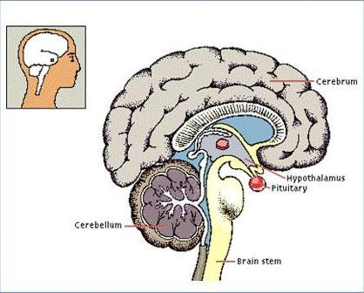
The Hypothalamus &
Pituitary Gland
These areas of the brain begin all the changes!
Notes:
TEACHER SCRIPT:
During puberty the hypothalamus in the brain releases substances called hormones that travel to the pituitary gland. The pituitary gland at the bottom of the brain releases other hormones that travel through the blood and signal the reproductive glands (ovaries & testicles) to begin making what we call the sex hormones (estrogen & testosterone).

Slide 4

In Males
Growth spurt
Weight gain
Facial hair
Armpit Hair
Body Hair
Pubic Hair
Emotional changes
Voice changes
Acne
Testicles grow
Penis & scrotum grow
Ejaculations/Wet Dreams
Notes:
TEACHER SCRIPT:
These are all changes that happen during puberty in boys because of the many hormones being released including growth hormone and testosterone. Some are physical and some are emotional. It is easy to understand hair growth and voice changes, whereas, emotional ups and downs are more difficult to understand. When these many changes occur, how fast they take place, and the degree of the change (ex. how tall you will be) depends on many factors including hormone production from the brain, pituitary gland, testicles, and other glands, and genetics (i.e. your family characteristics).

Slide 5
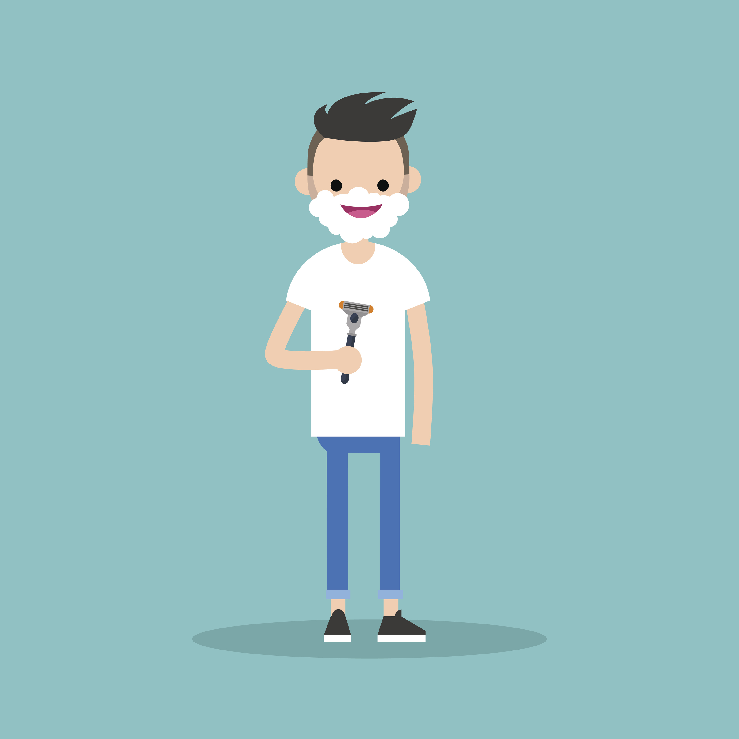
Body Hair
During puberty there are usually changes to body hair that include:
arm and leg hair growing and thickening
pubic hair growing
hair on growing on the chest and face
Body hair is completely natural and normal and serves a number of body functions.
Some people choose to remove some or all of their body hair in places that is unwanted. Hair can be removed using a number of methods, such as: shaving, waxing, hair removal creams, plucking, trimming, threading and lasering.

Slide 6
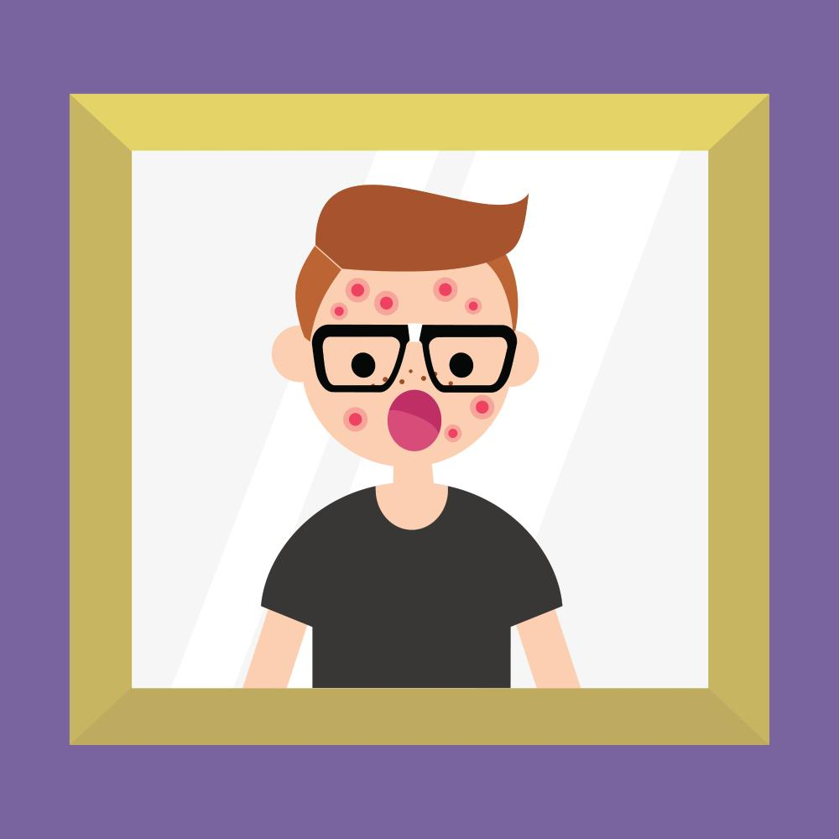
Skin Changes, Pimples and Acne
Puberty increases the production of oils in the skin which can cause pimples.
Some young people going through puberty can get acne.
There are a number of treatment options available, so students should seek advice if they find their experiences with acne to be a problem.

Slide 7
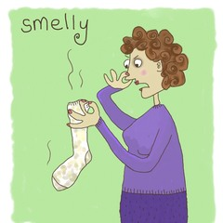
Potential Body Odor
Many young people going through puberty find they produce more oil and sweat than when they were younger.
To prevent body odor, washing and using deodorants, antiperspirants and wearing clean clothes is recommended.
There are certain areas of the body that contain more sweat glands than others - under arms, groin, feet. These areas are also often hidden away from the air which allows bacteria to grow more easily. Washing these areas of the body more frequently is required.
Exercise and hot weather also increase sweating and the potential for body odor, so washing more often during these times is important!

Slide 8
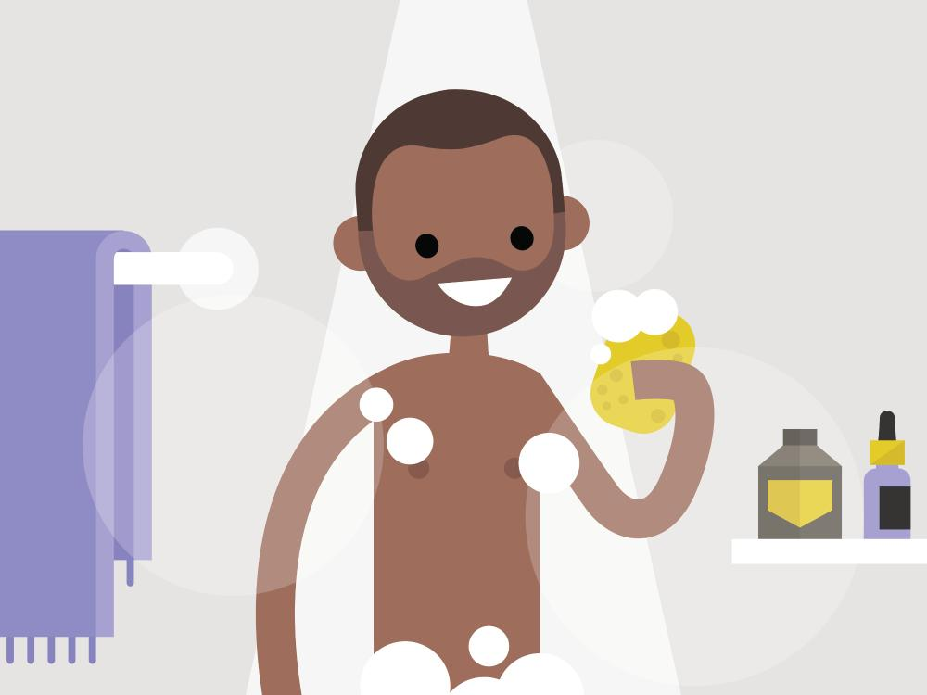
Bathing and showering
Bathing, washing or showering is important on a daily basis to remove dirt, sweat and odor from the skin's surface.
Using a cleansing agent/body wash/soap to clean the skin assists with keeping excess skin oils under control.
Rinse the skin well from cleansing agents/body wash/soap to prevent irritation before drying the skin.
Use clean towels to dry the skin, pay attention to drying skin creases e.g. under arms, feet, between toes and groin areas.
Brush, and wash hair regularly with shampoo and a conditioner to keep it clean and oil free.

Slide 9
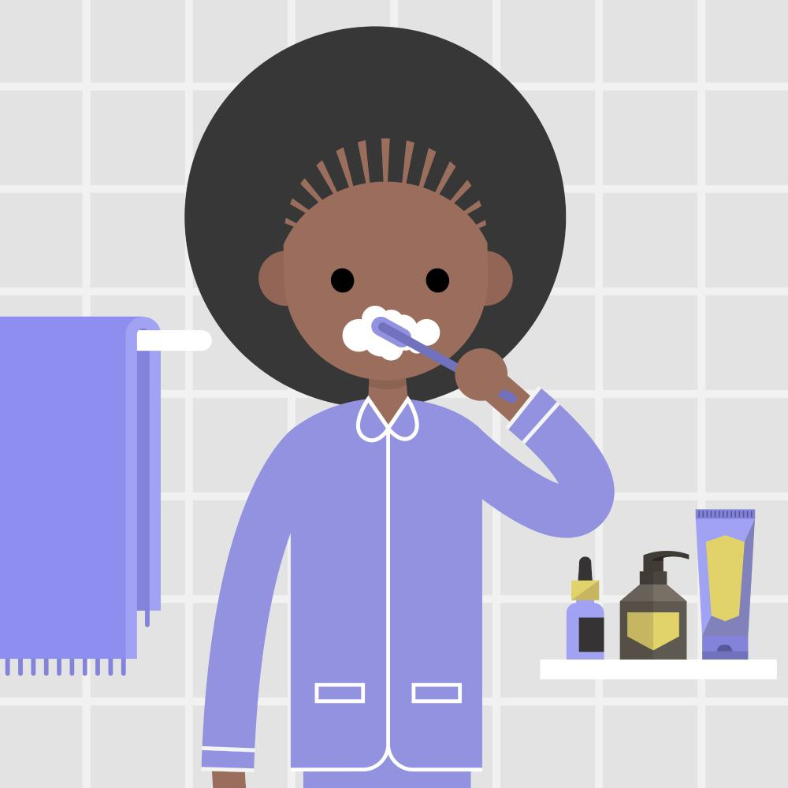
Oral Hygiene
Good oral hygiene practices should be part of everyday life.
Brush teeth, gums and tongue twice daily - morning and evening after eating to maintain healthy teeth and mouth.
Drink plenty of fresh water daily.
Floss teeth regularly to reduce the debris between teeth and gums.
Mouth wash may be used to rinse after brushing/flossing teeth.
Visit the dentist regularly for check-ups to maintain healthy teeth, gums and mouth.

Slide 10

Eat well-balanced diet
Drink plenty of water
Get rest and relaxation
Exercise regularly
Maintain appropriate personal hygiene.

