Slide 1

Academic Behavior intervention team
Overview
jpschools.org

Slide 2
Academic Behavior Intervention
Team (a/BIT) is Defined as:
Team of educators that apply a Multi-Tier System of Support in areas of Academics (RTI) and Behavior (SWPBIS)

Slide 3

A/BIT MEMBERS
(Tier II & III)
Principal or representative
504 Coordinator
Member of SWPBIS Team
Early Interventionist or Counselor
General Education Teacher
Parent
( Tier III )
Speech Therapist
SPED Social Worker
ELL Representative
SPOE – Pupil Appraisal

Slide 4
RESPONSIBILITY OF THE A/BIT
Minutes
A/BIT Log completed
Parent notification
Scheduling of Meetings
Collection & Reviews of Data
Ensure Tier III request form is completed
SPOE- Attends Tier III and IV

Slide 5
A/BIT LOG
Information collected by the school biased personnel
( a/bit chair)
A/BIT School LOG
Name of School: |  |  |  | Date: |  |  |  | Name of A/BIT Leader
A 1 – Teacher/ School Personnel | 2-Parent |  | 3-Courts |  | 4-Other: |  | Name of PA Representative:
*B 1 – No further action | 2- Intervention Tier II/ Tier III |  |  | 3-Refer to 504 |  | 4 – Refer to PA for support service |  |  | 5- Refer for Evaluation |  | 6- Team refuses to evaluate |  |  |  |  | 7-Other
Student's Name | Date of A/BIT | Grade | Referral Source*A | Reason for Referral | Decision | Parent in attendance | # ODRs | # OSS | Absents | Grade(s)Retained | Math: LEAP /iLEAP | ELA: LEAP /iLEAP | i Ready ELA | I Ready Math | Lexia | Comments

Slide 6
QUESTIONS
How often do A/BIT meet ? Varies by school and need.
How long should the meeting last? No more than 90 Minutes.
Do special education students go to A/BIT?
Students participate in SWPBIS and RTI.
any individualized interventions need to be documented on the IEP

Slide 7
Review
TIER I: School Wide-Class Wide
TIER II: Small Group
TIER III: Individualized Instruction
TIER IV: Individualized Assessment for Special Education Services

Slide 8
MULTI TIER SYSTEM OF SUPPORT
RTI
SWPBIS
SCHOOL PERSONNEL
TIER I
SCHOOL PERSONNEL
SCHOOL PERSONNEL
TIER II
SCHOOL PERSONNEL
TIER III
SCHOOL PERSONNEL
SPOE
SCHOOL PERSONNEL
SPOE
TIER IV
SPOE
SPOE

Slide 9
MONTHLY PerFORMANCE REPORT
Information reported by the spoe
School | Student’s Name | Grade | Referral Source*A | Reason for Referral | A/BIT Date | A/BIT Decision*B | A/BIT Decision Date

Slide 10
TRIGGERS TO INITIATION
TIER II INTERVENTIONS
ACADEMIC
One Grade Level
Below peers
BEHAVIOR
2 OSS
4 ODRs –Major infractions

Slide 11
Tier II
ACADEMIC
LEXIA
i Ready
https://www.tn.gov/education/topic/tdoe2-rti-current-update
https://www.tn.gov/education/article/tdoe3-rti-educators-implementation-guide
BEHAVIOR
Tier II ( Toolbox)
CICO
Social Group Training
Contracts
Social Skills group
Check and Connect

Slide 12
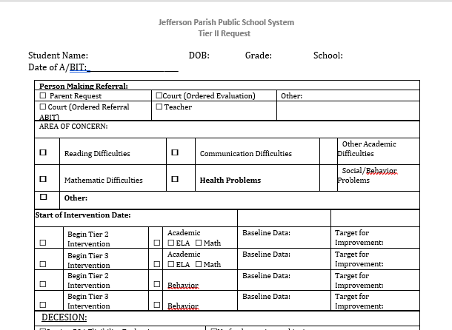

Tier II
Academic
Intervention Form

Slide 13
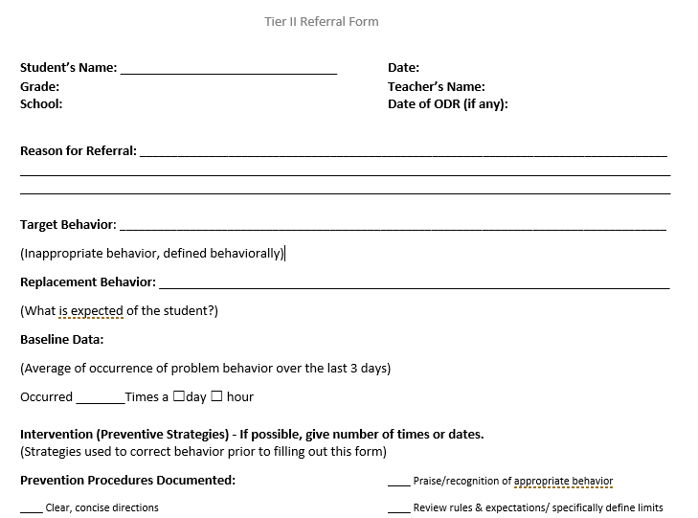
TIER II BEHAVIOR INTERVENTION FROM
http://jpschools.org/department/positive-behavior-interventions-and-supports-pbis/

Slide 14
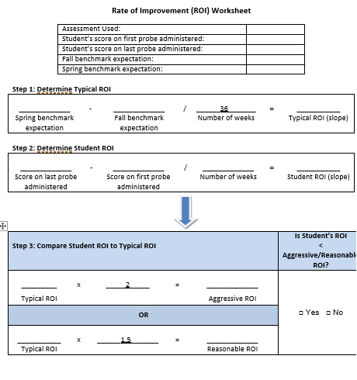
RATE OF IMPROVEMENT
6

Slide 15
Tier III Triggers
THE STUDENT HAS NOT RESPONED TO TIER II INTERVENTIONS
THE DEFICIT IS SO SEVERE THAT A TIER III IS NECESSARY
3> OSS

Slide 16
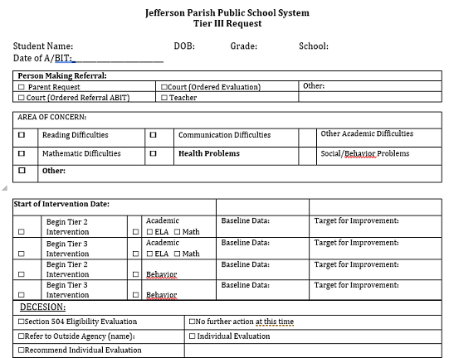
TIER III INTERVENTION REQUEST

Slide 17
TIER III
ACADEMIC
LEXIA
i Ready
https://www.tn.gov/education/topic/tdoe2-rti-current-update
https://www.tn.gov/education/article/tdoe3-rti-educators-implementation-guide
BEHAVIOR
Tier III
FBA/BIP
SHORT FBA/BIP
INDIRECT FBA/BIP

Slide 18
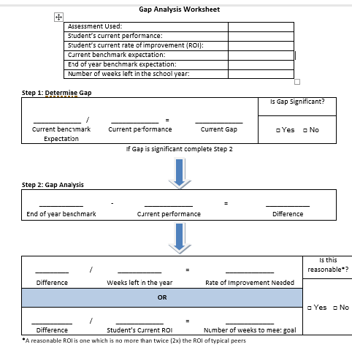
GAP ANALYSIS

Slide 19
RATE OF IMPROVEMENT

Slide 20
TIER IV
Special Education Evaluations
Pre-referral packet is completed

Slide 21
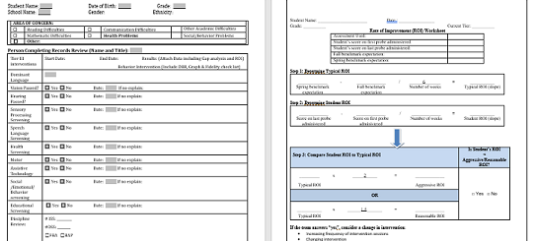
Pre-referral packet is completed

Slide 22
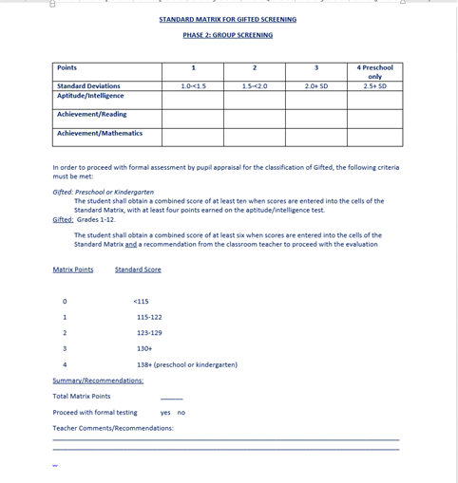
GIFTED
In the 2016-17 school year 189 students were evaluated for Gifted services.
75% of students evaluated did not qualify
2nd phase to Gifted screening added in the 2017-18 school year.
2nd phase of screening is conducted by pupil appraisal in a group setting.

Slide 23
QUESTIONS

