Slide 1

Section 504
Jefferson Parish School Board
August 23, 2017
Wayne T. Stewart, J.D., Ph.D.

Slide 2
What is Section 504 ?
Prohibits discrimination based on disability
Not originally directed at schools or children with disabilities, but original focus was on adults in employment context
Effectively subsumes all students with disabilities eligible under IDEA

Slide 3
What is ADA ?
Americans with Disabilities Act (1990 & as amended)
Effectively, a “companion” statute to Section 504
Also prohibits discrimination based on disability for students in public schools (Title II of ADA)
Amendments to ADA have also amended 504 over the years

Slide 4
What is ADA ?
The link between 504 and ADA has been recognized by courts for many years; in particular, our U.S. Fifth Circuit Court of Appeals has stated:
“Cases concerning either section apply to both.”
Doe v. Columbia-Brazoria Indep. Sch. Dist., 855 F.3d 681, 690 (5th Cir. 2017) (citing Hainze v. Richardson, 207 F.3d 795, 799 (5th Cir. 2000))

Slide 5
Qualified Individual with a Disability
Children who fall in one of the following groups:
(1) of an age during which students without disabilities are provided services in public preschool elementary, or secondary education;
(2) of any age during which it is mandatory under state law to provide public preschool elementary, and secondary services to children with disabilities; or
(3) to whom a state is required to provide FAPE under IDEA.
34 C.F.R. § 104.3(l)(2)

Slide 6
Definition of Disability
Disability:
(A) a physical or mental impairment that substantially limits one or more major life activities of such individual;
(B) a record of such an impairment; or
(C) being regarded as having such an impairment.

Slide 7
Physical Impairment
Any physiological disorder or condition, cosmetic disfigurement, or anatomical loss affecting one or more body systems, such as: neurological, musculoskeletal, special sense organs, respiratory (including speech organs), cardiovascular, reproductive, digestive, genitourinary, immune, circulatory, hemic, lymphatic, skin, and endocrine

Slide 8

Mental Impairment
Any mental or psychological disorder, such as intellectual disability, organic brain syndrome, emotional or mental illness, and specific learning disability

Slide 9
Major Life Activity
Activities include, but are not limited to:
  caring for oneself, performing manual tasks, seeing, hearing, eating, sleeping, walking, standing, sitting, reaching, lifting, bending, speaking, breathing, learning, reading, concentrating, thinking, writing, communicating, interacting with others, and working.

Slide 10
Major Bodily Function
A major life activity also includes the operation of a major bodily function, including but not limited to:
functions of the immune system, special sense organs and skin, normal cell growth, and digestive, genitourinary, bowel, bladder, neurological, brain, respiratory, circulatory, cardiovascular, endocrine, hemic, lymphatic, musculoskeletal, and reproductive systems. The operation of a major bodily function includes the operation of an individual organ within a body system.

Slide 11
Episodic or In Remission ?
Expanded definition of student with a disability (per ADA since Jan. 2009)
Term has been re-defined to include impairments that are episodic or in remission IF the impairment substantially limits a major life activity when active

Slide 12
Substantially Limits
The 2016 ADA regulations provide that
An impairment is a disability within the meaning of this part if it substantially limits the ability of an individual to perform a major life activity as compared to most people in the general population. An impairment does not need to prevent, or significantly or severely restrict, the individual from performing a major life activity in order to be considered substantially limiting. Nonetheless, not every impairment will constitute a disability within the meaning of this section.
  28 C.F.R. § 35.108(d)(1)(v)

Slide 13
Substantially Limits
NOT limited to “significantly restricted”
Construed broadly in favor of expansive coverage, but NOT every “impairment” is a
“disability”
Limits ability to perform major life activity as compared to most people

Slide 14



What is NOT an Impairment ?

Slide 15
What is NOT an Impairment ?
Categorical exclusions under ADA:
  Homosexuality
  Bisexuality
  Non-disorders (e.g., pregnancy, left-handedness)

Slide 16
What is NOT a Disability ?
Categorical exclusions under ADA:
  An impairment that does NOT substantially limit a major life activity

Slide 17

What Impairments & How Many ?
Substantial Limitation of ONE activity is enough
OCR – May NOT focus solely on “learning”
(in fact, does not need to be learning at all)

Slide 18
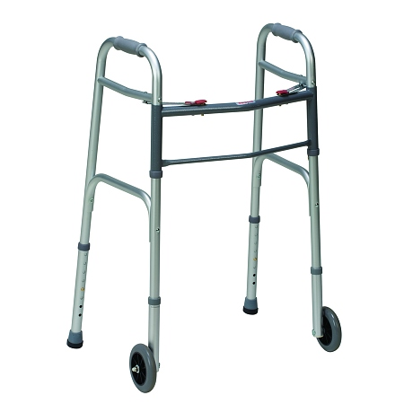


Mitigating Measures
Look behind the intervention
May NOT consider ameliorative effects of mitigating measures (except ordinary corrective lens)

Slide 19
Mitigating Measures ?
In other words, when determining eligibility your may NOT consider whether an intervention, device, or therapy works (or the degree to which it works)
You CAN consider what works and to what degree when determining services under a 504 Plan

Slide 20
“Importance” of Major Life Activity
Activity need not be of central importance to most people’s daily lives to be a “substantial limitation”
Impairment can be a “substantial limitation” if only one aspect of an activity is limited

Slide 21

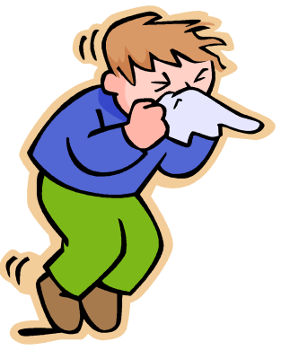


Allergies
Can be basis for eligibility
Must accommodate
To what extent do you accommodate?
“We can’t do that” should never be the first reaction; “Let’s discuss” is more reasonable.

Slide 22

“Record” of Impairment
An individual has a record of an impairment if the individual has a history of, or has been misclassified as having, a mental or physical impairment that substantially limits one or more major life activities.

Slide 23
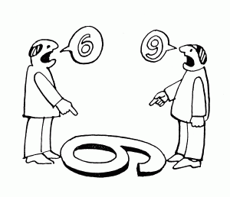
“Regarded” as Having Impairment
May NOT be sole basis of eligibility for services under Section 504
This applies to discrimination based on an actual or perceived impairment

Slide 24
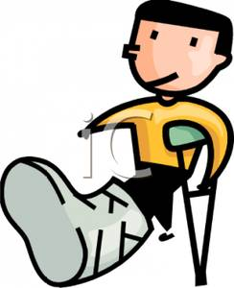
Transitory AND Minor Impairments ?
Condition, manner, and duration of an impairment are all factors to consider in determining substantial limitation
  E.g., Broken leg
“Transitory” (temporary) impairments (i.e., less than 6 months duration) are NOT categorically excluded – you must make case-by-case determination

Slide 25
Some Critical Components of
Section 504
At least annual written notice to parents of procedural rights
Least Restrictive Environment (LRE)
  Academic environments
  Non-academic environments
Re-evaluation PRIOR to change in placement
Manifestation Determination Review (MDR)

Slide 26

Not IDEA => Not 504 ?
Not necessarily
Case-by-case determination

Slide 27
Health & IHCPs
IHCPs are NOT sufficient procedurally to meet 504 mandates (e.g., diabetes treatment plan)
Health professionals (e.g., school nurses) are critical members of 504 teams when there are health and medication-related issues

Slide 28

504 Forever ?
Maybe
504 team determines eligibility and whether student is no longer eligible

Slide 29

Related Services ?
OK under 504
May include medication administration or assistance with health care
  Diastat
  Glucagon
  Epi-pen

Slide 30

Consistency of Process
Section 504 requires decisions by a TEAM of knowledgeable individuals

Slide 31


Reasonable Accommodations ?
OCR does not apply the reasonable accommodation standard for kids --- cost and inconvenience are NOT considerations in determining FAPE.

Slide 32

Accommodations in Advanced Placement and Honors Classes ?
YES, if appropriate.
Students with disabilities under Section 504 cannot be required to forfeit necessary programs and services when participating in accelerated classes and programs.

Slide 33
Cypress-Fairbanks Factors
Individualized on the basis of the student’s assessment and performance
Provided in the least restrictive environment (LRE)
Implemented in a coordinated and collaborative manner
Demonstrated academic and non-academic gains
Cypress-Fairbanks Indep. Sch. Dist. v. Michael F., 118 F.3d 245 (5th Cir. 1997)

Slide 34
LRE Issues
Must be educated with non-disabled peers to maximum extent appropriate
Section 504 Team decision
Applies to more than classroom
  E.g., transportation, lunch, recess, halls, field trips, extra-curricular activities

Slide 35
504 Plan Implementation
Section 504 Plan establishes obligations on the school district
If a service is in the plan, it MUST be provided
Lack of staff, money, or willingness of staff to perform duties NOT a justification for failure to implement
Failure to implement could result in $ damages !

Slide 36

Consistent Implementation
It is imperative that your LEA train staff and monitor implementation of Section 504 mandates and your LEA’s procedures
Failure to locate, indentify, evaluate, provide services (if appropriate), or provide parents appropriate due process protections exposes your LEA to a host of liability issues

Slide 37
Staffing for Health-Related Issues
Must respond promptly to staffing issues for students with health issues
Failure to provide appropriate staff to meet health needs is a denial of FAPE
Failure to provide appropriate training to staff will be potentially disastrous

Slide 38

If not eligible, then … ?
Not Eligible but Still Accommodated … What ?!
Obligation remains to make reasonable changes to policies, practices, or procedures

Slide 39

Procedural Safeguards
Parents have a right to contest the outcome of a Section 504 evaluation, but may also use the procedural safeguards and due process mechanism to contest the Section 504 Plan and its implementation.

Slide 40

Procedural Safeguards
  The opportunity to examine the student’s records
  Prior written notice (PWN) before the school district proposes or refuses action regarding the identification, evaluation, educational placement, or provision of FAPE to the student
  The opportunity to present a complaint through an impartial due process hearing
  The opportunity to receive notice of the procedural safeguards

Slide 41
It’s The Law
(for students with disabilities)
Non-Discrimination on the basis of disability (academics/non-academics)
Free Appropriate Public Education (FAPE)
Individualized program and services (IEP or IAP)
Invite (in writing) and Encourage Parental Participation
Consider Parent Input and Documents
Manifestation Determination Review (MDR) (Both 504 & IDEA)
“Coordinate and Collaborate”
Parental Rights to Redress (Due Process Hearing)

Slide 42

Other Critical 504 Issues
Individualized Determinations
Re-evaluation PRIOR to change in placement
Absences
Discrimination & FAPE

Slide 43
What Does OCR Consider
Discriminatory Harassment ?
Student is a member of a statutorily protected class (race, color, national origin, sex, or disability), and the peer harassment is based upon the protected class
School system knew or should have known of the discriminatory harassment
Harassment is so severe, pervasive, or persistent as to interfere with or limit participation in the student’s education
School system failed to eliminate the harassment and prevent it from reoccurring
Dear Colleague: Harassment and Bullying (OCR Oct. 26, 2010)

Slide 44
Bullying/Harassment
Bullying/Harassment of a student with a disability (SWD) is prohibited discriminatory conduct – whether based on the student’s disability or not
Research is clear that, in the bullying/harassment context, SWDs with disabilities are among the most vulnerable students
As with any student, bullying/harassment can have deleterious effects on SWDs – educationally and otherwise

Slide 45
Bullying/Harassment & FAPE
Bullying/Harassment of a SWD may adversely affect the student’s ability to participate in or benefit from educational activities; this would likely be a denial of FAPE (as well as prohibited discriminatory behavior)

Slide 46
Bullying/Harassment & FAPE
If bullying/harassment of a SWD has occurred, it is imperative that the 504 Team (or IEP Team) meet to determine appropriate steps to address any loss of educational opportunities, to consider remedial or compensatory services, and to modify the IEP to address the student’s needs

Slide 47
Bullying/Harassment & FAPE
“Educational activities” include not only academics, but all other activities which students typically have the opportunity to access daily or periodically in school-related environments, such as:
  Lunch
  PE
  Bus
  Hallways, recess
  Extra-curricular (e.g., sports, clubs)
  Field trips

Slide 48
Bullying/Harassment & FAPE
Student “needs” (as reflected in the 504 Plan or IEP) in response to bullying could include, for example:
  Counseling as a related service
  Additional assistance with transitions
  Social skills training
  Bus aide
  Before/After-school academic supports

Slide 49
Bullying/Harassment: The rest of the school environment
If bullying/harassment has occurred, the LEA is obligated to take direct and affirmative steps which are reasonably calculated to prevent the recurrence of such behavior
Training of staff and broad dissemination of appropriate information are important components of a comprehensive plan to address bullying/harassment of all students

Slide 50
Resources
Dear Colleague Letter: Responding to Bullying of Students with Disabilities (OCR Oct. 2014)
  Includes references to prior USDOE guidance letters and information on bullying
Parent & Educator Resource Guide to Section 504 in Public Elementary and Secondary Schools (OCR Dec. 2016)

Slide 51

Questions ?

