Slide 1
Naviance/Clever
Career Cluster Finder

Slide 2
How do Students Log-in to their account:
Students, please follow the directions given below.
(Screenshots of directions below are in the following 3 screens.)
Students go to :
https://clever.com/
  Go to “Log In As a Student”
  Type in school name as “Flora”, then choose AC Flora from Drop down menu
Username: Student ID, example 11344
Student password: M/D/YYYY Ex: 5/9/2004
            MM/DD/YYYY Ex: 12/24/2003

Slide 3
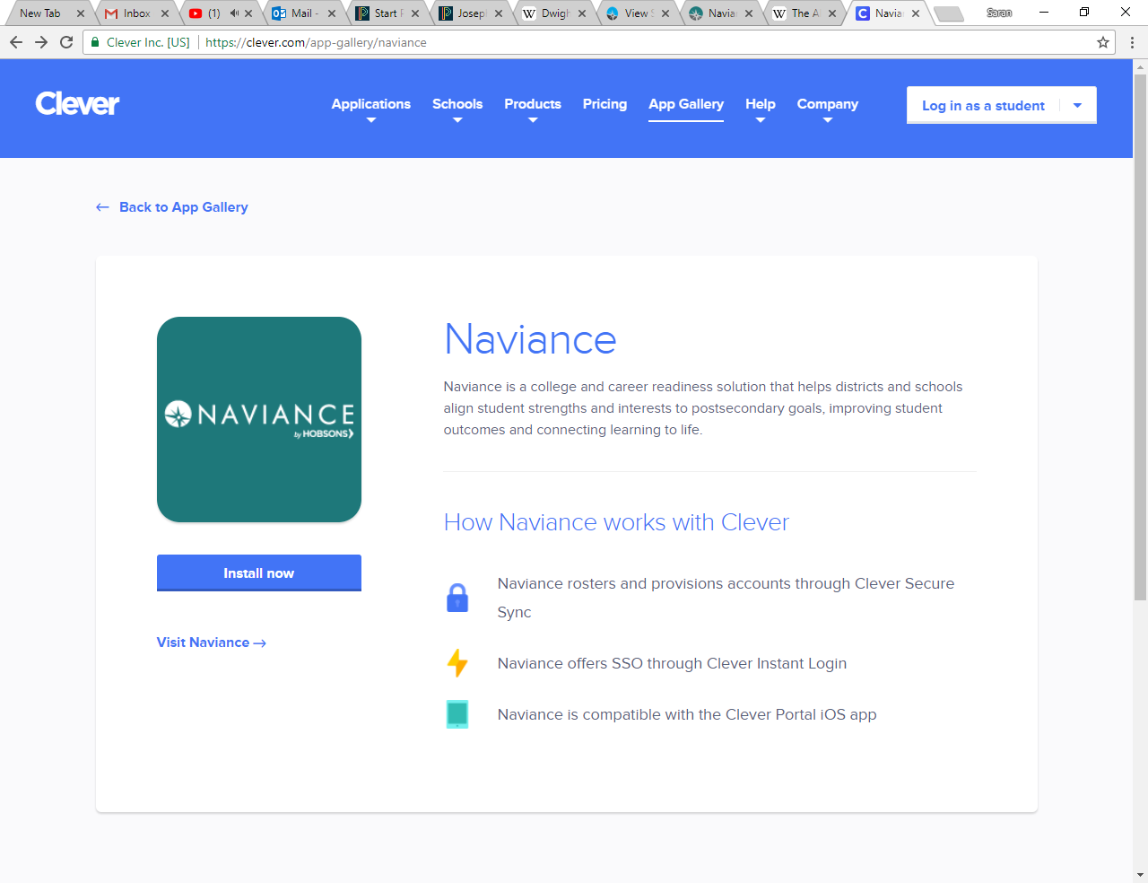
In the upper right hand corner, click on the log in tab

Slide 4
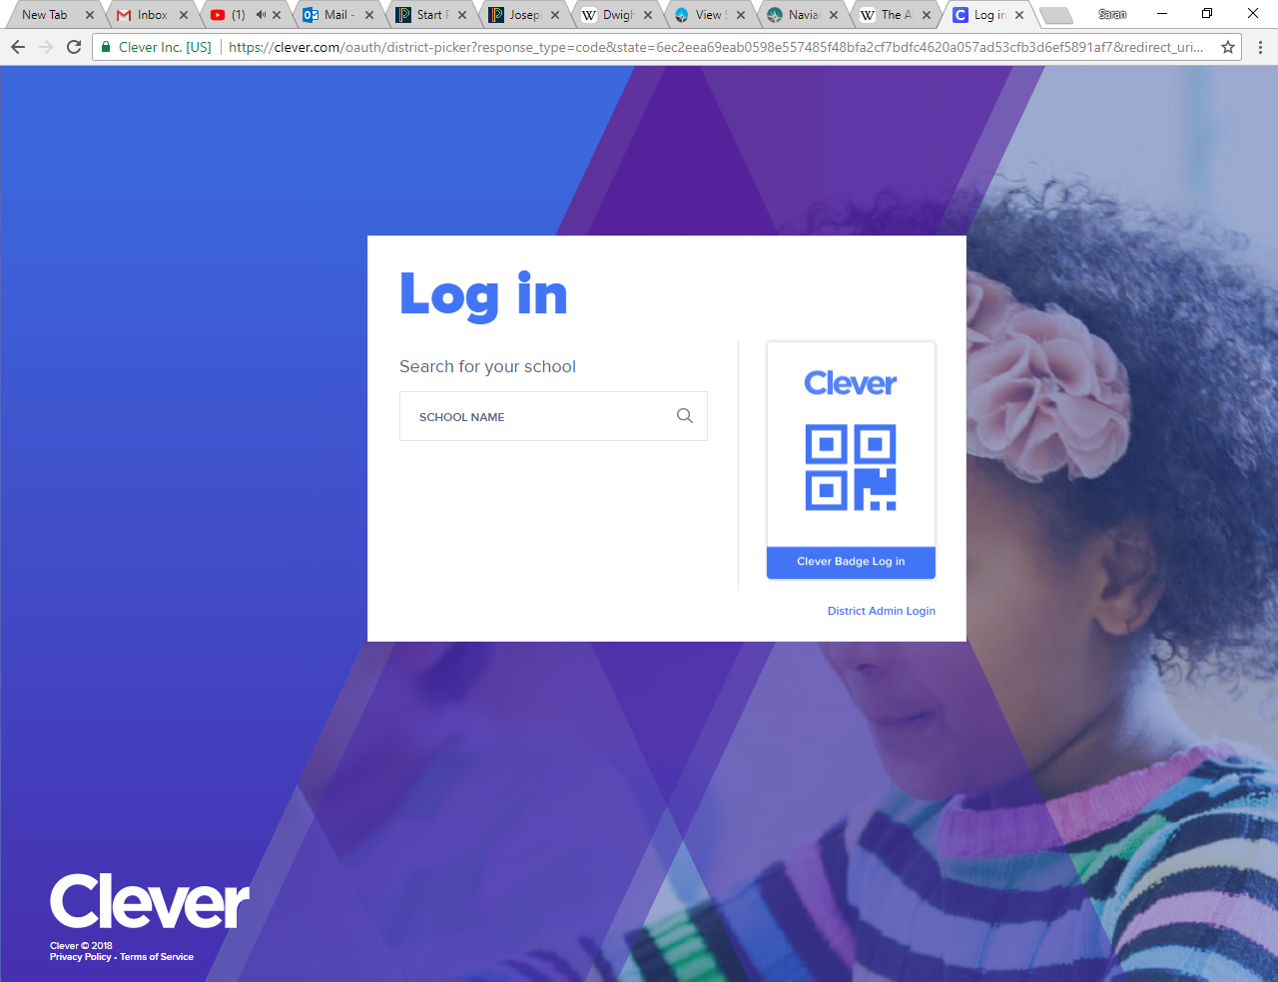
If this screen appears: Type Flora in the school name section; and then select AC Flora High School.

Slide 5
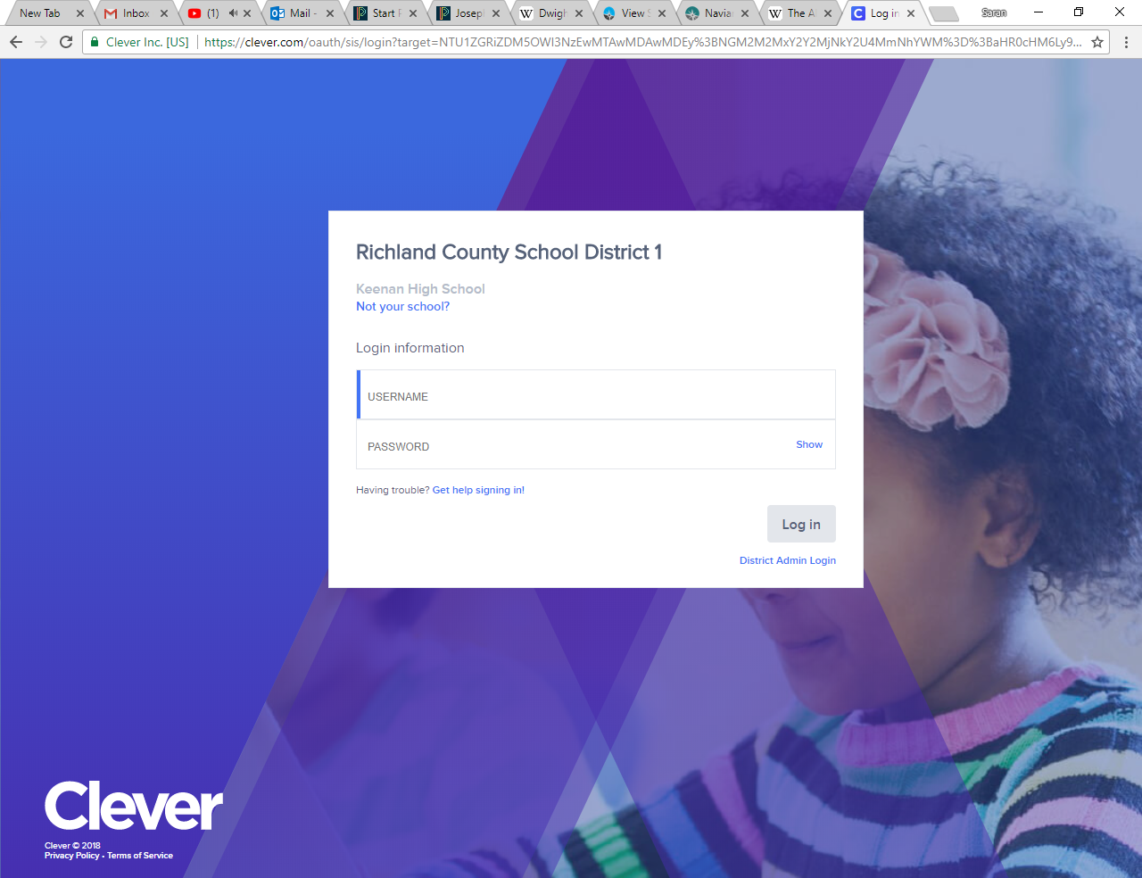
Your username is your school ID (the entire ID number)
Your password is your birthday (if you have a 0 at the beginning of the month or day of your birthday DO NOT TYPE THE ZERO). For example students born in the month of January should write 1/2/2001.

Slide 6
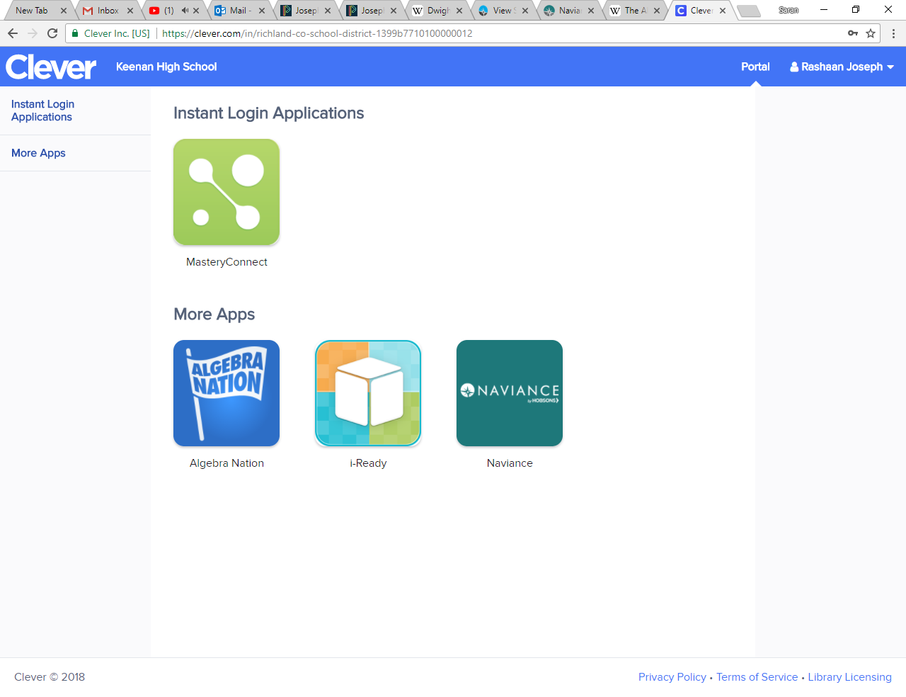
Once in the site, go to the Naviance tab

Slide 7
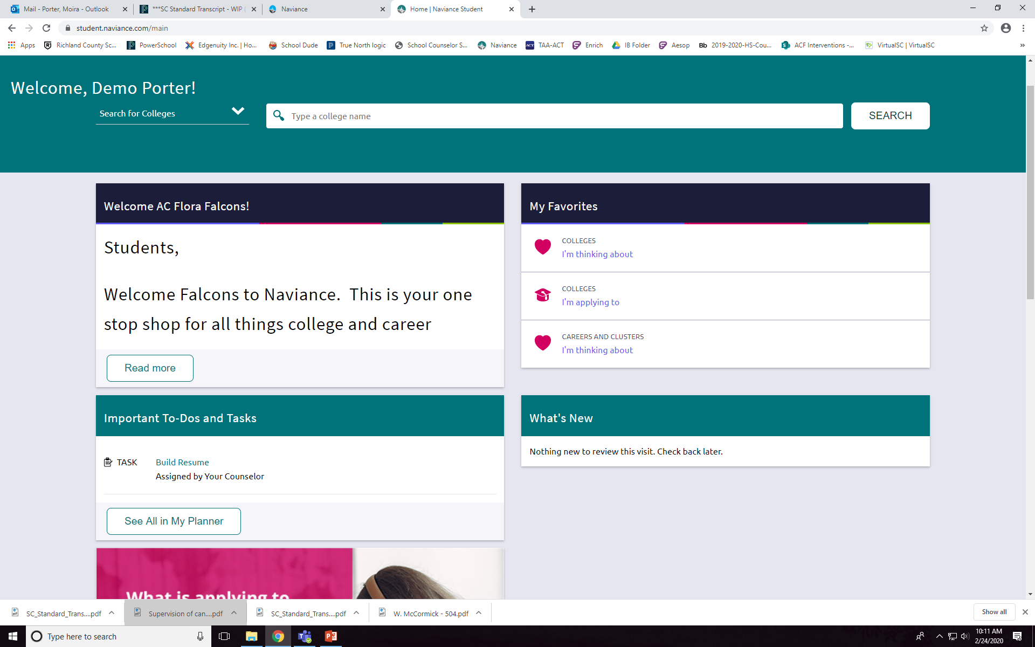
You did it!!!!! This site will be used for various activities, etc.

Slide 8
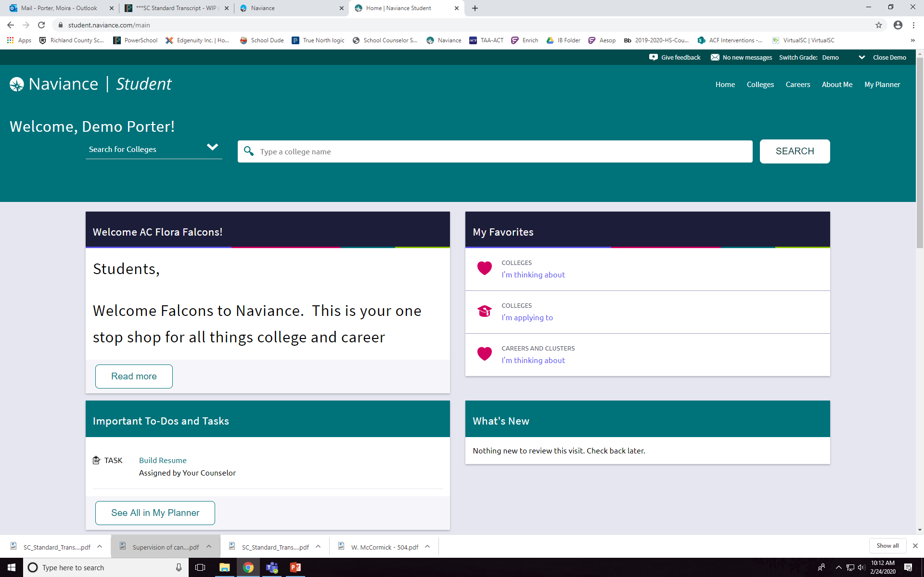
Now, go to the top RIGHT corner and click on Careers.

Slide 9
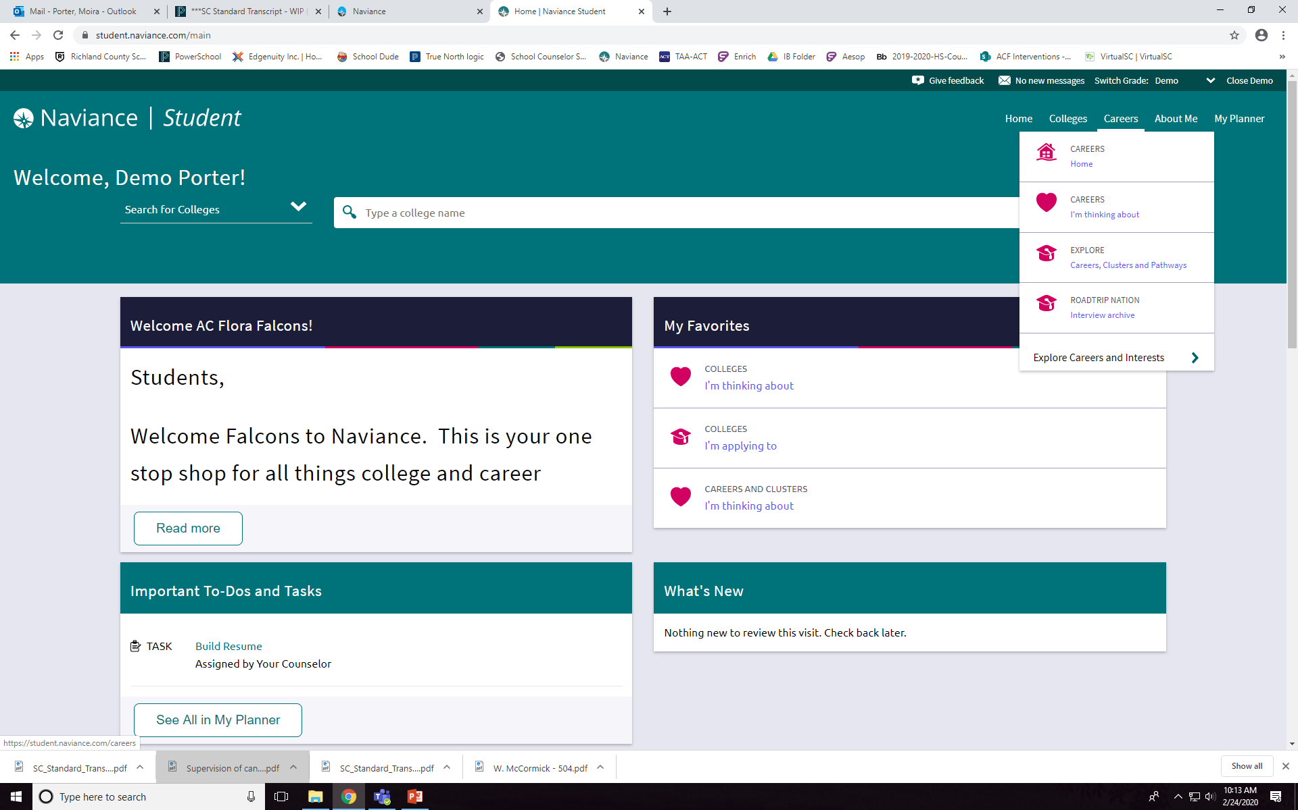
Select Explore

Slide 10
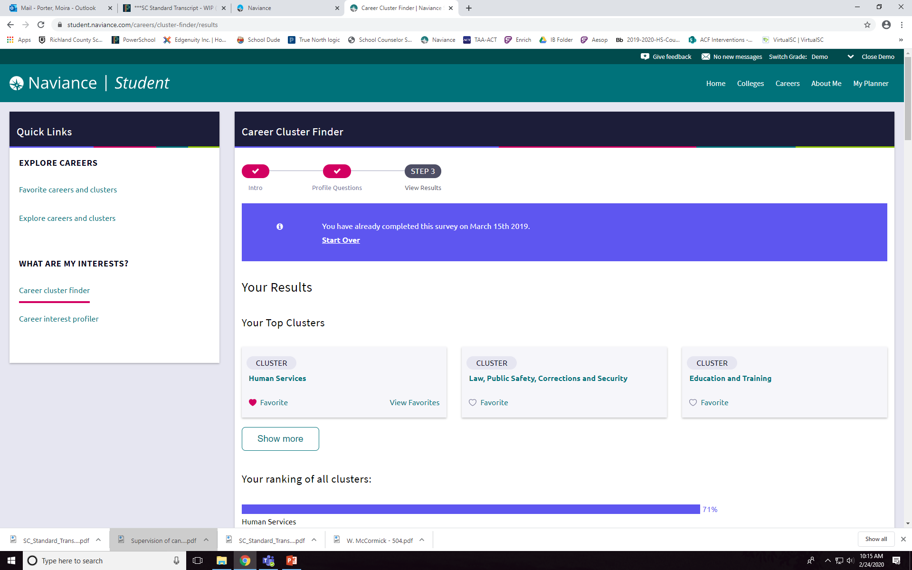
Choose Career Cluster Finder. If it has been completed; click Start Over and retake the assessment.

Slide 11
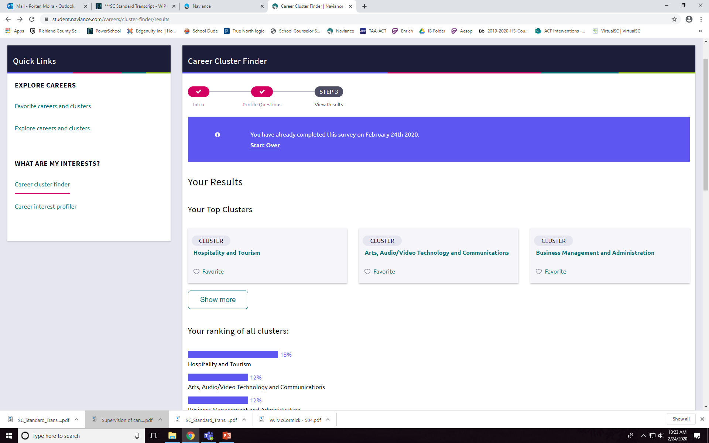
Once you have completed the assessment, click on each cluster that yo0u have listed and read about/research one career that interested you in that cluster.

Slide 12
Once you have completed this, you have completed your tasks for this session.

